Slide 1
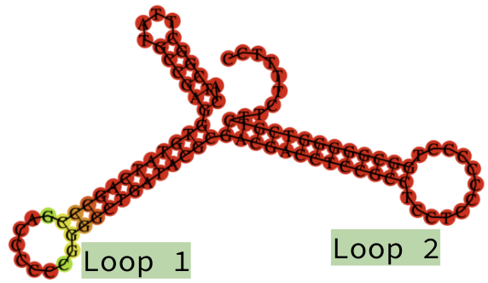
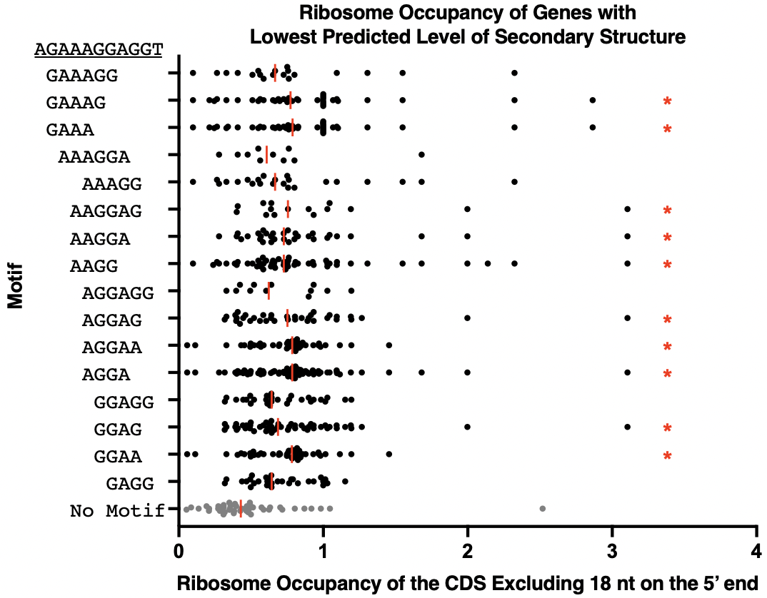
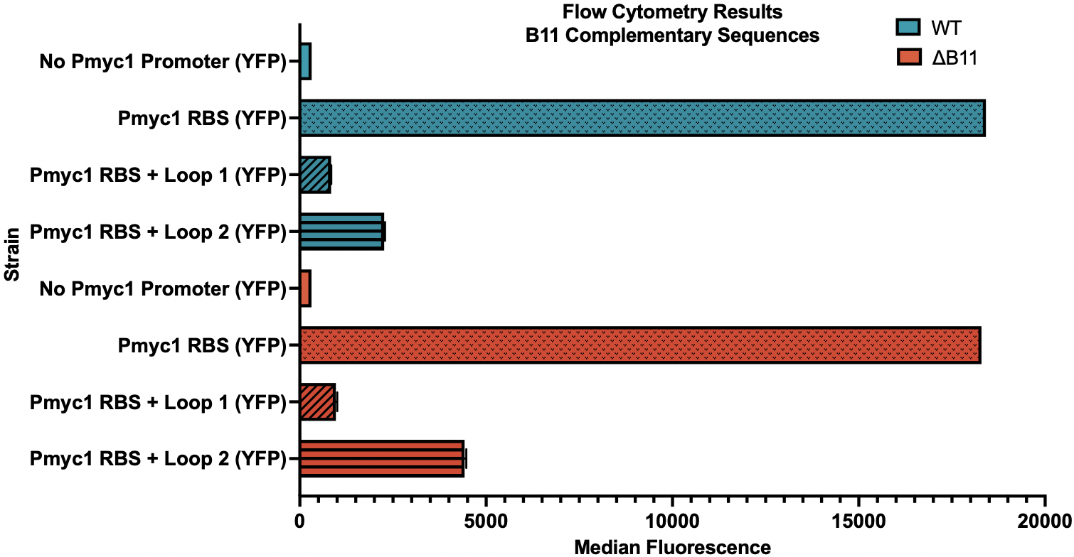
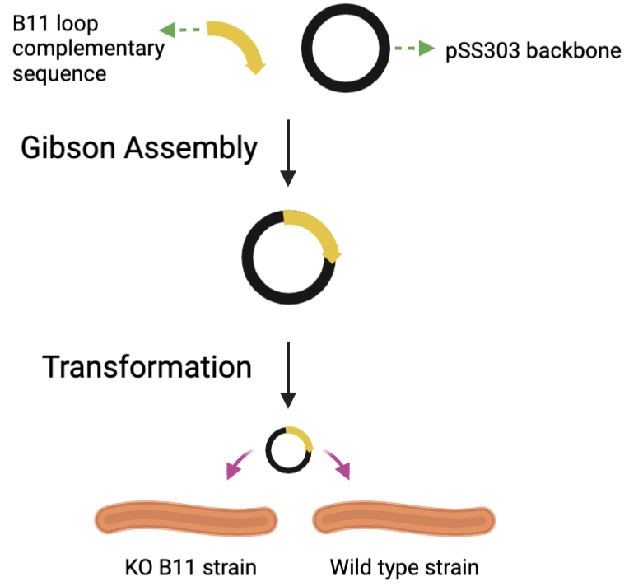
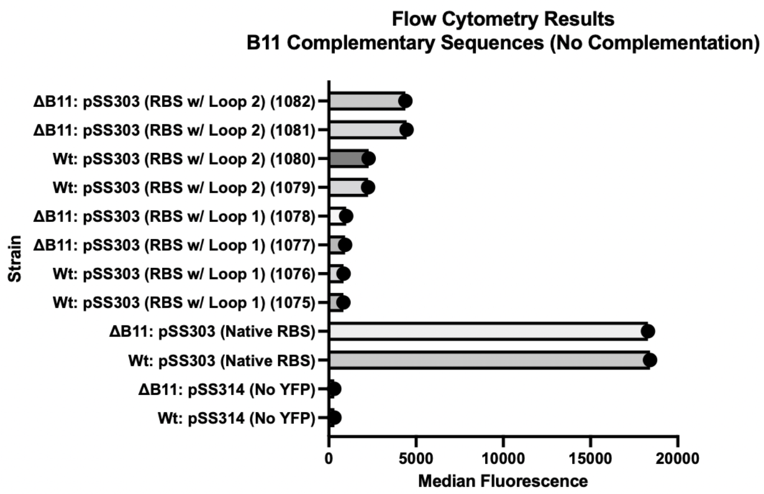
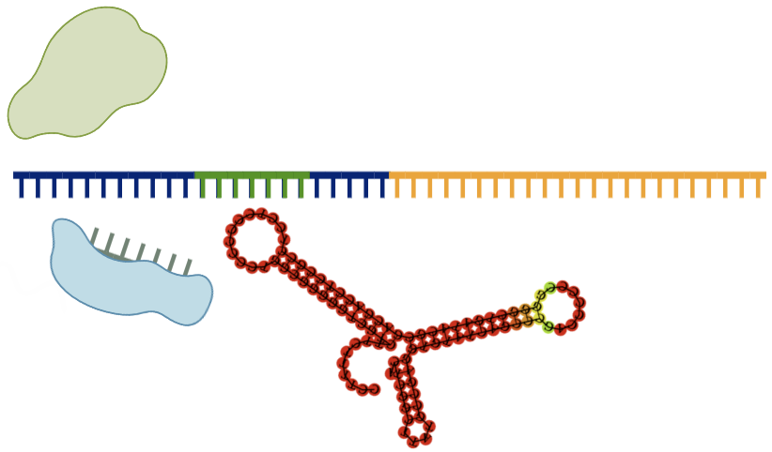
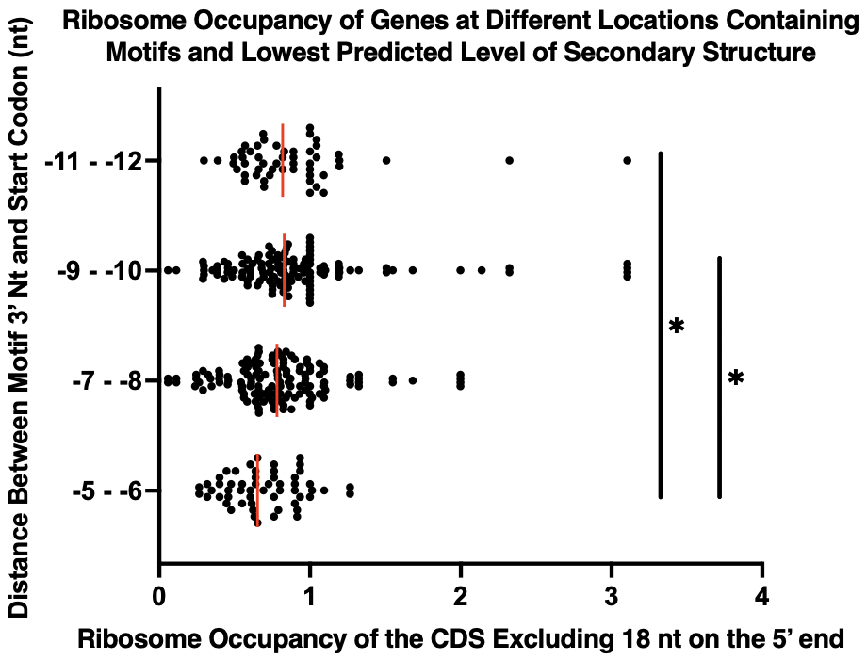
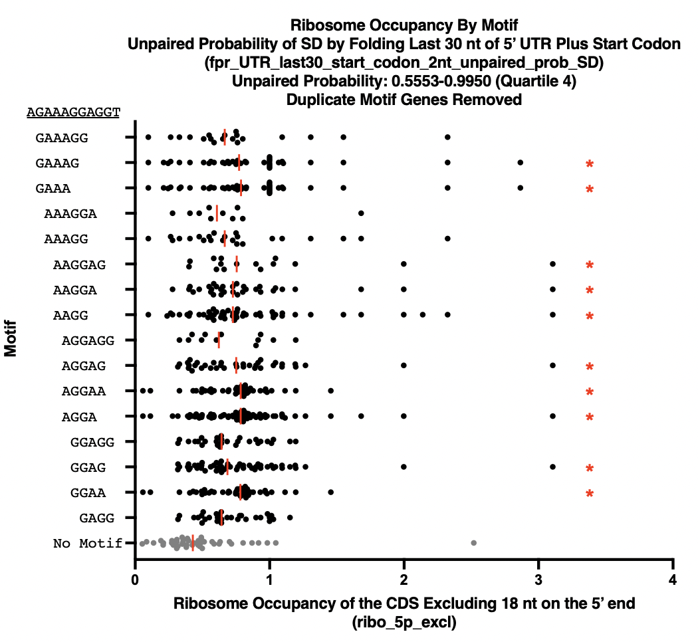
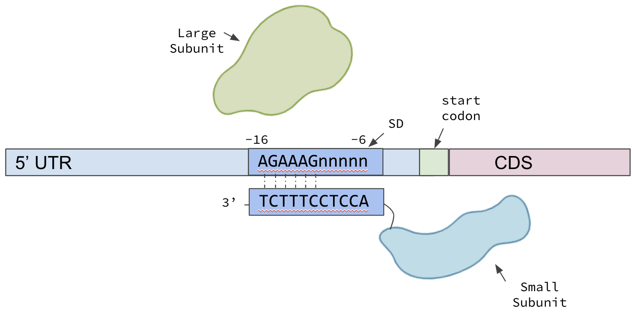
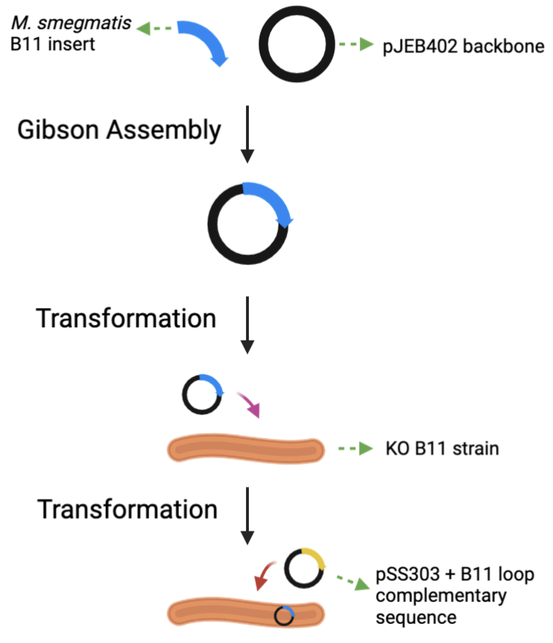
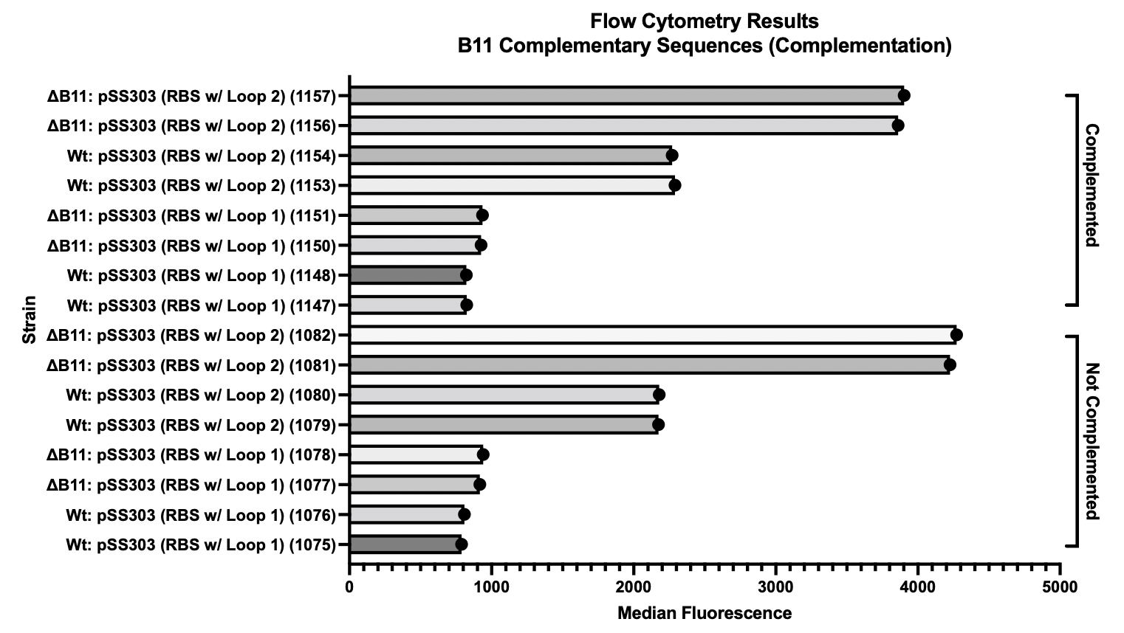
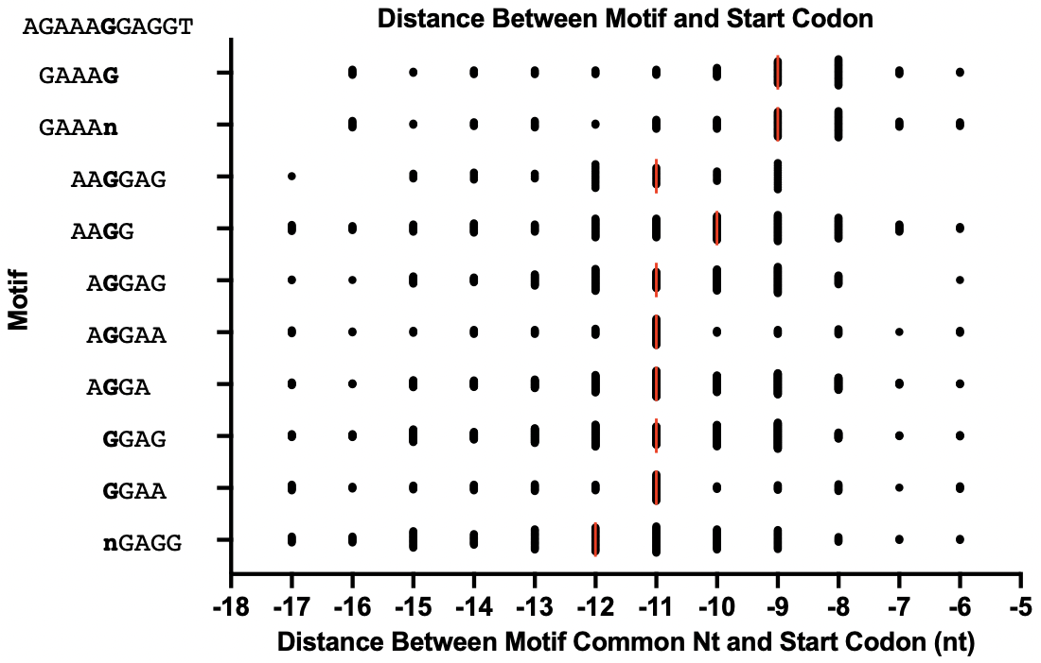
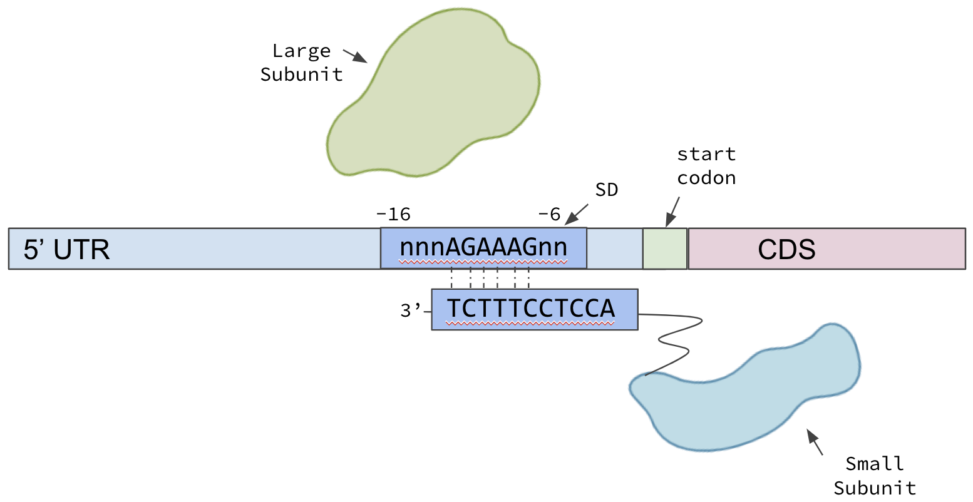
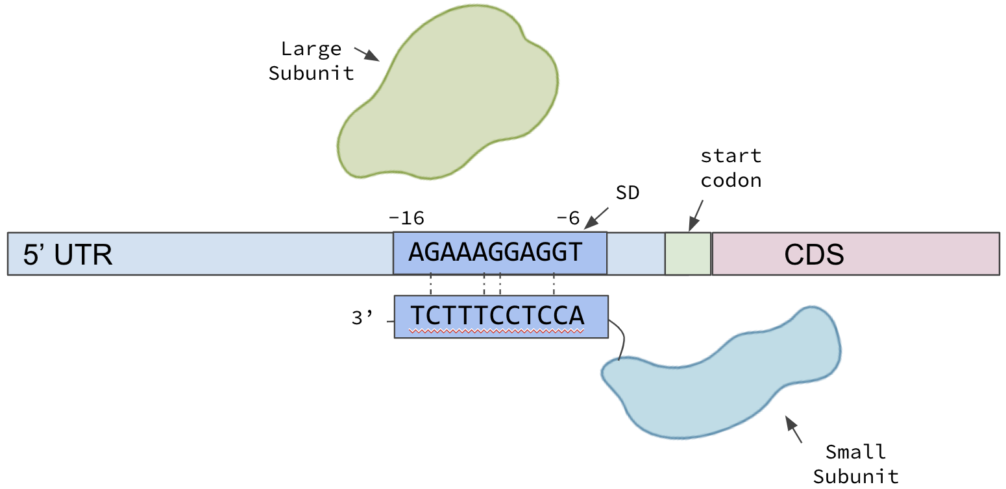
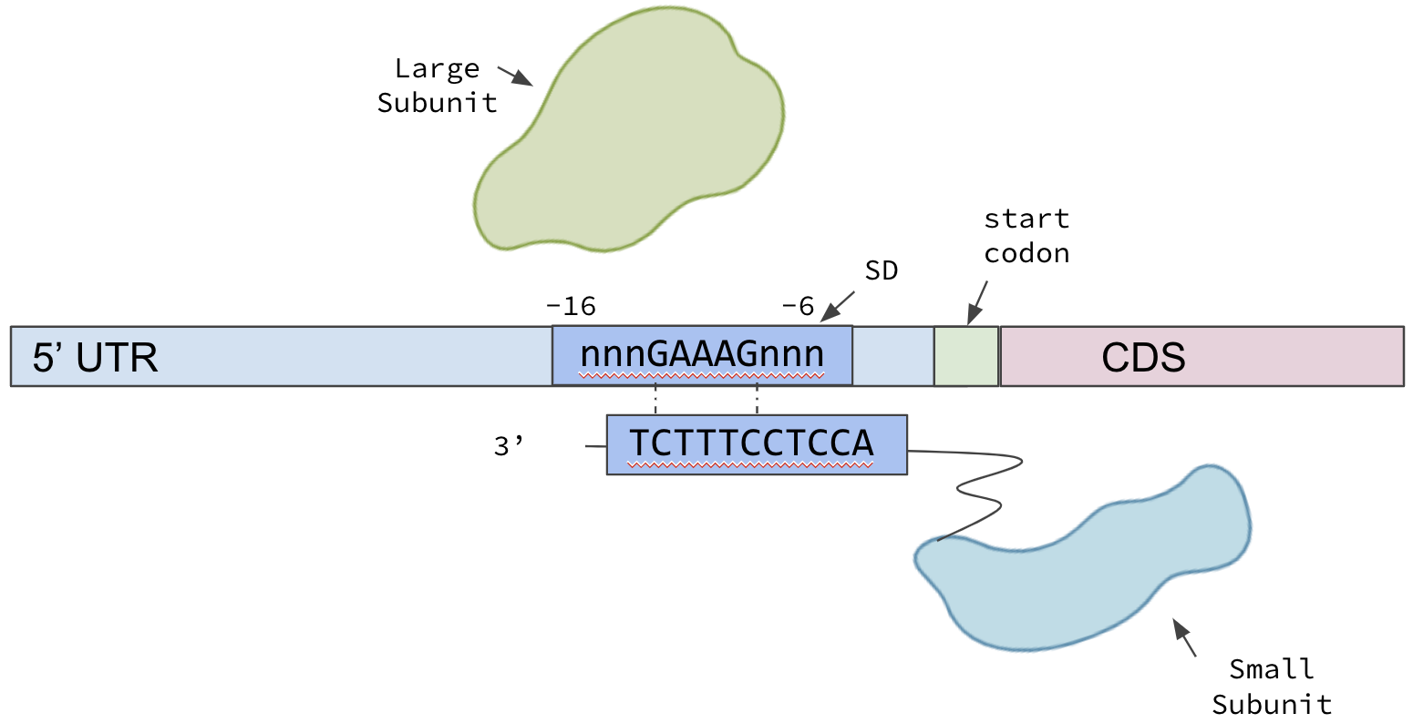
The impact of ribosome binding site
sequences on translation in mycobacteria
Catherine Masiello (BBT)
Advisor: Professor Scarlet Shell (BBT)
Project Overview
Methodology and Results
Methodology and Results
The goal of this project was to determine the impact of ribosomal binding site characteristics on translation efficiency in mycobacteria.
The Shine-Dalgarno sequence and it’s position relative to the start codon effects translation efficiency.
Ribosome binding site sequences complementary to the B11 sRNA result in lower translation efficiency in the presence of B11.
Our results can be used in future plasmid designs to maximize translation.
Investigating the Impact of SD Sequence and
Location on Translation Efficiency
Altering RBS Sequences in the Lab
While controlling for a lower level of secondary structure around the SD and aligning motifs of interest relative to a theoretically perfect SD sequence, examine the statistical significance between M. smegmatis gene characteristics
Replaced a portion of the RBS near the SD of a YFP fluorescent reporter with a sequence complementary to one of B11’s loops
Unpaired Probability of SD by Folding Last 30 nt of 5’ UTR Plus Start Codon
Background
The presence of particular Shine-Dalgarno (SD) motifs in the ribosomal binding site (RBS) may result in more effective ribosome binding to mRNA for translation initiation. (1)
Presence of any motif correlates with higher ribosome occupancy
No motif is more fit than another
Alteration of the RBS with either B11 complementary sequence decreases translation efficiency
Greater decrease in fluorescence in the WT strain than the ΔB11 strain, especially for the loop 2 construct
sRNAs, such as B11, have the ability to bind to complementary sequences in the RBS and block ribosome binding. (2, 3, 4) Secondary structure around the SD can also prevent ribosome binding. (5)
Longer motifs aren’t more fit than shorter motifs
Upstream or downstream locations doesn’t affect fitness
Conclusions and Future Work
We complemented a ΔB11 strain with the suspected B11 sequence.
Ribosome occupancy is higher for motifs farther upstream
Original Model
Acknowledgments
Investigate direct relationship between B11 binding to complementary sequences and impact on fluorescence
Fluorescent constructs to evaluate impact of specific motif presence and location
Fluorescent constructs to evaluate impact of secondary structure levels
Thanks to…
Huaming Sun for compilation of the M. smegmatis feature table data.
Jessica Kelly for secondary structure data.
National Science Foundation (NSF) for funding.
References
Motif alignment model may not impact the anti-SD’s ability to bind in the correct spot to initiate translation
New Model
Saito, K., Green, R., Buskirk, A. R. (2020). Translation initiation in E. coli occurs at the correct sites genome-wide in the absence of mRNA-rRNA base-pairing. eLife, 9, e55002. https://doi.org/10.7554/eLife.55002
Baker, C. S., Eöry Lél A., Yakhnin, H., Mercante, J., Romeo, T., & Babitzke, P. (2020). CsrA inhibits translation initiation of Escherichia coli hfq by binding to a single site overlapping the shine-dalgarno sequence. Journal of Bacteriology, 189(15), 5472–5481. https://doi.org/10.1128/jb.00529-07
Bar-Oz, M., Martini, M.C., Meir, M., Riva, C., Lore, N.I., Masiello, C.S., Sun, H., Moy, J.K., Cirillo, D.M., Shell, S.S., & Barkan, D. The small non-coding RNA B11 is a master regulator of Mycobacterium abscessus virulence. SUBMITTED.
Mai, J., Rao, C., Watt, J., Sun, X., Lin, C., Zhang, L., & Liu, J. (2019). Mycobacterium tuberculosis 6C sRNA binds multiple mRNA targets via C-rich loops independent of RNA chaperones. Nucleic acids research, 47(8), 4292–4307. https://doi.org/10.1093/nar/gkz149
Studer, S. M., & Joseph, S. (2006). Unfolding of mrna secondary structure by the bacterial translation initiation complex. Molecular Cell, 22(1), 105–115. https://doi.org/10.1016/j.molcel.2006.02.014
Chen, Y. X., Xu, Z. Y., Ge, X., Sanyal, S., Lu, Z. J., & Javid, B. (2020). Selective translation by alternative bacterial ribosomes. Proceedings of the National Academy of Sciences of the United States of America, 117(32), 19487–19496. https://doi.org/10.1073/pnas.2009607117

