Slide 1
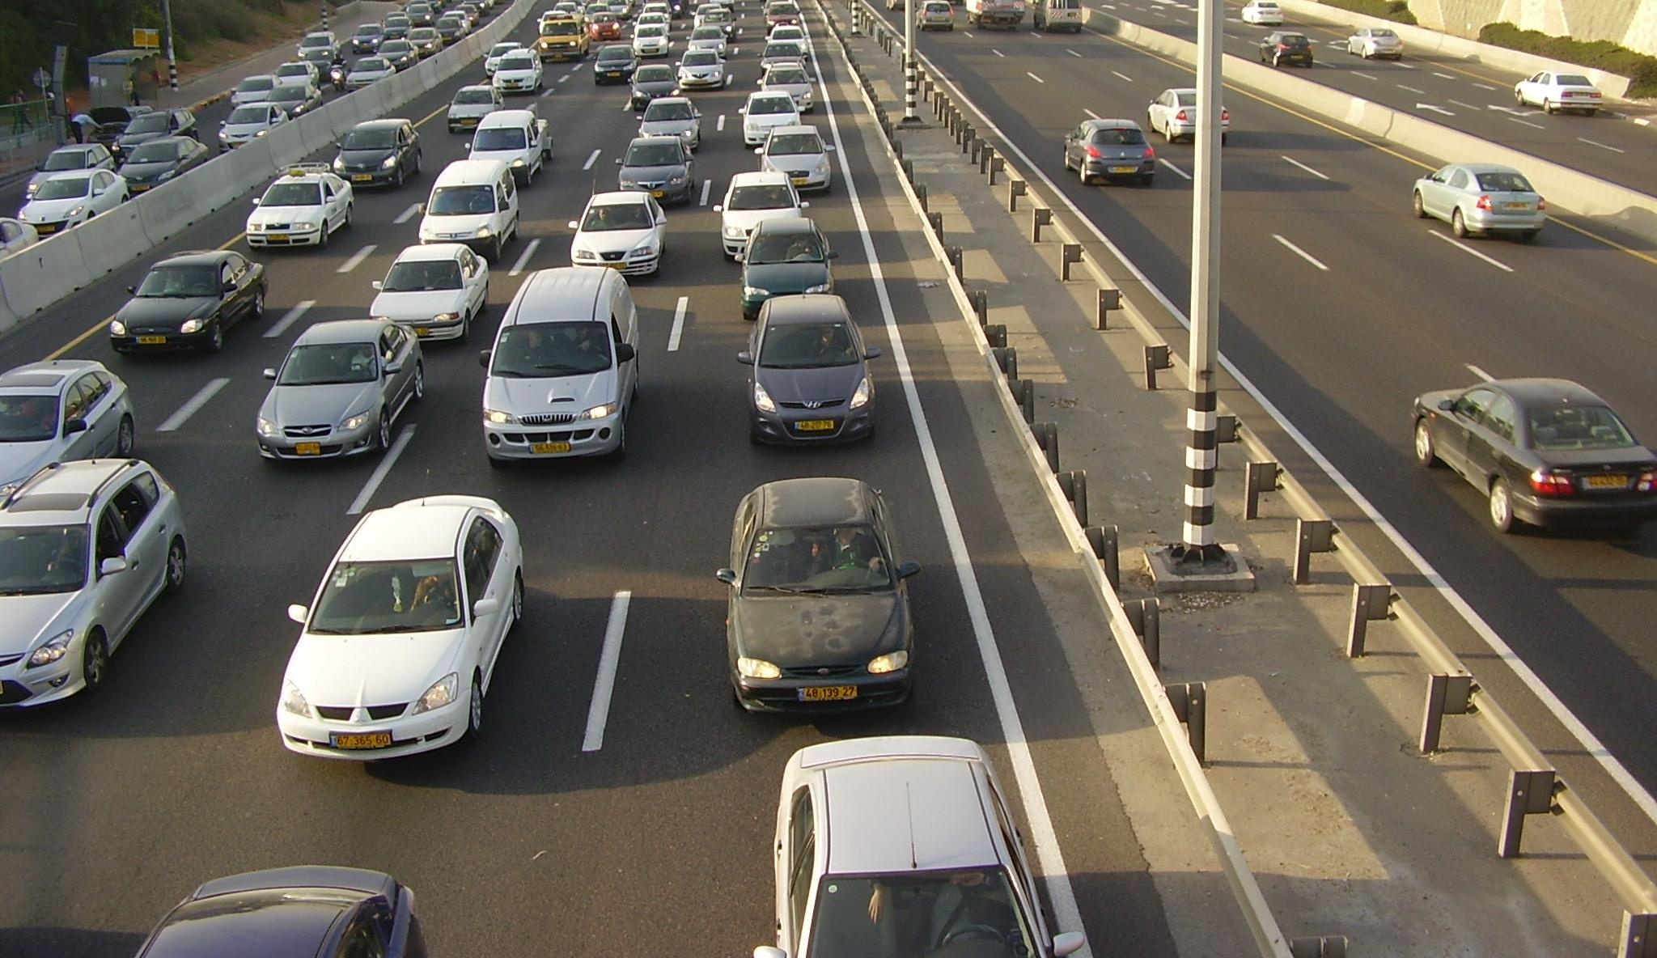
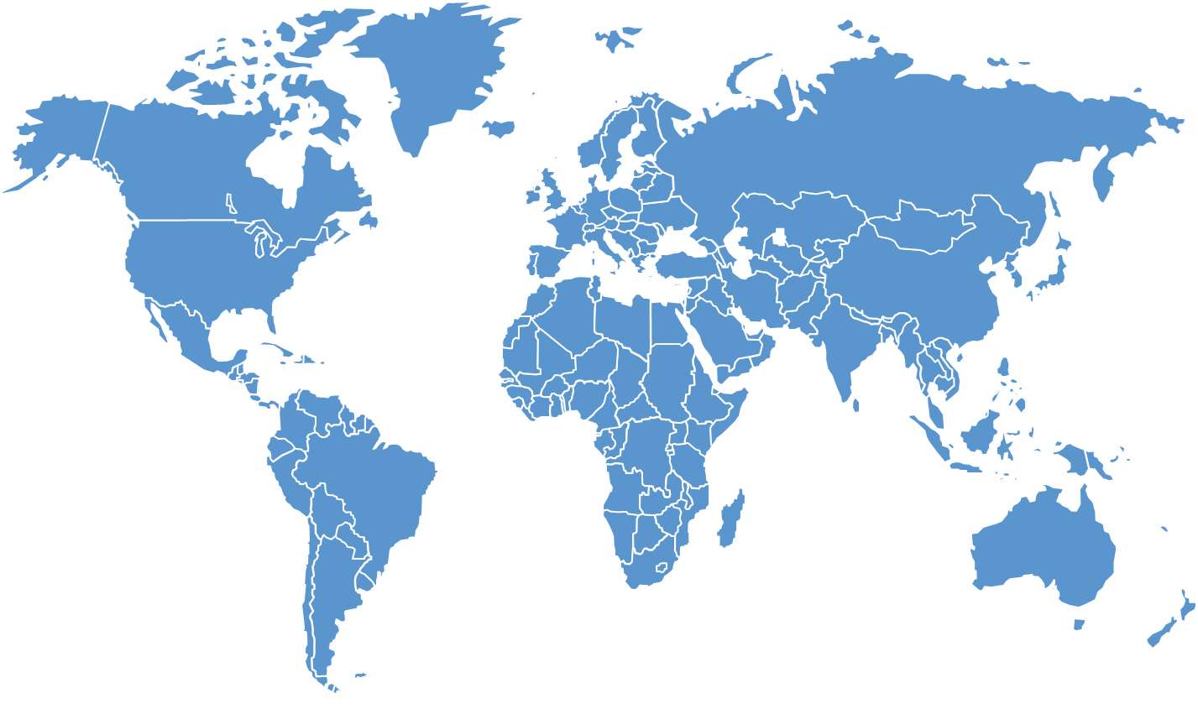
The Global Traffic Challenge
Notes:
New York, Singapore, London, Karmiel. What do they all have in common? They are all places that have struggled with traffic congestion for a long time. All places that have already took action by taxing drivers traveling through big cities during rush hours.
For our project we have been tasked with tackling this issue starting with Karmiel.

Slide 2
Walk to School
Notes:
Hello everyone and welcome to the wts final presentation
We are WPI students working with Braude College of Engineering
In collaboration with Kramim High School

Slide 3
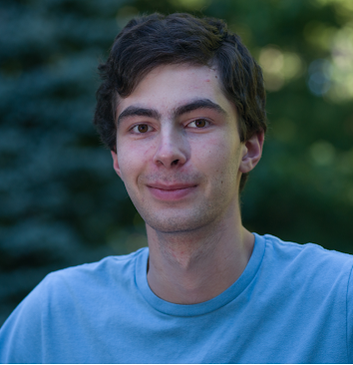
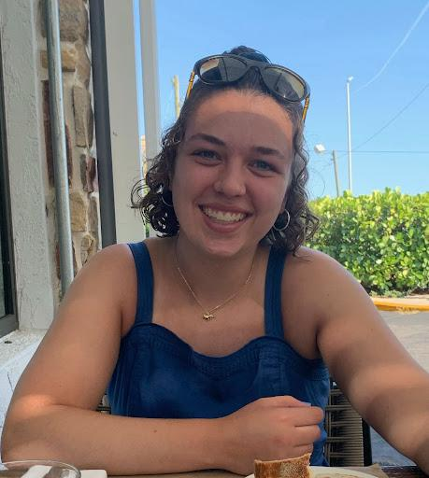
The WPI Team
Benjaminh Brodeur
Andrei Ignatiev
Nathan Pollock
Dylan Nguyen
Serena Mower
Team Lead
Data Collector/
Analyst
Programming Lead
Software Administrator
Editorial Lead
Notes:
Sadly Serena, our editorial lead could not attend. Nonetheless, her contributions were invaluable to our project

Slide 4
The Braude Team
Dr. Nirit Gavish
Dr. Anat Dahan
Bar Levy
Head of Industrial Management at Braude
Professor of Computer Science at Braude
Braude Industrial Management Student
Notes:
We would like to acknowledge our Braude sponsors, Dr. Nirit Gavish, Dr. Anat Dahan, and student Bar Levy
We also have honorable mentions of Hani Eival, Dvir Vahav who helped lead the data collection students at the highschool

Slide 5
Table of contents
01
03
05
Walk2School App
Introduction
02
04
What’s Next
Preliminary Data
Results
Go for a walk
Notes:
Ben

Slide 6
Introduction
01
Notes:
Serena

Slide 7
Our Purpose Statement
Reducing traffic in Karmiel around Kramim by encouraging students to walk to school rather than go by car.

Slide 8
Our Research Question
What strategies can be implemented to increase the number of students who walk to school?
Notes:
TO do this we started off by researching…

Slide 9
80/20 Rule
“the last 20% of cars to join a congested road reduce road speed by 80%”
Notes:
This might seem like a big task but the 80/20 rule explains that it takes minimal effort to prevent traffic congestion.

Slide 10
Preliminary Data
02
Barriers to Walking
Goals and Solutions
Notes:
Dylan

Slide 11
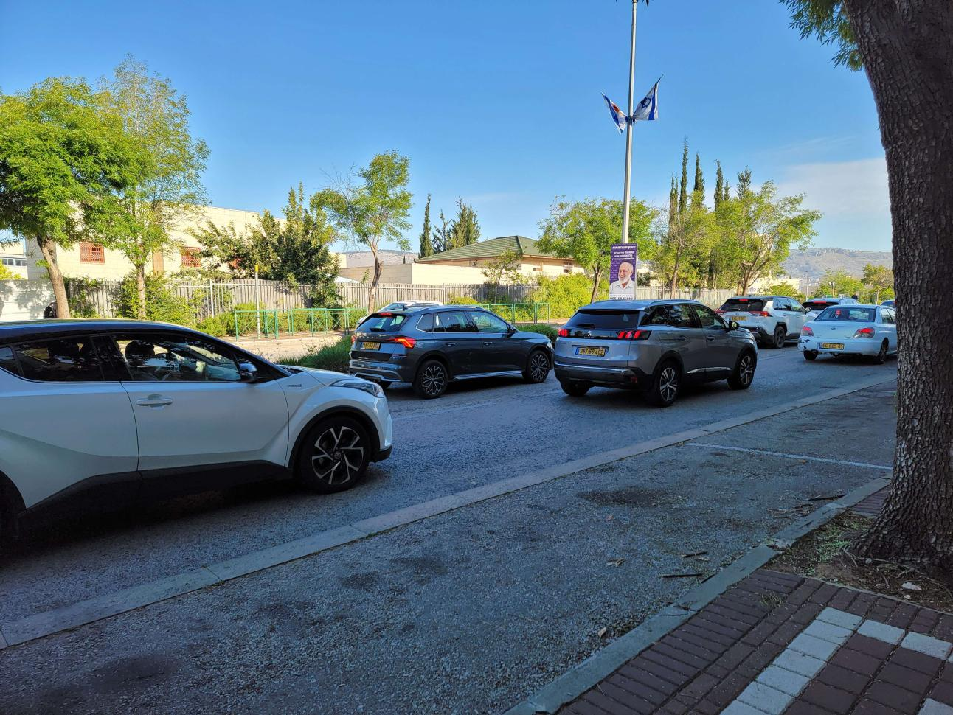
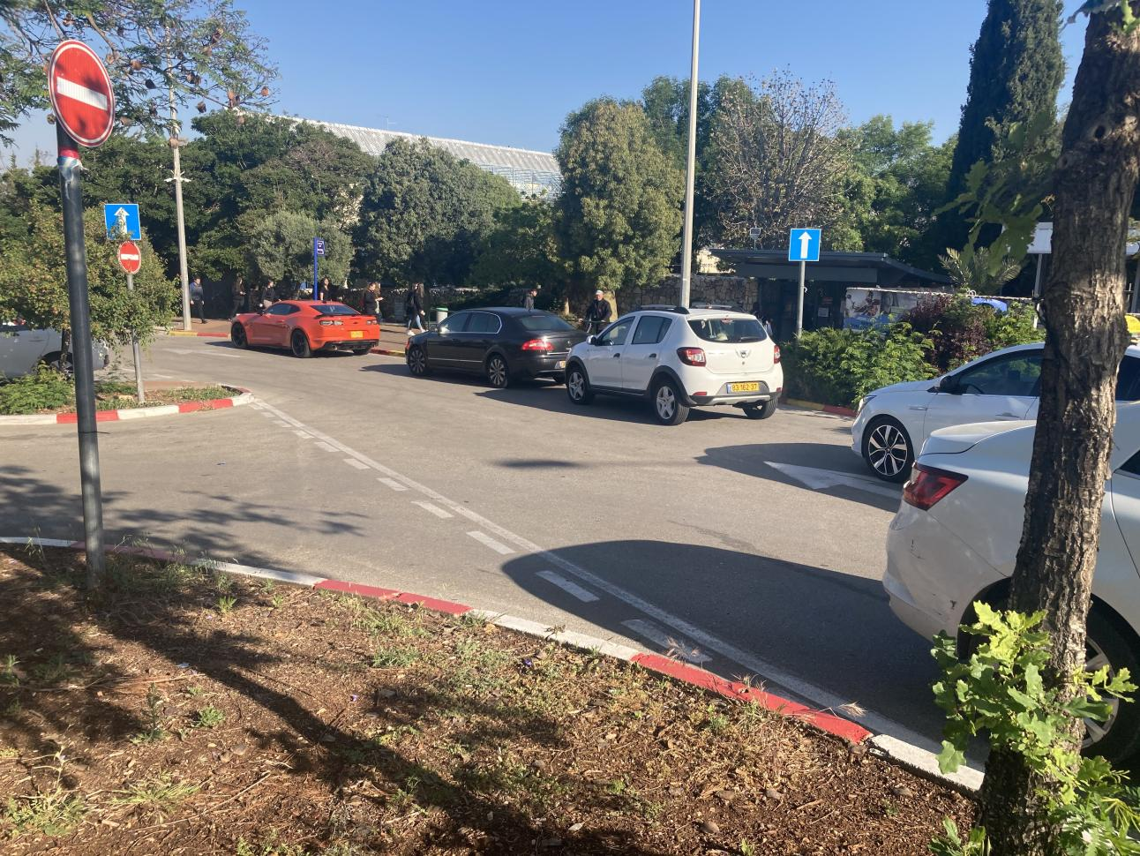

Slide 13
Barriers to Walking
Matter of convenience
Too hilly
Too hot
Too many other options
Must devise creative solutions for students with no apparent barriers
Notes:
Andrei

Slide 14
Data Collection Plan
Walk-to-school Day
Enjoy!
Test application in the field
Employ socialization and incentivization principles at event
Surveys
Interviews
Collect and analyze preliminary data
Discuss walking with students and teachers
Notes:
Surveys:
Online surveys used to gather data
Collect basic demographic information
Clarify relevancy of walking habits and barriers
Pass judgement on solutions
Interviews:
Meet with students and teachers over zoom
Lead conversations about how people feel about walking to school
Role of convenience in decision-making
Gauge opinion on severity of traffic in Karmiel

Slide 15
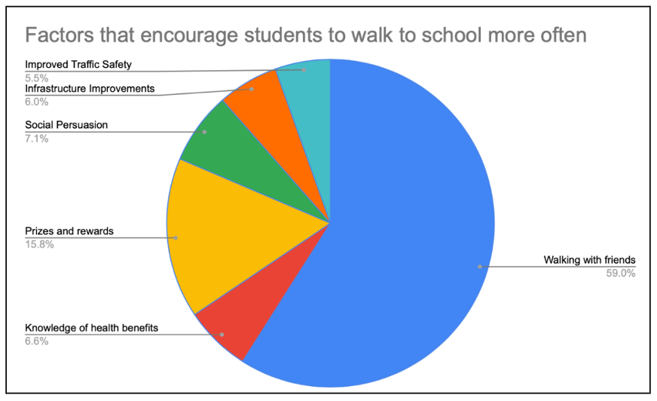
Thoughts on Data Collection
Outcomes
Promote walking with friends
Capitalize on Israeli fitness culture
Military service looms over students
Realize prospect of rewards
Coupons for cafeteria or local restaurants
Free gym credit

Slide 16
Goals and Solutions
Admire the elements!
Move students away from other transportation methods
Incentivization
Intrinsic vs extrinsic motivations
Gamification of walking to school
Hold walk-to-school days
Notes:
Dylan
Extrinsic: Rewards, walking with friends
Intrinsic: Personal drive to stay in shape

Slide 17
Application should promote socialization and stimulate interest by providing material rewards

Slide 18
Critical Findings
What we thought
What we did
What we found
What needs to be done
Incentivization is ideal for student retention
Rewards & Student Interaction
Greater expansion upon socialization
Socialization is by far the determining factor

Slide 19
Walk 2 School App
03
Solution Overview
Walk2School Application
Admin Panel
Data Collection and Database
Enjoy the walk!
Notes:
Lets move on to the fun part, our walk2school application, first lets talk about our solution overview

Slide 20
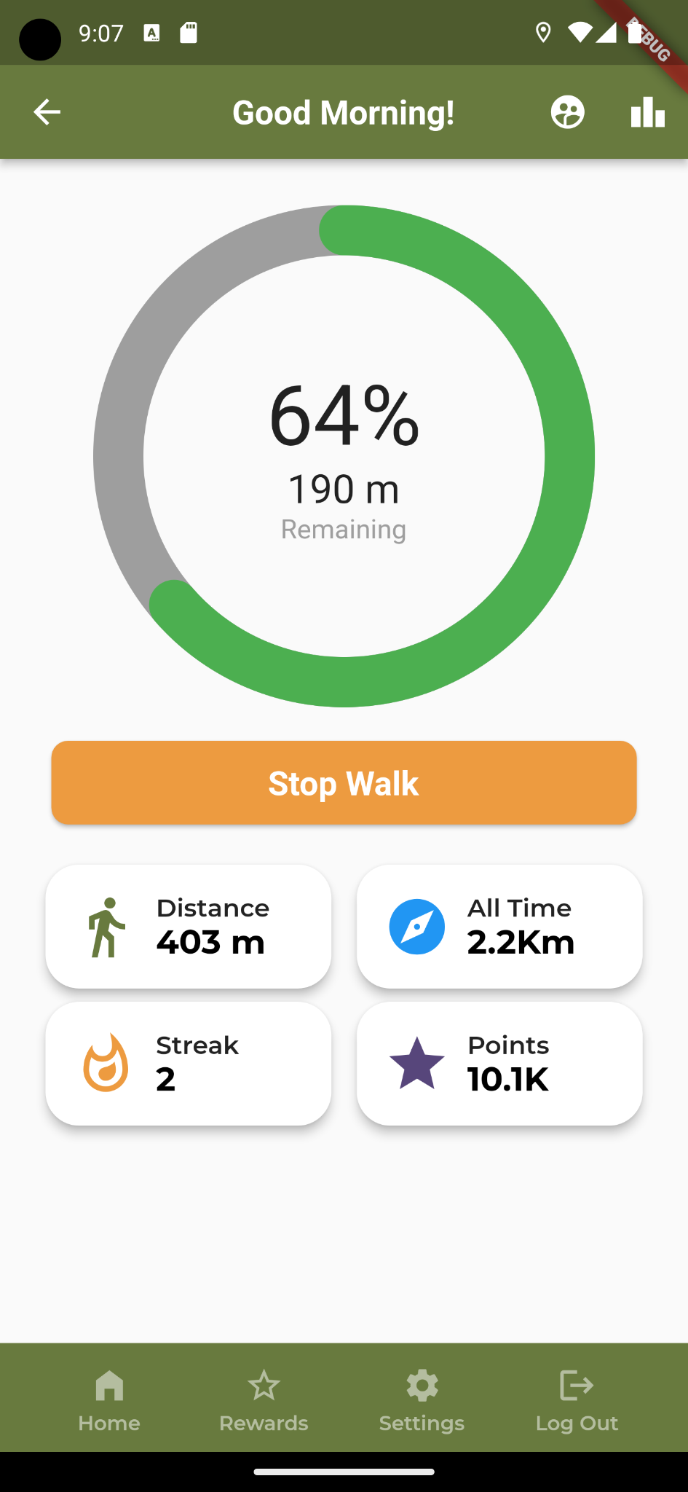
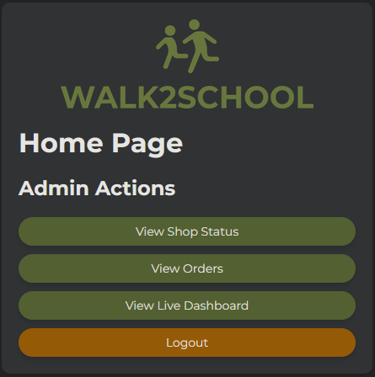
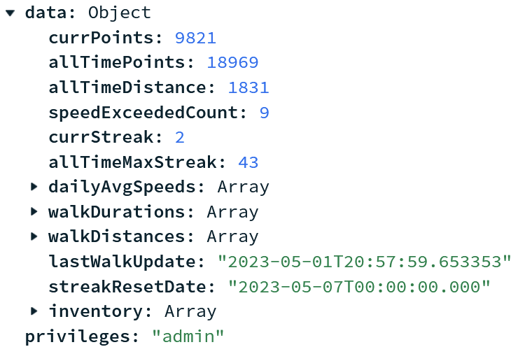
Solution Overview
Walk2School App
Admin Panel
Database
Notes:
Here you can see our suite of apps as well as database, first things first, the walk2school app. This app gamifies walking to school allowing students to gain points to turn in for rewards, in addition to, bolstering socialization between students. Next we have the admin panel which is primarily used for creating reward listings and redeeming rewards. Finally we have our database used to collect important information
gamifies walking where students gain points which can be used to purchase real rewards JUST by walking to school
Admin panel where teachers can manage the shop and rewards
Database to collect data

Slide 21
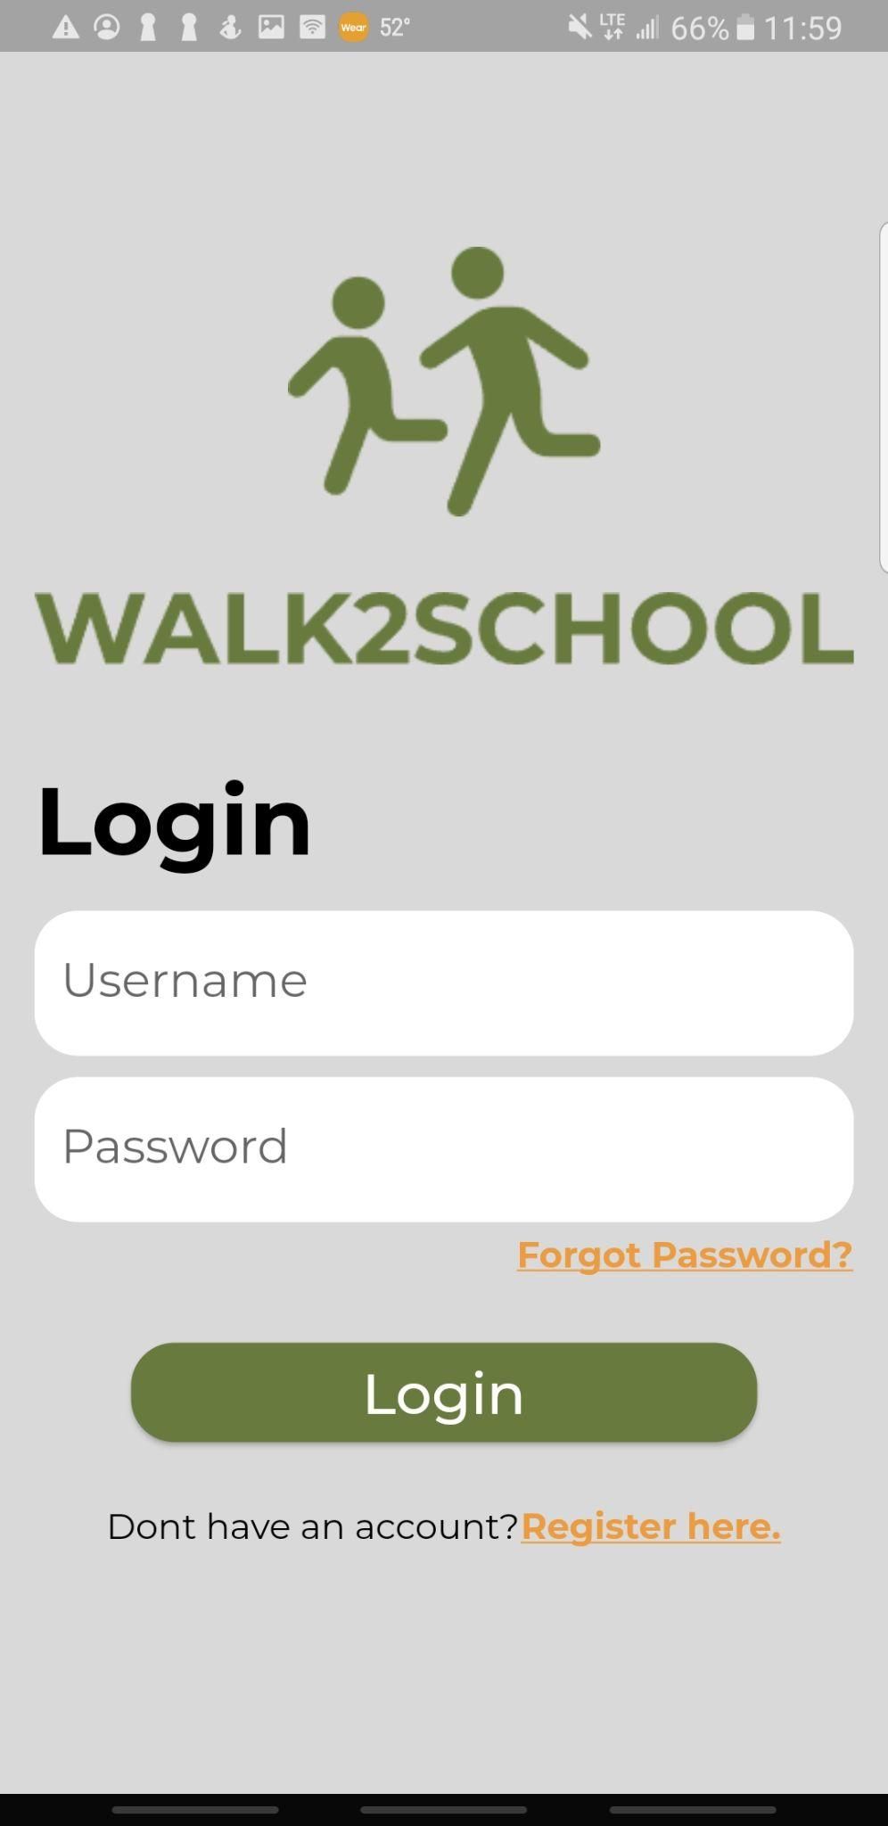
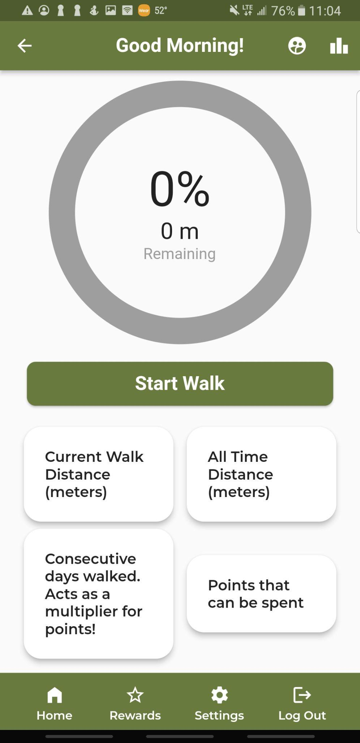
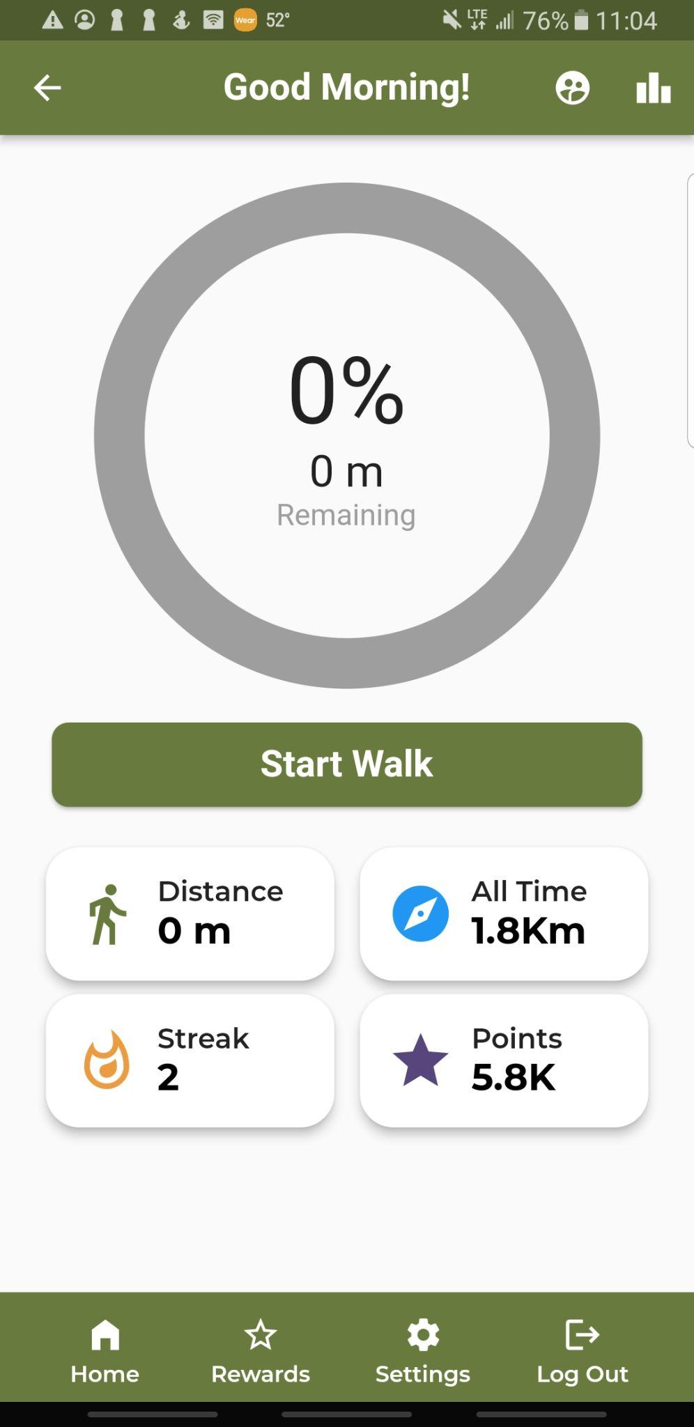
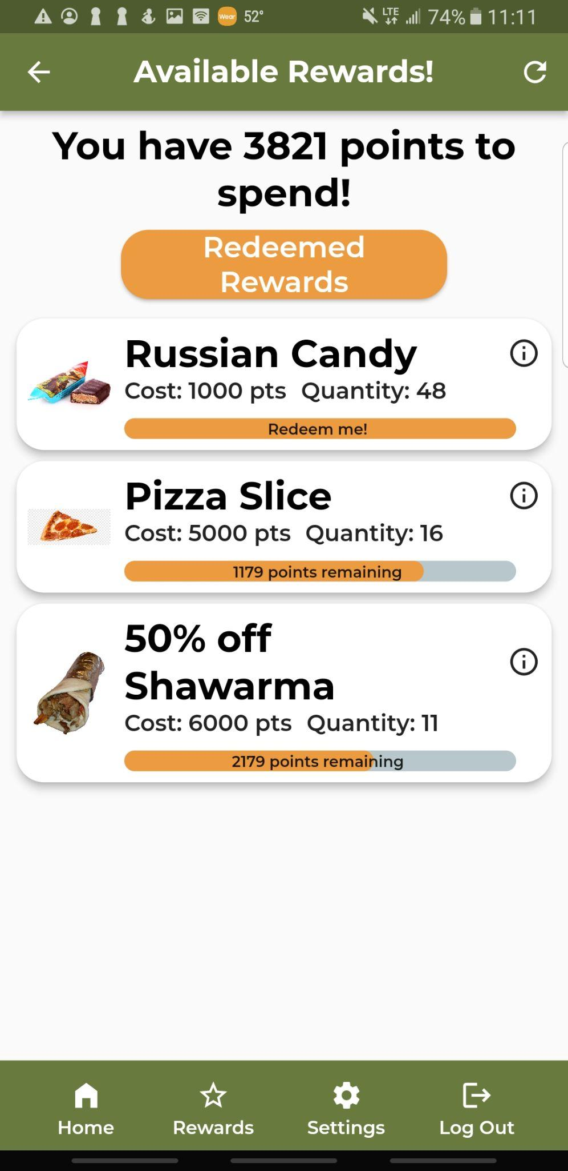
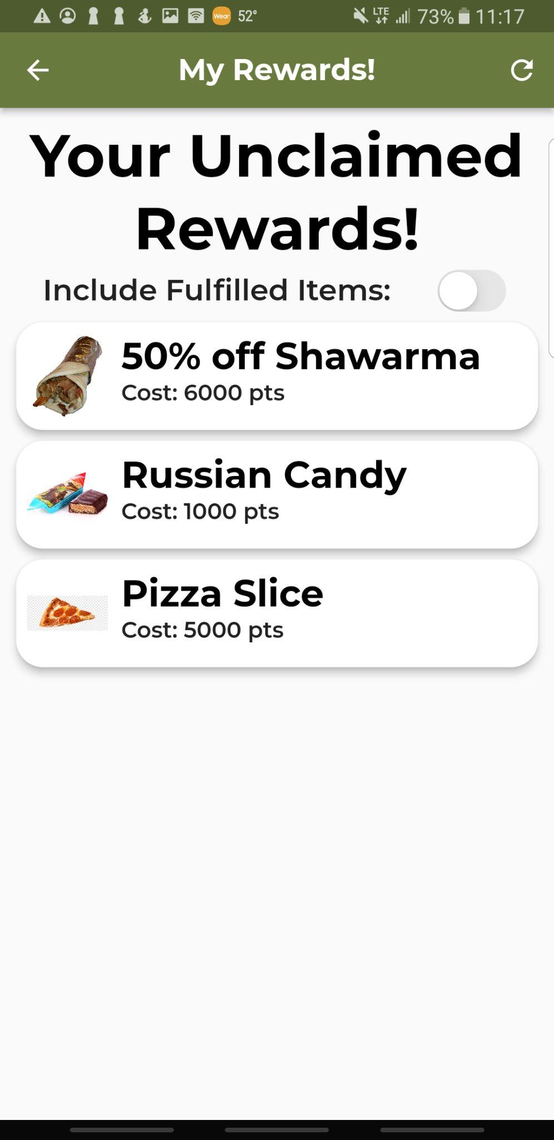
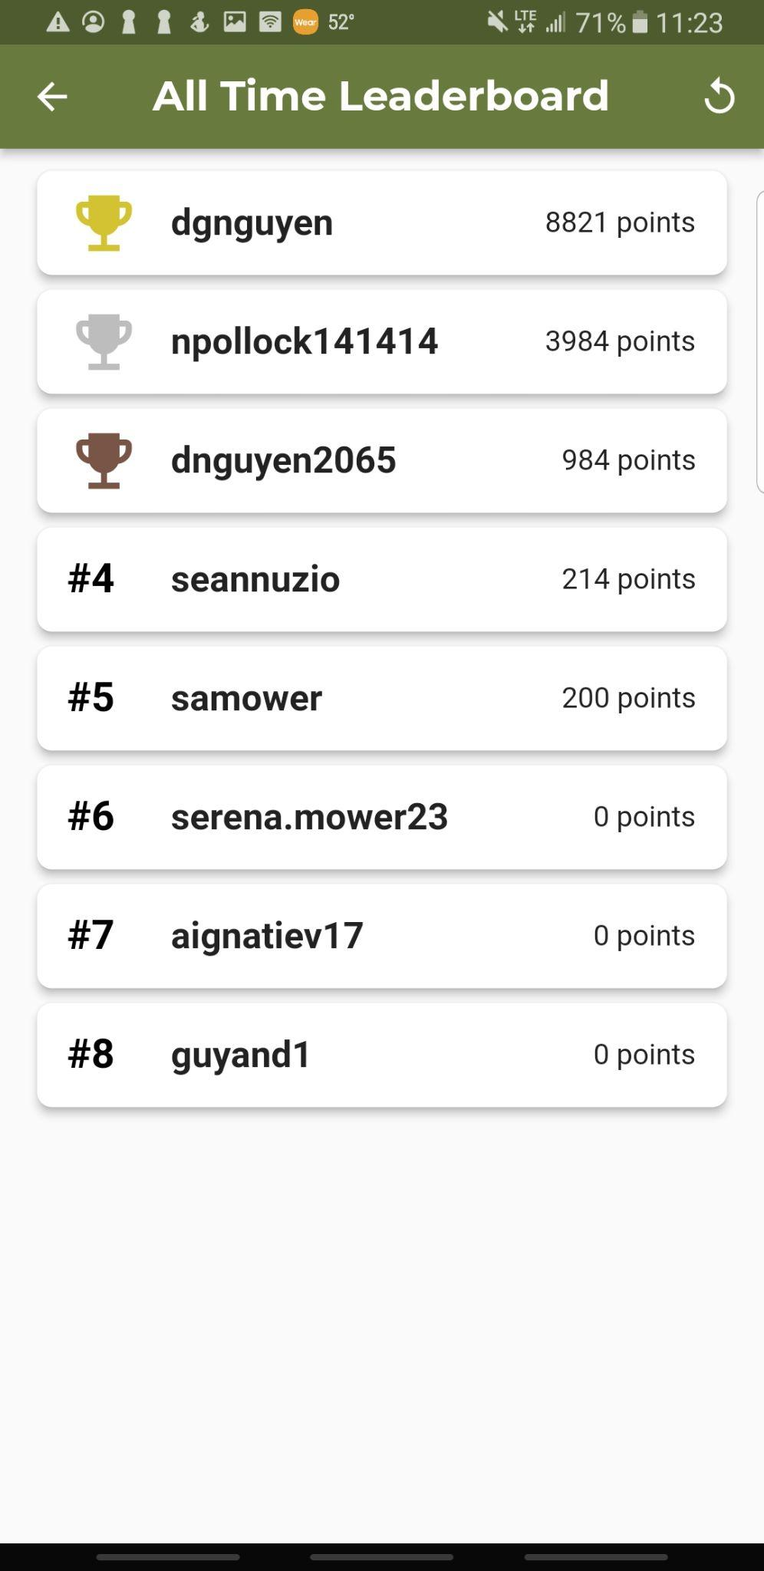
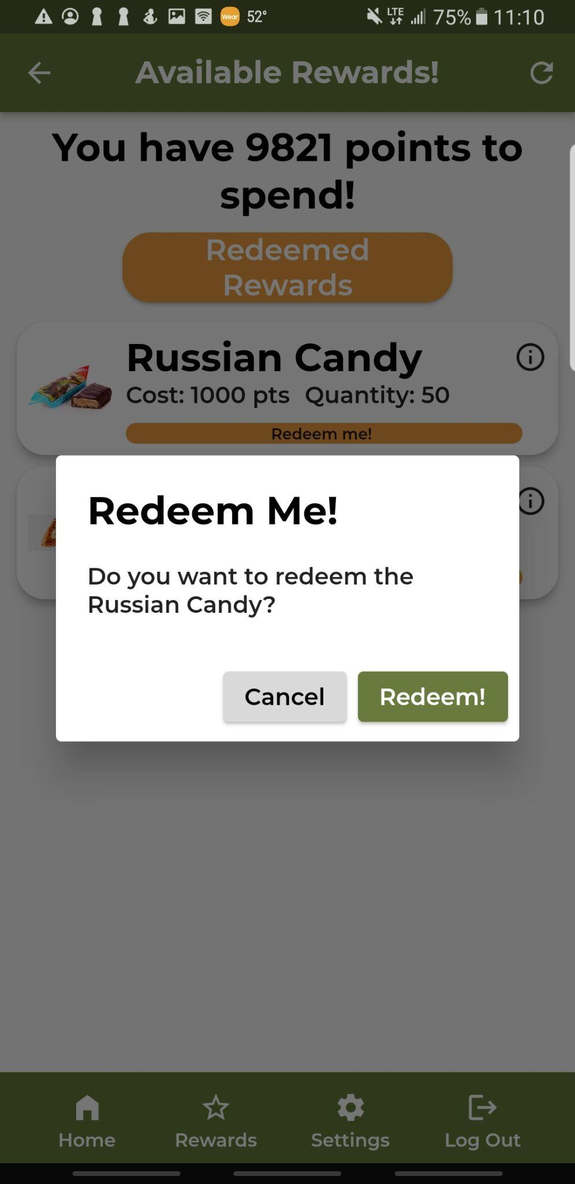
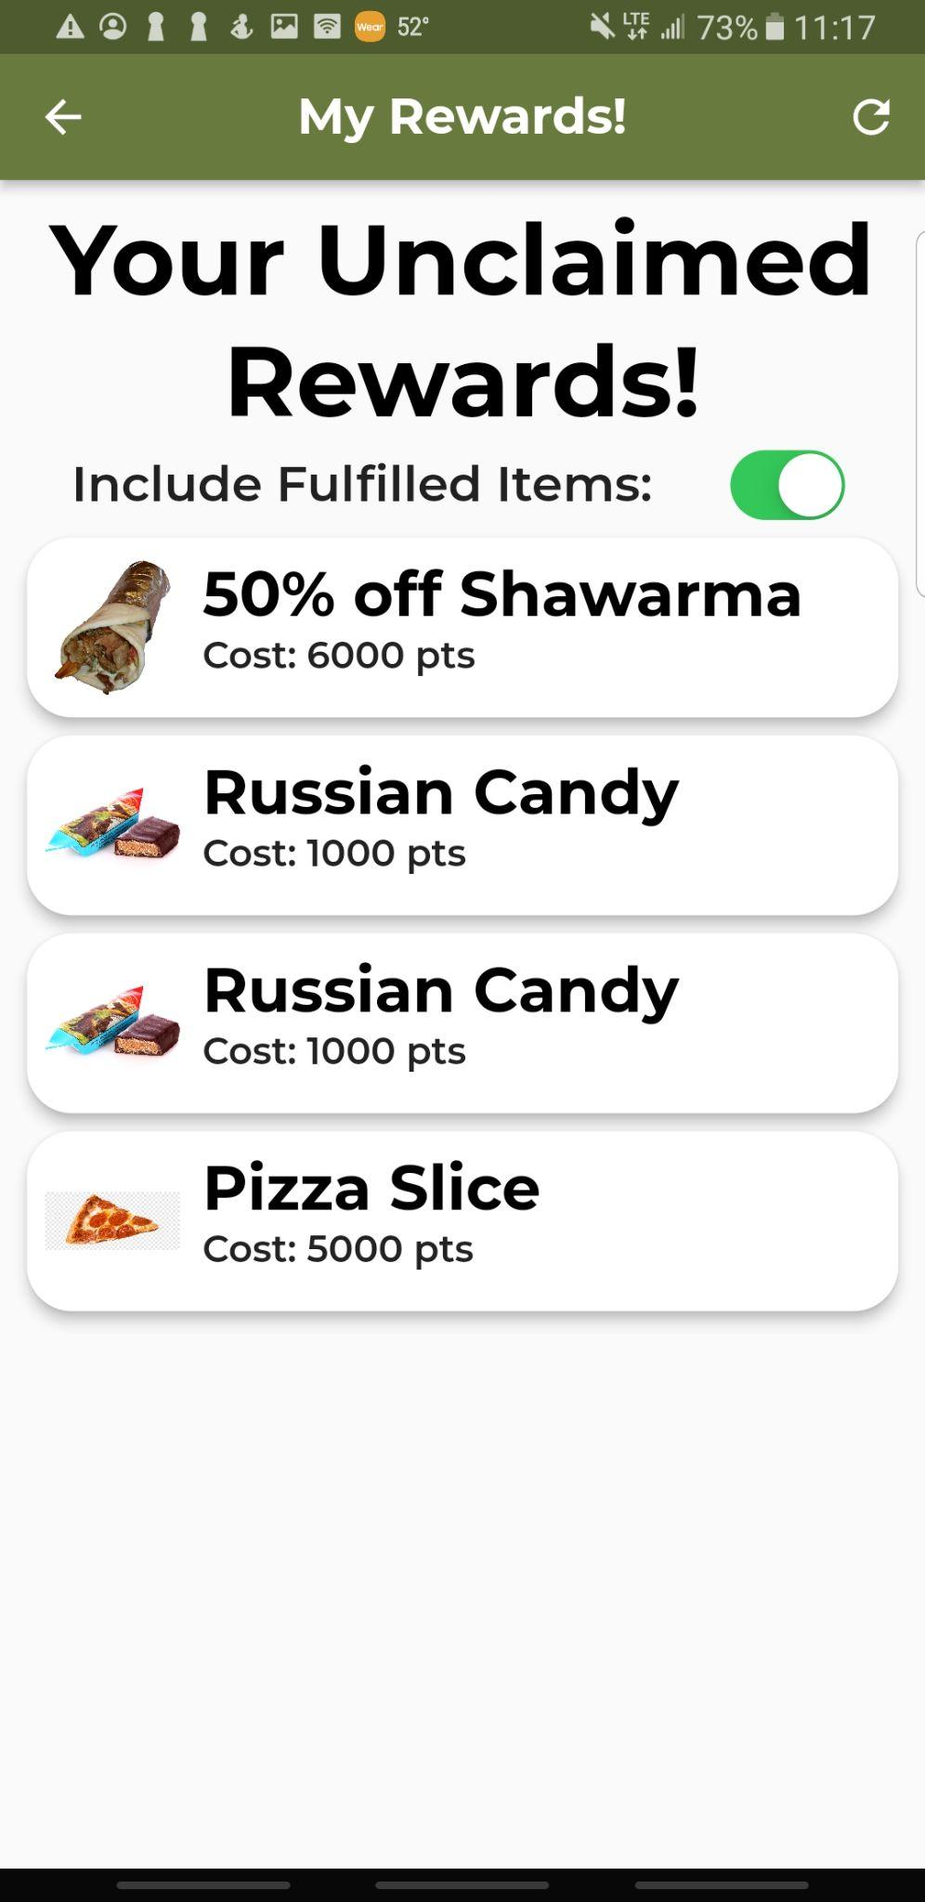
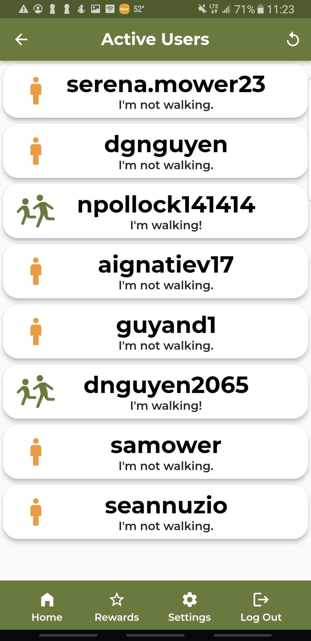
Walk2School Application

Slide 22
Notes:
First id like to describe whats happening. On the left is a pre planned route that the phone on the right will be following. Now that the student has started their walk, you can see data updating in real time as the student approaches the school. At the top you can see your remaining distance from the school. You can also see current distance, all time distance and points updating live. As for points each meter walked translates to one point earned however you can see the streak here. If you walk multiple days in a row you increase your streak which acts as a multiplier on your points. You also get 100 points just for starting a walk, this adds inclusivity in to our app for those who live very close to the school while still giving further incentivization for those who may live further.

Slide 23
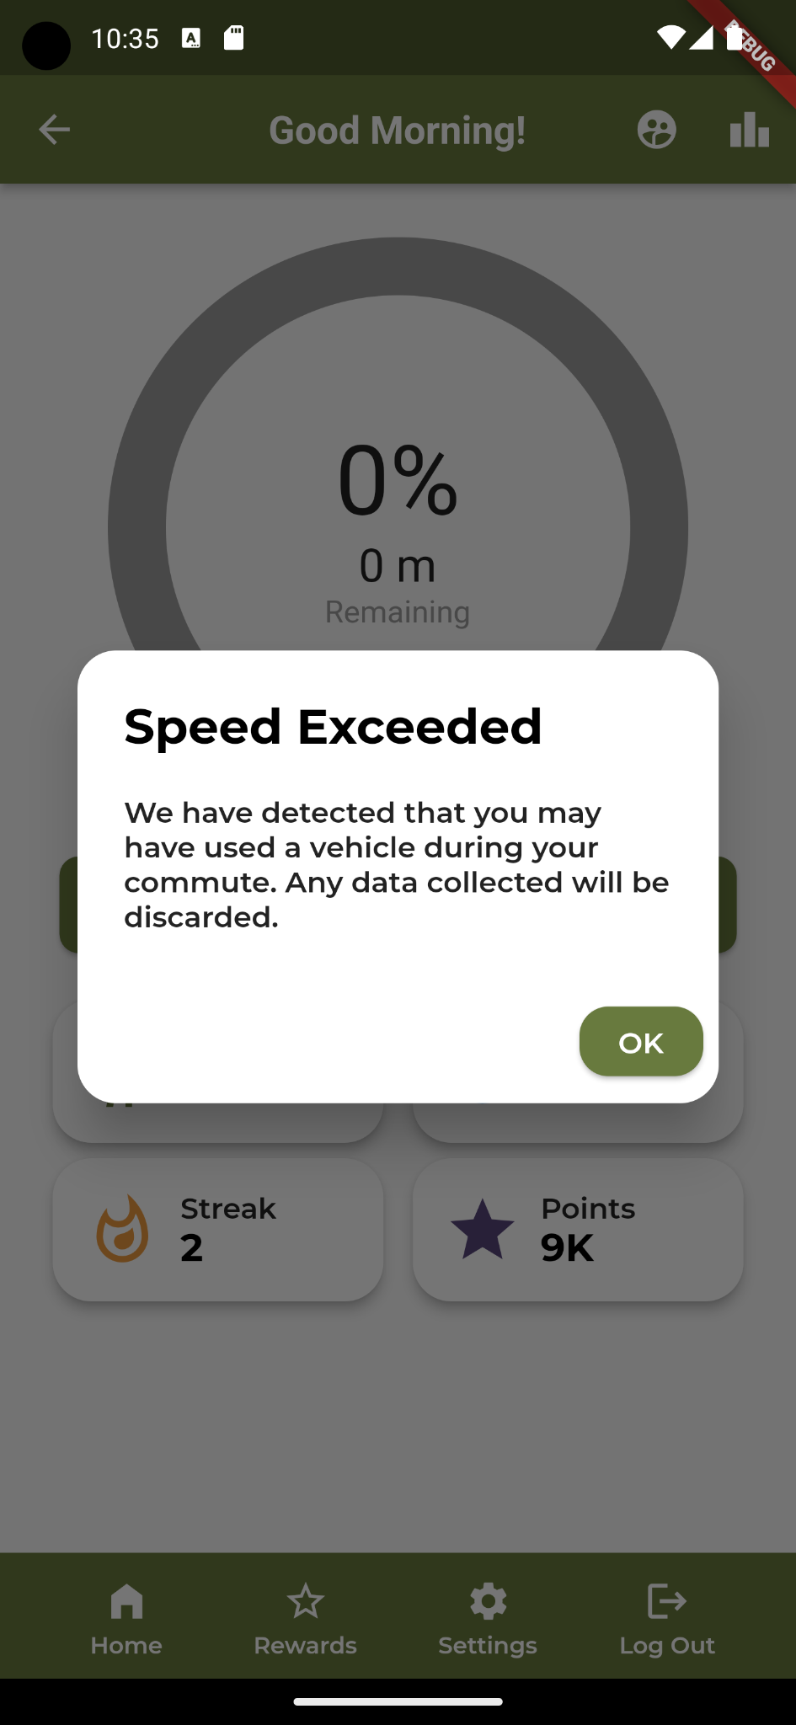
Walk Verification
Prior to walking it must:
Be a weekday
Be before the start of class
Be your first walk of the day
During a walk you must:
Not exceed 40kph
After walking you must:
Be within 100m of school
Be before the start of class

Slide 24
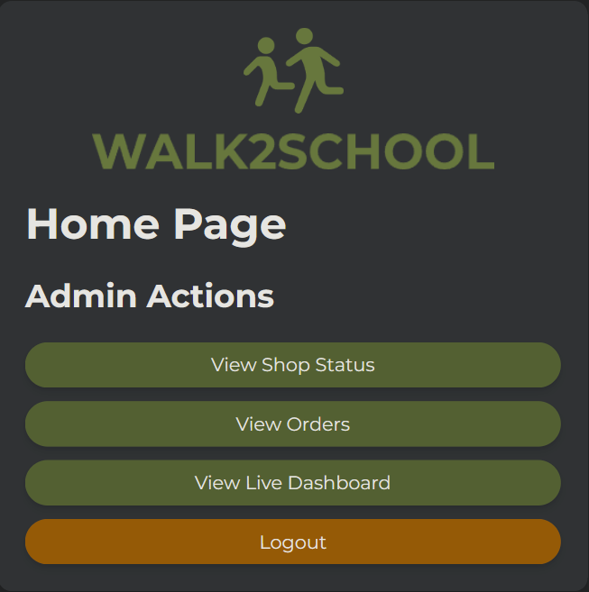
Admin Panel
Allows an administrator to monitor and maintain the app
Notes:
Now I will introduce our admin panel which is the second main component of our solution.
This is a website that allows administrators to monitor and maintain various aspects of our app
For example, an admin is able to view and edit the shop, check the queue of orders that users have placed, and view live analytics of the app in a dashboard.
This analytics page has not yet been implemented but I will now go over the other pages in more detail.

Slide 25
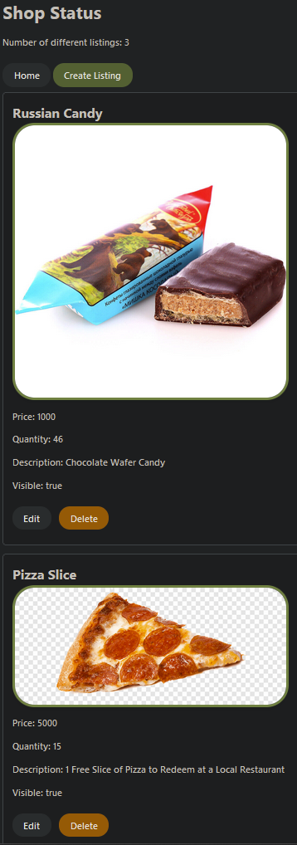
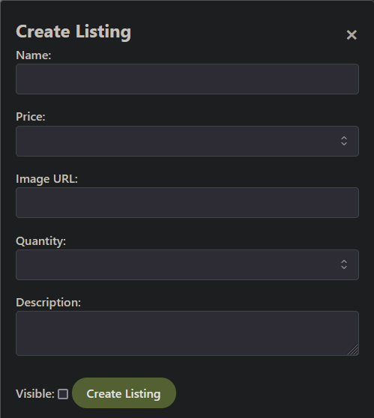
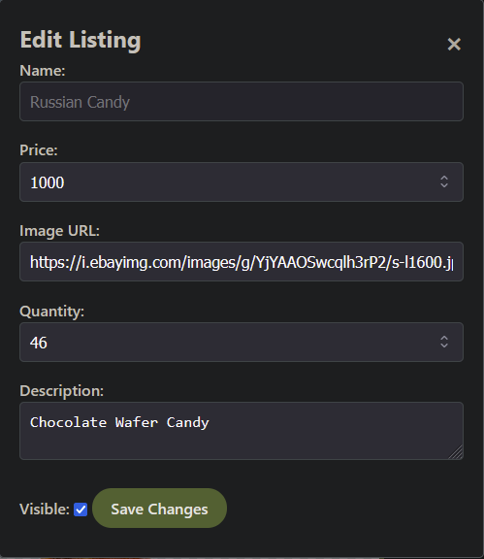
Shop Dashboard
Monitor and update reward listings.
Notes:
This is the shop dashboard where an admin is able to view, create and edit listings that are shown to users in the app.
Here they are able to do things like adjust the quantity in stock, the price, and add an image so that users are easily able to see what they are purchasing.
They can also set the visibility of items in the shop if they choose to do so.

Slide 26
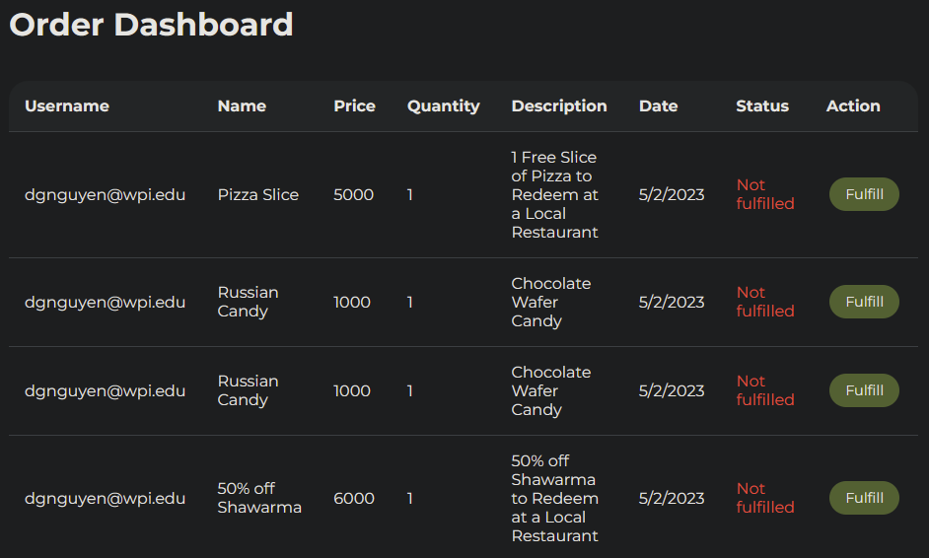
Order Dashboard
Allows an admin to monitor and fulfill redeemed orders
Notes:
Here is the order dashboard.
This is the place where orders will show up after a user makes a purchase in the app.
Here the admin is able to view the status of each order and can fulfill orders once students receive the item that they ordered.

Slide 27
Database
User data is collected for both app functionality and analytics
No personally identifiable data
Notes:
Now I will talk about our database and data that we collect which is the third main component of our solution.
The data we collect is primarily for app functionality but some data is purely for analytics to help improve the user’s experience.
On the left you can see a sample of some of the data we collect. For example there are things like current points and streak which are used for the functionality of the app but also there are things like average speeds and walk durations which can be used for analytics.
It is important to note that none of the data we collect is personally identifiable to maintain user privacy.

Slide 28
Data Security
SHA256 Password hashing
End-to-end data encryption
Session Tokens
User Privileges
Notes:
On the topic of user privacy, Ill highlight some of our data security measures.
We use Session tokens so that users don’t have to sign in with their username and password every time they use the app and if a hacker is able to obtain a session token, it is much less valuable than obtaining a credentials.
Also we have implemented a user privileges system so that administrators are able to assign different permission levels for various users. This means that admins can restrict access to certain pages for different users.

Slide 29
Results
04
Notes:
Nathan

Slide 30
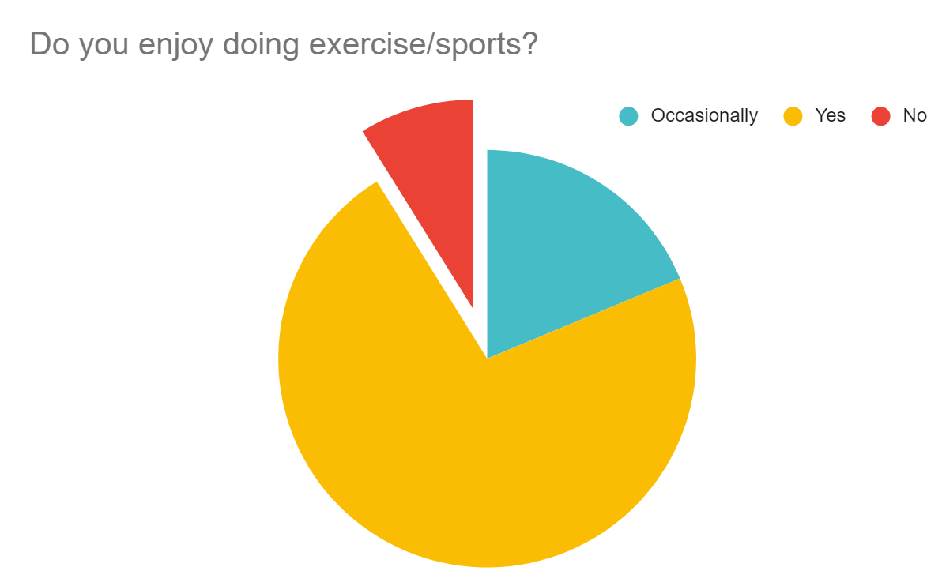
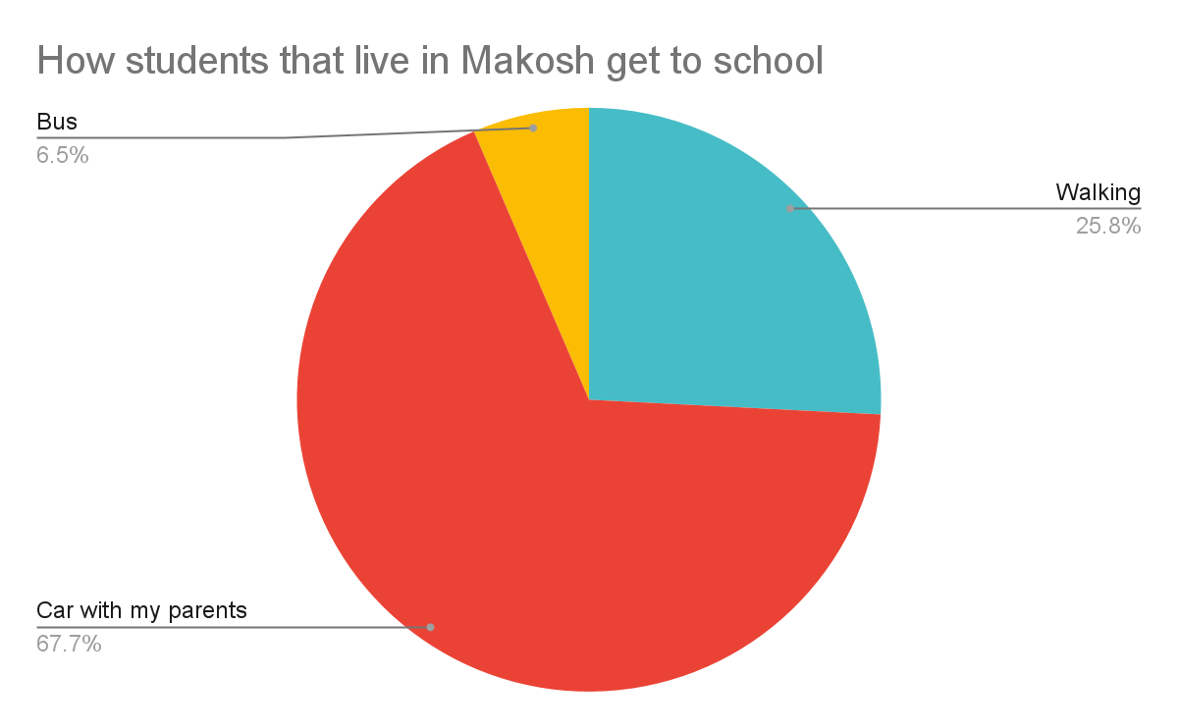
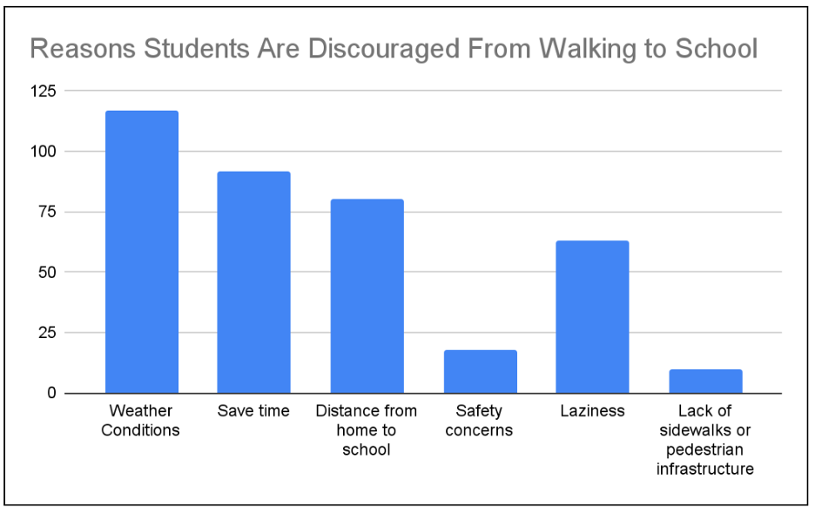
Survey Data
Notes:
Besides the main discovery that the majority of students would walk to school more often if it was with friends, I’m going to go through some other interesting conclusions we found through the survey.
Weather conditions are the primary factor that discourage students to walk. “Just make it colder”
Only 9% of students dislike exercise/ sports
Over 2/3 of the students that live in the Makosh neighborhood drive to school
This percentage is twice are large compared to the entire surveyed population.

Slide 31
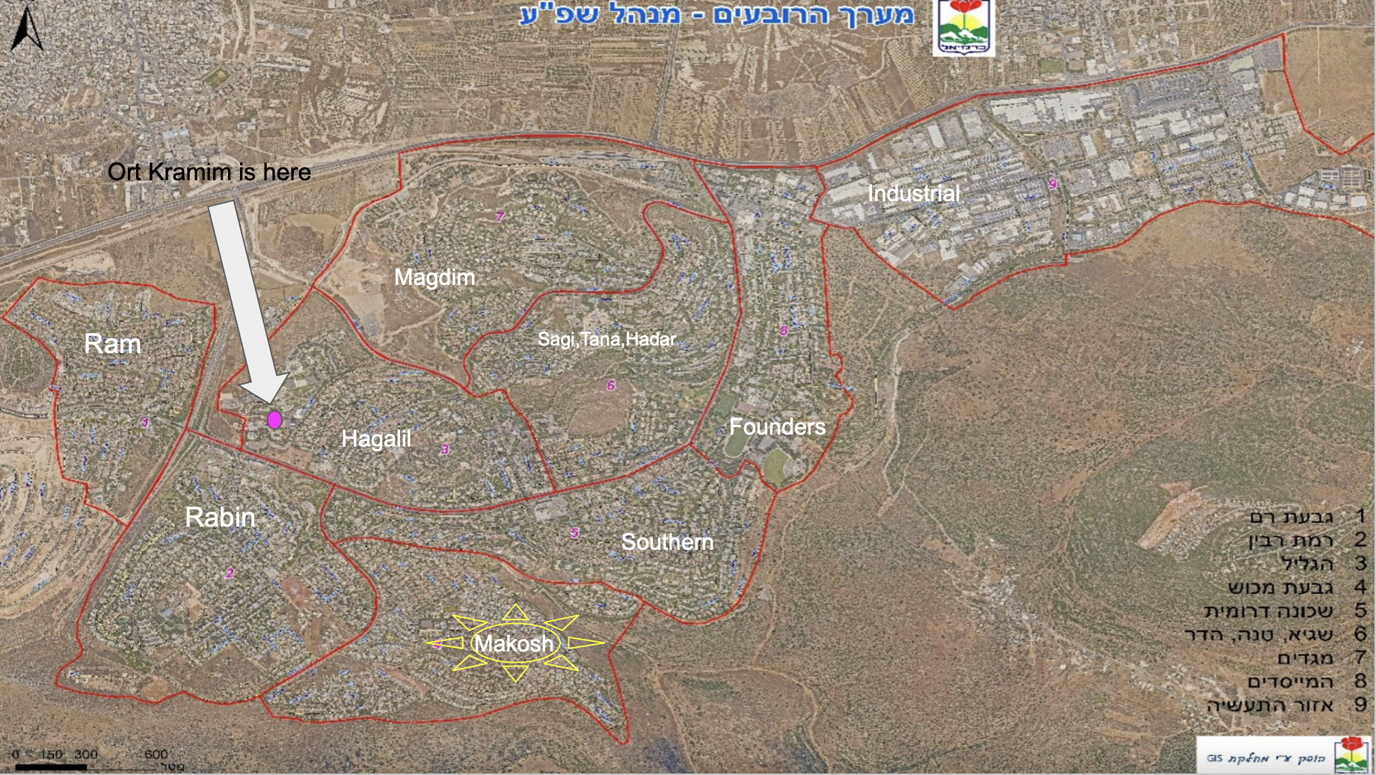
Map of Karmiel
Notes:
This is odd, especially when, as you can see the Makosh neighborhood isn’t that much further than Rabin and Southern
Why might this be?

Slide 32
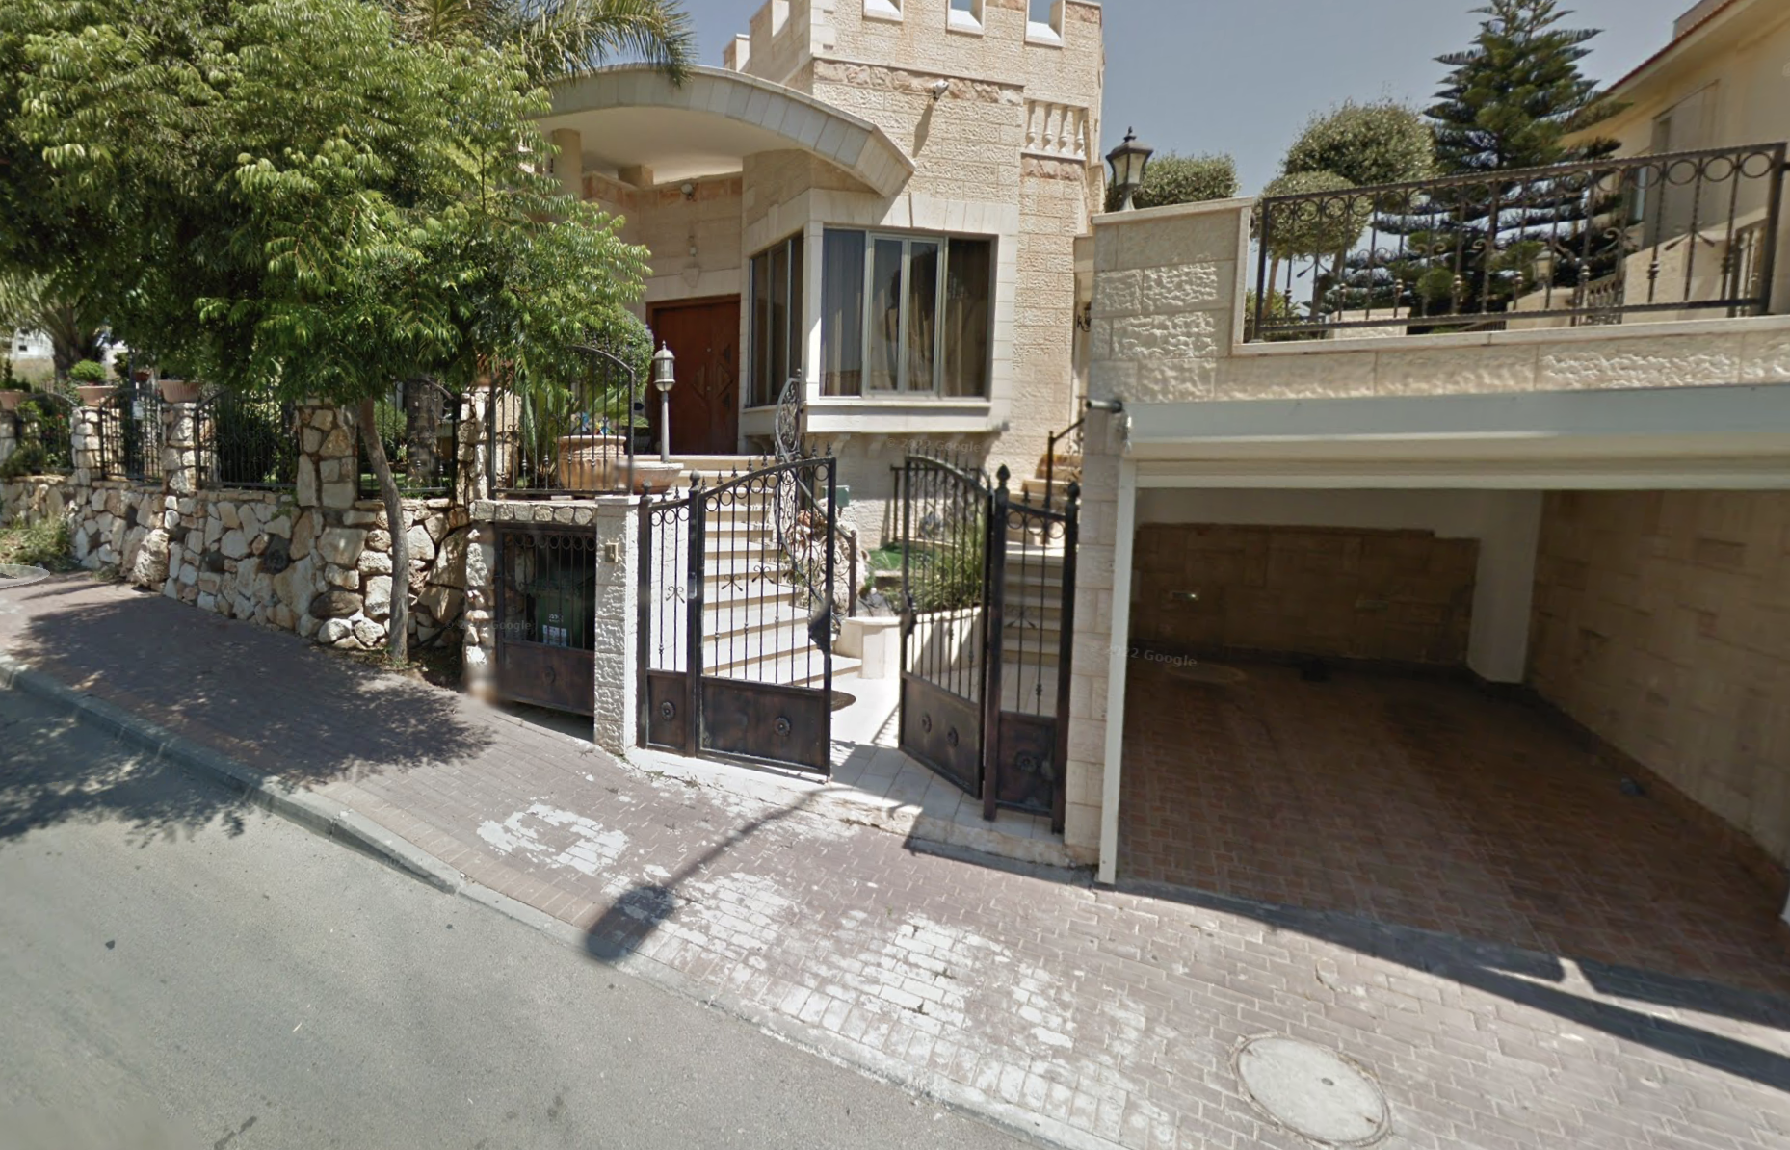
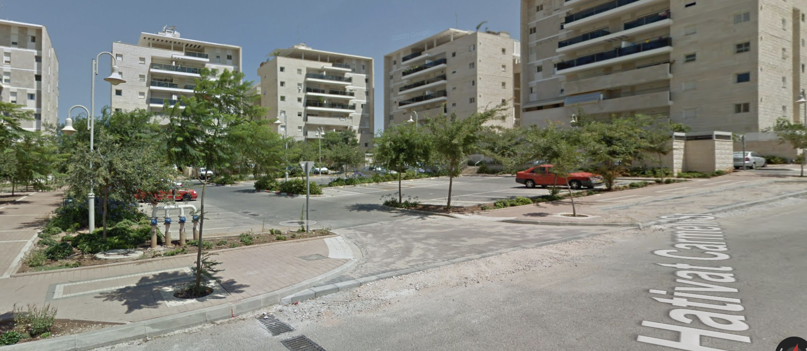
VS
Rabin
Makosh
Notes:
Well, in the right picture is a street view of a home in Makosh with a garage making cars more common
This is compared to the picture on the left which shows apartment buildings making it less suitable to have a personal vehicle

Slide 33
What’s Next
05
Application Future
Research Future
Final Words
Notes:
Finally we’re

Slide 34
Application Future
Expand Social Aspect
Apple IOS Support
Data Analysis and Visualizations
Friends list
Request group-walks
Increase user base and inclusivity
Expanded dashboard

Slide 35
Research Future
Data
Rewards
Connections
Time
More, More, More
Enhance data set
Larger budget, better rewards
Community efforts
Most valuable resource
Notes:
We can summarize the future of our research by “more, more, more”
More students walking, more traffic data
More events hosted by the community such as walk to school days and embrace the walking culture
More rewards to incentivize students to use our app and walk to school more often
All of this can be done with more time

Slide 36
Final Words
Make walking a social activity
Gamify walking
Lots of ideas
Social > Incentivization
Scalable to other schools
Walk!
Notes:
To end off this presentation, We need to make walking a social activity
There are lots of ideas we have looked at to increase the number of students that walk to school
The idea we thought would be the best is incentivize students through the creation of our app
However, to continue this project, we would prioritize the social aspect instead of incentivisation
We set a strong foundation for this project to be further worked on
And it is very scalable, scalable to other schools in Karmiel, Israel or other countries as traffic congestion occurs all over the world

Slide 37
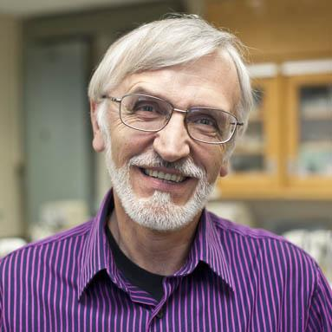
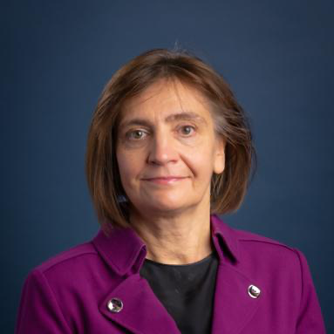
The WPI Staff
Alejandro Manga
Ivan Mardilovich
Svetlana Nikitina
Notes:
We would like to thank all the people who helped bring this project to life. First on the WPI end, Professor Manga was instrumental to building the foundation for our project. Professors Mardilovich and Nikitina did an immaculate job guiding us through the IQP process even when things seemed very uncertain.

Slide 38
The Braude Team
Dr. Nirit Gavish
Dr. Anat Dahan
Bar Levy
Head of Industrial Management at Braude
Professor of Computer Science at Braude
Braude Industrial Management Student
Notes:
We would like to acknowledge our Braude sponsors, Dr. Nirit Gavish, Dr. Anat Dahan, and student Bar Levy

Slide 39
Honorable Mentions
Hani Eival
Dvir Vahav
Notes:
we also have honorable mentions of Hani Eival, Dvir Vahav who helped lead the data collection students at the highschool
As well as Ort Kramim teachers Ortal, Limor, and Inbal who we do not have pictures for
Finally we cant forget the students of Ort Kramim Highschool who showed us around and were very excited to help us collect data.

Slide 40
Thanks!
Does anyone have any questions?
gr-WalkToSchoolD23@wpi.edu

Slide 41
Resources
Active Living Research. (2012). Physically Fit and Active Children Perform Better in School. https://activelivingresearch.org/sites/activelivingresearch.org/files/Brief_ActiveEducation_Factsheet_July2012.pdf
Baranek, L. (1996). The Effect of Rewards and Motivation on Student Achievement. Masters Theses. https://scholarworks.gvsu.edu/theses/285
Braza, M., Shoemaker, W., & Seeley, A. (2004). Neighborhood Design and Rates of Walking and Biking to Elementary School in 34 California Communities. American Journal of Health Promotion, 19(2), 128–136. https://doi.org/10.4278/0890-1171-19.2.128
CDC. (2002). Barriers to Children Walking and Biking to School — United States. (1999). Morbidity and Mortality Weekly Report, 51(32), 701–704. https://www.jstor.org/stable/23312541.
​​Chiang, Y. -., Sullivan, W., & Larsen, L. (2017). Measuring neighborhood walkable environments: A comparison of three approaches. International Journal of Environmental Research and Public Health, 14(6) doi:10.3390/ijerph14060593
Cohen, T., & Scheer, S. (2015). Israel’s soaring population: Promised Land running out of room? Reuters.https://www.reuters.com/article/uk-israel-demographics/israels-soaring-population-promised-land-running-out-of-room-idUKKCN0RP0ZG20150925
Crime in Karmiel. Safety in Karmiel. (2022). Numbeo. https://www.numbeo.com/crime/in/Karmiel-Israel
de Freitas, A. A., & de Freitas, M. M. (2013). Classroom Live: A software-assisted gamification tool. Computer Science Education, 23(2), 186–206. https://doi.org/10.1080/08993408.2013.780449
Differences in parental perceptions of walking and cycling to high school according to distance. (2020). Transportation Research Part F: Traffic Psychology and Behaviour, 71, 238–249. https://doi.org/10.1016/j.trf.2020.04.013
Gissel, M., Millet, S., & Usechak, P. (1999). Merton safer routes to schools. London: Worcester Polytechnic Institute. https://digital.wpi.edu/concern/student_works/xs55mc58h?locale=en
Keall, M. D., Shaw, C., Chapman, R., & Howden-Chapman, P. (2018). Reductions in carbon dioxide emissions from an intervention to promote cycling and walking: A case study from New Zealand. Transportation Research Part D: Transport and Environment, 65, 687–696. https://doi.org/10.1016/j.trd.2018.10.004
Lee, H., & Kim, S. N. (2021). Perceived Safety and Pedestrian Performance in Pedestrian Priority Streets (PPSs) in Seoul, Korea: A Virtual Reality Experiment and Trace Mapping. International journal of environmental research and public health, 18(5), 2501. https://doi.org/10.3390/ijerph18052501

Slide 42
Resources
McDonald, N. C. (2008). Children’s mode choice for the school trip: The role of distance and school location in walking to school. Transportation (Dordrecht), 35(1), 23–35. https://doi.org/10.1007/s11116-007-9135-7
McKee, R., Mutrie, N., Crawford, F., & Green, B. (2007). Promoting walking to school: Results of a quasi-experimental trial. Journal of Epidemiology and Community Health (1979-), 61(9), 818–823.
Neef, M. D. (2013). Gradients and cycling: An introduction. The Climbing Cyclist. https://theclimbingcyclist.com/gradients-and-cycling-an-introduction/
Pearson, A. L., Clevenger, K. A., Horton, T. H., Gardiner, J. C., Asana, V., Dougherty, B. V., & Pfeiffer, K. A. (2021). Feelings of safety during daytime walking: associations with mental health, physical activity and cardiometabolic health in high vacancy, low-income neighborhoods in Detroit, Michigan. International Journal of Health Geographics, 20, 1-13. https://doi.org/10.1186/s12942-021-00271-3
Promoting Safe Walking and Biking to School: The Marin County Success Story. (n.d.). https://doi.org/10.2105/AJPH.93.9.1431
Reyer, M., Fina, S., Siedentop, S., & Schlicht, W. (2014). Walkability is Only Part of the Story: Walking for Transportation in Stuttgart, Germany. International Journal of Environmental Research and Public Health, 11(6), 5849–5865. https://doi.org/10.3390/ijerph110605849
Road safety report 2020 | Israel - International Transport Forum. (2020). Retrieved February 13, 2023, from https://www.itf-oecd.org/sites/default/files/israel-road-safety.pdf
Stewart, O., Vernez Moudon, A., & Claybrooke, C. (2012). Common ground: Eight factors that influence walking and biking to school. Transport Policy, 24, 240–248. https://doi.org/10.1016/j.tranpol.2012.06.016
Su, J. G., Jerrett, M., Mcconnell, R., Berhane, K., Dunton, G., Shankardass, K., Reynolds, K., Chang, R., & Wolch, J. (2013). Factors Influencing Whether Children Walk to School. Health & Place, 22, 153–161. https://doi.org/10.1016/j.healthplace.2013.03.011
Tal, A. (2017). Racing toward disaster: Israel’s unsustainable population bomb. The Jerusalem Post. https://www.jpost.com/jerusalem-report/racing-toward-disaster-israels-unsustainable-population-bomb-504249
Worcester, J., Wrabel, E., Fortner, E., & Pagliaccio, I. (2013). Walk-on-Wednesday in Croydon. London: Worcester Polytechnic Institute. https://digital.wpi.edu/pdfviewer/zk51vh341

