Slide 1
BEHIND THE FRONT LINE:
Vicarious Trauma Amongst Support Staff in Victoria’s
Emergency Management Sector
Hunter Daris, Ella Devault, Gavin George, Fredy Lenson
Notes:
“I compare VT to erosion. It is super predictable. You can see it coming but it happens so slowly that it is hard to catch it until something is at its breaking point. It makes it really hard for people to reach out because they have to have insight into the fact that it is happening.”
More regular check-ins to allow for more room for reflection of changes

Slide 2
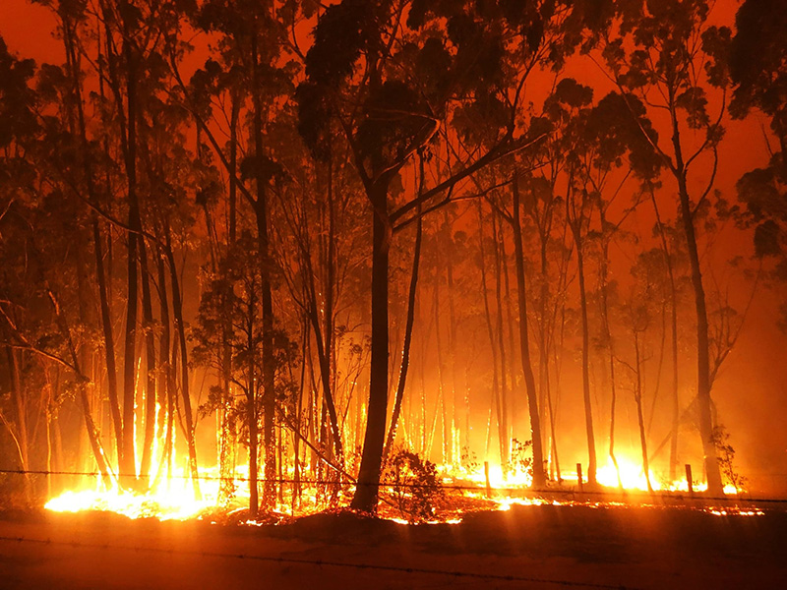
The impact of vicarious trauma in the emergency sector is profound and deeply significant
“I had no time to settle in… emergency warnings were being issued left, right and centre…. Parks were being closed and evacuated of campers between Bemm River and Mallacoota. It just kept coming at us!”
“I'm not on the ground, but I know my workplace is on the ground, and communities are on the ground.”
Mallacoota Fires (2019-2020)
Notes:
https://docs.google.com/document/d/1yKe6HeAUJOO1qDYswqTTkfQZXLLzfQZuY_KAHTeKyj4/edit?usp=sharing
“Used to wait until people were damaged before we did anything”
“Processes are not up the speed with the need”
The support staff worker we got these quotes from was also involved in support efforts during the black saturday bushfires
“I didn't realize what was going on for months…”
“Just because I’ve been through it once doesnt mean im damaged goods, it actually means im stronger”
“Do you guys even know what i’ve been through”
This particular situation pushed them to their mental health limit, and they didn't deal with it until the fire season ended - 6 months later

Slide 3
Our objectives:
Understand how vicarious trauma (VT) impacts support staff working in Victoria’s Emergency Management sector
Understand how it’s being addressed in the sector with an environmental scan
Understand leading practice

Slide 4
Agenda:
What we learned from desktop research
1
What we learned from people with specialist knowledge
4
What we learned from support staff individuals
2
Study conclusions and recommendations
5
What we learned from agency managers
3
Notes:
18 individuals from 12 different agencies
15 agency managers (all of ESF member agencies)
6 people with specialist knowledge

Slide 5
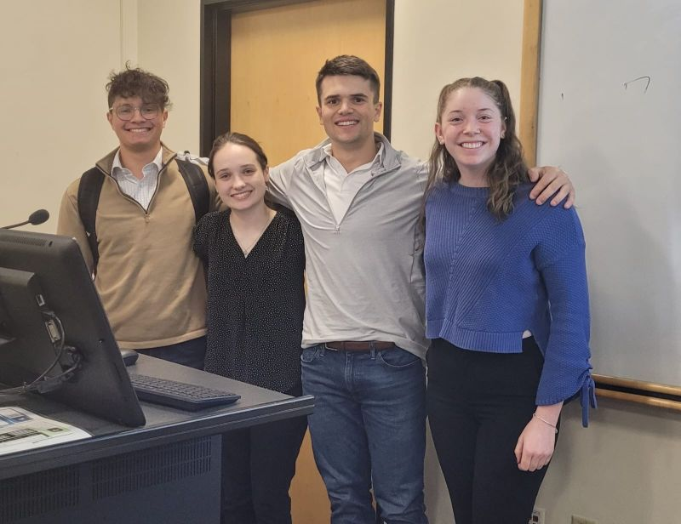
What we learned from background research and literature review

Slide 6
Any traumatic event has a ripple effect
Families of Workers
Emergency Support Staff
Frontline Workers
Community in Need
Notes:
Ripple effect (from suisan) - not as direct as an impact compared to frontline workers but still heavily affected
First: traumatic event that occurs - emergency frontliner workers witness event,
support staff directing the frontline also hear - can only help by moving ppl
The fact that they are usually unrecognized can pose even greater risk since they might not get the mental health assistance they need to function at their workplace properly.
dealing with emotional people in need, who are extremely anxious and vulnerable
In order to insert themselves into highly stressful situations, they must have a strong mental wellbeing

Slide 7
Our original understanding of vicarious trauma:
A trauma-based condition onset by cumulative secondary exposure to other people’s traumatic experiences

Slide 8
We determined a short list of support roles who might be impacted by VT
Dispatchers
Recovery Workers
Human Resources Staff
Communication Staff
Counselors
Interpreters
Notes:
Large increase in roles qualified by support staff
People who didnt even realize that they were support staff
This emphasized the importance of raising awareness regarding their needs
The fact that there are so many of them is a barrier for the agencies themselves because there are so many SS and they all have different needs that need to be addressed
Initiatives have to be able to be adaptable to each role

Slide 9
Poor management of psychosocial hazards increases risk of VT in support staff
Aspects of work that have the potential to cause psychological or physical harm
Traumatic Material
Work
Demands
Low Job
Control
Work
Relations

Slide 10
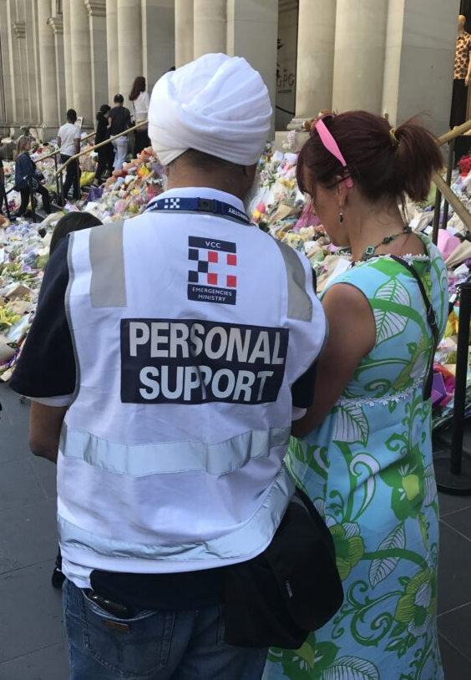
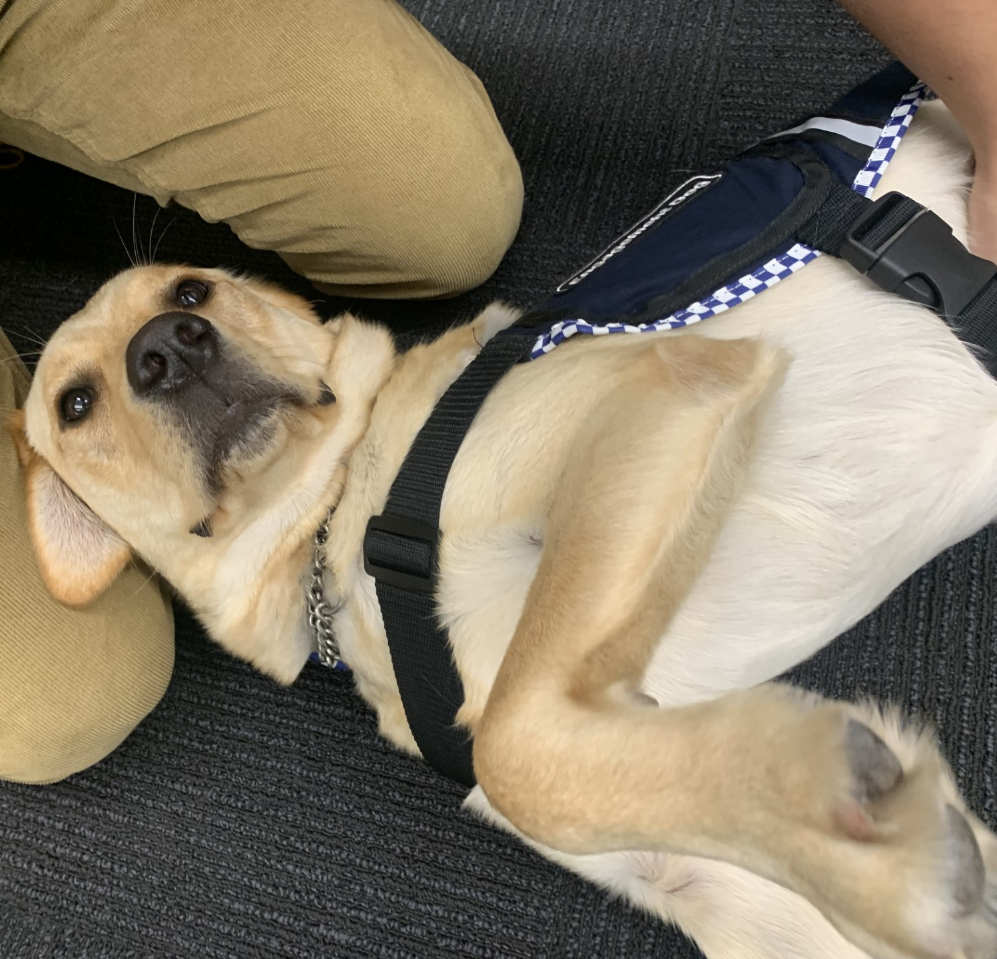
What we learned from individuals
in support roles

Slide 11
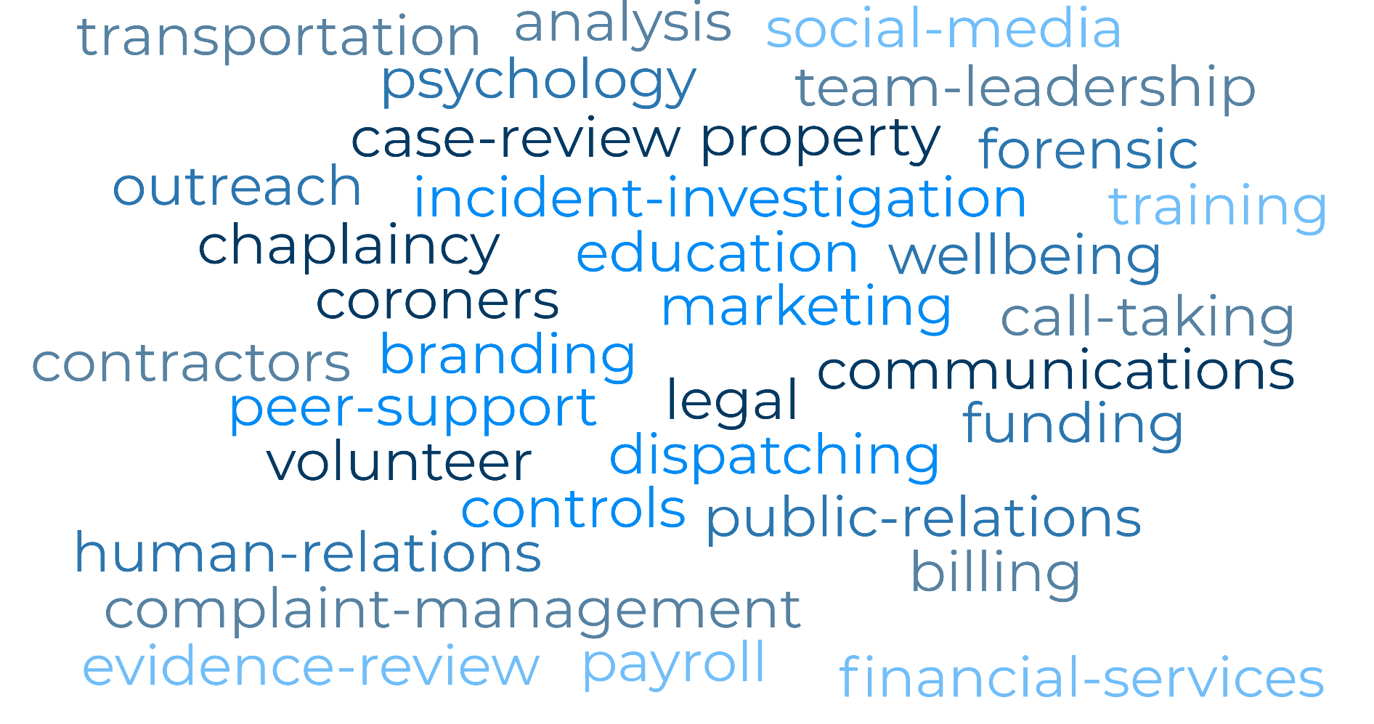
The range of support staff roles at potential risk of VT is much larger than expected
Dispatchers
Recovery Workers
Human Resources Staff
Communication Staff
Counselors
Interpreters
Notes:
Large increase in roles qualified by support staff
People who didnt even realize that they were support staff
This emphasized the importance of raising awareness regarding their needs
The fact that there are so many of them is a barrier for the agencies themselves because there are so many SS and they all have different needs that need to be addressed
Initiatives have to be able to be adaptable to each role

Slide 12
Every individual we spoke with said they have experienced VT in some way

Slide 13
Each individual is impacted differently
Personal
Organizational
“Each day I had this video reel playing in my head.”
“No one was looking after me, making sure my work was done."
“She was starting to have flashbacks about jobs she’s dispatched on.”
“We see it in the form of people just withdrawing.”
“I started having nightmares.”
“We see it in staff turn over.”
Notes:
Just like frontline workers

Slide 14
Support staff feel like they don’t deserve the same support as frontline workers
Heightened emotions affecting the workplace
Not validating their feelings
“There’s
always someone else who needs it more than me.”
Not utilizing mental health resources

Slide 15
There are divergent views in terms of how supported individuals feel by their agency
“We are not addressing it [mental health] at all.”
“We don't have enough on VT…focuses are on the physical impacts.”
“It is a constant support. It doesn’t come and go. It is there all the time.”

Slide 16
Support staff are using their own coping mechanisms
Mindset
Informal Debriefing
Physical Activity
Self Care
Religion
Social Connection
Religion
Social Connection

Slide 17
What we learned from agency managers

Slide 18
We categorized each agency’s focus on VT for support staff on a cumulative scale
Proactive
Measures in place to prevent the impact of VT before symptoms occur
Reactive
Measures in place to recover from VT
Acknowledgement
Recognizes that VT is an issue within the emergency management sector

Slide 19
There are some good things happening in isolation, but there is plenty of room for improvement throughout the sector
Notes:
Explain isolation

Slide 20
Some agencies are taking steps to address VT
Awareness
Recruitment
Education for support staff
Training for managers

Slide 21
The sector and agencies need more awareness about Vicarious Trauma
"Just having this conversation brings VT to the forefront and brings awareness.”
Awareness
]]]]
Notes:
FRV example, need good examples

Slide 22
Mitigation of VT can begin in agency
recruitment processes
“Staff said ‘I didn’t know I was going to be exposed to this, I didn’t know this was part of the job.”
“If you are prepared, that can reduce the shock.”
Recruitment
Notes:
Subnote, but it still isn’t being done
Peter sitting down with people (VicPol)

Slide 23
Education is important for understanding the effects VT
“People not even being aware of the symptoms is a barrier and when you are aware of the symptoms, not realizing you need help.”
Education for support staff

Slide 24
Managers need to be trained to know how to help themselves and address the specific needs of their teams
“If you think about the problem at the core, managers understanding their people’s exposure to VT and the impact and the managers actually changing the job design of the people is probably the best way to mitigate risk.”
Training for managers

Slide 25
Main initiatives used to mitigate VT:
Access to
Peer
Support
Making it okay to be vulnerable and seek help
Access to
EAP
Regular check-ins or debriefs
Mental health training

Slide 26
Even with initiatives in place, barriers to
seeking support for VT remain
Logistics
Stigma
Lack of Awareness
Heavy workload
Timing of support availability
Training budgets
Support staff feeling undeserving of support
Macho culture
Lacking knowledge about VT signs and resources
Compartment-
alizing emotions

Slide 27
Planned future improvements within the sector:
Risk factor assessment
Extensions of peer support programs
Not unnecessarily exposing staff to traumatic material
Improved awareness of VT
VT trainings for managers and staff
Notes:
In speaking with the managers, there was widespread acknowledgement that more needs to be done
Some managers articulated the sorts of things they thought would be helpful
Things such as…

Slide 28
What we learned from people with specialist knowledge

Slide 29
We adjusted our VT definition with feedback from different people with specialist knowledge
A trauma-based psychological response onset by individual or cumulative indirect exposure to other people’s traumatic experiences.
A trauma-based condition onset by cumulative secondary exposure to other people’s traumatic experiences.

Slide 30
Education on VT is available
“The reason they [agencies] might step away is the money. It is not they are rejecting the validity, it is more about presenting what they know.”

Slide 31
The impact of VT within the emergency sector is profound and deeply significant
This study provided an environmental scan and lived experience that hasn’t been done before
There is a need to increase VT awareness and education, and to normalize the conversation
Notes:
“We don't have enough on vicarious trauma… our focuses are on the physical impacts”
“I was worried I'd be considered weak because I wasn't mentally coping with what happened”

Slide 32
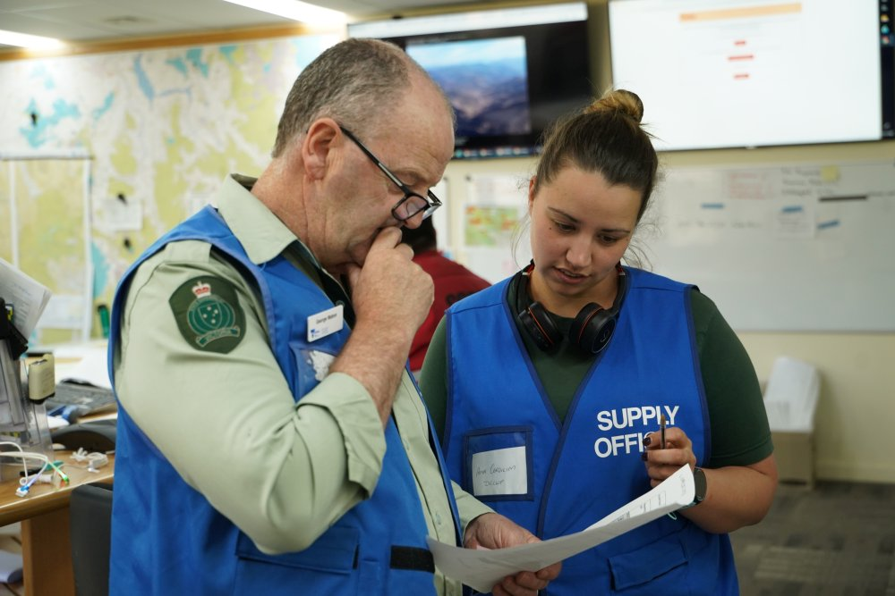
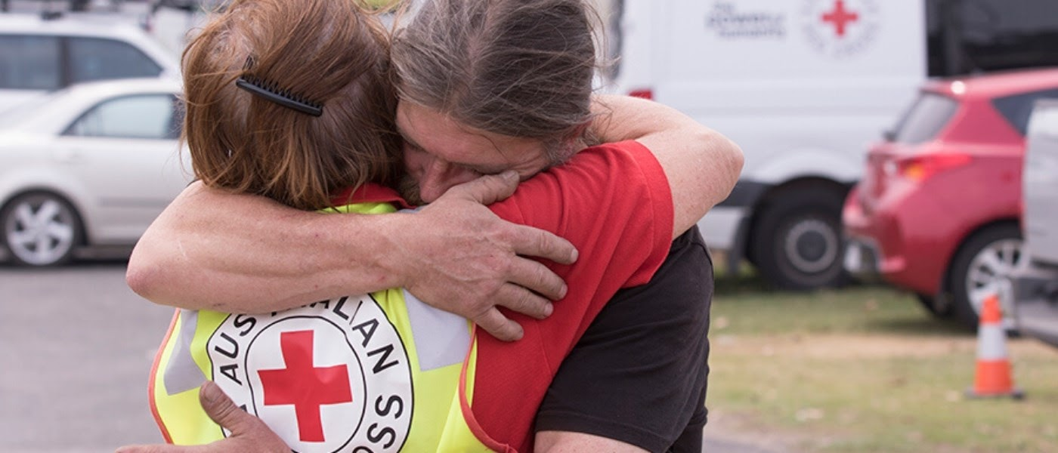
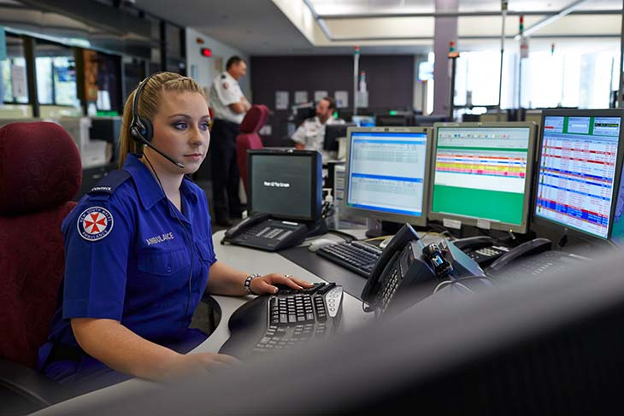
Recommendations

Slide 33
Provide honest and transparent recruitment that paints
a true picture of the potential exposure to VT
Job description is transparent regarding exposure to potentially traumatic material
Candidates are mentally prepared and educated before starting work
Psychological screening before entering role at risk for vicarious trauma

Slide 34
Raise awareness that support staff are as eligible for mental health support as frontline workers
Tailor messages specifically for support staff
Be cognizant of self-stigma that exists amongst support staff
Notes:
Fix this slide

Slide 35
Use education and train managers to better
understand the potential risk of VT
Review training to ensure vicarious trauma is adequately covered
Consider existing training
Notes:
Question CPSU, take a look at to see what they provide (include CPSU)
Adapt training to agency and relay to all employees - no one size fits all
Every agency will have to adapt this to suit their own operating environment

Slide 36
Have a forum to share what agencies are
doing to mitigate VT
Don’t reinvent
the wheel
Don’t keep good things to yourself, share them
Allow for support staff input and feedback
Notes:
Fix this slide

Slide 37
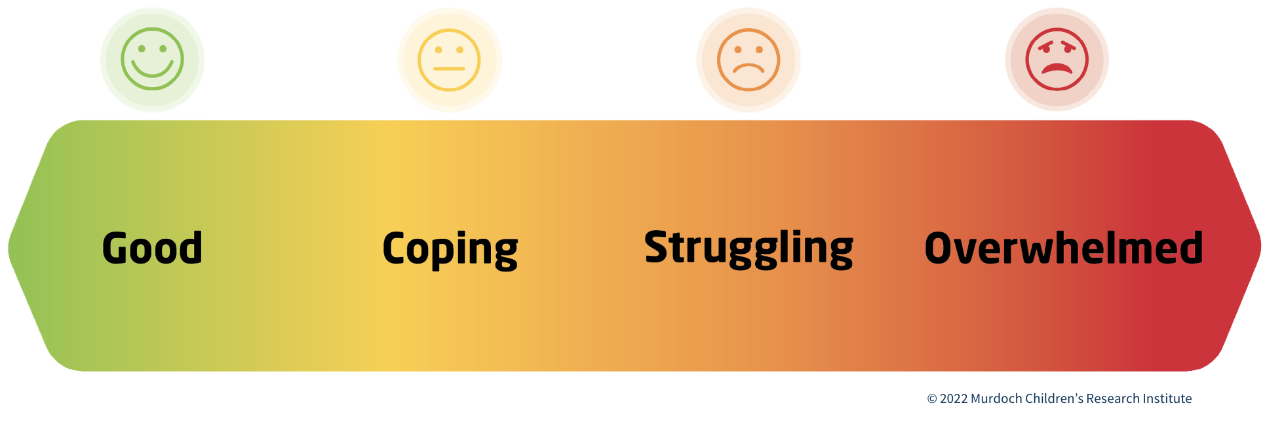
Mental health continuum can be applied
to support roles at risk of VT
Notes:
Refer to AV example
MH continuum is being widely used across the sector
It is really important to make sure that in the examples on it that support staff can relate to them

Slide 38
An enormous thank you to the Emergency Services Foundation, specifically
Siusan MacKenzie, Naomi Watt, & Ainsley Patton, as well as to all of our interviewees who made this study possible.
Questions?

Slide 39
References:
American Counseling Association (2021). Fact Sheet #9: Vicarious trauma. http://www.wendtcenter.org
Australian Senate Education and Employment References Committee (February 2019). The people behind 000: mental health of our first responders https://www.aph.gov.au/Parliamentary_Business/Committees/Senate/Education_and_Employment/Mentalhealth/Report
Beyond Blue (2018). Answering the Call. Beyond Blue https://www.beyondblue.org.au/docs/default-source/resources/bl1898-pes-full-report_final.pdf
Beyond Blue. (2022). Police and Emergency Services. Beyond Blue https://www.beyondblue.org.au/about-us/about-our-work/workplace-mental-health/pes-program
Bober, T., & Regher, C. (2005). Strategies for reducing secondary or vicarious trauma: Do they work?. Brief Treatment and Crisis Intervention. https://triggered.clockss.org/ServeContent?url=http%3A%2F%2Fbtci.stanford.clockss.org%2Fcgi%2Fcontent%2Ffull%2F6%2F1%2F1
Bontempo, K., & Malcomb, K. (2012). An Ounce of Prevention Is Worth a Pound of Cure: Educating Interpreters about the Risk of Vicarious Trauma in Healthcare Settings. In K. Malcomb & L. Swabey (Eds.), In Our Hands: Educating Healthcare Interpreters (pp. 105–130). Gallaudet University Press.
https://doi.org/10.2307/j.ctv2rcnmkt.9
British Medical Association (BMA) Vicarious trauma: signs and strategies for coping https://www.bma.org.uk/advice-and-support/your-wellbeing/vicarious-trauma/vicarious-trauma-signs-and-strategies-for-coping
Centers for Disease Control and Prevention (CDC) (2023) Hierarchy of Controls https://www.cdc.gov/niosh/topics/hierarchy/default.html
CFA (2023), Health and Wellbeing https://www.cfa.vic.gov.au/volunteers-careers/health-and-wellbeing
Full Stop Australia (2023), Vicarious Trauma Management https://fullstop.org.au/training/for-professionals/vicarious-trauma
Home - ESF (2023) Emergency Services Foundation. ESF. https://esf.com.au/
Lerias, D., Byrne, M. K. (2003). Vicarious Traumatization: Symptoms and Predictors. Stress and Health 19: 129–138
https://onlinelibrary.wiley.com/doi/pdf/10.1002/smi.969

Slide 40
References (cont.):
Marschall, A. (2023, May 1). Vicarious trauma: The cost of care and compassion. Verywell Mind. https://www.verywellmind.com/vicarious-trauma-the-cost-of-care-and-compassion-7377234
Molnar, B. E., Sprang, G., Killian, K. D., Gottfried, R., Emery, V., & Bride, B. E. (2017). Advancing science and practice for vicarious traumatization/secondary traumatic stress: A research agenda. Traumatology, 23(2), 129–142. https://doi.org/10.1037/trm0000122
Morrison, Z. (2007, September). ‘Feeling heavy’: Vicarious trauma and other issues ... “Feeling heavy”: Vicarious trauma and other issues facing those who work in the sexual assault field. https://apo.org.au/sites/default/files/resource-files/2007-09/apo-nid3525.pdf
Pierce, H., & Lilly, M. M. (2012). Duty-related trauma exposure in 911 telecommunicators: considering the risk for posttraumatic stress. Journal of Traumatic Stress, 25(2), 211–215. https://doi.org/10.1002/jts.21687
SBS (2019) Chaos and satisfaction: Life as an Australian emergency triple zero call-taker https://www.sbs.com.au/language/filipino/en/podcast-episode/chaos-and-satisfaction-life-as-an-australian-emergency-triple-zero-call-taker/mxvt685re
Self Care Psychology (2018). What is professional trauma and fatigue? https://www.selfcarepsychology.com/single-post/2018/12/07/what-is-professional-trauma-and-fatigue
SES (2023), Home https://www.ses.vic.gov.au/
Shakespeare-Finch, J., Rees, A., & Armstrong, D. (2015). Social Support, Self-efficacy, Trauma and Well-Being in Emergency Medical Dispatchers. Social Indicators Research, 123(2), 549–565. http://www.jstor.org/stable/24721618
The Age (2019) Lessons of Black Saturday ignored as Australians forget, research shows https://www.theage.com.au/national/victoria/lessons-of-black-saturday-ignored-as-australians-forget-research-shows-20190205-p50vtw.html
VCC (2023), About VCCEM. https://vccem.org.au/
Workplace Strategies for Mental Health (2023). Guarding Minds – Indicators of workplace stress or trauma https://www.workplacestrategiesformentalhealth.com/resources/guarding-minds-indicators-of-workplace-stress-or-trauma

