Slide 1
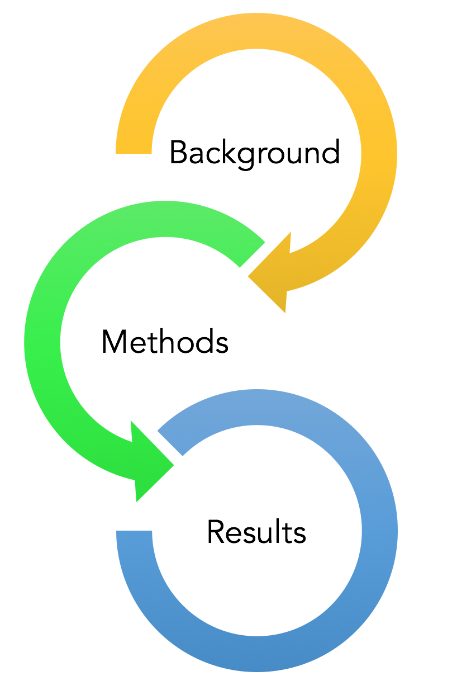
Strengthening the
Nantucket Cultural District:
Community Outreach & Data Collection
J. Berger, C. Mayforth, J. Metzger, J. Moon

Slide 2
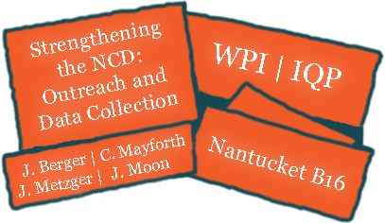
What is a Cultural District?
What are the Advantages and Challenges of a Cultural District?
What is the Nantucket Cultural District?
Notes:
What is a Cultural District
Advantages and Disadvantages
Cultural History of Nantucket
Nantucket Cultural District
Liaisons and Sponsors

Slide 3
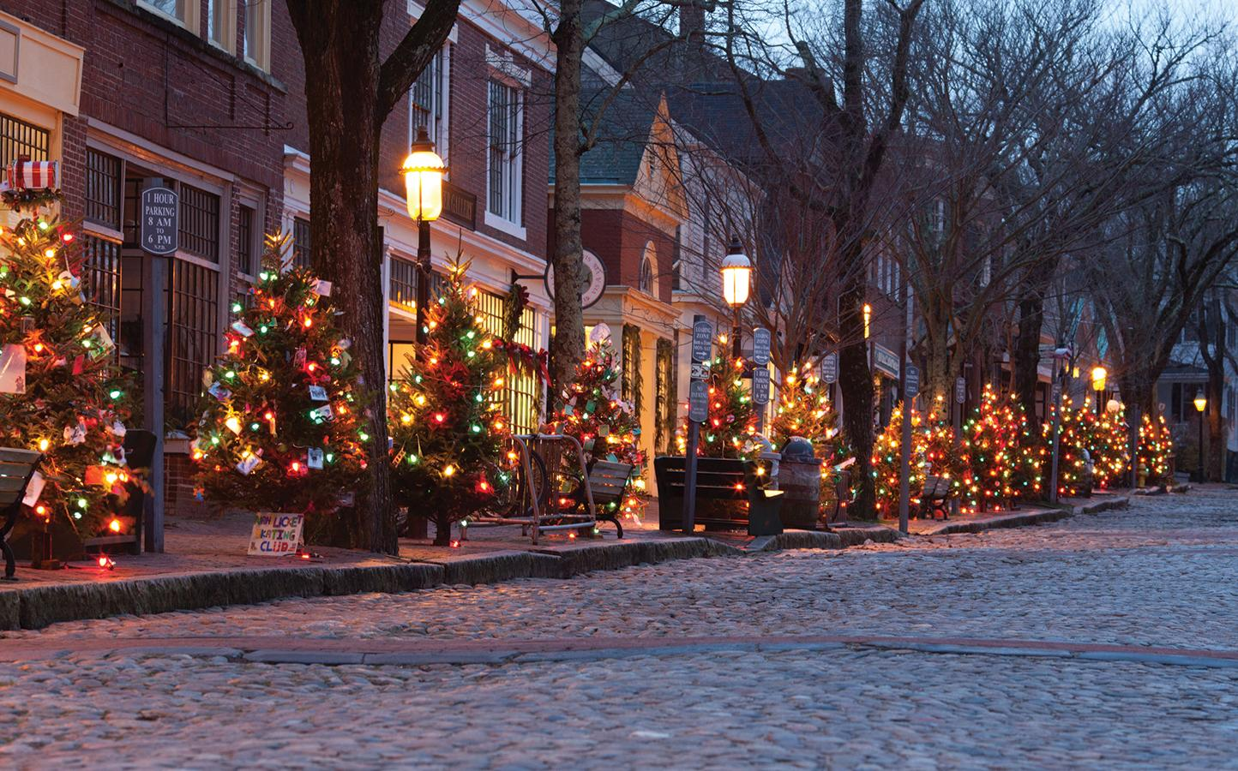
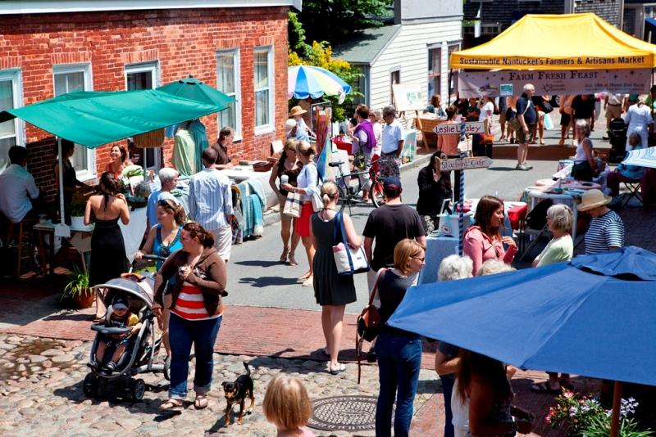
What is a Cultural District (CD)?
What is a Cultural District?
https://www.facebook.com/events/150264898784920/t
http://www.sustainablenantucket.org/category/uncategorized/page/4/
CM
http://www.modernthrill.com/wp-content/uploads/2015/11/Nantucket.jpg
Notes:
A group of cultural organizations and businesses working together to promote local arts and culture
Festivals, coupons

Slide 4
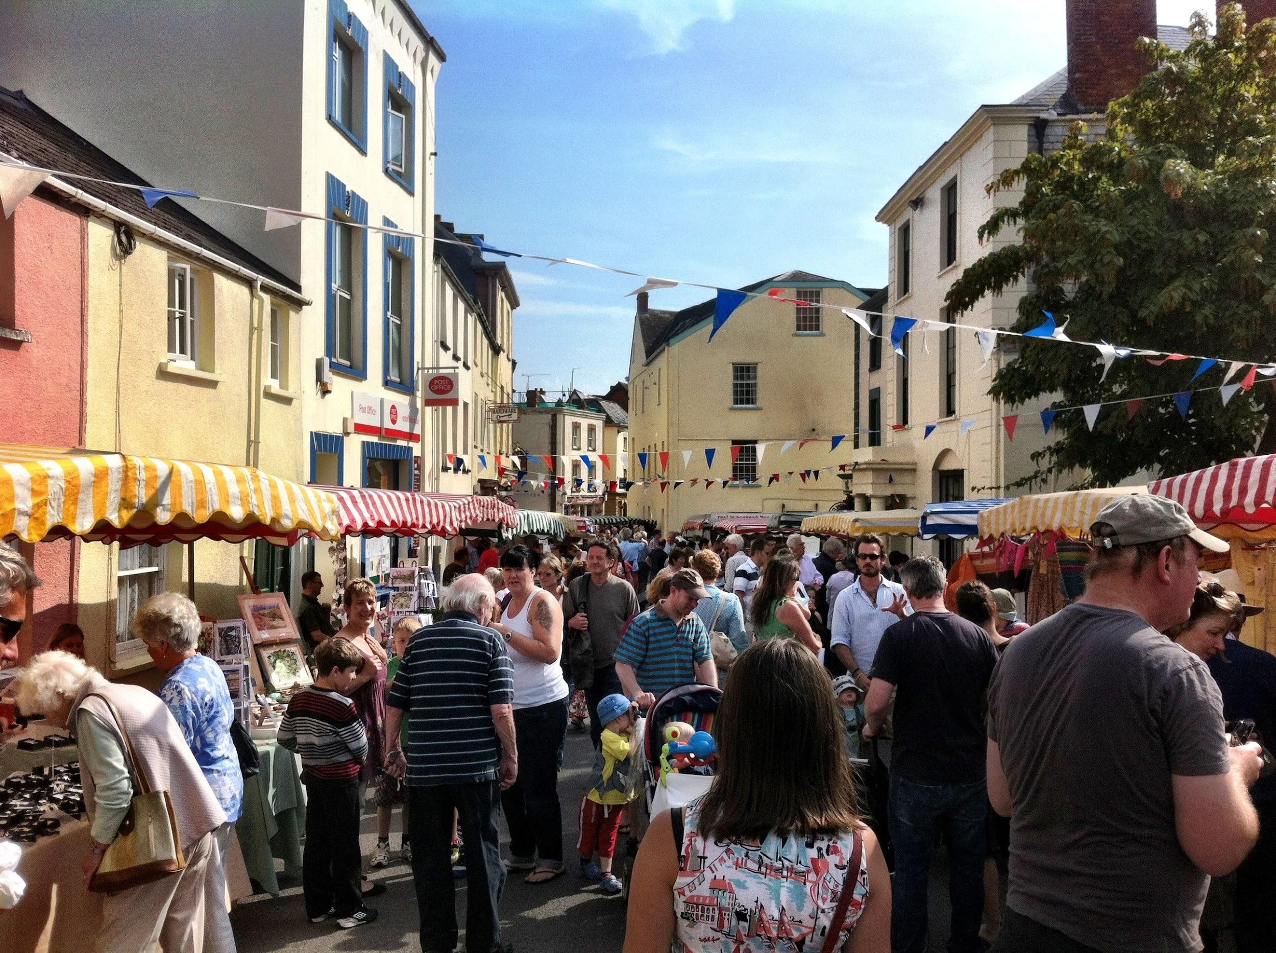
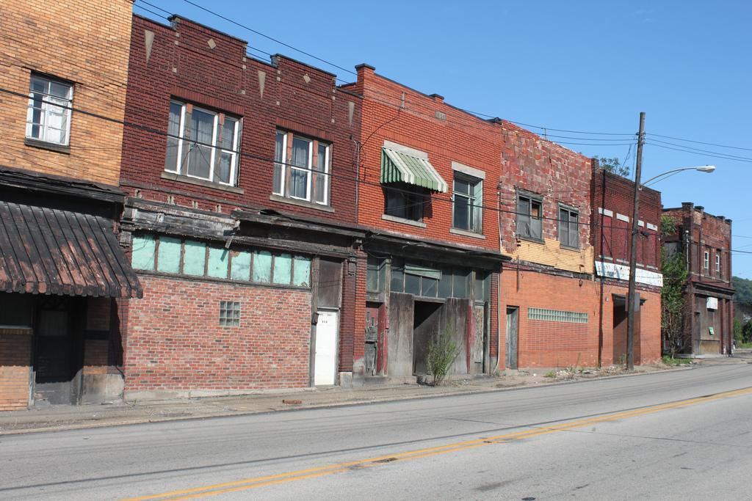
What are the Advantages and Challenges of a CD?
Advantages
  Economic Incentives
  Cultural Expansion
  Community Involvement
http://10parishesfestival.org.uk/wp-content/uploads/2013/03/last-year.jpg
Challenges
  Gentrification
  Over-commercialization
  Sustainability
https://c2.staticflickr.com/8/7136/7794927614_0789936e85_b.jpg

Slide 5
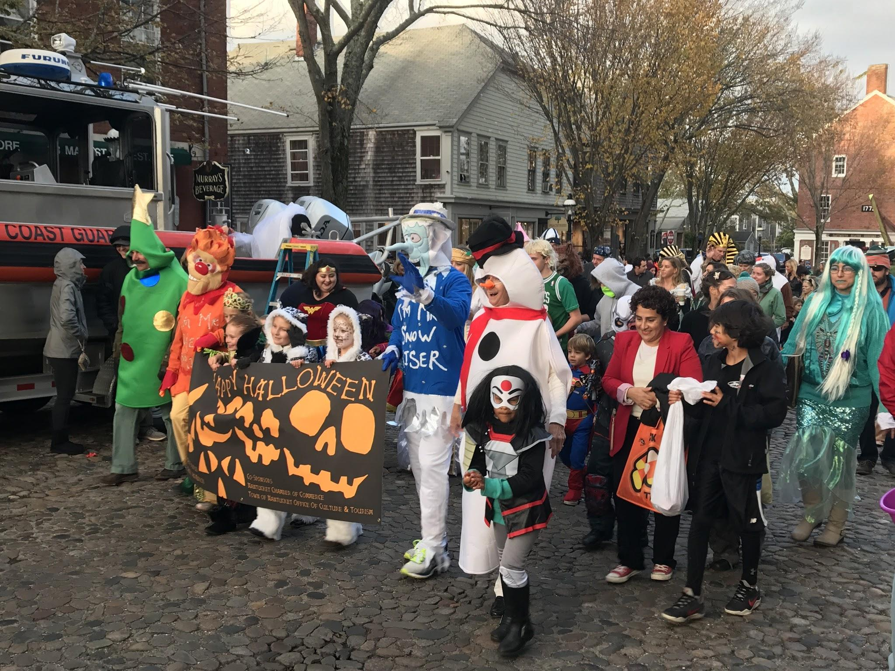
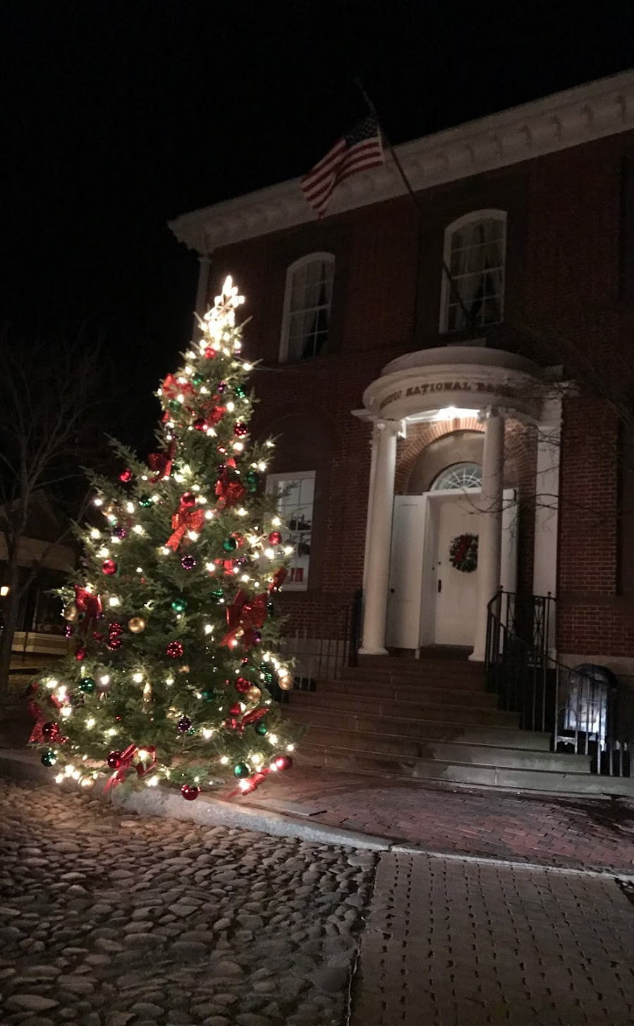

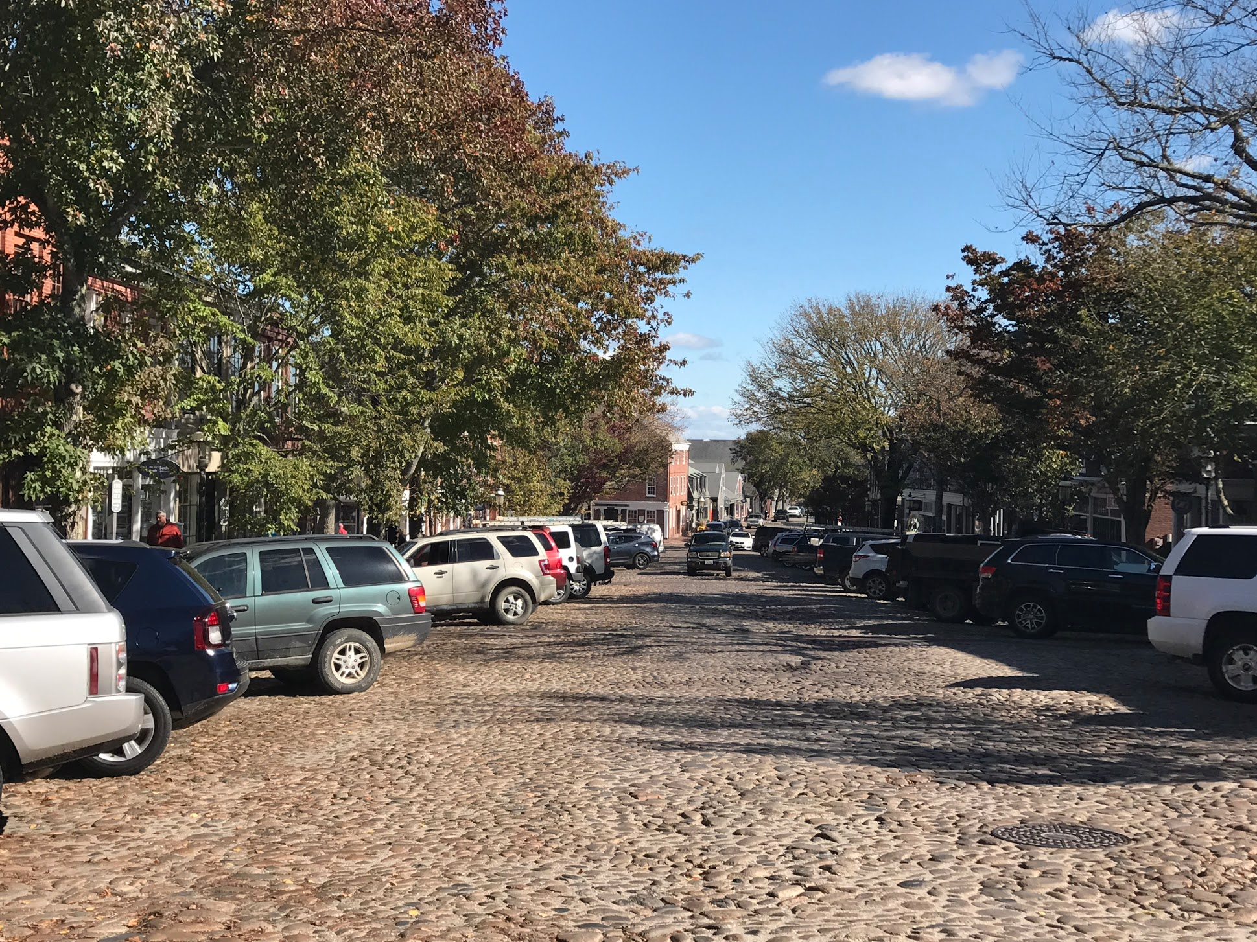
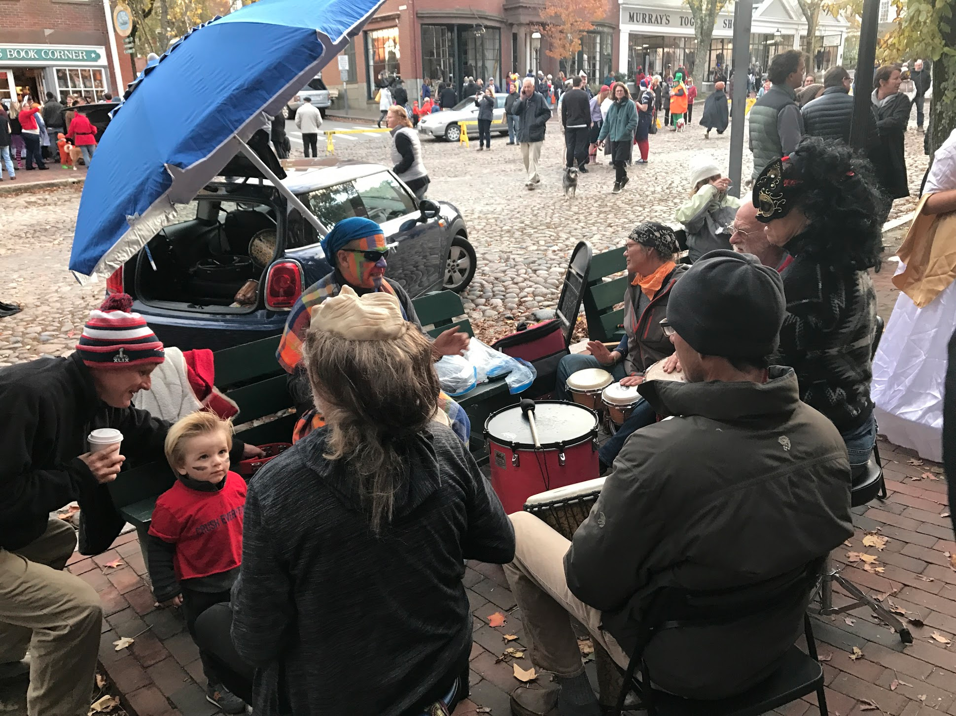
What is the Nantucket Cultural District (NCD)?
Notes:
A walkable downtown area in the town of Nantucket which encompasses cultural organizations, shops, restaurants, and galleries. It is intended to bolster a sense of community between residents and tourists as well as boost the local economy year-round. It was designated by the MCC, the massachusetts legislative body for cultural districts, in early 2016. The cultural district program was launched in 2011.

Slide 6
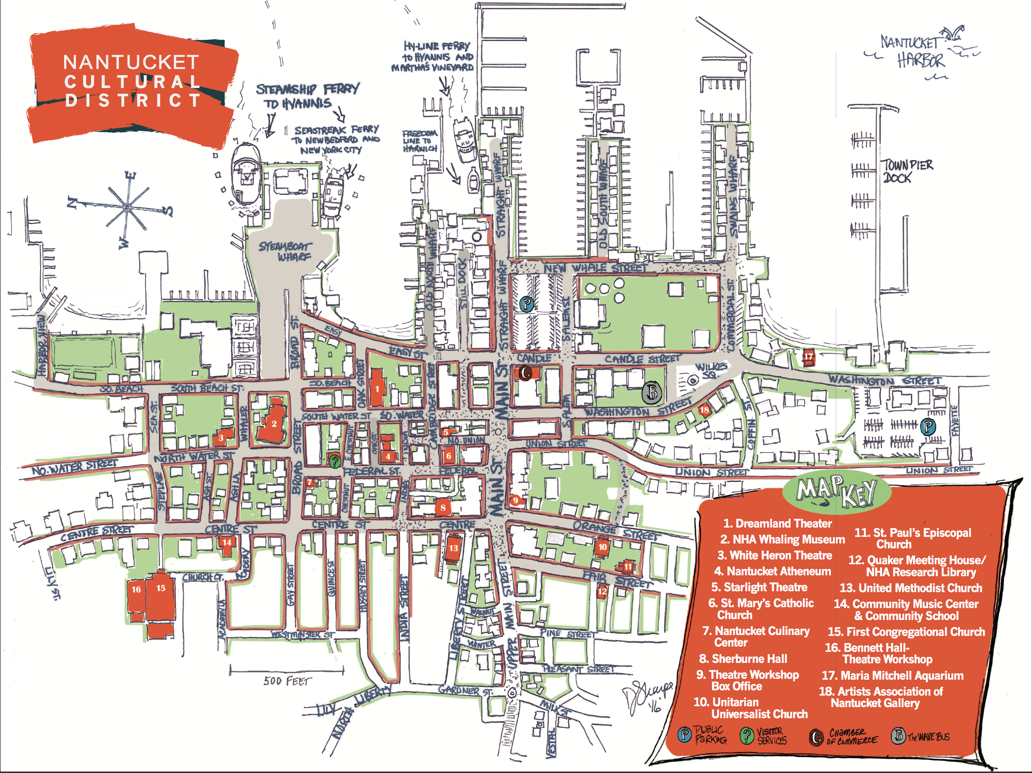
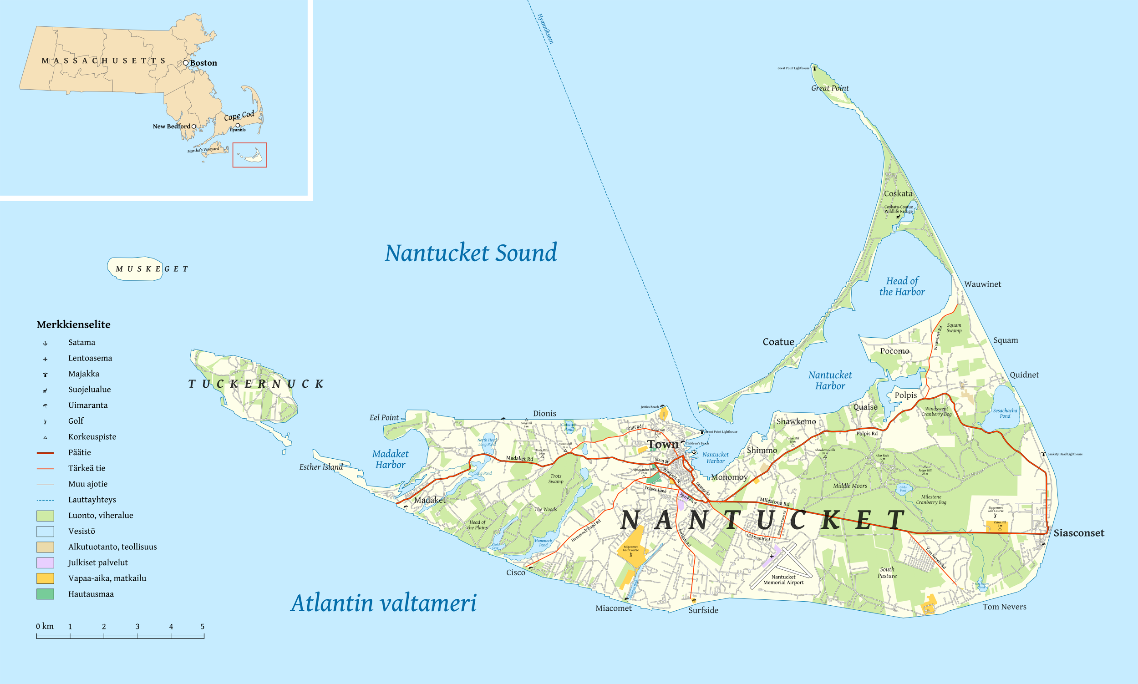
The Nantucket
Cultural District
https://upload.wikimedia.org/wikipedia/commons/4/42/Nantucket_map-fi.png
Images provided to us by our sponsors

Slide 7
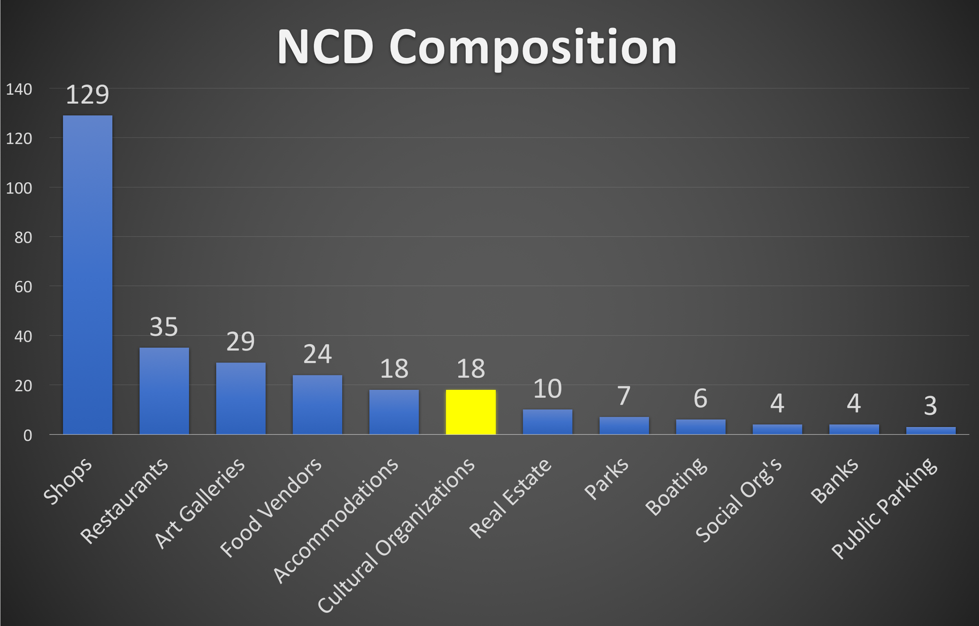
District Composition
CM
Notes:
Only about 16% are arts and culture

Slide 8
Mission Statement
Assist the Nantucket Cultural District by developing a community outreach plan and creating a system to collect and evaluate metrics to measure the impacts of the district.

Slide 9
Objectives
Outreach
Select Appropriate Metrics
Create System to Report and Analyze Metrics
Collect Data on Selected Metrics
Data Tool

Slide 10
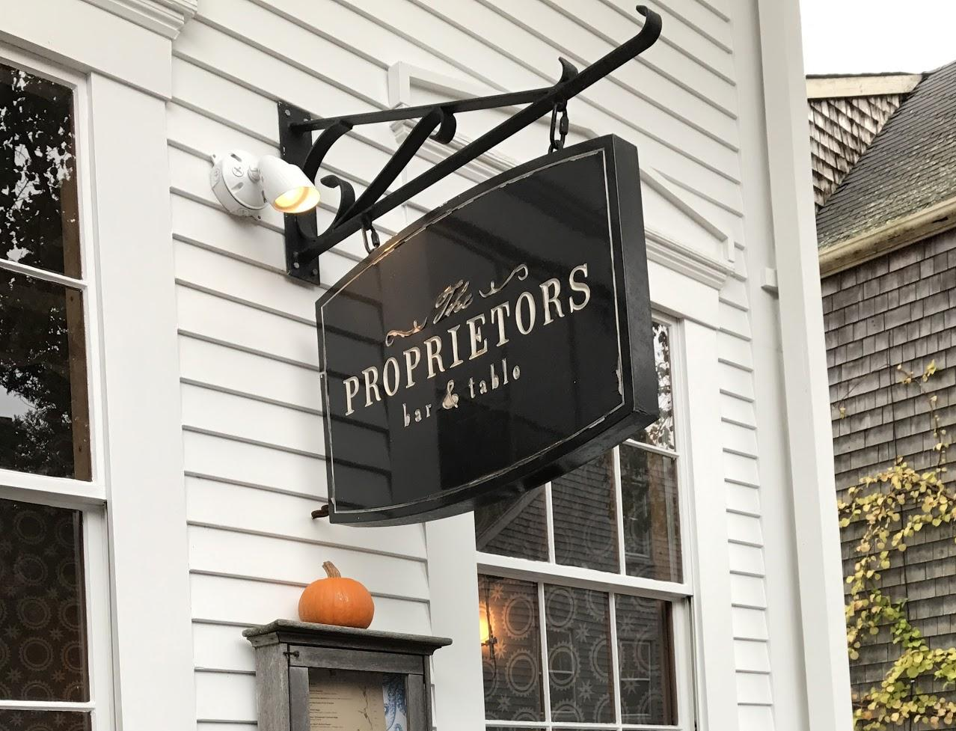
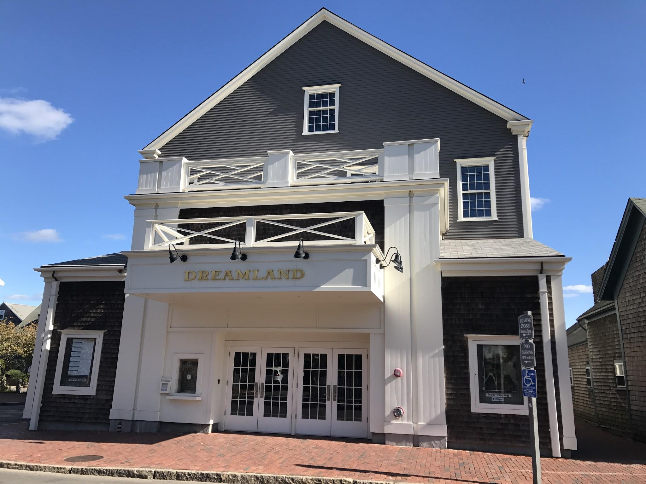
Project Goals
Develop Data Collection System
  Annual Report required for state designation
Increase Knowledge of District
  Expand Social Media & Internet Presence
Support Creation of Linkages
Linkage
Notes:
Define linkage in this slide, verbally
Update graphics

Slide 11
Metrics
Interviews
Focus Group
Notes:
Mission Statement
Objectives
Metrics
Qualitative
Quantitative

Slide 12
Metrics
Metric: | Adapted From:
Visitor Attendance | Mass Cultural Council Requirements
Change in Building Occupancy Rates | Mass Cultural Council Requirements
Percentage Change in Meals and Lodging Tax | Mass Cultural Council Requirements
Percentage Change in Gross Sales | NCD-Suggested Metric
Knowledge of the Cultural District | NCD-Suggested Metric
Internet/Social Media Presence | Springfield Central Cultural District
Changes in District Partnership | Springfield Central CD & Americans for the Arts
Number & Types of Major Cultural District Events. | Required in MD, KY
Registration Numbers for Cultural District Events | Salisbury Cultural District
Notes:
“There are 2 metrics that are required by the MCC for the cultural districts to track, which include visitor attendance and building occupancy rate. For our project we wanted to look deeper into the impacts that the district has on the community. To do this we set out to track changes in gross sales around the time of an event as well as the current knowledge of the district. The following metrics are used by other cultural districts around the country but were not chosen as part of our porject”

Slide 13
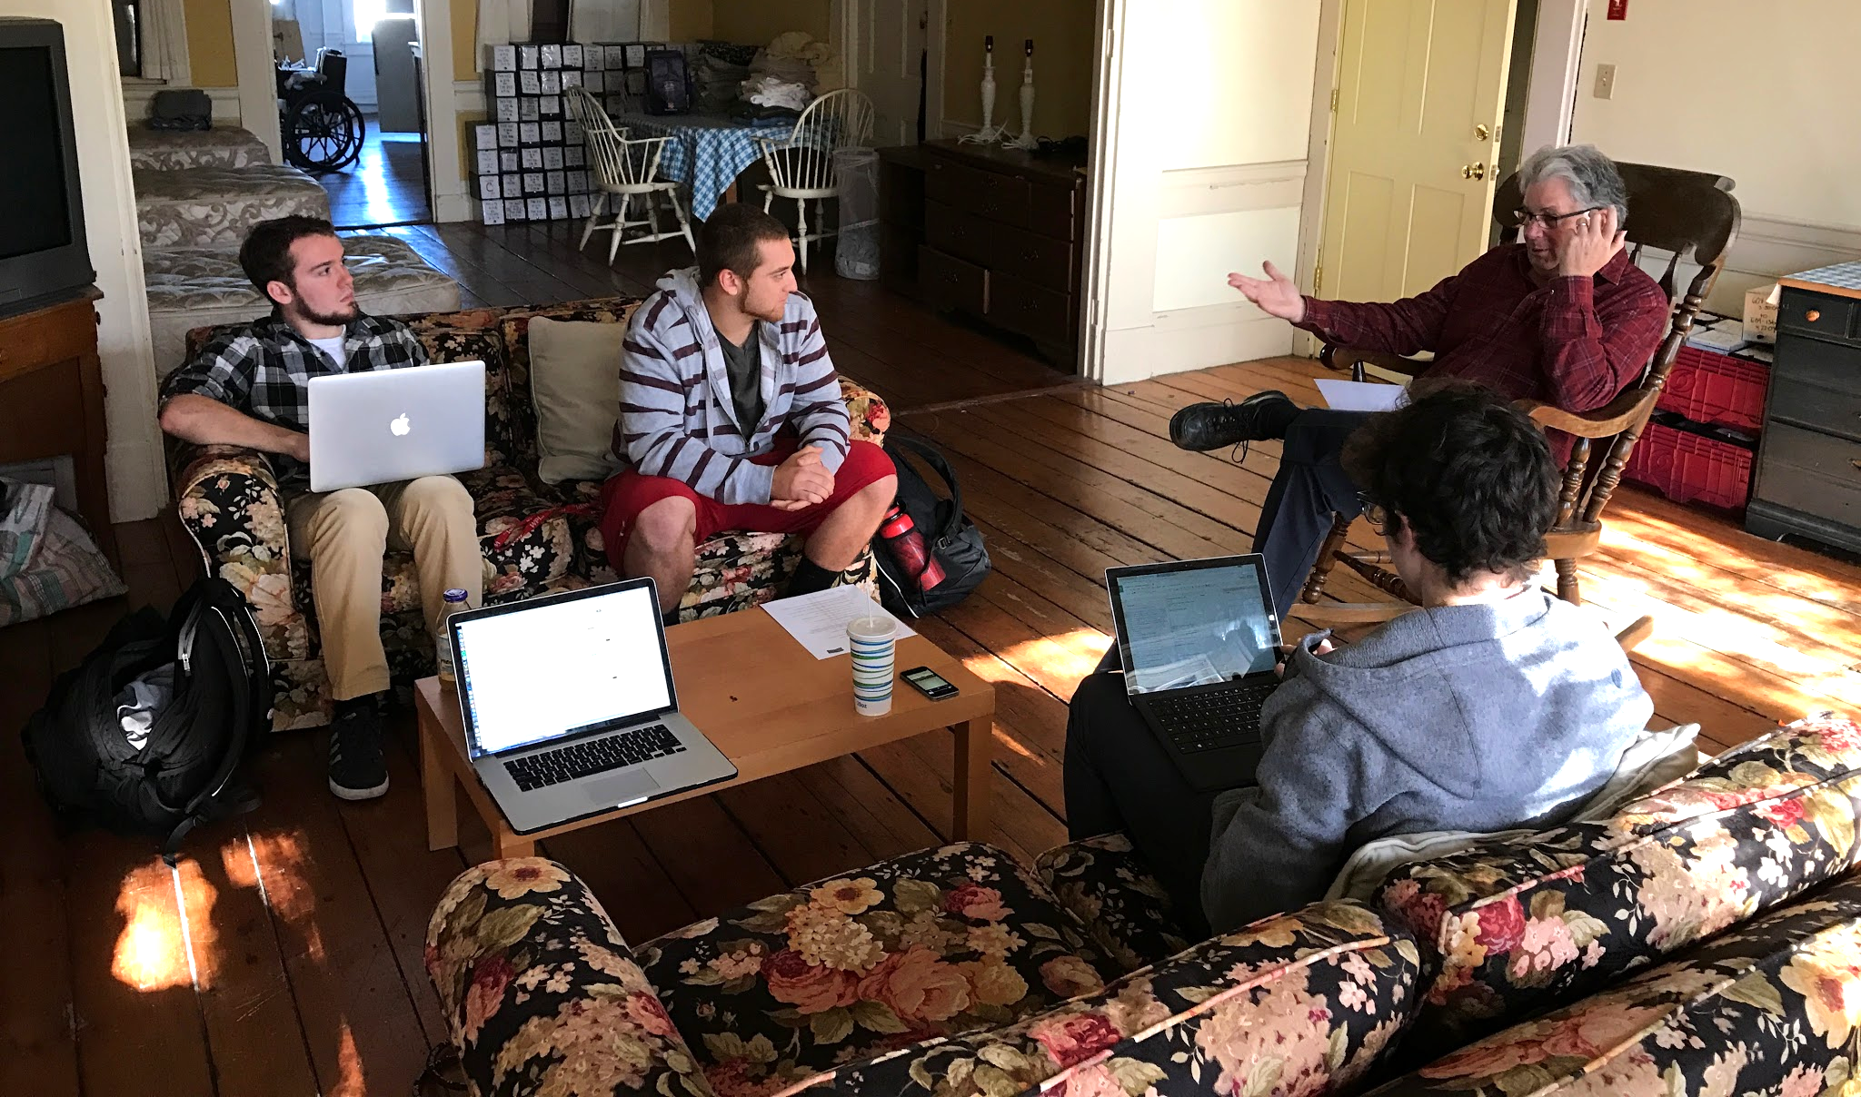
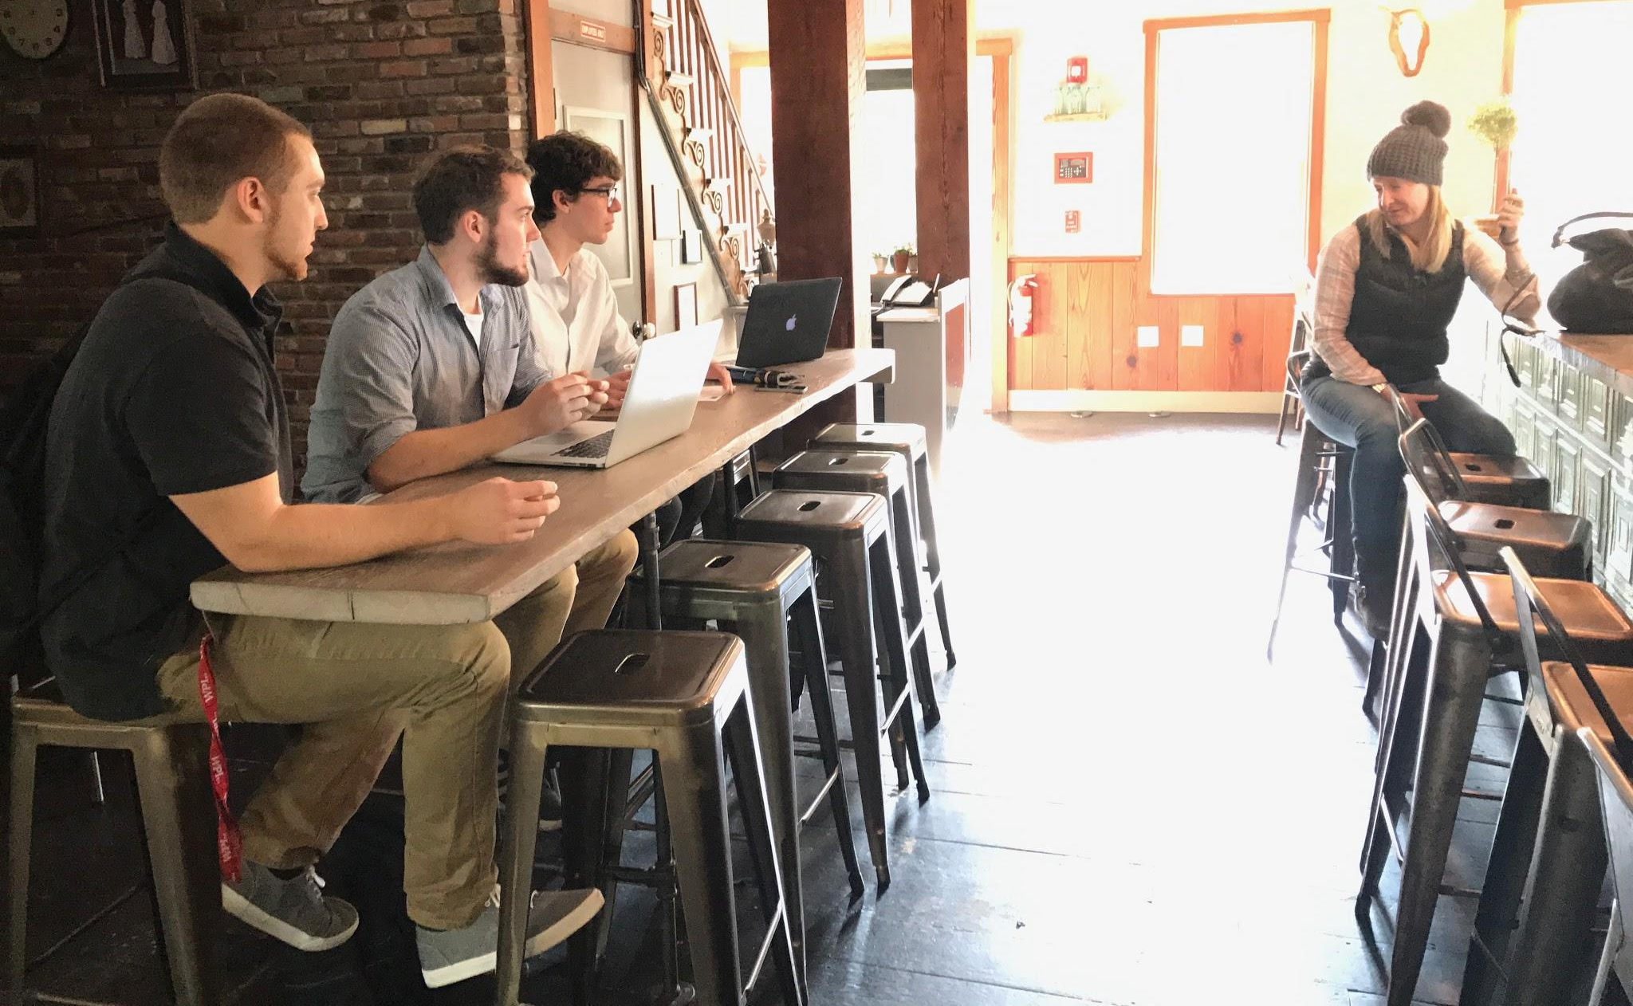
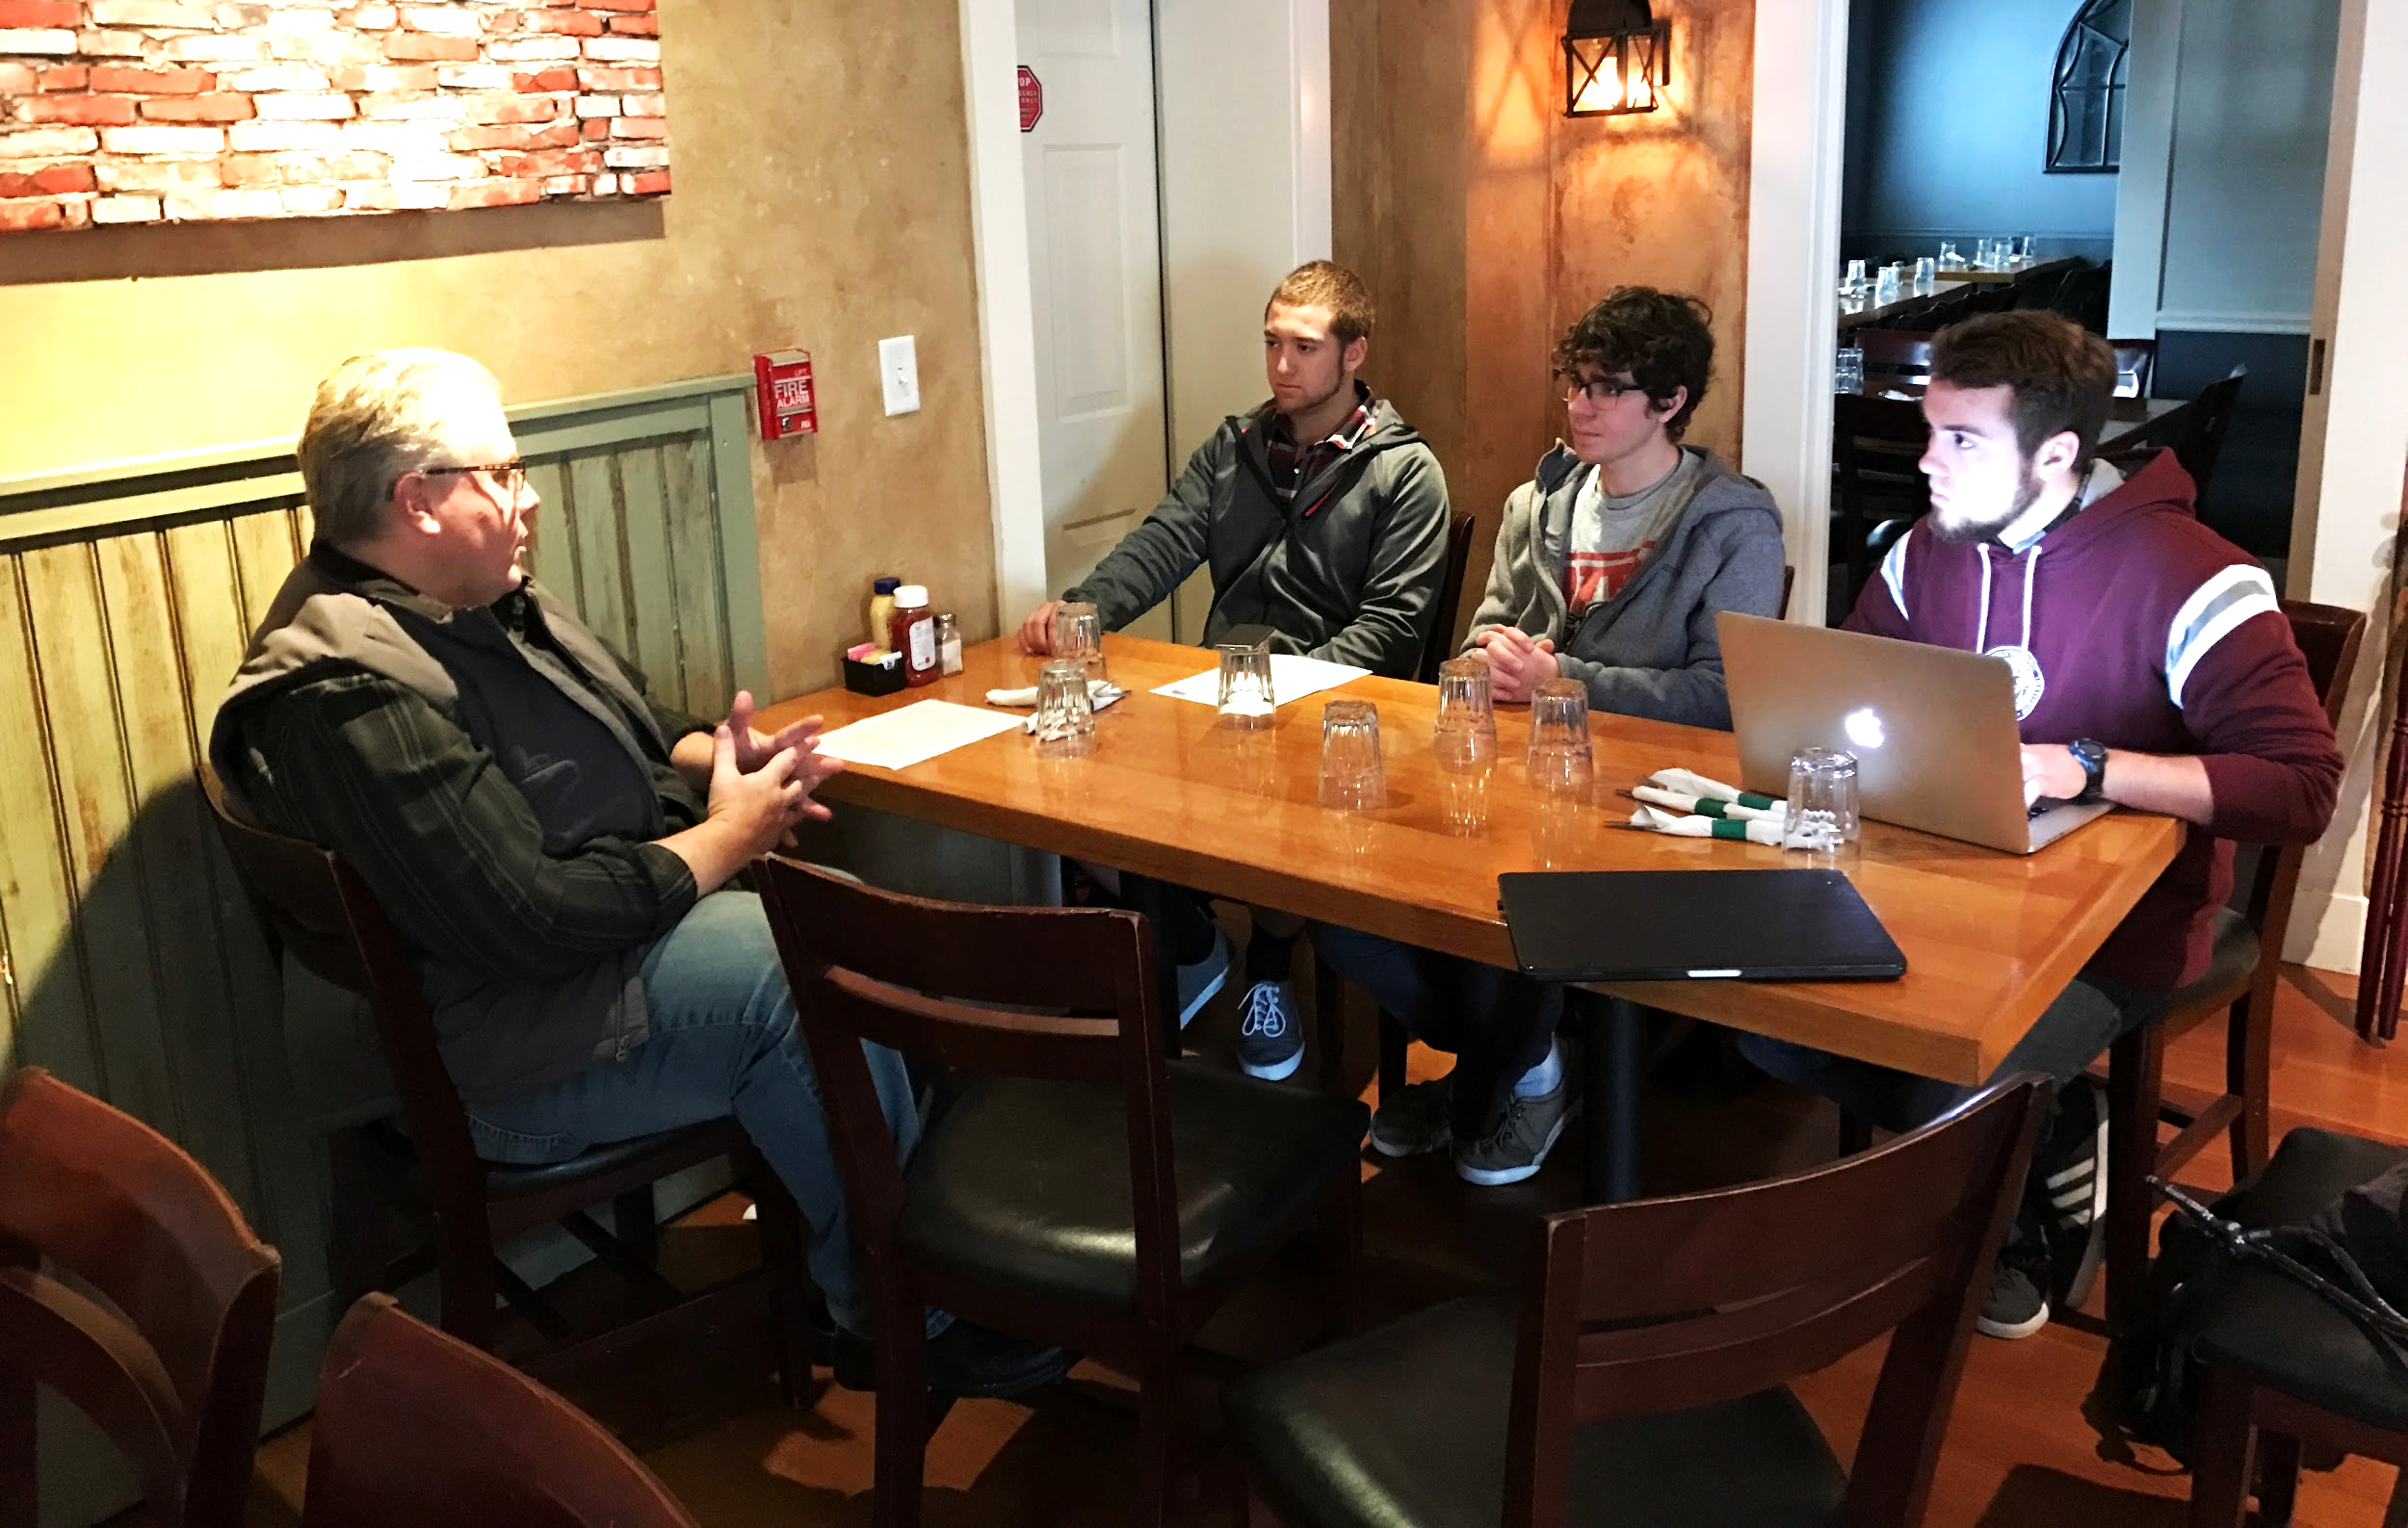
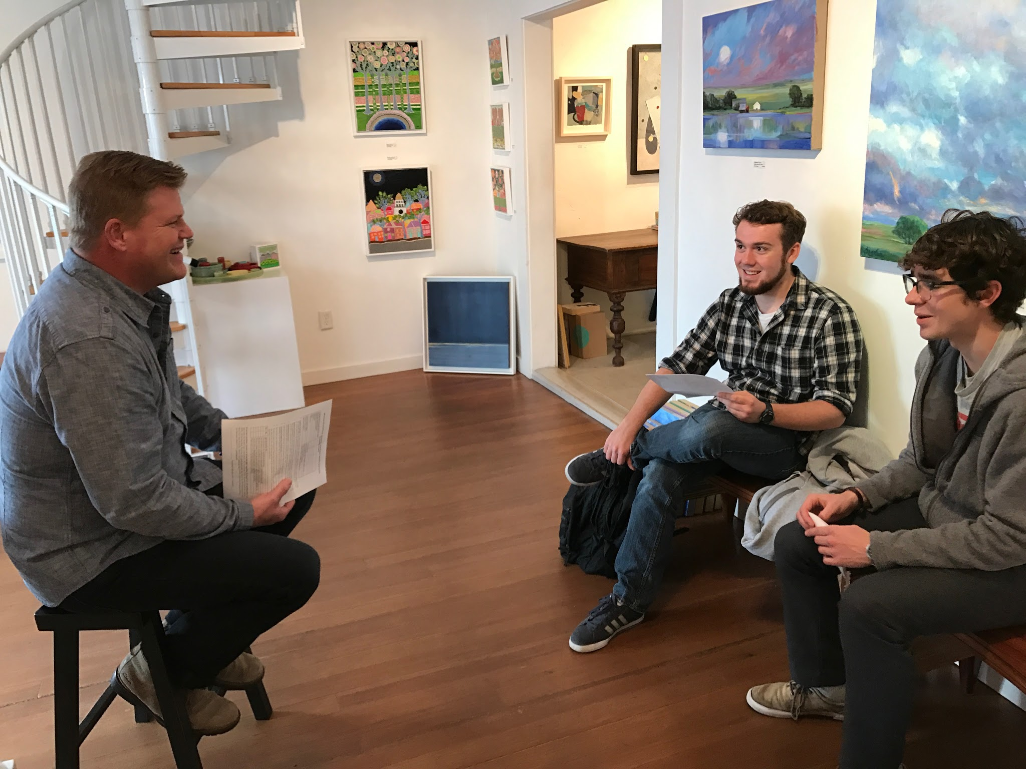
Interview Process
Notes:
“We interviewed residents from many different stakeholder groups including restaurants, shops, and cultural organizations. Our goal was to understand the current knowledge of the residents of the district and it’s purpose. We also held a focus group with NCD Steering Committee members with the intent to optimize the look and feel of the website.”
More details and specifc numbers for interviews and groups

Slide 14
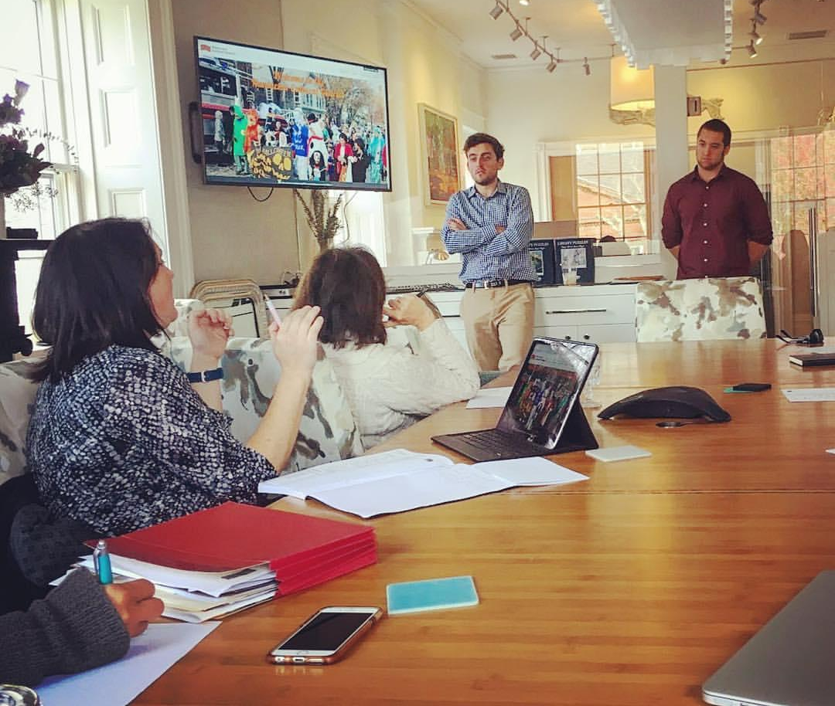
Focus Group

Slide 15
Outreach Plan
  Social Media
  Website
Data Collection and Analysis Tool
Notes:
Website → Calendar
Data Collection → Percent Change Calculator
Social Media Plan
Funding Structure

Slide 16
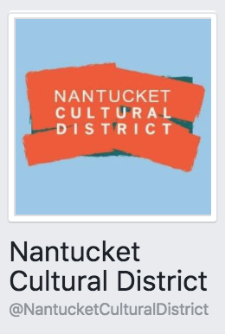




Social Media
Three Platforms

Slide 17
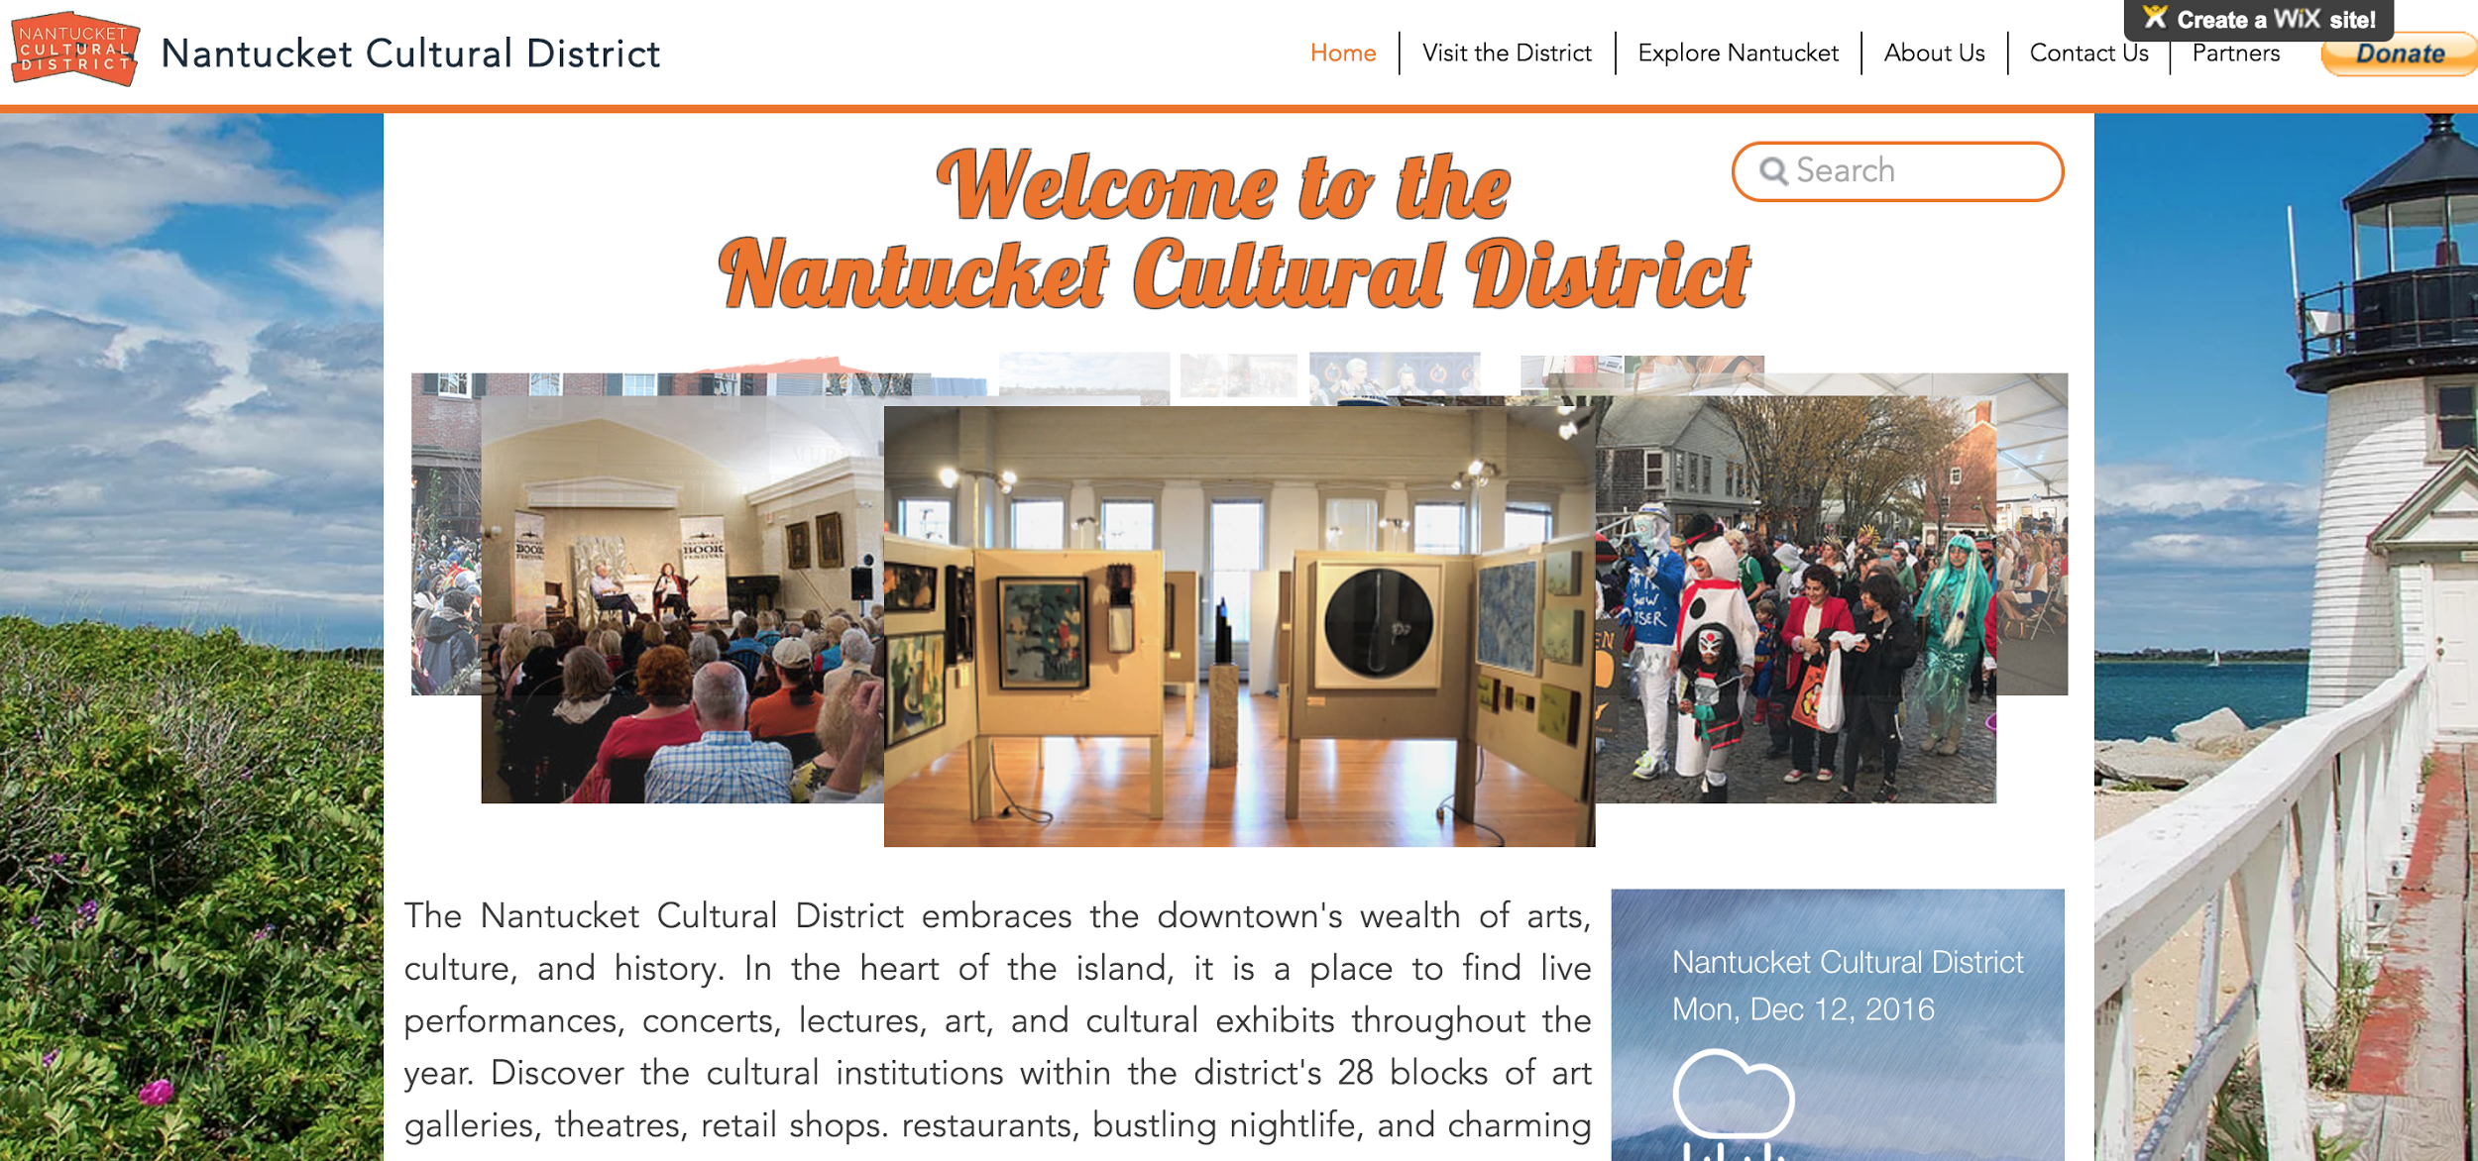
NCD Website: http://nantucketculturaldistrict.org
Notes:
Increase Residents and Visitors coming to the District
Place for Business and Cultural Organization Owners to Collaborate
UPDATE THE STEAMSHIP LINK TO GO TO http://www.hyannistonantucket.com

Slide 18
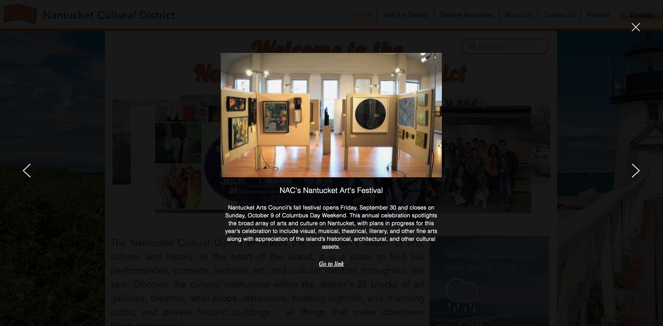
Notes:
Increase Residents and Visitors coming to the District
Place for Business and Cultural Organization Owners to Collaborate
UPDATE THE STEAMSHIP LINK TO GO TO http://www.hyannistonantucket.com

Slide 19
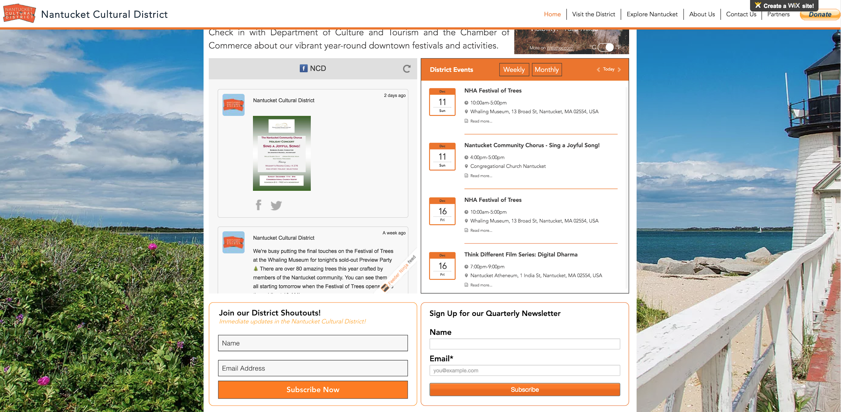
Outreach
JRM
Notes:
Increase Residents and Visitors coming to the District
Place for Business and Cultural Organization Owners to Collaborate
UPDATE THE STEAMSHIP LINK TO GO TO http://www.hyannistonantucket.com

Slide 20
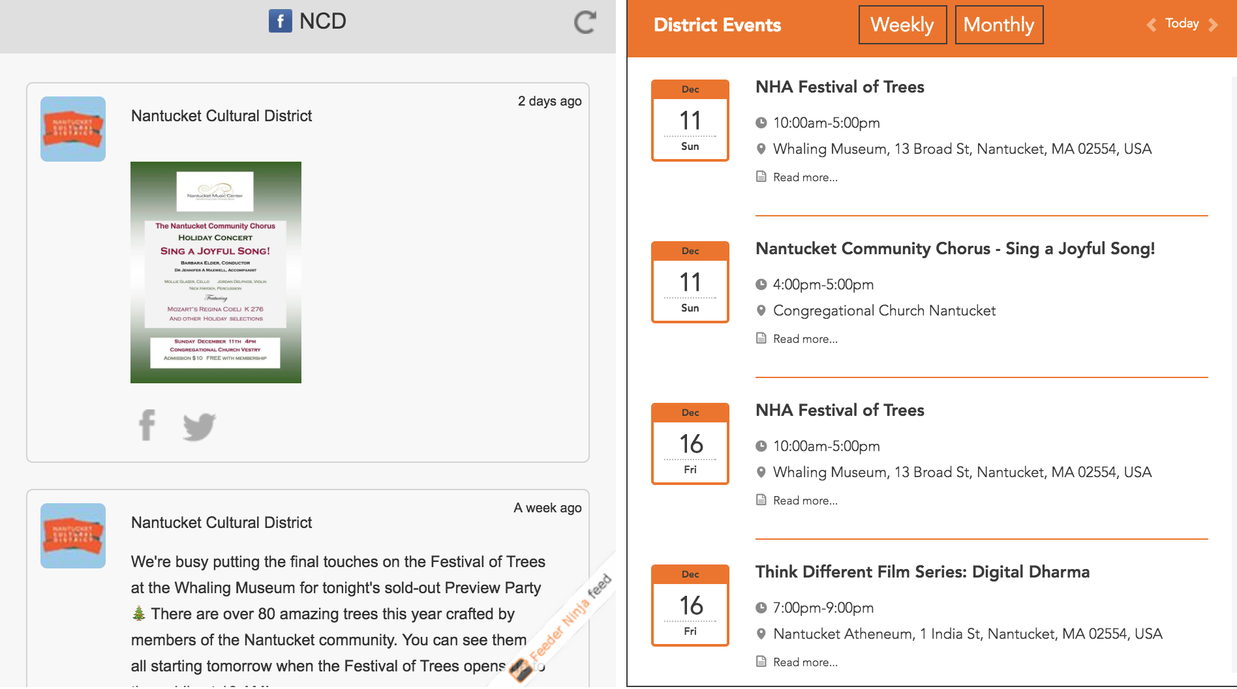
JRM
Notes:
Increase Residents and Visitors coming to the District
Place for Business and Cultural Organization Owners to Collaborate
UPDATE THE STEAMSHIP LINK TO GO TO http://www.hyannistonantucket.com

Slide 21
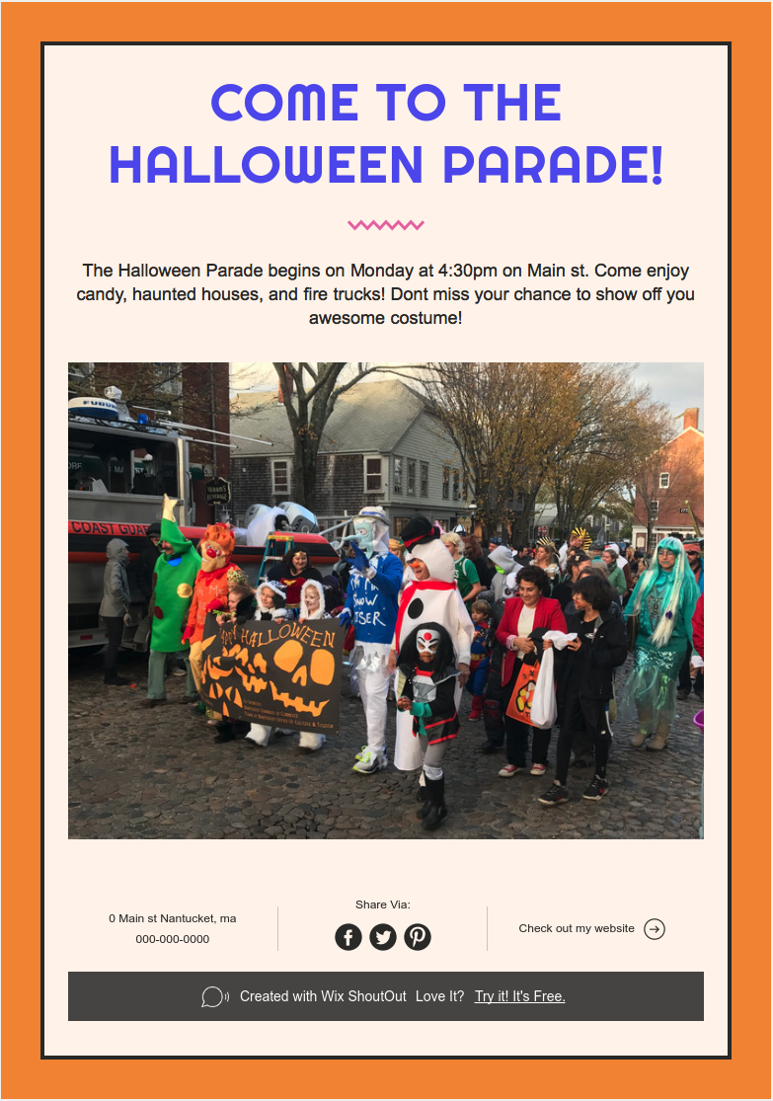
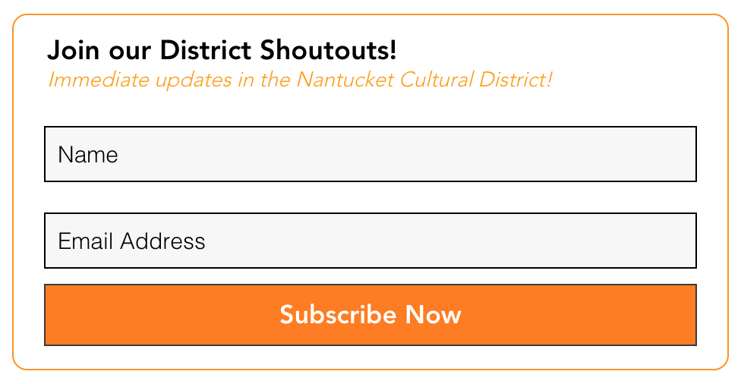
District Shoutouts
JRM
Notes:
Increase Residents and Visitors coming to the District
Place for Business and Cultural Organization Owners to Collaborate
Remove URL

Slide 22
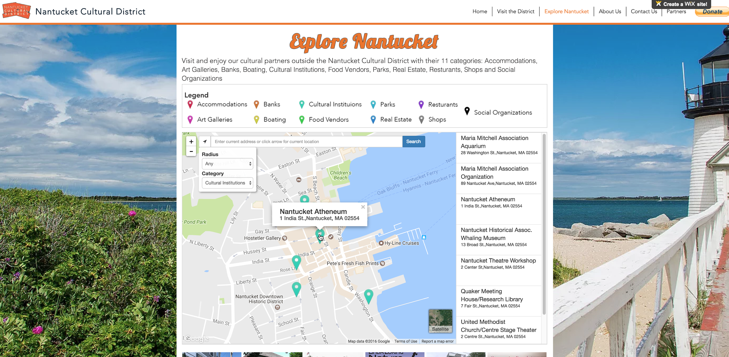
Explore Nantucket
Notes:
“Explore Nantucket” contains the organizations of the island and the Nantucket town website. It features the Nantucket Cultural District’s partner organizations outside of the district. A list of the organizations, which can be accessed with the top right button, is mentioned on the following slide.

Slide 23
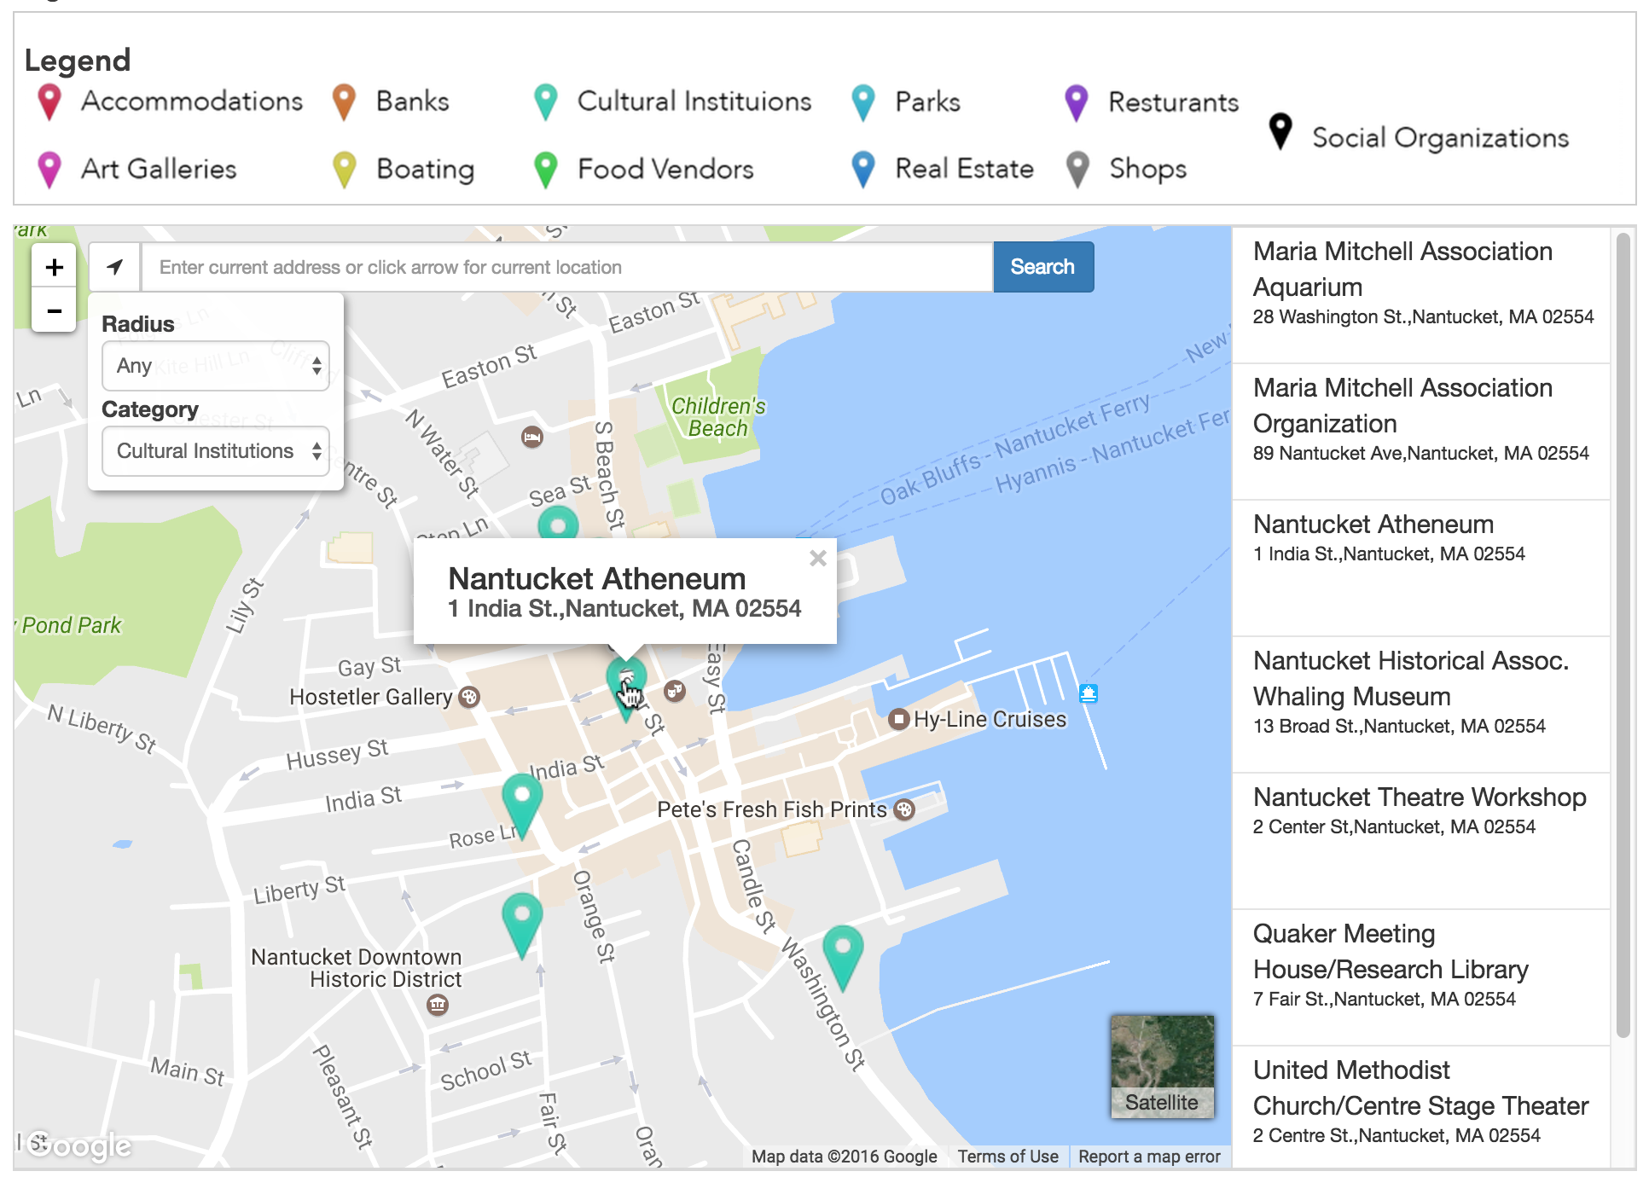
Notes:
“Explore Nantucket” contains the organizations of the island and the Nantucket town website. It features the Nantucket Cultural District’s partner organizations outside of the district. A list of the organizations, which can be accessed with the top right button, is mentioned on the following slide.

Slide 24
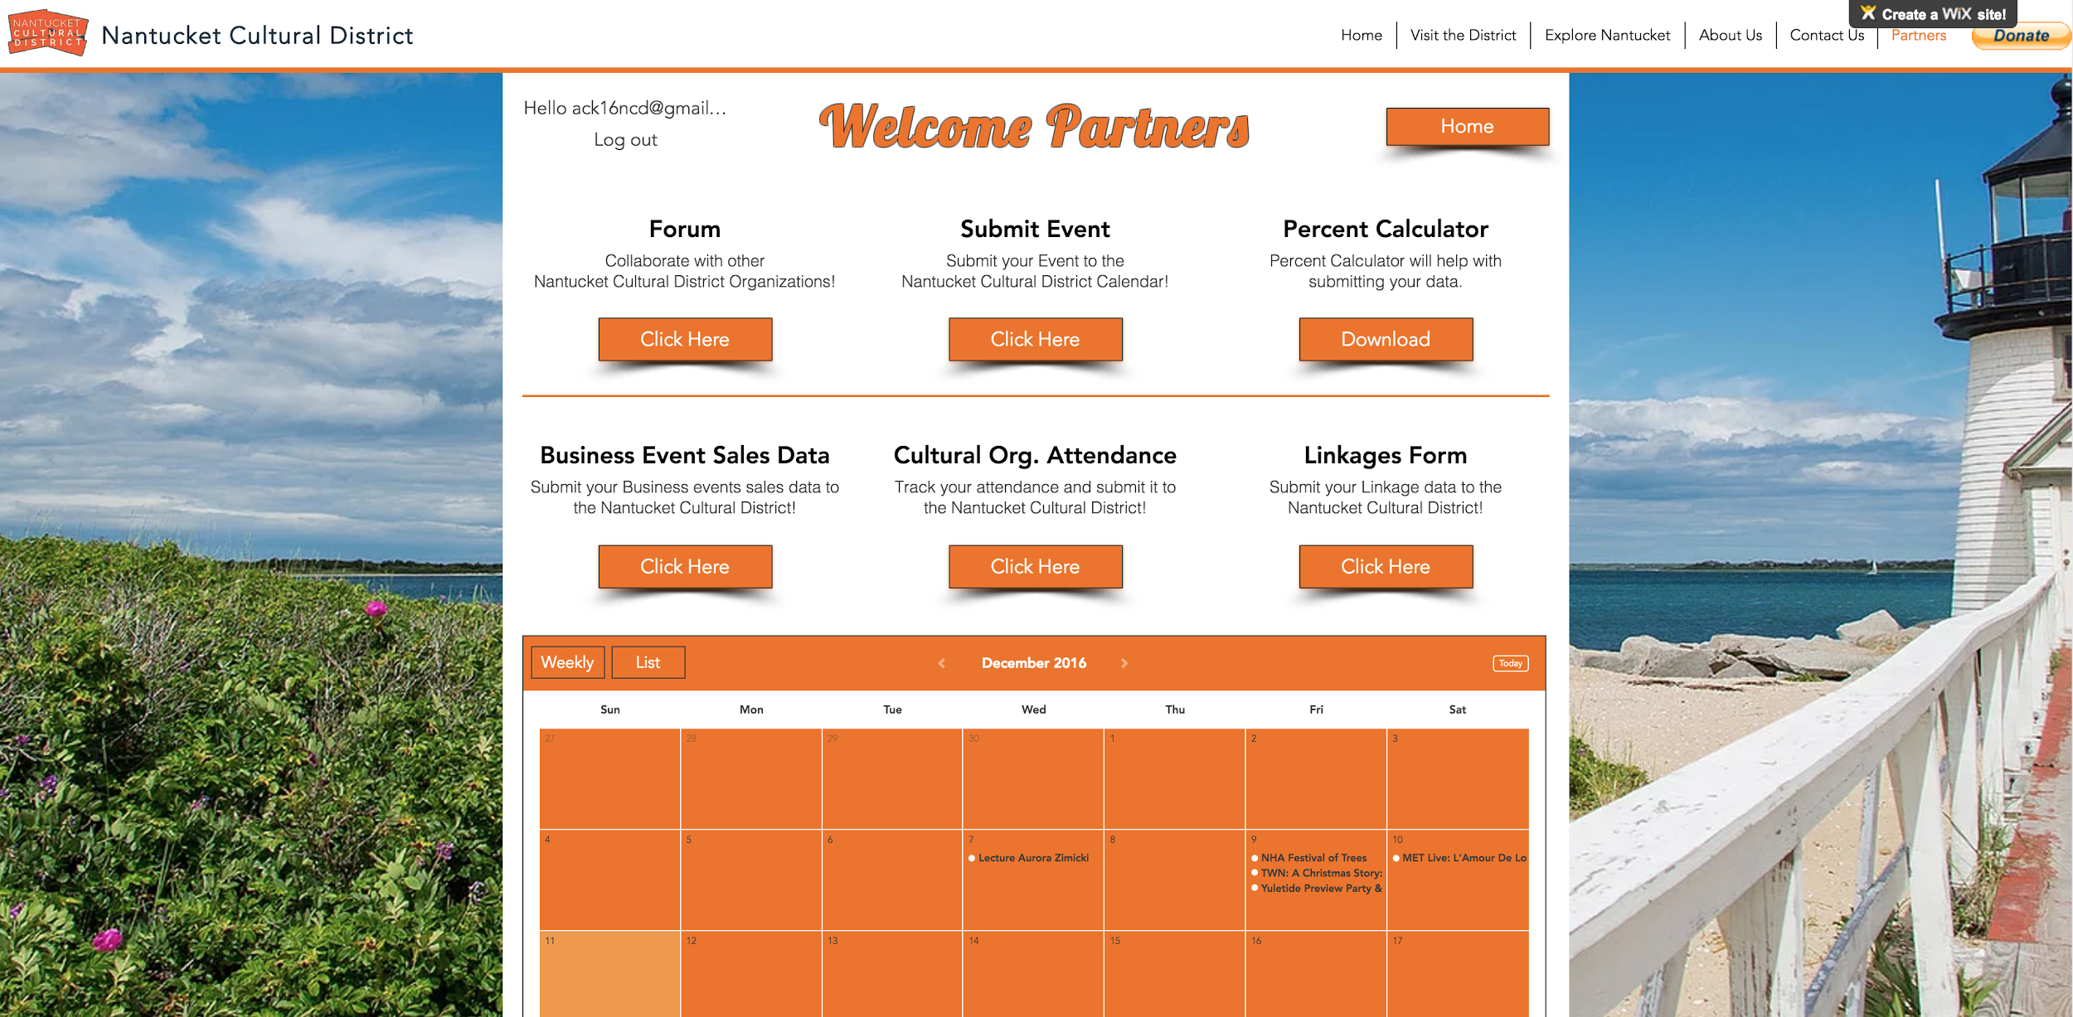
Partners Page
Notes:
Finally, the biggest part of the website is the “Members” page, which can only be accessed by a member account. Click “Home” on the top right to go back to the home page. Your login name appears to the upper left. The Members page contains:
Forum
Submit your Event
Business Event Sales
Percent Calculator
Cultural Organizations Attendance
Linkages
Monthly Calendar (not visible)

Slide 25
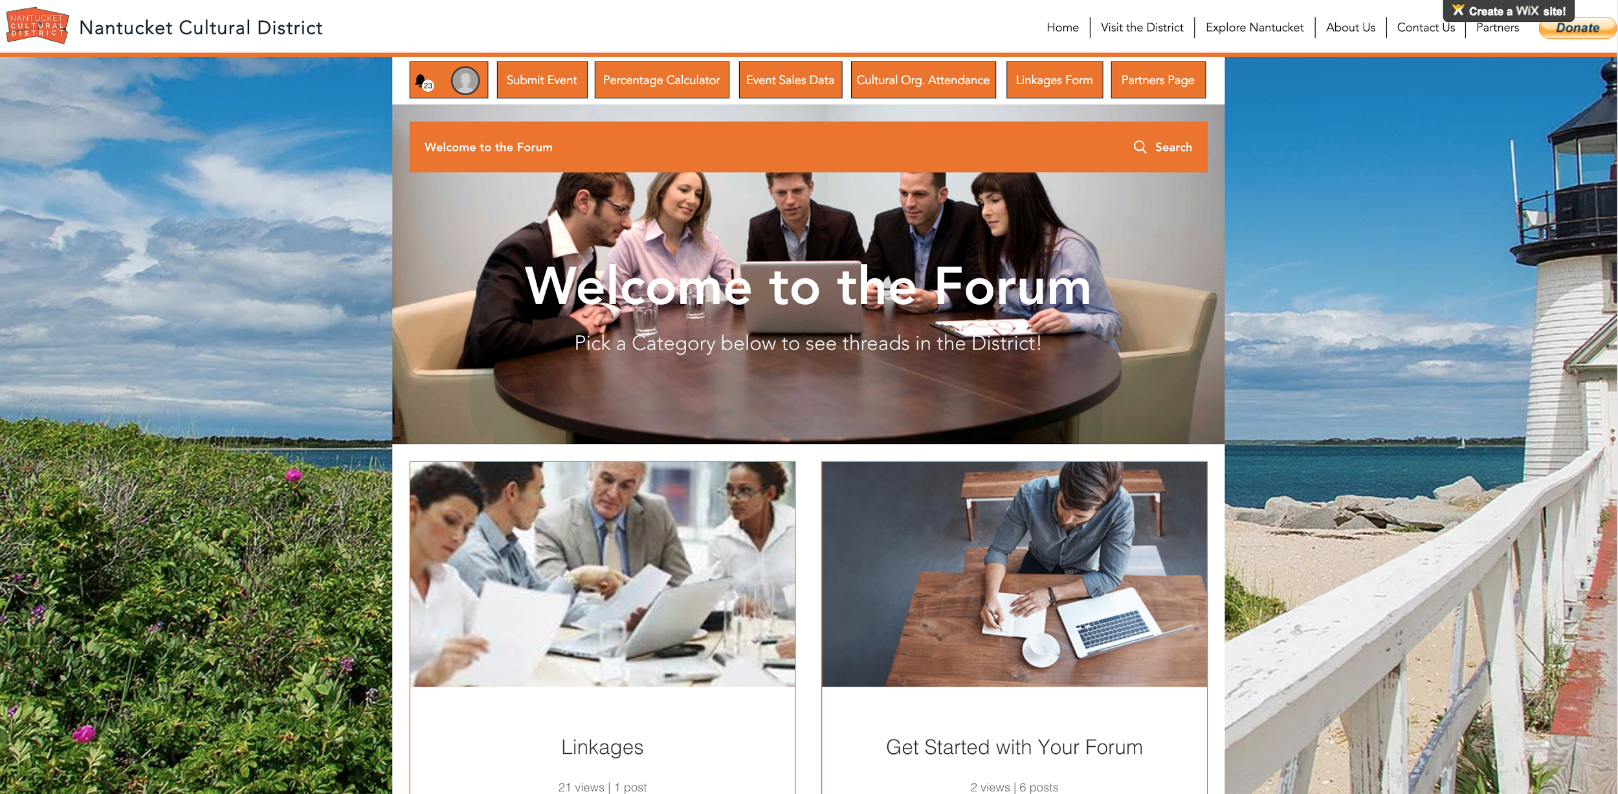
Forum
Notes:
Encourage Linkages
Possibilities of Collaborations with the organizations

Slide 26
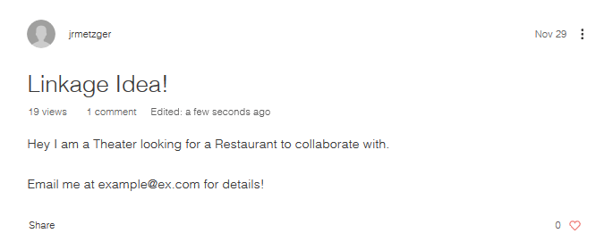
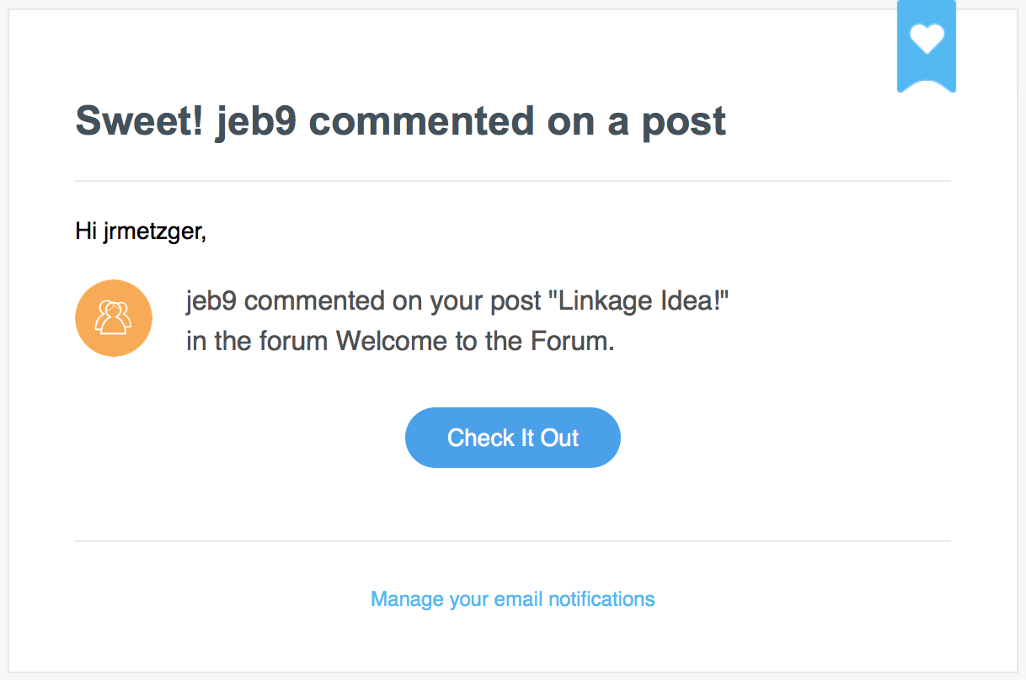
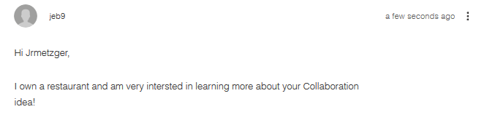
Forum Example
Notes:
Encourage Linkages
Possibilities of Collaborations with the organizations

Slide 27
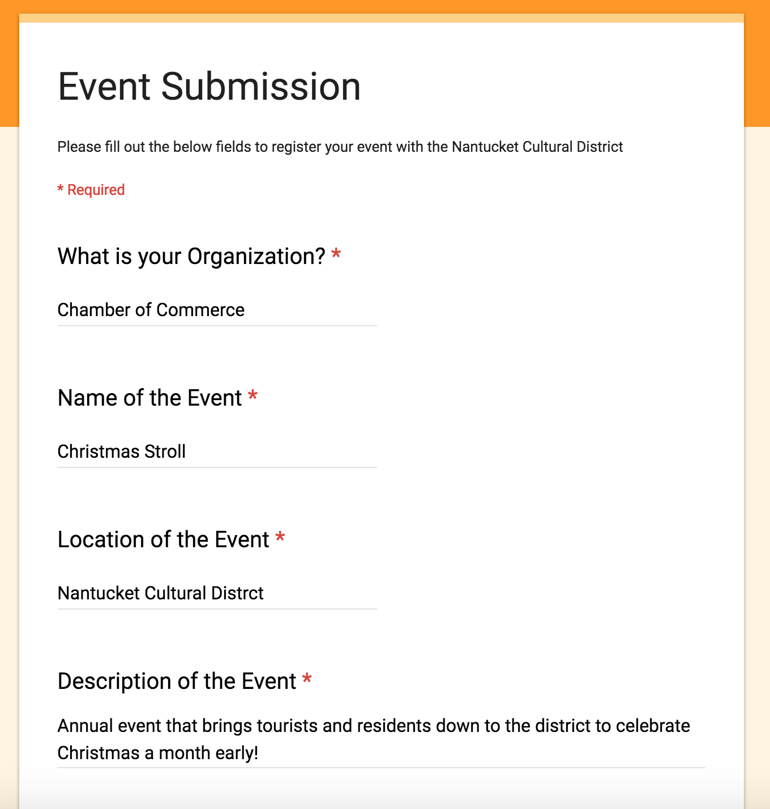
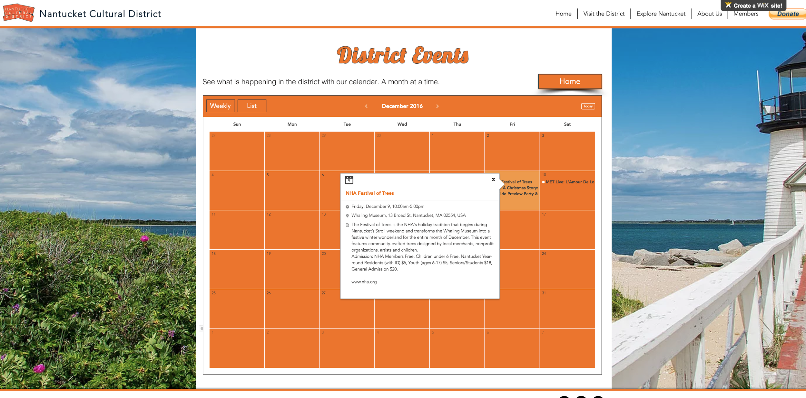
Submit your Calendar Event
Notes:
Form sent to an excel spreadsheet managed by the town’s “Special events coordinator for the town of Nantucket”

Slide 28
Outreach Plan
  Social Media
  Website
Data Collection and Analysis Tool
Notes:
Website → Calendar
Data Collection → Percent Change Calculator
Social Media Plan
Funding Structure

Slide 29
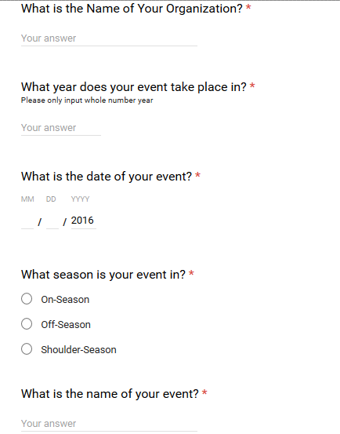
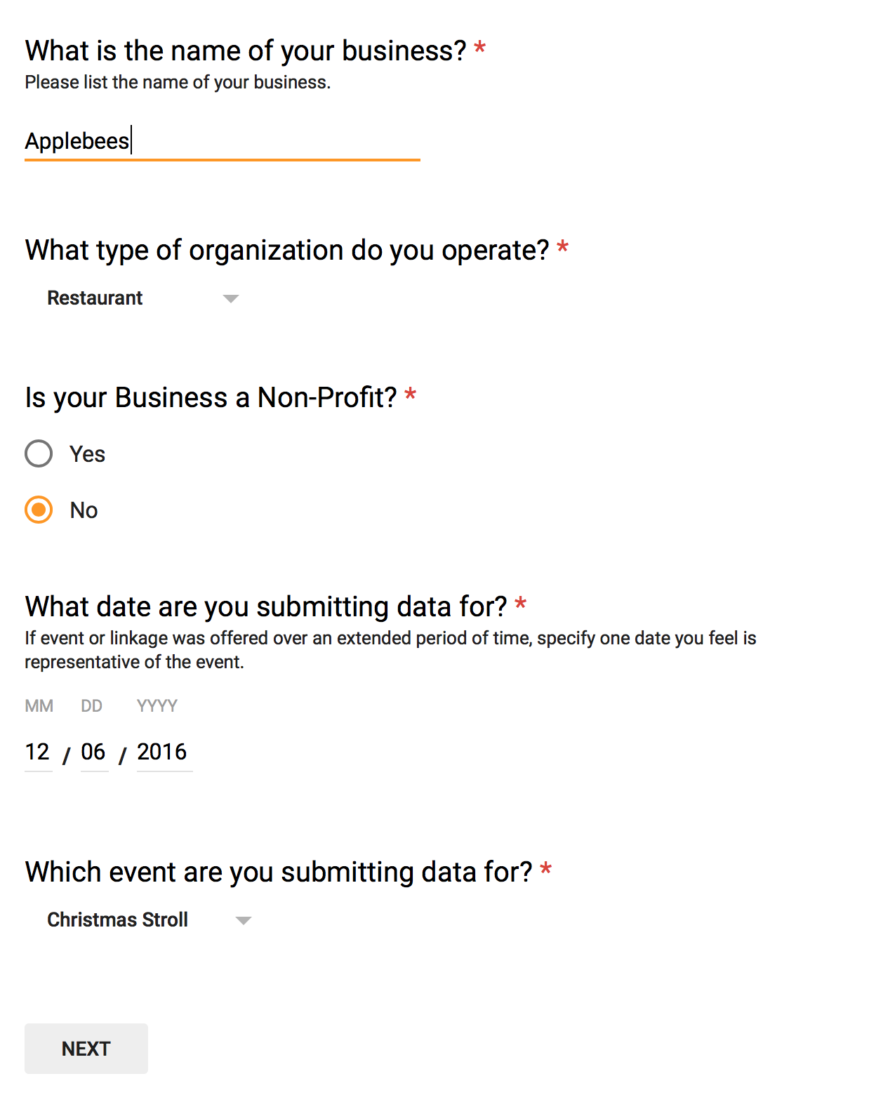
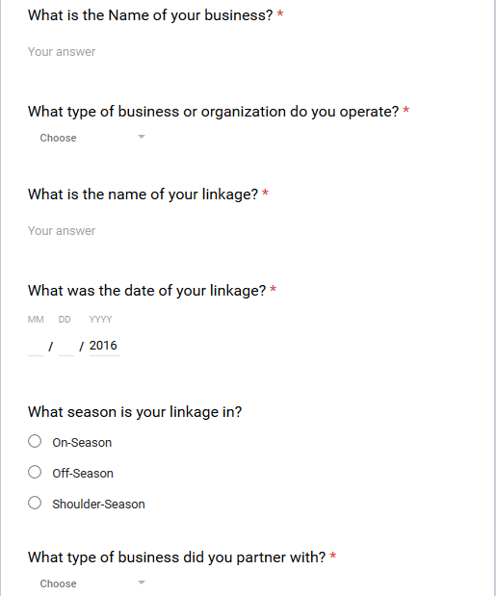
Forms
Cultural Organization Attendance
Linkage Data Collection
Business and Event

Slide 30
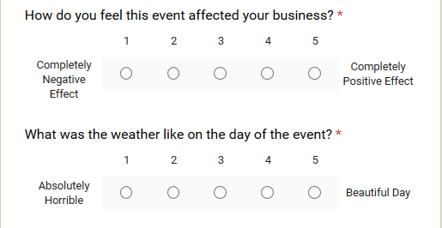
Business Events and Linkages Form
Business Event Data
and Linkages
Likert Type
Percent Change in Business correlated with Event
Linkage
Notes:
Talk about how we have all these options but are only focused on occupancy rates and attendance. Our sponsors want knowledge of the district and the impact of individual events.

Slide 31
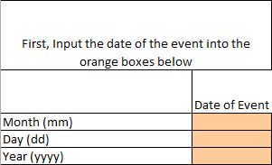
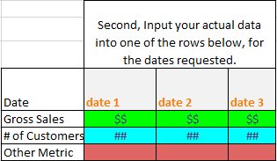
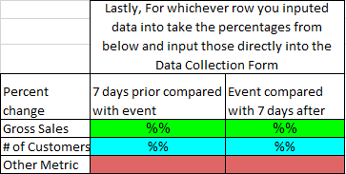
Percent Change Calculator

Slide 32
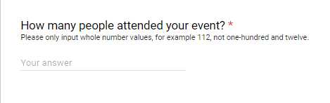
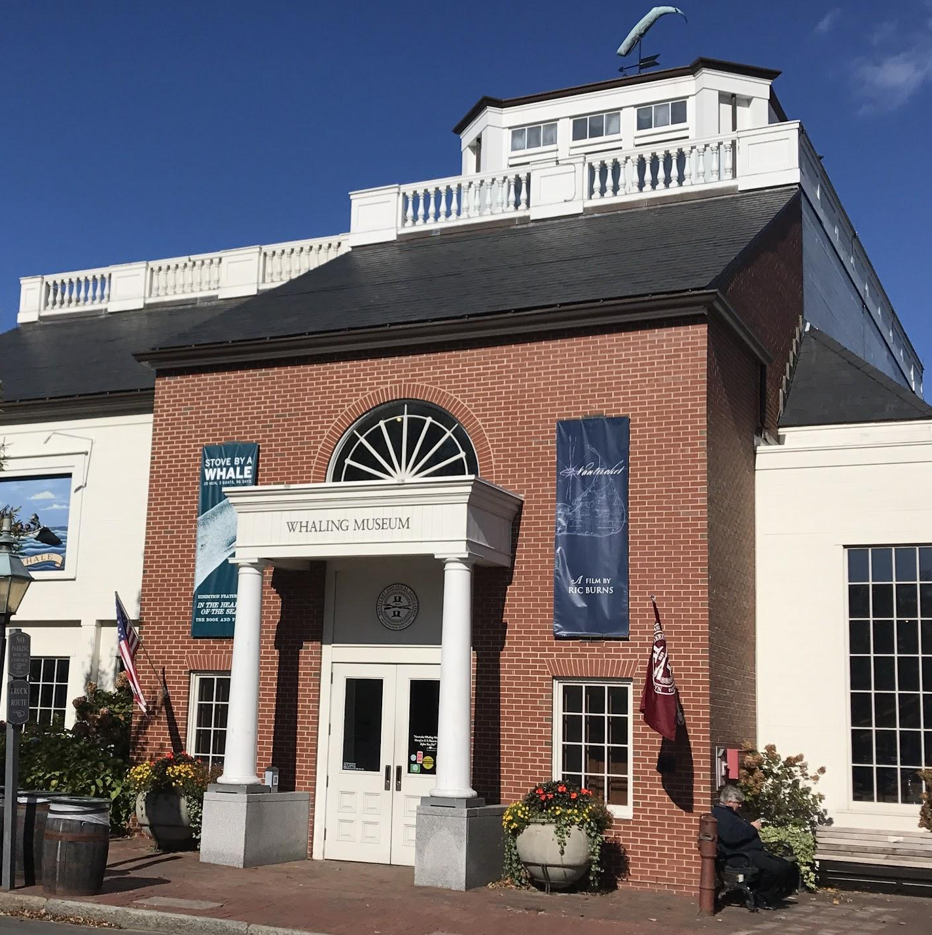
Cultural Events Data Collection Form
Two Annual Cultural Events per Organization
Likert Type
  Opinion
  Weather
Attendance
Notes:
Talk about how we have all these options but are only focused on occupancy rates and attendance. Our sponsors want knowledge of the district and the impact of individual events.

Slide 33
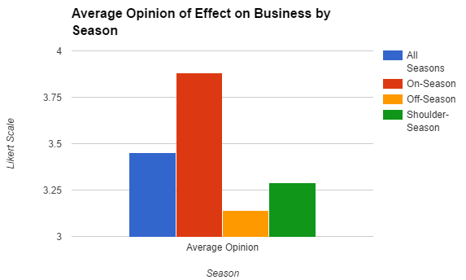
Data Analysis Tool
*Fake data for presentation purposes

Slide 34
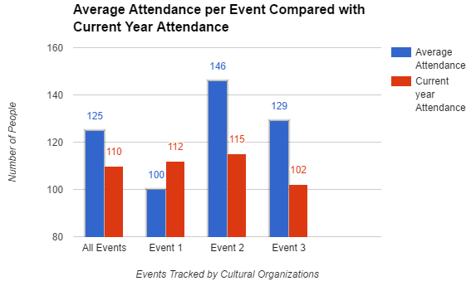
Data Analysis Tool
*Fake data for presentation purposes

Slide 35
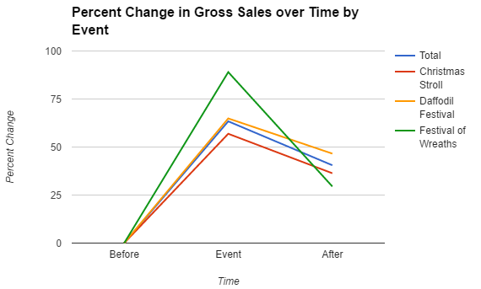
Data Analysis Tool
*Fake data for presentation purposes

Slide 36
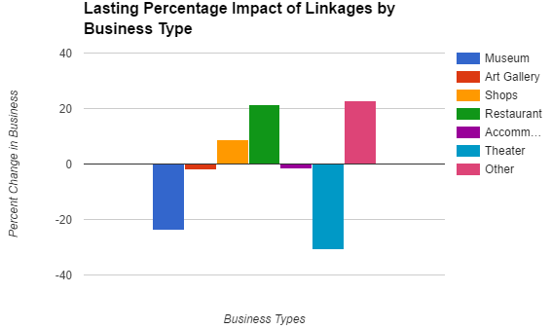
Data Analysis Tool
*Fake data for presentation purposes

Slide 37
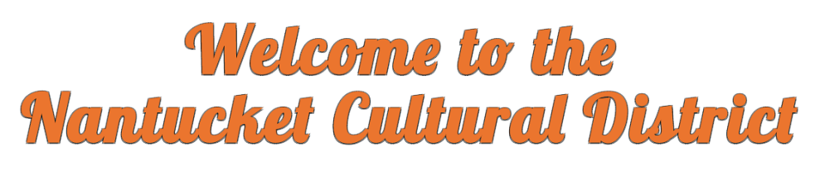


Results Recap
Increase Knowledge of District
  Social Media Plan
  Website
  Calendar
Annual Report for the MCC
  Google Forms
  Data Collection Tool
Create and Foster Linkages
  NCD Partners Forum

Slide 38
Recommendations
Short term
Adopt the New NCD Website
  Improve Social Media Presence
  Expand District Partnerships
Long Term
  Begin Data Collection from Businesses
  Track Additional Metrics

Slide 39






Acknowledgements
The Nantucket Cultural District
Our Liaisons
  Janet Schulte
  Melissa Murphy
  Virna Gonzalez
Fred Looft and Scott Jiusto
Everyone we Interviewed
Maria Mitchell Association

Slide 40

Questions?
CM

Slide 41

Interactive Qualifying Project Nantucket 2016
Advisors Scott Jiusto and Fred Looft

