Slide 1
Calendar Visualizations of Money Earlier or Later
Questions
By Yahel Nachum
Major Thesis Advisor: Professor Daniel Reichman
Thesis Reader: Professor Neil Heffernan
Notes:
11 content slides before future experiments (5/6 split)
16 content slides total (8 slides each)

Slide 2




Acknowledgements
Professor Daniel Reichman
Professor Lane Harrison
Professor Ravit Heskiau
Professor Neil Heffernan

Slide 3


Acknowledgements
Peter Cordone
Yiren Ding

Slide 4

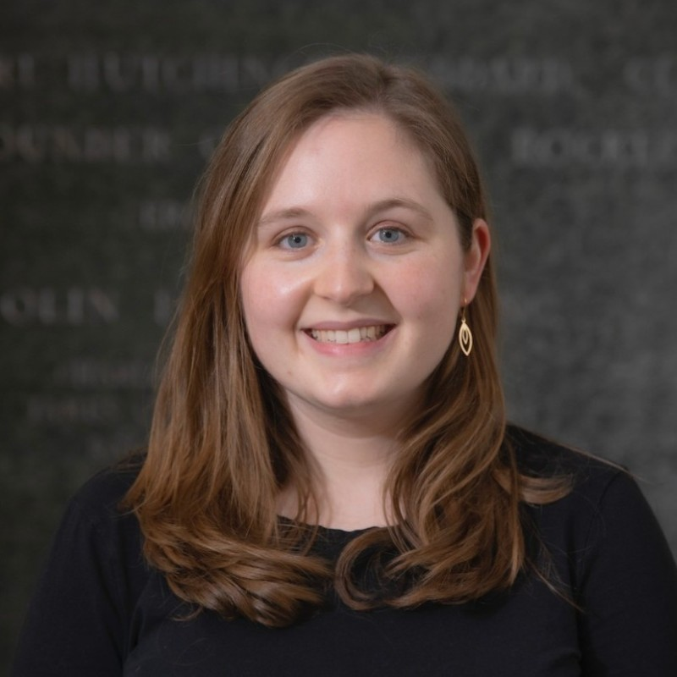
Acknowledgements
Lastly, but most importantly, Caroline Muirhead, my wife.

Slide 5

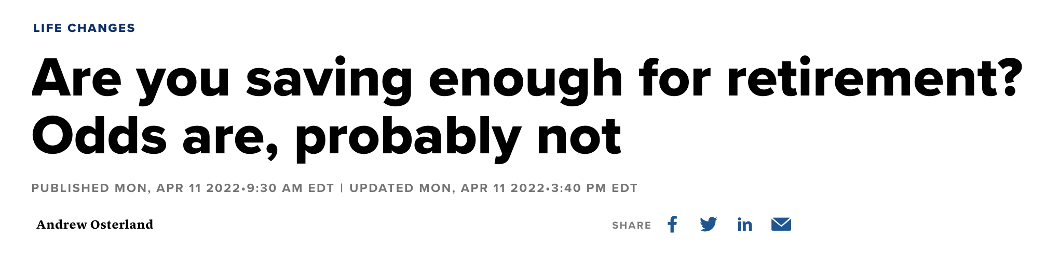
Notes:
CNBC
something we always hear
we should be saving more
Retirement
About half of all Americans are at risk of not being able to maintain pre-retirement standards of living
https://www.google.com/url?sa=i&url=https%3A%2F%2Flogos-world.net%2Fcnbc-logo%2F&psig=AOvVaw34sFTqZJj4WT3d0cWK0RkX&ust=1681925645840000&source=images&cd=vfe&ved=0CBAQjRxqFwoTCIjJ7bb7s_4CFQAAAAAdAAAAABAE
https://www.cnbc.com/2022/04/11/are-you-saving-enough-for-retirement-odds-are-probably-not.html

Slide 6
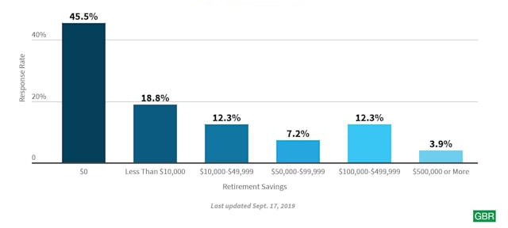
Most Americans Do Not Have Enough Savings For Retirement
Notes:
GoBankingRanks
2,000 responses
64% of Americans are now expected to retire with less than $10,000 in their retirement savings accounts
$0 bracket, 45% said they couldn’t save for that reason low-income
At least 25% of respondents are able to
Study was in 2019
https://finance.yahoo.com/news/survey-finds-42-americans-retire-100701878.html

Slide 7

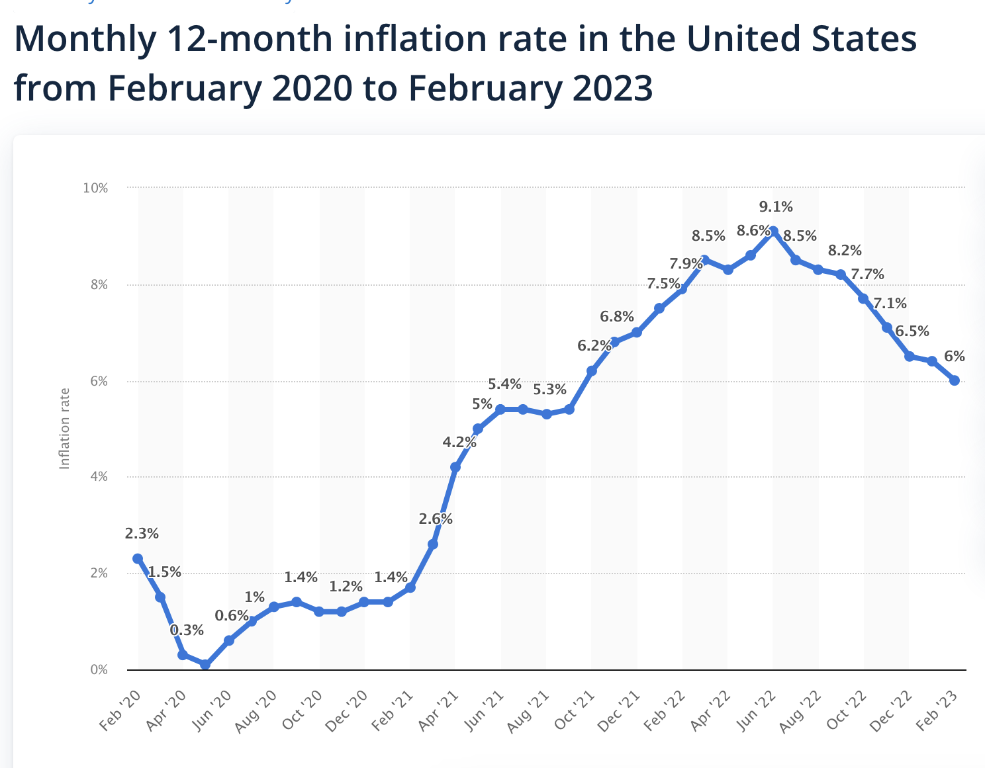

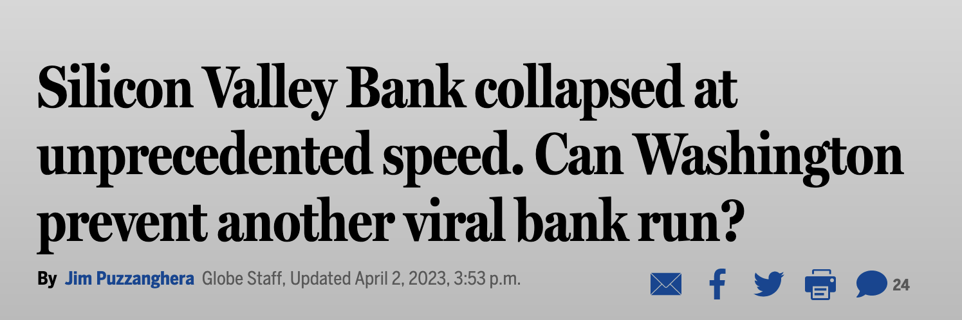
Inflation Makes Saving Money More Difficult
Notes:
TODOTODOTODO
Statista
Inflation over 6% for the past 2 years
Boston globe
Silicon valley bank collapse
withdrawals can be made with the push of a button, no bank is safe from a run
Time magazine
people start inferring that something’s wrong with other banks
https://www.google.com/url?sa=i&url=https%3A%2F%2Fwww.statista.com%2F&psig=AOvVaw2mFOrrMyJcPwfbtgASxW56&ust=1681925706235000&source=images&cd=vfe&ved=0CBAQjRxqFwoTCOCe4NP7s_4CFQAAAAAdAAAAABAE
https://www.statista.com/statistics/273418/unadjusted-monthly-inflation-rate-in-the-us/
https://www.google.com/url?sa=i&url=https%3A%2F%2Fcommons.wikimedia.org%2Fwiki%2FFile%3AThe_Boston_Globe.svg&psig=AOvVaw1qH_6-yEV9E3sj2twuRhSV&ust=1681925752263000&source=images&cd=vfe&ved=0CBAQjRxqFwoTCLCYz-n7s_4CFQAAAAAdAAAAABAE
https://www.bostonglobe.com/2023/04/02/nation/silicon-valley-bank-collapsed-unprecedented-speed-can-washington-prevent-another-viral-bank-run/
https://time.com/6262567/money-safe-silicon-valley-bank/

Slide 8


Why Do People Struggle To Save Money?
Low-income earners
Poor financial decisions
Notes:
Two bins of people
People that don’t have a choice with their money
Low income earners
Living Paycheck-to-paycheck
People that have flexibility with their money
Make poor financial decisions
Expensive car
https://www.google.com/url?sa=i&url=https%3A%2F%2Fonlinecounselingprograms.com%2Fresources%2Fmanage-financial-stress%2F&psig=AOvVaw1V43xJVEX0R6AGJByqgP3o&ust=1682026536786000&source=images&cd=vfe&ved=0CBMQ3YkBahcKEwiA3OCj87b-AhUAAAAAHQAAAAAQBA
https://www.google.com/url?sa=i&url=https%3A%2F%2Fwww.linkedin.com%2Fpulse%2Fnow-vs-later-delayed-gratification-do-better-future-biswadeep-mandal&psig=AOvVaw091zx6FIo2yhgYc1gk_WH7&ust=1682026550756000&source=images&cd=vfe&ved=0CBMQ3YkBahcKEwj4-bSq87b-AhUAAAAAHQAAAAAQBA

Slide 9
Why Do People Struggle To Save Money?
Low-income earners
Poor financial decisions
Notes:
We are focusing on the second bin of people
These are people that have an option to delay gratification and save for a later date
https://www.google.com/url?sa=i&url=https%3A%2F%2Fonlinecounselingprograms.com%2Fresources%2Fmanage-financial-stress%2F&psig=AOvVaw1V43xJVEX0R6AGJByqgP3o&ust=1682026536786000&source=images&cd=vfe&ved=0CBMQ3YkBahcKEwiA3OCj87b-AhUAAAAAHQAAAAAQBA
https://www.google.com/url?sa=i&url=https%3A%2F%2Fwww.linkedin.com%2Fpulse%2Fnow-vs-later-delayed-gratification-do-better-future-biswadeep-mandal&psig=AOvVaw091zx6FIo2yhgYc1gk_WH7&ust=1682026550756000&source=images&cd=vfe&ved=0CBMQ3YkBahcKEwj4-bSq87b-AhUAAAAAHQAAAAAQBA

Slide 10





Delayed Gratification Is An Important Skill
VS
Notes:
Delayed gratification
Study dubbed marshmallow experiment
1970
Stanford
group of children
Let them take a single marshmallow immediately
Or wait a period of time
15 min
and receive 2 marshmallows
Rewards were not actually marshmallows, simplification
Two animal cookies or 5 pretzels
Determined what child preferred before offering one of them as immediate reward
1990
Follow up study
Tracked kids back
Correlated delayed-gratification with academic success
SAT scores
Criticism
generally no more or less financially secure, educated or physically healthy than their more patient peers
delay of gratification might be primarily a middle- and upper-class value
many of the kids were children of Stanford students or professors
size of the correlation was half that of the original paper
correlation almost vanished when Watts and his colleagues controlled for factors like family background and intelligence
https://www.vox.com/science-and-health/2018/6/6/17413000/marshmallow-test-replication-mischel-psychology
https://anderson-review.ucla.edu/new-study-disavows-marshmallow-tests-predictive-powers/
https://www.google.com/url?sa=i&url=https%3A%2F%2F1000logos.net%2Fstanford-logo%2F&psig=AOvVaw2WzYuP7kyYPCpco-7KpgHo&ust=1682026568986000&source=images&cd=vfe&ved=0CBMQ3YkBahcKEwiIjYSz87b-AhUAAAAAHQAAAAAQBA
https://www.google.com/url?sa=i&url=https%3A%2F%2Fwww.vecteezy.com%2Fpng%2F8534045-falling-marshmallow-cutout-png-file&psig=AOvVaw1n_OW-glzL_WVjvmcHOi4-&ust=1682026581784000&source=images&cd=vfe&ved=0CBMQ3YkBahcKEwjwkJ2587b-AhUAAAAAHQAAAAAQBA

Slide 11
Goal of project: Find ways to encourage people to delay gratification and save money

Slide 12
We Can Study How People Save Money Through Money Choice Questions
Money decision making (now vs later)
Previous Money Earlier or Later (MEL) research
Would you like to receive $100 on May 1st, 2023 or $150 on May 1st, 2033
Would you like to receive $100 on May 1st, 2023 or $150 on May 2nd, 2023
Notes:
dfs
Earlier amount?
Later Amount
Amount stays the same
Choice changes with time
https://www.statista.com/statistics/273418/unadjusted-monthly-inflation-rate-in-the-us/

Slide 13
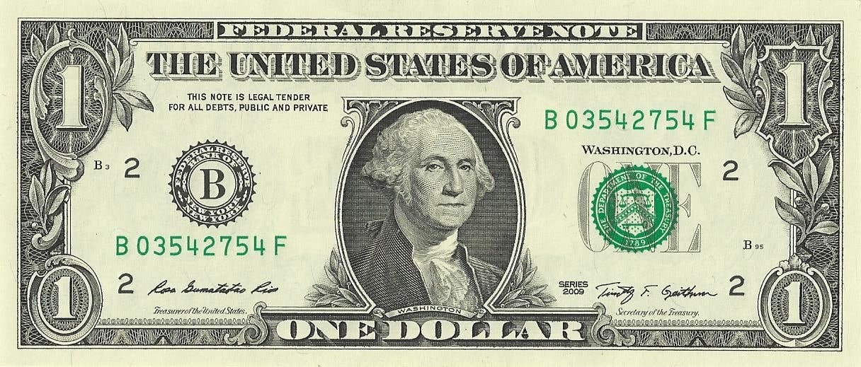
Discount Rate
Today
Tomorrow
≠
1 year from now
Today
=
50% discount rate
Notes:
$1 today is not the same as $1 tomorrow
$1 today
Equivalent choice
$2 a year from now
If so,
50% discount rate
Amount by discount rate
Discount rate is the rate at which people devalue money
Constant discount rate was first proposed by Paul Samuelson in 1937 in his discounted utility model

Slide 14
The Discount Rate Is Not Constant Across Time
1 year from now
Today
=
50% discount rate
10 years from now
11 years from now
≅
Notes:
Take the previous example
Now consider the choice of $1 10 years from now
And $1, 11 years from now
There isn’t as much of a preference between these two options
This means the discount rate is not constant across time
Hyperbolic discounting
Once options are far enough into the future people do not mind waiting for the later option

Slide 15



Reasons For Discounting
Emotions
Instant gratification
Anxiety about future
Inflation
Utility
Notes:
TODO

Slide 16
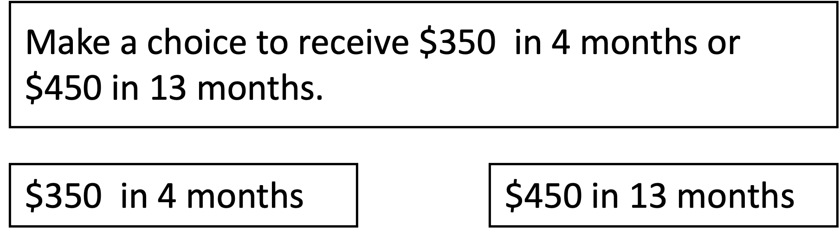
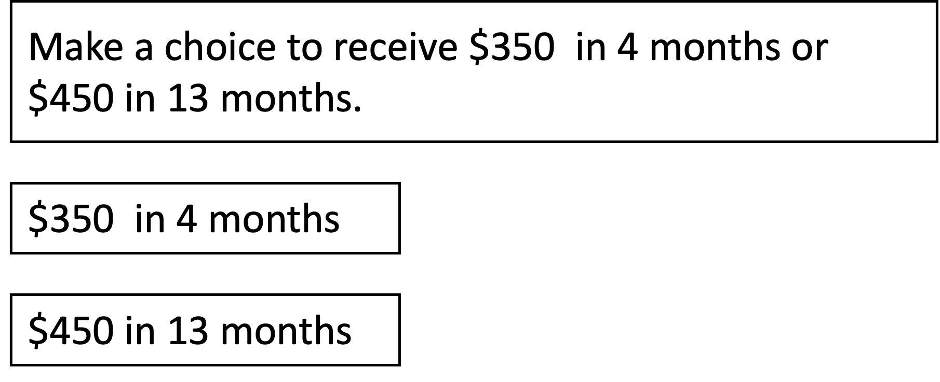

Layout Of Choices Affects Discounting
discount rate
Notes:
Romero et al, 2019 showed interesting effects of layout on choices
Presented MEL question answers
Horizontally
Vertically
Found that vertical layouts decreased the discount rate, they chose the later option more often
Lower discount rate, means that the decision between the two options becomes more about the amount than the time
attention to time
Western audiance
overestimate how long it will take to receive benefits

Slide 17
Wording Of Choices Affects Discounting
$10 dollars in a month
$10 dollars on May 20th, 2023
discount rate
Notes:
Read et al, 2005 showed interesting effects of wording on choices
Delays vs dates
Dates lowered the discount rate, they chose the later option more often
Lower discount rate, means that the decision between the two options becomes more about the amount than the time
we have not isolated its psychological bases
Attention focusing to value
People prefer precise dates
Date more concrete

Slide 18
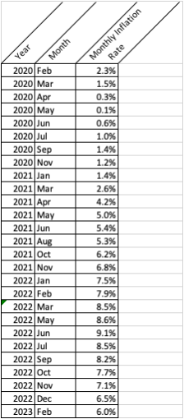
Visualizations Help People Understand Data
Notes:
Transitioning over to visualizations
Can anybody make out any inferences on the left
Now when visualizing the data
Does it become easier to get a trend
A quick average?
https://www.statista.com/statistics/273418/unadjusted-monthly-inflation-rate-in-the-us/

Slide 19
Converting Text To Visualizations Improved Economic Decisions
Would you like a:
050% chance
0000of receiving $100
0000and
050% chance
0000of receiving 00$0
chance of
00receiving $100
0000and
chance of
00receiving 00$0
0000or
0000or
100% chance
0000of receiving $45
chance of
00receiving $45
Notes:
Previous research has been conduced for uncertain economic decisions
$50 above is economic sound
Defined as on average what will give you the most money
Converted to icon arrays and other visualizations to depict the chances
Least deviation from risk neutrality

Slide 20
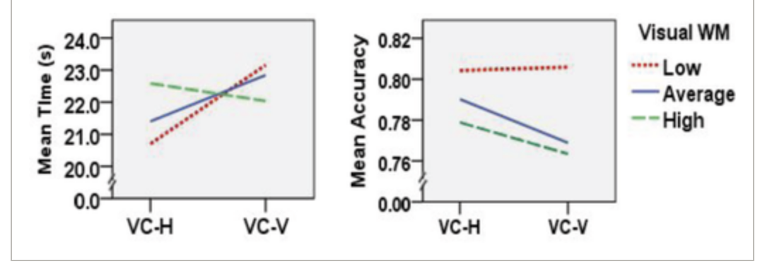
Layouts Can Have Unique Effects Across Participants
Different visual layouts have unique effects on participants
Notes:
Tested vertical and horizontal layouts on participants (value charts)
Low visual working memory
Mean time lowered with horizontal
Accuracy stayed high for low visual working memory across layouts

Slide 21
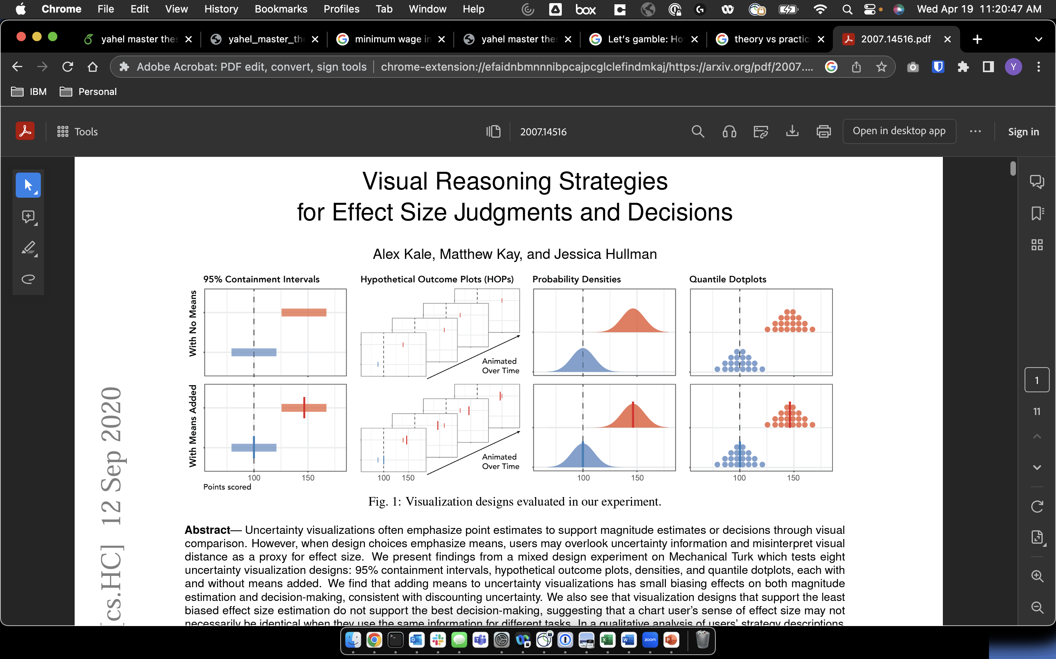
Theory Does Not Always Work In Practice
Must choose best visualization for the data and analysis in question
  Theory does not always match human behavior
Notes:
Point estimates
Emphasize means

Slide 22


Calendars Are The Most Common Type Of Timeline Visualization
Notes:
https://www.google.com/url?sa=i&url=https%3A%2F%2Fwww.qualitylogoproducts.com%2Fblog%2Fhistory-of-calendars%2F&psig=AOvVaw1d_RMQsPB_3ow4IPifaZWv&ust=1681925559933000&source=images&cd=vfe&ved=0CBAQjRxqFwoTCKj2kI77s_4CFQAAAAAdAAAAABAX

Slide 23
Goal of project: Find ways to encourage people to delay gratification and save money
More specifically, we want to see if a calendar visualization can affect people’s discounting.

Slide 24
Hypothesis
Calendar visualizations will help participants to make the more optimal choice compared to textual versions.

Slide 25
High Level Overview Of Methods
Designed a survey with word questions and calendar visualizations
Implemented the survey in React
Ran the survey on Proflic, gathered data, and analyzed

Slide 26
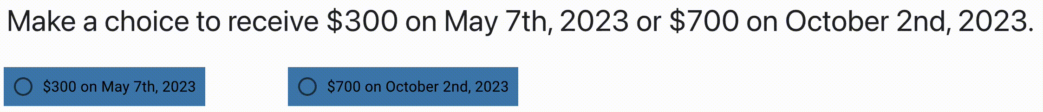
Word Version Of MEL Question
Notes:
Horizontal more natural for filling out the space
Vertical would have caused a narrow column

Slide 27
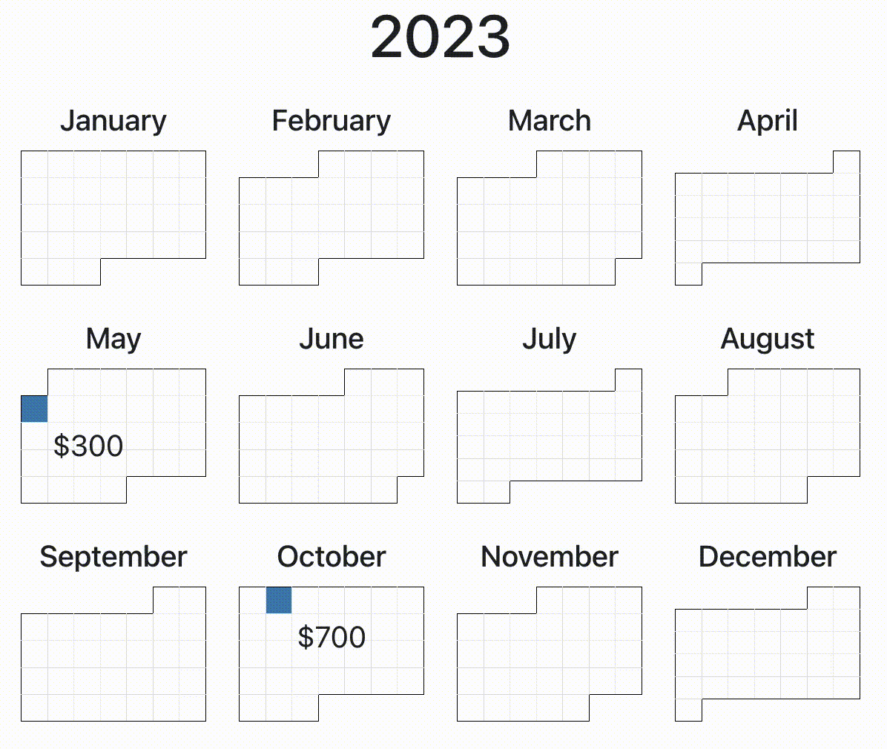
Calendar Version Of MEL Question
Notes:
One month
Too short
Amounts too little
Two year
Big visualization
Crowded
4 rows of 6 months
Unfamiilar layout

Slide 28
Comparing The Two Conditions
Which visualization would steer you towards the later option?
Notes:
Same
Font
Styling
Coloring
Interaction styles

Slide 29
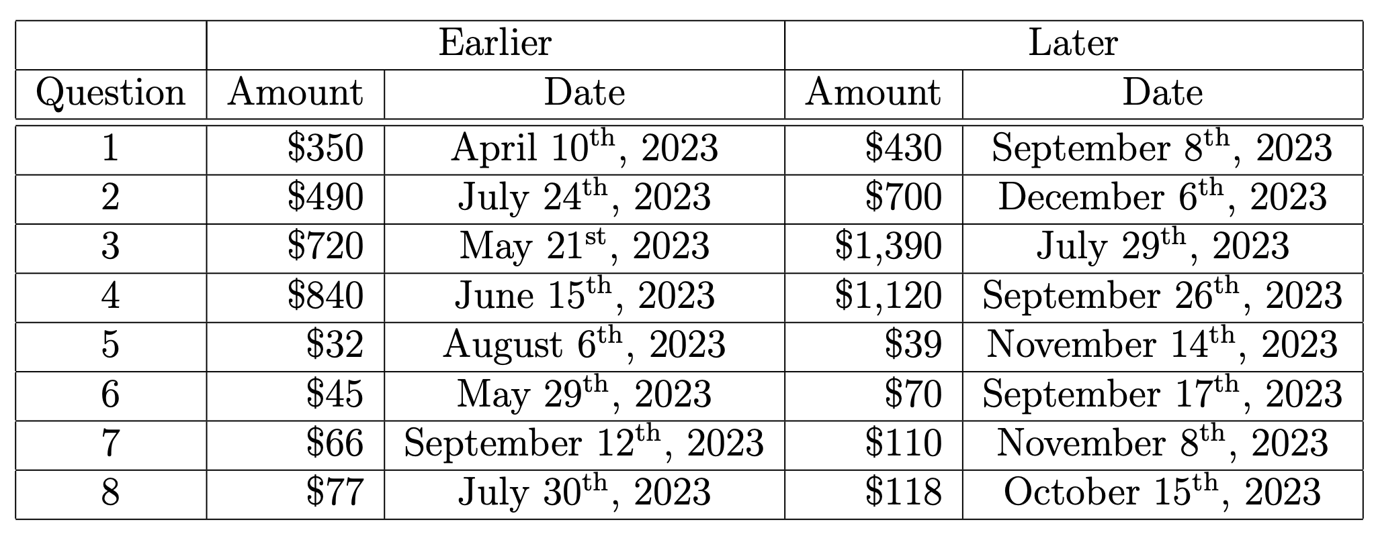
Picking Amounts And Dates
Read et al. [13] paper on dates vs delays
Conversion from British Pounds to USD
Converted dates (randomly)

Slide 30
How am I determining the optimal financial choice?

Slide 31
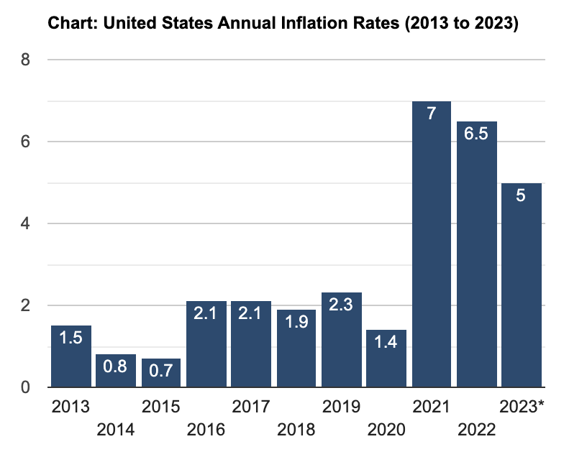
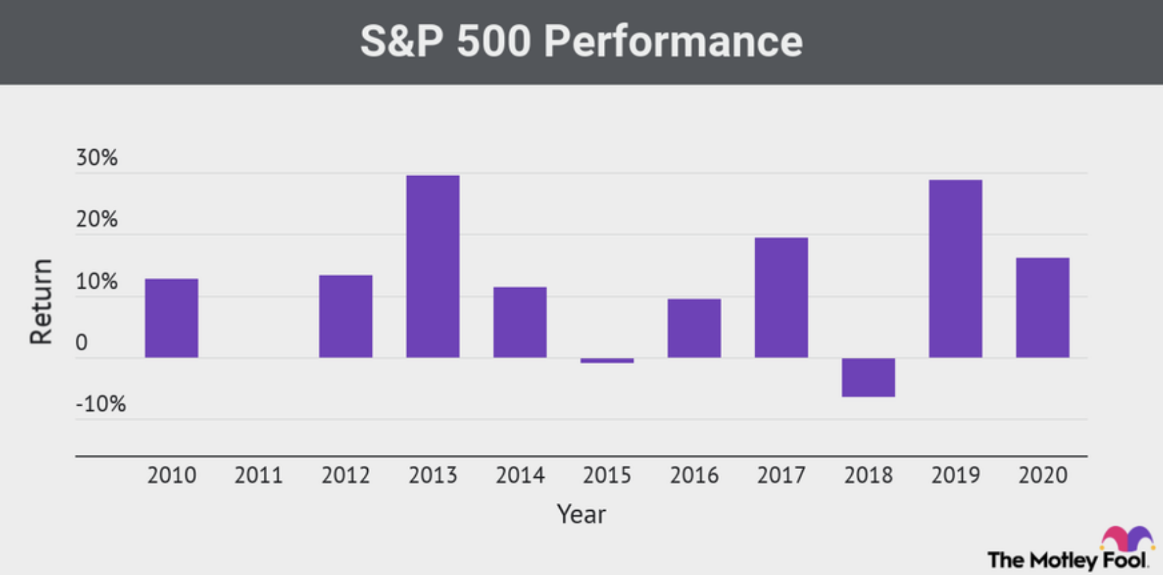
Defining The Optimal Choice
Inflation 6%
Return on investment (ROI) in the stock market 7%
Notes:
https://www.usinflationcalculator.com/inflation/current-inflation-rates/
https://www.fool.com/investing/how-to-invest/stocks/good-return-on-investment/

Slide 32
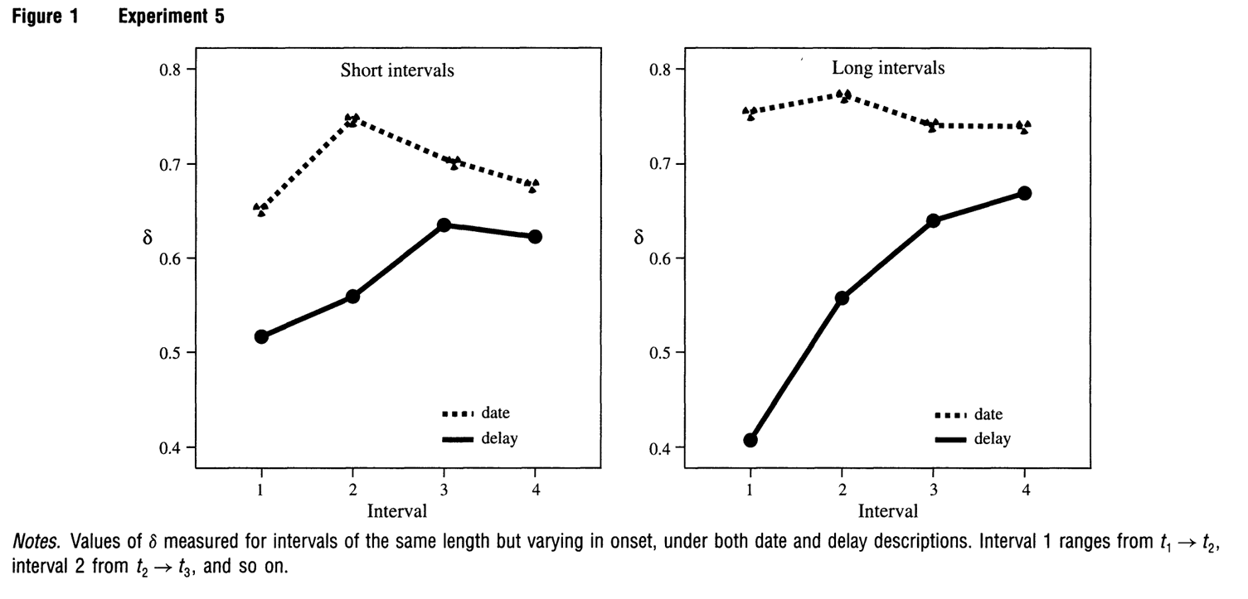
Defining The Optimal Choice
Read et al. [13] paper on dates vs delays
  ~60% discount rate
Current Inflation 6%
Discount rate of 166%
Notes:
Read et al paper
60% discount rate
Inflation between then and now is 2.76 times higher
166% discount rate now

Slide 33
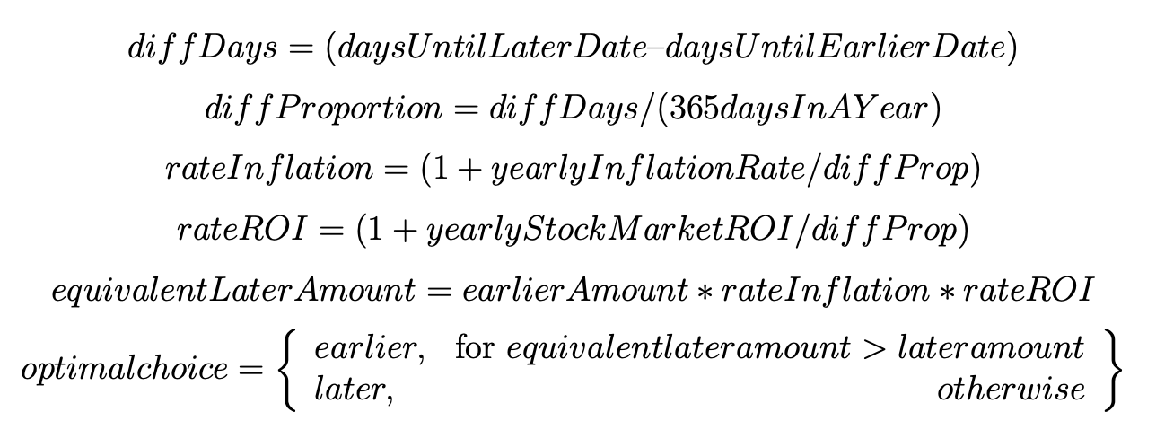
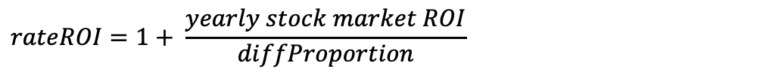
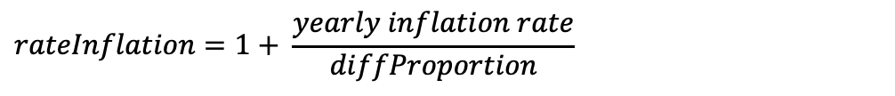
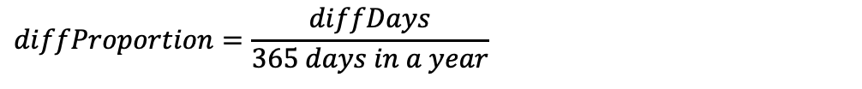
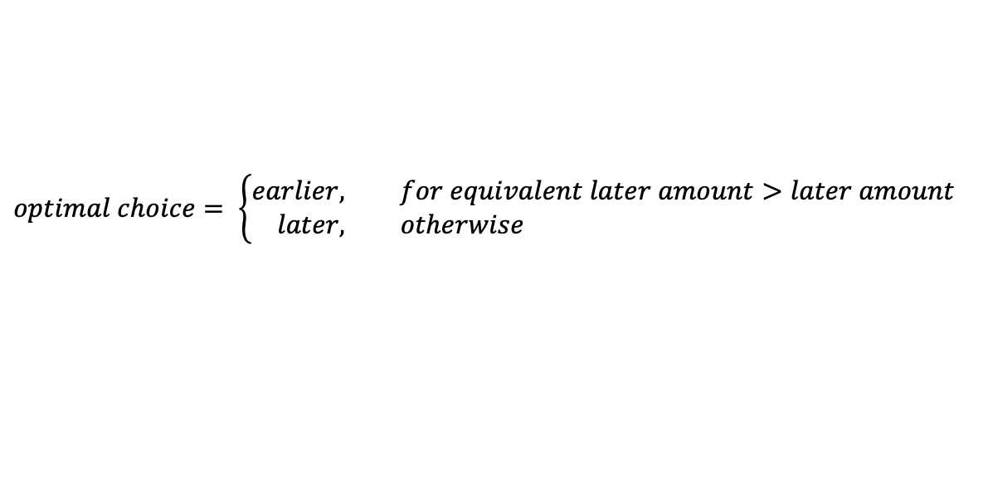
How To Calculate Optimal Behavior
$$diffDays=days until later date −days until earlier date$$
$$diffProportion=\frac{diffDays}{365 days in a year}$$
$$rateInflation=1+ \frac{yearly inflation rate}{diffProportion}$$
$$rateROI=1+ \frac{yearly stock market ROI}{diffProportion}$$
$$equivalent later amount=earlier amount ∗rateInflation ∗rateROI$$
$$optimal choice= \left\{\begin{aligned}earlier, for equivalent later amount>later amount \\ later, otherwise \end{aligned}\right.$$
Notes:
TODO possibly format equations better

Slide 34
How To Calculate Optimal Behavior
$$diffDays=days until later date −days until earlier date$$
$$diffProportion=\frac{diffDays}{365 days in a year}$$
$$rateDiscount=1+1.66 calculated discount rate ∗diffProportion$$
$$equivalent later amount=earlier amount ∗rateInflation ∗rateROI$$
$$optimal choice= \left\{\begin{aligned}earlier, for equivalent later amount>later amount \\ later, otherwise \end{aligned}\right.$$
Notes:
TODO possibly format equations better

Slide 35
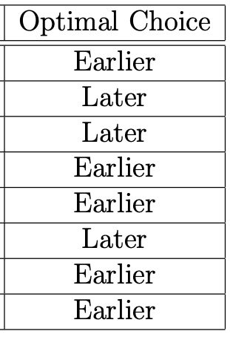
Optimal Behavior With Our MEL Values
Notes:
TODO possibly combine into a single table

Slide 36
Optimal Behavior With Our MEL Values
Notes:
TODO possibly combine into a single table

Slide 37
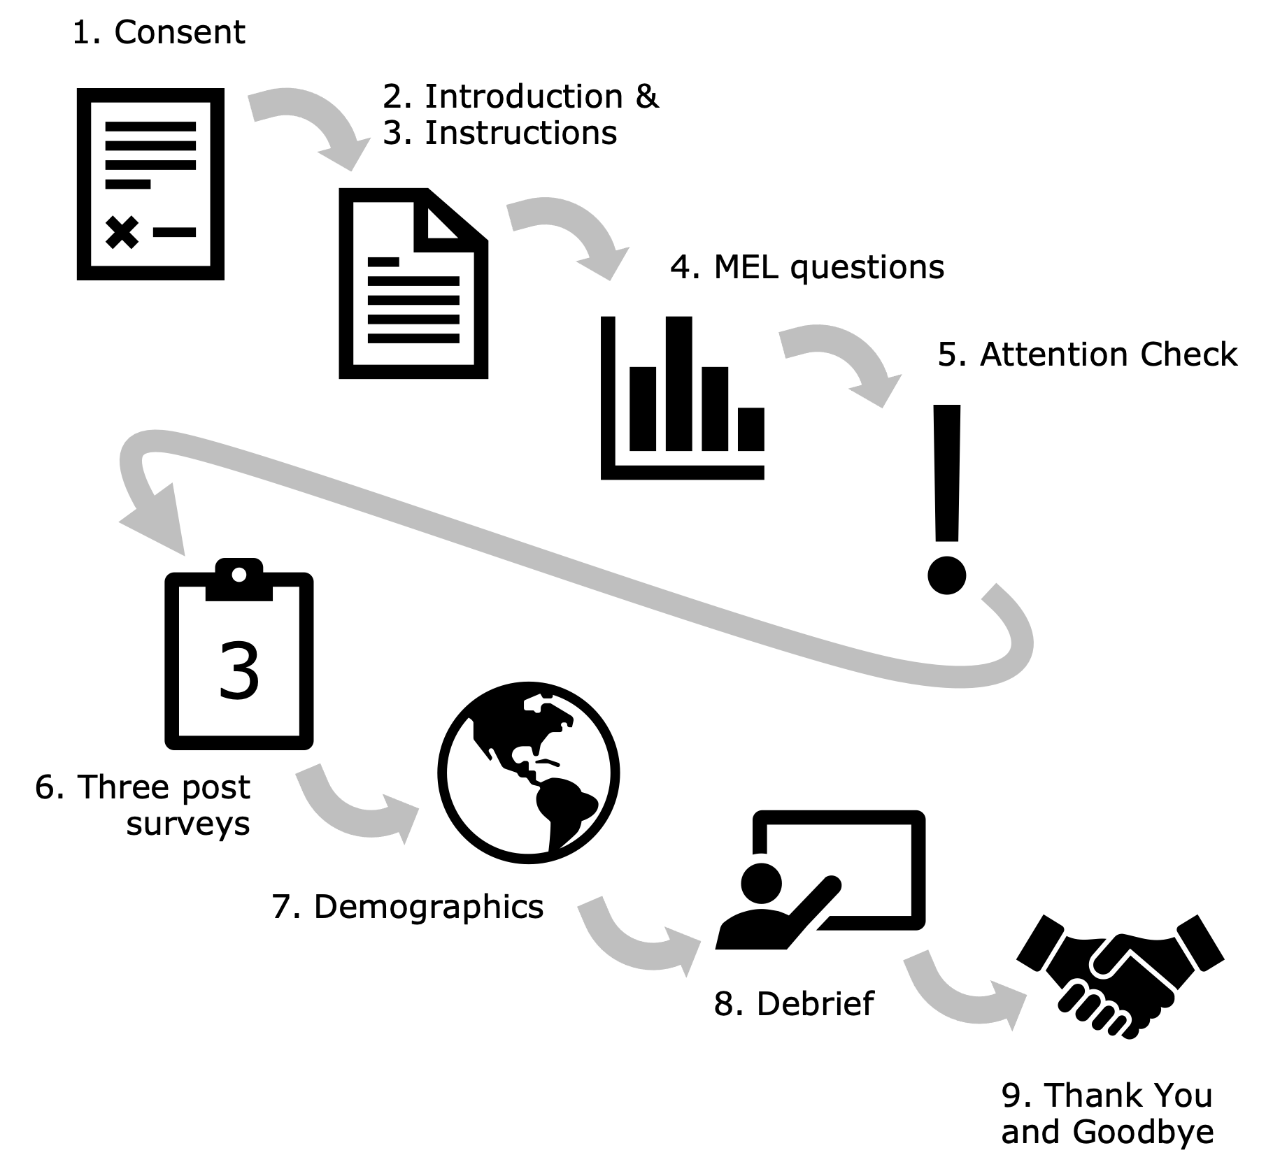
Flow Of Survey

Slide 38




3 Post Surveys To Get Descriptive Statistics
Experience
Financial Literacy
Sense of Purpose

Slide 39

Participants Were Paid Fairly For Their Time
10 minute survey
$3 per participant
$18 per hour equivalent

Slide 40

Overview Of How We Implemented The Survey
React application
  Reuse components
  Integrate third-party modules
  Host webpage and data storage online
  Continuously test throughout development

Slide 41
Reusing Components In React
Interactive Example in Instructions
Single-year Calendar
Set of 8 MEL Questions
x12
MEL Presentation
Single-month calendar

Slide 42


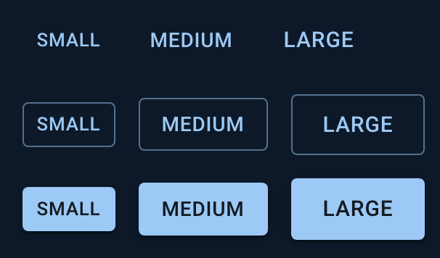
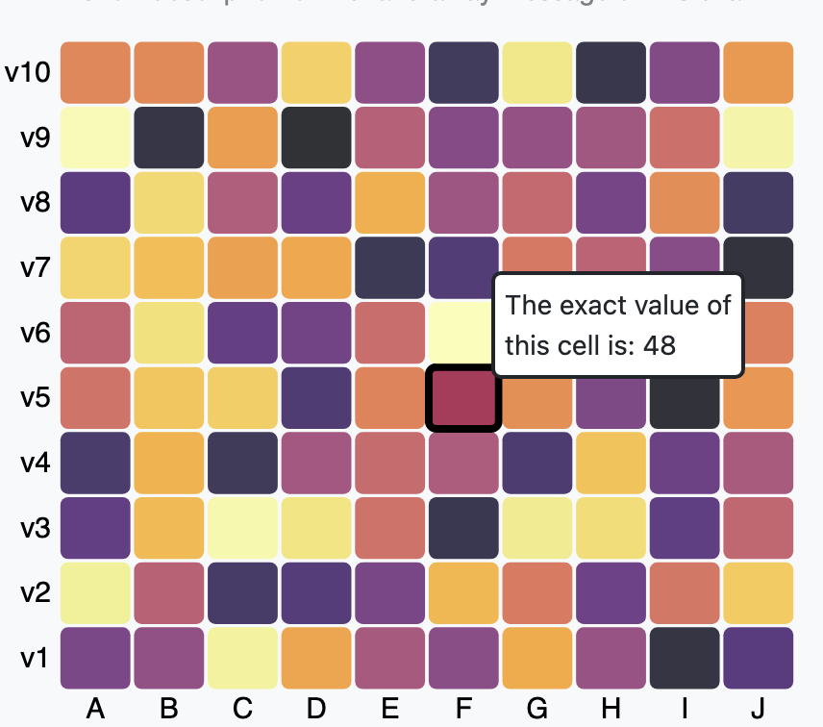

Third-party Modules We Integrated With

Slide 43




Hosting And Data Storage On
Hosted on
Data Storage
Write-only
Continuous Deployment
GitHub The-Discounters release-calendar

Slide 44

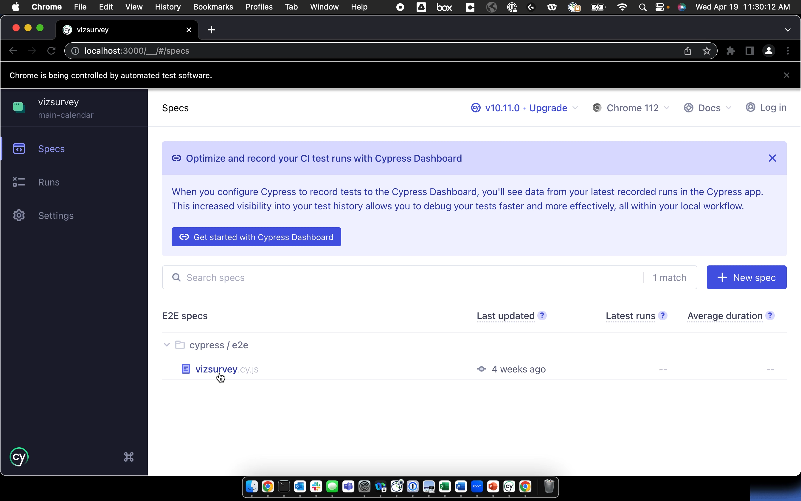
Continuous Testing With

Slide 45

Data Collection & Analysis
Between-subject design
  Worded version using dates
  Single-Year Calendar
Prolific
  April 5th, 2023
  60 U.S. participants
    30 word
    30 calendar

Slide 46
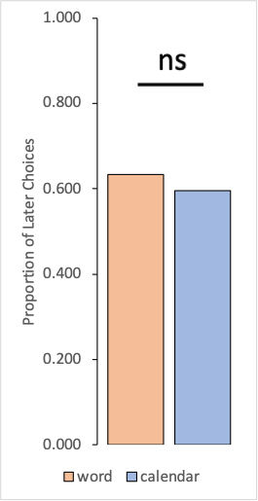
No General Difference In Discounting
Chi-square test of independence
Notes:
On this graph
Average proportion of later choices between the two conditions
We mapped earlier to 0
And later to 1
Orange bar on the Left is word
Blue bar on the Right is calendar
There is a numerical difference between the bars
But using a chi-square test of independence it is not significant
This test was used since there were only two options
Earlier or later
Which were mapped to integers and this would not generate a normal distribution
Hence the chi-square test of independence

Slide 47
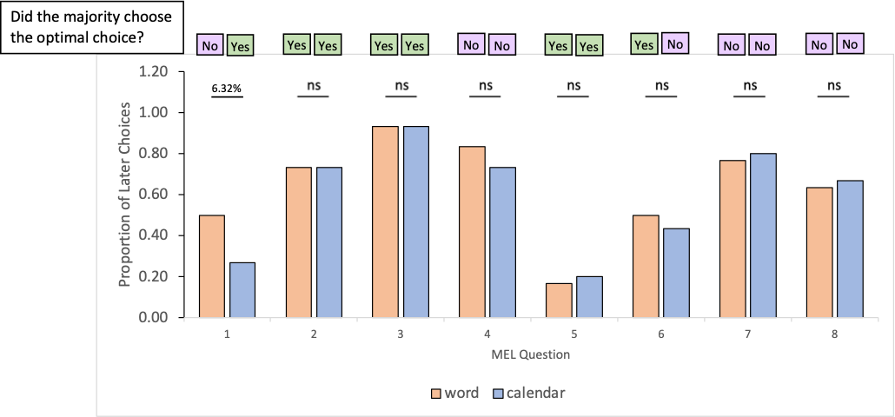
First MEL Question Showed The Biggest Difference
.0632
Chi-square test of independence
Notes:
Same y axis as before, proportion of later choices
All of the tests were not significant
First test was the closest to significance
Calendar condition discounted more
Will discuss this closer with the actual visualizations later
But next we will compare this with the optimal choice

Slide 48
Responses Of Participants Compared To Optimal Choices
.0632
Chi-square test of independence
Notes:
Interesting to see the optimal choice that we calculated
First one flipped
4th 7th , 8th, they both picked the non-optimal choice

Slide 49
Responses Of Participants Compared To Optimal Choices
.0632
Chi-square test of independence
Notes:
Interesting to see the optimal choice that we calculated
First one flipped
4th 7th , 8th, they both picked the non-optimal choice

Slide 50
Amounts Compared To Participant’s Responses
Word
Calendar
Notes:
4th magnitude effect
7th and 8th people have a lower discount rate farther out
More likely to be patient

Slide 51
Amounts Compared To Participant’s Responses
Word
Calendar
Word
Calendar
Notes:
4th magnitude effect
7th and 8th people have a lower discount rate farther out
More likely to be patient

Slide 52
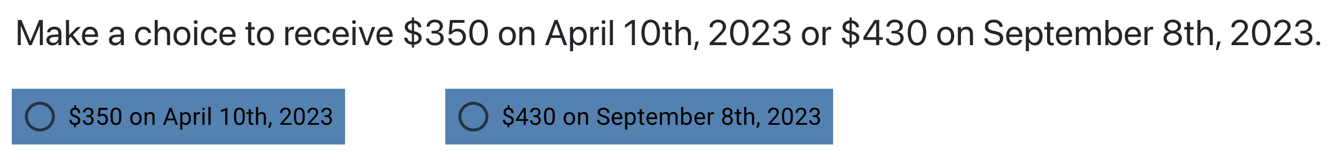
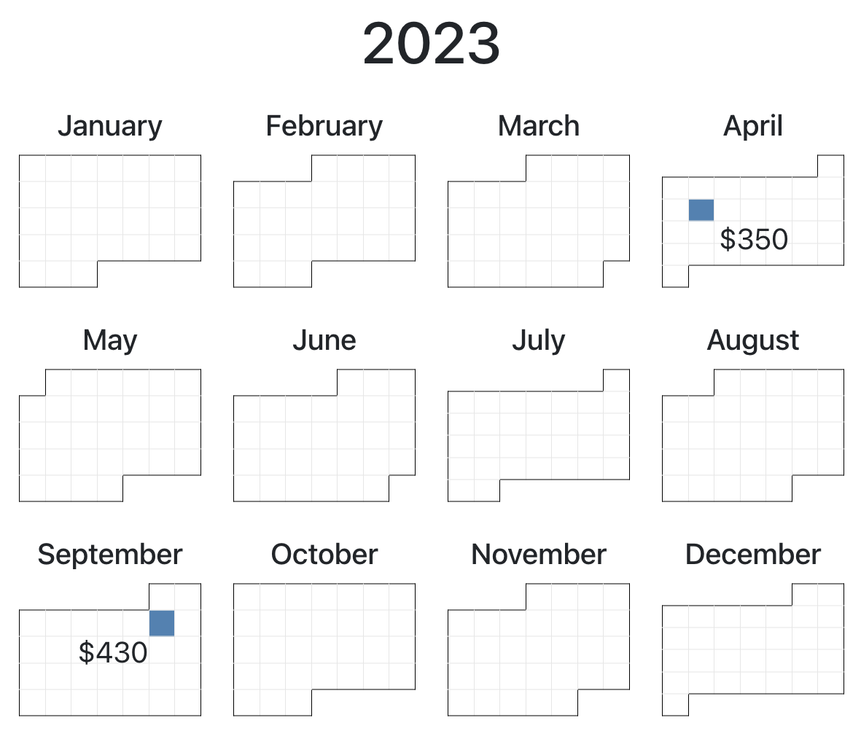
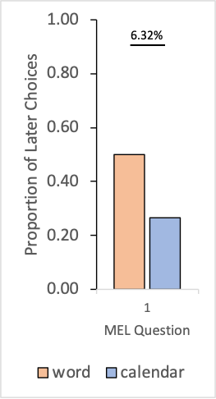
First MEL Question
.0632
Notes:
Almost sig diff
Flipped on optimal choice
Calendar emphasized how close the date apr 10th was to the study date apr 5th
Also, the diagonal is the farthest distance between two days on this format, it is a 5 month difference
The opposite diagnol would have been an 11 month difference

Slide 53
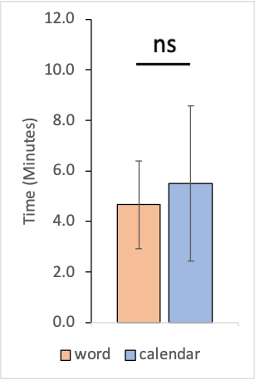
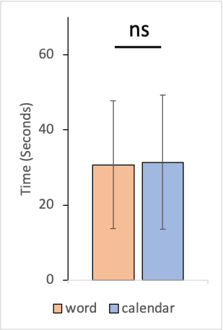
No General Difference In Time To Complete Survey
Entire Survey
MEL Question Section
Two-tailed, homoscedastic T-test
Notes:
On this graph
Average time taken between the two conditions
Orange bar on the Left is word
Blue bar on the Right is calendar
Using a two-tailed, homoscedastic t-test showed no significance between the conditions
This test was used since time is a continuous variable and we assumed a normal distribution

Slide 54
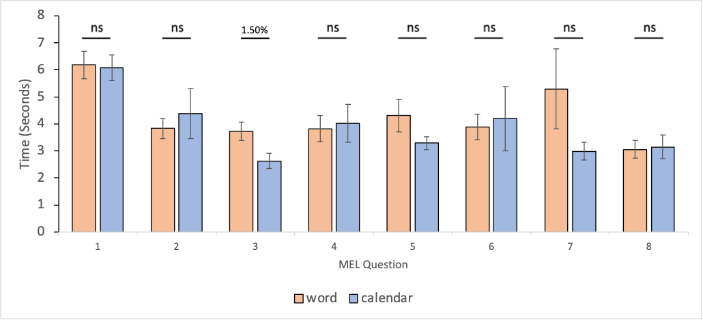
Third Question Showed A Difference In Time
.015
Two-tailed, homoscedastic T-test
Notes:
Same y axis as before, average time
one of the tests was significant
.015
Calendar condition was about a second faster
Lets look at this in context of the question and the discount results on the next slide

Slide 55
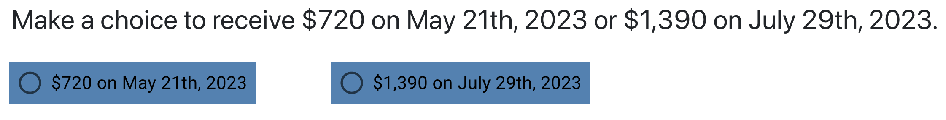
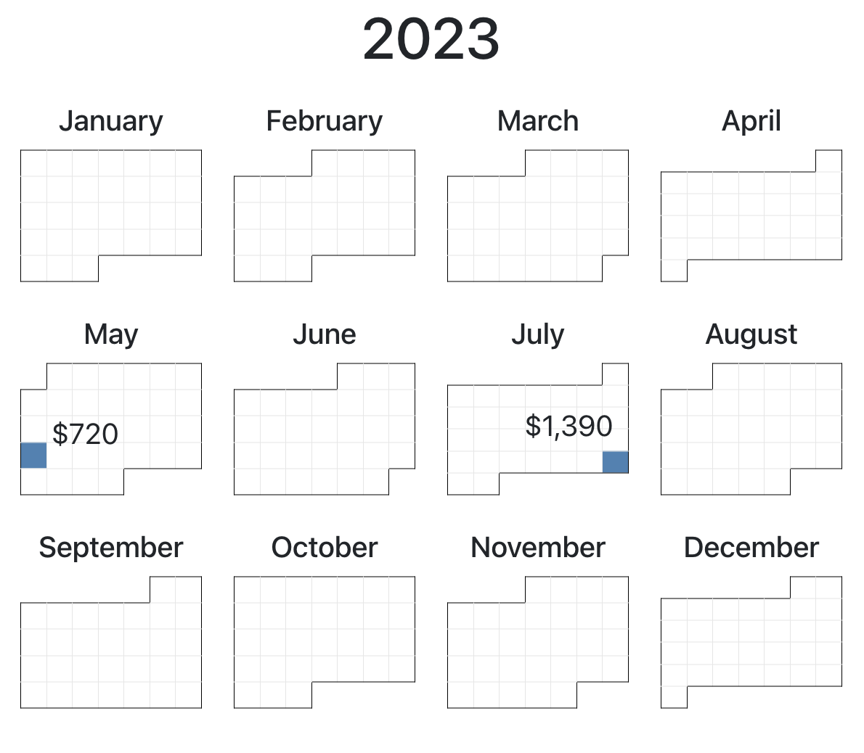
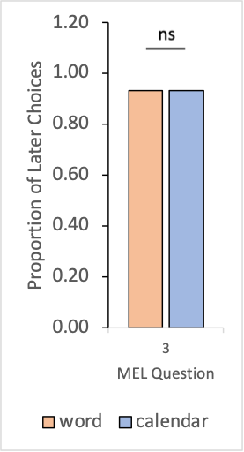
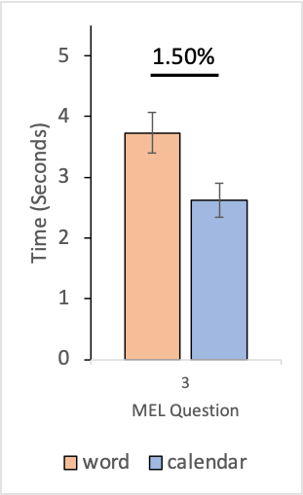
Third MEL Question
.015
Notes:
Both conditions answered on average the same, more later
Which is the more optimal choice
There wasn’t a sig diff in the choice
So why did the calendar cause this timing effect
Since they both picked the same question
Also it might be that given this pair of amounts and dates it was a much quicker decision on the calendar compared with other amounts and dates

Slide 56
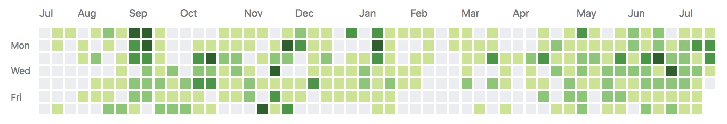
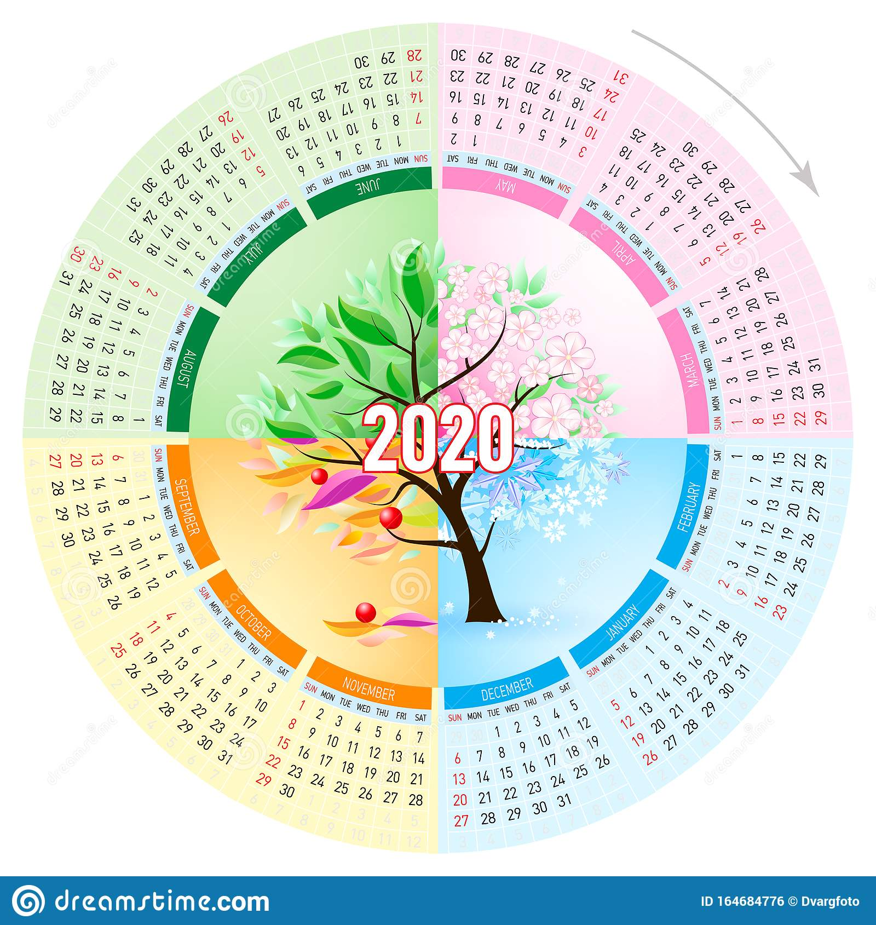
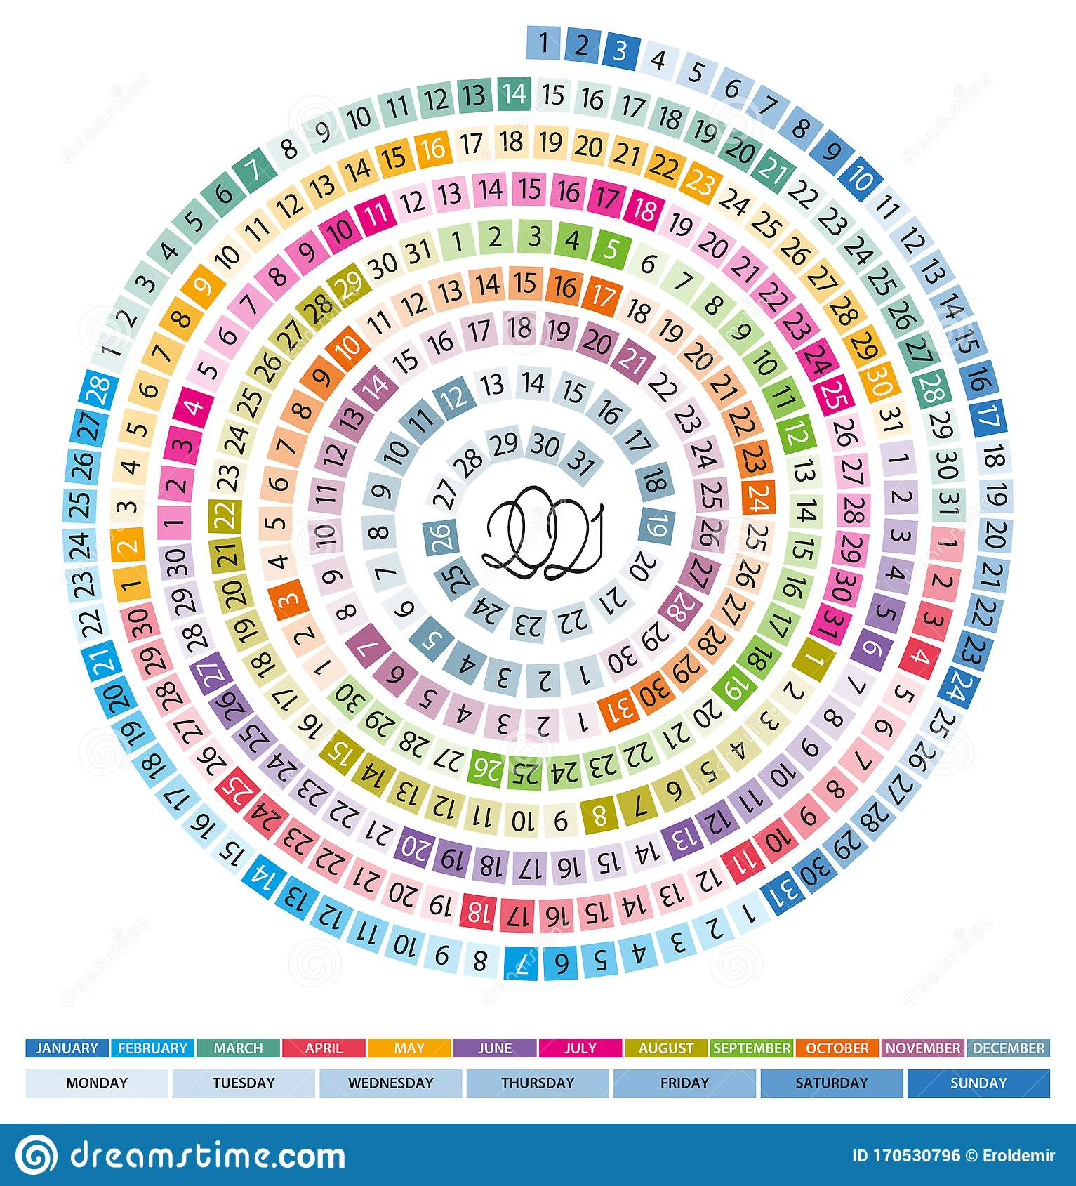
Future Work
Notes:
No general effect
Too familiar
Possibly try out unfamiliar calendar layouts
Github contribution
Radial calendars

Slide 57
Conclusions
Did not find a significant effect across general discounting or timing
We did find significant effects across 2 specific questions in regards to discounting and timing
Notes:
Sig effects
Probably due to how close the date was to the earlier date
Making earlier choice more attractive
Magnitude effect and dates being farther out
More obvious choice quicker

Slide 58
Thank You

Slide 59
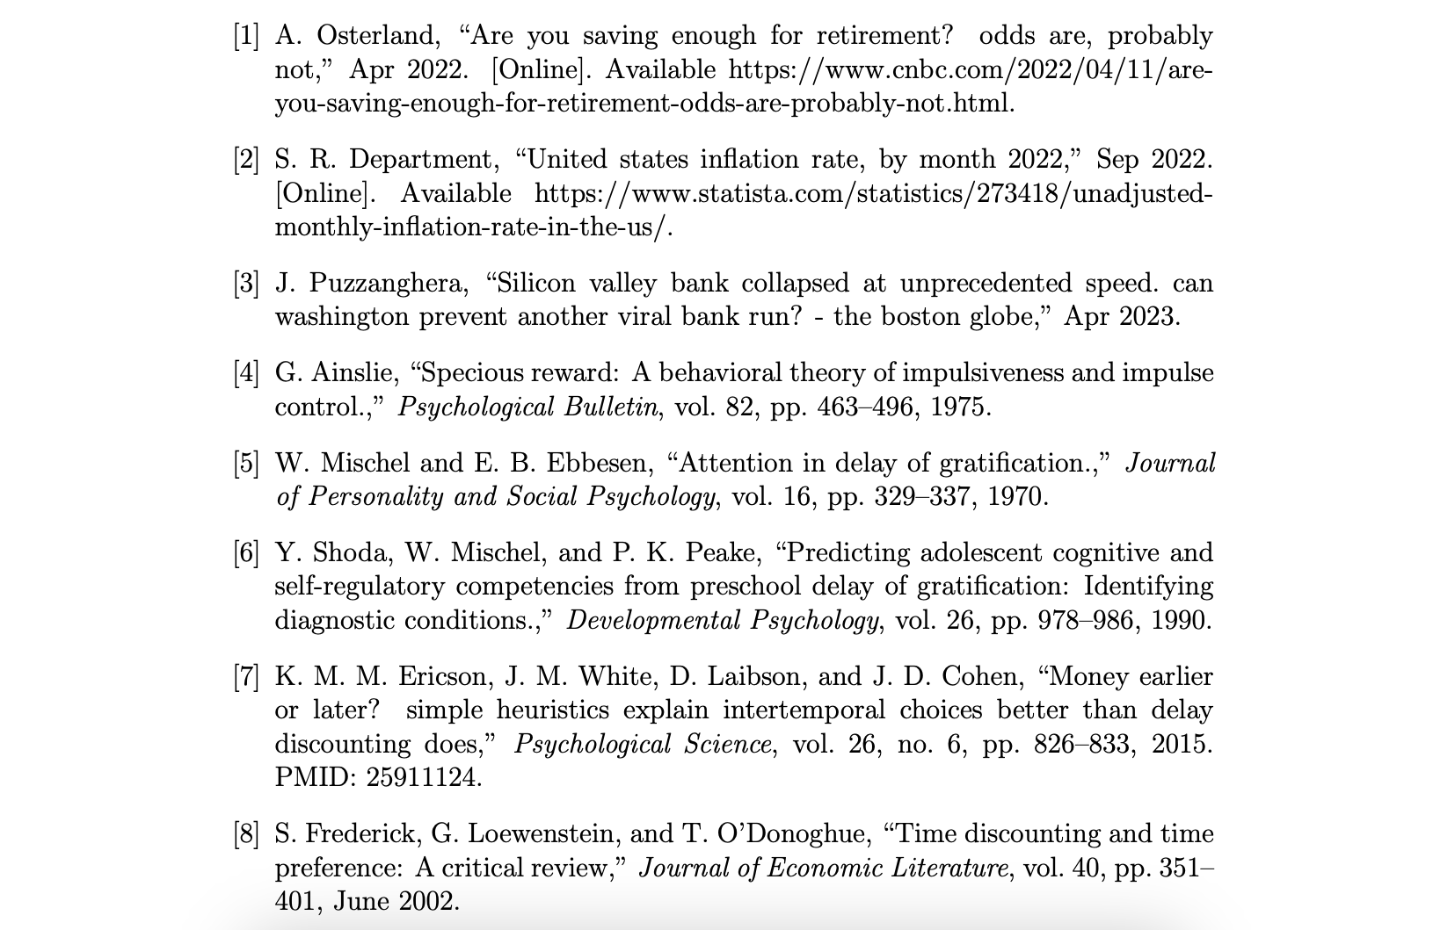
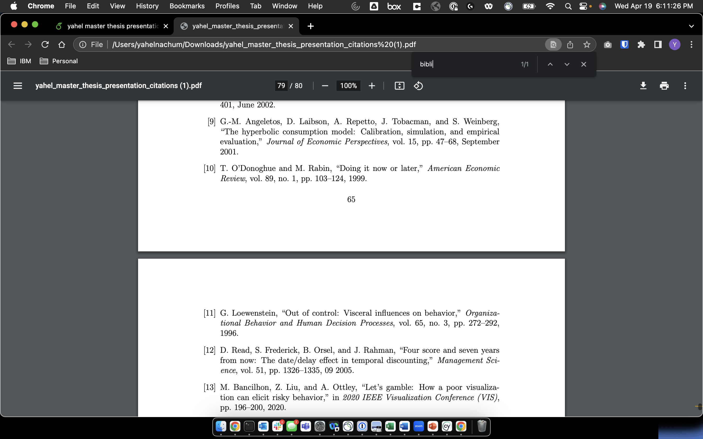
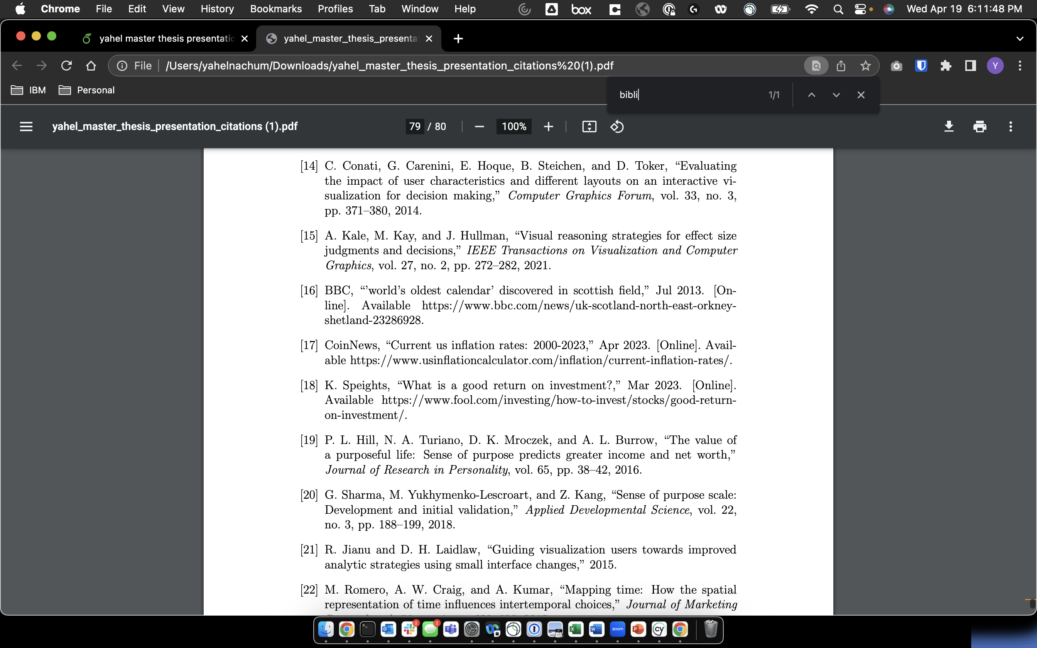
Citations

Slide 60
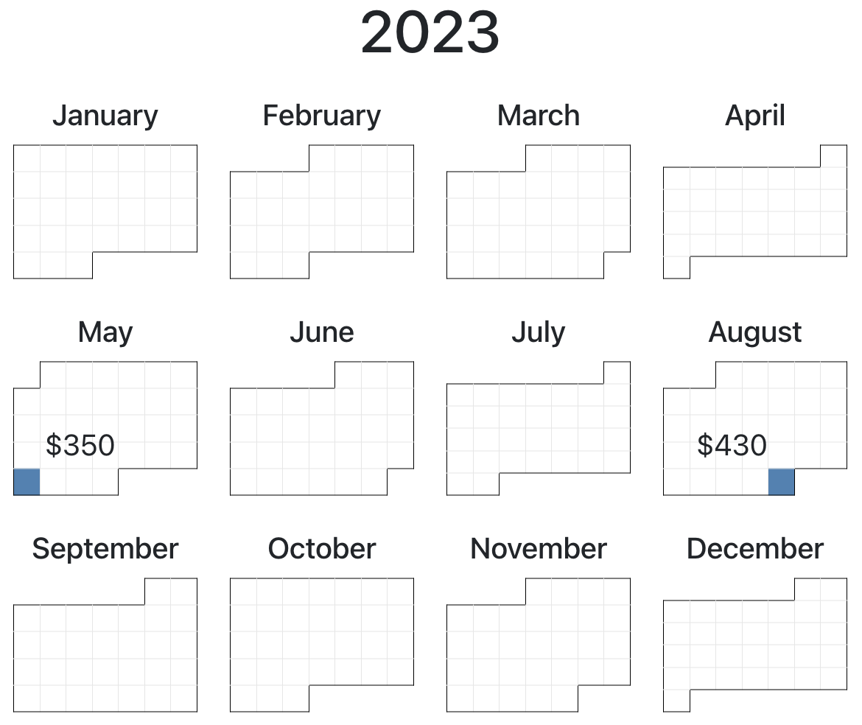
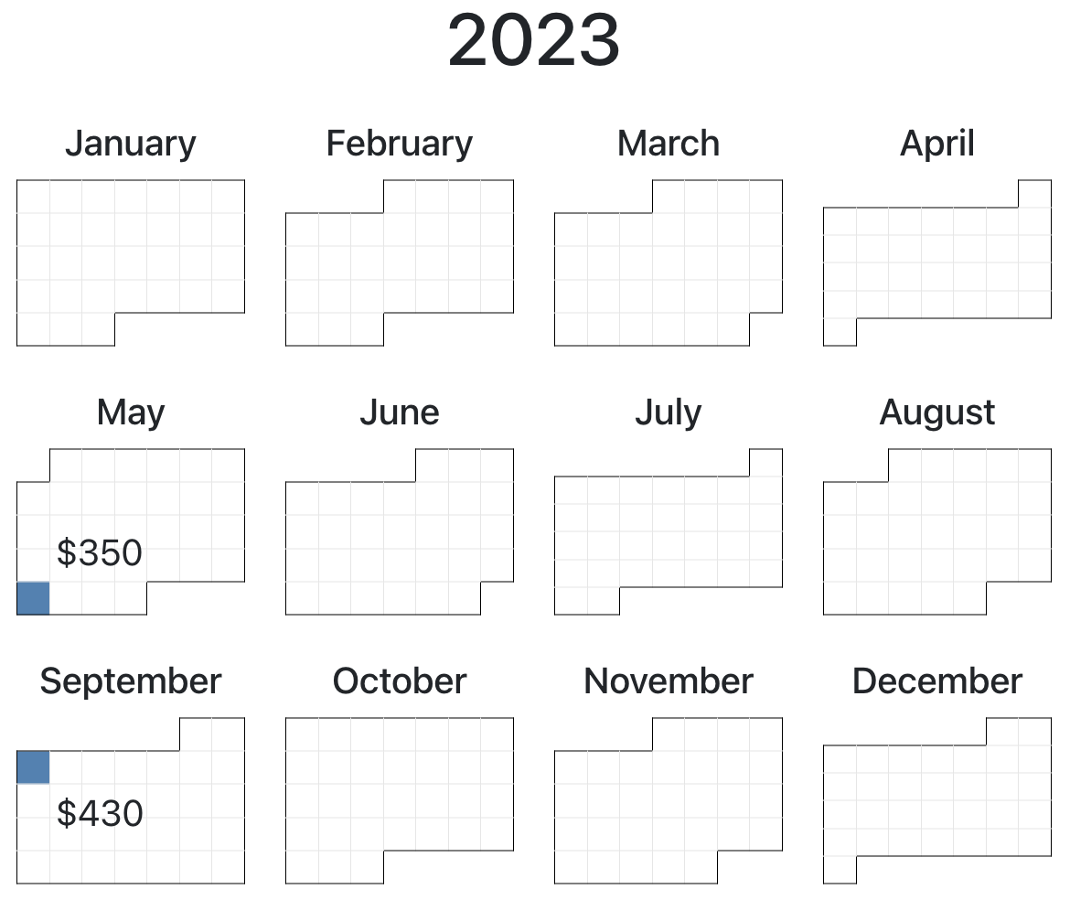
Future Work

Slide 61
Outline
Savings and the current economic state
Economics research
Visualizations research
Novelty and hypothesis
Experiments and design
Results
Discussion
Conclusion

Slide 62
Visualizations improve speed and quality of decision
Improve speed of decision as well as quality

Slide 63
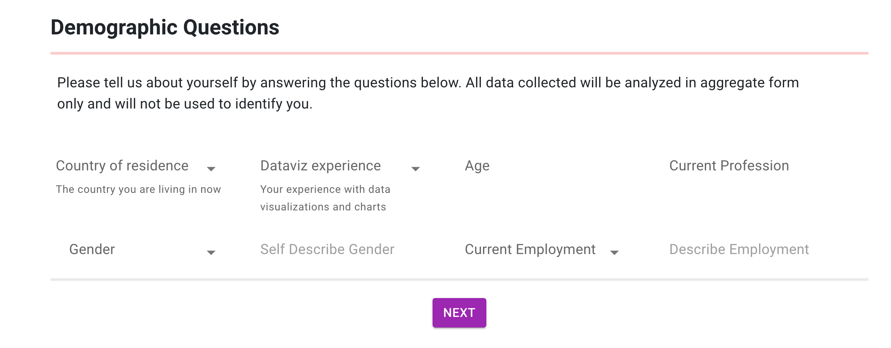
Methodology – Demographics
Age
Vis familiarity
Gender
occupation
employment

Slide 64
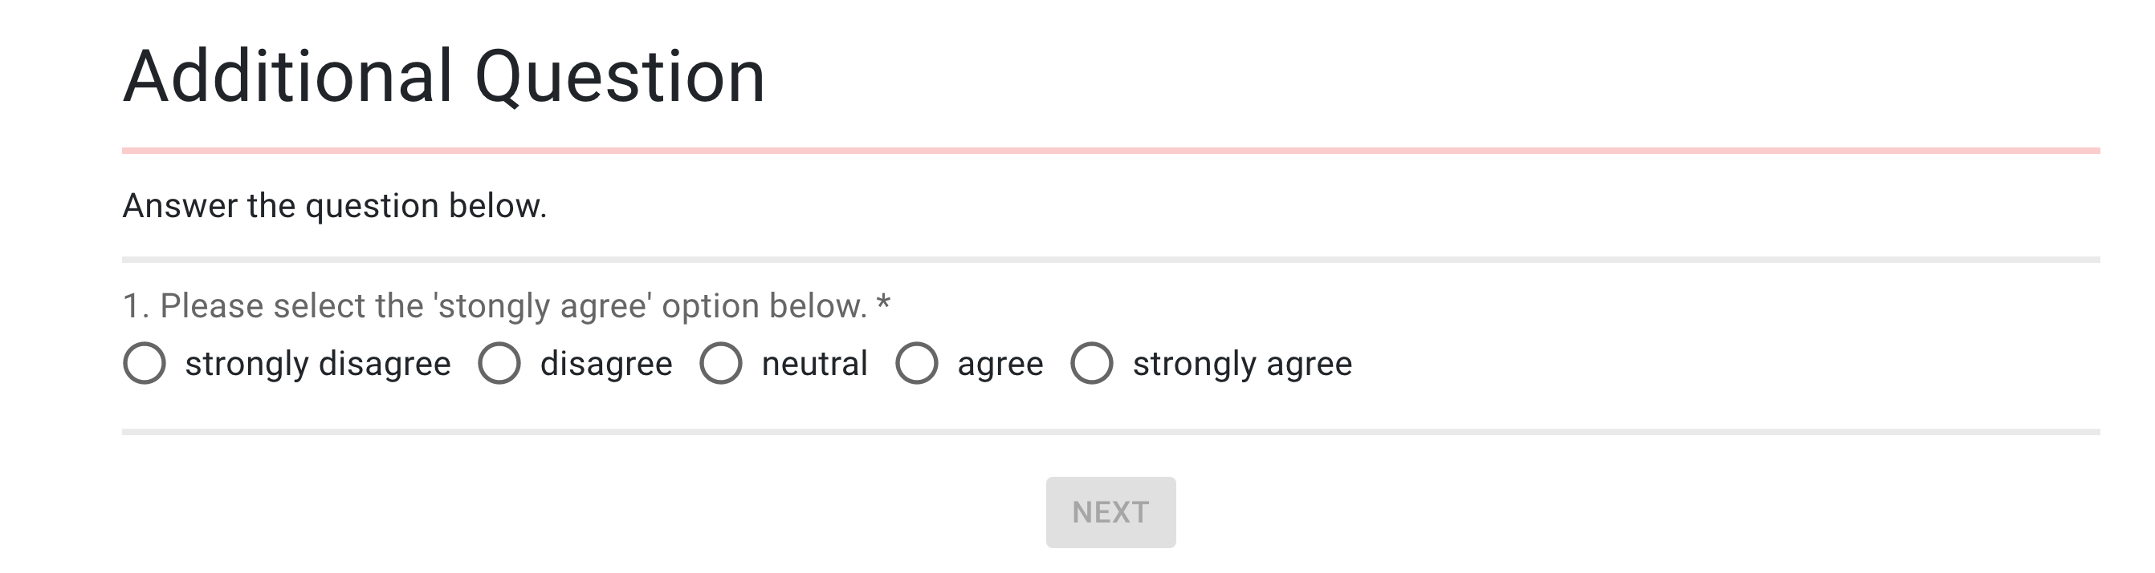
Methodology – Attention check
TODO

Slide 65
Descriptive Statistics
Similarity of population between conditions
  Post surveys
    Experience
    Sense of Purpose
    Financial Literacy
  Age
The more similar the more significant our results will be

Slide 66
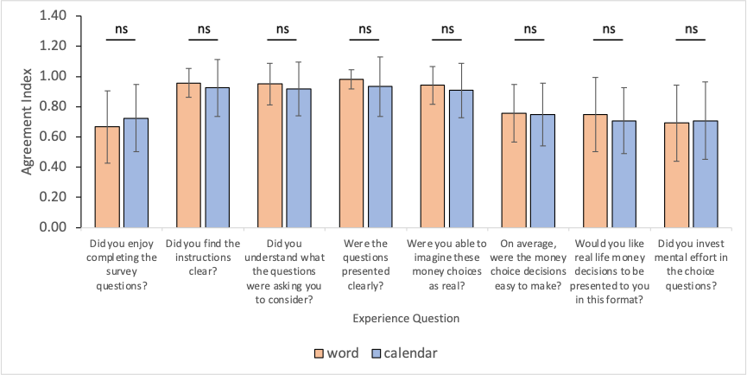
Descriptive Statistics – Post Survey - Experience
Two-tailed, homoscedastic T-test

Slide 67

Sense of Purpose
Two-tailed, homoscedastic T-test

Slide 68

Financial Literacy
Two-tailed, homoscedastic T-test

Slide 69

Visualization Familiarity
Two-tailed, homoscedastic T-test

Slide 70

Average Age Across Conditions
Two-tailed, homoscedastic T-test

Slide 71


Histogram of Ages
Word
Calendar

Slide 72

Example of Experience Survey Question

Slide 73

Example of Financial Literacy Survey Question

Slide 74

Example of Sense of Purpose Survey Question

Slide 75


Descriptive Statistics – Demographics – Gender

Slide 76


Descriptive Statistics – Demographics – Employment

