Slide 1
Combating Biofouling
Garrett Brogan, Nick Dalton, and Sean Fallon

Slide 2
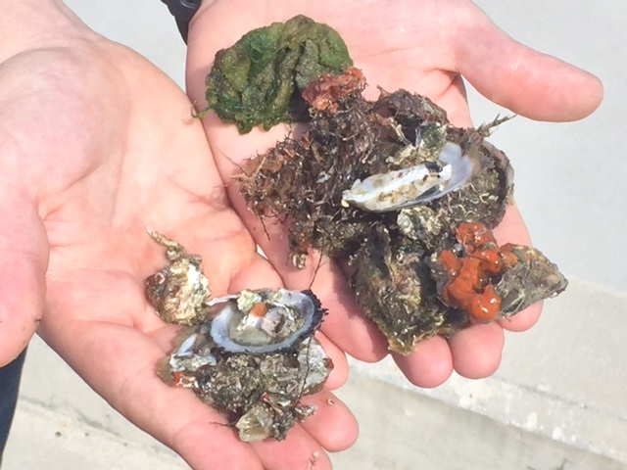
What is the Issue?
Biofouling is incredibly aggressive in
San Juan Bay
Sector San Juan cutters are budgeted for only one in-water cleaning a year
Biofouling over time will reduce a ship’s top speed and decrease its fuel efficiency

Slide 3
Video Overview

Slide 4
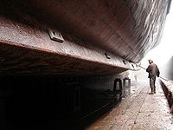
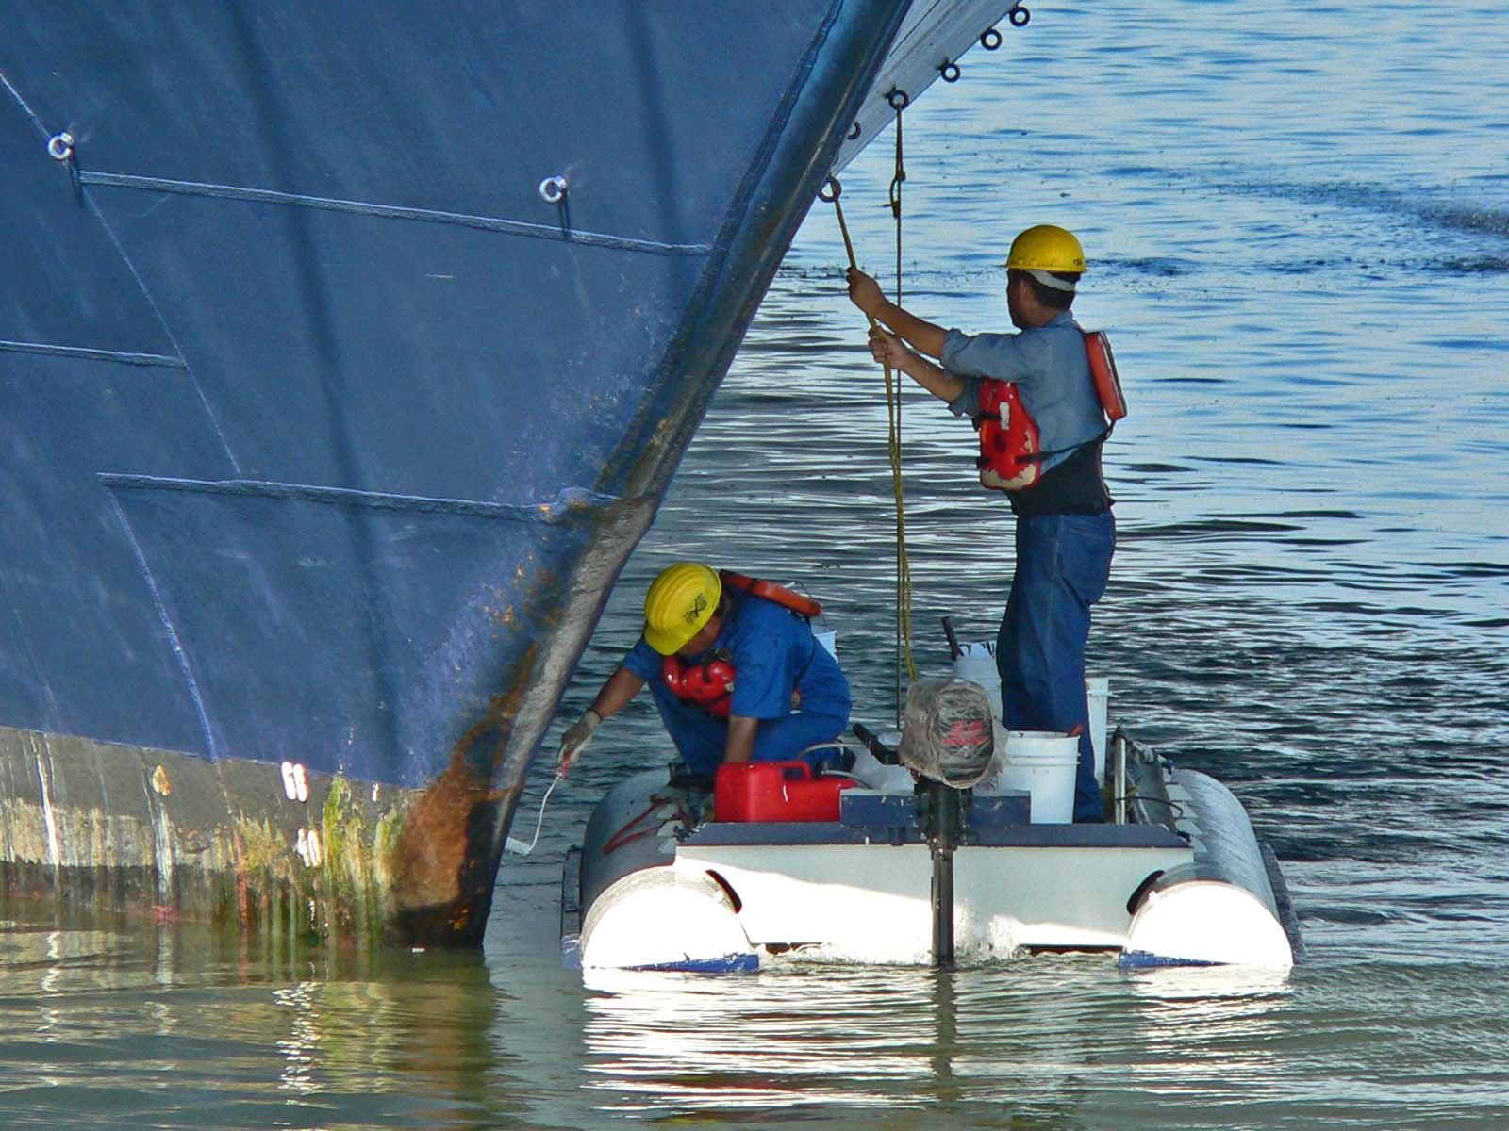
Our Approach
Early on, it was discovered that data needed to make quantitative and accurate conclusions was not available
Three Main Deliverables:
I
II
III
Data collection
and analysis protocol
Recommendations
for alternative
hull cleaning tools and techniques
Recommendations for alternative antifouling coatings
Source: https://upload.wikimedia.org/wikipedia/commons/d/d6/Dry_docking.8.JPG
Source: https://commons.wikimedia.org/wiki/File:Cleaning_the_hull_3.jpg
Notes:
Templar52 (Photographer). (2008, June 30). Dry docking [digital image]. Retrieved from https://upload.wikimedia.org/wikipedia/commons/d/d6/Dry_docking.8.JPG
Shebs, Stan (Photographer). (2005, November 3). Cleaning the Hull [digital image]. Retrieved from https://commons.wikimedia.org/wiki/File:Cleaning_the_hull_3.jpg

Slide 5
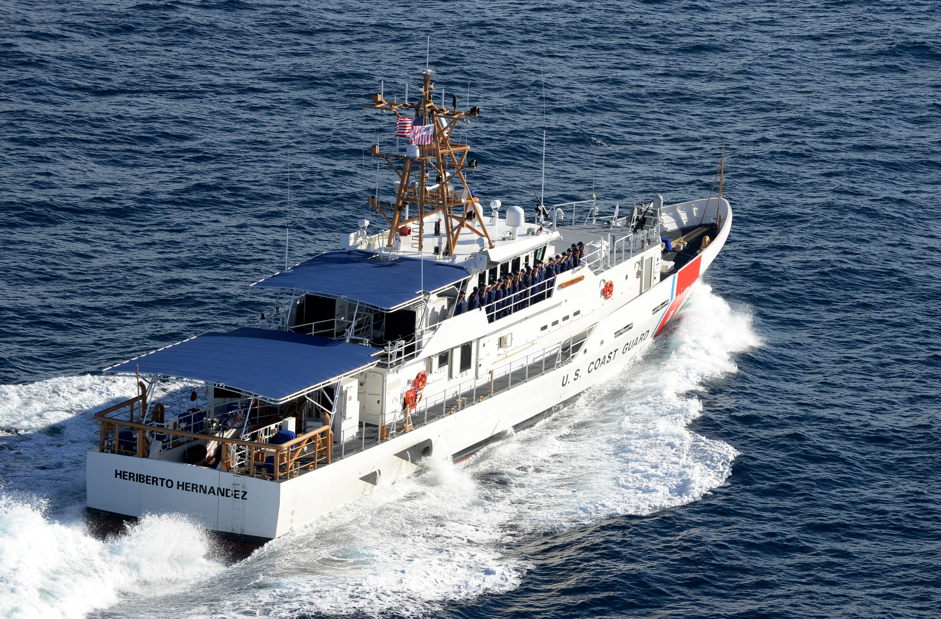
1st Deliverable: Data Protocol
Designed a protocol to collect and analyze the necessary data to illustrate the potential savings in fuel costs for an altered cleaning schedule
Data necessary:
Biofouling Accumulation
Speed and associated RPM
Fuel Burn
Distances Traveled
Gallons per hour
Source: www.dvidshub.net
Notes:
Barney, Mark. Cutter Heriberto Hernandez [Online Image]. (2015). Retrieved December 7, 2015 from www.dvidshub.net

Slide 6
Data: Biofouling Accumulation
Why:
To illustrate the nature of biofouling accumulation in sector San Juan
To base initial estimates for new cleaning schedule off of
How:
Use an underwater video camera with extension pole to record the hull fouling
This will occur every time a ship returns to base and before it goes underway
Analyze the video using a visual fouling guide and input fouling data into the fouling form

Slide 7
~ 4 ft
10 ft
2 ft
Cutter
Hull
4 ft
6 ft
Underwater Camera Setup Dimensions

Slide 8
Analysis: Biofouling Accumulation

Slide 9
Example Biofouling Accumulation
Data collected via analysis of underwater hull footage
(Data in the chart is self generated)

Slide 10
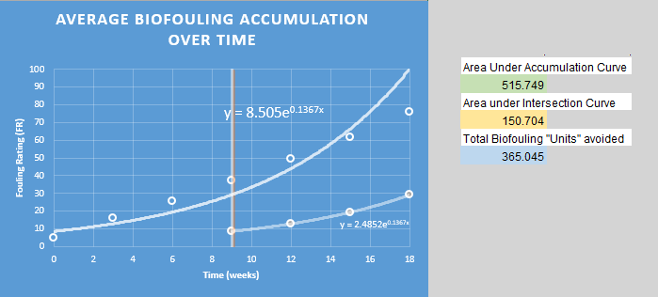
Example Biofouling Accumulation
How biofouling accelerates
(Self-Generated Data)

Slide 11
Data: Fuel Burn and Distances Traveled
Why:
Necessary to calculate cost savings from altered cleaning schedule
How:
Fuel burn data from round sheets
Distances from Log-Weather Observation and Operational Summary Sheet

Slide 12
Analysis: Fuel Burn and Distances Traveled

Slide 13
Example Fuel Efficiency Loss
Date (Week) | Self Generated Fuel Burn Data
 | Fuel Burn (gal) | Distance Travelled (NM) | NM/Gallons | Gallons/Nautical Mile
1/7 | 148.6 | 81.48 | 0.548317631 | 1.823760432
2/7 | 148.6 | 81.2331 | 0.546656124 | 1.829303572
3/7 | 148.6 | 80.9862 | 0.544994616 | 1.834880511
4/7 | 148.6 | 80.7393 | 0.543333109 | 1.840491557
5/7 | 148.6 | 80.4924 | 0.541671602 | 1.846137027
6/7 | 148.6 | 80.2455 | 0.540010094 | 1.851817236
1 | 148.6 | 79.9986 | 0.538348587 | 1.857532507
1 1/7 | 148.6 | 79.7517 | 0.536687079 | 1.863283165
1 2/7 | 148.6 | 79.5048 | 0.535025572 | 1.86906954
1 3/7 | 148.6 | 79.2579 | 0.533364065 | 1.874891967
1 4/7 | 148.6 | 79.011 | 0.531702557 | 1.880750782
1 5/7 | 148.6 | 78.7641 | 0.53004105 | 1.886646327
1 6/7 | 148.6 | 78.5172 | 0.528379542 | 1.892578951
2 | 148.6 | 78.2703 | 0.526718035 | 1.898549003
2 1/7 | 148.6 | 78.0234 | 0.525056528 | 1.904556838
2 2/7 | 148.6 | 77.7765 | 0.52339502 | 1.910602817
2 3/7 | 148.6 | 77.5296 | 0.521733513 | 1.916687304
2 4/7 | 148.6 | 77.2827 | 0.520072005 | 1.922810668
2 5/7 | 148.6 | 77.0358 | 0.518410498 | 1.928973283
2 6/7 | 148.6 | 76.7889 | 0.516748991 | 1.935175527
3 | 148.6 | 76.542 | 0.515087483 | 1.941417784
Data continues on to 18 weeks

Slide 14
Example Fuel Efficiency Loss
Doubling Cleaning Frequency
Tripling Cleaning Frequency

Slide 15
2nd Deliverable: Antifouling Recommendations
Two Types of Antifouling coatings:
Non-Biocidal
Creates a low friction surface so fouling may be removed easily
Biocidal
Releases chemicals to prevent biofouling
Most common biocidal paint is an ablative
Ablative paints work by “wearing away” while in the water and are typically much softer than most other coatings

Slide 16
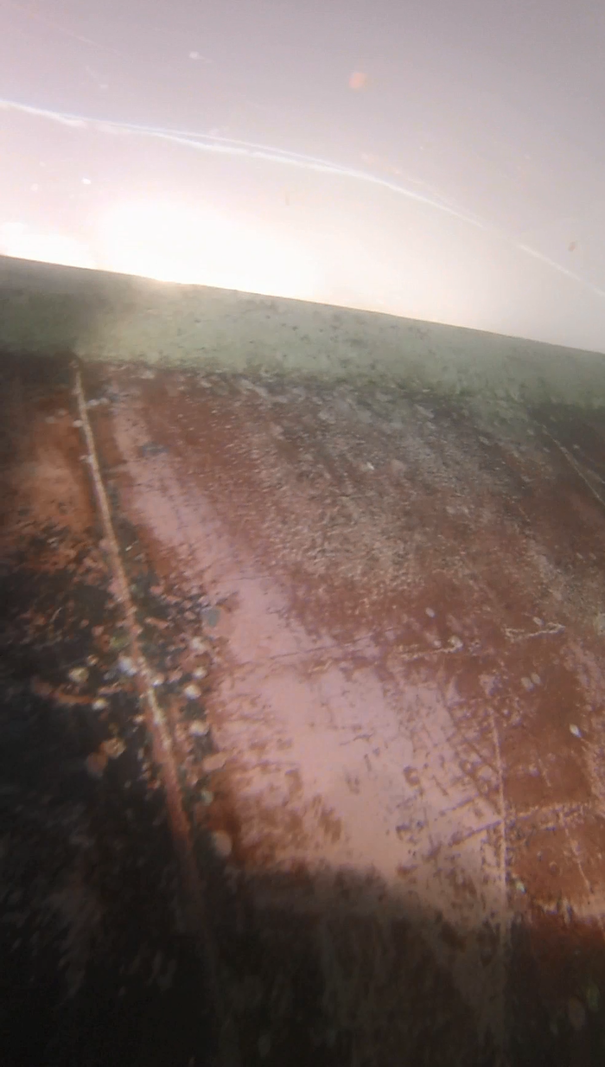
Current Vessel Coating
Cutters employ International Interspeed BRA 640
Copper ablative
COs and contract divers state the paint is soft
Paint is worn away after cleanings
Reduces effectiveness
Prevents coating from fully succeeding
Screenshot from a Sector San Juan Cleaning
Provided by USCG Sector San Juan
Notes:
Screenshot from USCGC Reef Shark Hull Cleaning. [Video Image]. (2015).

Slide 17
Time For a Change
Navy is halting use of copper based products
Will also work better with more frequent cleanings
Harder paint of a different type
Due to this, we believe a Fouling Release may be more suitable

Slide 18
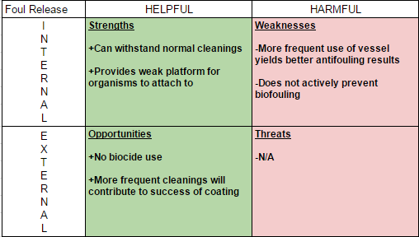
SWOT Analysis

Slide 19
Antifouling “Playbook”
Following this suggestion, we have found the following coatings to be good candidates:
Once an effective cleaning interval has been determined, we believe these coatings may offer a better defense against biofouling
SigmaGlide 1290
International 700
International 900

Slide 20
3rd Deliverable: Cleaning Techniques
Employed a three part methodology in our study of different hull cleaning techniques
1) Learned the current techniques used by Coast Guard contractors
2) Consulted scientific literature
3) Drew conclusions that will make cleanings more efficient

Slide 21
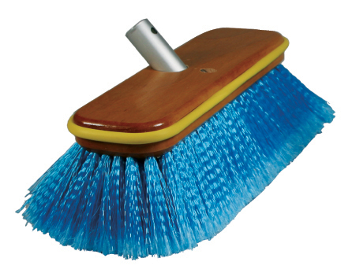
Summary: Implement Groomings to Cleanings
Groomings are light cleanings, using soft bristled brushes and materials with lower coefficients of frictions
Nylon-bristled brushes
Circular brushing methods
Once the macrofouling is removed,
applying groomings to the hull will
remove microfouling
This reduces the environment
for the macrofouling to grow,
optimizing cleanings and lengthening
the time between cleanings
Source: www.biokleen.com
Notes:
[Biokleen Boat Brush]. Retrieved December 7, 2015 from www.biokleen.com

Slide 22
Future Possibilities
Scientific literature has suggested the possibility of autonomous hull cleaning tools
Still in the trial stages, but could revolutionize the way in which hulls are cleaned
Howell Ultrasonic Transducer

Slide 23
Summary
Save Sector San Juan money lost due to fuel inefficiencies
Develop a protocol to produce cleaning schedules
Propose alternative Antifouling Technologies
Propose new hull cleaning tools and techniques
Determine data that needs to be collected
Research
Antifouling
on the market
Compare Antifouling with SWOT Analysis
Analyze current
hull cleaning procedure
Research hull cleaning techniques
Analyze current data collected

Slide 24
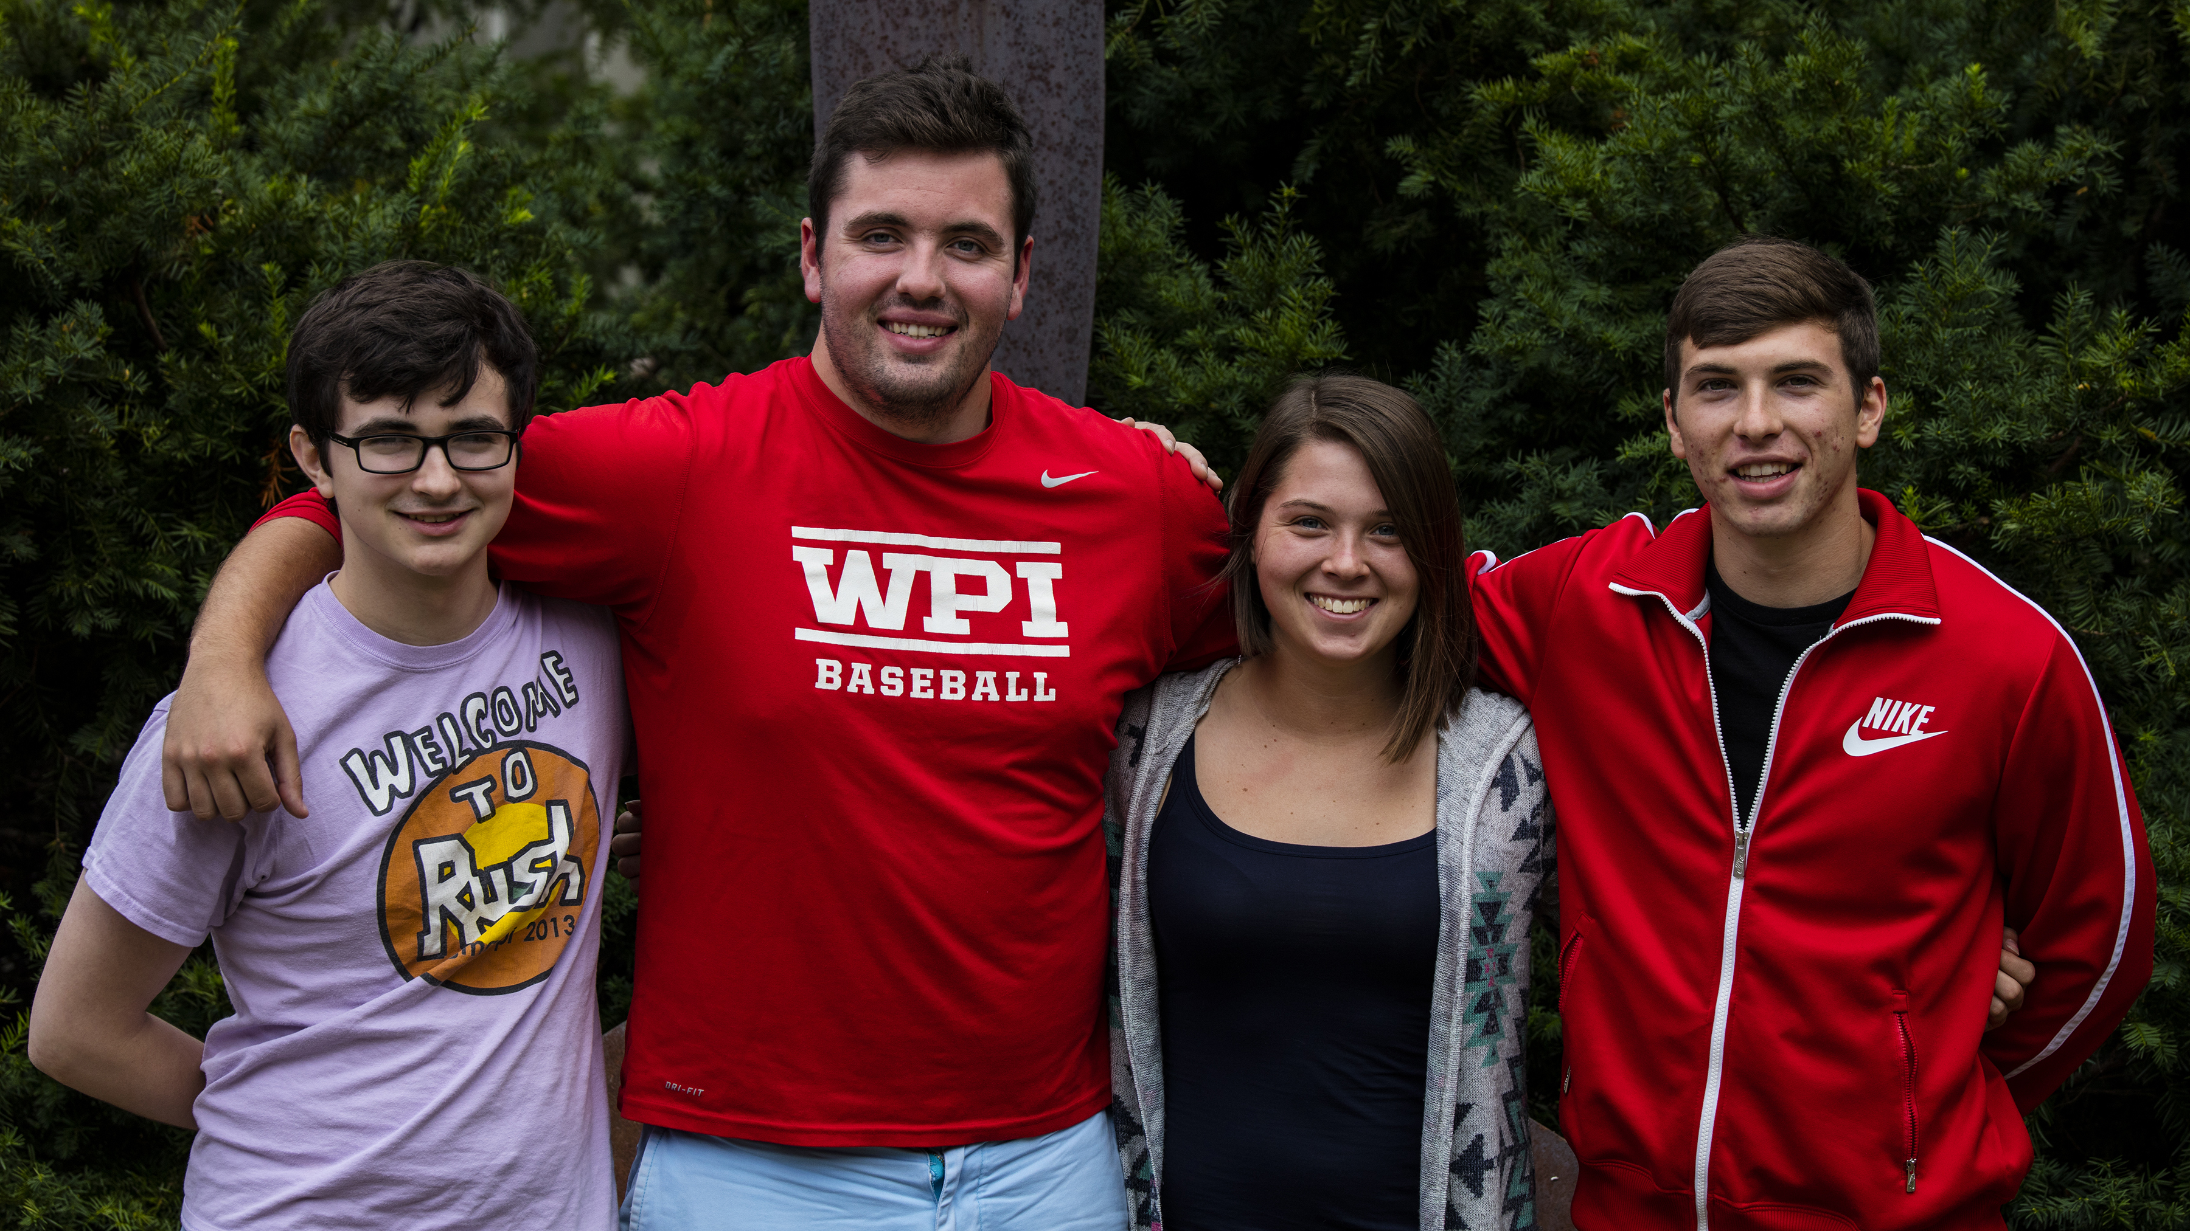
Thank you for your time!

Slide 25
References
Barney, Mark. Cutter Heriberto Hernandez [Online Image]. (2015). Retrieved December 7, 2015 from www.dvidshub.net
[Biokleen Boat Brush]. Retrieved December 7, 2015 from www.biokleen.com
Screenshot from USCGC Reef Shark Hull Cleaning. [Video Image]. (2015).
Shebs, Stan (Photographer). (2005, November 3). Cleaning the Hull [digital image]. Retrieved from https://commons.wikimedia.org/wiki/File:Cleaning_the_hull_3.jpg
Templar52 (Photographer). (2008, June 30). Dry docking [digital image]. Retrieved from https://upload.wikimedia.org/wikipedia/commons/d/d6/Dry_docking.8.JPG

