Slide 1
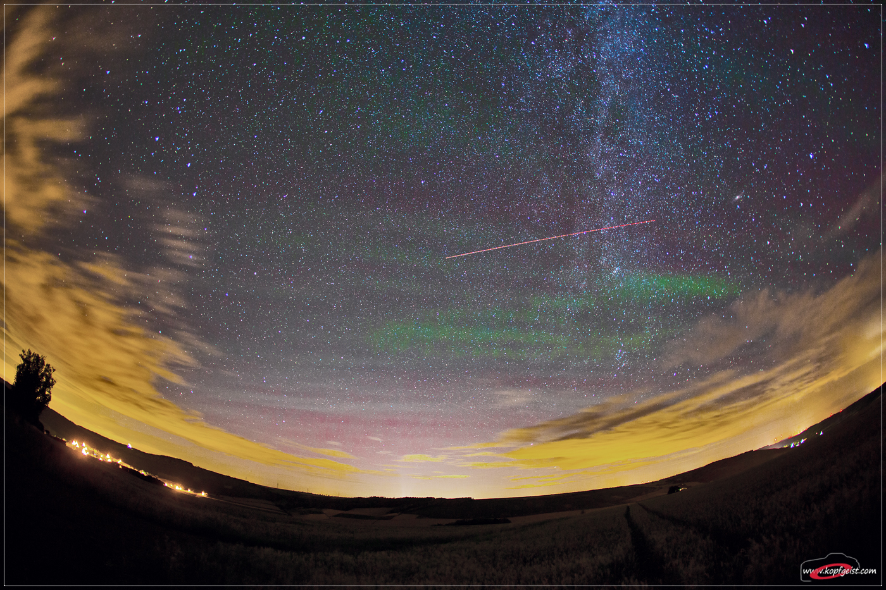
Mid-latitude All-sky-imager Network for Geophysical Observation 2
Presented by:
Danielle Riccardi &
Luis Vinke
04/23/2015
Notes:
Image: http://apod.nasa.gov/apod/image/1209/airglow_hackmann_1400.jpg
Luis

Slide 2
MISSION STATEMENT AND SPONSORS
GOAL 1: Display a mosaic of
images on a map.
GOAL 2: Analyze and identify
ionospheric wave
features from images.
Notes:
Images:
WPI: https://www.wpi.edu/Images/CMS/Marketing/WPI_Inst_Prim_FulClr.png
SRI: http://www.iri.upc.edu/people/jsola/JoanSola/fitxers/sri_logo.gif
Goal 1: Display a mosaic of images on a map
Goal 2: Analyze and identify ionospheric wave features from images
Luis

Slide 3
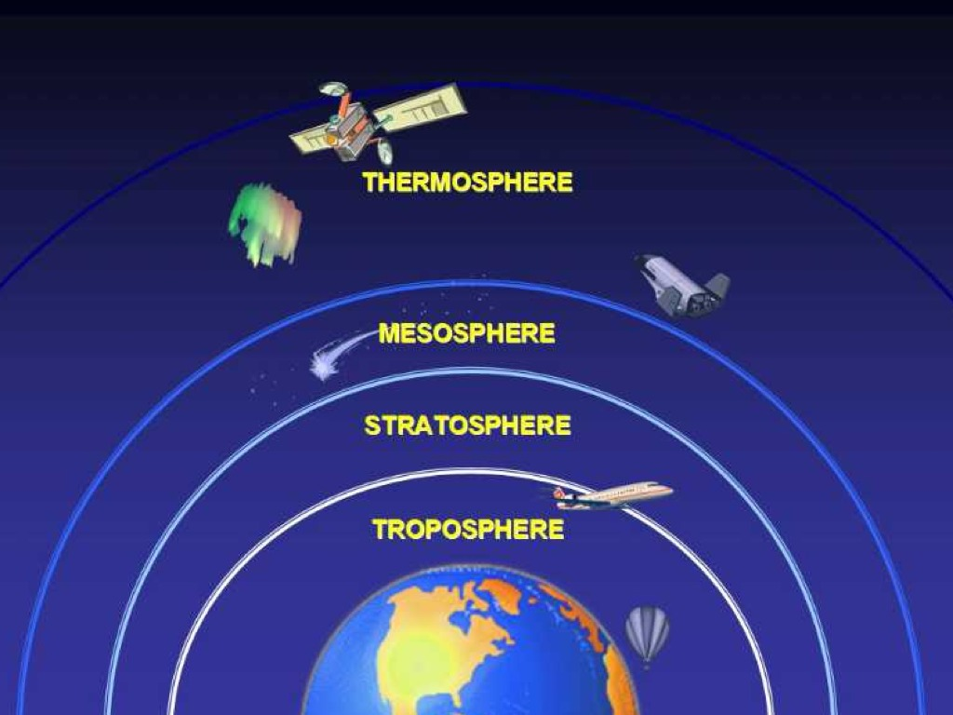
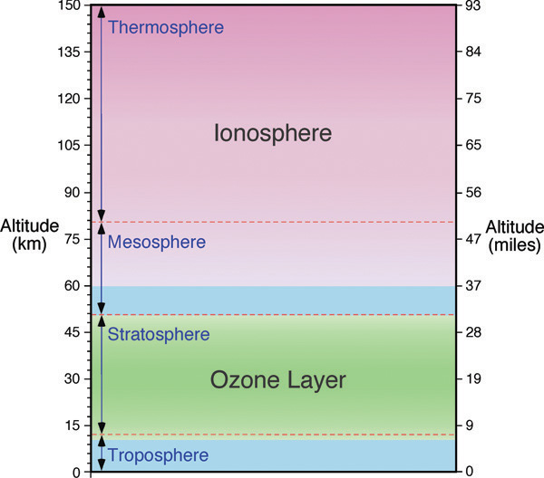
EARTH’S ATMOSPHERE
EXOSPHERE
Notes:
Space Image: http://media.showmeapp.com/files/103696/pictures/thumbs/250914/last_thumb1341934762.jpg
Layers Image: http://static.trunity.net/files/155501_155600/155561/atmslayers_ions.jpg
Danielle

Slide 4
IONOSPHERIC WAVES
Notes:
Ionospheric Waves are atmospheric manifestations of gravity waves.
Image: http://ericparrott.com/wp-content/uploads/2010/09/Pondripples.jpg
Danielle

Slide 5
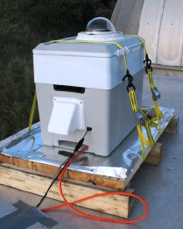
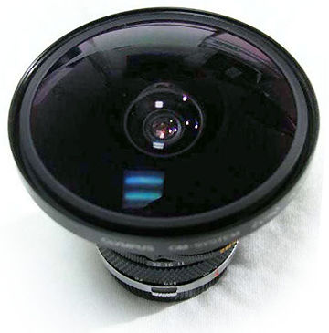
ATMOSPHERIC IMAGING: PRINCIPLES
Vs.
Sky-Imager
Fisheye Lens
Result
Notes:
Luis

Slide 6
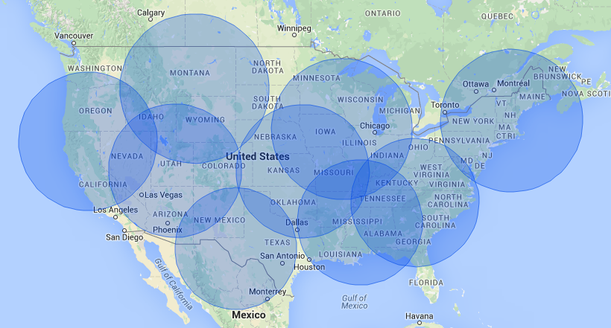
SRI’s ALL-SKY IMAGING NETWORK
Notes:
Luis

Slide 7
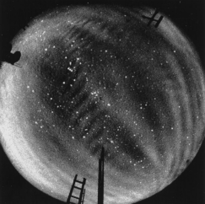
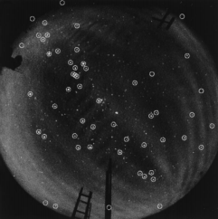
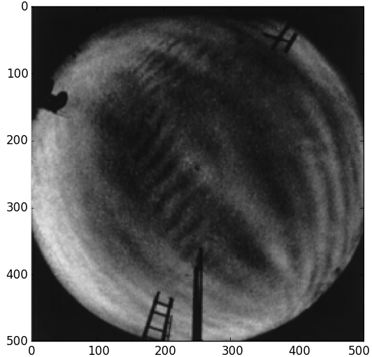
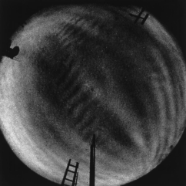
REQUIRED IMAGE PROCESSING
Original
Star Detection
Uniformly Spaced Grid
Star Removal
Notes:
Luis

Slide 8
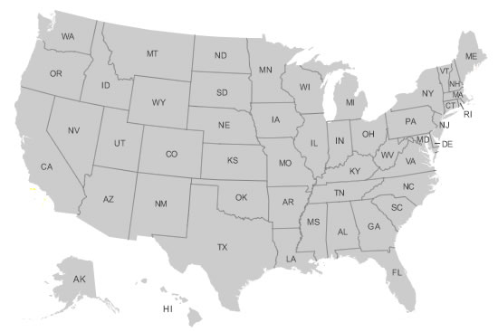
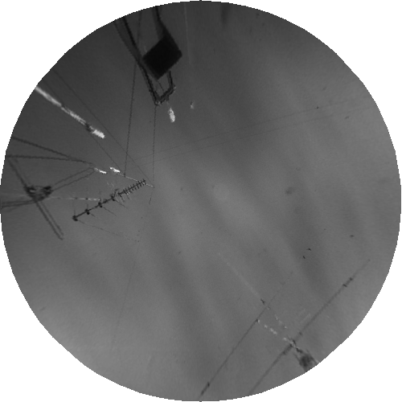
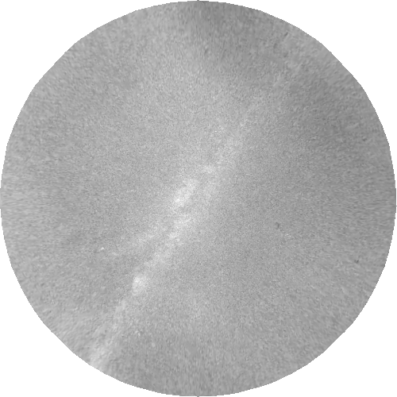
MAIN OBJECTIVES – GOAL 1
Continental US
Geographical Map
Display mosaic
on map
Image Overlapping
Notes:
Image:
Aurora: http://abrokenlaptop.files.wordpress.com/2013/04/aurora-borealis-manitoba-canada.jpg
Danielle

Slide 9
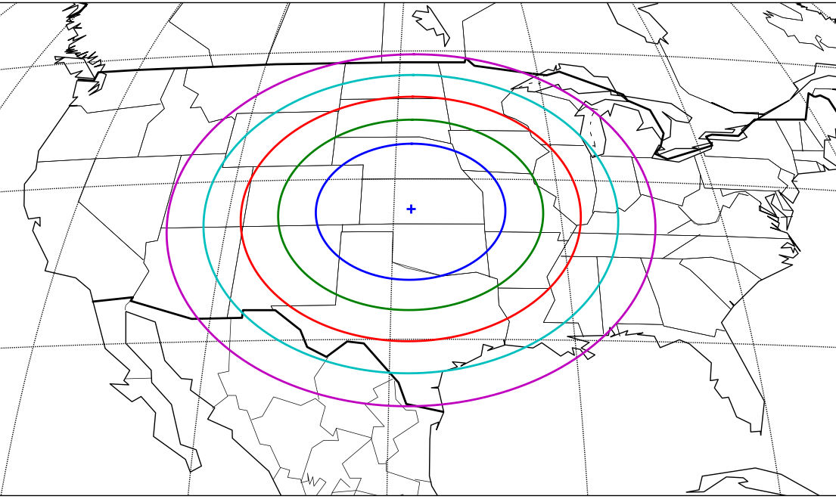
GEOGRAPHICAL MAP PROJECTIONS
Gall Stereographic Projection
Geostationary Projection
Notes:
Left – Albers Equal Area
http://matplotlib.org/basemap/users/aea.html
Center – Lambert Conformal
http://matplotlib.org/basemap/users/lcc.html
Right – North Polar Stereographical Projection
http://matplotlib.org/basemap/users/pstere.html
Danielle

Slide 10
STEP 1: CREATE MAP PROJECTION USING PYTHON
Lambert Conformal Conic Projection
Notes:
Danielle

Slide 11
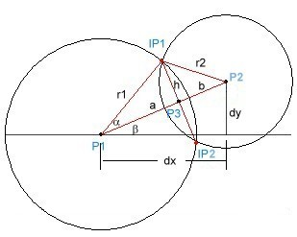
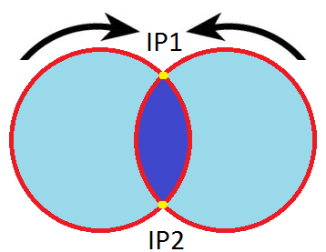
STEP 2: CALCULATE INTERSECTION POINTS
Approach 2:
Matching
Coordinates
Approach 1: Geometrically
Notes:
Finkel’s comments: “done geometrically” “matched coordinates”
Luis

Slide 12
STEP 2: CALCULATE INTERSECTION POINTS
Result: Intersection Points
Notes:
Luis

Slide 13
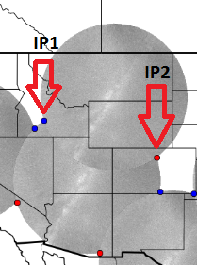
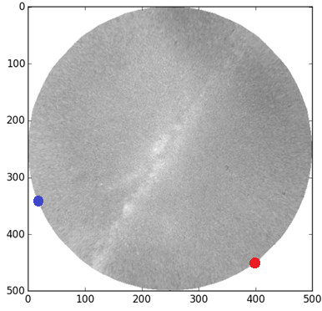
STEP 3: CONVERT IPs TO PIXEL COORDINATES
Map Coordinates
Pixel Coordinates
IP1 = [1691743.973, 2404715.008]
IP2 = [3034931.511, 2062597.157]
[12, 328]
[395, 453]
Luis
Notes:
Luis

Slide 14
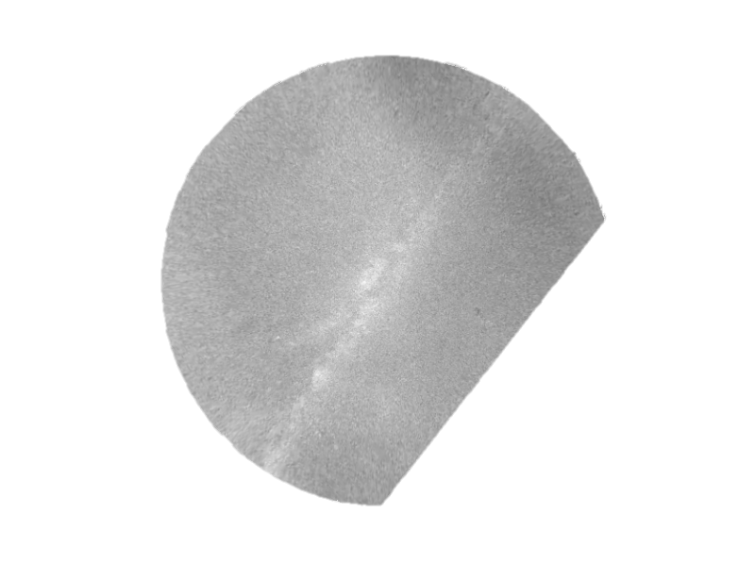
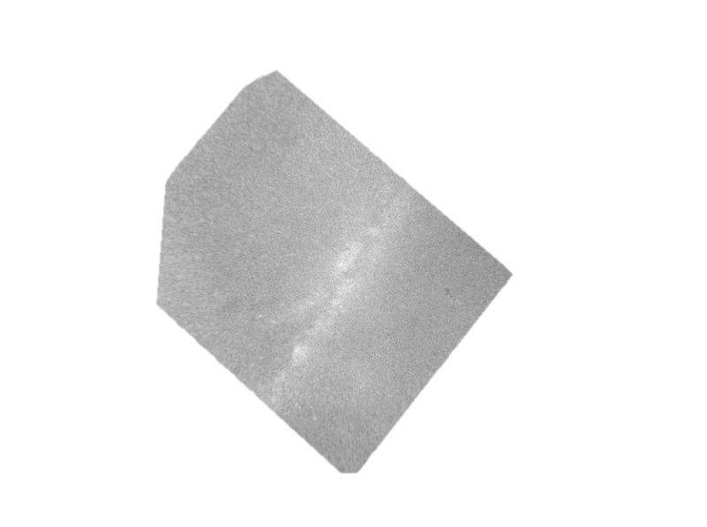
STEP 4: CREATE MASKS
Notes:
Danielle

Slide 15
STEP 5: DISPLAY MOSAIC
Notes:
Danielle

Slide 16
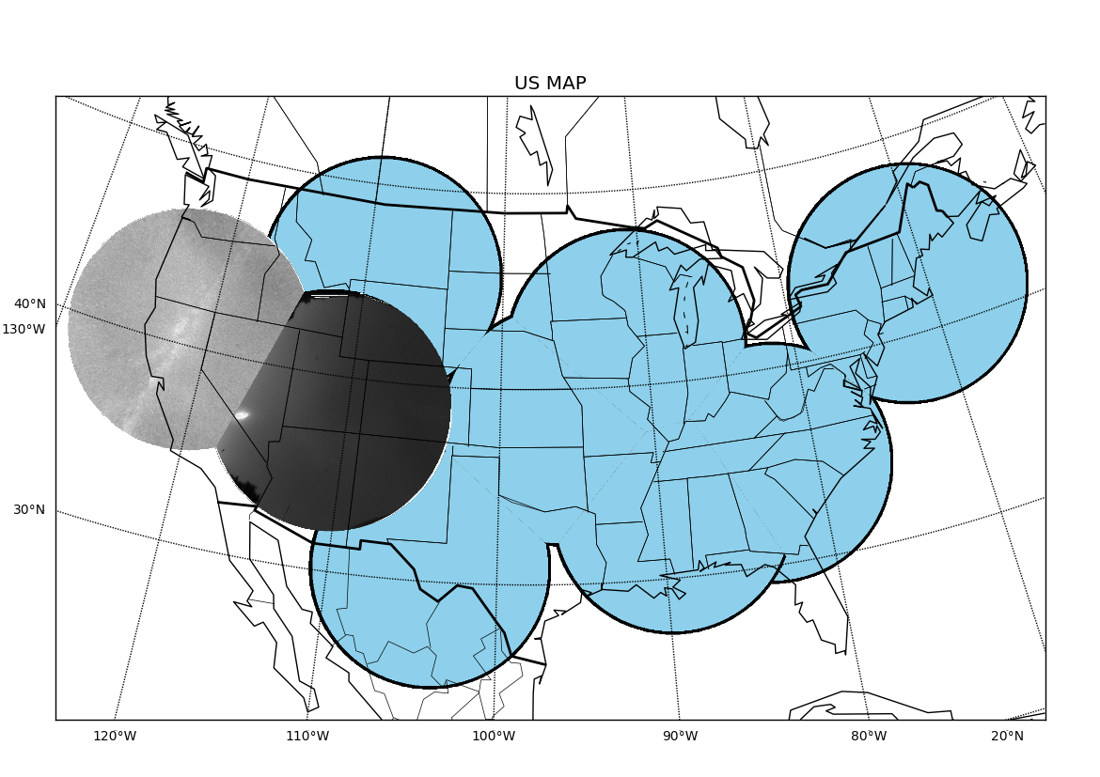
STEP 5: DISPLAY MOSAIC
Notes:
Danielle

Slide 17
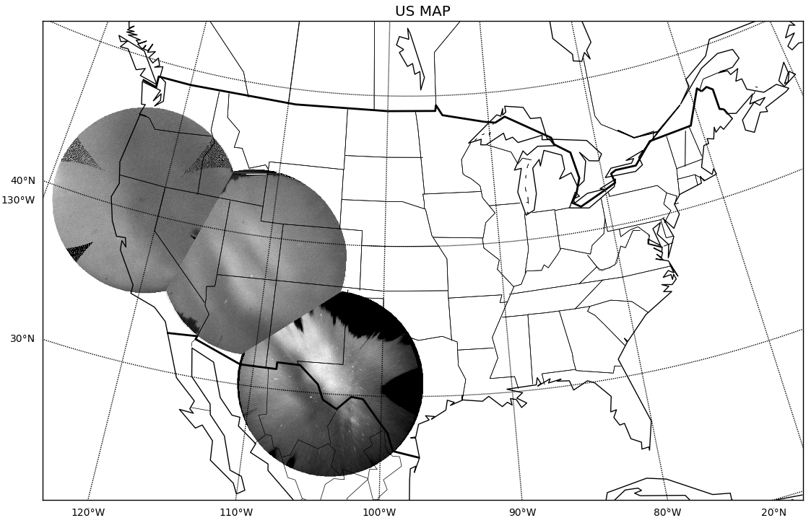
STEP 5: DISPLAY MOSAIC

Slide 18
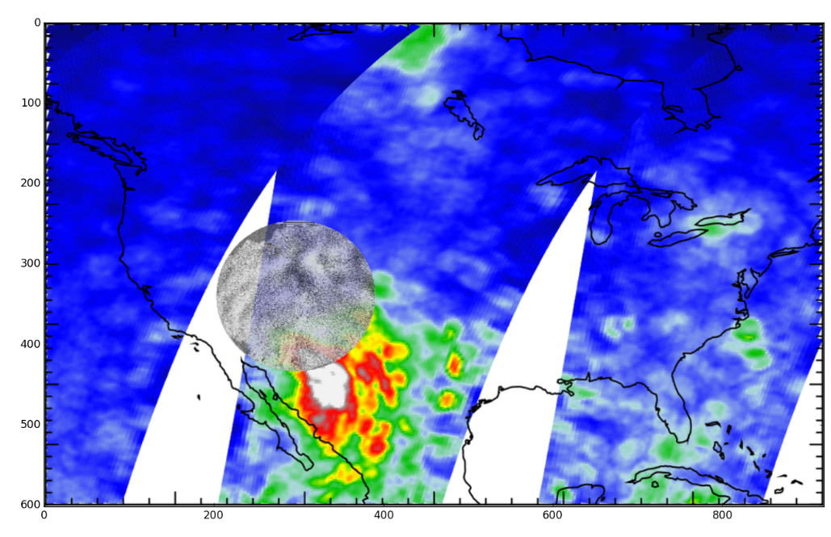
STEP 5: DISPLAY MOSAIC
Notes:
Finkel’s comment here: ‘Tell us more on the other data” NASA AIRS
Parameters
Map on background
Transparent Background
Transparent Images
Labels
Title
Danielle

Slide 19
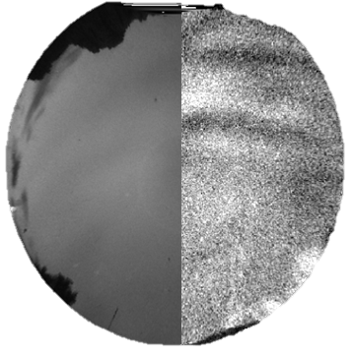
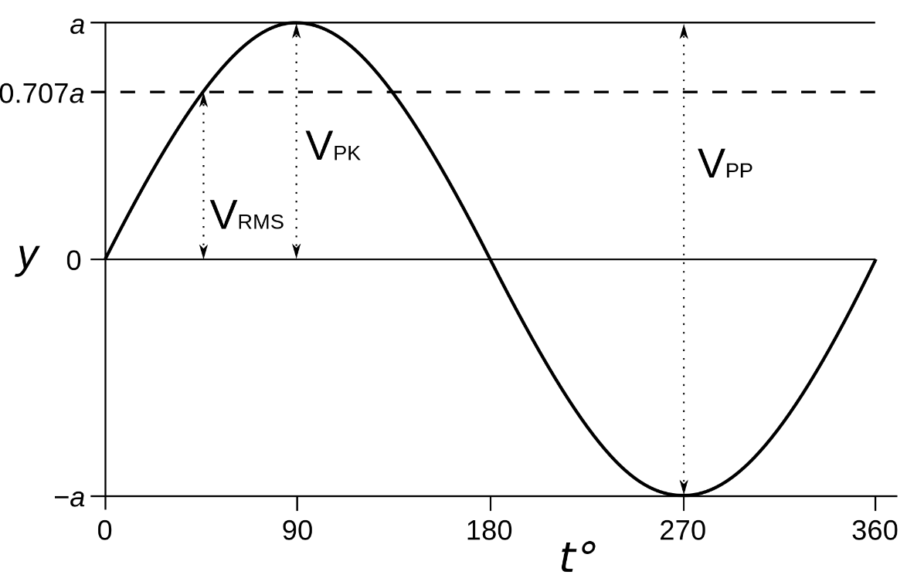
MAIN OBJECTIVES – GOAL 2
Image Enhancement
Image
Analysis
Notes:
Image:
Aurora: http://abrokenlaptop.files.wordpress.com/2013/04/aurora-borealis-manitoba-canada.jpg
Luis

Slide 20
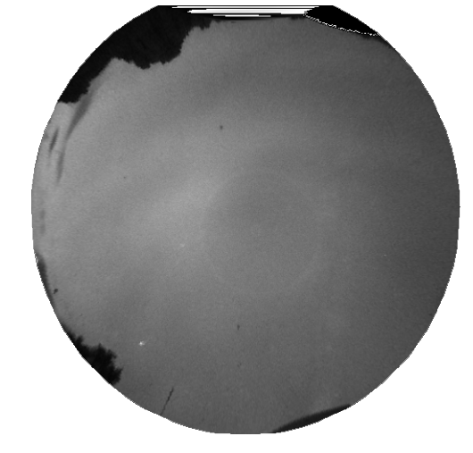
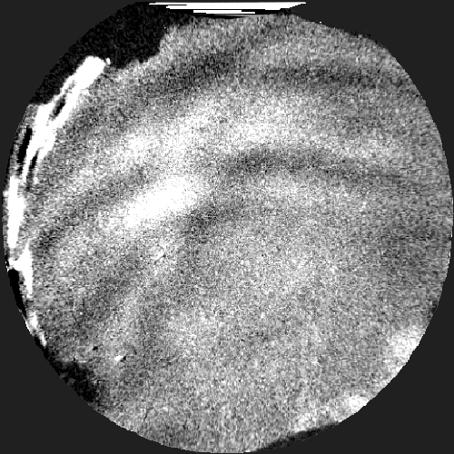
STEP 1: IMAGE SUBTRACTION AND HISTOGRAM EQUALIZATION
-
=
03:45:41 UTC
03:51:14 UTC
03:45:41 UTC
Notes:
MAYBE ADD IMAGE OF WHAT HISTOGRAM LOOKS LIKE? SO SOMETHING LIKE
PIC 1 – PIC 2 + HISTOGRAM = RESULT ???
Luis

Slide 21
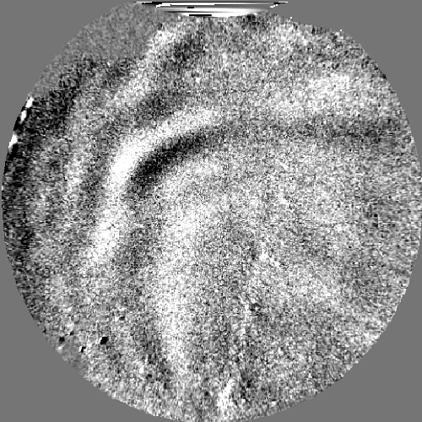
STEP 2: WAVE DIRECTION ANALYSIS
Notes:
Luis

Slide 22
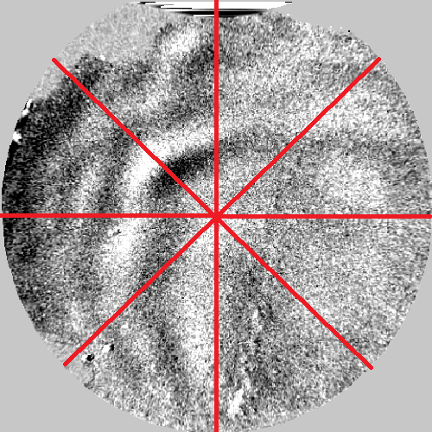
STEP 2: SAMPLE IMAGE
Notes:
Danielle

Slide 23
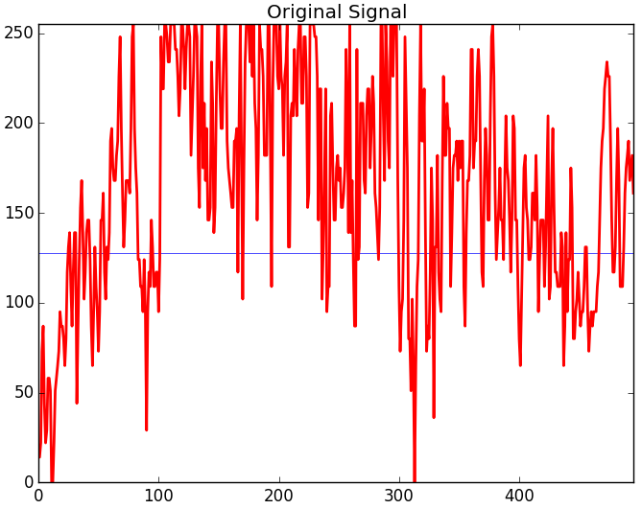
STEP 2: PLOT PIXEL INTENSITIES
Notes:
Danielle

Slide 24
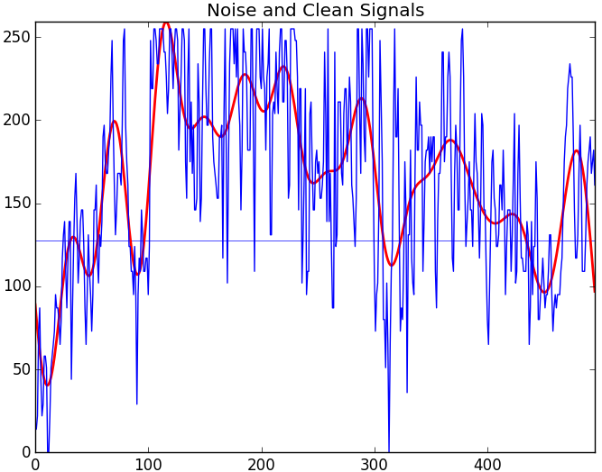
STEP 2: CLEAN PIXEL INTENSITIES
Notes:
Danielle

Slide 25
STEP 2: PLOT BOTH IMAGE PIXEL INTENSITIES
Image 1
Image 2
Notes:
Danielle

Slide 26
STEP 2: PLOT ALL SAMPLES
Image 1
Image 2
Notes:
Finkel’s comments: “point out which ones look better (\ Cut, -- Cut), and which look really meh (/ Cut)”
Danielle

Slide 27
STEP 2: CALCULATE VALUES
Image 1
Image 2
Notes:
Danielle

Slide 28
STEP 2: CALCULATE VALUES
Positive
Negative
Notes:
Danielle

Slide 29
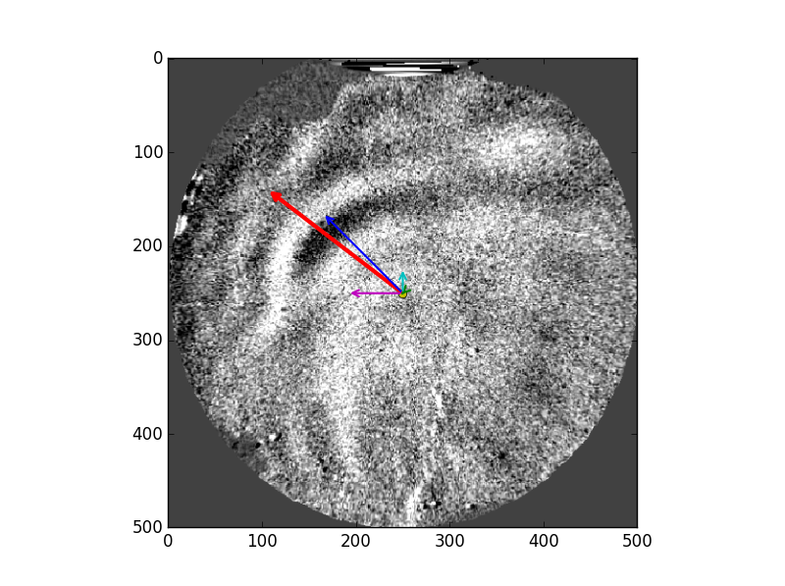
STEP 2: DRAW VECTORS
Notes:
Luis

Slide 30
STEP 2: DRAW VECTORS
Notes:
Luis

Slide 31
STEP 2: CALCULATIONS - RESAMPLE
Notes:
Luis

Slide 32
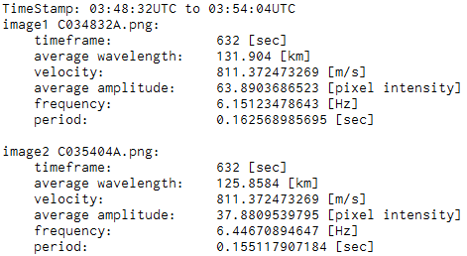
STEP 3 – CALCULATE WAVE FEATURES
Notes:
Luis

Slide 33
RESULTS
Notes:
Luis

Slide 34
THANK YOU!
Mid-latitude All-sky-imager Network for Geophysical Observation 2
Luis Vinke
Danielle Riccardi
Notes:
Danielle

Slide 35
APPENDIX A – SPECIFIC LOCATIONS
Location | Latitude | Longitude | Location
1 | 45.298377, | -108.918643 | Bridger, MT
2 | 41.888844, | -91.498607 | Eastern Iowa Observatory, IA
3 | 42.611913, | -71.484704 | Millstone Hill Observatory, MA
4 | 35.201148, | -82.874855 | Pisgah Astronomical Observatory, NC
5 | 33.292046, | -89.386532 | Rainwater Observatory, French Camp, MS
6 | 38.12713, | -96.138625 | Madison, KS
7 | 30.6714, | -104.0225 | McDonald Observatory, TX
8 | 38.185269, | -111.179774 | Capitol Reef Field Station, UT
9 | 40.8, | -121.47 | Hat Creek Observatory, CA

Slide 36
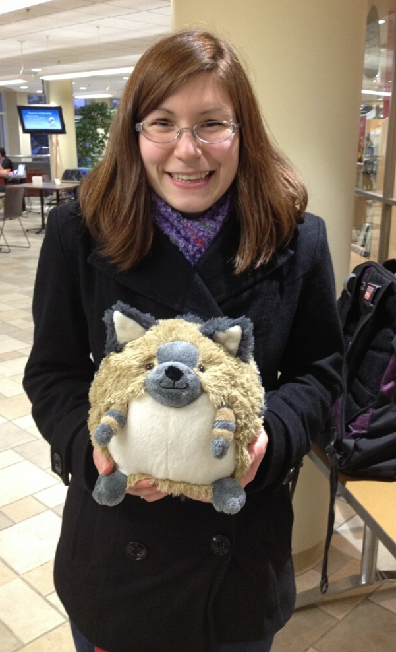
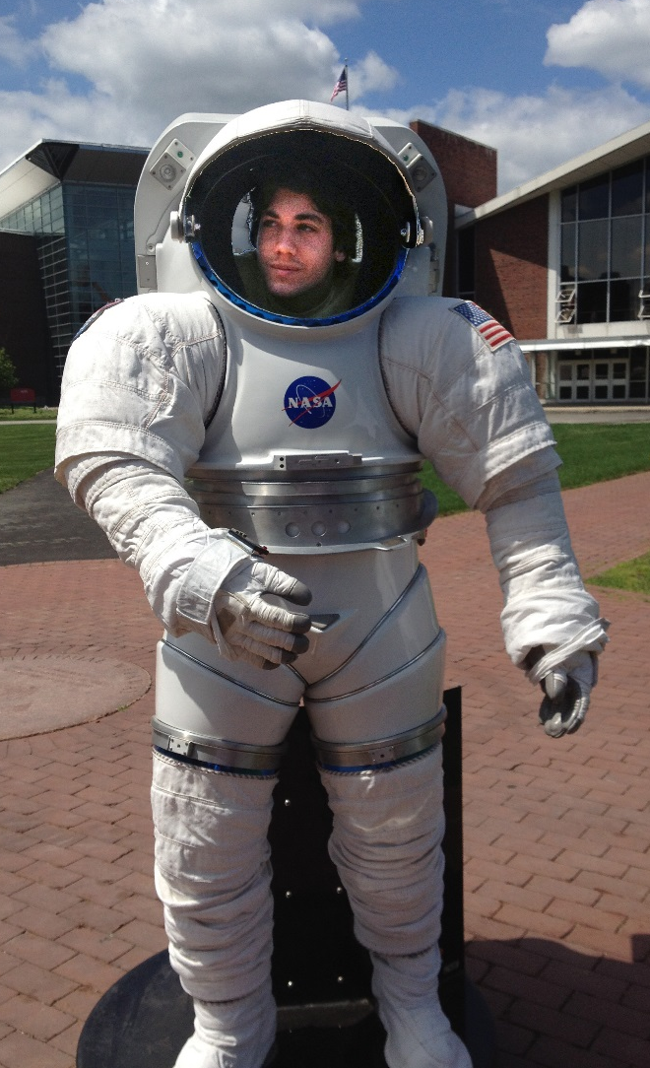
THANK YOU!
Mid-latitude All-sky-imager Network for Geophysical Observation 2
Danielle Riccardi
Luis Vinke

Slide 37
THANK YOU!
Mid-latitude All-sky-imager Network for Geophysical Observation 2
Luis Vinke
Danielle Riccardi

