Slide 1
Assessing the Validation and Standardization of Alternatives to Animal Experimentation
By:
Aurora Bas
Nicole Burns
Andrew Gulotta
James Junker

Slide 2
Task
Motivation
Final Product
Investigate and simplify the process for approval and standardization of alternatives to animal experimentation with a focus on nanomaterials
Ethical, practical, financial, global impact
We have produced a written report with the intention to pursue publication in the ALTEX Journal
Notes:
Aurora

Slide 3
Relevancy of our Project
Spoke with the Swiss authorities responsible for approving and standardizing these alternative methods
Presents up-to-date information in a concise and easy to understand manner
The information compiled may help reduce test approval time to below the usual 10-15 year period
If published, report will potentially have influence not just within Switzerland, but over 36 OECD member states
Notes:
Aurora
Books have been written, but researchers won’t have the time to read through a 200-page instruction manual
Our report is 23 pages, much more reasonable
Updated version
OECD standard would reduce animal testing in 36 countries (at least)

Slide 4
Methodology
Notes:
Nicole
First part- meet with AMI and confirm interviews
Second part- interviews and follow up
Third part- writing and presentations

Slide 5
Methodology
Interviews
Dr. Samuel Constant: COO of Epithelix
Drs. Markus Hofmann and Christoph Studer: Current and former National Coordinators of the OECD Test Guideline Program for the Swiss Federal Office of Public Health
Dr. Lothar Aicher: Regulatory Toxicologist at the Swiss Center for Applied Human Toxicology
Dr. Chantra Eskes: Director of the Swiss 3R Competence Center
Notes:
Nicole
Constant- test developer talked about the lack of communication
Hofmann and Studer- NC’s role in approval process
Aicher- explained the difficulties surrounding nanomaterials specifically
Eskes- clarified the whole process and helped us explain it better and more concisely

Slide 6
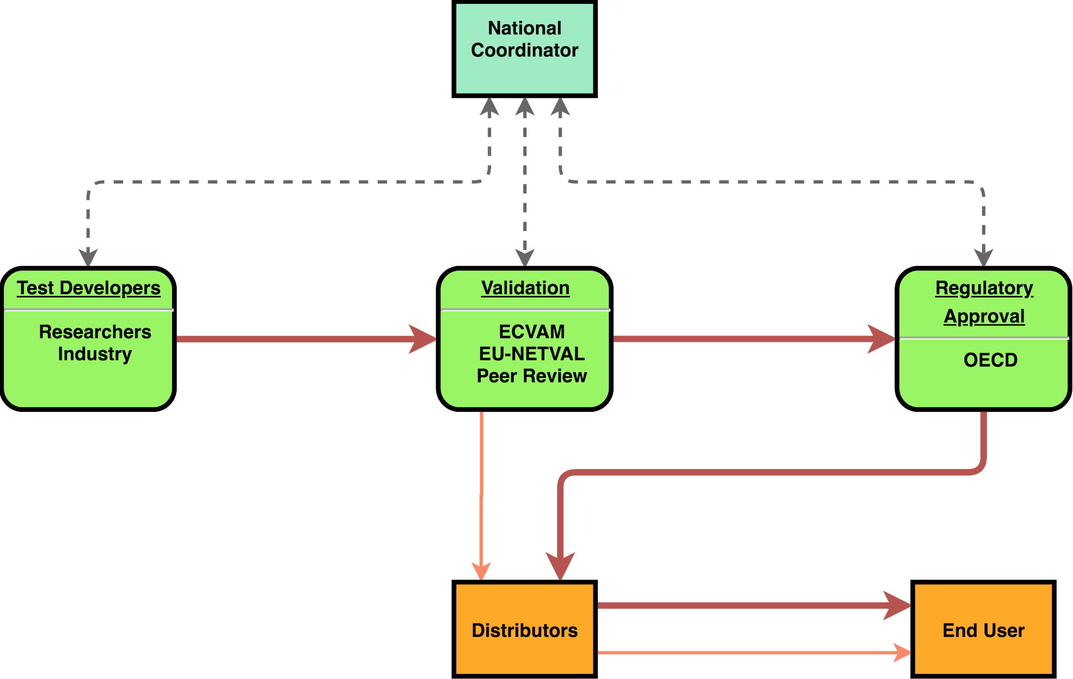
Organizations Involved
Notes:
Briefly describe the organizational interplay

Slide 7
Regulatory Resources
National Coordinator:
Can organize all parties in the approval process
Is capable of expediting steps in certain situations
Only works with a limited number of projects at a time
3Rs Competence Center:
Educates on 3R principles
Provides a place of networking for researchers, regulators, and industry
Provides grants to support projects involving the 3Rs
Notes:
Nicole
NC of OECD test Guidelines program, projects they work with are accepted based on the relevance and need of a test
As you may know 3Rs refinement, reduction, replacement of animal tests

Slide 8
Regulatory Resources
ECVAM:
Main center for validation of alternative methods in Europe
Can oversee and organize validation as a sponsor or management group
Organizes 3rd party GLP-certified laboratories for validation under EU-NETVAL
OECD:
Defines GLP and MAD policies
Maintains useful guidance documents
Can organize peer review
Has final say in the instatement of test guidelines
Widespread reach (36 member countries)
Notes:
Nicole
European Union Network of Laboratories for the Validation of Alternative Methods
GLP and MAD aid in the sharing of data between member countries

Slide 9
The Process
Notes:
James

Slide 10
General Process
Notes:
Now that we’ve identified the different organizations involved in the approval process, we can begin to see how they interact.
For the first stage there are the
Test Developers which are comprised of....
Validation…
Reg approval…
Two main paths
Faster to end user, however may be limited to us ein own countries and end user may have to decide whether to use test or not
OECD, opens up to many more countries, and once guidelines OECD member countries must use the test
European Union Network of Laboratories for the Validation of Alternative Methods

Slide 11
Phase 1
Research and Development
Optimization
Relevancy
Accuracy
Reproducibility
Optimized test and SOP?
Phase 2
No
Yes
Notes:
James
Won’t get perfect test on first shot
Should focus on continual improvement of test in optimization process
3 parameters will help later on - based on validation requirements
Cycle

Slide 12
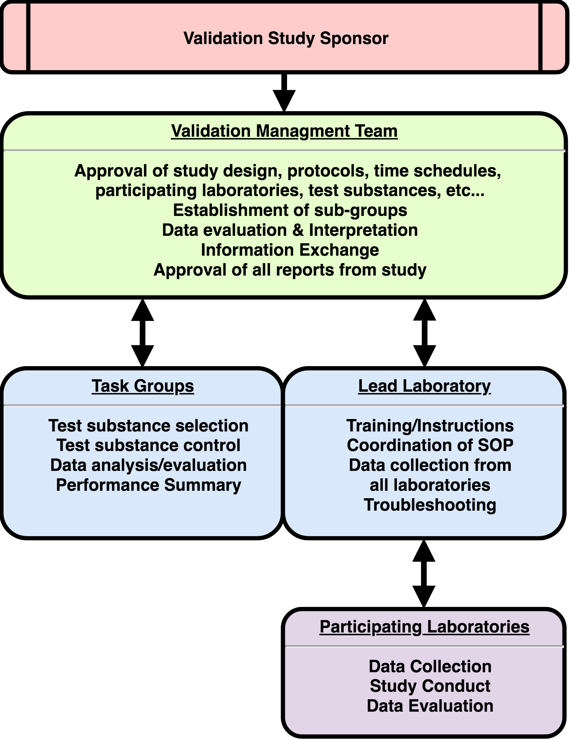
Breakdown of Validation Study
Notes:
James
Sponsor can be national organizations or international ones like ECVAM or OECD
They appoint Validation Manager or team
Combined knowledge on test, and validation studies
….
Follow slide

Slide 13
Phase 2
Validation
Modular Approach
Test
Definition
Intra-laboratory Repeatability
Inter-laboratory Transferability
Inter-laboratory Reproducibility
Predictive Capacity
Applicability Domain
Performance Standards
Test Definition:
Scientific purpose of the test
Standard operating procedure
Variability in results:
Intra-laboratory: within the same laboratory
Inter-laboratory: between separate laboratories
Performance Standards:
Compilation of test performance data
Allows for faster validation of similar future tests
Predictive Capacity:
Accuracy
To what degree does the test predict the proper result?
Applicability Domain:
How useful is the test’s application?
Does the test have any other possible applications?
Pass Validation Management Group Review?
Peer Review
Optimization
No
Yes
Notes:
Andrew
ECVAM has developed a modular approach to test validation
These 7 modules define specific characteristics of the method to be tested
Test definition: design and reasoning behind test and SOP
Repeatability, Transferability, Reproducibility: variation in results within original lab and other labs, as well as how transferable the results are between labs
Predictive capacity: how accurate the test is and how well it serves its intended purpose
Applicability domain: how applicable the test method is. Any other possible applications may make it more favorable and relevant
Performance standards: compilation of test performance data to allow for quicker approval of similar future tests or changes to the original test

Slide 14
Test Method Performance Acceptable?
Phase 3
Regulatory Acceptance
Peer Review
Yes
No
Acceptance by all OECD members?
Optimization
Yes
OECD Test Guideline
Notes:
Andrew
A panel of independent peer reviewers is established to evaluate the results of the validation study
Peer reviewers must be experts with experience in the relevant fields
Must have no conflicts of interest with the outcome of the study, such as financial gain
The panel compiles a report on the study and comments on whether or not the method fulfills its intended purpose, does not have to be unanimous
If test method is not acceptable, more work must be done
If test method is acceptable it can be declared as validated for its intended purpose
Once validated, any regulatory body may choose to individually accept the test method
For widespread use and standardization, it can be proposed to be an OECD guideline
Unanimous decision among OECD experts from all member countries
Transition statement to nanomaterials
So that concludes the approval process. Now we’ll go over some of the specifics of nanomaterial assessments.

Slide 15
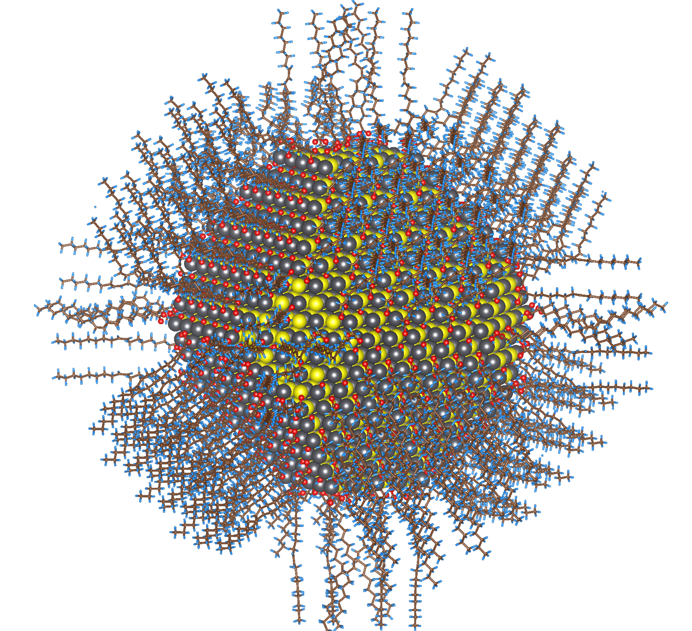
Nanomaterials
Five Variables of Nanomaterial Testing:
Size
Surface Chemistry
Core Material
Environment
Morphology
Alternative methods should allow for individual testing of all variables
A combination of multiple methods may be needed for proper hazard assessment
Many regulators do not have much background knowledge about nanomaterials
Notes:
Andrew
High surface area to volume ratio, higher reactivity
Small size can be more hazardous
Hard to test low doses over long periods of time
Size
Surface chemistry, corona
Core material chemistry
Environment, affect reaction and corona
Morphology, shape

Slide 16
Recommendations
When presenting to regulators:
Lay out and explain endpoint
Simplify data
Explain why your test is better than existing methods
Design Phase
Relevant
Accurate
Reproducible
20XX
20XX
Contact National Coordinator for guidance during the process
Regulators: simplify what steps need to be taken case-by-case to move the process forward
Notes:
Aurora
Parameters: make these priorities, as stated previously -> should save time later on in the validation by focusing on these during development
NC

Slide 17
Acknowledgments
A Huge Thank You to:
AMI and the University of Fribourg for being gracious hosts
Prof. Rothen, Dr. Drasler, Dr. Lehner, everyone else at AMI
Our Interviewees
Prof.’s Dirk Albrecht and John Orr, our primary advisors
Prof. Nancy Burnham for setting up this communication/project with AMI
The Worcester Polytechnic Institute
Our Audience
Notes:
Aurora

Slide 18
Questions

Slide 19
Other sources…
If you’d like to learn more, here are a few helpful documents
Guidance Document on the Validation and International Acceptance of New or Updated Test Methods for Hazards Assessment
OECD Series on Testing and Assessment Number 34
Workshop on acceleration of the validation and regulatory acceptance of alternative methods and implementation of testing strategies
Identifying Tools Available for Risk Management Measure and Uncertainties Driving Nano-Specific Data Needs
Series on the Safety of Manufactured Nanomaterials No. 88
Evaluation of in vitro methods for human hazard assessment applied in the OECD Testing Programme for the Safety of Manufactured Nanomaterials
Series on the Safety of Manufactured Nanomaterials No. 85
Investigating the Different Types of Risk Assessments of Manufactured Nanomaterials
Notes:
Andrew

Slide 21
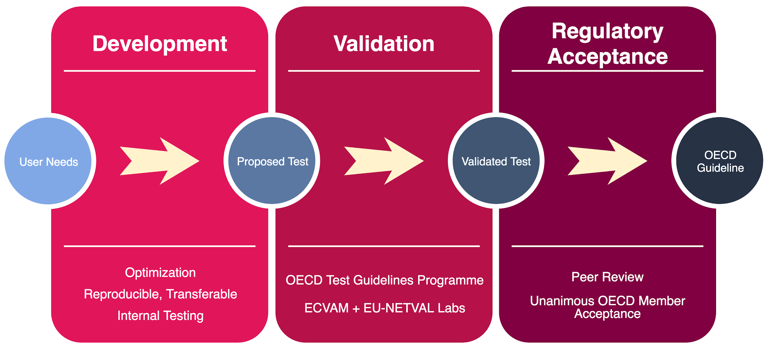

Slide 22
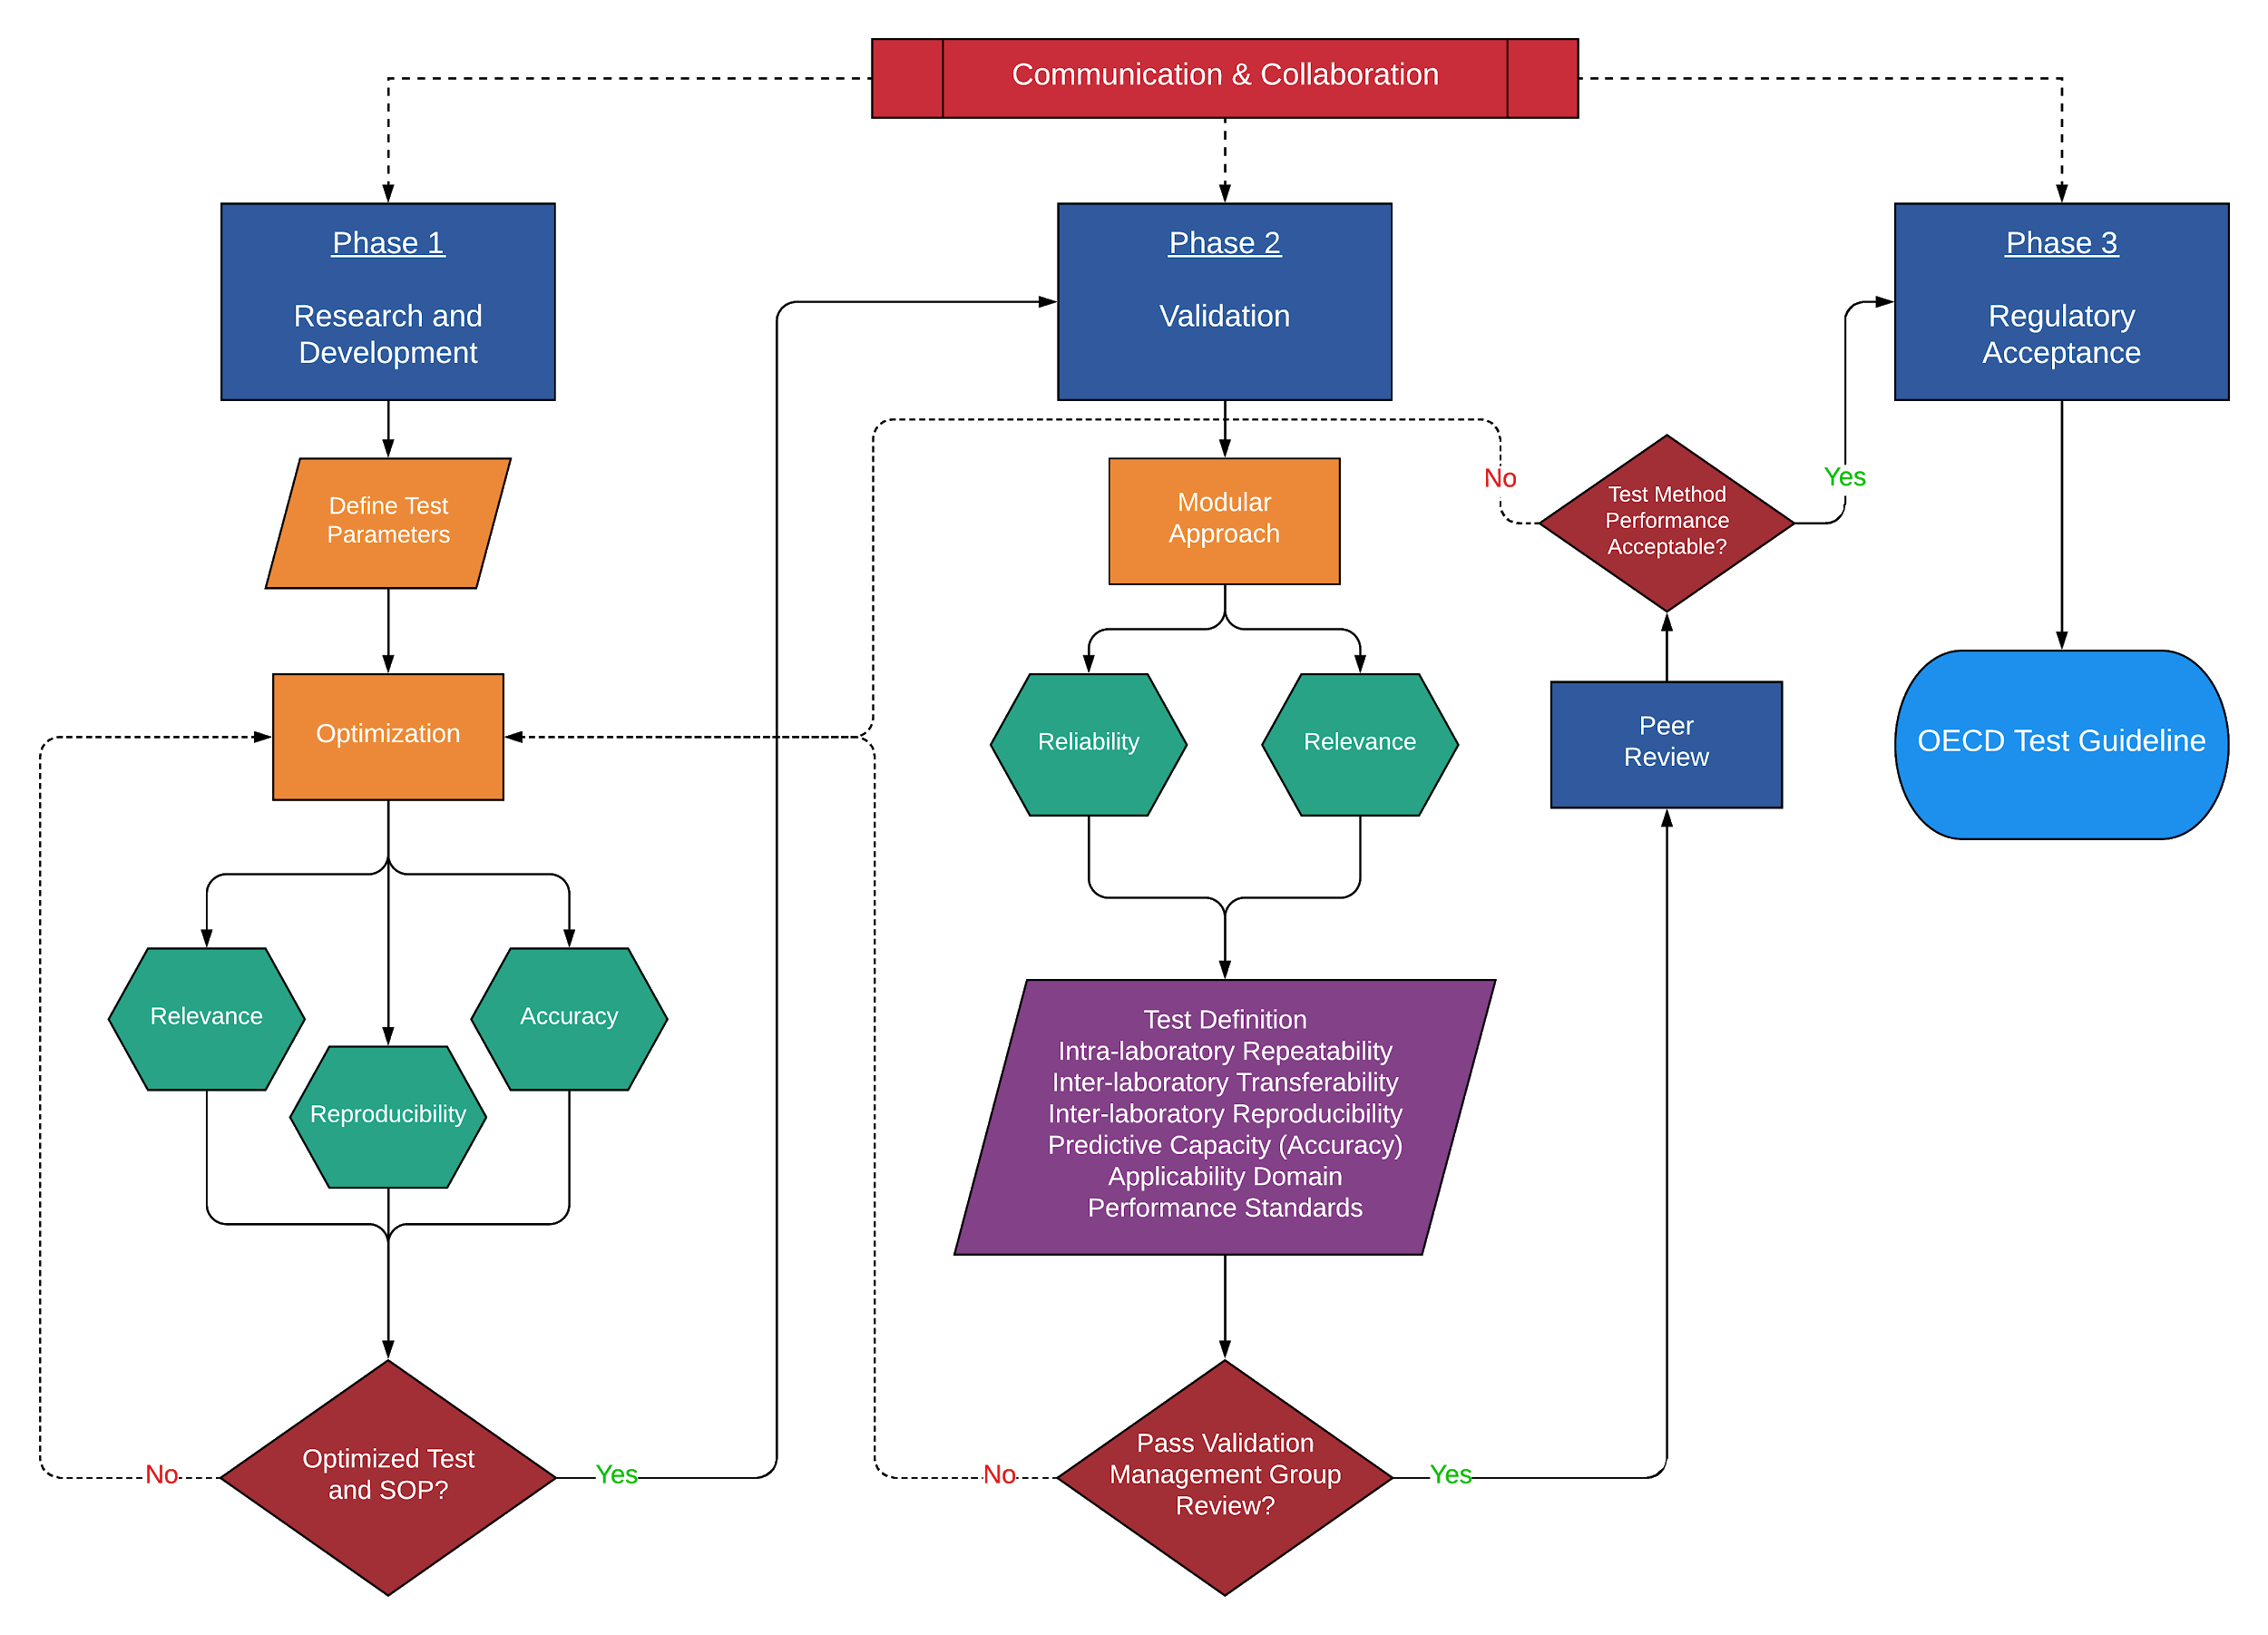

Slide 23
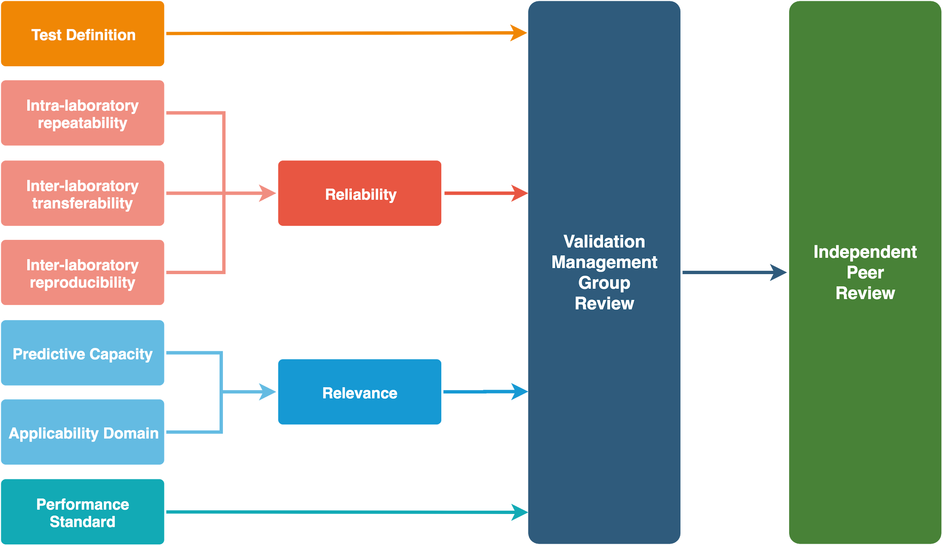

Slide 24
