Slide 1
Parking Reservation
System at Many Glacier
For Glacier National Park
Andrew Hand, Dan Oates, Liz Callahan

Slide 2
Presentation Overview
Visitor Needs vs Park Assets
Structure vs Assessment
Established Systems

Slide 3
Established Systems
How have other National Parks implemented reservation systems?
1

Slide 4
Established Systems
Haleakala
Sunrise reservations
Gated System
$1.50 fee
Rec.gov

Slide 5
Established Systems
Haleakala
Sunrise reservations
Gated System
$1.50 fee
Rec.gov
Muir Woods
All day
Parking attendants
$8 fee
GoMuirWoods.com

Slide 6
Established Systems
Haleakala
Sunrise reservations
Gated System
$1.50 fee
Rec.gov
Muir Woods
All day
Parking attendants
$8 fee
GoMuirWoods.com
Yosemite
August weekends
Parking attendants
$1.50 fee
Rec.gov

Slide 7
Visitor Needs
What do visitors expect in a reservation system?
2

Slide 8
63%
Of visitors were at Acadia for the first time

Slide 9
63%
66%
Of visitors were at Acadia for the first time
Of visitors were willing to pay for a parking reservation

Slide 10
63%
66%
82%
Of visitors were at Acadia for the first time
Of visitors were willing to pay for a parking reservation
Of visitors prefer remote booking methods (online, phone app, call in)

Slide 11
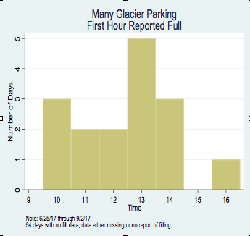
Visitor Needs
Many Glacier was reported full 5 times between 1:00 - 2:00 pm

Slide 12
Asset Mapping
What features in Many Glacier can support a reservation system?
3

Slide 13
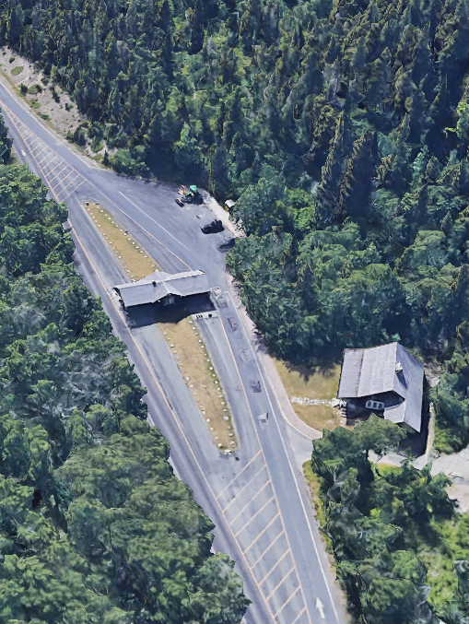
GATE
Access to Many Glacier is controlled through a gate, which allows for reservations to be checked more easily.

Slide 14
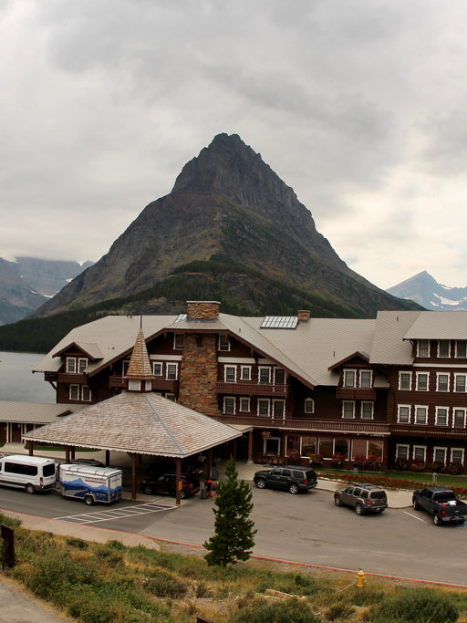
Concessionaires
Having concessionaires allows park staff to designate parking areas for different types of visitors.
Hotel Reservations
Horseback Riding
Hikers

Slide 15
NEEDS
Electronic System
Book your parking reservation online or over the phone, and show it to attendants at the gate.

Slide 16
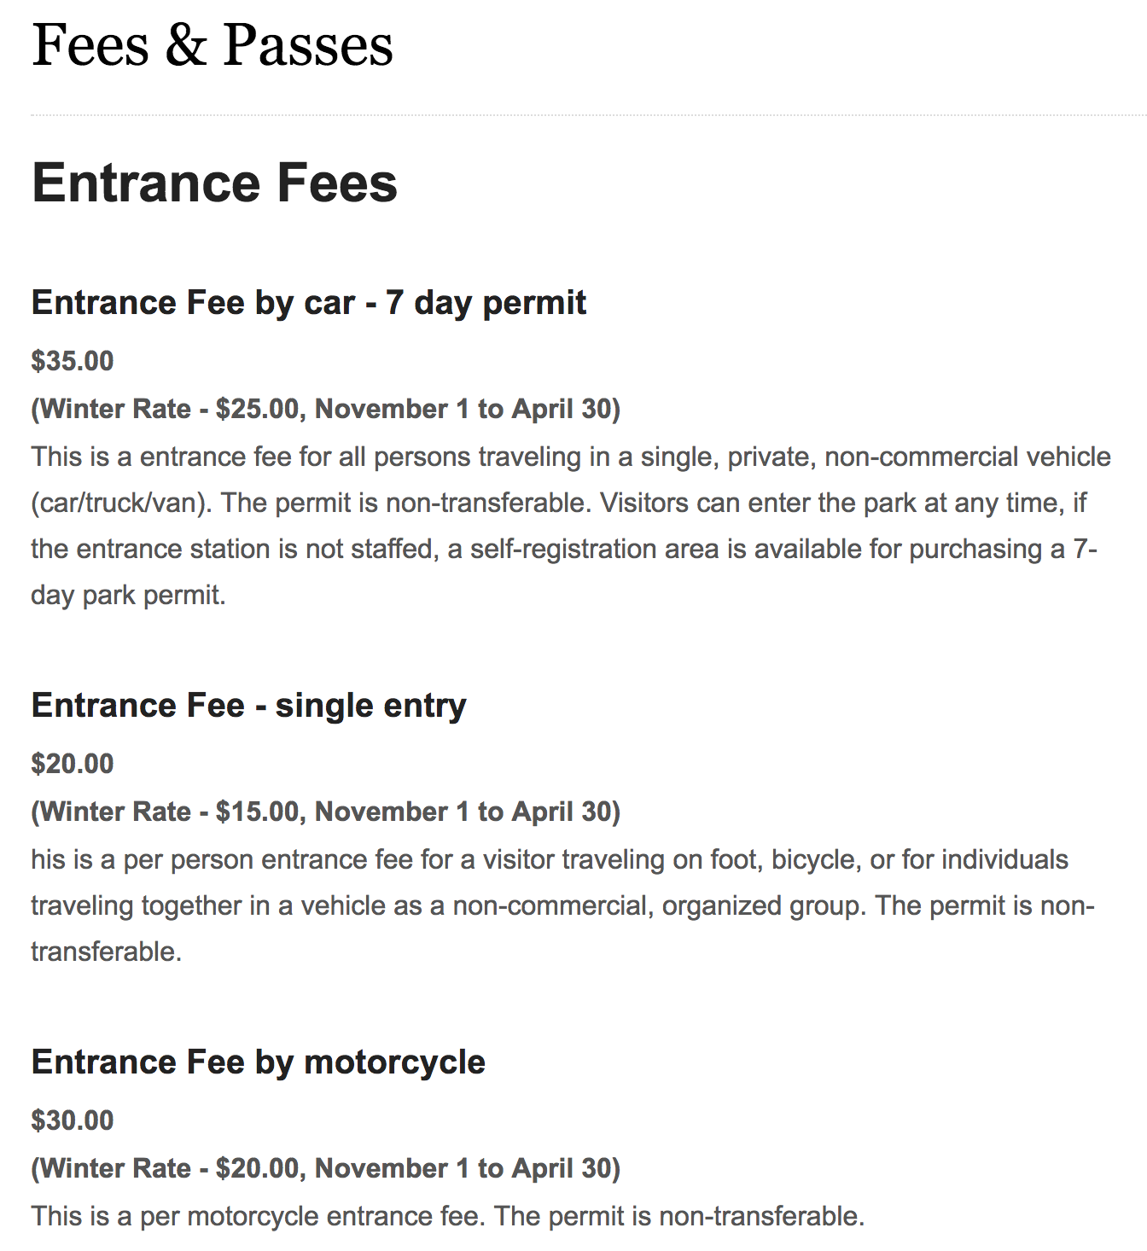
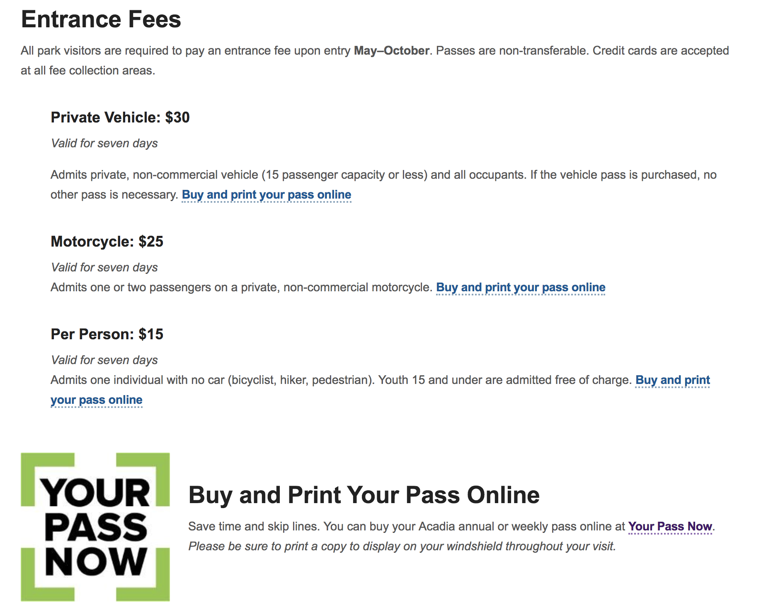
Website Display - Glacier vs. Acadia

Slide 17
NEEDS
Electronic System
Book your parking reservation online or over the phone, and show it to attendants at the gate.
Signs
Clearly designate parking for specific visitors through visible signs.

Slide 18
Types of Signs

Slide 19
NEEDS
Electronic System
Book your parking reservation online or over the phone, and show it to attendants at the gate.
Signs
Clearly designate parking for specific visitors through visible signs.
Enforcement
Displaying your reservation on your dash for non-hotel guests & fines for violators

Slide 20
System Implementation
How does our reservation system design fit Many Glacier’s needs?
4

Slide 21
Online Structure
How would a visitor make a parking reservation online?

Slide 23
Parking Lots
How do we manage different parking lots and reserved spaces in Many Glacier?

Slide 24
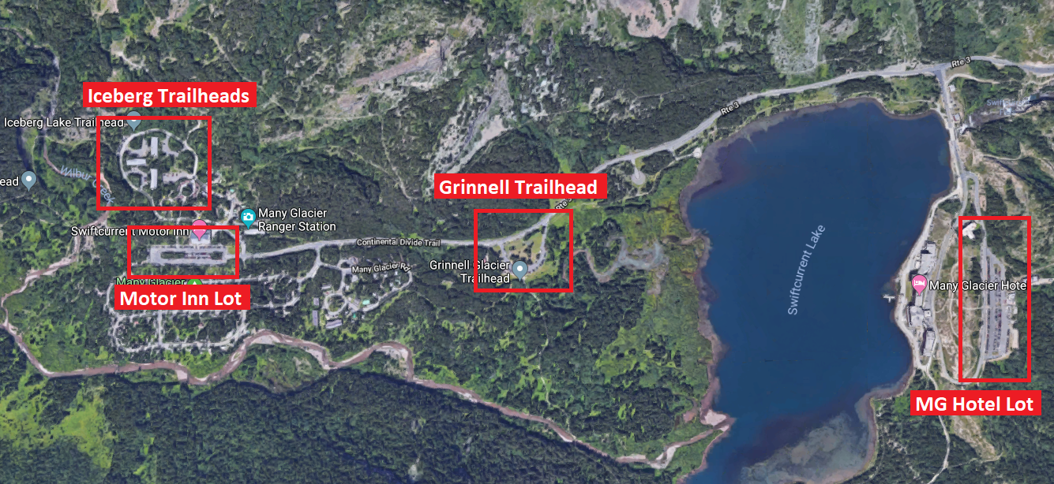
Parking Overview

Slide 25
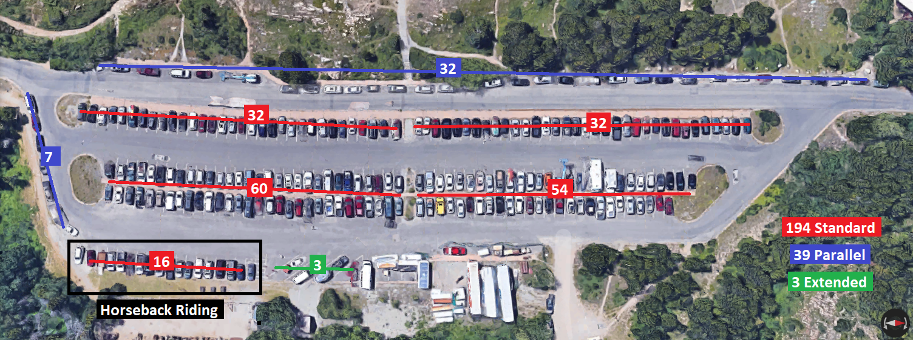
Many Glacier Hotel Lot

Slide 26
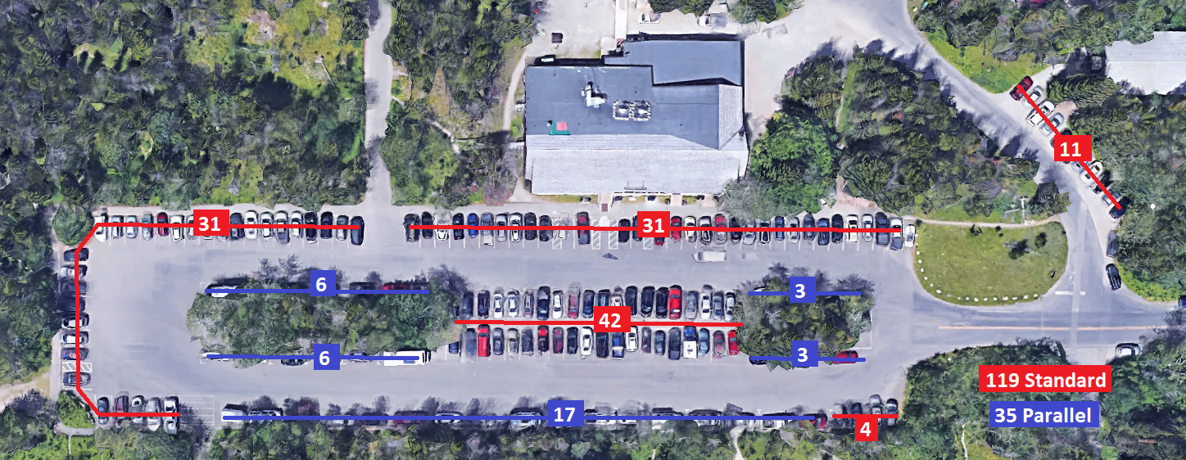
Swiftcurrent Motor Inn Lot

Slide 27
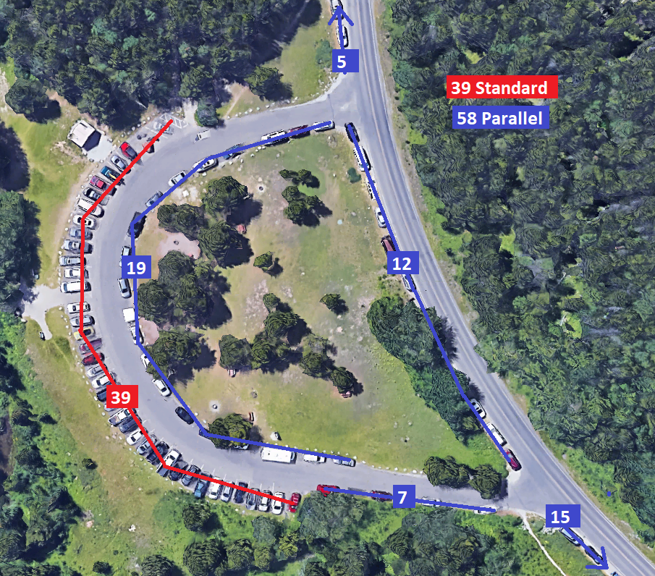
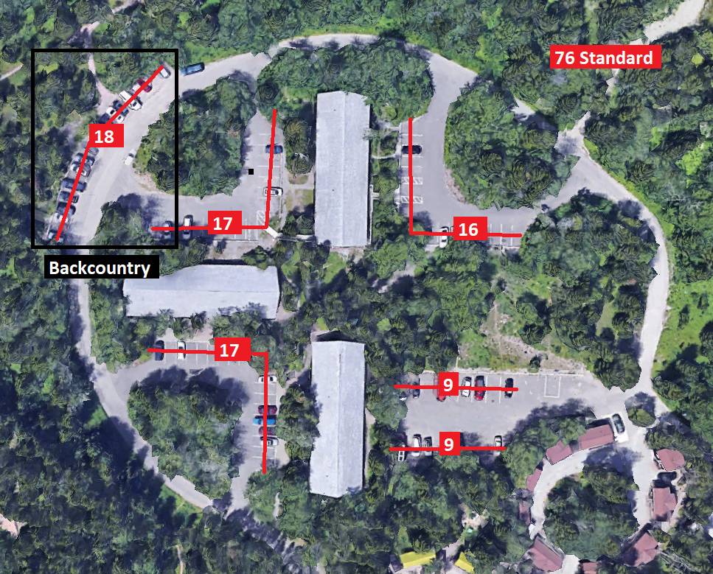
Trailhead Lots

Slide 28
Violations & Enforcement
Possible Visitor Violations
Arriving before gate ranger
Parking in a Hotel lot
Overstaying reservation
Solutions & Mitigations
Ticketing violators
Offering less reservations

Slide 29
Visitor Timeline
What would a visitor need to do prior to arrival and during their arrival to ensure and validate their parking reservation.

Slide 30
Timeline
1.Visitors make their parking reservation online and print out their reservation
Prior to Arrival
In Parking Lot
At Gate
Leaving the Car

Slide 31
Timeline
1.Visitors make their parking reservation online and print out their reservation
Prior to Arrival
In Parking Lot
At Gate
Leaving the Car
2. Visitors show their printed reservation to the parking attendant at the Many Glacier gate.

Slide 32
Timeline
1.Visitors make their parking reservation online and print out their reservation
3. Visitors park in designated areas, which are visible by signs at each of the 4 parking lots
Prior to Arrival
In Parking Lot
At Gate
Leaving the Car
2. Visitors show their printed reservation to the parking attendant at the Many Glacier gate.

Slide 33
Timeline
1.Visitors make their parking reservation online and print out their reservation
3. Visitors park in designated areas, which are visible by signs at each of the 4 parking lots
Prior to Arrival
In Parking Lot
At Gate
Leaving the Car
4. Visitors leave their printed reservation in the dash of your car for rangers to ensure that a reservation was made
2. Visitors show their printed reservation to the parking attendant at the Many Glacier gate.

Slide 34
Outcome Assessments
How can you assess and continually improve this system?
5

Slide 35
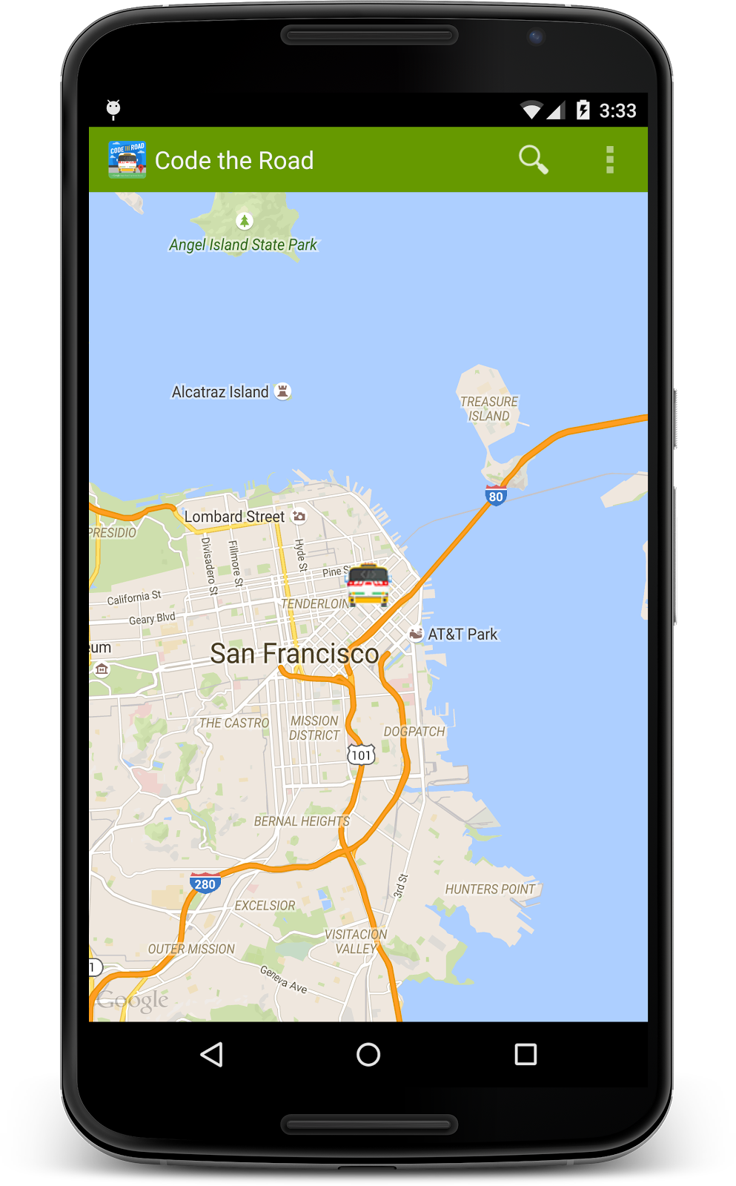
GPS Tracking App
STEP 1
STEP 2
STEP 3
Phone application that tracks a user's location using their cellular network or GPS with a timestamp.
Store tracking information using the offline database on the phone.
Sync information to an online database when WiFi or network signal is available.

Slide 36
NPS Request for Information
“The National Park Service is seeking qualified firms who are interested in providing effective methods and leverage creativity to perform data collection using location-based services (LBS) data, navigation-GPS data, contextual data, and wireless network signaling data (big data) that would be processed and analyzed for use in visitor use management planning and long range transportation planning across federal land management agencies at multiple landscape levels.”

Slide 37
Project Purpose
Distribute
Maximize
Provide
Visitors over a greater time period
Space provided in the parking lots without using overflow parking
Park staff with tools to assess and improve this system

Slide 38
Thank You!
gnp18-reserve@wpi.edu

