Slide 1
Shifting Seasonality and Its
Impact on Urban Beekeeping
Saida Bahtierova, Isabella DeFronzo,
Vijay Mistry, Benjamin Penti, James Teague
Notes:
Hello Everyone!
We are the group for the CALENDARS Project and today we would like to present to you our findings on
Shifting Seasonality and Its Impact on Urban Beekeeping
My name is … [ NAMES ]

Slide 2
(CALENDARS Project, n.d.)
CALENDARS focuses on co-producing a revised calendar to enhance understanding of seasonal changes
Notes:
Before we begin, we do want to mention our sponsor first for this project,
The CALENDARS Project is a researched based project that focuses on producing a revised calendar to enhance
understanding of seasonal changes

Slide 3
Shifts in seasonality and temperature are affecting ecosystems natural calendars
Kayser-Bril, Nicolas (2018)
Notes:
Now to start off our topic
As you can see in this photo right here,
Shifts in seasonality and temp are affecting ecosystems natural calendars
The arrows show how much the temp has increased since last century, with the colors indicating how much change has occurred.
With green being the least to red being the most drastic

Slide 4
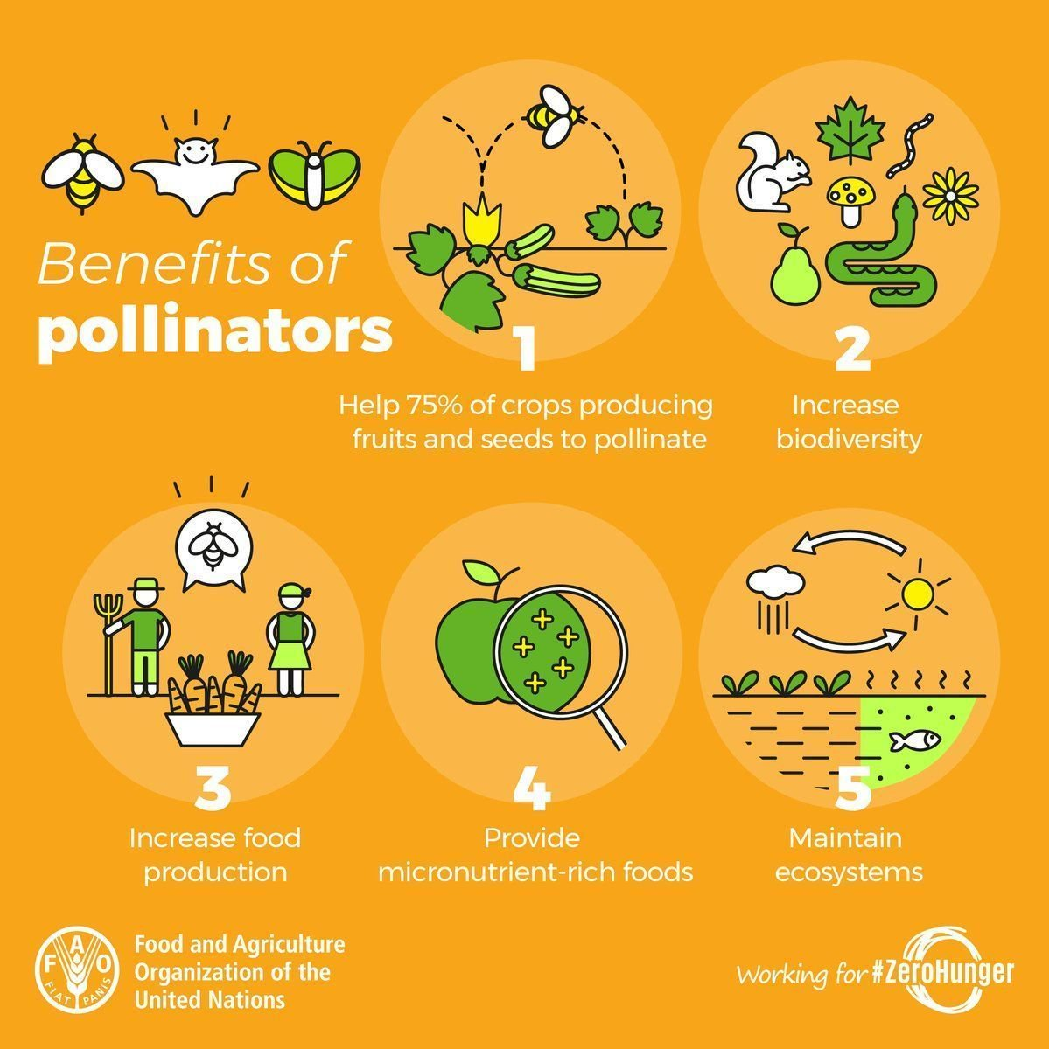
Bees play an important role in our daily lives
Kayser-Bril, Nicolas (2018)
Notes:
These changes in temp are affecting the world's ecosystems and
one of the most important parts in our ecosystem's are pollinators, such as bees
Bees play an important role in our daily lives
With being:
They help75% of crops producing fruits and seeds to pollinate
Increase food production
Provide micro-nutrient rich foods
Increase biodiversity
Maintain ecosystems
With pollinators being so important, bees are getting affected due to shifting seasons

Slide 5
Methodology

Slide 6
Methodology
Objective 3.
Identify technology used to mitigate seasonal impact on beekeeping
Objective 1.
Identify relevant weather patterns that affect beekeepers
Objective 4.
Create an app proposal to help beekeepers to adapt practices
Objective 2.
Characterize key practices of urban beekeepers that define their seasons
Notes:
With this our project aims to improve beekeepers ability to react to changes in yearly seasonal timing
To achieve our goal, we have outlined 4 main objectives to help frame and organize our flow of research, which follows:
Objective 1: … with our steps being

Slide 7
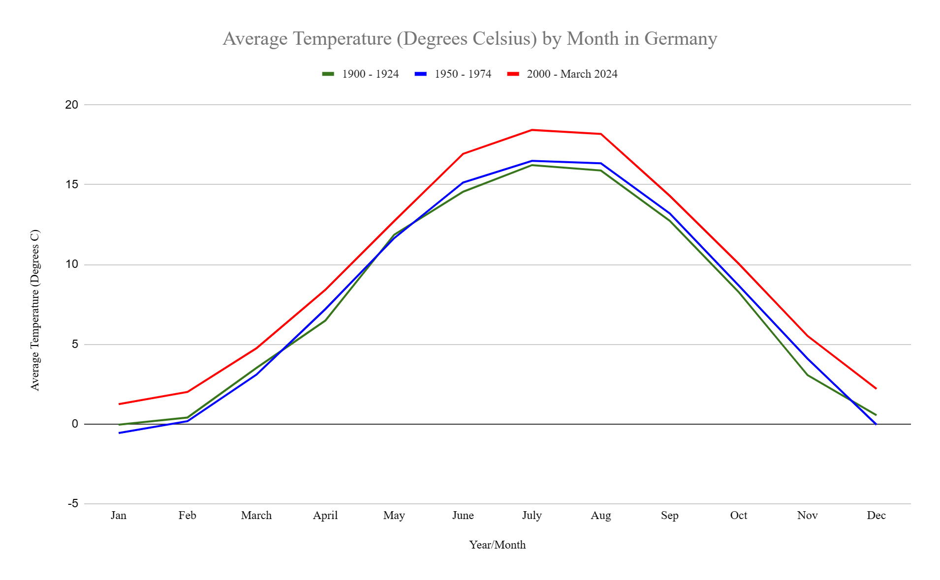
Germany’s temperature has increased over the past century
January temperatures now are the same as mid-February was historically
Notes:
Bees flying in January now, hazlenuts in bloom but not enough food for bees
No more frost in winter based on red line
Varroa treatment not as effective

Slide 8
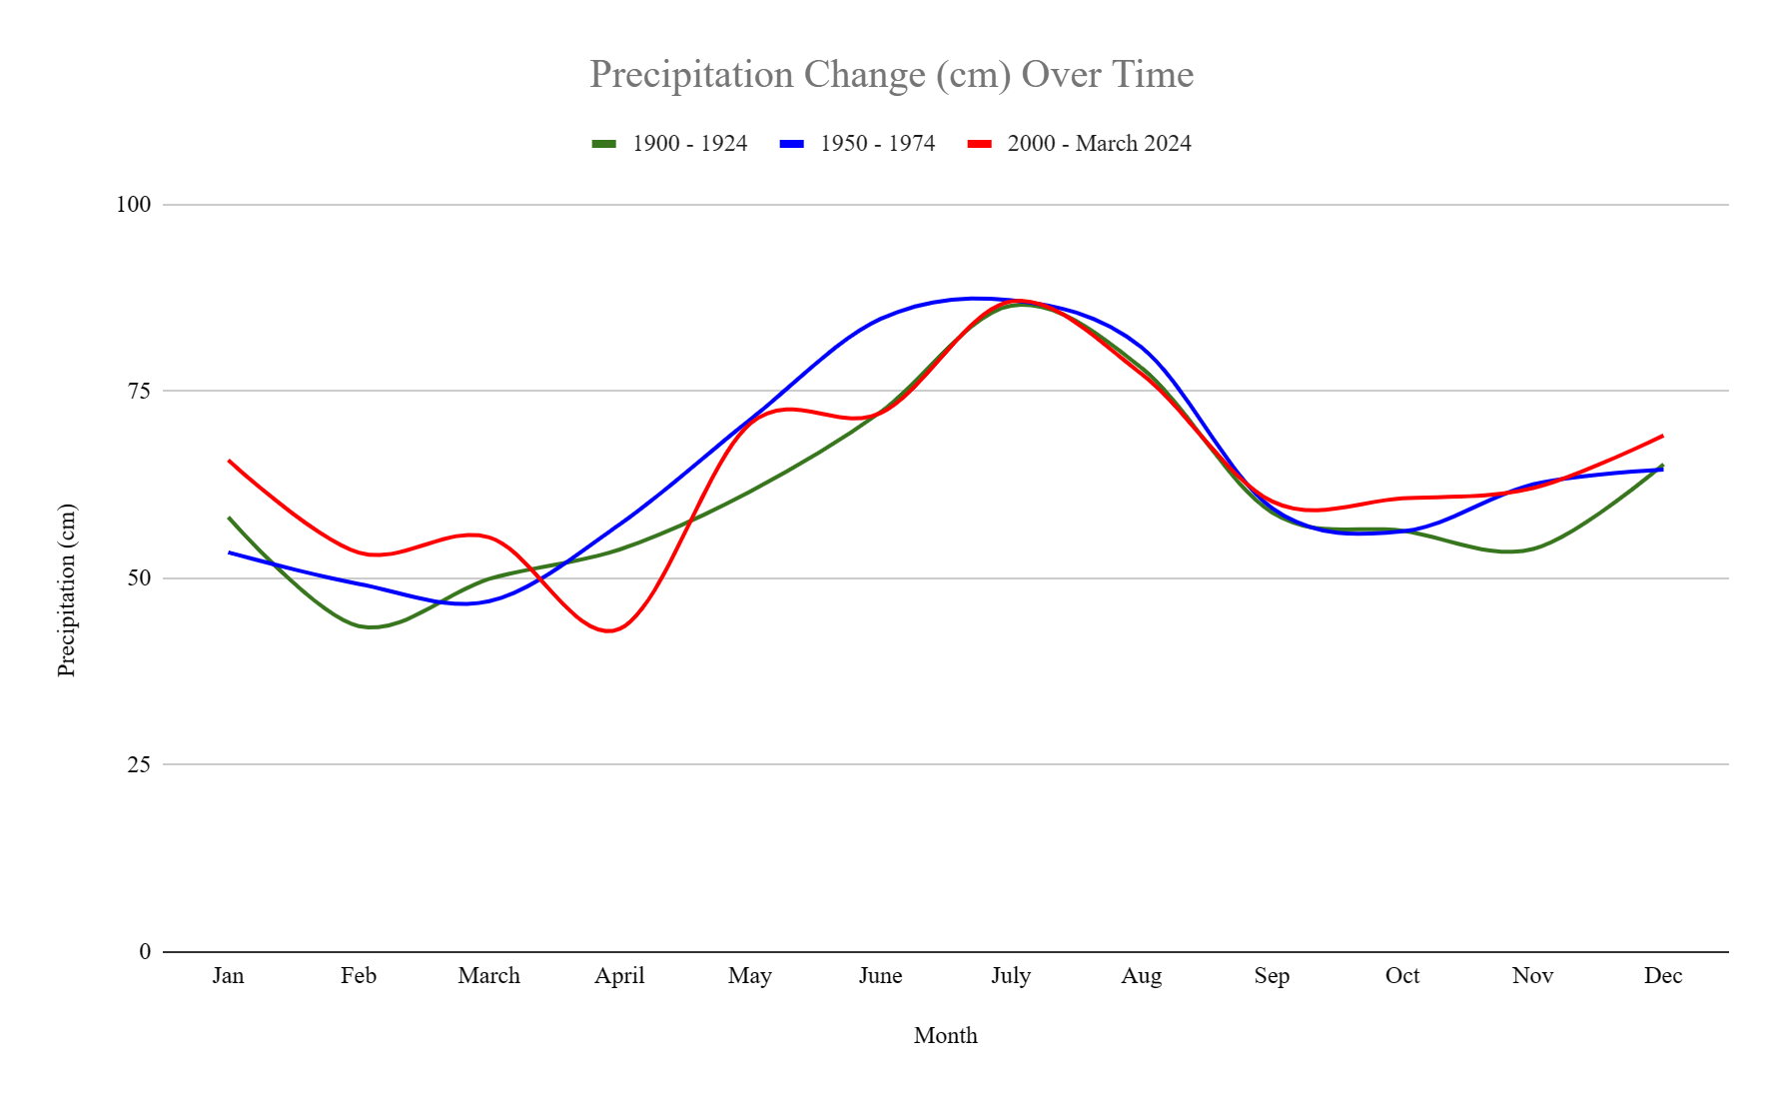
Germany’s precipitation has become more variable
Increased variability is bad for bees
Notes:
If rains too often in spring, bees will not be flying or pollinating -> main time get nectar so beekeepers do not get enough honey -> pollination not as effective as it used to be

Slide 9
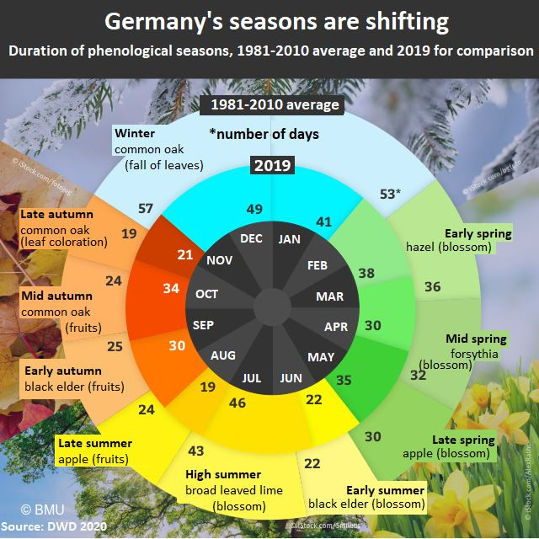
Germany’s seasons shift with more drastic​ weather changes
Notes:
Could mention in take yellow portion -> summer starts earlier now -> some areas of germany even earlier that august -> autumn is longer and warmer -> bees active until mid-november without finding enough food sources -> graph interesting but misleading

Slide 10
Interviews Were Conducted to Back-up Our Research
Heinz Riße
Mellifera
Jonas Geßner
Statdbienen

Slide 11
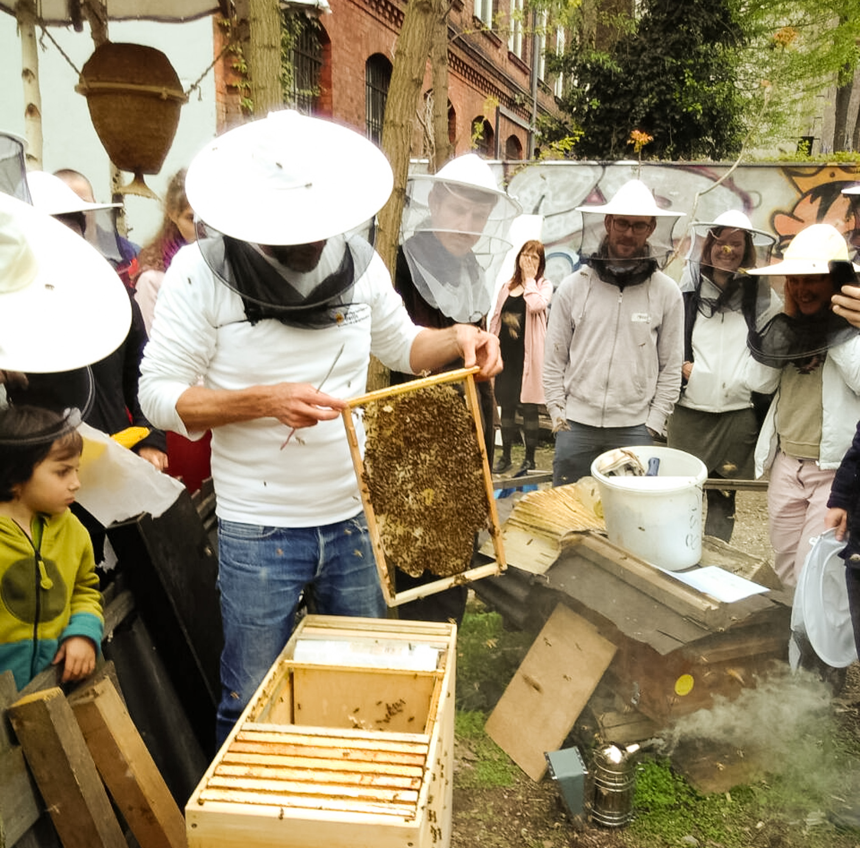
Mellifera and Stadtbienen Have Specific Seasonal Calendars
Notes:
7 Steps:
Swarming (May)
Tools and Equipment (June)
Varroa Mite Treatment and Honey Harvest (July)
Winter Preparations (September)
Winter Varroa Mite Treatment (December)
Check Food and Water Supplies (March)
Adding Frames (April)
7-Step Photo: https://www.stadtbienen.org/angebote/kurse/imkerkurs/
Mellifera Photo: https://mellifera-berlin.de/ausbildung/

Slide 12
Hive Management Techniques Differ Based on the Beekeepers Philosophy

Slide 13
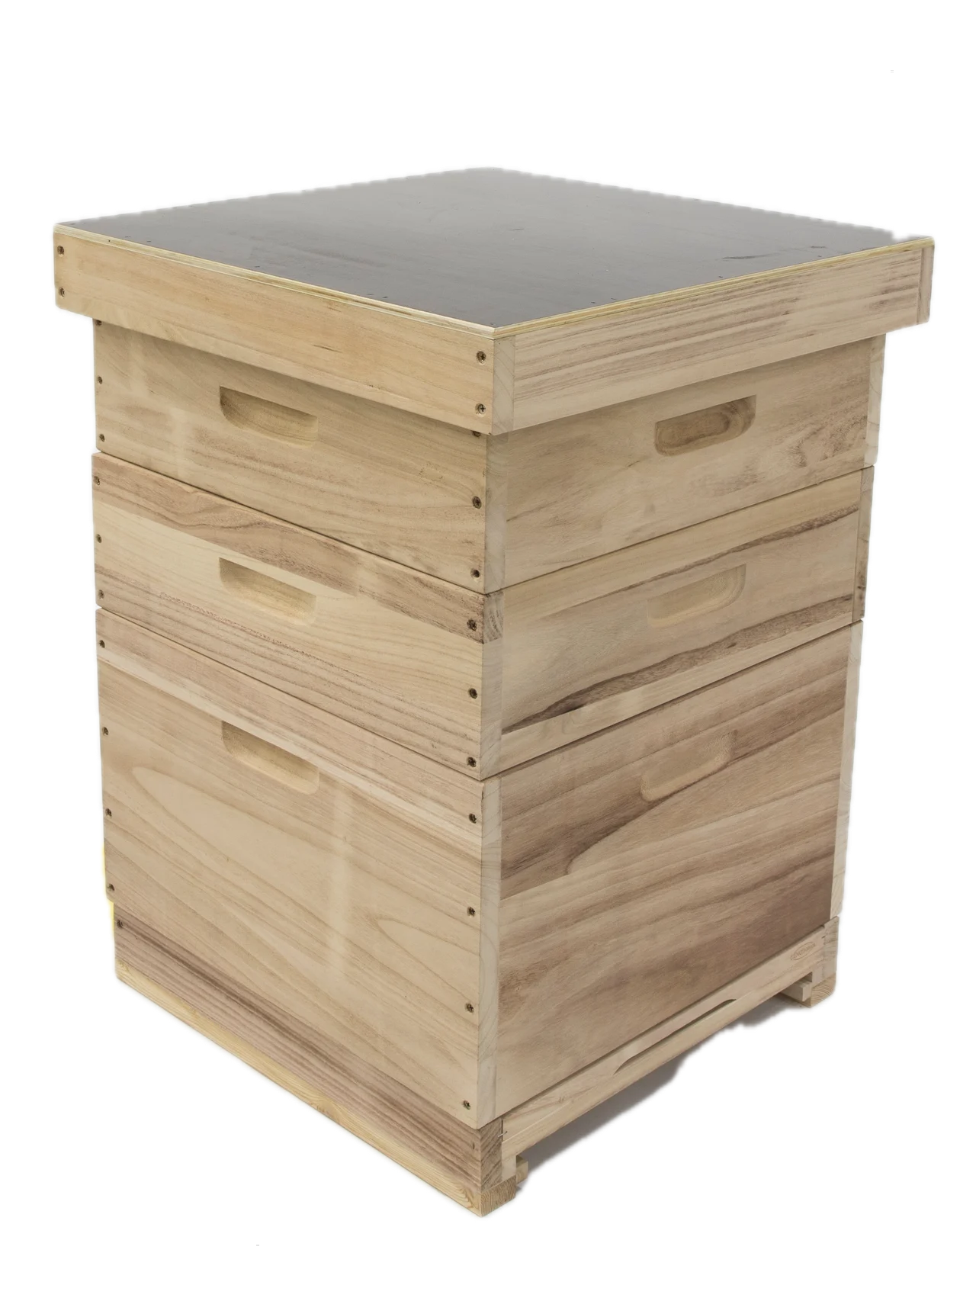
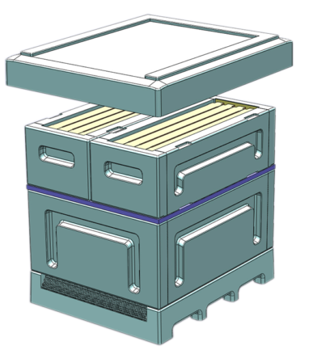
Modern hive materials are adopted by modern beekeepers

Slide 15
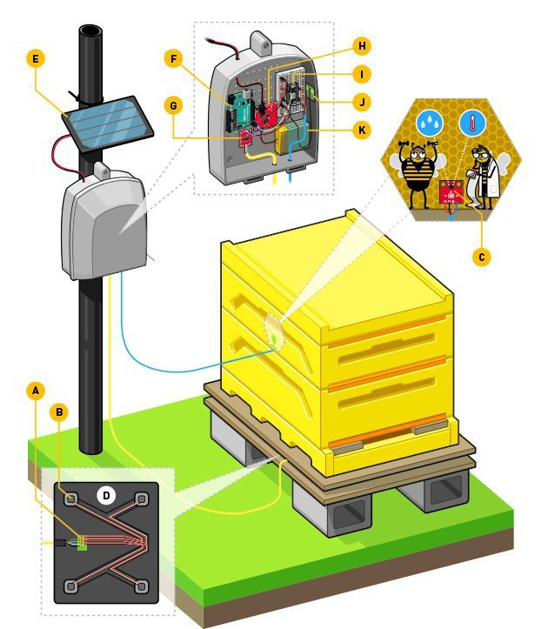
Sensors are being used to collect various types of data

Slide 16
Beekeeping apps are used
to store and organize data
BeeInTouch
https://beeintouch.de/
Beep
https://beep.nl/

Slide 17
…there is people who have put a lot of electric gear nowadays in hives where you can measure temperature, weight, humidity, and you get that sent to your smartphone 24-7… But at this stage, I see there's a lot of data collected, but it's not used or processed a lot yet.
Jonas Geßner

Slide 18
Proposed features for an innovative application
Integrated weather tracking that provides alerts of events
A digital library of beekeeping techniques and practices
A predictive algorithm that recommends strategies to mitigate harm

Slide 19
Work Cited
Kayser-Bril, Nicolas (2018). Europe is getting warmer, and it’s not looking like it’s going to cool down anytime soon. (n.d.). European Data Journalism Network - EDJNet. Retrieved February 22, 2024, from https://www.europeandatajournalism.eu/cp_data_news/europe-is-getting-warmer-and-it-s-not-looking-like-it-s-going-to-cool-down-anytime-soon/
Willige, A.(Dec 2019) 75% of crops depend on pollinators - they must be protected. World Economic Forum. https://www.weforum.org/agenda/2019/12/protect-pollinators-food-security-biodiversity-agriculture/
Wetter und Klima - Deutscher Wetterdienst - Our services - Time series and trends. (n.d.). Www.dwd.de. https://www.dwd.de/EN/ourservices/zeitreihen/zeitreihen.html
Seasons in Germany shifting to shorter winters, earlier summers. (2020, March 12). Clean Energy Wire. https://www.cleanenergywire.org/news/seasons-germany-shifting-shorter-winters-earlier-summers
Redaktion, S. M.-M. (2023, December 20). Lass Dein Herz entscheiden… | Heinz Risse - Mellifera Berlin. Mellifera Regionalgruppe Berlin. https://mellifera-berlin.de/imkerportraits/imkerportrait-lass-dein-herz-entscheiden-heinz-risse/
Über uns. (n.d.). Stadtbienen. https://www.stadtbienen.org/vision-mission/
Aus- und Weiterbildung. (n.d.). Mellifera Regionalgruppe Berlin. Retrieved April 27, 2024, from https://mellifera-berlin.de/ausbildung/
Imkerkurs. (n.d.). Stadtbienen. Retrieved April 27, 2024, from https://www.stadtbienen.org/angebote/kurse/imkerkurs/
Alburaki, M., & Corona, M. (2021). Polyurethane honey bee hives provide better winter insulation than wooden hives. Journal of Apicultural Research, 61(2), 190–196.https://doi.org/10.1080/00218839.2021.1999578
Underwood, R., PhD. (n.d.). Methods to Control varroa mites: An Integrated pest Management approach.https://extension.psu.edu/methods-to-control-varroa-mites-an-integrated-pest-management-approach
Kridi, D. S., De Carvalho, C. G. N., & Gomes, D. G. (2016). Application of wireless sensor networks for beehive monitoring and in-hive thermal patterns detection. Computers and Electronics in Agriculture, 127, 221–235.https://doi.org/10.1016/j.compag.2016.05.013
BeeInTouch - Die kostenlose Imker App und Stockkarten App. (n.d.).https://beeintouch.de/
BEEP - Digital beekeeping. (n.d.). BEEP - Bijenmonitoring.https://beep.nl/index.php/home-english

Slide 20
Acknowledgements

Slide 21
Thank you! Questions?

