Slide 1
Updating Nantucket’s GHG Inventory
Notes:
Brennan - Good afternoon everyone, we are the team responsible for updating Nantucket’s Greenhouse Gas inventory.

Slide 2
Brennan Aubuchon
Computer Science Major
Class of 2022
Tyler Melo
Mechanical Engineering Major
Class of 2022
Callan Moriarty
Business Major
Class of 2022
Jared Poulos
Computer Science Major
Class of 2022
Meet the Team
Notes:
All of us

Slide 3
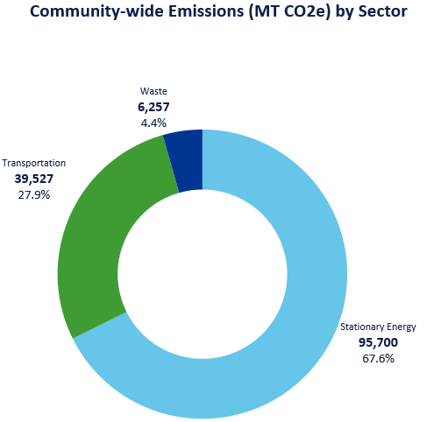
Nantucket’s Greenhouse Gas Emissions, by Sector
Total
141,484
MT CO₂e
Notes:
Tyler

Slide 4
Background
Notes:
Tyler

Slide 5
What is a Greenhouse Gas inventory?
Notes:
Tyler - A tool for communities to quantify their emissions

Slide 6
Why does Nantucket want to update it?
Previous GHG inventory for Nantucket was developed in 2009
Contained more limited assumptions based on national estimates
Notes:
Brennan - The previous inventory was conducted in 2009, but the tools and protocols that they had at the time forced them to make some very general assumptions. For instance, in the case of purchased electricity and how that electricity is generated, they used a national US average, which much more heavily favored coal for electricity generation compared to the much greener generation that is in Massachusetts. It was limited assumptions like these that unfortunately led the inventory and the subsequent climate action plan to not be accepted by the town.

Slide 7
Why MAPC?
Notes:
Jared:

Slide 8
Main Goal:
To develop a baseline inventory of Nantucket’s greenhouse gas (GHG) emissions
Notes:
Jared

Slide 9
Review MAPC guidelines and usage in other communities
Determine how MAPC protocols should be modified
Notes:
Brennan & Jared

Slide 10
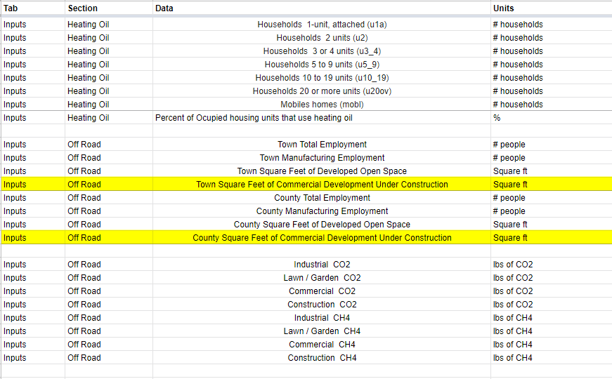
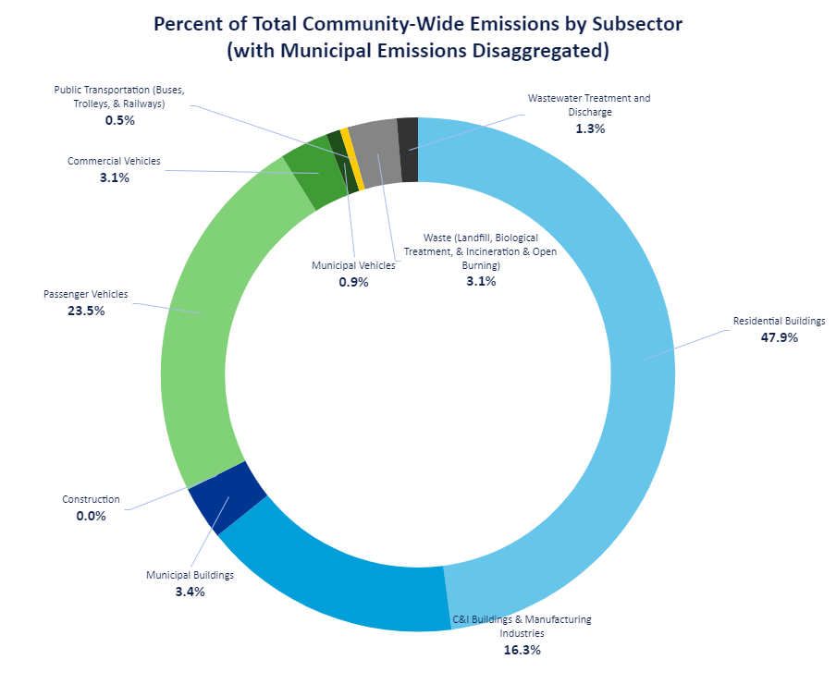
Sourced pertinent data to create the baseline inventory
Analyzed and interpreted key findings revealed by the inventory
Notes:
Tyler & Brennan

Slide 11
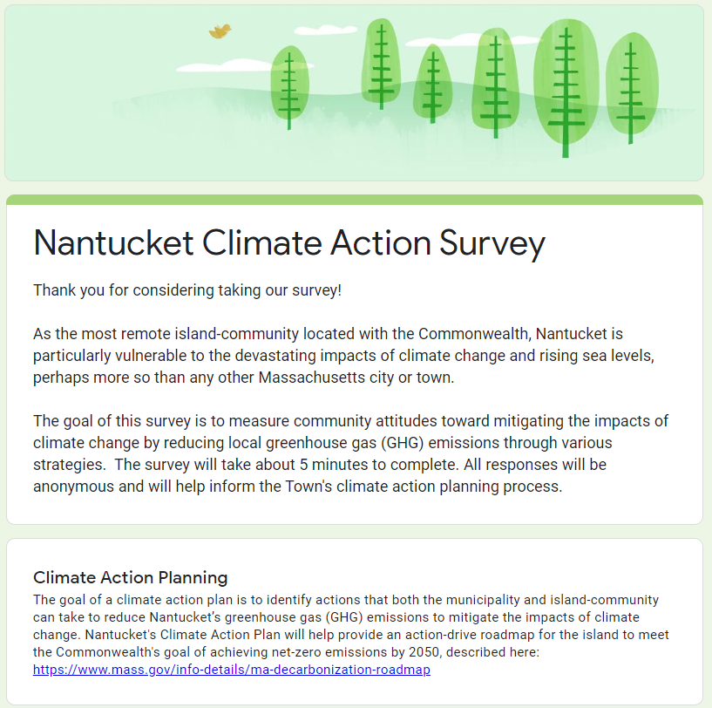
Gauge public opinion about GHG emissions and emissions reduction strategies
Notes:
Callan

Slide 12
Findings
Notes:
Jared

Slide 13
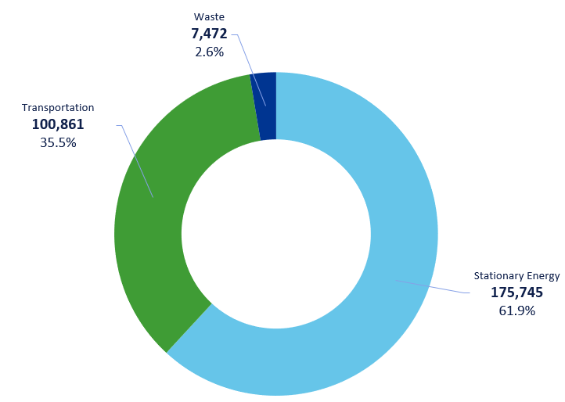
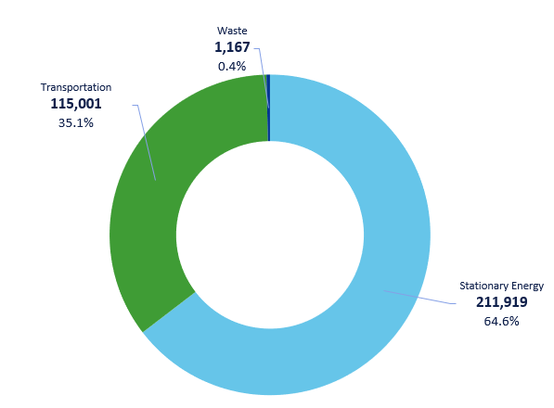
Nantucket’s Emissions (MT CO₂e) by Sector
Arlingtons Emissions (MT CO₂e) by Sector
Natick’s Emissions (MT CO₂e) by Sector
Total
141,484
MT CO₂e
Total
284,078
MT CO₂e
Total
328,088
MT CO₂e
Notes:
Jared

Slide 14
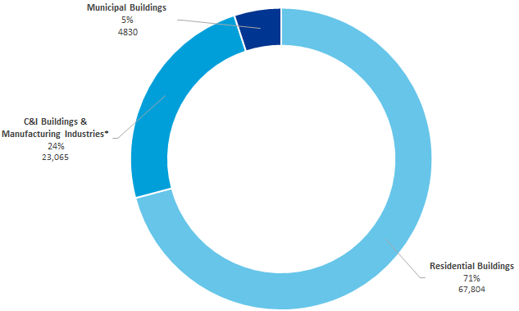
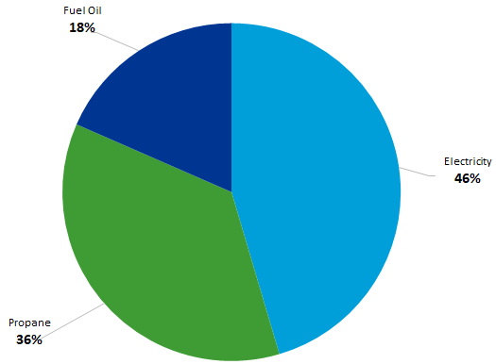
Stationary Energy
Percentage of Stationary Energy Emissions by Subsector
Percentage of Building Energy Emissions by Source Energy

Slide 15
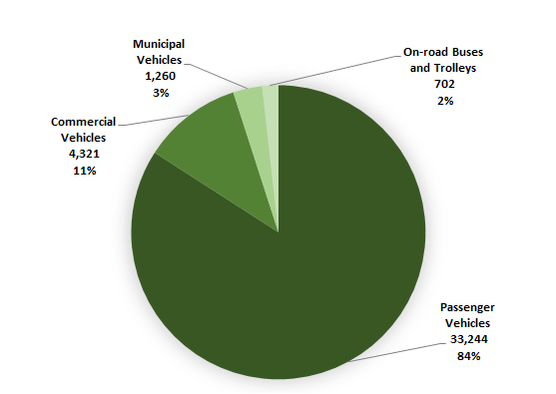
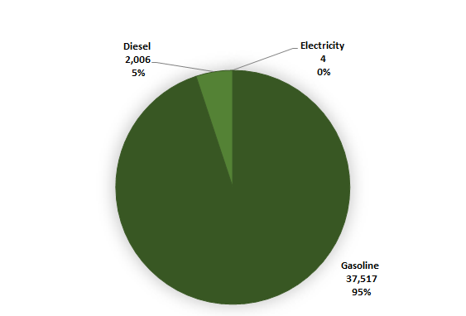
Transportation
Transportation Emissions (MT CO₂e) by Sector
Transportation Emissions (MT CO₂e) by Fuel Type
Notes:
Brennan

Slide 16
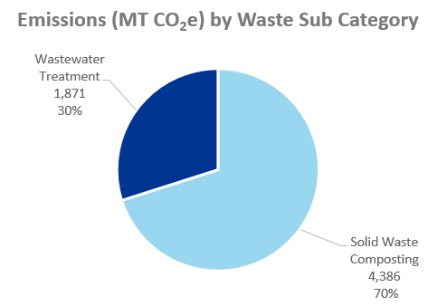
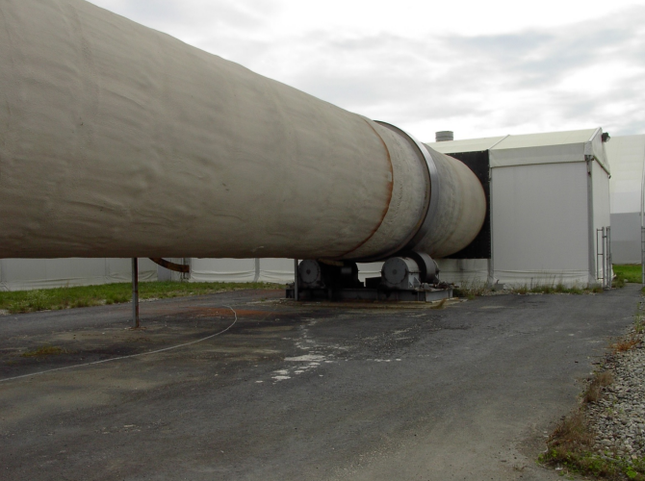
Waste
Notes:
Jared

Slide 17
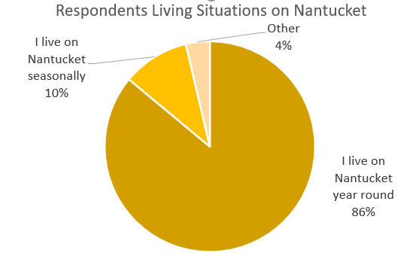
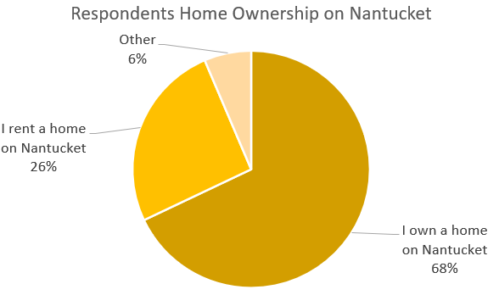
Survey Respondents
118 respondents at the time of info gathering
Sent to a mailing list from our sponsor
Sent to the town staff
Posted on ACK Smart Energy Instagram
Notes:
Some of the sampling data is 86% of respondents live on Nantucket while 10% live on Nantucket seasonally
68% of respondents own a home while 26% rent a home on Nantucket
Please note that this sampling data many not truly represent

Slide 18
Conclusions and Recommendations
Notes:
Callan

Slide 19
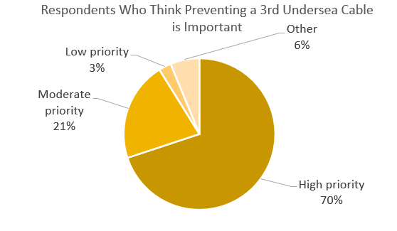
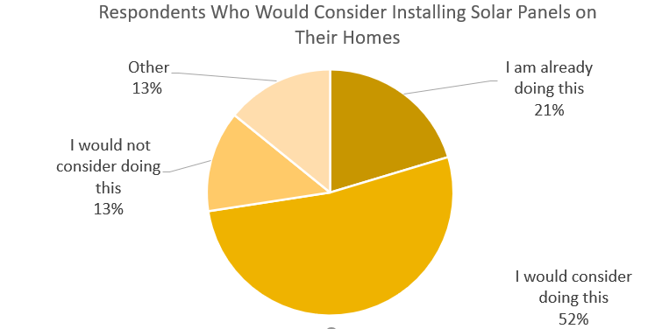
Stationary Energy
Lower energy use all together
More island based renewable sources for electricity
Cleaner heating and cooling systems for homes

Slide 20
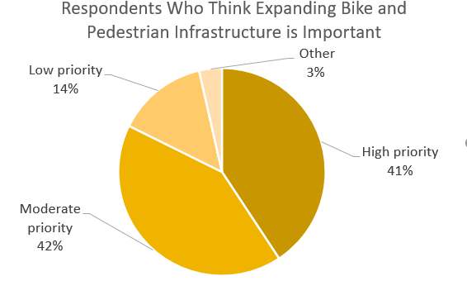
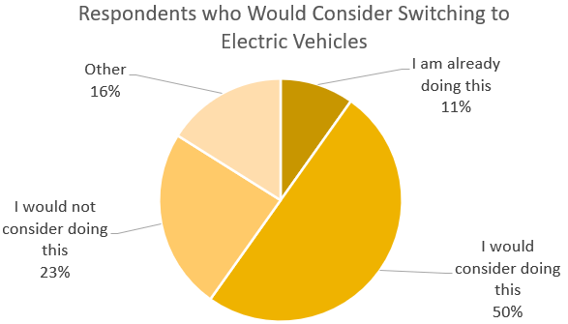
Transportation
Expand bicycle and pedestrian infrastructure
Switch to electric vehicles

Slide 21
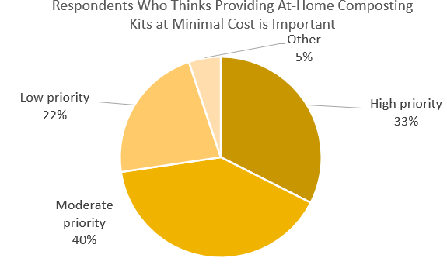
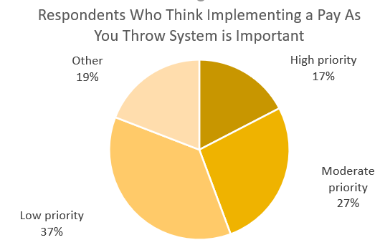
Waste
Create at home composting kits
Do not implement a “Pay As You Throw” system.

Slide 22
Thank you!

Slide 23
Questions?

