Slide 1
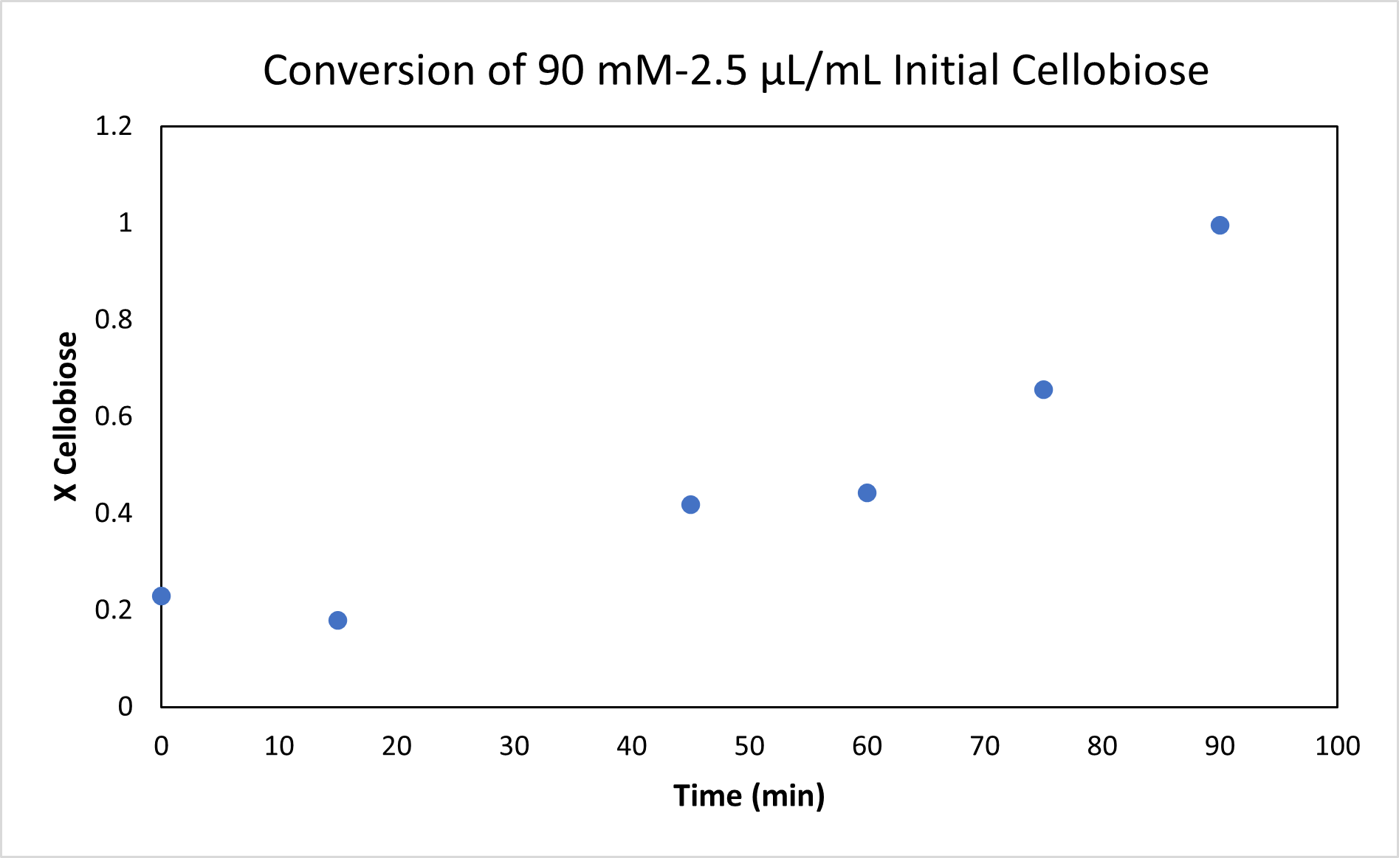
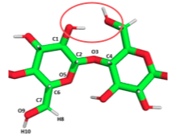
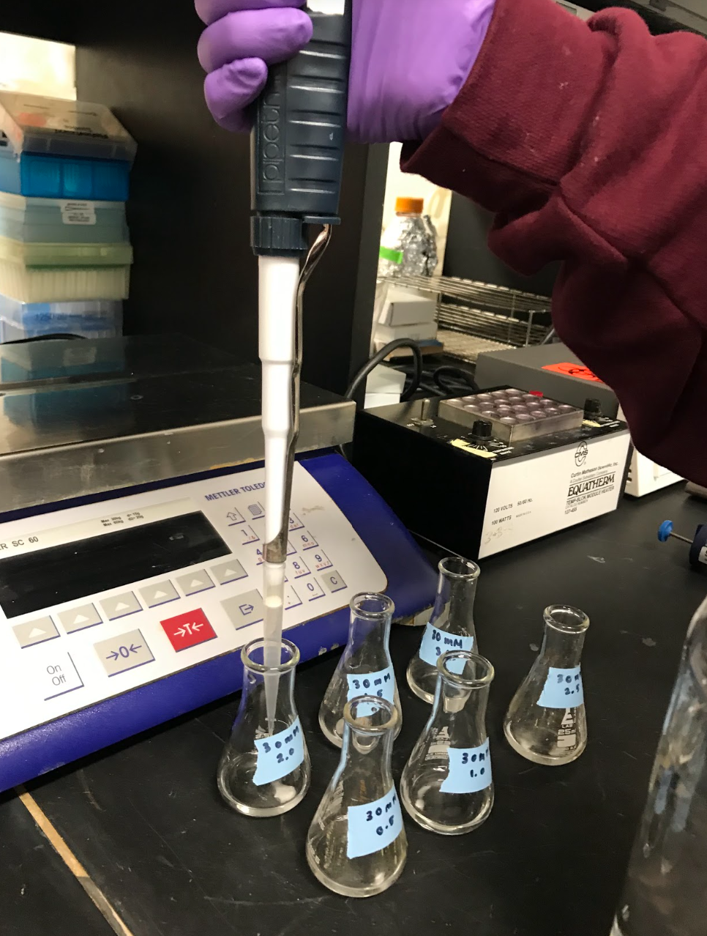
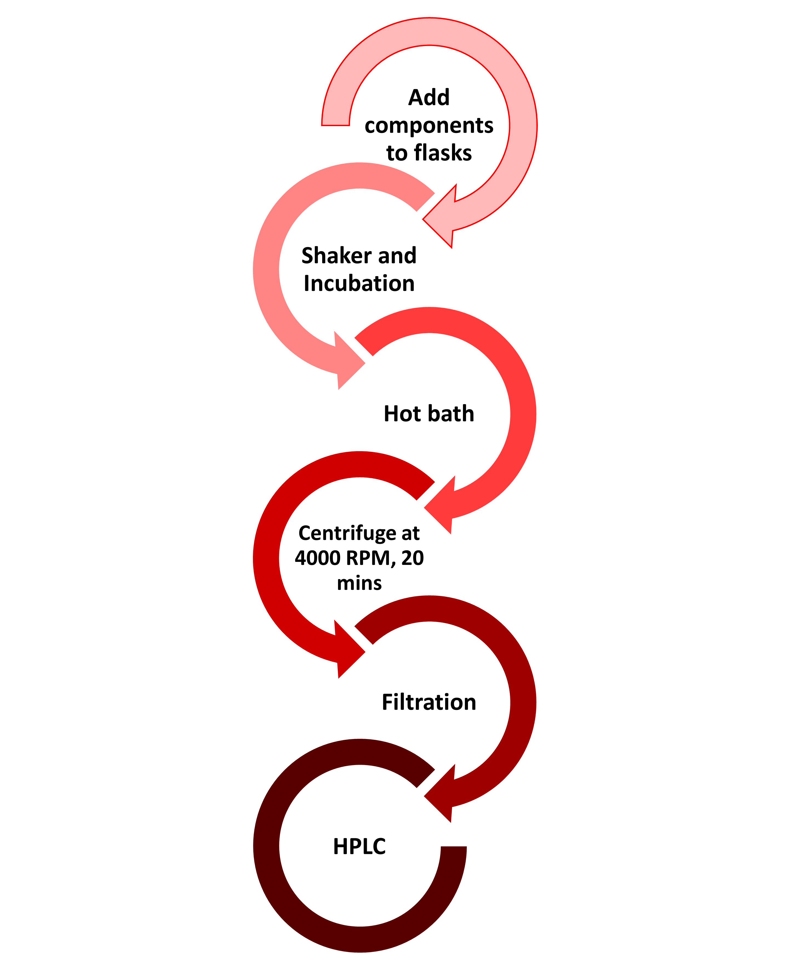
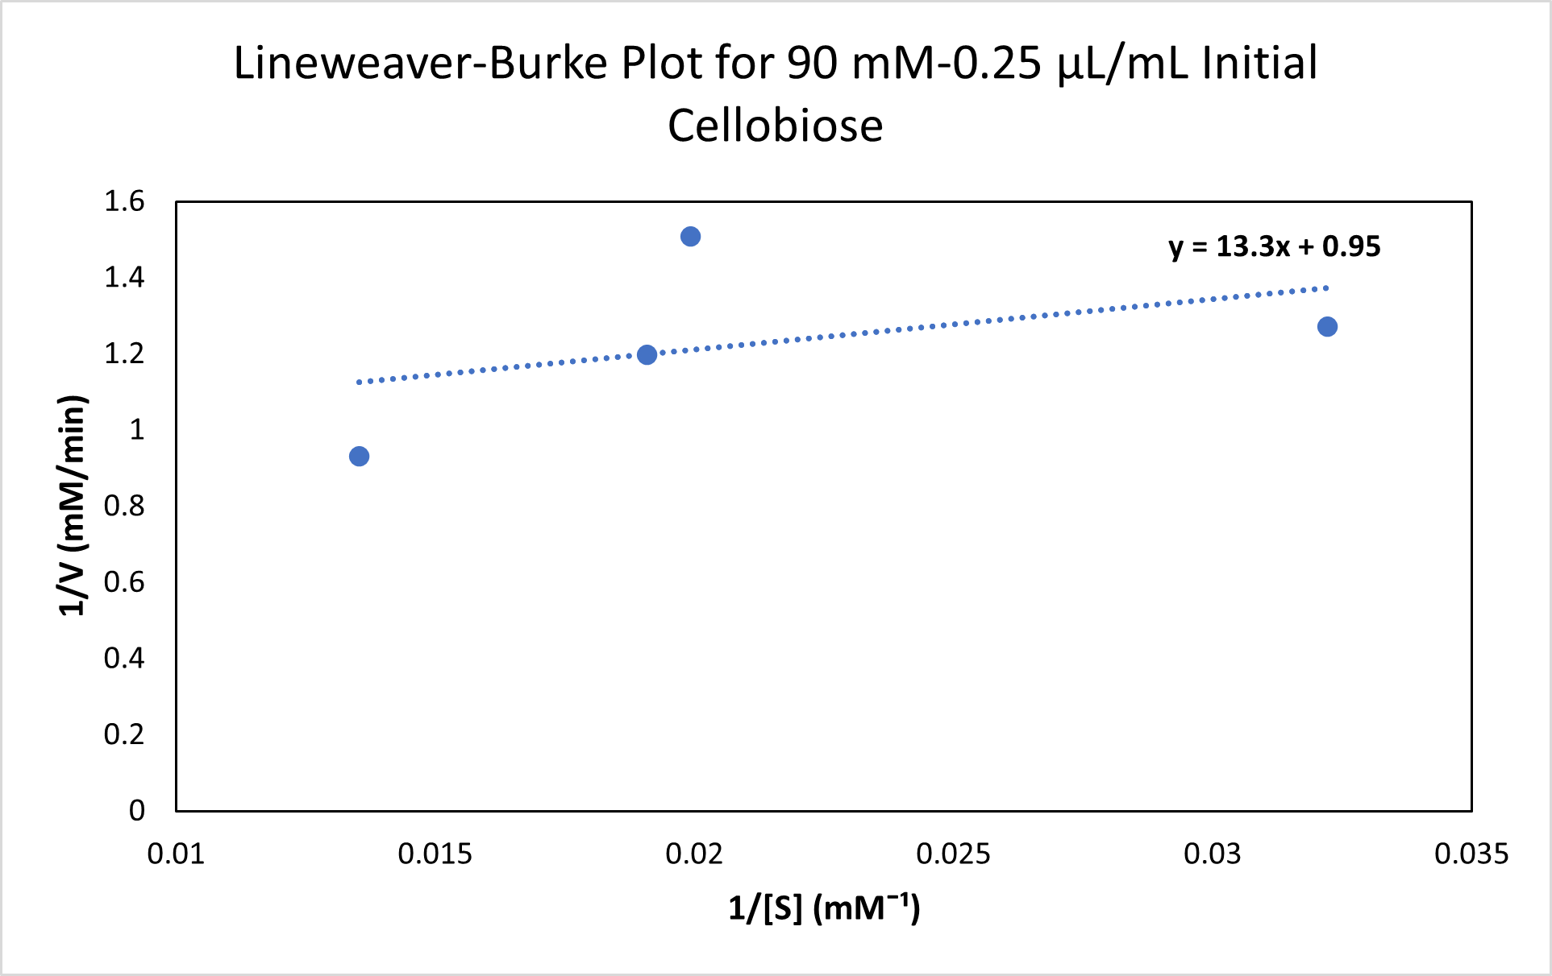
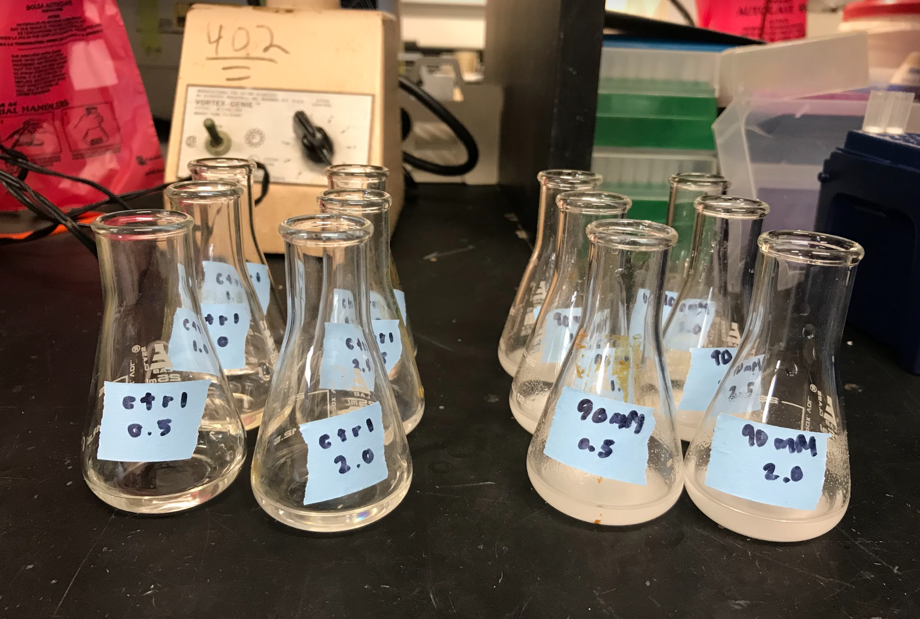
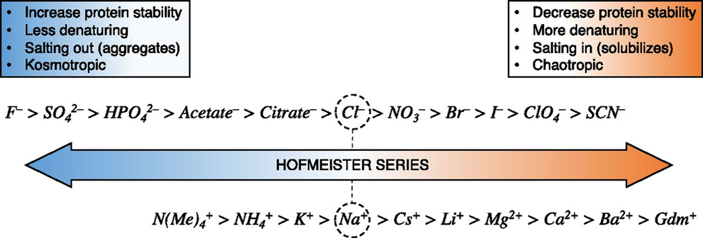
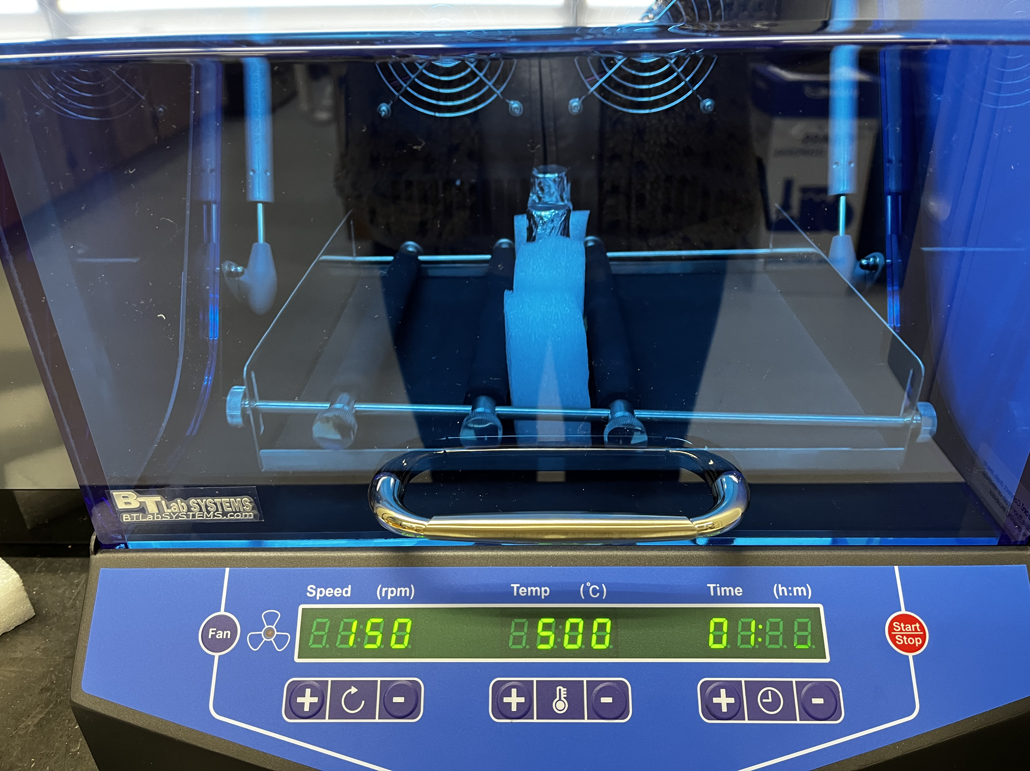
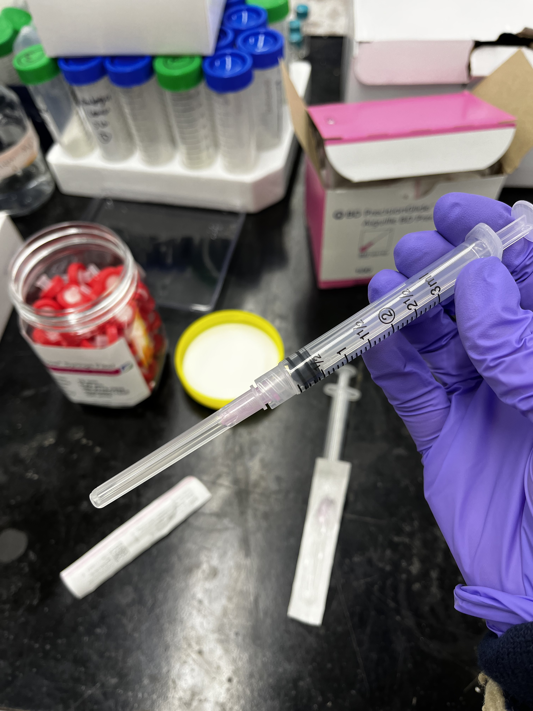
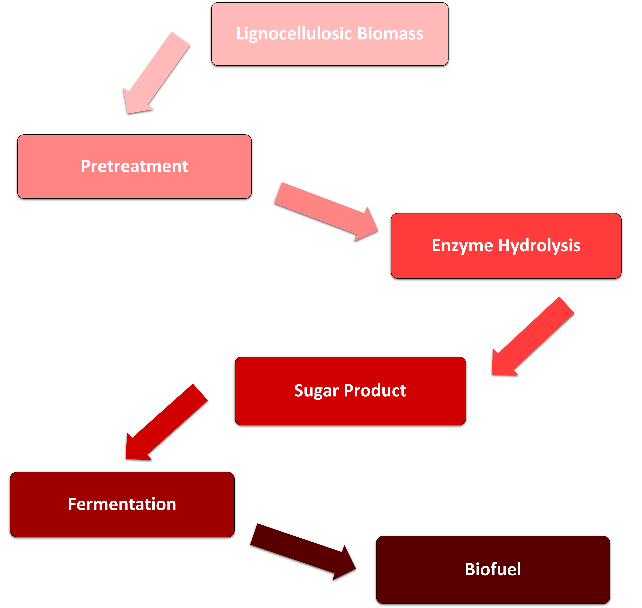
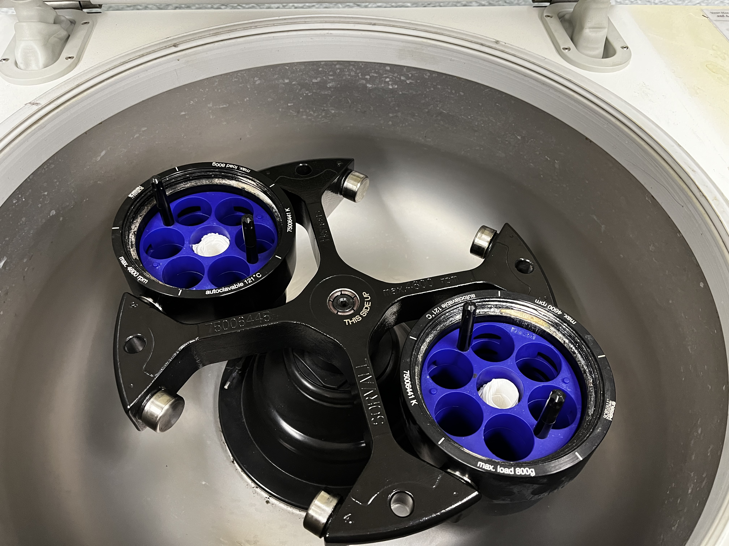
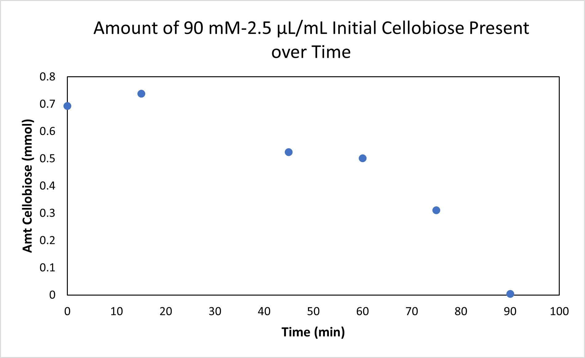
CELLOBIOSE ENZYME HYDROLYSIS FOR IDEAL GLUCOSE PRODUCTION
Hailey Hanscom (CHE), Kim Mori (CHE), Emma Paxton (CHE)
Advisors: Professor Michael T. Timko (CHE), Professor Ali A. Salifu (BME)
Chemical Engineering, Worcester Polytechnic Institute, Worcester, MA
BACKGROUND
​
OBJECTIVE
RESULTS
Biomass has been used in biofuel production for a long time, but this project focuses on the great potential for biomass substrates, lignocellulosic biomass (LB) collected from bamboo specifically, to be used in enzyme hydrolysis reactions. Through this process, the maximum yield of glucose from cellobiose will be discovered, which is necessary for increased biofuel production. The goal was to also study the potential of the "Hofmeister Effect" using different salts to optimize the process.
To determine optimal parameters for cellobiose-based enzyme hydrolysis for high yields of glucose for bioethanol fermentation.
The amount of cellobiose that was used up by the reaction in terms of conversion
METHODOLOGY
V_{max}= 1 mM/min
K_{m}= 14 mM
LB plot to determine the Vmax and Km values for the kinetics of the reaction
THE PROCESS
DISCUSSION
​
Throughout the course of this project, different concentrations of cellobiose were tested to determine optimum glucose production. The reaction time that was chosen varied, as was the different concentrations of cellobiose; the concentration of glucose produced reached its peak in the beginning of the reaction. In addition to making the reaction time shorter, the samples were pulled at smaller time intervals to be able to closely analyze how enzyme hydrolysis influences cellobiose and glucose production. The data from the graphs show how cellobiose concentrations changed based on enzyme addition and volume.
No food or animal stock feed harvested from marginal lands makes LB a second-generation biofuel.
Mechanochemical pretreatment combine both the chemical (enzyme hydrolysis) and mechanical (ball-milling) processes without limitations.
RESULTS
​
CONCLUSION
​
Although the expected data was not able to be collected for an analysis that would draw telling conclusions for this procedure in particular, recommendations for bettering this procedure can be made.
Hydrolyzed LB produces simple sugars that can be fermented and used in production of biofuels.
ACKNOWLEDGEMENTS
​
Thank you to Professor Timko, and Professor Salifu for supporting us throughout the project period. Additionally, thank you to Professor Stewart and Longkuan Xiang for aiding in research space and equipment.
Amount of cellobiose in samples after the different reaction time points that the samples were pulled out at.

