Slide 1
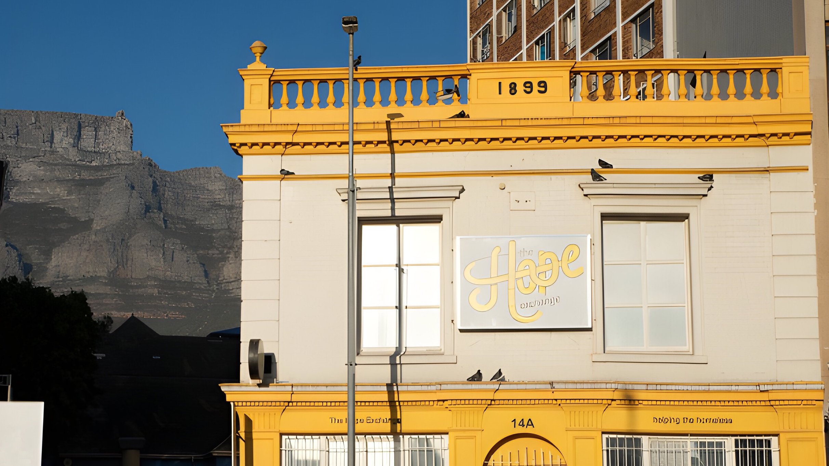
Barista Skills Program Pipeline
Brent Weiffenbach, Kenyon Coleman, Scott West, Sean Sullivan

Slide 3
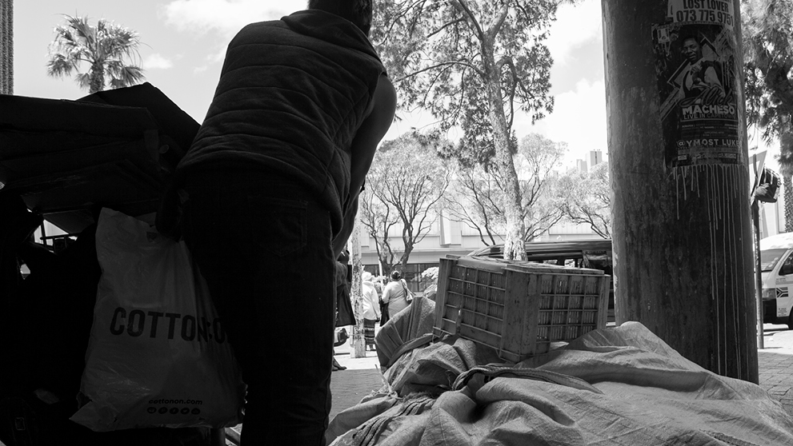
~14,000 Homeless
~71% for more than 1 Year
~50% Chronic Homelessness

Slide 6
?

Slide 7
5 Phases of the Pipeline
1
2
3
4
5
THE Screening
Job Readiness
Barista Training
Job Shadowing
Post Graduation

Slide 8
1
2
3
4
5
THE Screening
Job Readiness
Barista Training
Job Shadowing
Post Graduation

Slide 9
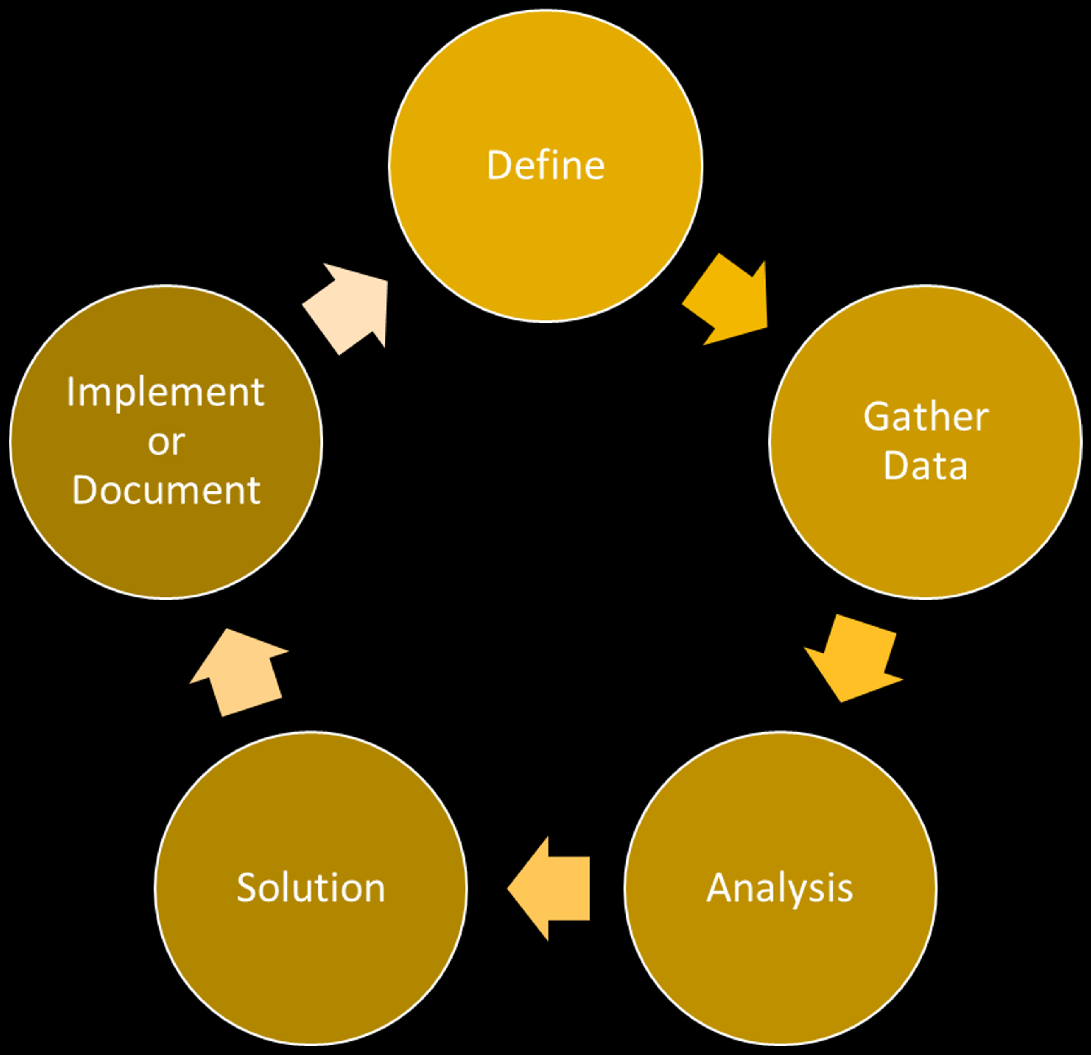
Cyclical Process Improvement Method

Slide 10
Overview of the New Process
Past
Current
Future

Slide 11
The Hope Exchange Screening
Current Process Map
Past
Current
Future

Slide 12
The Hope Exchange Screening
Current

Slide 13
The Hope Exchange Screening
Current

Slide 14
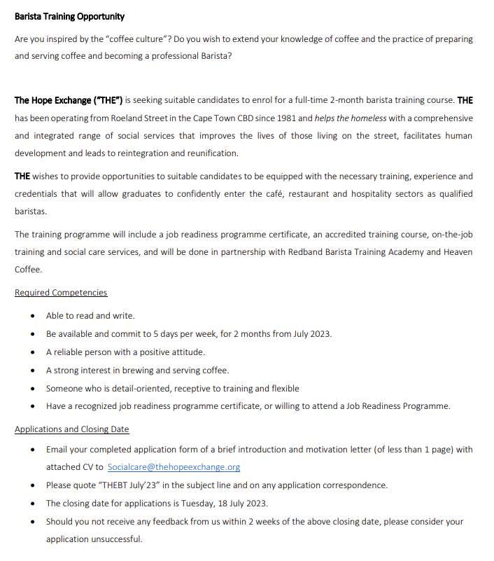
The Hope Exchange Screening

Slide 15
The Hope Exchange Screening
Current

Slide 16
Job Readiness
Current

Slide 17
Job Readiness
Current

Slide 18
Job Readiness
13-day job readiness Course
Teaches skills ranging from resume/CV creation to financial literacy
Located in Manenberg, a dangerous area
Transportation costs were greater than the cost of the training
11-day job readiness course
Teaches a similar set of skills to W4AL course
Offered with RedBand or potentially in-house with CCID
Cheaper than W4AL

Slide 19
Job Readiness
Current

Slide 20
Job Readiness
Future

Slide 21
Job Readiness
Current

Slide 22
Current
Barista Training

Slide 23
Current
Barista Training

Slide 24
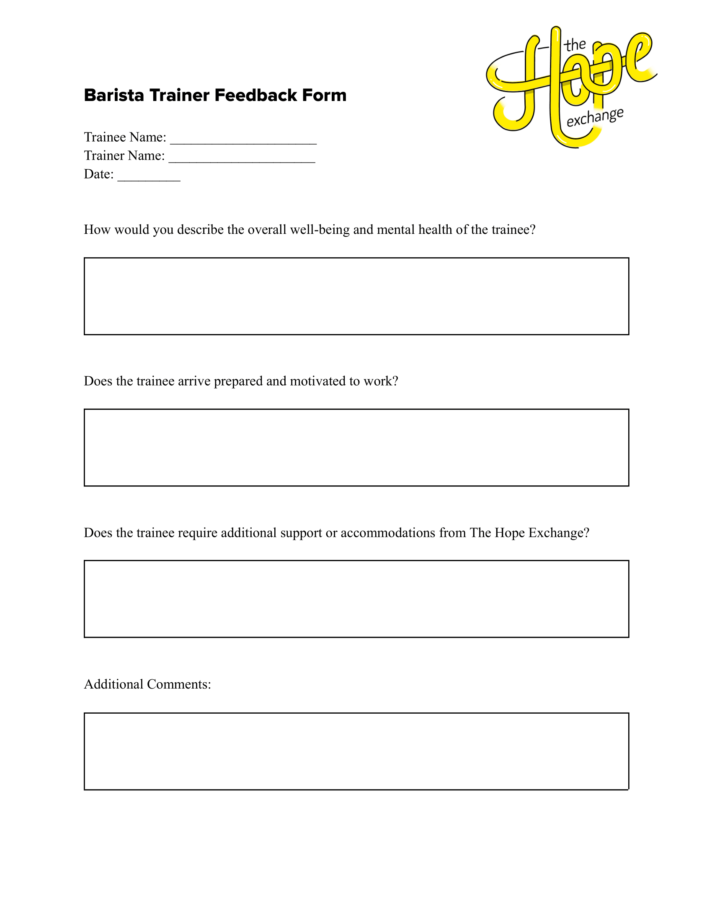
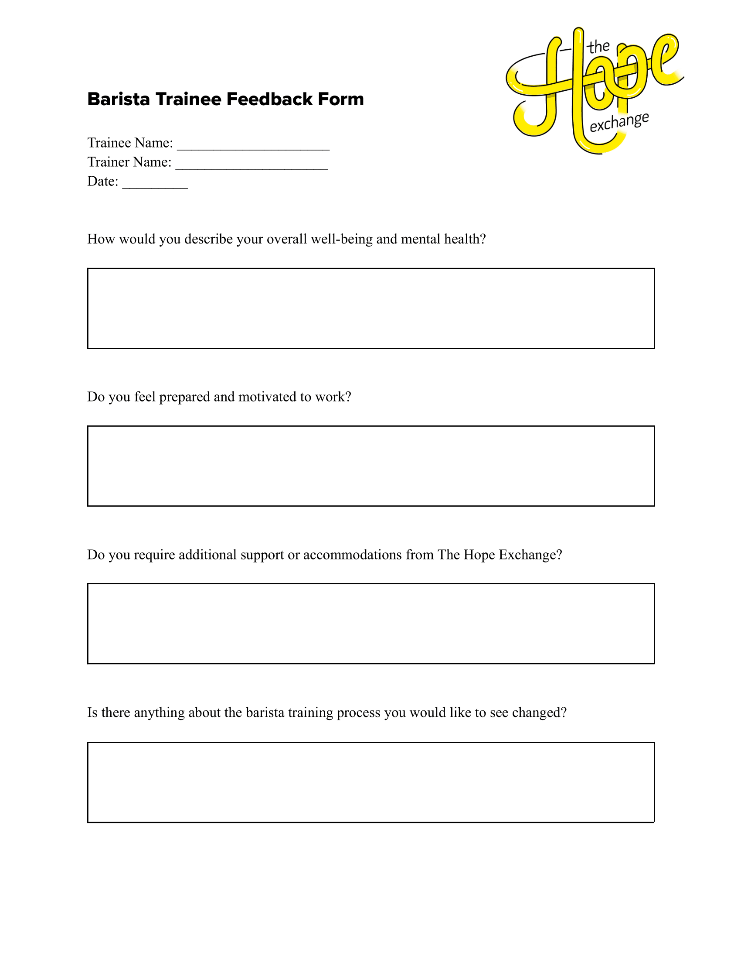
Barista Training

Slide 25
Current
Barista Training

Slide 26
Job Shadowing
Current

Slide 27
Job Shadowing
Current

Slide 28
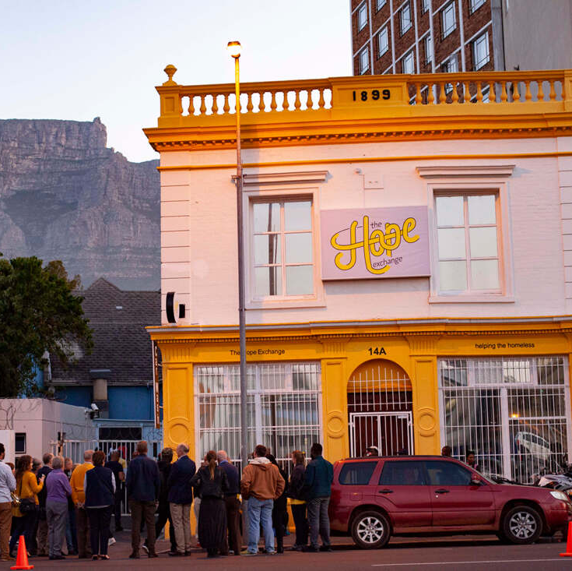
Job Shadowing

Slide 29
Job Shadowing
Current

Slide 30
Job Shadowing
Future

Slide 31
Job Shadowing
Current

Slide 32
Post Graduation
Current

Slide 33
Post Graduation
Current

Slide 34
Post Graduation

Slide 35
Final Comparison
Past
Future

Slide 36
Future Implications

Slide 37
Conclusions
Increased Communication
New
Partners
Greater
Funding
Better
Experience

