Slide 1
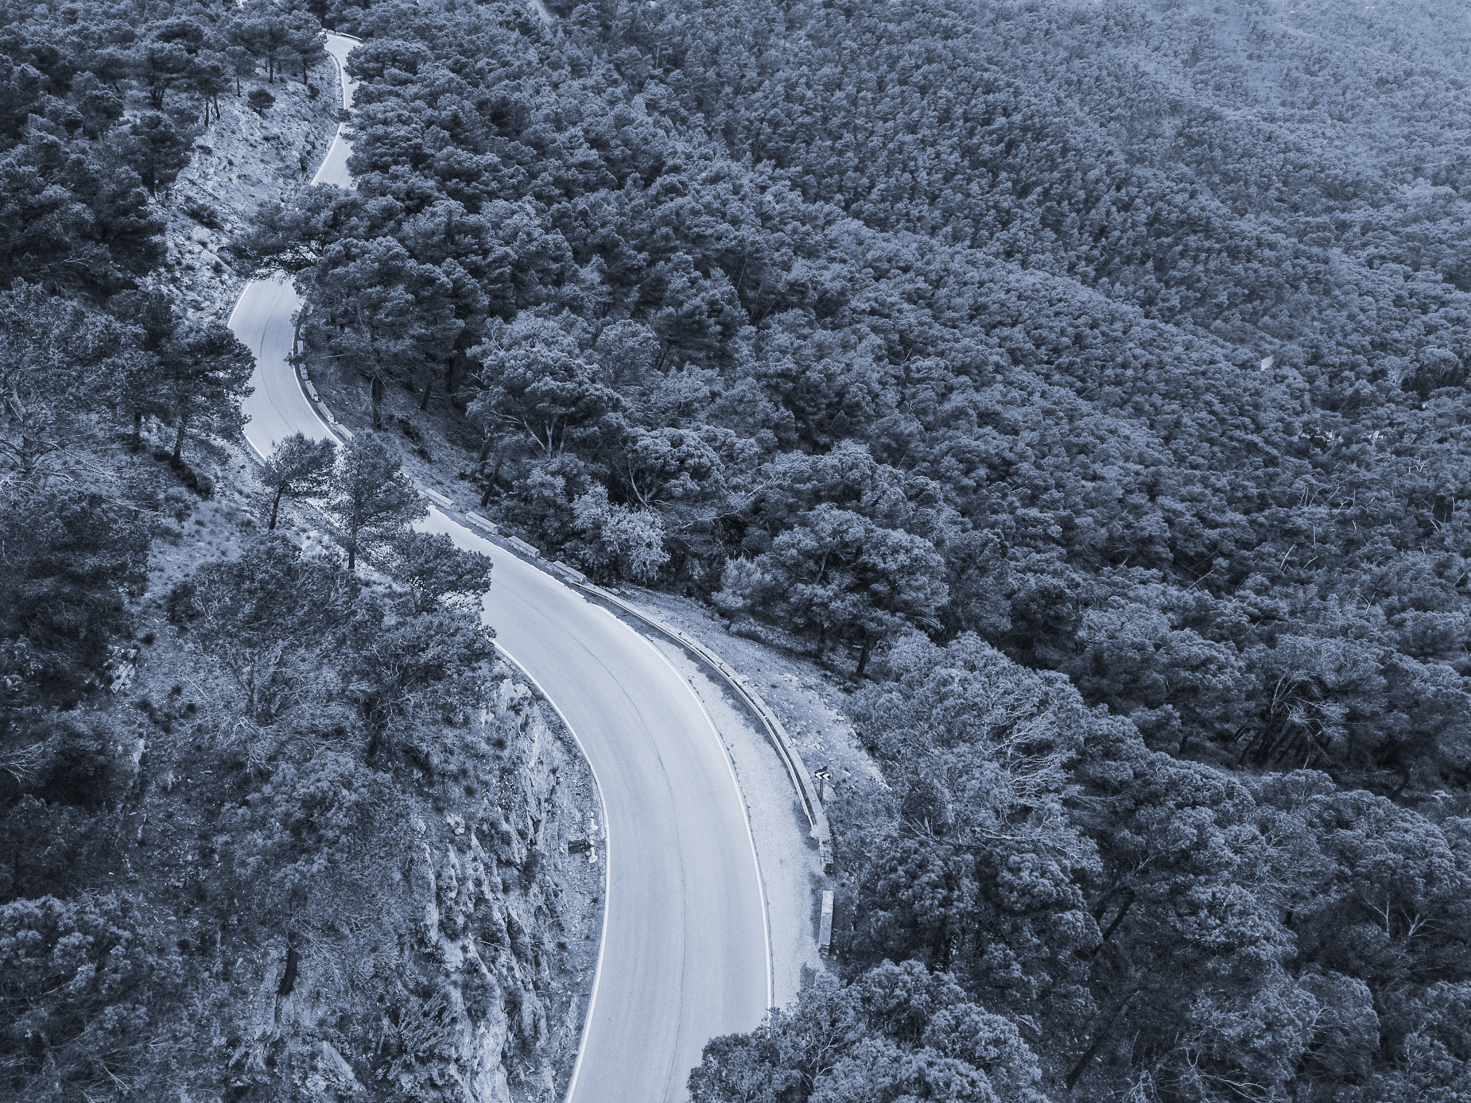
IDAAN Hydraulics Modeling Optimization
Bridget Gillis – Civil Engineering
Steven Defreitas – Biomedical Engineering and Interactive Media
Nicholas Thornton – Mechanical Engineering

Slide 2
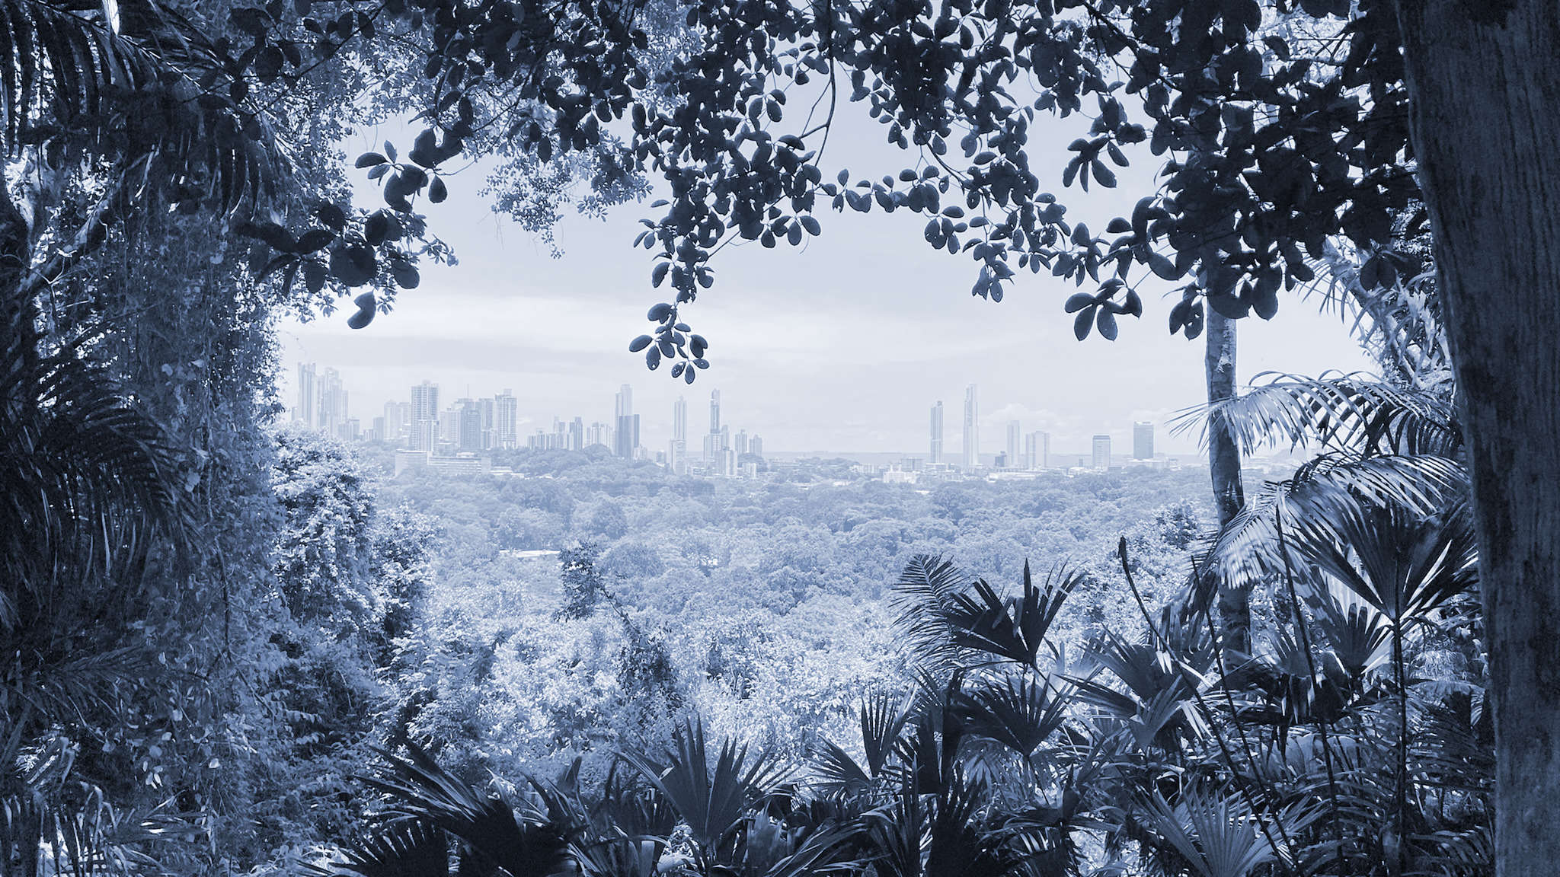
INTRODUCTION
01

Slide 3
THE ISSUE
Irregular water supply in Corregimiento Kuna Nega (~ 2 days a week)
Poor water pressure and flow issues
Limited government funds hold back progress
Leads to poor health outcomes, premature deaths, and a diminished quality of life
Water is a central part of life: necessary for sanitation, domestic chores, and, of course, drinking. The people’s health and dignity are at stake.
Notes:
Bridget:
For many Panamanians living in rural and depressed neighborhoods outside the city, a steady supply of potable (drinking) water is not guaranteed. This is true for Kuna Nega…
Water is delivered about 2x a week
And this is not because of a lack of water supply - its due to distribution challenges
Low pressure and low flow rates mean the water can’t reach its destination
This situation could easily be fixed if there was enough funding for more powerful pumping equipment and proper maintenance - but the government underfunds
Not having water holds back residents in Kuna Nega economically, but can often also lead to poor health outcomes, premature deaths, & diminished quality of life
Our project is particularly interesting because its potential to impact the over 11 thousand residents of Corregimiento Kuna Nega.

Slide 4
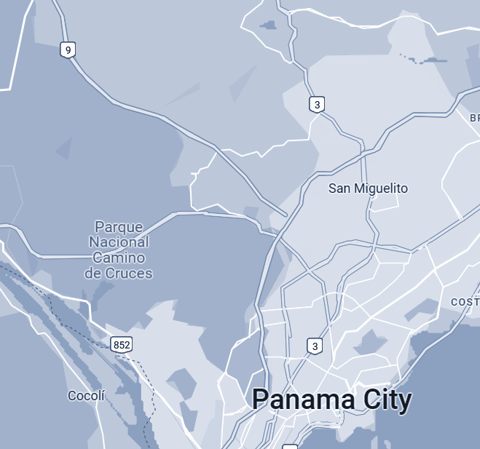
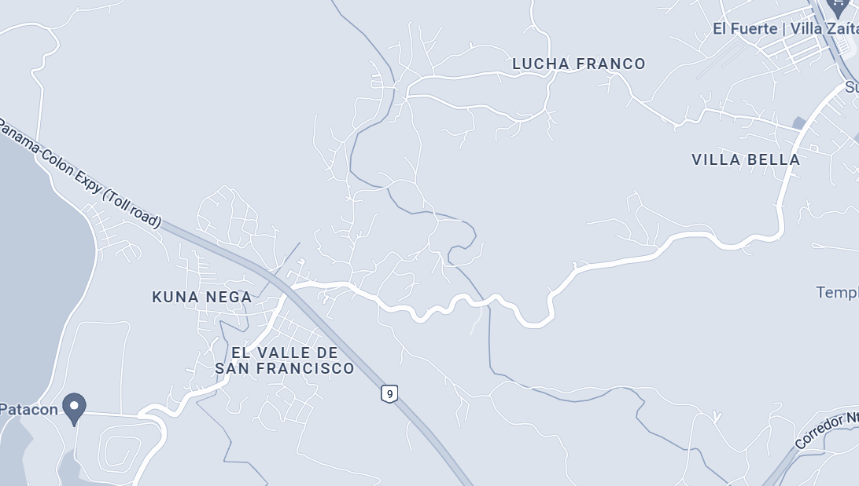
WATER DISTRIBUTION SYSTEM LOCATION
Corregimiento Kuna Nega
Panama City Metropolitan Area
Notes:
Bridget:

Slide 5
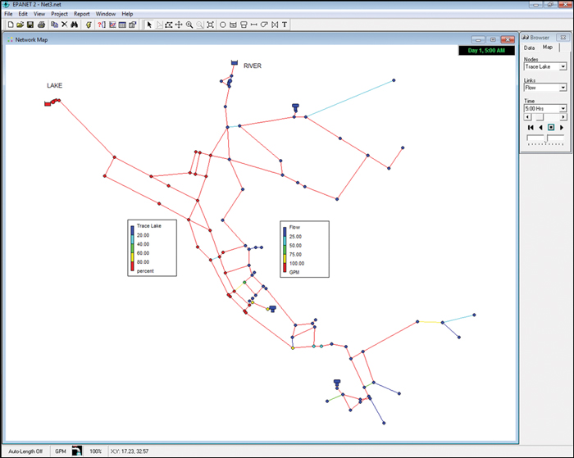
PROJECT GOALS
National Institute of Aqueducts and Sewers (IDAAN)
Evaluate current network in Corregimiento Kuna Nega using EPANET software
Field Data
Propose a schedule for equitable water distribution
Suggest optimization changes for the future
[1]
[2]
[3]
Notes:
Bridget:
We worked with IDAAN - Government Agency in charge of Aqueducts and Sewers - to evaluate the current water network in Kuna Nega
using modeling software called EPANET, developed by the EPA, we would map out entire network. we can identify where things in the system are going wrong using simulations
Do to this we needed a whole lot of data; general things, like where is the water infrastructure located in relation to each other, as well as very specific things like each pipe’s diameter in the network
Once complete, we used our model to
Propose a new schedule for equitable water distribution
Suggested optimization changes - MENTION PATACON

Slide 6
BACKGROUND
02

Slide 7
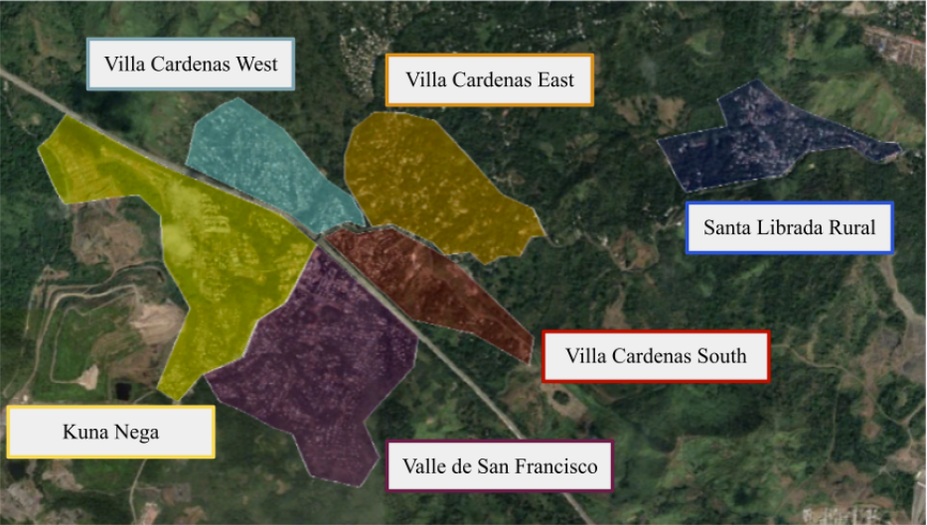
Notes:
Steve
9 mi long
3.5 sq mi

Slide 8
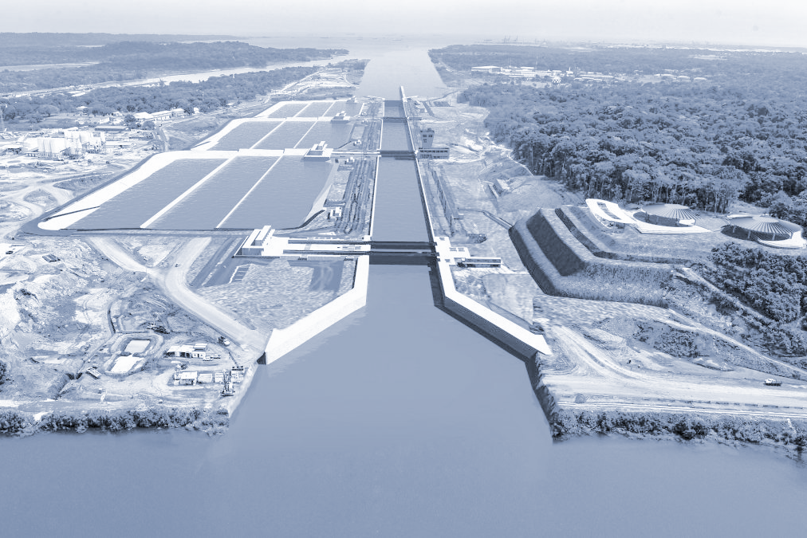
POPULATION & DEMAND
Rapid population growth increases demand
Restricted water supply encourages unsafe water storage
Rotational vs Demand Supply
[5]
Notes:
Steve
Emphasize poverty and proximity to landfill

Slide 9
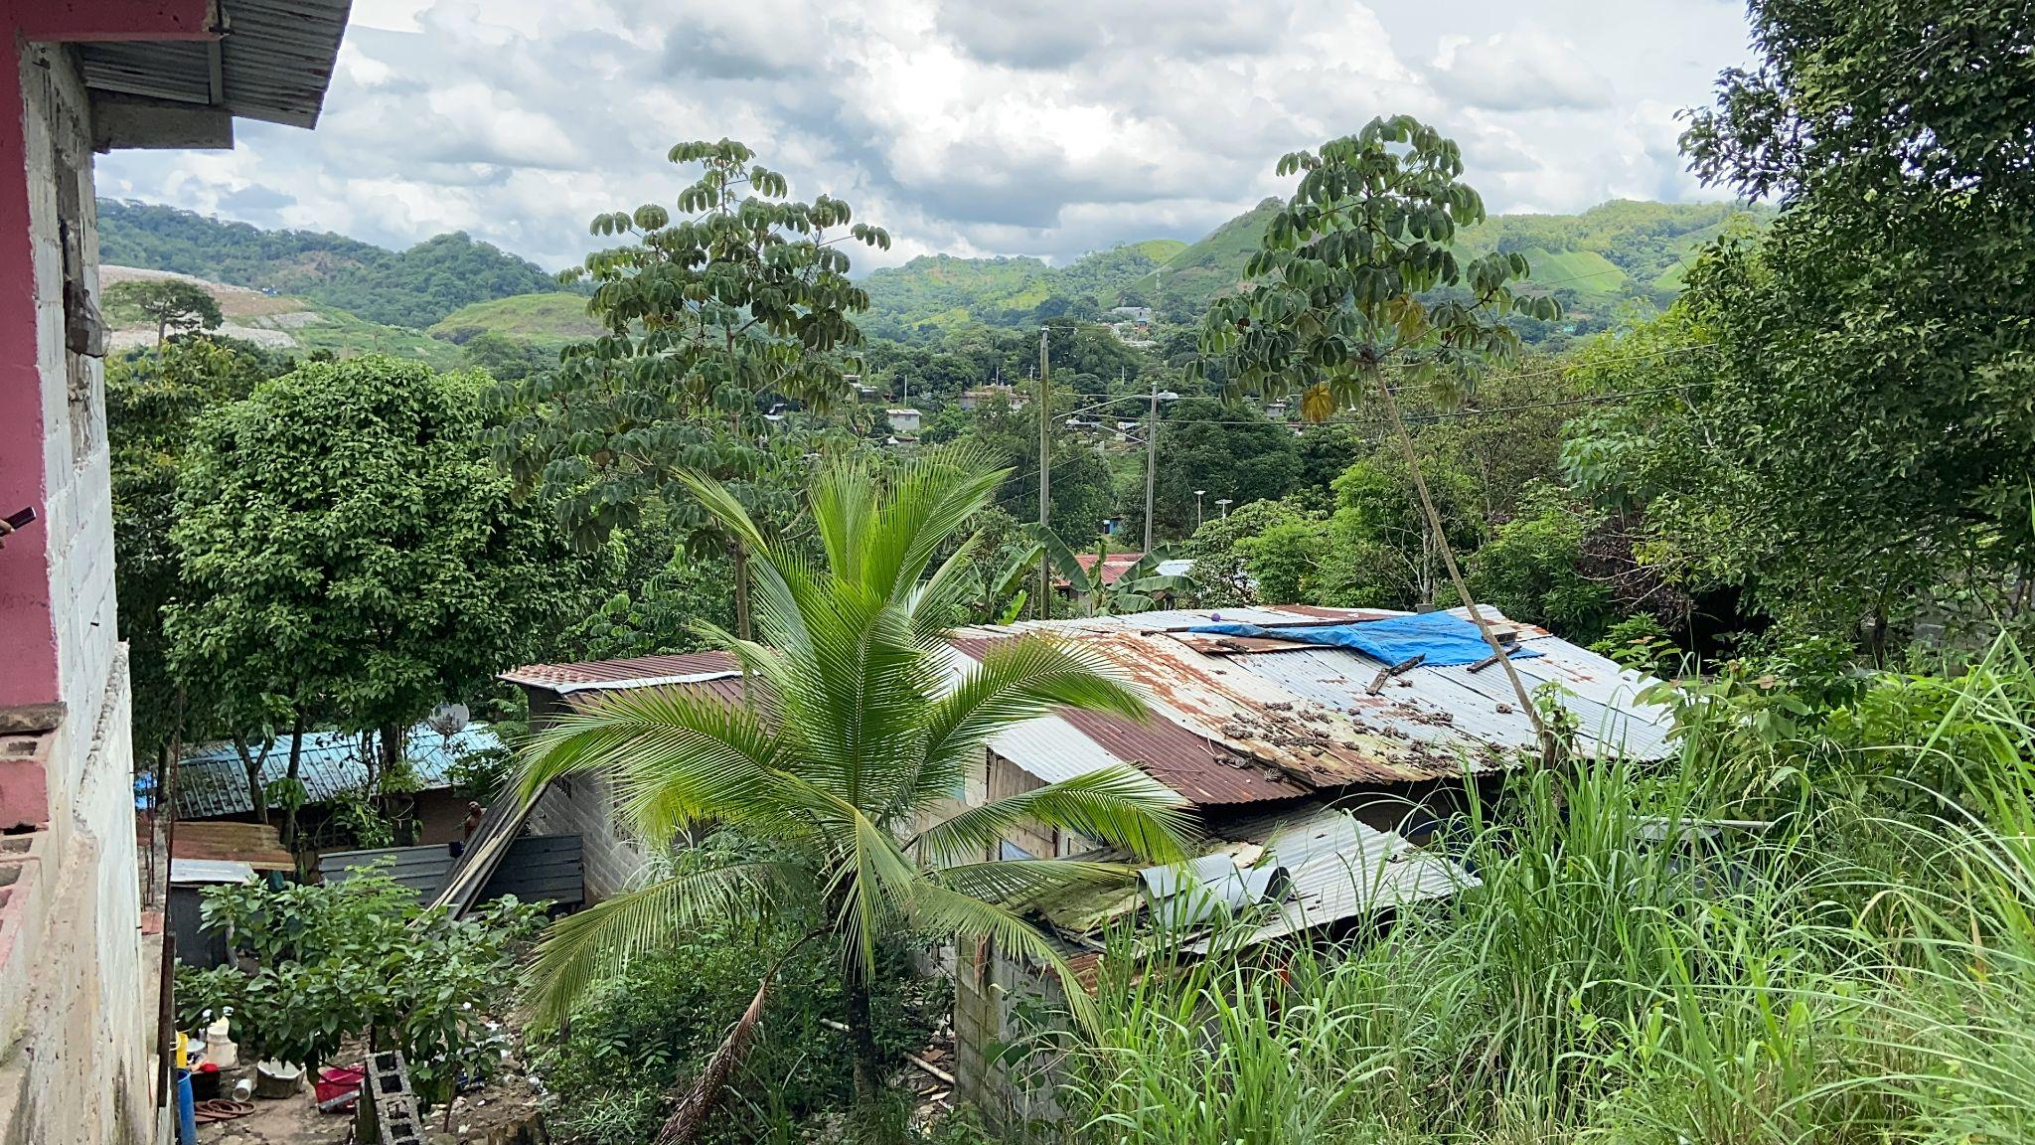
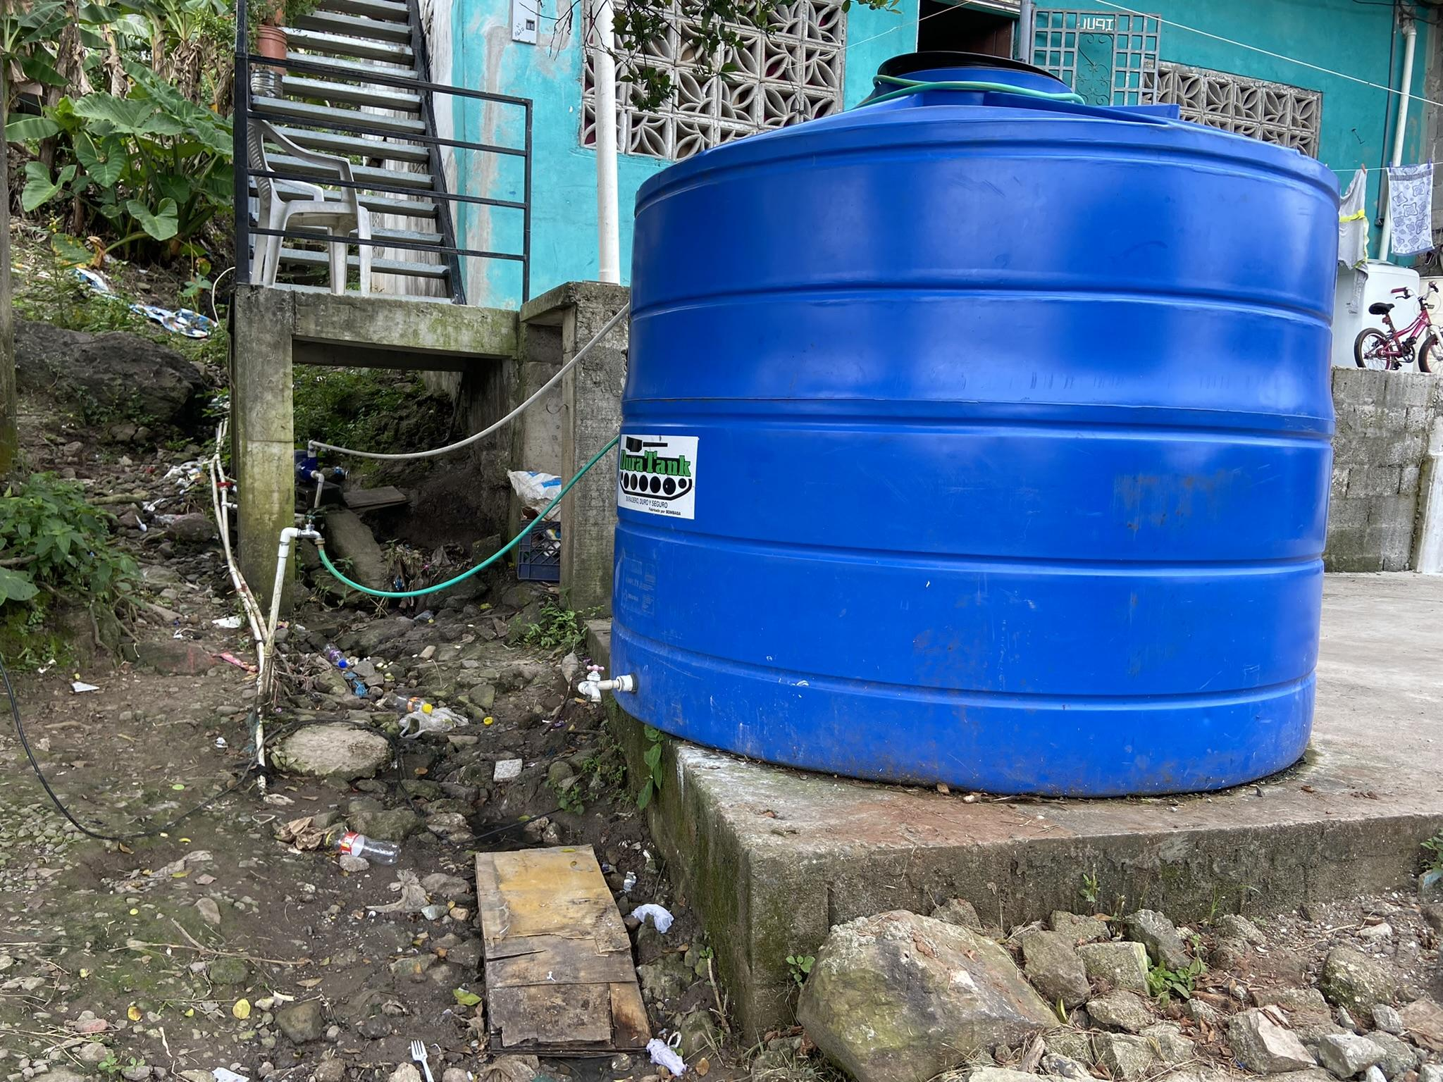
Notes:
Steve
Emphasize poor storage pic & health outcomes

Slide 10
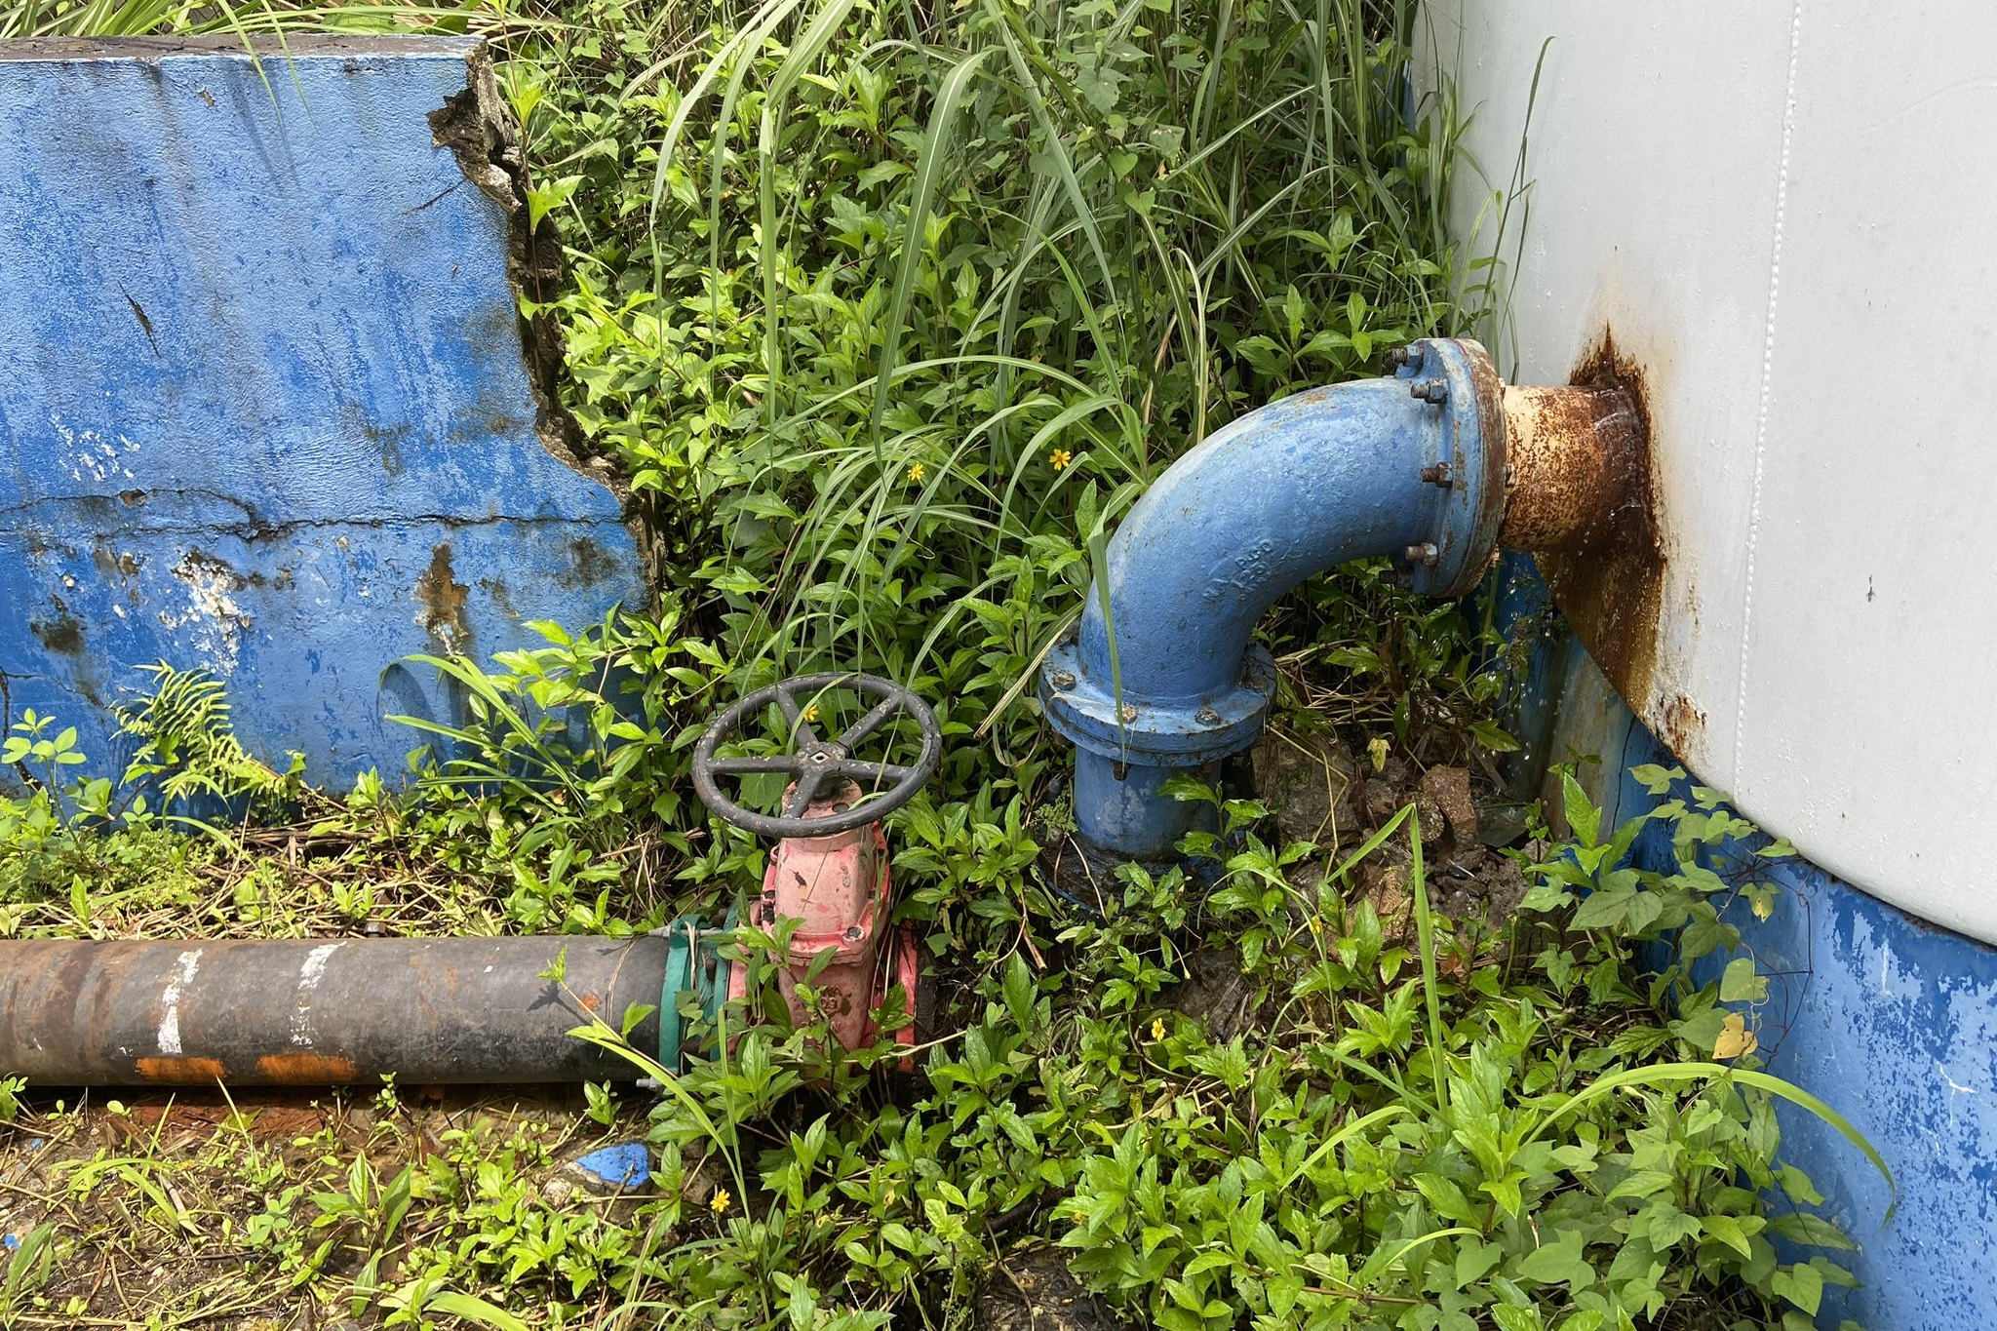
CURRENT PROBLEMS
Political
Constitutional Rights
Economic
Low payback rates
Geography
Mountainous & Landfill
Notes:
Steve

Slide 11
METHODOLOGY
03

Slide 12
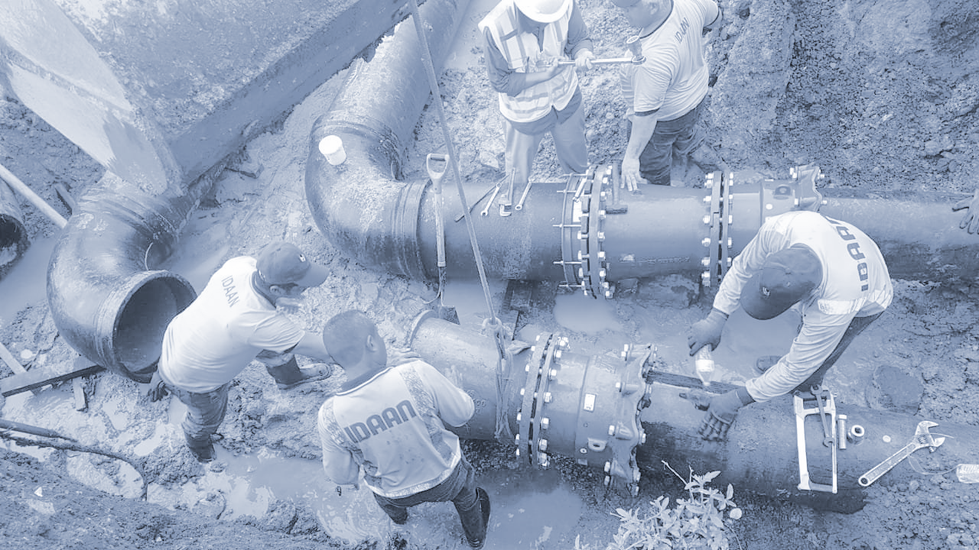
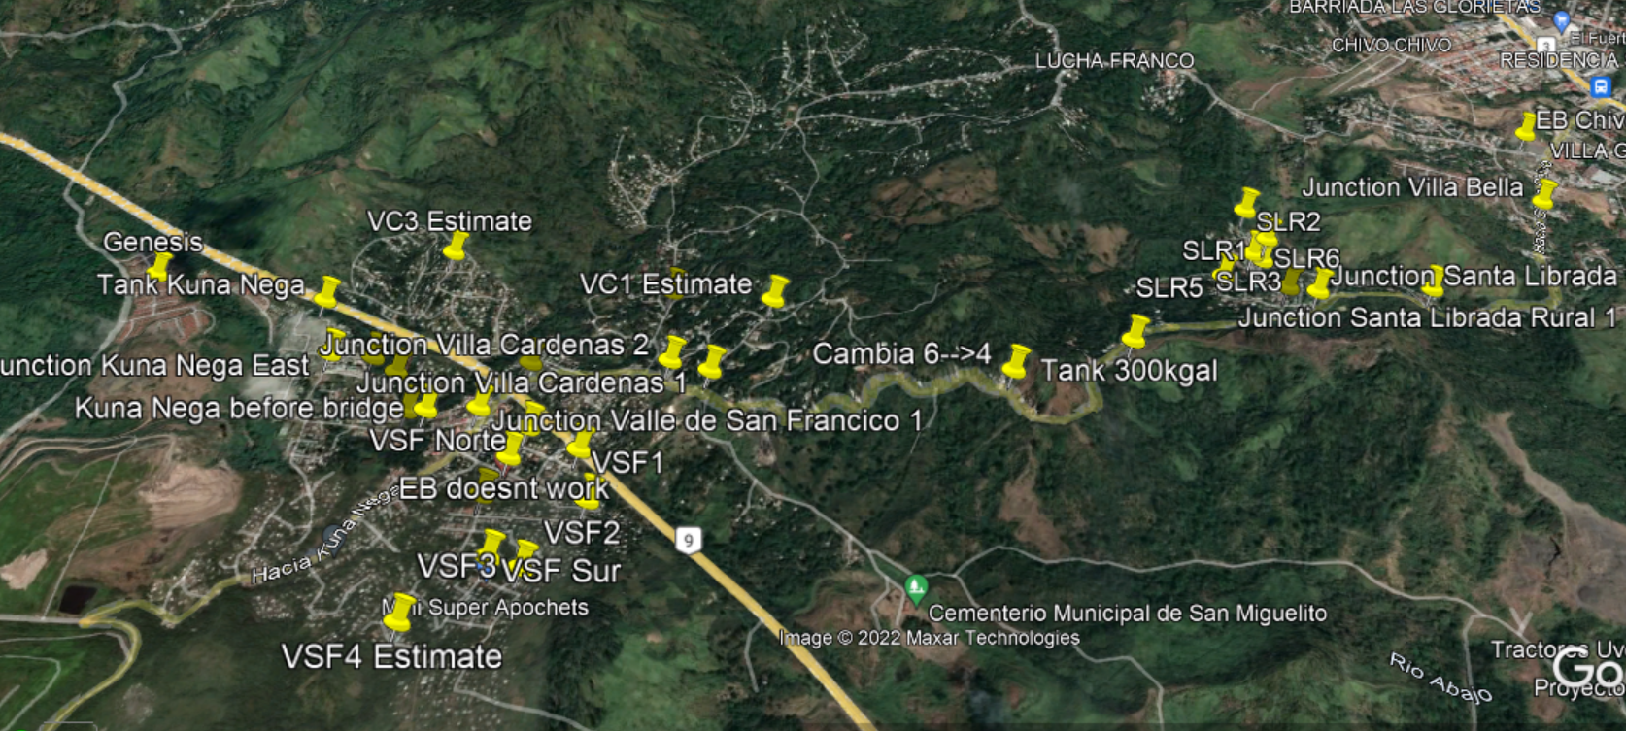
MAPPING
Locate Pipes
Diameter
Material
Tank Dimensions
Pump Curve
[4]
Notes:
Nick - went into the field about 3-4 days a week

Slide 13
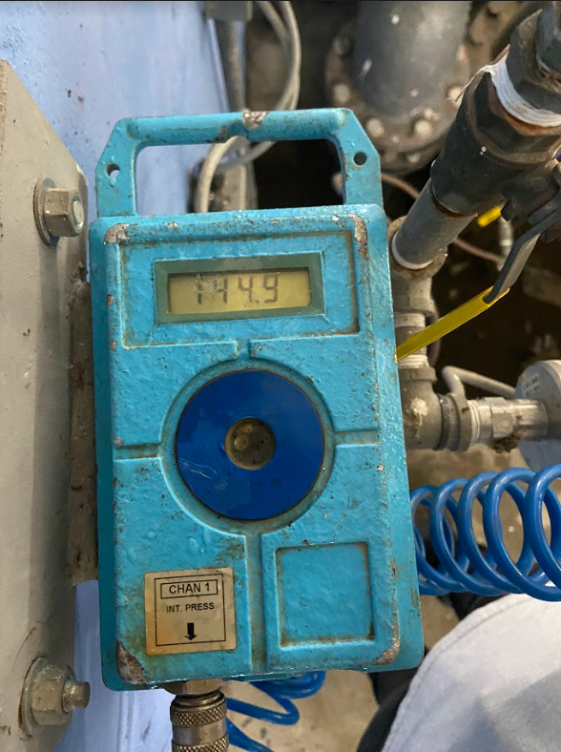
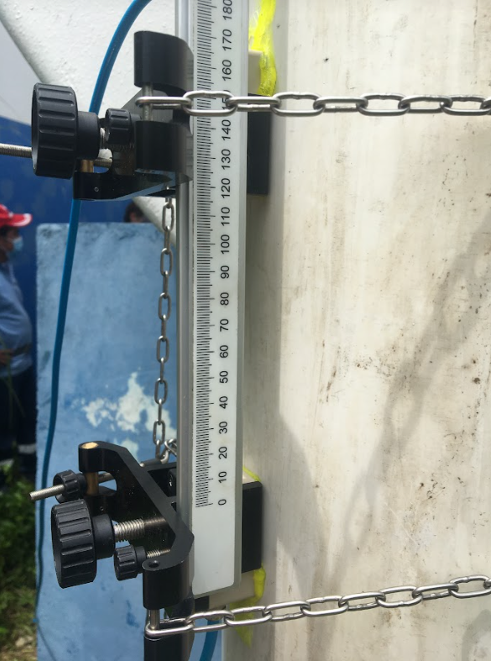
MEASUREMENTS
Pressure
Flow Rate
Elevation
[4]
Notes:
Nick

Slide 14
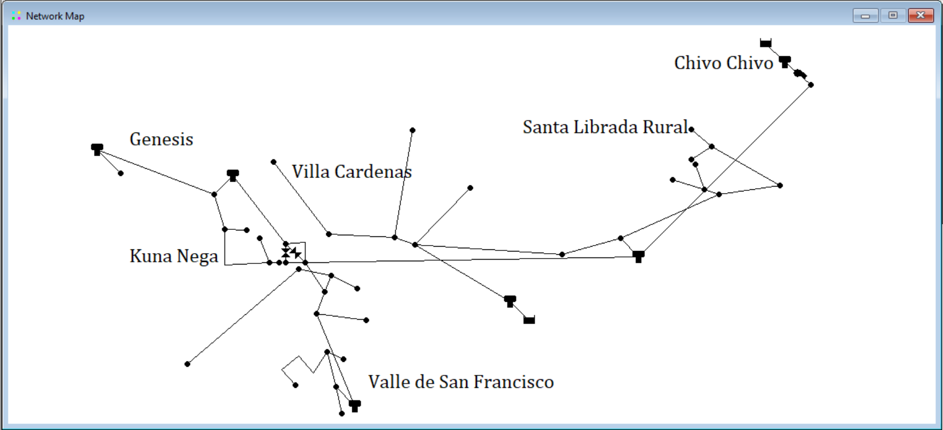
EPANET
EPANET Inputs:
The elevation of each junction
The length, diameter, and roughness coefficient of each pipe
The volume, base area, and elevation of each tank
The pump curve of each pump
[4]
Notes:
Nick

Slide 15
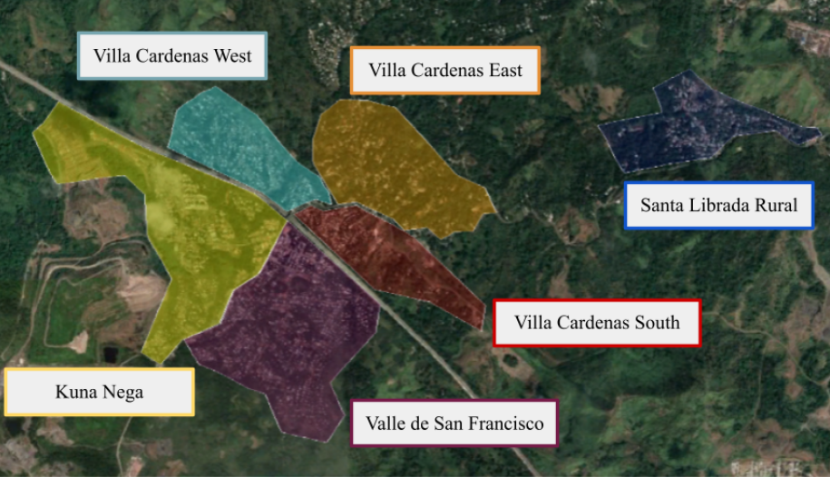
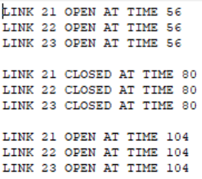
DEMAND
Demand: House Count
Scripts
[4]
Notes:
Nick

Slide 16
FINDINGS
04
Notes:
Steve

Slide 17
Node | Length (ft) | Houses (#) | Node Demand (GPM)
Pipe 1 | 781 | 241 | 83.68
Pipe 3 | 1273 | 0 | 0.00
Pipe 4 | 2337 | 16 | 5.56
Pipe 5 | 1675 | 5 | 1.74
Pipe 6 | 416 | 11 | 3.82
Pipe 7 | 1376 | 225 | 78.13
Pipe 8 | 3065 | 58 | 20.14
Pipe 9 | 192 | 0 | 0.00
Pipe 10 | 1475 | 168 | 58.33
Pipe 11 | 1758 | 50 | 17.36
Pipe 12 | 559 | 57 | 19.79
Pipe 13 | 495 | 79 | 27.43
Pipe 14 | 3492 | 79 | 27.43
Pipe 15 | 412 | 12 | 4.17
Pipe 16 | 305 | 29 | 10.07
Pipe 17 | 332 | 14 | 4.86
HOUSE COUNT
Focus on demand by node
5 residents / home
100 gallons / day
Domicile leakage rates included in metrics
Notes:
Steve

Slide 18
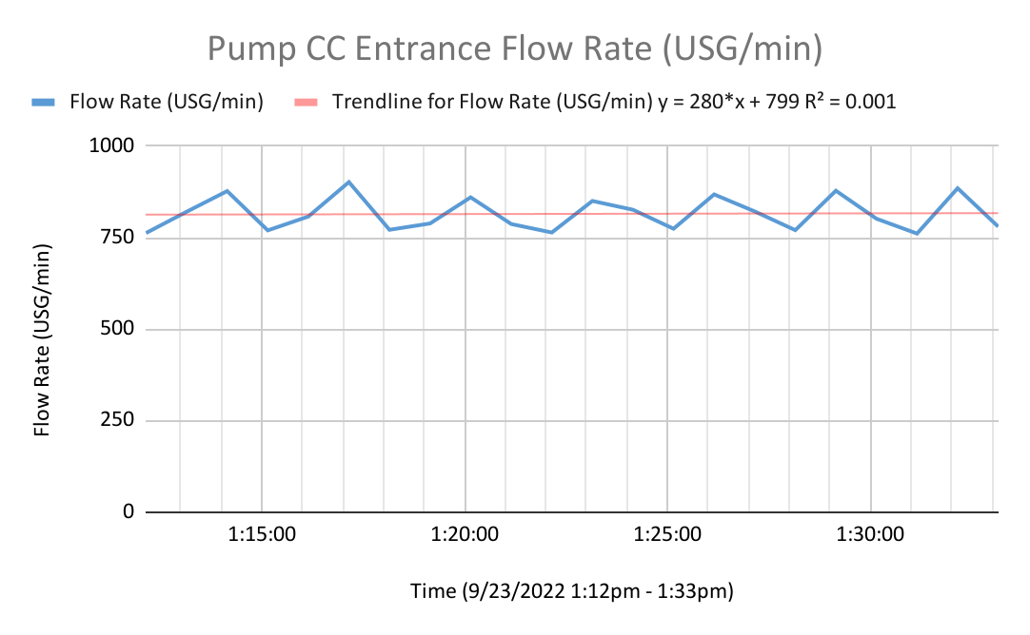
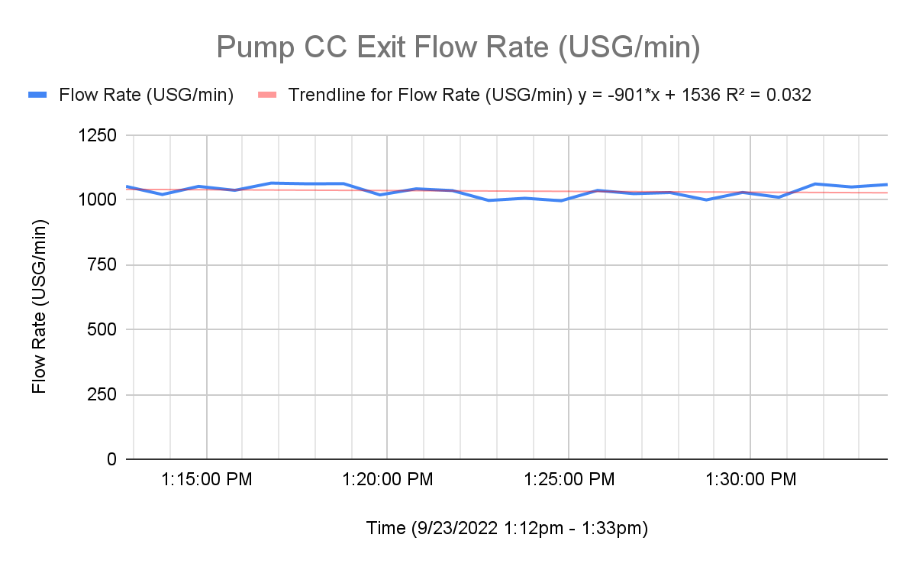
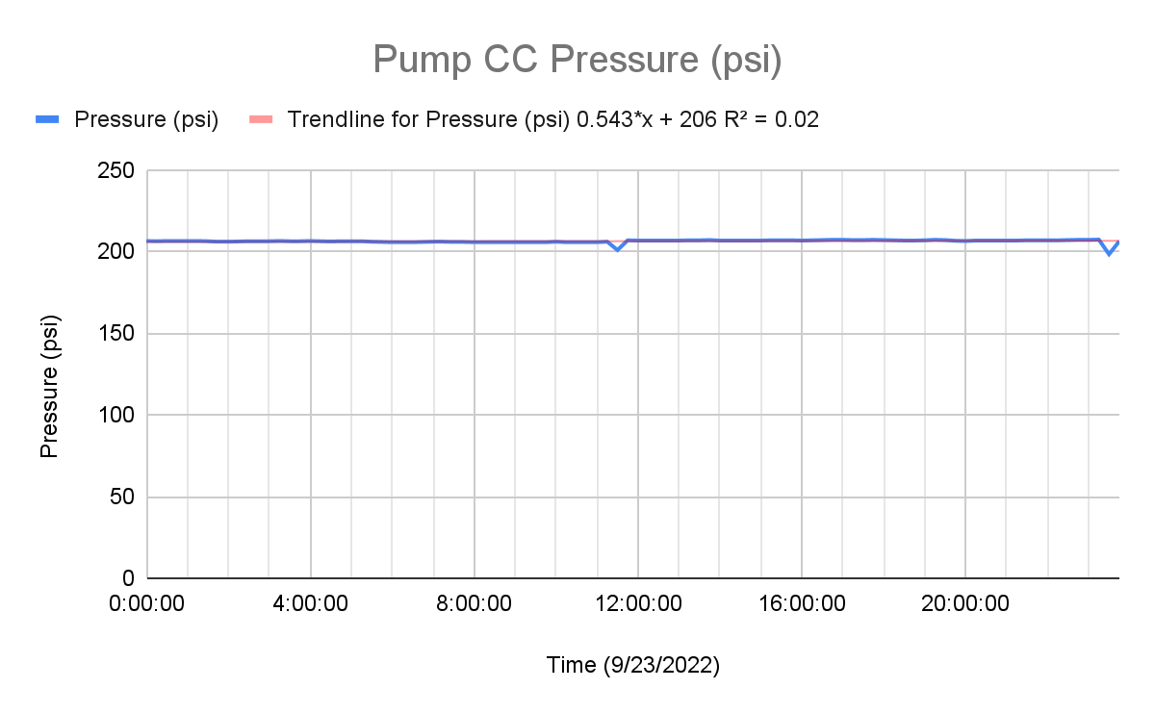
CHIVO CHIVO PUMP STATION DATA
Collected 9/23/2022
Notes:
Steve

Slide 19
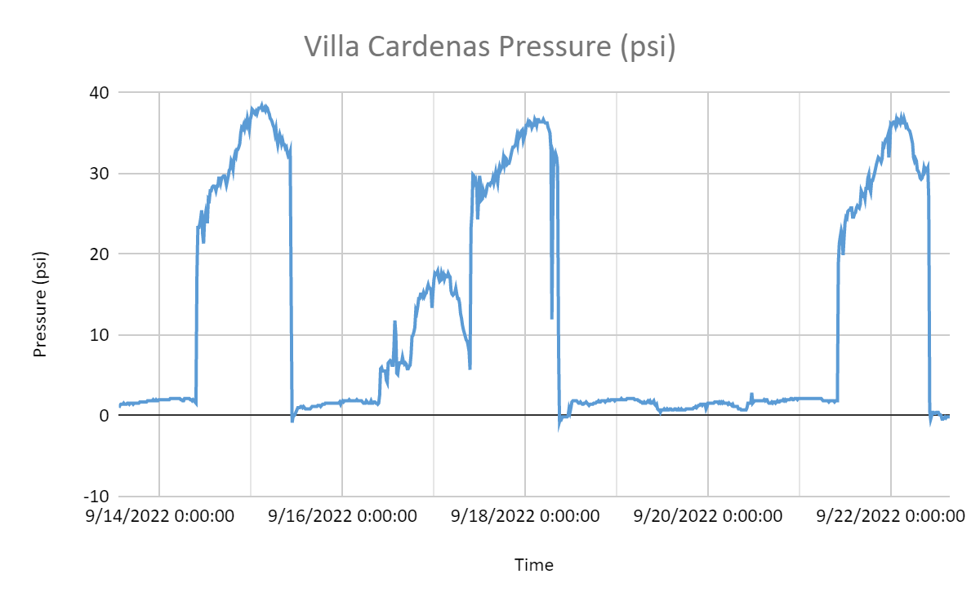
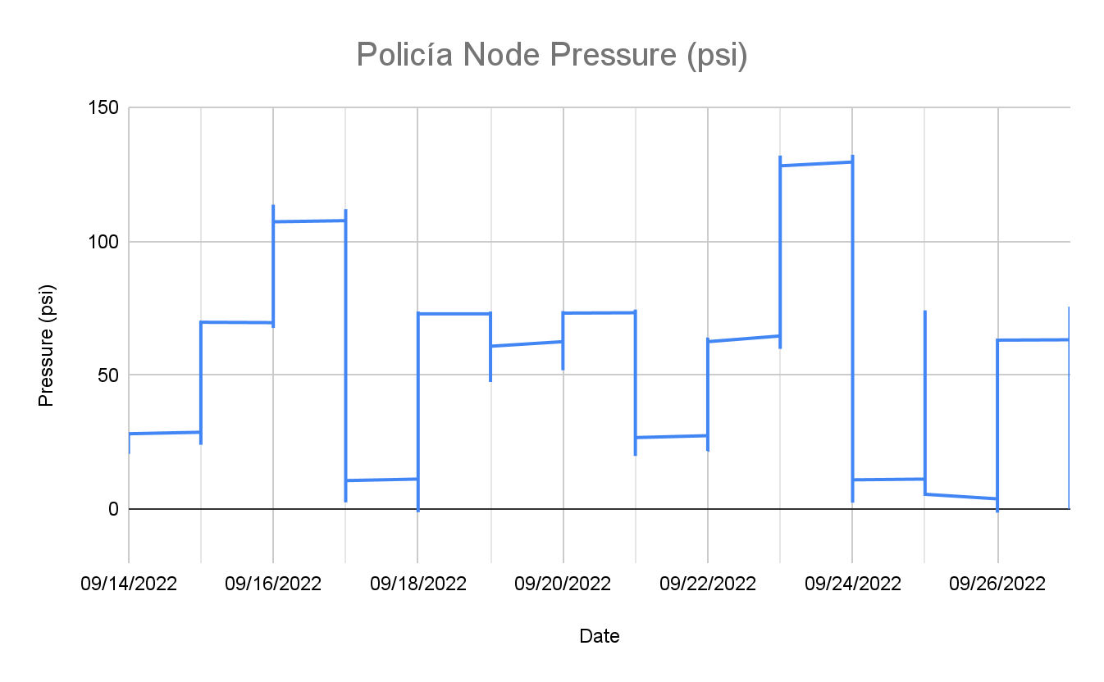
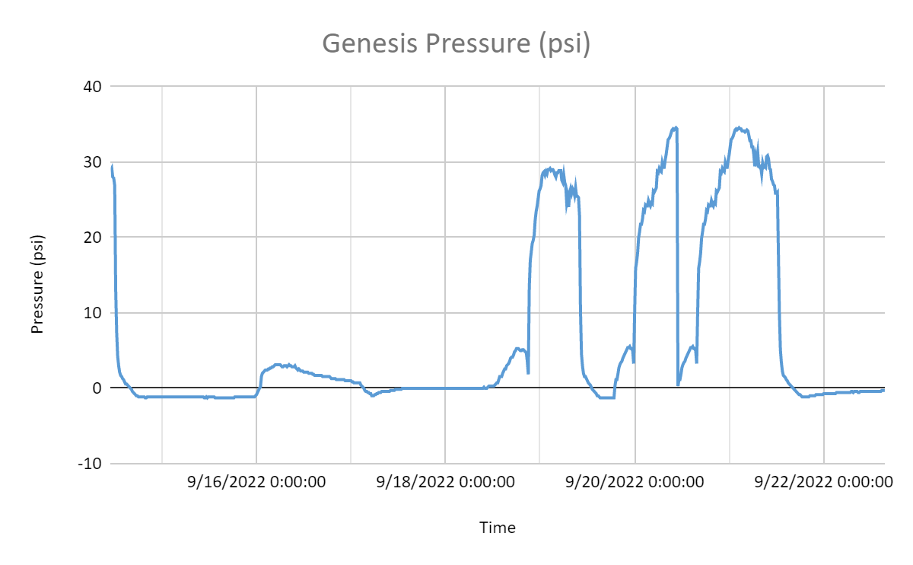
JUNCTION PRESSURE DATA
T W Th F Sa Su M T W Th
Collected 9/13/2022 - 9/26/2022
W Th F Sa Su M T W Th
W Th F Sa Su M T W Th F Sa Su M
Notes:
Steve

Slide 20
CONCLUSIONS & RECOMMENDATIONS
05

Slide 21
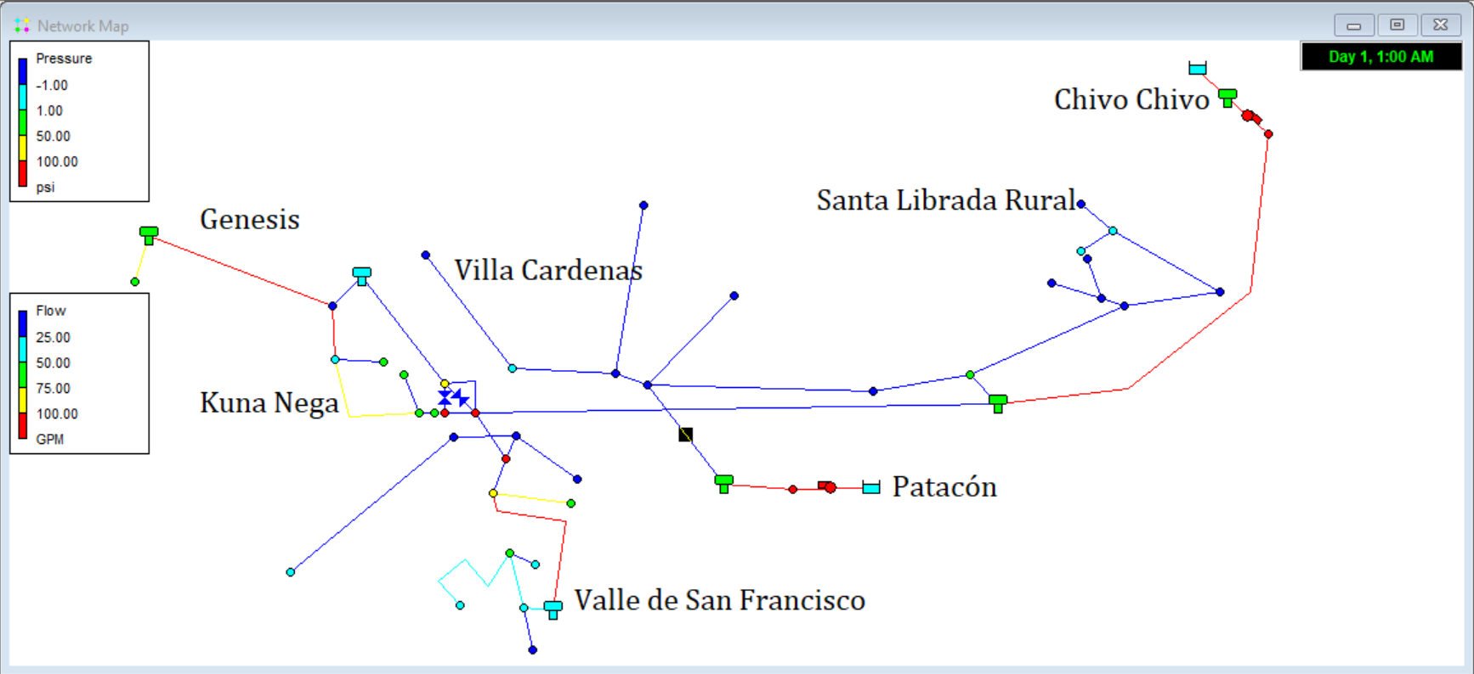
FINAL EPANET MODEL
Patacón Connection
Santa Librada Rural Tank
Villa Cardenas Pipes
Notes:
Nick & his recommendations

Slide 22
CENSUS
RECOMMENDATIONS FOR OUR MODEL
MORE DATA
Accurate population count
2020 Census cancelled
Too time consuming
Collect population count of Corregimiento Kuna Nega
Elevation
Leakage
Flow & Pressures
Excavation of piping necessary
More data input would mean a more accurate model
Notes:
Bridget

Slide 23
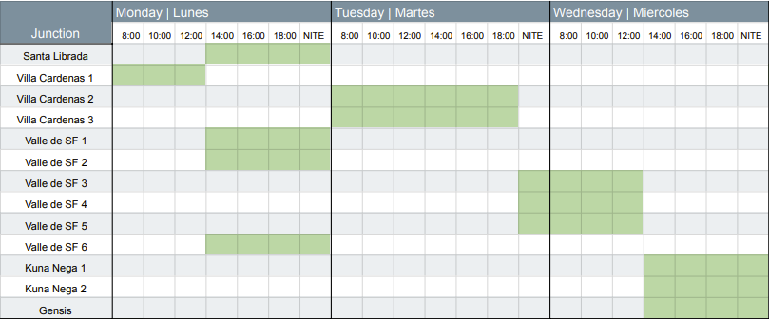
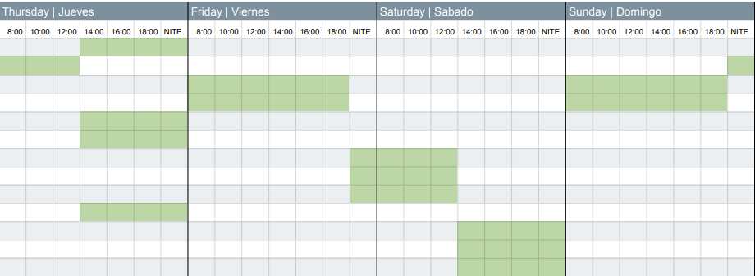
OPTIMIZED SCHEDULE
Equal supply per person on average
If stored, each rotation block supplies 3 days of water
Valve operation between 8am - 8 pm
Notes:
Steve

Slide 24
PERFORMANCE-BASED CONTRACTS
RECOMMENDATIONS FOR IDAAN
LEAKAGE
Maintenance
Would provide incentives for current infrastructure
Work would be overseen by a third party, that would approve pay based on performance
Would improve distribution to users
The organization could keep track of leakage
Notes:
Bridget

Slide 25
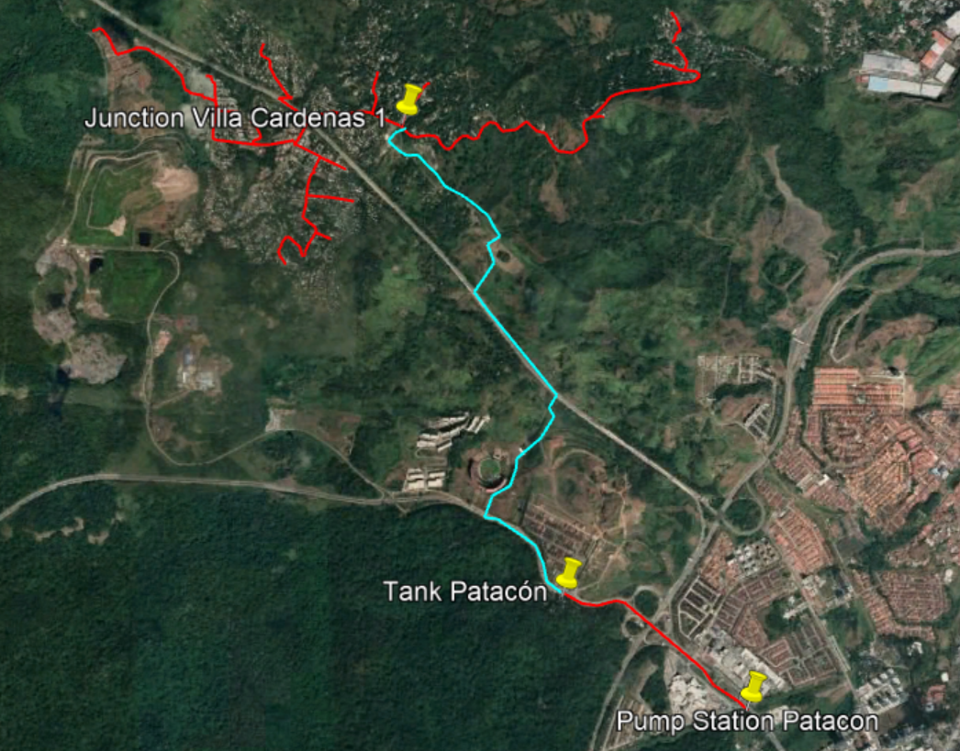
Most Likely Patacon Connection Route
Notes:
Bridget

Slide 26
REALLOCATE RESOURCES
RECOMMENDATIONS FOR PATACON CONNECTION
A PROBLEM OF PRESSURE
Investigate Santa Librada Rural Tank before considering Patacón Connection
Use existing funds to improve deteriorating infrastructure instead of spearheading new projects
The Patacón Connection would provide more flow, but more pressure is needed
Instead of supplementing flow, increase pressure in the system
Notes:
Bridget Our final recommendation is less so how do we make the patacon connection work, it's more of a YES or NO. and we say no!

Slide 27
ACKNOWLEDGEMENTS
06

Slide 28
THANK YOU!
Professor Chiarelli
Professor Burrier
Gray Hauff
Kevin Batista, Head of Distribution and Loss
Javier Sanchez, Head of Optimizations
Juan Li, Electromechanical engineer
Sharmain Murillo, Engineer
Kambip Chiari, Engineer
Enrique Ortega, Sanitation Engineer
The many engineers who provided us with field transportation & aided with data collection
Rick Montanari, VP
Valmy Guerrero, Operations
Notes:
Bridget

Slide 29
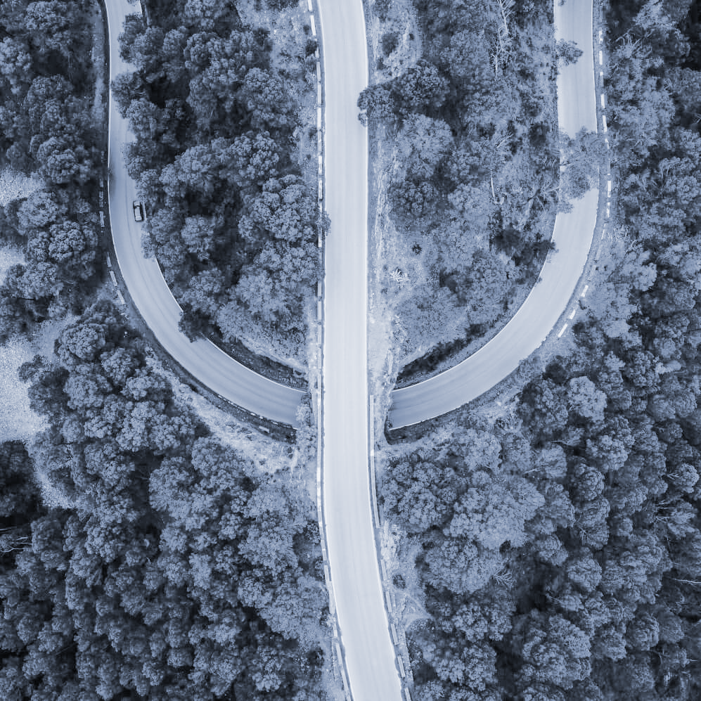
QUESTIONS?
07
[5]

Slide 30
PHOTO REFERENCES
08
https://yt3.ggpht.com/a-/AAuE7mBExhG4f_3coXsI9u11bwLBrK6dw9JX6A3t8A=s900-mo-c-c0xffffffff-rj-k-no
https://waterfm.com/pix/stories/2015/02/hydraulic-epanet.jpg
https://www.epa.gov/water-research/epanet
http://www.nexpanama.com/wp-content/uploads/2019/09/tuberia_idaan.jpeg
Presentation template by Slidesgo

Slide 31
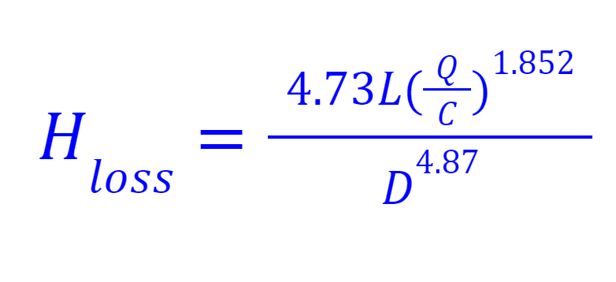
APPENDIX
09
WATER MODELING MATHEMATICS: Hazen-Williams Equation

Slide 32
APPENDIX
09
ArcGIS MODELING
BEFORE
AFTER

Slide 33
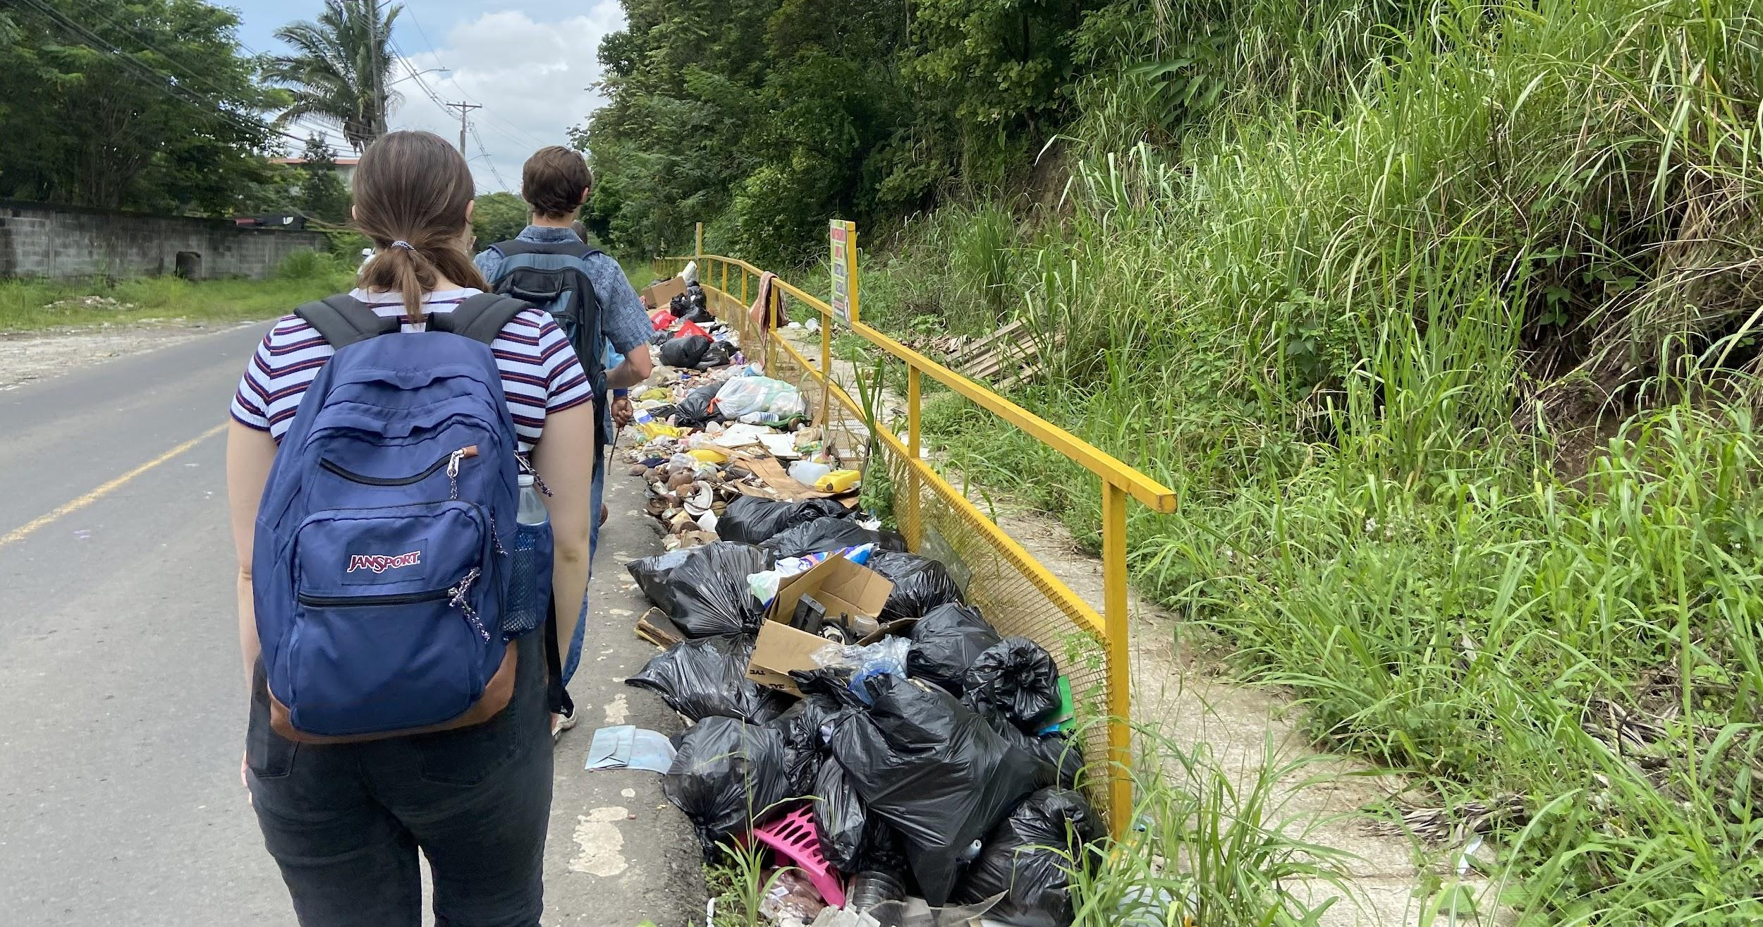
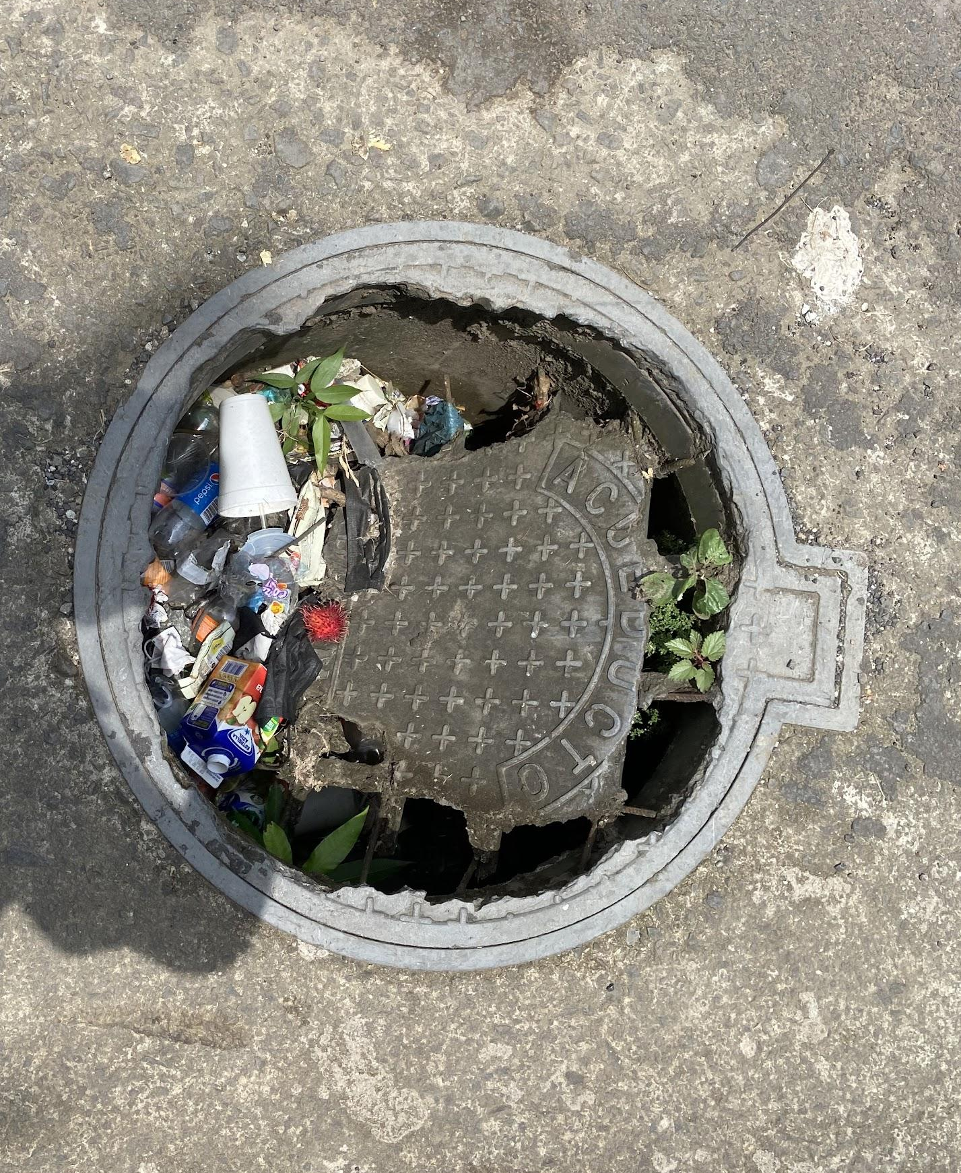
APPENDIX
09
POLLUTION OF WATER INFRASTRUCTURE IN CORREGIMIENTO KUNA NEGA

