Slide 1
A Design and Analysis of Solid Oxide Electrolysis Cells
By Stephen Davis, Sam Krimmel, and Alexander Kochling
August 17, 2022
Notes:
Steve

Slide 2
Presentation Overview
Problem Statement, Goals, and Objectives
Background
Methodology
Results and Discussion
Conclusion and Recommendations
Notes:
Steve

Slide 3
Saint-Gobain
Originally founded in 1665 by Jean-Baptiste Colbert as a mirror manufacturer, the company currently serves as one of the largest world manufacturer of raw materials, high-performance energy systems, and more.
There are currently focusing on more environmental-friendly, low-cost, and sustainable sources of energy, one of which is Solid Oxide Cells.
Our MQP Sponsor Company
Notes:
Steve

Slide 4
Problem Statement
Increasing material strain on the environment and the depletion of natural resources have increased the demand for environmentally-friendly, low-cost, and self-sustainable energy sources.
Fuel cell technology is a developing area of research designed to both combat this problem and meet modern energy needs. While Reversible Solid Oxide Cells have potential to aid the transition to renewable energy, they are currently not cost-effective and suffer from shorter-term degradation when compared to similar technologies.
Notes:
Steve

Slide 5
Project Goal
Project Objectives
Simulate SOFC/SOEC models to better understand their functionality and potentially devise ways to increase their efficiencies.
1
3
2
Use software platforms to recreate SOFC models from the previous year’s project with updated equations.
Discuss and analyse how efficiencies are variable based on the input parameters that are used.
Use software platforms to create new SOEC models and test with updated equations.
Notes:
Steve

Slide 6
Background
Notes:
Sam

Slide 7
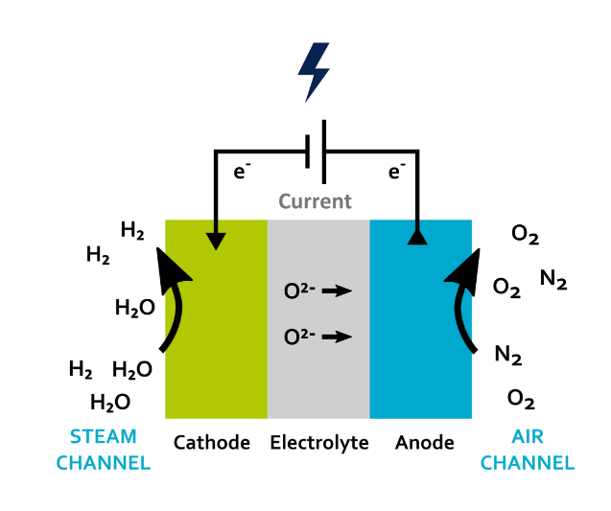
Solid Oxide Electrolysis Cells (SOEC)
An SOEC operates by separating a conductive anode and cathode by an insulating and ionically conductive electrolyte.
In solid oxide cells, water electrolysis is used to separate H₂O into H₂ and O₂.
The chemical reaction for electrolysis of water is represented by the following:
2H₂O → 2H₂ + O₂
This reaction can then be run in the opposite direction in an RSOC to generate electricity from H₂ and O₂.
E. Fontell, T. Hakala, & T. Matikainen (n.d.). Technology. Convion Fuel Cell Systems. https://convion.fi/technology/
Notes:
Sam - The soec functions by separating a conductive anode and cathode by an insulating electrolyte. The reaction that takes place is the electrolysis of water into hydrogen and oxygen. The electrolyte allows the oxygen ions to flow through, and forces a current (electrons) to flow through the conductive anode and cathode and an external conductor. This reaction is the reverse reaction of a fuel cell, therefore it requires electricity instead of producing it.

Slide 8
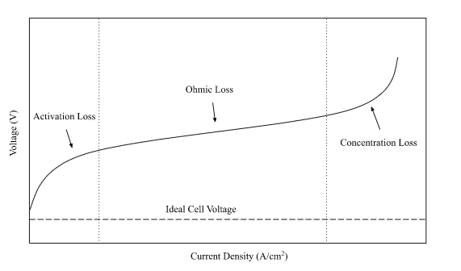
SOEC Polarization Curve
Displays the relationship between voltage and current density
Current density is used to allow for comparison of different sized cells
Ideal cell voltage - E_{n}
Three zones of the polarization curve
Activation loss
Ohmic loss
Concentration loss
Notes:
Sam - The polarization curve is a commonly used metric to measure SOEC and SOFC performance. It compares voltage and current density - which is used to allow for the comparison of different sized cells. The ideal cell voltage can be seen on the bottom of the graph (this is the voltage without any losses considered). The polarization curve with losses contains three main zones. At low current densities, activation loss is most significant. At intermediate current densities, ohmic losses dominate and exhibit linear behavior due to ohms law. Finally, at high current densities, concentration loss is the greatest. These losses and their equations will be described in the next section.

Slide 9
Methodology

Slide 10
Three Methods:
Mathematical Model
Aspen Plus Model
IDAES Coding
Notes:
Steve

Slide 11
SOEC Mathematical Model
E_{cell} = E_{n} + ΔE_{act} + ΔE_{ohm} + ΔE_{conc}
Menon. et al., 2013
E_{n} - A theoretical cell voltage without considering losses, often called Nernst voltage
ΔE_{act} - Loss due to the activation energy required to initiate the chemical reaction
ΔE_{ohm} - Loss due to the ionic and electrical resistance of cell components
ΔE_{conc} - Loss caused by the inefficiencies in mass transport
Notes:
Sam - This equation is the equation which forms the polarization curve covered in the previous slide. The real cell voltage is Ecell. En is the theoretical ideal voltage of the cell without considering any losses. Delta E act, E ohm, and E conc are the three various forms of losses considered in our mathematical model. The activation loss, ohmic loss, and concentration loss respectively.

Slide 12
Nernst Voltage
The theoretical maximum voltage produced by the chemical reaction in the SOEC
O’Hayre. et al., 2016
Jørgensen & Fath, 2008
Notes:
Sam - In our mathematical model, this equation calculates the nernst voltage. The most important parameters here are gibbs free energy change (which is given by the equation below), and the entropy change term which is very important. Many papers do not consider this term due to its negligible effect on voltage, but we decided to include it as we intend to measure changes with temperature. Finally, the nernst term which accounts for concentration differences. The next three slides will cover our modeling equations used for the losses

Slide 13
Activation Losses
The activation energy required to initiate the reaction results in a quantifiable loss
Low current density → Higher activation losses
Meaning it takes more activation energy for the reactions to occur at lower current densities, which causes a more severe drop in output voltage
Hauck et al., 2017
Hauck et al., 2017
Notes:
Alex - Activation losses occurs as a result of the electrochemical reactions taking place inside the cell, with a proportion of the voltage generated being lost and instead used to drive chemical reactions for electron transfer. As shown previous on the example full polarization curve, activation losses are the foremost losses to occur at lower current densities.

Slide 14
Ohmic Losses
Ohmic losses are made up of the loss from the resistance of the conductive materials and the loss due to the ionic resistance of the electrolyte
Ohmic loss generally displays a linear relationship with current density (Ohm’s Law)
Ohmic losses are most significant at intermediate current densities
Hauck et al., 2017
Notes:
Alex - Also called resistive losses, Ohmic losses are incurred from the resistance to flow of electrons through the numerous plates (anode, cathode, dividing layers) and the ionic resistance of the electrolyte, all of which are partially material related. It is also so named for its linear behavior and adherence to Ohm’s law. These losses are most significant at intermediate current densities, and will not display linear behavior at lower or higher current densities.

Slide 15
Concentration Losses
At high current density, concentration losses are the most significant (due to high current density = high mass transport)
This that it is less efficient to move larger portions of mass (or current) through the fuel cell at a time, which causes a lower overall voltage yield (or higher concentration losses).
O’Hayre. et al., 2016
O’Hayre. et al., 2016
Notes:
Alex - Mass transport of concentration losses are the result of changes in concentration of reactants at the surface of electrodes as fuel is used. The reduction in concentration during fuel utilization is a result of failure to transport sufficient reactant to the surface of the electrode, either due to a imbalance between transport rate and rate of reaction or product buildup at the cell exit pathway. It is therefore less efficient to move larger portions of mass or current through the cell at a time, as it will yield lower overall voltage due to higher concentration loss.

Slide 16
Simulation Constants
Constant Description | Symbol | Value | Units
Universal gas constant | R | 8.314 | J/K mol
Faraday's constant | F | 96485 | C/mol
Reference pressure | P_ref | 1 | atm
Reference temperature | T_0 | 298.15 | K
Moles of charge electrons transferred in reaction | n_e | 2 | mol
Entropy change of reaction at STP | d_s | 44.34 | J/K
Notes:
Steve

Slide 17
Simulation Parameters
Parameters | Symbol | Value | Units | Reference
Input anolyte pressure | H2_p | 0.5 | atm | Chehadeh et al., 2022
Output anolyte pressure | H2O_p | 0.5 | atm | Chehadeh et al., 2022
Catholyte pressure | O2_p | 0.21 | atm | Chehadeh et al., 2022
Transfer coefficient | a | 0.5 | - | O’Hayre et al., 2016
SOEC Resistance | R_ohm | 0.057 | ohm*cm^2 | Hauck et al., 2017
Limiting current density | i_L | 0.65 | A/cm^2 | Chehadeh et al., 2022
Electrolyte thickness | thick_e | 0.00125 | cm | Hauck et al., 2017
Electrolyte ionic conductivity | ion_e | 333.3 | 1/(ohm*cm) | Hauck et al., 2017
Pre-exponential factor: fuel side | gam_f | 205100 | A/cm^2 | Ni et al., 2007
Pre-exponential factor: oxygen side | gam_o | 1344000 | A/cm^2 | Ni et al., 2007
Activation energy: fuel side | e_f | 120000 | J/mol | Ni et al., 2007
Activation energy: oxygen side | e_o | 100000 | J/mol | Ni et al., 2007
Fuel utilization factor (SOFC) | fuel_u | 1.0 | - | Chehadeh et al., 2022
Steam utilization factor (SOEC) | steam_u | 0.6 | - | AlZahrani & Dincer, 2017
Notes:
Steve

Slide 18
Assumptions
General Assumptions
Cell structure is planar
Current density is uniform throughout the cell
Operating temperature is constant through each individual simulation
System is steady-state and in thermal equilibrium
Materials do not degrade
The fuel supplied to the system is an ideal gas after heating
Cell resistance is constant
Fuel Cell Model
Electrolysis Cell Model
Fuel utilization is 1 (100%, meaning all hydrogen and oxygen supplied is used).
All the gasses supplied to the SOEC system are pure. An oxygen partial pressure of 0.21 is used to simulate percentage of oxygen within air, but no other gasses from air are considered.
System is isothermal, and all components are thermally insulated
The H₂O supplied to the SOEC system is pure.
The steam utilization factor is 0.6
Notes:
Steve

Slide 19
Software Platforms
Aspen Plus
Founded in the 1980s as a modeling tool for energy systems
Integrated flowsheet framework for both SOFC and SOEC models
IDAES
Founded in the late 2010s as a framework software for renewable energy innovations
Does not possess integrated graphical interface or component framework like Aspen
Notes:
Sam - The two softwares used for this project, in addition to the mathematical models, are Aspen Plus and IDAES. Aspen plus was founded in the 1980s as a modeling tool for large scale energy systems such as power plants or chemical plants. It contains a graphical user interface in which users can form of flowsheets, input various components and materials, and simulate a chemical process. IDAES was founded in the late 2010s as a framework software for studying and innovating in the renewable energy sector. It does not have a graphical user interface, and in this project it is used as a coding framework to run mathematical equations and approximate cell voltage.

Slide 20
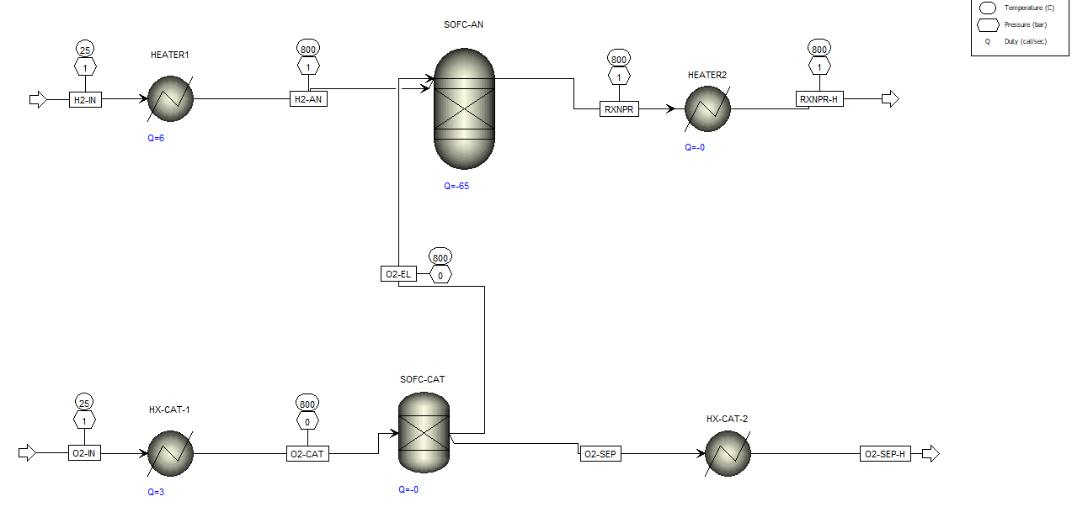
ASPEN Simulation Flowsheets
SOFC Model
SOEC Model
Notes:
Sam - The work in Aspen consisted of reconstructing the fuel cell model developed in last year’s project, and developing a novel electrolysis cell model. The flowsheets for these models from Aspen are shown here. The most important components in these flowsheets are the RGibbs reactor in the SOFC model, and the RStoic reactor in the SOEC model. These components where the reactions take place in the flowsheet. Therefore, to obtain a Gibbs free energy change we need to gather the gibbs free energy data of each material stream before and after the reaction point. Then, this data for Gibbs free energy change can be input into our mathematical models to obtain Aspen specific polarization curves, and to assess the validity of each model.

Slide 21
Results & Discussion

Slide 22
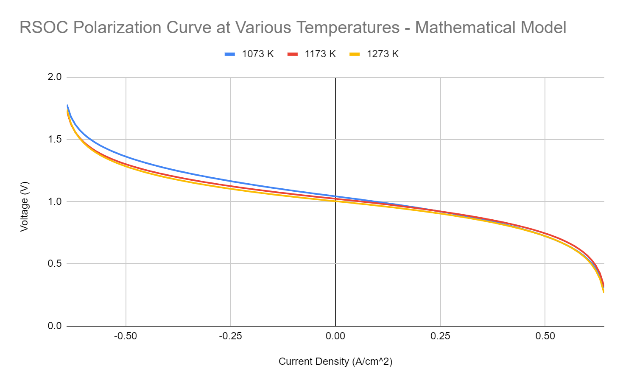
Mathematical Model Results
Notes:
Sam - We were able to construct an RSOC curve from our mathematical results, and find that based solely on the modeling equations, the SOEC has a lower voltage requirement at higher temperatures. This result is supported by other studies. Transitioning into SOFC operation, at low current densities, SOFC voltage is higher with lower temperatures, but as ohmic and concentration losses become more significant, the performance of the cell at higher temperatures improves. This behavior is expected, but slightly less pronounced in our models than in other studies.

Slide 23
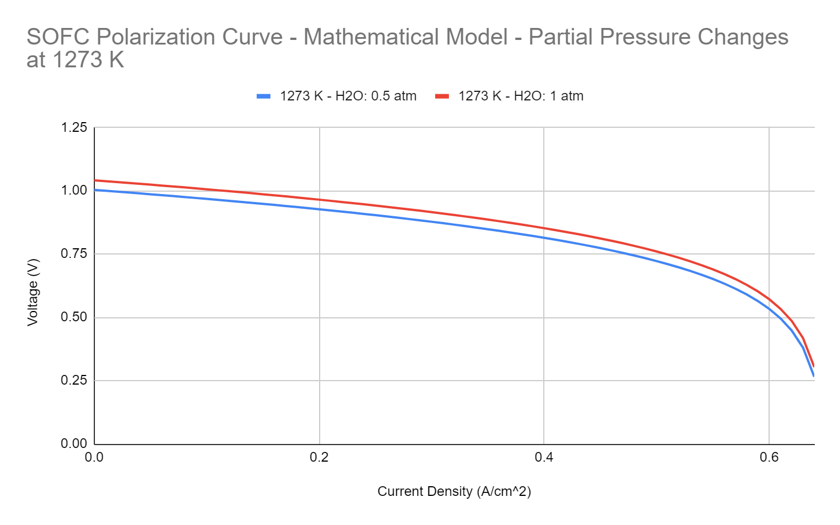
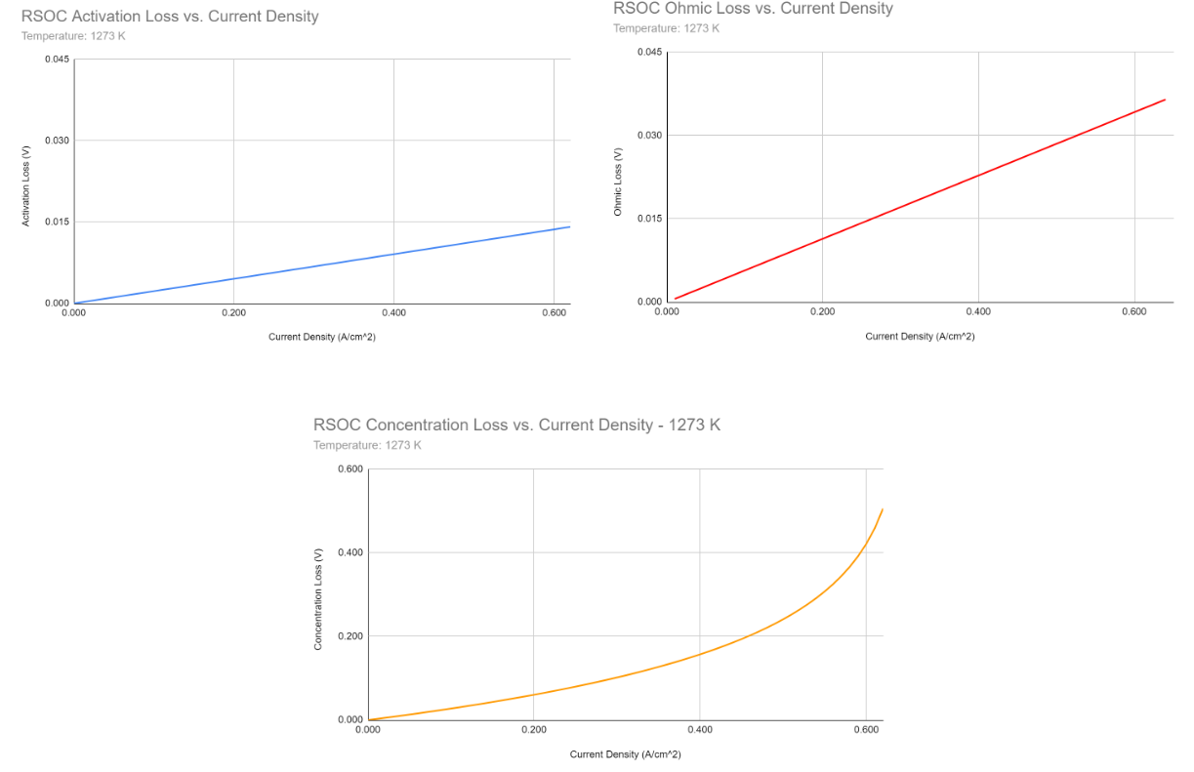
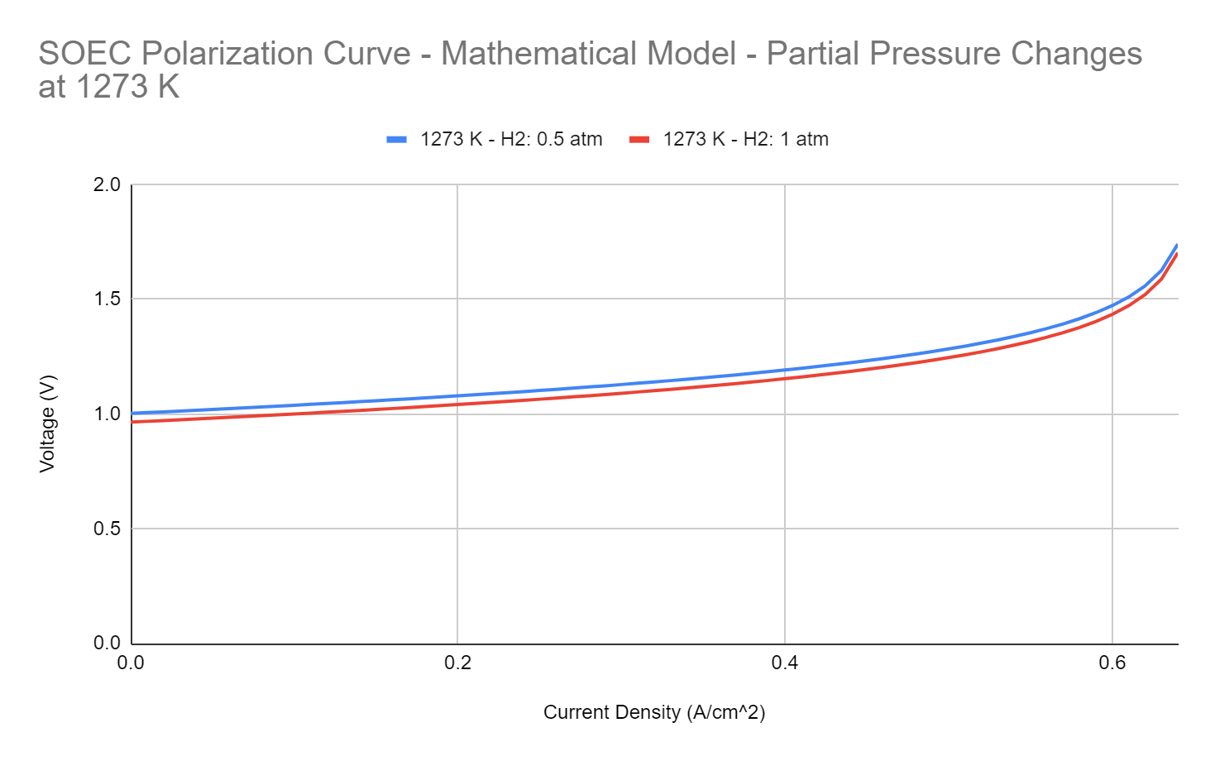
Mathematical Model Results Cont.
Notes:
Sam - A great advantage of using the mathematical models is the ability to isolate losses, or quickly assess the effects of various parameter changes. As seen here, isolating the losses from our modeling equations shows us that the activation loss and ohmic loss are both approximated linearly, with the ohmic loss having a steeper slope. The concentration loss however, is approximated logarithmically. Therefore, it increases significantly as we approach the limiting current density. We were also able to assess the effects of partial pressure changes within the mathematical model. We found that in SOFC mode, increasing the water partial pressure relative to the hydrogen partial pressure will increase voltage. Similarly, in SOEC mode, we found that increasing the hydrogen partial pressure relative to the water partial pressure will decrease voltage.

Slide 24
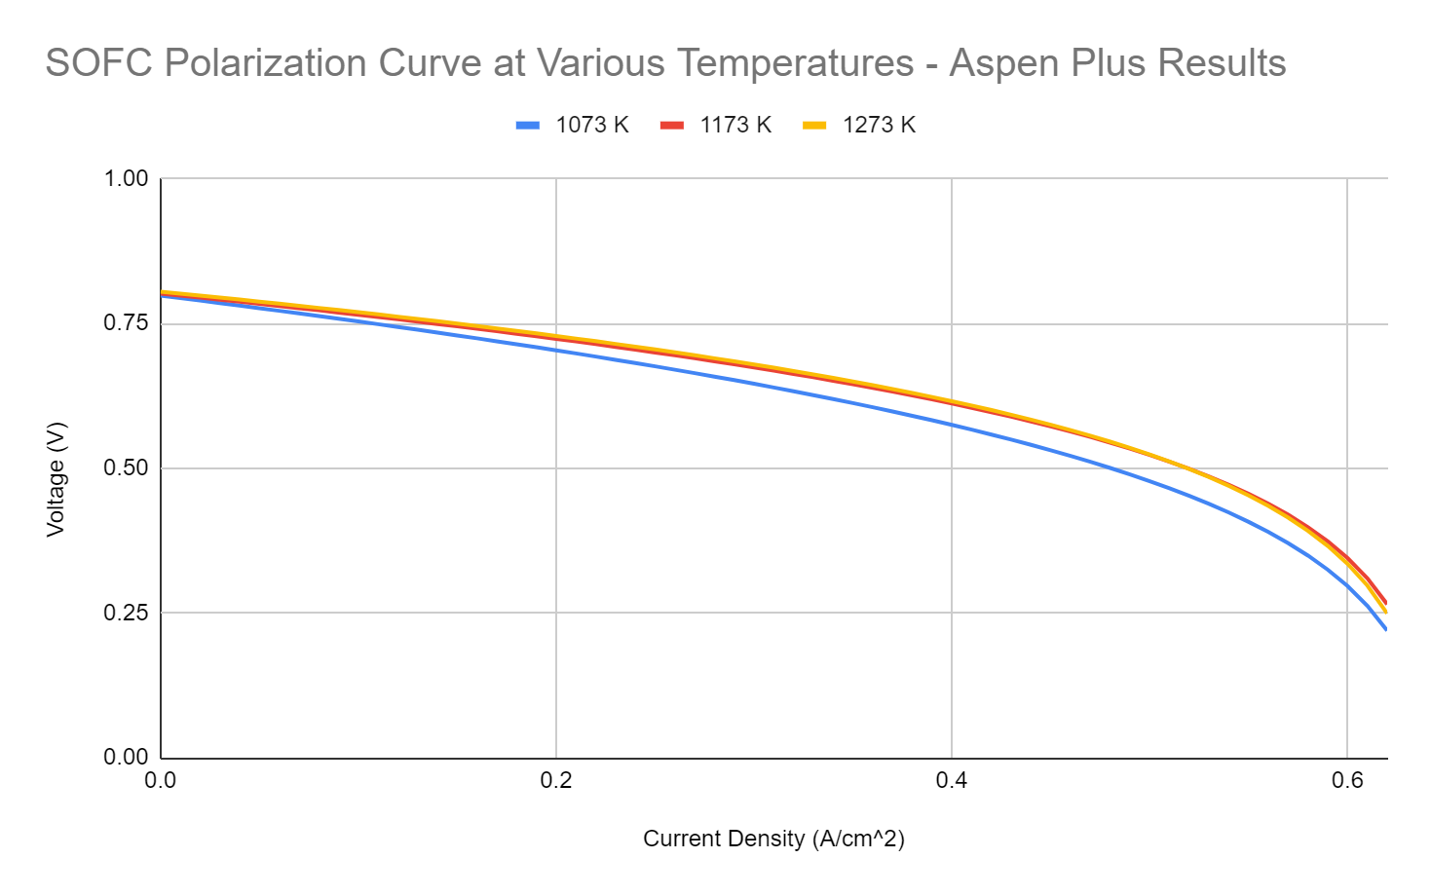
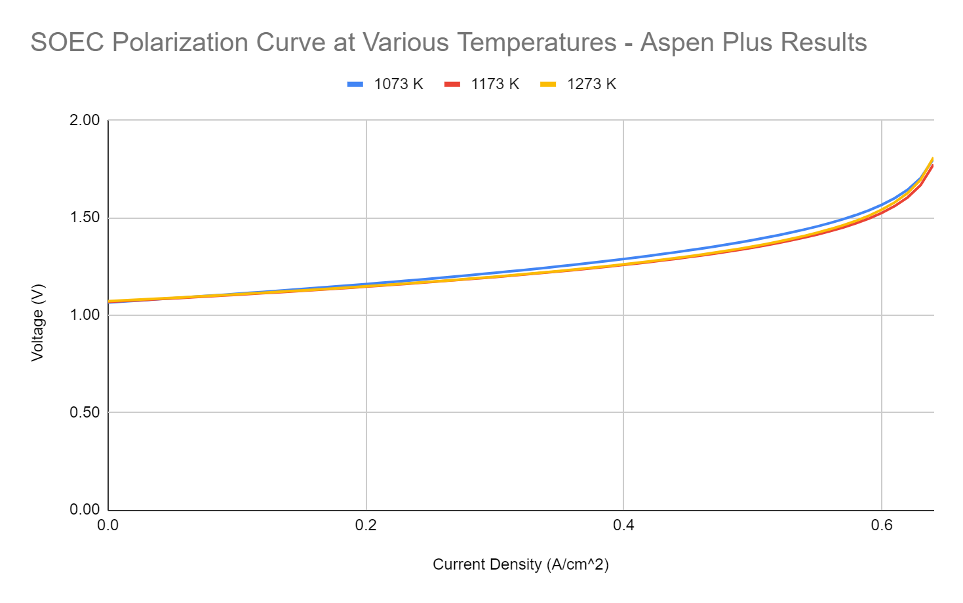
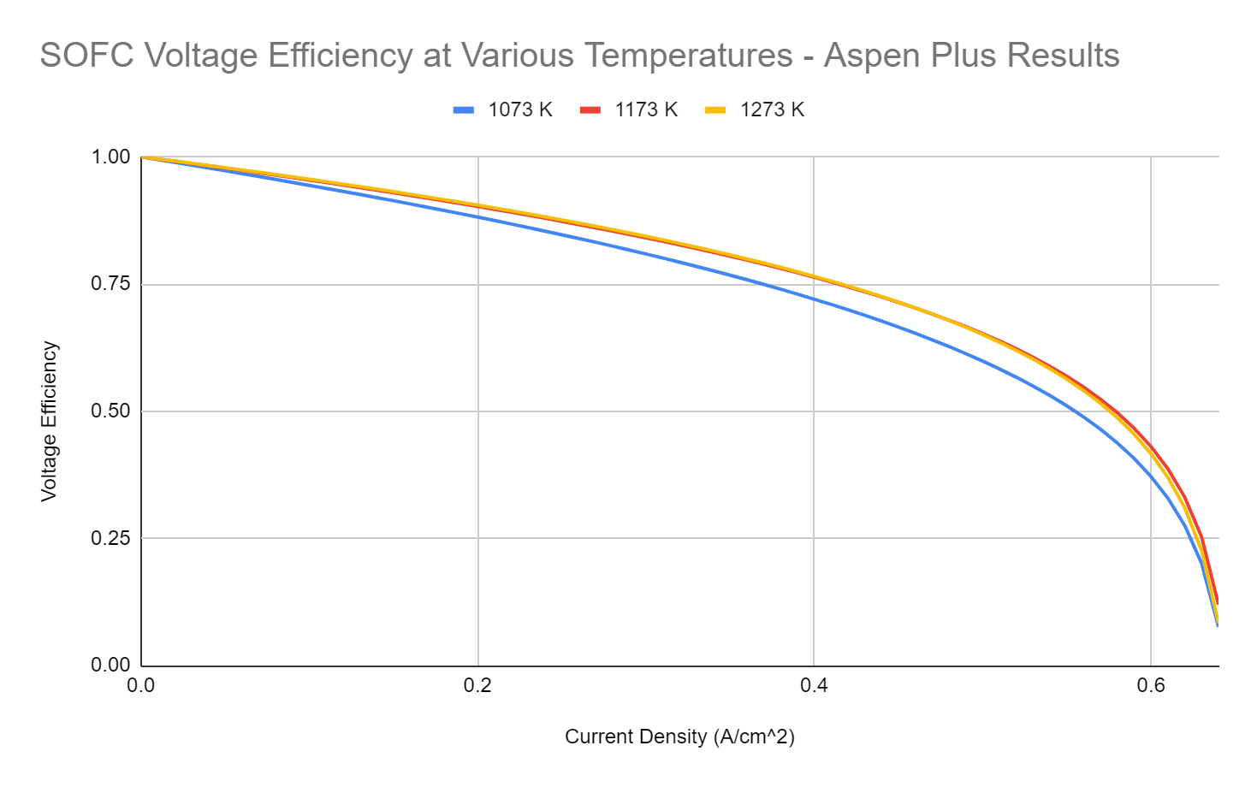
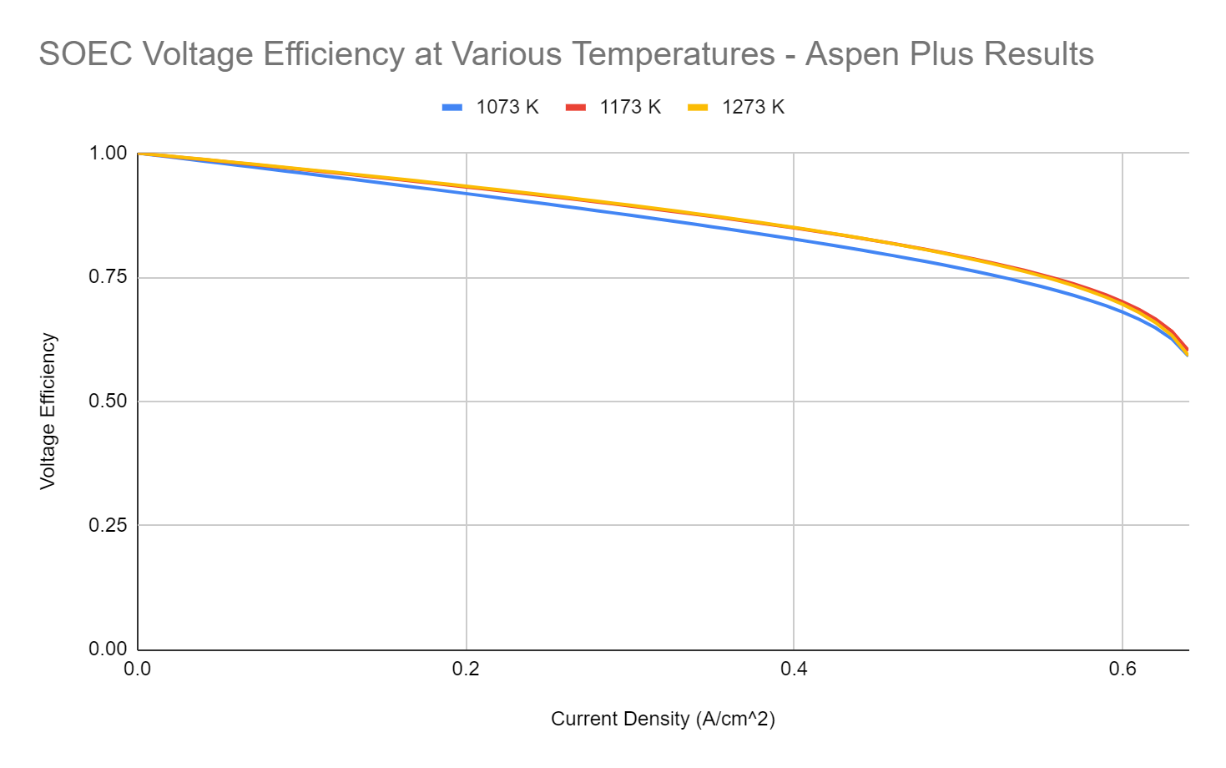
Aspen Results
Notes:
Sam - Here are our results from inputting the data from the Aspen simulation into the mathematical model. We found that SOFC voltage increases with temperature, but is generally much lower than expected, around 0.8 volts instead of 1.0. For SOFC voltage efficiency, we found that higher temperatures give higher voltage efficiencies, and that running the cell at lower current densities is very important. For the SOEC simulation, we found that the Aspen flowsheet approximated the voltage much better than the SOFC, and that higher temperature led to better performance and efficiency. The SOEC voltage efficiency also remained much higher than the SOFC efficiency at high current densities.

Slide 25
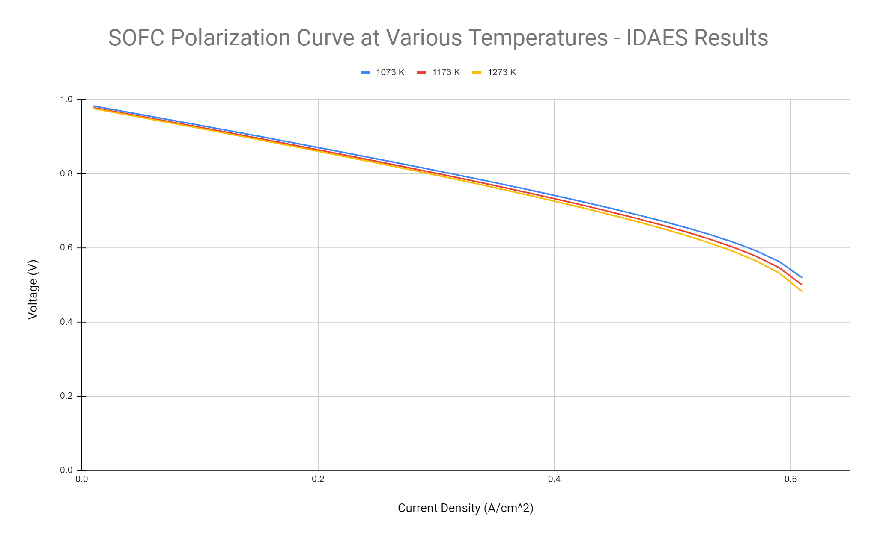
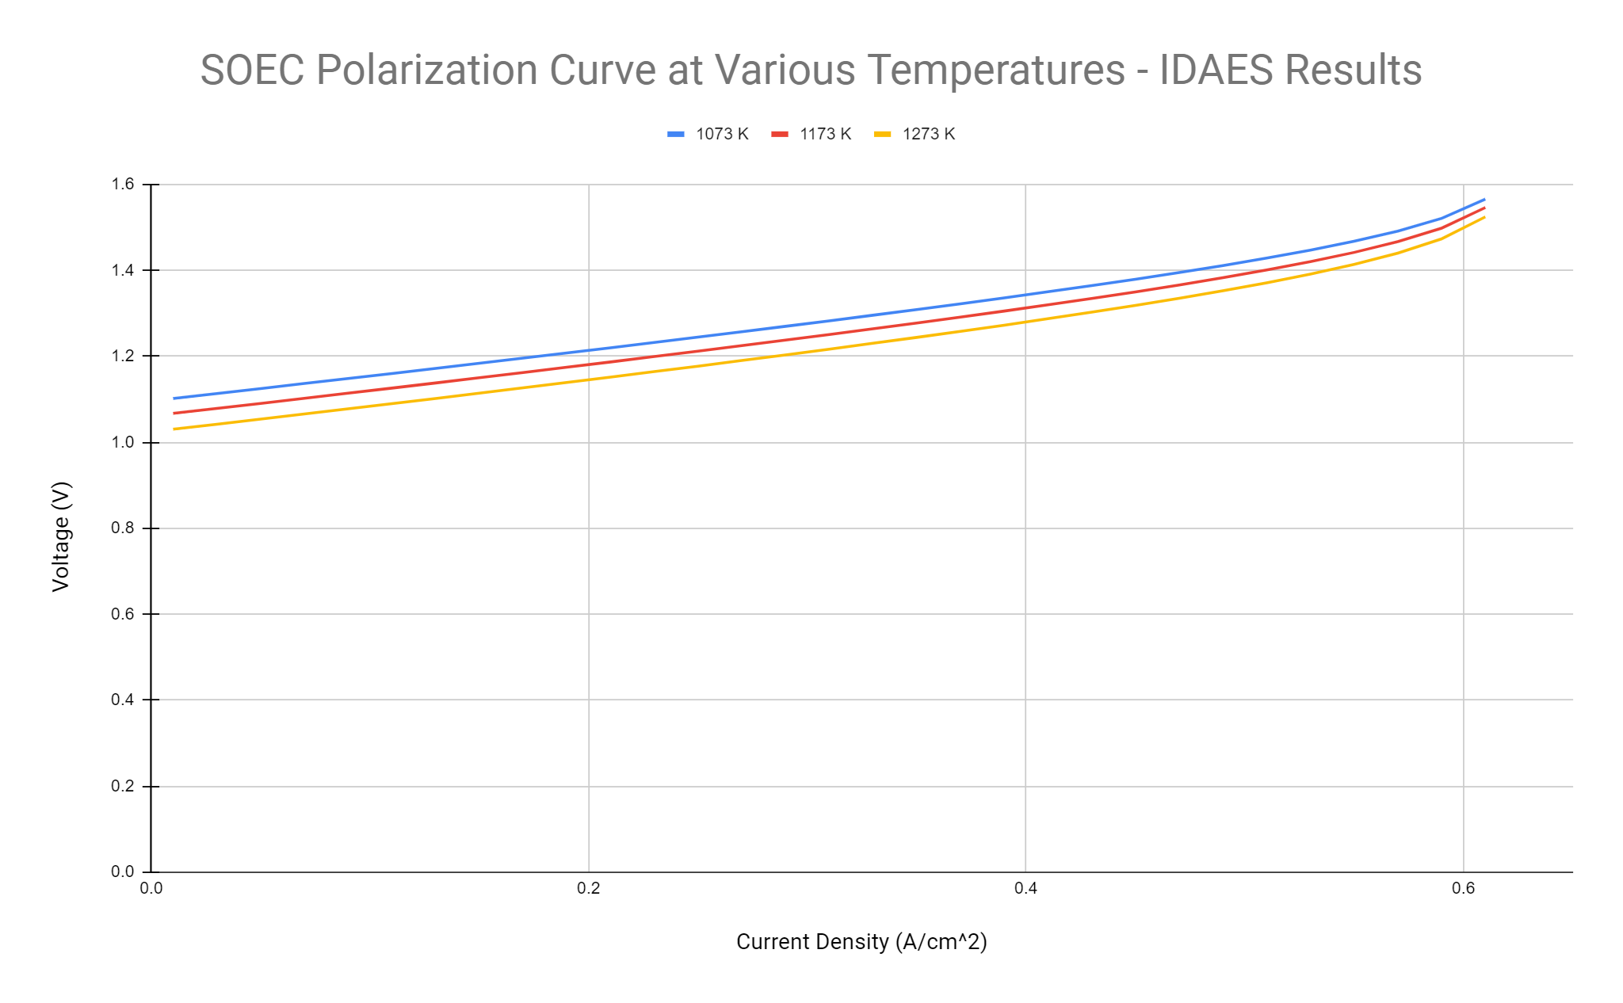
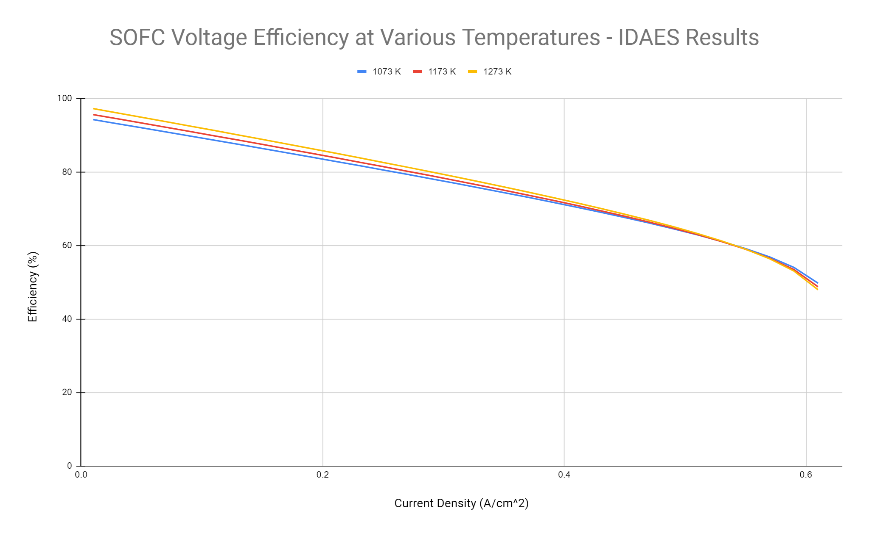
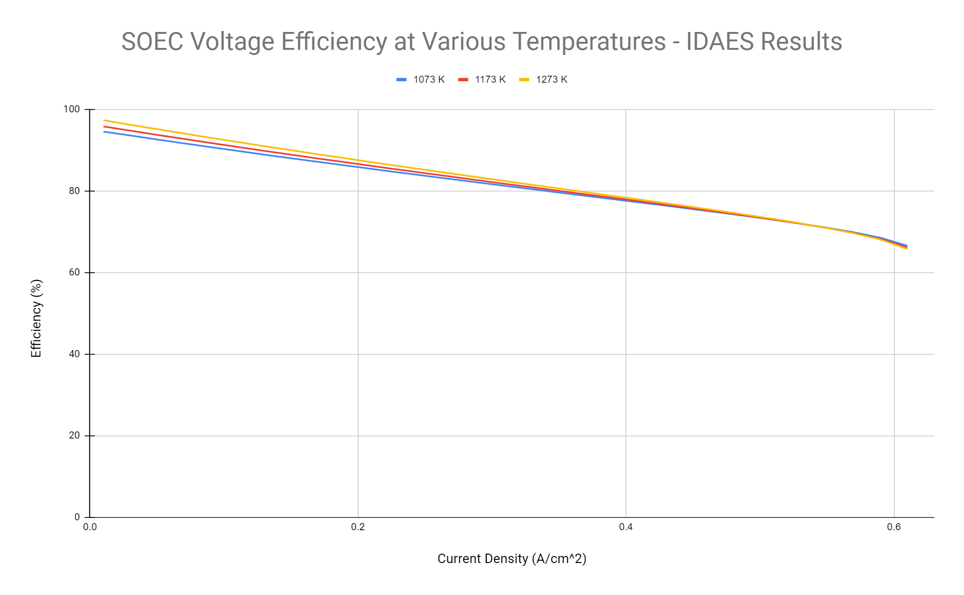
IDAES Results
Notes:
Alex - Here are our results from inputting the data from the IDAES code into the mathematical model. We found that like with the Aspen simulations, SOFC voltage increases with temperature, but initial output is closer to 1. For SOFC voltage efficiency, we found that higher temperatures give higher voltage efficiencies, and that running the cell at lower current densities is very important. For the SOEC simulation, lower temperature led to better performance and efficiency. The SOEC voltage efficiency still remained much higher at high current densities than that of SOFCs.

Slide 26
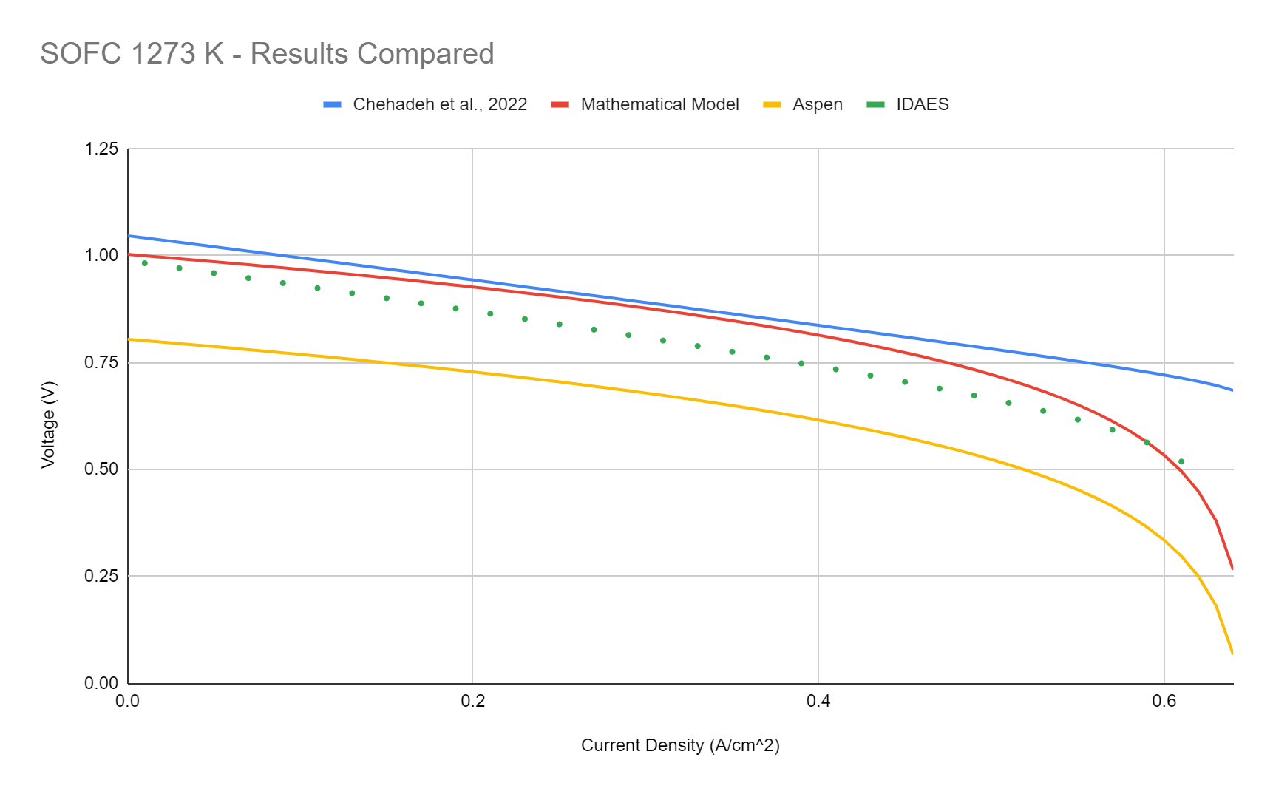
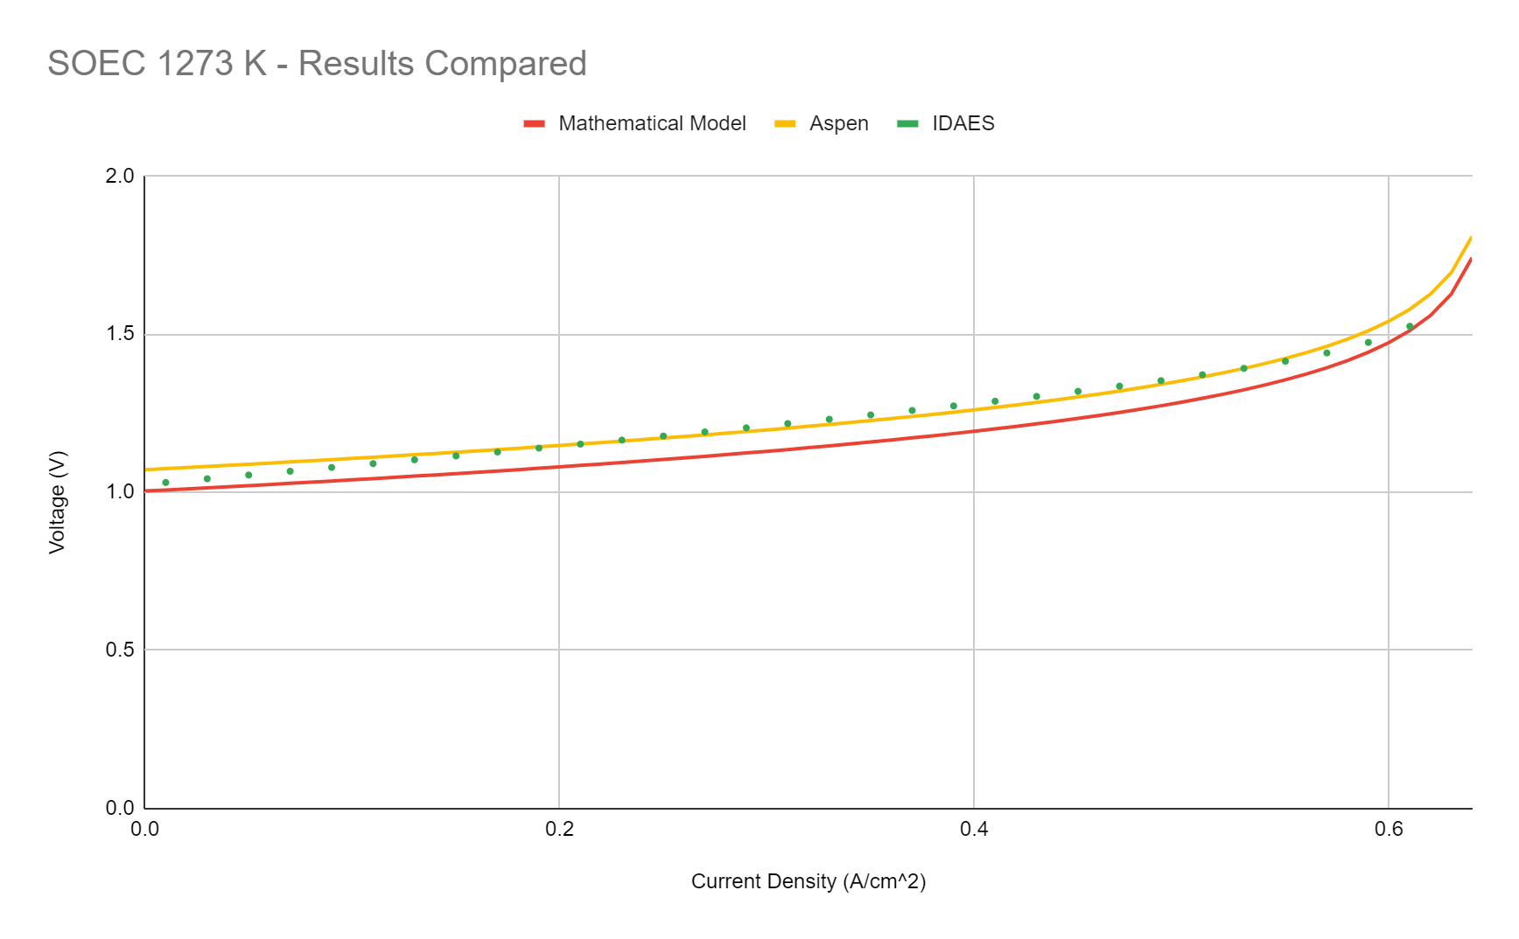
Comparison of Results
Notes:
Sam - Here are two graphs, corresponding to SOFC and SOEC modes, with all of our results compared. In SOFC mode, we see that the previous group predicted a higher voltage, and lower activation loss and concentration loss than our model. We can also see the large difference in voltage with the Aspen SOFC, suggesting the flowsheet needs to be improved or redesigned. The SOEC results showed much closer voltage to what we expected, with the mathematical model giving a lower voltage than either Aspen or IDAES. The results here suggest the Aspen SOEC model flowsheet is an accurate approximation of the cell.

Slide 27
Conclusions and Recommendations

Slide 28
Conclusions
Mathematical models:
Activation loss, though present, is not as pronounced as we expected
These partial pressure changes improve performance:
For SOFC: increasing H₂O partial pressure relative to H₂, and decreasing O₂ partial pressure
For SOEC: increasing H₂ partial pressure relative to H₂O, and increasing O₂ partial pressure
A higher temperature leads to better SOEC performance, and has a smaller effect on SOFC performance
Aspen Simulations:
Higher temperatures improves SOFC performance and SOEC performance
Voltage efficiency has a limited relationship with temperature, but if recommendations were to be made a temperature of 1173K or 1273K is recommended over 1073K
The SOEC is an accurate model, but the SOFC may need improvement. These flowsheets could be combined in future work to form an RSOC
IDAES Coding:
Temperature relationships with regards to performance and efficiency match Aspen observations, but entropy change term was not considered (resulting in higher initial output voltage and ideal operating temperature of 1273K)
Notes:
Steve

Slide 29
Recommendations
Software
Consider different model aspect behaviors (deterioration over time, natural resistance, current buildup, etc.) and other adjusted parameters to simulate realistic conditions to determine how they also affect efficiency
If IDAES is not further developed, consider substituting with similar software platforms such as EES, Vali, gPROMS, etc. Alternatively, use solely Aspen Plus for future work.
Additional Resources
Utilize external resources for help with model parameters and conditions (sponsor, other research groups, etc.)
Always feel free to contact us at gr-fuelcellmqp@wpi.edu, and we’ll try to assist future groups to the best of our abilities
Notes:
Alex

Slide 30
Special Thank You
to
Saint-Gobain Research North America
John Pietras, SGRNA
Dr. Yu Zhong, WPI

Slide 31
References
AlZahrani, A. A., & Dincer, I. (2017). Thermodynamic and electrochemical analyses of a solid oxide electrolyzer for hydrogen production. International Journal of Hydrogen Energy. 42(33), 21404-21413. https://doi.org/10.1016/j.ijhydene.2017.03.186
Chehadeh, M., Ourdyl, T., Blechinger-Slocum, D., & Tabandeh, M. (2022). A thermodynamic analysis of solid oxide fuel cells. Worcester Polytechnic Institute.
E. Fontell, T. Hakala, & T. Matikainen (n.d.). Technology. Convion Fuel Cell Systems. https://convion.fi/technology/
Hauck, M., Herrmann, S., & Spliethoff, H. (2017). Simulation of a reversible SOFC with Aspen Plus. International Journal of Hydrogen Energy. 42(15), 10329-10340. https://doi.org/10.1016/j.ijhydene.2017.01.189
Jørgensen, S. E., & Fath, B. D. (2008). Encyclopedia of Ecology. Elsevier Science.
Menon, V., Janardhanan, V. M., & Deutschmann, O. (2013). A mathematical model to analyze solid oxide electrolyzer cells (SOECs) for hydrogen production. Chemical Engineering Science, 110, 83-93. https://doi.org/10.1016/j.ces.2013.10.025
Ni, M., Leung, M. K. H., & Leung, D. Y. C. (2007). Parametric study of solid oxide fuel cell performance. Energy Conversion and Management, 48(5), 1525-1535. https://doi.org/10.1016/j.enconman.2006.11.016
O’Hayre, R., Cha, S., Colella, W. G., & Prinz, F. B. (2016). Fuel cell fundamentals. John Wiley & Sons.

