Slide 1
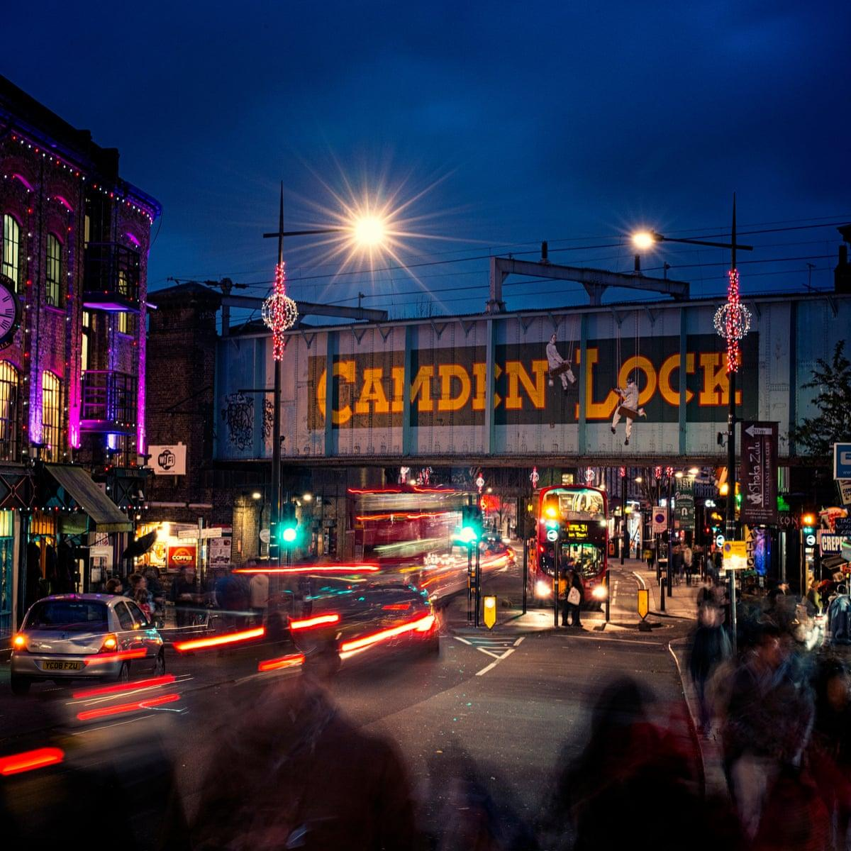
COMMUNITY
Creating a contemporary profile of the Somali community in Camden
(4/26/22)
By Spencer Francis, Roopsa Ghosh, Jackson Lombardi, and Dillon McCarthy
Notes:
Roopsa

Slide 2
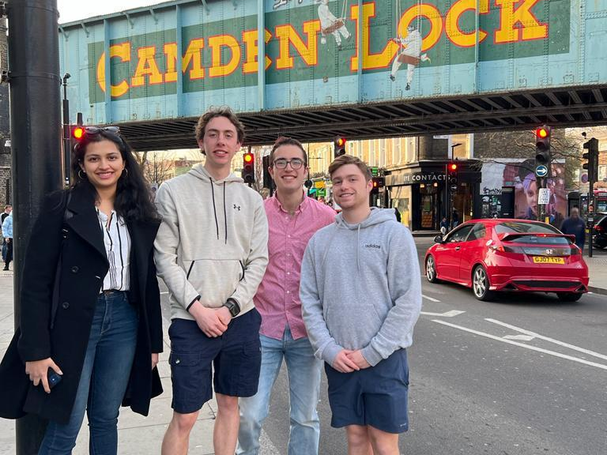

Slide 3
Policymakers and Somali community based organizations lack up-to-date information on the Somali community in London.
Notes:
The Somali community in London has been growing since the 1990s, but we still lack information on what their daily lives look like. Somalis are often grouped together with other Black communities in England, but their religion and culture make them and the challenges they face distinct.
Roopsa

Slide 4
Supporting Further Services for the Somali Community
Understand the challenges and accomplishments
Collect new quantitative data
Gather new qualitative data from interviews
Encapsulate findings in a report and summarise through infographics.
Notes:
From this report we wish to help identify challenges to help the SYDRC better support the youth and study how challenges are linked
Help secure more funding for the SYDRC
Inform future policies and services to support the Somali Community
Contribute recent information to the wider body of research of Somalis in London
Talk in Past tense ,....objectives were

Slide 5
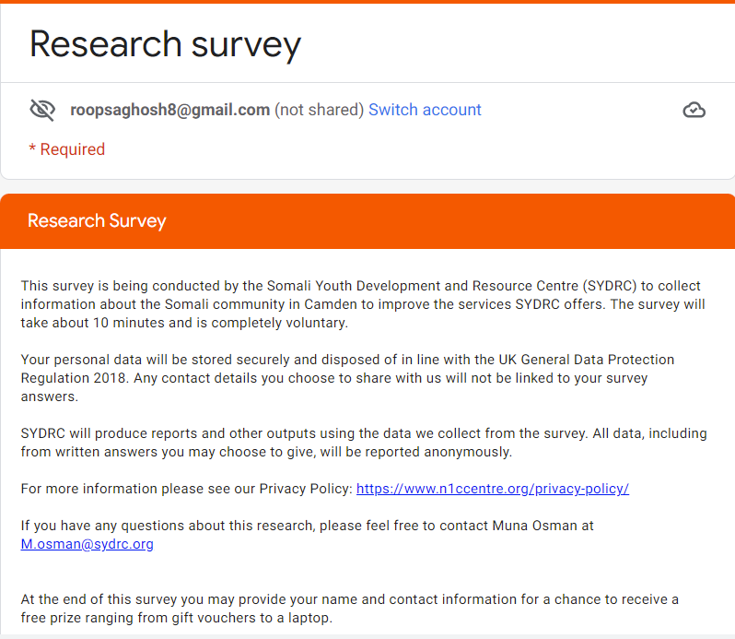
Collecting Quantitative Data
Notes:
Roopsa
Survey open for 4 weeks

Slide 6
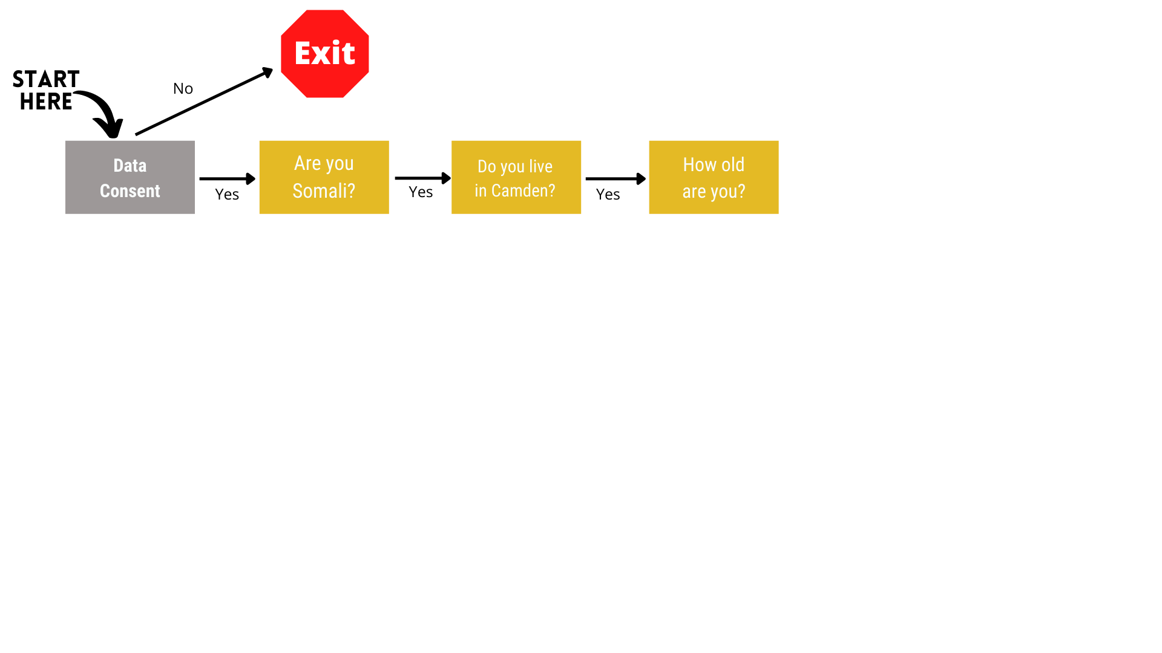
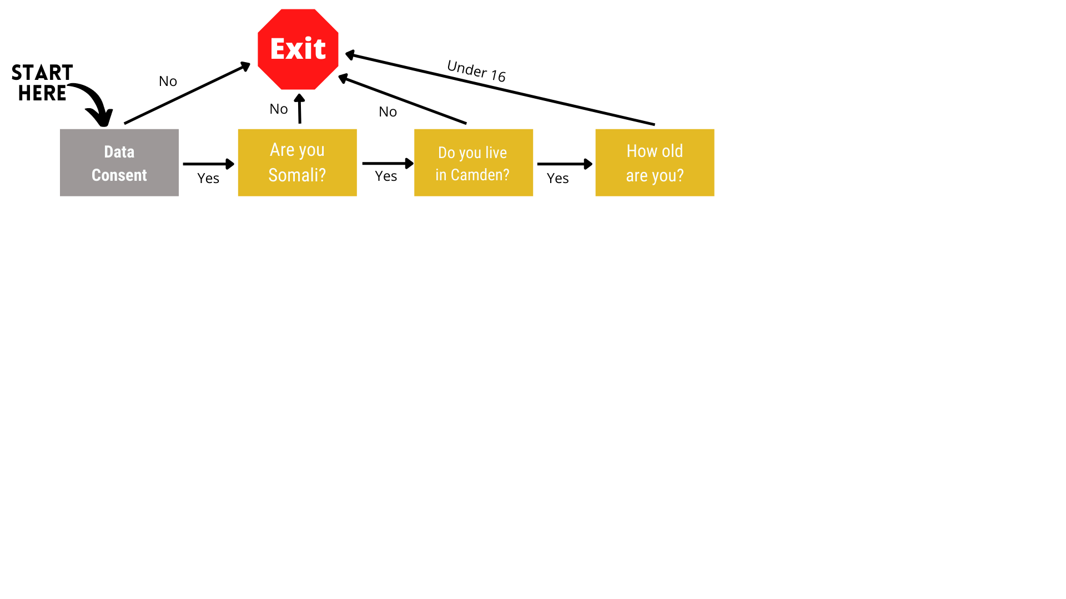
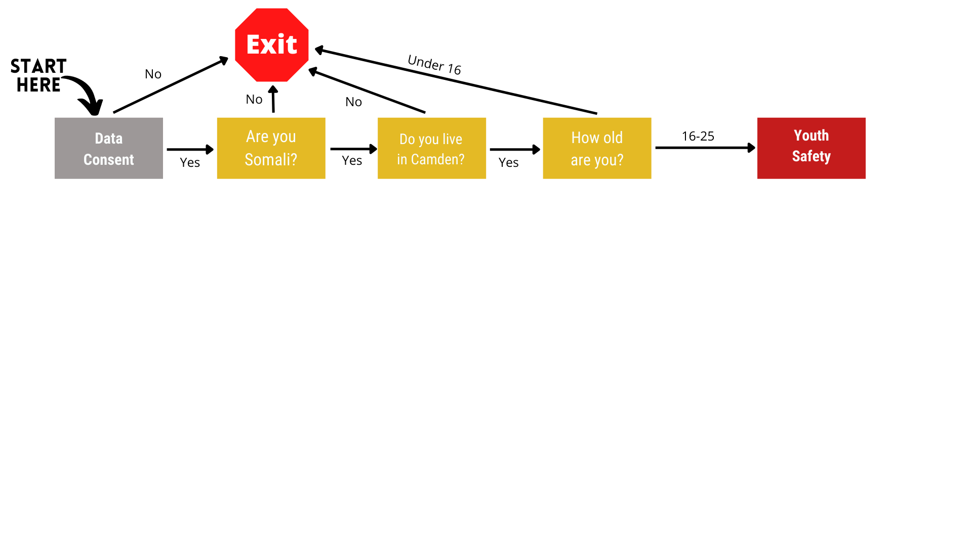
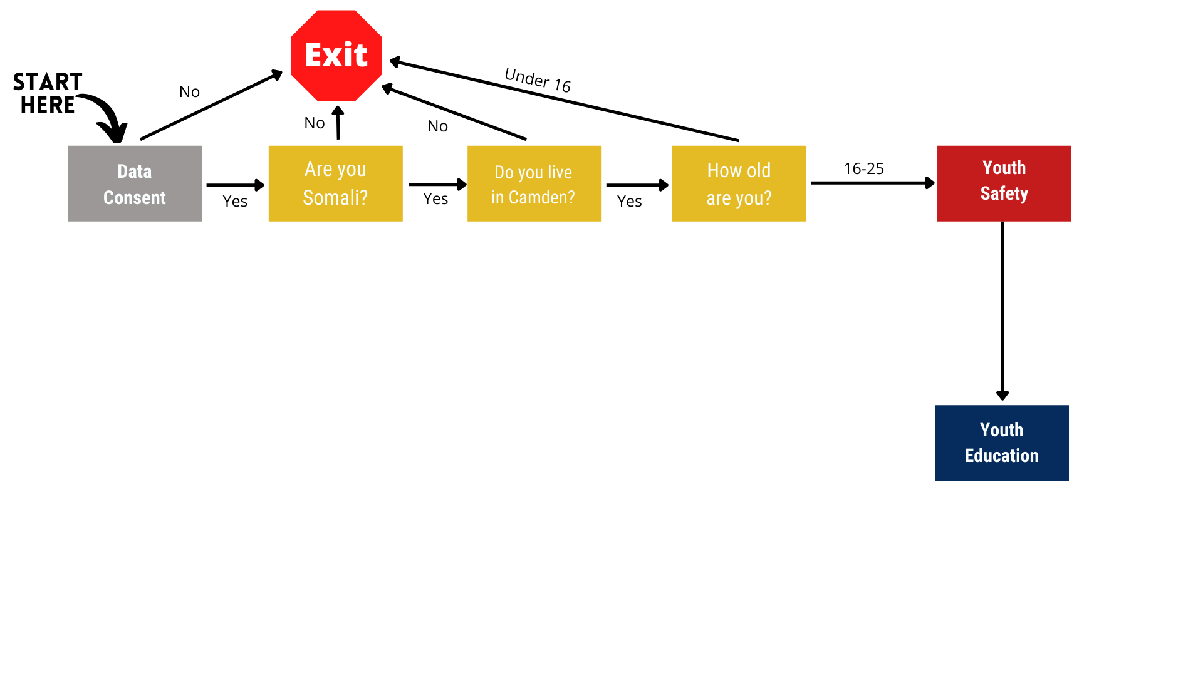
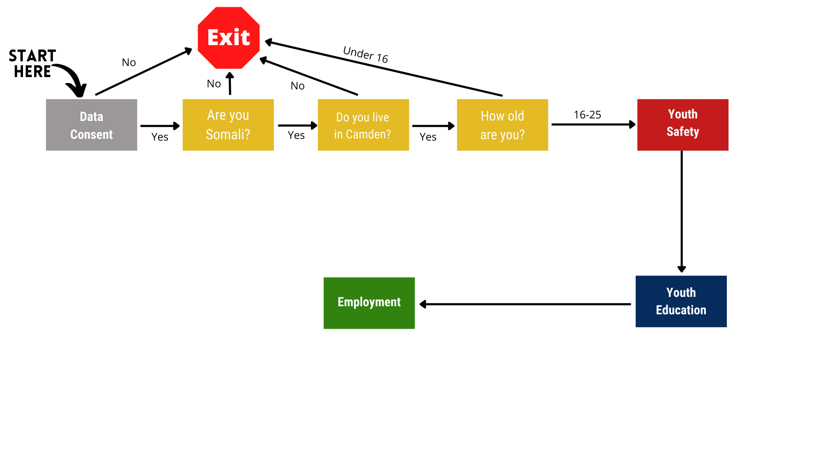
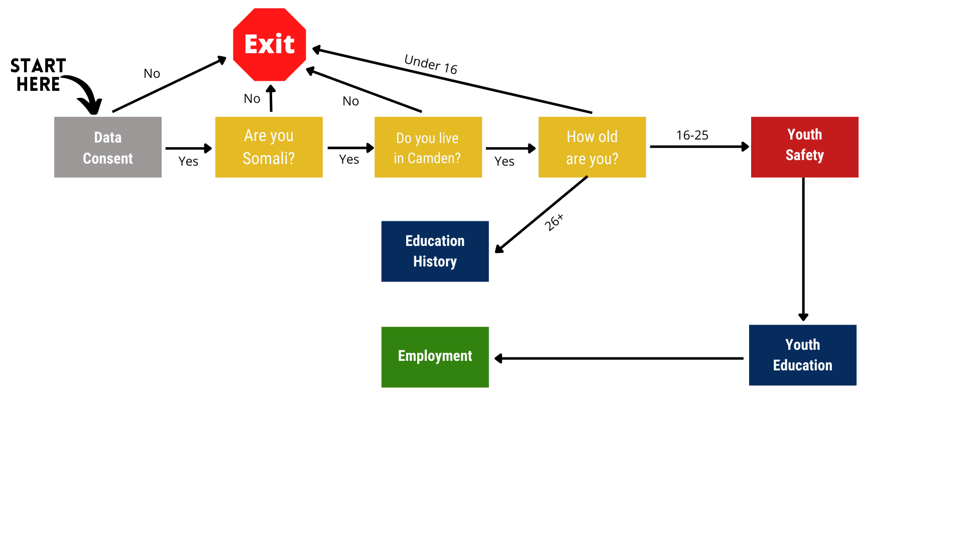
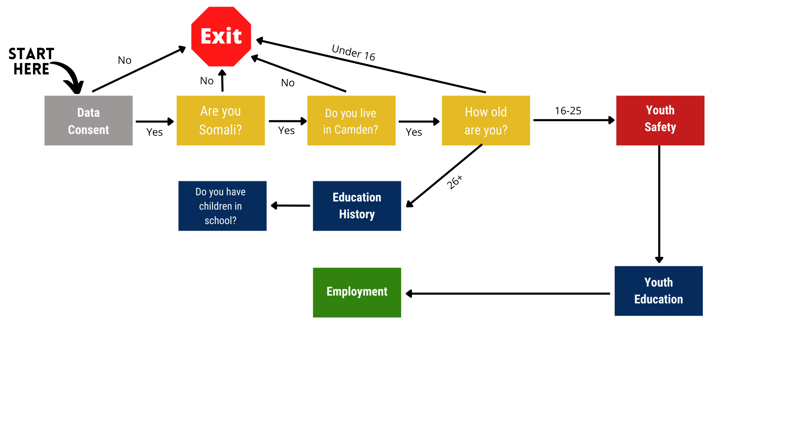
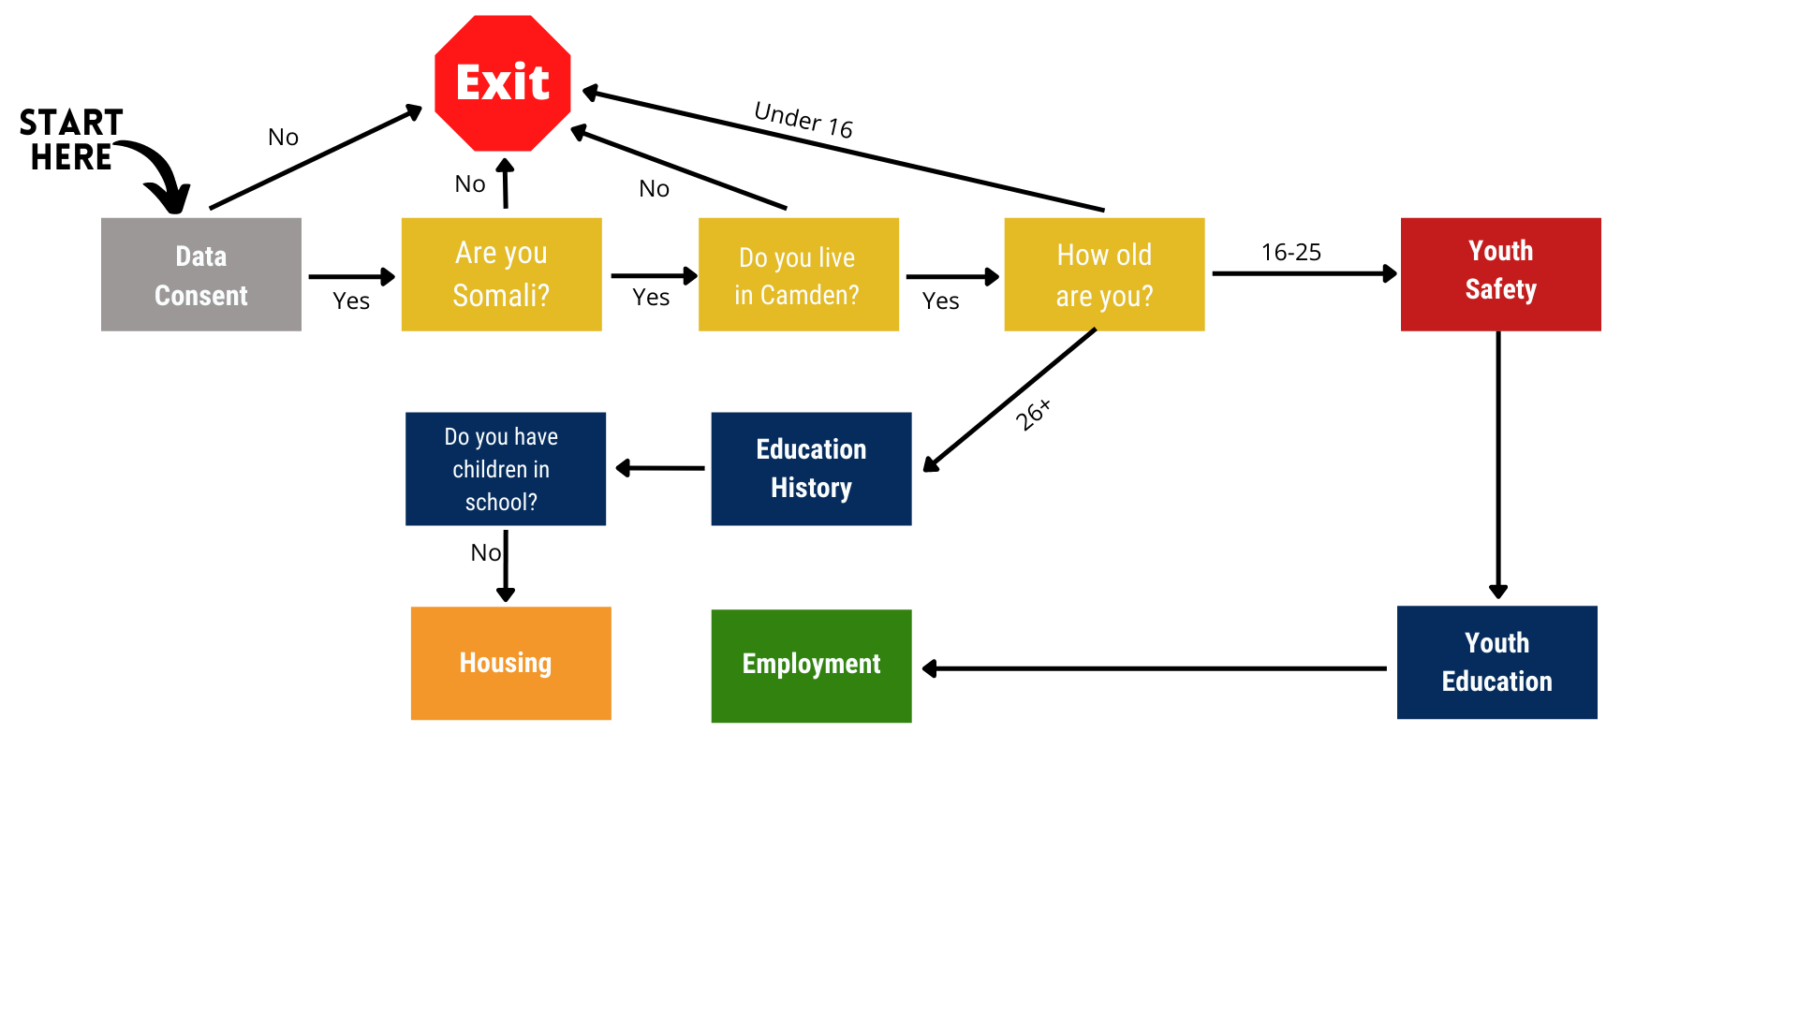
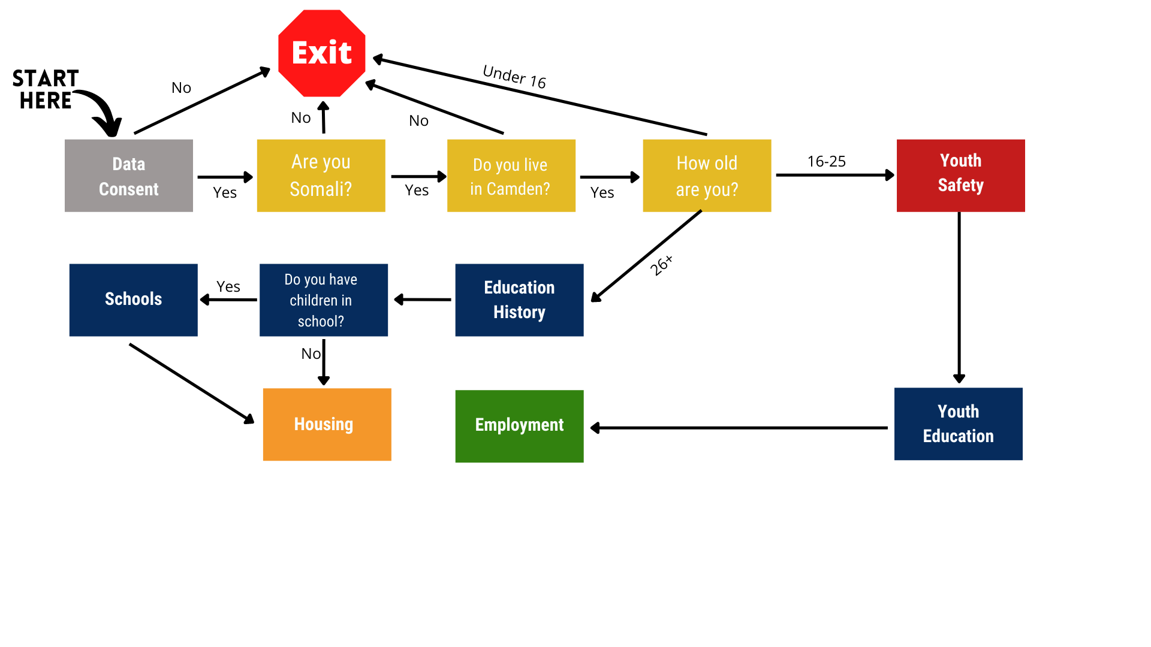
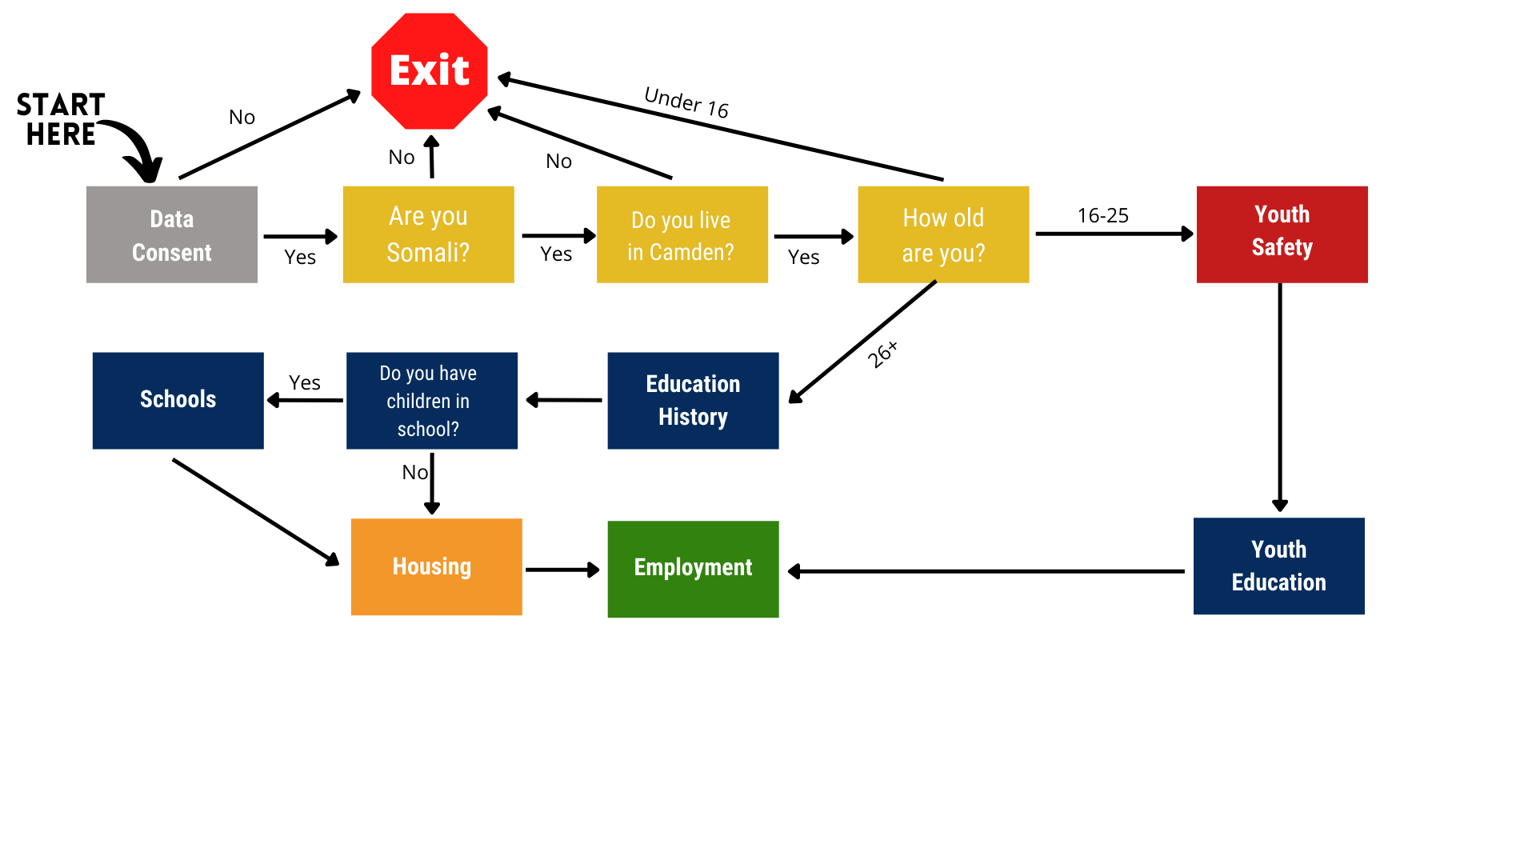
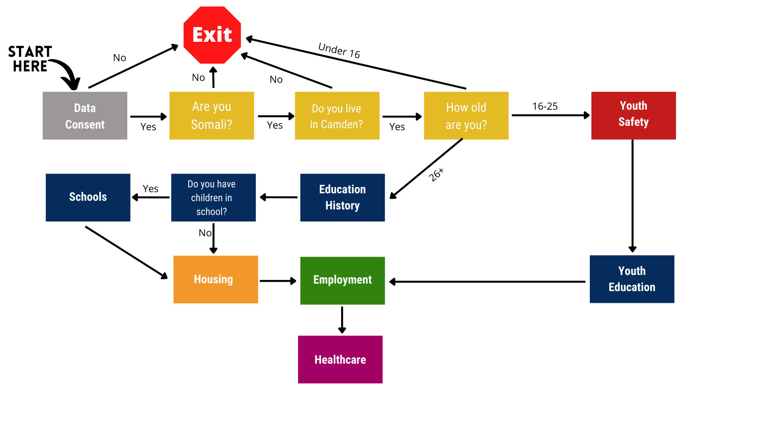
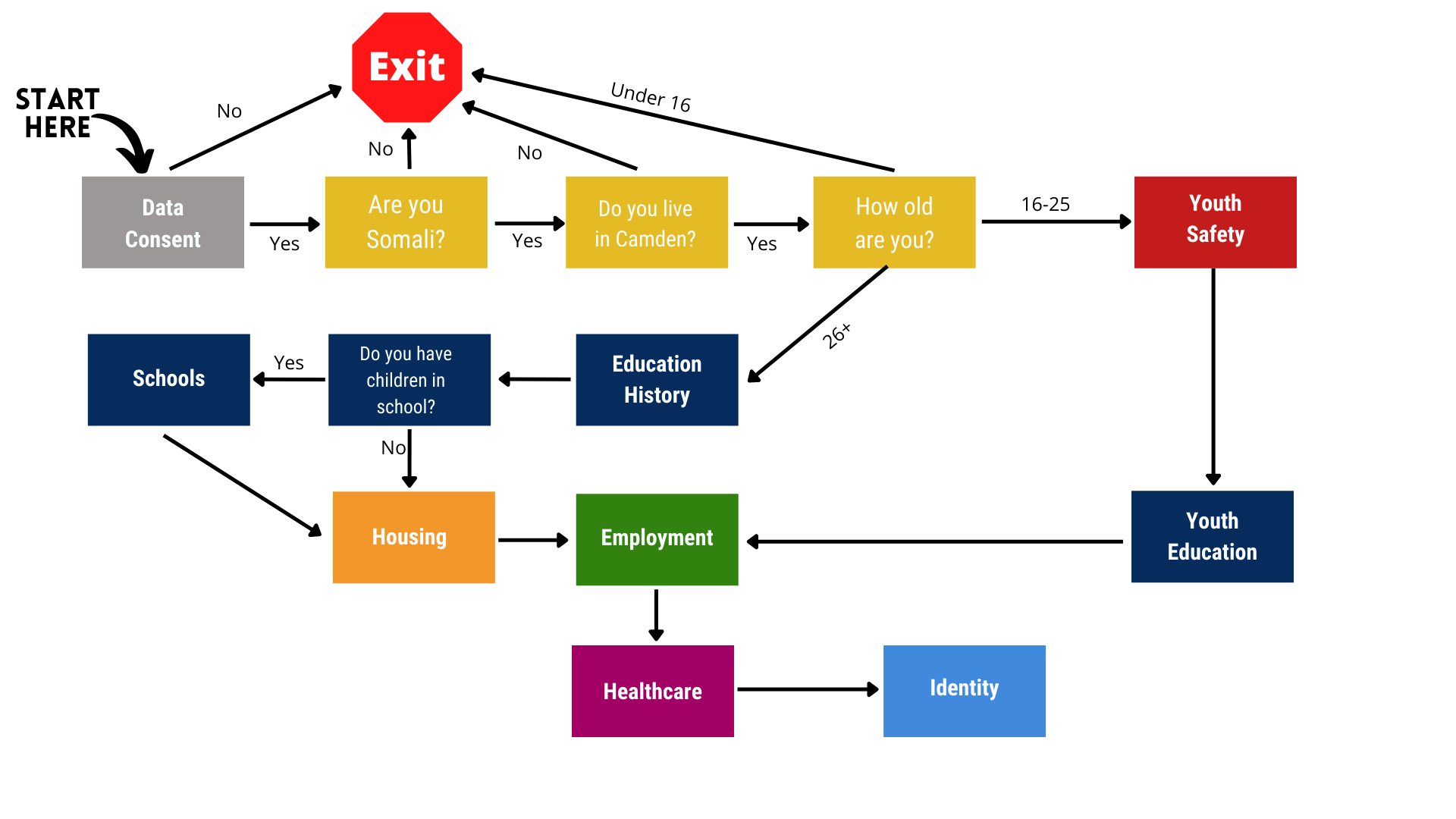
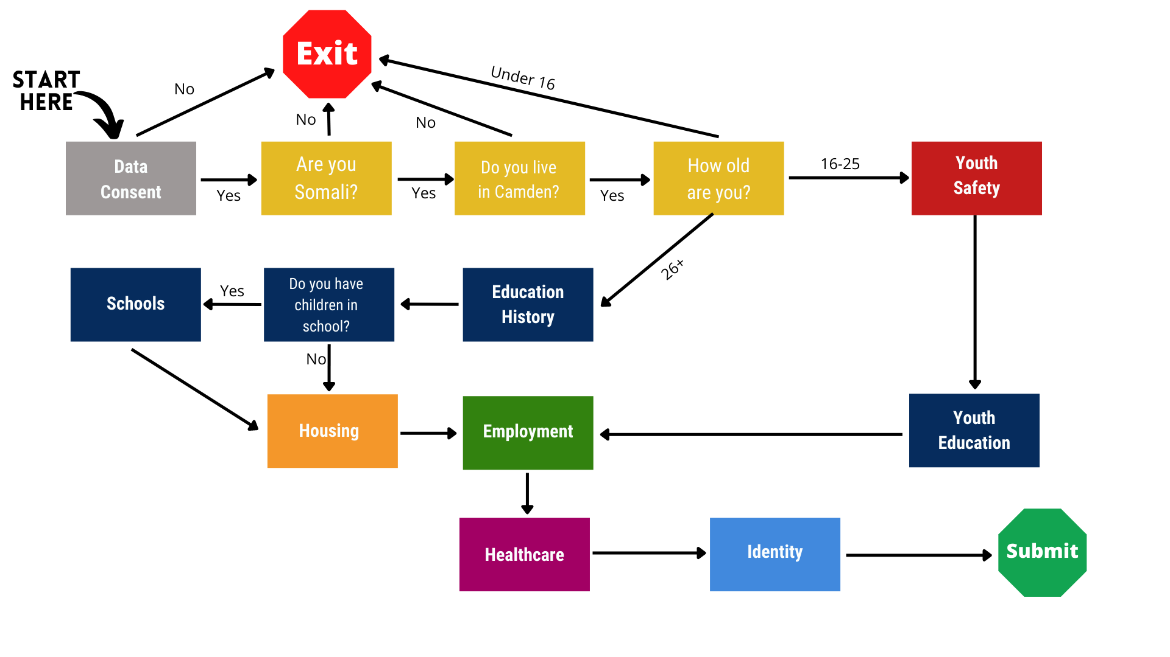
Notes:
Spencer

Slide 7
Gathering Qualitative Data
Notes:
Roopsa

Slide 8
Gathering Qualitative Data
Notes:
Roopsa

Slide 9
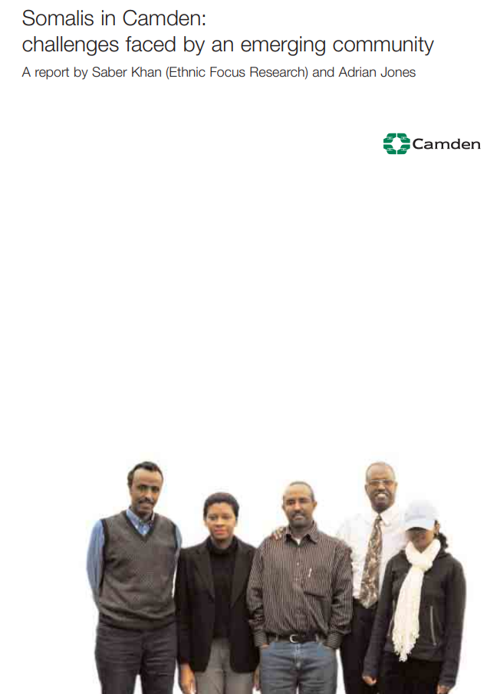
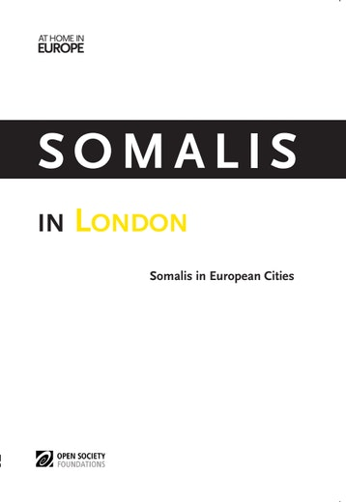
Khan and Jones (2003) and Open Society Foundations (2014) offer benchmarks in four areas for the community.
Employment
Education
Health
Housing
Notes:
Jackson

Slide 10
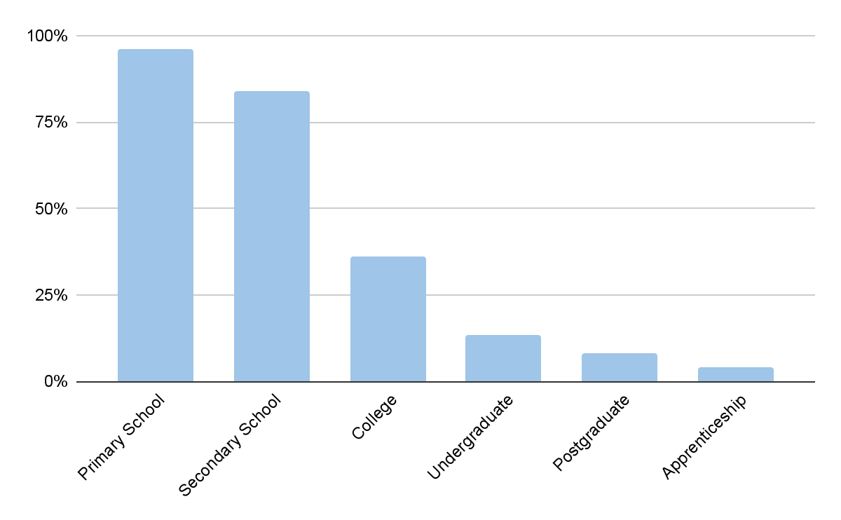
Khan & Jones (2003) found low attainment of higher education
Notes:
Jackson
Explain that they had limited sample pf 100 but unclear how recruited and how representative of the community

Slide 11
Khan and Jones reported 95% unemployment
Notes:
Jackson

Slide 12
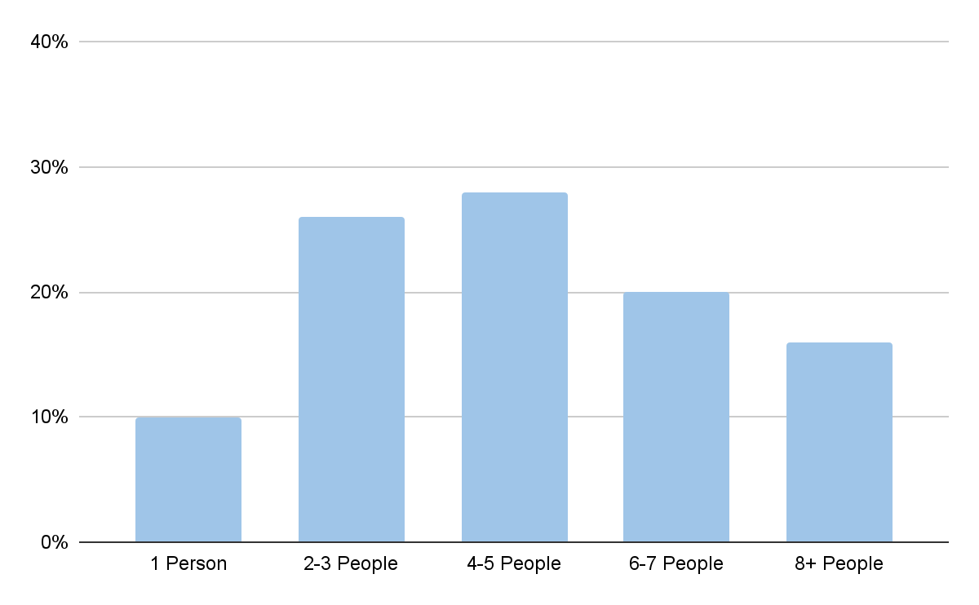
Khan and Jones found widespread overcrowding
Notes:
Dillon

Slide 13
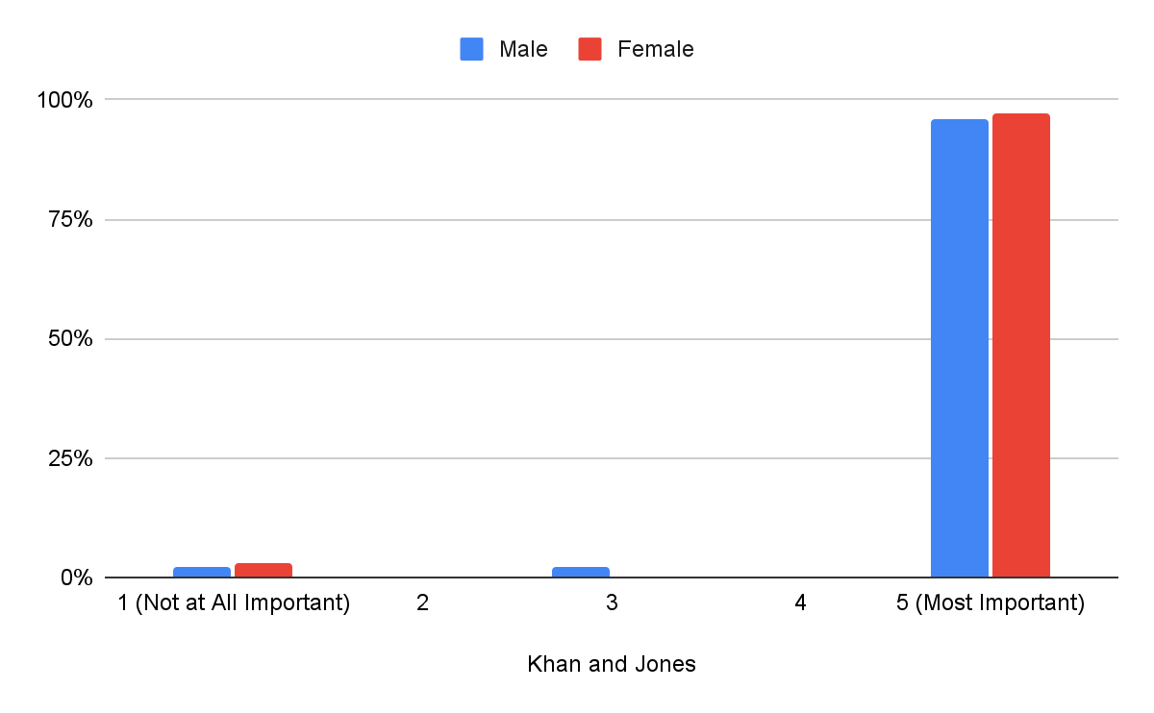
Religion was an important aspect of respondents’ identities
Notes:
Dillon

Slide 14
Demographics

Slide 15
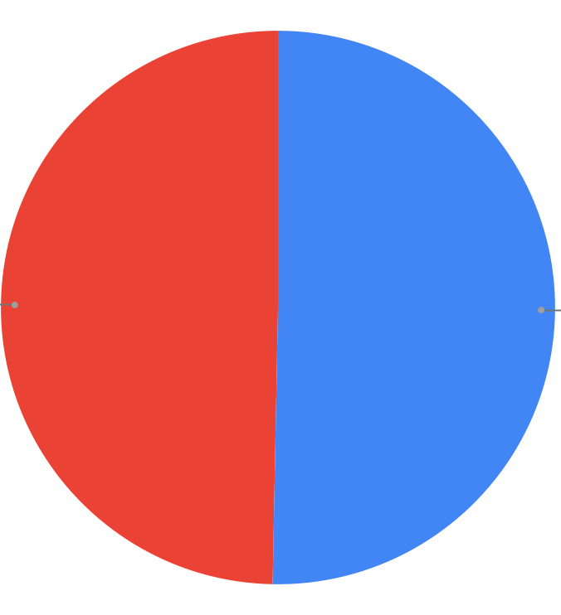
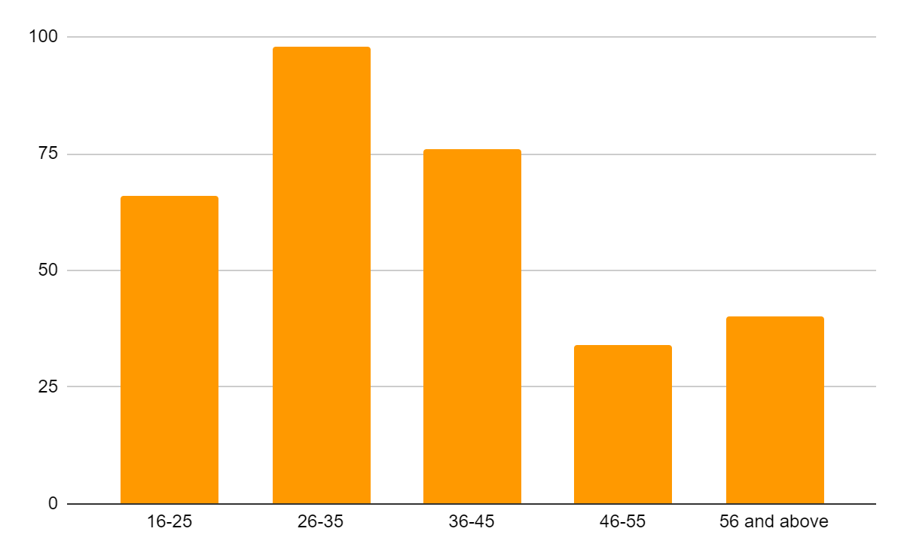
Respondents were evenly distributed between men and women, but lacking in older respondents
Male
Female
Notes:
Spencer

Slide 16
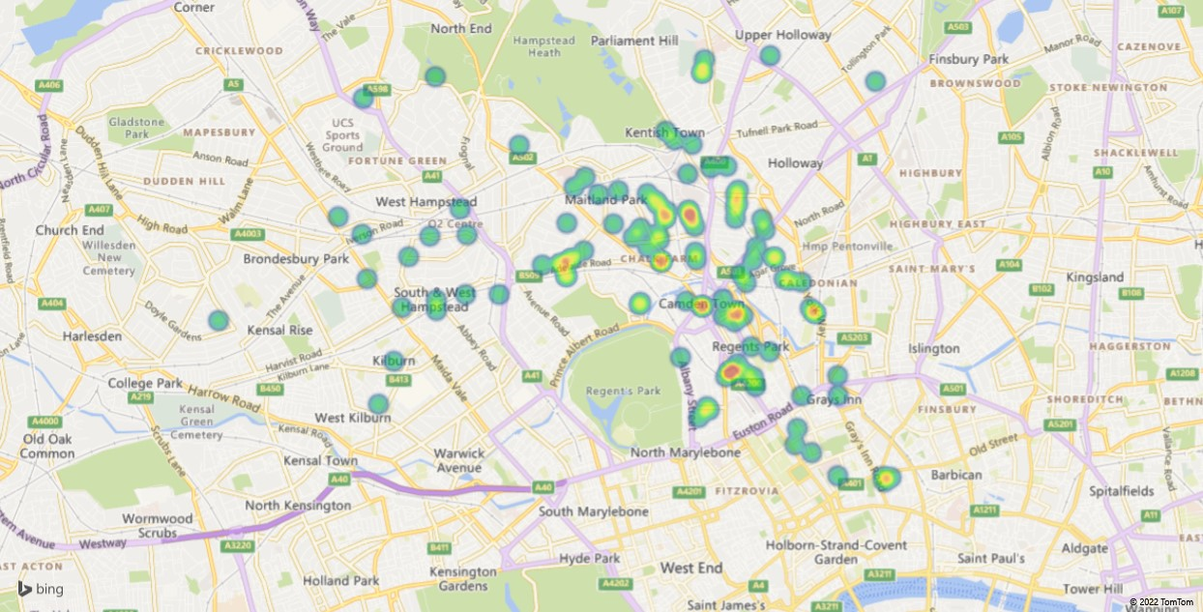
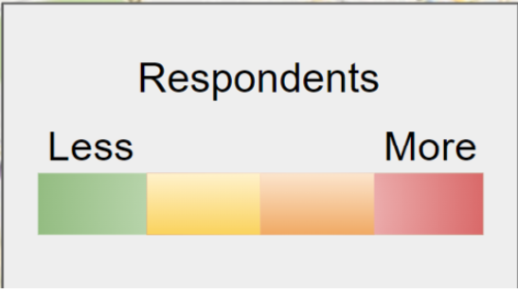
Respondents lived mostly in Camden Town and Kentish Town
Respondents
Fewer
More
Notes:
Jackson
These data agree with where interviewees said Somali populations were concentrated.

Slide 17
Health

Slide 18
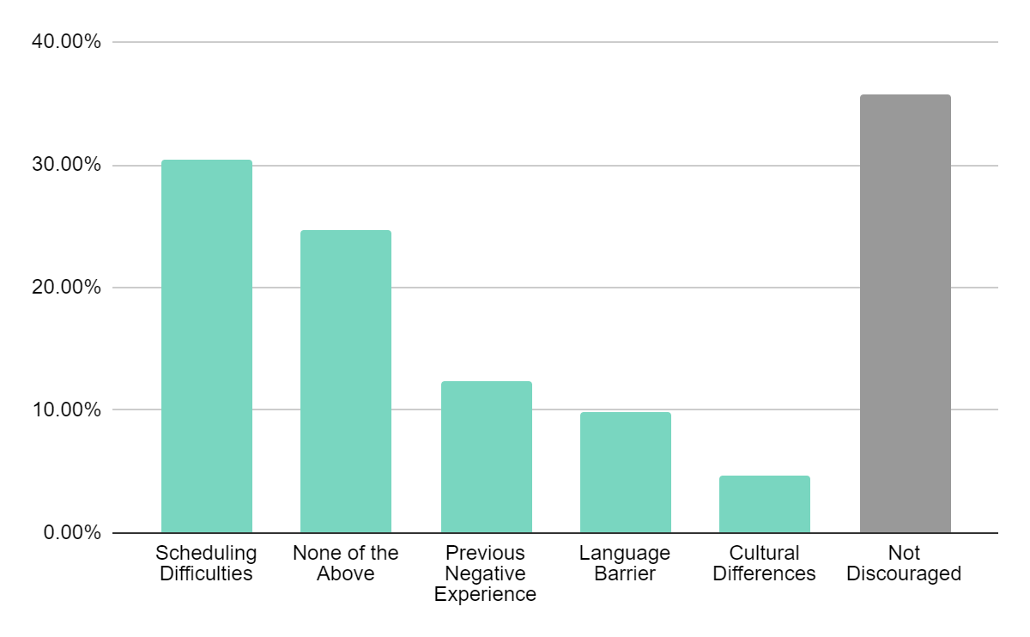
Language barriers have become less of an issue for Somalis in the healthcare system
The largest issue reported was scheduling difficulty, which is common across the UK
22%
2003
→ 9.8%
2022
Notes:
Spencer

Slide 19
Language barriers could still be reduced
As Hanad Mohamed, the Director of Equalities for Camden Council explains:
“The system is not really set up to support communities like the Somali community. And one simple thing is translation.
A good example I always use is, when the public health announcements were happening every day, on 10 Downing street, they were all in English. How were they communicating to people from the Somali community? It was a huge barrier.”
Notes:
Spencer

Slide 20
Somalis report mostly positive healthcare interactions
Notes:
Dillon

Slide 21
Housing
Notes:
Roopsa

Slide 22
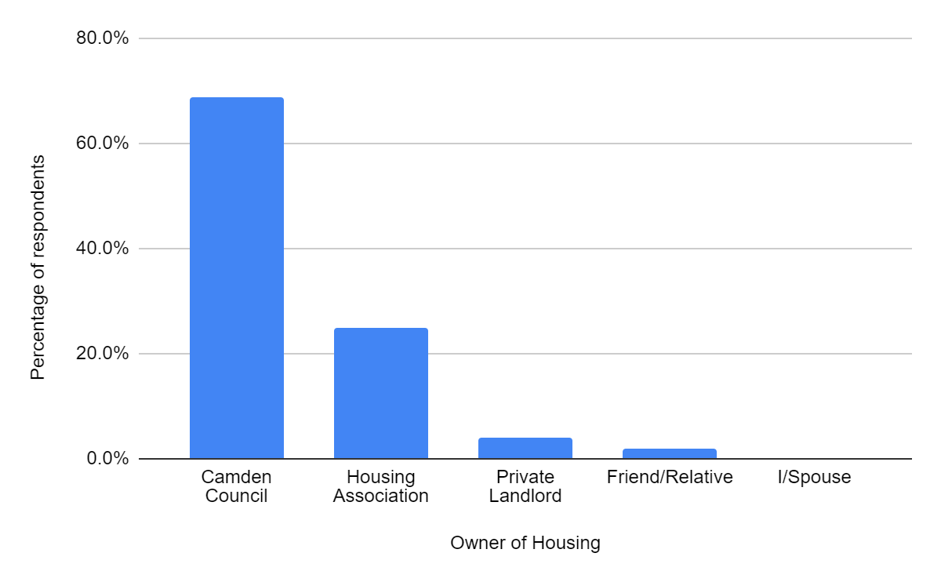
In our sample, most housing is owned by the Camden Council
Notes:
Roopsa
Not a single person surveyed owned their own house
More than 90% camden council and housing association

Slide 23
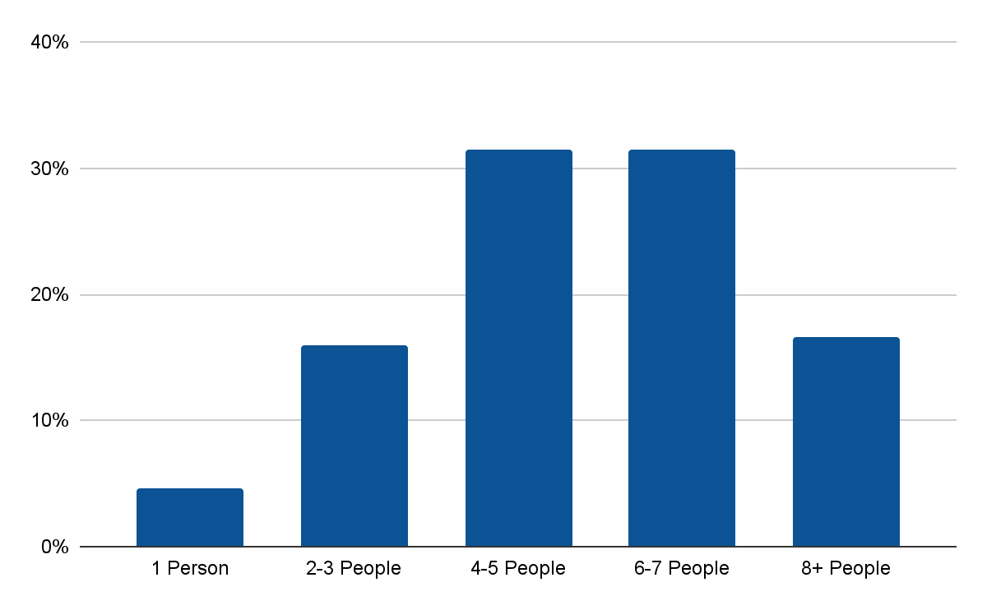
Responses indicate more people living in households
Number of people living in a home
Number of people living in a home
2003
2022
Notes:
Dillon
54% have 3 or fewer rooms
Add animations

Slide 24
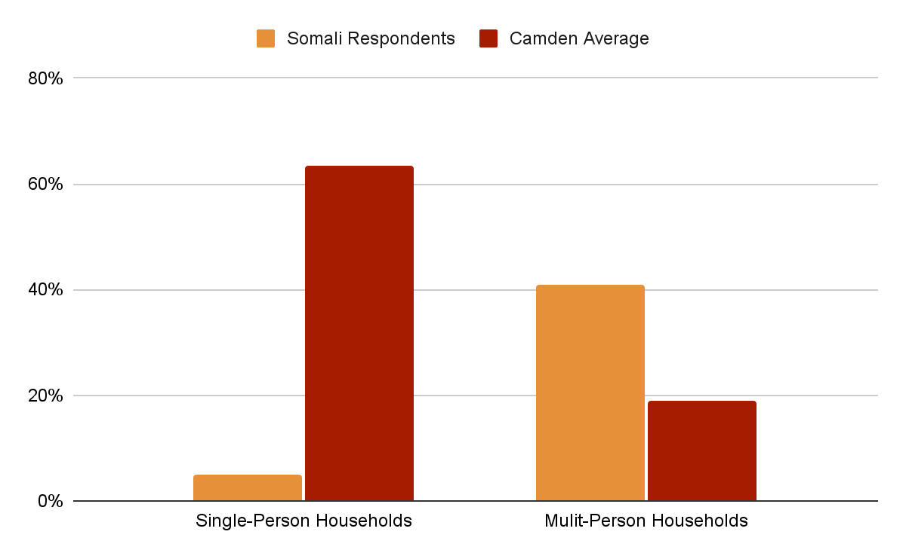
Somali respondents had more people per household than the Camden average
Notes:
Dillon
Single-Person Households: Somali - 5%, Camden - 64%
Multi-Person Households: Somali - 41%, Camden - 19%

Slide 25
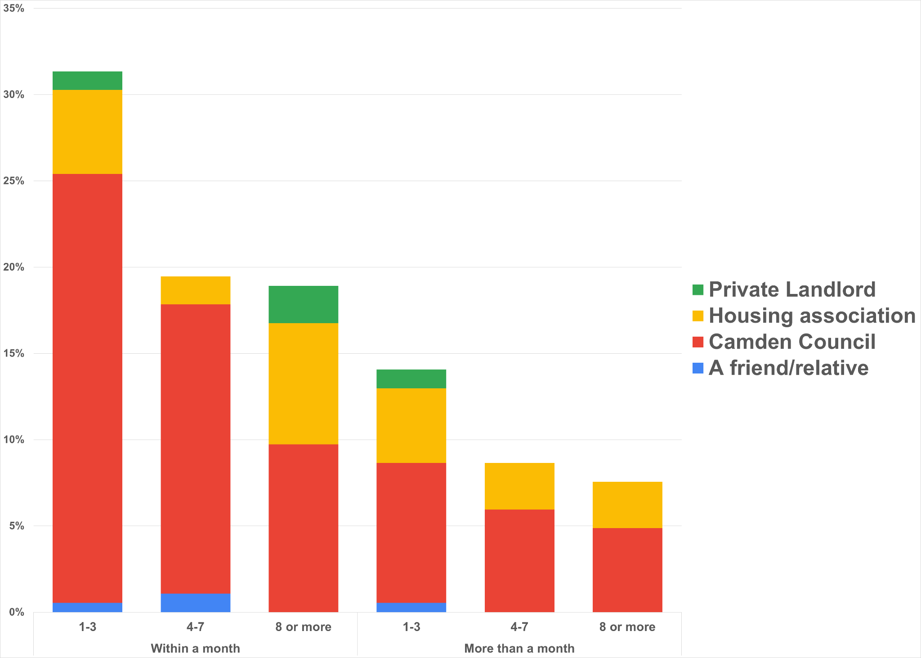
30% of respondents have housing problems for more than a month
Notes:
Roopsa

Slide 26
Employment

Slide 27
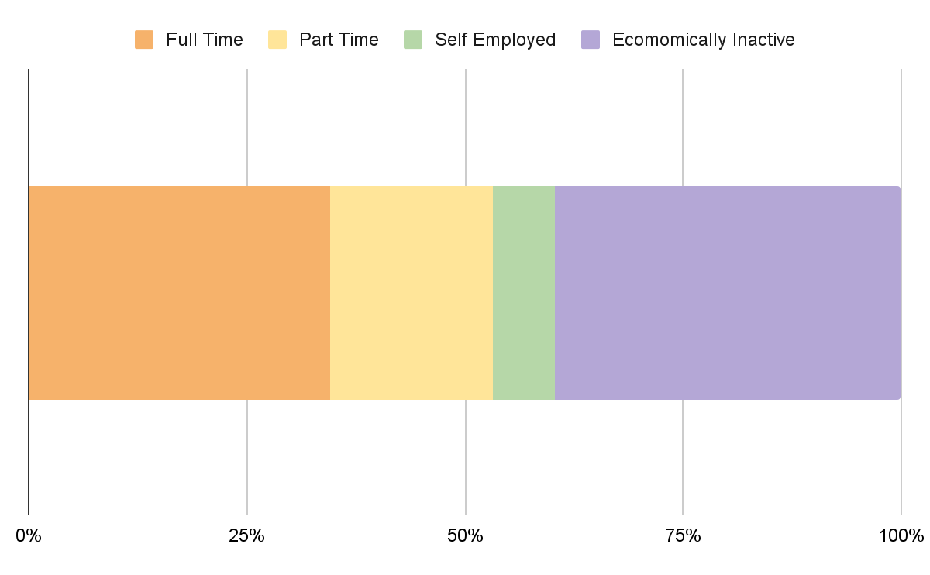
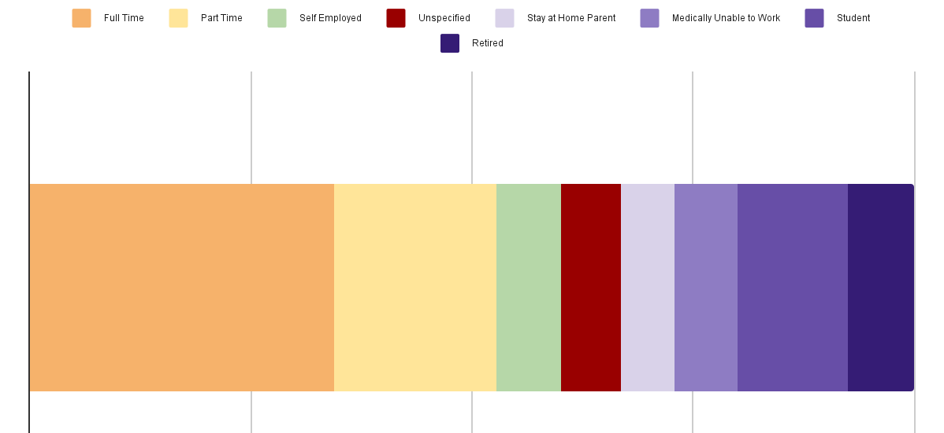
Of those surveyed, 40% did not have paid employment
However, of those 40%, only 7.2% were seeking employment.
Notes:
Spencer
Data from the 2003 Khan & Jones report. Open societies names no official figure, but claims “Somalis have the lowest employment rates” out of all migrant groups in the UK.

Slide 28
At least
90.6%
are below the median household income in Camden
Notes:
Jackson

Slide 29
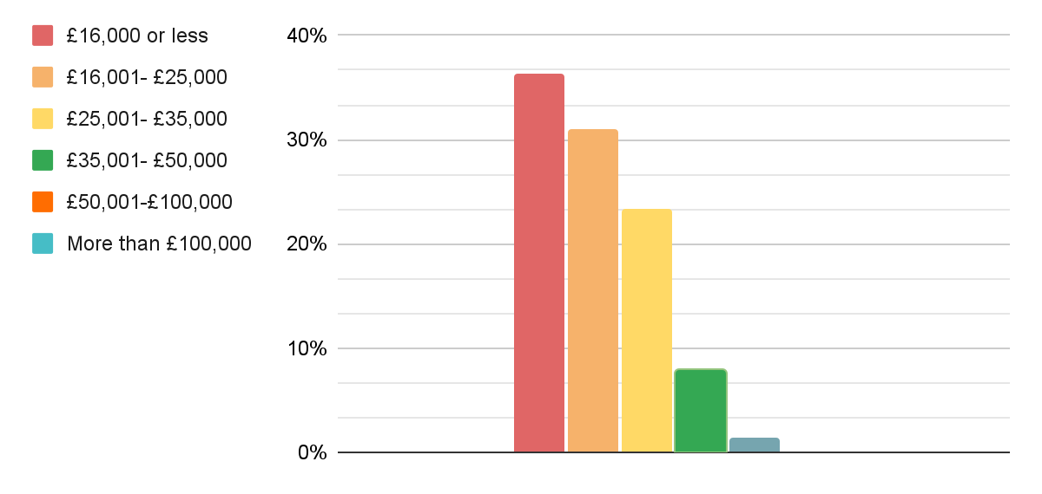
Household income of survey respondents
UK Poverty Line (£16,000)
Camden Median Income (£39,994)
Notes:
Jackson
36% poverty
90.6% below average
What’s interesting actually is [Camden does] have quite a diverse workforce. Our lower level, our entry level work, so for example with the caretakers, the cleaners, the security guards, our social workers, they are predominantly black and asian. But actually the more senior you become, the less diverse it is, and I think that's where the problem is.

Slide 30
Education

Slide 31
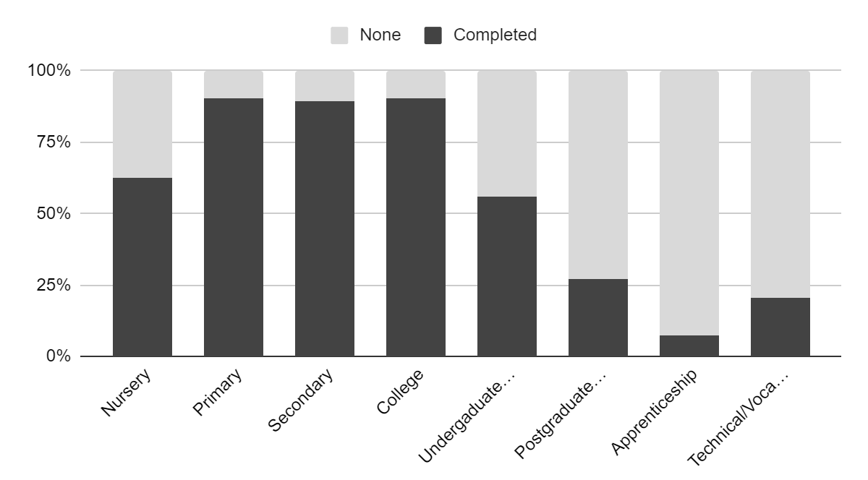
Our survey indicates respondents are highly educated
Notes:
Spencer

Slide 32
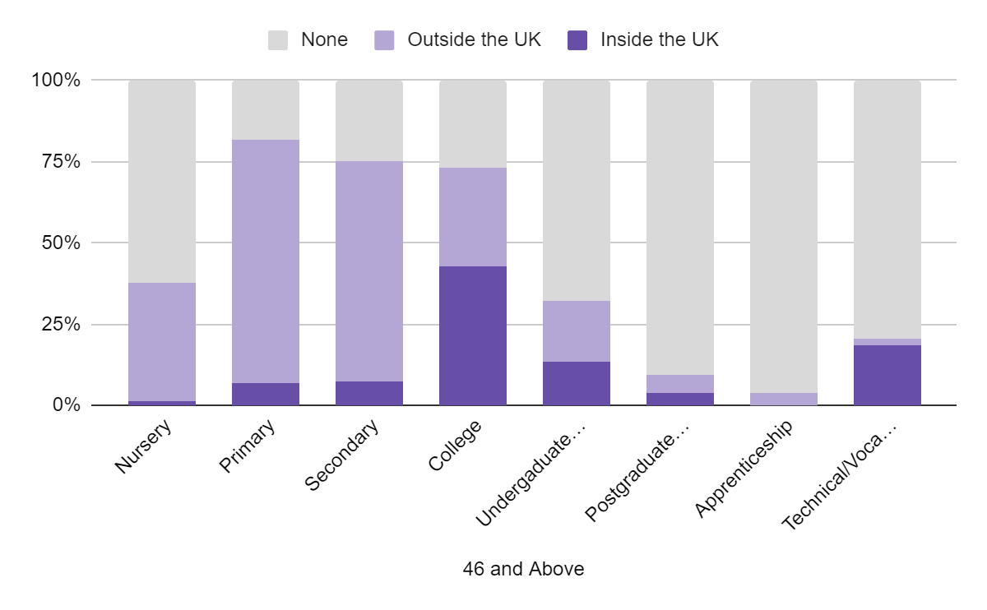
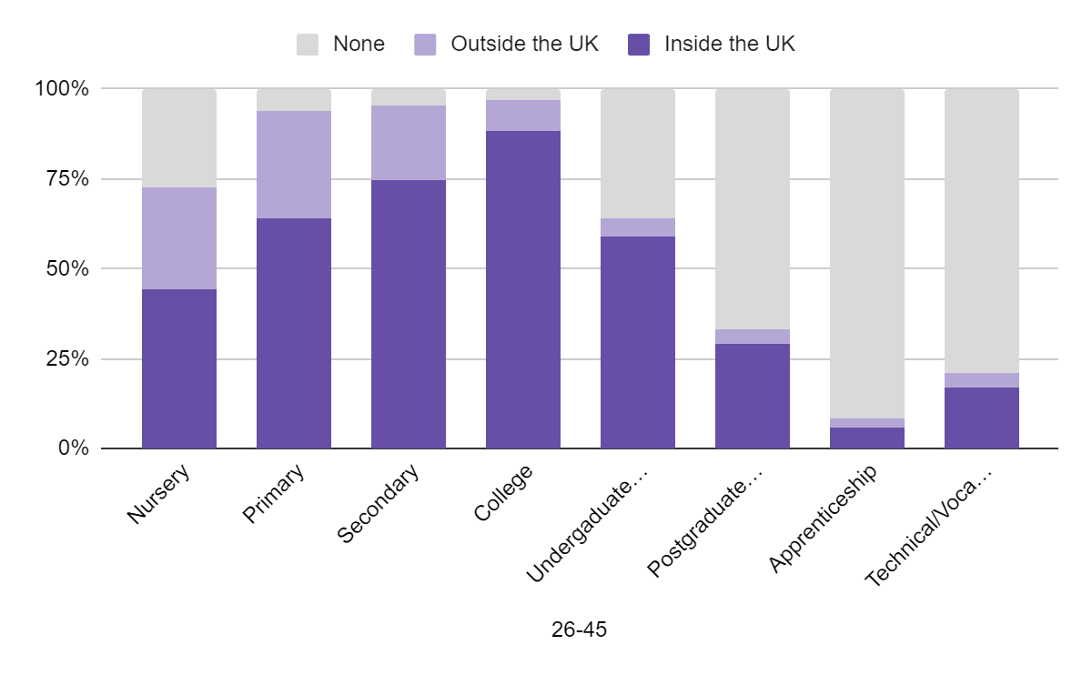
Younger generations attained even higher levels of education
Notes:
Spencer

Slide 33
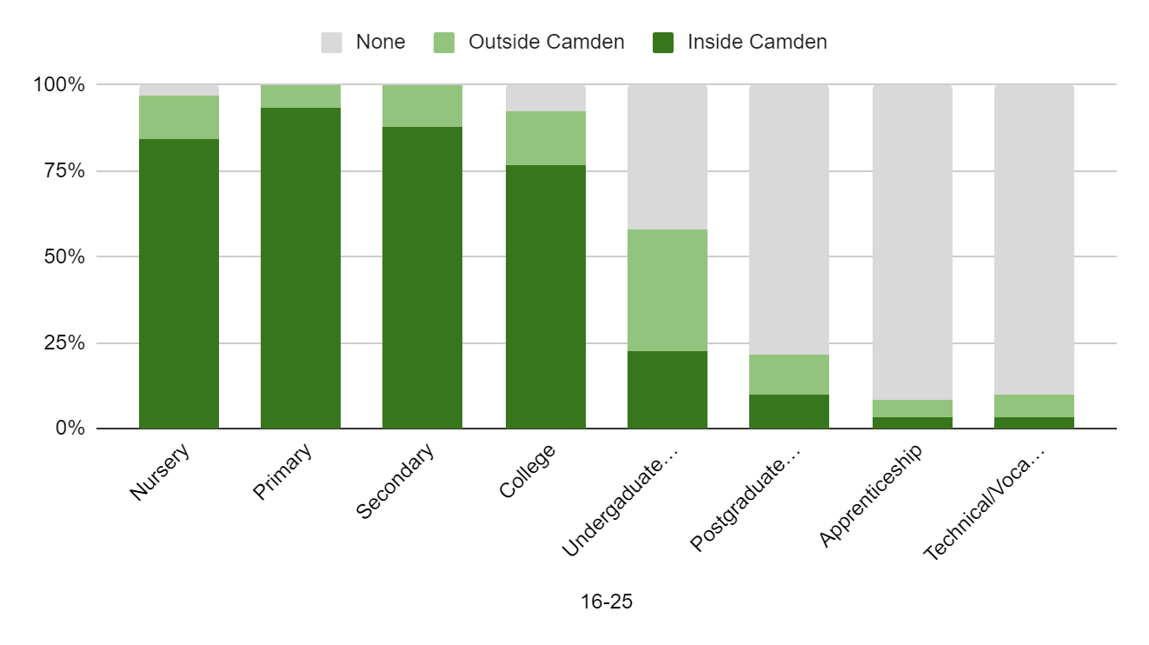
But apprenticeship and vocational rates were low amongst younger respondents
Notes:
Spencer

Slide 34
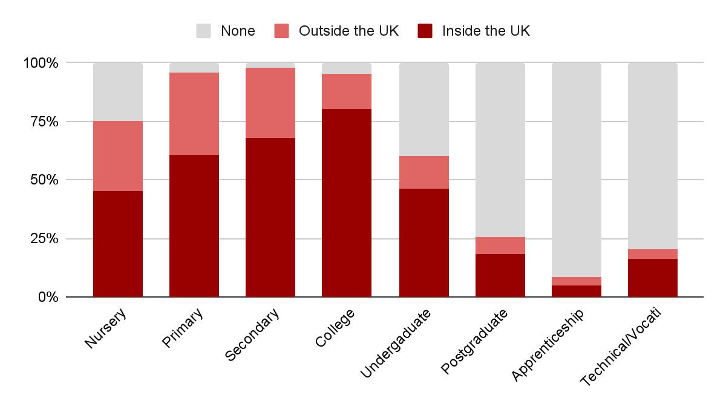
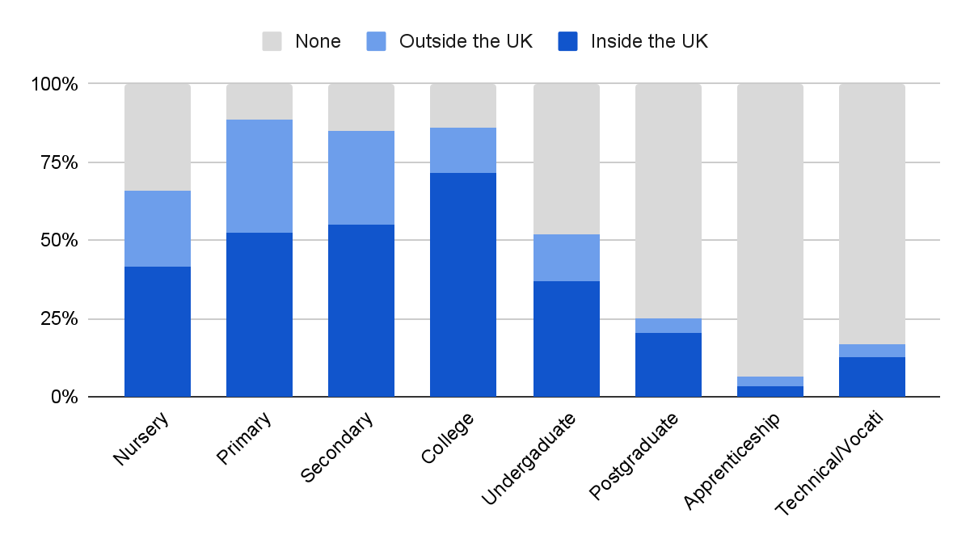
Overall, education was equal between men and women
Notes:
Spencer

Slide 35
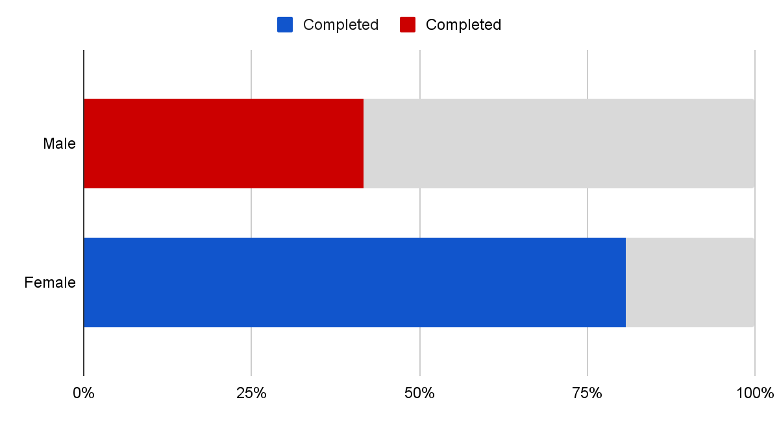
But amongst the youngest generation, their male respondents had lower rates of University Completion
Notes:
Spencer

Slide 36
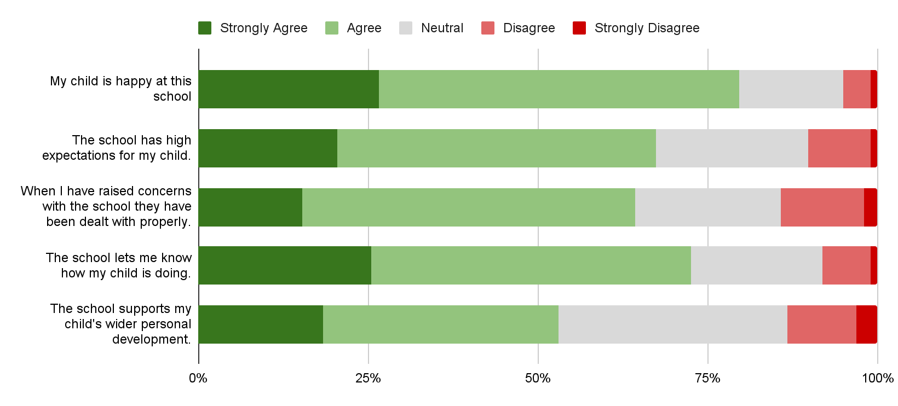
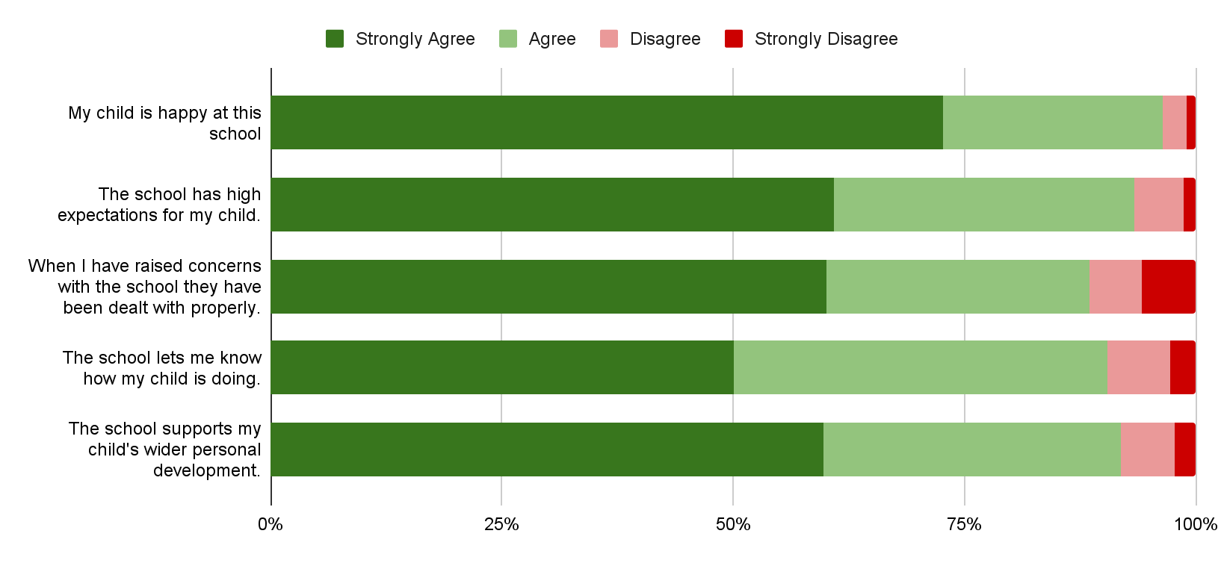
Somali respondents indicated a lower quality school experience compared with the Camden average
Notes:
Dillon

Slide 37
Schools lack Somali and black representation
“
The biggest effect on the Somali students is the parents [not] understanding the new system. There are not many Somali teachers in schools, and the lack of the parents understanding the English language to be able to actually clearly understand what the new system means has hindered them.
”
Notes:
Dillon

Slide 38
Somalis are viewed negatively in schools and face low expectations
“
They suffer from the concept of them being African, so black. So automatically, these kids aren't seen as bright enough.
“
It's like starting a race, but the people running your race have run 200m already and you're told to go and chase them.
”
”
– Somali teacher in a Camden school
Notes:
Dillon

Slide 39
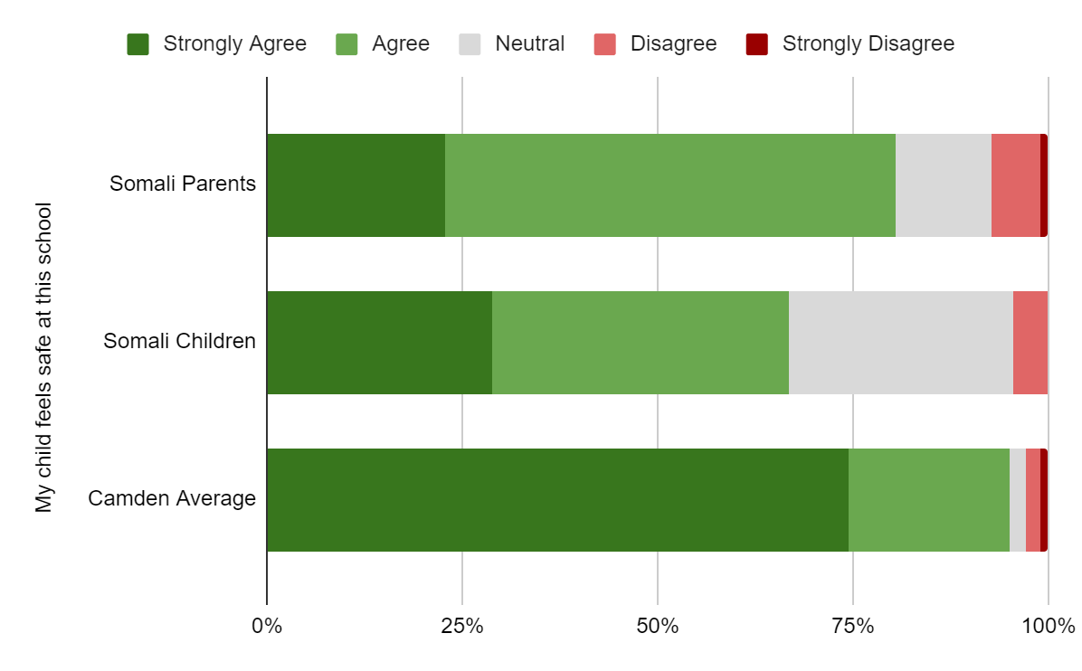
Somali Respondents felt less safe in schools.
Notes:
Dillon

Slide 40
Youth Safety

Slide 41
Interviewees were concerned for young Somali boys.
“
Knife crime. We're losing young boys on a regular basis with knife crime. The local authorities have a massive role to play whether it's Camden or Tower Hamlet or Ealing or whatever else it may be.
– Abdihafid Jama, Somali Journalist
“
Camden is very much known for this, we’ve really suffered with youth violence. As victims and as suspects [...] For me, the biggest issue would certainly be youth violence.
– Yusuf Deerow
”
”
Notes:
Dillon

Slide 42
There is a clear divide between West and East regions of Camden on where respondents felt safe
Notes:
Jackson

Slide 43
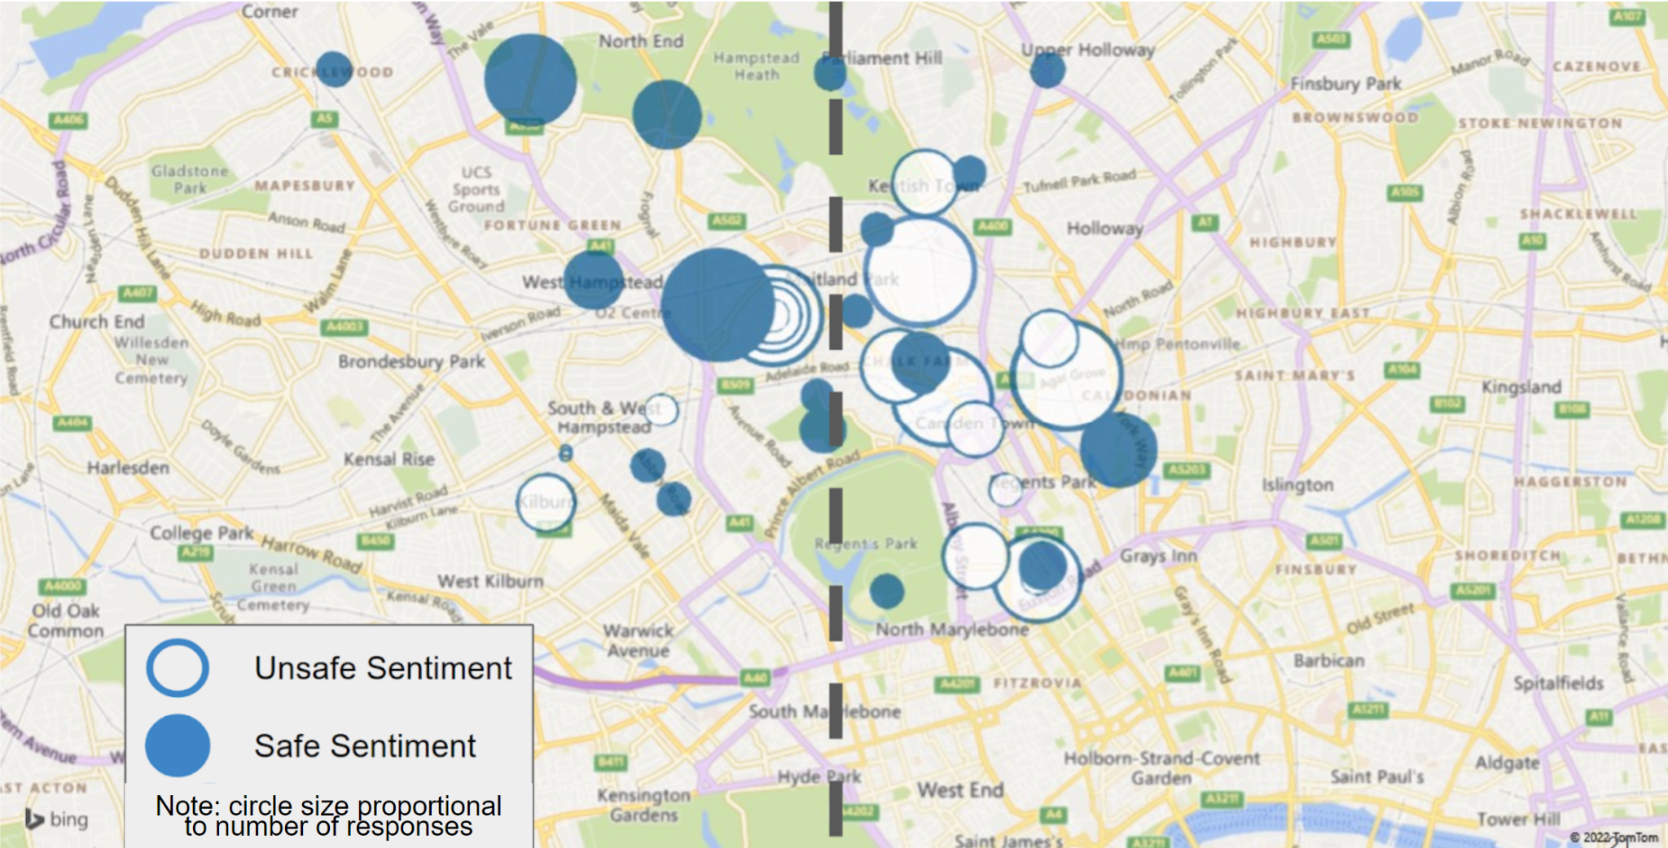
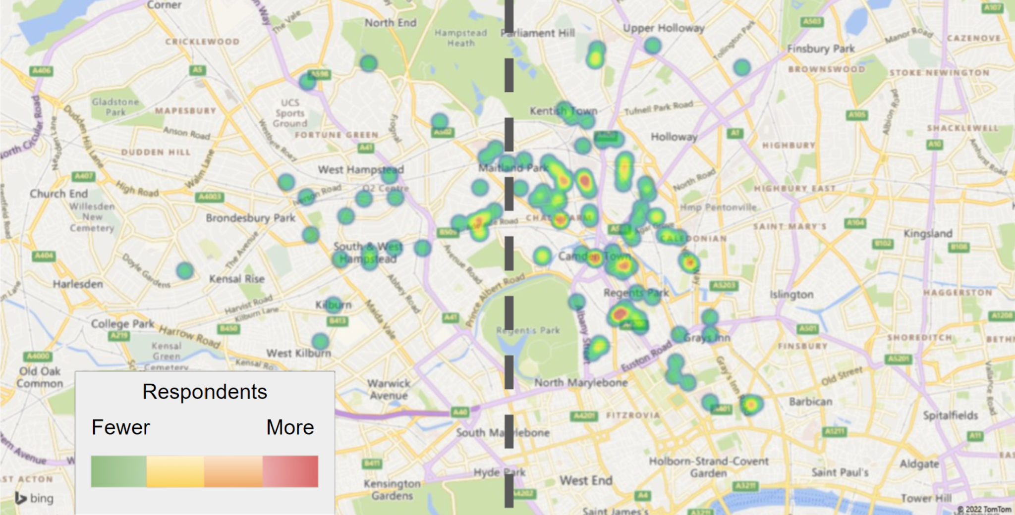
Notes:
Jackson

Slide 44
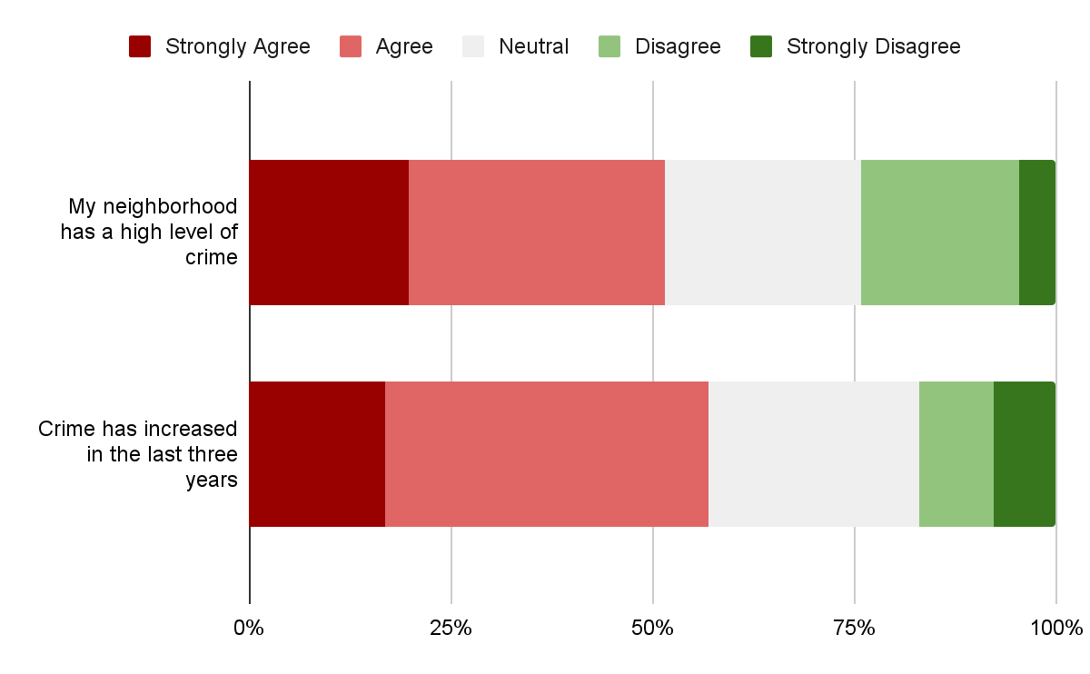
Youth respondents have high levels of crime in their neighborhoods…
but most still feel safe
Notes:
Jackson

Slide 45
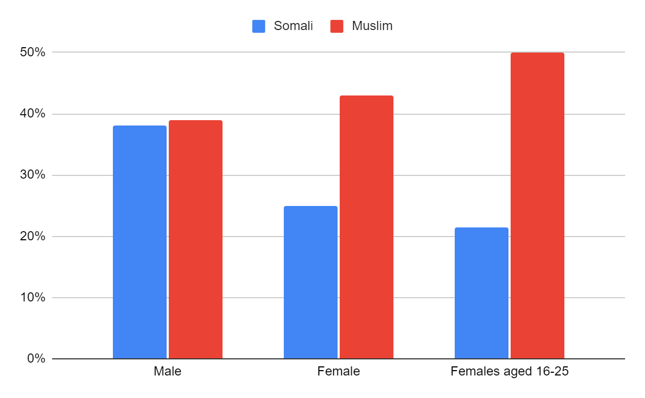
Young Women indicated they faced higher levels Islamophobia.
Have you ever been the target of crime, harassment, or violence because you are…
Notes:
Dillon

Slide 46
Somali Identity

Slide 47
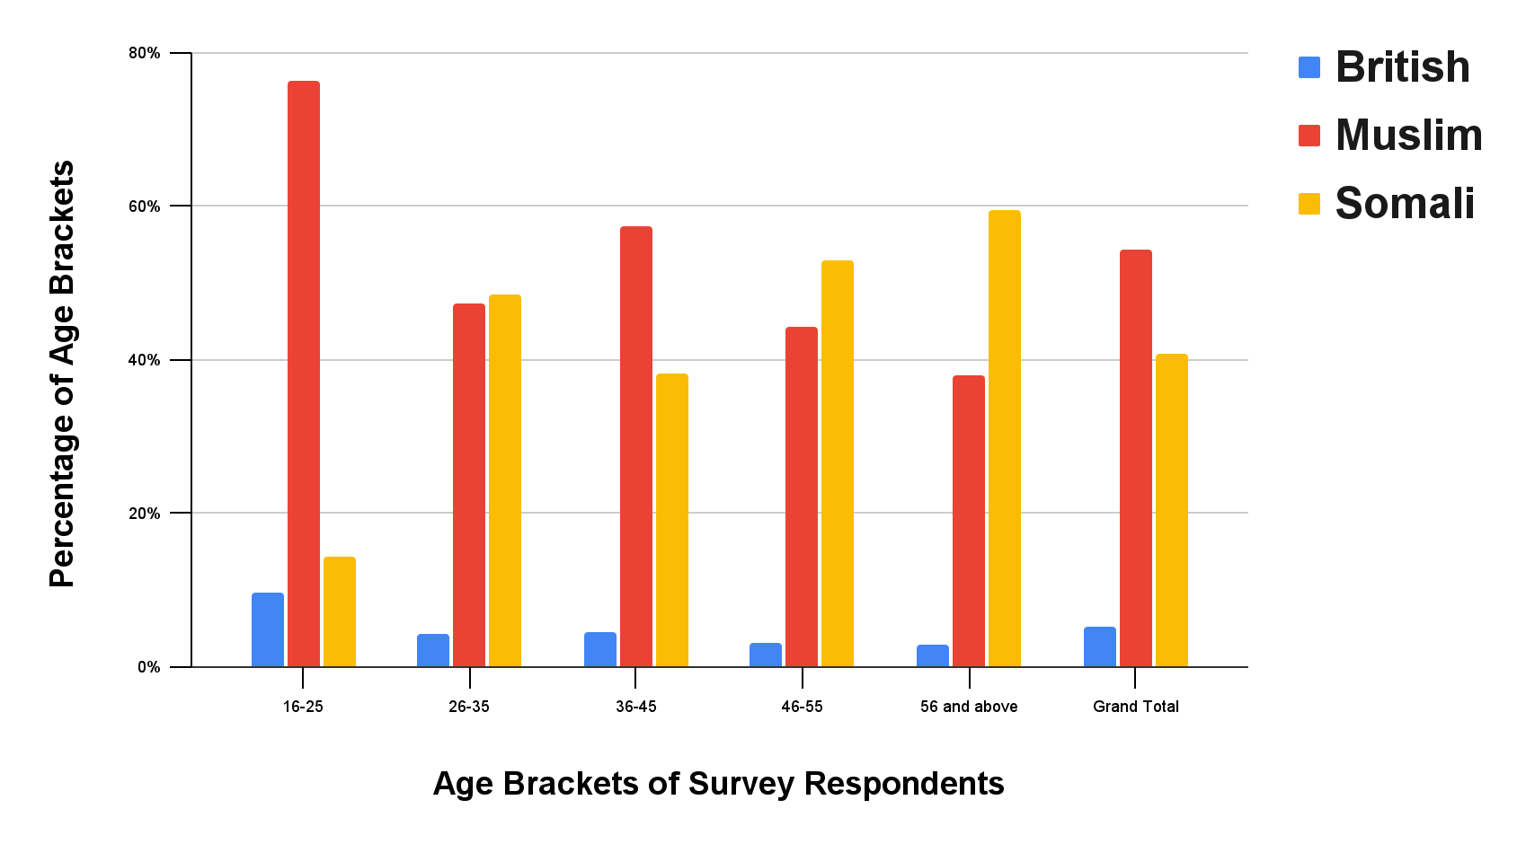
Islam is passed down as the key element of Somali identity
Notes:
Roopsa

Slide 48
Islam is passed down as the key element of Somali identity
“UK Somalis, they’ve only adapted Islam as their religion, to be their culture and to be their religion. Only one. But other countries, like America, have them both. They have their culture and their religion.” — Somali Father (Focus Group)
“For parents living in western countries outside Somalia, we’re trying to keep our Islamic faith. A religious status to keep our children to pass the Islamic faith. Other than that, cultures are always evolving…..My culture is not their culture, the way I was raised is completely different from the Somali society today. One thing that parents ensure is passing Islamic faith.” — Somali Father (Focus Group)
“My kids were born here so they are already British and it is not possible to compare a kid born here and in Somalia they are different but at the same time I am raising them as Muslim. I have three girls and I am teaching them our Muslim culture.” — Somali Mother (Focus Group)
Notes:
Roopsa

Slide 49
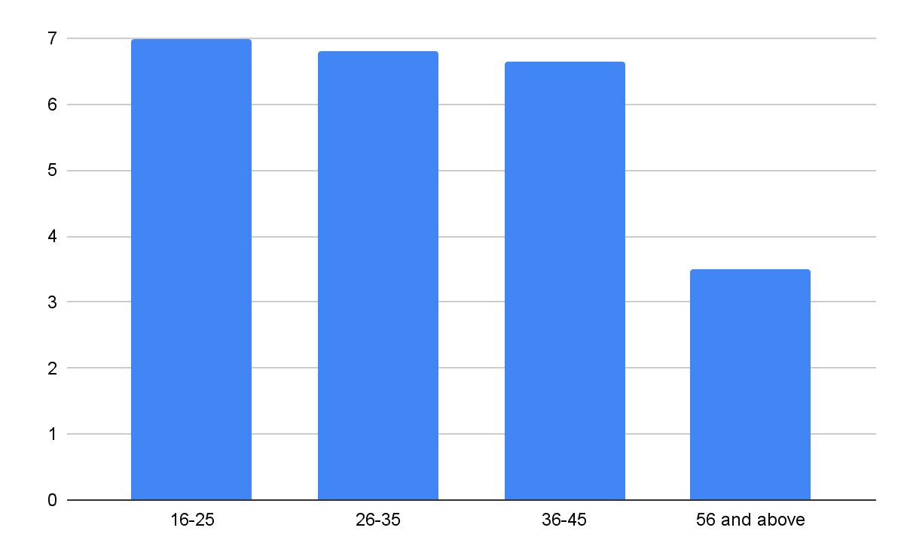
Older generations are less fluent in English
Notes:
Spencer

Slide 50
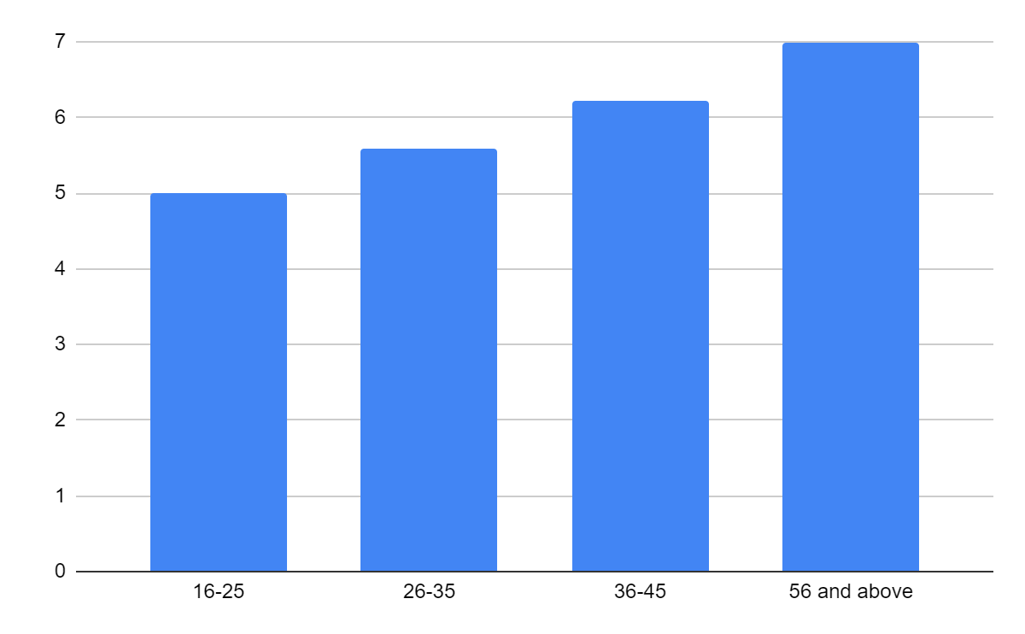
But Younger generations are less fluent in Somali
Notes:
Spencer
There is a quote about this from the girls group

Slide 51
Religion Remains important to the Somali Identity
Notes:
Roopsa
Less than 60% aged 26-35 gave a 5
More than 40% gave a 3 or 4

Slide 52
Looking to the Future

Slide 53
Survey respondents opinion on things they wish to see in the community was primarily focused around Culture
THEME | COUNT
Activities related to Somali culture and language | 26
Sports | 24
Youth activities | 17
Fitness and health activities | 13
Entertainment | 11
Travel/Tours | 10
Career advice/support | 10
Elderly socials | 9
Supplementary classes | 9
After school studies / Tutoring groups | 9
Counseling | 5
Housing workshops or assistance | 5
Theme | Count
Build better relationships with-in the community | 17
Housing support | 9
Help and support | 9
Free youth activities | 8
Youth safety | 7
Resource allocation | 6
They’re invisible | 5
Raising awareness | 5
Cultural awareness and events | 4
Career advice | 4
Teach children Somali language | 3
More staffing at SYDRC / Broaden services / Outreach workers | 3
More clarity in needs of community | 3
Notes:
Jackson

Slide 54
There was a strong desire for a more visible community
Notes:
Jackson

Slide 55
Thank you!
Special thanks to our sponsors Abdiwahab Ali, Muna Osman, Yusuf Deerow and the SYDRC team
And our advisors Dominic Golding and Lorraine Higgins
Notes:
Roopsa

