Slide 1
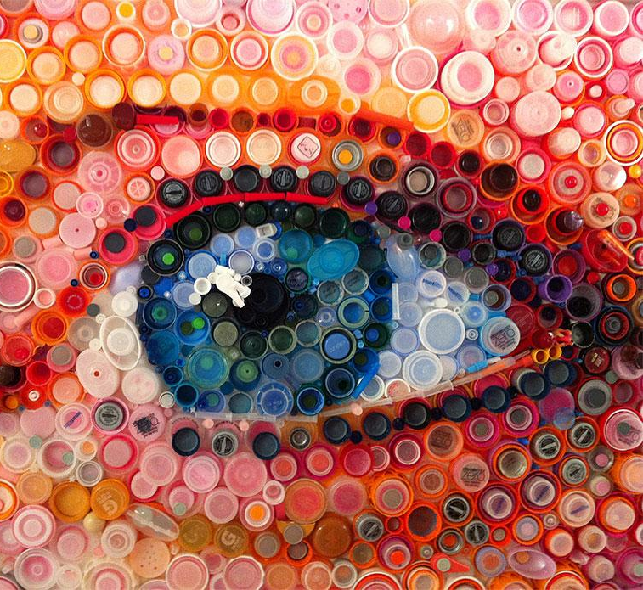
Regenerative Plastics:
An Opportunity for
Job Training
Adam Giordani
Melissa Kelly
Faith Suwannapong
27 April 2023

Slide 2
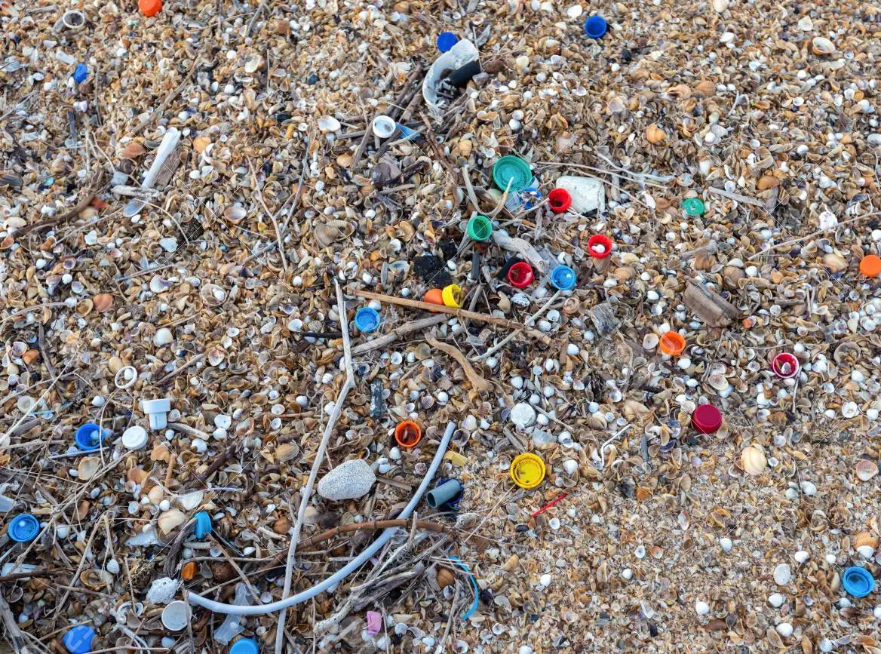
84% of
plastic bottle caps
end up in landfills
(Australian National Plan Summary,2021)

Slide 3
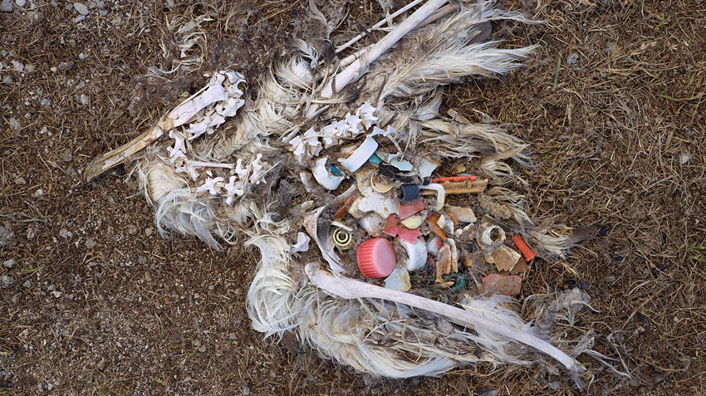
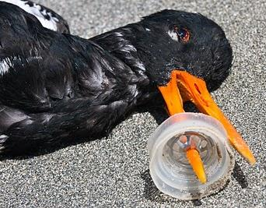
Bottle caps pose risks to wildlife
Content Warning
The following images contain sensitive content.

Slide 4
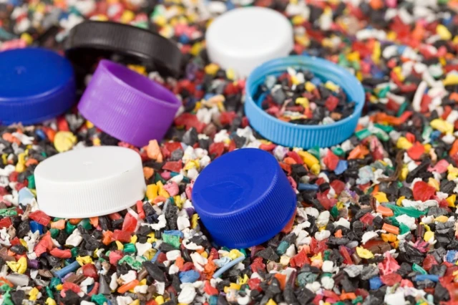
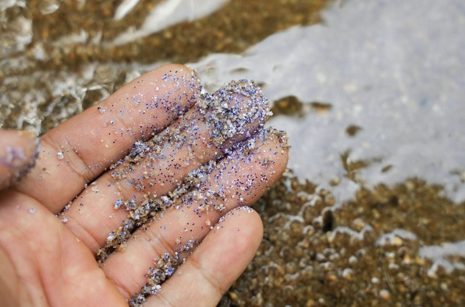
Plastic waste is not biodegradable
but eventually gets broken down into microplastics

Slide 5
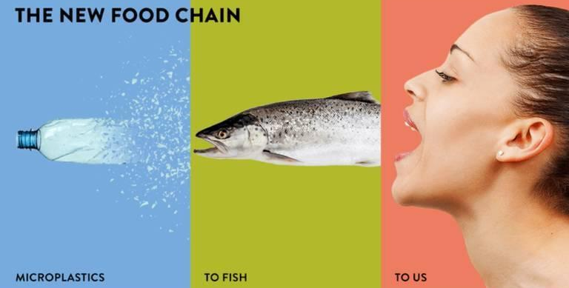
Microplastics are consumed by marine life and work their way up the food chain until they are ingested by humans (Nan, 2020).

Slide 6
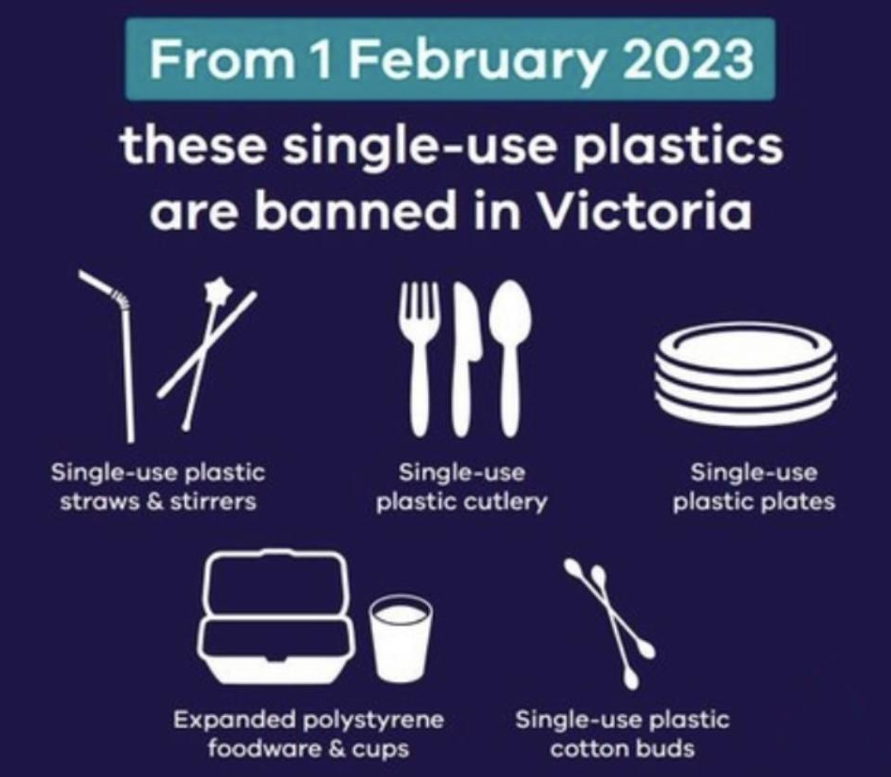
Bottle caps
are not included in Victoria’s ban!

Slide 7
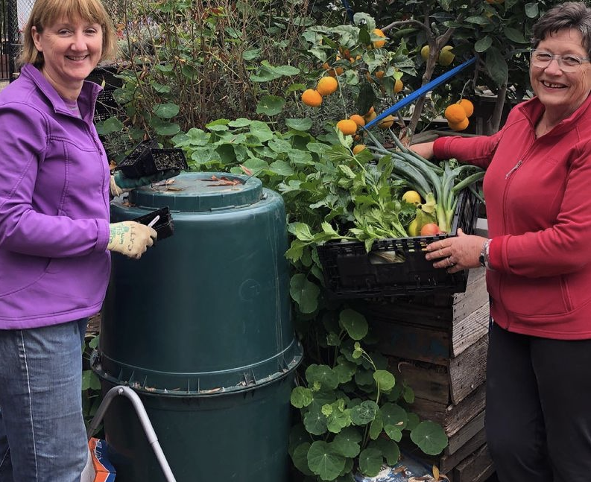
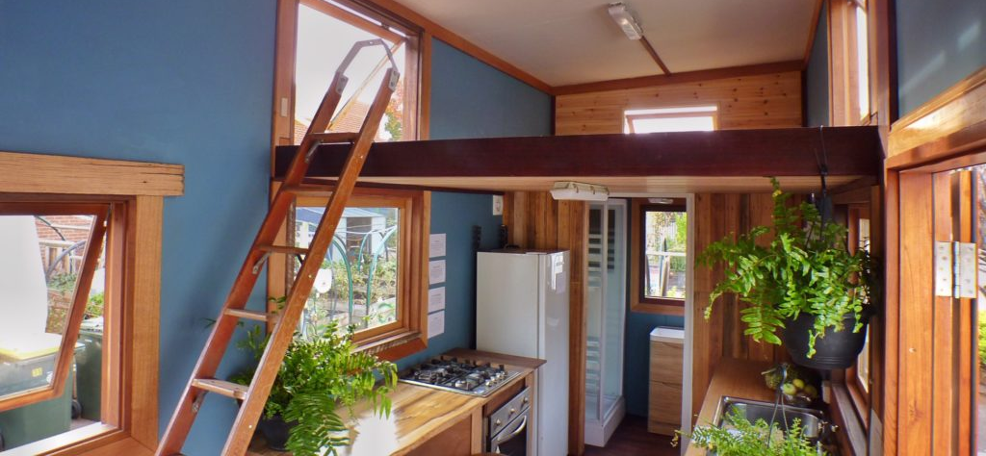
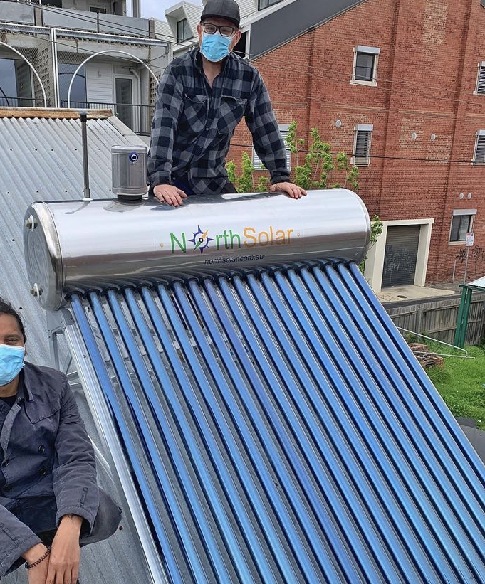
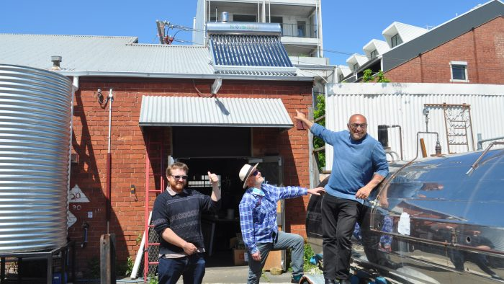
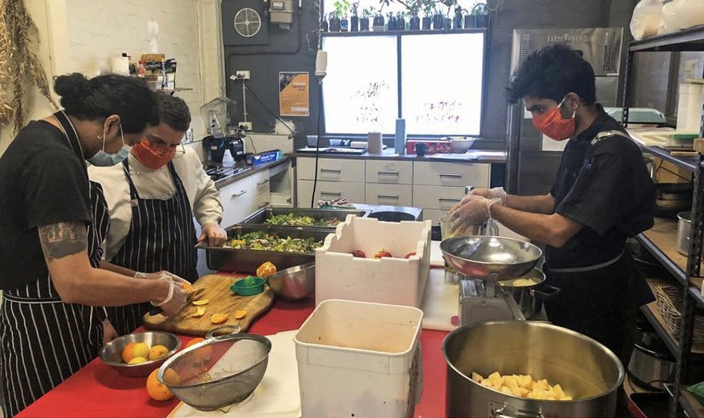
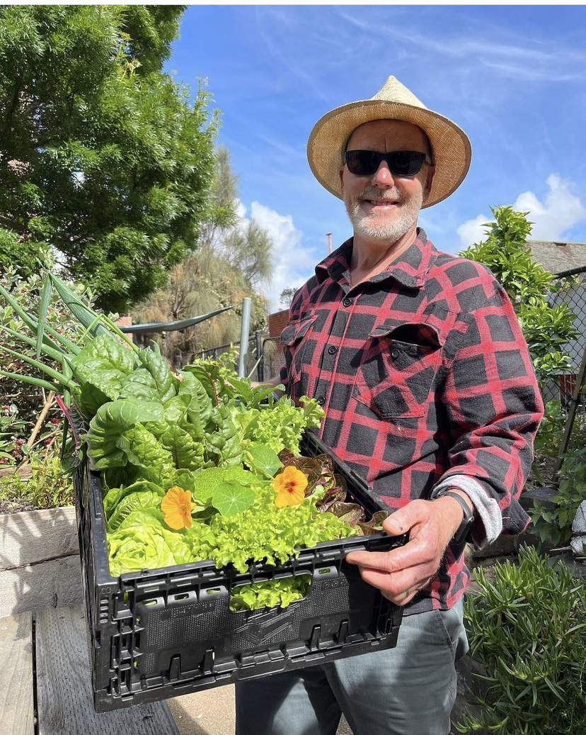
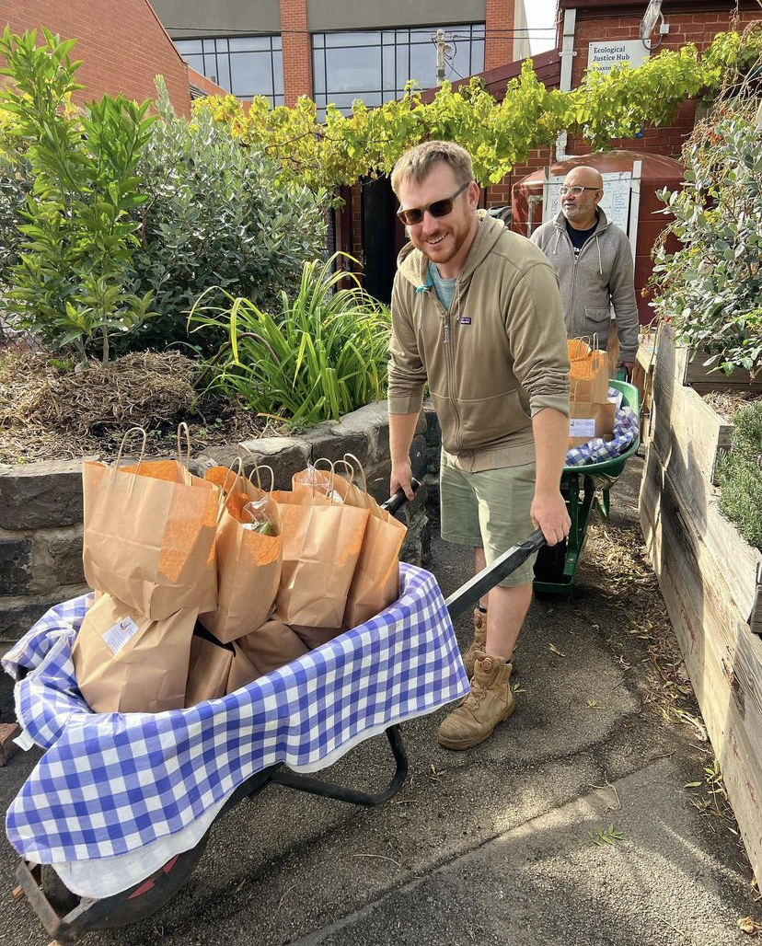
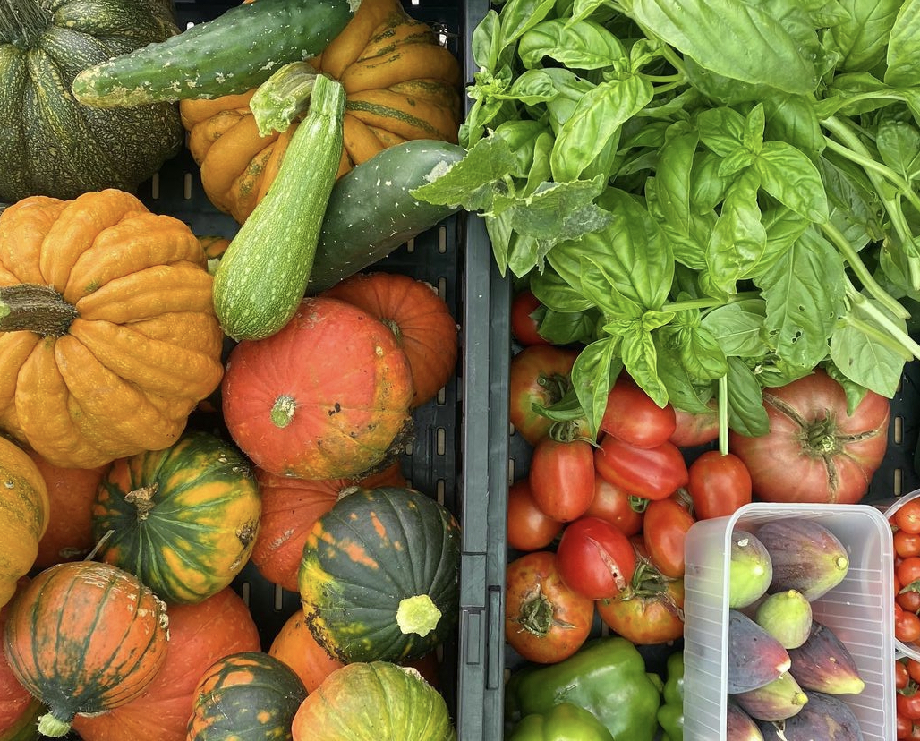
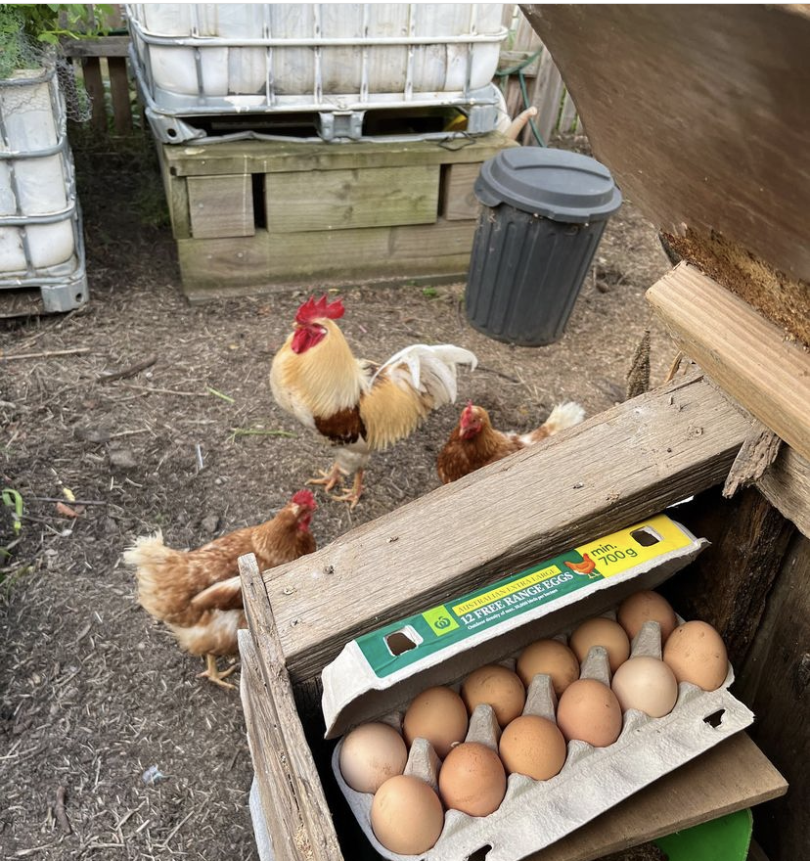
Ecological Justice Hub

Slide 8
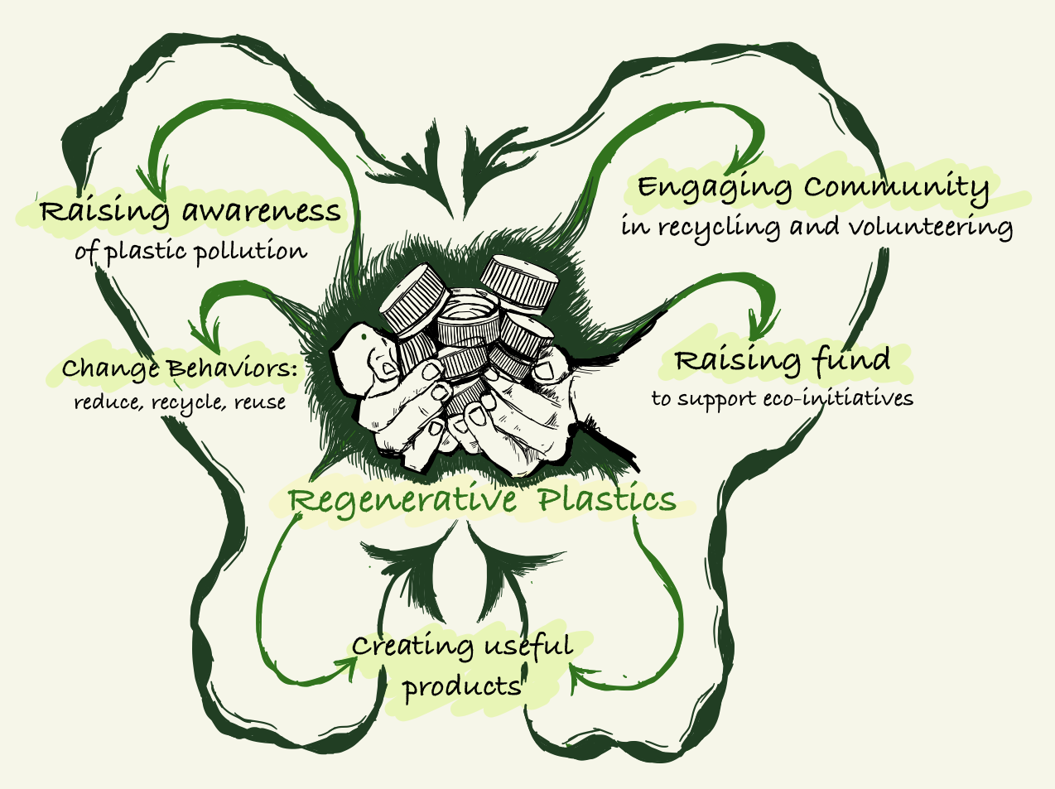

Slide 9
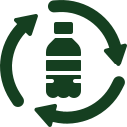
Our goal in this project was to assist the Ecological Justice Hub in developing a plastic recycling process that can be used to increase community awareness, education, and engagement in recycling.
PROJECT GOAL

Slide 10
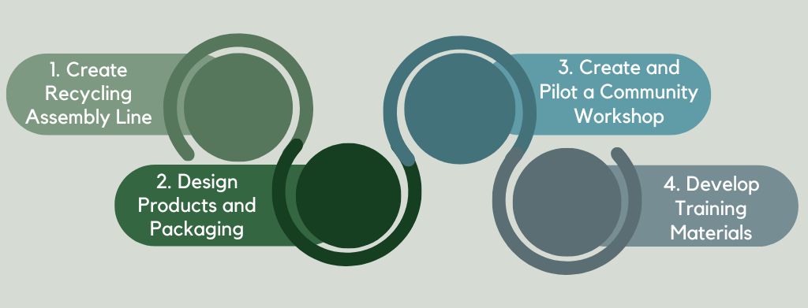
4 Key Components in The Project

Slide 11
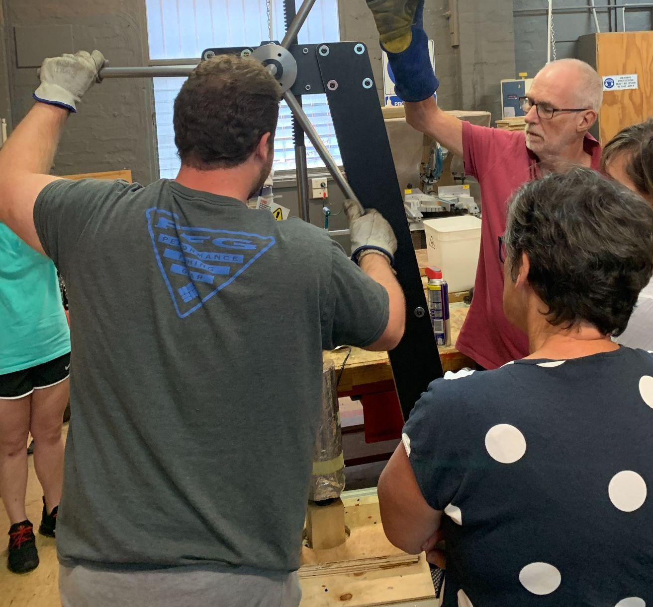
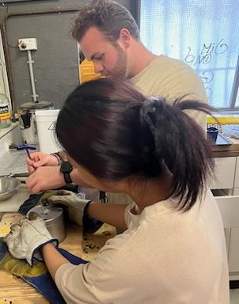
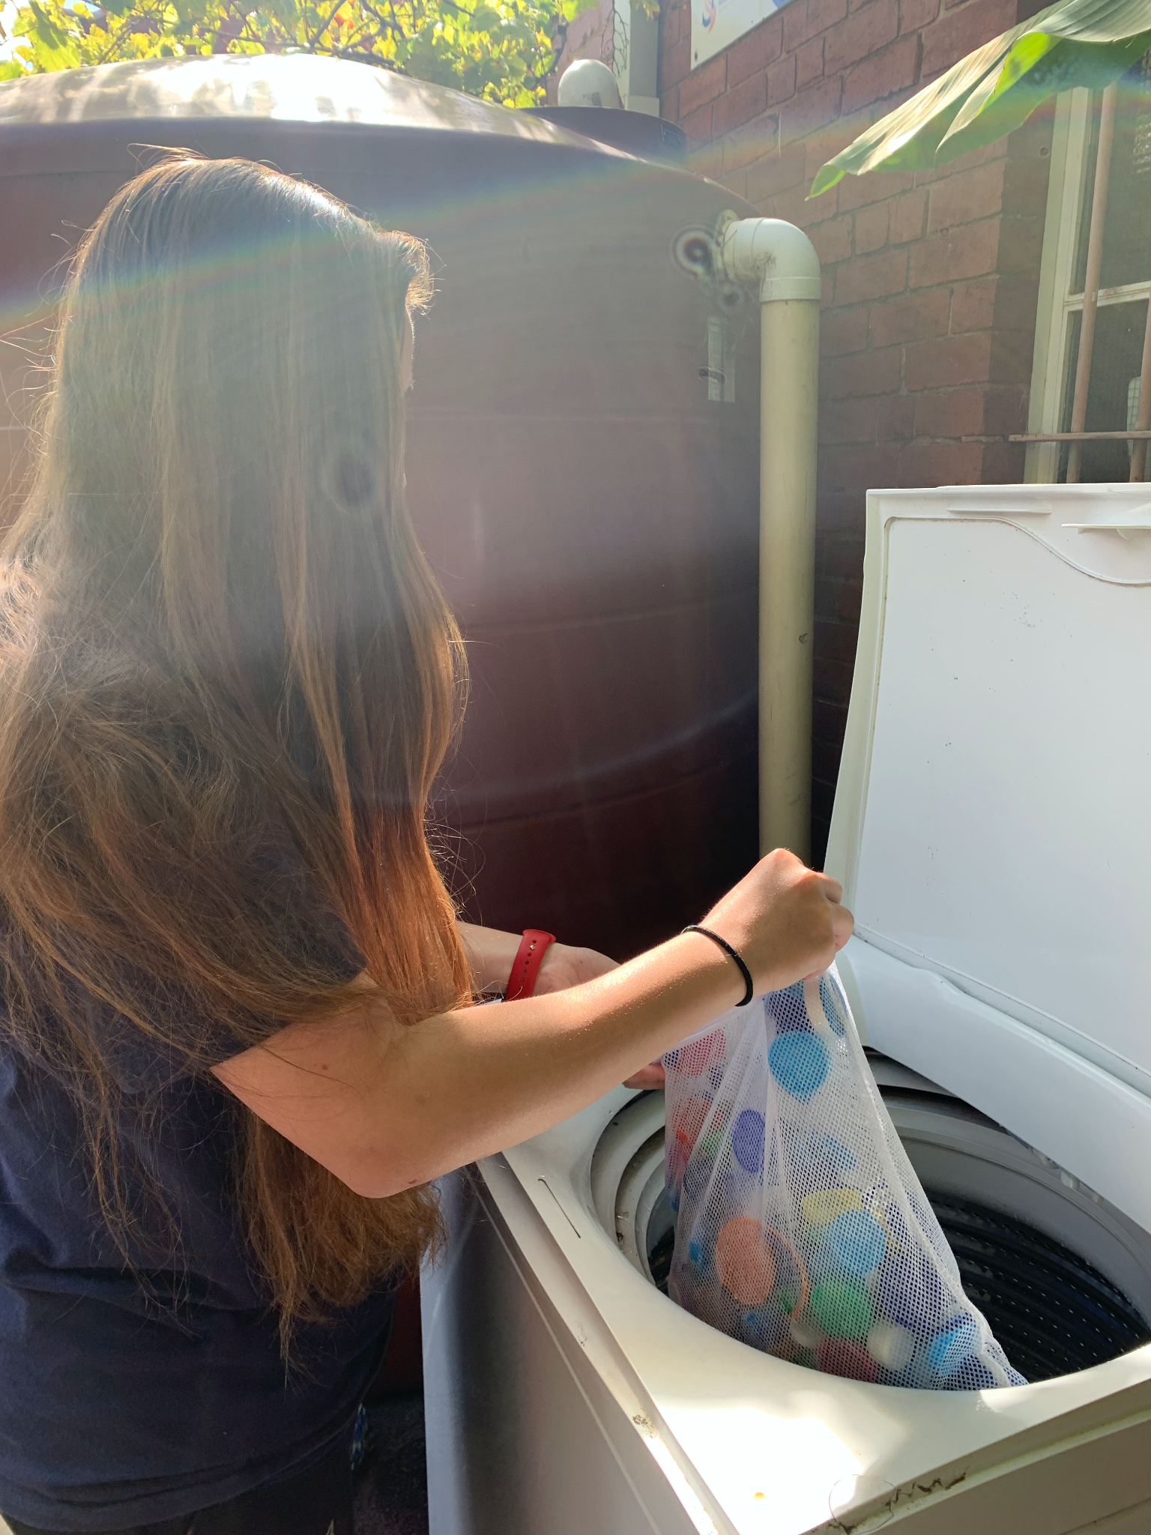
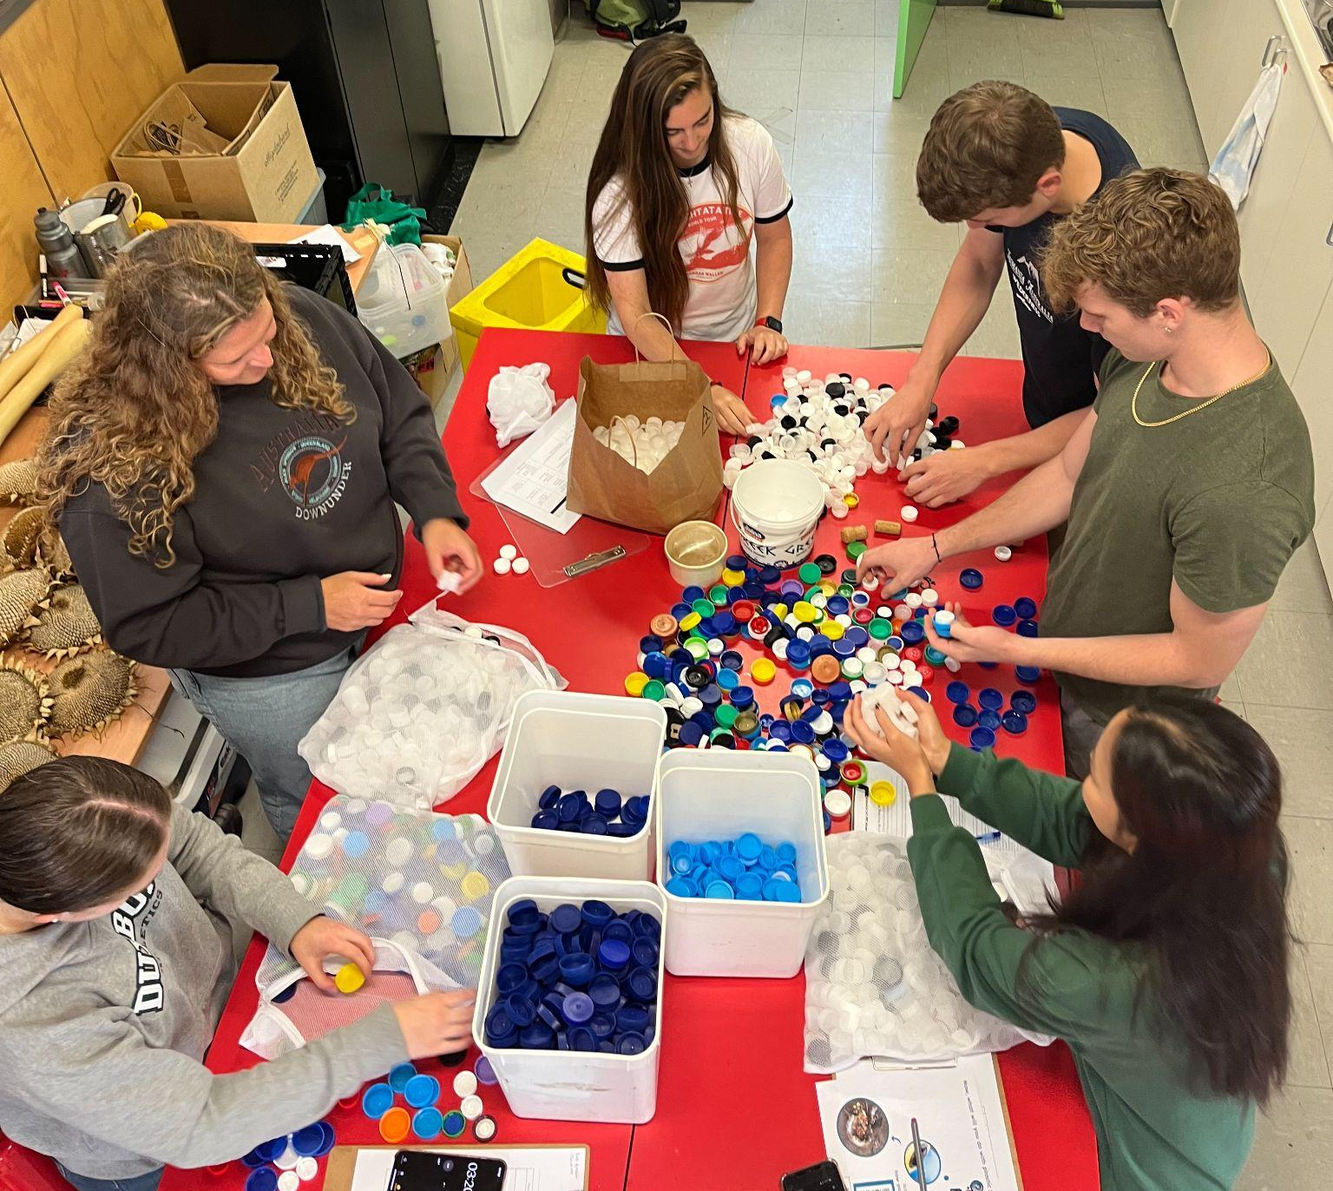
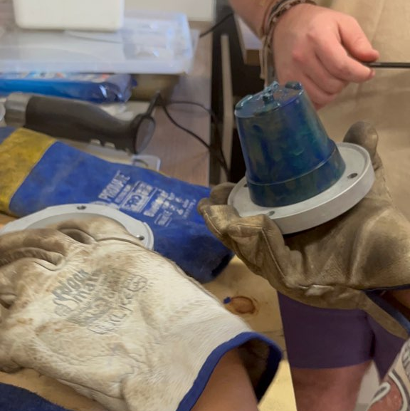
1. Organize and Improve Assembly Line
5. Making a plant pot
1. Cleaning the lids
2. Sorting the lids
6. Disassembling the mold
3. Shredding the lids
7. Removing product from mold
4. Putting lids in injector
Final recycled product :)

Slide 12
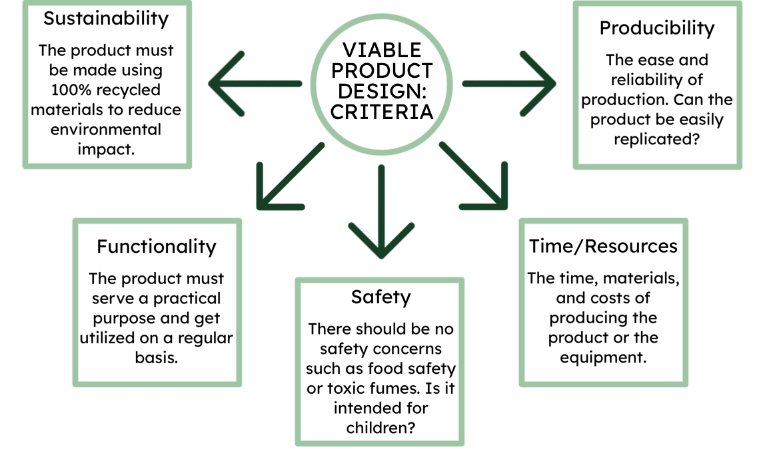
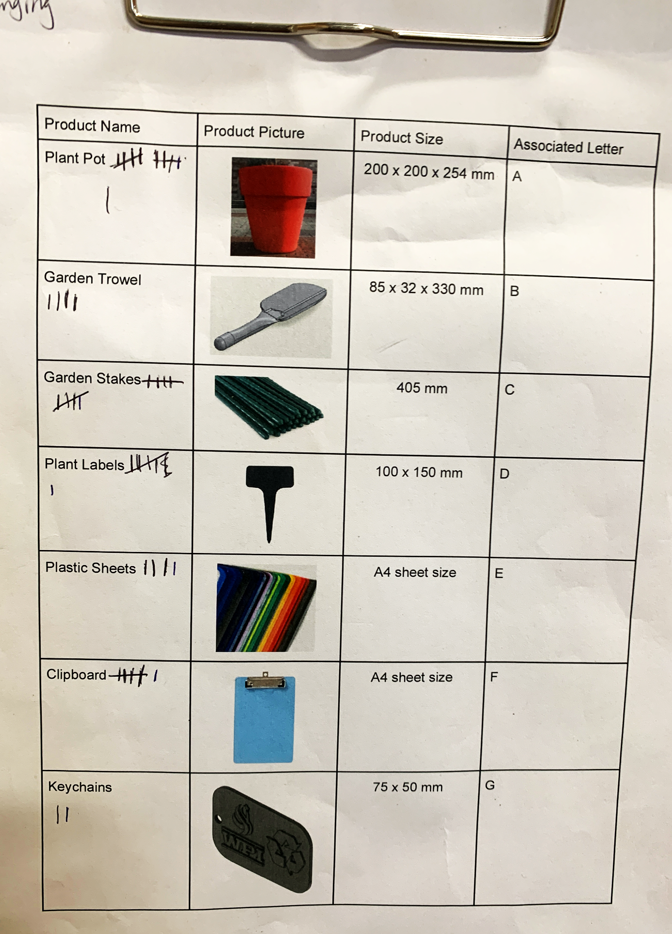
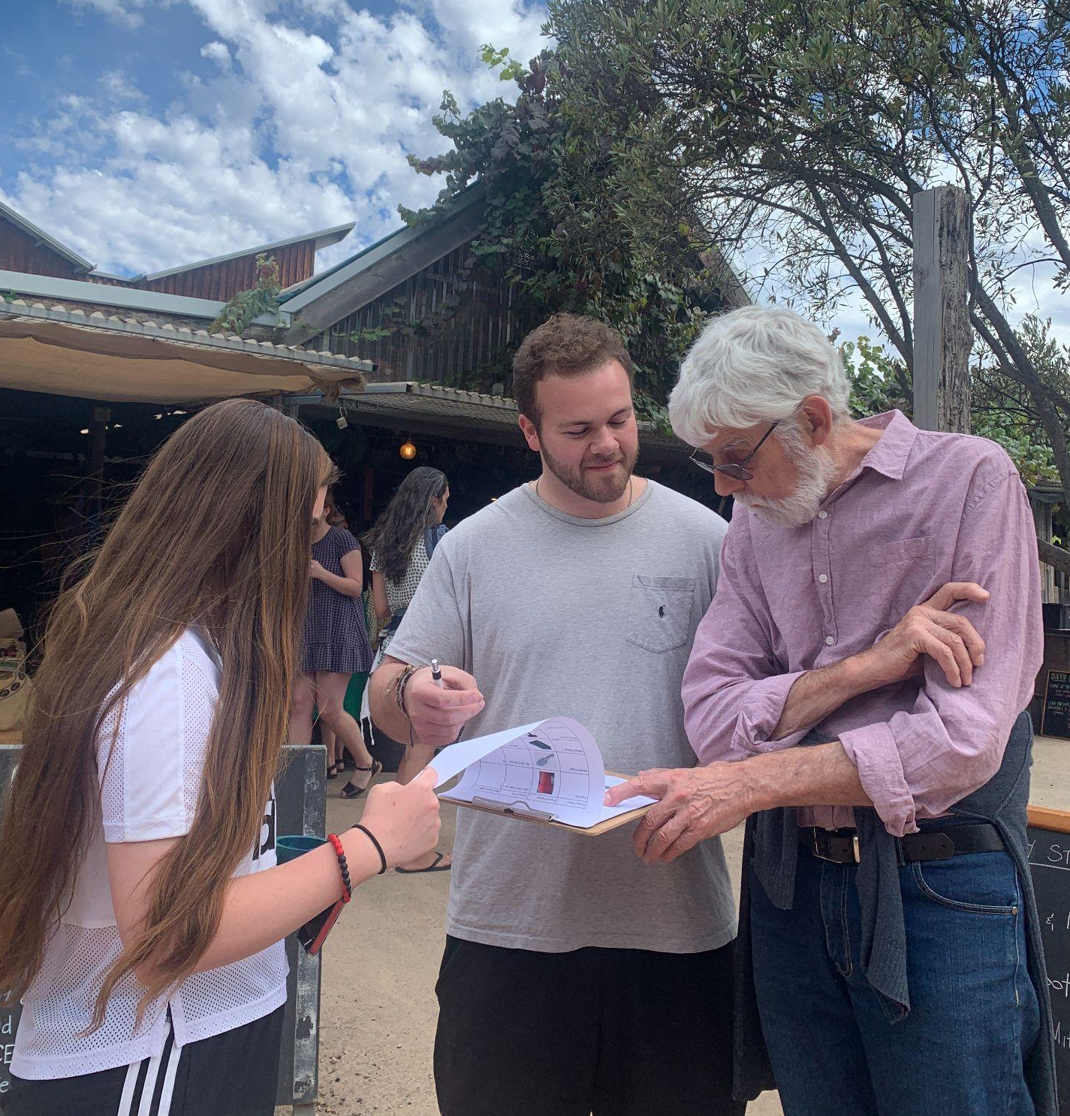
2. Co-Design Plastic Products and Package

Slide 13
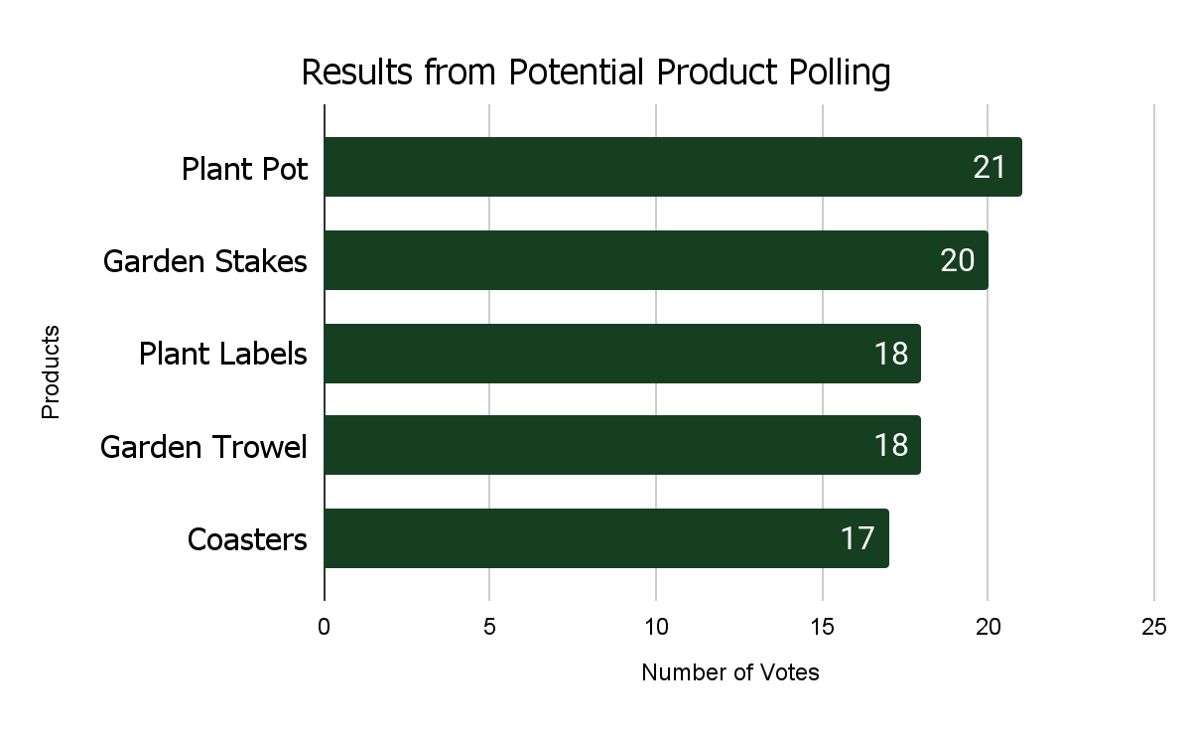
2. Co-Design Plastic Products and Package
Top 5 Final Products From the Poll
Suggestions of Potential Products
From the Poll
Photo Frames
Supermarket Trolley Token
Self-Water Plant Pot
Toothbrush
Plant Pot Saucer
Colanders
Sunglasses

Slide 14
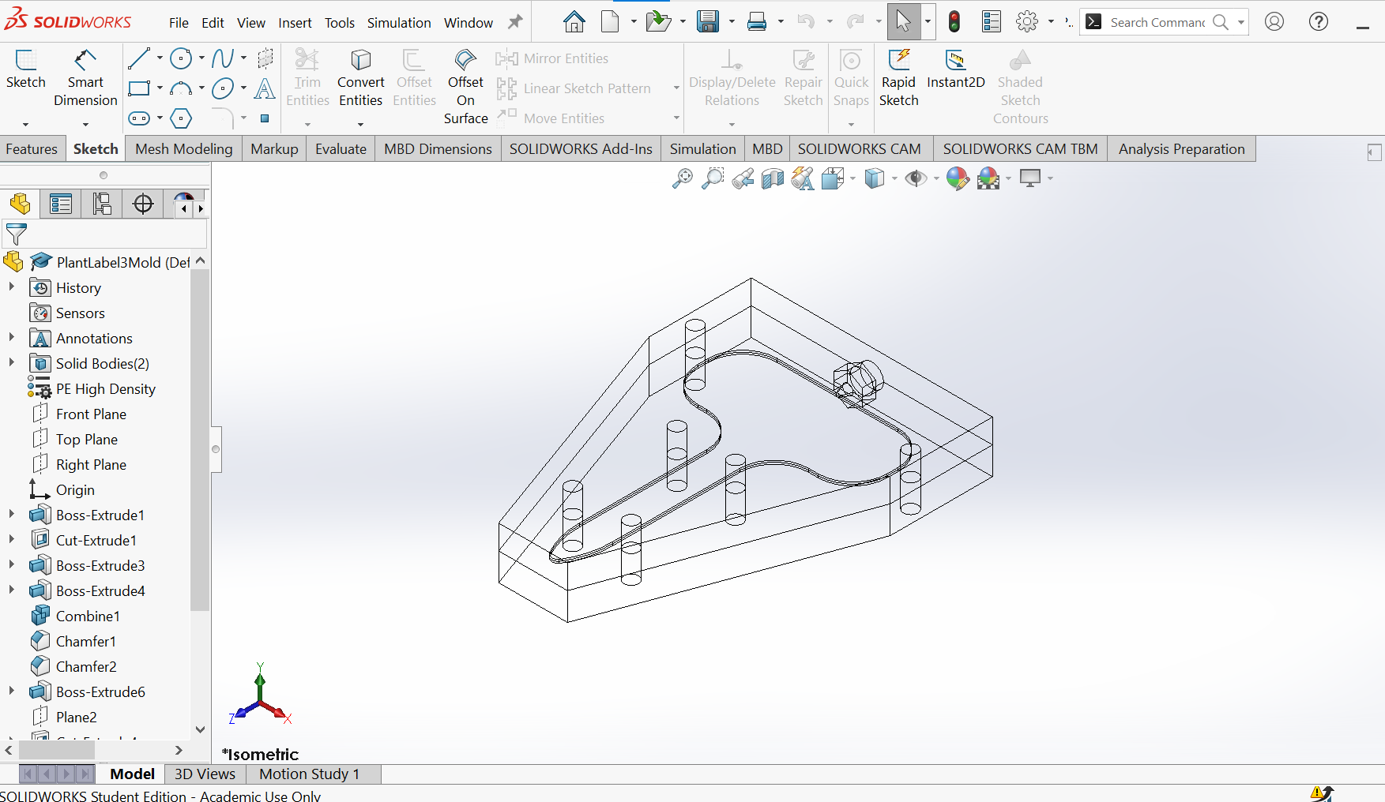
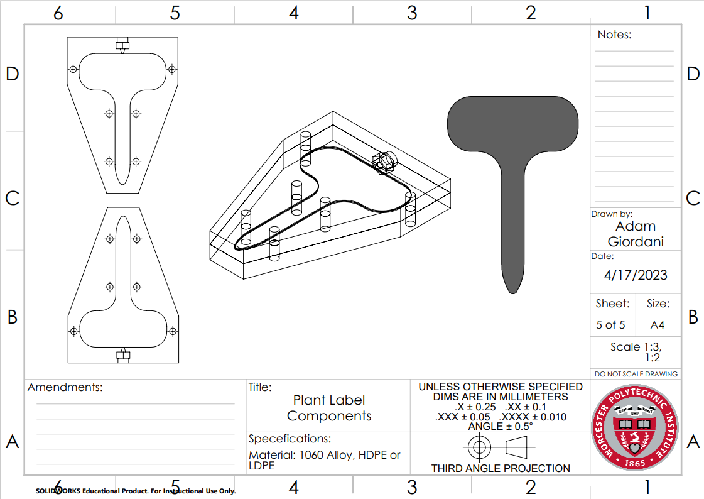
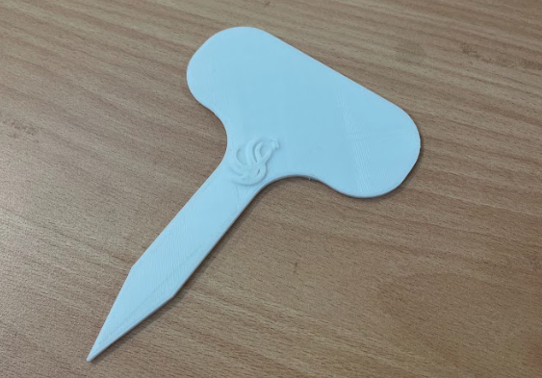
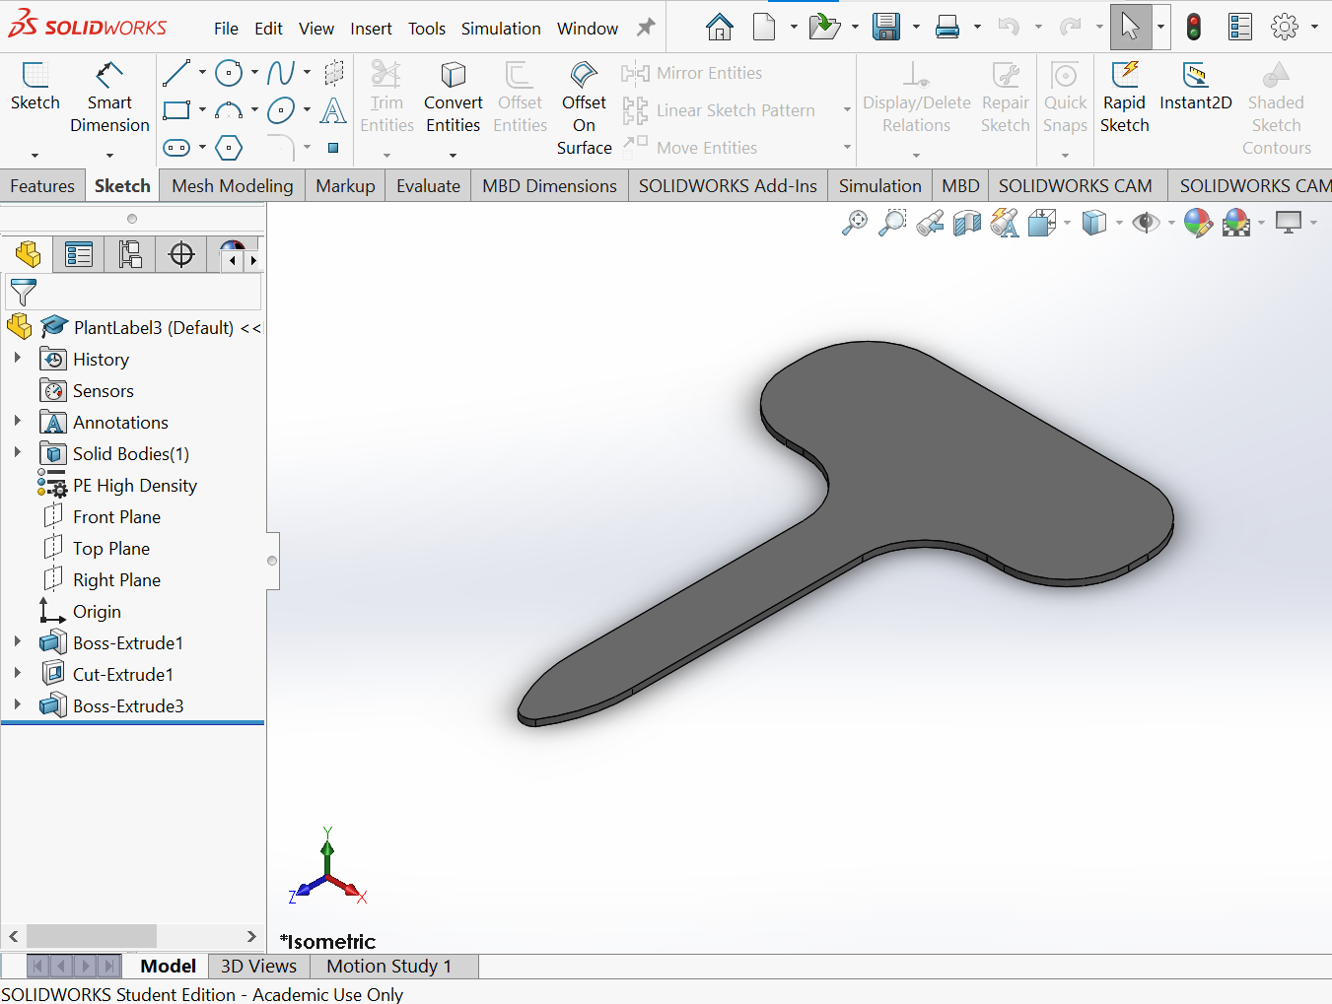
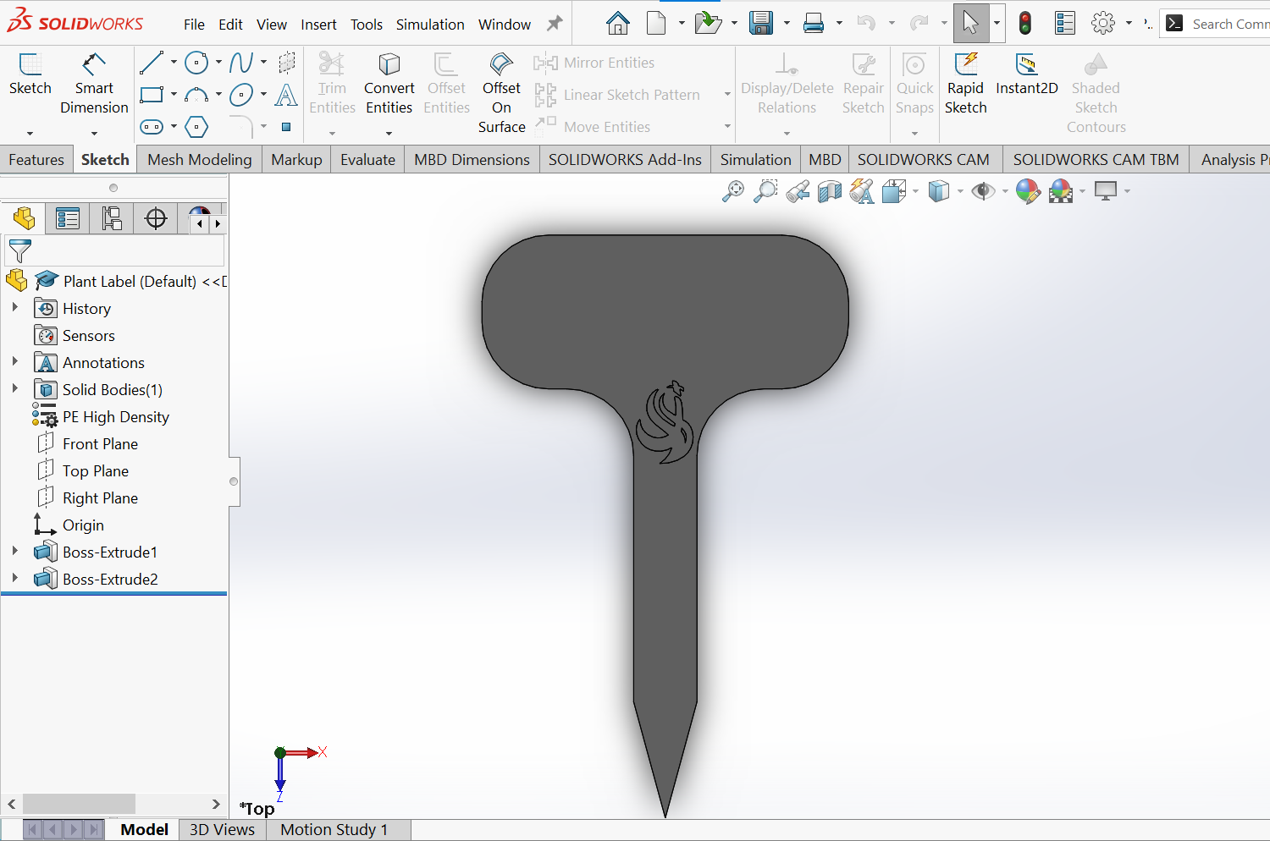
2. Co-Design Plastic Products and Package
The Design Process
Designing mold
3D printing prototype
Solidworks designing
Correcting design
Creating technical drawings

Slide 15
2. Co-Design Plastic Products and Package
The Products

Slide 16
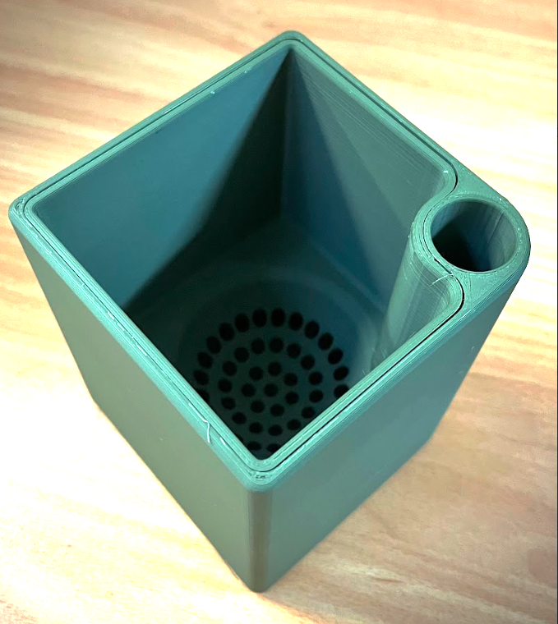
2. Co-Design Plastic Products and Package
Self-Watering Plant Pot

Slide 17
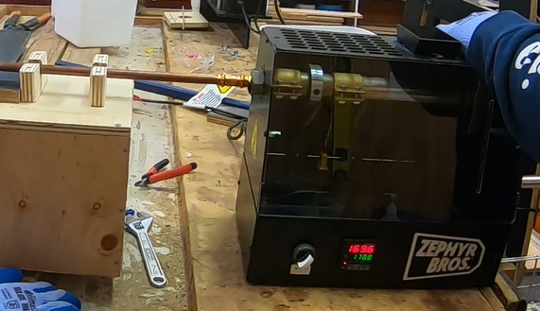
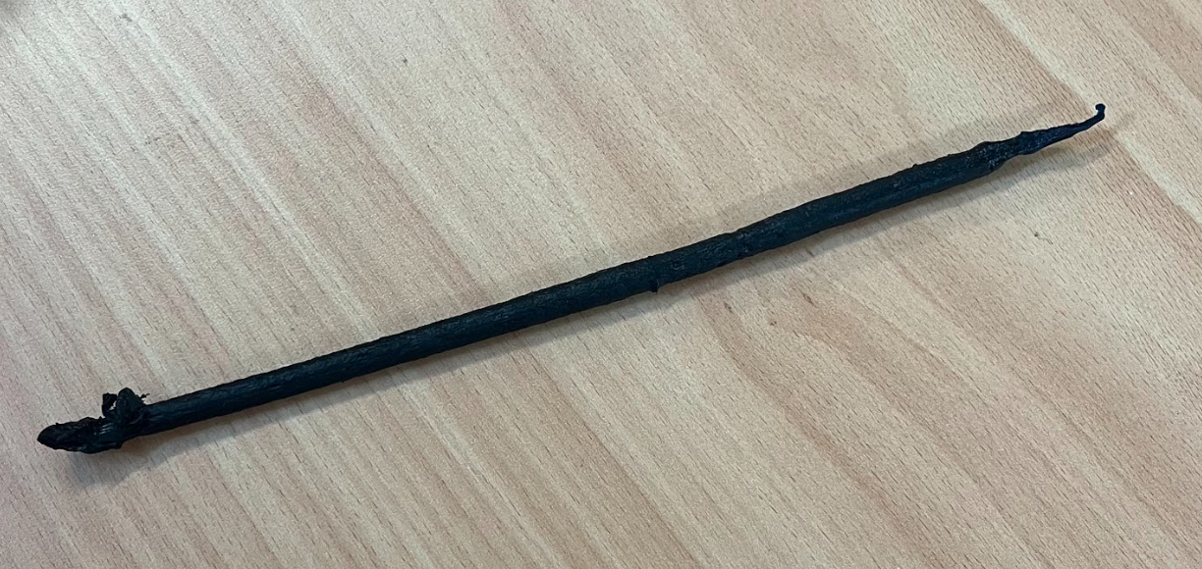
2. Co-Design Plastic Products and Package
Garden Stake

Slide 18
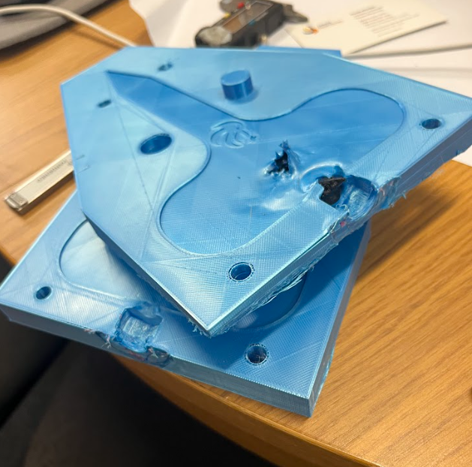
2. Co-Design Plastic Products and Package
Plant Label

Slide 19
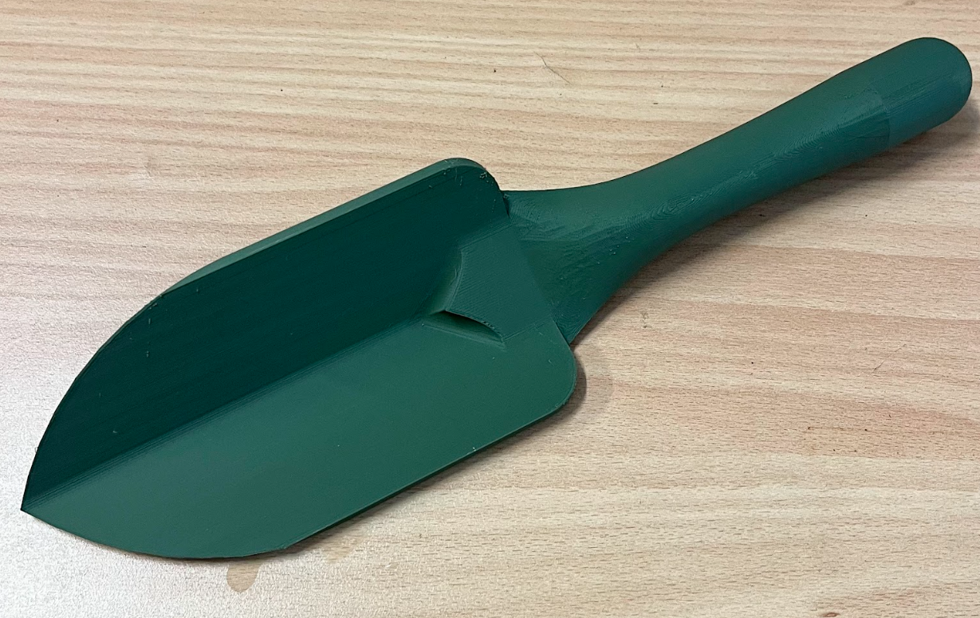
2. Co-Design Plastic Products and Package
Garden Trowel

Slide 20
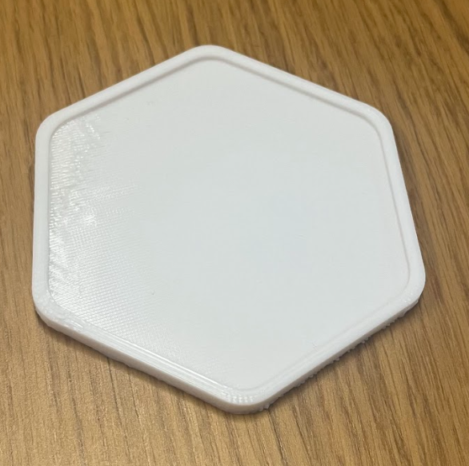
2. Co-Design Plastic Products and Package
Coaster

Slide 21
2. Co-Design Plastic Products and Package
Packaging
—Logo

Slide 22
2. Co-Design Plastic Products and Package
Packaging
—Story Telling
Appreciation
Community Impacts
Uniqueness

Slide 23
2. Co-Design Plastic Products and Package
Packaging
—Story Telling
Environmental Impacts
Steps to make the product
Attached Additional Information

Slide 24
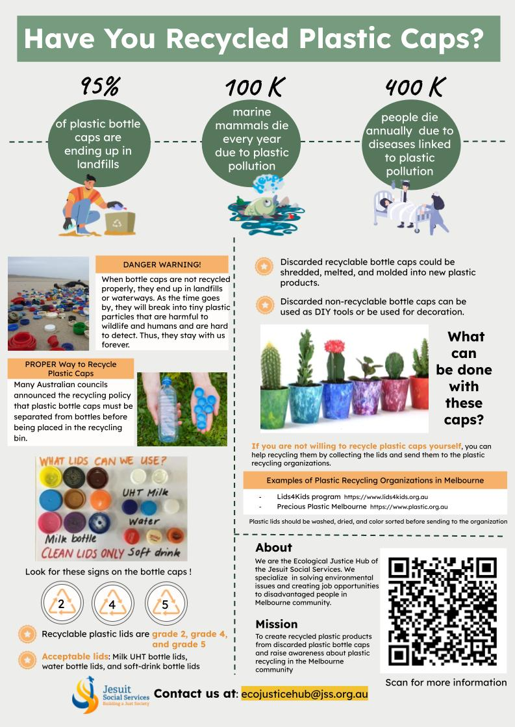
Attached Additional Information

Slide 25
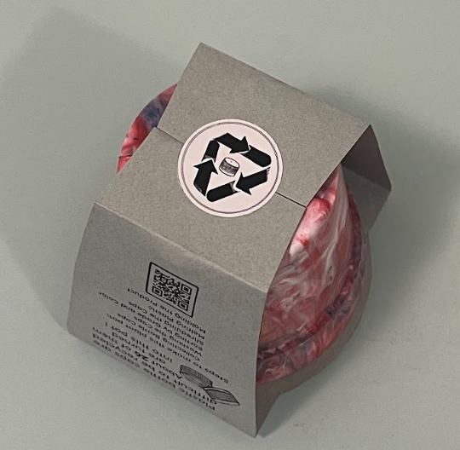
2. Co-Design Plastic Products and Package
Final Packaged Product

Slide 26
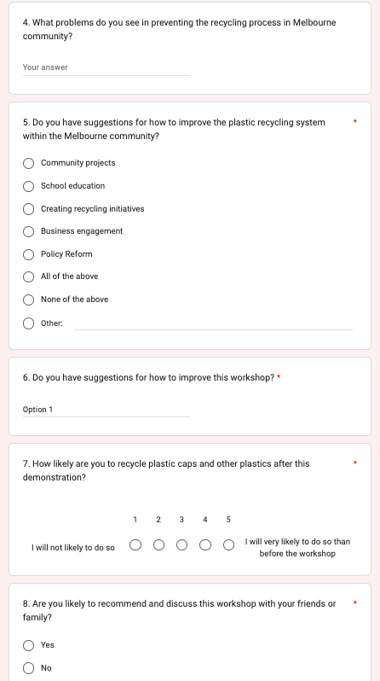
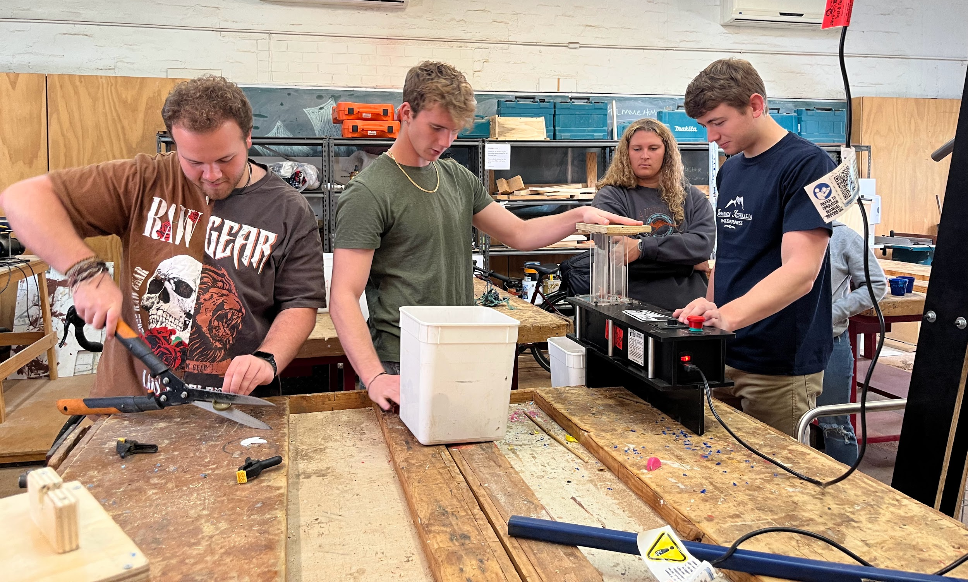
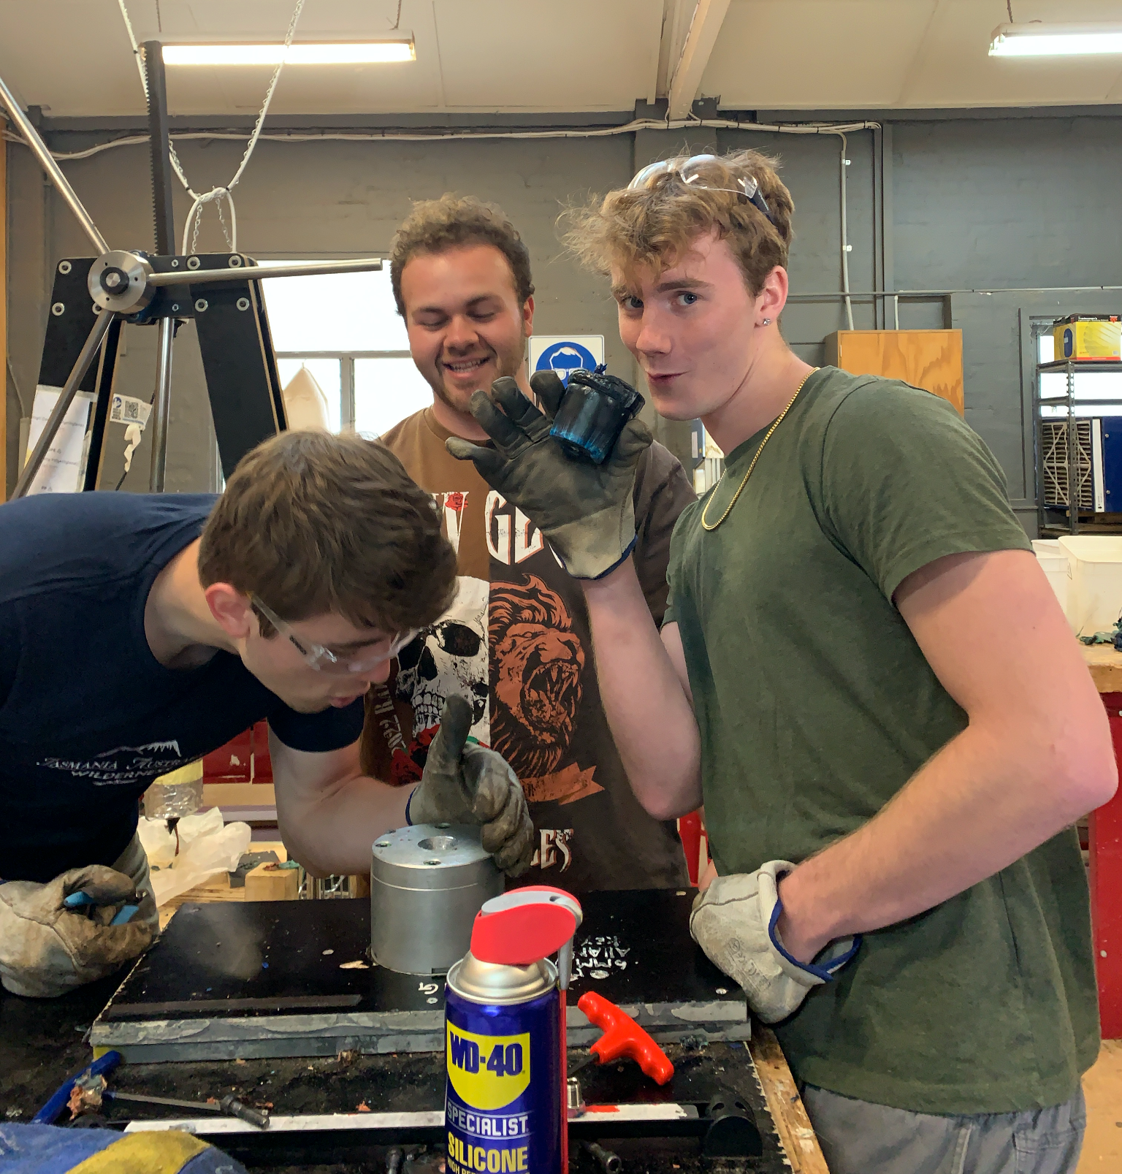
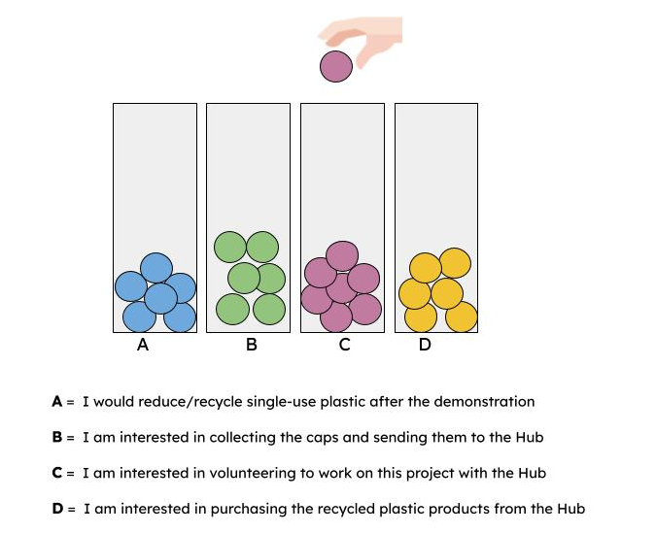
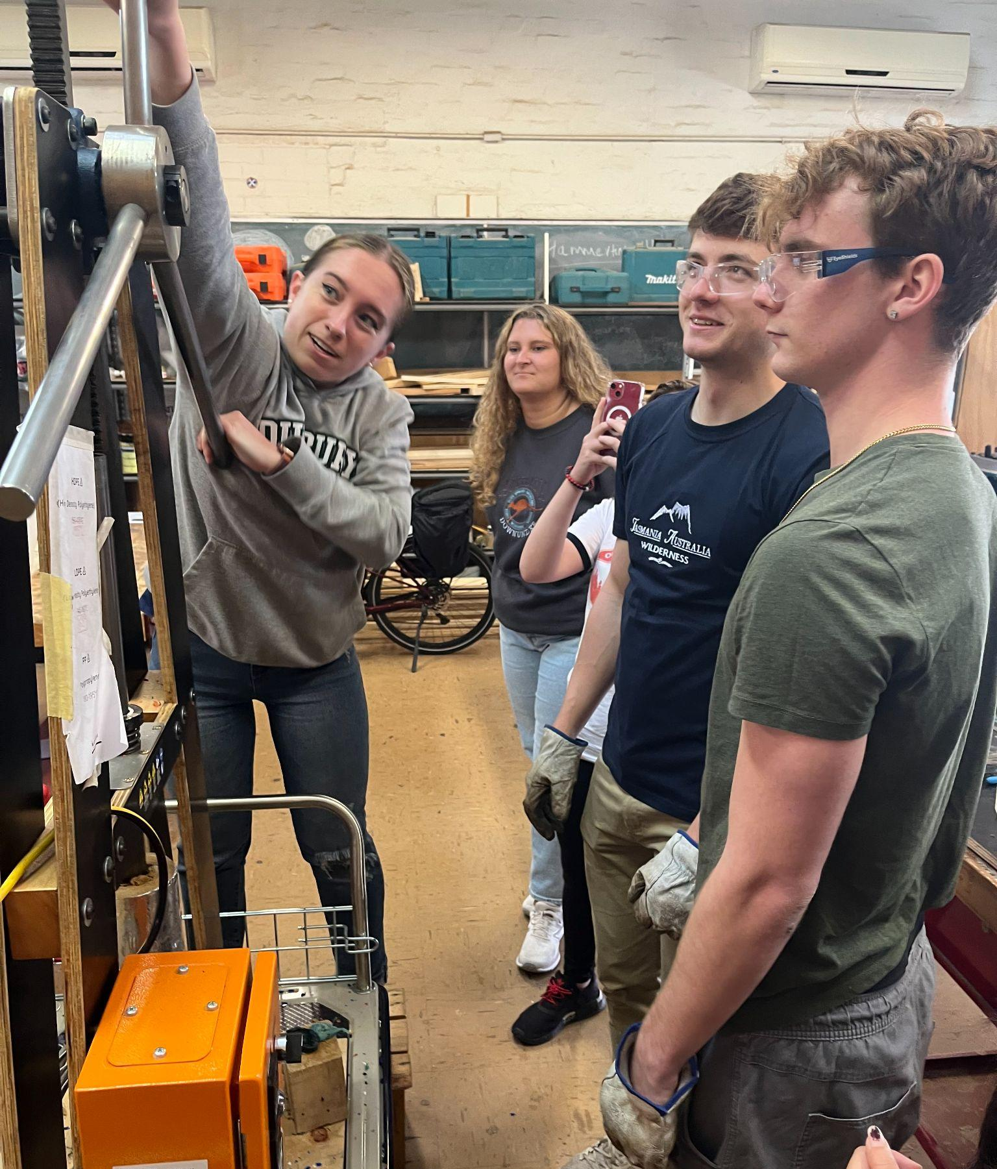
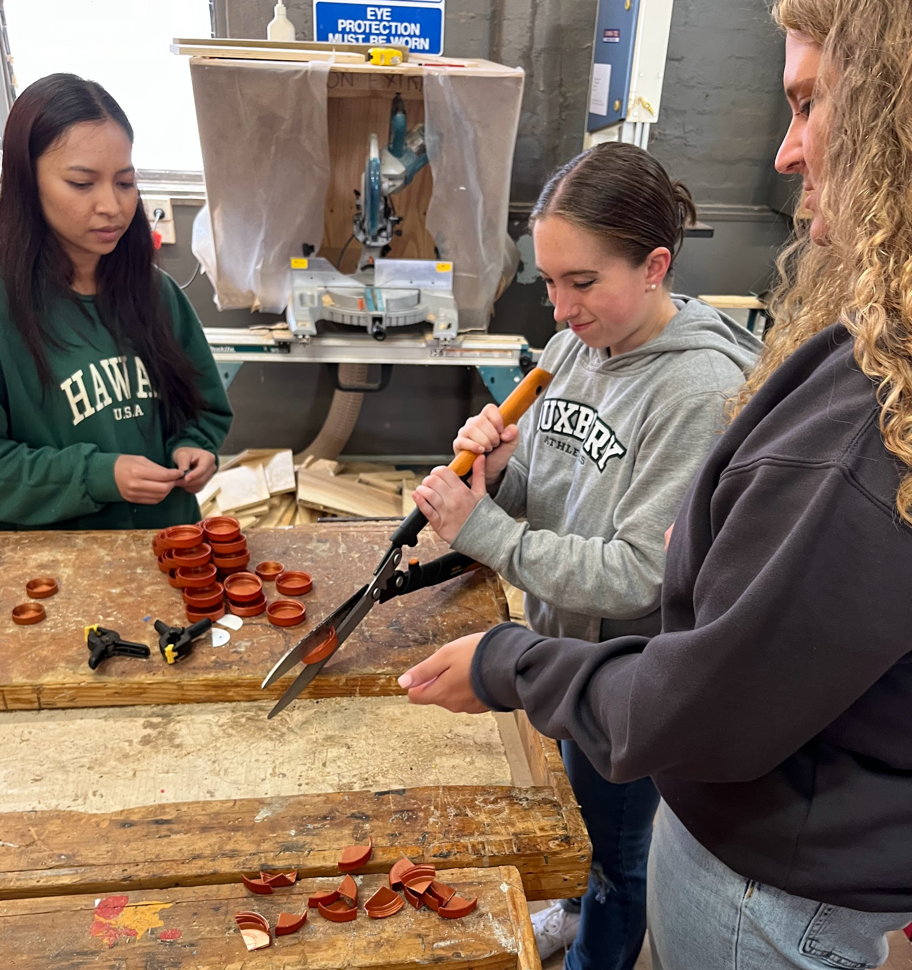
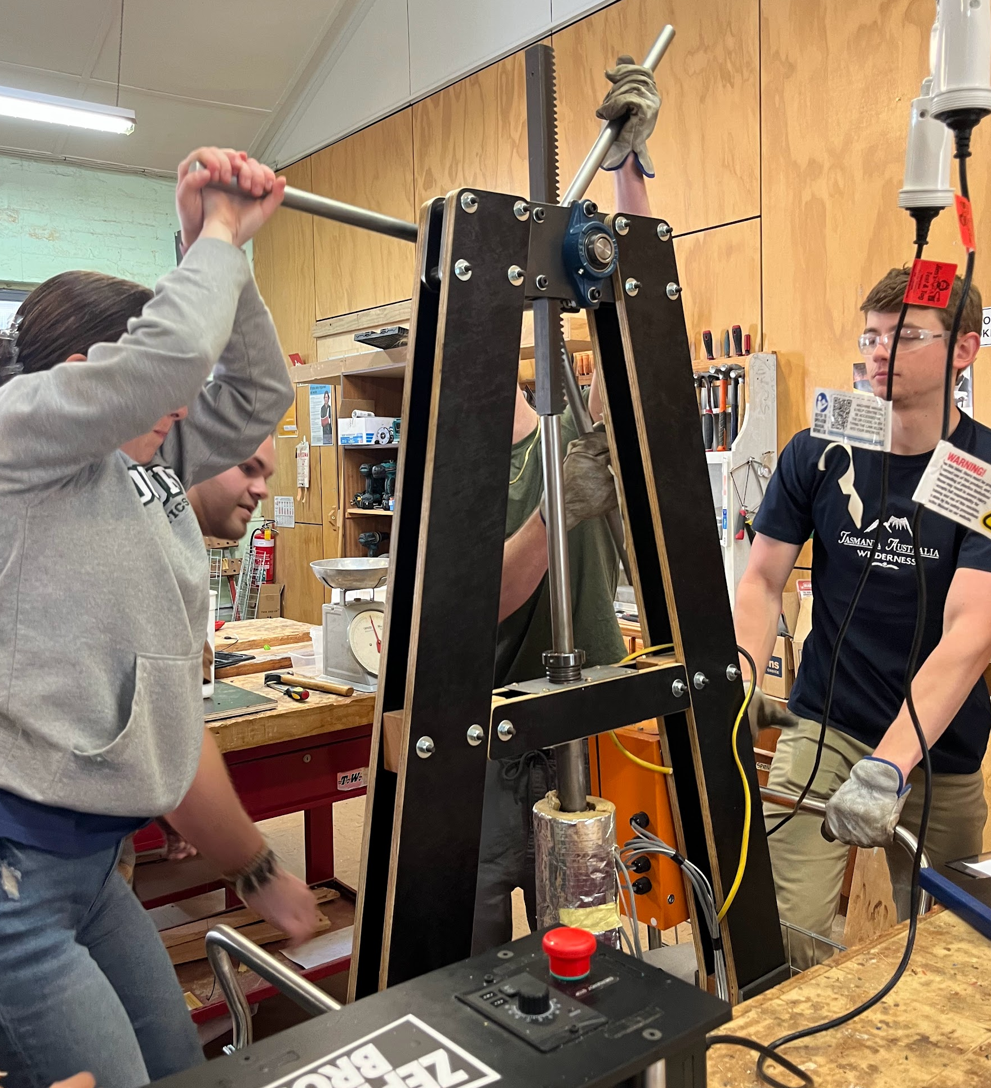
3. Hands-On Workshops
2-3 hours
8-12 community participants
Interactive Poll
1. Informative material on plastic recycling
2. Pre workshop Survey
3. Safety Training
4. Hands-on demonstration and participant involvement in each step of assembly line
5. Post workshop survey
6. Participants leave with a pot

Slide 27
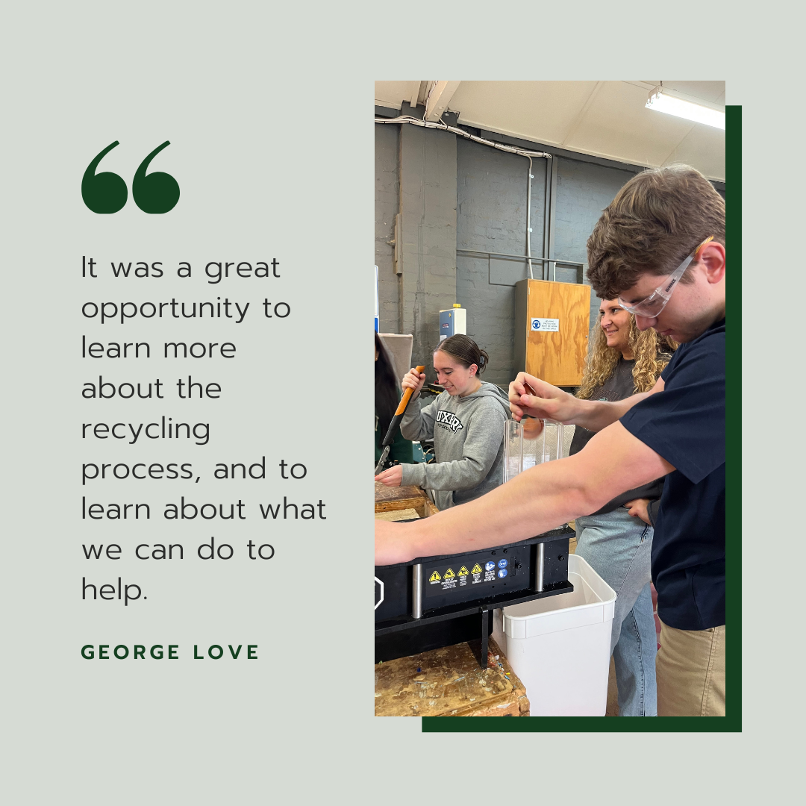
3. Hands-On Workshops
After the workshop, participants understood the proper way to discard bottle caps and said they are more likely to recycle plastic bottle caps afterwards

Slide 28
4. Training Materials

Slide 30
The Hub’s Next Steps for the Initiative
Collect workshop survey data to measure impact on knowledge, behavior, and engagement
Market products to the community
Get molds for different products
Run demonstration workshops
1
2
3
4

Slide 31
Thank you! Any Questions?

