Slide 1
Brought to you by:
Solar City

Slide 2
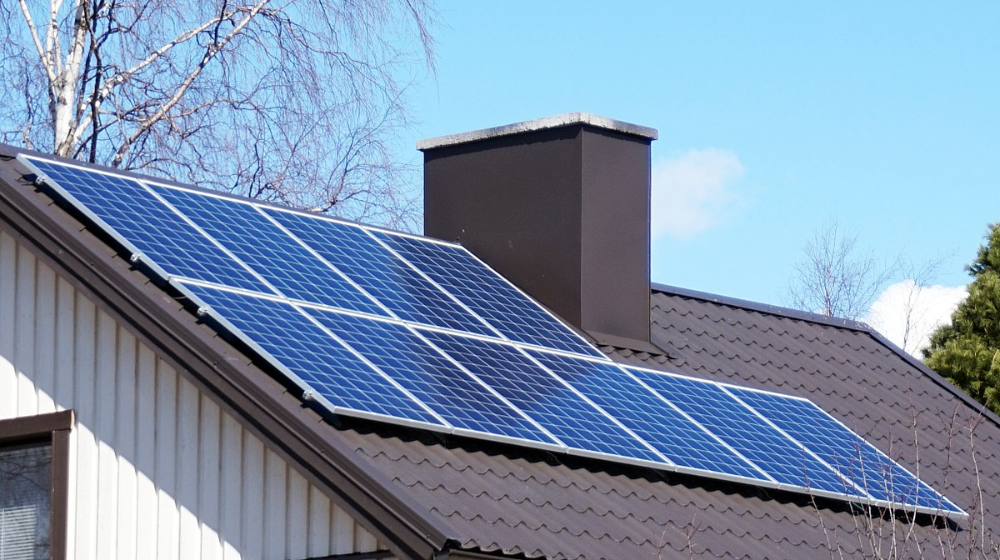
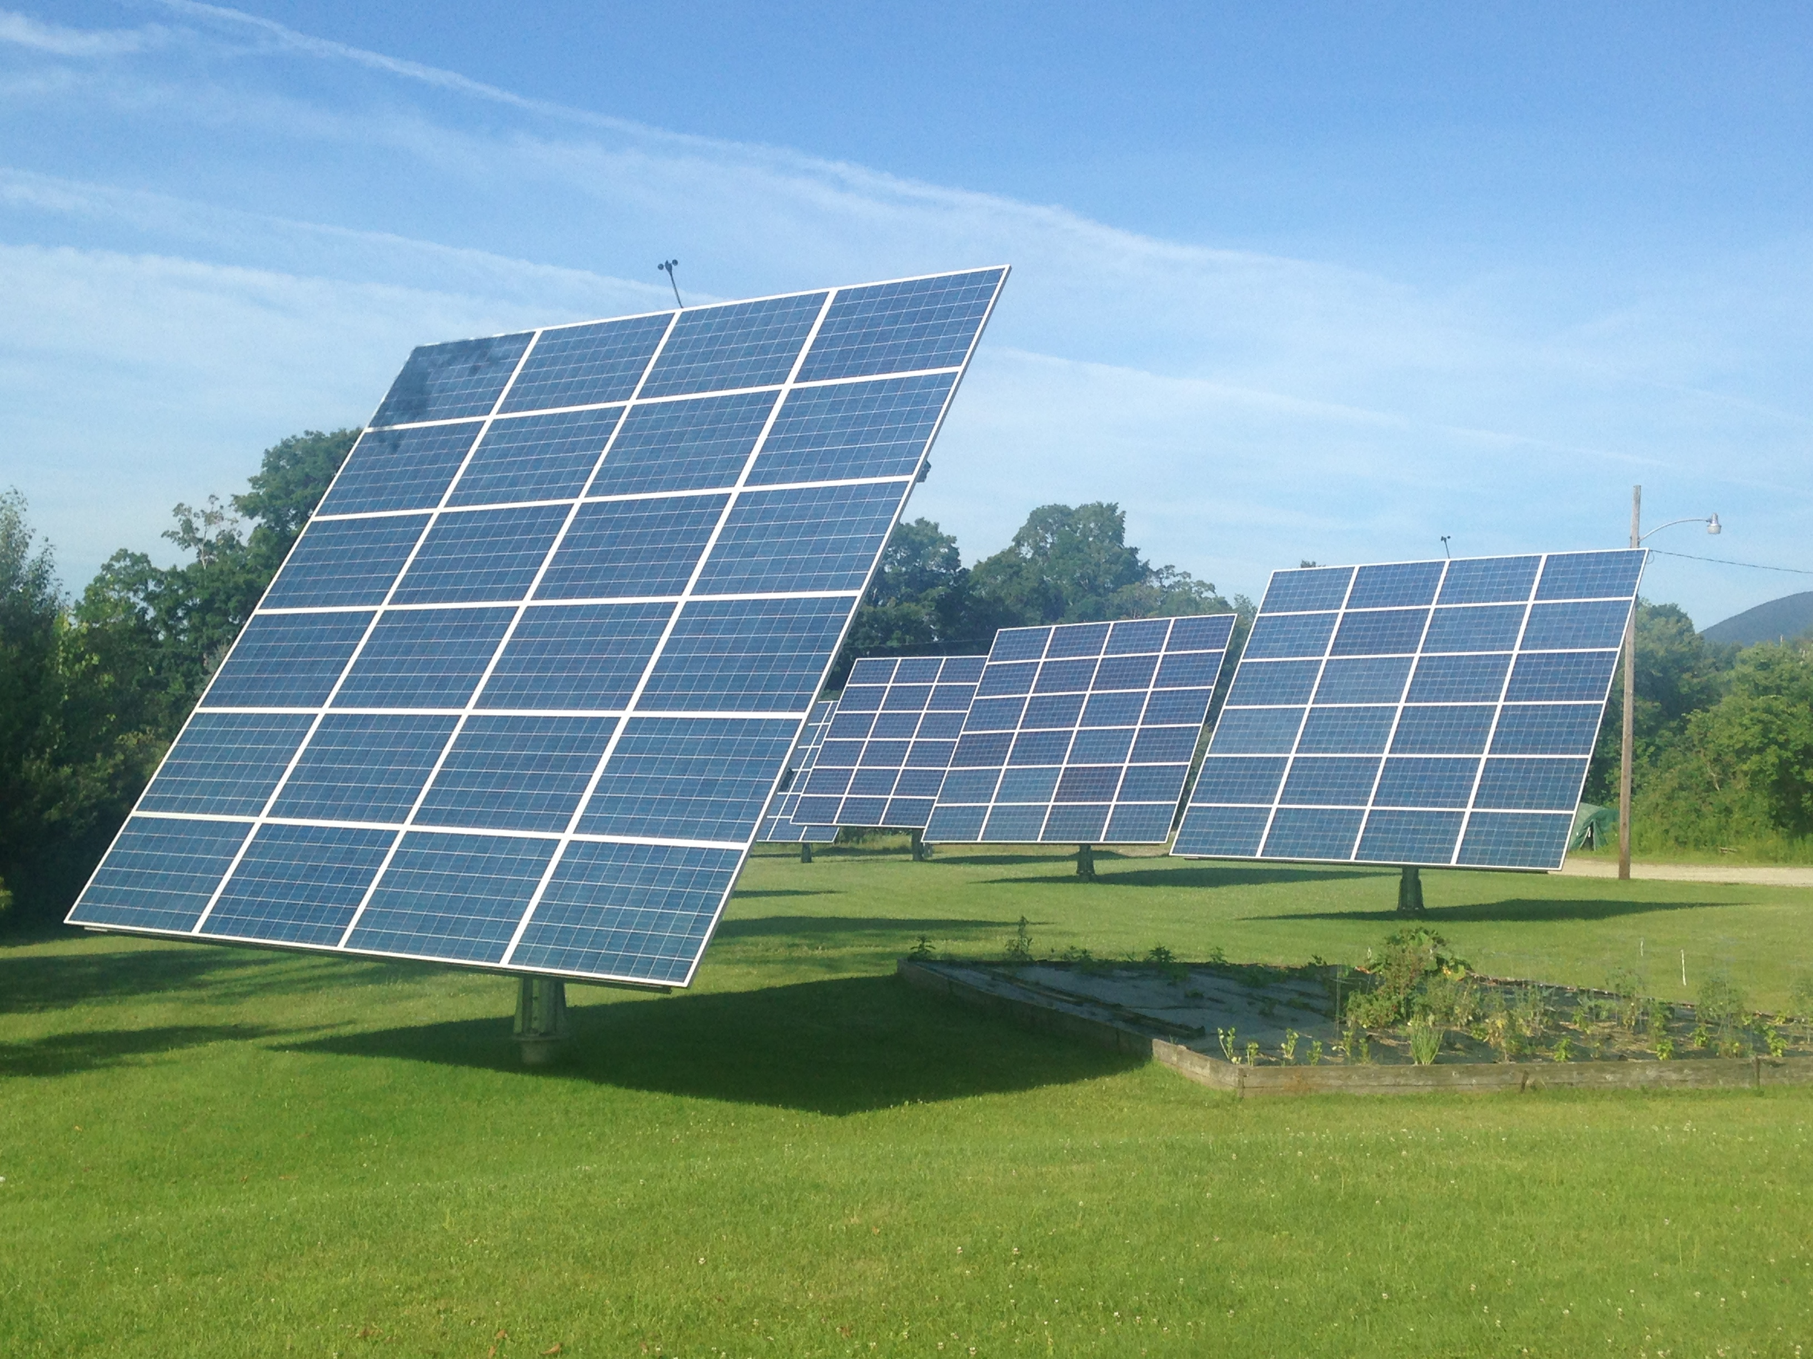
Lesson Overview
Solar energy is usually a negative for building designers. It generates extra heat that must be eliminated by air-conditioning. However, this perspective is changing as architects and buyers begin to see solar energy as a free energy source. By designing a house properly, it can use the sun to power photovoltaic panels or to passively heat the house.

Slide 3
Students should be able to:
Understand how building design can accommodate solar panels
Understand how building design can be used to take advantage of passive solar energy .
Objectives

Slide 4
Vocabulary

Slide 5
Architectural Engineer
- A type of engineer that designs the layout of a building
Blueprint
- A detailed plan or technical drawing used to represent the dimensions of a building
Dimensions
- A measurement that describes the size and shape of an object
Electrical Engineer
- A type of engineer that designs the electrical systems of a building

Slide 6
Model
- A representation of something for imitation, comparison or analysis, sometimes on a different scale
Solar Array
- A group of two or more photovoltaic panels
Solar Panel
- A device that converts radiant energy from the sun into electricity
Solar Power
- Electric power created from converting radiant energy from the sun into electricity that can be used to do work.

Slide 7
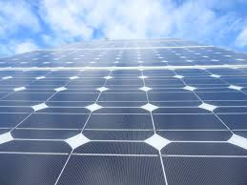
Types of Solar Panels
Monocrystalline Silicon: Most efficient, uses individual cells
Polycrystalline Silicon:
Solid with flake-like pieces of silicon
Amorphous Silicon:
Non-crystalline, thin film
Monocrystalline

Slide 8
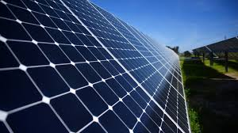
Photovoltaic Cells
Converts radiant energy from the sun directly into electricity.
They use materials called semiconductors.
When the sun falls on these materials, one side of the plate becomes positively charged while the other becomes negatively charged. The opposite charged plates cause a flow of electrons, or electricity.

Slide 9
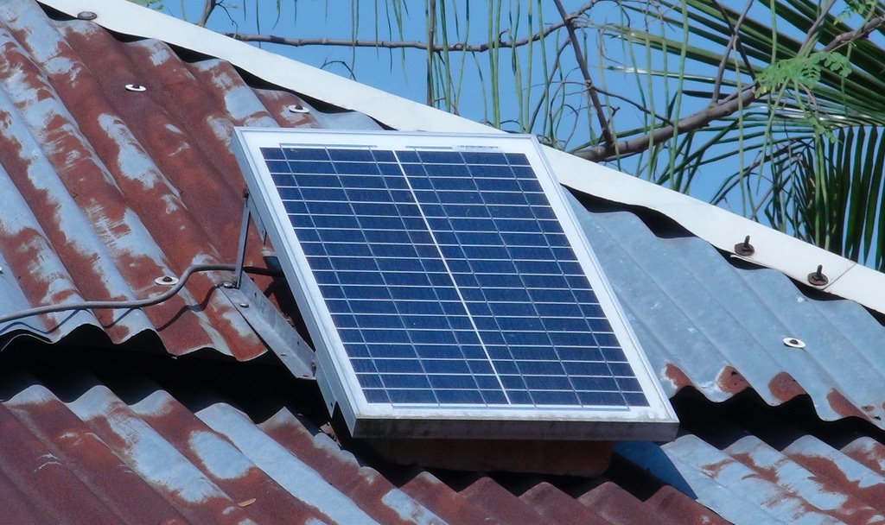
Where to Mount
It is important to mount the panels on a surface that receives direct sunlight and is not shaded by trees or other buildings
An array on a roof can be angled to take advantage of how the earth is positioned relative to the sun

Slide 10
Advantages & Disadvantages of Solar Panels
Disadvantages
Expensive
Output can fluctuate
Supply must meet demand
Energy cannot be generated at night
Advantages
No direct emissions
Beneficial in remote locations
Protection against blackouts

Slide 11
Resources

Slide 12
Lab Procedure
Let’s design a solar city!

Slide 13
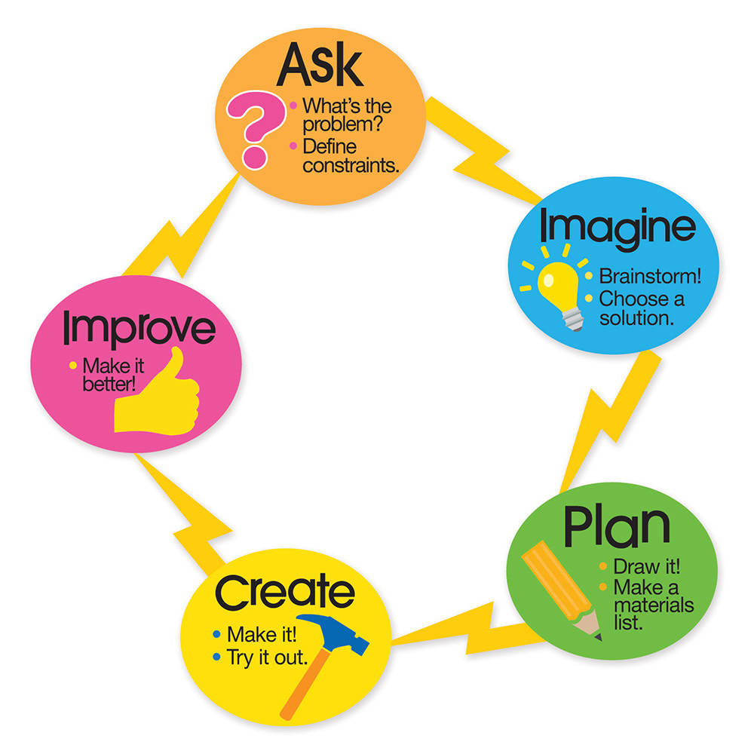
The Engineering Design Process
As students are conducting this activity, they are performing some of the classical steps of the Engineering Design Process.
Engineering
Design Process

Slide 14
Each group will need:
Mini solar PV panel
Piece of foam core board, on which to tape the solar panel
2 small alligator clamps
A single light, such as a small Christmas light or any individual bulb from a hobby/craft/electronics store that can be hooked up in the circuit
(Optional) Voltmeter
Materials

Slide 15
City Construction
here your design
This video shows a close-up of the construction of the houses

Slide 16
Gather materials (Since this is an open-ended activity in which students do most of the designing, as they begin to build, students may think of more materials they require, such as popsicle sticks)
Pre-cut the foam board to use as the walls and roofs of the buildings. Vary the sizes so that each group’s building has different dimensions
Collect enough large pieces of cardboard to serve as land plots
Collect enough lights, make sure they are all working properly
Set-Up
Follow these instructions before Day 1!

Slide 17
Day 1
Start the activity in class
Anticipatory Activity: Start with the following introduction and activity.
After Demonstration: Lead a class discussion about where the best place to attach the solar panel would be.

Slide 18
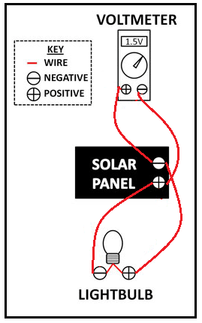
Introduction
The Demo
Set up the demo as pictured (voltmeter optional)
The solar panel connected in series with a light

Slide 19
Show the students the circuit you created. Explain how it is called a solar panel and is like a battery, but instead of storing energy it converts it.
Discussion Topics
How do we use energy at school? Does anyone know where we get electricity?
As engineers we must find better ways to create the energy we rely on everyday to power all our buildings!
Explain that when a building uses a row of two or more solar panels it is called a solar array.

Slide 20
Take the class outside!
Now the light will turn on
Notice how the tilt of the solar panel and the direction the panel faces affects the brightness of the bulb
Continued
Explain to students that we know when the solar panel is creating electricity when the light bulb is illuminated.
Ask them why they don’t see a light. Explain that there is not enough light in the classroom to generate electricity.
Which direction is best?
In the direction of direct sunlight, which is east in the morning and west in the afternoon

Slide 21
Day 2
Divide the class into teams
Have students brainstorm Solar City building ideas in their groups
Once a group has decided on the type of building they want to build give them the precut wall and roof pieces for a generic model building.
From this have them measure and draw to make a two dimensional scale of the buildings.

Slide 22
Reminders
Remind students to address:
Placement of doors windows, roofs, and solar panels
Available construction materials

Slide 23
Day 3
Distribute the large pieces of carboard (for the plots of land) to accommodate students’ pre-cut model buildings.

Slide 24
Step 1
Have the students draw on the cardboards pieces where they want doors and/or windows cut

Slide 25
Step 2
Have teachers or responsible adults help students cut the board using a knife.

Slide 26
Once the doors and windows are cut, have adults help students use hot glue or tape to adhere the building walls onto the cardboard bases, as well as the other building design components. This will take a lot of hot glue or tape so have plenty on hand.
Tip: Assemble roof geometries, but wait to affix them until after the wiring is done.
Step 3

Slide 27
Step 4
Have students decorate the exterior building walls with any materials you might have on hand. They can design their building to be a school, house, store. This is up to their imagination.

Slide 28
Math!
Optional Exercise:
Have all teams measure and calculate the footprint area of their buildings.

Slide 29
Attach the solar panels to the roofs of the houses using looped pieces of tape. Attach the light in a circuit using wires and alligator clamps (See the diagram on slide 18). Then, use hot glue or tape to secure the roofs to the building walls.
Once the structures are complete, move them all outdoors into the completed Solar City. Have each group make a presentation of their building, how they integrated their solar panel, what it is used for and at least one thing they learned during the activity.
Day 4

Slide 30
Day 5
Lead a class discussion about the use of electricity. Ask the students how to use it at home, at school, or in other buildings in their communities. What are the advantages and disadvantages of using photovoltaic panels on a building?

Slide 31
Bring it Home
Optional: Have students write a persuasive letter to parents or principals inviting them to tour the class’s Solar City. Have them incorporate their opinions about solar energy use.

Slide 32
Where is the best place to attach a solar panel to generate the maximum amount of electricity?
Answer: The best place to put solar panels is on the roof of a house away from anything that will block sunlight. To get the most sunlight angle the panel using your understanding of the Earth’s orbit around the sun and the longitude and latitude of your house.
What happens when the solar panel is tilted at different angles?
Answer: The amount of electricity produced changes depending on the panels relative position of the sun. When the entire solar panel is facing the sun, it gets the most energy possible. As you tilt the panel away from the sun it receives decreased sunlight and the amount of electricity generated decreases as well.
How can the solar panels help people that do not have access to the electrical power grid?
Answer: With solar panels, people can generate electricity without needing to be connected to the electrical grid. This can help people living in remote areas.
Investigating Questions

Slide 33
For lower grades:
Permit drawings to be less detailed and not to scale.
For upper grades:
Have students create three-dimensional drawings of their designs.
Ask teams to use their drawing scales to calculate real life dimensions
For more advanced students:
Do not pre-cut the foam board. Allow students to design freely and cut their own pieces as specified on their own scaled drawings.
Activity Scaling

Slide 34
Alternative Lab
This lab requires only household materials!

Slide 35
Each group will need:
Pizza box
Skewer
Aluminum foil
Tape
Ruler
Plastic wrap
Black paper
Something to melt (Chocolate spread, marshmallows, and digestive cookies are used in this video)
A sunny day!
Materials

Slide 36
Oven
Construction
here your design
This video shows a close-up of the construction of the Solar Oven

Slide 37
Credits
Lab
Lab procedure:
https://www.teachengineering.org/activities/view/cub_solarcity_activity1
Copyright
®2009 by Regents of the University of Colorado
Shapes & Icons
Vectorial Shapes in this Template were created by SlidesPPT
Icons on this template have been downloaded from Flaticon

