Slide 1
A Virtual Resource for Developing Online Learning Content
William Aaron
and
Nicole Racca
[1]

Slide 2
Content Outline
STEAM Education
Our Motivation & Mission
Our Sponsor
Cultural Issues
Objectives & Methodology
Research Findings & Results
Impact
In Summary
[2]
Notes:
Source: https://pbs.twimg.com/profile_images/891362290980847616/cDPxsHxl.jpg

Slide 3
STEAM Education
Good Critical Thinking Skills
Higher Proficiency in Science Literacy
Build a More Cohesive Education
Younger Generations of Innovators
[3]
What is STEAM Education?
The Benefits

Slide 4
Motivation
Panama’s education system does not include STEAM education
The COVID-19 quarantine has caused a paradigm shift in education towards online learning
[4]

Slide 5
Mission
Our Mission is to develop tutorials and materials informing teachers on how to create and distribute online learning STEAM education content.
[4]

Slide 6
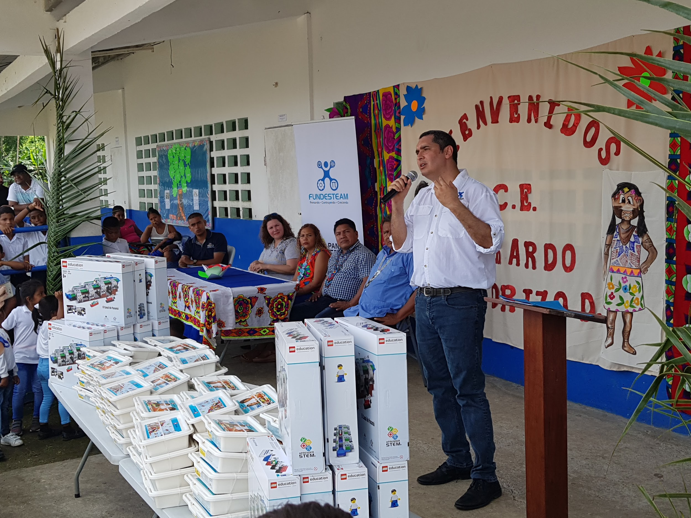
Our Sponsor
[5]
Marvin Castillo- CEO of Fundesteam

Slide 7
Cultural Issues
[6]
[7]
[8]
Lack of STEAM Education
Resistance to Reform Education
Availability of Technical Resources

Slide 8
Objectives
Identify the Current Methods of Virtual Learning and the Obstacles
Obtain the Perspective of Current Instructors
Develop Guidelines and Tutorials for Resources for the Website
[9-12]
Notes:
Source: https://www.digitallearninglab.org/investigating-virtual-learning-environments/
Camera
http://clipart-library.com/free/cartoon-camera-transparent.html
Communicate
https://www.google.com/url?sa=i&url=http%3A%2F%2Fclipart-library.com%2Ftalking-cliparts.html&psig=AOvVaw0TuSGEp7mc8j4hku9UaemB&ust=1588744488449000&source=images&cd=vfe&ved=0CA0QjhxqFwoTCODKrsmEnOkCFQAAAAAdAAAAABAD
rl=
Wrench: https://www.google.com/url?sa=i&url=https%3A%2F%2Fwww.clipart.email%2Fclipart%2Fwrench-and-hammer-clipart-222571.html&psig=AOvVaw2TdRVLHYpUvHDv1CBs0eB3&ust=1588785422410000&source=images&cd=vfe&ved=0CA0QjhxqFwoTCOCiqYmdnekCFQAAAAAdAAAAABAJ

Slide 9
Methodology Flowchart
Objective 1
Objective 2
Objective 3
Identify the Current Methods of Virtual Learning and the Obstacles
Develop Guidelines and Tutorials for Resources for the Website
Obtain the Perspective of Current Instructors
Deliverable:
Create a Website as a Virtual Resource informing Panamanian Teachers on how to create Online Learning Content
Interview Educators and Experts
Analyze Functioning Teaching Methods

Slide 10
Research Findings
Services/Techniques
Challenges
Opinions
[13]
Notes:
https://www.youtube.com/watch?v=zlcmdx3MF6I
https://www.timeshighereducation.com/student/blogs/real-experience-online-only-university-student

Slide 11
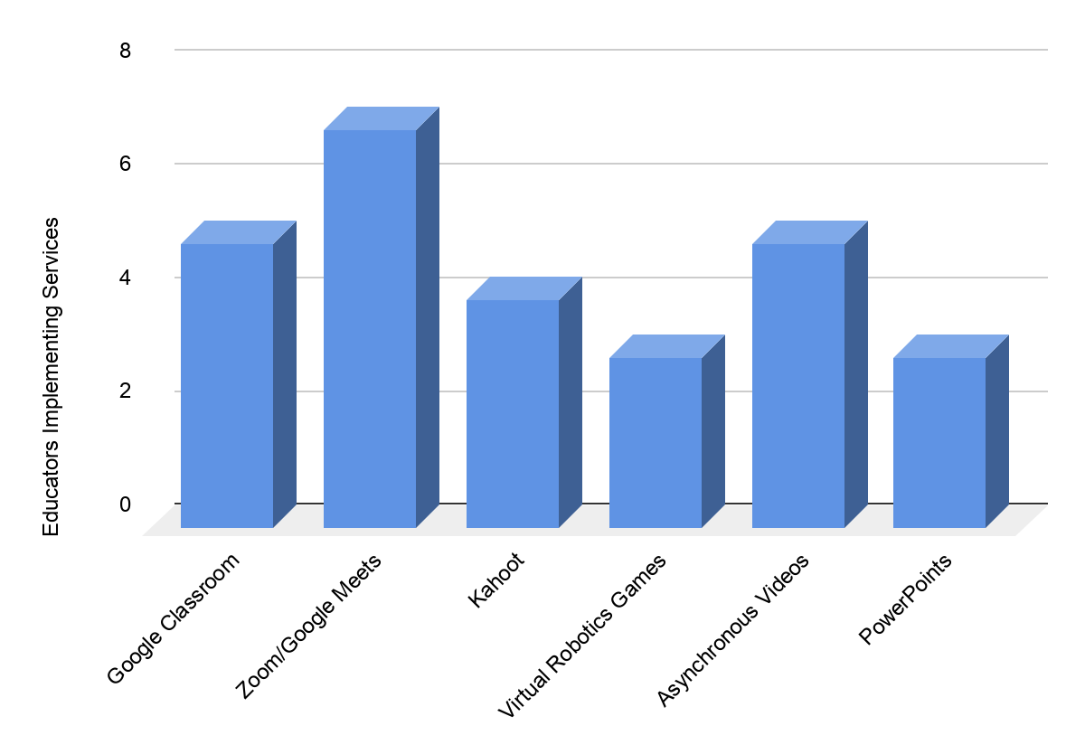
Research Findings: Services/Techniques
n=7
Most common platforms, services, and techniques used
Notes:
https://www.profweb.ca/en/publications/real-life-stories/bringing-some-fun-and-friendly-competition-to-the-college-classroom-with-kahoot
https://unsplash.com/photos/qnWPjzewewA
https://unsplash.com/photos/Ciz4lHr8Jgw

Slide 12
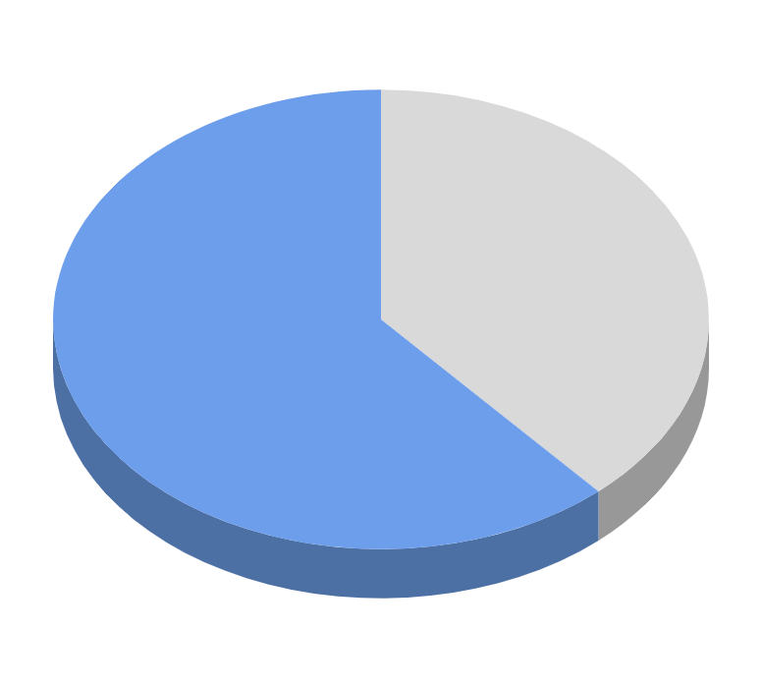
Research Findings: Challenges
n=7
5 out of 7 educators interviewed discussed the challenges in maintaining students’ attention during online learning
5
3
3 educators expressed concern for the countless hours it takes to create content
Notes:
https://en.wikipedia.org/wiki/File:Current_event_clock.svg

Slide 13
Research Findings: Opinions
“I think it went as well as could be expected... I don't think that any virtual setting can match that dynamic of a classroom. …[T]here's that back and forth, being the kids and the instructor and it just, it's kind of like magic. It's kind of hard to experience that virtually”
- Michael Costello
Notes:
.
https://www.profweb.ca/en/publications/real-life-stories/bringing-some-fun-and-friendly-competition-to-the-college-classroom-with-kahoot
https://unsplash.com/photos/qnWPjzewewA
https://unsplash.com/photos/Ciz4lHr8Jgw

Slide 14
Design Considerations
Simplicity of Information
Simplicity of Design
Compartmentalization
[14-16]
Notes:
http://clipart-library.com/clip-art/1-14245_paper-and-pencil-png-paper-and-pencil-icon.htm
https://www.clipartkey.com/view/iJxibo_clipart-computer-monitor-computer-clipart-black-and-white/
http://clipart-library.com/free/box-clipart-black-and-white.html

Slide 15
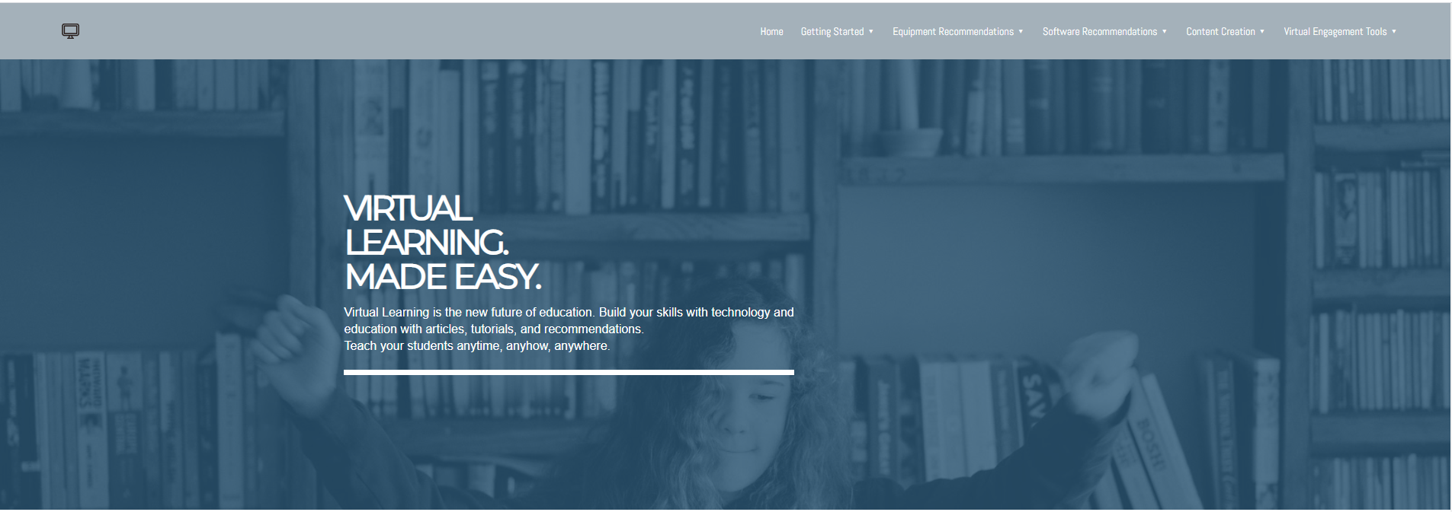
Website: Home Page

Slide 16
Website: Home Page

Slide 17
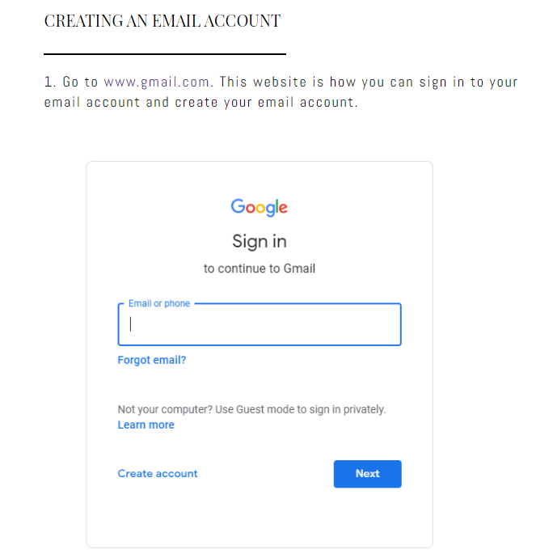
Website: Tutorial
Step-By-Step Process
Direct Language
Pictures and Infographics

Slide 18
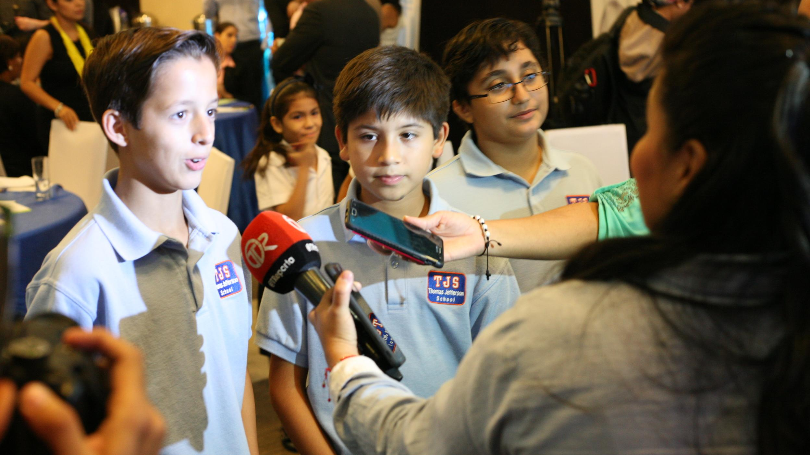
Impact
This website and these tutorials will positively benefit many educators:
Fundesteam Educators
Panamanian Educators
Home-Schooling Educators
Virtual Educators
[17]
Notes:
Source: https://www.fundesteam.org/

Slide 19
In Summary
Our team developed recommendations and guidelines for creating online learning content for Panamanian educators, and designing a website to host this information.
[4]
Notes:
.

Slide 20
References
Stauffer, R. (2018, January 19). [Woman sitting with a laptop]. Retrieved 2020, from https://www.timeshighereducation.com/student/blogs/real-experience-online-only-university-student
[PanamaSTEM Logo]. (2016). Retrieved 2020, from https://touch.facebook.com/panamastem/?__tn__=HH-R
Sprout School Supplies. (2019, May 29). [STEAM- The Importance of Art in STEM Education]. Retrieved from
[Fundesteam Robotics Students]. (2018). Retrieved 2020, from https://www.fundesteam.org/#become-a-volunteer
[Marvin Castillo, Director of Fundesteam, gives speech as the organization donates robotics kits to a school.]. (2018). Retrieved 2020, from https://www.fundesteam.org/news/
https://sproutsupplies.com/blog/steam-the-importance-of-art-in-stem-education/
[Digital image]. (n.d.) Retrieved from https://www.clipartkey.com/view/iioxhb_calculator-clipart-black-and-white/
[Digital image]. (n.d.) Retrieved from https://pixabay.com/vectors/book-reading-education-knowledge-2022460/
[Digital image]. (n.d.) Retrieved from https://publicdomainvectors.org/en/free-clipart/Computer-smartphone-and-tablet-vector-icons/11007.html
[Investigating Virtual Learning Environments]. (2020). Retrieved 2020, from https://www.digitallearninglab.org/investigating-virtual-learning-environments/
[Digital image]. (n.d.). Retrieved from http://clipart-library.com/free/cartoon-camera-transparent.html
[Digital image]. (n.d.). Retrieved from http://clipart-library.com/talking-cliparts.html
[Digital image]. (n.d.). Retrieved from https://www.clipart.email/clipart/wrench-and-hammer-clipart-222571.html
[Digital image]. (n.d). Retrieved from (Put in)
[Digital image]. (n.d.). Retrieved from http://clipart-library.com/clip-art/1-14245_paper-and-pencil-png-paper-and-pencil-icon.htm
[Digital image]. (n.d.). Retrieved from https://www.clipartkey.com/view/iJxibo_clipart-computer-monitor-computer-clipart-black-and-white/
[Digital image]. (n.d). Retrieved from http://clipart-library.com/free/box-clipart-black-and-white.html
[Fundesteam].(2018). Retrieved 2020, from https://www.fundesteam.org/
Greco, H. (2020, March 28). [Fourth Grader working on math from home]. Retrieved 2020, from https://www.reporternewspapers.net/2020/03/28/local-dekalb-schools-parents-students-adjust-to-tech-and-stress-of-virtual-learning/
Groves, J. (2018, October 10). ANCON HILL VIEWPOINT (CERRO ANCON) IN PANAMA CITY [Digital image]. Retrieved 2020, from https://www.journeyera.com/ancon-hill-viewpoint-panama-city/
[18]
Notes:
https://www.google.com/url?sa=i&url=https%3A%2F%2Fwww.reporternewspapers.net%2F2020%2F03%2F28%2Flocal-dekalb-schools-parents-students-adjust-to-tech-and-stress-of-virtual-learning%2F&psig=AOvVaw0yXSWLT5sJxasS0m-ukJ6I&ust=1588749304820000&source=images&cd=vfe&ved=0CA0QjhxqFwoTCOD05s-WnOkCFQAAAAAdAAAAABAE

Slide 21
Acknowledgements
Professor Chiarelli-WPI
Professor Kinicki-WPI
Marvin Castillo-Fundesteam
[18]
Notes:
https://www.google.com/url?sa=i&url=https%3A%2F%2Fwww.reporternewspapers.net%2F2020%2F03%2F28%2Flocal-dekalb-schools-parents-students-adjust-to-tech-and-stress-of-virtual-learning%2F&psig=AOvVaw0yXSWLT5sJxasS0m-ukJ6I&ust=1588749304820000&source=images&cd=vfe&ved=0CA0QjhxqFwoTCOD05s-WnOkCFQAAAAAdAAAAABAE

Slide 22
Questions?
Thank you for your time!
[19]
Notes:
https://www.youtube.com/watch?v=0efqnvYz4YI
Source: https://www.journeyera.com/ancon-hill-viewpoint-panama-city/

Slide 23
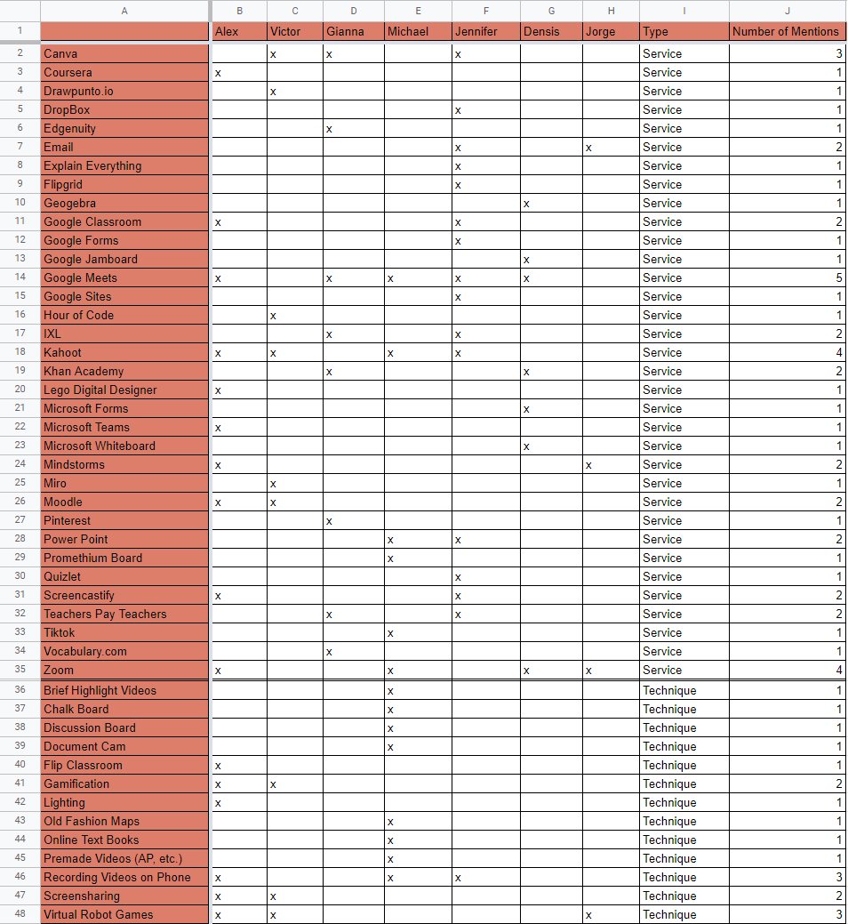

Slide 24
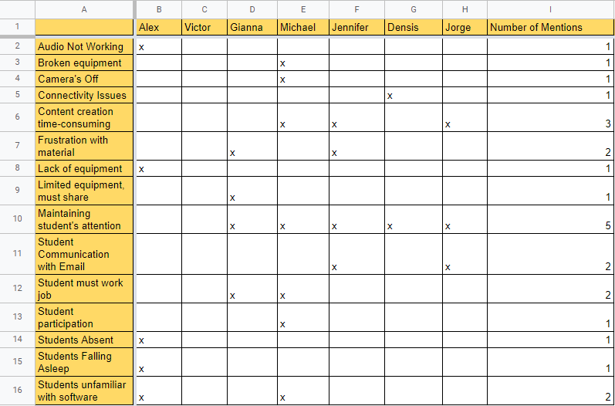

Slide 25
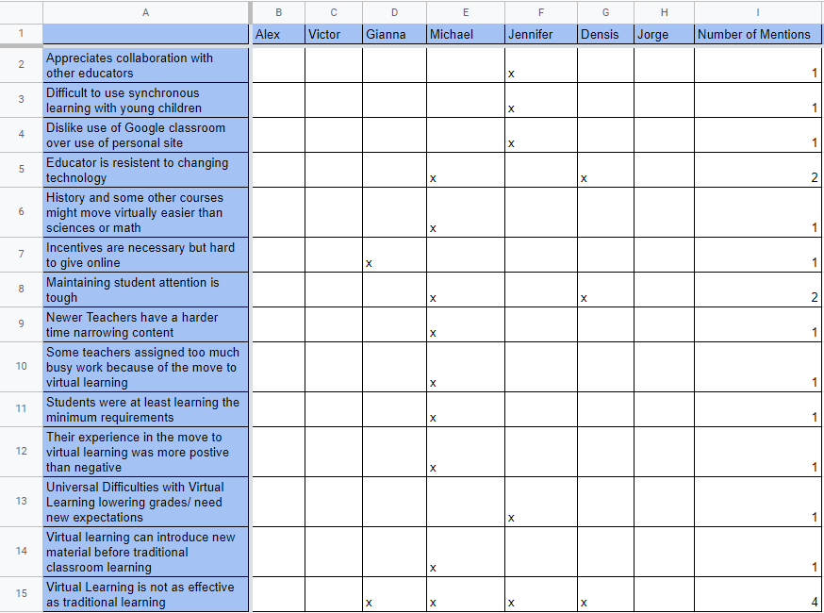

Slide 26
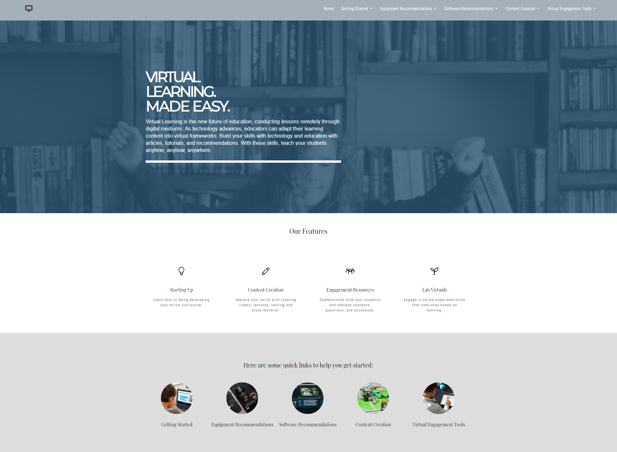

Slide 27
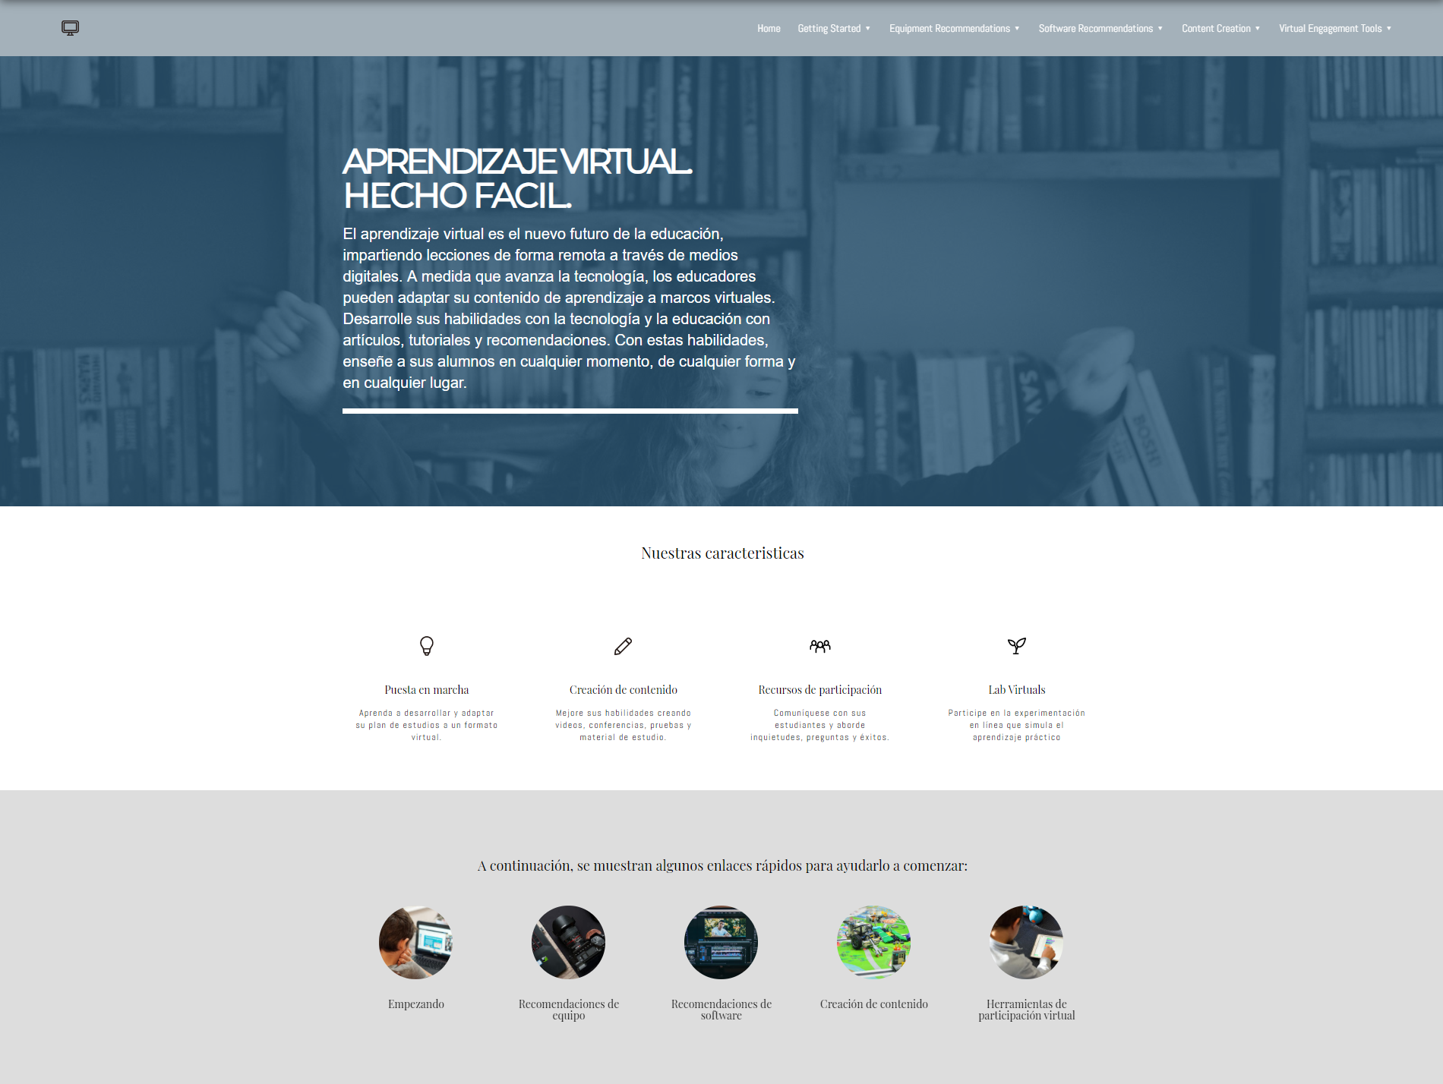

Slide 28
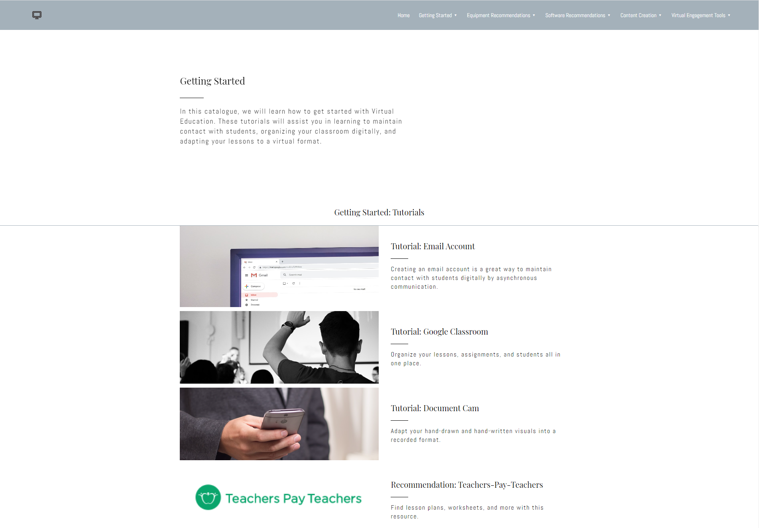

Slide 29
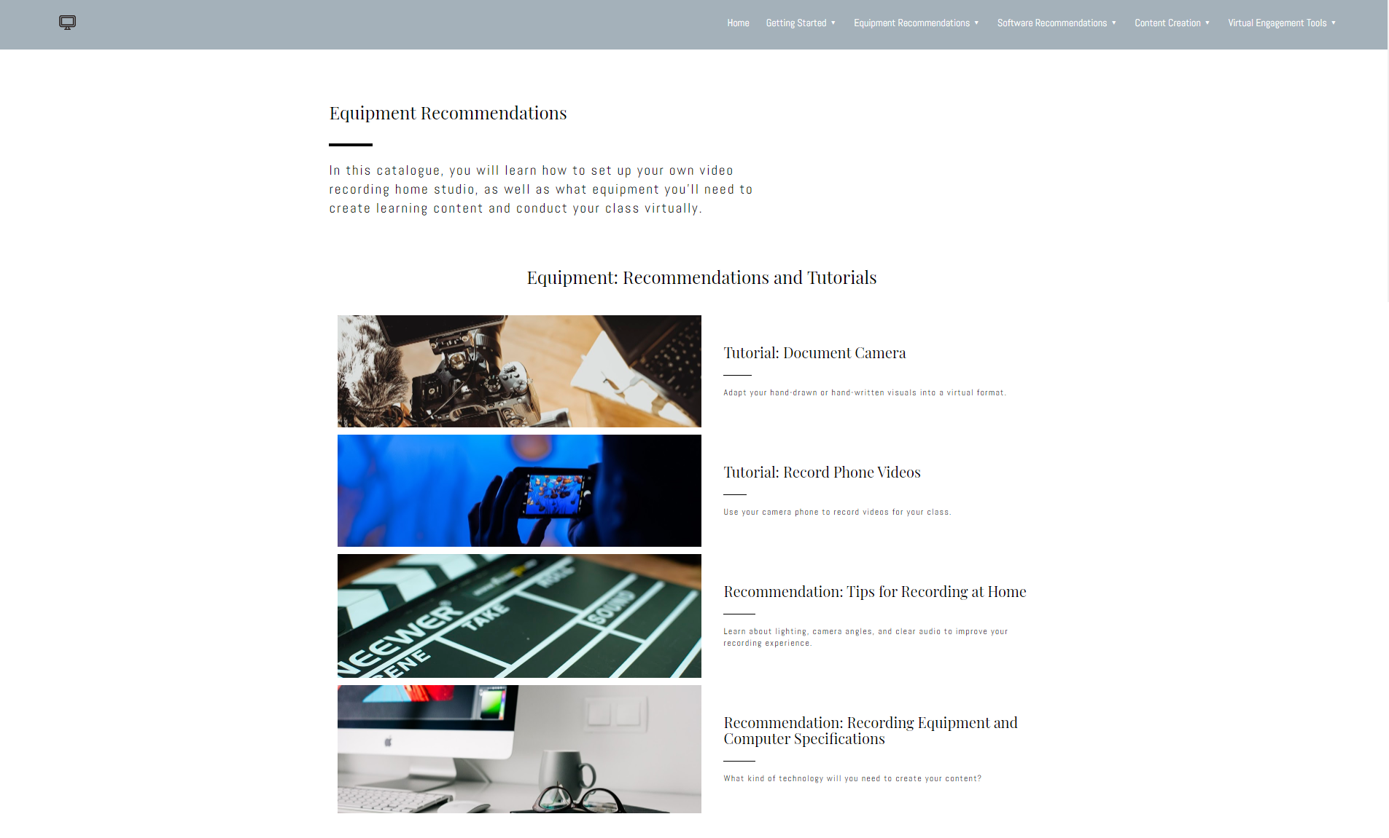

Slide 30
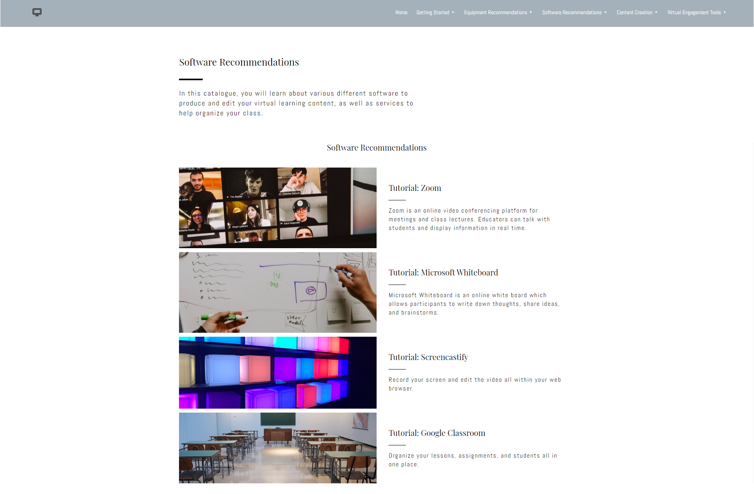

Slide 31
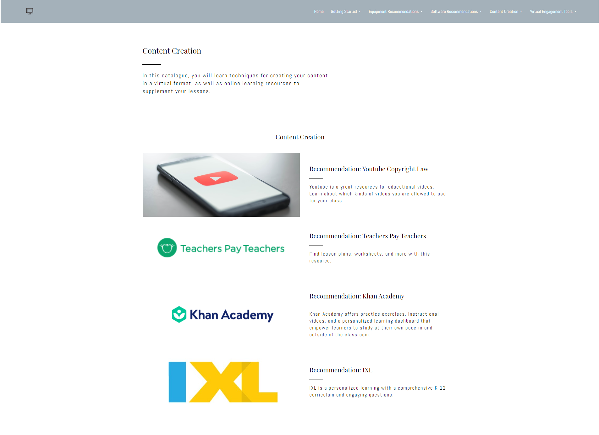

Slide 32
