Slide 1
Implementing Underwater Artificial Intelligence Object Detection
DISTRIBUTION STATEMENT A. Approved for public release. Distribution is unlimited.
This material is based upon work supported by the Under Secretary of Defense for Research and Engineering under Air Force Contract No. FA8702-15-D-0001. Any opinions, findings, conclusions or recommendations expressed in this material are those of the author(s) and do not necessarily reflect the views of the Under Secretary of Defense for Research and Engineering.
© 2022 Massachusetts Institute of Technology.
Delivered to the U.S. Government with Unlimited Rights, as defined in DFARS Part 252.227-7013 or 7014 (Feb 2014). Notwithstanding any copyright notice, U.S. Government rights in this work are defined by DFARS 252.227-7013 or DFARS 252.227-7014 as detailed above. Use of this work other than as specifically authorized by the U.S. Government may violate any copyrights that exist in this work.
Jason Dominguez
10/12/2022

Slide 2
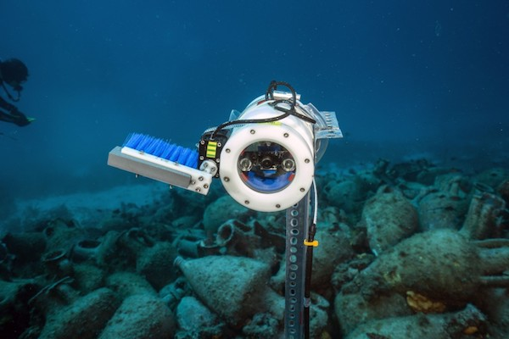
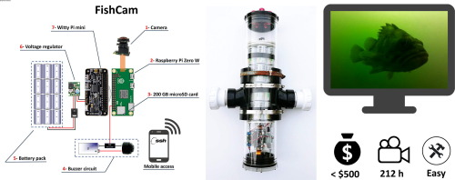
The Problem
Current underwater AI systems require a surface power system in order to provide power and data storage, causing them to have limited deployment
NOUS Camera Housing
https://www.raspberrypi.com/news/undersea-shipwreck-surveillance-with-nous/
Graphical Abstract of FishCam
https://www.sciencedirect.com/science/article/pii/S2468067220300195
Current underwater AI systems either consume a lot of power or do not have enough memory limiting its use and placement of the camera
Notes:
Nus is currently used on ship wreck in greese, uses PI3 and 4 to run object detection need big surface power system as unit does not move and also uploads video feed to the internet
Fishcam has 14day battery life run on the zero and cost a very little though there is no AI running on the pi
Say sentence what the problem actually is

Slide 3
Why using AI for Underwater is Good
Implementing AI is able to save storage as the camera is not saving every second of the video feed.
Utilizing AI can allow for extra features, such as power saving, autonomous surveillance, and alarm notification
AI Object Detection allows for extra benefits as well as extra features

Slide 4
Desired Design Goals
The model should be as accurate as possible
The model should fully utilize the CPU and RAM
The model should take up the minimum space on the SD card
The model should identify an object as quickly as possible
Notes:
Some requirements for the

Slide 5
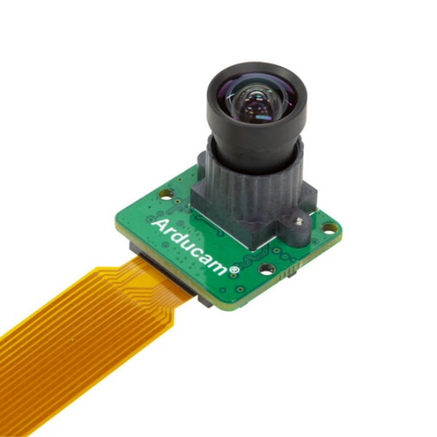
Hardware
The Sony IMX477: 12.3Mega-Pixel CMOS image Sensor
The Raspberry Pi Zero 2W: lower power mini computer
Arducam Sony IMX477
https://www.arducam.com/product/arducam-12mp-imx477-mini-high-quality-camera-module-for-raspberry-pi/
Raspberry Pi Zero 2W
https://www.zdnet.com/article/raspberry-pi-zero-2-w-review-performance-in-a-small-form-factor/
Notes:
Hardware need for the project include a sony imx477 image sensor because the camera being used is built for this sensor
The Pi Zero is a low powered computer it has a four core cpu and contains .5gB of ram
These two systems are going to connect together through a mipi connection as this connection takes up little room and is able to provide a fast frame rate

Slide 6
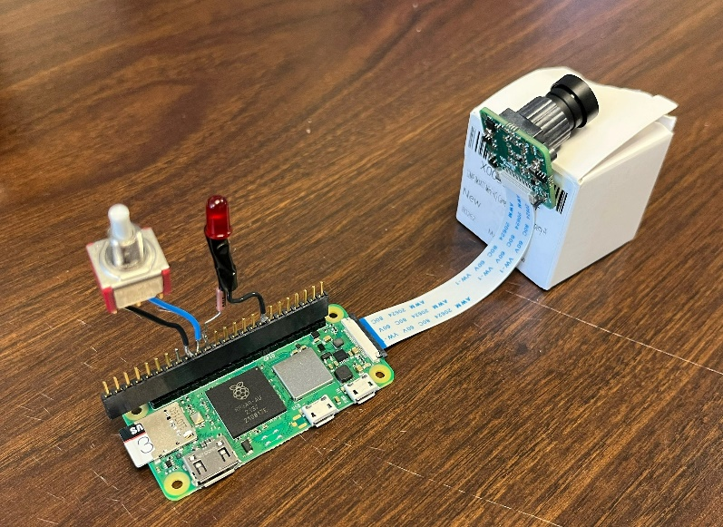
Utility Video Recording Program
Created digital video recording (DVR) program to store video from camera
Created an electrical interface device to show recording status
DVR Status LED
User Interface Button

Slide 7
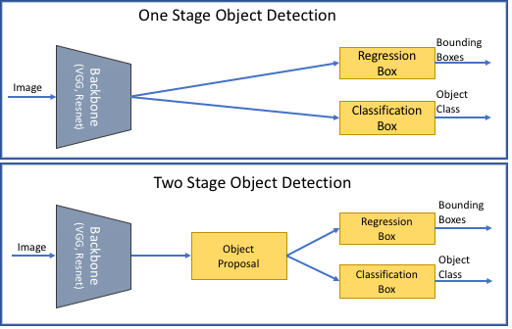
What Stage AI
There are two types of AI object detection, one and two stage:
Two stage performs an additional object region proposal step
Difference between One Stage and Two Stage AI
A one stage detector is better suited for this application because it uses less processing power and is faster
https://www.researchgate.net/figure/Two-stage-vs-one-stage-object-detection-models_fig3_353284602
Notes:
One stage= Looks at the image and tries to find the images well as placement based on its training
Two stage = will start look at where the image may be of importance and then looking at those regions it will run object detection.
Scanns the image to see where in the image it may be work for second looking for the object detection

Slide 8
Object Detection
Different tested architectures: EfficientDet, YOLO, MobileNet
Data retrieved from Roboflow Universe annotated image library
TensorFlow allows for better model compatibility on mobile devices
TensorFlow has better model combability on mobile devices, while Roboflow Universe allows for easy gathering of large datasets

Slide 9
Methodology
A demo model for each architecture was run to evaluate its performance
Testing was done on a Raspberry Pi 4b to speed up development, and provide more general interface connections
Based on the performance of demo versions of the models we eliminated the YOLO model and pursued two remaining models
EfficientDet
MobileNet
Utilized “Transfer Learning” to train a Common Everyday Objects” (COCO) model to add custom objects
Evaluation of the model was done using “Cross Validation”

Slide 10
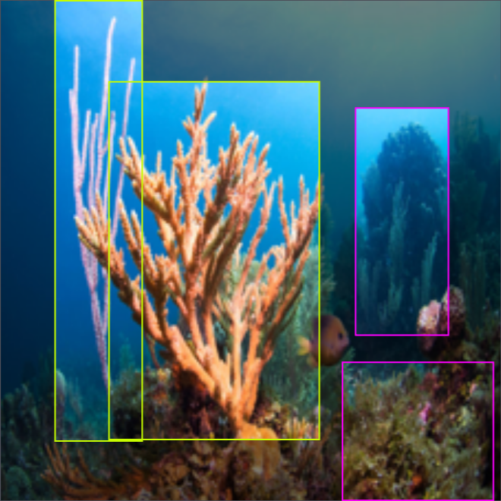
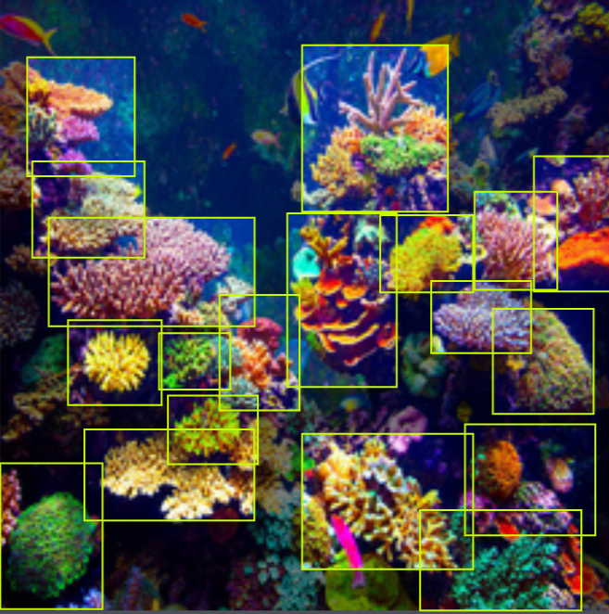
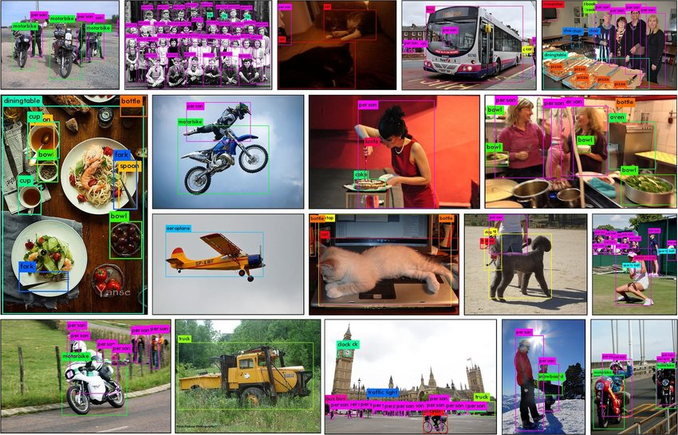
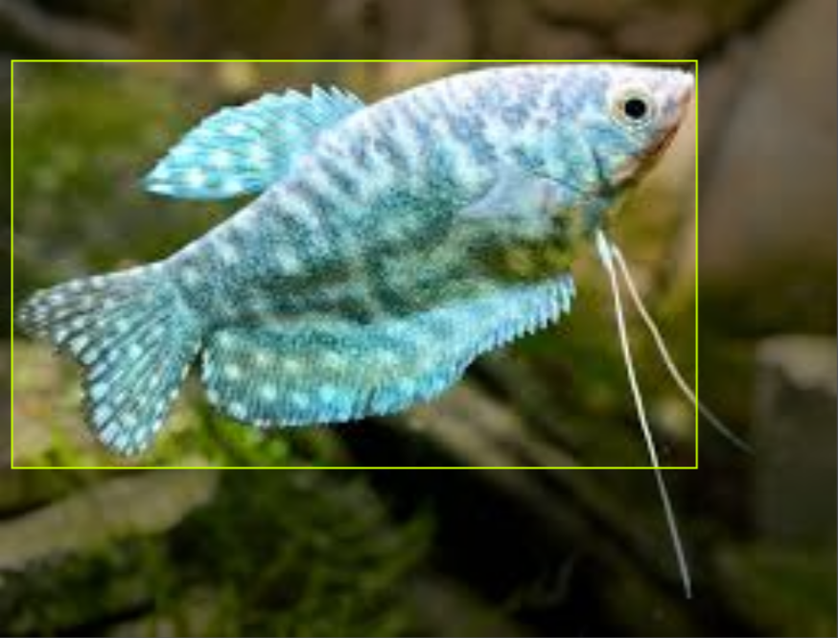
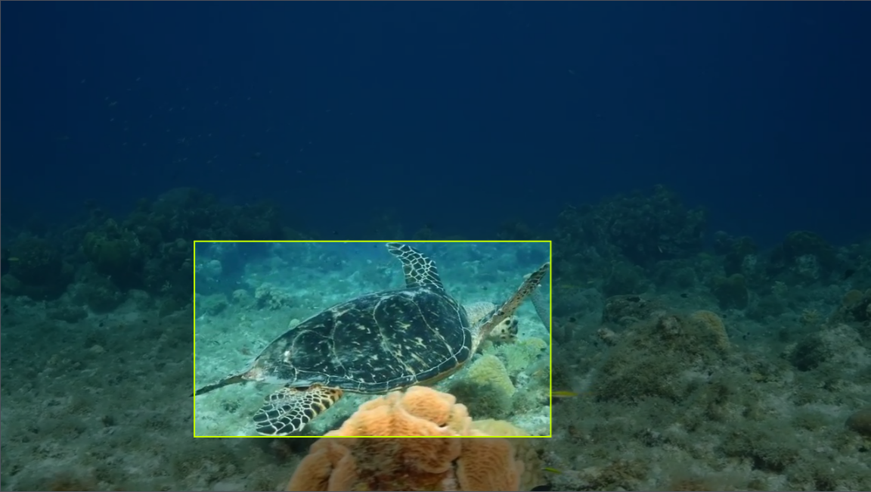
Transfer Learning
Transfer Learning was utilized to train a model on underwater animals:
+
COCO Dataset
https://www.researchgate.net/figure/Some-qualitative-examples-of-our-object-detection-results-on-MS-COCO-data-set_fig3_335865923
Custom Underwater Dataset
https://universe.roboflow.com/fyp-bekec/yolov4-38k4c/, https://universe.roboflow.com/parvej-hosen/turtle-f9xgw, https://universe.roboflow.com/thesis-fcq63/classification-of-corals

Slide 11
Cross Validation
Can allow for the average accuracy of a model to be evaluated
Complete Dataset
Split0
Split1
Split2
Split3
Split4
Test
Train

Slide 12
Cross Validation
Can allow for the average accuracy of a model to be evaluated
Split0
Split1
Split2
Split3
Split4
Test
Train

Slide 13
Cross Validation
Can allow for the average accuracy of a model to be evaluated
Split0
Split1
Split2
Split3
Split4
Test
Train

Slide 14
Cross Validation
Can allow for the average accuracy of a model to be evaluated
Split0
Split1
Split2
Split3
Split4
Test
Train

Slide 15
Cross Validation
Can allow for the average accuracy of a model to be evaluated
Split0
Split1
Split2
Split3
Split4
Test
Train

Slide 16
Results
MobileNet had a faster frame rate
MobileNet is closer to real time enabling prompt recording
 | Run1 | Run2 | Run3 | Average
EfficientDet | 1.1 | 1.08 | .95 | 1.04
MobileNet V1 | 3.42 | 2.86 | 3.12 | 3.13
Frames Per Second (FPS) (larger better)
 | Test 1 | Test 2 | Test 3 | Test 4 | Test 5 | Average
EfficientDet | 2.04 | 1.85 | 1.84 | 1.98 | 1.85 | 1.91
MobileNet V1 | 1.00 | 0.88 | 1.08 | 0.88 | 1.00 | 0.97
Lag Time (sec) (lower better)
MobileNet preformed better: faster frames per second and minimal lag

Slide 17
CPU and Storage usage
MobileNet was found to utilize the CPU more than EfficientDet
MobileNet takes up less space on the SD card allowing for more storage of videos/ pictures
MobileNet uses less RAM
 | Run1 | Run2 | Run3 | Average
EfficientDet | 85.1 | 89.5 | 89.8 | 88.13
MobileNet V1 | 96.1 | 95.4 | 95.8 | 95.8
 | Size
EfficientDet | 7227
MobileNet V1 | 5456
CPU Usage (%) (higher better)
 | Run1 | Run2 | Run3 | Average
EfficientDet | 149 | 150 | 153 | 151
MobileNet V1 | 142 | 148 | 148 | 146
Storage (KB)
(lower better)
RAM Usage (MB) (lower better)
MobileNet fully utilized the CPU and consumed the least amount of RAM and SD card memory

Slide 18
Class Average Precision
The “Average Precision” of the model is calculated by summing the precision of the different classes and dividing by the number of valid classes
Fish | .8156
MARKED NULL | -1
Healthy Coral | .2527
Bleached Coral | .2499
Dead Coral | .0610
Turtle | .6961
Different Class Accuracies
A model may be very accurate for some classes, but limited by low numbers of images in certain class datasets

Slide 19
Results
EfficientDet had a higher average precision
 | Split0 | Split1 | Split2 | Split3 | Split4 | Average
EfficientDet | .415 | .415 | .427 | .428 | .432 | .4234
MobileNet V1 | .277 | 255 | .291 | .278 | .282 | .2766
Model Accuracy (Average Precision)
EfficientDet has a higher overall accuracy

Slide 20
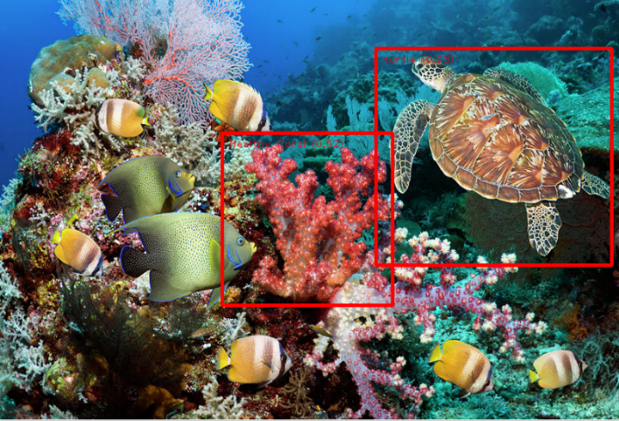
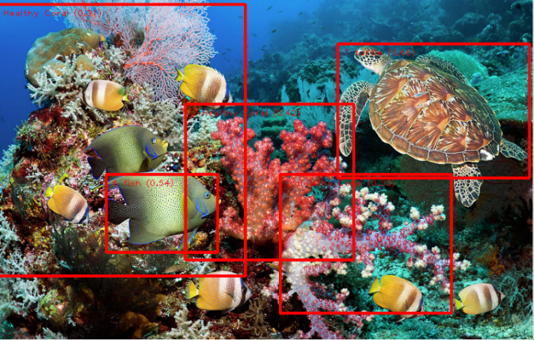
Example of Image Analysis
MobileNet identified more objects though with less precision
EfficientDet has a higher precision though identifies less objects in the same image
EfficientDet
MobileNet
MobileNet identified more objects though with less accuracy compared to EfficientDet
Coral image taken by Georgette Douwma: https://photos.com/featured/green-sea-turtle-over-coral-reef-georgette-douwma.html
Notes:
Efficientdet turte=.93 and healthy coral is .52
Mobilenet turtle .66, healthy coral=.42, .33,.31, fish .54,

Slide 21
Summary
Tasks Completed:
Implemented a digital video recording application
Implemented hardware user interface
Implemented object recognition AI system:
Compared YOLO, EfficientDet and MobileNet
Applied transfer learning to EfficientDet and MobileNet
Evaluated models using cross validation
Selected MobileNet based on results on comparison study
EfficientDet model also available for use
Documented work for end users

Slide 22
Questions?

