Slide 1
Life Stories
in a Cultural Village
Educational Exhibit
Brianna Courteau, Xandria Korn,
Thomas Scaplen, Jessica Walsh
12/12/2017
Sponsored by the Centre for Education and Research in Environmental Strategies
http://www.morelandfoodgardensnetwork.org/p/community-gardens_21.html
Notes:
Xandria’s Slide
We are a group of students from Worcester Polytechnic Institute. I’m------------ . For the past 7 weeks we have been working in Australia with CERES to complete our project life stories in a cultural village educational exhibit and today we have a 25 minute presentation to share what we have accomplished.

Slide 2
We acknowledge the Wurundjeri People of the Kulin Nation as the Traditional Custodians of this land.
https://pixabay.com/en/aboriginal-flag-australia-158372/
Notes:
Xandria

Slide 3
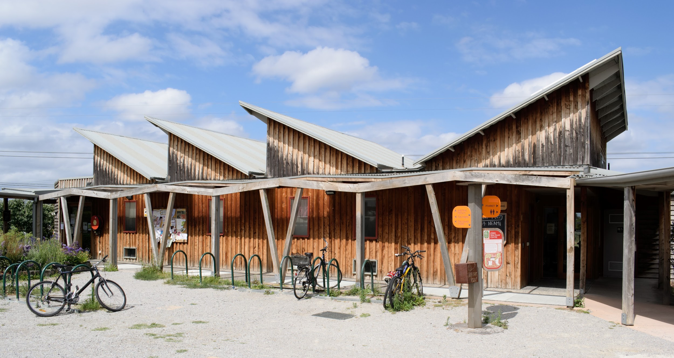
We will begin with a brief introduction to CERES...
Notes:
Xandria

Slide 4
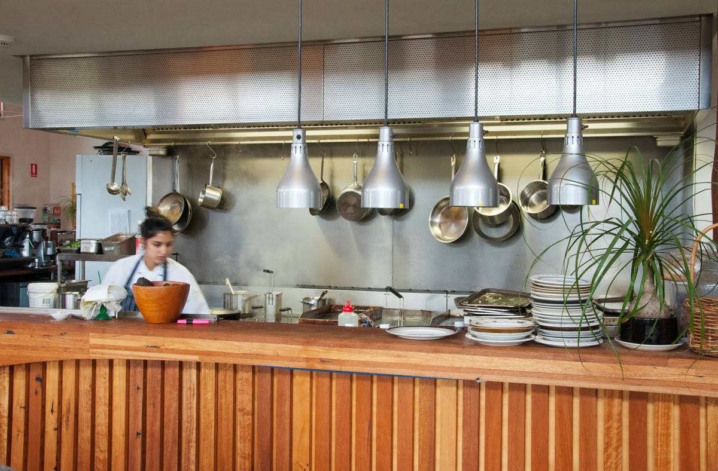
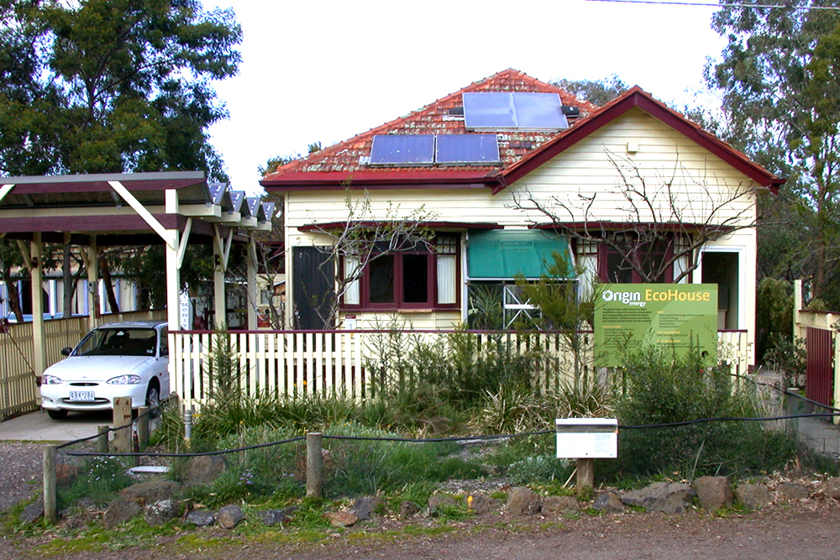
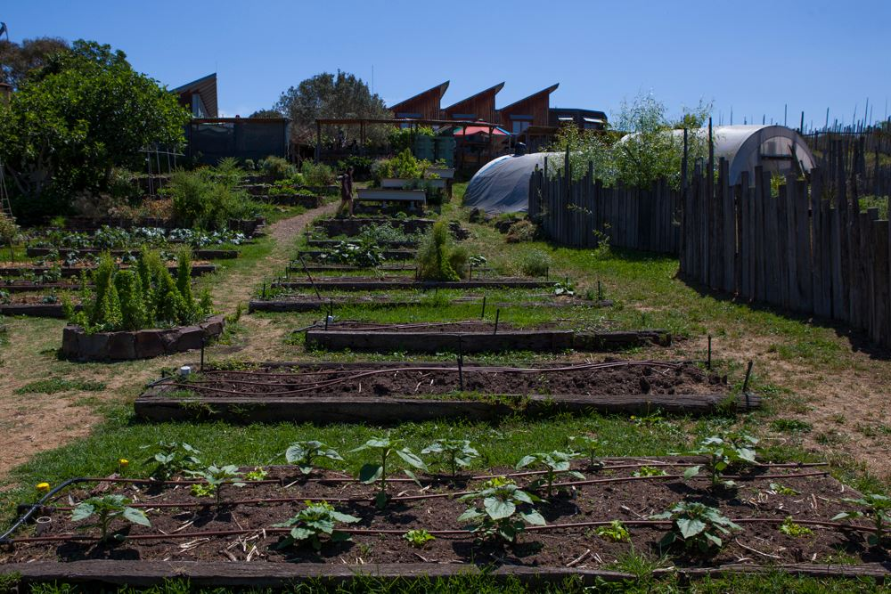
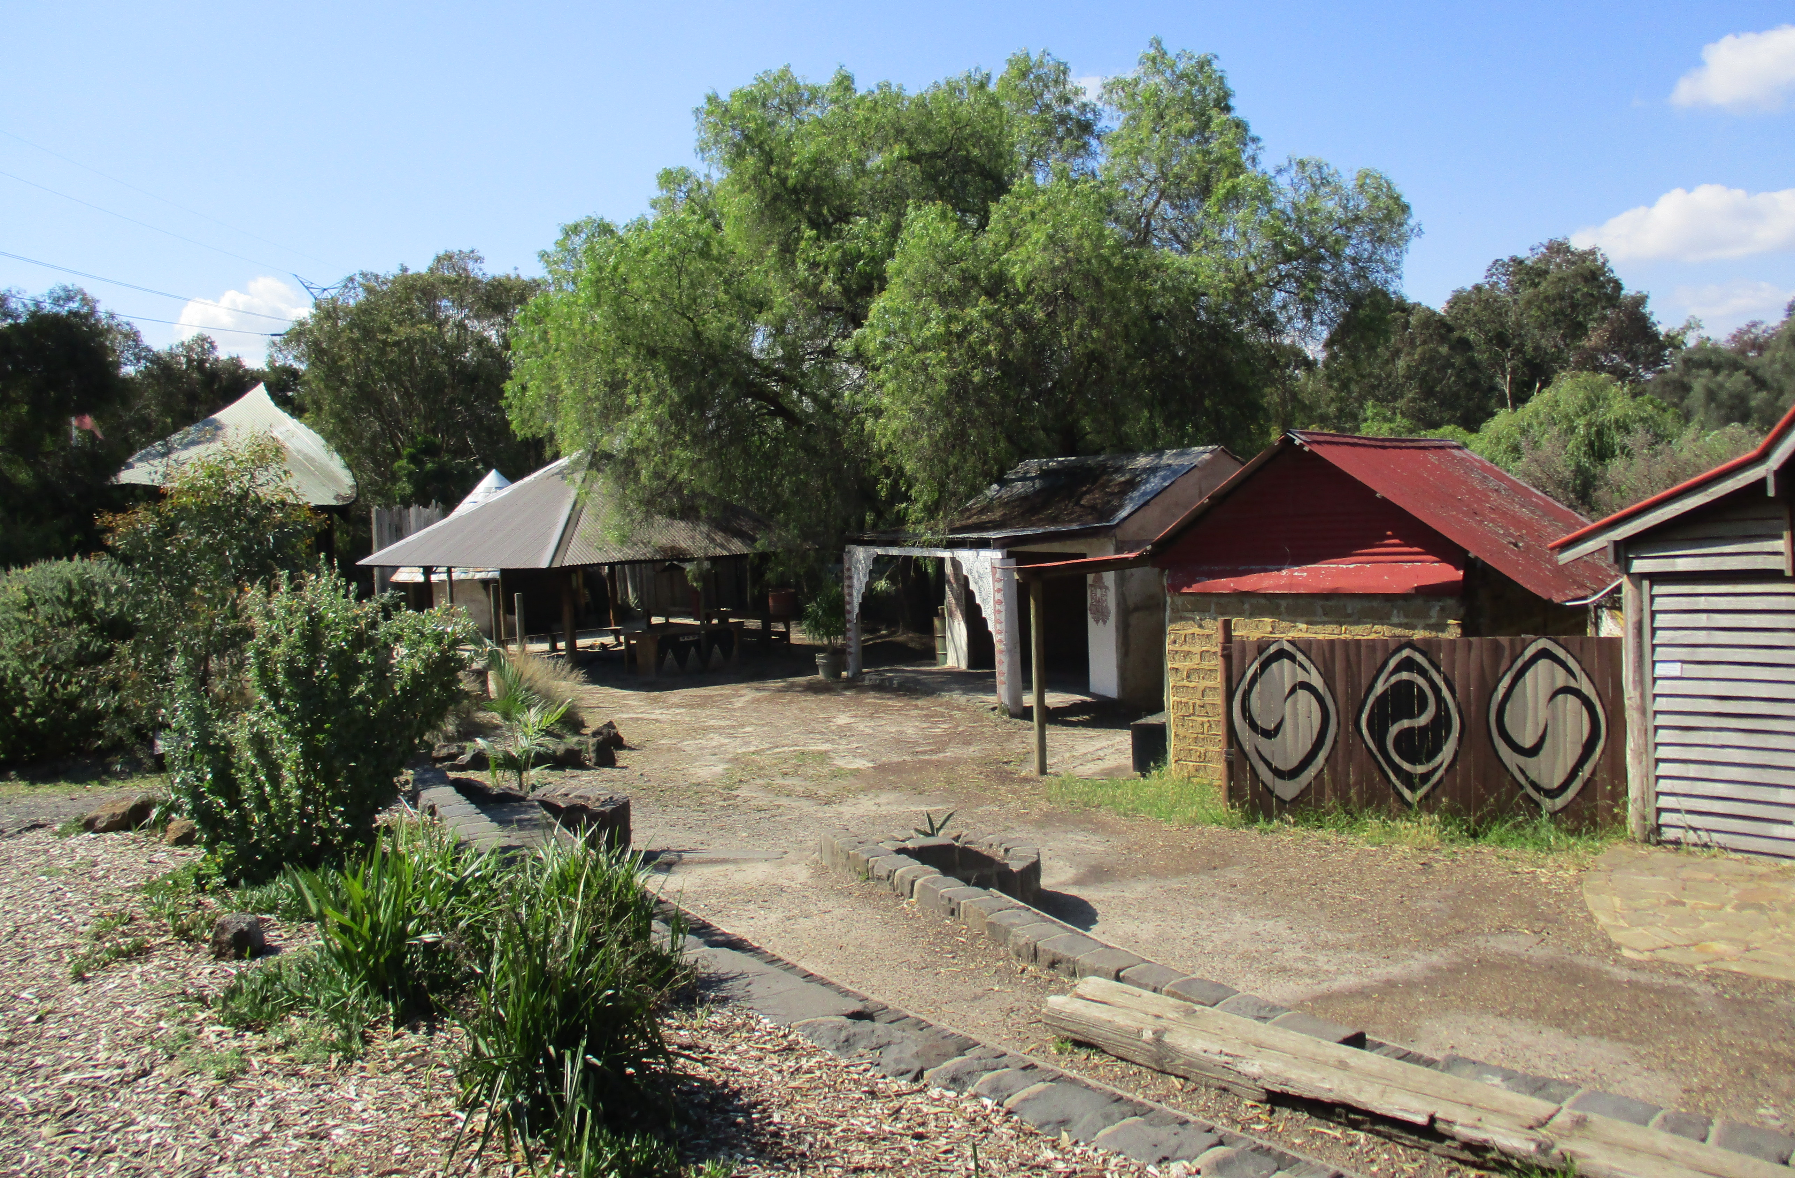
CERES unites communities by sharing economic, social, and environmental issues and solutions.
Education
Social Enterprise
Village
Farm
Notes:
Brianna’s Slide
For those of you who are not familiar with CERES. CERES is a community environment park that *read the assertion* To do this, the park is split into four precincts: social enterprise, farm, education, and village. Social enterprise consists of the Merri Table Cafe and organic grocery. The goods for these two places come from the organic garden and bee farm, which are in the farm precinct. The education precinct includes an eco-house, and a model dam. The village precinct focuses on Aboriginal and Torres Strait Islander, Indian, African, and Indonesian. Past IQPs have developed activities in the African and Indonesian villages, CERES wants to further connect their mission of environmental sustainability with the cultural villages and feels that there is a need to include a personal aspect, which will be the sharing the narratives of life in Indonesia.

Slide 5
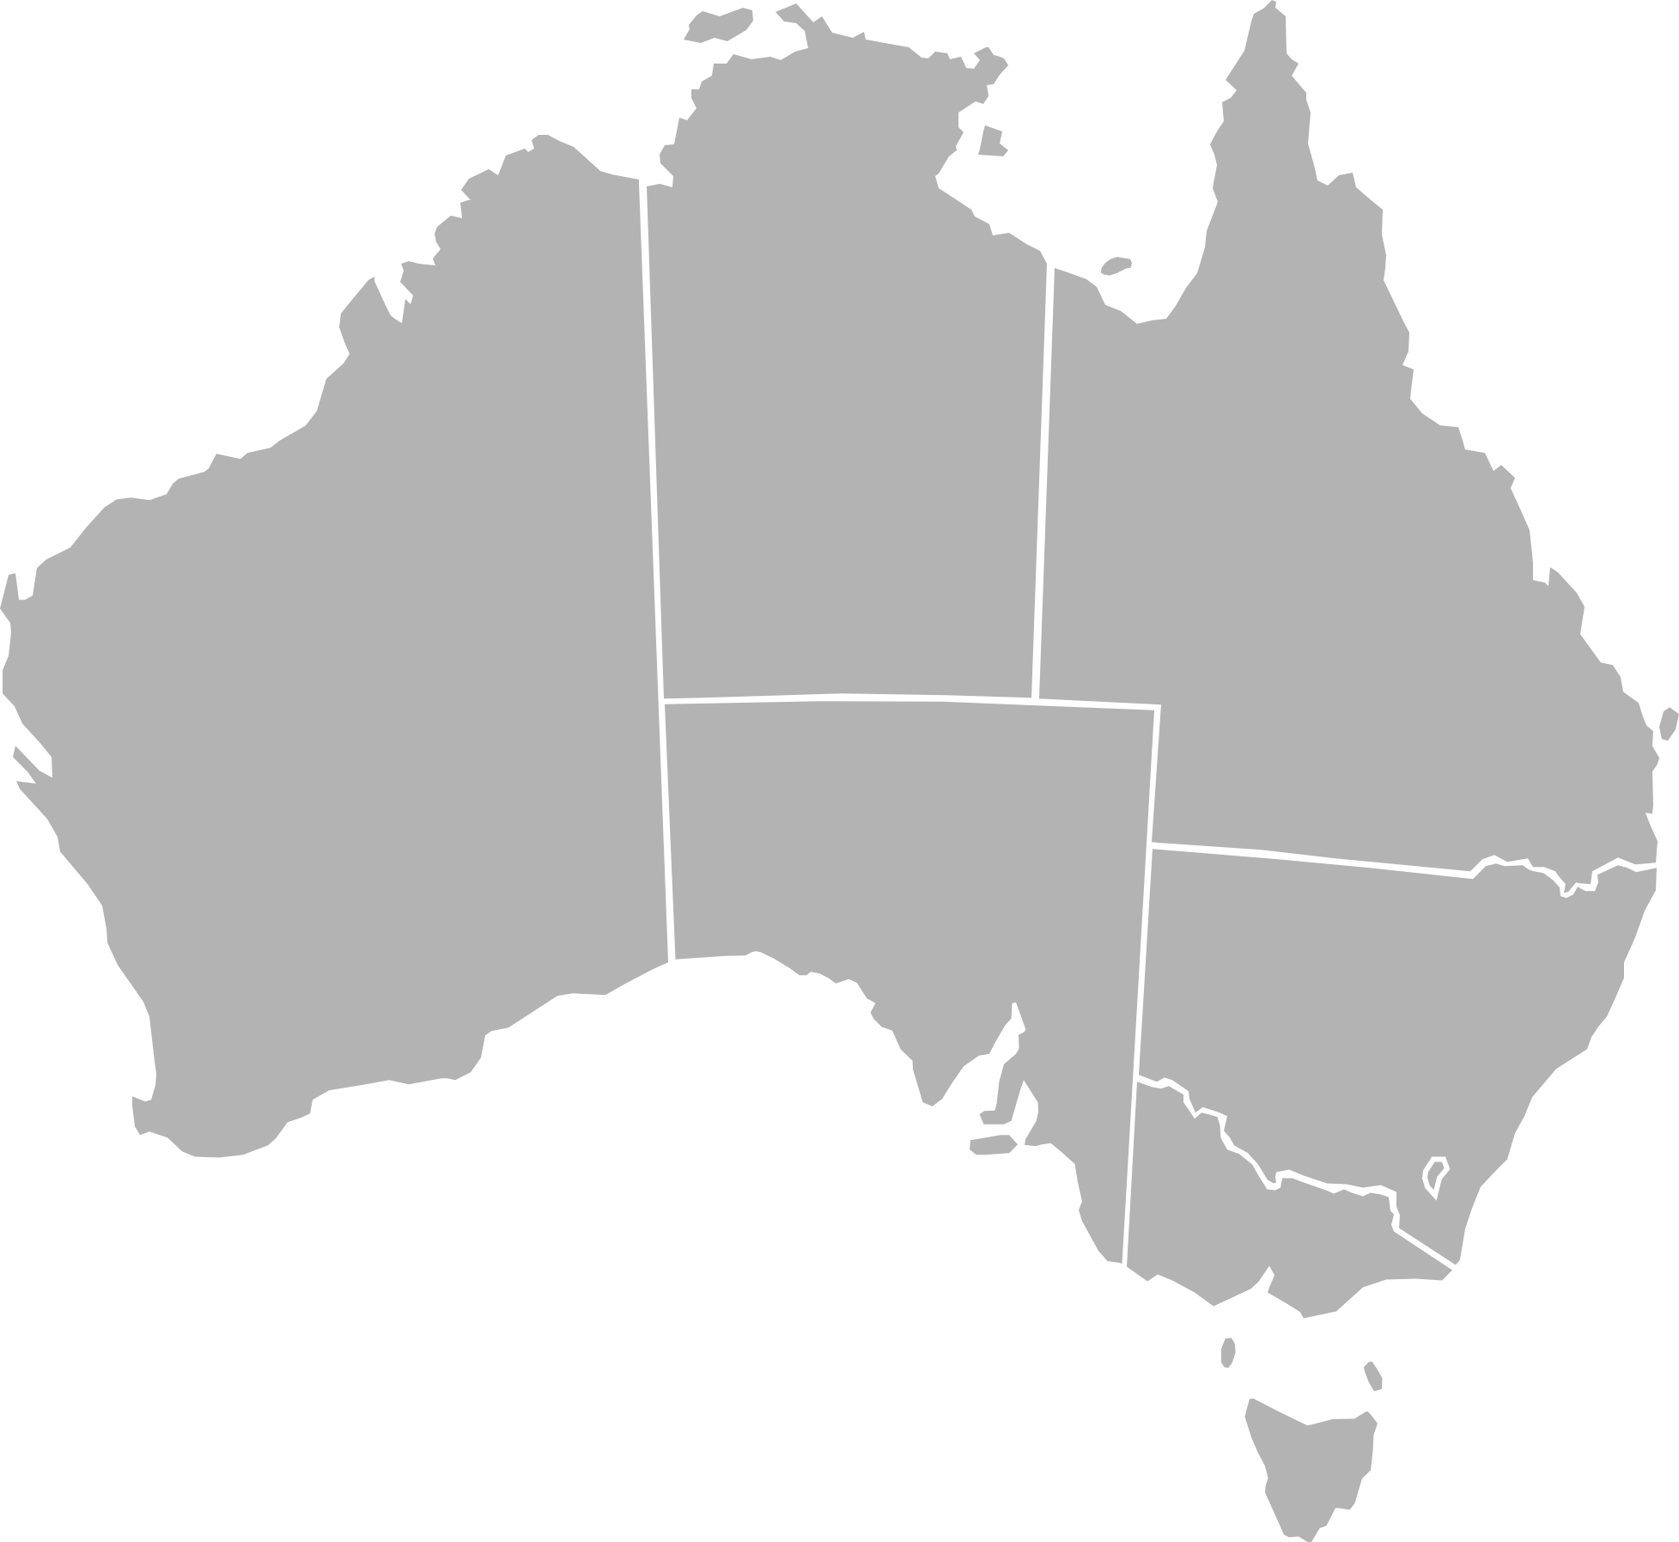
Goal
Produce videos of personal narratives from individuals of Indonesian origin to enhance the Indonesian cultural village exhibit at CERES.
Objectives
Conduct a baseline site assessment to understand the current education programs at CERES
Identify and evaluate best practices for designing an effective exhibit
Elicit and record authentic narratives from Indonesian community members which reflect the environmental issues they have experienced in Indonesia
http://jdsupra-videos.s3.amazonaws.com/f8f2e69d-c4a3-4ffd-a3c8-a568b751ed65_0000.png
https://pixabay.com/p-147292/?no_redirect
https://pixabay.com/p-152746/?no_redirect
https://upload.wikimedia.org/wikipedia/commons/c/c2/Australia_states_blank.svg
Notes:
Thomas:
Our goal was to produce videos of personal narratives from individuals of Indonesian origin to enhance the Indonesian cultural village exhibit at CERES. To accomplish our goal, we have conducted a baseline assessment to understand the current education program at CERES, evaluated best practices for designing an effective exhibit, and recorded personal narratives from Indonesian community members which reflect the environmental issues they have experienced in Indonesia.

Slide 6
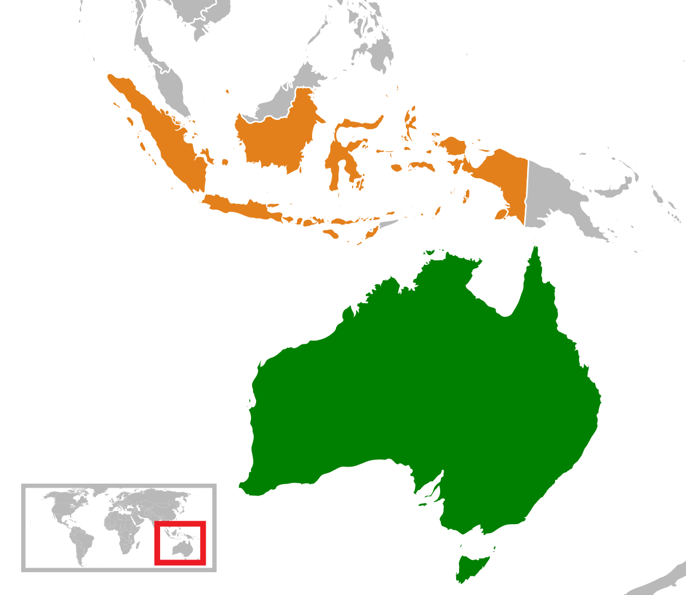
Australia is a popular choice for immigration and studies.
https://pixabay.com/en/australia-continent-gray-silhouette-306393/
6
https://en.wikipedia.org/wiki/Australia%E2%80%93Indonesia_relations
Notes:
Jess’ Slide
-2011 census found that just under half population id as immigrants or children of immigrants
-more than 80,000 of this population id as indonesian
-we will be focusing on indonesian overseas students for this project-> has been found that about a quarter of indonesian students who choose to study abroad have chosen australia
-indonesia fifth largest provider of overseas students to aus

Slide 7
Environmental Issues in Indonesia

Slide 8
Water Access
80% without access to potable water
40% forced to find new source of water
https://www.wearewater.org/images/280633/image_gallery_close_up.jpg
Notes:
*read assertion*
Water access -Xandria
Water access is an issues and as recent as in 2008 it was found that 80% of the Indonesian population were without clean water supplied to their house. Droughts have a great impact on Indonesia’s water access. The severe drought of 1997 for example killed more than 600 people in indonesia.

Slide 9
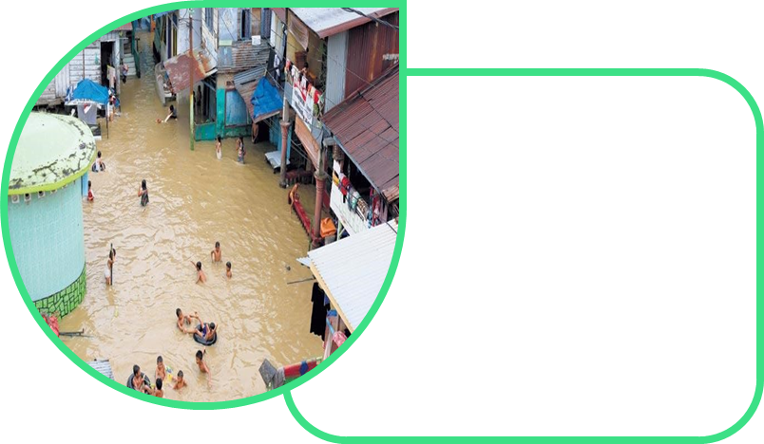
Flooding
January 2013
Major Flood damaged
120 villages
98,000 houses
http://harian.analisadaily.com/headline/news/banjir-rendam-ribuan-rumah-kim-lumpuh/193386/2015/12/01http://harian.analisadaily.com/headline/news/banjir-rendam-ribuan-rumah-kim-lumpuh/193386/2015/12/01
Notes:
Flooding -Brianna
Indonesia experiences a wet and dry season
The Wet season is sept to march
Monsoons are common during the wet season and cause flooding of homes and streets.
In 2016 a flood killed 13 and destroyed many homes, but the as seen in the picture the people keep their spirits high

Slide 10
Industrialization
60% of farmers have unclear ownership of land
https://www.google.com/url?sa=i&rct=j&q=&esrc=s&source=images&cd=&cad=rja&uact=8&ved=0ahUKEwjLrYrehODXAhXIqJQKHd2FCbgQjRwIBw&url=http%3A%2F%2Fwww.onegreenplanet.org%2Fenvironment%2Ffamilies-in-indonesia-fighting-deforestation%2F&psig=AOvVaw3AK9INAFd3fxysfuBLWO4S&ust=1511916120865793
Notes:
Industrialization -Jess
As a wave of industrialization appears to be overtaking indonesia, authorities are forcing farmers off of their land- replacing them with companies or big businesses. Considering that around 60% of farmers have unclear ownership of the land that their families have overseen for many generations, it is sadly fairly easy for larger authorities to push them off of their property. Many of the interviewees have spoken about the decrease in rice fields in their land due to industrialization

Slide 11
Deforestation
21st
3rd
In GHG Emissions
In GHG Emissions
https://www.google.com/url?sa=i&rct=j&q=&esrc=s&source=images&cd=&cad=rja&uact=8&ved=0ahUKEwjJq5mMk9bXAhXFI5QKHW3xAvMQjRwIBw&url=https%3A%2F%2Fnews.mongabay.com%2F2016%2F10%2F139-scientists-shoot-down-misleading-reports-from-malaysia-peat-congress%2F&psig=AOvVaw1wrBDzYo618ClRo9xziinC&ust=1511576403849408
Notes:
Peatlands -Jess
The tropical climate of Indonesia contributes to the formation of peatlands throughout the land. This ecosystem is essentially a biogenic deposit that consists of the partially decayed vegetation of the landscape. Large amounts of carbon are stored within the depths of this ecosystem. Poses a problem as the land has been cleared for big businesses and industrialization. 21st largest emitter of ghg to 3rd.

Slide 12
Palm Oil Production
35 Million Tons in 2016
68% GHG Emissions
https://guineandreams.wordpress.com/tag/african-oil-palm/
http://www.sfgate.com/opinion/brinkley/article/Palm-oil-proving-unhealthy-for-people-environment-5063474.php
Notes:
Palm Oil -Brianna
Palm oil is a type of vegetable oil and it is used in a wide variety of products ranging from cosmetics to food. Indonesia is the top producer of palm oil, producing 35 million tons of palm oil in 2016. Although palm oil is a big part of the vegetable oil industry, it has negative effects on the environment and animals. Burning of the forests for palm oil production accounted for 68% of Indonesia’s greenhouse gas emissions in 2014. Every hour 400 acres of land is cleared across the globe for palm oil production.

Slide 13
Palm Oil Production
50,000 Orangutans died
90% habitat loss
since 1997
http://www.wwf.org.au/get-involved/win-a-trip-to-discover-wild-borneo
Notes:
Brianna
The clearing of land in Indonesia is leading to habitat loss for many animals. The orangutan of Borneo and Sumatra has lost 90% of its habitat and 50,000 of them have died in the past 20 years and are expected to become extinct in the next 10 years.

Slide 14
Mining
45% of rivers in South Kalimantan (3000 km of river length) affected by toxic pollution
Notes:
Mining - Thomas
The last environmental concern for Indonesia we will talk about comes from the mining industry. Environmental effects of mining include deforestation and pollution. About 45% of rivers in South Kalimantan are downstream from coal mines, and are polluted by the toxic wastewater.

Slide 15
Objectives and Methods

Slide 16
Conduct a baseline site assessment to understand the current education programs at CERES
Objective 1:

Slide 17
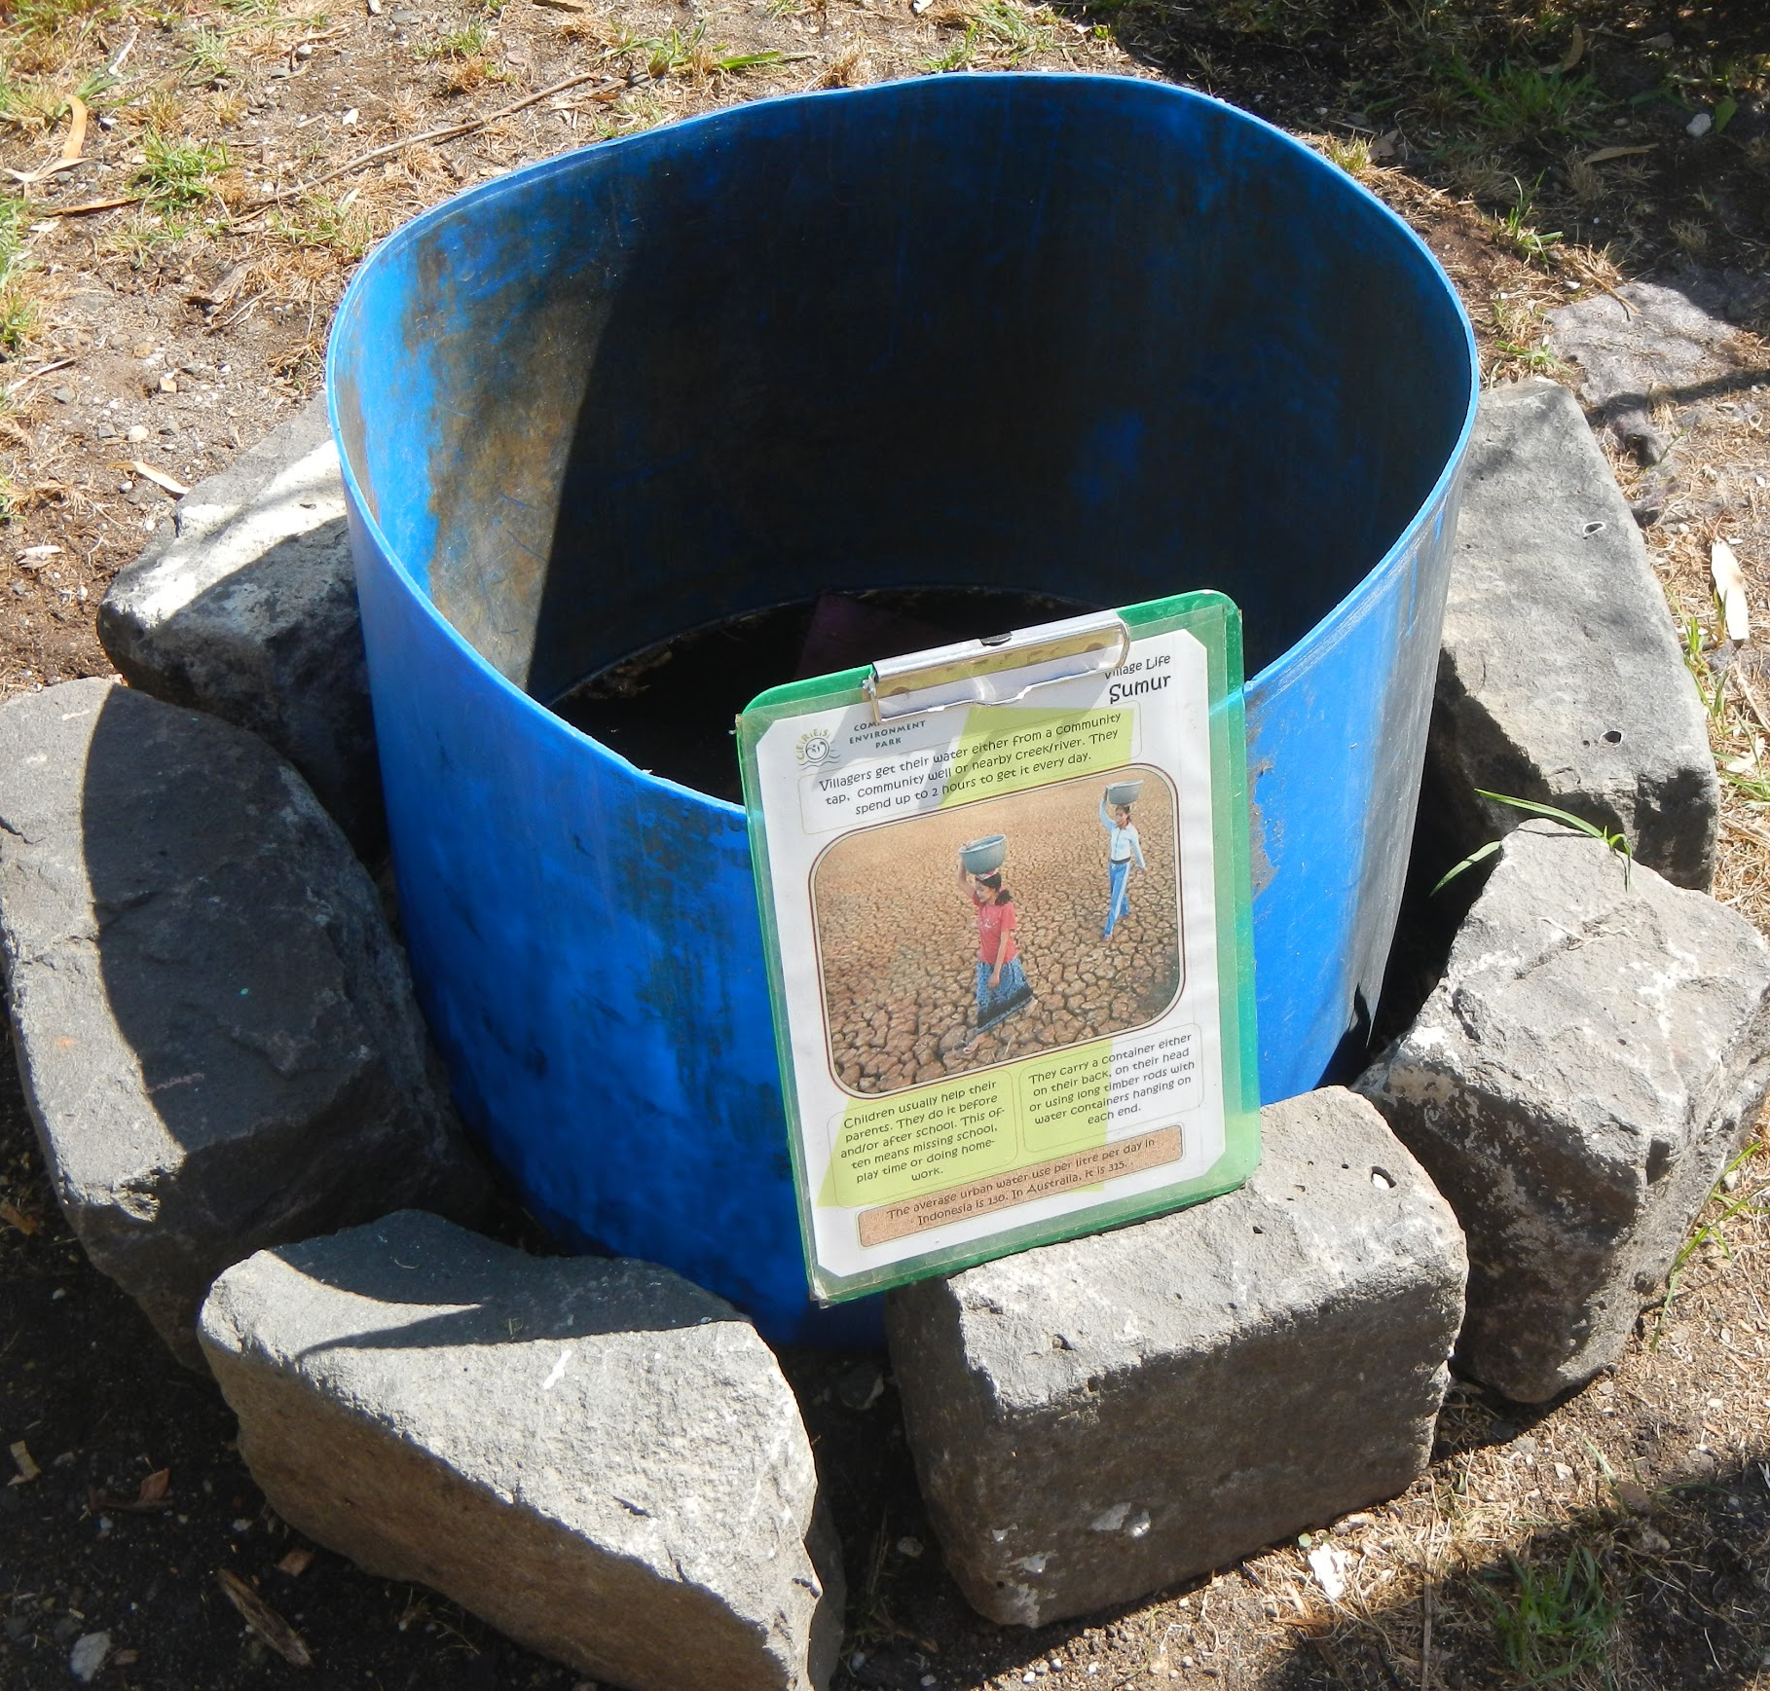
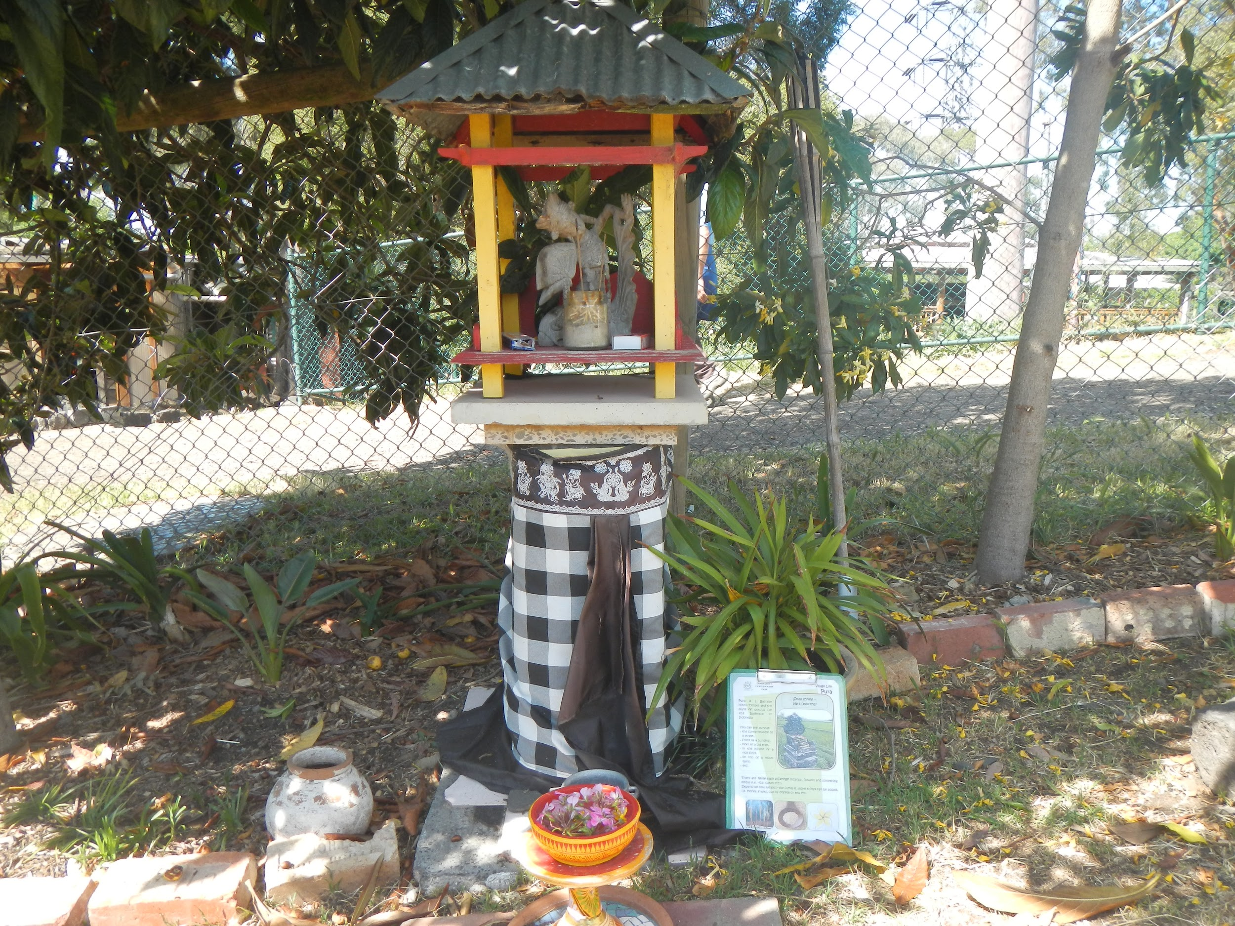
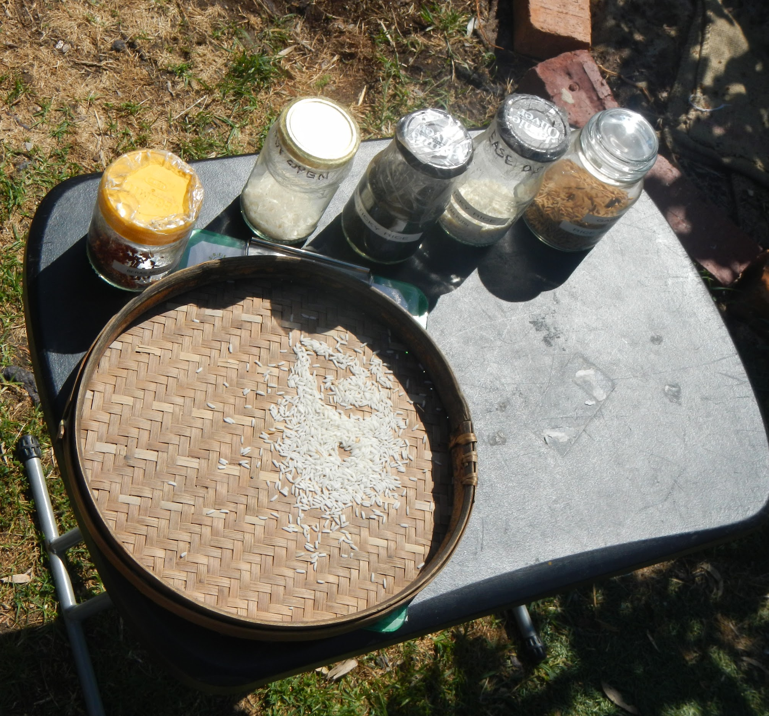
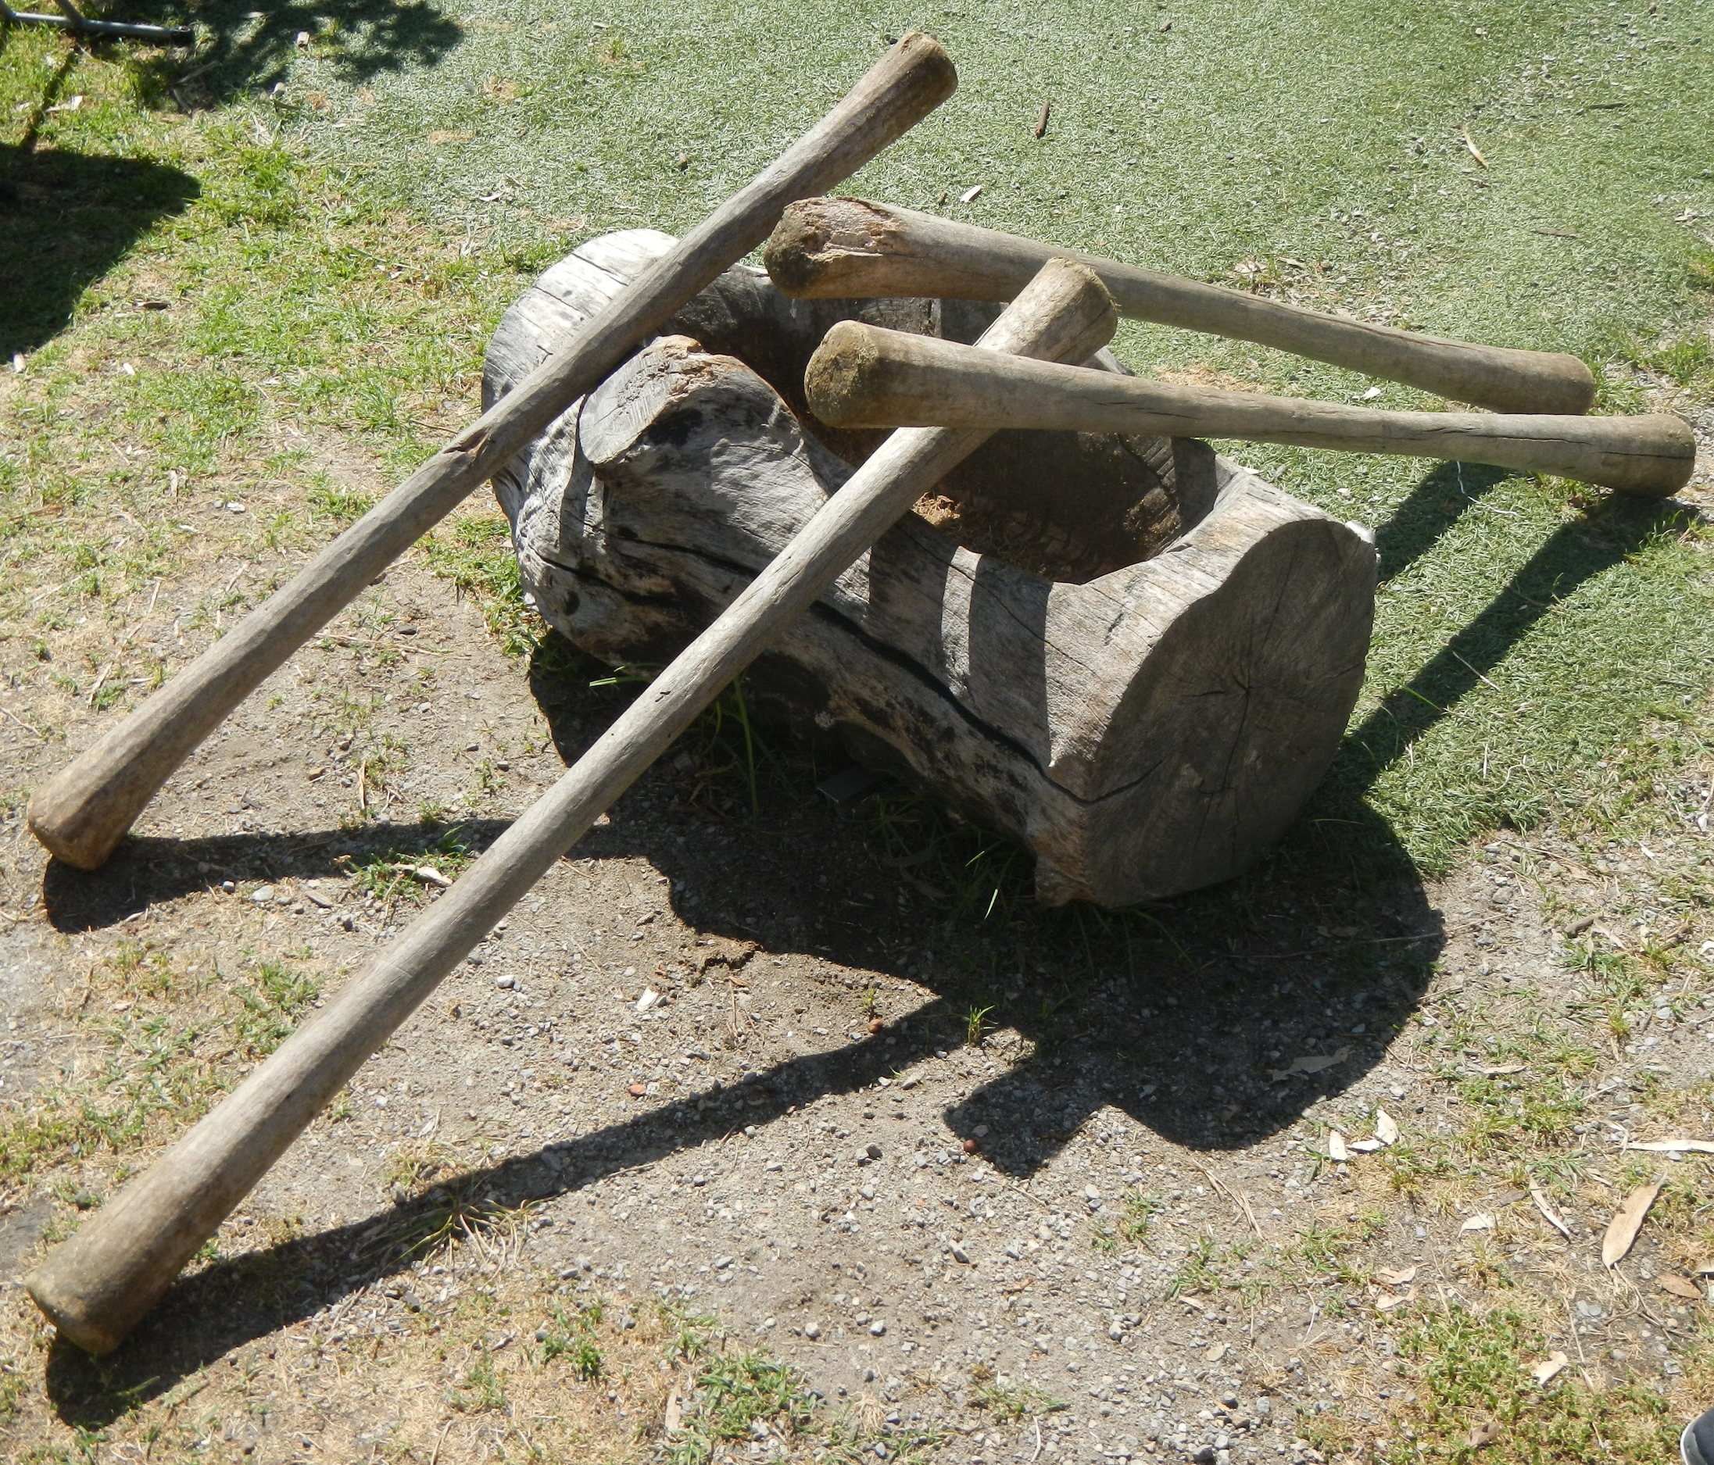
Observing the current education program gave us insight into the visitor experience.
17
Notes:
Brianna’s Slide
-we observed the Education Staff teach a class on energy sustainability within their eco-house
The class began by prompting the students to fill in a pie chart related to energy usage in Australian homes. They gave suggestions for the different pie chart categories, such as home appliances, heating and cooling, and standby. Then they split into groups and looked at different types of insulation and light bulbs. From observing this class, we learned that the teaching staff prefers to engage the students with interactive activities.
-observed cultural programs
In the African village, the instructor told the students about her village designs and builds their homes. The children were then able to stomp in the mud to make bricks similar to how the instructors village does. They also built a house that resembled the style of houses built in Kenyan villages.
In the Indonesian village, The instructor told the students the background about each of the activities being prayer, rice production, or batik and then the students were able to participate in each of the activities.
From observing the cultural village we noted that interactive activities are key to the CERES classes.

Slide 18
Identify and evaluate best practices for designing an effective exhibit
Objective 2:

Slide 19
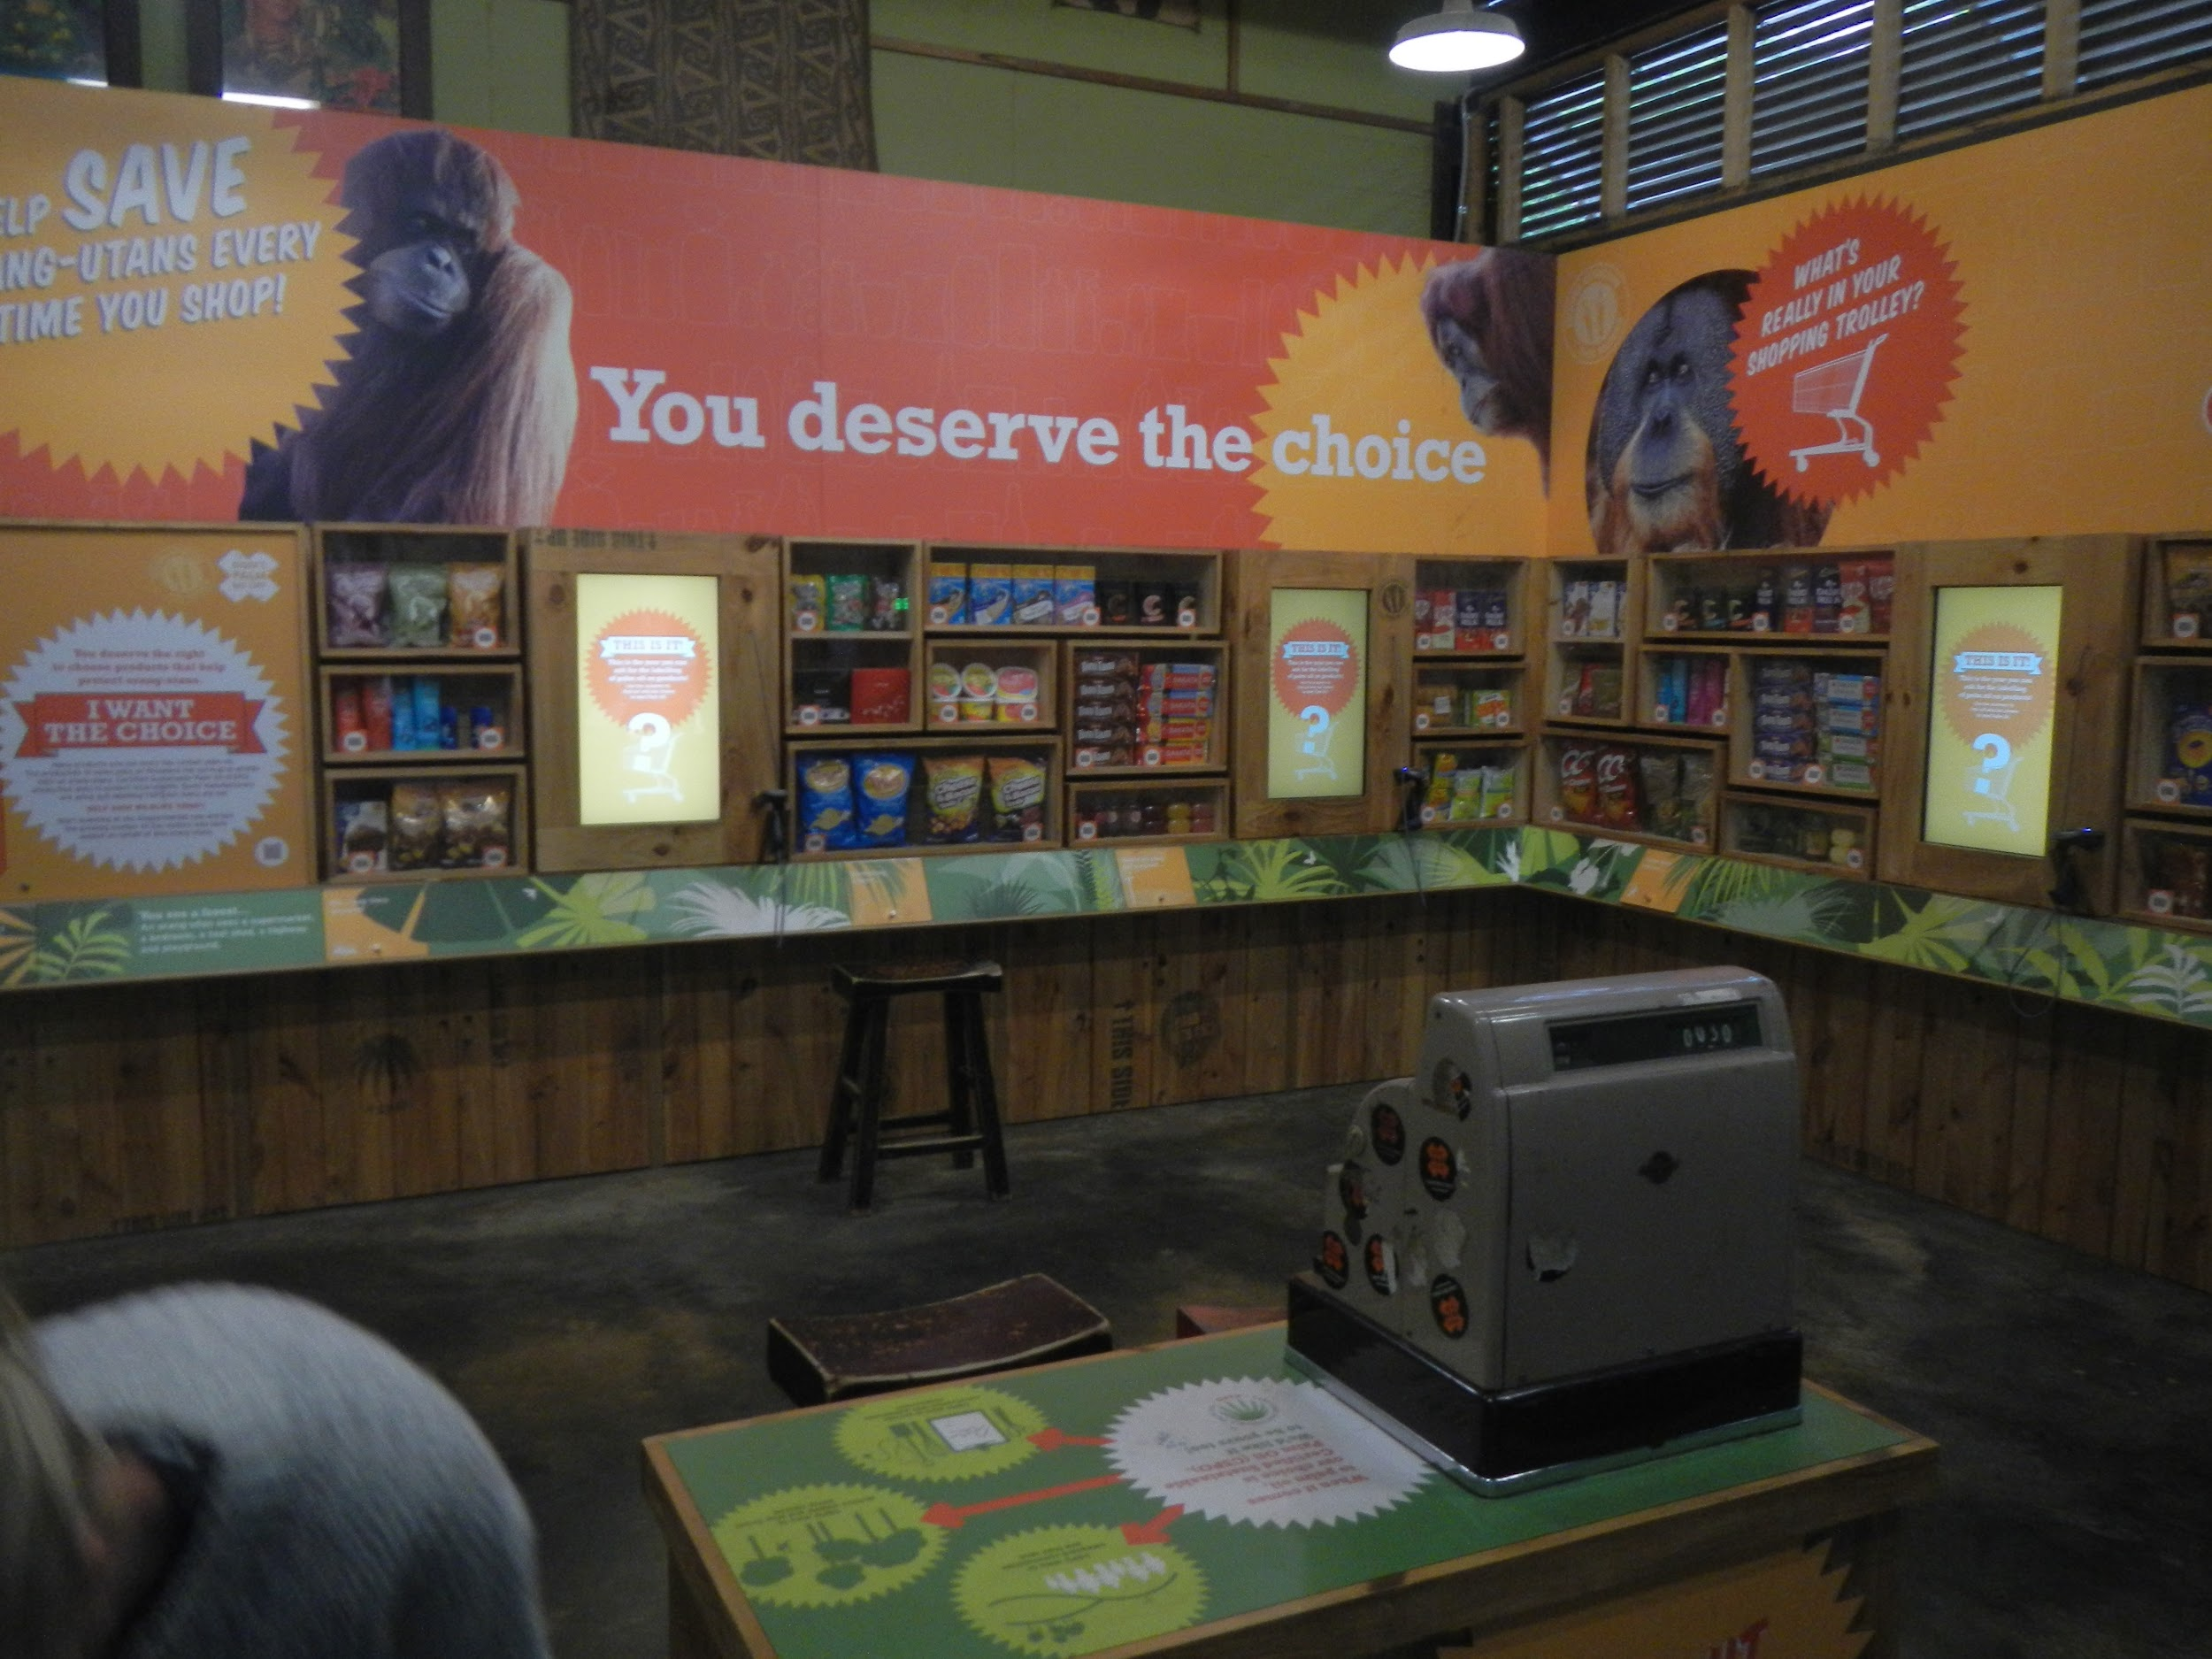
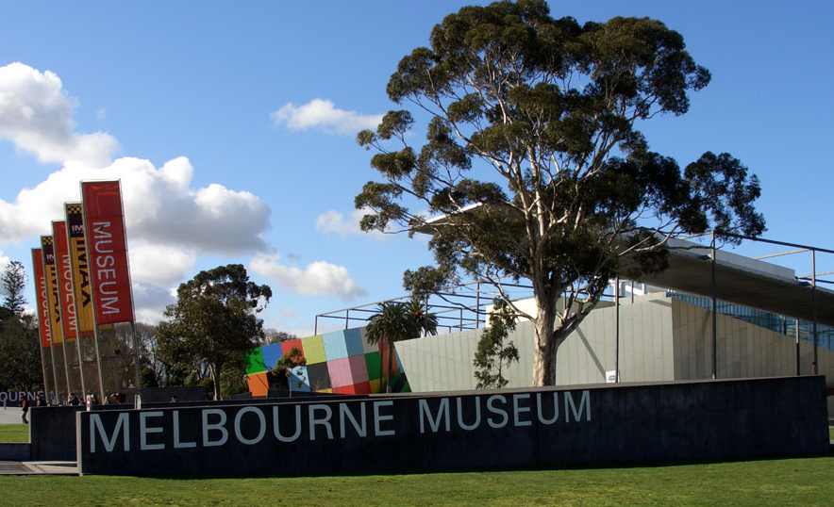
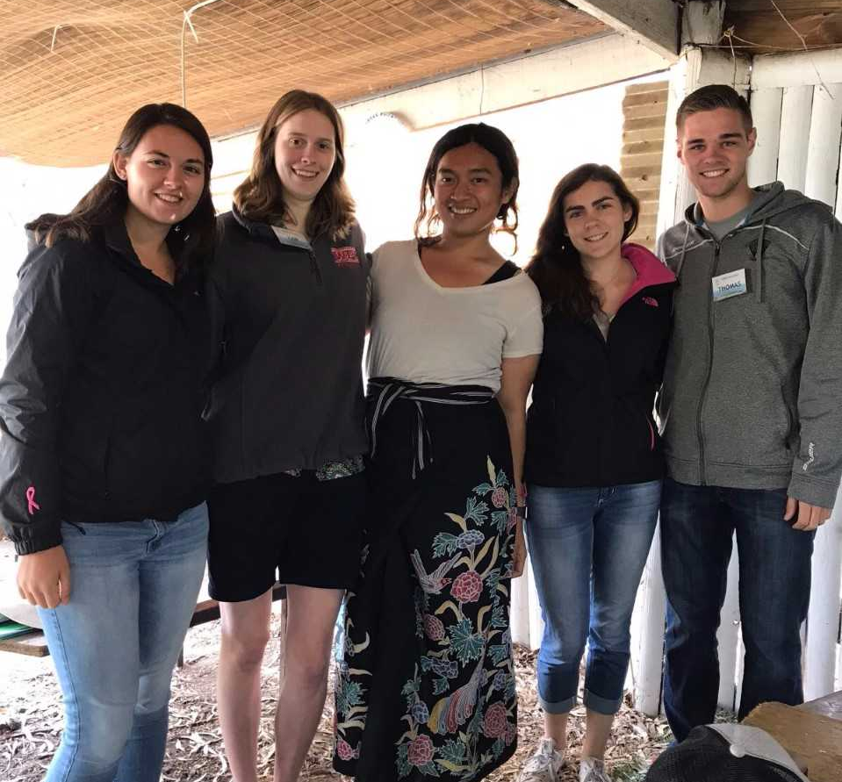
Best practice exhibits showed us how to engage our audience.
https://spiible.com/sites/default/files/gallery/MelMuseum.jpg
Palm Oil Campaign at Melbourne Zoo
Notes:
Jess
-Visited other exhibits in the Melbourne area, such as the Melbourne Zoo and Museums Victoria
-Participate completely in the exhibits
-Semi-structured interview the curators of the exhibits, Cyrelle at the zoo and Carolyn at the museum
-@ the zoo, we learned that their motto for exhibit design was to connect, understand, and act ->connect w animal, understand struggle facing, and act in a way beneficial to them. This was seen at the orangutan exhibit w palm oil.
-@ museum, difficult to make ppl download app, so include as much signage as possible, in addition to having staff provide personal communication advertising it. Possibly aim the advertisement of the app to children
-Spoke with individuals who are knowledgeable in teaching the Indonesian cultures
-Semi-structured interview with Tian, who is the Indonesian cultural teacher at CERES -> helped give an introduction to indonesian culture and introduce us to the indonesian community of Monash university. Taught us about Indonesian dance and the level of respect that exists in the culture regarding how they speak to their elders. Also gave us insight into how CERES has helped him to gain a better connection w his own culture. Upon this communication it was decided that Tian would be our first interviewee, with his friends at Monash following him,

Slide 20
Elicit and record authentic narratives from Indonesian community members which reflect the environmental issues they have experienced in Indonesia
Objective 3:

Slide 21
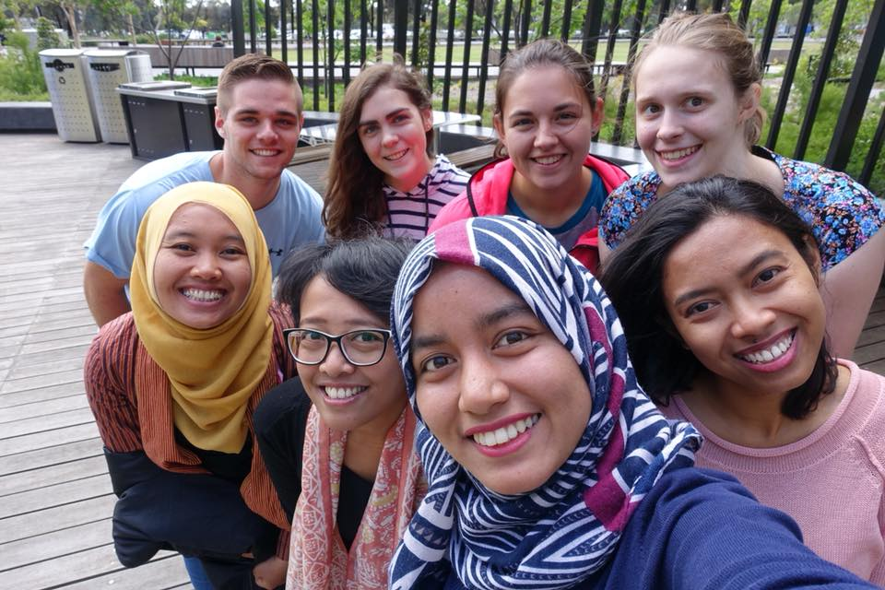
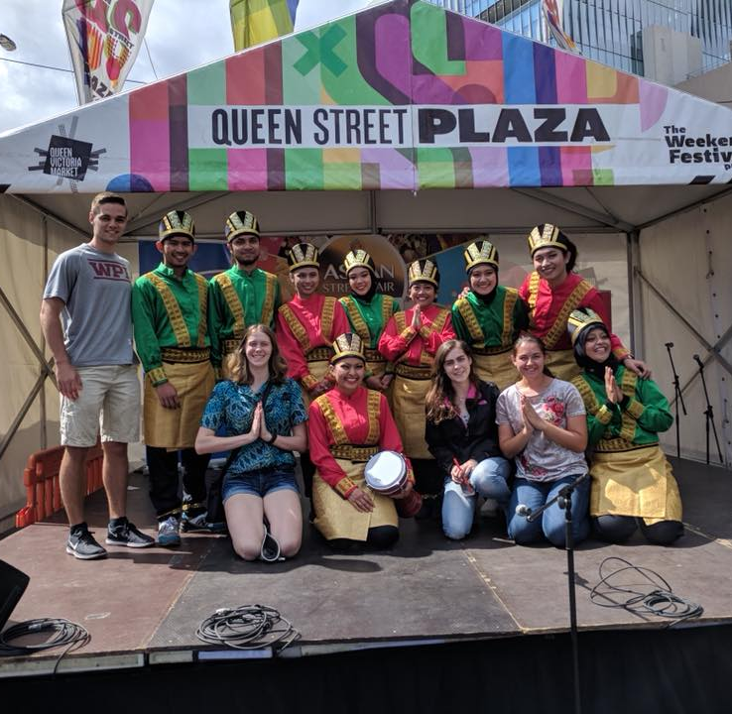
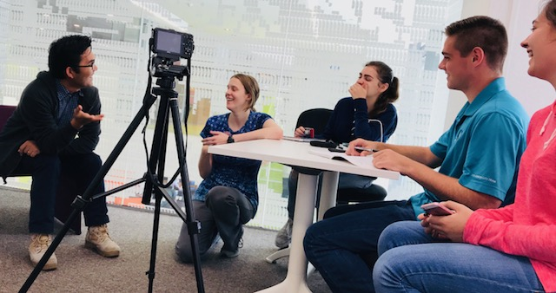
Narratives will provide visitors a better connected, immersive educational experience.
Bukowski, 2016
Notes:
Thomas
The narratives we collect will provide visitors with a better connected, immersive educational experience. To begin our search for interviewees, we used a roundtable discussion to introduce ourselves to some Indonesian students at Monash University who were interested in participating and inform them a little bit more about the intentions of our project. From there, we have conducted 19 individual interviews to collect our data, and have also interviewed an additional 3 people via email. In the interviews we started by asking general background questions such as their name, where they are from, and a little bit about their family. After that, we moved on to more focussed questions about their experiences with environmental issues. Every interview was videotaped from at least two angles and audio recorded so that educational videos could be created from them.

Slide 22
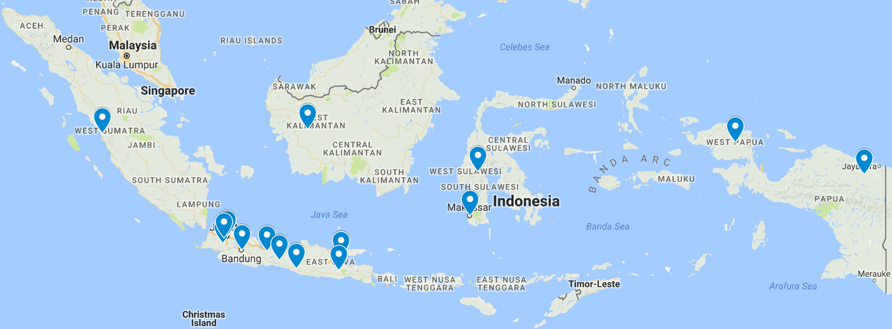
A geographically diverse group of Indonesian community members was interviewed.
Notes:
Thomas
A geographically diverse group of Indonesian community members was interviewed. However, we understand that 22 people is of course a small percentage of Indonesia’s population of about 242 million, and we do not want to generalize the country from these 22 participants. There are many islands, villages, cultures, and minority groups that are inevitably unrepresented in this study. With this in mind, our focus was to capture the stories of individuals from Indonesia and educate people about the environmental struggles they have faced.

Slide 23
Results

Slide 24
Coding the interview videos highlighted common environmental concerns in Indonesia.
Mining
Water Access
Industrialization
Flooding
Notes:
Xandria- *assertion* four of the most prevalent concerns were mining, flooding, industrialization, and water access.

Slide 25
Mining
6/22
https://www.google.com/url?sa=i&rct=j&q=&esrc=s&source=images&cd=&cad=rja&uact=8&ved=0ahUKEwi0u_q089_XAhUBkJQKHZWVCM4QjRwIBw&url=http%3A%2F%2Fclipart-library.com%2Fclipart%2F58063.htm&psig=AOvVaw2oF_JIqhMqoJB6Qh_Ysq54&ust=1511911440099577
Notes:
Xandria -
Mining
6 of our 22 participantes talked about the effects of mining. An email interview revealed that although mining causes deforestation some companies try to counteract the issue by replanting trees. Another interviewee, discussed how mining causes controversy: it is beneficial for money, but destroys the environment. Also, he mentioned that the mining companies marginalize the locals because the companies prefer to hire from other locations.

Slide 26
Flooding
8/22
https://www.google.com/url?sa=i&rct=j&q=&esrc=s&source=images&cd=&cad=rja&uact=8&ved=0ahUKEwjg25rz7d_XAhWIUbwKHW6pD0AQjRwIBw&url=http%3A%2F%2Fmoziru.com%2Fexplore%2FWave%2520clipart%2520art%2F&psig=AOvVaw3gyKzL6r0qIunfr6U4CS-G&ust=1511910002427998
Notes:
Brianna
Flooding
We found during the interviews that flooding in very common and is seen as an expected event. 8 out of our 22 participants either experienced floods or had family who experienced floods regularly. Several of the participants said that the floods are more sever now and harder to predict as the rainy and dry season are starting to meld.

Slide 27
Industrialization
15/22
https://www.google.com/url?sa=i&rct=j&q=&esrc=s&source=images&cd=&cad=rja&uact=8&ved=0ahUKEwi4i5SS8d_XAhXDmZQKHaGEBWIQjRwIBw&url=https%3A%2F%2Fwww.clker.com%2Fclipart-buildings-blue-tower-1.html&psig=AOvVaw3FjdLyFOwqh0yVGsAELVok&ust=1511910679132149
Notes:
Thomas - Industrialization
Industrialization is an environmental problem that was more frequently discussed. 15/22 Interviewees talked about industrialization during the interviews and it’s affect on where they live in indonesia. The concerns of participants included the loss of rice fields and other public spaces, the development of corporations and housing, an increase in motor vehicle usage, a decrease in air quality, and a refocus on technology

Slide 28
Water Access
15/22
https://www.google.com/url?sa=i&rct=j&q=&esrc=s&source=images&cd=&cad=rja&uact=8&ved=0ahUKEwizoO_n7N_XAhWHFJQKHeb7CjUQjRwIBw&url=http%3A%2F%2Fclipartbarn.com%2Fwater-drop-clipart_7103%2F&psig=AOvVaw2GK8vI_slI79MlmeN7EQ_u&ust=1511909729794705
Notes:
Jess- Water access
Out of the 22 interview participants, 15 have had trouble obtaining potable water in their villages or cities in Indonesia. Pollution and poor recycling programs contribute to the lack of sanitation in accessible water sources. In order to eliminate some pollutants, the participants spoke of the use of homemade filters and boiling water. The remaining seven participants claimed that clean water is easily accessible where they lived in the mountainous regions of Indonesia because of the fresh runoff water from the springs.

Slide 29
Flooding Video
Notes:
Xandria - From this we have created 3 two minute videos. The topics of the videos are water access, flooding, and industrialization. These short videos will be put on the CERES chook app. The video we will be showing today is the water access (show video)

Slide 30
Recommendations

Slide 31
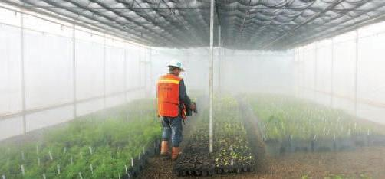
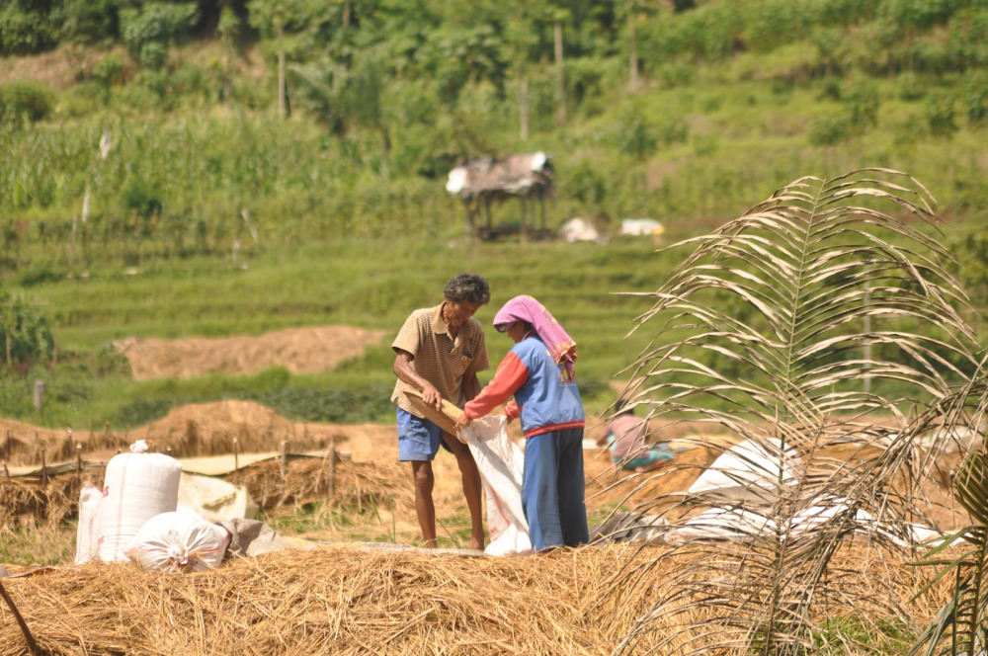
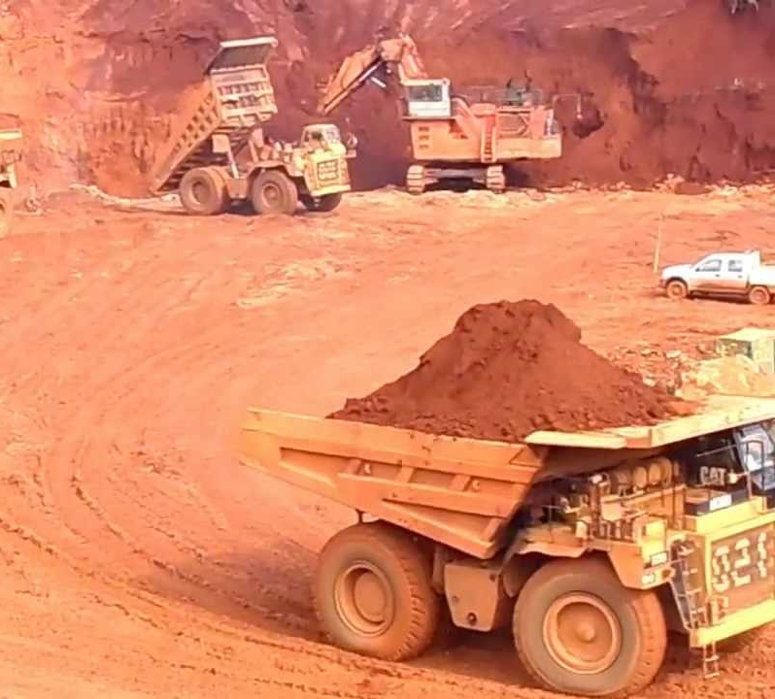
CERES should create more videos for their Chook app.
Photos courtesy of Kalvin
Notes:
Brianna
we recommend that videos be produced for the environmental topics that we did not have time to make. This includes mining, weather changes, pollution, and agricultural. To increase the effectiveness of the environmental videos, CERES staff should obtain footage of the environmental issues in Indonesia. This footage could have an impact on the visitors and cause them to be more inclined to help in the efforts to improve these conditions in Indonesia. We also recommend that the CERES staff create videos to promote Indonesian culture such as traditional dance, religion, and community.

Slide 32
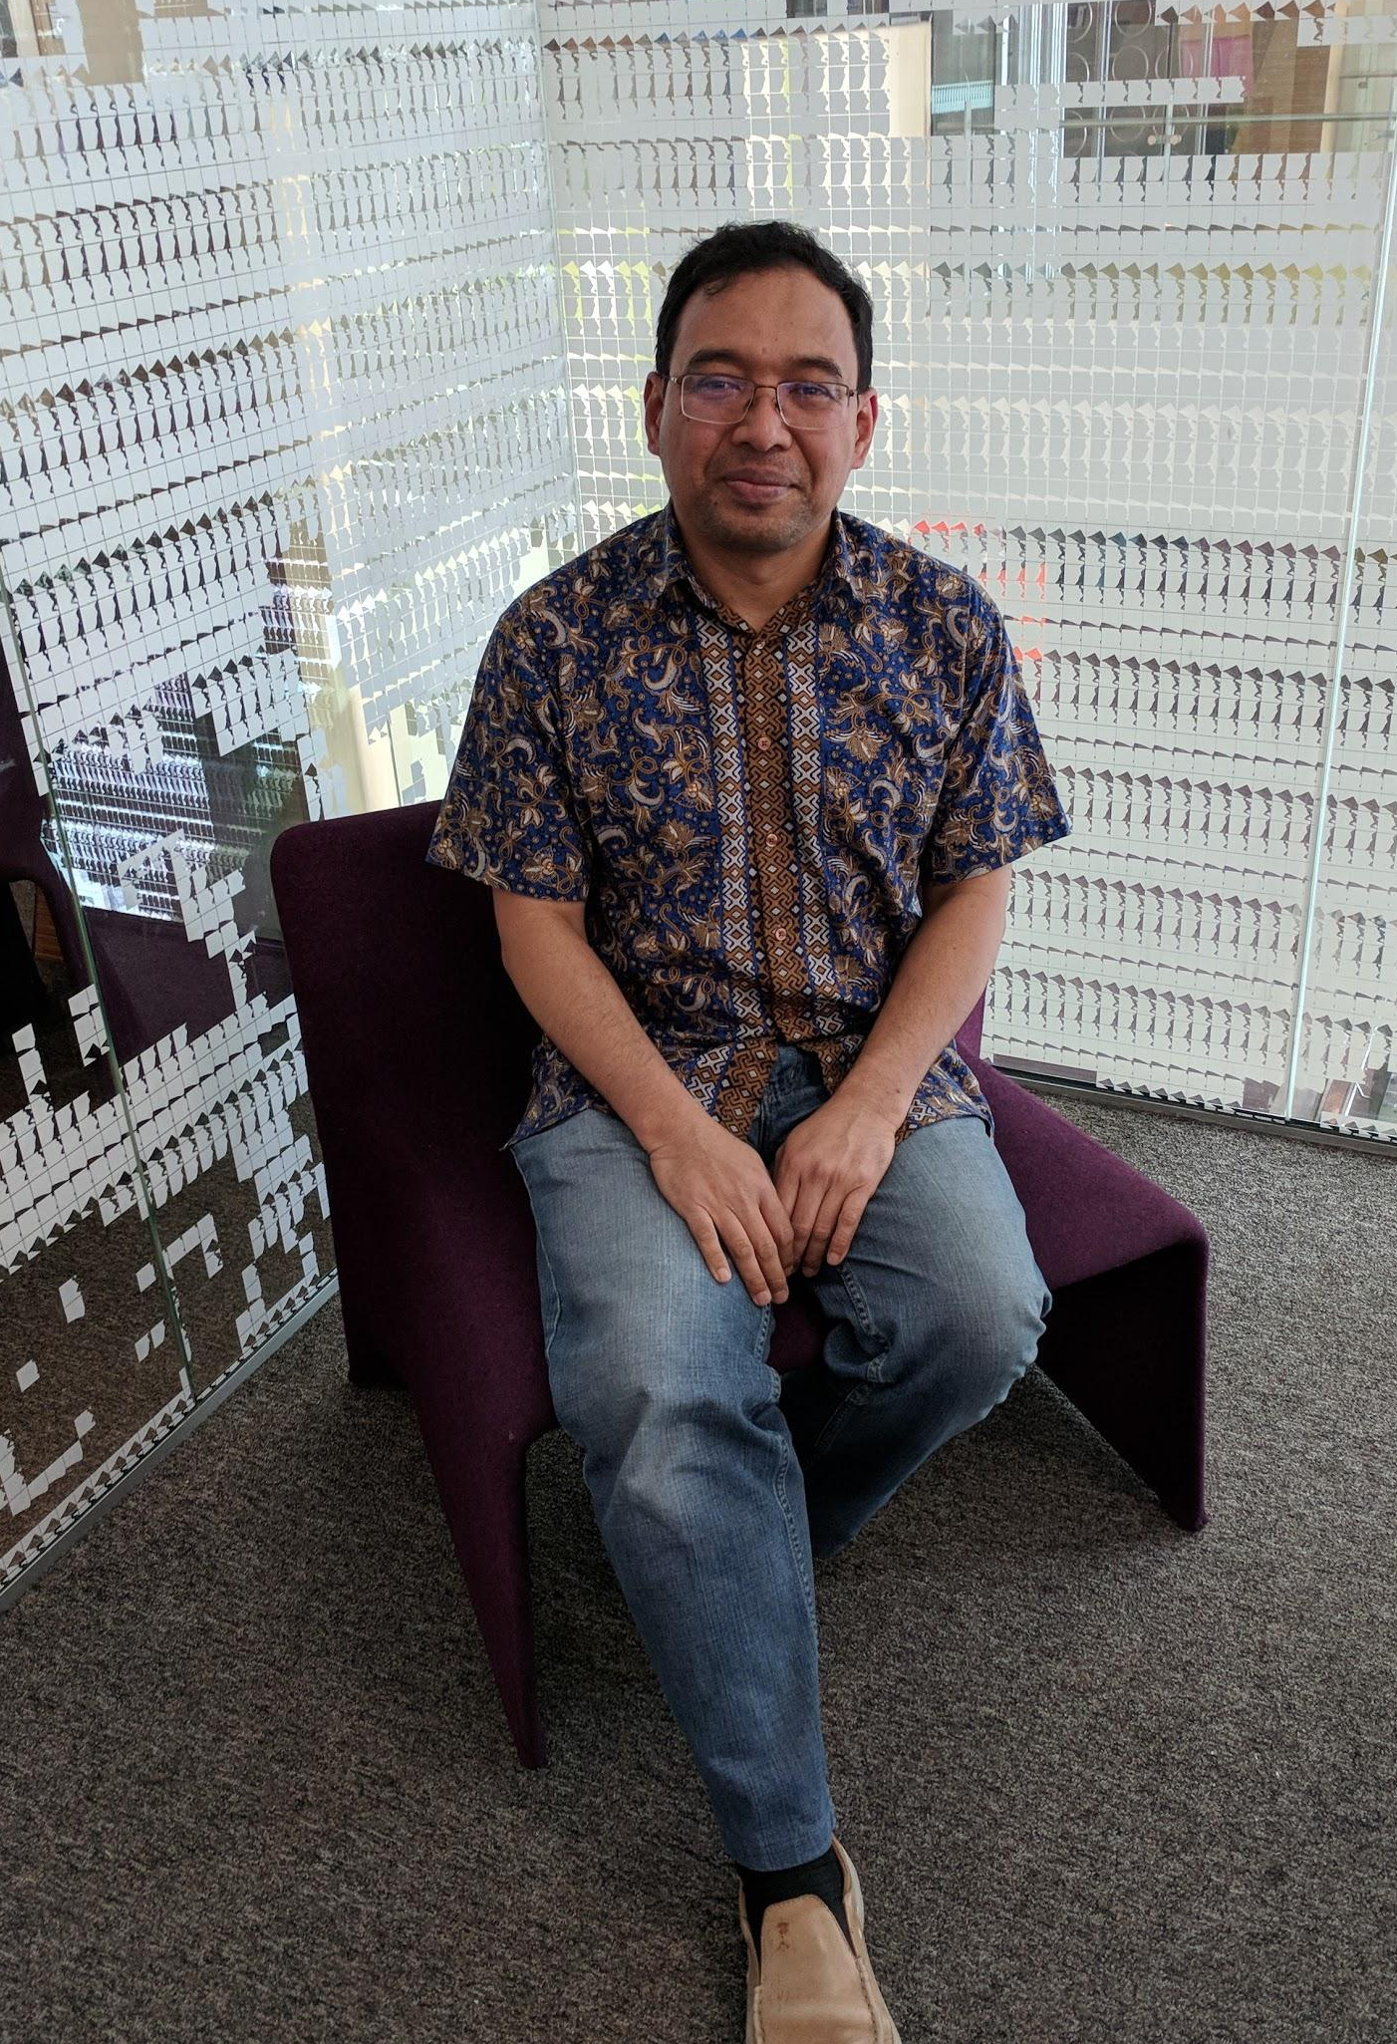
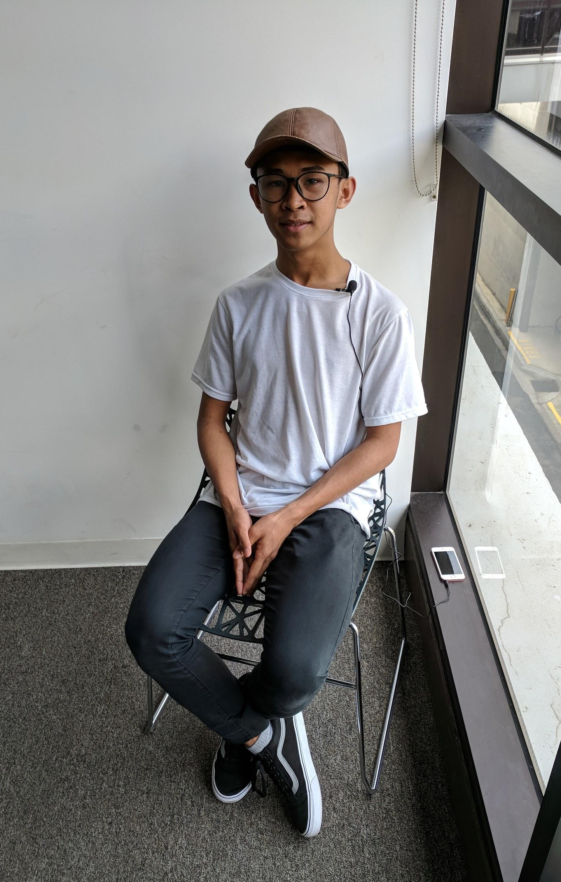
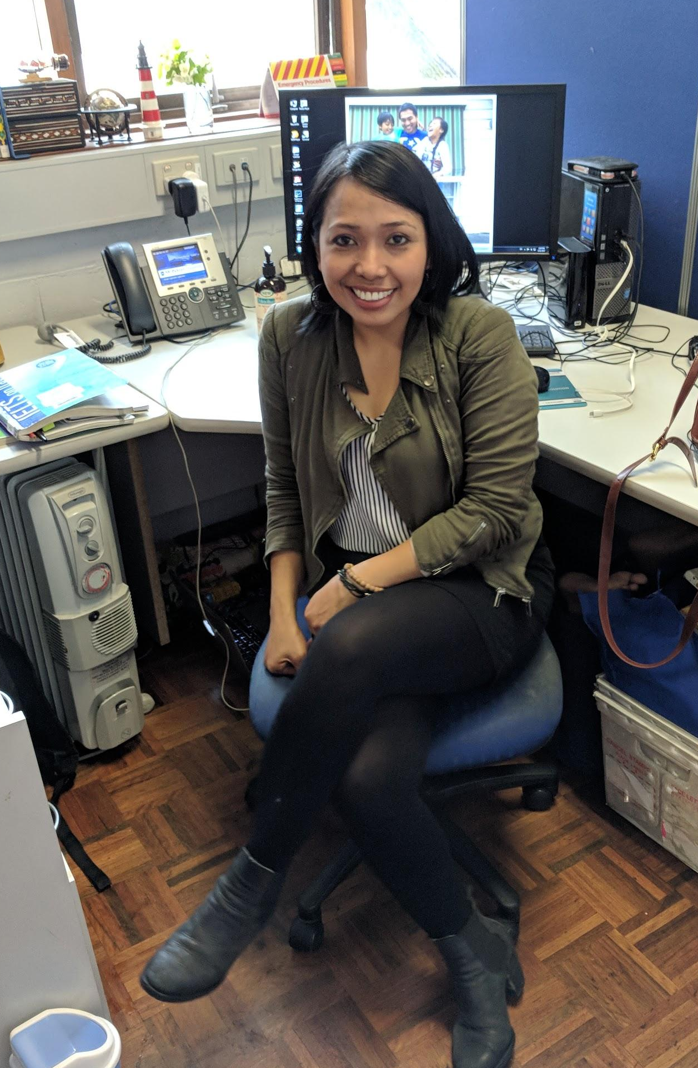
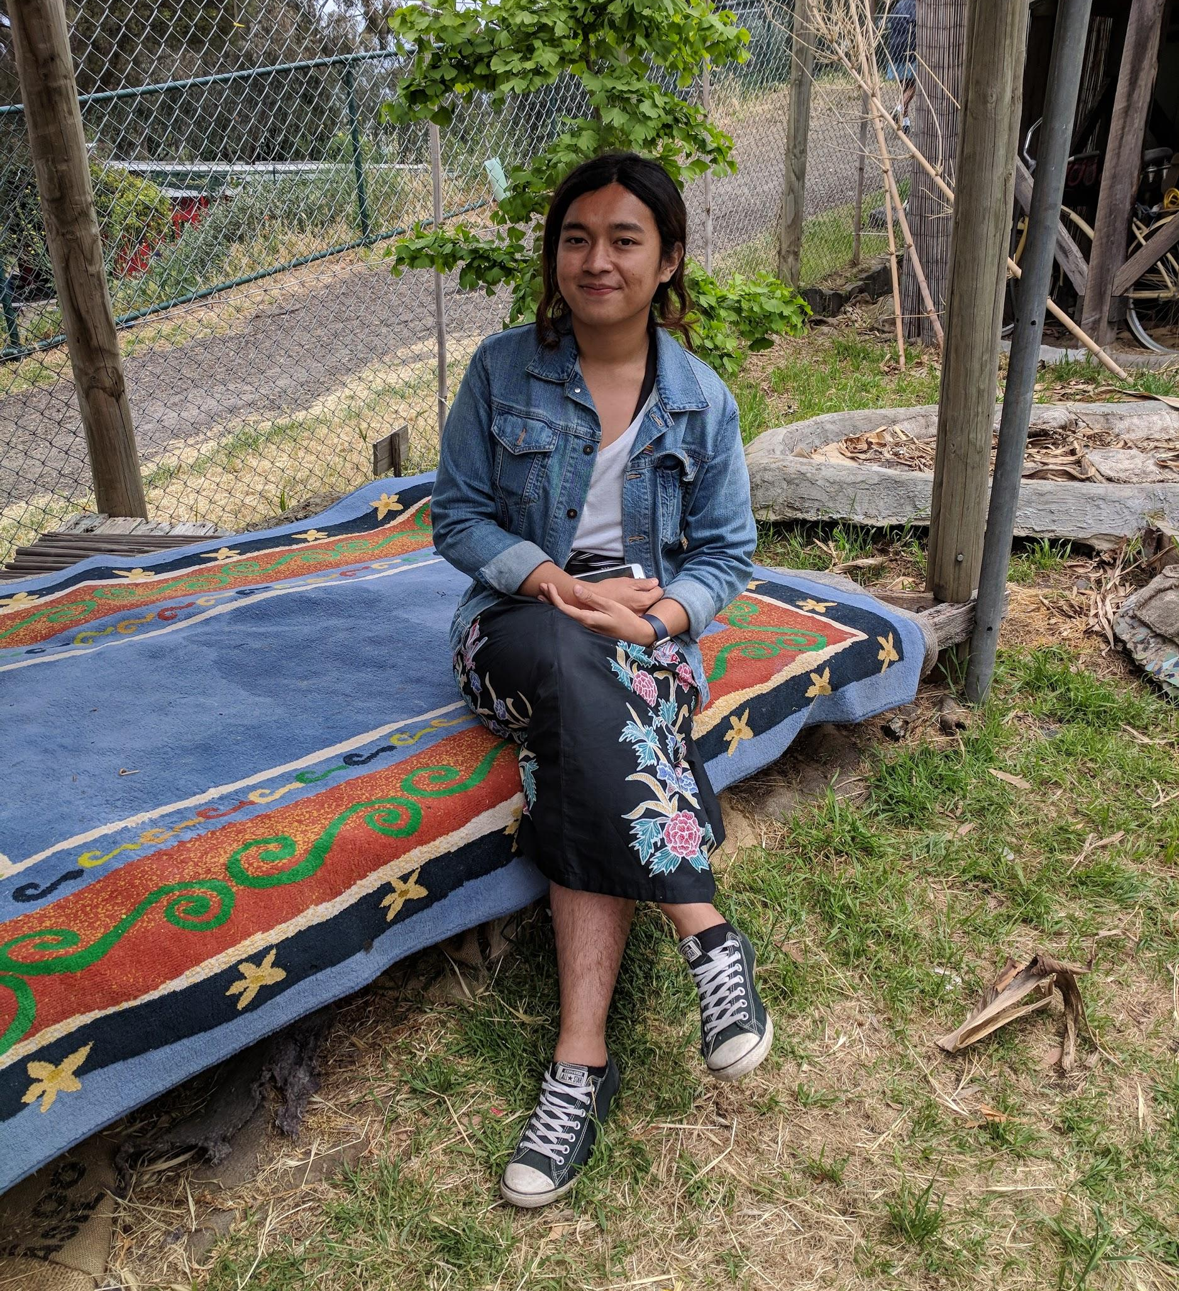
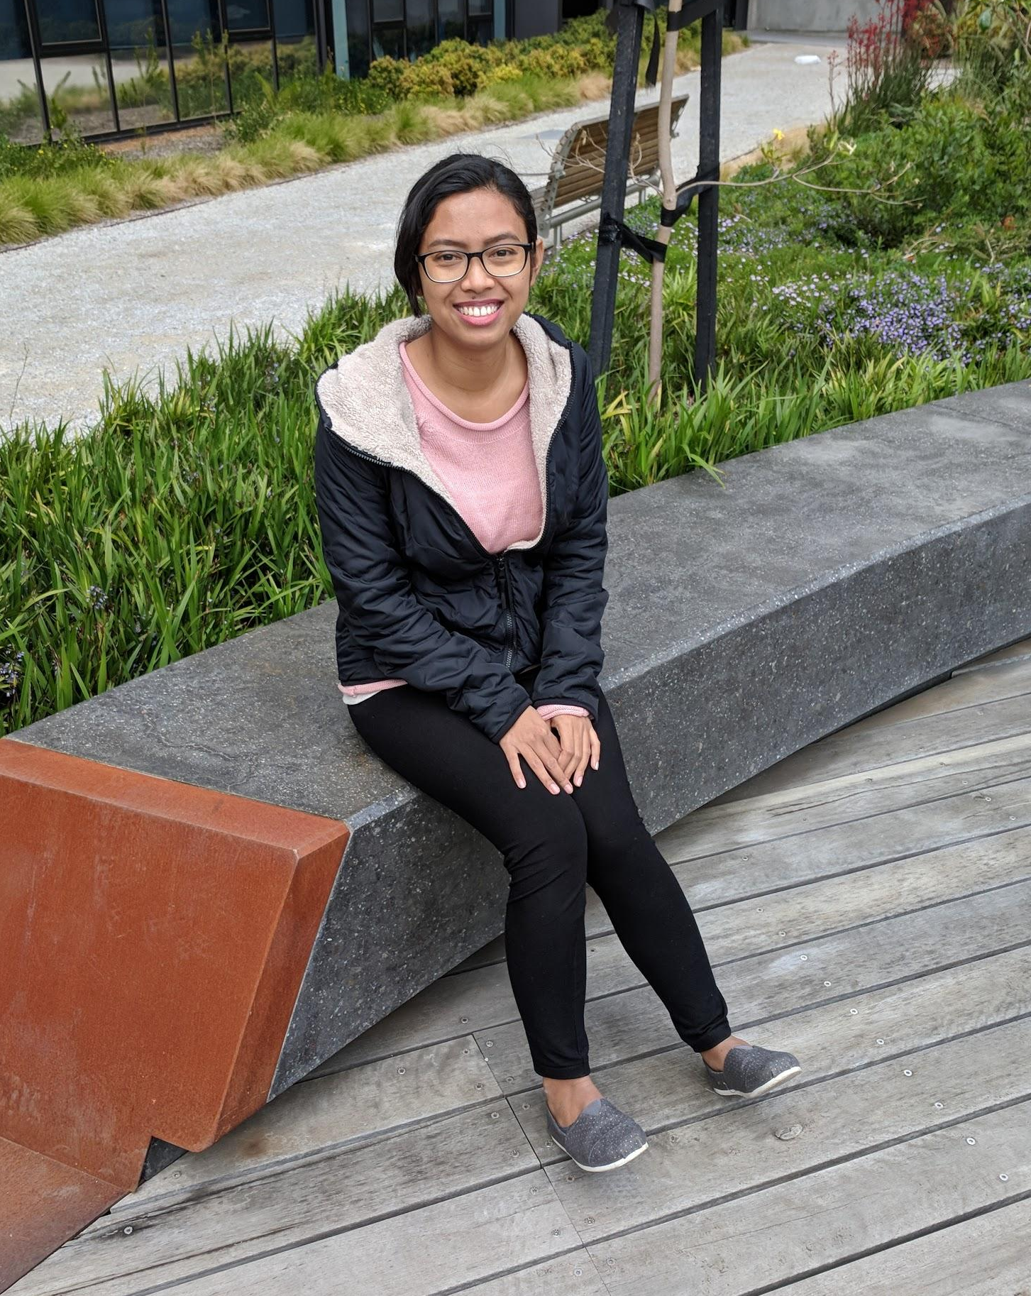
CERES should create videos with focus on individuals.
Notes:
Xandria
Additional videos that focus on individual participants will allow the viewer to connect with the participant. These longer videos should be uploaded onto their YouTube channel. A way to implement these videos would be to add links following the short environmentally focused video on the Chook app, so that the viewers could click on them and discover more about any of the interviewees that have sparked their interest.

Slide 33
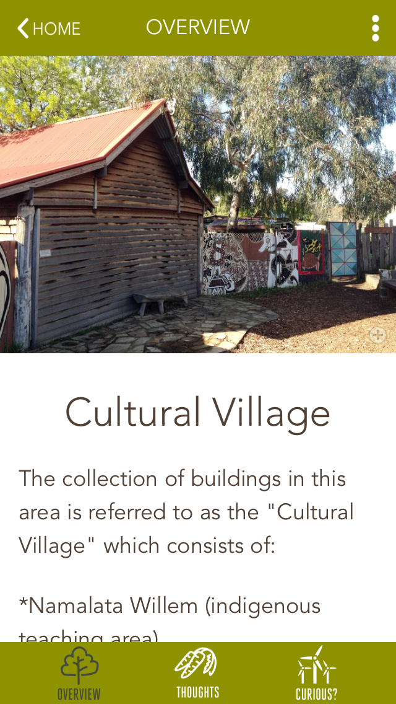
CERES would benefit from increased advertisement for their Chook app.
https://www.google.com/imgres?imgurl=http%3A%2F%2Fis5.mzstatic.com%2Fimage%2Fthumb%2FPurple1%2Fv4%2Fec%2F3d%2F26%2Fec3d2635-8446-412e-ed11-284f134fc19e%2Fsource%2F1200x630bb.jpg&imgrefurl=https%3A%2F%2Fitunes.apple.com%2Fau%2Fapp%2Fchook-ceres-environment-park%2Fid1019062596%3Fmt%3D8&docid=4F8XVay_T4kVPM&tbnid=Q1cbfQHq55y_XM%3A&vet=10ahUKEwjO6LyYuefXAhWIUrwKHW3kDTMQMwhFKAcwBw..i&w=630&h=630&bih=900&biw=1920&q=ceres%20chook&ved=0ahUKEwjO6LyYuefXAhWIUrwKHW3kDTMQMwhFKAcwBw&iact=mrc&uact=8
CERES Chook App
Notes:
Jess
-carolyn-best practices
-signage, personal communication, market the app toward children
-chook mascot

Slide 34
CERES should continue to expand their other cultural villages in a similar manner.
Notes:
Xandria
The next group of WPI students that works in collaboration with CERES should focus on the collection of African narratives to expand upon the environmentally focused African village activities that the 2016 WPI team prototyped.
We recommend that the CERES staff and the future WPI group find contacts within the African community prior to the group’s arrival in Australia because this allowed us to establish interviews before our arrival and ultimately lead us to conduct a total of 22 interviews. We recommend getting in contact with Jonathan Chee of Banksia Gardens because he has contacts within the African community.
Before travelling to Australia, the future group of WPI students should also gather background knowledge on the major environmental issues in Africa. This will also help them to obtain better information from the interviews as they will be able to ask more in depth questions about where the participants are from and what environmental issues may affect them in specific regions.

Slide 35
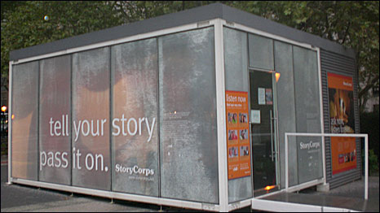
CERES should look into the creation of a storybooth in order to continuously collect narratives.
https://www.google.com/url?sa=i&rct=j&q=&esrc=s&source=images&cd=&cad=rja&uact=8&ved=0ahUKEwi3xMe5tufXAhWJxbwKHfKlASYQjRwIBw&url=http%3A%2F%2Fwww.bbc.co.uk%2Fworldservice%2Fdocumentaries%2F2009%2F11%2F091126_storycorps.shtml&psig=AOvVaw0via2xZWgTqy3aeke5Iw4g&ust=1512169968922081
Notes:
Thomas
CERES should look into the creation of a storybooth in order to continuously collect narratives. It took us 4 weeks to plan, organize, and complete 22 interviews. Conducting interviews is an effective way to collect personal narratives but it is time consuming and unsustainable. A storybooth would allow CERES to create a continuously growing archive of life experiences, and would also give more people the opportunity to share their stories. One possible way to implement this is to set up a room or space at CERES, maybe once a month, where people could record themselves. These days would need to be well-advertised and make people want to share their story.

Slide 36
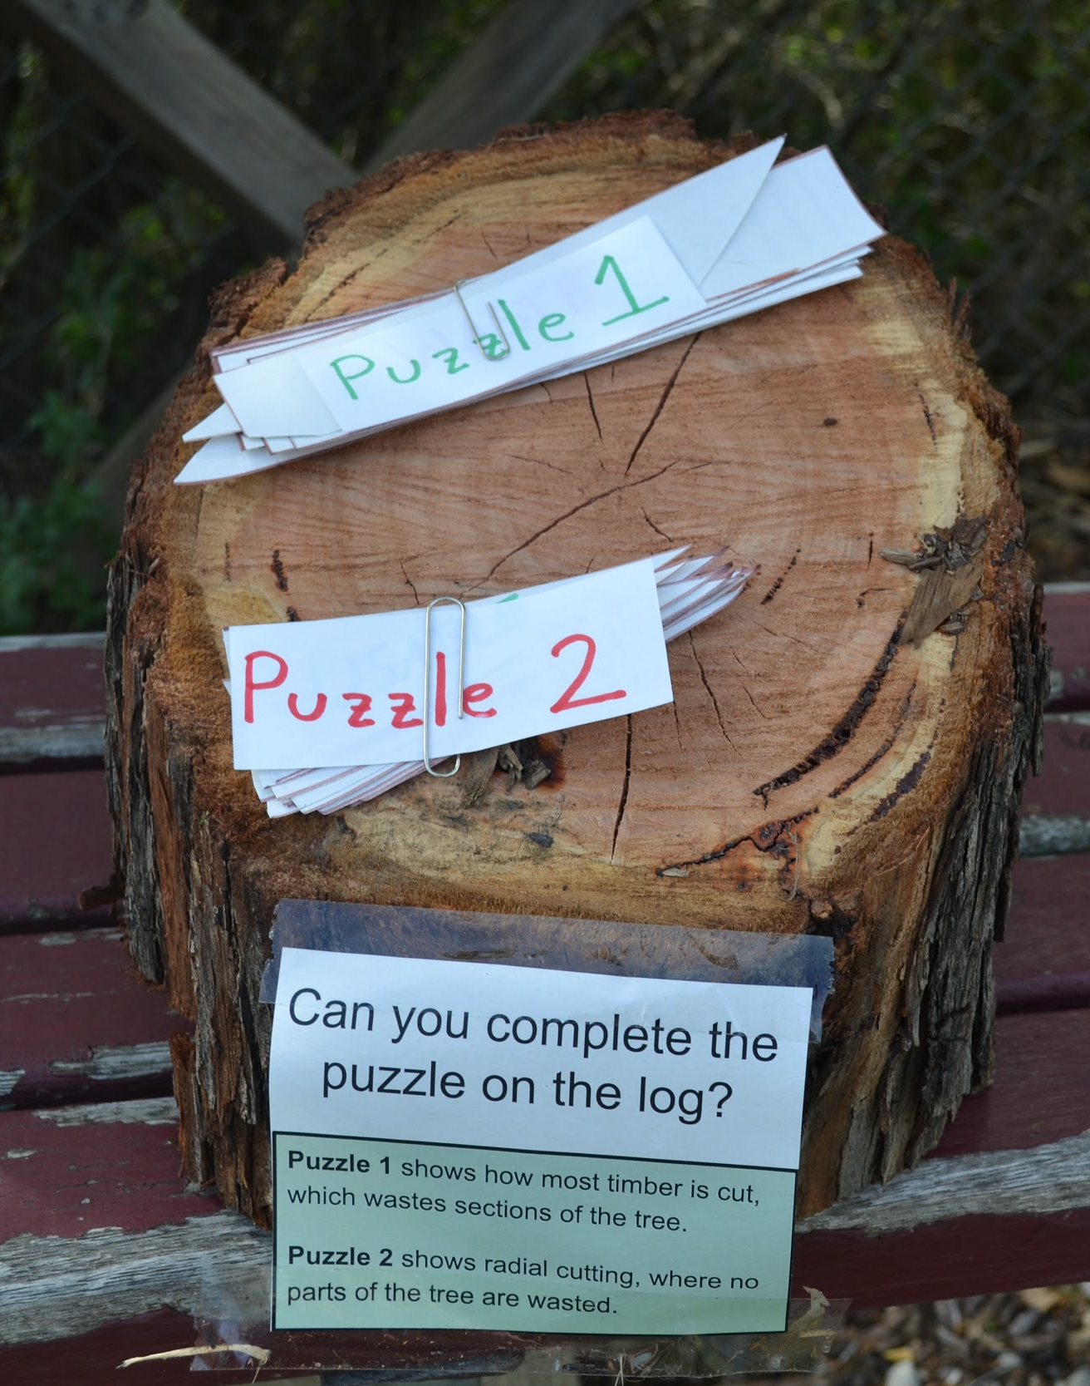
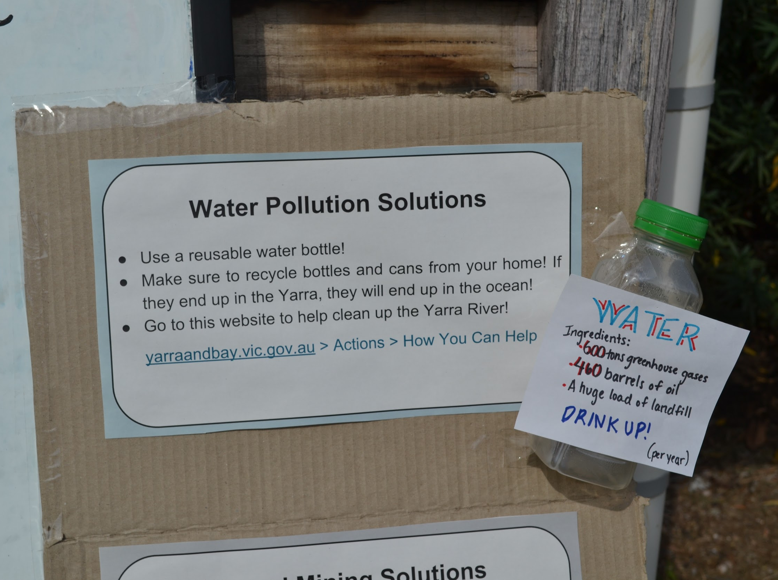
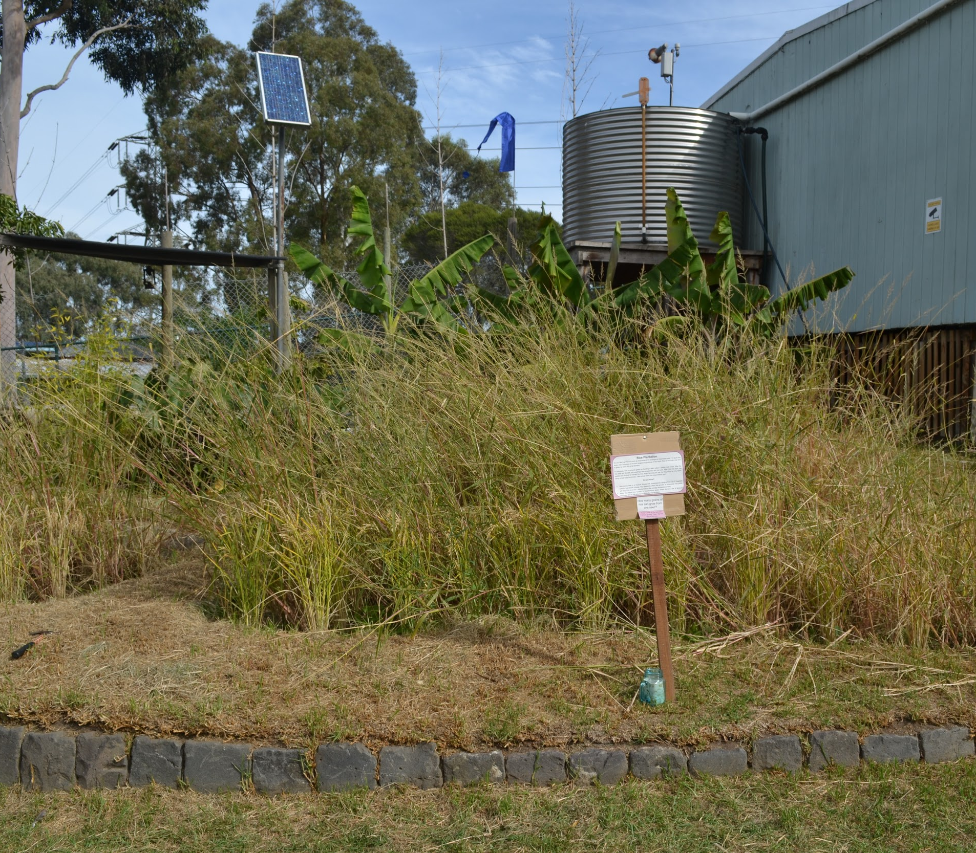
CERES should directly link the videos to the learning activities in the Indonesian village.
Pictures of activities? From previous group?
Photos courtesy of WPI ‘15 CERES team
Notes:
Thomas
CERES should directly link the videos to the learning activities in the Indonesian village. In order to do this, CERES or another WPI group should compare and contrast the information collected in the interviews to the information presented in the prototype activities. With information that is the same, a link should be posted at the corresponding activity in the village that will lead the visitor to a short video for more information on that environmental concern. With information that is different, CERES should evaluate, adapt and create activities accordingly to facilitate the integration of the videos.
We recommend that in the future expansion of other villages, that CERES reverses the order of collecting data. Trying to ask questions to get information about the issues in the activities proved to be challenging. if the stories were collected first, and then activities were created around the information that the intervieweees shared, Ceres would be able to seamlessly integrate the videos..

Slide 37
CERES provided us the opportunity to be exposed to Indonesian culture.
http://sustainability.ceres.org.au/school-programs/excursions/cultural/
Notes:
Xandria
*Read assertion*
In summary, we collected narratives from 22 Indonesians and created 3 short videos. Although we were worried about the depth in which we could explore these topics our Indonesian participants were thrilled to talk about their lives and culture. Through this we were able to understand how the environmental topics directly affect the community members interviewed. We hope that the integration of the videos will help CERES to completing their goal in linking the cultural villages to their overarching focus of environmental sustainability.

Slide 38
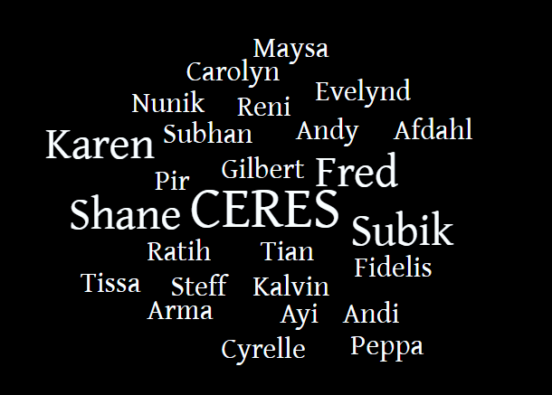

Slide 39
Questions
http://cliparting.com/free-question-mark-clip-art-7625/
Notes:
Xandria
Thank you for your time and attention we will now be accepting questions.

