Slide 1
STORY MAPPING SEA LEVEL RISE:
THE HISTORY AND FUTURE OF THE
NANTUCKET WHALING MUSEUM
Photo: Michael Dwyer, January 2015
Daniel Barmakian, Jeremy Bornstein,
John Carrotta, and Samantha Turner
Notes:
https://abcnews.go.com/US/blizzard-2015-mass-ive-storm-slams-coast-nantucket/story?id=28512649
Dan

Slide 2
Project Goal
Project Goal
To create a prototype story map for the NHA’s internal use communicating the effects of flooding and rising sea levels on the Nantucket Whaling Museum and its history in an engaging, meaningful, and educationally effective manner.
Photo: Courtesy of the Nantucket Historical Association, 1930s
Notes:
Jeremy

Slide 3
Esri’s ArcGIS StoryMaps
Used to tell stories using maps alongside text and visuals
Sequence of animated elements that progress as you scroll
Highly customizable and interactive

Slide 4
Sea Level Rise
(SLR)
Photo: Flint Ranney, January 1987

Slide 5
SLR Key Terms
Mean Sea Level (MSL): The arithmetic mean of hourly heights observed over a 19-year period.
Mean Higher High Water (MHHW): The average of the higher high water height of each tidal day observed over a 19-year period.

Slide 6
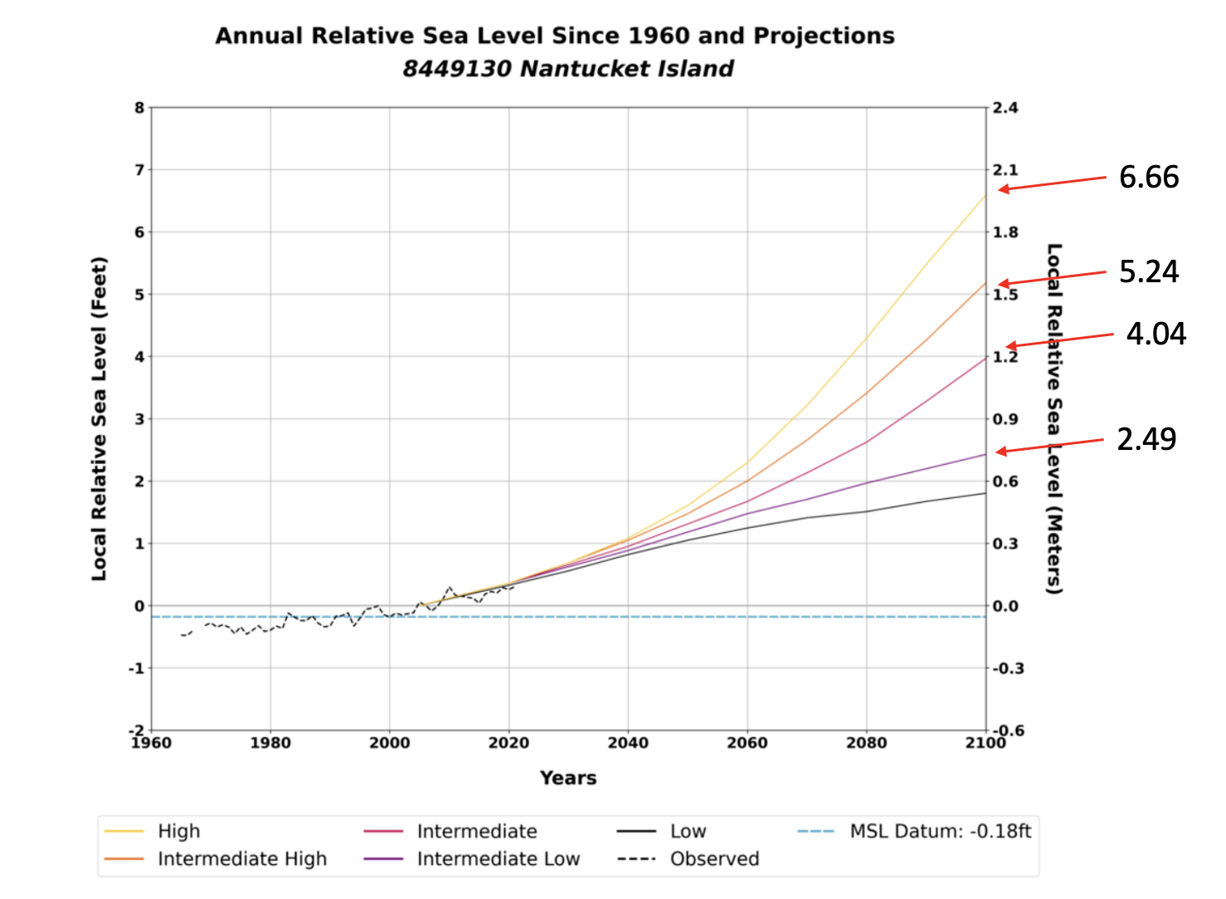
Data: NOAA
Notes:
Dan

Slide 7
Newest Projections
SLR projected scenarios, from 2017
2017
SLR projected scenarios, from 2022
Up to ½ ft
higher on same Inter-Low
track
2022
Data: NOAA
Notes:
Dan

Slide 8
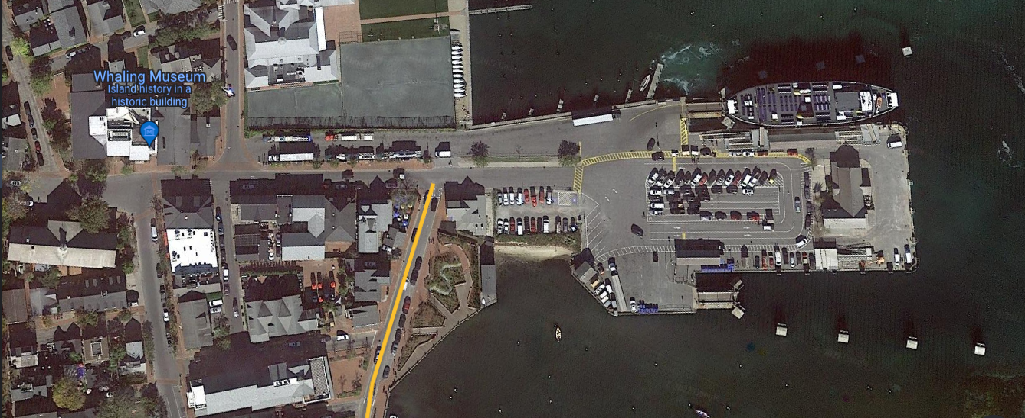
Oak Street
Easy Street
NOAA Tide Station
Imagery: Google Earth
Notes:
Putting this sea level rise on a local context, can be shown on Easy Street, which floods at the drop of a hat when it rains, during a storm or hurricane

Slide 9
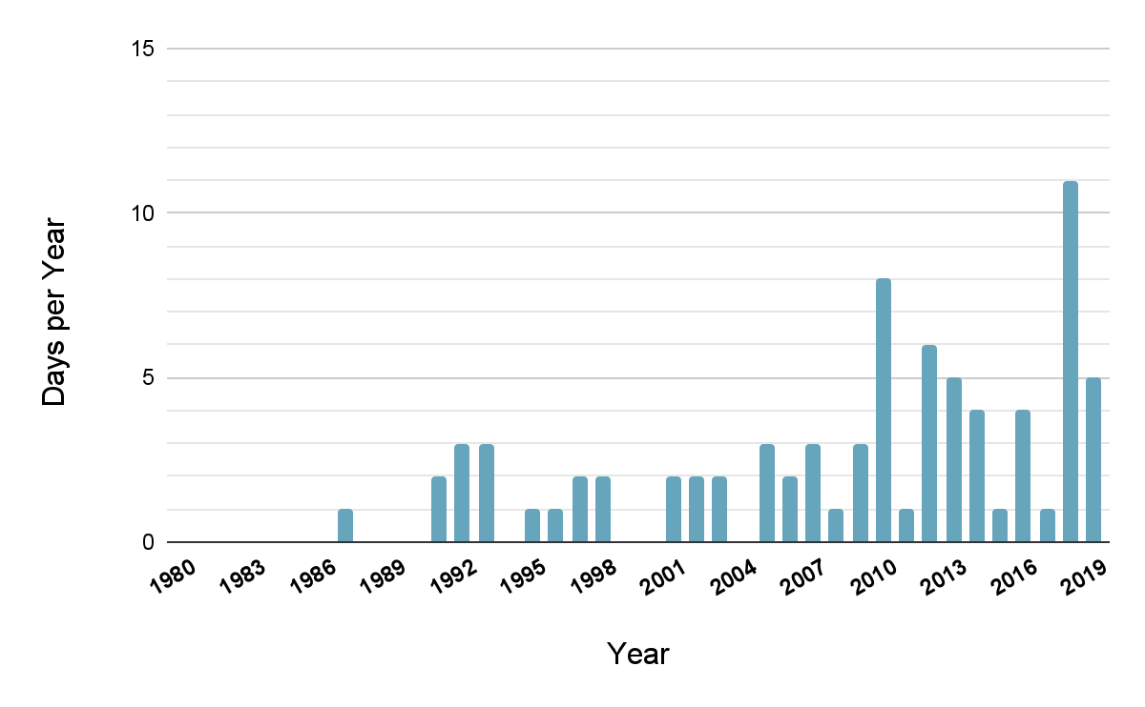
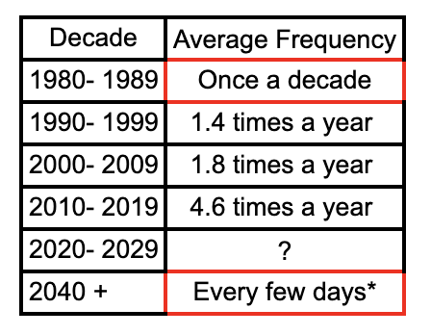
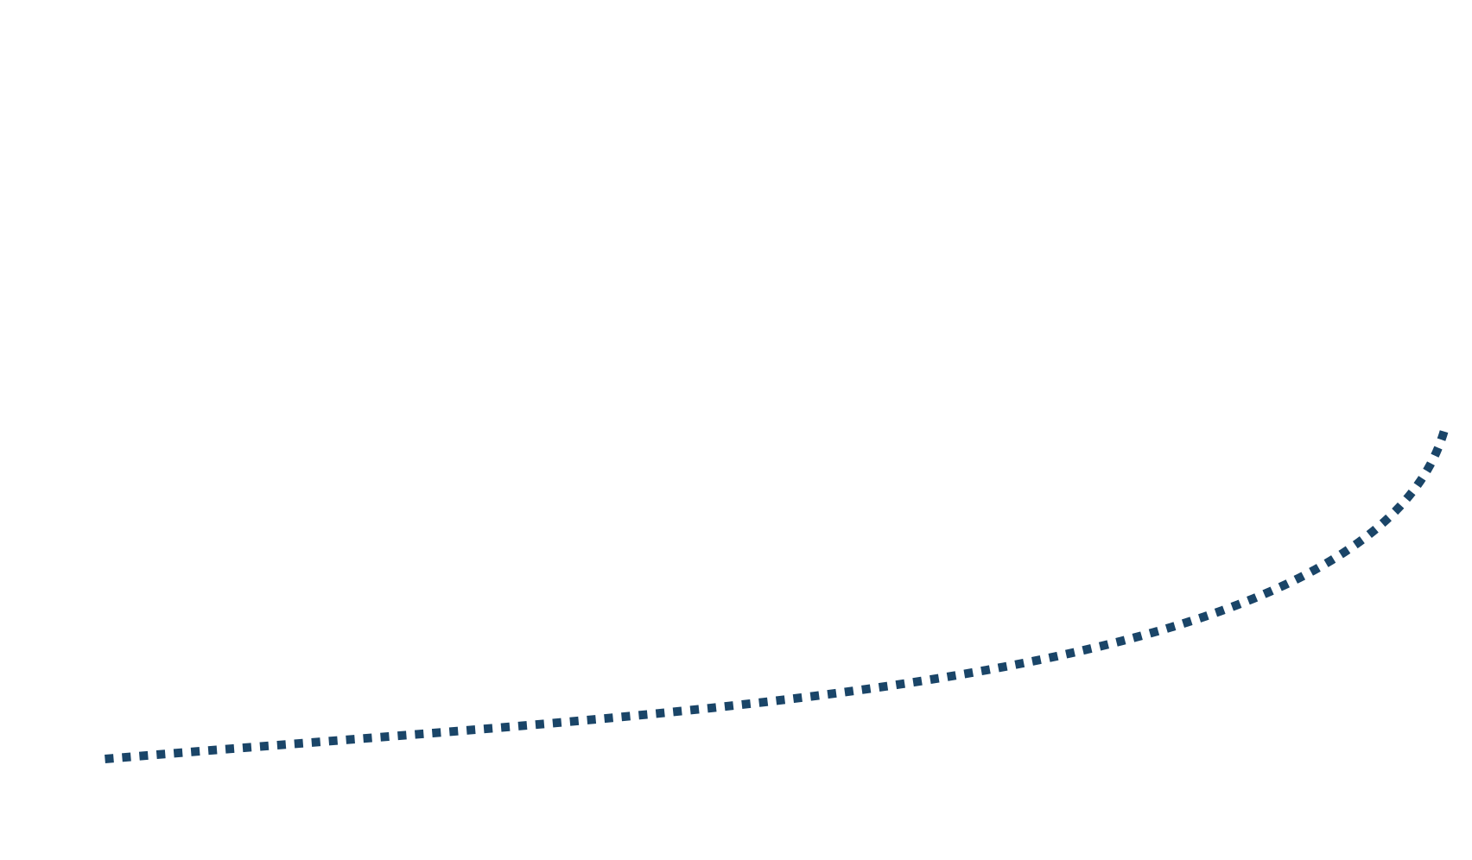
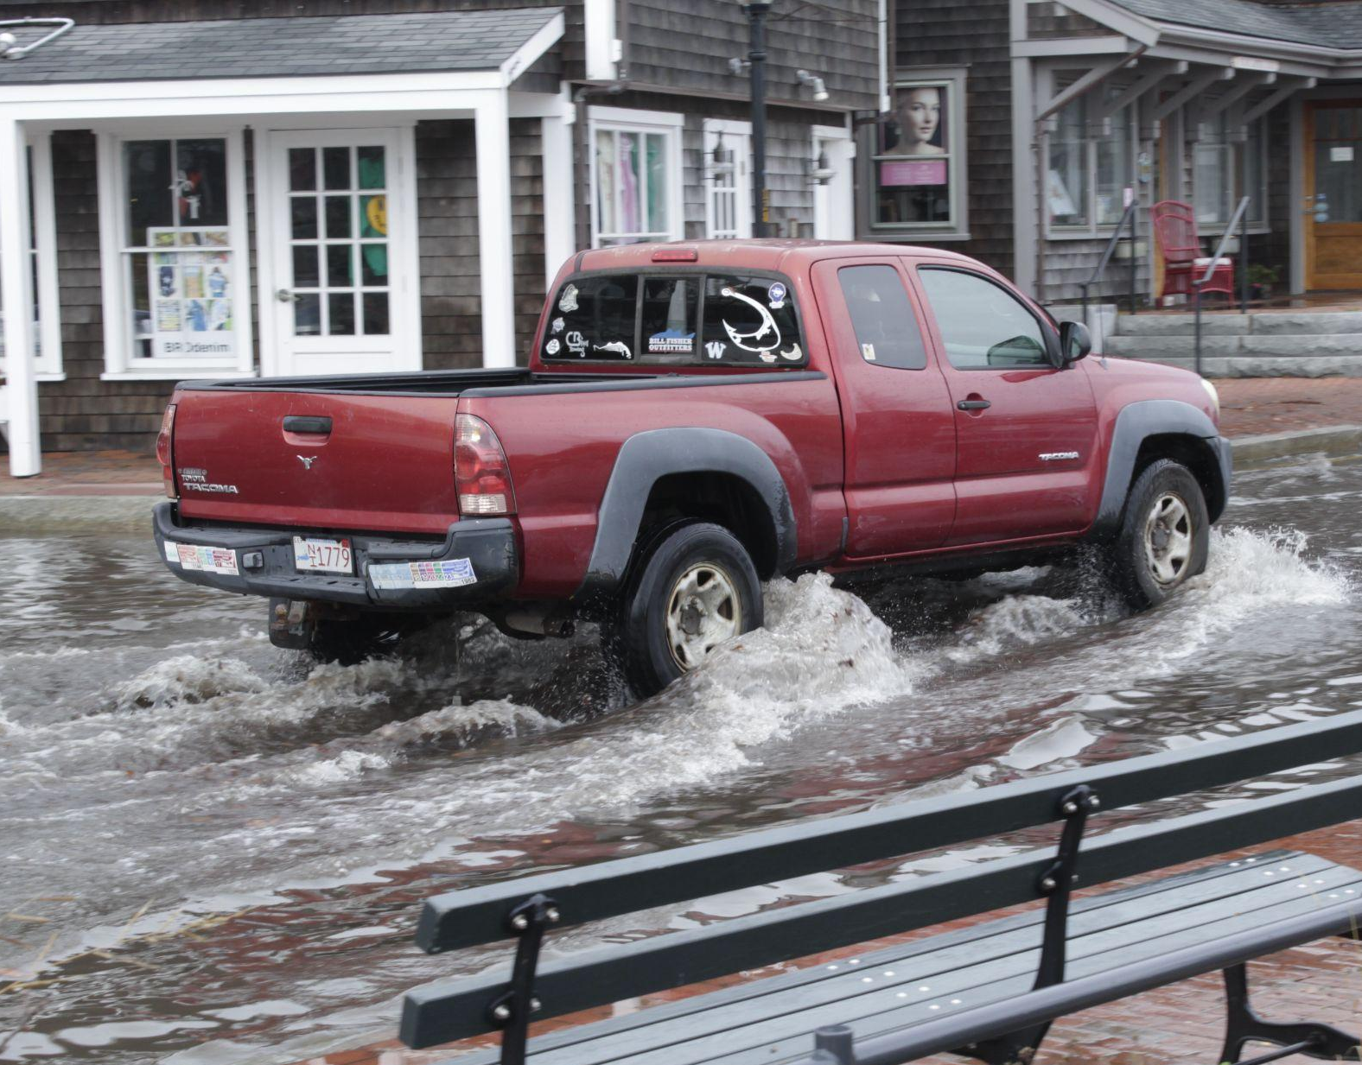
SLR: Current State and Projections
Number of Days Having Water Levels ≥ 1.8ft. MHHW By Year
10-year average
4.6
1.4
1.8
0.1
Data: Easy Street: An Update on High-Tide Flooding by Chuck Larson
Notes:
Dan

Slide 10
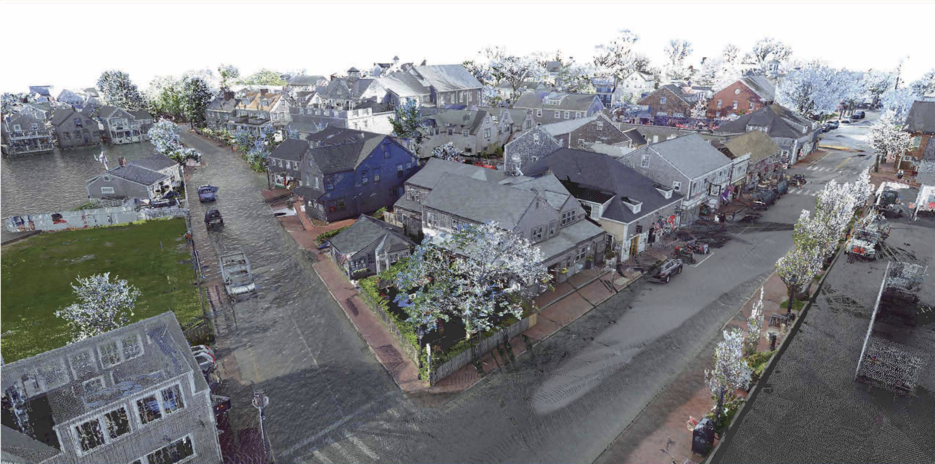
The Whaling Museum
University of Florida - Year 2040 MHHW based on 2017 NOAA projections
Notes:
Dan

Slide 11
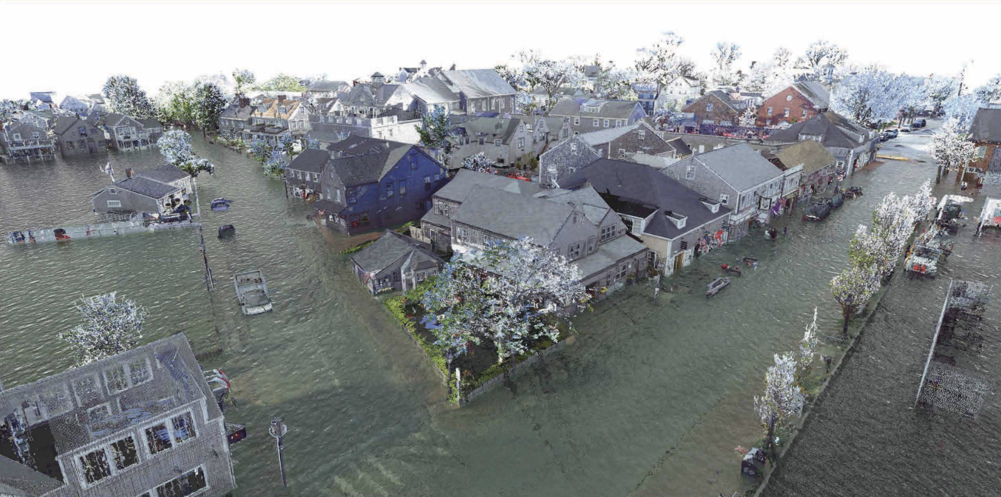
The Whaling Museum
University of Florida - Year 2080 MHHW based on 2017 NOAA projections
Notes:
Dan

Slide 12
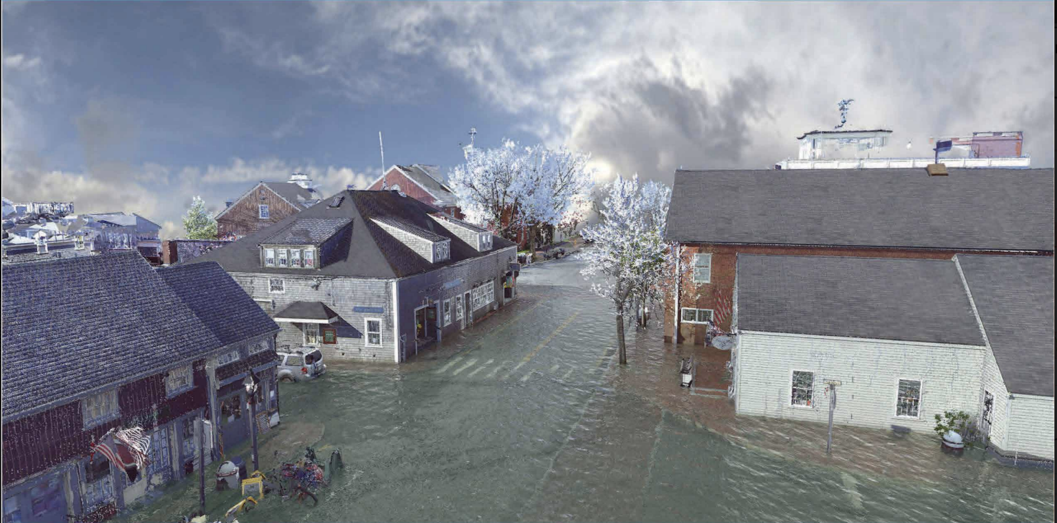
University of Florida - Year 2080 MHHW based on 2017 NOAA projections
Notes:
Dan

Slide 13
A Focus on the Whaling Museum
Photo: Peter Vanderwarker. Courtesy of the Nantucket Historical Association, 2005
Notes:
John

Slide 14
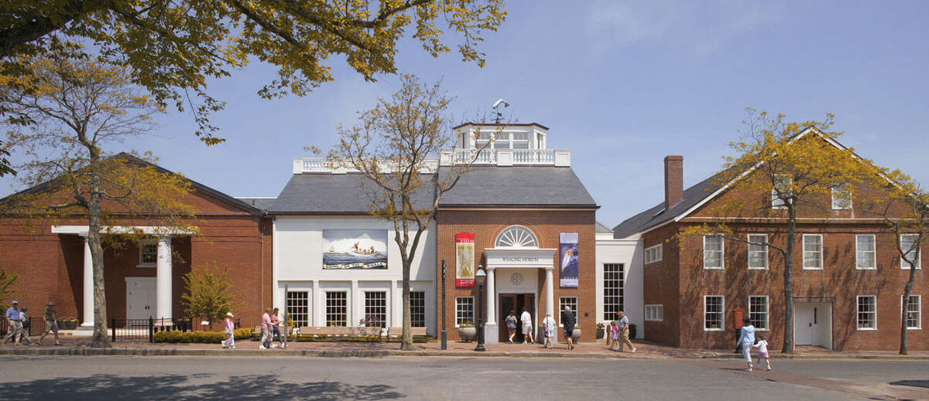
The Whaling Museum
Photo: Courtesy of the Nantucket Historical Association
Notes:
John
100,000 visitors /year
Main attraction
First thing people see when they come off the boat

Slide 15
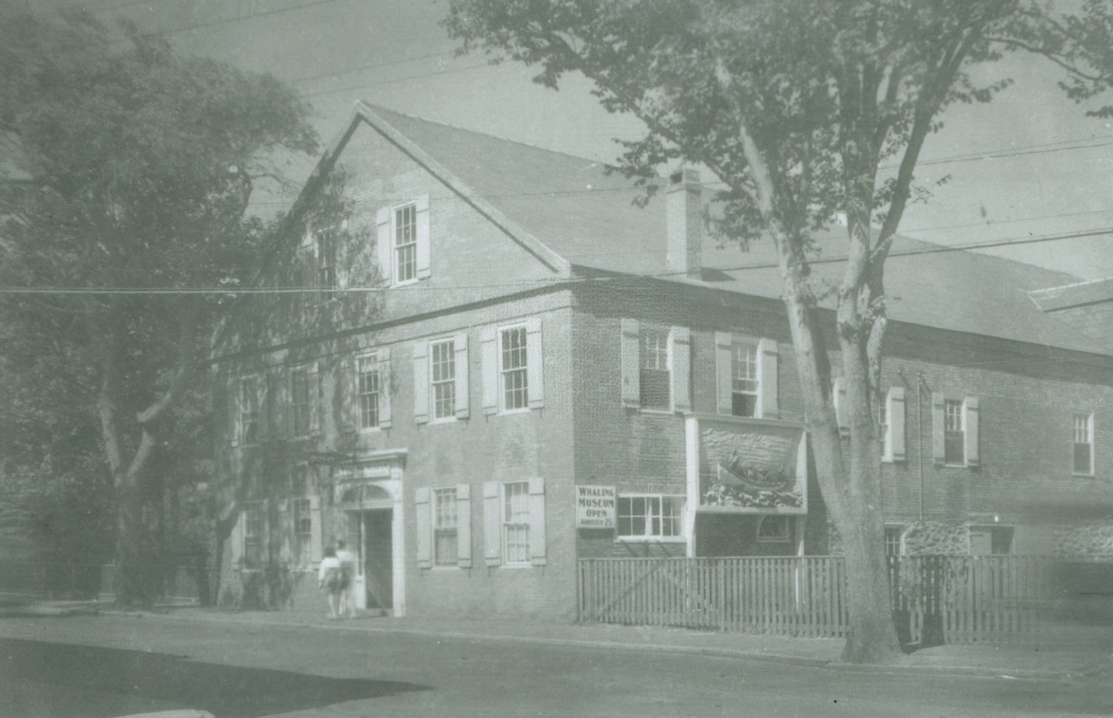
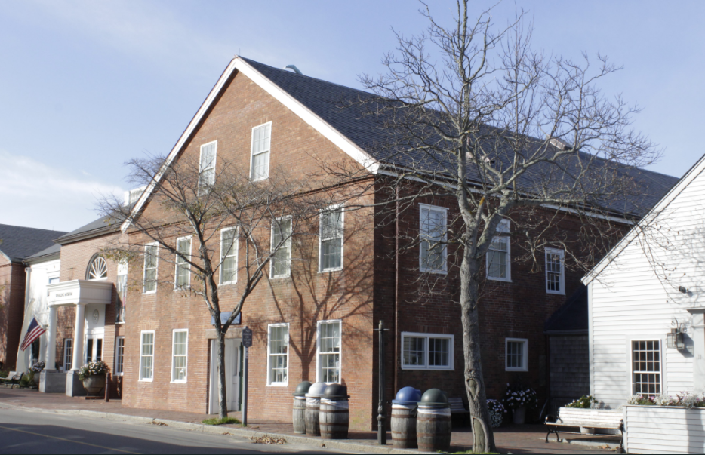
The Museum Over Time
1931
2022
Photos: Courtesy of the Nantucket Historical Association and Jeremy Bornstein
Notes:
John

Slide 16
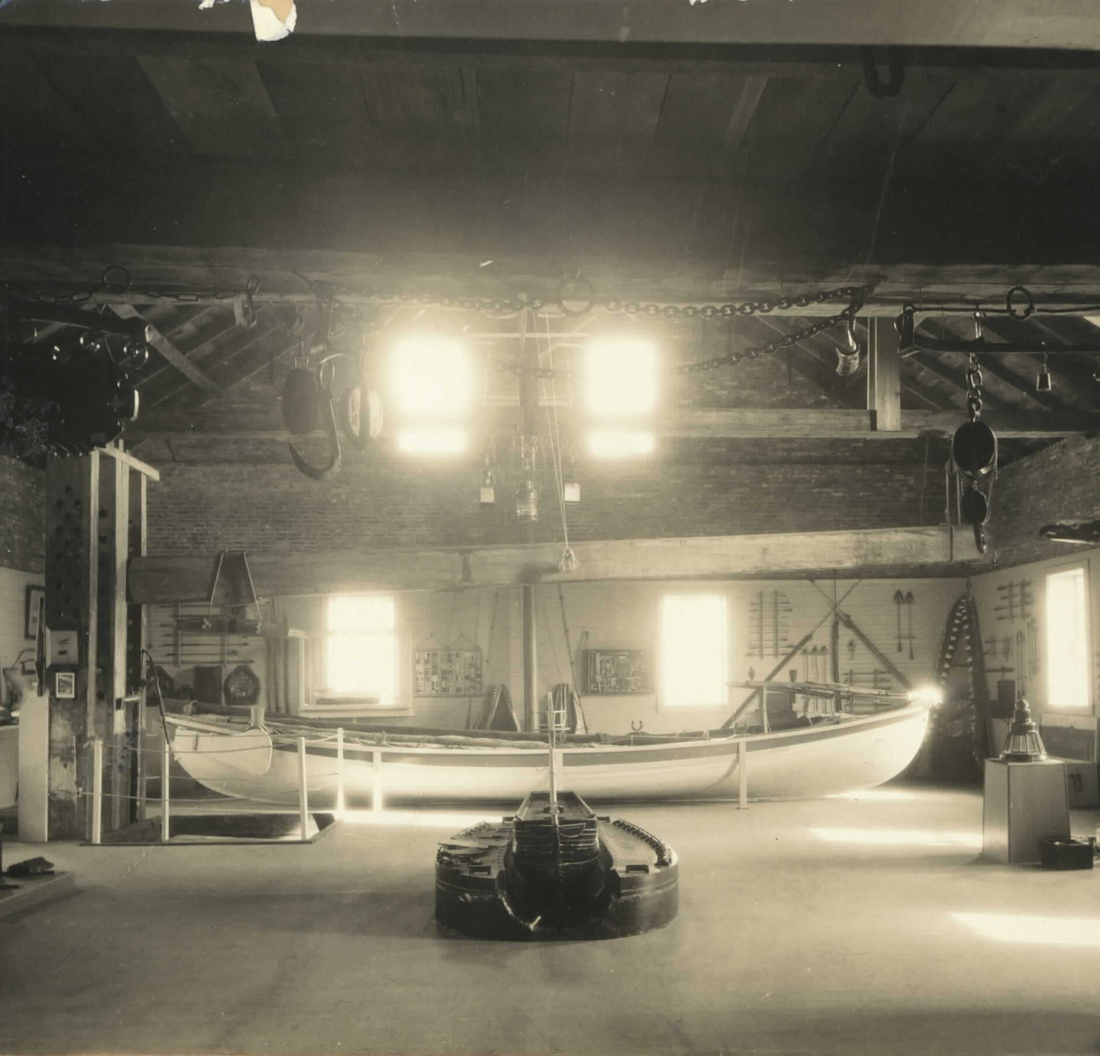
The Candle Factory
1930s. Photo: Courtesy of the Nantucket Historical Association
1960s. Photo: John McCalley. Courtesy of the Nantucket Historical Association
Notes:
John
broad strokes: incredibly valuable, incredibly vulnerable

Slide 17
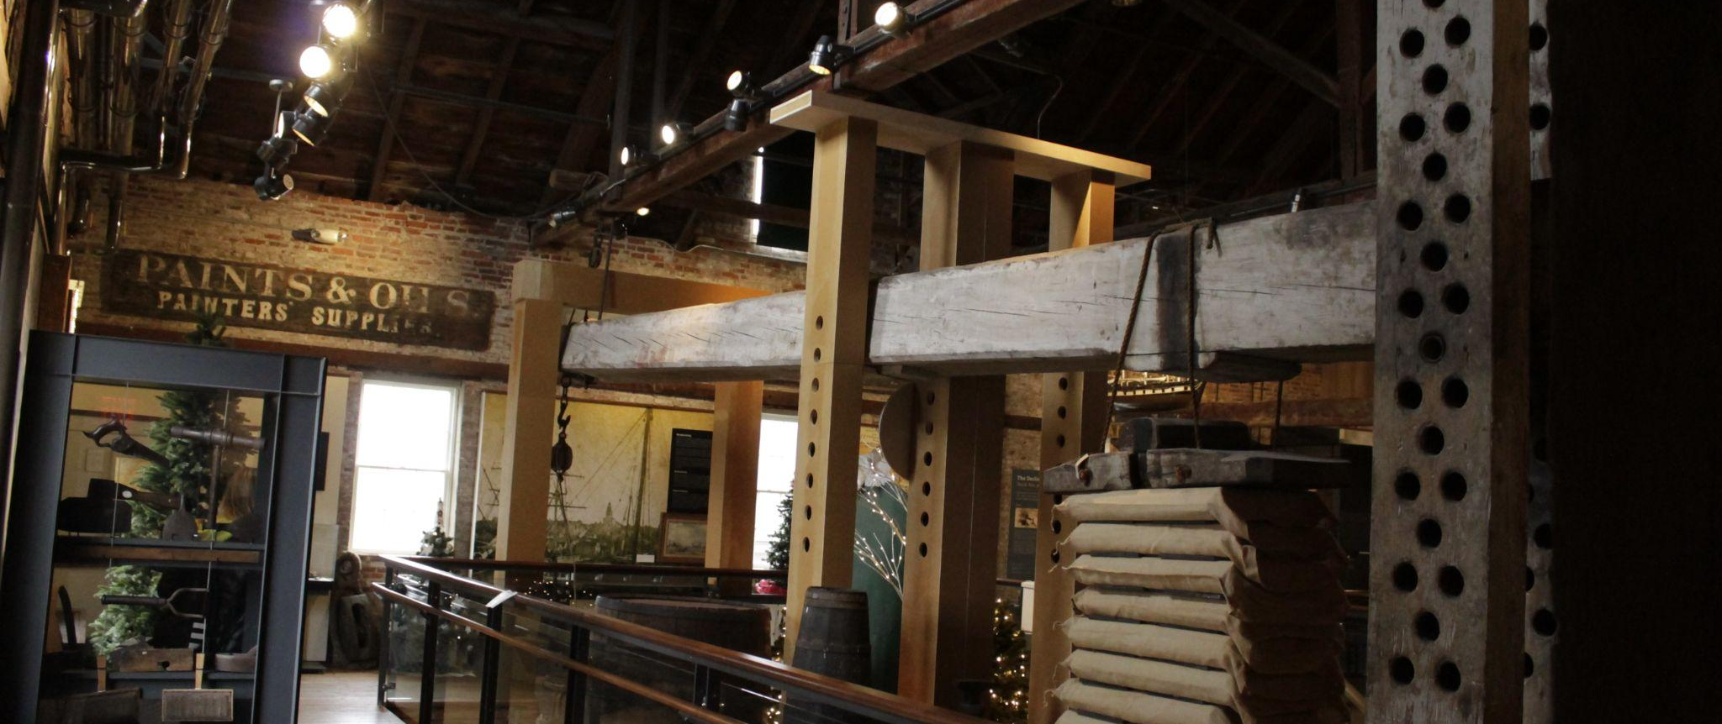
The Candle Factory
2022. Photo: Jeremy Bornstein
Notes:
John
broad strokes: incredibly valuable, incredibly vulnerable

Slide 18
The Story Map
Image: Courtesy of the Nantucket Historical Association, 1880s
Notes:
Jeremy

Slide 19
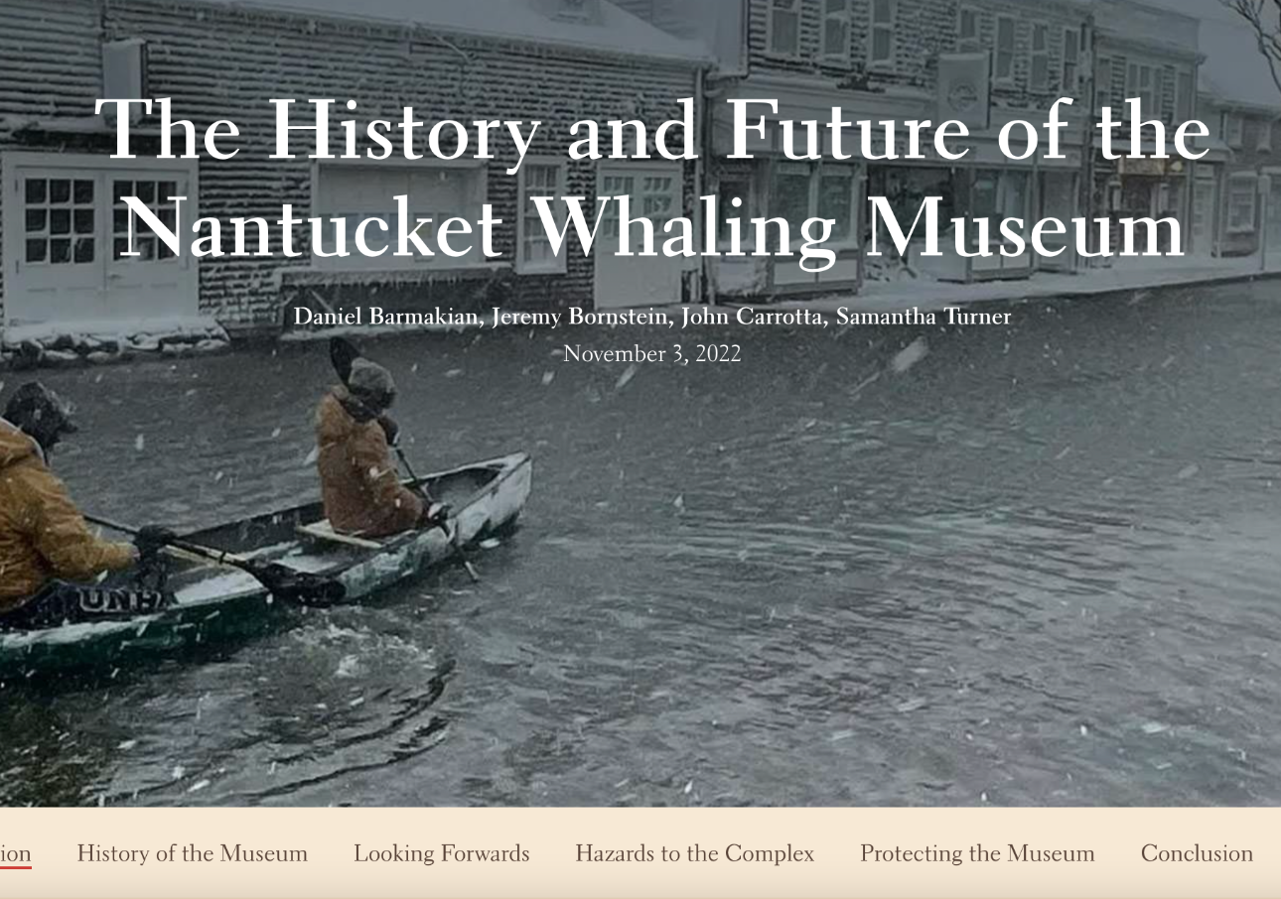
Story Map Breakdown
Four Main sections:
History of the Museum
Looking Forward
Hazards to the Complex
Protecting the Museum
Notes:
Jeremy

Slide 20
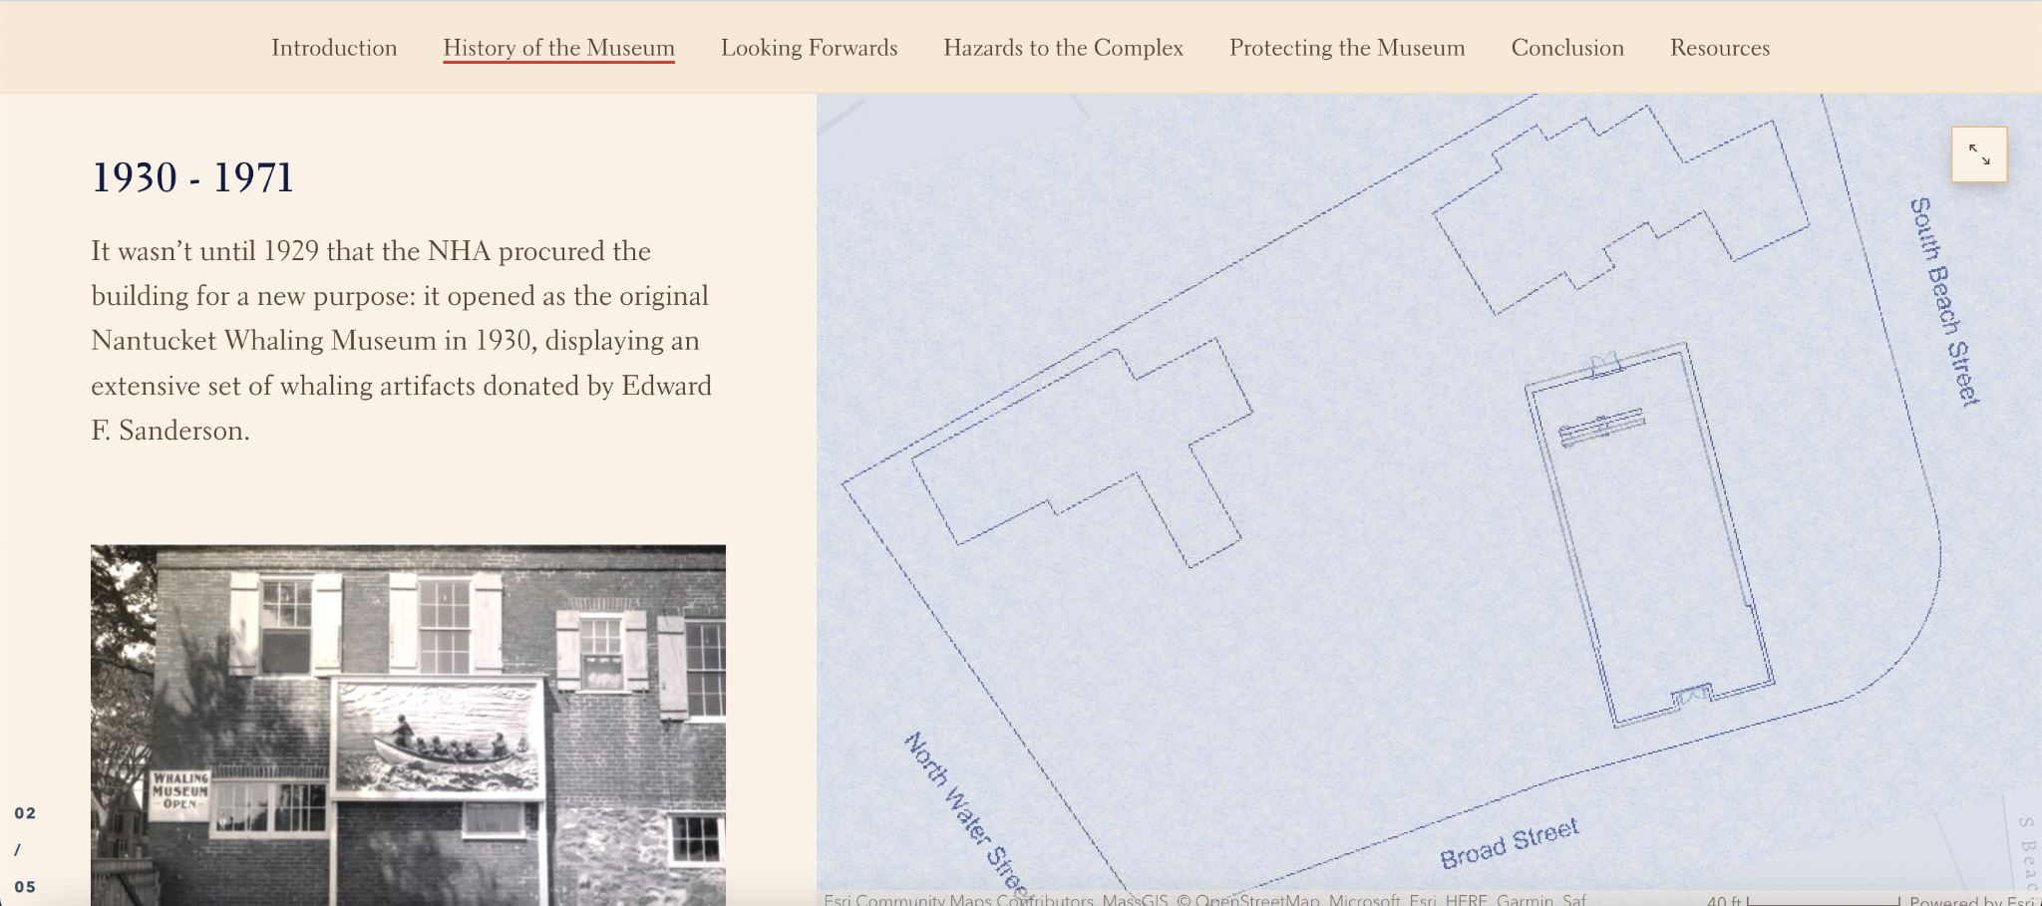
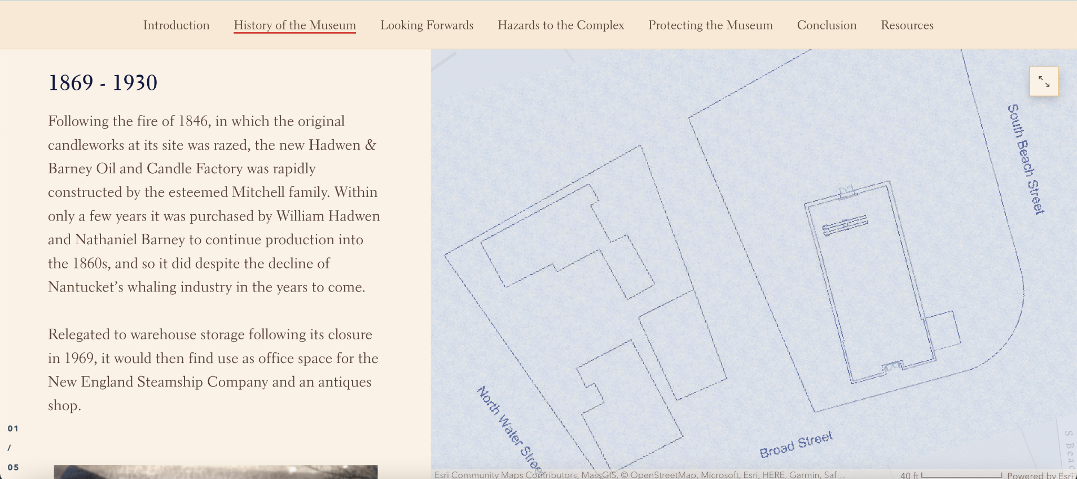
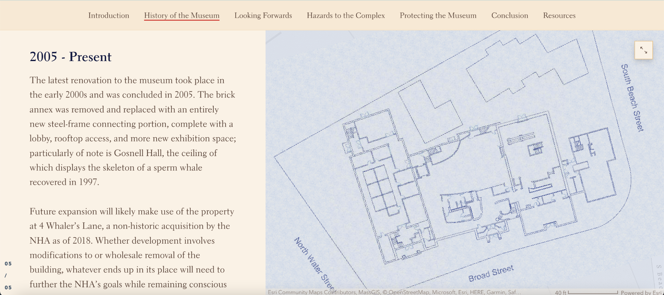
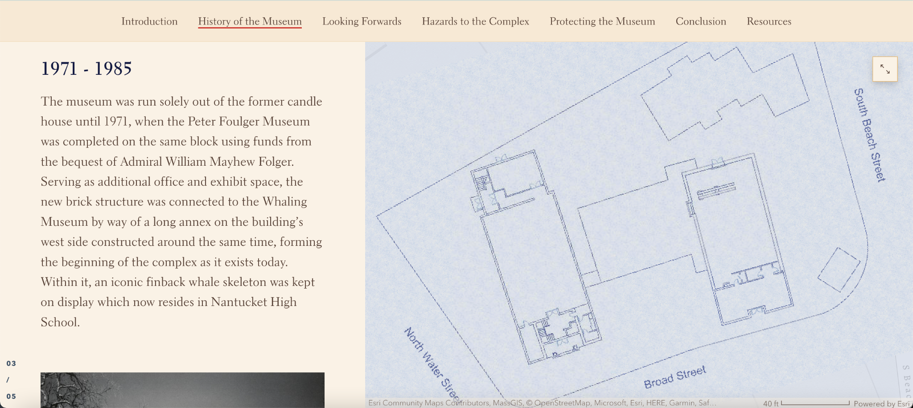
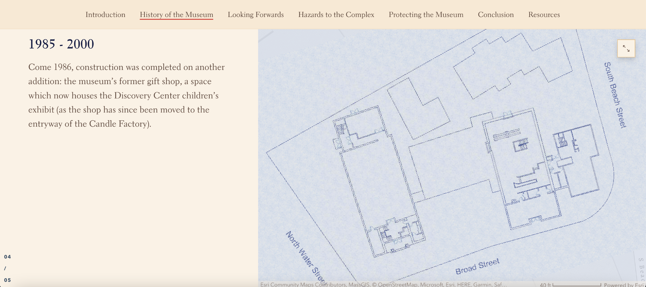
History Timeline
Notes:
John

Slide 21
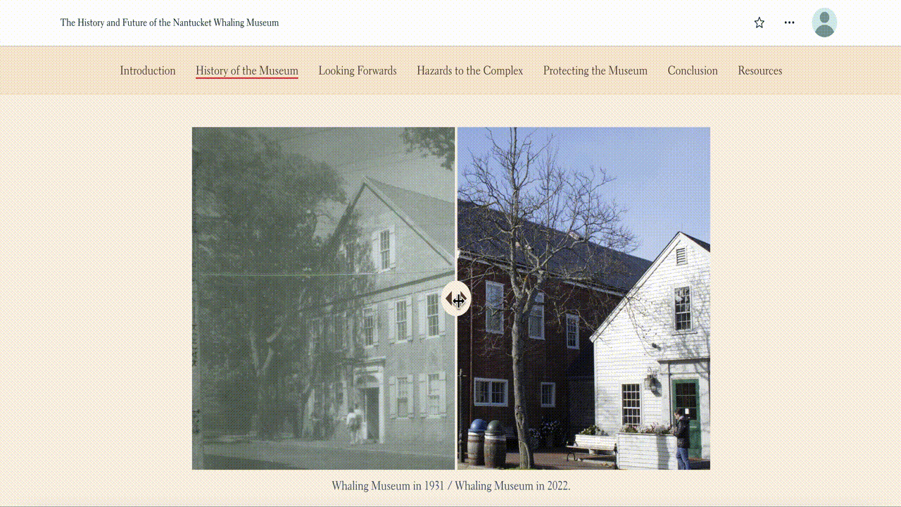
Notes:
Jeremy

Slide 22
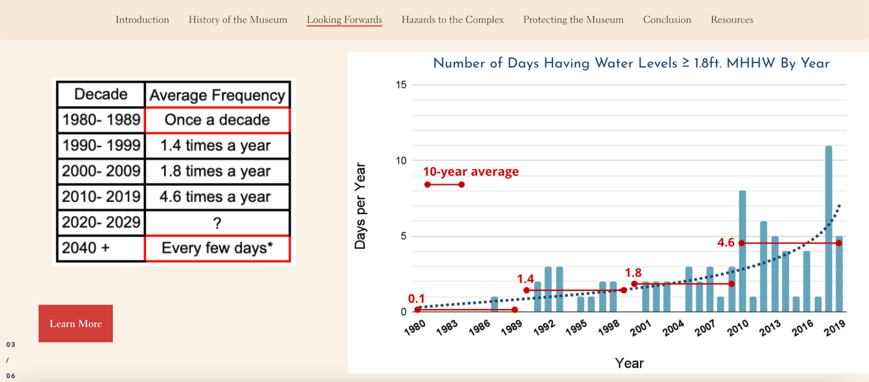
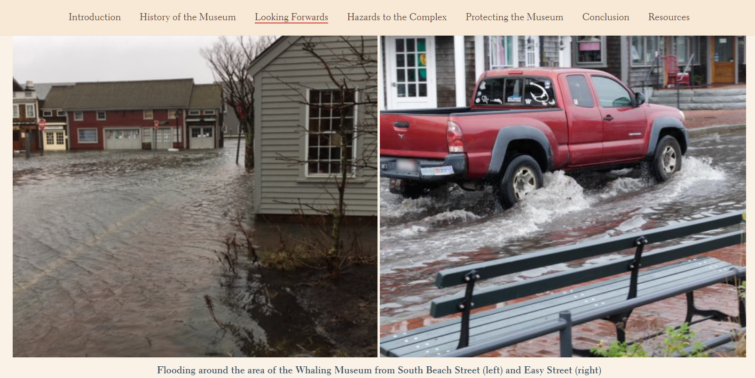
Looking Forwards
“WATER IS COMING”
Notes:
Jeremy

Slide 23
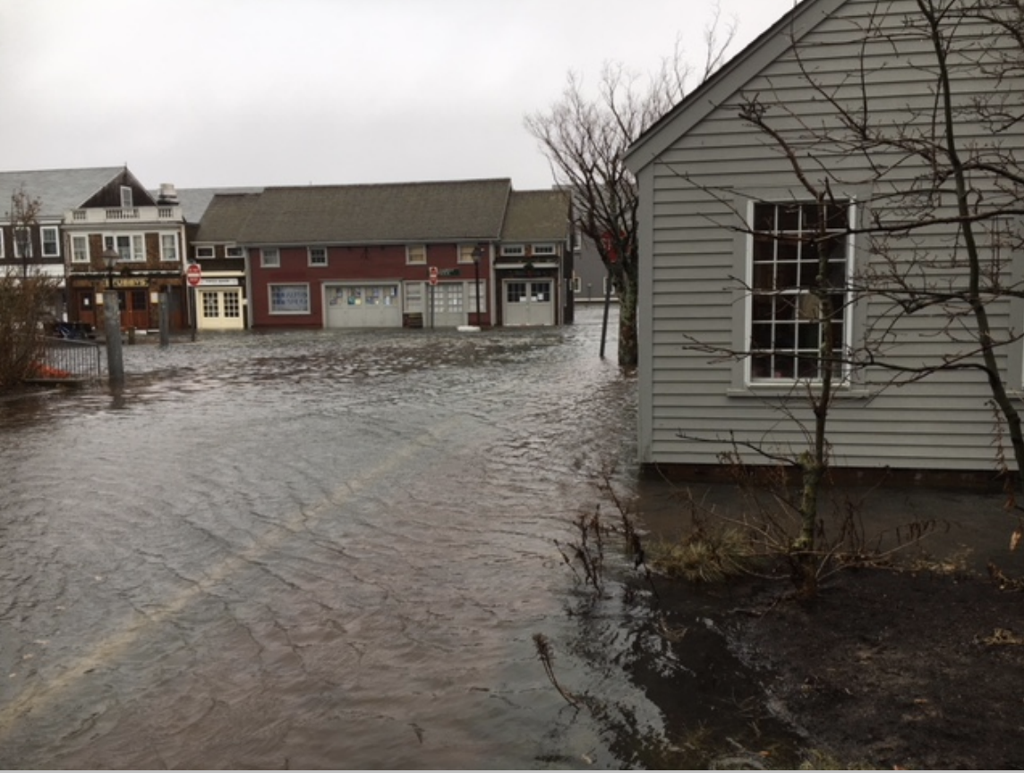
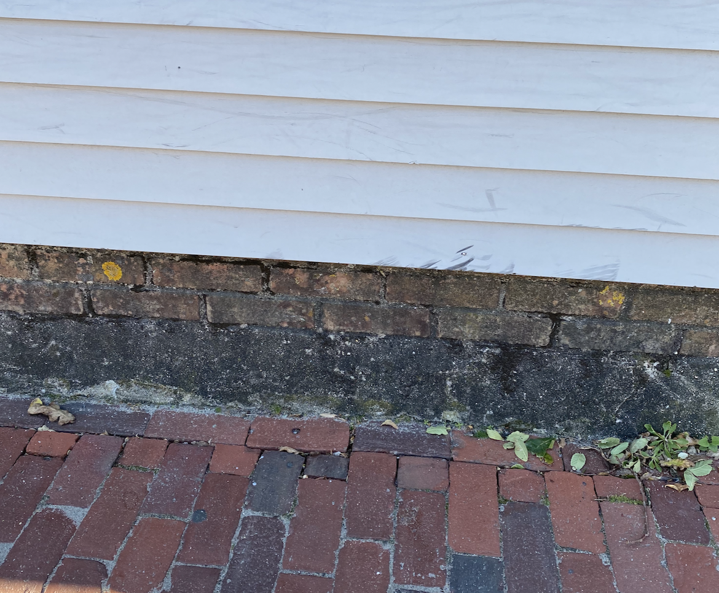
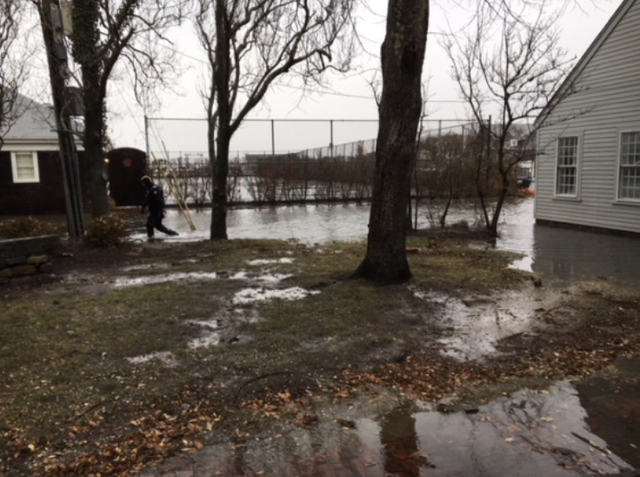
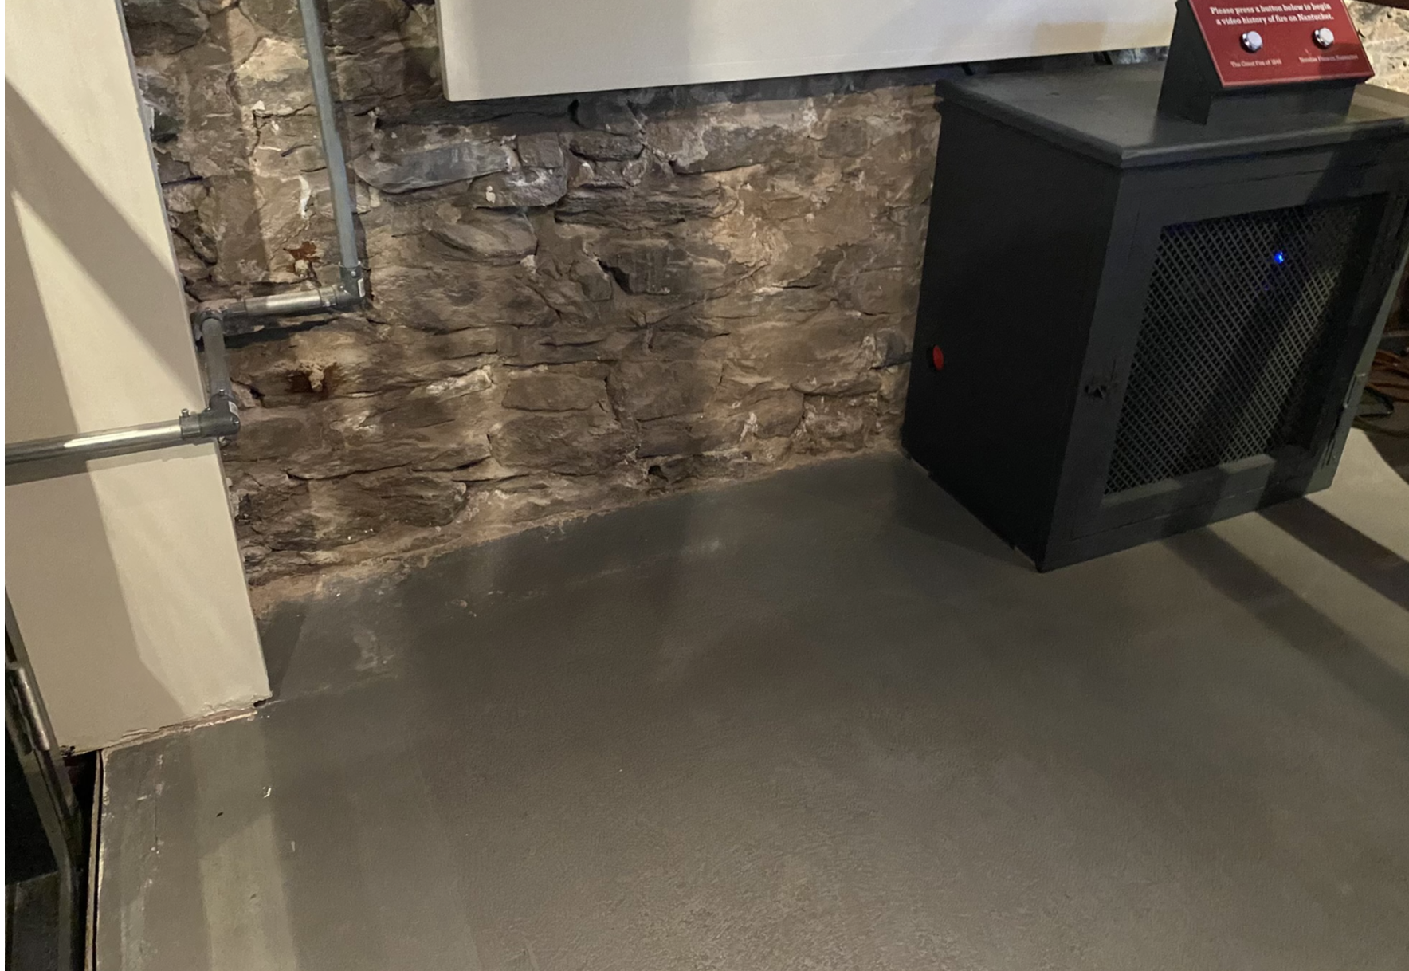
Issues the Museum Complex Faces
Flood Damage
2017
Foundation Erosion
2022
Wind and Debris
Damage
2017
Interior Flood Damage
2022
Photos: McGrath Architecture and Samantha Turner

Slide 24
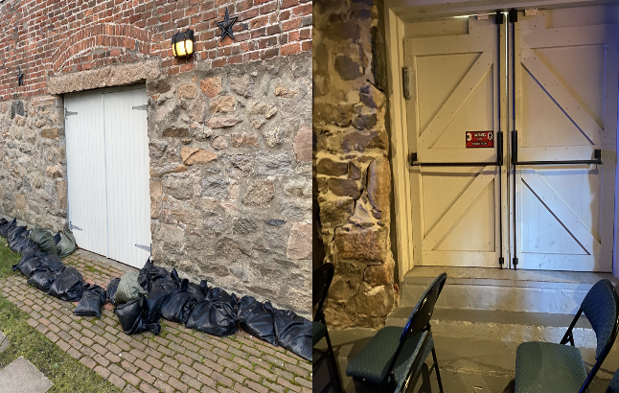
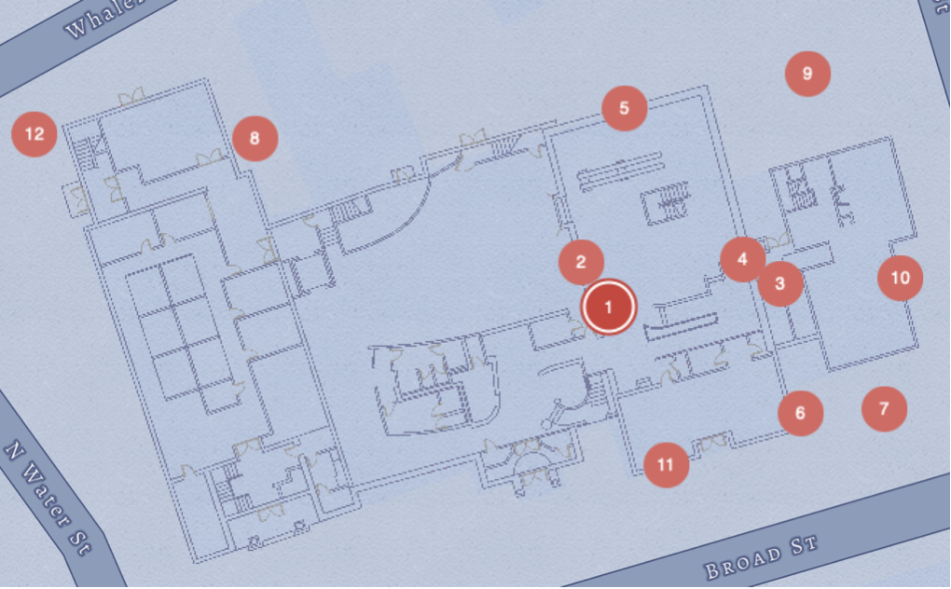
Hazards to the Museum
1. Elevator shaft flooding
2. Groundwater intrusion through wall
3. Toilets overflow
4. Cold joint
5. North elevation doorway flooding
6. Downspouts
7. Low drainage through pavement
8. Cistern filling up
9. Dated pipes
10. Foundation erosion
11. Cracking due to portland cement
12. Electrical transformer box
Notes:
st

Slide 25
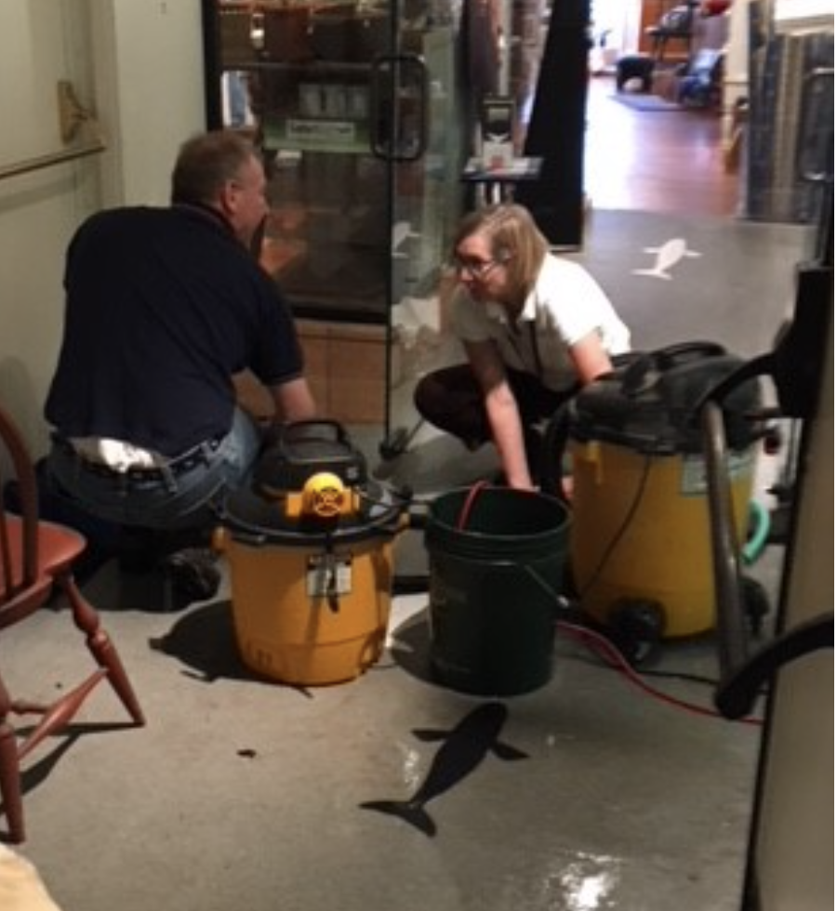
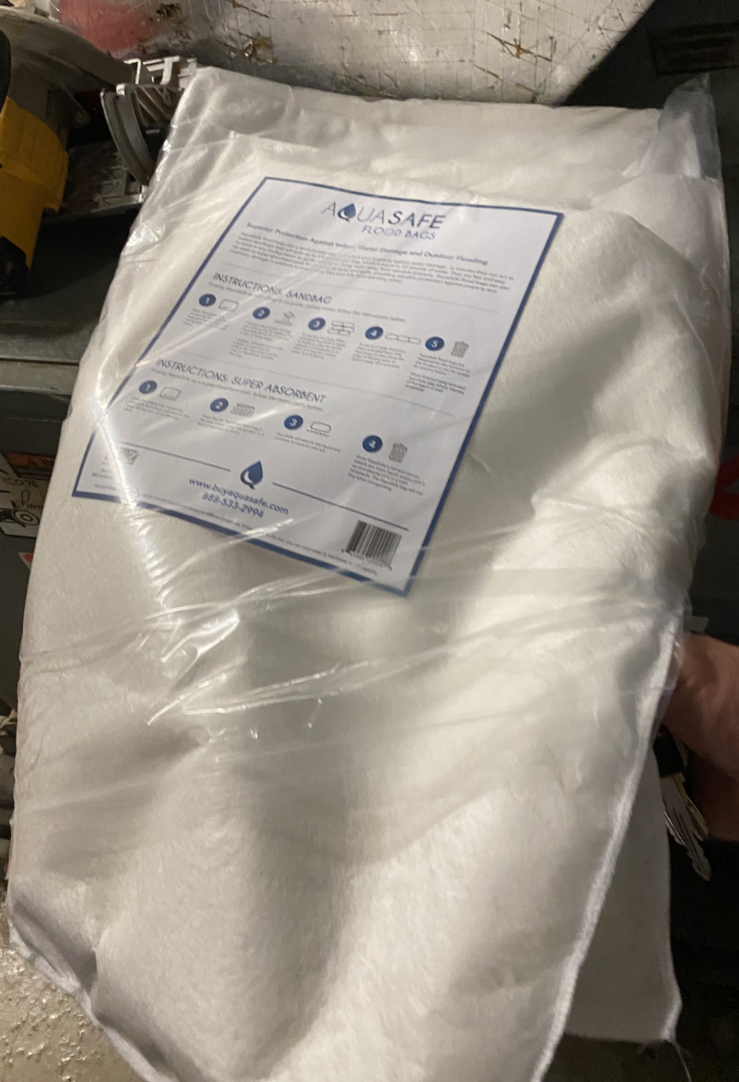
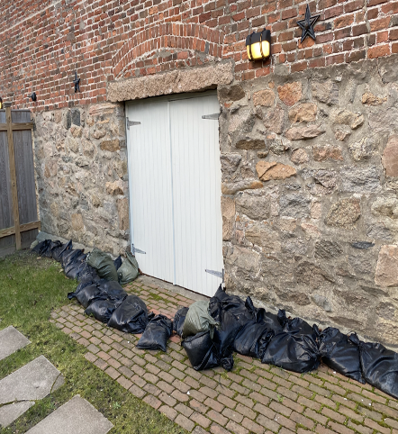
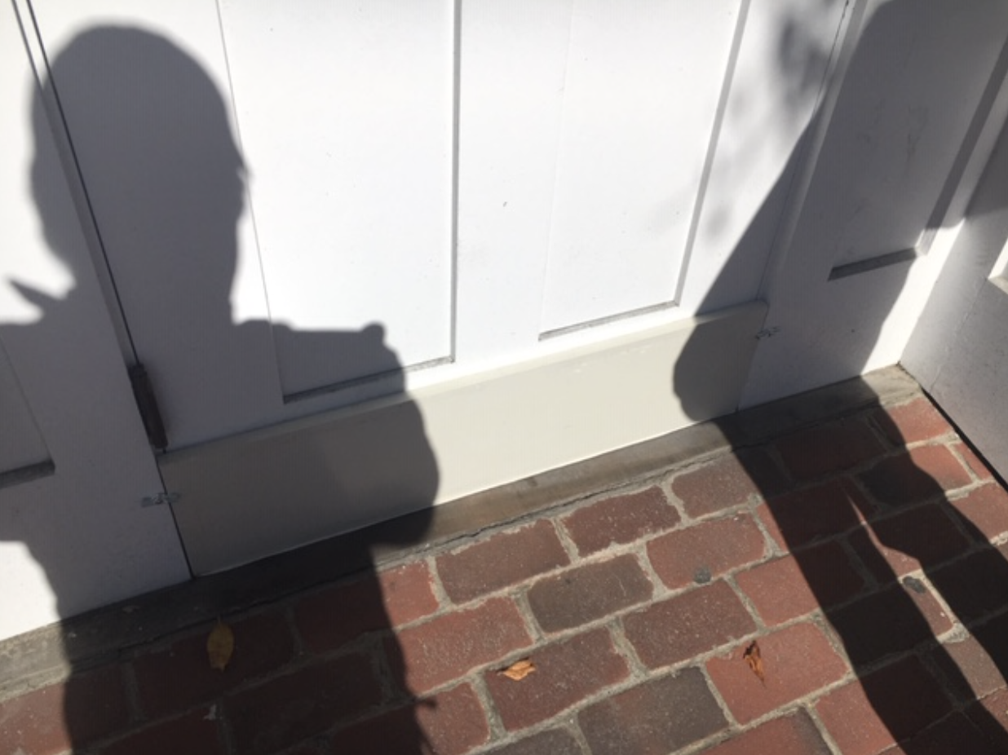
Current Flood Prevention Measures
Wet Vacs
Flood Sacks
Sandbags
Drop-in
Flood Barriers
Photos: McGrath Architecture, Ed Rudd and Samantha Turner
Notes:
st

Slide 26
Possible Solutions
Photo: Courtesy of the Nantucket Historical Association, December 1986
Notes:
https://nantuckethistory.org:443/permalink/?key=6000_i21471

Slide 27
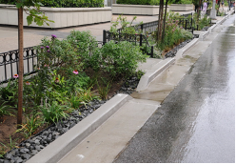
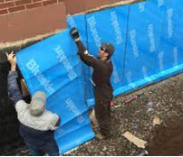
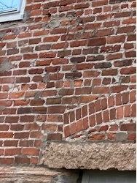
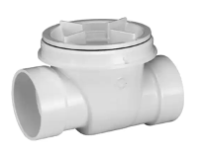
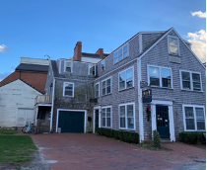
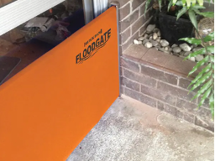
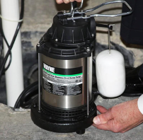
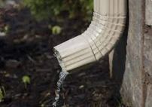
Potential Mitigation Strategies
Short Term (by 2030)
Landscape Adaptations
Dry Floodproofing
Rain garden
Self-adhesive membrane
Evaluate wall integrity and repoint
Install backflow valves
Elevation
Demolition and build elevated structure at 4 Whalers Lane
Flood gate in lower level bathroom
Sump pump
Clear downspouts
Notes:
st

Slide 28
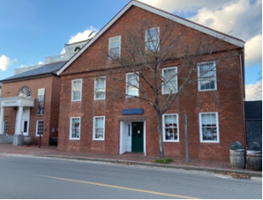
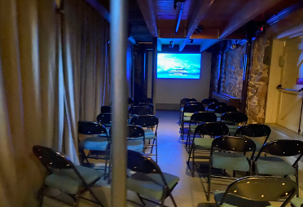
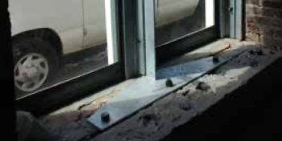
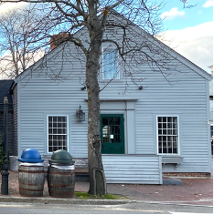
Potential Mitigation Strategies
Medium Term (2050-2070)
Dry Floodproofing
Wet Floodproofing / Elevation
Examine and maintain the structural integrity of the masonry
Raise floor to allow water to flow underneath
Elevate Discovery Center to aid with absorption
Structural reinforcement
Notes:
st

Slide 29
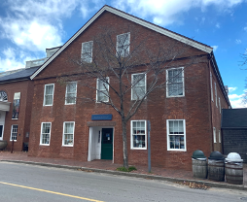
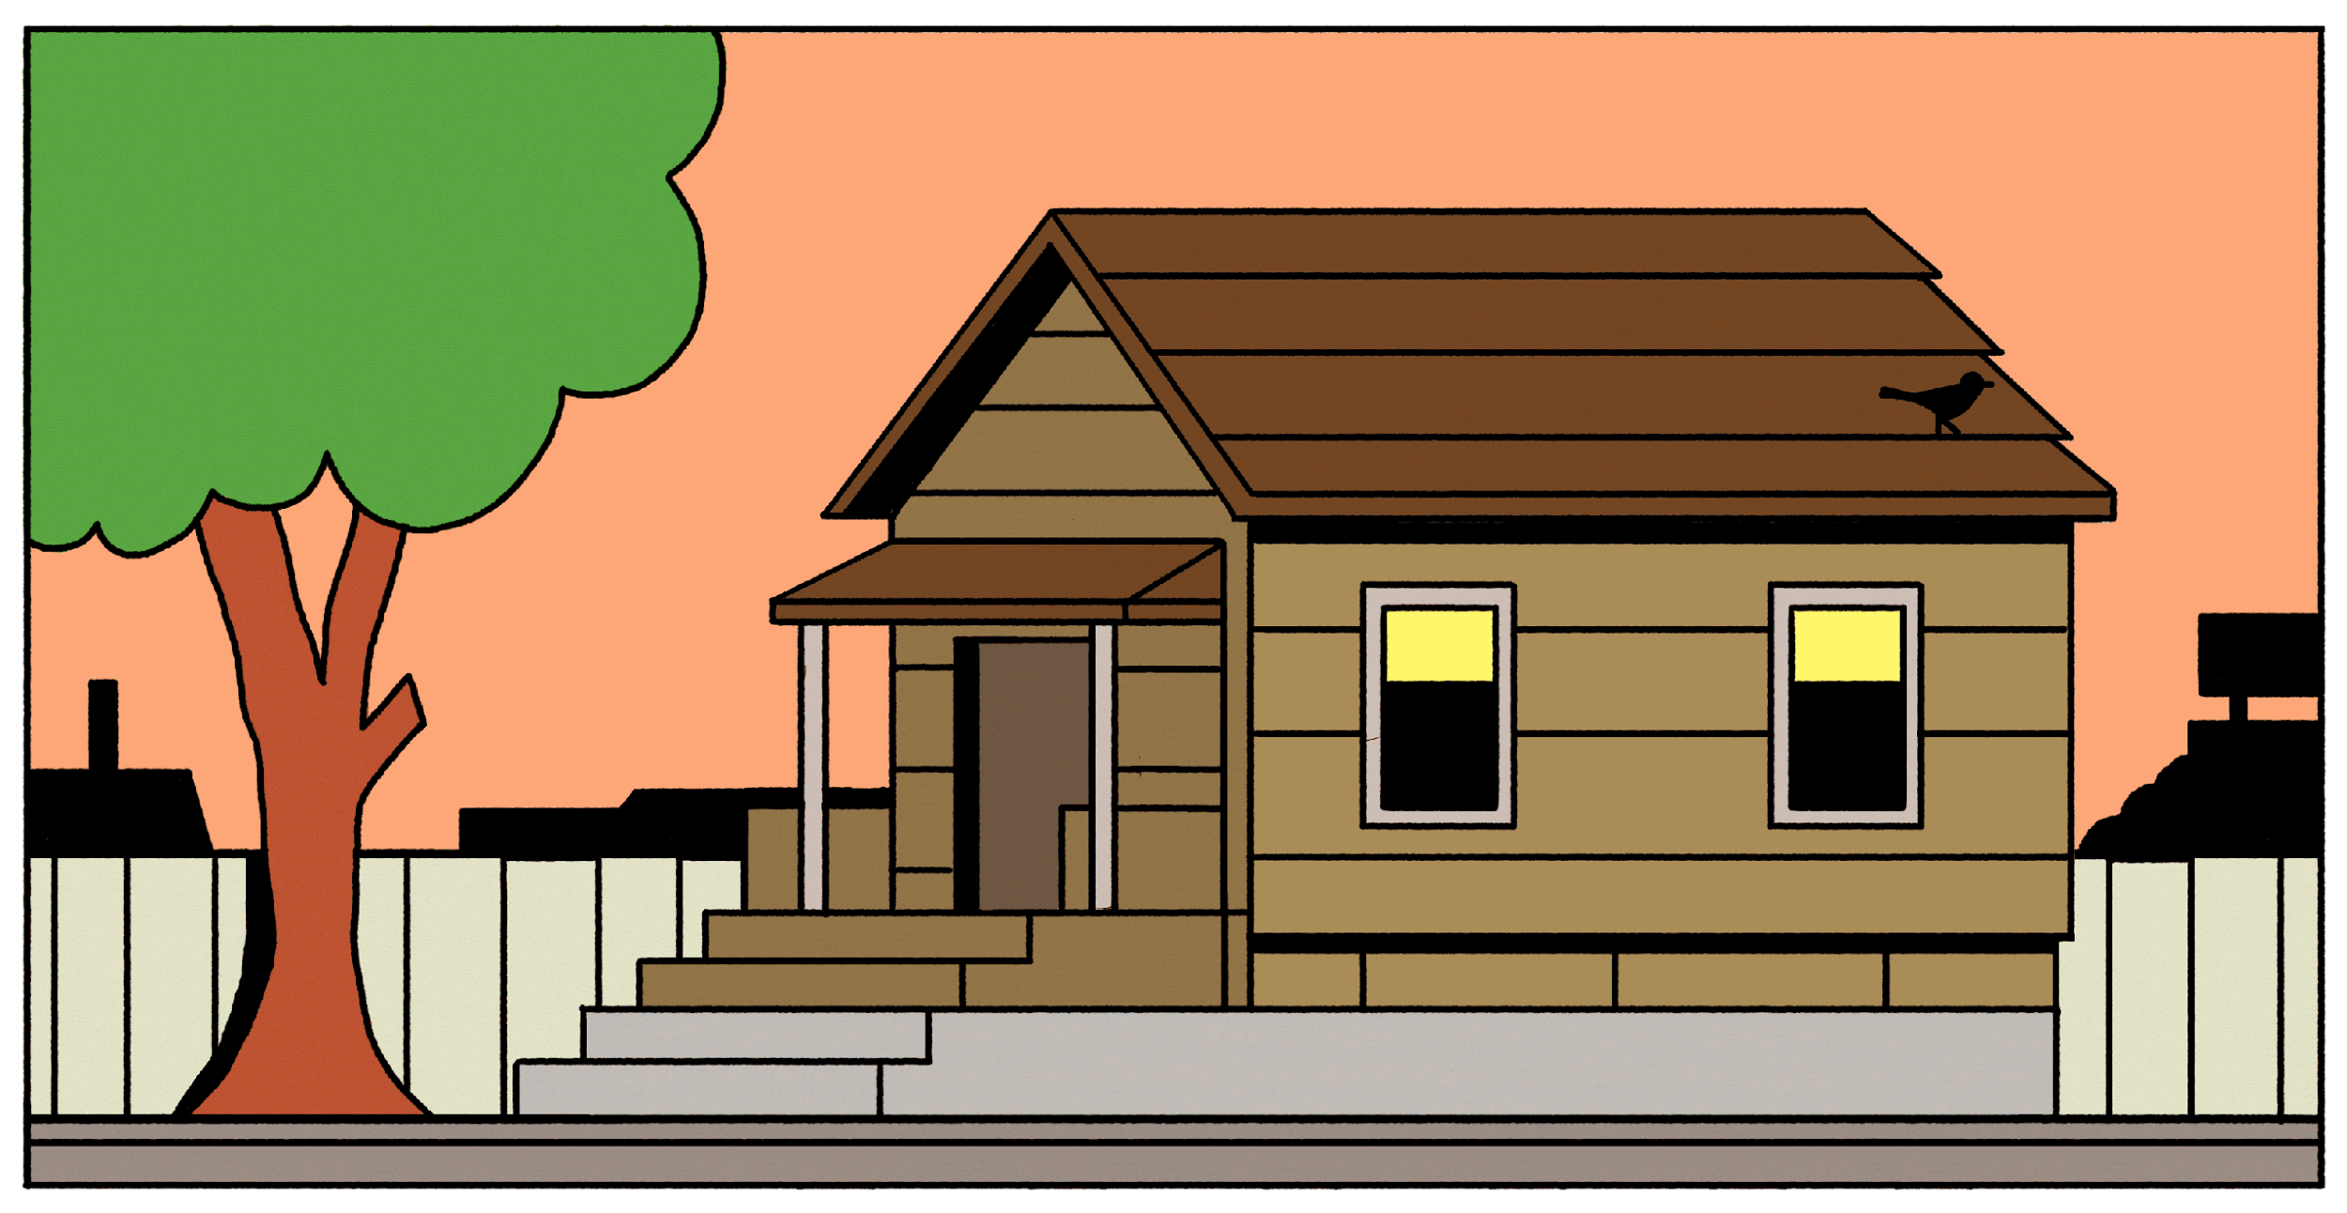
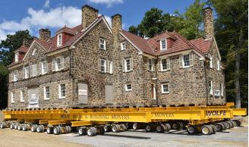
Potential Mitigation Strategies
Long Term (2100+)
Elevation
Assess feasibility to elevate structure
Adaptation
Retrofit with a Buoyant Foundation.
Retreat
Relocate structure to preserve and protect
Notes:
st

Slide 30
Acknowledgements
Nantucket Historical Association
Niles Parker
Ed Rudd
Mary Novissimo
Staff of the Whaling Museum and Research Library
Vince Murphy
Holly Backus
Peter Morrison
Advisors
Bruce Bursten
Dominic Golding
Photo: Ian Williams, January 2022

Slide 31
Thank you
Questions?
Photo: Ian Williams, January 2022
Notes:
st
https://www.ack.net/stories/winter-storm-watch-friday-night-through-saturday,27370

Slide 32
References:
Agresti, S. (n.d.). Illustration Of Amphibious Architecture - gif. A Floating House to Resist the Floods of Climate Change. Retrieved from https://www.newyorker.com/tech/annals-of-technology/a-floating-house-to-resist-the-floods-of-climate-change.
Backflow Valve. (n.d.). photograph. Retrieved from https://www.homedepot.com/p/OATEY-3-in-PVC-Backwater-Valve-43900/303424700..
Downspout. (n.d.). photograph. Retrieved from https://mastershield.com/downspout-facts/.
Petrella, L. (n.d.). Structural Reinforcement. photograph, Baltimore, MD; National Park Service. Retrieved from https://www.nps.gov/orgs/1739/upload/flood-adaptation-guidelines-2021.pdf.
Quick Dam Flood Gate. (n.d.). photograph. Retrieved from https://www.homedepot.com/p/Quick-Dam-Flood-Gate-Side-Rails-QDFGSIDES/306863276.
Rain Garden. (2019). photograph. Retrieved November 11, 2022, from https://rew-online.com/rain-garden-plan-will-kick-sewer-overflow-to-the-curb/.
Rudd, E. (n.d.). Enlargement - Bricks over North Elevation Doors Candle Factory. photograph.
Self Adhesive Membrane. (n.d.). photograph. Retrieved from https://www.waterproofmag.com/2013/01/choosing-a-peel-and-stick/.
Sump Pump. (n.d.). photograph. Retrieved from https://www.bobvila.com/articles/best-sump-pump/.
Turner, S. (2022). 4 Whalers Lane. photograph, Nantucket, MA.
Turner, S. (2022). Candle Factory - South Elevation. photograph, Nantucket, MA.
Turner, S. (2022). Candle Factory Lower Level Theater Area. photograph, Nantucket, MA.
Turner, S. (2022). Discovery Center - South Elevation. photograph, Nantucket, MA.
Walker Mansion Relocation. (n.d.). photograph, Edgeworth, PA. Retrieved from https://www.wolfehousebuildingmovers.com/project/walker-mansion-relocation/.
Nantucket Historical Association. (n.d.). Online Catalog. Nantuckethistory.org. Retrieved December 12, 2022, from https://nantuckethistory.org/
Photo: Ian Williams, January 2022

