Slide 1
Masters’ thesis
Effect of Continuous Shear Stress and Enzymatic Disaggregation on Cell Health and Secondary Metabolite Production in Taxus Plant Cell Culture
Caroline Rauber
Advisor : Pr. Susan Roberts
Notes:
This PowerPoint Template includes a series of slide masters with predefined layouts and color schemes for formatting slides
Slide Masters are displayed when you right click on a slide and select Layout from menu

Slide 2
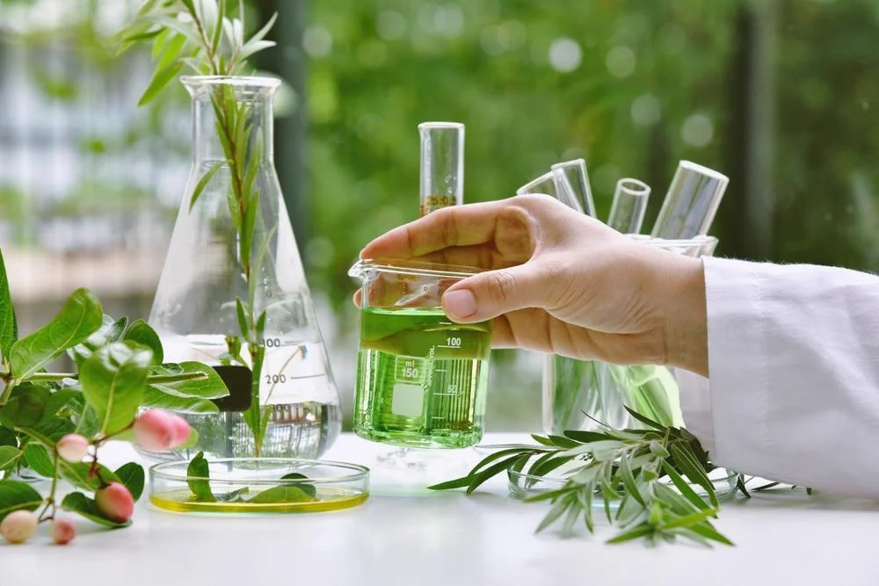
Medicinal plants are rich sources of specialized metabolites that are of great importance to plants, animals, and humans
Plants produce a variety of unique and bioactive compounds for defense and attraction of other organisms
Around 1,000 of 250,000 plant species have been found to possess significant anticancer properties
40% of the drugs behind the pharmacist’s counter in the Western world are derived from plants

Slide 3
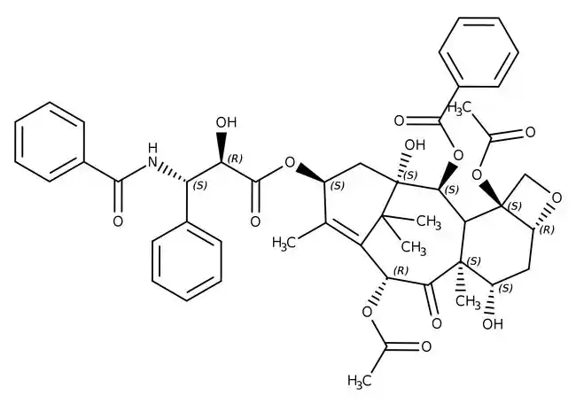

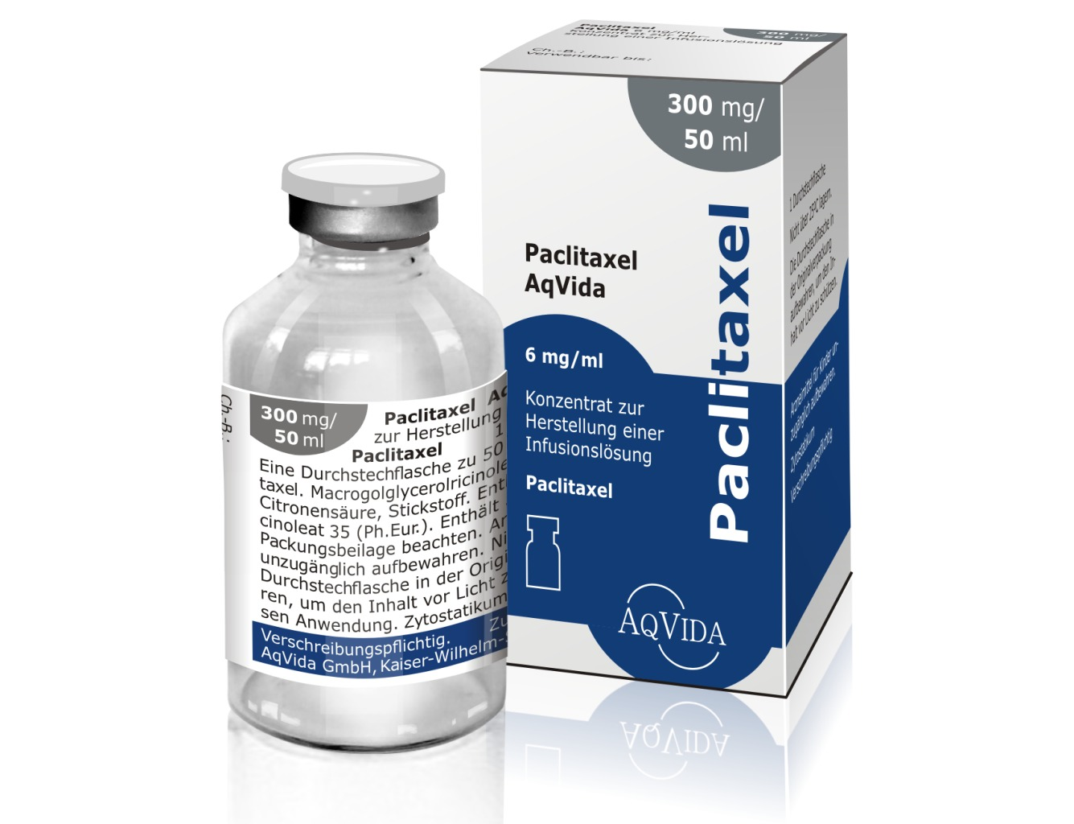
What is paclitaxel ?
Only 0.01% on a dry weight basis of paclitaxel can be found in the bark of the yew tree

Slide 4
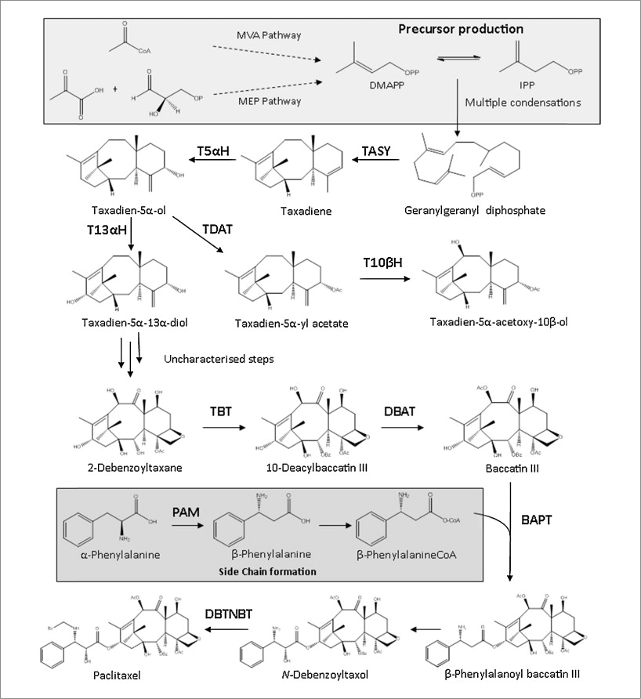
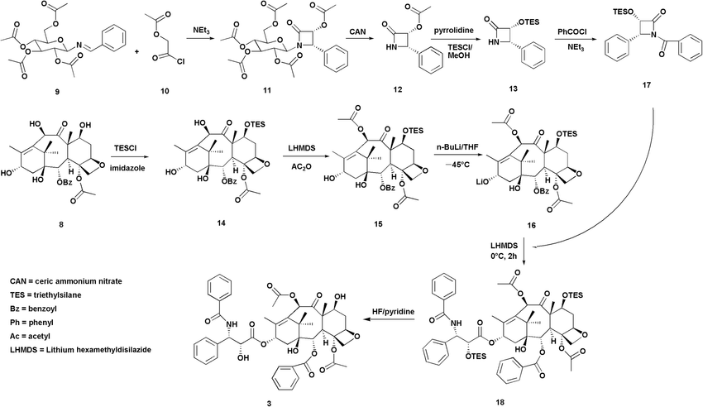
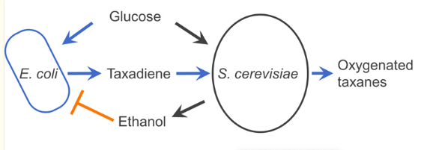
What are the methods to produce paclitaxel?
Total chemical synthesis
Semi-synthesis using 10-DAB
Complex and environmentally unfriendly purification
Production by bacteria or fungi
Very complex biosynthetic pathway leading to many unwanted side products
Limited due to difficult expression of cP450 in microbial systems

Slide 5
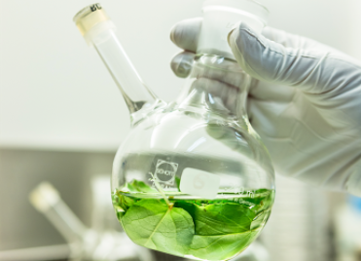


Why is plant cell culture (PCC) the best alternative?
Uniform and continuous paclitaxel quality
Production independent of seasonal and geographical variations
Environmentally friendly
Renewable resource

Slide 6
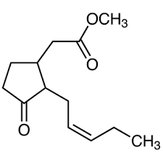
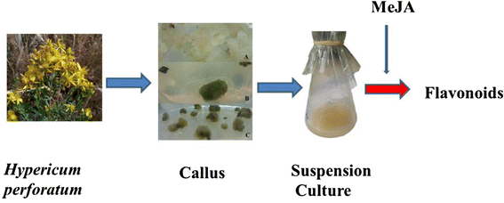
Methyl jasmonate elicitation

Slide 7
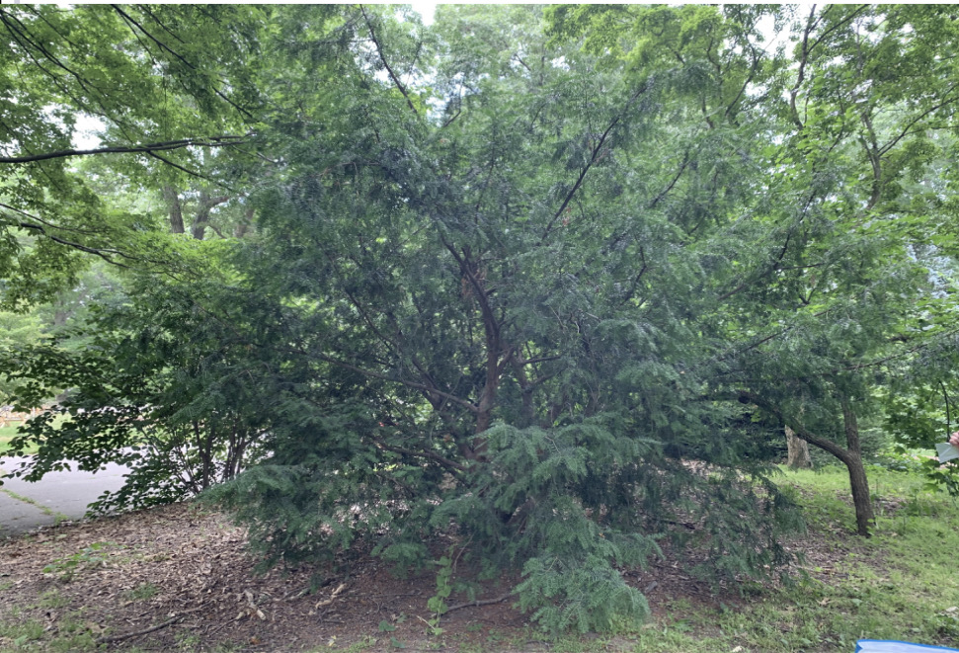
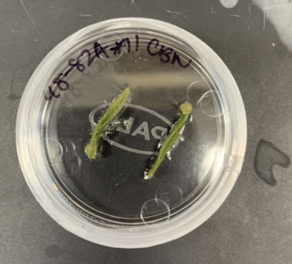
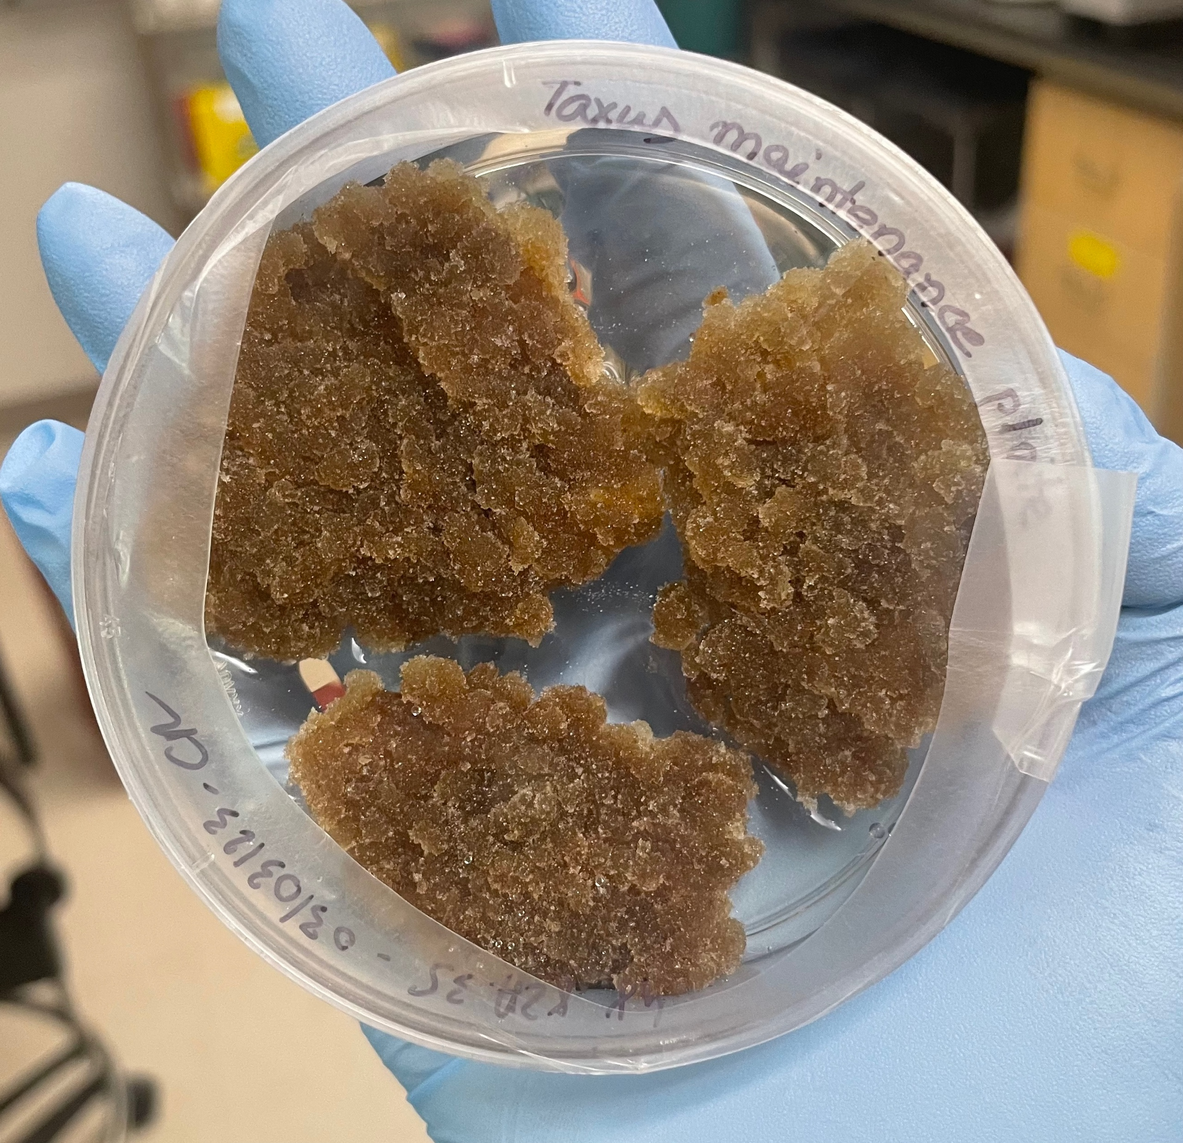
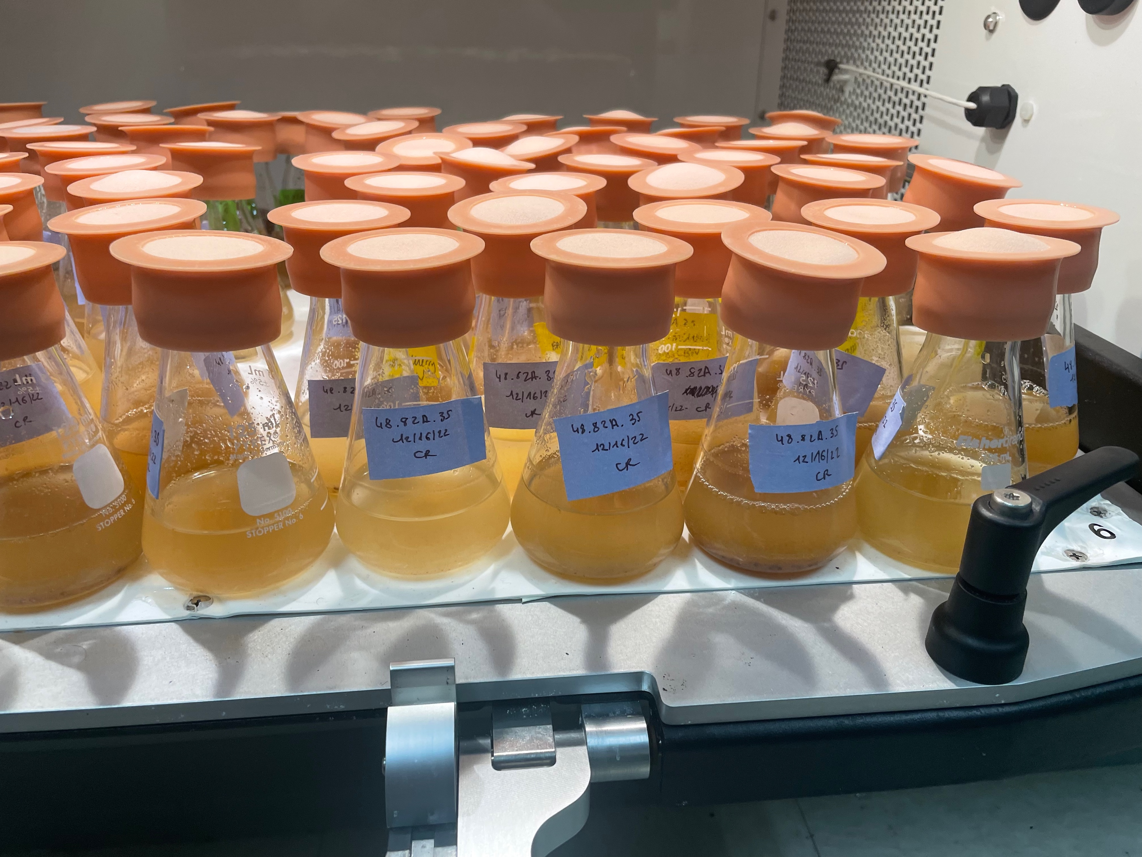
How does PCC work?
Taxus chinensis
Needles
Callus
Suspension

Slide 8
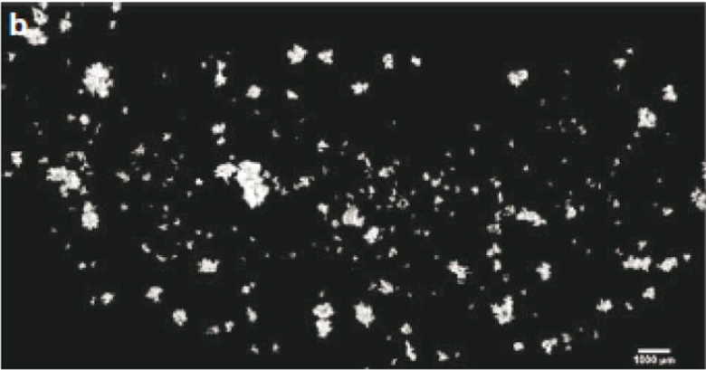
Aggregation phenomenon
Aggregates are connected via the middle lamella
They range from 100-2000 um
It leads to culture heterogenity, changes in growth, metabolism
Studies by filtration have shown that smaller aggregates accumulate higher levels of paclitaxel.
Composite image of aggregates stained with flourescein diacetate in Taxus cuspidata
Kolewe, M. et al. 2011 Biotechnology Progress, 27 (5), 1365-1372.

Slide 9
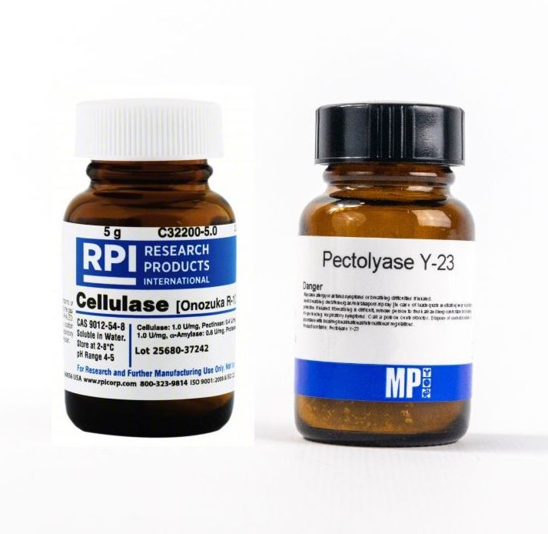
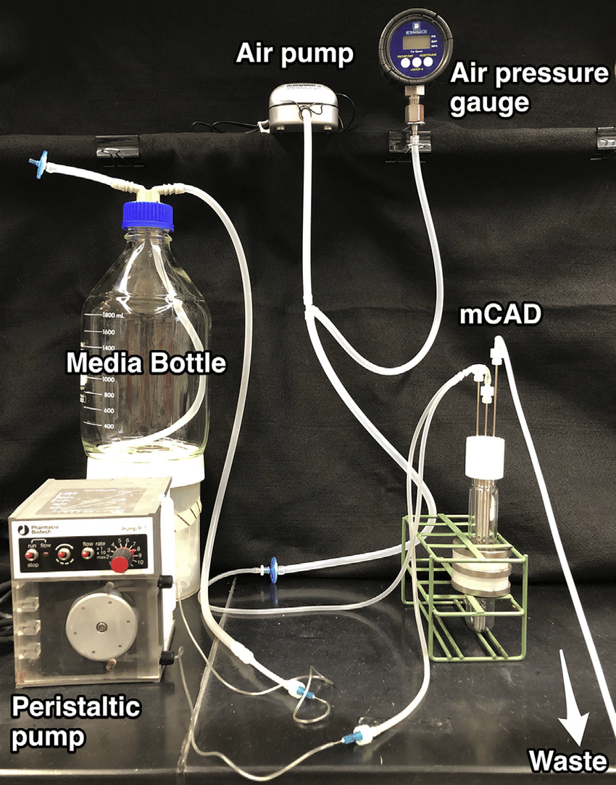

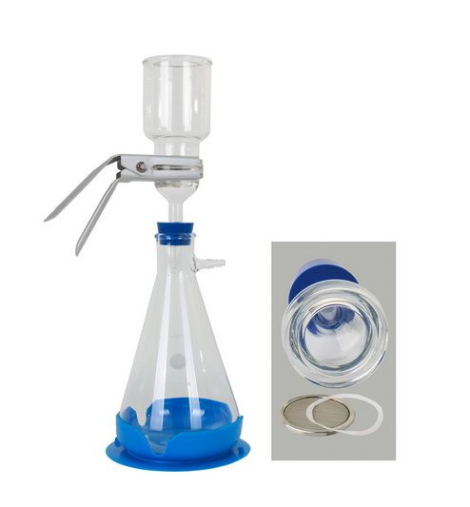
How can we break down the aggregates ?
Enzymes¹
Pressurized air chemostat³
Manual shearing²
Filtration⁴

Slide 10
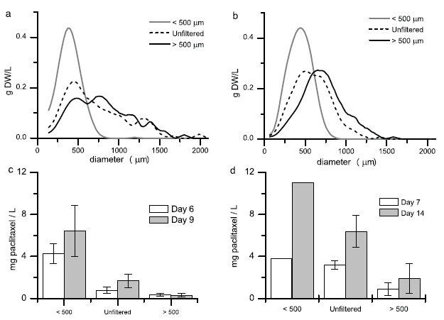
Aggregate size correlates with paclitaxel accumulation

Slide 11
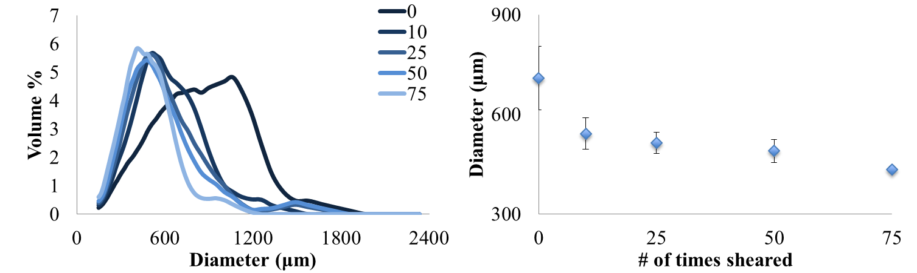
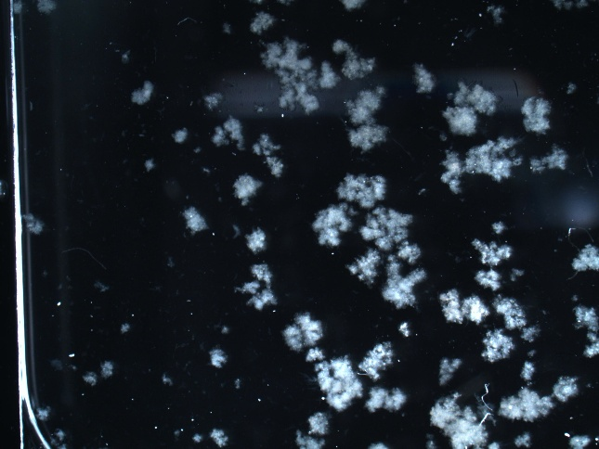

Manual shearing reduces aggregate size
Unsheared
Sheared 75 times

Slide 12
Aims of the research
Aim 1 : Design a device allowing continual shear stress on Taxus cultures with selected parameters (flowrate, intermittent or continuous shearing, shearing time and pipetting cycles) and perform short-term tests to determine the optimized parameters for promoting optimal cell health and dissociation of aggregates.
Aim 2 : Determine the long- term effect of continuous shearing combined with methyl jasmonate elicitation on taxoid production, global secondary metabolism and cell viability.
Aim 3 : Optimize the disaggregation protocol using enzymes and compare it to the shearing technique.

Slide 13
Methods
Results

Slide 14
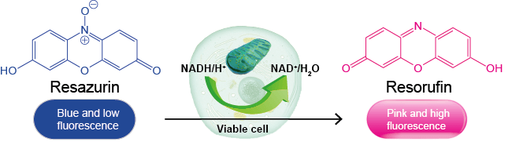
Resazurin cell metabolic activity assay
Metabolic activity is proportional to viability

Slide 15
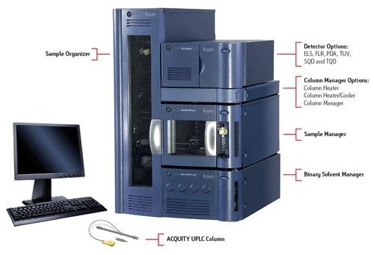
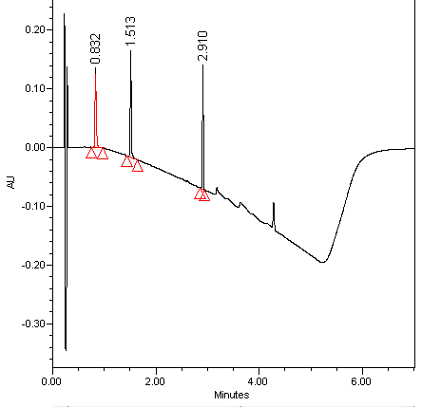
UPLC for measuring paclitaxel production
10-DAB
Baccatin III
Paclitaxel

Slide 16

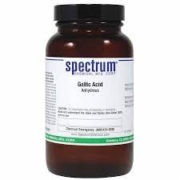
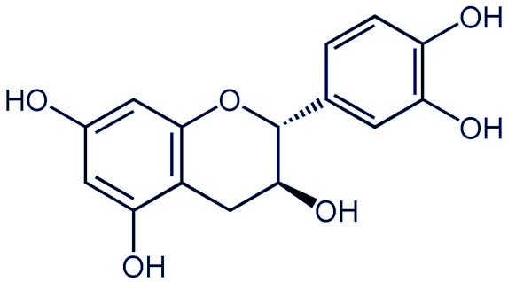
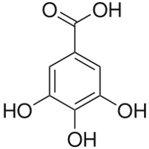
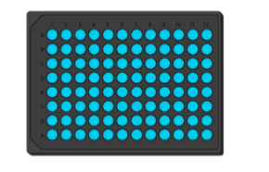
Global secondary metabolite analysis
Gallic acid standards for phenolics analysis
Catechin standards for flavonoids

Slide 17
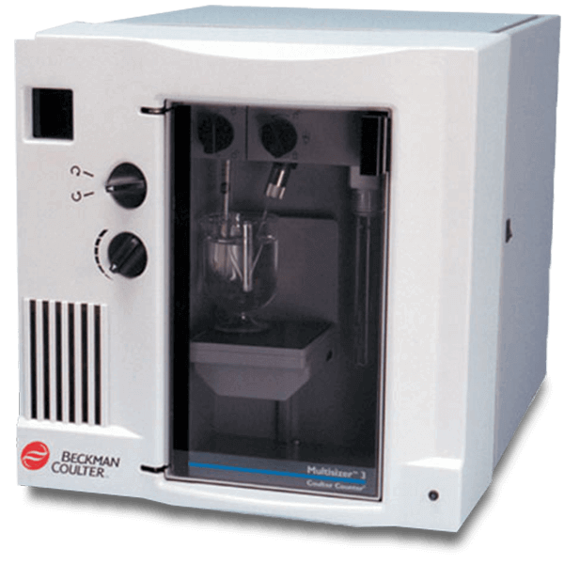
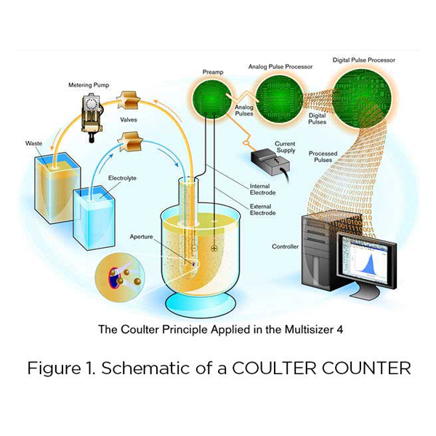
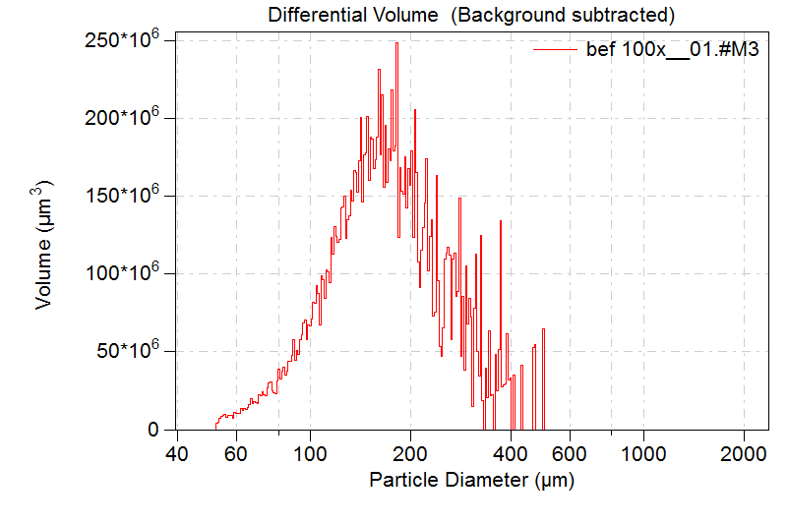
Coulter Counter for growth and aggregate size analysis

Slide 18
Aim 1 : Design a device allowing continual shear stress on Taxus cultures with selected parameters (flowrate, intermittent or continuous shearing, shearing time and pipetting cycles) and perform short-term tests to determine the optimized parameters for promoting optimal cell health and dissociation of aggregates.
Results

Slide 19
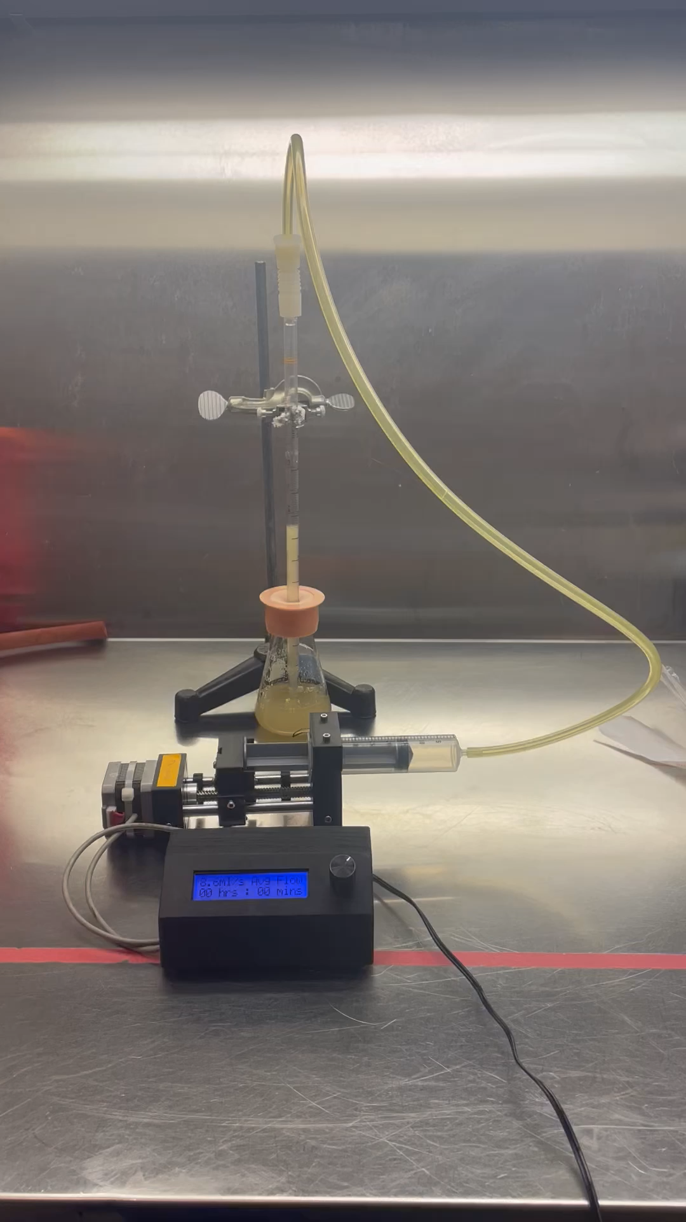
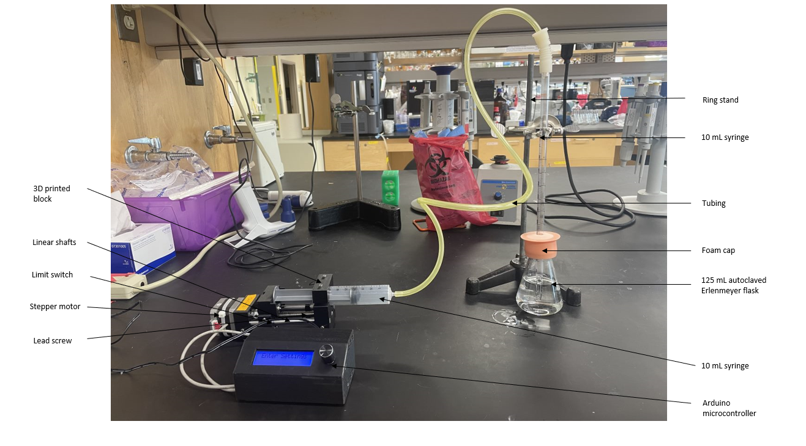
Automated shearing device

Slide 20
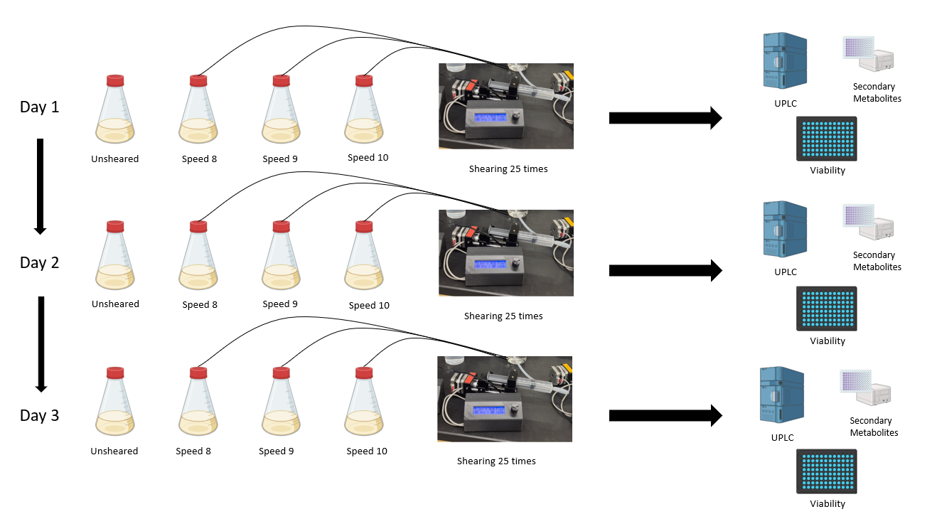

Preliminary testing of the shearing device
Speed 8 : 4.3 mL/s ; Speed 9 : 5.2 mL/s ; Speed 10 : 8.6 mL/s

Slide 21
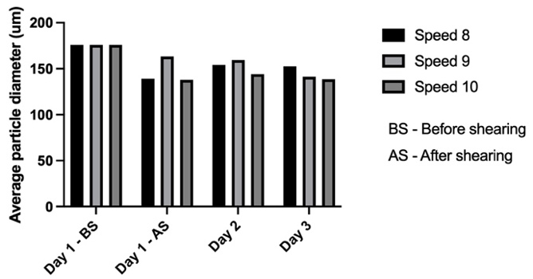
Aggregate size decreases upon automated shearing
At the end of Day 3:
Different flowrates did not impact cell metabolic activity or global secondary metabolites synthesis
Speed 8 | Speed 9 | Speed 10
152 μm | 141 μm | 138 μm

Slide 22
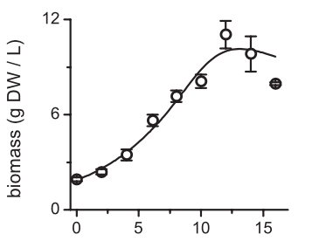
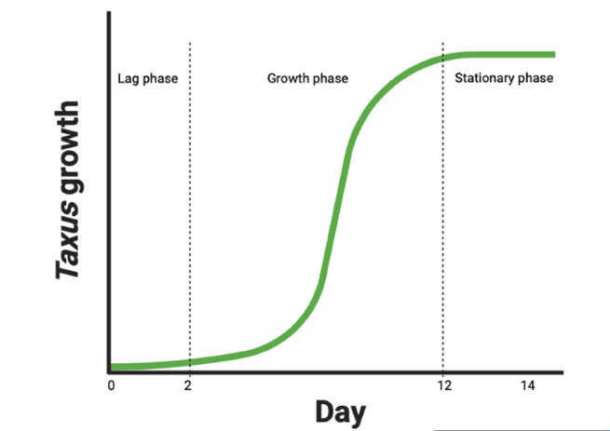
Does the device work differently on cultures of different ages?

Slide 23
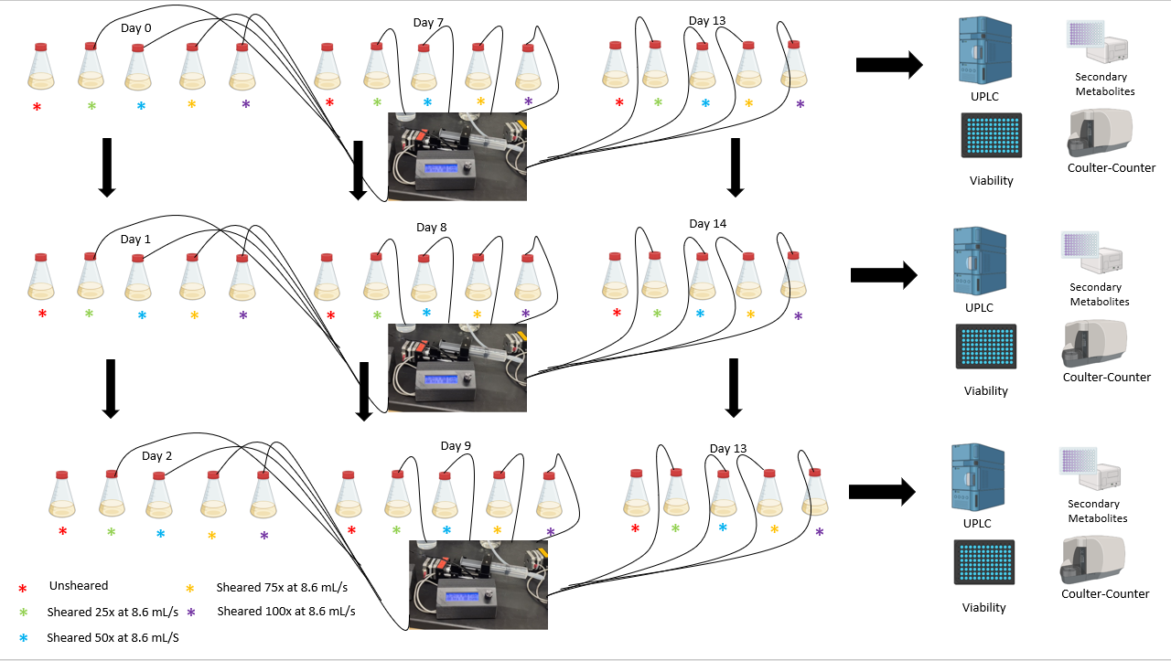
Test 1 : Intermittent shearing for different phases of the culture cycle

Slide 24
Intermittent shearing did not negatively impact cell metabolic activity
The highest metabolic activity was achieved during the exponential growth phase

Slide 25
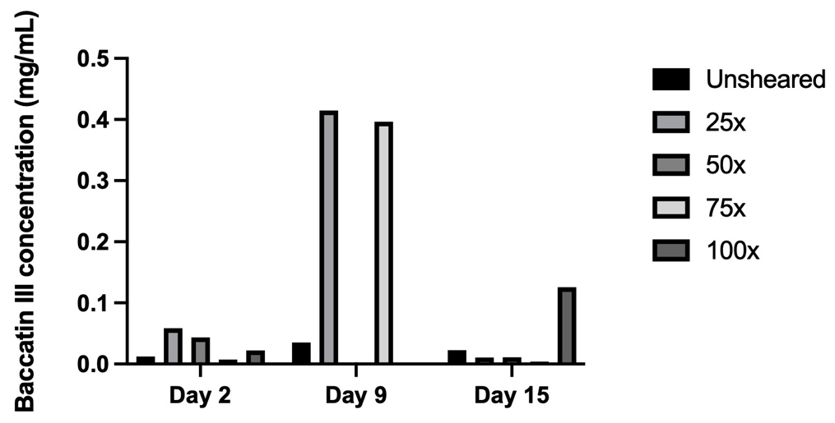
Baccatin III levels increased upon intermittent shearing
The highest levels of baccatin III (mg/mL) were found during the growth phase on Day 9, for sheared cultures

Slide 26
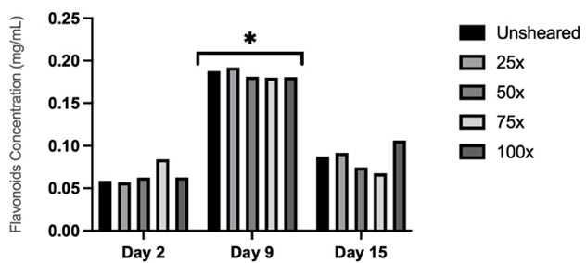
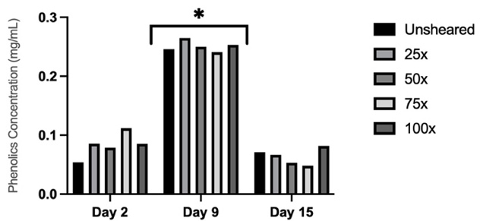
Low levels of intermittent shearing does not impact global secondary metabolism
Higher levels of phenolics (mg/mL) and flavonoids (mg/mL) were found for all types of cultures during the growth phase on Day 9.

Slide 27
Intermittent shearing decreased mean aggregate diameter
Lag phase
Exponential growth phase
Stationary phase

Slide 28
Low to moderate levels of intermittent shearing have no impact on cell growth
Higher numbers of shearing cycles have more impact on cell growth and health

Slide 29
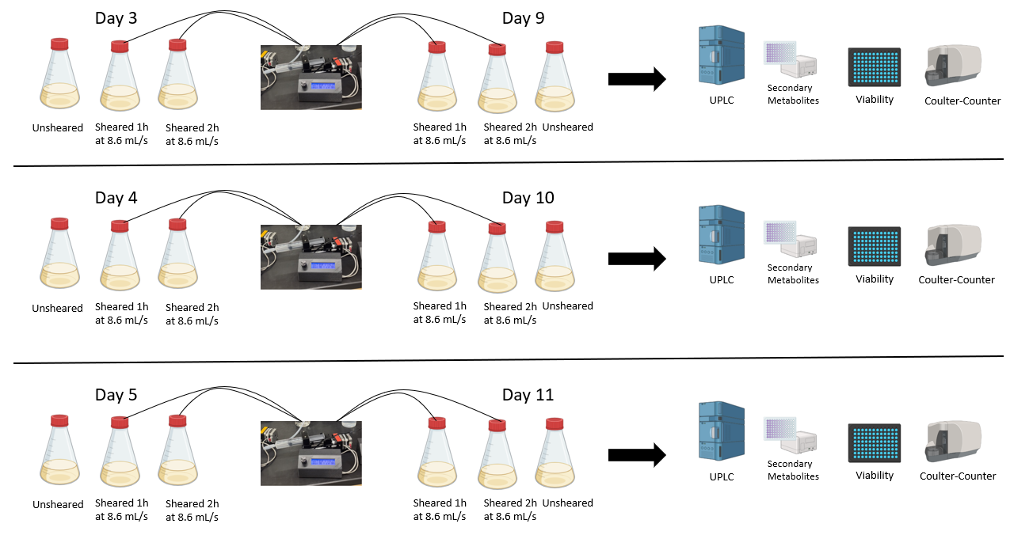
Test 2: Continuous shearing for distinct days of the exponential growth phase

Slide 30
Continuous shearing had no impact on cell metabolic activity during the exponential growth phase
During the exponential growth phase, the metabolic activity remains close to 100% for most cultures

Slide 31
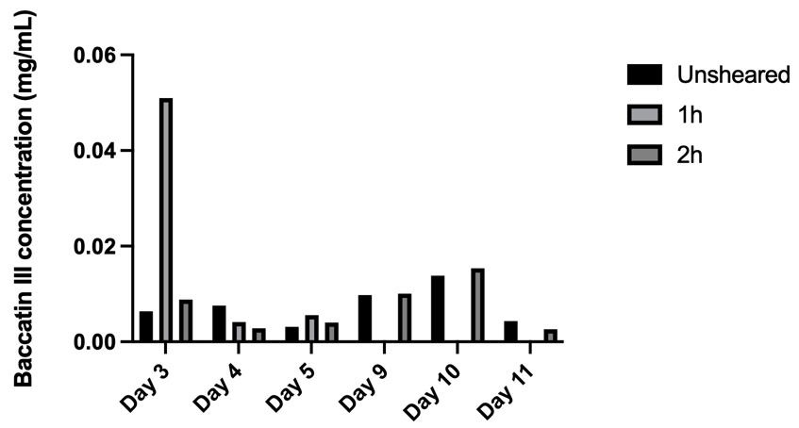
Baccatin III levels increased upon continuous shearing
The highest levels of baccatin III (mg/mL) were found during the growth phase on Day 3

Slide 32
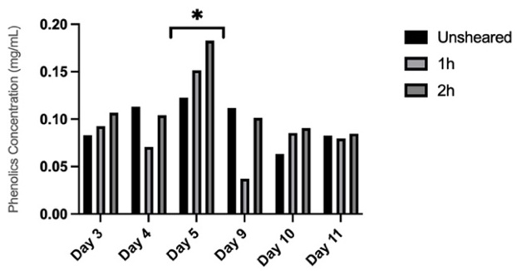
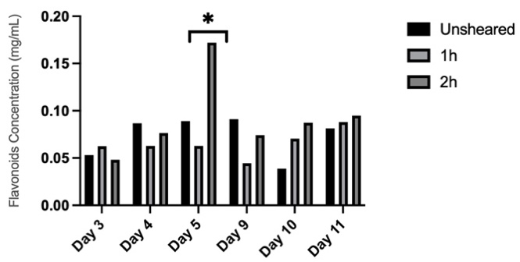
Global secondary metabolites increased with continuous shearing during exponential growth phase
There is a significant increase in phenolics and flavonoids concentration during the growth phase, confirming previous results

Slide 33
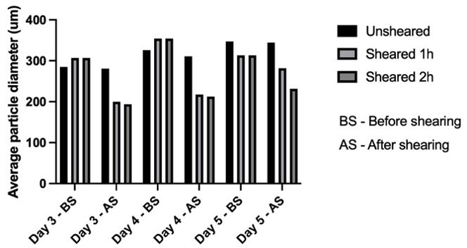
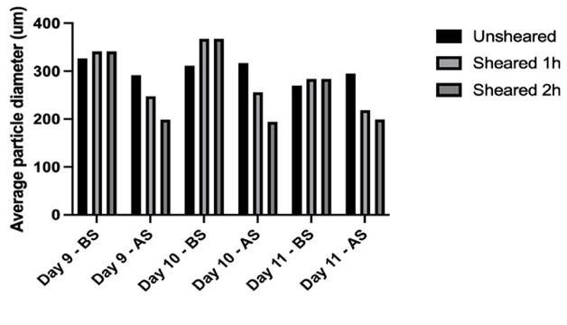
Longer continuous shearing times result in larger decrease in aggregate diameter
Cultures sheared for 2 hours have a more significant decrease in aggregate size than cultures sheared for 1 hour

Slide 34
Aim 2 : Determine the long-term effect of continuous shearing combined with methyl jasmonate elicitation on taxoid production, global secondary metabolism and cell viability.
Results

Slide 35
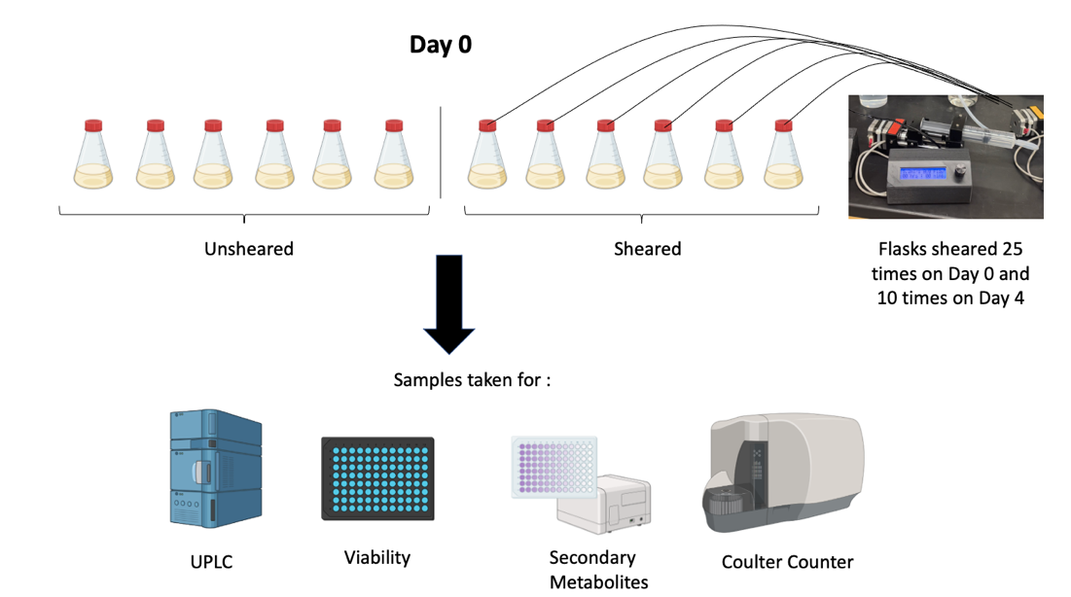
Long-term shearing experiment

Slide 36
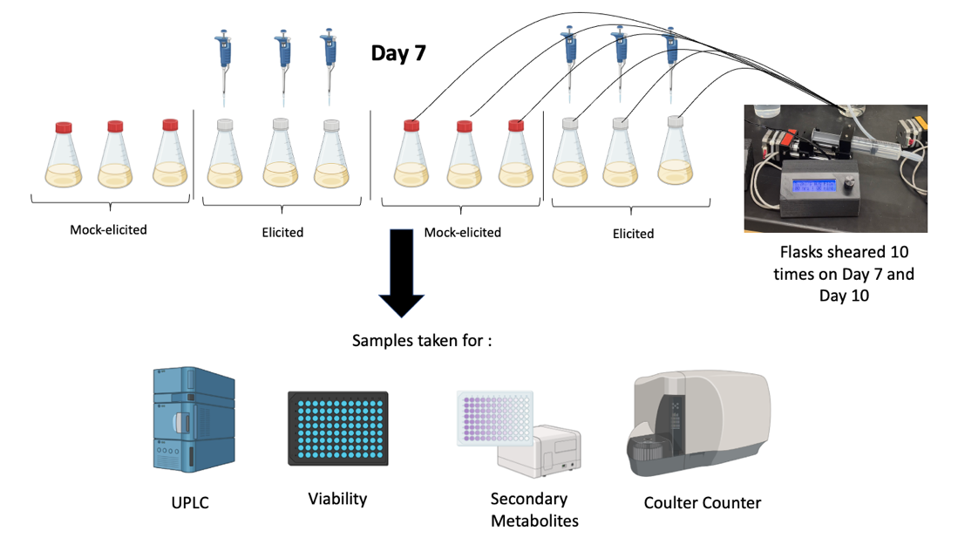
Long-term shearing experiment

Slide 37
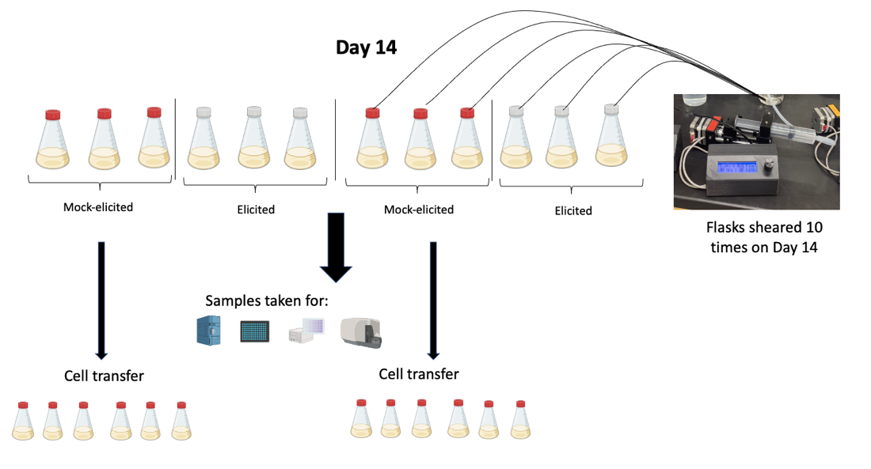
Long-term shearing experiment

Slide 38
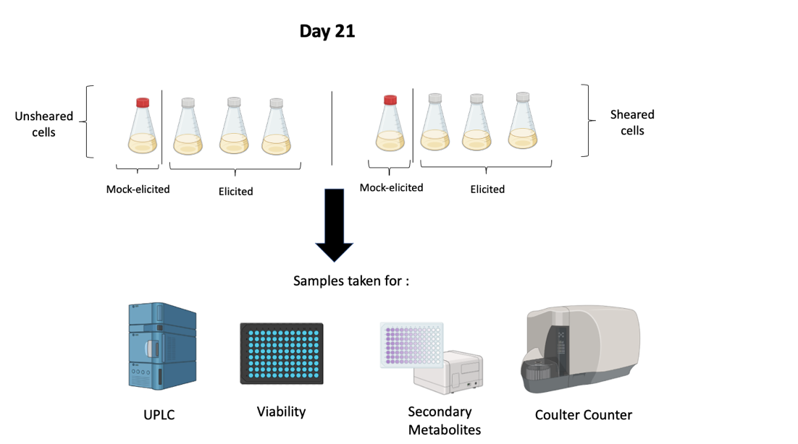
Long-term shearing experiment

Slide 39
Higher paclitaxel concentration found for sheared cultures
Most significant increase of paclitaxel production for sheared MeJa-elicited cultures

Slide 40
Shearing induced a slight increase in phenolics levels and had no impact on flavonoids

Slide 41
Long-term shearing decreased mean aggregate diameter
A significant decrease in mock-elicited sheared cultures was observed from day 0 before and after shearing

Slide 42
Long-term shearing impacted cell metabolic activity
Decrease in cell metabolic activity right after transfer on Day 0

Slide 43
Culture transfer impacted cell growth
Coulter-Counter volume (mL/L) =2.5*biomass (g/L)

Slide 44
Aim 3 : Optimize the disaggregation protocol using enzymes and compare it to the shearing technique.
Results

Slide 45

Comparison of enzymatic disaggregation and shearing

Slide 46
Shearing is the less impactful disaggregation method on cell metabolic activity
Metabolic activity for enzyme treatment
2.3 %
42.7 %
After more sterile conditions
were applied

Slide 47



Better cell separation was observed for sheared cells
Unsheared / Untreated
Sheared
Treated with enzymes
Aggreggate size reduction more significant for sheared cultures

Slide 48

Shearing resulted in the highest decrease in mean aggregate size
Aggreggate size reduction more significant for sheared cultures for four and five hours

Slide 49
Aims of the research
Aim 1 : Design a device allowing continual shear stress on Taxus cultures with selected parameters (flowrate, intermittent or continuous shearing, shearing time and pipetting cycles) and perform short-term tests to determine the optimized parameters for promoting optimal cell health and dissociation of aggregates.
Aim 2 : Determine the long- term effect of continuous shearing combined with methyl jasmonate elicitation on taxoid production, global secondary metabolism and cell viability.
Aim 3 : Optimize the disaggregation protocol using enzymes and compare it to the shearing technique.

Slide 50
Conclusion
Successful automated shearing device created
The most effective phase to shear the cells is the exponential growth phase / Low numbers of shearing cycles are recommended
Shearing technique more effective than enzymatic disaggregation
Increased levels of paclitaxel upon shearing

Slide 51
Future experiments
Short-term shearing experiment with methyl jasmonate during the exponential growth phase
Different concentrations of pectolyase and cellulase should be tested along with different lengths of treatment
Reproduce the long-term experiment with higher cell density
Test if increased levels of paclitaxel are the result of continuous shearing or simply the result of increased paclitaxel synthesis via smaller cellular aggregates

Slide 52
References
Brzycki C., “Secondary Metabolite Production in Plant Cell Culture: A New Epigenetic Frontier” https://doi.org/10.1007/978-3-030-58271-5_1
Dinicu A. (2022) Master’s thesis : “Effect of Shear Stress on Cell Health and Secondary Metabolite Production in Taxus Plant Cell Culture”
Enaksha R.M., et al., (1994) « Taxus Cell Suspension Cultures: Optimizing Growth and Production of Taxol” https://doi.org/10.1016/S0176-1617(11)80541-9
Furusaki S., et al., (2011) “ Plant Cell Culture”. Retrieved March 13th 2023, from https://www.sciencedirect.com/topics/immunology-and-microbiology/plant-cell-culture
Gibson D.M., et al., (1993) “Initiation and growth of cell lines of Taxus brevifolia (Pacific yew)” https://doi.org/10.1007/BF00236091
Graham M.D., et al., (2003) « The Coulter Principle: Foundation of an Industry” https://doi.org/10.1016/S1535-5535-03-00023-6
Halder M., et al., (2019) “Elicitation: A biotechnological tool for enhanced production of secondary metabolites in hairy root cultures” DOI: 10.1002/elsc.201900058
Howat S., et al., (2014) “Paclitaxel: biosynthesis, production and future prospects” https://doi.org/10.1016/j.nbt.2014.02.010
Jun Kim B., et al., (2005) “Relationship of Viability and Apoptosis to Taxol Production in Taxus sp. Suspension Cultures Elicited with Methyl Jasmonate” DOI : 10.1021/bp050016z
Kampam M., et al., (2015) “Paclitaxel and Its Evolving Role in the Management of Ovarian Cancer” https://doi.org/10.1155/2015/413076
Ketchum R., et al., (1999) “The kinetics of taxoid accumulation in cell suspension cultures of Taxus following elicitation with methyl jasmonate” https://doi.org/10.1002/(SICI)1097-0290(19990105)62:1<97::AID-BIT11>3.0.CO;2-C
Kolewe M., et., (2011) “A population balance equation model of aggregation dynamics in Taxus suspension cell cultures” https://doi.org/10.1002/bit.23321
Kolewe M., et al., (2011) “Analysis of aggregate size as a process variable affecting paclitaxel accumulation in Taxus suspension cultures” https://doi.org/10.1002/btpr.655
Kolewe M., et al., (2010) “Characterization of aggregate size in Taxus suspension cell culture” https://doi.org/10.1007/s00299-010-0837-5
Kuete V. (2017) “Anticancer Activities of African Medicinal Spices and Vegetables” https://doi.org/10.1016/B978-0-12-809286-6.00010-8
Kurz W.G.W, (1971) “A chemostat for growing higher plant cells in single cell suspension cultures” https://doi.org/10.1016/0014-4827(71)90104-2
McKee M., et al., (2021) “The Interface amongst Conserved and Specialized Pathways in Non-Paclitaxel and Paclitaxel Accumulating Taxus Cultures” https://doi.org/10.3390/metabo11100688
Naill M. (2012) “Paclitaxel uptake and transport in Taxus cell suspension cultures” https://doi.org/10.1016/j.bej.2012.01.006
Naill M., (2004) “Preparation of singke cells from aggregated Taxus suspension cultures for population analysis” https://doi.org/10.1002/bit.20083
Nielsen E., et al., (2019) “Improvement of phytochemical production by plant cells and organ culture and by genetic engineering” https://doi.org/10.1007/s00299-019-02415-z
Patil R., et al., (2013) “Cellular aggregation is a key parameter associated with long term variability in paclitaxel accumulation in Taxus suspension cultures” https://doi.org/10.1007/s11240-012-0237-3
Resazurin Assay Kit (Cell Viability) (ab129732) (Updated In 2019) https://www.abcam.com/products/assay-kits/resazurin-assay-kit-cell-viability-ab129732.html
Samokhin A. S. (2020) “Syringe Pump Created using 3D Printing Technology and Arduino Platform” https://doi.org/10.1134/S1061934820030156
Siegel R., et al. (2023) “Cancer statistics, 2023” https://doi.org/10.3322/caac.21763
Wilson S., et al. (2020) “A population balance model to modulate shear for the control of aggregation in Taxus suspension cultures” https://doi.org/10.1002/btpr.2932
Zhong J., (2002) “Plant Cell Culture for Production of Paclitaxel and Other Taxanes” https://doi.org/10.1016/S1389-1723(02)80200-6

