Slide 1
Cycling Without Age IT Strategy
Worcester Polytechnic Institute
Copenhagen, Denmark 2023

Slide 2
Meet our team
Codey Battista
Lily Lancellotti
Kristin Lavoie
Biomedical Engineering
Biochemistry
Data Science

Slide 3
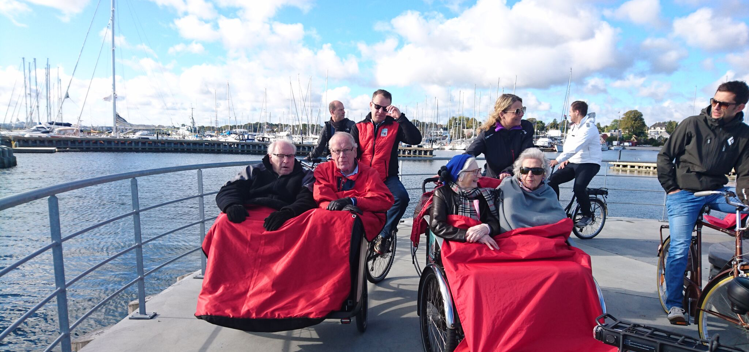
Cycling Without Age
NGO improving the lives of seniors through trishaw rides
Growth of 125% in last 5 years

Slide 4
The Problem
CWA's growth has revealed inefficiencies, resulting in a fragmented and disorganized IT strategy
Notes:
Talk about lack of integration

Slide 5
Our Mission
Analyze CWA’s current IT strategy to suggest a new strategy better suited for their continued growth while prioritizing their values and resources

Slide 6
Our Objectives
Identify​
Determine
Develop
Identify CWA needs and the effectiveness of existing IT platforms
Determine if better systems or integration are available
Develop an IT Strategy for future growth and CWAs values

Slide 7
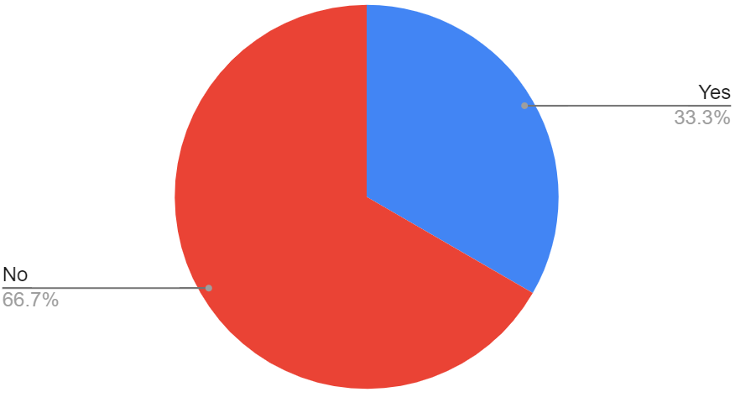
WordPress and CMS
Do you use the shared WordPress?
Recommendations
Partners
Limit users of the site
Create templates/Manual for how to use
Integrate with other sources
Affiliates

Slide 8
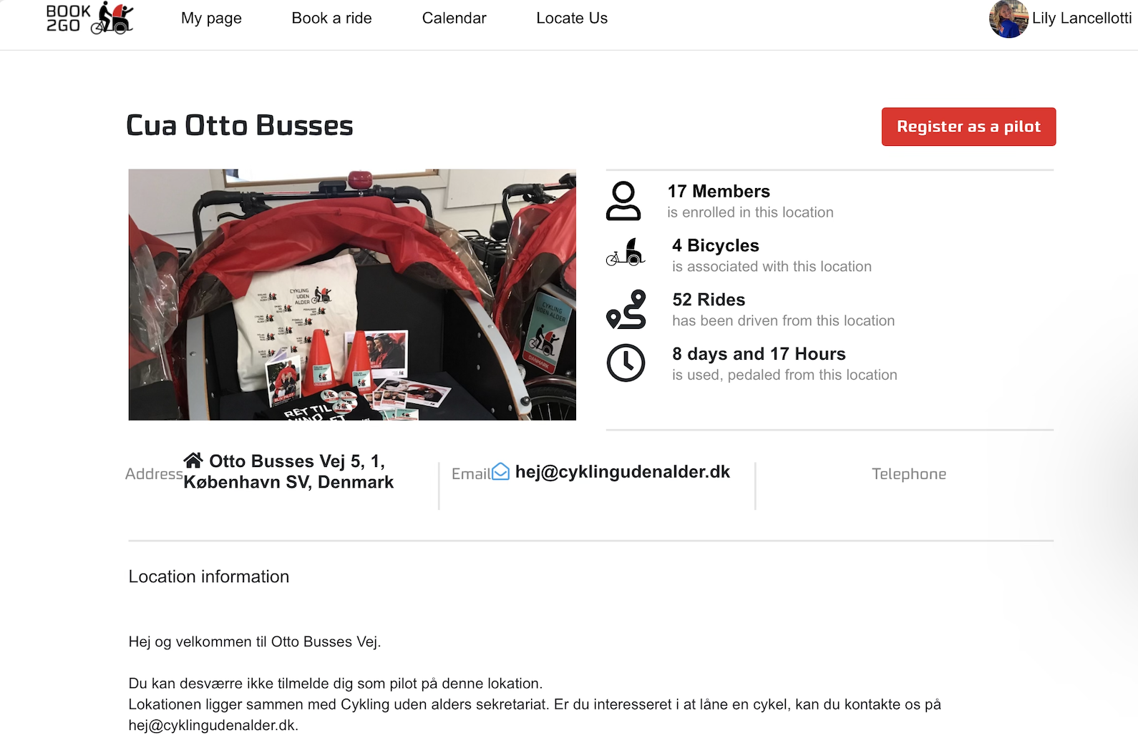
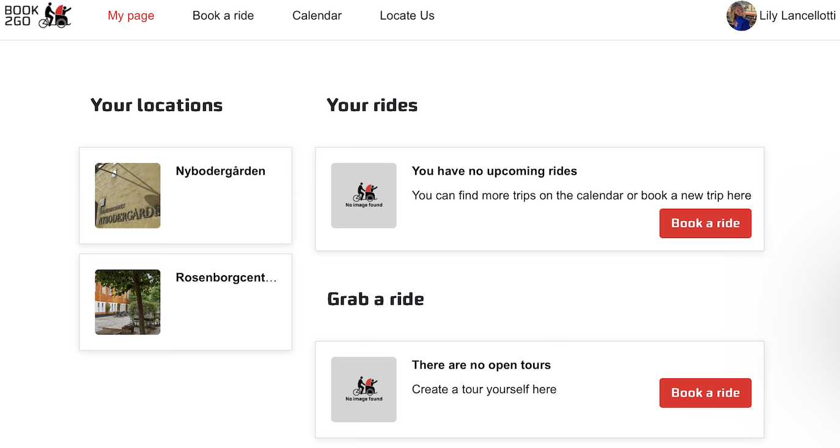
Book2Go
RECOMMENDATIONS
Each chapter gets their own page
Individual site linked from here
Populates map
Updates to ride booking/calendar
Updated permissions (relating to coordinator)

Slide 9
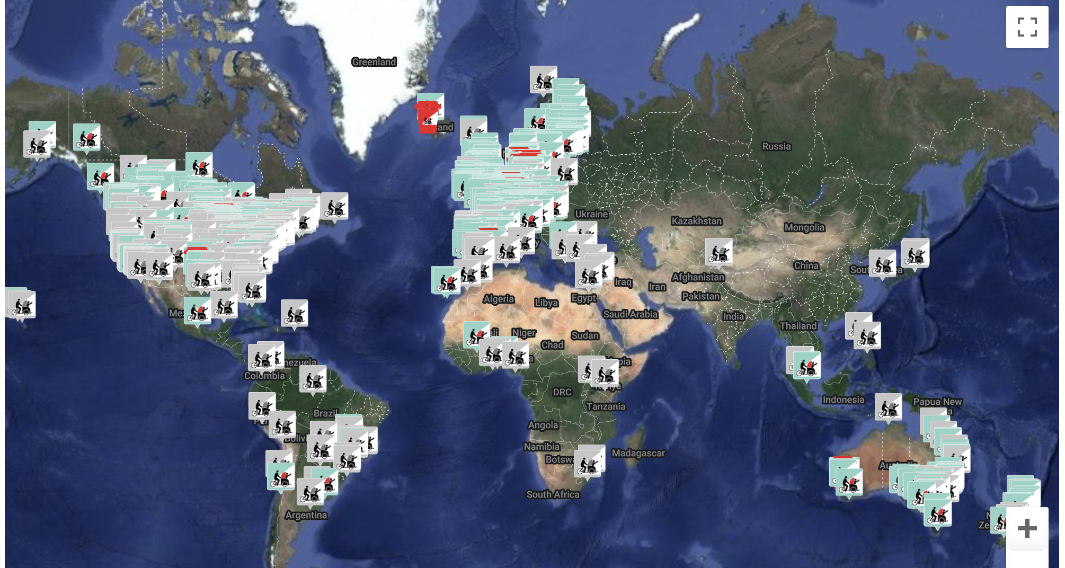
The WordPress Map is Flawed

Slide 10
CWA should move to the Book2Go Map

Slide 11
Podio and CRM
Podio
Forms and CRM
Doesn’t integrate well
Fragmented presence
Other CRM
Use internationally and individually
Monday or CiviCRM
Notes:
Talk about the levels, how Monday would be used by both partners and chapters, and any value internationally

Slide 12
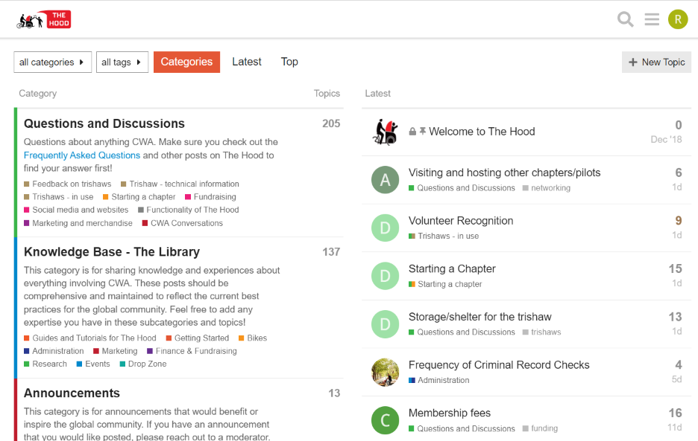
The Hood Lacks Structure and Moderation
Recommendations:
Added structure to The Hood
Categories
Added Moderators
Ability to Translate

Slide 13
Concluding Feedback
Lacking Integration within IT
Need Accessibility within IT
Needing an Online Presence and Marketing
Connection to Effective Booking Platform
Desire for a Single Sign On (SSO)
Therefore…
Option 1:
Enterprise Integration Dashboard
Option 2:
WordPress Integration

Slide 14
Enterprise Integration Dashboard Option 1
Most Prevalent Available Platforms:
Make (Integromat) – Most Valuable Dashboard
Zapier – Best Dashboard with Extra Features
NeonCRM – CRM that can be Integrated with Zapier
Kindful – CRM with Available Dashboard
Okta – Best for Security Purposes
Benefits:
Individual SSO
Customization
Easily Accessible

Slide 15
WordPress Integration Option 2
Benefits:
Cost Effective
Localized
Book2Go
Notes:
Add donation page to Wordpress site
Provide marketing resources and advice via the hood
Paypal, Venmo etc

Slide 16
Final Recommendations
1
2
3
4
5
Selection of One of the Integration Options
Continued Development of Book2Go
Wordpress Permission Updates
Added Structure to the Hood and Increased Fundraising Tools
Adoption of a CRM

Slide 17
Thank you! Questions?
Email: gr-d23-cwait@wpi.edu

