Slide 1
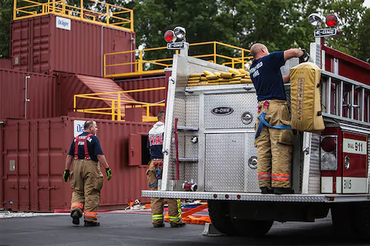
LIVE FIRE TRAINING STRUCTURE
El Cuerpo de Bomberos de Costa Rica
Hannah Borges, Ava Schlesinger, Liam Spence, Connor Sullivan
[1]

Slide 2
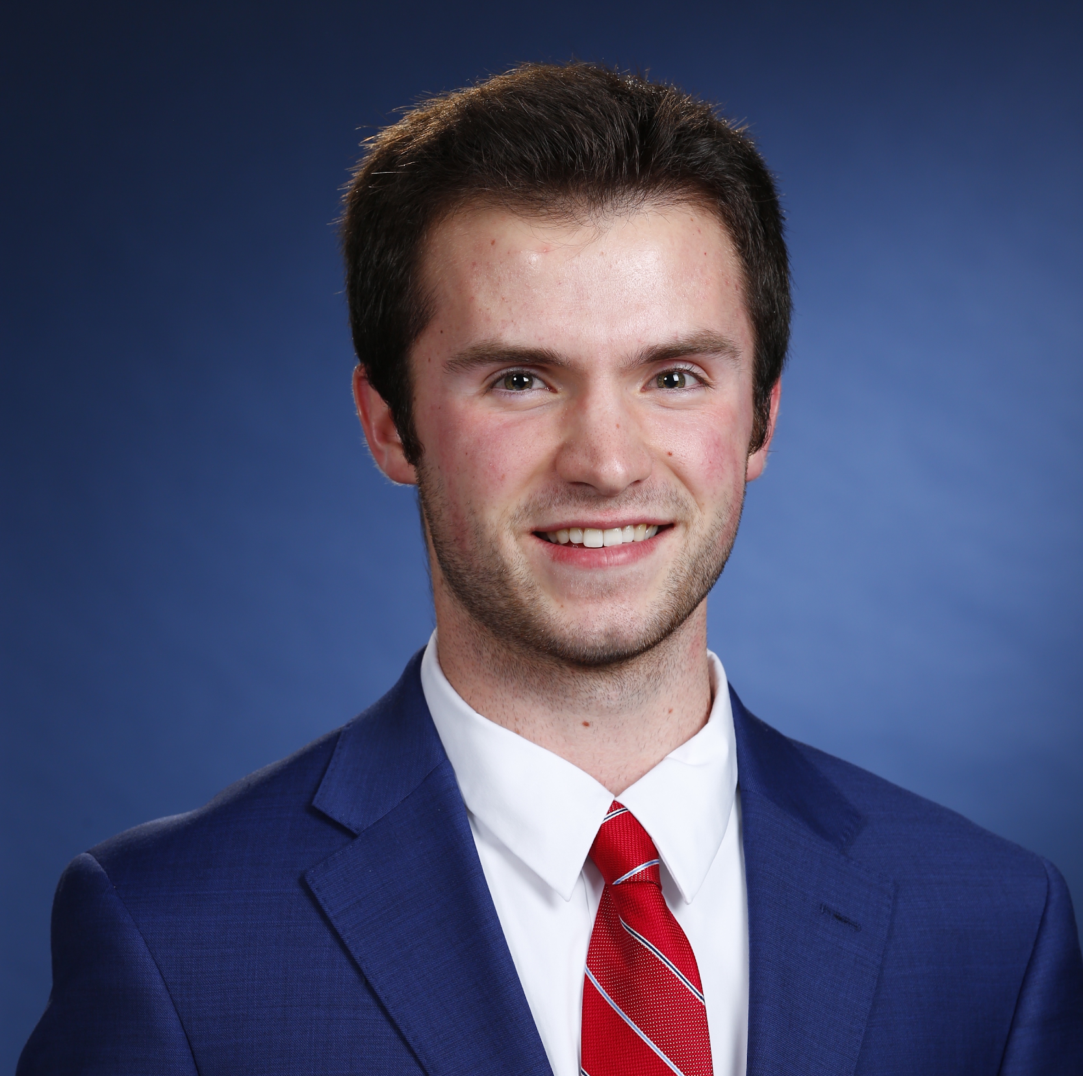
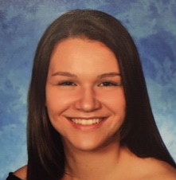
TEAM MEMBERS
Hannah Borges
Liam Spence
Ava Schlesinger
Connor Sullivan
Biomedical Engineering
Mechanical Engineering
Civil Engineering
Mechanical Engineering

Slide 3
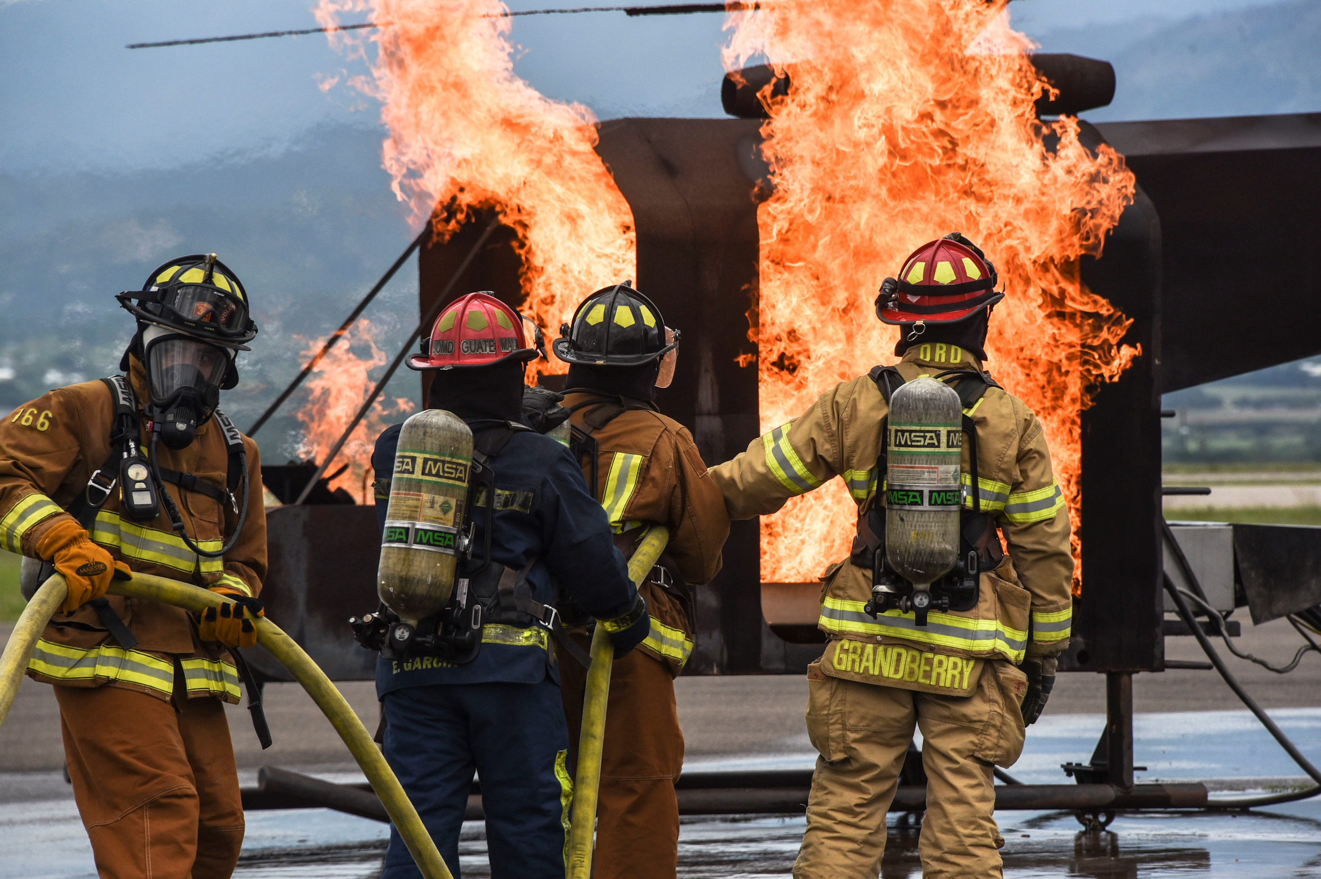
PROJECT GOAL
The goal of our project was to investigate and define the elements needed to design a live fire training structure on the Bomberos’ training ground. We focused on maintaining high levels of safety with respect to feasibility to ensure that the training structure was well-received by the Bomberos.
[2]

Slide 4
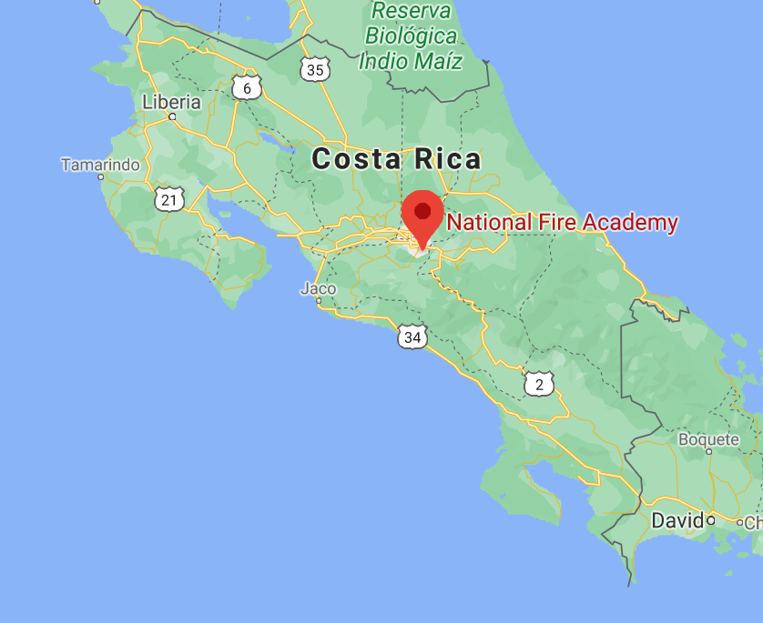
SAN JOSÉ,
COSTA RICA
Dry season occurs between November and April;
Greater Metropolitan Area (GAM) accounts for 4% of Costa Rica’s land;
More than 50% of country’s population lives in the GAM;
[3]

Slide 5
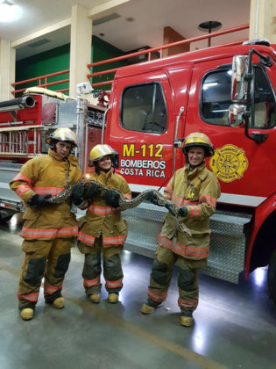
WHO ARE THE BOMBEROS?
Organization responsible for controlling fires and maintaining the safety of Costa Rican citizens;
Trained at the National Fire Academy;
Requested a design for a new fire training tower.
[4]

Slide 6
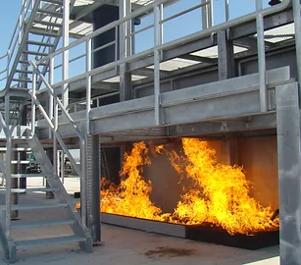
FIRE TRAINING STRUCTURES
A decrease in fire incidents led to the necessity of fire simulators.
To be prepared for real situations, firefighters need hands-on skills development.
There are many different simulators that integrate modern construction models and techniques.
[5]

Slide 7
TIMELINE
OBJECTIVE 2
OBJECTIVE 4
Research of Fire Protection code
Establish set of requirements
OBJECTIVE 1
OBJECTIVE 3
OBJECTIVE 5
Background research of training structures
Interviews with fire professionals
Modeling and design of tower

Slide 8
TIMELINE
OBJECTIVE 2
OBJECTIVE 4
Research of Fire Protection code
Establish set of requirements
OBJECTIVE 1
OBJECTIVE 3
OBJECTIVE 5
Background research of training structures
Interviews with fire professionals
Modeling and design of tower

Slide 9
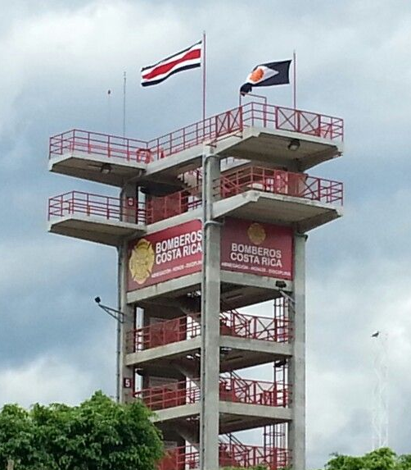
Current Tower
Open-air
Rappelling exercises
Training with hoses on stairwells
Not compatible for conducting live fire evolutions
[6]
Notes:
.

Slide 10
Search and Rescue
Obscure vision
Carry unconscious victims
NFPA 1001
Rope Rescue and Laddering
Ascend and descend fixed-rope systems
Place, mount and dismount ladders
Live-Fire
Any evolution conducted in a burn room

Slide 11
01
02
BELOW-GRADE BASEMENT
ENCLOSED STAIRWELL
ORIGINAL REQUESTS
03
04
WATER COLLECTION
LIQUID PETROLEUM GAS
Practice basement fire evolutions.
Separate from the main body of the structure.
Reuse water in future training exercises.
Fuel system for interior fires.

Slide 12
NFPA COMPLIANT OPTIONS
OPTION 1
OPTION 2
OPTION 3
enclosed
Full basement
No live-fire
Half below-grade
Live-fire
BASEMENT
Separate stairwell
enclosed, no fire
Separate stairwell,
windows and live-fire
STAIRWELL
FUEL SYSTEM
LPG
Propane
Wooden pallets & hay
WATER COLLECTION
Interior collection system
Exterior drain system

Slide 13
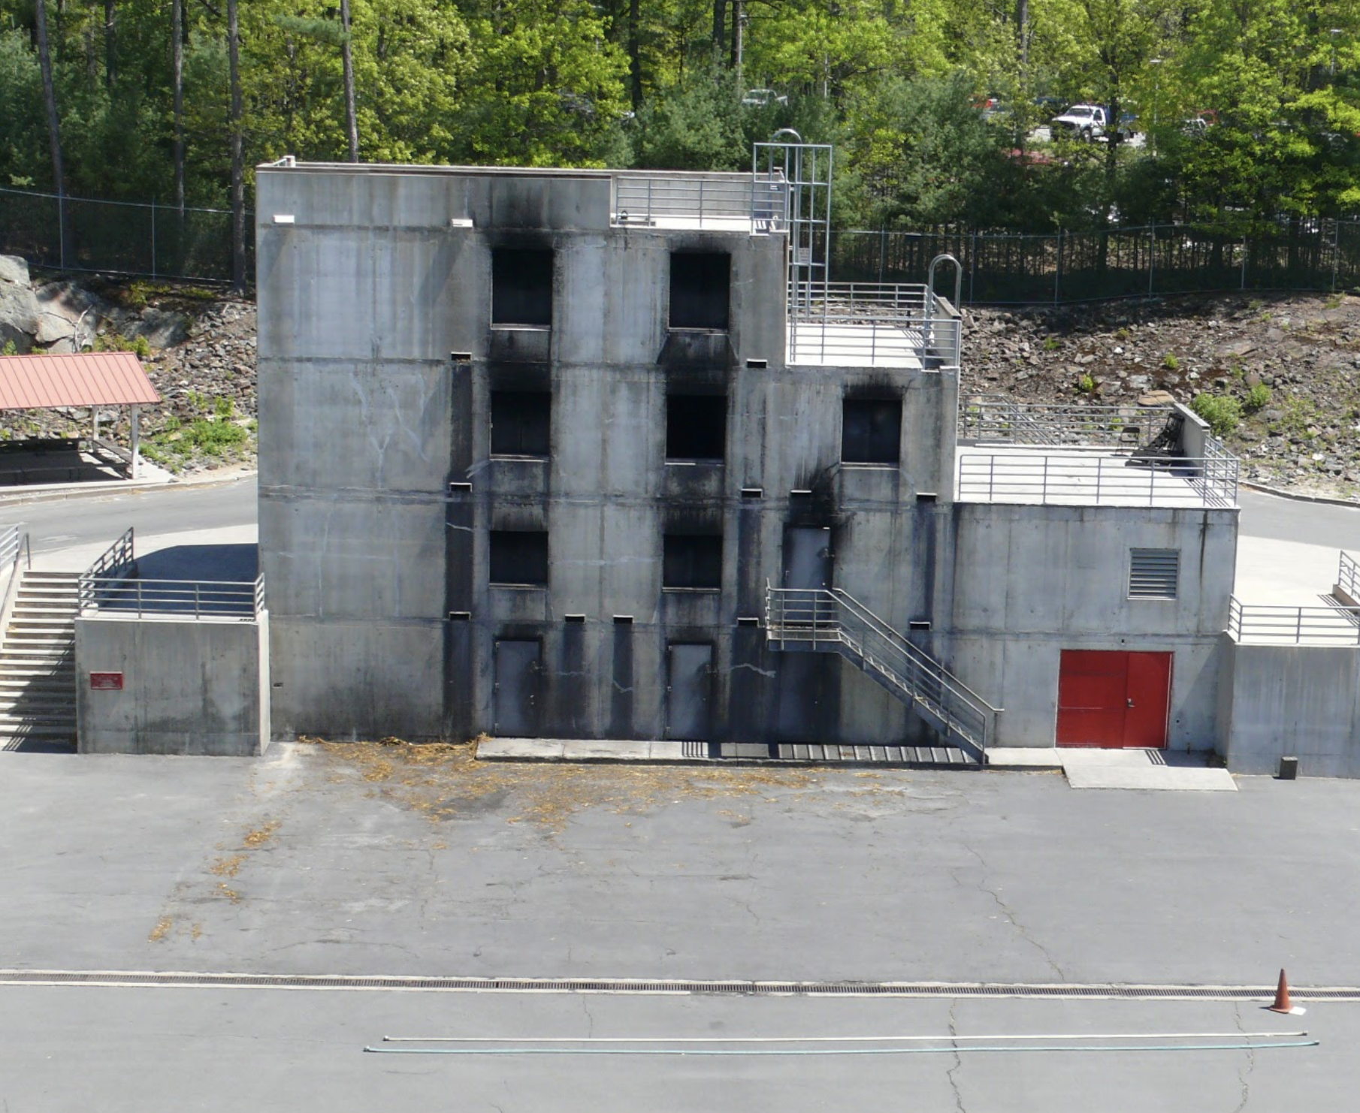
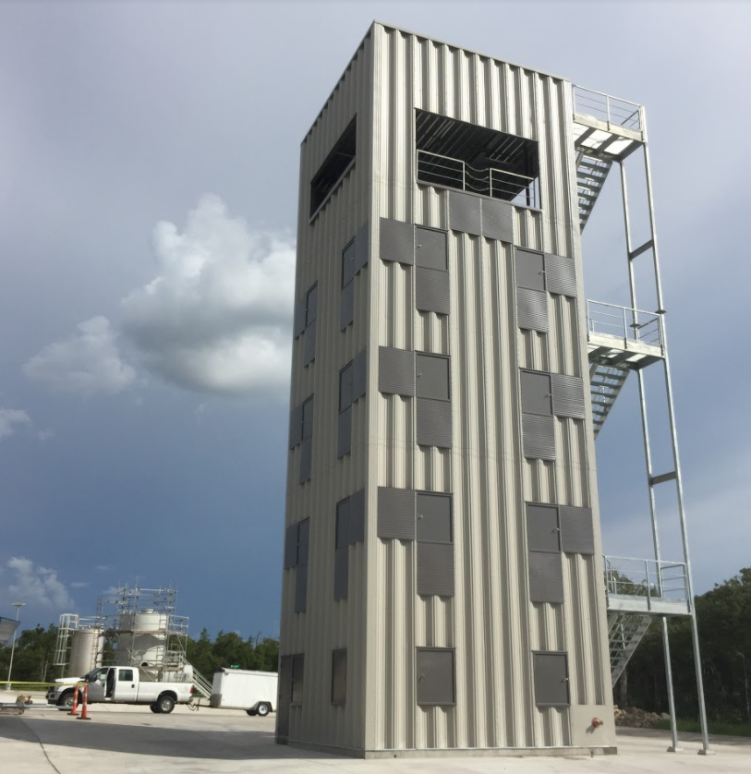
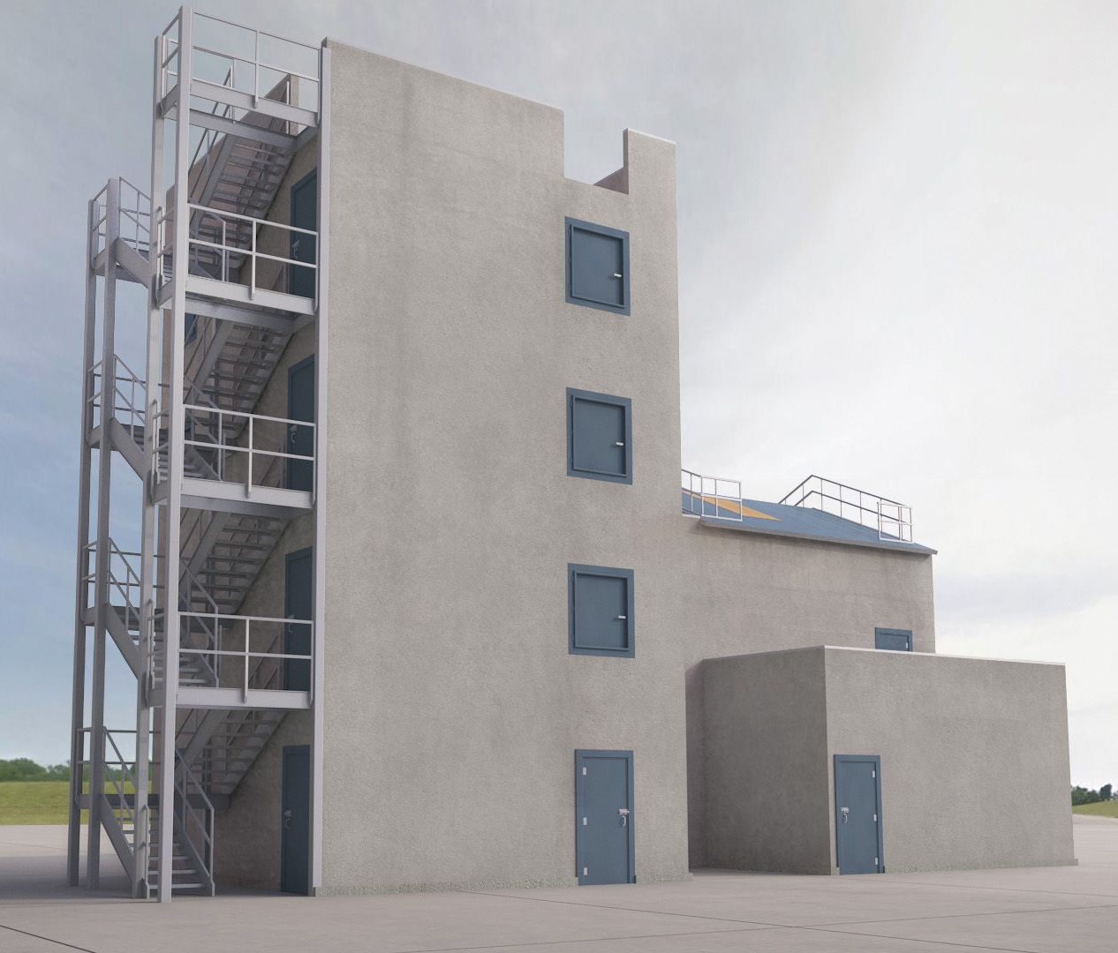
DIFFERENT TOWER DESIGNS
TOWER A
TOWER B
TOWER C
[7]
[8]
[9]
Concrete Structure
LPG Gas
Half-Basement
Footprint of 64 m²
Steel Structure
No Fires in Basement
Full Basement
Footprint of 36 m²
Concrete Structure
Wooden Pallets and Hay
No Basement
Footprint > 150 m²

Slide 14
PUGH MATRIX
Criteria | Weight | Tower A |  | Tower B |  | Tower C
 |  | Score | Total | Score | Total | Score | Total
Cost | 3 | 5 | 15 | 2 | 6 | 2 | 6
Performance | 4 | 4 | 16 | 4 | 16 | 3 | 12
Safety | 5 | 5 | 25 | 2 | 10 | 5 | 25
Visual Appeal | 2 | 3 | 6 | 3 | 6 | 4 | 8
Eco-Friendliness | 3 | 2 | 6 | 5 | 15 | 1 | 3
Effectiveness | 4 | 3 | 12 | 3 | 12 | 5 | 20
 | Sum |  | 80 |  | 65 |  | 74

Slide 15
LPG
Stairwell
Basement
OUR FINAL RECOMMENDATIONS
Concrete
Thermal Imaging
Ventilation
Cleaner fuel with easier control.
Enclosed staircase with no real fire.
Half-basement is safer and complies with NFPA code.
More resistant to fire over time in comparison to steel.
Handheld equipment carried by firefighters.
Ventilation system with fans to monitor smoke levels.

Slide 16
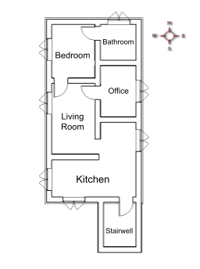
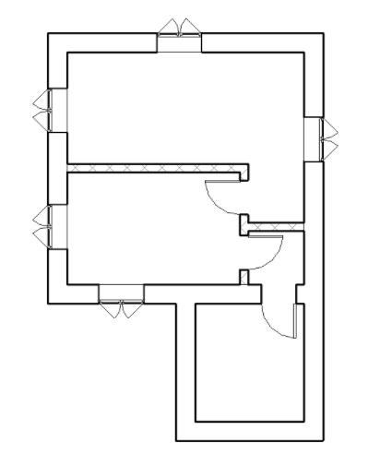
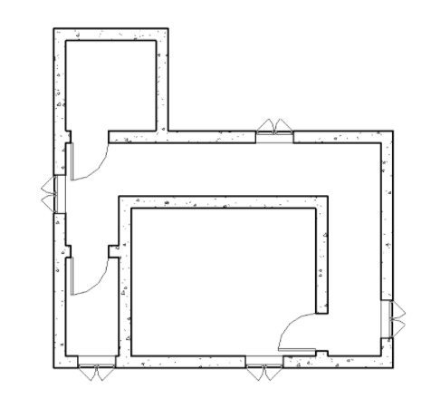
Floor Plans Iterations
Notes:
Ava

Slide 17
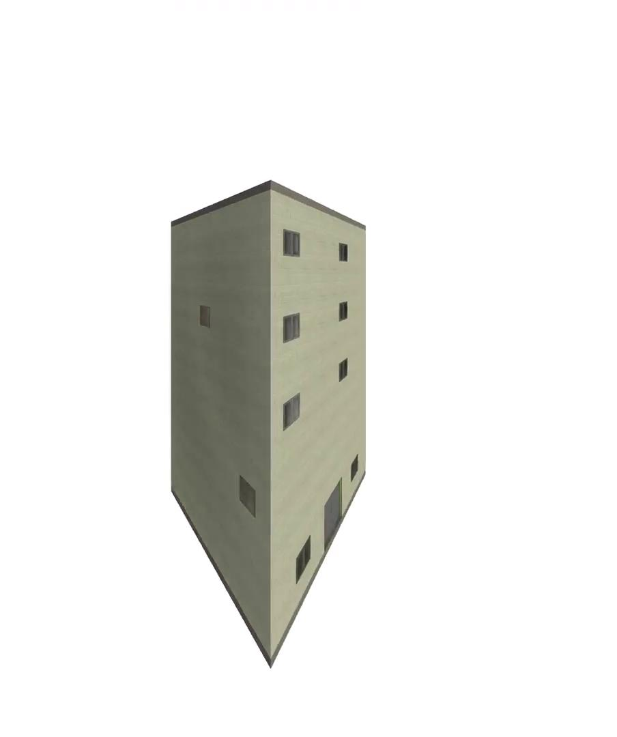
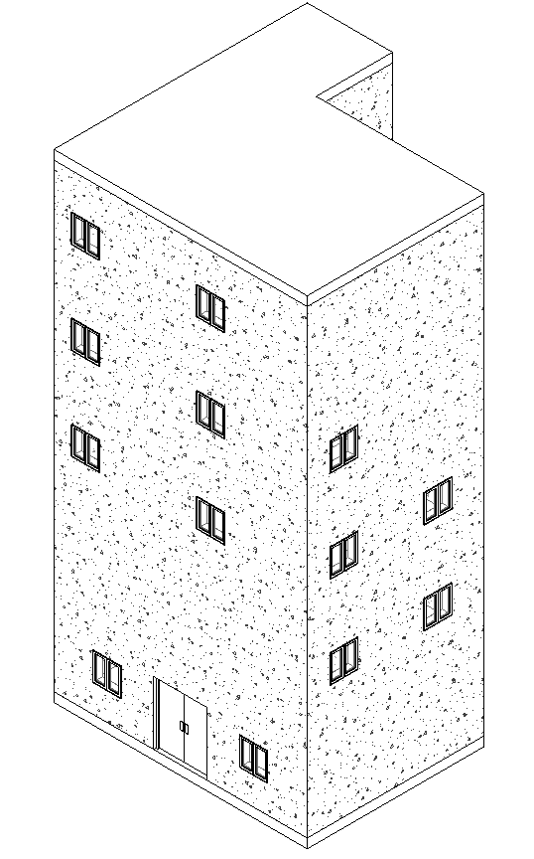
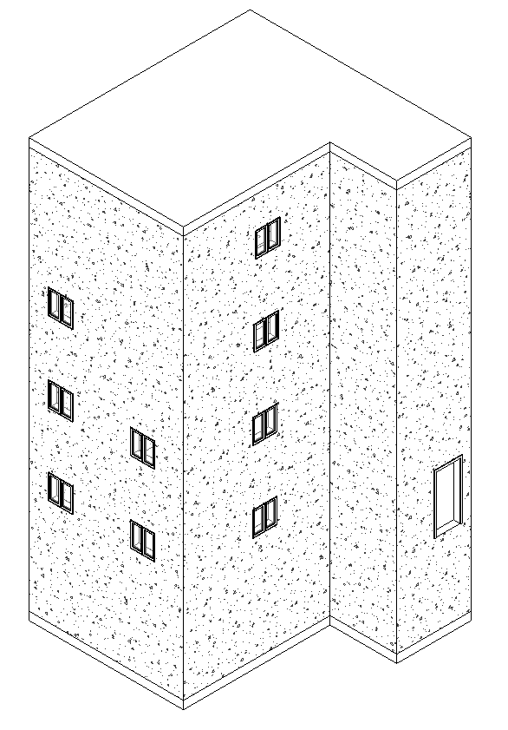
Revit Model

Slide 18
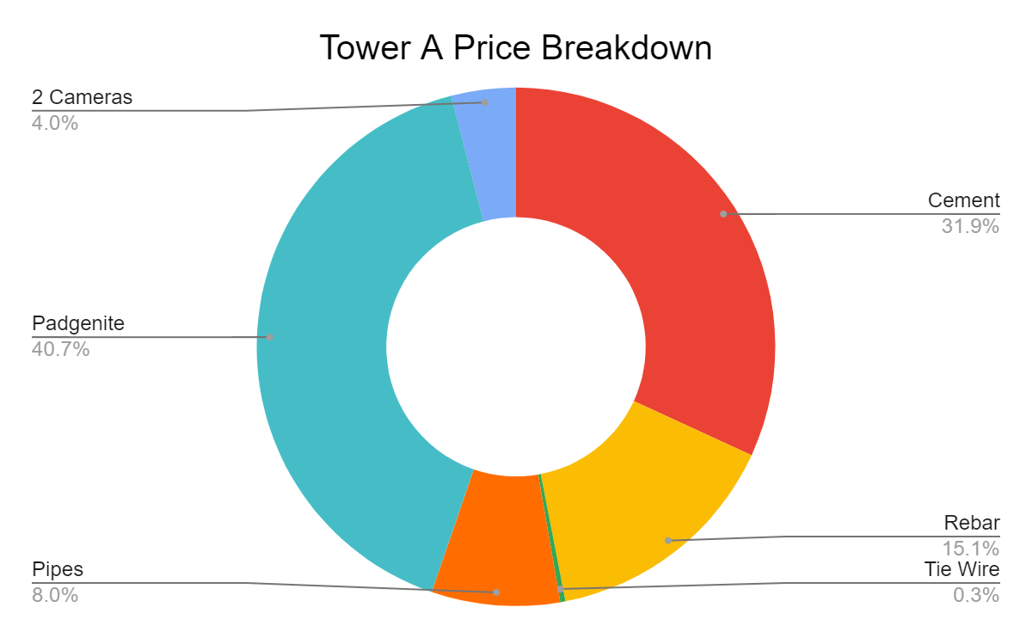
COST SUMMARY
Material | Cost (USD)
Cement | 51361.43
Rebar | 24299.46
Tie Wire | 520.93
Pipes | 12894.34
Padgenite | 65600
2 Cameras | 6490
Total (USD) | 161166.16
Total (CRC) | 98582116.75

Slide 19
FUTURE WORK
WATER FILTRATION
AIR FILTRATION
In addition to water collection system, integrate previous IQP filtration system.
Due to the high cost of HEPA filters, we recommend future research on a more cost-effective filtration.

Slide 20
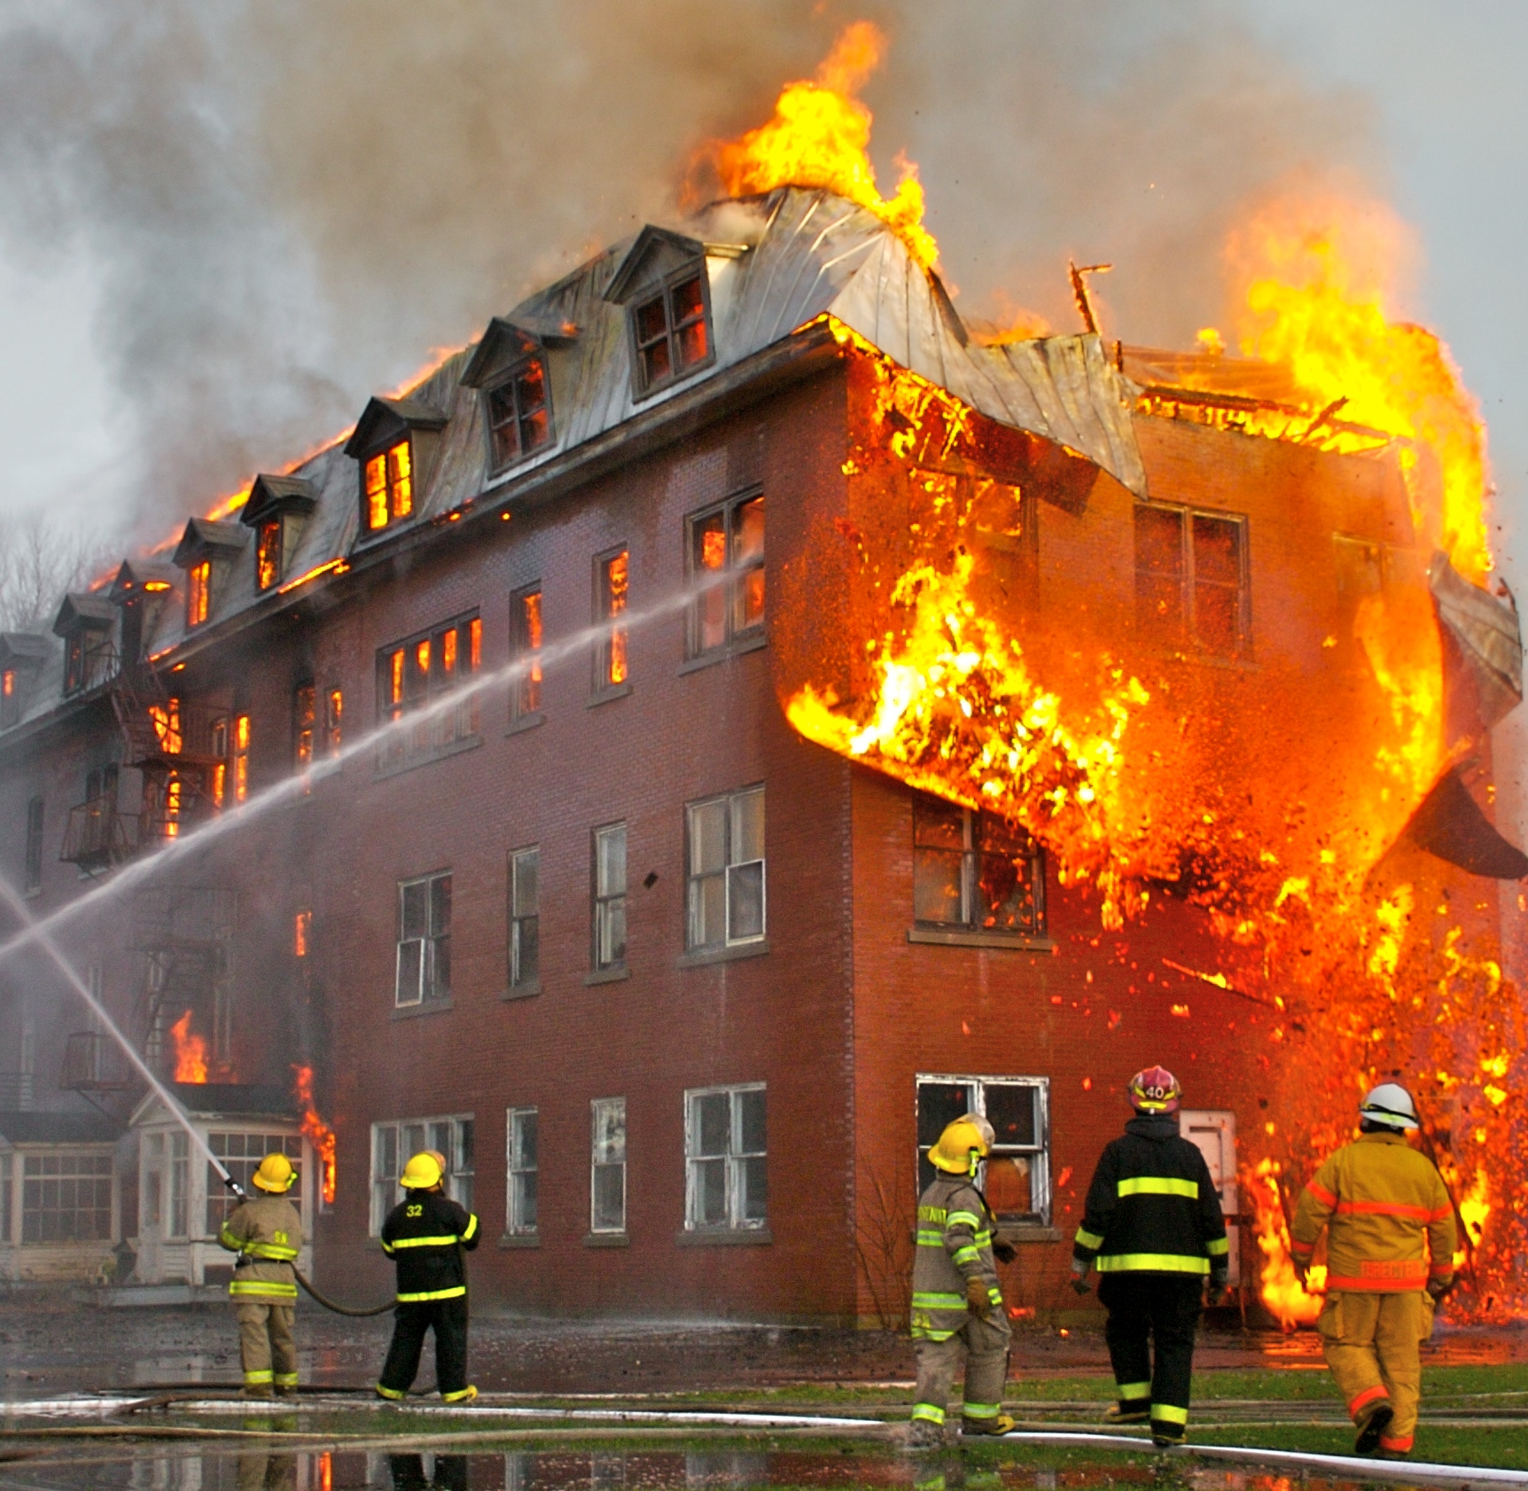
Questions?
Thank you to our sponsors and advisors for helping us with this project!
[10]

Slide 21
REFERENCES
REFERENCES
Boie, T., Muenchow, K., Vangos, T., & Vodola, K. (2018). Designing a Sustainable Water Supply Network for El Cuerpo de Bomberos Training Practices. Worcester; Worcester Polytechnic Institute.
Ciolfi, J., Nippert, K., Picho, K., Spalding, L. (2020). Exploration of A Robot Development Program for the Costa Rican Fire Department. Worcester; Worcester Polytechnic Institute.
Mason, Mike. (2006, July 10). Live Fire Training - Part 2. Firehouse. https://www.firehouse.com/operations-training/article/10505079/live-fire-training-part-2
National Fire Protection Association. (2021). NFPA: Overview. https://www.nfpa.org/overview
O’Donnell, R. (2015) Global Trends in Fire Training Facilities. Firehouse. https://www.firehouse.com/home/article/12092033/firefighter-training-trends-in-fire-training-facilities-around-the-world
Spell, J. (2020, October 19). A firefighter’s guide to fireground search and rescue- part 2. FireRescue1. https://www.firerescue1.com/fire-products/rescue-equipment/articles/a-firefighters-guide-to-fireground-search-and-rescue-part-2-TRLszcH6HvQpBhlJ/
www.mrrabbit.cr. (2020). Bomberos Costa Rica. http://www.bomberos.go.cr/.
IMAGE REFERENCES
https://www.draeger.com/Library/Media/containerized-live-fire-training-system-prepare-to-train-3-2-d-9083-2016.jpg?imwidth=480
https://media.defense.gov/2019/Aug/28/2002176592/-1/-1/0/190821-O-VI420-0216C.JPG
https://www.google.com/maps/place/National+Fire+Academy/@10.2457299,-84.2867847,7.79z/data=!4m5!3m4!1s0x8fa0e3b309439e9d:0x22e5358dbedfb05d!8m2!3d9.8963261!4d-84.0448266
http://www.usexpatcostarica.com/wp-content/uploads/2017/04/Fire-Department-315x420.jpeg
http://www.asoquemcr.com/project03.html
https://www.pinterest.com/pin/320459329706116951/
MA Firefighting Academy. (n.d.) Burn Building.
WHP Trainingtowers. (2015) Custom 1st Alarm - Four Story Rope Tower.
https://www.pinterest.de/pin/299489443970081516/
https://upload.wikimedia.org/wikipedia/commons/8/8f/Fire_inside_an_abandoned_convent_in_Massueville%2C_Quebec%2C_Canada.jpg

