Slide 2
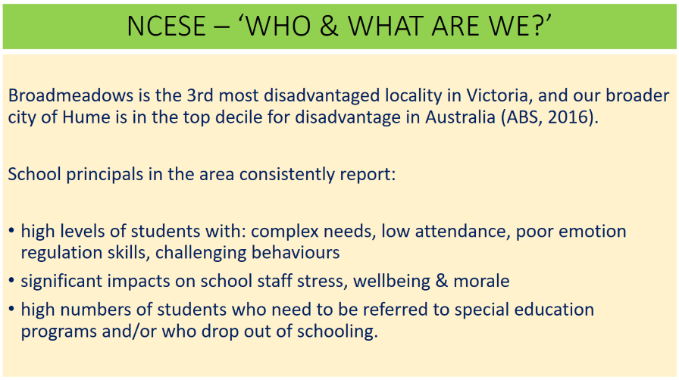

Slide 3
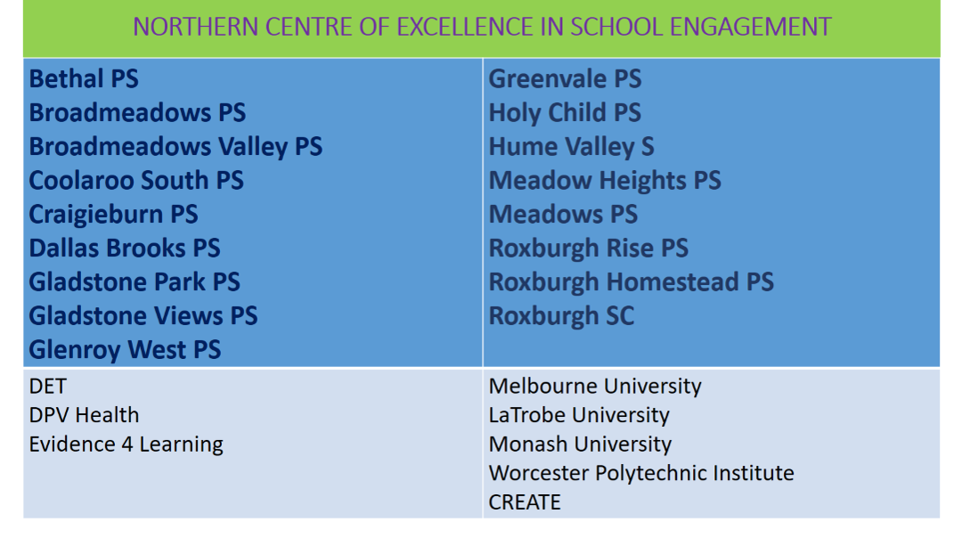

Slide 4
Investigating Models and Practices for Enhancing Social and Emotional Learning
By Margaret Earnest, Coleman Owings, and Olivia Scola

Slide 5
We would like to recognize the Nipmuc people as the original custodians of Central Massachusetts and the Wurundjeri people as the original custodians of Melbourne, Australia. We pay respect to their Elders, past, present, and emerging.

Slide 6
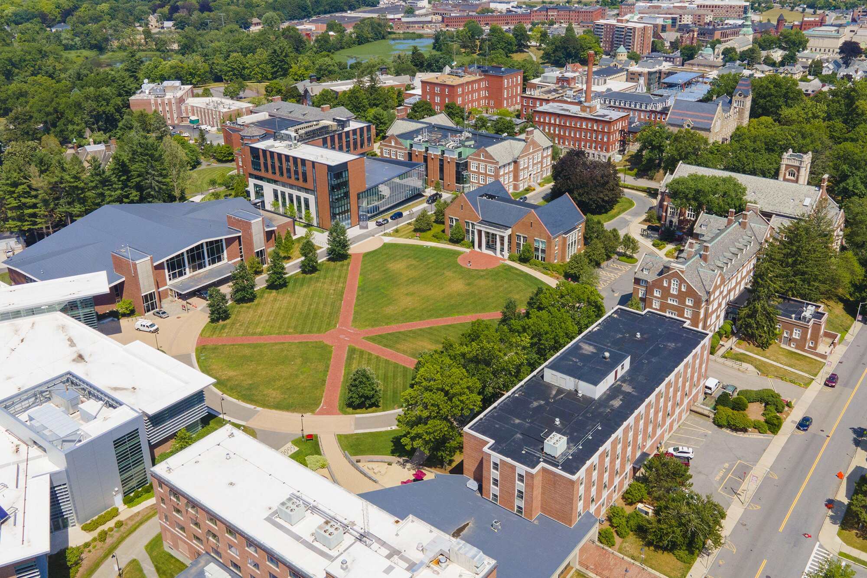
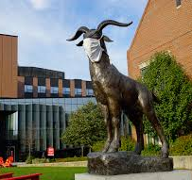
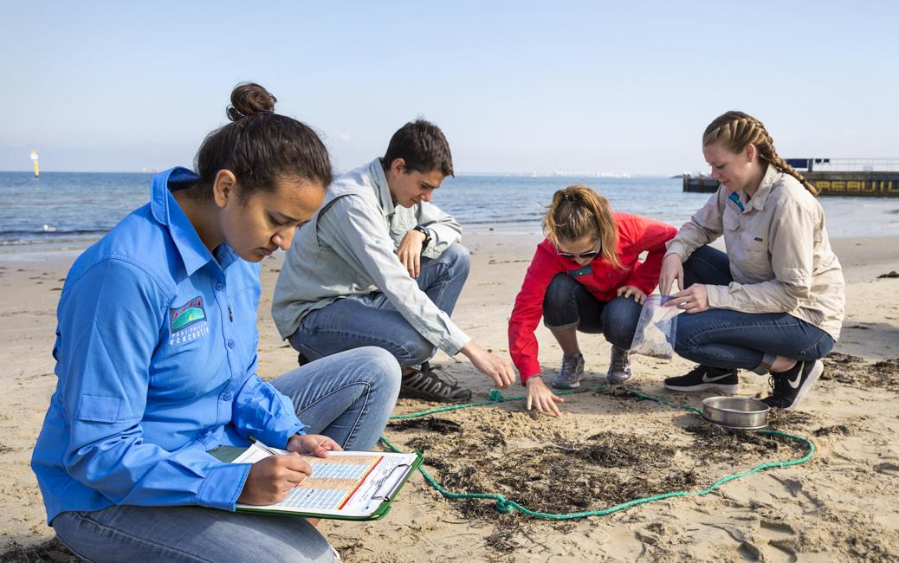
Who We Are
Project Center
Melbourne
Olivia Scola
Margaret Earnest
Coleman Owings
Management Engineering
Computer Science
Biochemistry
7 week, project based program, partnering students with local sponsors
Notes:
Define Interactive Qualifying Project
Project center, project sponsor

Slide 7
What is Social and Emotional Learning?
The ability to identify, understand and regulate emotions
SEL Competencies
Self-awareness
Self-management
Responsible decision making
Social awareness
Relationship skills
Notes:
JUST READ OUT THE 5 COMPETENCIES AND NOTE THAT THESE ARE WIDELY ACCEPTED AND THAT SEL IS EQUIVALENT TO, OR SOMETIMES REFERRED TO AS EMOTIONAL INTELLIGENCE

Slide 8
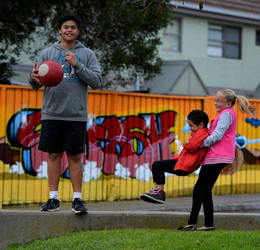
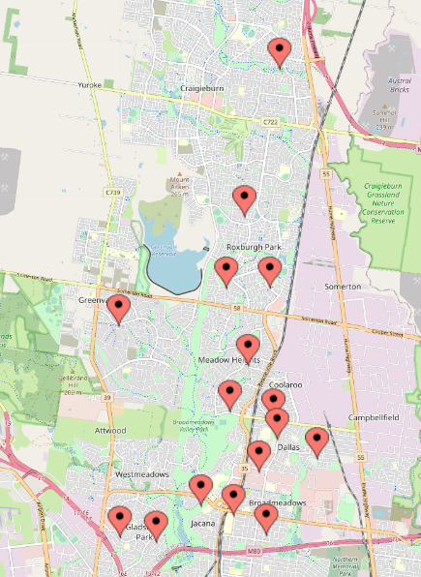
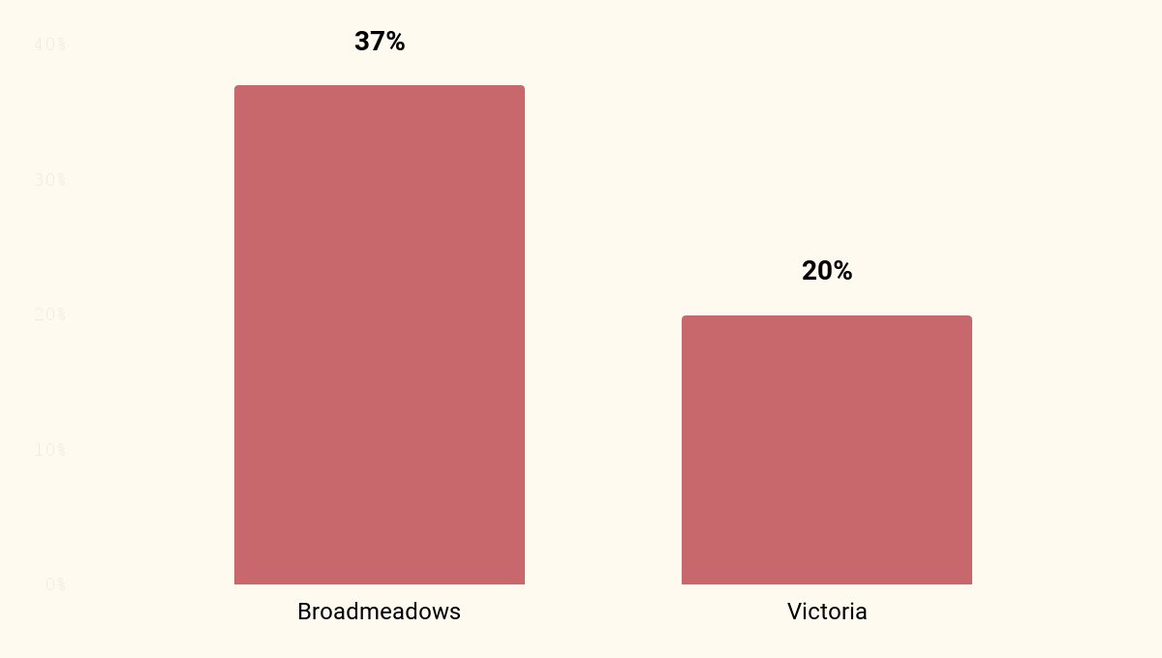
Why Research SEL?
Broadmeadows, Australia
5
Notes:
Acknowledge Eric and Jaime
Talk about broadmeadows context
The NCESE specializes in supporting student engagement
Broadmeadows is located in the South-East of Hume City in Melbourne, Victoria. The population in Broadmeadows is a diverse mix of cultures, incomes, religions, ethnicities and races, and has higher than average public tenancy. Banksia Gardens Community Services exists to serve the health, welfare and education needs of this diverse range of local people. AEDC data is about vulnerability and school readiness at ages 5-6 years. As you can see, Broadmeadows have twice the levels of student vulnerability, or low schools readiness, as these ages.

Slide 9
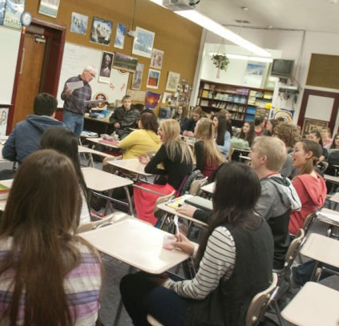
Disadvantaged communities have the highest need for SEL support
But often the least resources to research and implement that support

Slide 10
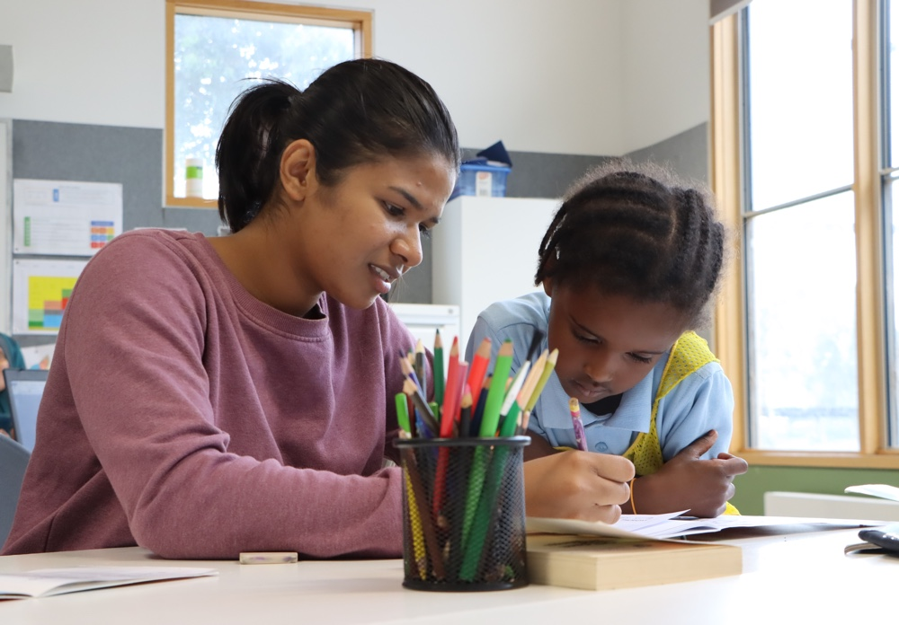
Goal and Process
Our goal is to understand good practice in teaching SEL in disadvantaged communities and help to connect the NCESE with US SEL providers & programs
Identify
Investigate
Synthesize

Slide 11
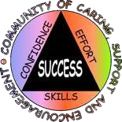
Who We Talked To
Caring School Community
Notes:
WE REVIEWED THE CASEL DATABASES - SHOW SLIDE - AND WE FOUND...
THEN WE SPOKE TO THESE GREAT PEOPLE - WHO GENEROUSLY GAVE US FANTASTIC ON THE GROUND INFORMATION, EG...

Slide 12
Limitations in Our Research
We tried, but could not interview schools using these programs because schools are overloaded with work
Could only interview limited number programs due to time constraints
This was a fully remote project
Our own limited background in SEL before this project
Notes:
WHAT WE LEARNED ABOUT SEL, ITS IMPORTANCE IN LEARNING, AND ITS VALUE IN DISADVANTAGED COMMUNITIES, AND HOW IT CAN HELP US..AS WPI STUDENTS AND AS PEOPLE

Slide 13
Findings

Slide 14
Notable Program Aspects
Student Success Skills
Social Skills Improvement System
Incredible Years
Tools of the Mind
Commitment to providing affordable SEL Resources
Use of extensive SEL Assessments
Engaging hands-on Content
Intensive support program
Roleplay
Academic integration
Data Analysis
Notes:
Incredible Years - use of engaging puppets and pull out program
Tools of the Mind - use of extensive roleplay, academic integration, and data analysis
Social Skills Improvement System (SSIS) - for integration of SEL assessments
Student Success Skills - for commitment to providing affordable SEL resources

Slide 15
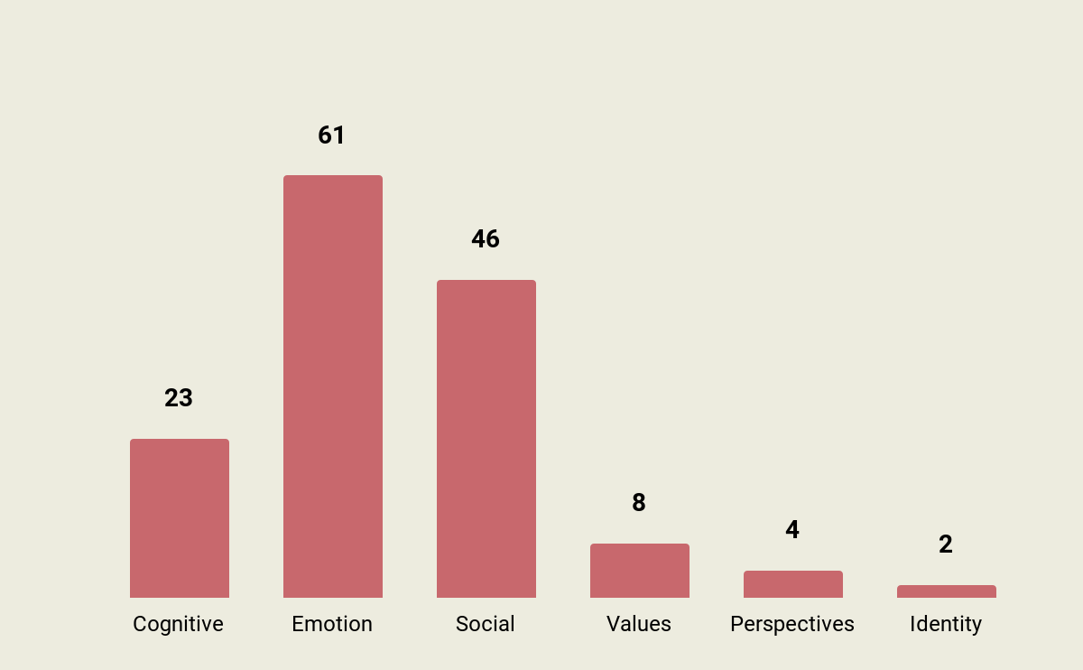
Program Snapshot
30 years of research
Highly scripted
Contains an evaluation tool
High use of language and vocabulary exercises
Initial kit per classroom with refresher kits
Pre K- 5
Evidence for grades 1-3
Have ten studies overall in the US, 6 worked with low income students
"There's a lot of emphasis on role playing, and teachers are encouraged throughout the curriculum to use generalization strategies ... in their own behavior: what they want students to do in different situations"
David Urbonas
Notes:
"What the PATHS program provides is a wide variety of strategies and activities that keeps it fresh for students and for teachers, but it also provides students with lots of practice and repetition of the skills that that you we want them to learn, and that's how students are going to learn, is by practicing"

Slide 16
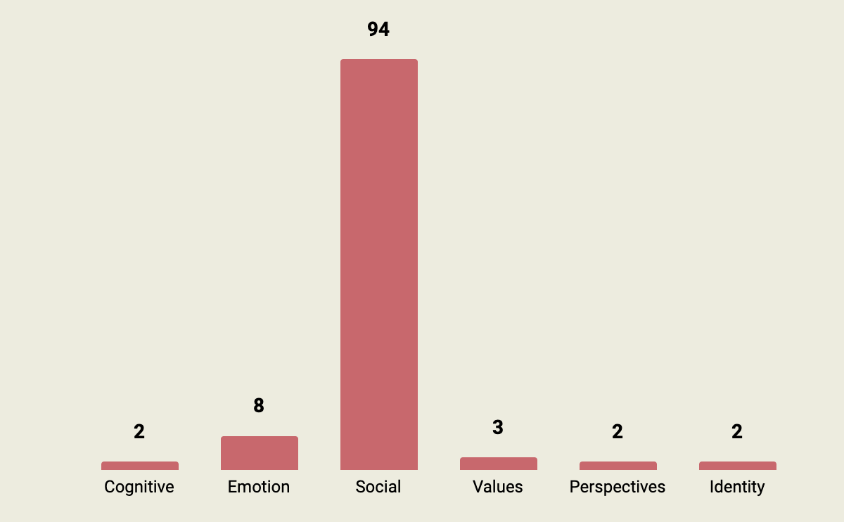
Caring School Community
High focus on social domain
Focused around relationships
Involve whole community
Uses community building activities
Low teacher training threshold
Kit for each classroom, no subscription
Program Snapshot
K- 8
Evidence for grades 3-6
Two US studies, one with a socioeconomically diverse group
“All the different components of Caring School Community really focus on building relationships, whether it's in the classroom, across the teacher and the kids, across classrooms in a school, or between the home and the school"
Peter Brunn

Slide 17
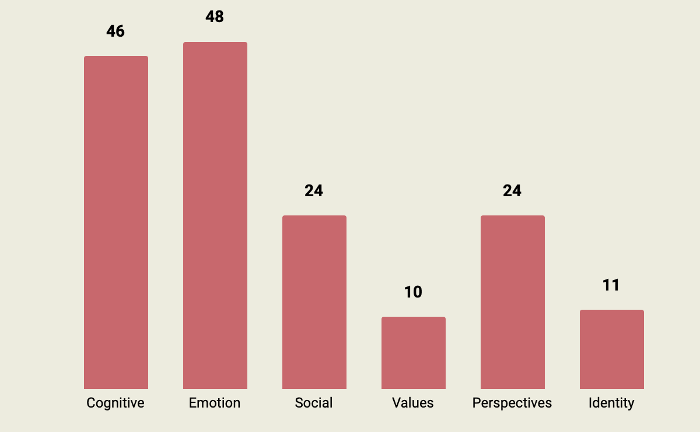
Program Snapshot
Teach students about brain states
Core pillars are neuroscience, mindful awareness, positive psychology, SEL
Integrates mindfulness
Accessible materials, subscription membership, add-on
components
Train the trainer
option
Pre K- 8
Evidence for grades 4-7
Two US studies, one with 72% of students being low income

Slide 18
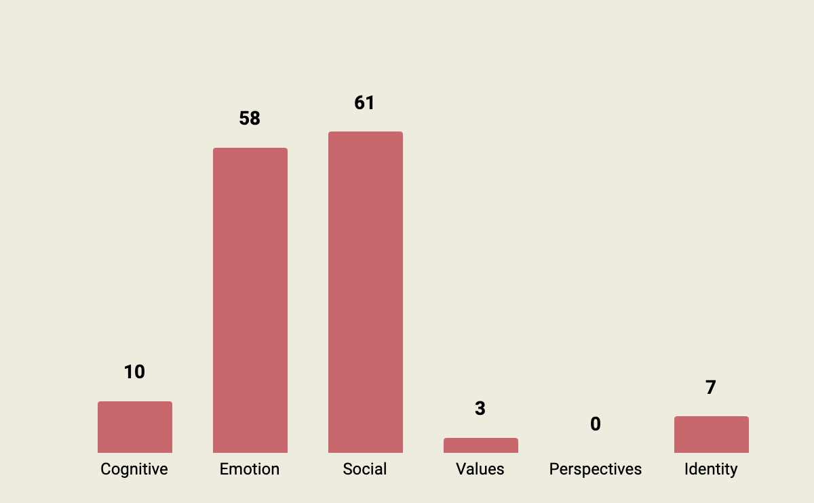
Program Snapshot
Focused on connection
Trauma-informed, creates safe spaces
Physical materials and routines reinforce community attitude
Believe adults need to learn SE skills before they can teach them
Ages 0 - 12
Evidence for Pre K
Five US studies, one with 69% of students being low income
"If children feel safe and connected then they are going to thrive, they are going to learn, they're going to develop the social skills that we want them to have"
Elizabeth Montero-Cefalo

Slide 19
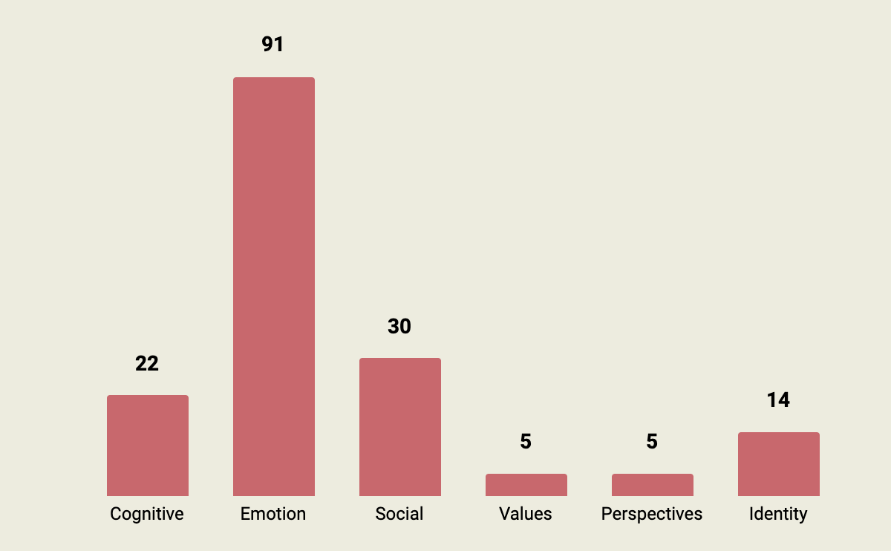
Highly recommended for further exploration by the NCESE
Program Snapshot
Focuses on emotional intelligence
RULER = Recognize, understand, label, express, and regulate emotions
Uses four tools: the charter, mood meter, meta-moment
and blueprint
Train the trainer approach
Two years of training before using curriculum
Cost for initial training,
then subscription
Pre K- 12
Evidence for Pre k and 5-6
Four US studies, one with 94% of students being low income

Slide 20
Everyone is Working on Emotional Intelligence
“You’ve got an old guy, … a first grader, and yourself, and I'm telling you: we're working on the same [SEL] skills right? I think the difference is we have different social situations where we have to read and apply those skills” Stephen Elliott

Slide 21
Thank You for Listening!
Any Questions?

Slide 22
Discussion Questions
We reviewed many programs that look great, but how should schools select from among them? Is there a “best practice” standard?
How competent do school staff need to be in SEL skills?
Which SEL programs and materials are translatable to the Australian setting? Would they need to be changed?
What is the future for SEL work in education and beyond?
Feel free to propose questions and discussion points not listed here!

