Slide 1
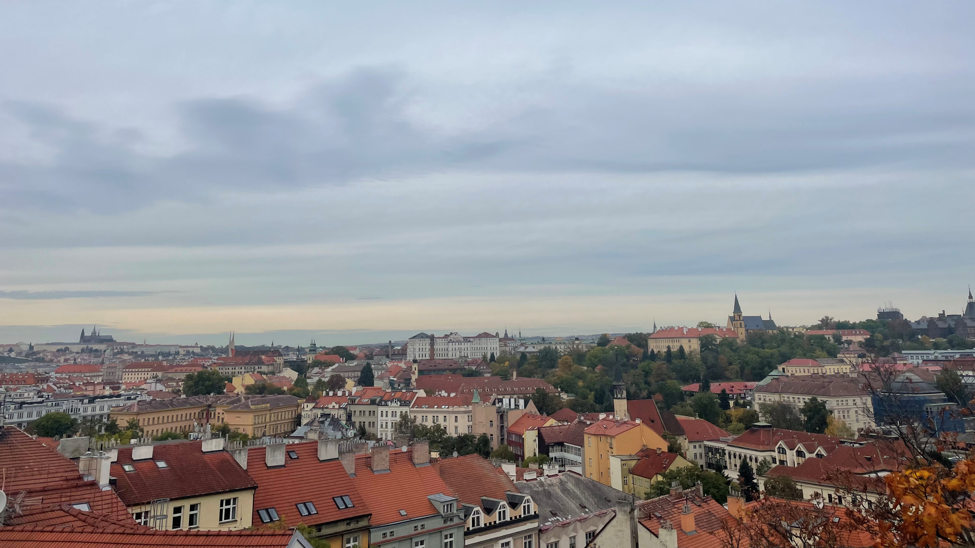
The WPI Prague Project Center
Kaylee Carr
Maxwell Friedman
Colleen Mullane
Aleksandr Samarin
Notes:
Title Slide

Slide 2
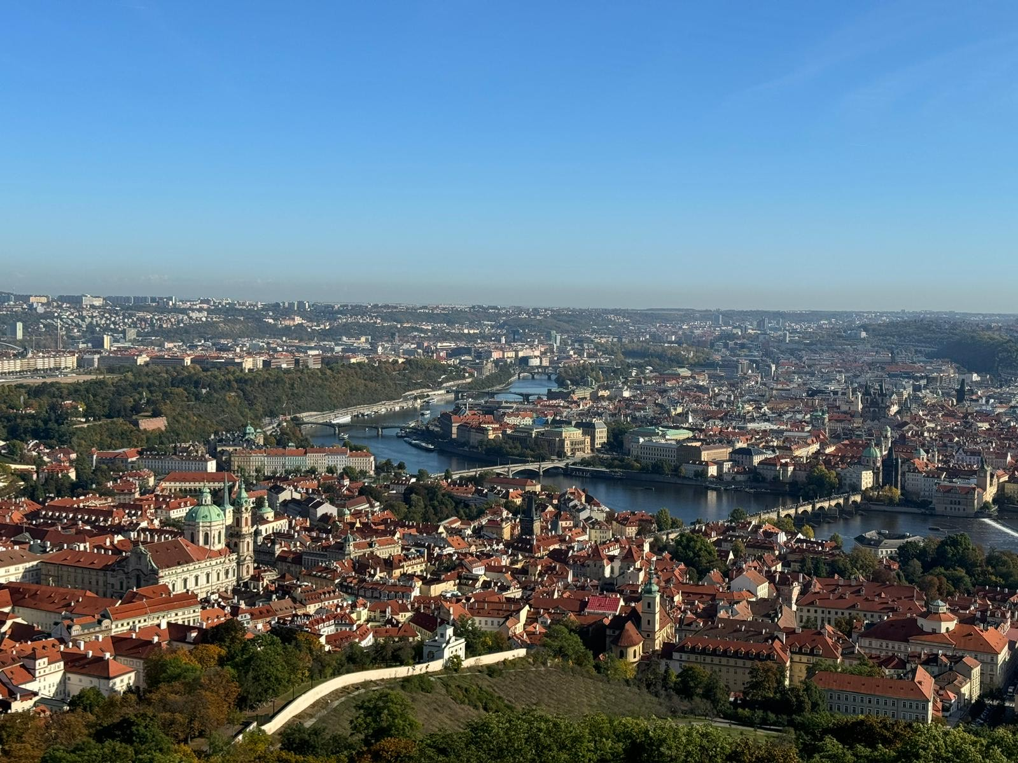
Our Team
Kaylee Carr
Civil Engineering
New York
Maxwell Friedman
Robotics Engineering
New Jersey
Colleen Mullane
Robotics Engineering
Connecticut
Aleksandr Samarin
Computer Science
Massachusetts
Notes:
Introduction to Team

Slide 3
Directors and Advisors
Aaron Deskins
Co-director
Laureen Elgert
Advisor
Philip Hultquist
Advisor
Marie Keller
Co-director
Notes:
WPI Faculty

Slide 4
Worcester Polytechnic Institute (WPI)
American technological university
Founded in 1865
Located in Worcester, Massachusetts
5,246 undergraduate students
Interactive Qualifying Project (IQP)
Abbott, I. (2016). WPI Quad from Morgan Hall [Photo]. https://www.flickr.com/photos/ian_e_abbott/30748623562/
Notes:
Introduction to WPI

Slide 5
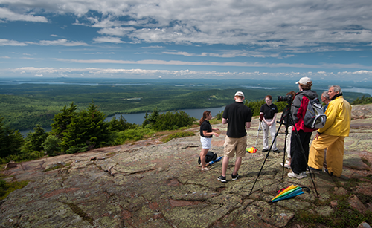
Interactive Qualifying Project (IQP)
A group of college students, alongside faculty advisors, partner with organizations from around the world to work on projects that support the organization’s mission.
Mutually beneficial for the students and the organization.
Students gain valuable experience working in a team.
Organizations benefit from a group of independent workers that will provide a fresh perspective.
Interactive Qualifying Project | Worcester Polytechnic Institute. (n.d.). Retrieved November 9, 2023, from https://www.wpi.edu/project-based-learning/project-based-education/interactive-qualifying-project
Notes:
Introduction to IQP

Slide 6
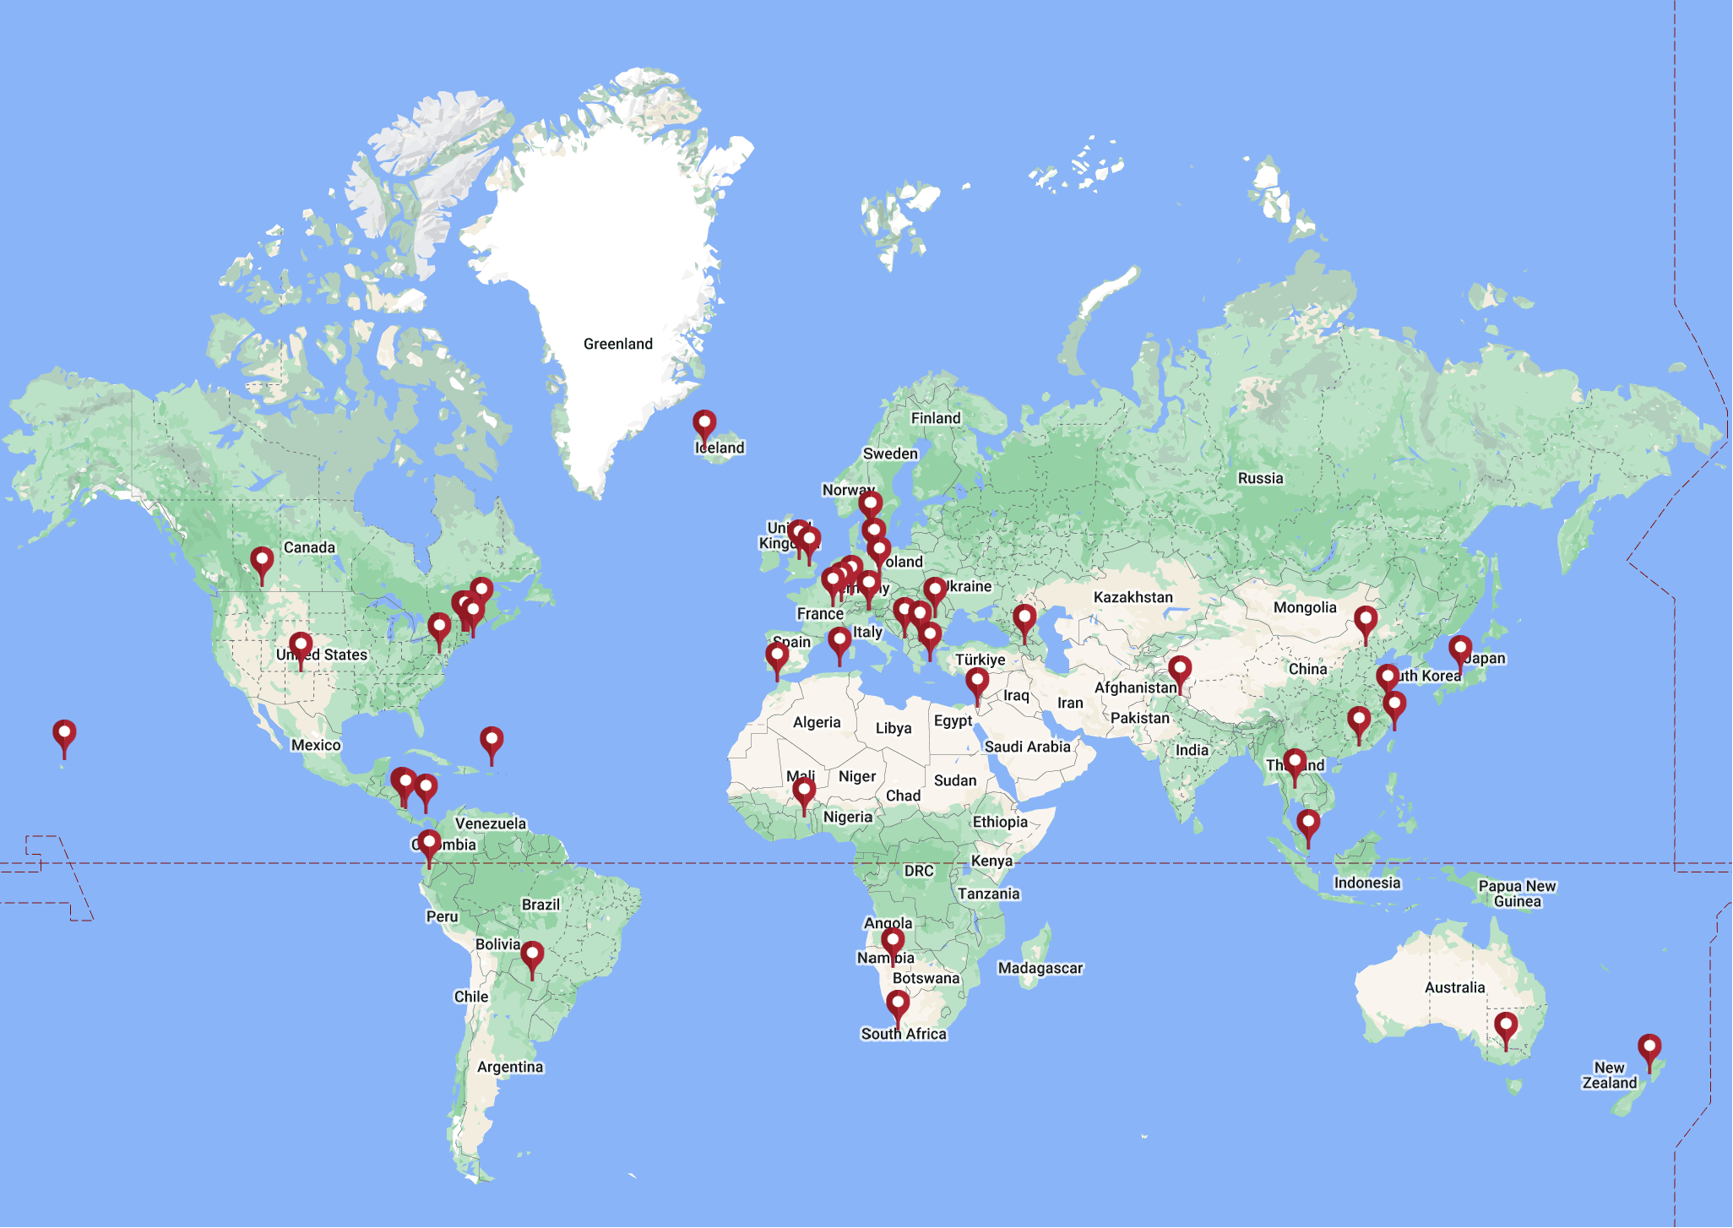
Project Center Locations
Notes:
Project Center Locations

Slide 7
Prague Project Center Information
Established in 2020.
First students came in October of 2021.
Operates in Prague every year from mid October to mid December.
Students have worked on projects with organizations like:
Zoo Praha
National Technical Museum
Notes:
Prague Project Center Information

Slide 8
Team Roles and Expectations
Center Directors | Faculty Advisors | Partner Organization | Student Team
Build relationships with organizations | Involved throughout the entire project | Provide project description | Research and prepare for the project off-site
Help develop project ideas | Guide students and their work | 1 hour each week for in-person meeting with team | Work 40 hours a week on the project when onsite
 |  | Additional time to respond to messages
Notes:
Team Roles and Expectations

Slide 9
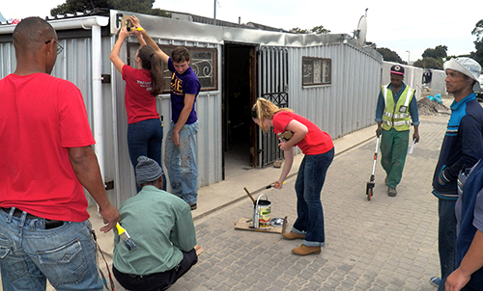
Good Projects Include
Open-ended solutions
Collaboration between students and organization
Interactions with local community
Interesting and helpful to partner organization
Notes:
General Project Characteristics

Slide 10
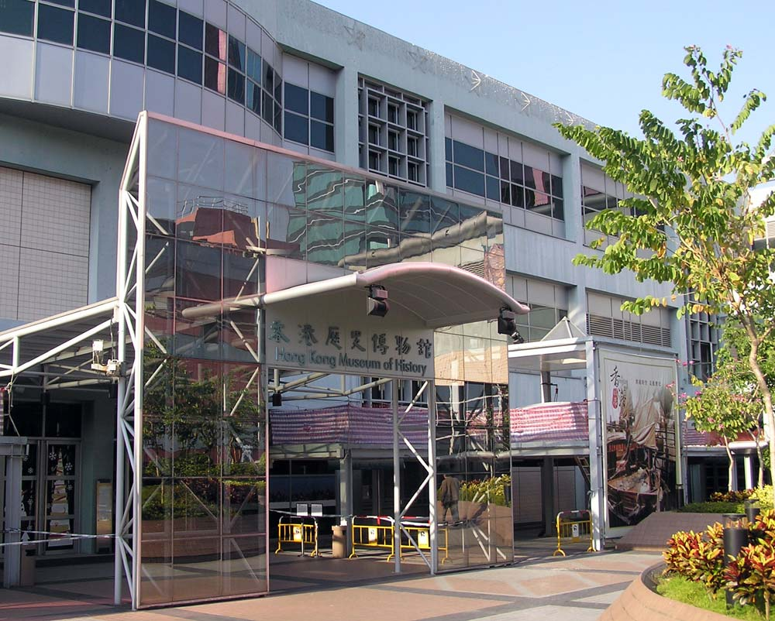
“Making History Interactive at the Hong Kong Museum of History” (Hong Kong, China)
Purpose: To preserve culture and educate the younger generations on cultural history and traditions.
Methodology:
Developed and implemented interactive computer and hands-on games.
Performed observational studies and created written surveys to evaluate games.
Outcome:
Confirmed that interactive games promote cultural learning among museum visitors.
Recommendations to improve room layout and each game.
Notes:
Project Example #1

Slide 11
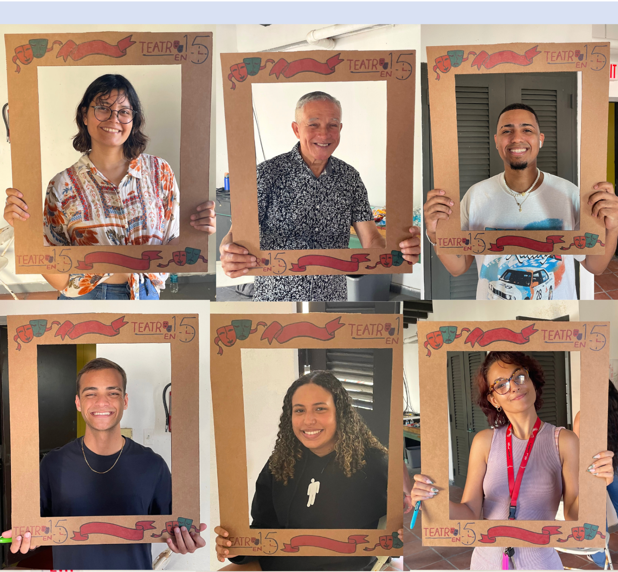
“Sala Siete: A Space for the Artist in Everyone” (San Juan, Puerto Rico)
Purpose: To design a rooftop café where artists are free to connect, create and perform.
Methodology:
Analyzed the current conditions of the rooftop.
Conducted interviews and workshops to understand what artists are looking for in a space like this.
Outcome:
Created a completed 3D model of the café.
Developed two resources and multiple recommendations the theater can use to further enhance the space.
Notes:
Project Example #2

Slide 12
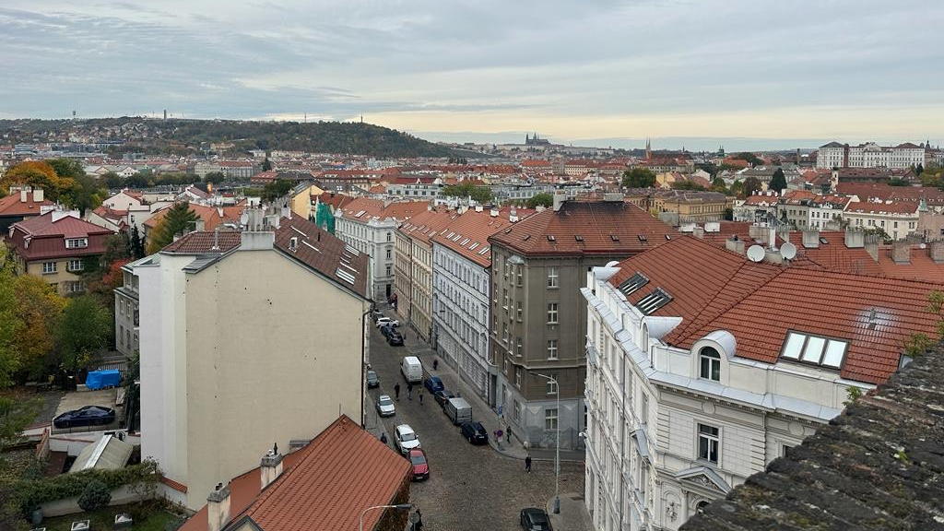
Project Timeline
Phase One Leadup to August
Discuss and Develop Project Description
Phase Two Starts End of August
Students Research and Prepare
Phase Three Starts Middle of October
Implementation in Prague
Notes:
Project Timeline

Slide 13
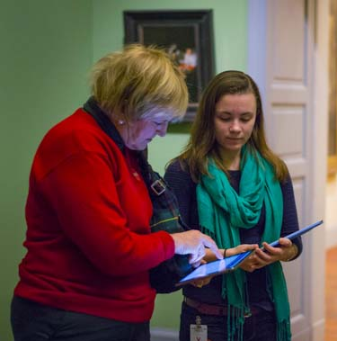
Benefits to Partners
Fresh perspective from young students.
WPI students have technological skills and are independent workers.
WPI Faculty ensure Quality work.
Notes:
Partner Benefits

Slide 14
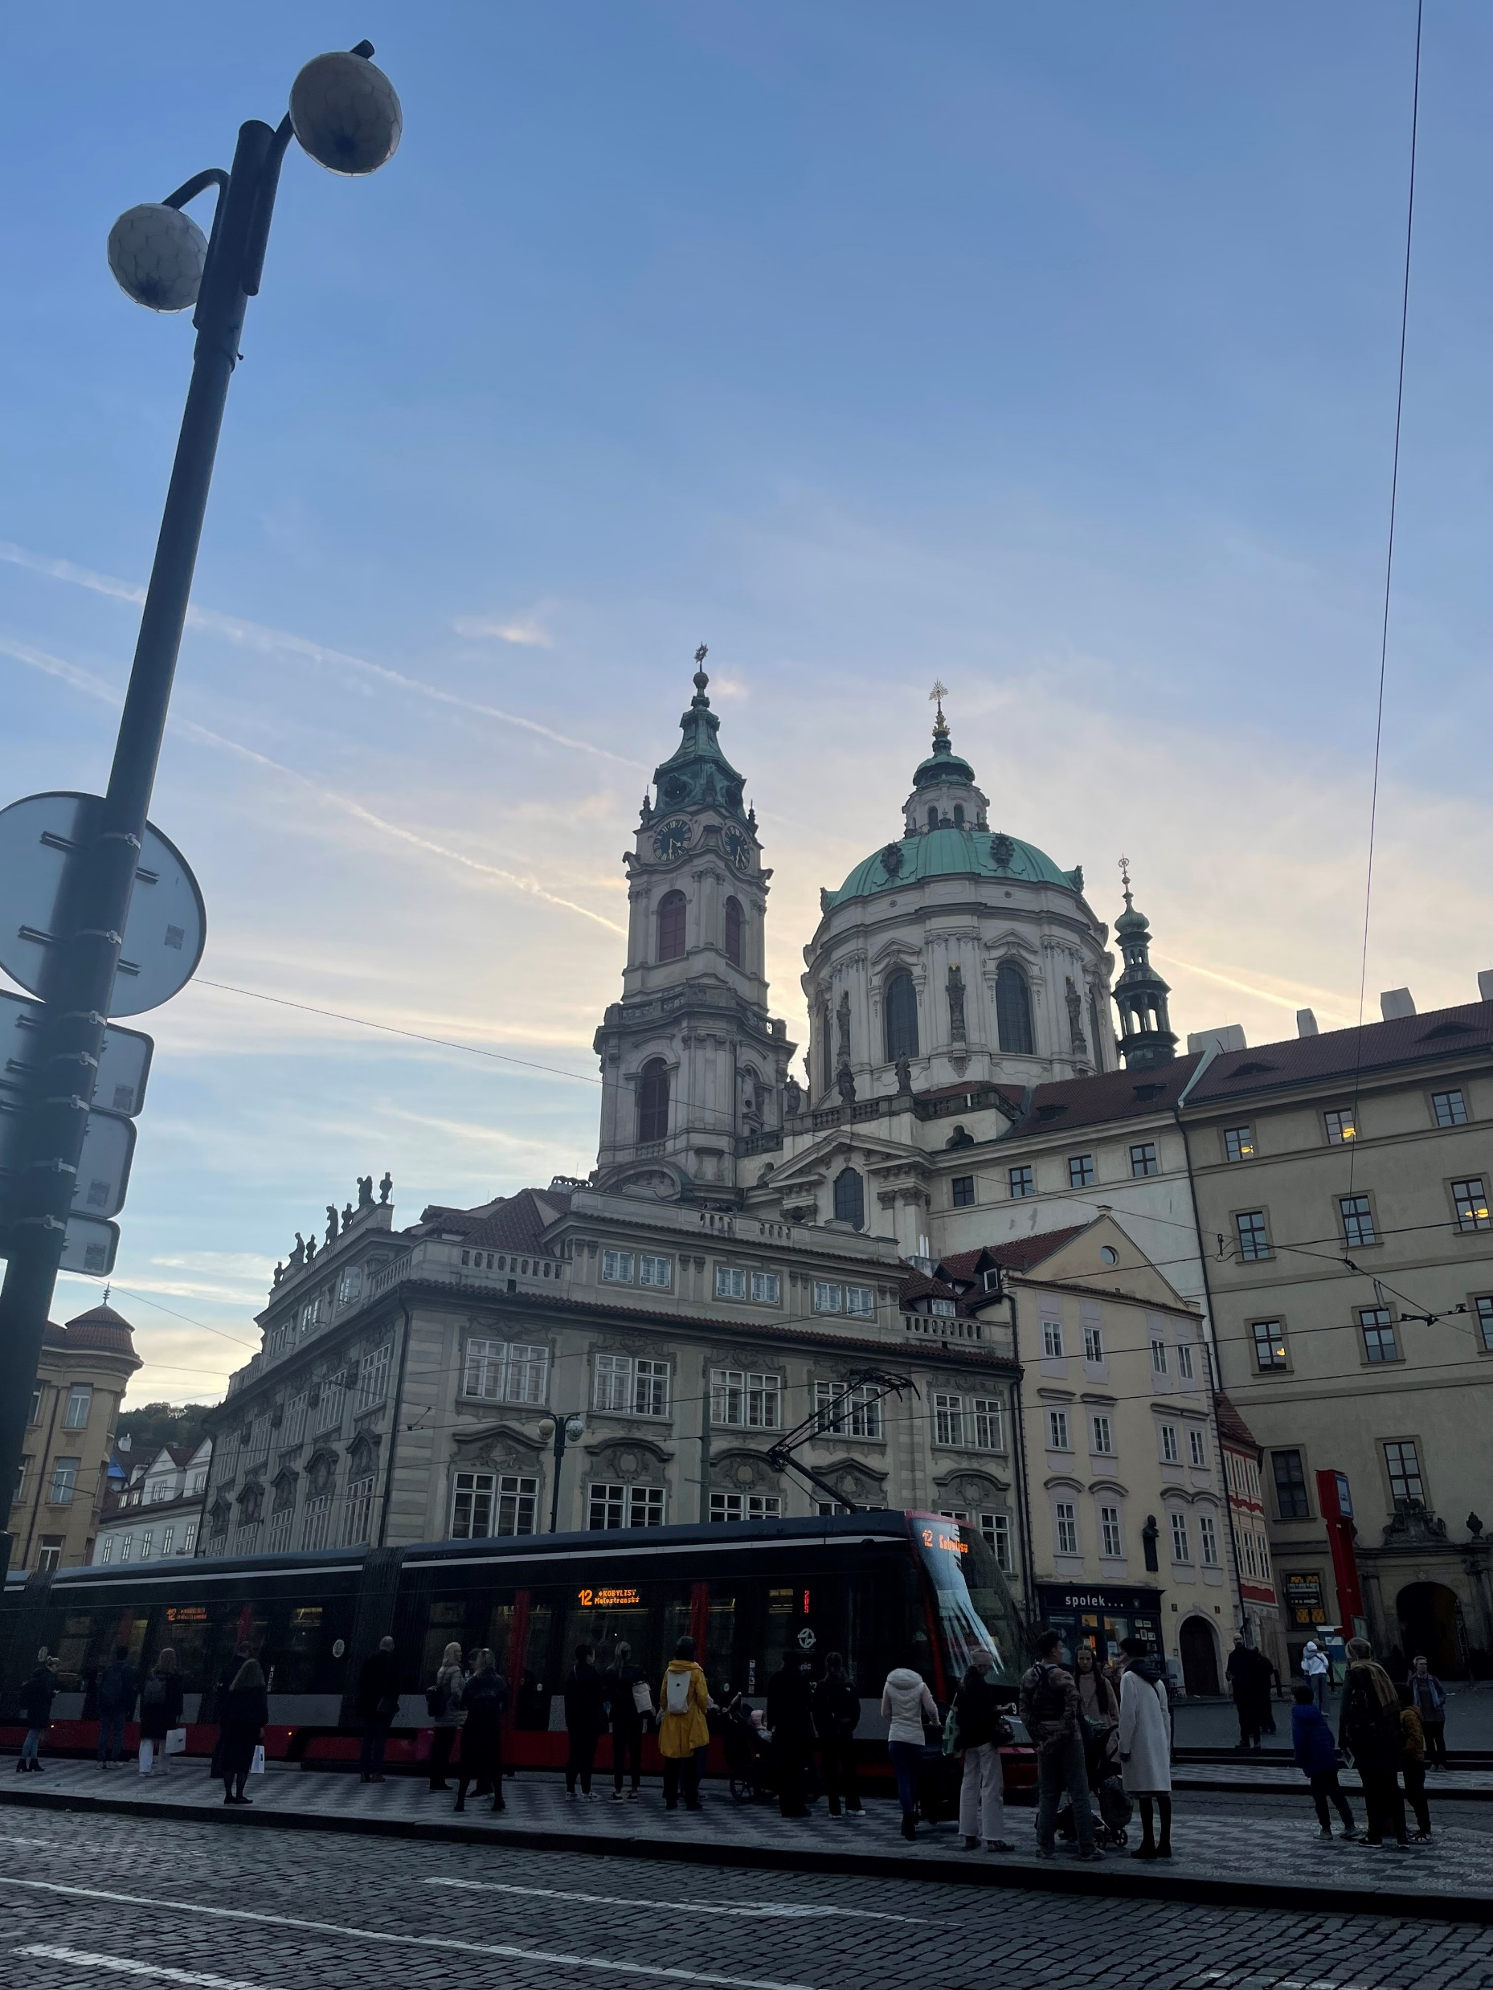
Contacts
Email us: gr-PraguePartnerships@wpi.edu
Project Center Directors (Slide 3):
- Aaron Deskins: nadeskins@wpi.edu
- Marie Keller: mkeller@wpi.edu
Check out our website: pragueprojectcenter.org
Notes:
Contacts

