Slide 1
Improving Digital Twin Usage to Reduce Energy Inefficiencies
Arturo Figueredo
James Nguyen
Rolando Salamea-Lopez
Ryan Tonry
Notes:
Good afternoon, everyone!
We are students at the Worcester Polytechnic Institute located in Worcester MA
James
Arturo
Ryan
Rolando
We’re here on a research project studying the Digital Twin technology and energy reduction in the Sheila Scott building

Slide 2
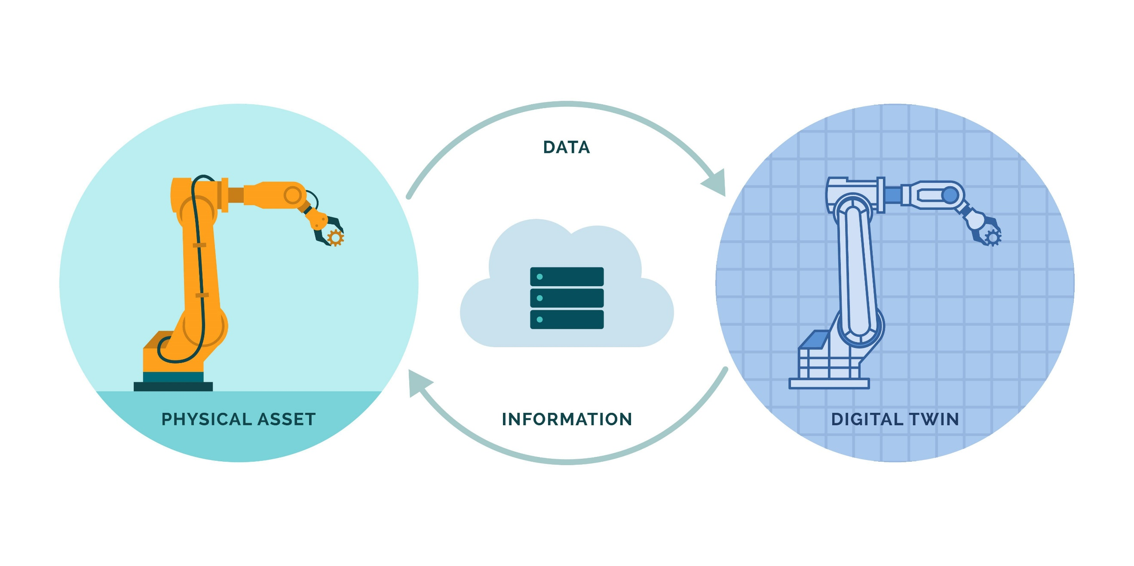
Digital Twin Usage Provides Insightful Data Analysis

Slide 3
Digital Twins Have Many Levels of Sophistication
1
Digital Model of the Entity
2
Collect Historical Data
3
Collect Real Time Data
4
Integrate Third Party Sources
5
Autonomous Digital Twin

Slide 4
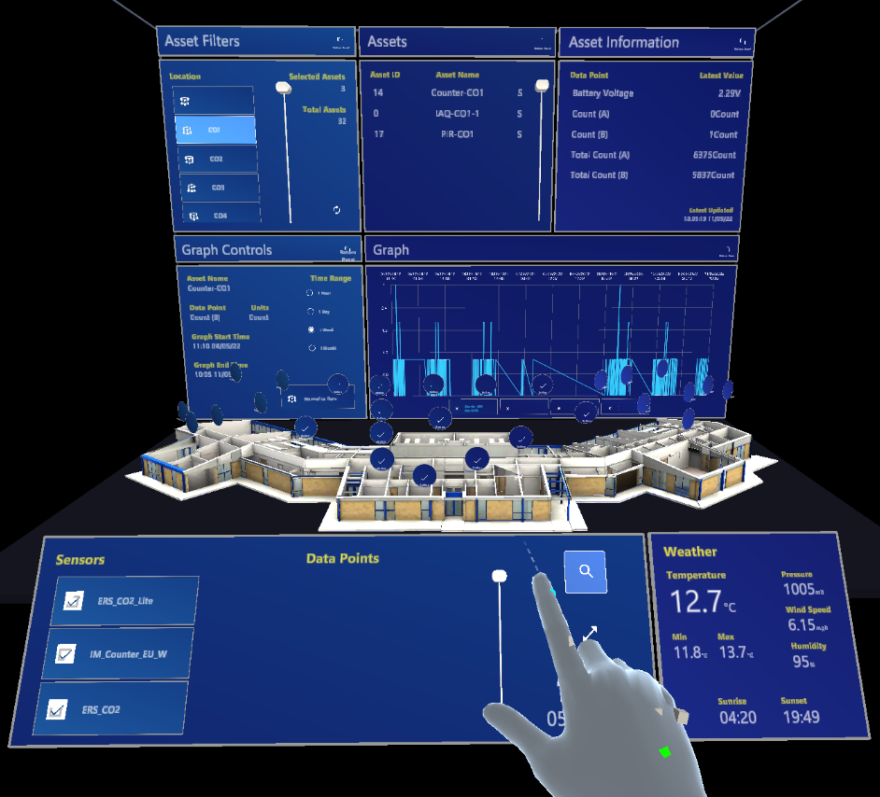
HoloLens Technology Aids Information Visualization

Slide 5
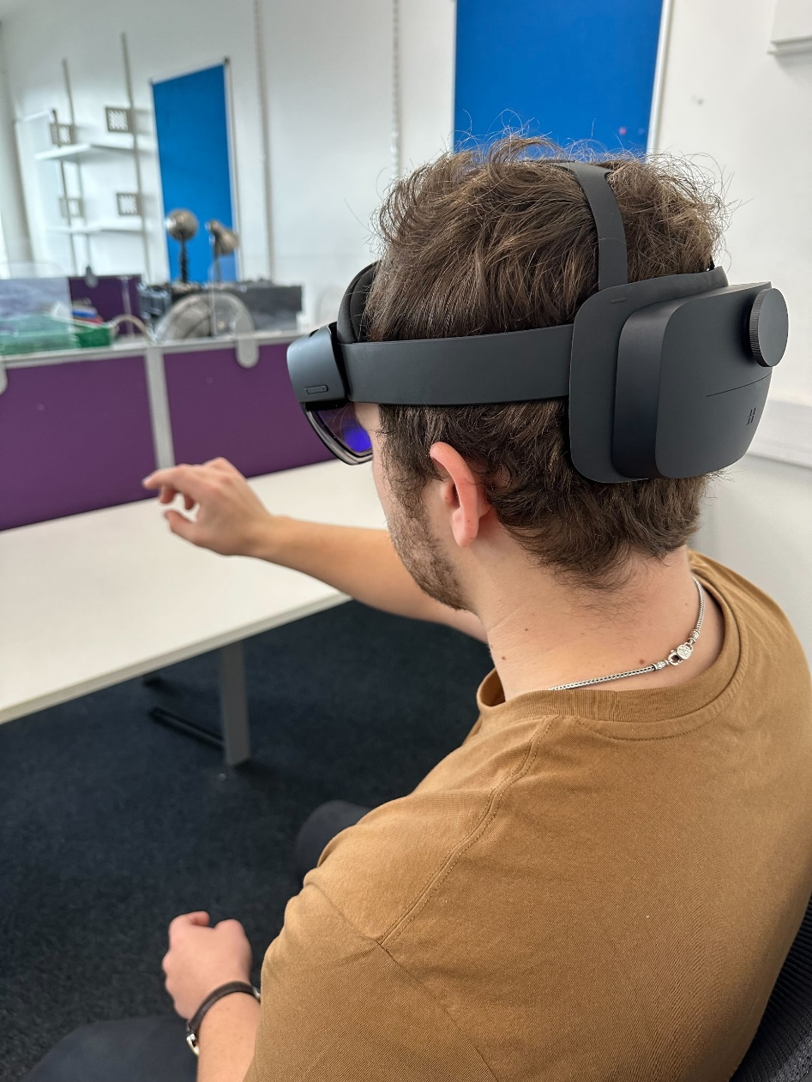
Digital Twin Technology Can Create Positive Change
Automatic meter readings system
Environmental heating system controller
Lighting control system
Integrate weather station data

Slide 6
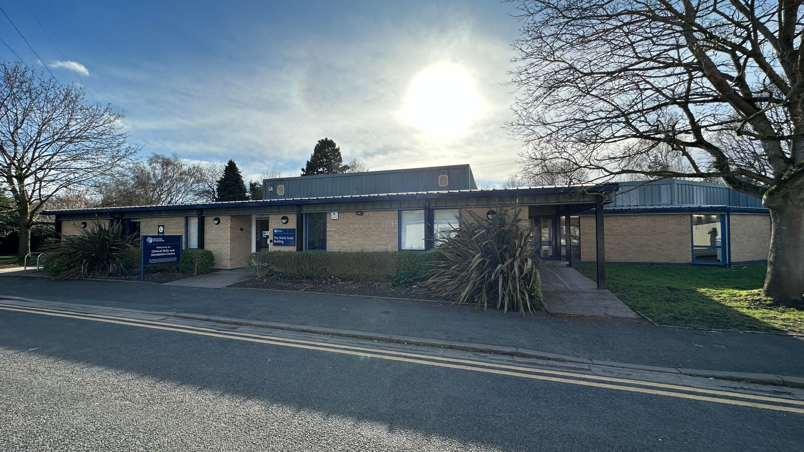
Sheila Scott Building as the Test Pilot For Digital Twin Technology
Notes:
Digital Twins are being implemented in universities worldwide to understand the energy behavior of a building, and to optimize or reduce its energy consumption.
The University of Worcester is aiming to maintain energy efficiency of the entire campus with the goal net zero carbon by 2030. and here is where the idea of the Digital twin technology comes alive. Where... In the Sheila Scott building
The Sheila Scott building is located at the University of Worcester’s St. John’s campus and is the site of a digital twin pilot.
This building is known as the Clinical Skills and Simulation Center.
and is used to educate students through realistic simulations. Some of the programs that the University holds in this building include Paramedic Science, Nursing, and Occupational therapy.
The Sheila Scott building is been using the Digital twin technology for almost a year and they are currently in the third stage which is collecting data in real time.
How are they collecting data well...? Next slide and explain sensors ubication.
The university of

Slide 7
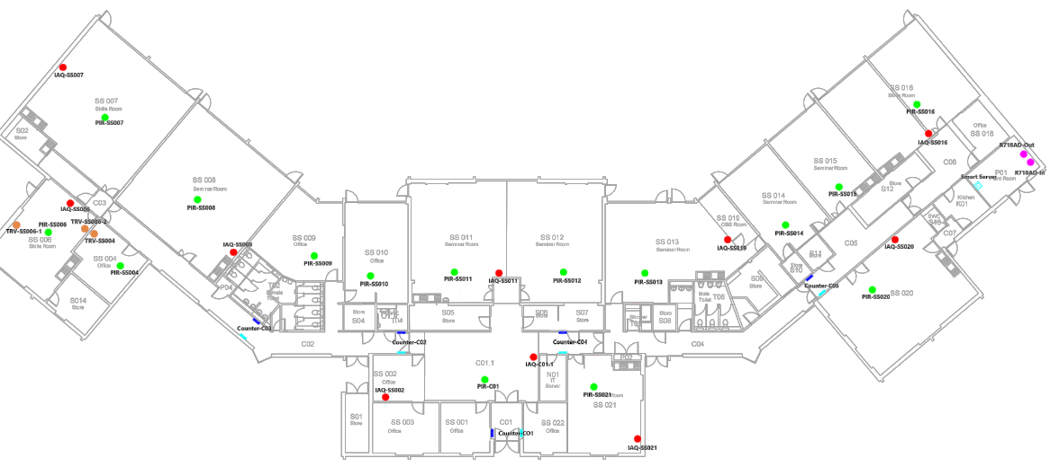
Sheila Scott Building Layout & Contrasting Room Characteristics
W
S
N
E
Notes:
The Sheila Scott Building currently has 7 types of sensor and 37 sensors in total from the north side to the south side of the building.
They are located in specific areas of the building to ensure accurate (aquiuret) measurement depending on sensors that’s been used
The two type of sensor that are more important are the air quality that measure the CO2 level (10 which are red dot) humidity and CO2, and the occupancy (O'-qiupanci) sensor (measure every hour to every minute to every second) (15 which are the green dot) that mainly use in room where lectures are been held, 5 people counter sensors that register the among of people circulating in the building, and some smart thermostats sensors.
Every day every hour, every minute, every second
After analyzing the data from the Sheila Scott building and the digital twin pilot, we established our project goal.

Slide 8
The goal of this project is to utilize the digital twin model to identify energy inefficiencies and key human interaction factors in the University of Worcester.
Notes:
Utilize (iurulais)

Slide 9
Objectives
Understand the design and the use of the digital twin model
1
Understand the behavior of the Sheila Scott building’s users.
2
Identify energy inefficiencies in the Sheila Scott building
3
Create recommendations on how to advance digital twin model
4
Notes:
In order to implement this technology, we wan to carry out theses objective.
to achieve theses objectives through

Slide 10
Research Methodology
Understand the design and the use of the digital twin model
1
Understand the behavior of the Sheila Scott building’s users.
2
Identify energy inefficiencies in the Sheila Scott building
3
Create recommendations on how to advance digital twin model
4
Notes:
In order to implement this technology, we wan to carry out theses objective.

Slide 11
Research Methodology
Understand the design and the use of the digital twin model
1
Interview Users and University Personnel
Observations of Sheila Scott Building
Understand the behavior of the Sheila Scott building’s users.
2
Identify energy inefficiencies in the Sheila Scott building
3
Create recommendations on how to advance digital twin model
4
Notes:
Now to accomplished/achieve these objectives
We Interview building users and university personal
We observe users' behavior in the Sheila Scott
We consult the Heat Decarbonization plan
And we review the information collected from the sensors
For the observation (we look for any detail that the sensor cant pick )
Now I'll bring back to James that he's going talk about our finding

Slide 12
Research Methodology
Understand the design and the use of the digital twin model
1
Interview Users and University Personnel
Observations of Sheila Scott Building
Understand the behavior of the Sheila Scott building’s users.
2
Consult Heat Decarbonization Plan
Identify energy inefficiencies in the Sheila Scott building
3
Create recommendations on how to advance digital twin model
4
Review Sensor Data
Notes:
Now to accomplished these objectives
We Interview building users and university personal
We observe users' behavior in the Sheila Scott
We consult the Heat Decarbonization plan
And we review the information collected from the sensors
Now I'll bring back to James that he's going talk about our finding

Slide 13
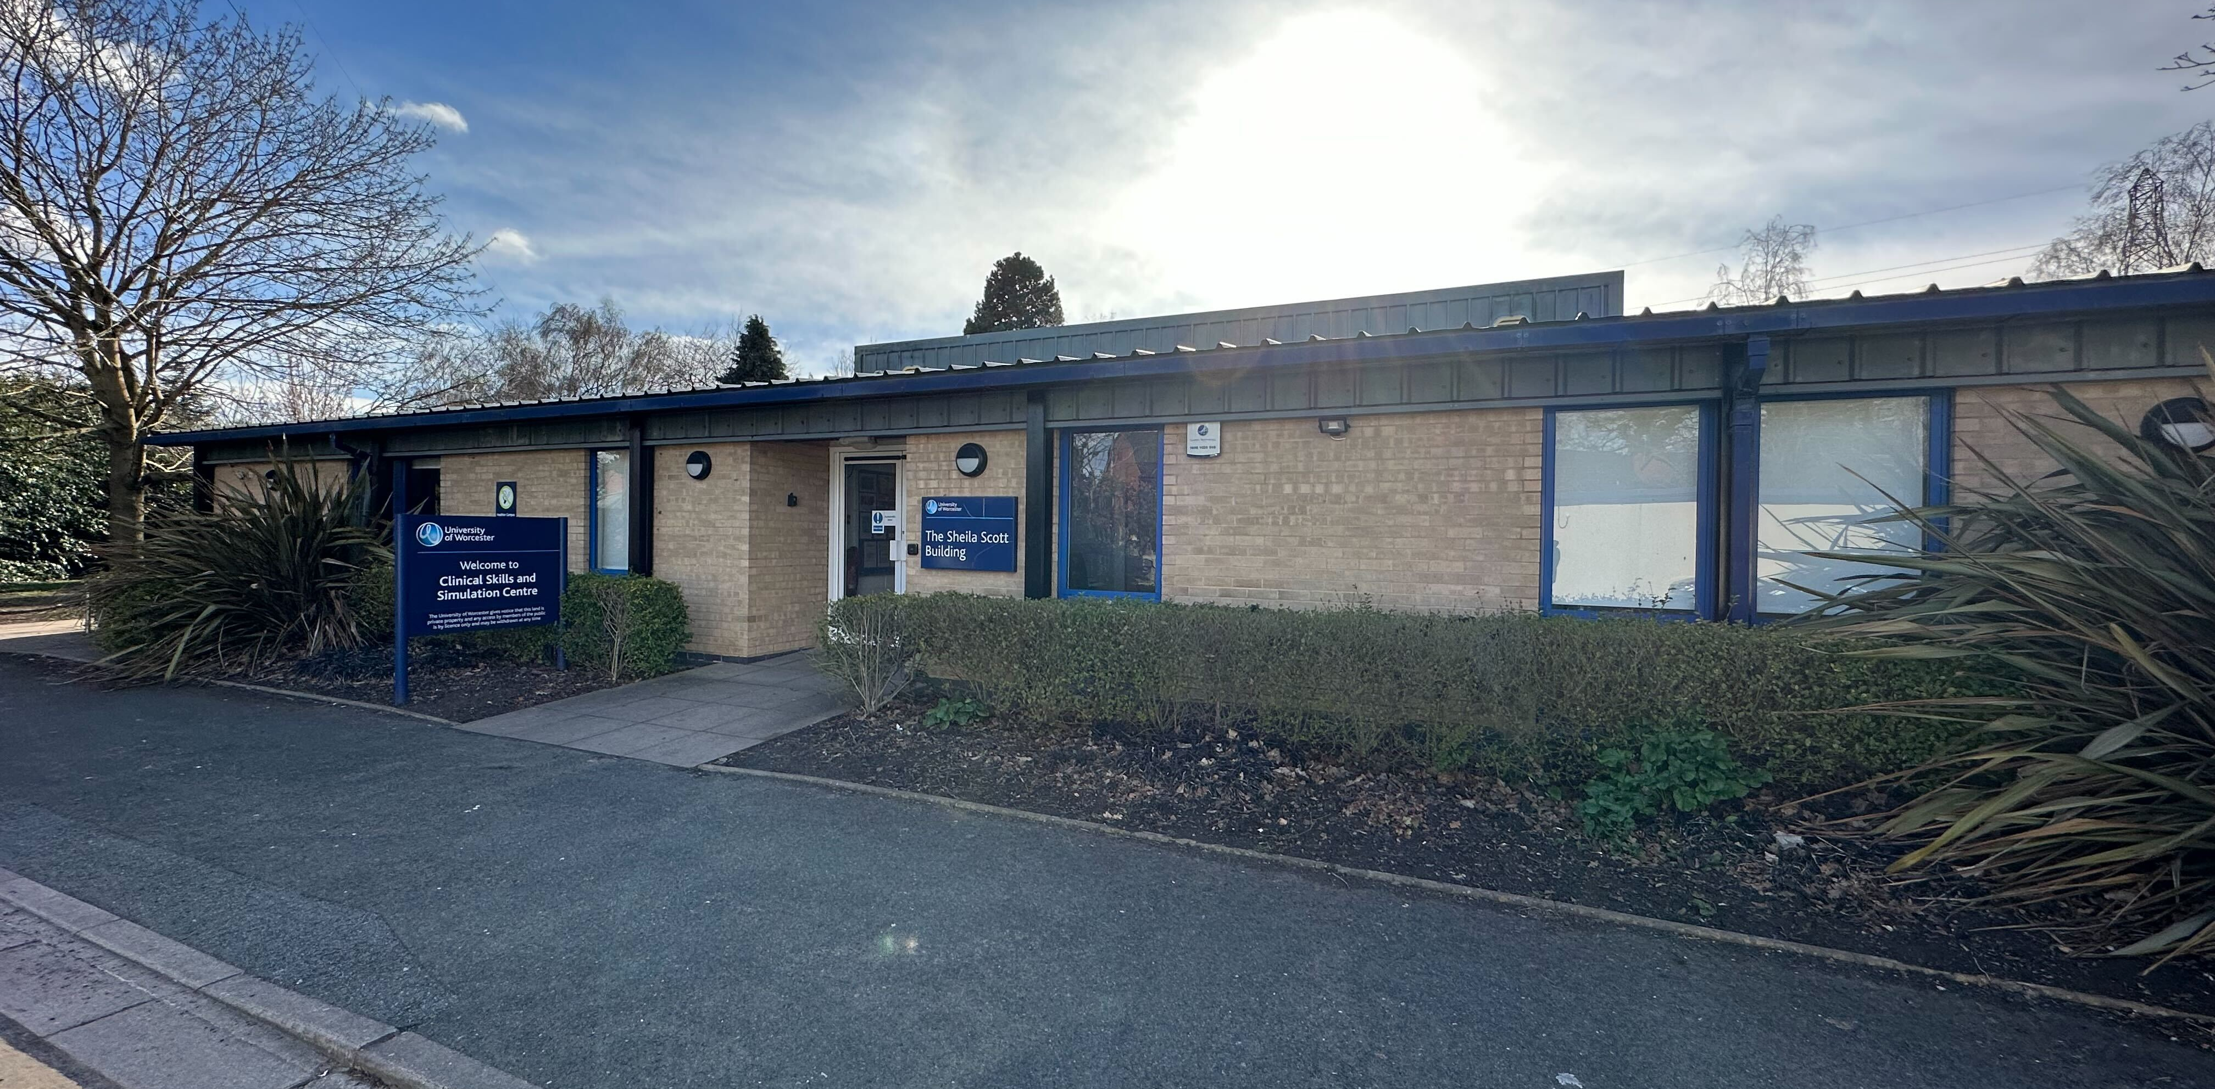
Findings
Notes:
After interviewing students, professors, technicians, and timetabling staff, we’ve become more familiar with the innerworkings of the timetabling system
We learned that as professor, you must set your classroom reservations up to a year in advance
This is before you learn your class size, class time, and most importantly your course material
And after all this, your reservation isn’t even guaranteed
To combat this, professors are reserving multiple classrooms at the same time for long hours to ensure they get their preferred time slot
Moreover, the timetabling system doesn’t just affect professors or students
Because teachers requesting, and sometimes receiving all their requested classrooms, lab technicians have to operate on a day-by-day basis on classroom setup
Let’s travel back in time to 12 months ago
You’re a professor who’s currently teaching class
You are asked to prepare for the following academic year
You have no student head count on the class, very little material prepared, and no inclination on everyone’s schedules
Now you must reserve a room for the entire academic year…now
And you’re not guaranteed your room reservation, so you reserve multiple to combat the lottery system
This is the reality of the University’s timetabling system and why a lot of energy is wasted with the heating of these quote unquote reserved rooms
Now this current timetabling system doesn’t just affect university professors or students...it affects the Sheila Scott building’s technician staff
Instead of being able to prepare for a class weeks or even days in advance, it operates on a day-by-day basis since the reservation schedules don’t accurately reflect classroom occupancy

Slide 14
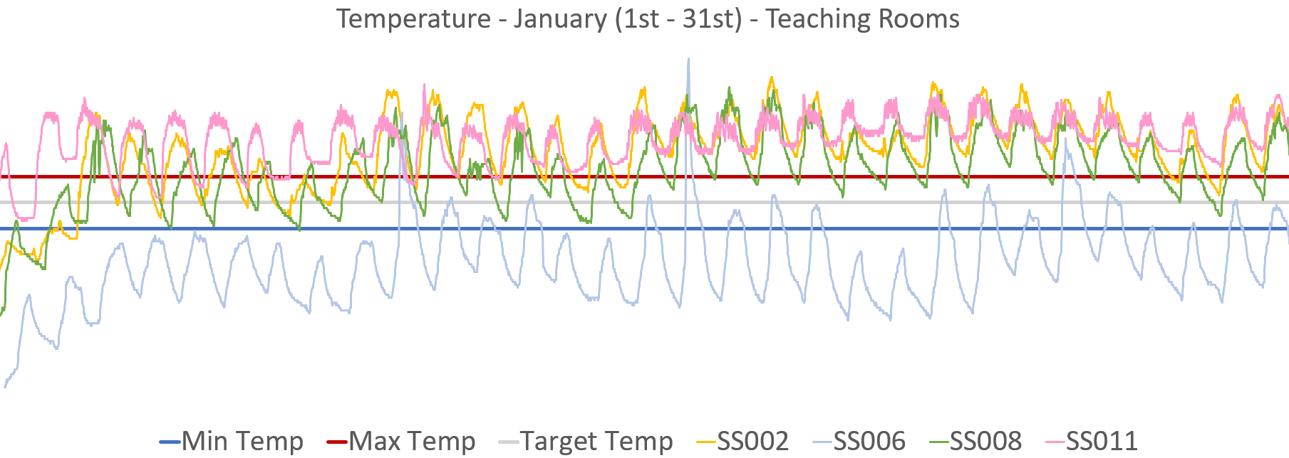
1) Are Rooms Consistently Within University Temperature Guidelines?
20°C
19°C
18°C

Slide 15
2) What Rooms are Problematic in the Sheila Scott?
21°C
19°C
16°C

Slide 16
Digital Twin Technology Reveals Energy Inefficiencies
21°C
19°C
16°C

Slide 17
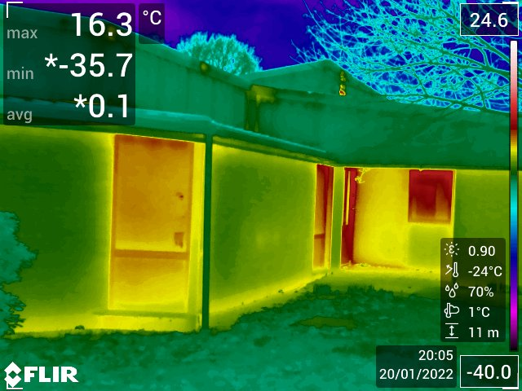
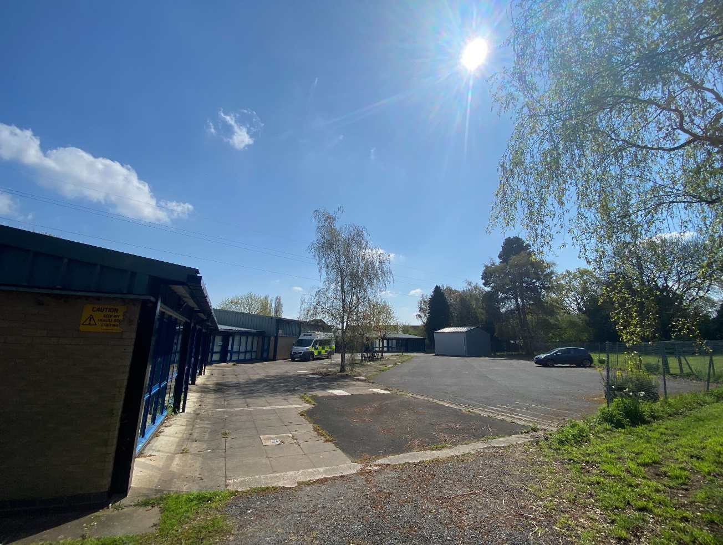
Heat Retention is Significantly Impacted by the Infrastructure

Slide 18
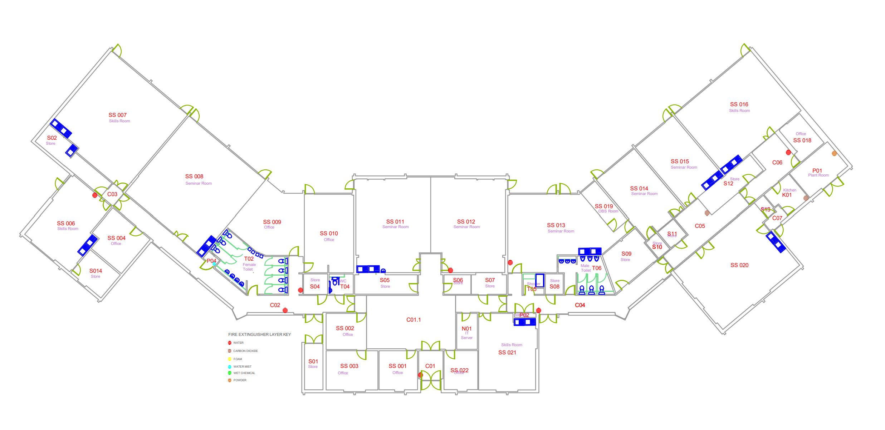
The HVAC System with Human Factors can Lead to Energy Waste
21°C
19°C
16°C

Slide 19
The HVAC System with Human Factors can Lead to Energy Waste
21°C
19°C
16°C

Slide 20
The HVAC System with Human Factors can Lead to Energy Waste
21°C
19°C
16°C

Slide 21
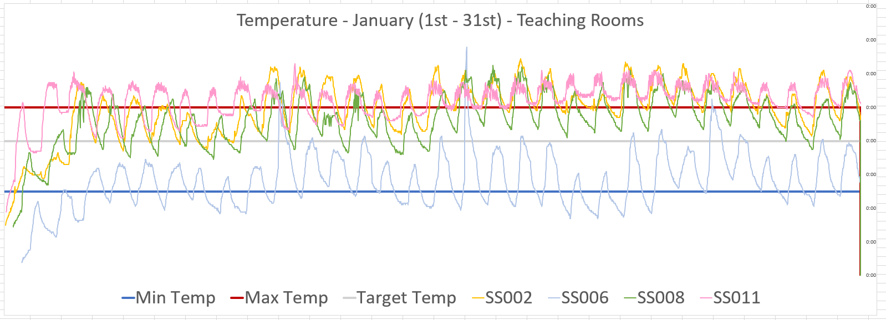
The HVAC System with Human Factors can Lead to Energy Waste
21°C
19°C
16°C

Slide 22
The HVAC System with Human Factors can Lead to Energy Waste

Slide 23
Recommendations
Notes:
After interviewing students, professors, technicians, and timetabling staff, we’ve become more familiar with the innerworkings of the timetabling system
We learned that as professor, you must set your classroom reservations up to a year in advance
This is before you learn your class size, class time, and most importantly your course material
And after all this, your reservation isn’t even guaranteed
To combat this, professors are reserving multiple classrooms at the same time for long hours to ensure they get their preferred time slot
Moreover, the timetabling system doesn’t just affect professors or students
Because teachers requesting, and sometimes receiving all their requested classrooms, lab technicians have to operate on a day-by-day basis on classroom setup
Let’s travel back in time to 12 months ago
You’re a professor who’s currently teaching class
You are asked to prepare for the following academic year
You have no student head count on the class, very little material prepared, and no inclination on everyone’s schedules
Now you must reserve a room for the entire academic year…now
And you’re not guaranteed your room reservation, so you reserve multiple to combat the lottery system
This is the reality of the University’s timetabling system and why a lot of energy is wasted with the heating of these quote unquote reserved rooms
Now this current timetabling system doesn’t just affect university professors or students...it affects the Sheila Scott building’s technician staff
Instead of being able to prepare for a class weeks or even days in advance, it operates on a day-by-day basis since the reservation schedules don’t accurately reflect classroom occupancy

Slide 24
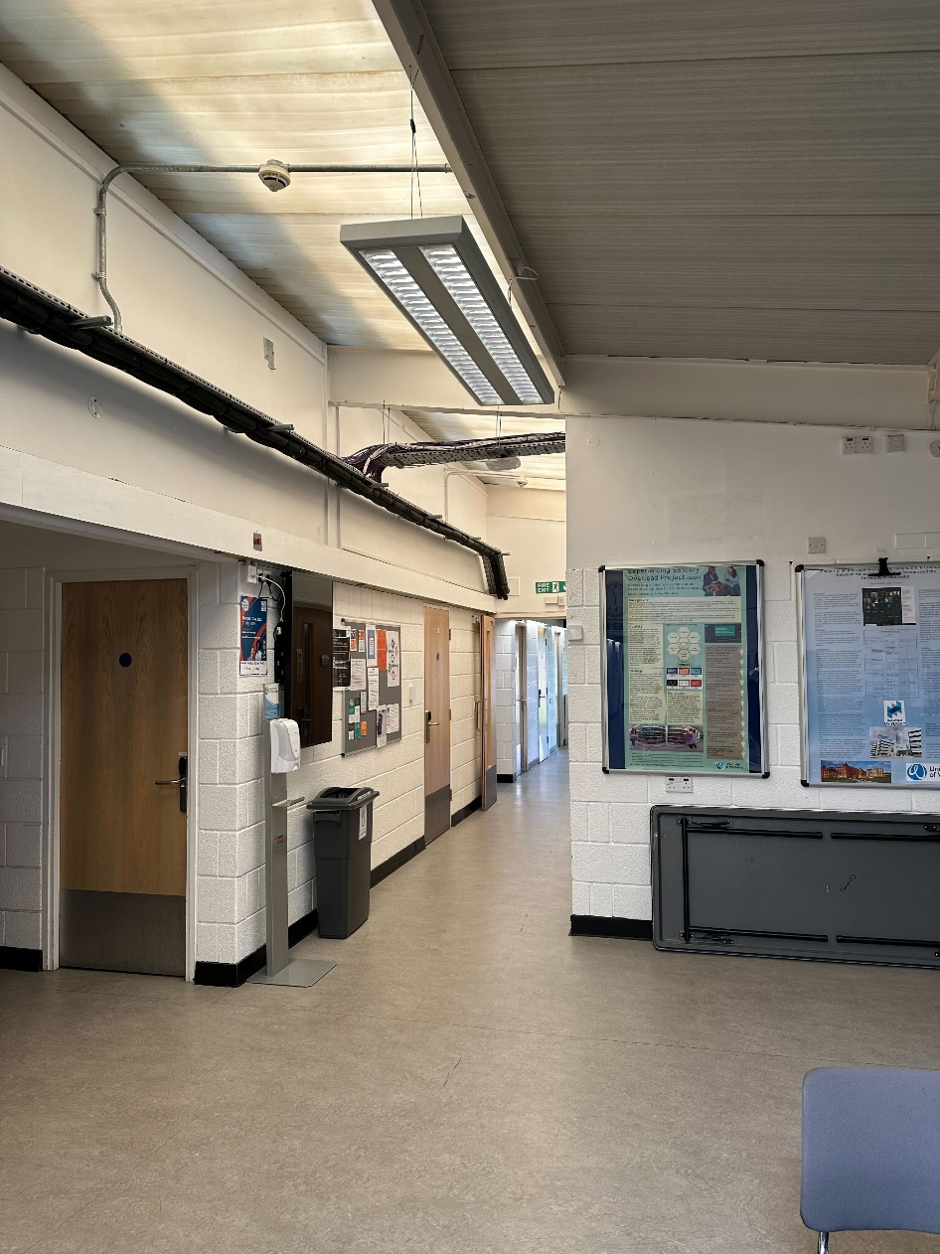
Short Term Recommendations
Improved Heat Retention
Window Insulation
Heat Pipe Insulation
Building Technology Upgrades

Slide 25
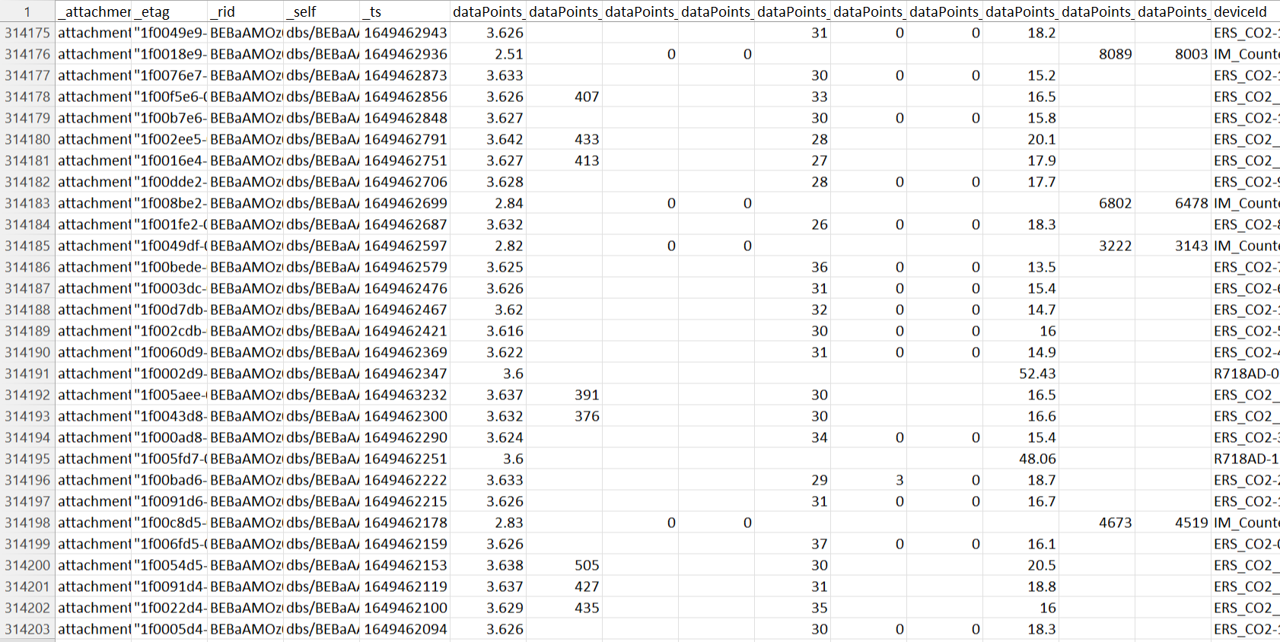
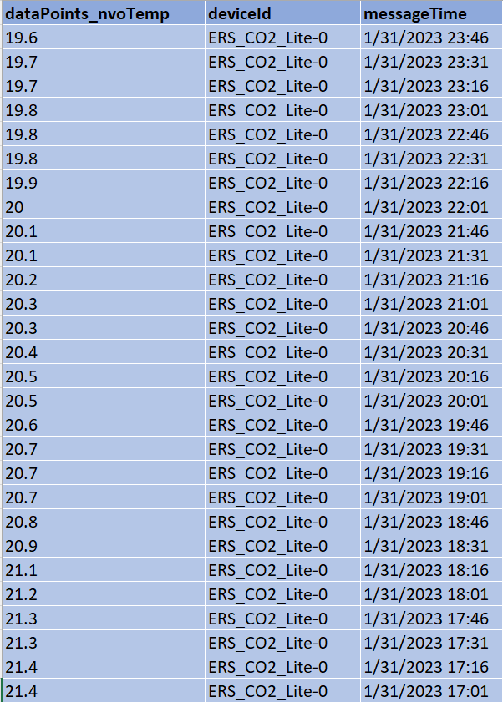
Post-Processing for Streamlined Data Storage & Visualization

Slide 26
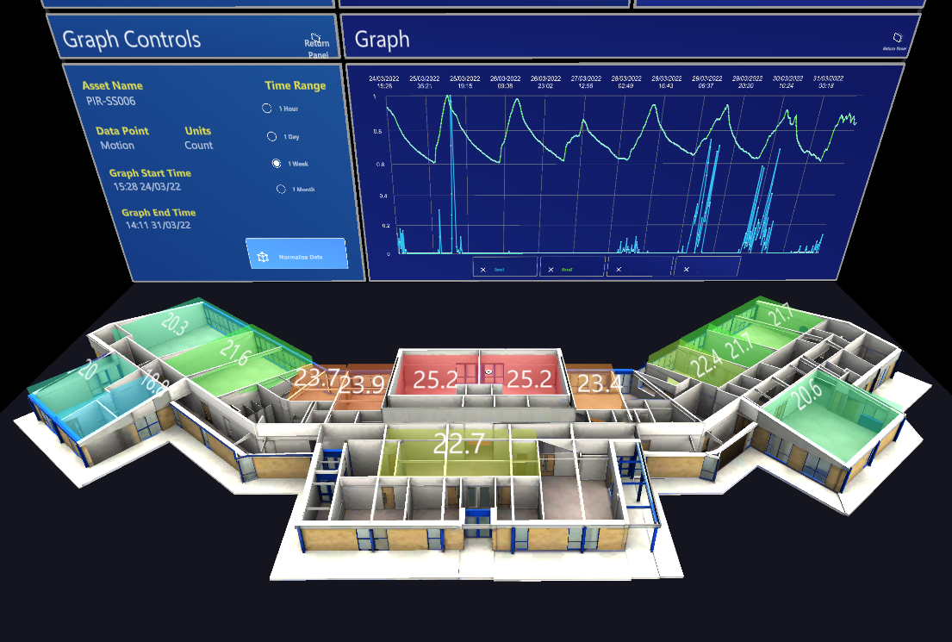
Create Accessible Digital Twin Visualization

Slide 27
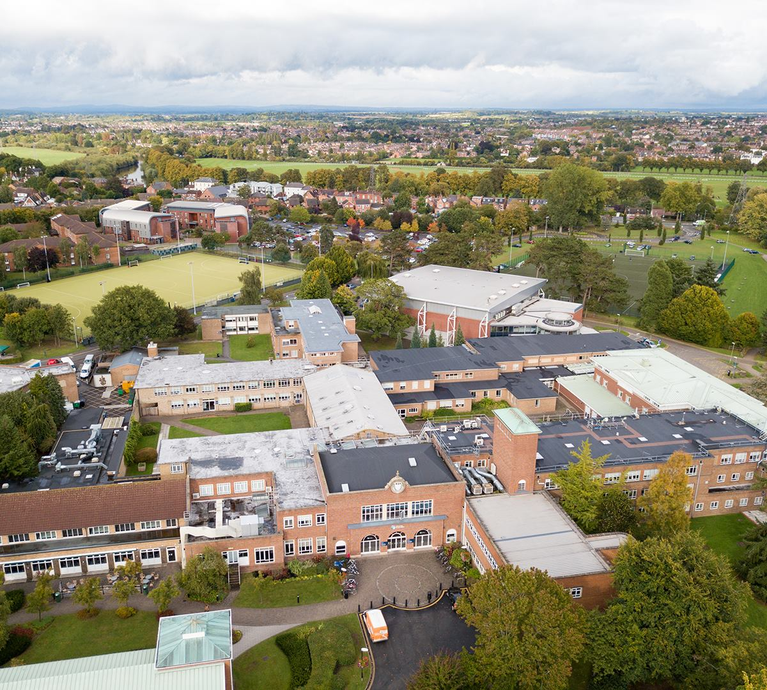
Slow Implementation of the Digital Twin

Slide 28
Acknowledgements
Thank You!​
Richard Vaz
Global School Professor
Fred J. Looft
Professor
Linda Carre Looft
Professor
Katy Boom
Director of Sustainability
Simon Dutton
Service Development Manager
Dr Andrew Tomlinson
Senior Lecture Department of Computing
And the Allied Health and Community Lectures, Clinical Skills Technicians, Estates and Facilities, Registry Services, Information Technology Staff

Slide 29
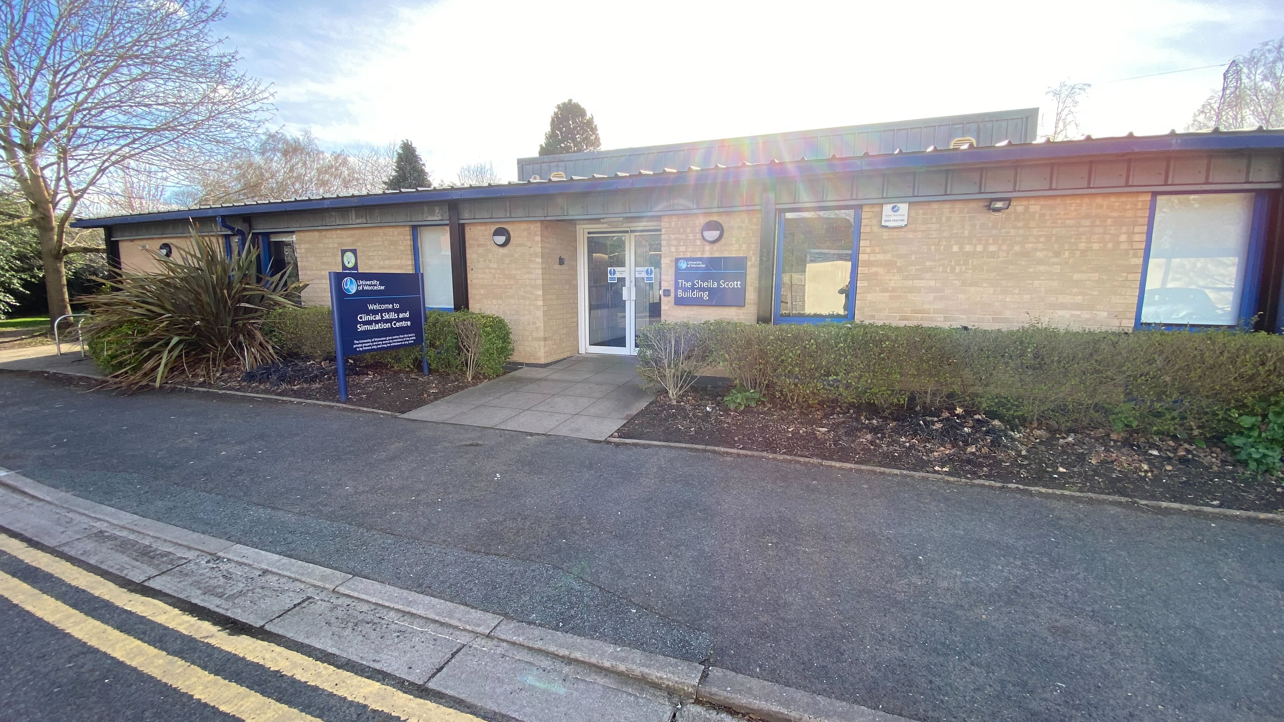
Thank You!​
Notes:
Good evening, everyone!
We are students at the Worcester Polytechnic Institute located in Worcester MA
James
Arturo
Ryan
Rolando
We’re here on a research project studying the Digital Twin technology in the Sheila Scott building

