Slide 1
Lecture Topic 1
Introduction to Acoustics

Slide 2
Why?
Topic 1 is meant to give the necessary context in order to begin understanding and modeling acoustic systems

Slide 3
What are we learning?
01
02
03
04
Introduction
Some history
What is acoustics?
A little background for context
Terminology
Propagation
Important quantities and how to use them
Conceptual overview of the propagation of sound

Slide 4
—Ning Xiang and Jens Blaubert
“It is audition and not vision that is the most relevant social sense of human beings. The auditory system is their most prominent communication organ, particularly in speech communication. Take as proof that it is much easier to educate blind people than deaf ones.”

Slide 5
Why study acoustics?
Arguably the most important human sense:
Hearing is compulsory; you can't close your ears
The field of hearing extends 360°
Can hear around optical barriers
For something so fundamental to our lives, we ought to try and understand it!

Slide 6
Why might it be important to study acoustics? What do you want to know from this course?

Slide 7
01
Introduction
What is acoustics?

Slide 8
Three Important Terms
Sound
Auditory Event
Acoustics
Mechanic vibration caused by a disturbance in an elastic medium
An event that exists as heard, only becoming actual after the act of hearing
The study and science of sound and its accompanying
auditory events

Slide 9
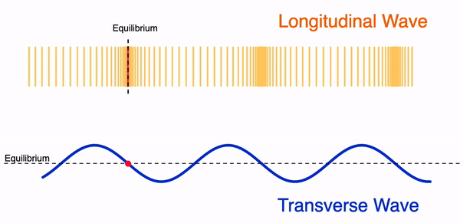
Acoustics
Formally, acoustics is the study of the generation, transmission, and reception of energy as vibrational waves in matter
When molecules of a fluid or solid are displaced, an internal elastic restoring force arises.
Essential concept which governs all vibrating systems
Notes:
NEED GIF Citation

Slide 10
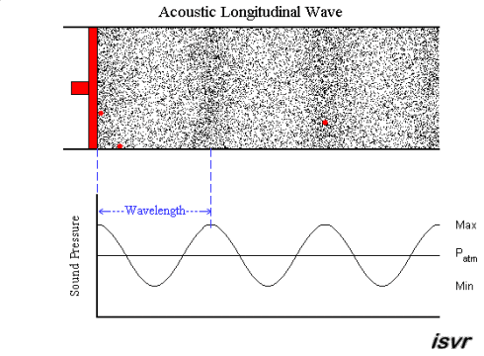
Sound
Sound Waves
Needs an elastic medium to propagate
Particles oscillate about an equilibrium position
What happens when there's no medium?
Propagation
Sound is a pressure wave
Sound propagates in all directions
We will describe more properties in depth in further sections
Notes:
NEED GIF CITATION

Slide 12
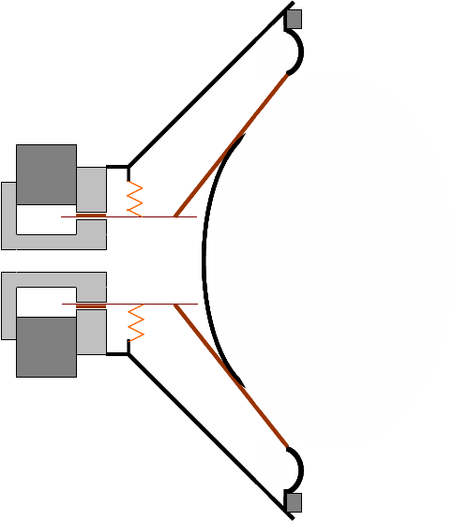
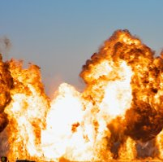
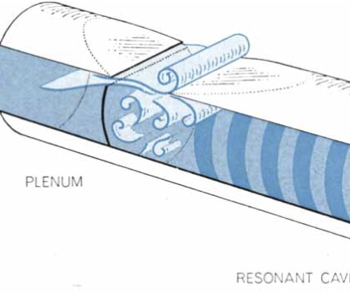
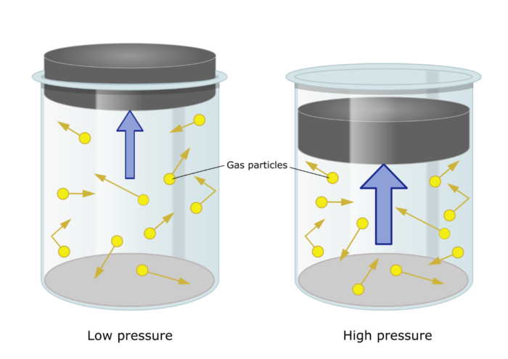
Common Sources of Sound
Vibration
Explosion
Vibrating Bodies – focus of this course
Shockwaves and nonlinear acoustics
Air Stream
Thermal
Air across a bottle top or whistle
pressure variation from temperature change
Notes:
CITATIONS

Slide 13
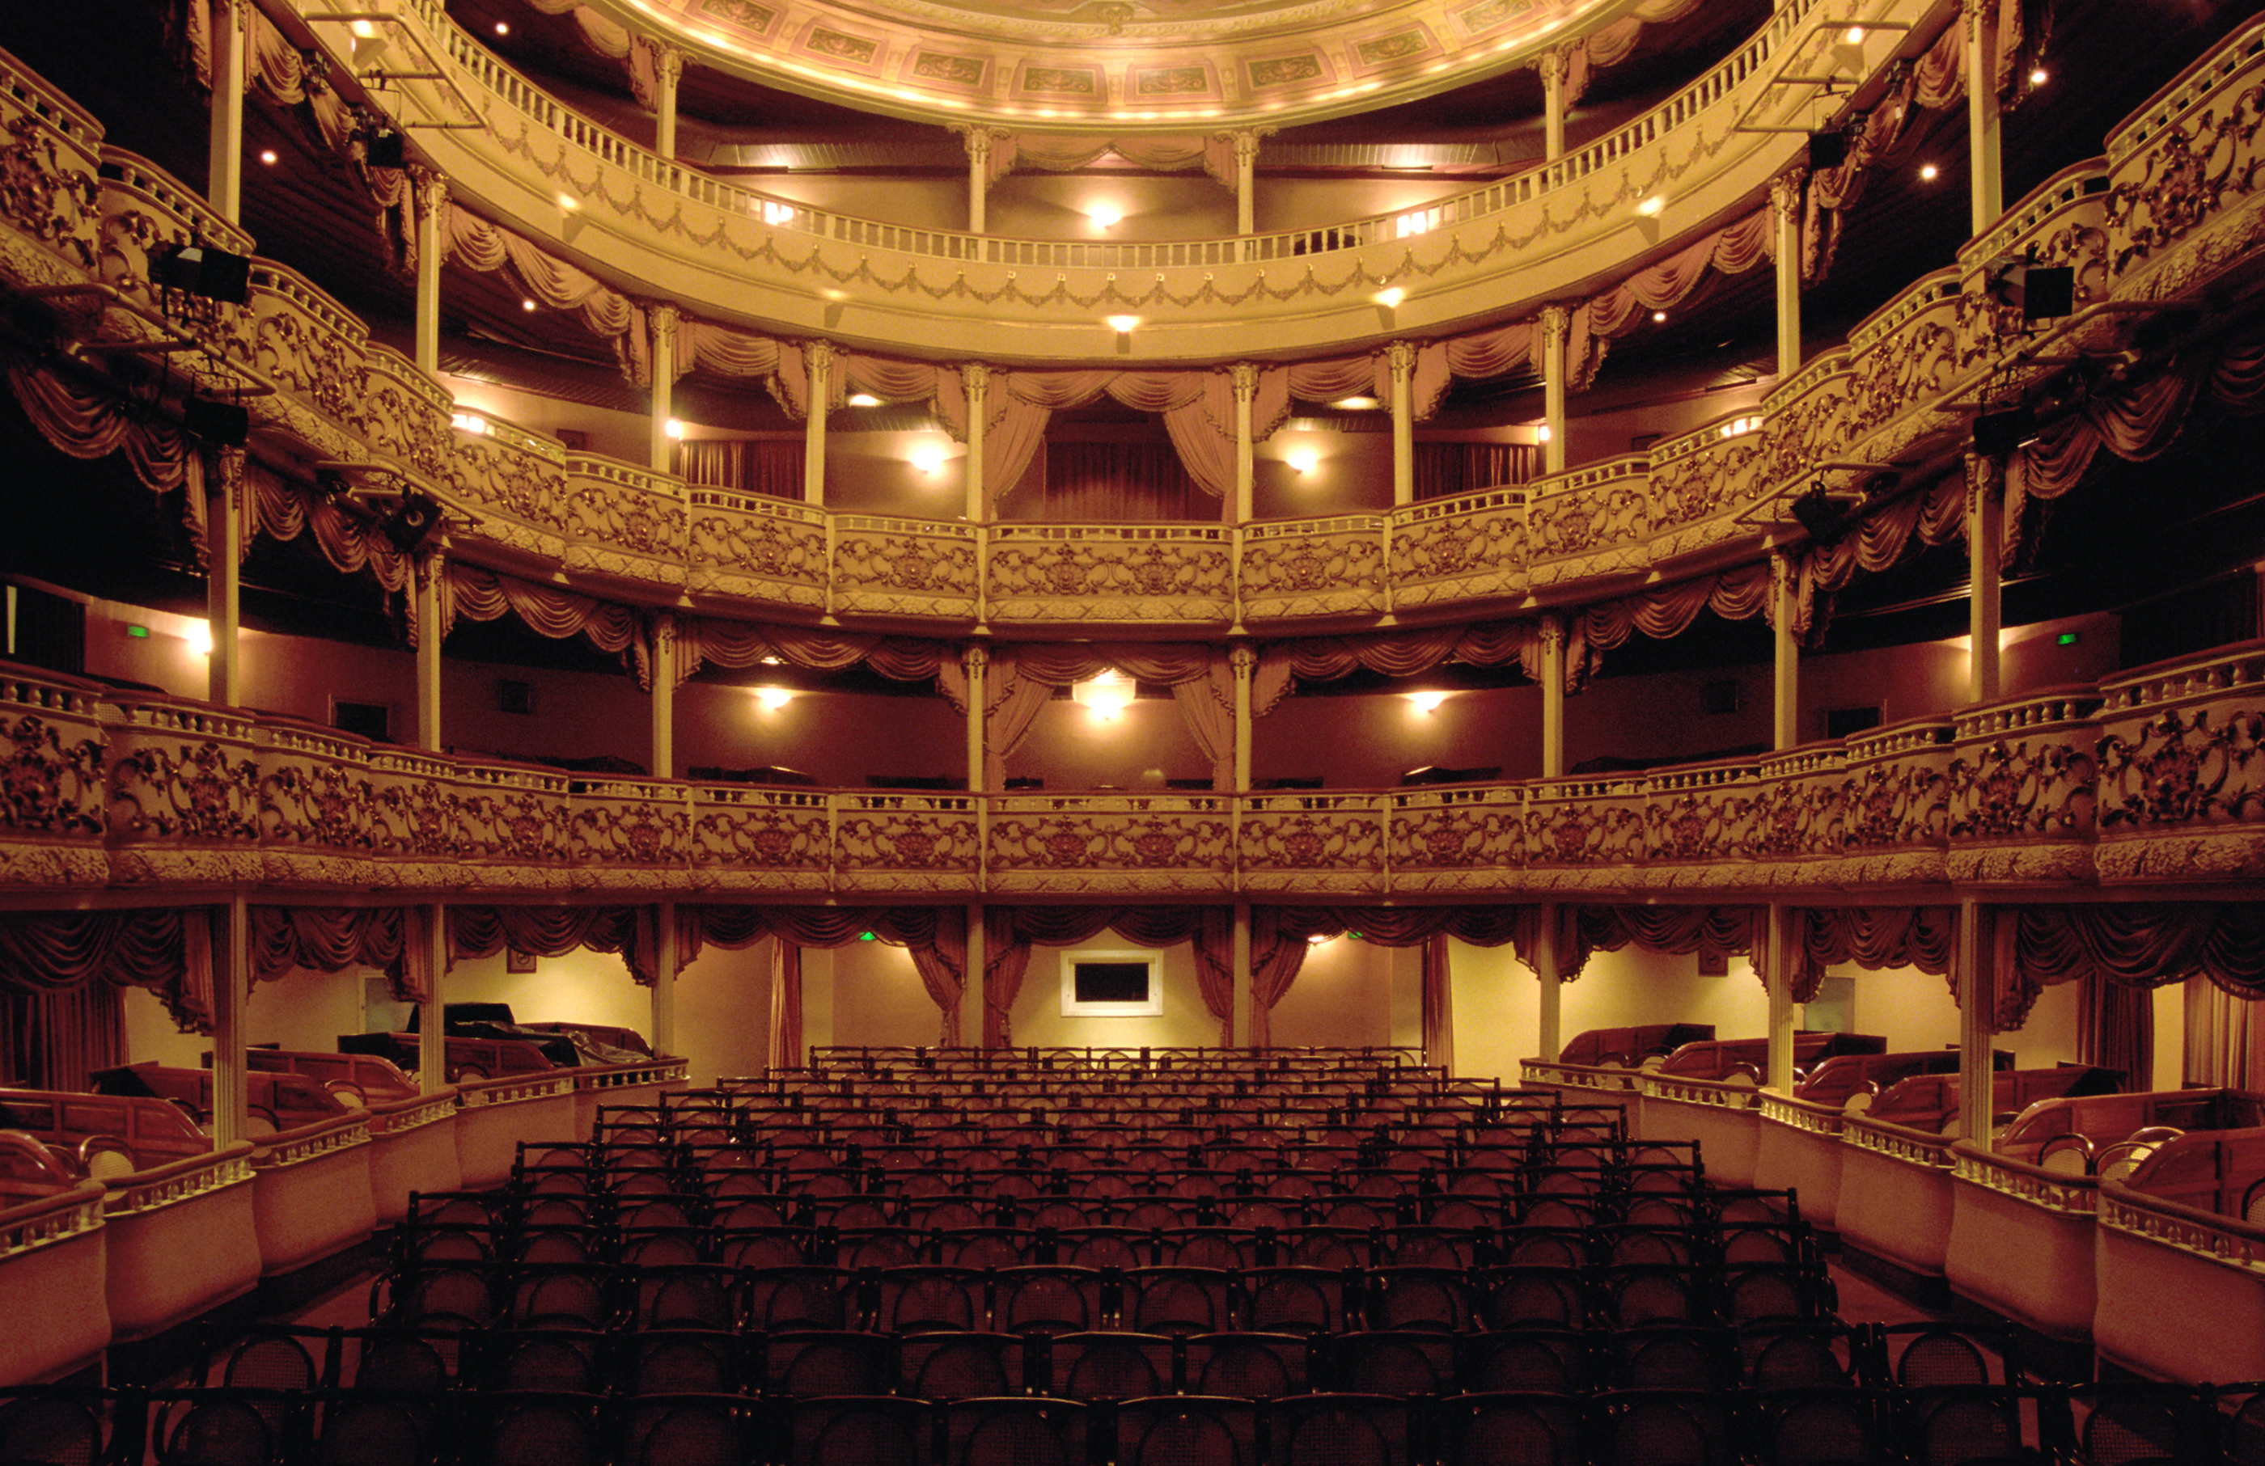
02
A Little History
Where did acoustics come from?
Notes:
Image is stock photo of a theatre

Slide 14
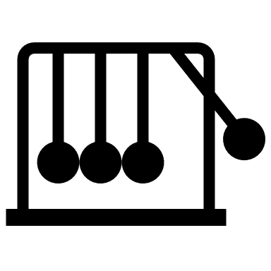
History of Acoustics
500 BC
1842
1910
Pythagoras find the relationship between string length and pitch
von Lieben and de Forest invent the vacuum tube triode allowing for amplification of weak signals
Chladni Introduced acoustics as a separate branch of physics
1643
1896
Toricelli demonstrated that sound cannot propagate in a vacuum
Acoustics had now matured and Rayleigh writes a full text on acoustics

Slide 15
Notable Inventions
Telephone
Radio
PA Loudspeakers
1867
1920
1920s
Consumer Audio
DSP
Smartphones
1930s
1970s
1990s

Slide 16
So many applications!
Mechanical Engineering
Electrical Engineering
Acoustics
Psychoacoustics
Vibroacoustics, Noise Control, Architectural, Seismology, Underwater Acoustics
Signal Processing, Amplifier Design, Bio-Sensing, Sound Reproduction, Sound Recording
Human Perception of sound; Loudness, Sharpness, Tonality, Roughness, Pitch

Slide 17
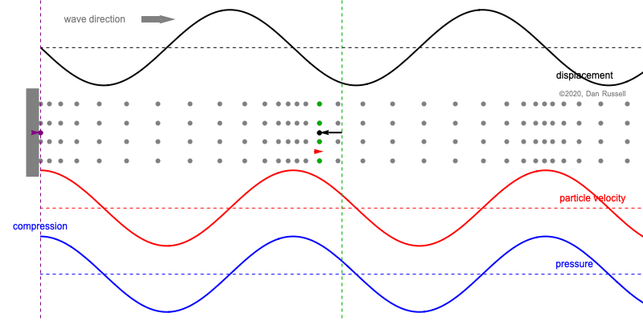
Terminology
03
The vocabulary to describe acoustics
Notes:
https://www.acs.psu.edu/drussell/Demos/phase-p-u-sine/phase-p-u-sine.html

Slide 18
Measurable aspects of sound
Let us first consider what measurements might be made on a medium
Let’s take a gas at rest for example, what can be said about:
Particle movement?
Pressure?
Density?

Slide 19
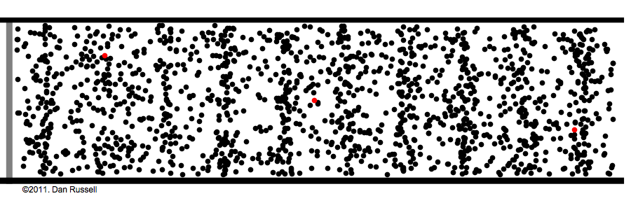
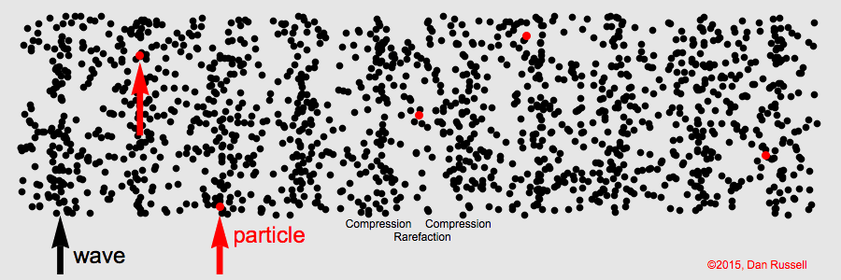
Measurable aspects of sound
When a sound wave propogates through that medium what can be said about:
Particle position?
Particle velocity/acceleration?
Pressure?
Temperature?
Density?
Notes:
GIF CITATION

Slide 20
Properties on Waves
Wavelength(λ)
x
λ (meters)
Amplitude (A)
+A
t
Frequency (ν)
-A
Period (T)
T (seconds)
Displacement (x)

Slide 21
Properties of a Waves
Frequency (ν)
The number of complete cycles in each amount of time
Period (T)
The amount of time taken to complete one full cycle
Wavelength(λ)
The linear distance between two wavefronts
Amplitude (A)
The maximum displacement from equilibrium position
Amplitude represented as pressure
λ (meters)
Longitudinal – sound in air

Slide 22
Relevant Terminology
Particle Velocity
Sound Pressure
Frequency Band
Alternating velocity of an oscillating particle/element;
Meter/Second [m/s]
Alternating pressure caused by particle oscillation;
Newton/Meter² = Pascal [N/m² = Pa]
Interval in the frequency domain, usually defined by an upper and lower frequency;
Hertz [Hz]

Slide 23
Relevant Terminology
Acoustic Impedance
Sound Pressure Level
Sound Intensity
the opposition a system has to the acoustic flow resulting from an acoustic pressure;
Newton * Second/Meter² [Ns/m⁵]
Level on a logarithmic scale of the effective sound intensity to a reference;
SPL = 10log(I/I_ref) [dB]
Sound power per unit area, where area is only the area component perpendicular to propagation;
Watts/Meter² [W/m²]

Slide 24
Numerical Context: Frequency Bands
Human hearing extends from 20 – 20kHz, here are some common examples of frequency bands
 | Frequency Band
Kick Drum, Bass, Organ | 20 – 40 Hz
Vocals | 100 – 3 kHz
Guitar | 2.5 – 5 kHz
Hi-hat, cymbals, snare | 8+ kHz
Notes:
Source: http://hyperphysics.phy-astr.gsu.edu/hbase/hframe.html​

Slide 25
Spectrogram
Let’s See for Ourselves

Slide 26
Numerical Context: Particle Velocity
Particle velocity can be solved for using the following relationship:
$Pressure=Acoustic Impedance ∗Particle Velocity$
Using the above relationship and an acoustic impedance of air of $≈412 \frac{Ns}{m^{3}}$, solve for the following particle velocities:
Measured pressure of $20μPa$
$v=\frac{P}{Z_{air}}=\frac{0.000002}{412}=5∗{10}^{−8}\frac{m}{s}$
Measured pressure of $100mPa$
$v=\frac{P}{Z_{air}}=\frac{0.1}{412}=25∗{10}^{−5}\frac{m}{s}$
Measured pressure of $100Pa$
$v=\frac{P}{Z_{air}}=\frac{100}{412}=0.25\frac{m}{s}$

Slide 27
Numerical Context: Sound Pressure and SPL
The quantity sound pressure level (SPL) is a common quantity for measuring the sound pressure with respect to a reference pressure
This reference is commonly the threshold of human hearing at $20μPa$
As shown before: $SPL−dB=10log⁡\left(\frac{{Intensity}_{measured}}{{Intensity}_{reference}}\right)$
$Acoustic Intensity=\frac{{pressure}^{2}}{density ∗ speed of sound}$
How would you express SPL in terms of sound pressure?
$SPL−dB=10\log\left(\frac{I_{meas}}{I_{ref}}\right)=10log\left(\frac{\frac{{p_{meas}}^{2}}{ρc}}{\frac{{p_{ref}}^{2}}{ρc}}\right)=10log\left(\frac{{p_{meas}}^{2}}{{p_{ref}}^{2}}\right)=10log{\left(\frac{p_{meas}}{p_{ref}}\right)}^{2}$
$SPL−dB=20log\left(\frac{p_{meas}}{p_{ref}}\right)←$ This equation is frequently used!

Slide 28
Numerical Context: Sound Pressure and SPL
The lowest pressure change a human can hear is $20μPa$, called the threshold of hearing – This commonly serves as $p_{ref}$
A noise just above the threshold of hearing was recorded at $30μPa$, express that in terms of dB-SPL
${SPL}_{low}=20log\left(\frac{30μPa}{20μPa}\right)≈3.5dB$
A person talking generates a sound pressure change of $100mPa$, express that in terms of dB-SPL
${SPL}_{norm}=20log\left(\frac{100mPa}{20μPa}\right)≈34dB$
The loudest a human can hear before pain is $100Pa$, express that in terms of dB-SPL
${SPL}_{norm}=20log\left(\frac{100Pa}{20μPa}\right)≈130dB$

Slide 29
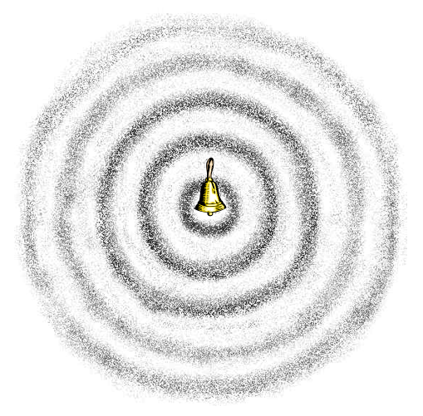
04
Sound Propagation
How does sound travel?
Notes:
https://cecm.indiana.edu/361/acoustics.html

Slide 30
Review on Waves
Transverse Waves
Displacement perpendicular to the direction of propagation
Ex) Wave on a string
Longitudinal Waves
Displacement in the direction of propagation
Ex) Slinky or Sound in air
Notes:
Insert Source: Reference - Hyperphysics

Slide 31
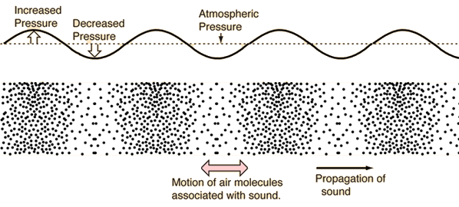
Sound waves in air
Oftentimes, transverse waves are used graphically to describe the motion of sound in air
Notes:
IMAGE CITATION

Slide 32
Sound Propagation
Sound propagates in all directions around the sound source
As such, sound tends to propagate spherically unless interfered with
Notes:
IMAGE CITATION

Slide 33
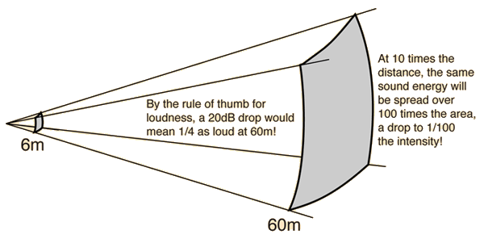
Sound Propagation in Air
Due to this spherical propagation, sound energy distributes following the inverse square law
Notes:
Source: Hyperphysics

Slide 34
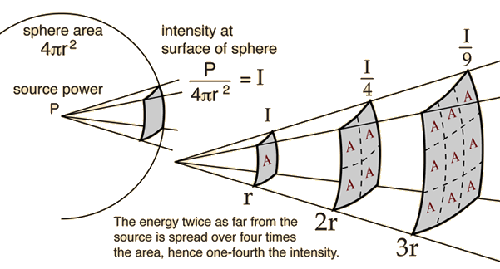
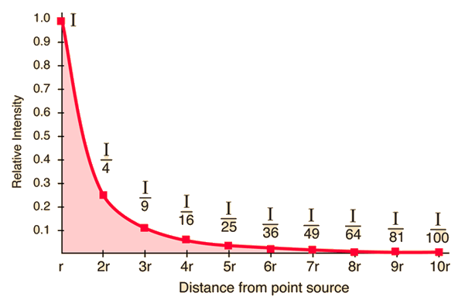
The Inverse Square Law
Click for simulation!
Notes:
CITATION

Slide 35
Numerical Context: Sound Propagation
Consider a point source producing an acoustic power of 1 Watt in free air;
What is the difference in intensity heard by listener 1 when compared to listener 2?
$I_{1}=\frac{P}{4π{r_{1}}^{2}}=\frac{1}{4π{(3)}^{2}}=0.0088\frac{W}{m^{2}}$, $I_{2}=\frac{P}{4π{r_{2}}^{2}}=\frac{1}{4π{(7)}^{2}}=0.0016\frac{W}{m^{2}}$, $I_{1}−I_{2}=0.0072\frac{W}{m^{2}}$
What would this difference be in decibels?
$I_{1}−I_{2}=0.0072\frac{W}{m^{2}}$, $20\log\left(\frac{0.0072}{0.000002}\right)≈50dB$
3m
4m
$$x_{1}$$
$$x_{2}$$

Slide 36
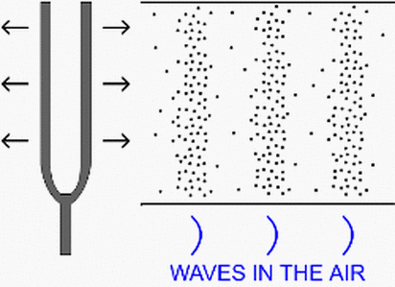
Speed of Sound
Dependent on Medium and Temperature
Generally, the speed of sound is not dependent on:
Frequency
Period
Amplitude
Etc.
Variables Affecting Speed
Elastic property; Bulk Modulus, $B$
Inertial Property; Density, $ρ$
Related by:
$$v=\sqrt{\frac{B}{ρ}}$$
Notes:
CITATION

Slide 37
Table of Propagation Speeds
Gases
Hydrogen (0$°C)$ | 1286
Helium (0$°C)$ | 972
Air (0$°C)$ | 343
Air (20$°C)$ | 331
Liquids at 25$°C$
Water | 1493
Sea Water | 1533
Mercury | 1450
Solids
Diamond | 12000
Iron | 5130
Aluminum | 5100
Brass | 4700

Slide 38
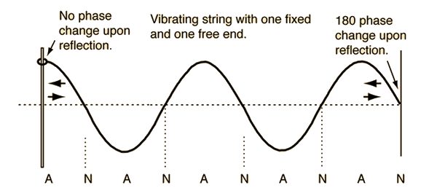
Reflection
Angle of reflection
Phase Change
When sound reflects off a perpendicular wall a $180°$ phase shift occurs
Free End
Fixed End
Antinode
Node
Click for simulation!
Notes:
CITATION

Slide 39
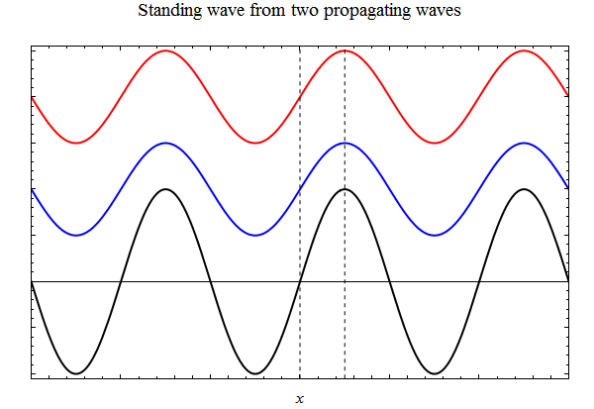
Standing Waves
Incident Wave
Reflection
Standing wave appear to stand still, oscillating around nodes and antinodes
Standing wave amplitude is twice the incident wave amplitude
Click for simulation!
Incident + Reflection = Standing Wave
Notes:
GIF CITATION

Slide 40
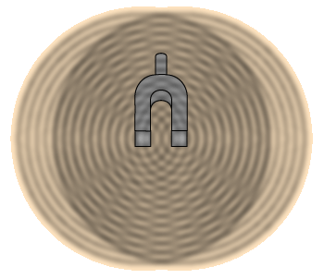
Interference
Two travelling waves that exist in the same medium will interfere with each other
Notes:
IMAGE CITATION

Slide 41
Interference
Constructive
Destructive
If phases align and amplitudes add, it is considered constructive
If phases misalign and amplitudes subtract, it is considered destructive
Simulation

Slide 42
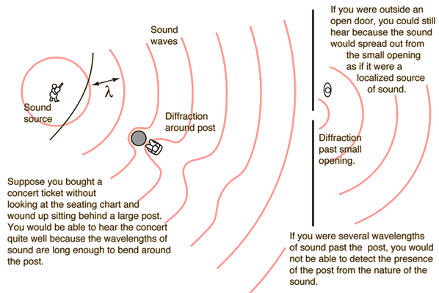
Diffraction
If an obstacle is sufficiently smaller than the wavelength of an incident wave, it will bend around that object
Click for simulation!

Slide 43
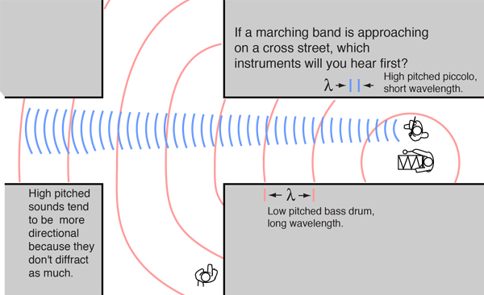
Diffraction
Directionality
Because higher frequencies have shorter wavelengths, they “spread out” less than lower frequencies
This makes higher frequencies more directional than lower frequencies

Slide 44
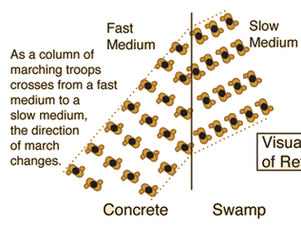
Refraction
As previously discussed, when sound travels through two different mediums its speed will change
As its speed changes, the travelling wave changes direction in the new medium
The change in the medium changes the speed of propagation, and due to $v=fλ$, the wavelength changes as well

Slide 45
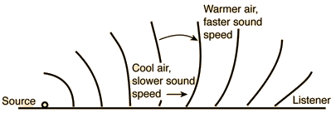
If the air above the ground is warmer than the air on the ground, it acts as a medium change
This causes an effect where not only the direct sound from the source can be heard, but additional sound that is bent down
Fisherman have often described being able to hear much greater distances on water than on land due to the water cooling the surface air, allowing more sound to be refracted down

