Slide 1
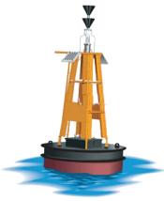
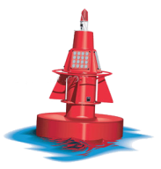
Designing A Living Victoria Harbour

Slide 2
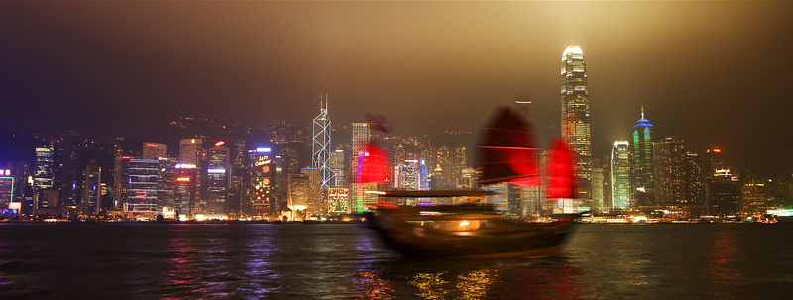
A Living Harbour
Notes:
The goal of this project is to turn Victoria Harbour into a “living harbour.” What does that mean? A “living harbour” is a harbour in which all users exist in a symbiotic, mutually-beneficial relationship. This means industrial users, commercial users, and recreational users, all using the harbour in harmony. So how do we intend to do this?
PHOTO CREDIT: http://si.smugmug.com/Portfolio/Portfolio/1674201_UxZmP#114392120_FbSjx-L-LB

Slide 3
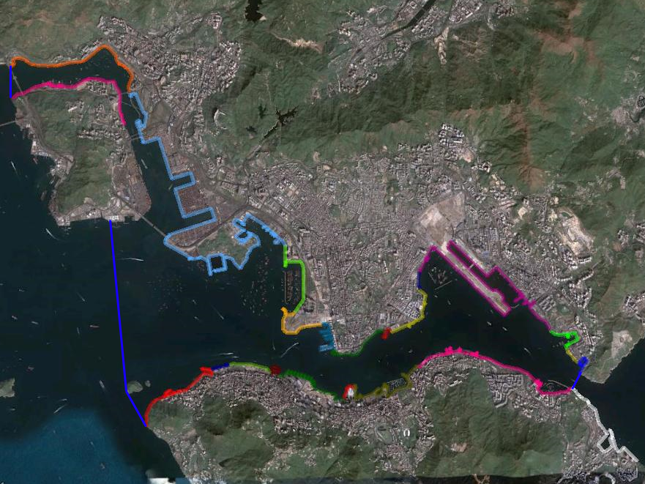
Study Area
Notes:
We divided the entire Victoria Harbour waterfront into twenty-three (23) separate action areas, and then walked the entire fifty (50) kilometer waterfront twice with a waterfront evaluation form; a form that included a checklist of all land-water interfaces and marine users that we would like to see; things such as landing steps, public cargo working areas, and marinas.

Slide 4
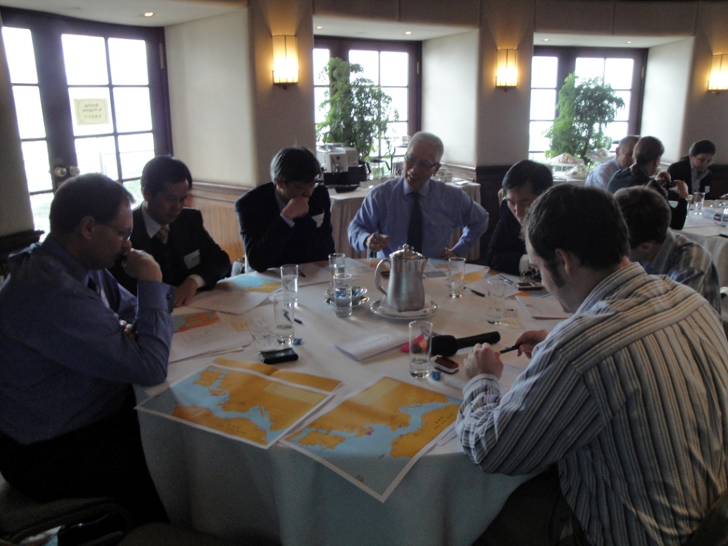
Notes:
We also conducted thirty (30) interviews with various waterfront stakeholders, as well as holding a stakeholder conference at the Royal Hong Kong Yacht Club to help us try to predict the future trends of Victoria Harbour’s marine users.
PHOTO CREDIT: Santiago Lora

Slide 5
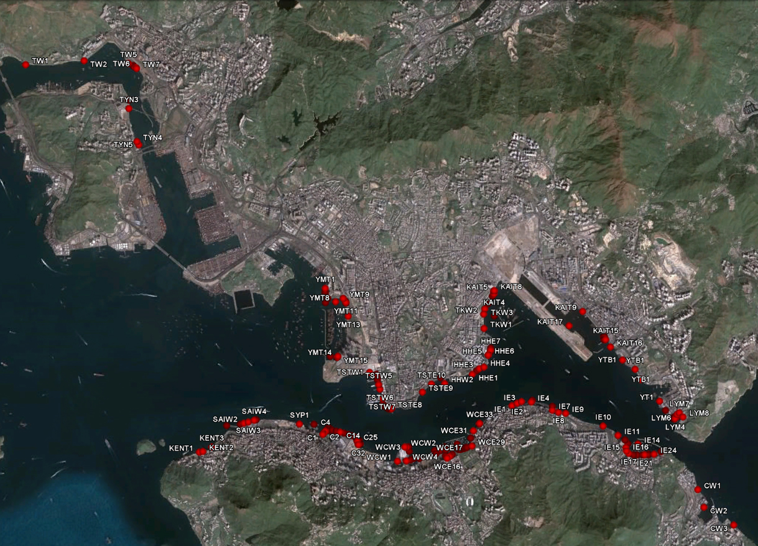
Google
Earth
Notes:
When our study is complete, what will we be leaving behind? Aside from the actual hard-copy report itself, we’re creating a Google Earth database that includes all the marine resources that we’ve found. Google Earth is a program that contains satellite maps of the entire world, and also contains lots of user-generated content. As we find marine resources in our audits, we add them to our Google Earth database.

Slide 6
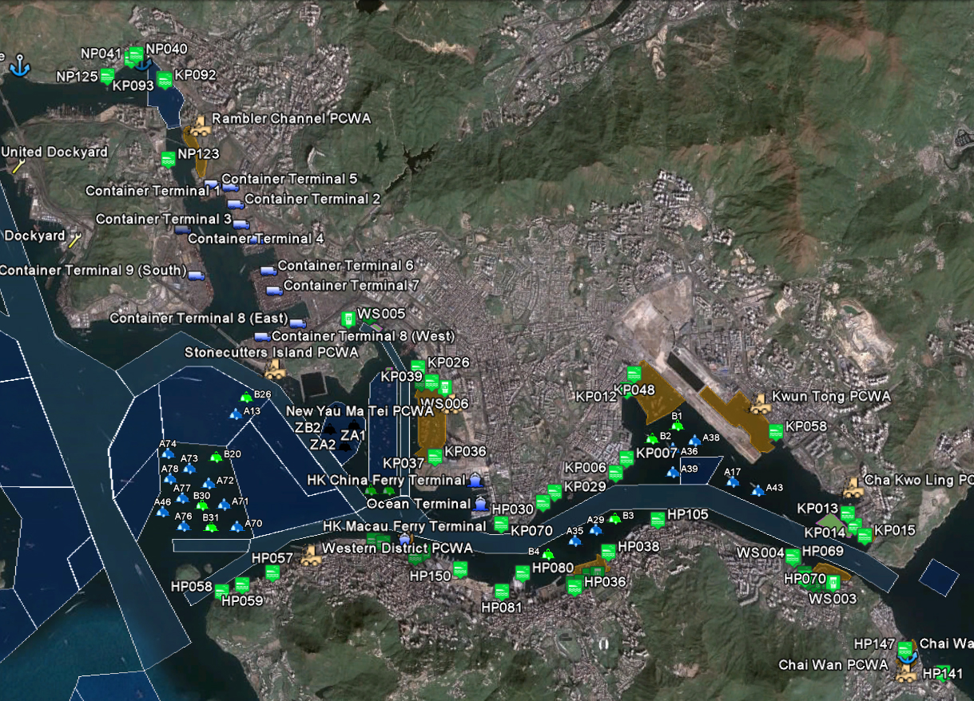
Google
Earth
Notes:
We are also including other valuable marine resources, such as fairways, anchorages, and cargo terminals. When this is complete, it will be usable by anyone in Google Earth or Google Maps, and is very easy to use and navigate.

Slide 7
History
Notes:
We believe a good place to begin is with Hong Kong’s history. Hong Kong has a rich maritime history, seeing as it began as a fishing village. There have always been a variety of marine users and land-water interfaces, but as reclamation has occurred, these interfaces, along with some of their users, have disappeared. It would be a great shame to see these interfaces and users disappear from Victoria Harbour.

Slide 8
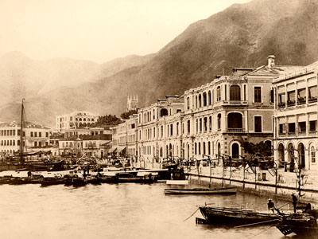
Hong Kong’s Heritage: An Active Harbourfront in the City Centre
Notes:
PHOTO CREDIT: http://www.millionwebs.ws/heritage

Slide 9
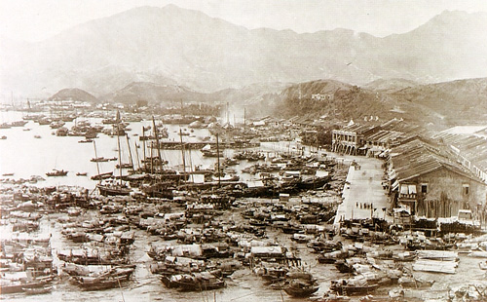
Hong Kong’s Heritage: An Active Harbourfront in the City Centre
Notes:
PHOTO CREDIT: http://www.millionwebs.ws/heritage

Slide 10
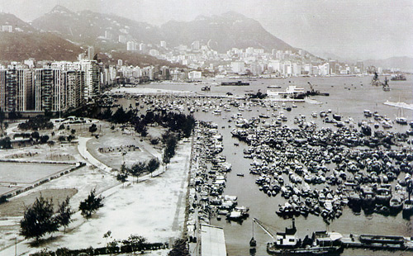
Hong Kong’s Heritage: An Active Harbourfront in the City Centre
Notes:
PHOTO CREDIT: http://www.millionwebs.ws/heritage

Slide 11
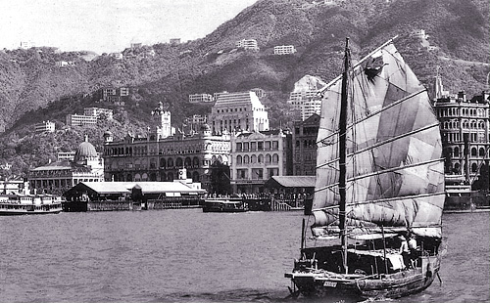
Hong Kong’s Heritage: An Active Harbourfront in the City Centre
Notes:
PHOTO CREDIT: http://www.millionwebs.ws/heritage

Slide 12
Facilities
Notes:
Now we’re going to define some terms that we’ll use later on in the presentation.

Slide 13
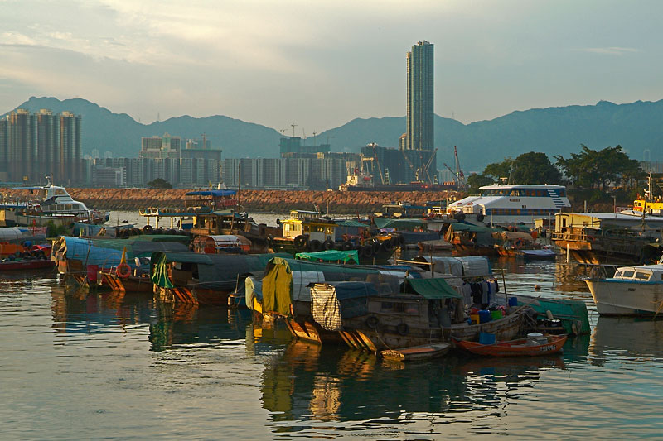
Sheltered Water & Typhoon Shelters
Notes:
In our study, sheltered water is defined as any area inside of the harbour with reduced wave action. A typhoon shelter is a type of sheltered water, specifically designated by the Marine Department to be safe to store a boat in during a typhoon.
PHOTO CREDIT: http://www.pbase.com/besati/image/55419108 (Bernard Tse)

Slide 14
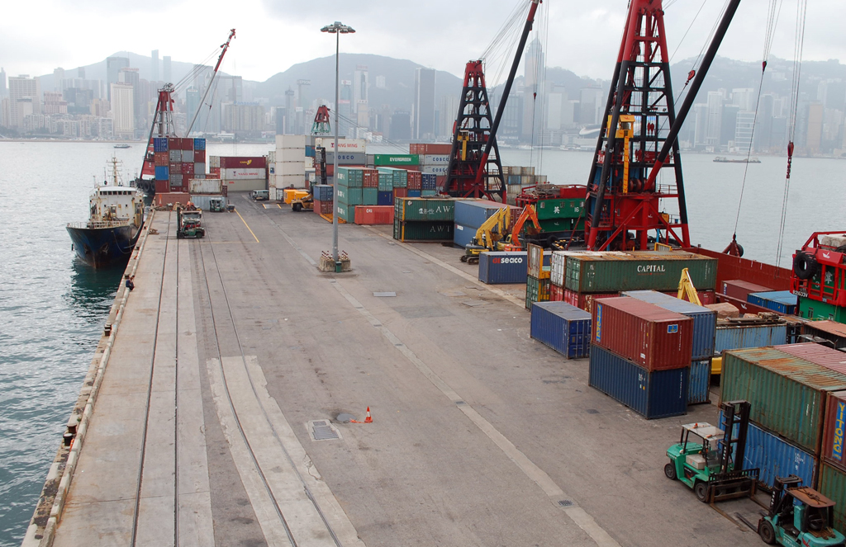
Public Cargo Working Area
Notes:
Cargo working areas are areas where small cargo handlers, typically river-trade vessels, can load/unload cargo.
PHOTO CREDIT: Santiago Lora

Slide 15
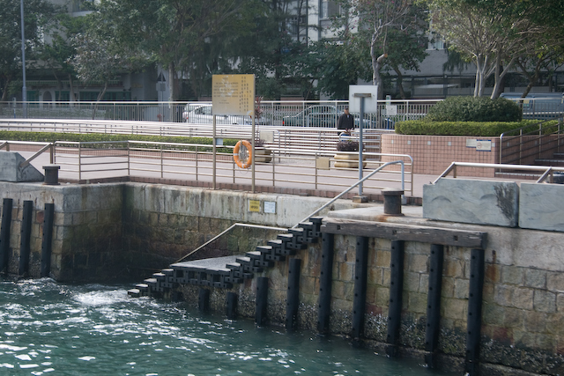
Landing Step
Notes:
A landing step is a staircase built into the seawall. They are typically used to get people on and off of boats.
PHOTO CREDIT: Eric Rosendahl

Slide 16
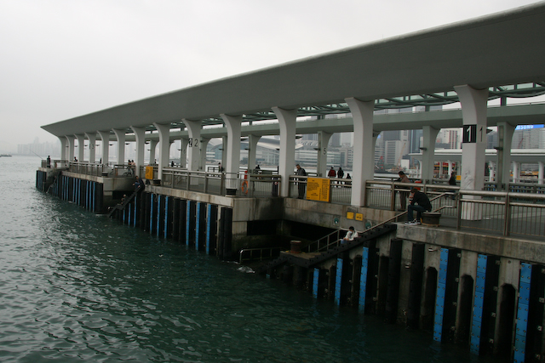
Pier
Notes:
A pier is a raised walkway over the water supported by piles or pillars used to add additional space along the waterfront. In this case a public pier adds more landing steps.
PHOTO CREDIT: Eric Rosendahl

Slide 17
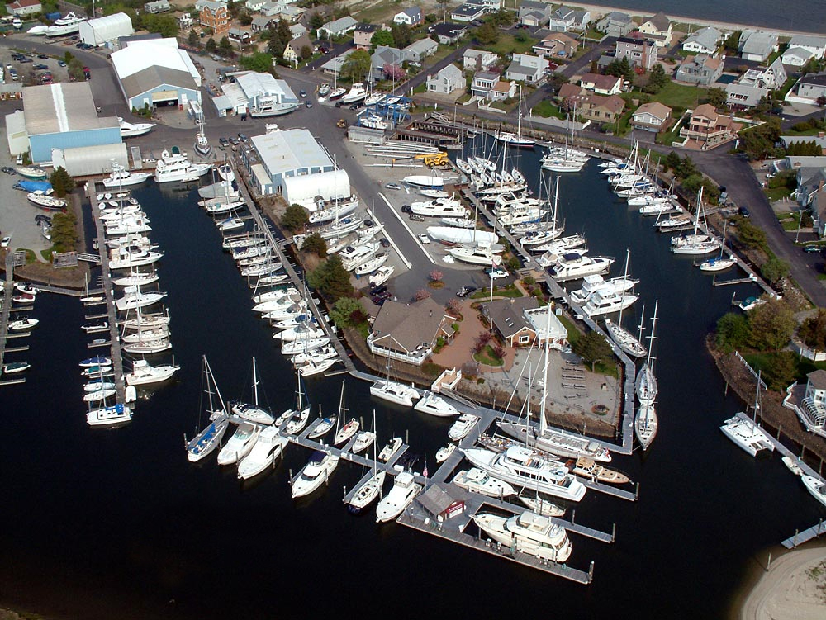
Marina
Notes:
A marina can be a public or private club that caters to leisure boats.
PHOTO CREDIT: http://swingingbridgemarina.com/ (Mark Cappitella)

Slide 18
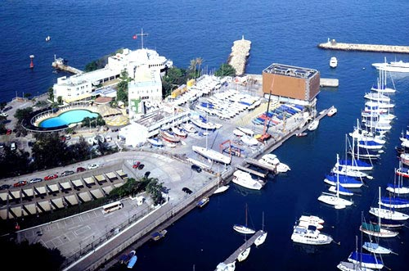
Parking
Clubhouse
Slipway
Access
Road
Boat Yard
Hoist
Moorings
Notes:
They are characterized by an access road, parking lots for cars, a clubhouse for members, slipways to roll boats into the water, moorings to tie up boats, hoists to lower boats into the water, and boat yards for boat storage and boat repair.
PHOTO CREDIT: http://travelart.wordpress.com/2008/08/05/sailing-southeast-asia/ (RHKYC)

Slide 19
Users
Notes:
Now that you have seen some of the major land/water interfaces in Victoria Harbour, let us take a look at the people who use them.

Slide 20
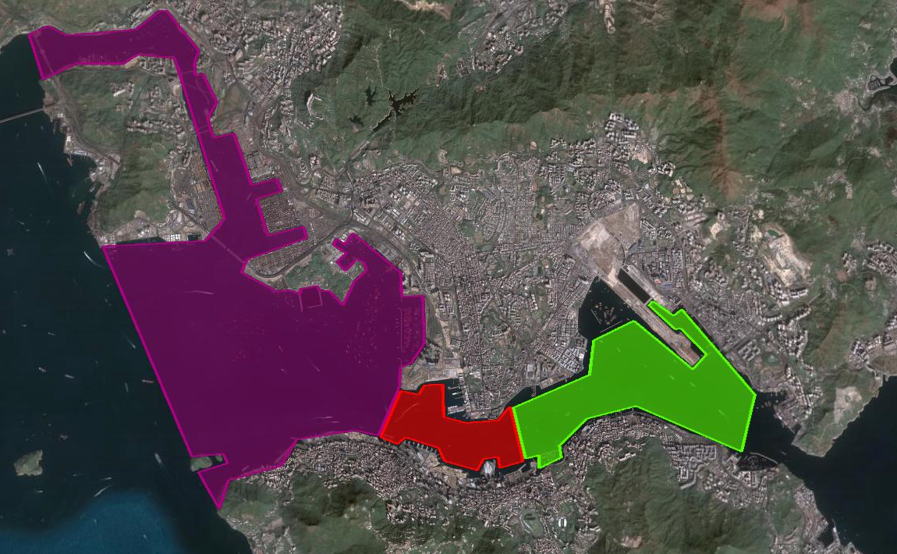
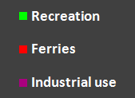
Usage Zones
Notes:
This is a general breakdown of which categories of users are where in the harbour – you have industrial and commercial mainly in the west, ferries generally in the middle, and recreational boating in the east.

Slide 21
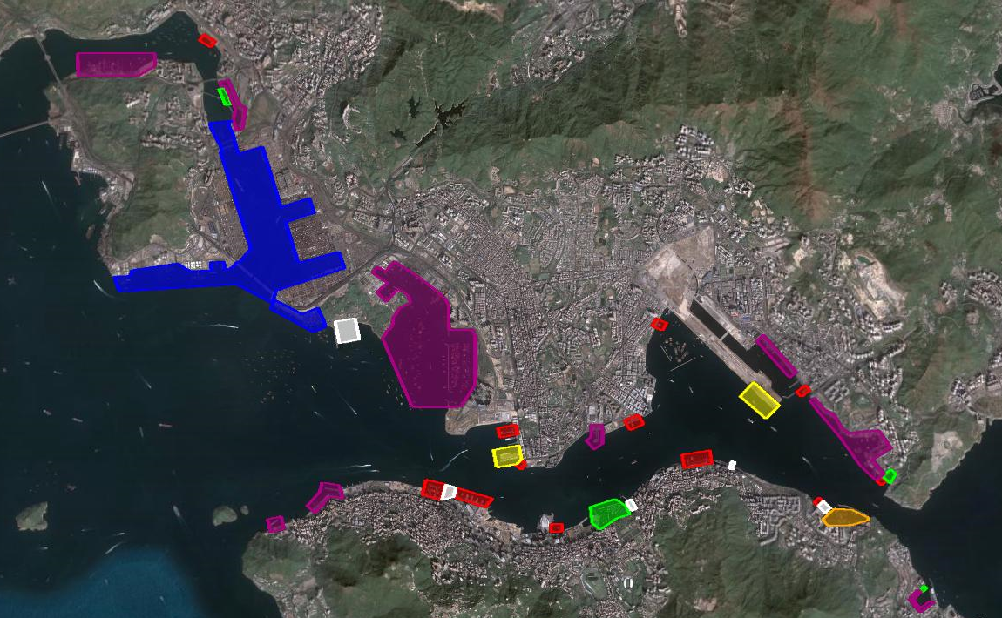
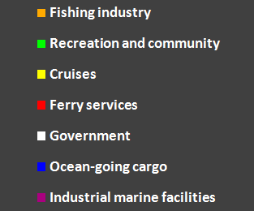
Usage Zones
Notes:
Here is the distribution of usage zones for each of the marine user groups in the harbour; you have the fishing industry, recreation and community, cruises, ferries, the government, ocean-going cargo, and industrial marine facilities. The arrow next to each marine user indicates the predicted future trends for that user group based on data we have collected – red signifies a decrease, yellow represents no change, and green indicates an increase.

Slide 22
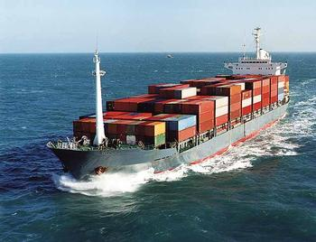
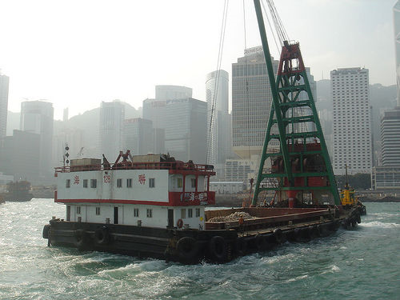
Industrial Users
Notes:
Industrial users are one of the largest marine user groups in Victoria Harbour; the shipping industry is still a cornerstone of the Hong Kong economy.
PHOTO CREDIT:
- http://www.flickr.com/photos/fuzheado/4143025/ (fuzheado)
- http://www.dssglobalsecurity.com/Featured_Solutions_PRW4.html

Slide 23
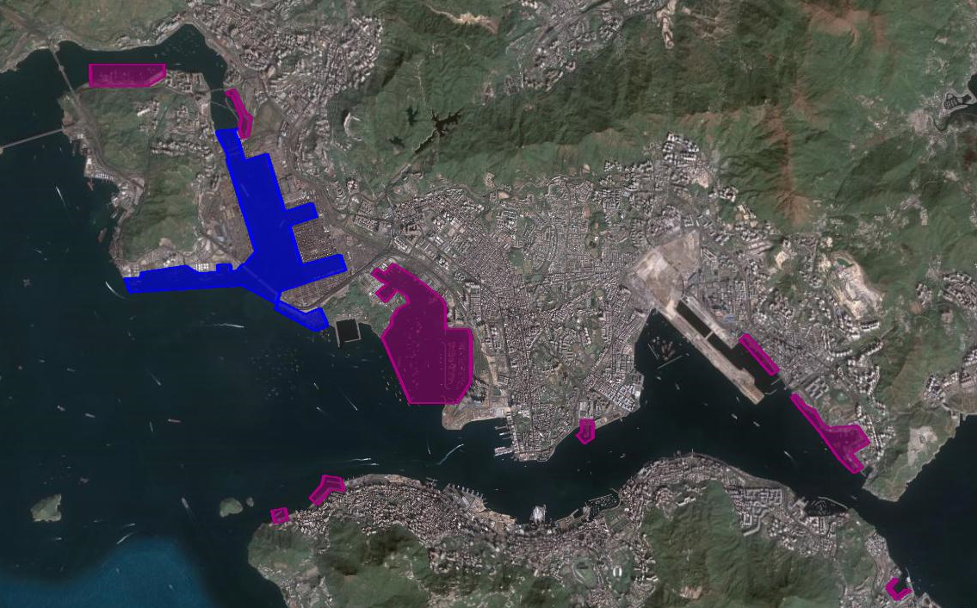
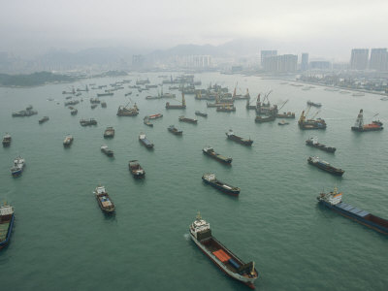
Cargo & Industrial Areas
Notes:
Ocean-going cargo facilities are concentrated in the blue area in the northwest because of the large container vessels require a lot of space and easy accessibility to the open seas, whereas smaller scale industrial facilities are scattered all over the harbour in public cargo working areas.
PHOTO CREDIT:
- http://www.allposters.com/-sp/Container-Ships-in-Hong-Kong-Harbor-Waiting-for-Cargo-to-Be-Loaded-Posters_i3587100_.htm
- Santiago Lora

Slide 24
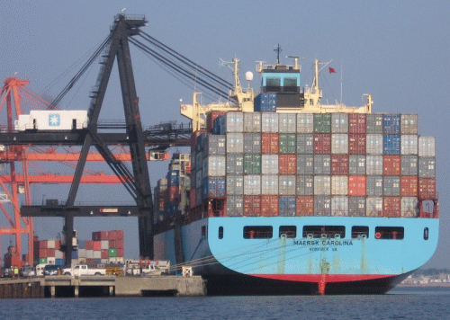
Source: Marine Department
Notes:
Hong Kong’s cargo throughput has been on the rise, with the recent decline caused by the global recession.
PHOTO CREDIT: http://www.asgillglobalshipping.com/

Slide 25
Source: Marine Department
Notes:
But in comparison to shipping ports such as Singapore and Shanghai, Hong Kong has lost its lead; its rate of growth is noticeably lower than that of its major competitors.
PHOTO CREDIT: http://www.asgillglobalshipping.com/

Slide 26
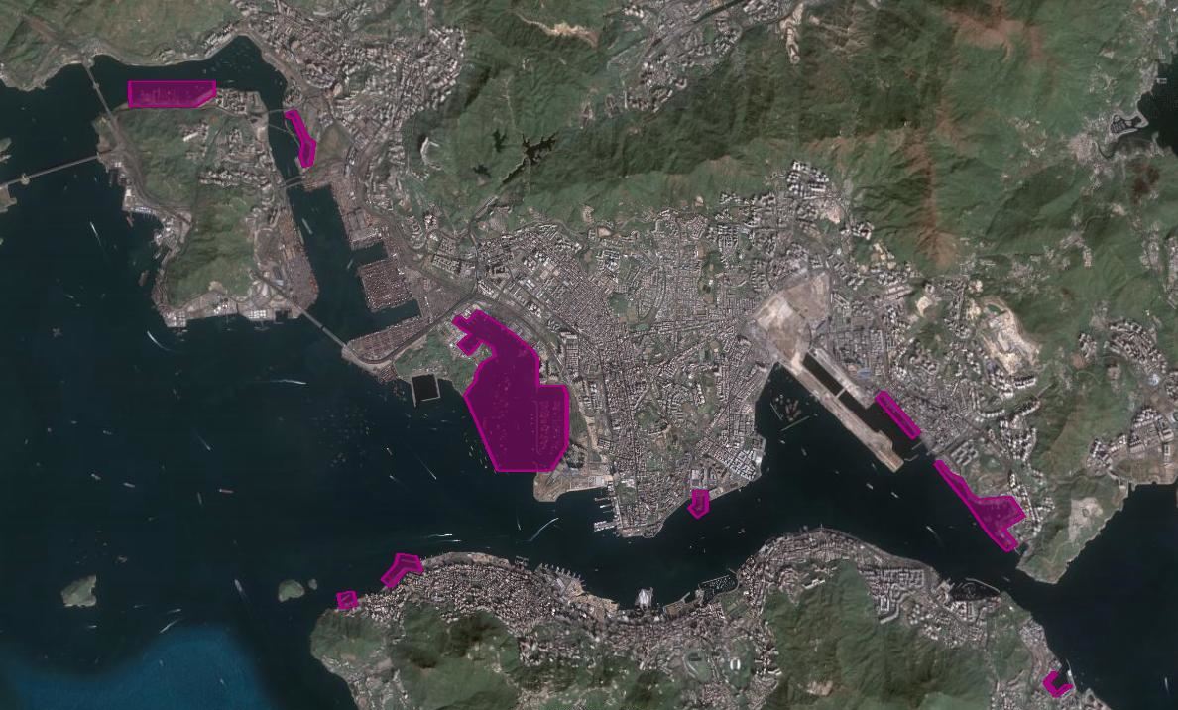
Changing Cargo Working Areas & Dockyards
Notes:
The distribution of public cargo working areas is also changing; those in Kwun Tong, Cha Kwo Ling, and Hung Hom have been rezoned for other purposes – such as residential, and will soon disappear.

Slide 27
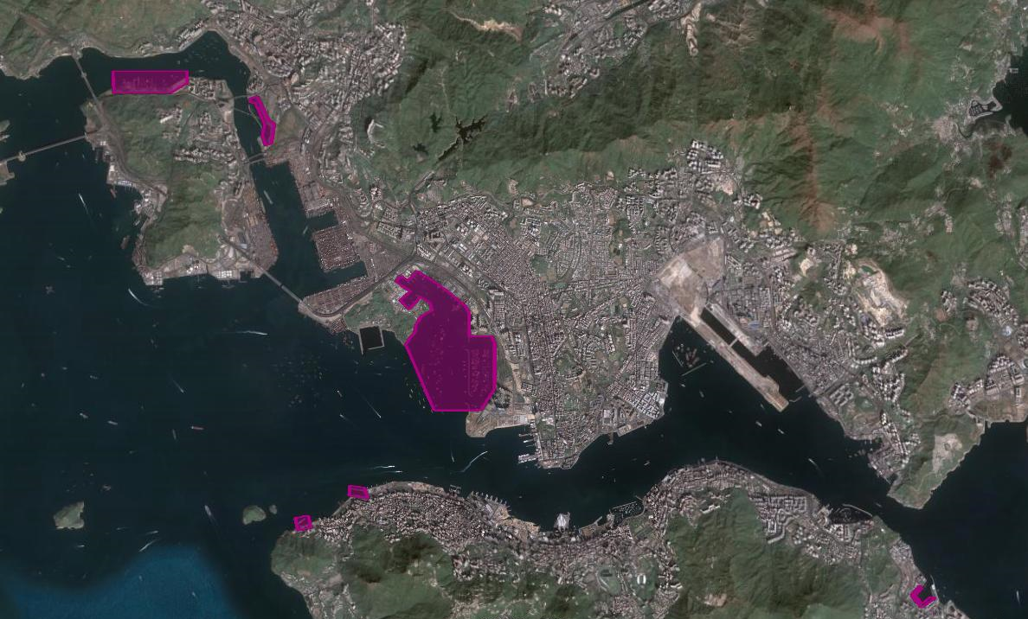
Changing Cargo Working Areas & Dockyards
Notes:
We should also take note that the recycling industry sharing the Kwun Tong public cargo working area will move to Chai Wan.

Slide 28
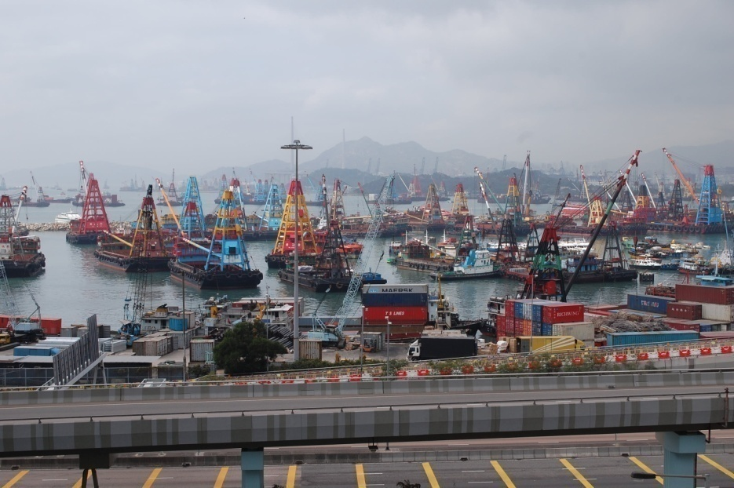
Changing Cargo Working Areas & Dockyards
Recommendation: Conglomeration of PCWAs in Yau Ma Tei
Notes:
The remaining industrial and public cargo handling facilities will be concentrated in the western harbour, especially in the area between Yau Ma Tei and Stonecutter’s island.
There is some pressure to rezone this area for residential purposes. Yau Ma Tei will be vital for the public cargo handling industry. It offers a conglomeration of marine services, includes everything from cargo handling to fuel and repair facilities. *Recommendation* protect and modernize the facilities in Yau Ma Tei so the industry can operate efficiently and cost-effectively and support Hong Kong as a maritime and shipping hub.
PHOTO CREDIT: Santiago Lora

Slide 29
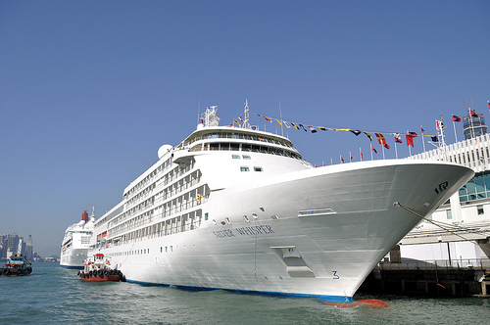
Cruise Ships
Notes:
On the other hand, the tourism sector is on the rise, so we will talk about how they use the waterfront; one such user group are the cruise passengers.
PHOTO CREDIT: http://www.flickr.com/photos/2careless/3066798806/ (2careless)

Slide 30
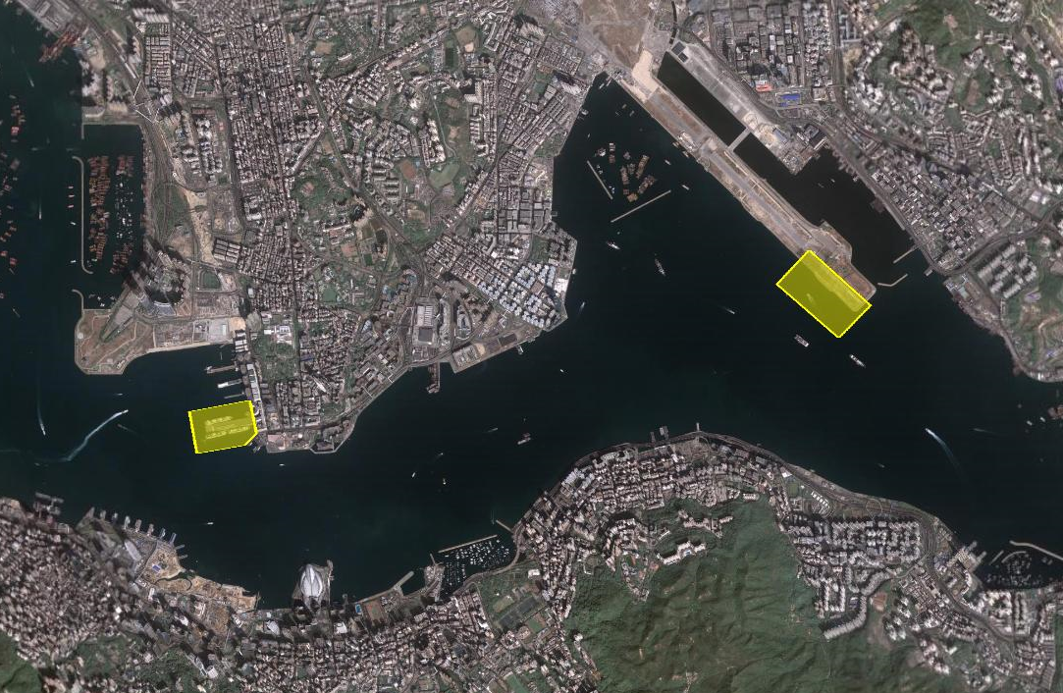
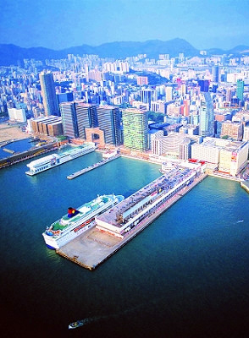
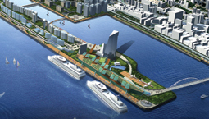
Cruise Terminals
Notes:
There is currently only one pier in Victoria Harbour servicing cruise ships and that is the Ocean Terminal in West Tsim Sha Tsui. However, a new, larger facility is scheduled to be built at the tip of the Kai Tak runway.
PHOTO CREDIT: - http://www.getlvhandbags.com/century-wharf-group-classic-industries/
- http://www.conexpoasia.com/EN/Overview/SouthChinaProjects/images/KaiTak.jpg

Slide 31
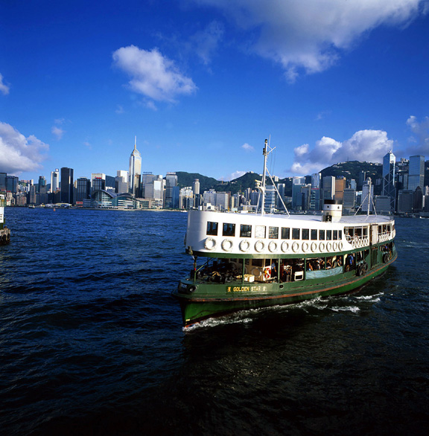
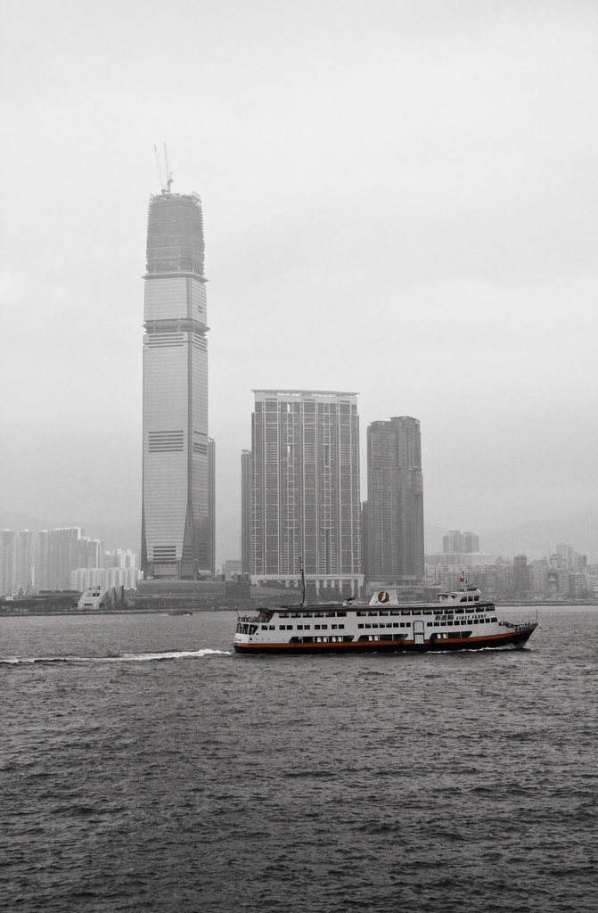
Ferries
Notes:
Ferries are another significant marine user group in the harbour.
PHOTO CREDIT:
- http://www.asia2002.gov.hk/press/pict/details_121.htm
- http://www.flickr.com/photos/gaffie/3757876893/ (gaffjones)

Slide 32
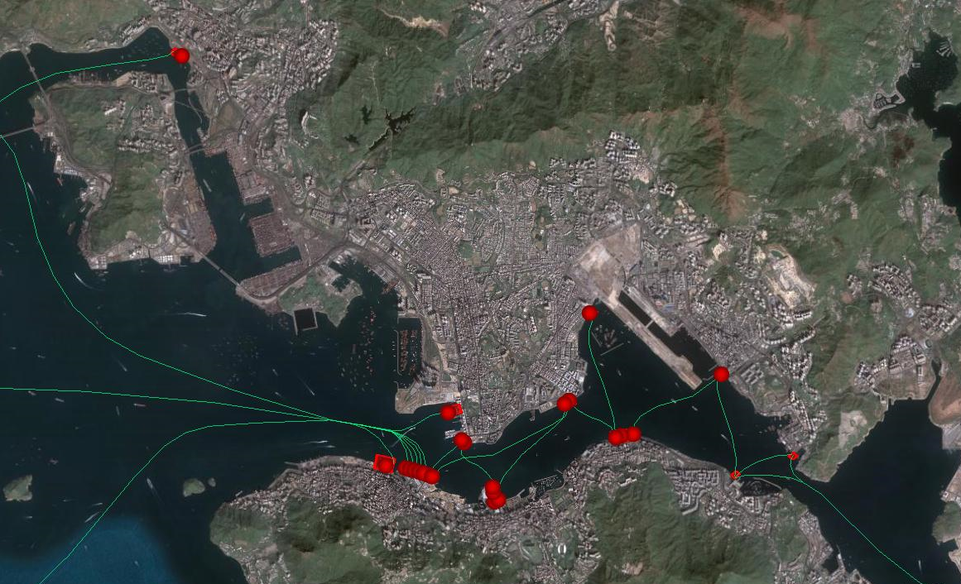
Ferry Piers and Routes
Notes:
This map shows all the ferry piers, and the routes of the ferries which use them. As is clearly visible, the traffic is concentrated mostly around Central piers 1 through 8. There are cross-harbour ferries, cross-boundary ferries such as the mainland China and Macau ferries, ferries to outlying islands, and dangerous goods ferries, used by vehicles that aren’t allowed in the cross-harbour tunnels. We expect the cross-harbour ferry activity to decrease after the Shatin-Central link is added. The Shenzen-Guanzhou rail may also decrease the Hong Kong-China ferry activity.

Slide 33
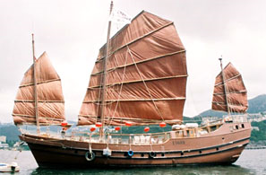
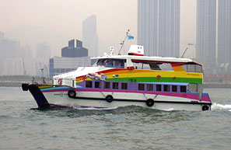
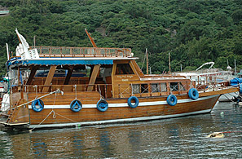
Tourism Boats
Notes:
Tourists in Hong Kong also patronize various tourism boats, such as junks, floating restaurants, and ships giving tours of the harbour.
PHOTO CREDIT:
http://www.watertours.com.hk/boats.asp
http://www.saffron-cruises.com/ginseng.php
http://www.saffron-cruises.com/ginseng.php
http://www.saffron-cruises.com/nutmeg.php

Slide 34
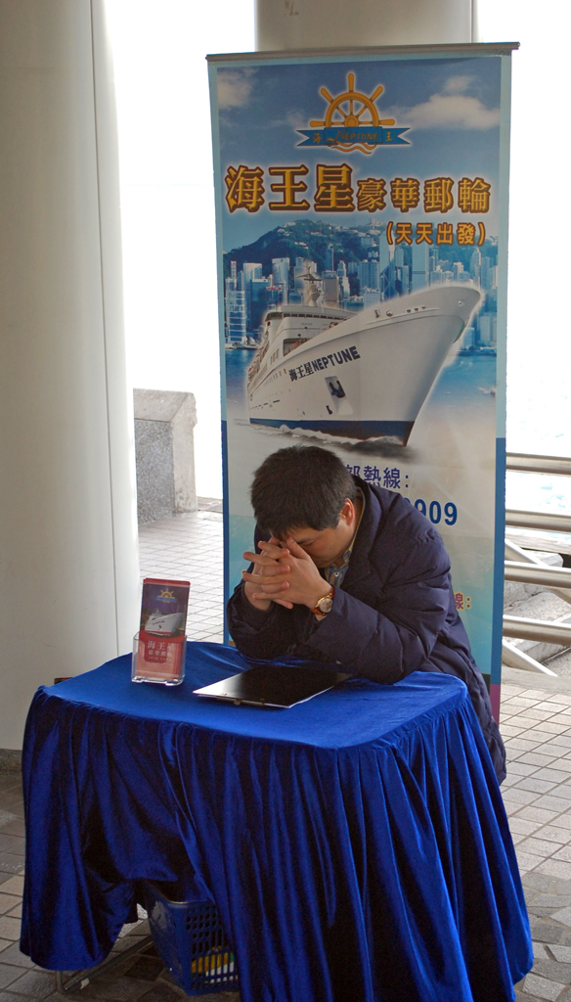
Notes:
What those businesses need is space for actual ticketing kiosks, so they do not have to set up impromptu tables like this person here has done.
PHOTO CREDIT: Santiago Lora

Slide 35
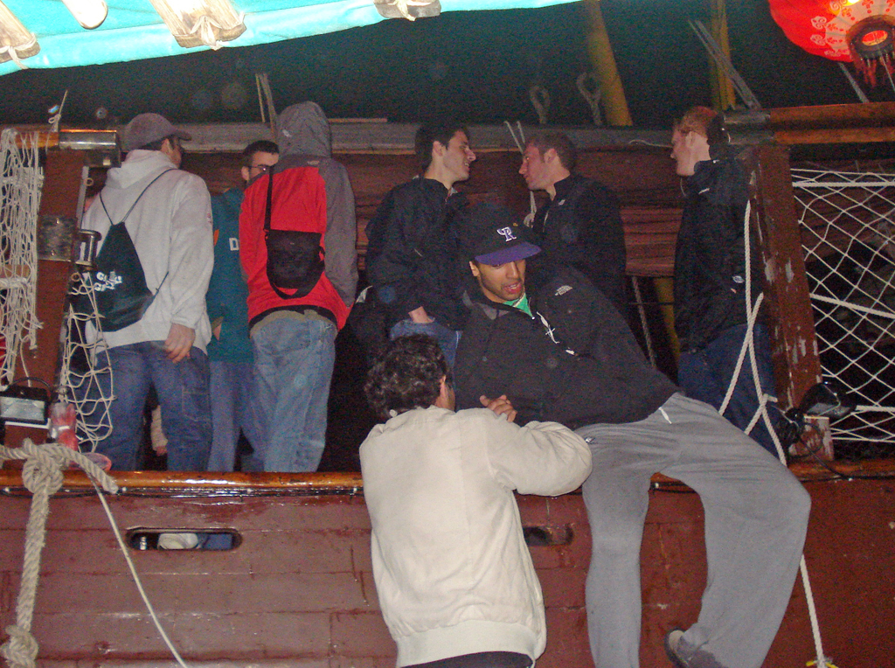
Notes:
Another problem they face is getting the passengers on and off their boats, especially if the side of the boat is much higher than the adjacent sampan or pier.
PHOTO CREDIT: Becky Yang

Slide 36
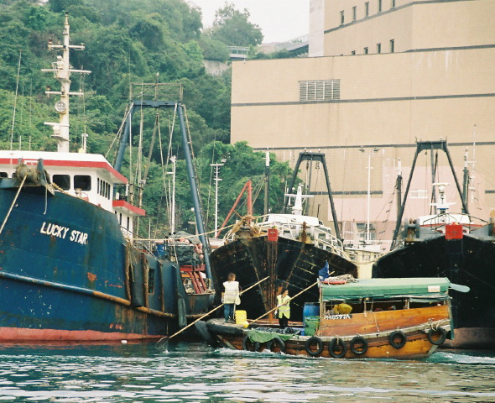
Notes:
Despite not being tourism boats, this photo illustrates the potential difference in heights between vessels.
PHOTO CREDIT: via Paul Zimmerman

Slide 37
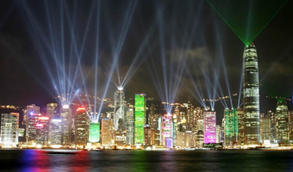
Number of Tourists (Millions)
14%
19%
20%
24%
Source: Immigration Department
Notes:
According to the Tourism Board, the annual number of tourists coming to Hong Kong is increasing; within the portion travelling by plane, the percentage of tourists who participated in harbour tours saw an increase of from 14% in 2005 to 24% in 2008.
PHOTO CREDIT: http://www.clipclip.org/activity/view/8/visit-hong-kong-soon

Slide 38
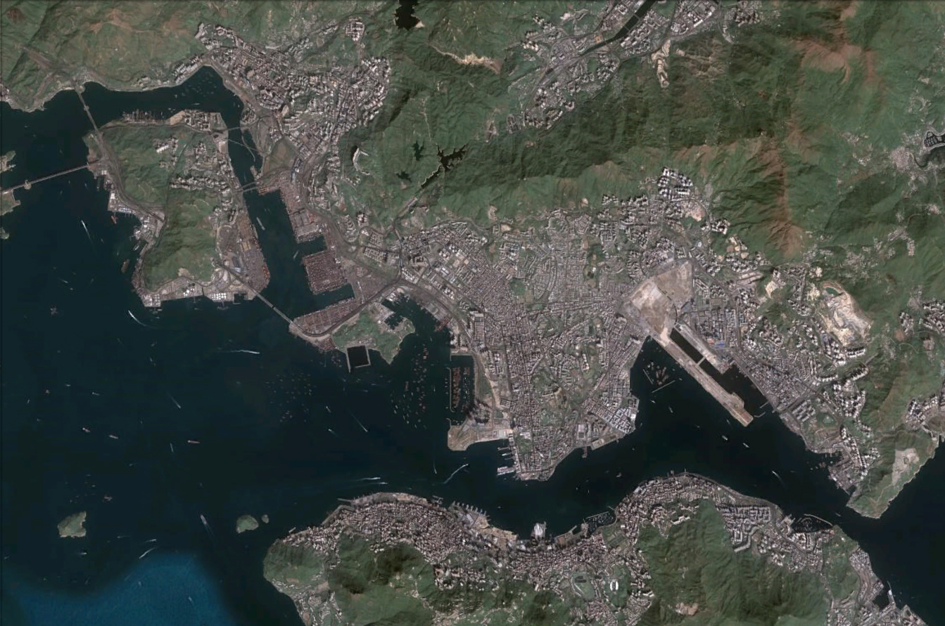
Recommendation: Provide mooring space for tourism
vessels in the harbour
Notes:
Tourism boats would like to be able too moor in the harbour, so mooring space should be provided for them, such as in the To Kwa Wan typhoon shelter.

Slide 39
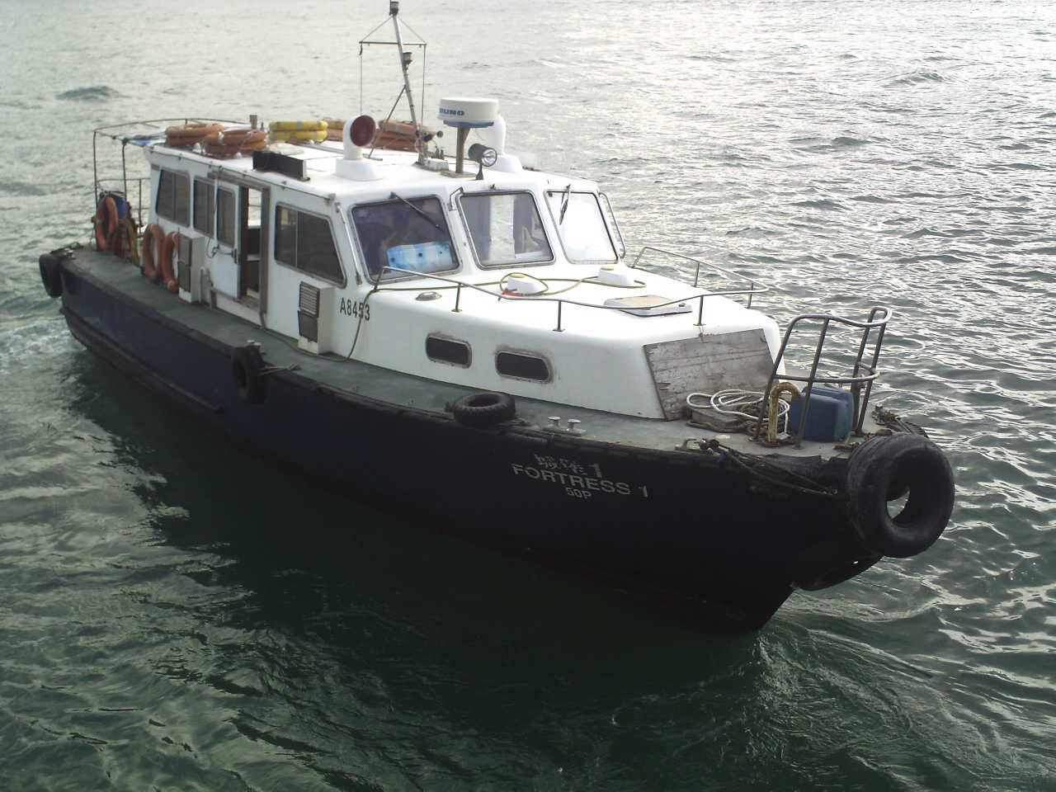
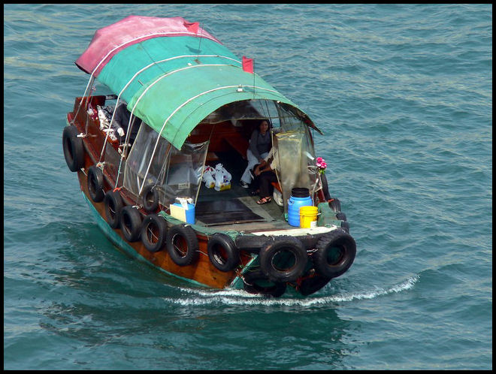
Small Harbour Businesses
Notes:
An often overlooked class of harbour users are the small harbour businesses. They include launches, water taxis, sampans, fishing vessels, small cargo transport, etc.
PHOTO CREDIT:
- via Paul Zimmerman
- http://svenningbjensen.blogspot.com/

Slide 40
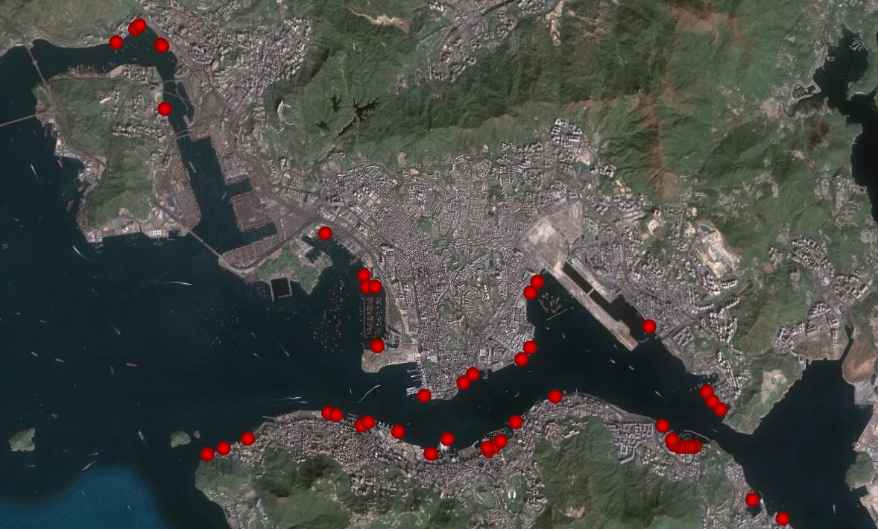
Landing Steps & Public Piers
Notes:
They are the primary users of landing steps and public piers, shown here.

Slide 41
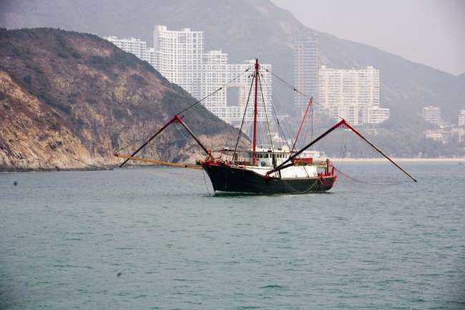
Fishing
Number of Fishing Vessels
Source: Marine Department
Notes:
While the number of registered fishing vessels has been decreasing for a few years, fish distribution is still an important part of the harbour.
PHOTO CREDIT: http://www.maestromaazel.com/gallery/show/new_york_philharmonic_asia_2008_tour_hong_kong_12

Slide 42
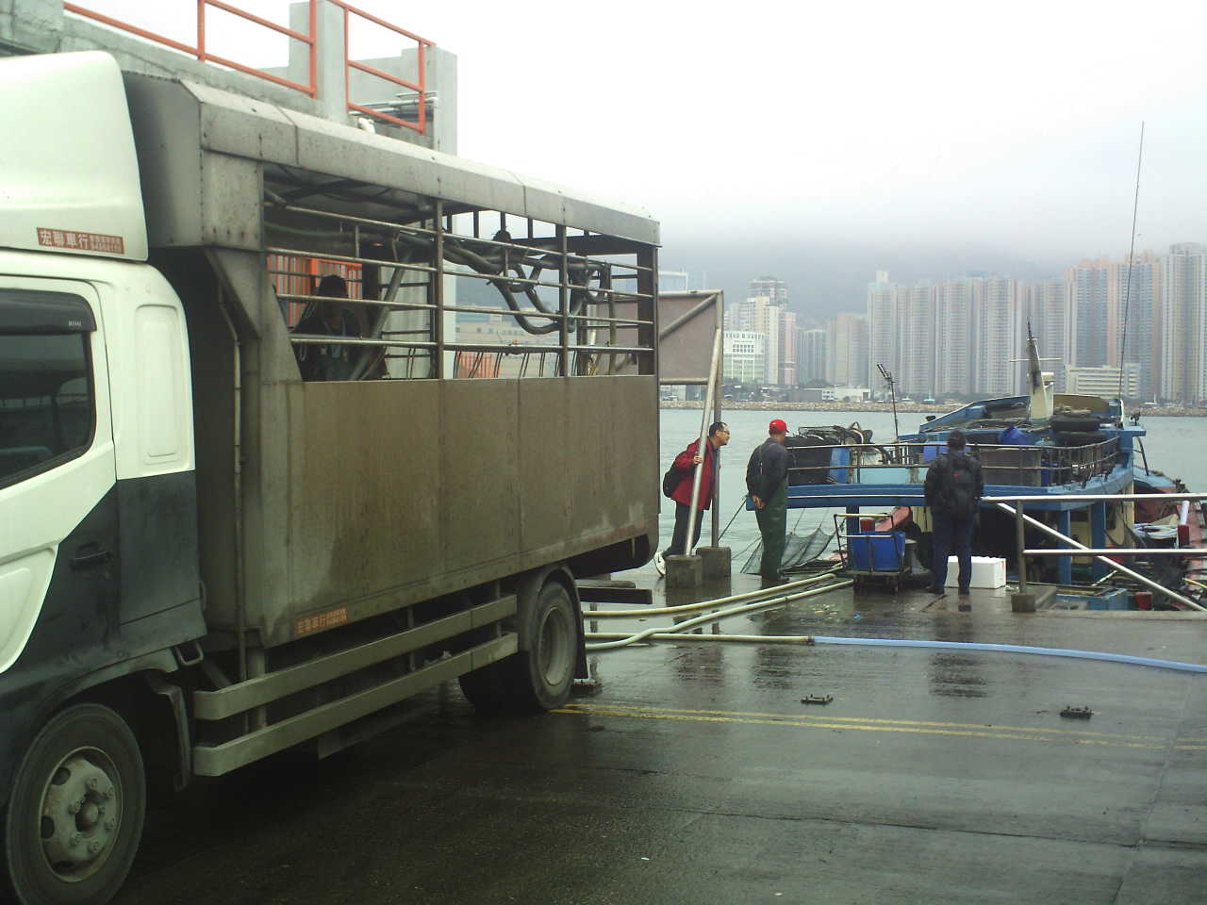
Fish Distribution
Notes:
Fish distribution, shown here at Lei Yue Mun, needs road access and parking for their trucks near the landing step.
PHOTO CREDIT: via Paul Zimmerman

Slide 43
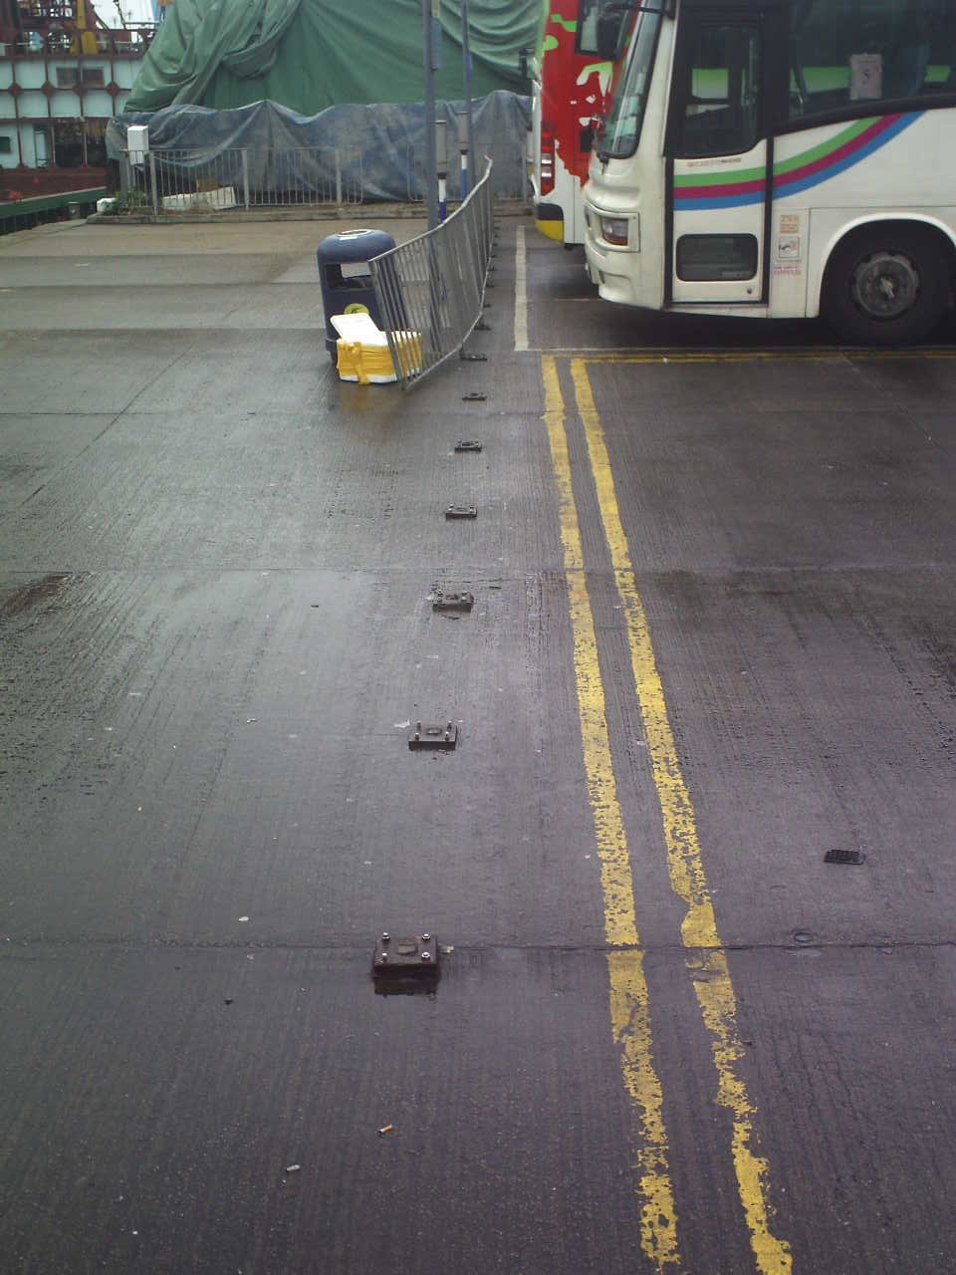
Fish Distribution
Notes:
Here they had to remove a fence in order to make the landing step more accessible.
PHOTO CREDIT: via Paul Zimmreman

Slide 44
Small Cargo
Notes:
Small cargo handlers are a vital link to many businesses. Their jobs don’t always take them near public landing steps, so from their perspective the more steps in the harbour the better.
PHOTO CREDIT:

Slide 45
Small Cargo
Notes:
Road access is also important to these users.
PHOTO CREDIT: Lucas Scotta

Slide 46
Passenger Transport
Notes:
Sampans, water taxis, etc are the personnel transports of the harbour. They need covered waiting areas, railings, access to the road and appropriate signage. Getting on and off these vessels can be dangerous, so having life buoys nearby is a must.
PHOTO CREDIT: via Paul Zimmerman

Slide 47
Passenger Transport
Notes:
This is in Wan Chai East. A launch is pulling up to an area where there is no publicly accessible landing step. The landing step in the foreground is beyond a locked fence, and is marked as private.
PHOTO CREDIT: Lucas Scotta

Slide 48
Passenger Transport
Notes:
These people have to climb over a fence to get from the covered waiting area to the launch.
PHOTO CREDIT: Lucas Scotta

Slide 49
Passenger Transport
Notes:
The covered waiting area is located in a great area, it is right next to the harbour and there is road access, but there is no landing step and there is a fence in the way.
PHOTO CREDIT: Lucas Scotta

Slide 50
Passenger Transport
Notes:
Getting on and off the landing steps can be very dangerous. The lighting in this photo, taken in Tsim Sha Tsui, is from the camera flash, as there is no provided lighting for this landing step.
PHOTO CREDIT: Eric Rosendahl

Slide 51
Notes:
Here’s another poor step. There’s an improvised shelter and horrendous land access from the other side of the road. Also notice that it’s getting dark and there’s no lighting.
PHOTO CREDIT: Lucas Scotta

Slide 52
Recommendation: Improve landing steps
Notes:
This is a good step in Aberdeen. It has lighting (green), signage (light green), a covered waiting area (yellow), railing (orange), a life buoy (red), and road access (dark red). We recommend that, wherever possible, the landing steps should be improved along these lines.
PHOTO CREDIT: Lucas Scotta

Slide 53
Notes:
One last thing, this is a metal life buoy in Lei Yue Mun typhoon shelter. There are 20 or so of these and no real ones. They are all welded to the railing. This is really dangerous and should be fixed soon.
PHOTO CREDIT: Alex Muir

Slide 54
Public Piers
Recommendation: Add more piers and improve their quality
Notes:
We recommend that there should be more piers, and the quality of existing piers to be improved, in order to help facilitate the increase in harbour tourism, and to benefit small harbour businesses (cargo distribution, water taxis, etc). This should be done at the following locations:
North Point
Tsim Sha Tsui East
Kennedy Town
Kai Tak (when complete)
WKCD (when complete)

Slide 55
Recreational Vessels & Floating Communities
Notes:
Recreational vessels & floating communities are the last of the users groups that we’ll talk about. Here we see some villages, a rowboat, and some sailboats out racing. They need sheltered water to store their boats near the harbour and ways to get on and off their boats with ease- at least numerous landing steps, or better yet a docking system.
PHOTO CREDIT:
- Eric Rosendahl
- Eric Rosendahl
- http://app2.rthk.org.hk/pda/news/content.php?id=513861
- Alex Muir

Slide 56
Recreational Vessels & Floating Communities
Notes:
These are the areas reserved by the Marine Department for these types of vessels to use in the harbour. As you can see, it’s not a lot.

Slide 57
Recreational Vessels & Floating Communities
Notes:
In fact, only 6% of the total area in the territory reserved for these users by the Marine Department is in the Harbour.

Slide 58
Recreational Vessels & Floating Communities
Notes:
Of all the sheltered water in Victoria Harbour, only a combined 8% is reserved for pleasure vessels and water-based communities.

Slide 59
Source: Marine Department
Notes:
This is a problem because as you can see, the number of registered pleasure vessels has been increasing steadily for the last few years.
PHOTO CREDIT: Eric Rosendahl

Slide 60
Recreational Vessels & Floating Communities
Notes:
We can see here that there is not a suitable way for this small boat owner to get to or from his boat, so he had to rig a pulley system and rickety ladder to get to and from his boat.
PHOTO CREDIT: Alex Muir

Slide 61
Recreational Vessels & Floating Communities
Notes:
These small boat users must tie their boat to the seawall because there would be no other way to access their boat.
PHOTO CREDIT: via Paul Zimmerman

Slide 62
Recreational Vessels & Floating Communities
Notes:
These stairs in Lei Yu Mun are now nearly useless, because they go up into a wall. It is a bad idea to develop over existing land-water interfaces without improving or replacing them, as it makes it more difficult for communities to use the waterfront.
PHOTO CREDIT: Alex Muir

Slide 63
Recreational Vessels & Floating Communities
Notes:
This glass wall on the waterfront is in Kwun Tong. This is sterilizing the waterfront and should be avoided at all costs, especially within the rare sheltered water areas.
PHOTO CREDIT: via Paul Zimmerman

Slide 64
Recreational Vessels & Floating Communities
Notes:
This railing in Tsing Yi is another example of problematic waterfront access, and general poor use of the waterfront.
PHOTO CREDIT: Alex Muir

Slide 65
Recreational Vessels & Floating Communities
Notes:
A marina could easily be added to the current plans for Kai Tak. In this example, land would have to be reclaimed, but the marina could be laid out however is necessary.
PHOTO CREDIT: http://www.pland.gov.hk/pland_en/p_study/prog_s/sek_09/website_chib5_eng/english/ES_Eng.pdf

Slide 66
Recreational Vessels & Floating Communities
Notes:
The marina could be combined with a new use for the Kai Tak nullah, in this case a world class rowing and dragonboating facility.
PHOTO CREDIT:
- Hong Kong China Rowing Association
- via Paul Zimmerman
- http://app2.rthk.org.hk/pda/news/content.php?id=513861

Slide 67
Recommendation: Include land-water interfaces,
marinas, and watersports facilities in future developments
Notes:
Our first recommendation for these users is to include convenient land/water interfaces for these users in future developments such as Kai Tak, the Causeway Bay typhoon shelter, and the ex-PCWA directly to the West of Causeway Bay (green). These areas have a high potential to become centres of recreational boating. Additionally, Yau Tong Bay could be used by a small marina, and Shau Kei Wan typhoon shelter could have a dock system put in place so that the community users there can get on and off their boats without the need to call a sampan.

Slide 68
Sheltered Water
Recommendation: Increase the amount of sheltered water
Notes:
Community users have a right to sheltered water in the Harbour because they’ve always been here- they are an important aspect of Hong Kong’s cultural heritage. Pleasure vessels need sheltered water in the harbour because as their distance from the harbour increases, the value decreases- people want their boats near where they live and where all the action is, which is in the Harbour. Moving forward, these users are going to be competing over sheltered water more and more, especially in the Harbour, so our second recommendation is to increase the amount of sheltered water inside of the Harbour.

Slide 69
71
62
66
70
26
37
25
34
33
31
33
15
12
44
15
11
15
17
28
19
20
Recommendation: Increase the amount of sheltered water
Notes:
This is a list of all areas considered sheltered water by the Marine Department outside of Victoria Harbour, along with the distance to the Central Piers, measured in kilometres. This journey would include traversing the dangerous and choppy waters of the zone primarily occupied by ferries, highlighted in red.

Slide 70
Recommendation: Increase the amount of sheltered water
Notes:
By increasing the amount of sheltered water inside Victoria Harbour, more boats could be facilitated there without having an adverse effect on the floating communities that have existed there for centuries.
PHOTO CREDIT:
- via Paul Zimmerman
via Paul Zimmerman
- Eric Rosendahl

Slide 71
Recommendation: Increase the amount of sheltered water
Notes:
The first place where this is possible is the To Kwa Wan typhoon shelter, by moving and expanding the breakwaters.

Slide 72
Recommendation: Increase the amount of sheltered water
Notes:
This would be especially important if the marina and rowing facilities were to be added east of Kai Tak because of the lost typhoon shelter space. This could be easily made up for by expanding the To Kwa Wan typhoon shelter.

Slide 73
Recommendation: Increase the amount of sheltered water
Notes:
The second place where this is possible is the Causeway Bay typhoon shelter.

Slide 74
Private Moorings
Royal Hong Kong Yacht Club
Floating Community
Recommendation: Increase the amount of sheltered water
Notes:
Also, by rearranging the breakwater at the ex-PCWA, that area can be made usable as well. The diversity of uses that could be utilized in this newly expanded typhoon shelter could include more private moorings, retained or expanded space for the community users, and more space for the Royal Hong Kong Yacht Club.
PHOTO CREDIT: Alex Muir

Slide 75
Future Plans
Notes:
Here, we will discuss some of the waterfront redevelopment plans that we have reviewed.

Slide 76
Urban Design Guideline
Notes:
The most important urban design guideline in waterfront redevelopment is to create an active waterfront with a wide range of available activities, not a walled off section of the harbourfront that does not permit any recreational or tourism-related uses.
PHOTO CREDIT: http://www.pland.gov.hk/pland_en/p_study/comp_s/udg/udg_es/udg_es_eng.pdf

Slide 77
Notes:
This is the current Kai Tak plan: there will be 3 landing steps (green) and 2 public piers (yellow), but that is not enough. As mentioned before, we recommend a ferry/public pier be built at the end of the runway (orange), as well as incorporating other plans into the development process, such as a rowing centre between the apron and the runway, the addition of a marina, and the expansion of the To Kwa Wan typhoon shelter.
PHOTO CREDIT:
- http://www.pland.gov.hk/pland_en/p_study/prog_s/sek_09/website_chib5_eng/english/ES_Eng.pdf
- Hong Kong China Rowing Association
- http://swingingbridgemarina.com/ (Mark Cappitella)

Slide 78
Notes:
The next plan is for Central: only 3 additional landing steps (green) will be added to the waterfront while the 2 public piers (yellow) are unchanged, which is still hardly sufficient.
PHOTO CREDIT: http://www.pland.gov.hk/pland_en/p_study/prog_s/UDS/eng_v1/otherinfo_eng.htm

Slide 79
Notes:
An alternative plan submitted by the UDA also leaves the public piers alone, but has the PLA berth (green) moved out into the water for a more continuous promenade and includes space for a floating museum as well as sheltered water for small boats (yellow).
PHOTO CREDIT: http://www.urbis.com.hk/ud06.html

Slide 80
Notes:
This is the Wan Chai plan: there will be a water sports centre (green), space for ticketing kiosks and landing steps on this breakwater (yellow) – again, note that the breakwater will have to move to the right side for the water to be sheltered. The existing ferry pier (orange) remains the same.
PHOTO CREDIT: http://www.harbourbusinessforum.com/download/KYLeungPresentation.pdf

Slide 81
Recommendation: Include land-water interfaces,
marinas, and watersports facilities in future developments
Notes:
A now-outdated plan from the Royal Hong Kong Yacht Club of the same area has many more landing steps (green) and 2 large mooring areas (yellow) using the pontoon system so that people can walk to their boats without having to hire a sampan. Again, the existing ferry pier (orange) stays where it is. Note how this plan resembles the example of a good waterfront design. Again, as mentioned before, the size of the Causeway Bay typhoon shelter area should be increased. Our overarching recommendation here, once again, is for future developments to include convenient land/water interfaces.
PHOTO CREDIT: Royal Hong Kong Yacht Club

Slide 82
Recommendations
Notes:
At this point, we will summarize our recommendations.

Slide 83
Recommendation A
Conglomeration of Industrial Services in Yau Ma Tei
Notes:
Our first recommendation is to protect and modernize the facilities in Yau Ma Tei so the industry can operate efficiently and cost-effectively and support Hong Kong as a maritime and shipping hub.
PHOTO CREDIT: Santiago Lora

Slide 84
Recommendation B
Add more piers and improve their quality
Notes:
Our second recommendation is to add more piers and improve their quality. This is for both public piers and ferry piers, especially in the future development areas of the Western Kowloon Cultural District and Kai Tak.
PHOTO CREDIT: Eric Rosendahl

Slide 85
Recommendation C
Improve landing steps
Notes:
Our third recommendation is to improve the quality of landing steps, as the CEDD has suggested before. This includes adding shelter, lighting, railing, and (real) life buoys.
PHOTO CREDIT: http://www.harbourfront.org.hk/eng/content_page/doc/agenda090904/4.pdf

Slide 86
Recommendation D
Increase the amount of sheltered water
Before
After
Notes:
Our fourth recommendation is to increase the amount of sheltered water. This can be done easily in both the To Kwa Wan typhoon shelter and the Causeway Bay typhoon shelter, simply by moving out the breakwaters. This could help add mooring space for tourist boats within the harbour, which was another recommendation we made. Additionally, this would help add space for the increasing number of leisure and recreational vessels, without having to move the community users.

Slide 87
Recommendation E
Include convenient land-water interfaces, marinas,
and watersports facilities in future developments
Notes:
Our final recommendation is to include convenient land-water interfaces in future developments. This means a prioritization of the waterfront for water users, but without interfering with land-based users.
PHOTO CREDIT: http://www.parks.sfgov.org/site/recpark_index.asp?id=18158

Slide 88
Cape Town, South Africa
Notes:
Finally, we will take a look at a few cities with good examples of vibrant waterfronts. Cape Town, South Africa, is our first example. In the foreground there is a promenade for pedestrians and to look out over the water. On the left there are government service boats, such as fireboats and police boats, pleasure vessels on the right, and cargo in the background, with some restaurants and shops also on the right.
PHOTO CREDIT: http://www.tropicalisland.de/south_africa_cape_town.html

Slide 89
Hong Kong
Vancouver, Canada
Notes:
Vancouver, Canada, is another prime example. We can see that there is a road, a promenade, restaurants, and a pontoon mooring system for boats. This is superior to the Hong Kong style of fore-aft mooring, which requires users to hire a walla-walla or sampan to get to their boat, since it is not moored directly adjacent to the land.
PHOTO CREDIT:
http://rashbre2.blogspot.com/2008_07_01_archive.html
- Lucas Scotta

Slide 90
Singapore
Notes:
Singapore has a very active waterfront. There are restaurants, beautifully lit landing steps, moored boats, and many people along the promenade. This is a great example of a vibrant waterfront. This is the kind of thing we would love to see in Hong Kong.
PHOTO CREDIT: Santiago Lora

Slide 91
Please
continue
our
research!
Notes:
Our study is only seven weeks old, and only has one week left. We urge everyone to continue our study once we have finished, and to verify our findings. We are aware of the wide-ranging implications of some of our recommendations, including direct conflict with the Protection of the Harbour Ordinance, the reprioritization of waterfront land, and changing management of some facilities, so the implementations of our recommendations could be difficult.
PHOTO CREDIT: http://www.reliableautorepairil.com/Services/Fuel_Economy.html

Slide 92
Notes:
However, we believe that there are two ways to kill the harbour. The first is to fill it in with excess reclamation, as seen in this artist’s rendition of the western harbour.
PHOTO CREDIT: http://newsin18yrs.com/

Slide 93
Notes:
The second is to suffocate its users with a sterile waterfront.
PHOTO CREDIT:
via Paul Zimmerman
Alex Muir
Lucas Scotta
- Alex Muir

Slide 94
Notes:
We believe that our recommendations could help to turn Hong Kong’s Victoria Harbour into a truly “living harbour.”
PHOTO CREDIT: http://si.smugmug.com/Portfolio/Portfolio/1674201_UxZmP#114392120_FbSjx-L-LB

