Slide 1
Brought to you by:
Electrochemistry
Harnessing Electricity from Chemical Reactions

Slide 2
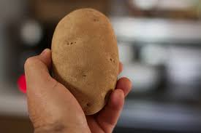
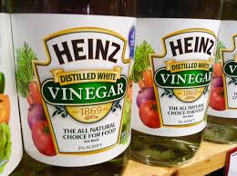
Overview
In this lesson, students will review electricity and simple circuits. They will learn the definition of electrochemistry. They will be able to make a circuit and light up a small LED clock with potatoes, pennies, and screws; or by using vinegar, nails, and copper wire.

Slide 3
Students should be able to:
Identify circuits in parallel and series
Define Electrochemistry
Construct a working circuit
Objectives

Slide 4
What is Electrochemistry?

Slide 5
Definitions
Electrochemistry:
- Using chemical reactions to generate electricity
Electro:
- Electricity
Chemistry:
- Science that studies the changes in matter

Slide 6
Additional Resources
Watch this video first!
Next, watch this video!

Slide 7
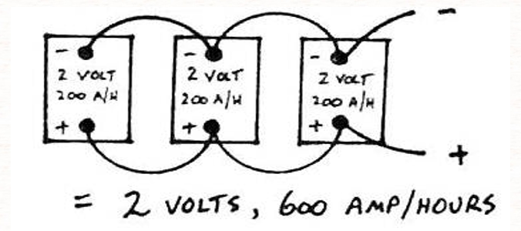
In Parallel
Positive terminals are only connected to other positive terminals, while negative terminals are connected to negative terminals
Increases amperage, not voltage
Batteries in Parallel

Slide 8
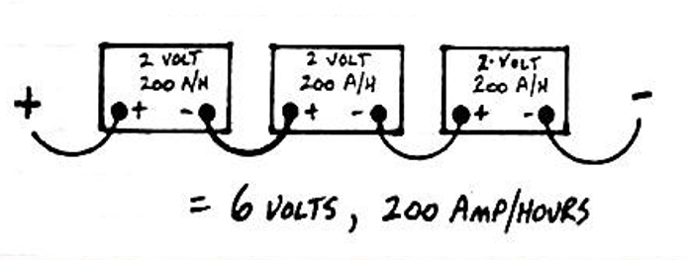
In Series
Every positive terminal is connected to a different negative terminal
Increases voltage, not amperage
Batteries in Series

Slide 9
Lab Procedure

Slide 10
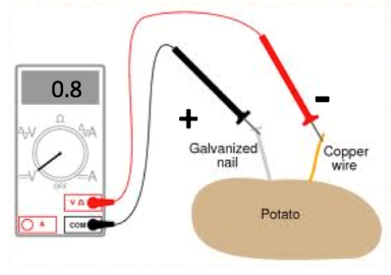
The Potato Battery
Able to generate a maximum of 0.8 V of electricity
The electrons travel from the copper wire to the zinc nail

Slide 11
Potato
An LCD Watch requires a 1.5 V battery, but a potato can only produce 0.8 V of electricity.
In order to create enough electricity, should we connect potatoes in parallel or series?
Clock
Problem

Slide 12
Clock Construction
here your design
This video is a close-up of how the clock should look after construction

Slide 13
Each group will need:
2 smooth alligator clips individually connected to 2 regular alligator clips
2 regular alligator clips
1 LCD watch head
2 zinc coated nails or screws
Copper wire
2 potatoes
Materials

Slide 14
Two electrons from copper are lost and combine with a zinc ion, forming zinc metal.
The flow of electrons from copper to zinc creates an electrical current. By using wires and the potato tissue to connect the zinc and copper, you can complete the electrical circuit.
How it works

Slide 15
Starting Activity:
Start by holding up the LCD watch and passing it around to students to look at.
Ask the class if they could power the watch without a battery.
Hold up the potato and ask the students if they could use it to power the watch.
Step 1

Slide 16
Define electrochemistry and chemistry.
Electrochemistry
Using chemical reactions to generate electricity
Chemistry
Science that studies the changes in matter
Step 2
The potato battery utilizes the following redox reaction between copper and zinc:
Cu(s) + Zn2 = Cu2 + Zn(s)

Slide 17
Describe the construction of the potato clock.
The nail/screw from potato #1 needs to be connected to the copper wire from potato #2.
The nail/screw of potato #2 needs to be connected to the watch terminal on the right, while the copper wire of potato #1 needs to be connected to the watch terminal on the left.
Step 3

Slide 18
Have students assemble the potato clock. You may want to leave a pre-built example out as an example to the class. Assist the students, as necessary.
While the time will work, the buttons on the clock will not function even when the clock is working because of the low amperage of the potatoes.
Step 4

Slide 19
Closing: This problem with low amperage can lead to a discussion on how to improve the potato clock.
One thing you could do is add potatoes to the system, but in parallel to the other potatoes. This would increase the amperage of the clock.
Also, the clock will stop eventually, because the reaction between copper and zinc will lose reactants. Talk about how you could fix this problem.
Step 5

Slide 20
Clean up: Have students take their clocks apart and return their materials. Potatoes can be disposed of as necessary, while the other materials can be saved for future experiments.
Step 6

Slide 21
This activity could be done without the clock construction instructions. Let the students determine how to construct the clock, and only help if they cannot figure it out
Optional Method

Slide 22
Alternative Lab
This lab uses household materials!

Slide 23
Ice Tray Battery Lab
here your design
This video walks you through the lab. If you have trouble lighting the LED, use more ice cube slots!

Slide 24
Each group will need:
5 steel screws
5 pieces of copper wire
Ice cube tray
Red vinegar or white vinegar
LED light
Materials

Slide 25
Credits
Lab
Photo Credits
Electrochemical Cell. Retrieved at http://sphs.spusd.net/apps/classes/show_assignment.jsp?classREC_ID=180029&start=0&pff=1&showAll=true&show=1000
All about circuits. Potato battery. Retrieved at http://www.allaboutcircuits.com/vol_6/chpt_3/16.html
Shapes & Icons
Lab Procedure File and powerpoint: https://smile.oregonstate.edu/lesson/electrochemistry-harnessing-electricity-chemical-reactions
Vectorial Shapes in this Template were created by SlidesPPT
Icons on this template have been downloaded from Flaticon

