Slide 1
Establishing a waste management business
By: MacKenzie Conlen, Nicholas Cunha,
Erika Snow, Daniel Sochacki

Slide 2
Utilizing Six Sigma Analysis for Business Development
Set of techniques and tools for process improvement
Originally stems from statistical analysis of manufacturing processes
Adapted to general process improvement
Aim to improve current process
Strives for a process to maximize utility and efficiency
Visualize
Achieve
Commit
Six Sigma
Improve
Prioritize
Characterize

Slide 3
Six Sigma Explained
Achieve:
Deliver measurable results
Data analysis
Communication
Visualize:
Create a vision for the future by identifying:
Current state
Desired state
Pressing demands
Need for change
Commit:
Identify potential partners:
Business partners
Service outsourcing
Improve:
Develop methods of improvement
New Processes
Process improvement
Characterize:
Define existing process and plan improvements using:
Business model canvas
Value proposition canvas
Prioritize:
Analyze root cause and possible decisions using:
Process mapping

Slide 4
Current state
Many municipalities in Greece do not have municipal waste collection methods nor methods of treating food waste
Desired state
These municipalities have a fully operational collection and treatment method, specifically food waste
Pressing demands
Greece has been subject to fines for not being in compliance with EU waste management directives and food waste reduction targets will become more stringent
5.672 trillion kg CO2-equivalent of greenhouse gas emissions per year are associated with food waste in landfills in Greece
Need for change
The current process is harming the environment nd Greece is losing millions of euros every year
Visualize-Create a vision for the future

Slide 5
Vision-Waste treatment is a lucrative business
04
Products can sell for high prices compared to the price of production
Food waste treatment is a rapidly growing industry worldwide
01
03
Expanding market influences the establishment of programs and businesses
As the market for recycled food waste products grows, companies and municipalities are able to expand their businesses
02
Notes:
Bootstrap Compost in Boston started in the owner’s backyard, and now partners with multiple organizations in Massachusetts
New York Compost Program is expanding and reaching out to more New Yorkers every year to participate in the compost program
Veteran Compost in Maryland started in the owner’s back yard, and now has 4 food waste treatment plants
Veteran Compost sells their vermicast for 4.56 times their compost

Slide 6
Prioritize-Determine root cause
Several municipalities in Greece do not comply with national European Union waste management directives
Problem: Many municipalities in Greece face problems with waste management
Determine root cause behind lack of waste management process within municipalities in Greece
The municipalities have not implemented waste treatment programs
Lack of waste management businesses in market
Little to no competition at the moment with an environmental and municipal need
Food waste treatment products are lucrative
Create a business out of food waste treatment

Slide 7
Commit-Identify potential partners
Waste management companies around the world partner with smaller organizations to aid in the waste treatment process
The municipality will supply food waste to be composted
Private haulers will transport the waste
Distributors will market and sell the product
Private haulers
Private waste management company
Distributors
Municipality
Private collectors

Slide 8
Strategies for treating waste
Aerobic Composting
Anaerobic Composting
Vermicomposting
Low labor requirements
Can be a slow process
Can require expensive equipment
Fast process
Higher quality product
Worm maintenance required
Advantages
Disadvantages
Advantages
Disadvantages
Generally maintenance free
Produces a lot of sulfur gas
Advantages
Disadvantages
Notes:
Aerobic Composting
Most widely used
Many of the municipal programs use it (New York, Boston, Barcelona)
Does not require a lot of labor
But it is a slow process
And it can be expensive if the system is automated (mechanical blowers, sensors, etc.)
Anaerobic Composting
Used by Denmark, Boston, and Barcelona
Yields natural gas and liquid fertilizer instead of compost
Natural gas can be used as a fuel (power motor vehicles, create electricity, cooking)
Although it’s generally maintenance free, it creates a lot of sulfur gases which can smell very badly (may need to add air purifiers/filters to not release into nearby area-can be expensive)
Vermicomposting
This is composting utilizing worms
Mostly used by private companies (Veteran Compost, Bootstrap Composting)
The fastest of the three processes (Can take as little as one month)
Produces vermicast which is much more nutrient rich than regular compost-making it several times more valuable
However, worms have to be taken care of (pH and moisture content have to be monitored and adjusted, and worms have to be fed periodically)

Slide 9
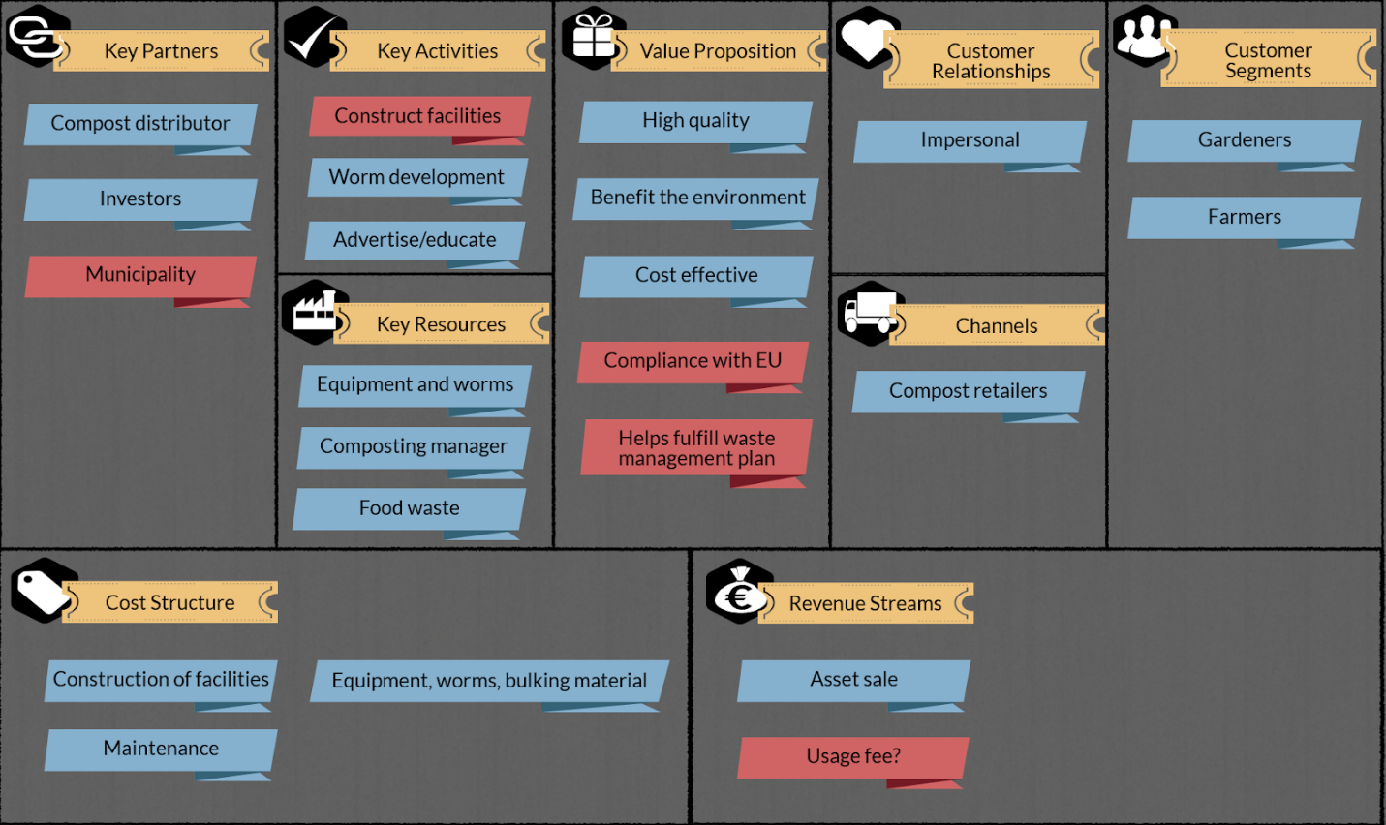
Characterize-Identify and plan improvements
Notes:
Additionally, to form the business plan, we created a business model canvas, which is a tool created by Alexander Osterwalder from Strategyzer to refine ideas that address a business opportunity. The canvas is split into the following nine categories:
Value proposition: the value a product or service provides
Customer segments: the specific market(s) on which a business is hoping to capitalize
Revenue streams: the ways in which a business makes money
Channels: the ways in which a product or service is delivered to the customers
Customer relationship: the type of relationship the business maintains with its customer segments
Key resources: the most important resources for the business venture
Key activities: the most important activities for the business venture
Key partners: important relationships formed with other entities in order to gain key resources or complete key activities
Cost structure: the biggest costs involved in running the business
In this case the municipality would be considered a partner and a customer because this program would treat their waste allowing them to comply with EU regulations. In addition to this because the business would be doing the municipality a service the business could charge a usage fee however this was not taken into account for the financiel projections.

Slide 10
Characterize-Identify and plan improvements
Notes:
This is the value proposition canvas, also developed by strategizer that identifies what kind of value the product can offer the consumer. This canvas is broken into two halves: the value map and the customer profile. The customer profile is further split into the jobs a customer is trying to complete, the pains they experience while doing a job, and the gains they are looking to achieve. The value map is split into the products and services a business provides, and the pain relievers and gain creators those products and services give to the customer

Slide 11
Improve-Develop methods of improvement
Current method of treatment is landfilling
New method improves the current waste treatment method by decreasing the amount of greenhouse gases and leachates created, while producing a profit for the business
Physical process map
Vermicompost is sold to consumers
Waste is collected from municipality
Waste is dropped off at composting location
Vermicompost is harvested and packaged
Waste is put into composter for 4 weeks
Compost is then transferred to vermicomposter for 2 months
Notes:
Justen Garrity of Veteran Compost notes that composting removes pathogens from the final product and stabilizes the temperature so that it is not too high for the worms. Additionally, vermicomposting speeds up the treatment process and produces a very high quality end product (Justen Garrity, personal communication, April 11, 2018). Veteran Compost uses this method, which takes around three months in total to execute - four weeks for aerobic composting and two months for vermicomposting. Garrity of Veteran Compost also mentioned that while composting followed by vermicomposting may take more steps than just composting, it results in much higher quality compost product that is highly marketable.
According to vermicomposting expert Rhonda Sherman, this method is optimal (personal communication, April 20, 2018).

Slide 12
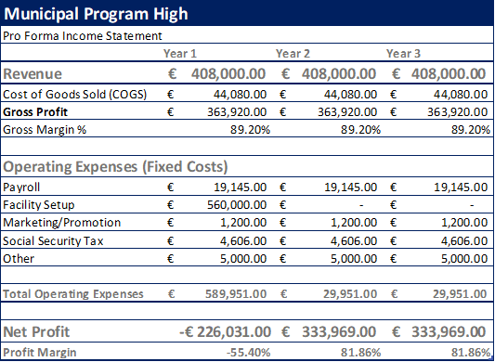
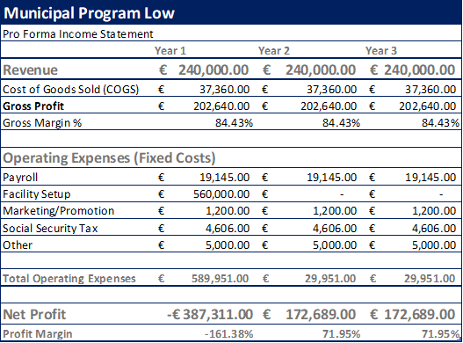
Achieve-Deliver measurable results
Pro forma income statements for a municipal scale program utilizing 3.5% of their food waste(3.5 tonnes/week)
High End Cost of Compost= €1.7196/L
Low end cost of vermicast= €1.0125/L
Notes:
This pro forma looks at a program taking in 3.5 tonnes of food waste a week, 3.5% of the muncipality’s total
On the high end of the price for vermicast (~1.7 EUR/L) the net profits in the first year would be negative 220,000 EUR, but every year after
The profit would be 340,000. So it would pay off and then some after the first year
On the low end of the price for vermicast (~1 EUR/L) the net profits in the first year would be negative 380,000 EUR, but every year after
The profit would be 179,000 EUR, so it would be payed back in the third year of operations
This can be applied to any other business as well, as this just takes into account the amount of waste taken in
This is also scalable to any level of waste that the business would prefer

Slide 13
Important
Considerations
Funding structures
Government grants
Taxes/Fees to citizens
Internal investment
Bank loans
Private equity investors
Publicity/Advertising methods
Distributor
Social media
Farmers markets
Legislation
Permits
Building Codes
Licenses
Quality Control
Product contamination decreases value of product
High quality product is necessary to continue business operations

Slide 14
For more information, please contact:
MacKenzie Conlen: maconlen@wpi.edu
Nicholas Cunha: njcunha@wpi.edu
Erika Snow: essnow@wpi.edu
Daniel Sochacki: dsochacki@wpi.edu

