Slide 1
Evaluating the Provision of Adult Education on Nantucket
December 13, 2022
Tim Loosigian, Caroline Major, Hannah Peloquin, and Akhi Yarlagadda

Slide 2
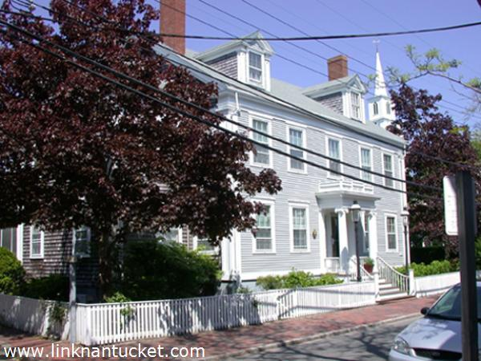
Overview of NCS
"Engage, strengthen, and connect"
Part of Public School System
Music center at 56 Center St.
Early childcare
Youth programs
Adult education courses.
And more
2

Slide 3
Project Goal
To recommend how the NCS can enhance its adult education program to better meet the needs of the community
3

Slide 4
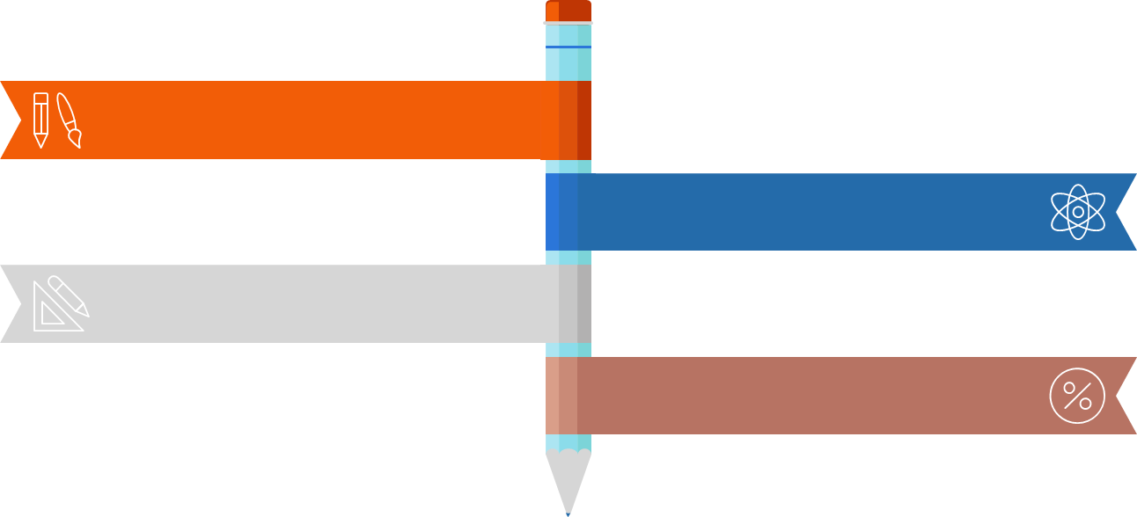
Objectives
Identify recent trends in the US
Assess lessons learned in communities similar to Nantucket
Evaluate courses offered by NCS
Determine collaborator preferences
4

Slide 5
Methodology
Background Research
Interviews with Other Adult Education Professionals
Surveys for Current, Past and Prospective NCS Students
Interviews with Current and Past NCS Students
Interviews with Employers
5

Slide 6
Trends
Through our background research, we determined that the biggest trend in Adult Ed was the shift from enrichment opportunities to workforce development. This was corroborated by our conversations with Adult education leaders.

Slide 7
Survey Branch Structure
Student Survey
1. Those who have participated in adult education
2. Those who have not participated in adult education but would like to in the future
3. Those who have not participated and are not interested
Notes:
Hannah: Our survey had three branches that gave the participant a distinct set of questions based on if they were someone who had taken courses at NCS in the past, if they had not taken courses at NCS before but would be interested in the future, and if they have not taken courses at NCS before an
d for whatever reason are not interested in taking courses in the future

Slide 8
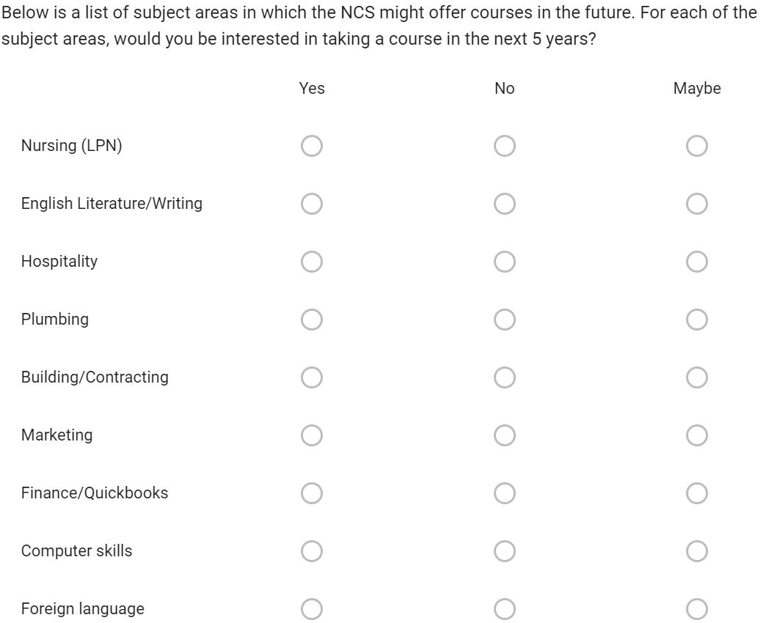
Survey
131 responses
93 English
31 Spanish
7 Portuguese
Email list of past students
INKY
ESOL (English for speakers of other languages) class
A Safe Place event
Take it or Leave it

Slide 9
Survey Findings
Notes:
In addition to the English version of our survey, we also made two translated versions of the survey into Spanish and Portuguese, which are the two most common languages spoken on the island other than English. For the purposes of the presentation, the graphs of the English-speaking respondents are in blue and the graphs for the non-English speakers version is in orange

Slide 10
Past NCS Students' Interest in Future Subjects
Notes:
Hannah: One of the questions we asked past NCS students was about their interest in taking courses in various subjects that are not yet offered by NCS. The most desired courses from participants of the English version were professional foreign language, finance/QuickBooks, and technology/computer skills. For the Spanish version, most people answered that they were in favor of foreign language, English literature and writing, and finance/Quick books

Slide 11
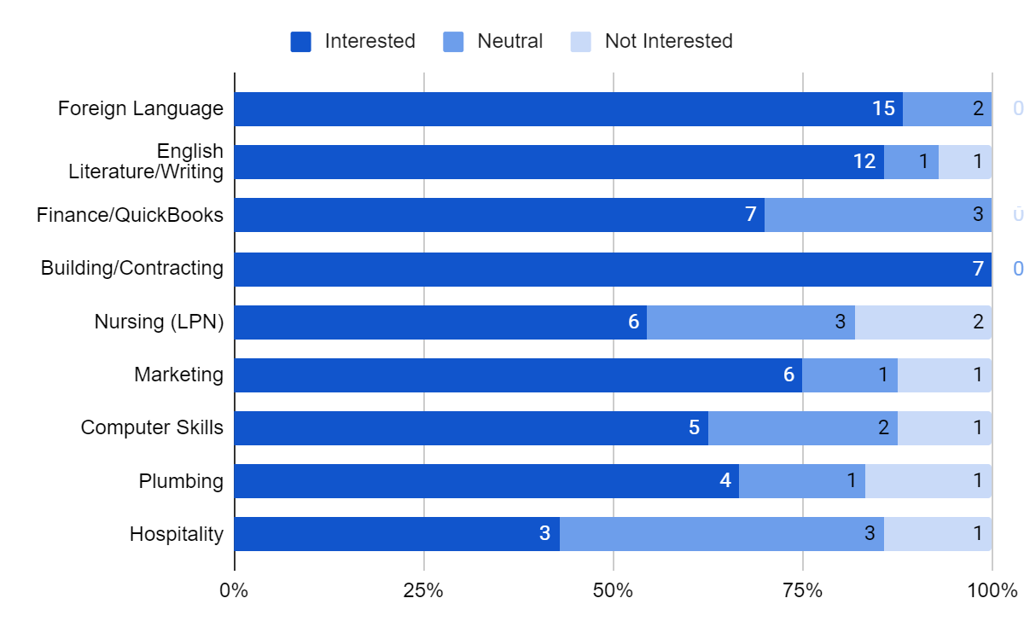
Past NCS Students' Interest in Future Subjects
Notes:
Hannah: One of the questions we asked past NCS students was about their interest in taking courses in various subjects that are not yet offered by NCS. The most desired courses from participants of the English version were professional foreign language, finance/QuickBooks, and technology/computer skills. For the Spanish version, most people answered that they were in favor of foreign language, English literature and writing, and finance/Quick books

Slide 12
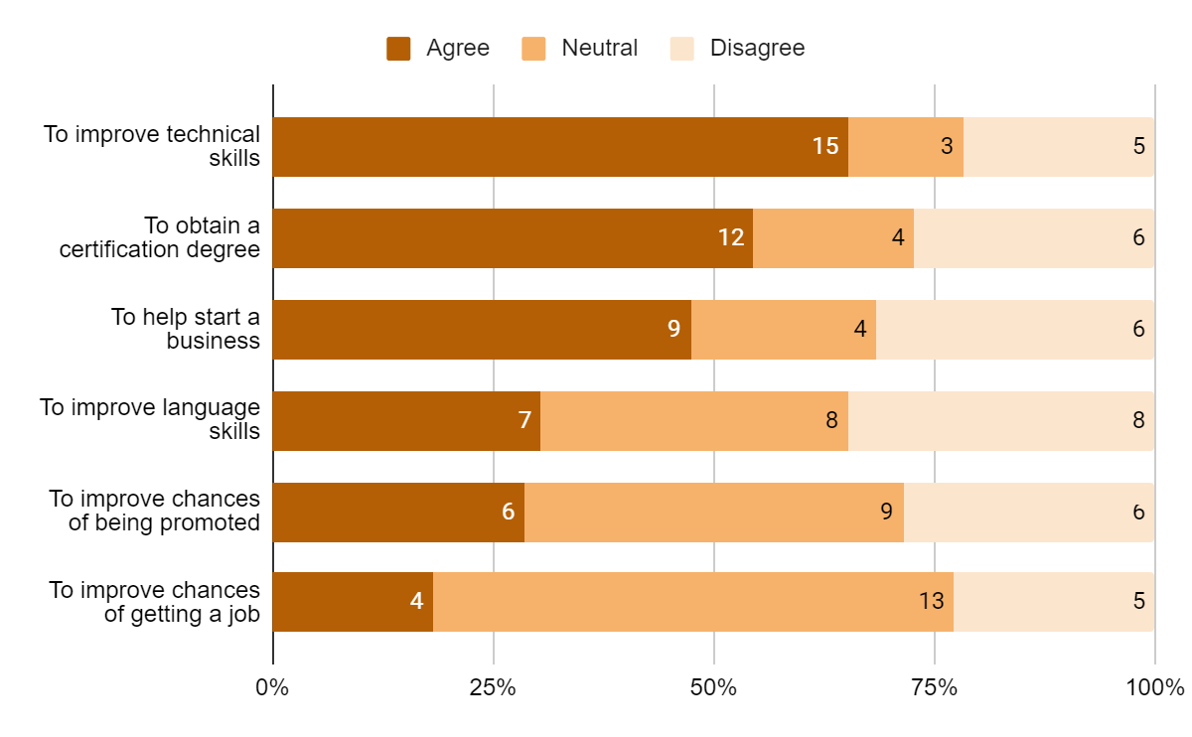
Past NCS Students' Motivations for Taking Courses
Notes:
Hannah: We also asked a question to gauge past NCS students' motivations for taking courses at the community school. Theesponsesvarieda bitbetween the English and non-English versions of the survey. English speakers primarily responded that they took courses timprovetechnical skills, obtain a certification degree, and to help them start a business. Non-English speakers were more likely to take courses to improve their language skills, improve their chances of getting a job, and to obtain a certification degree.

Slide 13
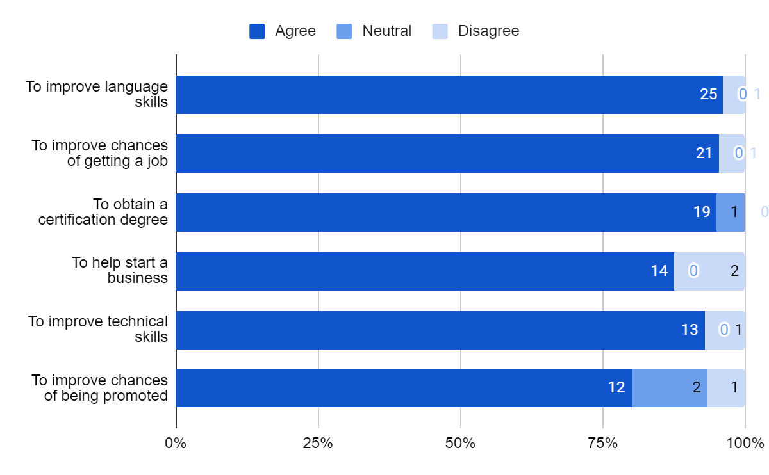
Past NCS Students' Motivations for Taking Courses
Notes:
Hannah: We also asked a question to gauge past NCS students' motivations for taking courses at the community school. Theesponsesvarieda bitbetween the English and non-English versions of the survey. English speakers primarily responded that they took courses timprovetechnical skills, obtain a certification degree, and to help them start a business. Non-English speakers were more likely to take courses to improve their language skills, improve their chances of getting a job, and to obtain a certification degree.

Slide 14
Prospective NCS Students' Interest in Future Subjects
Notes:
Hannah: For the prospective students, the people who have not taken adult education courses at NCS, we asked some similar questions. For their interest in subject areas that are not yet offered by NCS, the responses were pretty similar to past students. The English speaking participants responded that they would be most interested in finance/quickbooks courses, computer skills, and professional foreign language. Non-English speaking participants were most interested in taking English literature and writing, foreign language, and computer skills.

Slide 15
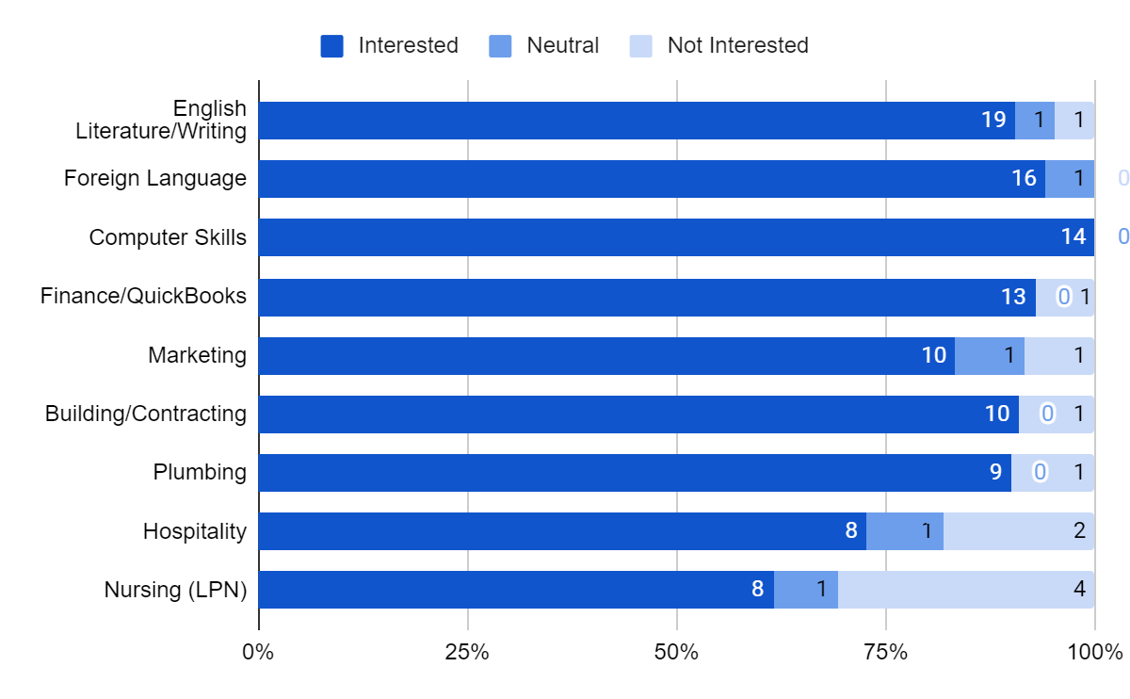
Prospective NCS Students' Interest in Future Subjects
Notes:
Hannah: For the prospective students, the people who have not taken adult education courses at NCS, we asked some similar questions. For their interest in subject areas that are not yet offered by NCS, the responses were pretty similar to past students. The English speaking participants responded that they would be most interested in finance/quickbooks courses, computer skills, and professional foreign language. Non-English speaking participants were most interested in taking English literature and writing, foreign language, and computer skills.

Slide 16
Prospective NCS Students' Motivations to Take Courses
Notes:
Hannah: Finally, we asked prospective NCS students about what would most motivate them to take courses at NCS in the future. We only included the graph for the English speaker version because the responses for the non-English versions were virtually identical to these. The main motivations for taking courses were the same as for past NCS students, specifically improving technical skills, obtaining a certification degree, and to help them start a business.

Slide 17
Interview Findings
Interviews
2. Leaders in the adult education community
3. Teachers at the NCS
1. Employers
4. Students
Current, Past, Prospective
Cape Cod
Martha's Vineyard

Slide 18
Employers
Rob Lucchini | Journeyman Instructor at NCS, Master Electrician
Ivana Stoyanov | Director of Strategic Growth, Chamber of Commerce
Brooke Mohr | Treasurer of Nantucket Resource Partnership, Bookkeeper
Amanda Perry | Town of Nantucket, Human Resources Director
Peter McEachern | General Manager, Nantucket Yacht Club
Annie-Kay Rose | Nurse
Sunny Daily | Doula/Midwife

Slide 19
Leaders in Adult Education
Holly Bellebuono | Executive Director, MVCET ​
Dianne Tattersall | President, Academy for Lifelong Learning​ (Cape Cod)
Mary Burke | Director of Adult and Continuing Education, Upper Cape Cod Regional Technical School
Tracy Nichols | Executive Director of Nantucket Resource Partnership, Previous NCS Director ​
Amanda Bardsley ​ | Director of STEM, Nantucket Public Schools ​

Slide 20
Teachers at NCS
David Harris | Exit Cape Realty, Real Estate Instructor
John Mynttinen | GED (High school equivalency) prep Instructor, NCS
Michelle Saravia | NCS Translator, ESOL Coordinator &Family Support Specialist

Slide 21
Students
Real Estate students
Career
Foreign language classes
ESOL (English for Speakers of Other Languages) students
Appreciated the leveling structure
Changying Sun, local sushi business owner
Took Driver's Ed class, now wants to improve his business
English, other Business Management courses

Slide 22
Interview Findings
Aligns with survey findings
Healthcare, management, and vocational/trade courses
Important to train employees on island

Slide 23
Conclusions & Recommendations

Slide 24
Certifications
Popular Subjects Desired
CPR and ESOL
GED and Real Estate
Healthcare and Trade/Vocational Courses

Slide 25
Recommendation 1:
The NCS add courses in finance and QuickBooks, technology and computer skills, and professional-level foreign language.

Slide 26
Recommendation 2:
The NCS offer more courses that allow students to gain a certification.

Slide 27
Recommendation 3:
We recommend that the NCS should continue offering the CPR and First Aid courses, ESOL, Real Estate, and GED courses.

Slide 28
Recommendation 4:
ESOL skill levels: we recommend that NCS break courses into different levels if applicable.
Notes:
Since the very popular ESOL course has a leveling system that allows students to enroll in a class with peers of similar abilities and skill levels, we recommend that NCS break courses into different levels if applicable.

Slide 29
Recommendation 5:
The NCS continue to build upon their marketing methods, so the community is more aware of the opportunities provided by the school.
Notes:
We recommend that the NCS continue to improve and build upon their marketing methods so that the community is more aware of the opportunities provided by the school.

Slide 30
Recommendation 6:
We recommend the NCS have a course evaluation/feedback system, to facilitate continuous improvement of course offerings

Slide 31
Challenges
Finding & Keeping Instructors
Housing
Marketing (Targeting Hard-To-Reach Groups)
Specific Curricula

Slide 32
Thank You!

Slide 33
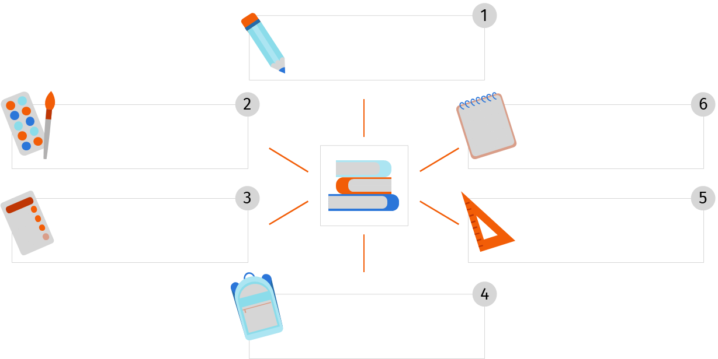
ACKnowledgements
Lindsay Pykosz & Brian Lenane
Dominic Golding & Bruce Bursten
The NCS
Dave Harris & Michelle Saravia & Other interviewees
The INKY
A Safe Place

Slide 34
References
Kelsey-Rogers. (2022, April 29). Women in real estate. Sponsored. Retrieved November 16,
2022, from https://sponsored.bostonglobe.com/studiob/2021-women-in-real-estate/.
Nantucket Community School. (2022). The Nantucket Community School. Nantucket
Community School. Retrieved November 16, 2022, from https://nantucketcommunityschool.org/
Nantucket County, Massachusetts. (2021). Census.gov.
https://www.census.gov/quickfacts/nantucketcountymassachusetts
Martha’s Vineyard Adult Learning Program. (2022). Martha’s Vineyard Adult Learning
Program. MVALP. September 12, 2022, https://mvalp.com/
Martha’s Vineyard Center for Education and Training. (n.d.). MVCET • Martha’s Vineyard
Center for Education & Training. MVCET • Martha’s Vineyard Center for Education and Training. September 12, 2022, https://mvcet.org/
Moustakas, L. (2018, July 17). Motivation and Obstacles to Adult Participation in Lifelong
Learning Programs: The Effect of Gender and Age. Open Journal for Educational Research, 2(1), 45–56. https://doi.org/10.32591/coas.ojer.0201.04045m
Punksungka, W. (2021, November 28). Re-examining adult education and training
participation by education ... Re-examining Adult Education and Training Participation
by Education, Literacy, Gender, and Race/Ethnicity in the U.S
Rainie, L., & Anderson, J. (2017, May 3). The Future of Jobs and Jobs Training. Pew Research
Center: Internet, Science & Tech. https://www.pewresearch.org/internet/2017/05/03/the-future-of-jobs-and-jobs-training/
Town of Nantucket. (2021, June). 2021 annual town report for the town of Nantucket. The
Country Press. https://www.nantucket-ma.gov/DocumentCenter/View/42103/Annual-Town-Report-2021-Town-of-Nantucket-PDF
UNESCO. (2015). Recommendation on Adult Learning and Education 2015.
https://uil.unesco.org/adult-education/unesco-recommendation/unesco-recommendation-adult-learning-and-education-2015
UNESCO Institute for Lifelong Learning. (2022). Making lifelong learning a reality: a
handbook. UNESCO.
FAQs • Nantucket, MA • CivicEngage. (n.d.). From https://www.nantucket-
ma.gov/Faq.aspx?QID=289
Course schedule - academy for lifelong learning of cape cod, inc. Academy for Lifelong
Learning of Cape Cod. (n.d.). from https://www.capecodall.org/wp-content/uploads/2022/08/Fall-2022-Course-Grid-Updated-8-9.pdf
Living with the cost of imported Labor. The Vineyard Gazette - Martha's Vineyard News. (n.d.).
from https://vineyardgazette.com/news/2003/07/25/living-cost-imported-labor
Bushard, B (2021, August 19). Census is in, but question of undercount lingers. Inquirer and
Mirror. Retrieved November 16, 2022, from https://www.ack.net/stories/census-is-in-but-question-of-undercount-lingers,25634
Boeren, E., Roumell, E., & Roessger, K. (2020, May). COVID-19 and the Future of Adult
Education: An Editorial. Adult Education Quarterly.
https://doi.org/10.1177/0741713620925029
Chang, B. (2020, November 30). Trends and direction of adult education. American Association
Adult and Continuing Education.
Chisholm, L. and Hasan, A. (2010). Global report on adult learning and education (Repr. with
minor revisions). UNESCO Inst. for Lifelong Learning.
Cincinnato, S., De Wever, B., & Valcke, M. (2014). The learning divide in formal adult
education: why do low-qualified adults participate less? In P. Guimarães, C. Cavaco, L.
Marrocos, C. Paulos, A. Bruno, S. Rodrigues, & M. Marques (Eds.), Local Change,
Social Actions and Adult Learning : Challenges and Responses, Proceedings (pp.
401–415). Lisbon, Portugal.
Desjardins, R. (2020). Acquiring Higher Levels of Education as an Adult Learner: Implications
for Active Ageing. In: Slowey, M., Schuetze, H., Zubrzycki, T. (eds) Inequality,
Innovation and Reform in Higher Education. Lifelong Learning Book Series, vol 25.
Springer, Cham. https://doi.org/10.1007/978-3-030-28227-1_12
Document Center • Nantucket, MA • CivicEngage. (n.d.).
https://www.nantucket-ma.gov/DocumentCenter
Economic Development Group & Mt. Auburn Associates. (2015). Learn without leaving: an
assessment of Nantucket's educational & workforce needs.
Horrigan, J. B. (2020, May 30). Lifelong Learning and Technology. Pew Research Center:
Internet, Science & Tech. https://www.pewresearch.org/internet/2016/03/22/lifelong-learning-and-technology/
Kalenda, J., & Kočvarová, I. (2022, June 16). "Why don't they participate?" reasons for
nonparticipation in adult learning and education from the viewpoint of self-determination theory. European Journal for Research on the Education and Learning of Adults.
34

Slide 35
Credit for slide pictures
credit Slidesgo and Freepik add links later

