Slide 1
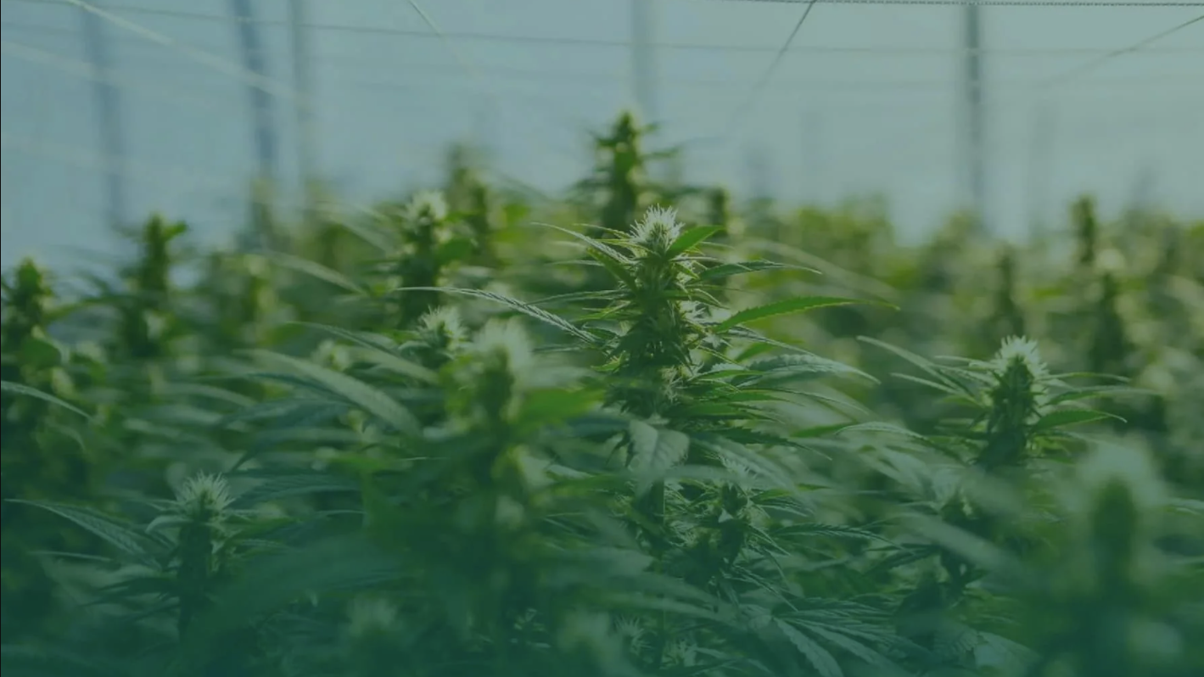
Assessing the Feasibility of a Cooperative Farming Model in the Thai Hemp Industry A collaborative project between Worcester Polytechnic Institute and Chulalongkorn University on behalf of Eastern Spectrum Group
February 25, 2022
Notes:
Jake
Hello everyone, thank you for coming to our presentation! Our project is [title] on behalf of our sponsor, Eastern Spectrum Group. Before we get started, we’re going to go around and have everyone introduce themselves
---
REFERENCES ON HOW TO FORMAT:
https://articles.bplans.com/what-to-include-in-your-pitch-deck/ (we’re not really doing a pitch deck but this does have some good tips on writing business things)
https://www.assertion-evidence.com/
A successful presentation regardless of format will: engage the audience and tell a story.
This means: avoiding bullet points and text-dense slides, and using graphics and images to support the slide.
What is also helpful in a presentation is a way to keep the audience on track in case they tune out for a second, they won’t be lost for long.
These principles are universal and bring success across business and technical presentations.
Notes
Introduction
Drop majors
Acknowledgements at the end
Put sponsors first
Drop objectives only slides
Methods is good and clear, spend more time explaining the slide
Remove term “weigh”
Data
Try and show data figures
To make it perfect
Look professional
Idea: hands in front
Ault
Work on our story, make it more fluid
Mention target audience, mention deregulation which is why its becoming a cash crop
Explain why we are interviewing tobacco farmings before we talk about tobacco farmers

Slide 2
The Team
This project is a joint effort between students at Chulalongkorn University (top) and Worcester Polytechnic Institute (bottom).
Notes:
Jake/Everyone (POND FIRST)
First names only, no majors. Be quick!
Bing bang bong
Great, now I’m going to hand off the mic to Asha to give our project some context and introduce the social problem

Slide 3
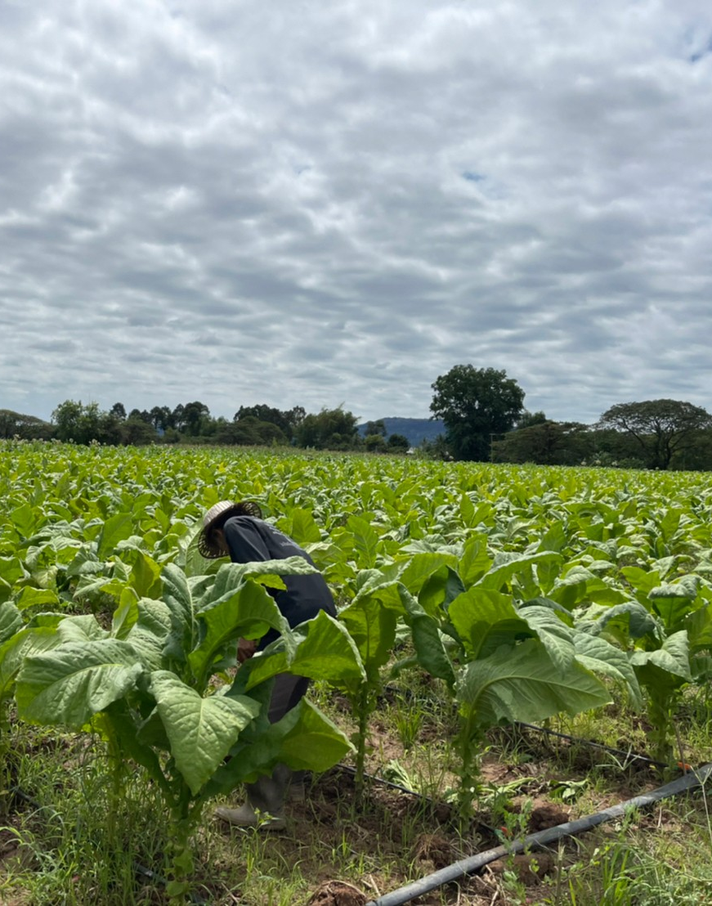
1 Introduction
Notes:
Jake

Slide 4
The Problem
Agriculture accounts for 10% Thai GDP
26% of farmers live in poverty
Climate change will exacerbate poverty
Cooperative farming:
increase the potential for profit
build a stronger agricultural economy
social protections
Notes:
Asha
Assessing the Feasibility of a Cooperative Farming Model in the Thai Hemp Industry
Agriculture is a key economic sector in Thailand, accounting for 10% of the Thai GDP.
Agriculture employs 30% of the Thai workforce, which is about 6.4 million households.
Despite the importance of agriculture in Thai economic development, Thai farm workers suffer from poverty at a disproportionate rate.
Poverty has been a growing problem among Thai farmers, and is projected to worsen as climate change affects farming
Although the Thai government has made steps to reduce this problem, they do not have the resources to single-handedly alleviate poverty in the agricultural sector.
Studies of Thai farmers and neighboring countries in the Southeast Asian region conclude that impoverished farmers need opportunities that
increase the potential for profit
build a stronger agricultural economy
social protections.
One possible solution to this is co-op farming.

Slide 5
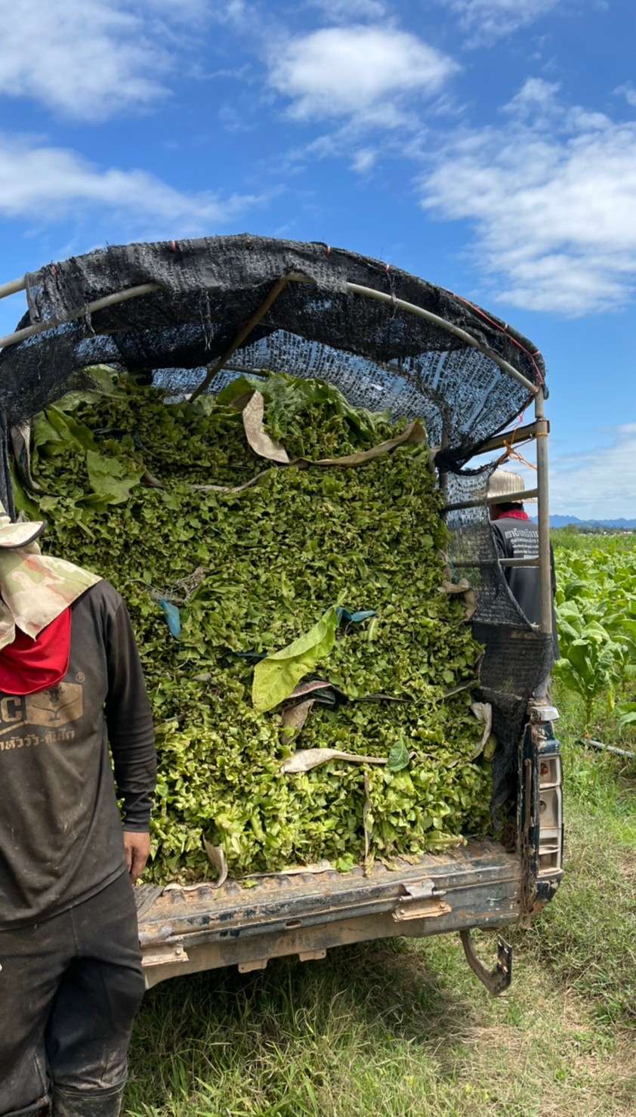
Project Goal
Create a value proposition for a cooperative farming model for Eastern Spectrum Group to improve current financial issues among Thai farmers by transitioning them to growing hemp.
Notes:
Namo
Our project goal is to create a value proposition for a cooperative farming model for the Eastern Spectrum Group, our project’s sponsor, to improve Farmer’s prosperity by switching them to growing hemp.

Slide 6
Poverty Relief: Cooperative Farming
An agreement between farmers and manufacturers that guarantees a constant stream of a specific commodity to the manufacturer.
The farmer secures:
Infrastructure
Reliable markets
Fixed price structures
Educational knowledge from the manufacturer
Notes:
Mhiw
Mhiw: Cooperative contract farming is an agreement between farmers and manufacturers that guarantees a constant stream of a specific commodity to the manufacturer.
In this mutually beneficial relationship, the farmer secures the necessary infrastructure, reliable markets, fixed price structures, and educational knowledge from the manufacturer; the manufacturer secures reliably high-quality raw materials and can bypass common land restraints or resource limitations. It is especially advantageous for the farmer because it provides support and a reliable income.

Slide 7
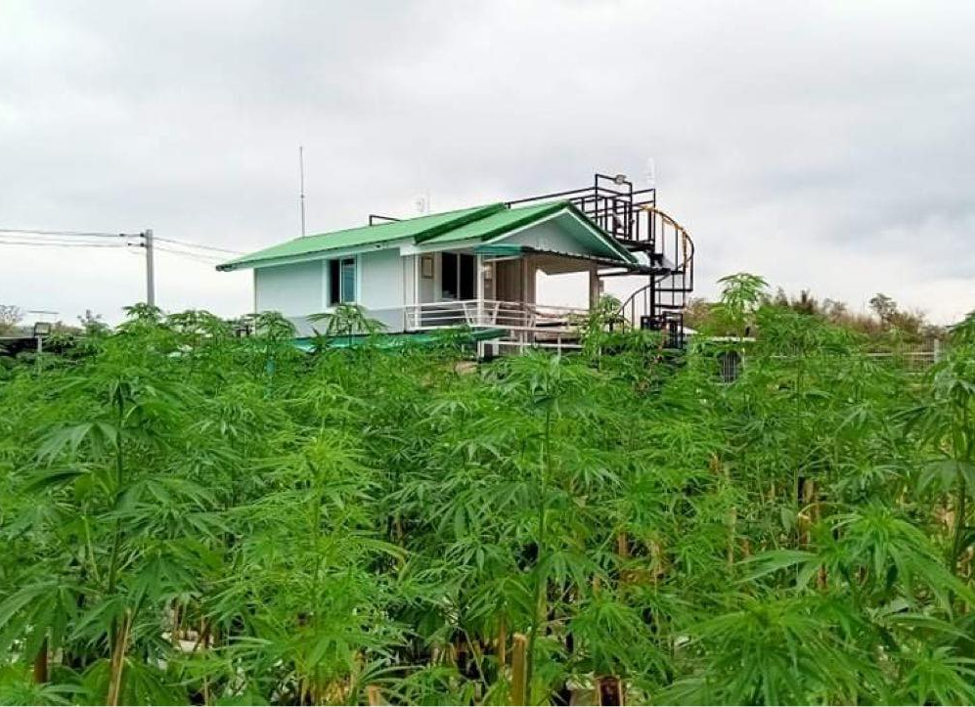
Industrial Hemp: An Emerging Crop in Thailand
Hemp was recently deregulated in Thailand
The Thai government is promoting hemp farming
New market opportunities
Notes:
Abby
In the face of climate change, new farming practices and more resilient crops are necessary to combat natural disasters. Industrial hemp is an adaptable and multifunctional crop that would be suitable for this purpose.
Hemp was recently deregulated in Thailand, and the Thai government is promoting hemp farming. The deregulation of hemp creates new opportunities for farmers to work towards poverty reduction.

Slide 8
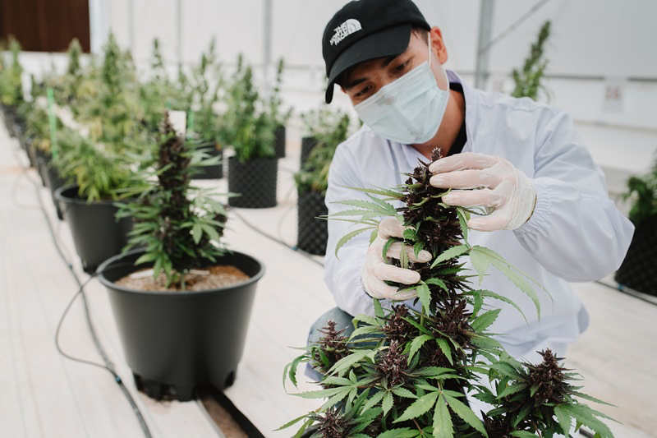
Eastern Spectrum Group
Thailand’s leading cultivator, manufacturer, and supplier of high-quality medical grade extracts, consumer hemp products, and hemp-derived industrial solution.
Notes:
Pond
Pond : ESG’s attraction to cooperative farming stems from one primary concern that is poverty relief. The company wants to scout farmers in declining agricultural sectors such as tobacco and sugarcane and excess commodities such as rice, corn, and cassava and propose a long-term cooperative farming agreement where farmers grow hemp for ESG.
Eastern Spectrum Group is Thailand’s leading end-to-end cultivator, manufacturer, and supplier of high-quality medical grade extracts, consumer hemp products, and hemp-derived industrial solution.
The company aims to serve as a benchmark for competitors and as a resource center for local farmers and agricultural cooperatives to learn, procure and adopt best practices and materials required for sustainable hemp production.

Slide 9
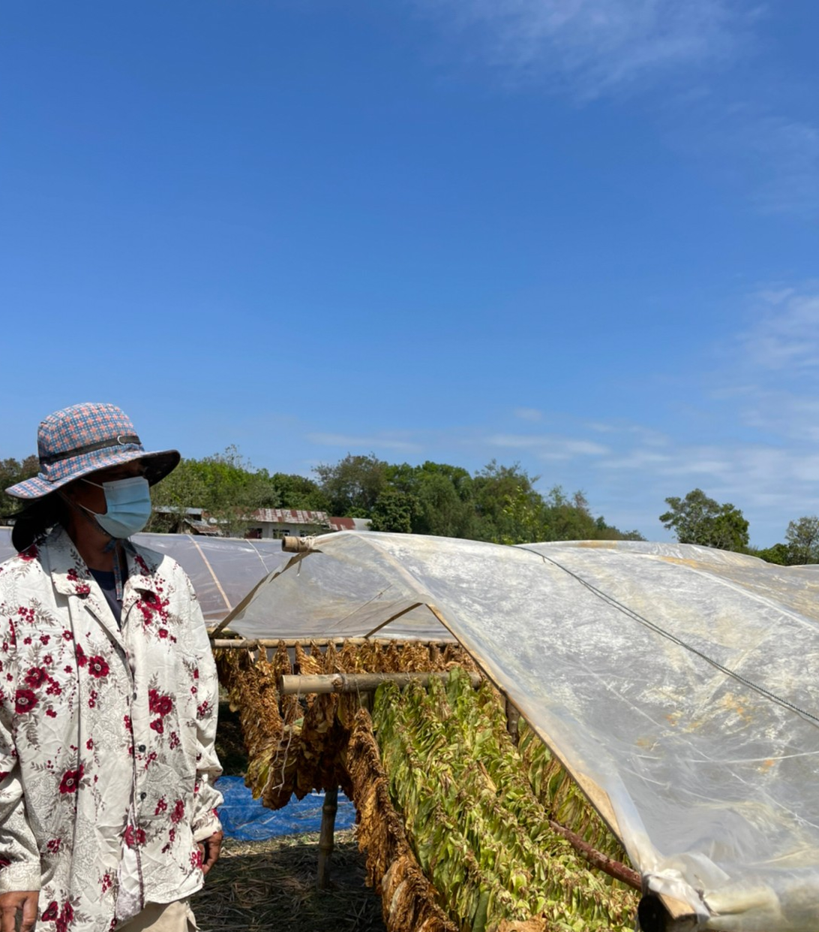
2 Methodology
Notes:
pond

Slide 10
Methods Flowchart
Determine the current business environment of primary stakeholders
Compile data from interviews with Thai farmers
Assess practicality of cultivating hemp with Thai farmers
OBJECTIVE
TASKS
Interview Thai farmers
Conduct content analysis of interview data
Validate or reject the proposed model
Gather information on the investment capabilities ESG
Create visual representations of interview data
Develop final deliverable
Notes:
Heads up! This thing is animated! Whoever is advancing the slide, there are 5 clicks on this! Pace them as I speak.
Por
This is our methods flowchart!
The first objective, which is to determine the current business environment of primary stakeholders, is shown in the green bubble and its associated tasks are shown below it in the grey bubbles. For this objective, we interviewed Thai farmers and gathered information.
The next objective was to compile data from the interviews, which is where we conducted our content analysis of the data.
The third objective was to develop a value proposition for the Thai farmers if they were to engage in cooperative farming. Here, we assess the costs and benefits of the model for everyone involved.
The last objective is to assess the practicality of cultivating hemp with Thai farmers where we validate the model.

Slide 11
Content Analysis
Interview # | HE | NH | LP | IN
1 | Y | N | N | Y
2 | N | Y | Y | N
3 | N | Y | Y | Y
4 | N | Y | Y | N
Example Result: All interviewed non-hemp farmers make less than 20,000 THB per rai, but only one non-hemp farmer is interested in cooperative farming
HE: | Hemp farmer
NH: | Non-hemp farmer
LP: | < 20K THB per rai
IN: | Interested in co-op
Data in this model is fictitious and is only used to explain the concept
Notes:
Jake
In this project we used content analysis to collate and analyze the data we collecting during our interview process.
In our actual content analysis, we conducted [20] interviews and sorted the data using 11 yes or no questions, labelled by the codes listed on the X axis of the table.
In the example shown above, the content analysis creates a binary data set, with a single interview in every row and a question’s associated code in every column.
We can sort the results of each interview by the codes in the top row, like HE for hemp farmers and NH for non hemp farmers. Here’s an example result we can gather from this data.
In our real data set, we were able to pull additional statistics from the 11 codes we used. We have codes for different questions like
Does the farmer have more than 10 rai? (MR)
Does the farmer use mechanical equipment? (ME)
Did the farmer mention drought or other natural disasters that negatively affected their crops?

Slide 12
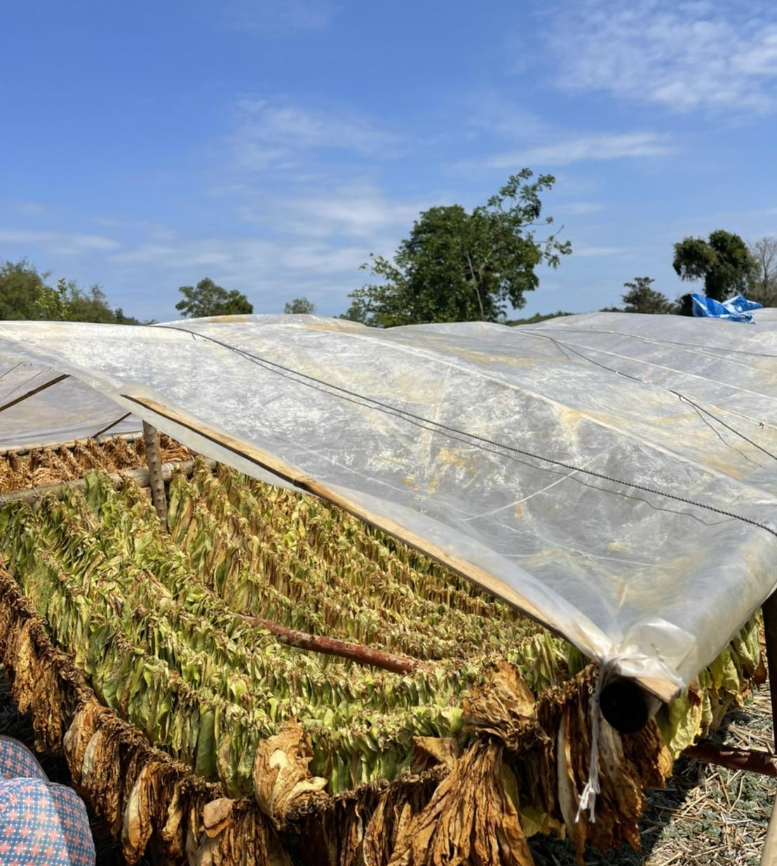
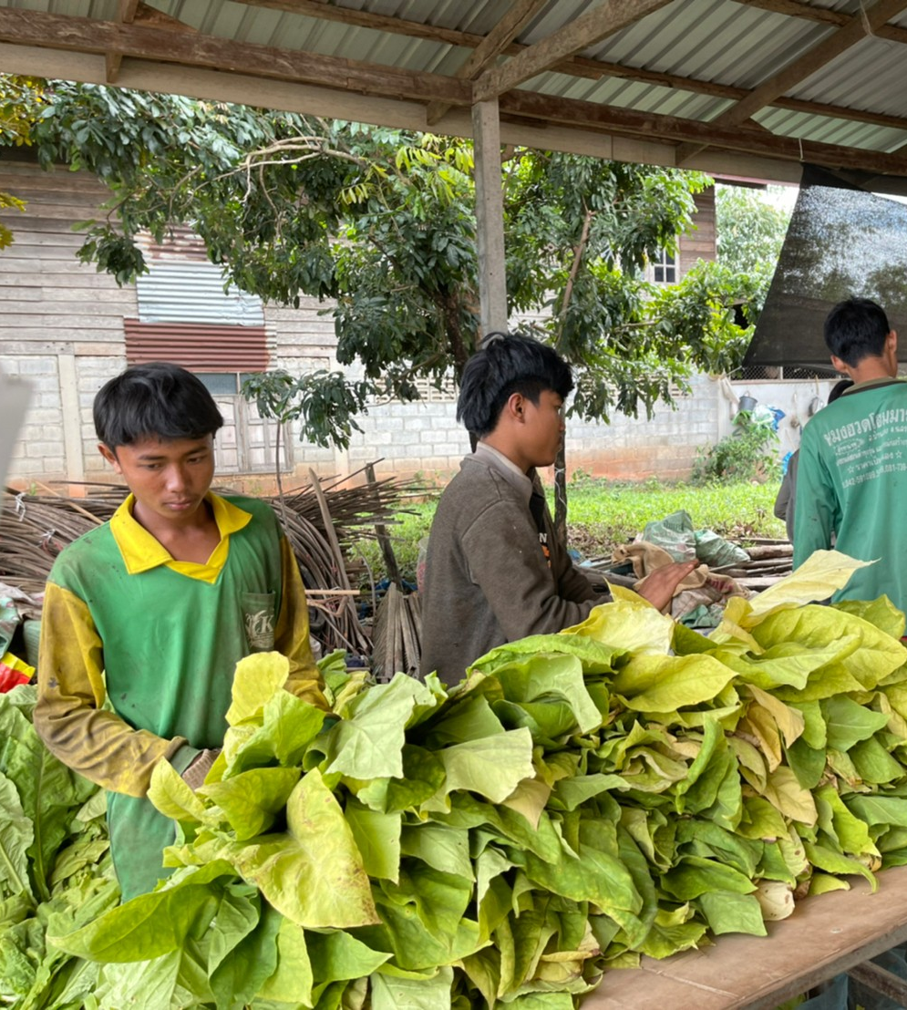
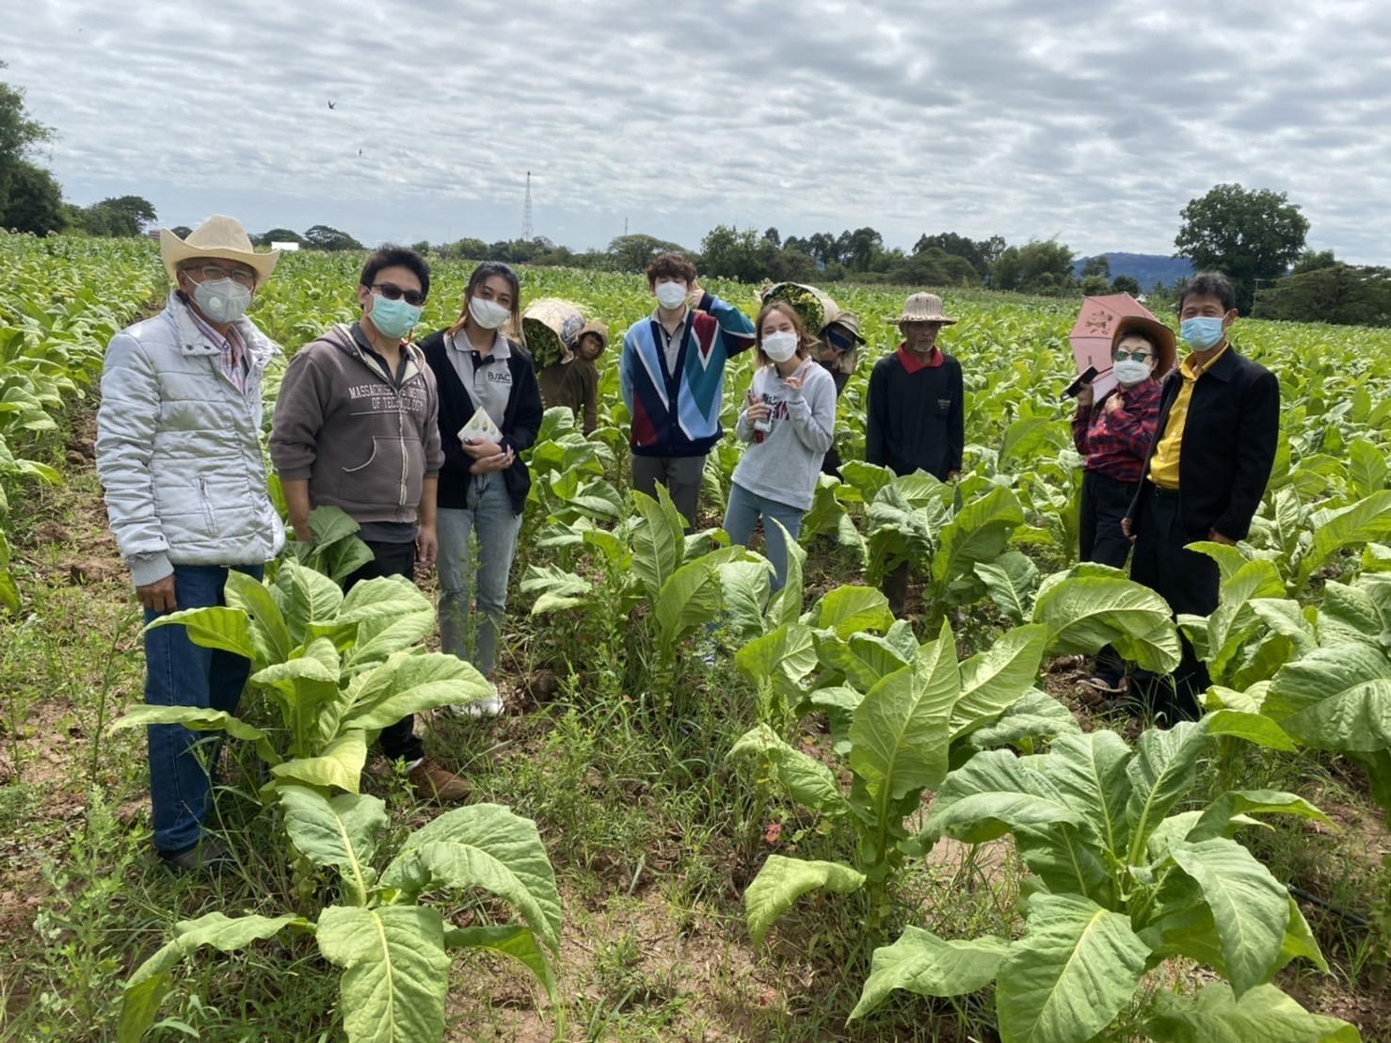
3 Findings & Recommendations
Notes:
Jake

Slide 13
The target demographic of farmers best suited for co-op farming with ESG are tobacco and sugarcane farmers.
Notes:
Asha
The sponsor has indicated that they are interested in partnering with tobacco and sugarcane farmers for the cooperative model, so we have done research to verify that these industries would be ideal for a cooperative farming contract.
Tobacco consumption is declining worldwide, and there are health concerns with farming tobacco.
Some studies predict that for tobacco farmers to maintain a farming lifestyle, they will need to consider different crops
Sugar cane has variable seasons in Thailand, last year it was really poor, and this year it appears to be thriving. Globally, artificial sugar consumption is surpassing natural sugar consumption, which may compromise the sugarcane industry. This would be artificial sugars like saccharin, aspartame, and sucralose, known by common names like stevia, splenda, and high fructose corn syrup
Sugarcane and Tobacco most interested cooperative farming & have more than 10 rai
Jake’s Notes:
The government subsidizes the tobacco industry so they are relatively safe, but sales in both industries are going down
Sugarcane is used as a natural sugar and
Big companies aren’t trusted by thai farmers, and they’re worried the company will just ditch them. We did mention that there would be a contract involved.
They tend to trust the government more
Any farmers with small amounts of land can probably plant crops more densely and expand their growing capabilities with ESG’s help through coop farming

Slide 14
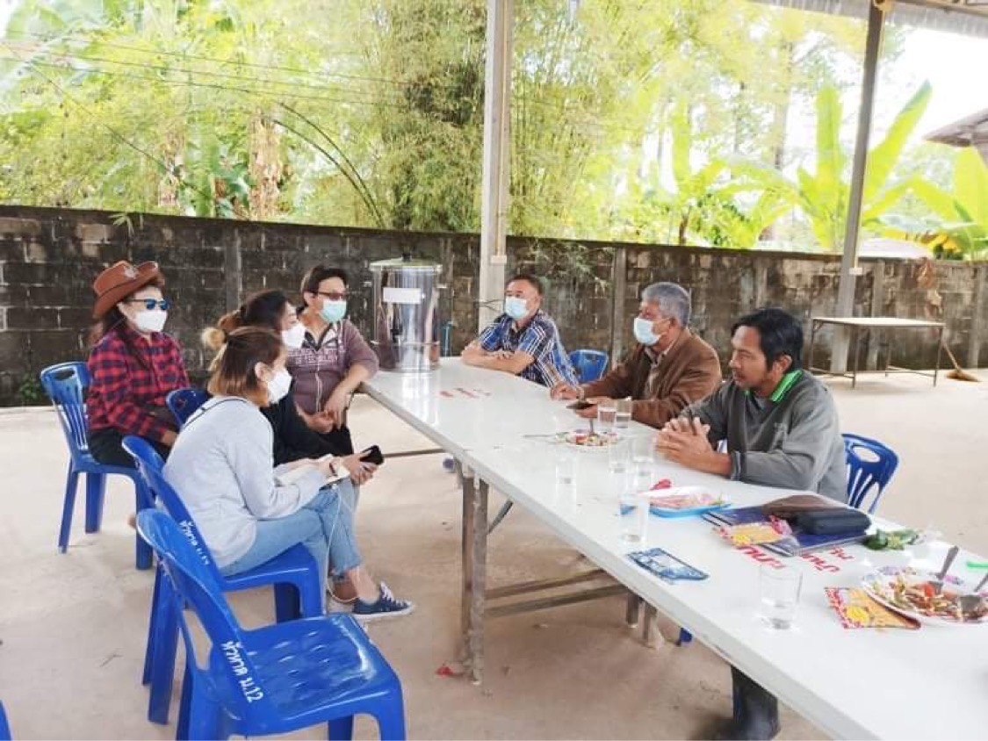
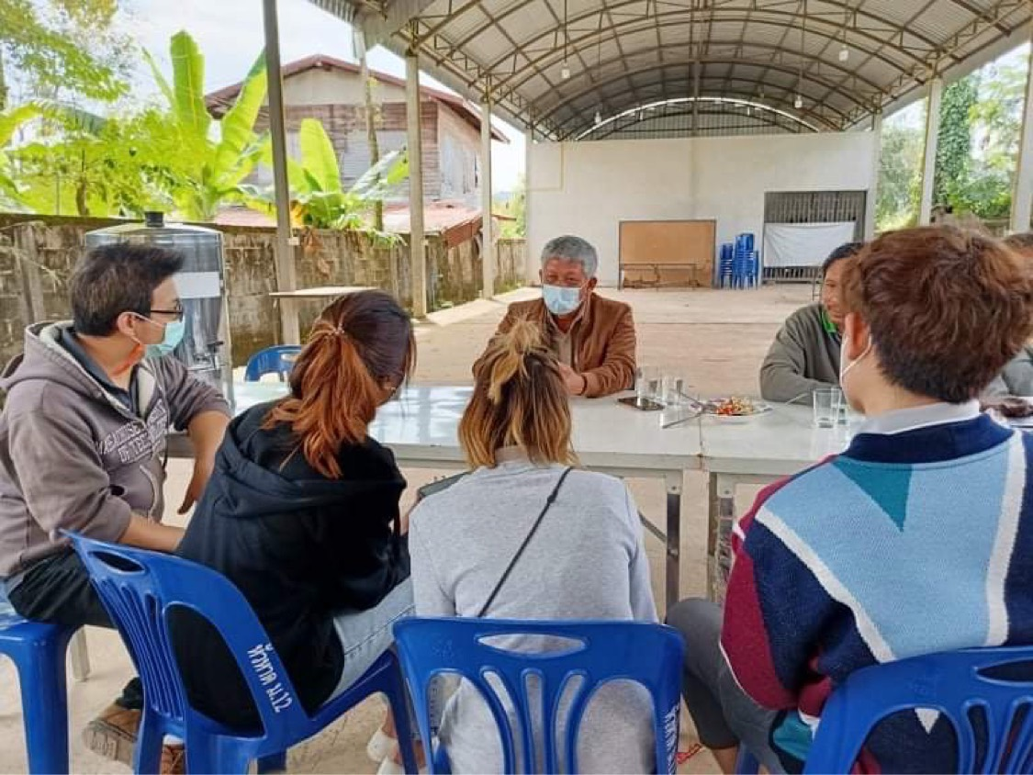
Mayor of Ban Paeng, Nakhon Phanom
Grows over 1,000 rai of tobacco
Has authority over 6,000 rai of land
Opportunity and build a career
Notes:
Namo
From our field trip to Nakhon Phanom province, we had a chance to meet with the Mayor of Ban Paeng, who grows over 1,000 rai of tobacco, has authority on over 6,000 rai of land and is also the representative of local farmers in the บ้านแพง area. For his profit figures, he invests 23,000 to 25,000 Baht, and in return, he receives 50,000 Baht for revenue per rai. This means that he keeps roughly half of the revenue as his net profit. For his concerns regarding the cooperative farming model, the company must provide enough information on the regulations and be clear and transparent on their contract. With that being said, he has high expectations from ESG as well. This includes, training on hemp plantation, providing more opportunities and ability to build a career for farmers, and contacting officials authorities in order to build trust with farmers.

Slide 15
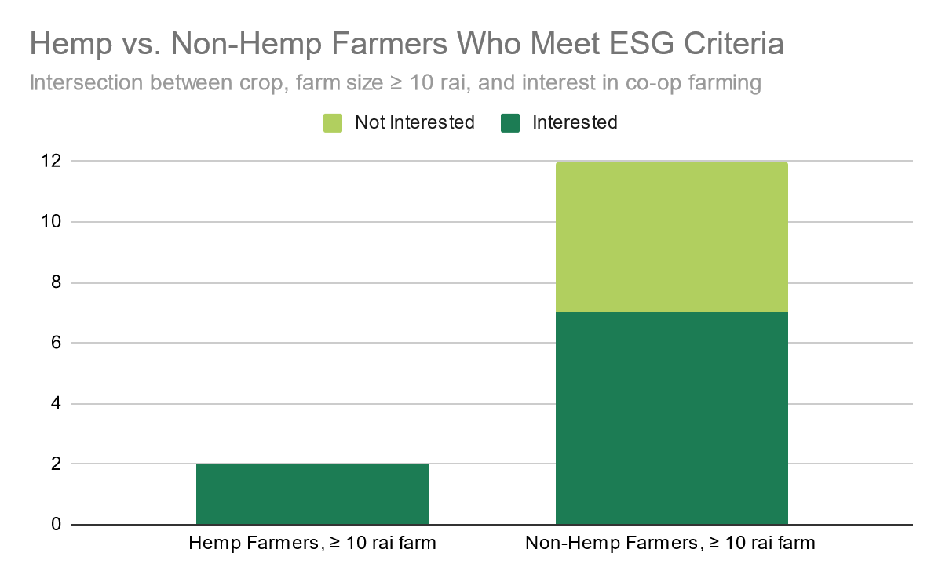
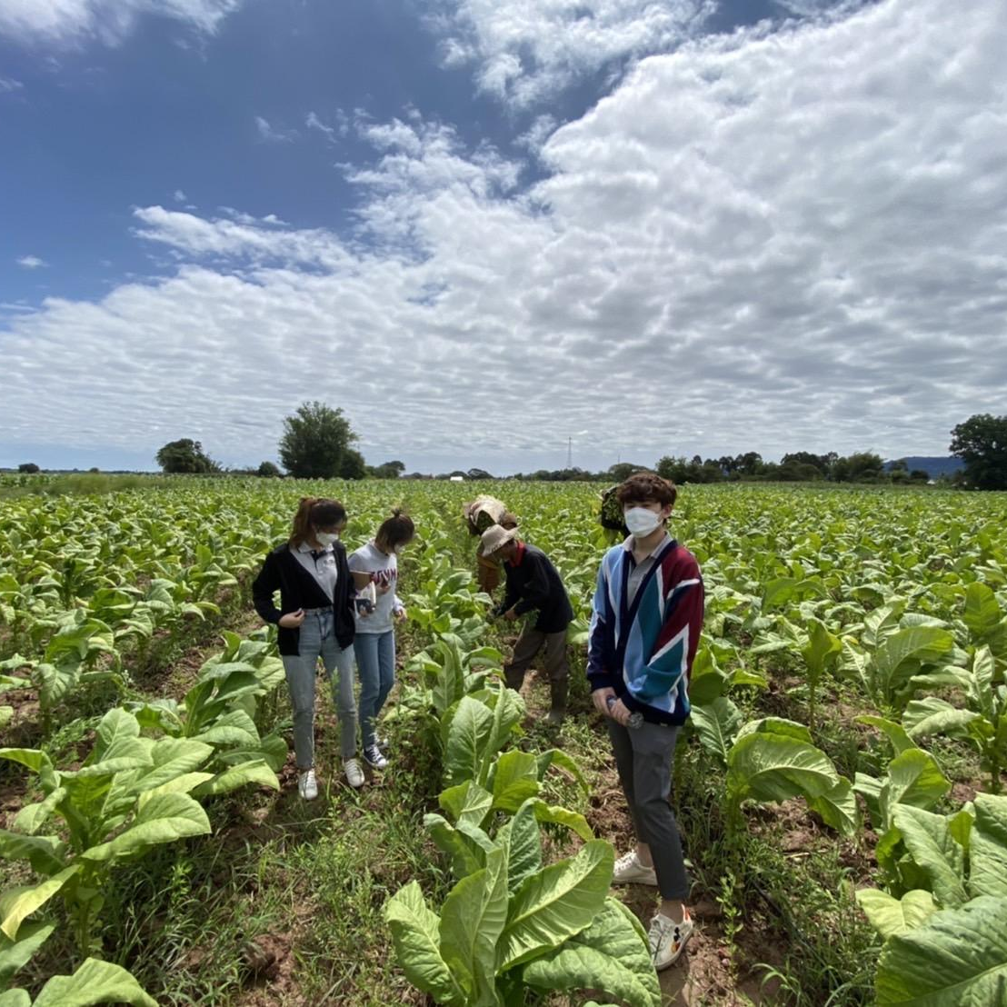
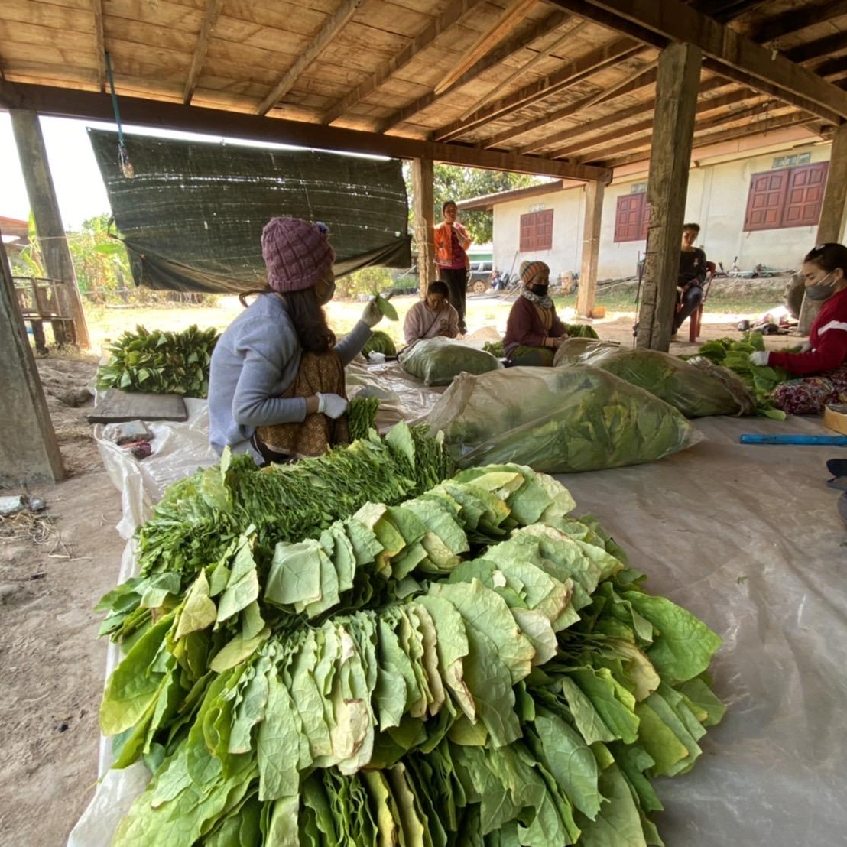
A majority of our interviewees are interested in a cooperative farming model with ESG.
Notes:
Brian
Two questions that were asked during our farmer interviews regarded interest in the cooperative farming model and farm size. ESG has identified the threshold of 10 rai, or 16,000 m2, for farm size as anything smaller would not benefit from the efficiency of mechanical harvesting and care.
From our content analyis, we can see that a majority of our interviewees who fit ESG’s criteria are interested in a cooperative farming model. 2/2 hemp farmers and 7/12 non-hemp farmers that have 10 or more rai are interested.

Slide 16
73% of non-hemp farmer interviewees reported a negative effect on their farm from natural disasters such as drought.
Hemp is more resilient to changes in the environment than traditional crops.
Notes:
Brian
Additionally, from the content analysis, we were also able to find that about 73% of non-hemp farmers that we interviewed experienced a negative effect on their crops due to natural disasters such as drought. The picture on the right shows a wilting tobacco plant from drought.
Switching to growing hemp would alleviate some concerns regarding natural disaster as the hemp plant is more resilient to dramatic condition changes as opposed to traditional crops.
https://www.gannett-cdn.com/presto/2018/09/21/PASH/7b337067-29b8-423d-b8a7-308b1162fec4-AP18263597658630.jpg

Slide 17
Recommendations for ESG
Education in best practices
Company Support of Farmers
Contracts
Successful Collaboration
Government Support
Build Trust
Village and Community Leaders
Notes:
Abby
With the goal of successful collaboration, we can offer ESG a few recommendations on moving forward with cooperative farming.
Most important factors:
Support from the company
Building trust with the farmers
For better support from the farmers, they said:
Need education in best practices for cultivating the hemp
Concerned that the company wouldn’t keep in contact with them while they grow the hemp
A contract would be necessary outlining exactly what support can be offered to the farmers and the money they will be paid for the crops
Professional representation from the company shows farmers ESG is ready to support them in the long haul, not just for a short-term hemp deal
Building trust with the farmers:
They trust the government more than big companies
They’ve been screwed over before by companies looking for quick cash
Gov’t has authority on hemp -> any collaboration will help farmers build trust with ESG
Farmer recommended company convincing leadership figures such as village headmen to promote the business model
Talked to a village headman who owned 3 rai, but knows of farmers from the village interested in growing hemp that have at least 100 rai between them
Building a relationship with the headman and other trusted authority will help ESG look much more legitimate in this endeavor.
With the current sample of interviews we’ve conducted, these are suggestions and possible solutions to implement as ESG finalizes their ideal candidates for cooperative farming.

Slide 18
Summary
Cooperative farming of hemp under ESG presents a stable solution to Thai farmers in poverty
The majority of Thai farmers interviewed that fit ESG’s guidelines are interested in a cooperative farming contract with ESG
ESG has the opportunity to establish strong relations with farmers if the company provides financial support and builds trust
Notes:
Mhiw
To review, cooperative farming is a stable solution proven to help farmers in poverty, and ESG has shown their commitment to farmers by looking to establish this new venture. Based on interviews with Thai farmers, about half of the farmers who fit ESG’s requirements, namely those who possess at least ten rai and grow non-hemp crops, are interested in a cooperative farming contract with ESG. Lastly, based on concerns raised by farmers and evidence from case studies, it is proven that companies that provide financial as well as material support and build strong relationships of trust with the farmers are the most profitable. By putting into practice those values, we believe ESG will be successful in both expanding their production and effectively supporting farmers.

Slide 19
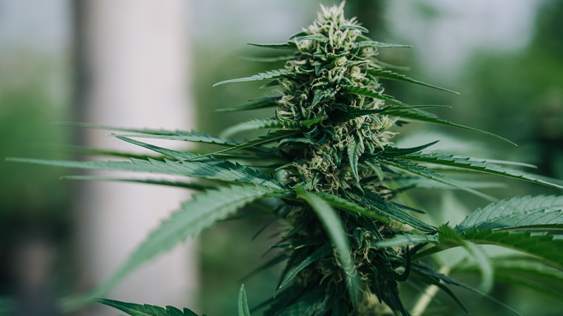
Acknowledgements
CEO, Thanisorn Bonsoong
Director of Innovation, Preet Marwaha
Professor Stephan Sturm
Professor Holly Ault
Professor Esther Boucher
Professor Numpon Insin
Professor Siripastr Jayanta
Professor Supawan Tantayanon
Notes:
Jake
Lastly we’d like to thank everyone who helped us during this project, especially our sponsor and liaisons, [names] for making this all possible. Finally, we appreciate all the support the WPI and Chula advisors have given us during this project. Thank you everyone!
We’d like to acknowledge all of the people who made this project happen and supported us along the way. From WPI, we’d like to thank Professors Stephan Sturm, Holly Ault, and Esther Boucher.
From Chulalongkorn University, thank you to Professor Numpon Insin, Siripastr Jayanta and Supawan Tantayanon. Our sponsor, Eastern Spectrum Group, has been very helpful through this whole process, especially Thanisoorn Bonsoong, the CEO, and the Director of Innovation, Preet Marwaha. Lastly, we’d like to thank everyone else we interviewed, especially all of the farmers who were kind enough to talk to us.

Slide 20
Thank You!
Notes:
At this time we’d like to open up the floor to any questions

