Slide 1
R.A.I.N. S.T.O.R.M
Rooftop Assembly Inchworm Network & Swarm Tiling Optimization for Roof Maintenance
Eli Benevedes, Dominic Ferro, Sam Gould, Filip Kernan
Advisors:
Prof. Carlo Pinciroli (RBE,CS,FPE), Prof. Greg Lewin (RBE, ME), and Prof. Markus Nemitz (RBE, ECE, ME)
Notes:
This PowerPoint Template includes a series of slide masters with predefined layouts and color schemes for formatting slides
Slide Masters are displayed when you right click on a slide and select Layout from menu

Slide 2
Team members
Eli Benevedes
Robotics Engineering and Computer Science
Dominic Ferro
Robotics Engineering
Sam Gould
Computer Science
Filip Kernan
Robotics Engineering and Computer Science

Slide 3
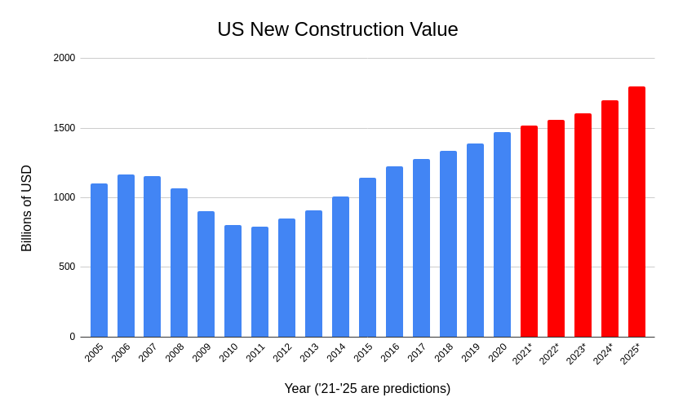
Background
Construction was 4% of the US GDP
Construction accounted for 20% of workplace fatalities
Roofing is especially dangerous
Automation isn’t heavily used (yet)
B. E. Sawe, “The biggest industries in the United States,” WorldAtlas, 01-Aug-2017. [Online]. Available: https://www.worldatlas.com/articles/which-are-the-biggest-industries-in-the-united-states.html.
“Number and rate of fatal work injuries, by industry sector.” https://www.bls.gov/charts/census-of-fatal-occupational-injuries/number-and-rate-of-fatal-work-injuries-by-industry.htm (accessed Sep. 20, 2021).
T. K. Fredericks, O. Abudayyeh, S. D. Choi, M. Wiersma, and M. Charles, “Occupational Injuries and Fatalities in the Roofing Contracting Industry,” J. Constr. Eng. Manag., vol. 131, no. 11, pp. 1233–1240, Nov. 2005, doi: 10.1061/(ASCE)0733-9364(2005)131:11(1233).
“Labor Productivity for Selected Construction Industries.” https://www.bls.gov/lpc/construction.htm (accessed Sep. 15, 2021).
Notes:
Eli
Construction is a critical industry for every country, as it supports almost every other industry. In 2011, 4% of the US’s GDP came from the construction industry. Since 2011, there has been steady growth, and this growth is expected to continue. Even though construction workers only make up 5% of the US workforce, construction workplace deaths accounted for 20% of all workplace deaths in 2019. Within construction, the roofing industry is especially dangerous. Injuries are almost entirely from falling, and injuries sustained are either fatal or cause long term problems.
Even though this industry is large and puts its workers at risk, automation within the industry hasn’t seen much growth yet. Other industries have seen increases in productivity over the last few decades, but construction has not. Automated construction will help the industry grow faster, and will keep its workers safer.

Slide 4
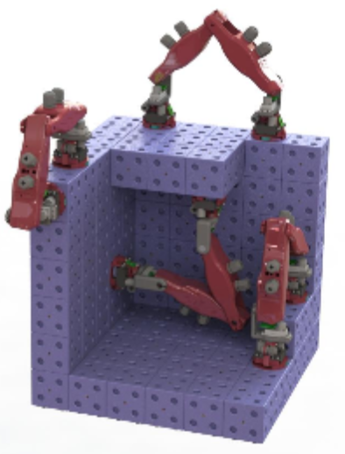
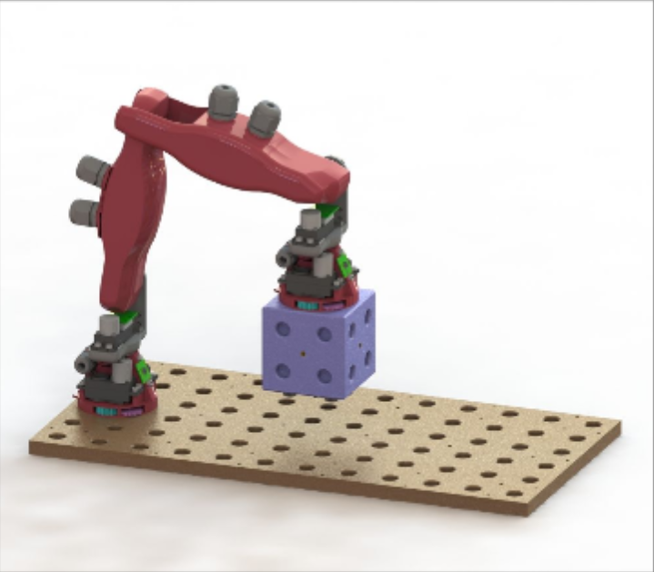
SMAC: Symbiotic Multi-Agent Construction
Inchworm robot swarm for 3D construction
Design allowed for movement around convex and concave corners
Structures built out of smart blocks
Caleb Wagner, Neel Dhanaraj, Trevor Rizzo, Josue Contreras, Hannan Liang, Gregory Lewin, Carlo Pinciroli. SMAC: Symbiotic Multi-Agent Construction. IEEE Robotics and Automation Letters with ICRA 2021 option, volume 6, number 2, pages 3200-3207. IEEE press.
Notes:
Sam
More info here!!!! (look at PDR)
mention that is a previous WPI MQP

Slide 5
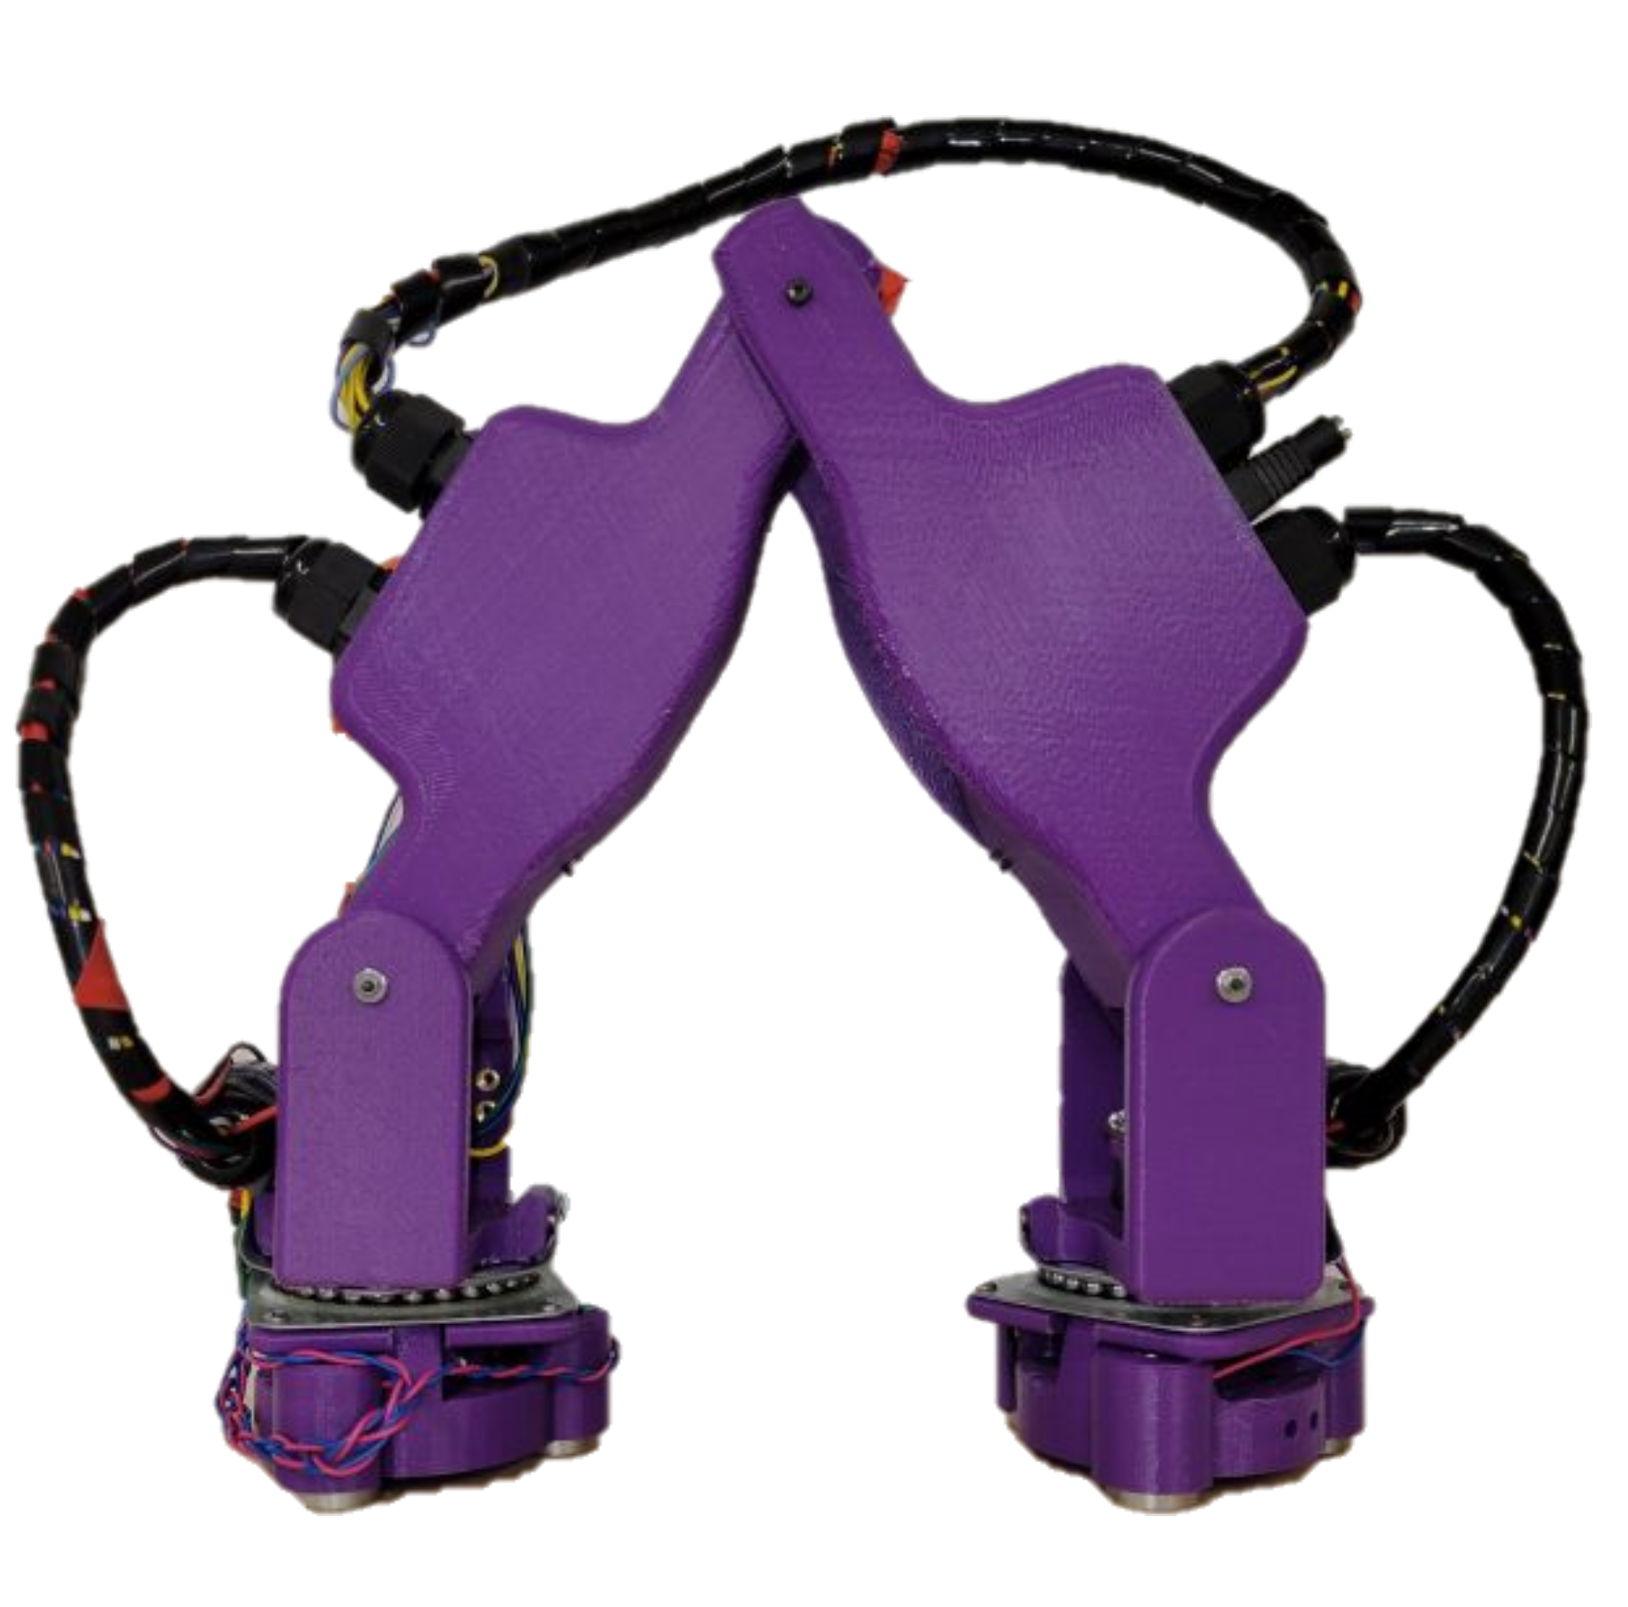
Our work
Applied swarm robotics to roofing
Adapted existing hardware to new application
Simulated swarm behaviors to demonstrate shingling a roof
C. Collins, J. Contreras, N. Dhanaraj, H. Liang, T. Rizzo, and C. Wagner, “Swarm Construction: A Method in Multi-Agent Robotic Assembly,” Worcester Polytechnic Institute. Accessed: Sep. 15, 2021. [Online]. Available: https://digital.wpi.edu/pdfviewer/ns0648746
Notes:
Sam
More info here!!!! (look at PDR)

Slide 6
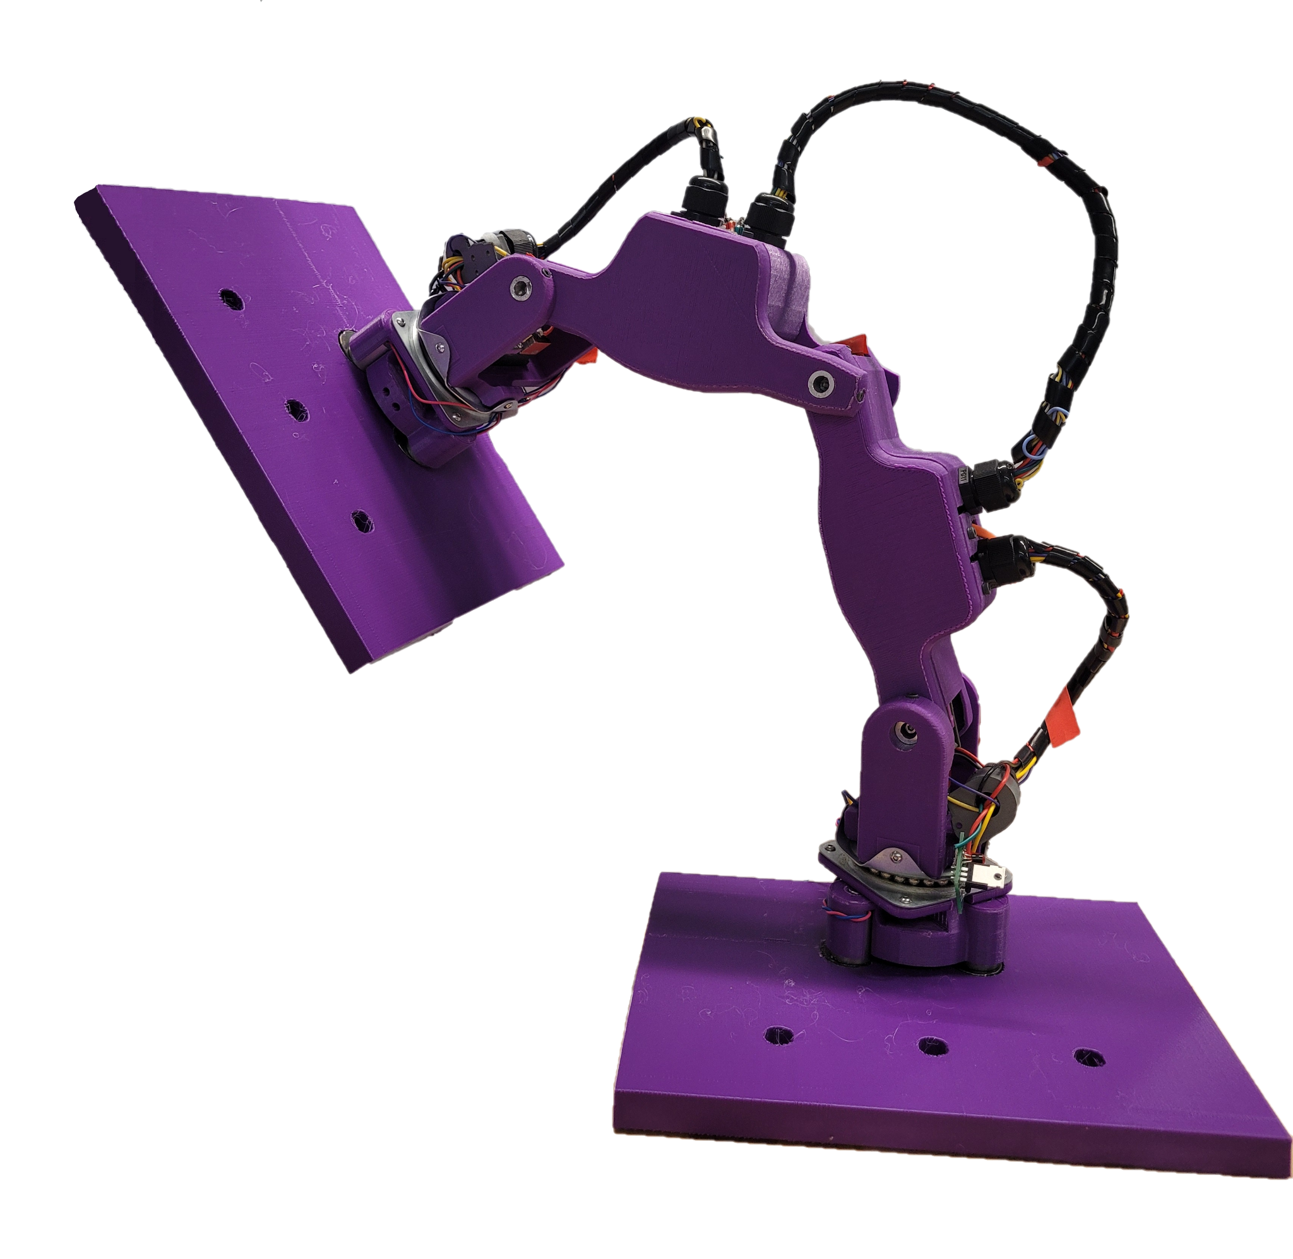
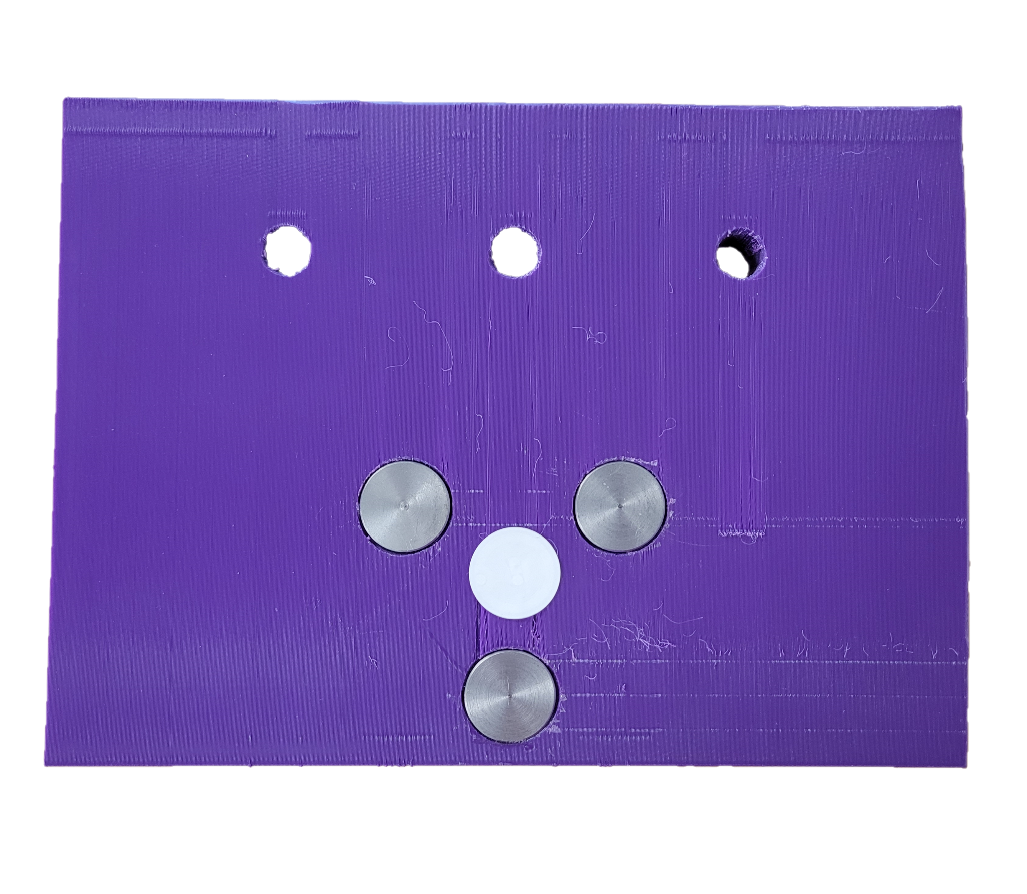
Design overview
5 DOF serial arm
Microcontroller that communicates with a control stack
Magnetic interface using permanent electromagnets
Shingle
Metal pieces on top to interface with
Notes:
Dom
5 dof serial arm with a non-fixed base
each of the links holds the electronics inside including a teensy that communicates with the control stack at
base station
We used permanent electromagnets that are passively on, and turn off with a current, in order to decreases current draw and overheating
as discussed by sam we are using this robot to manipulate roof shingles, the shingles we are moving have been designed in conjunction with a civil, architectural and environmental MQP

Slide 7
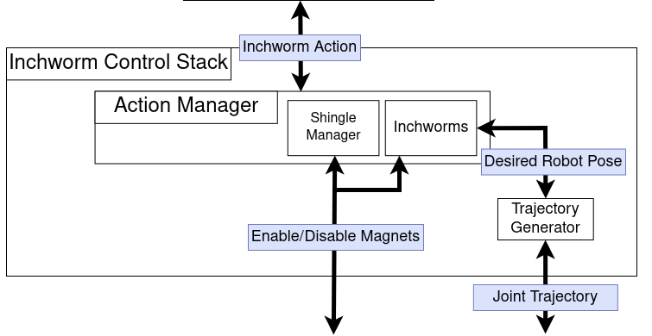
Block Diagram
Notes:
Sam
Inchworm Control Stack
talk about inchworm action -> move, pick, place

Slide 8
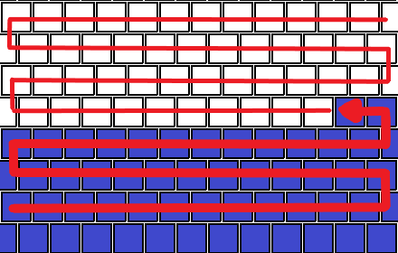
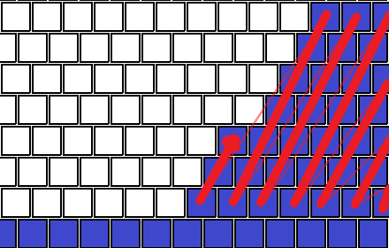
Swarm Behavior Simulator
High level simulator
Relatively computationally inexpensive
Easy to visualize
Distributed System
Each inchworm makes its own decisions
Inchworms communicate through shingles
Notes:
Filip
In order to facilitate efficient iteration of the swarm behaviors, we developed a high level simulator that is less computelialy expensive than the inchworm control stack and easy to visualize. The algorithm that runs on the swarm behavior simulator is distributed, so that each inchworm makes its own decisions based on it’s information. Inchworms store a version of the roof map, and communicate with the shingles to learn about the environment. The simulator supports several pattern, that you can see on the right.
– need to talk about the different patterns
– each inchworm is making its own decisions

Slide 9
Swarm Behavior Simulator
x16 Speed
Notes:
Dom
LEGEND

Slide 10
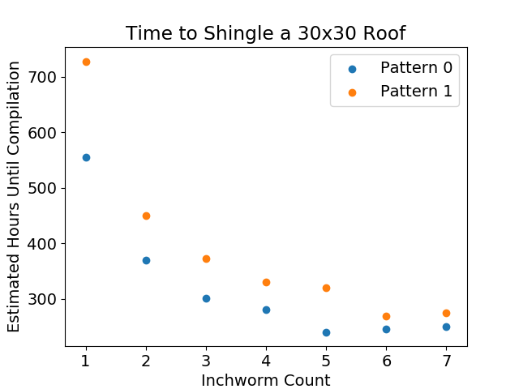
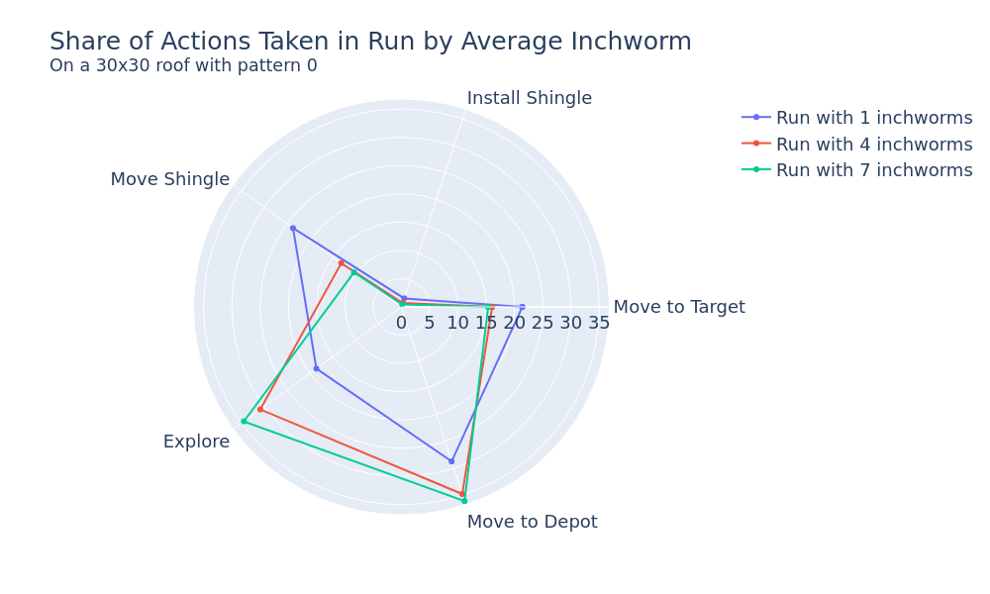
Swarm Behavior Analysis
Notes:
Filip
To analyse the efficiency of our swarm behavior and different shingling patterns we collected some data from our swarm behavior simulator. As you can see in the graph on the left, all patterns benefit from an increase in the number of inchworms present in the swarm, with efficiently decreasing as the roof crowded. To determine the distribution of the actions taken by inchworms, we recorded and averaged the actions taken by the inchworms. As you can see, as the number of inchworms in the swarm increases, the amount of time that inchworms spend exploring and moving to targets increases, while the amount of time inchworms spend moving shingles decreases

Slide 11
Inchworm Control Stack
~120x Speed
Notes:
Eli
The inchworm control stack is dual purpose. First, it can run simulations in the Gazebo physics simulator. The simulator supports magnets interfacing, which allows both robots and shingles to attach and detach from the roof. The video playing is a single robot shingling a 5x5 roof. The robot in this clip is not smart; it is replaying the set of actions needed to shingle a roof. The code to run this simulated robot is the same code that commands the real robot to move around. It took about 45 simulation minutes for this single robot to shingle the entire roof.

Slide 12
Integration
~360x Speed
Notes:
Dom

Slide 13
Embedded software
Arduino embedded C++ code
PID control for motors
ros_serial library
ROS node commands the robot through ROS topics
Inchworm control stack publishes targets
Embedded publishes current robot states
Embedded code reports debug and fault statements for monitoring
Notes:
Sam
More info? Needs some sort of image, feels bare-bones

Slide 14
Hardware

Slide 15
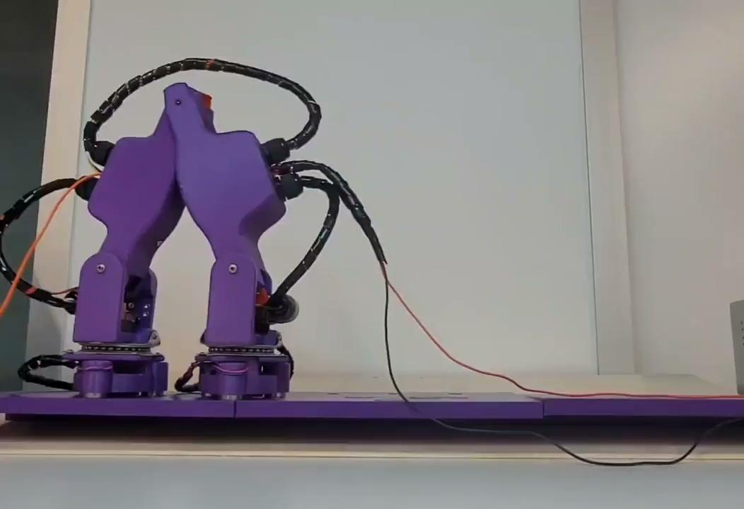
Hardware Demo
2x Speed
Notes:
Dom
here is a video of the robot walking,

Slide 16
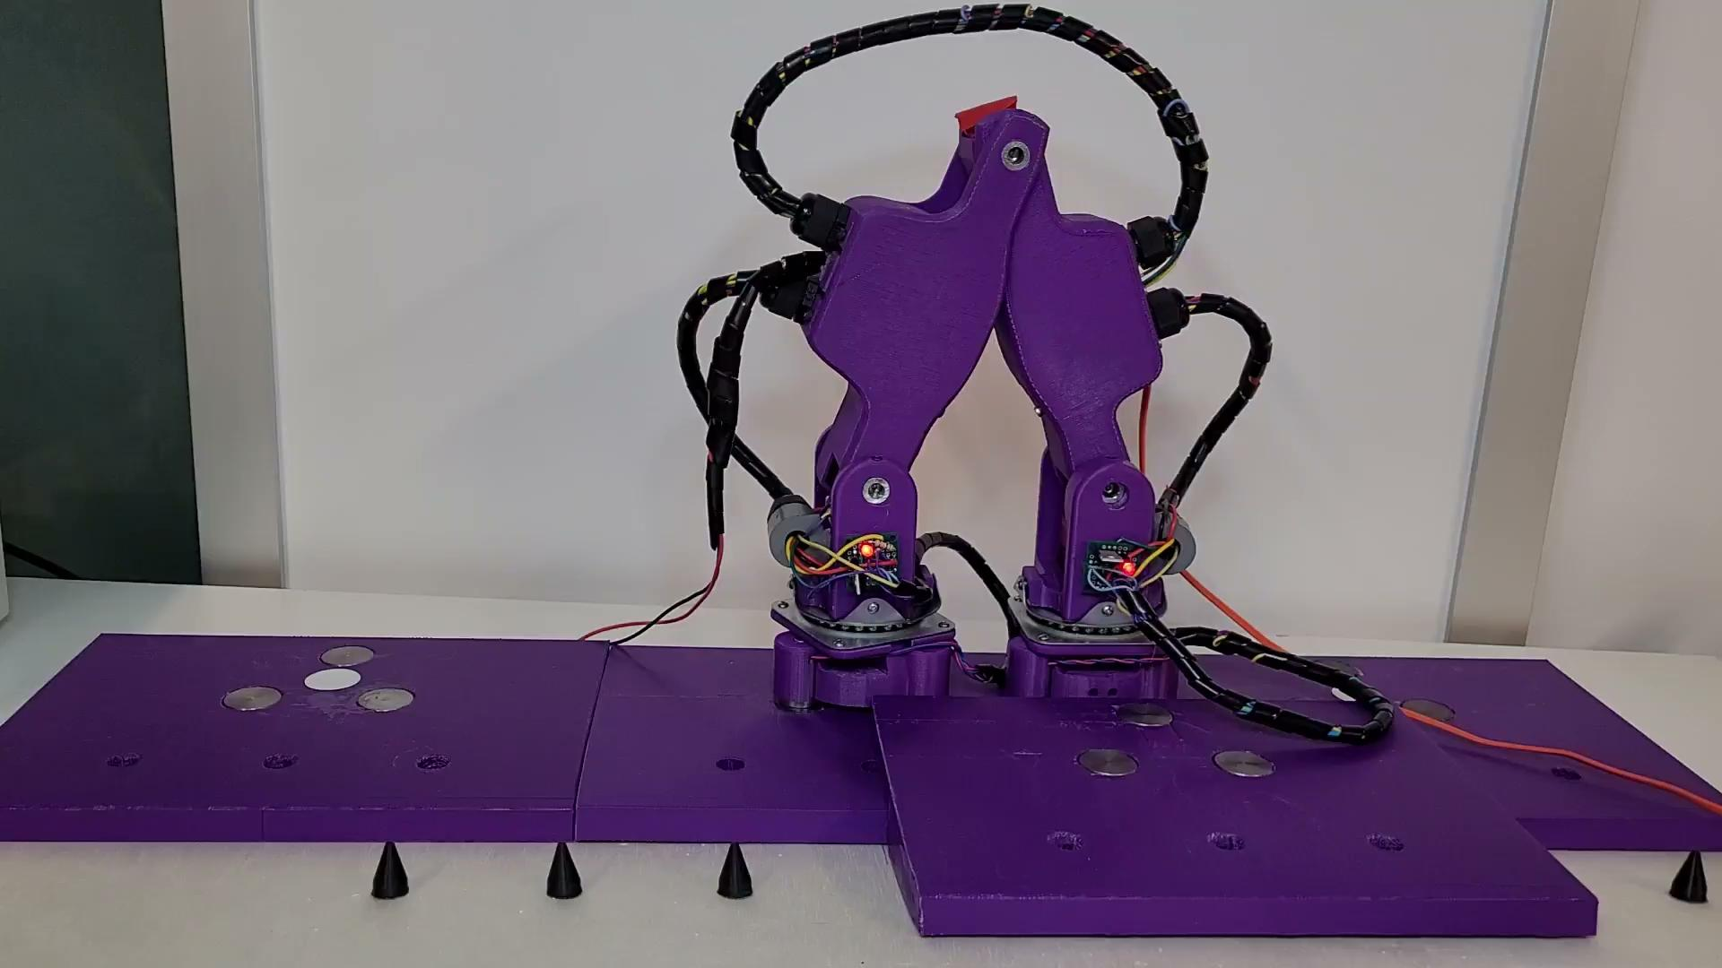
Hardware Demo
Notes:
Dom
here we can see the robot moving a shingle
the video shows a good angle on the magnet circuit and the LED that shows the magnet status
the magnet is on when the LED is on when it hovers over the shingle position it turns off
last two movements are the atomic movements to shingle the roof

Slide 17
Conclusion
Created algorithms to shingle a roof
Demonstrated the swarm can shingle a roof in multiple patterns
Simulated the physics of the robot and showed multi-robot collaboration
Demonstrated a swarm of robots physically shingling a roof
Successful integration of robot hardware
Demonstrated the robot could interact with the shingle as designed
Notes:
Sam

Slide 18
Questions?
Thank you to:
Advisors: Carlo Pinciroli, Gregory Lewin, Markus Nemitz
Machine shop: Professor Bergstrom and James Mitchell
Software: Jonathan Bohren, Honeybee Robotics
Shingle: Kimberly Coudrey, William Crist, Hannah Hirsch

Slide 19
Future Work
NFC
Implement NFC communication with RFID tags on shingles
Better modeling and tuning
Modeling robot dynamics would allow for better trajectory generation
More data logging, more realism in the models
Installing shingle on roof
Out of scope of project
Replace motors
Motors used in the robot are discontinued
The motors are heavily modified, an off-the-shelf solution would be better
Notes:
Filip - add stuff on algo

Slide 20
Robot
Notes:
Dom
Magnets are a versatile interface between the inchworm and the shingles
need to be able to be turned on and off- so an electromagnet was required, but to avoid overheating, since they need to have a magnetic charge most of the time,
we used permanent electromagnets that are passively on, and turn off with a current, this decreases current draw and overheating
NFC antenna allows for communication between the robot and the shingles
Limit switch confirms that the robot is holding or standing on a shingle

Slide 22
Swarm Behavior Analysis
GRAPHS!!!!!!!!!!!!!!!!!!!!!!!!!
Notes:
Filip

