Slide 1
Exploring Flexible
Infrastructure Opportunities
Eric Arthur, Robert Farrell, Chris Hagerman, Roger Rueda

Slide 2
1
Problems and Objectives
Approach to Data Collection
and Analysis
2
3
Findings and Conclusions
Notes:
Eric

Slide 3
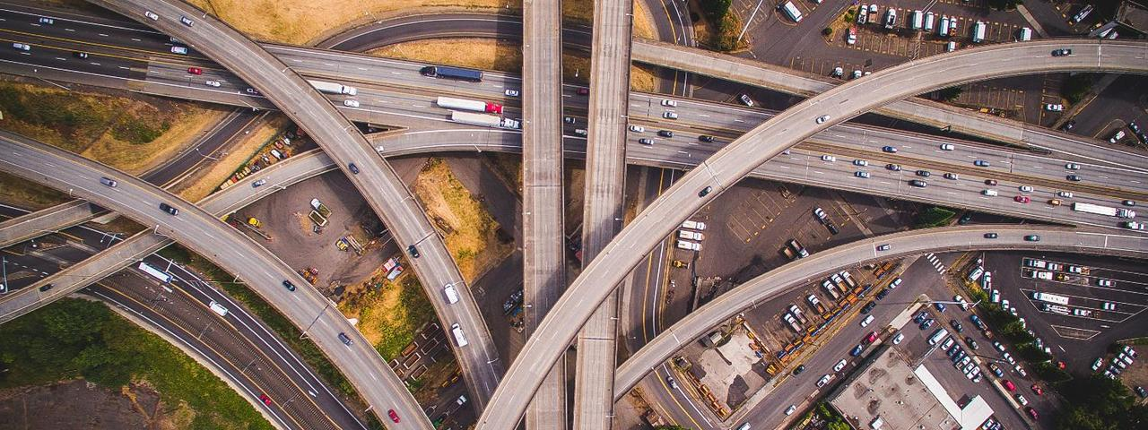
Infrastructure supports societal and economic growth
Notes:
Eric
Prior to discussing flexible infrastructure we will examine the state of current infrastructure. What is infrastructure? Infrastructure is defined as a public work that enables society to prosper. Infrastructure is built to serve one purpose such as transport or energy. Classic examples of infrastructure include roads, energy supply and water supply. Roads support societal and economic growth by allowing for transport of economic goods but also allowing for people to travel to social events. Infrastructure also has a strong interconnection where the effects of one infrastructure can be seen in another as shown in the graph. Increased amount of pavement in urban areas causes the temperature to increase because more heat is captured increasing the amount of A.C. required which directly increase the demand on energy infrastructure. This interconnection between infrastructure causes problems but can also be used as a benefit as shown later.

Slide 4
American infrastructure failing to meet needs
Notes:
Chris

Slide 5
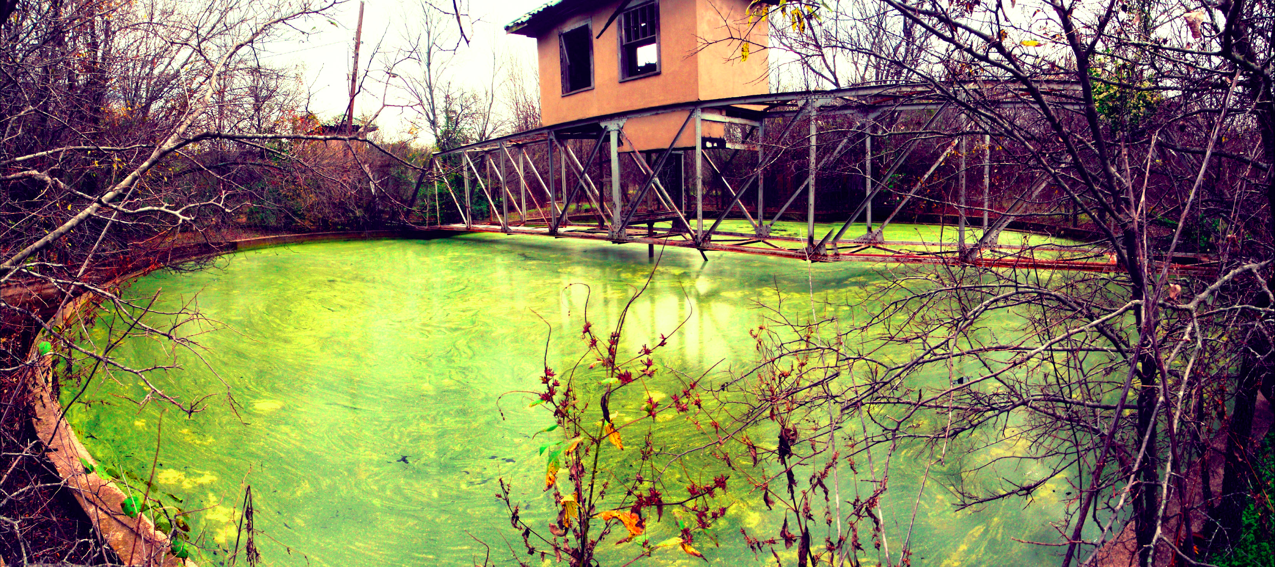
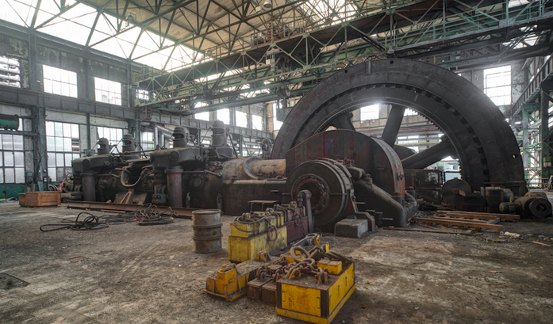
Infrastructure can become obsolete due to unforeseen changes
Notes:
Chris

Slide 6
Department of Energy exploring efficient solutions
Notes:
Robert
Acts implored doe to explore more flexible and efficient energy infrastructure

Slide 7
Characteristics of flexibility
Multi-Purpose
Responsive to Changing Demands Over Time
Transportable
Flexibility
Notes:
In our project we characterize flexibility in different ways which represent how they serve a purpose. The three major definitions of flexibility we researched were: multipurpose, responsive to changing demands over time, and whether they can be transported or adaptable in location.

Slide 8
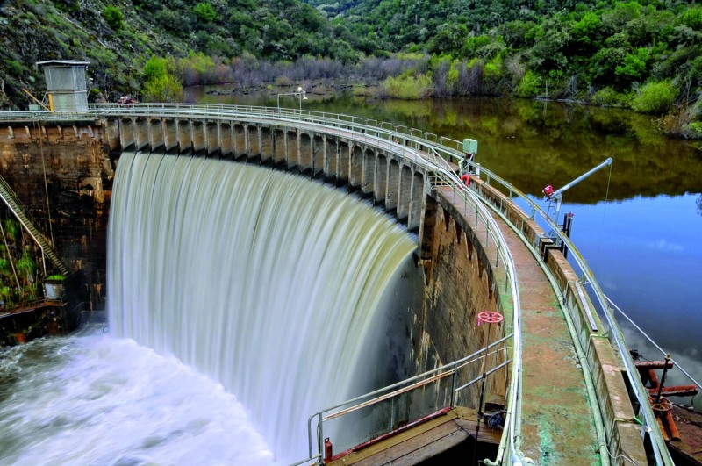
Dams are an example of multi-purpose infrastructure
Notes:
Dams are an example of multi-purpose infrastructure, since they have the ability to serve a range of purposes. Dams typically stabilize water flow, but may also function by generating hydroelectric power, preventing floods, irrigation for agriculture, or even recreational uses.

Slide 9
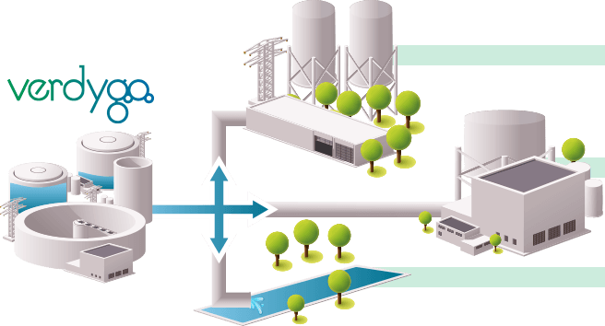
Flexible water treatment plants can adapt
to changing demands over time
Notes:
Eric

Slide 10
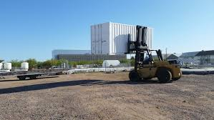
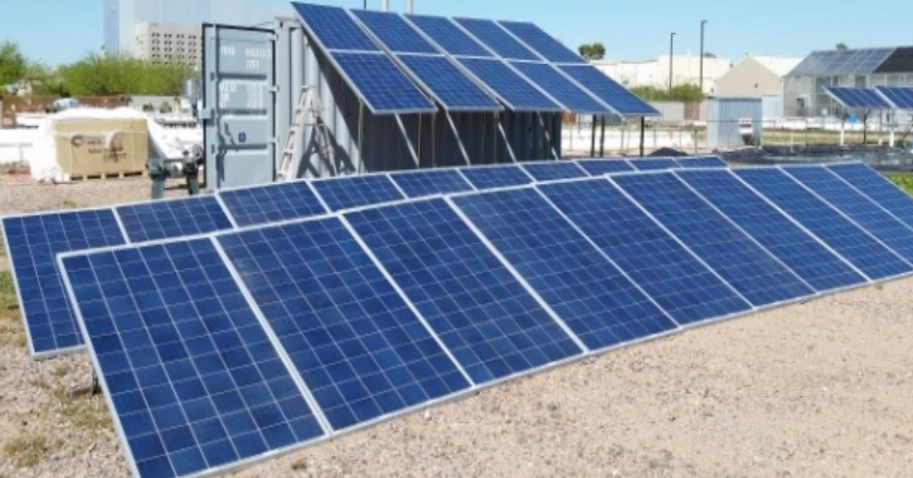
Transportable microgrids adapt to location of demand
Notes:
Chris

Slide 11
Objectives to accomplish our goal
Conduct a comparative analysis of the advantages and disadvantages of flexible infrastructure types and funding mechanisms
03
Clarify DOE’s interest and role in developing, promoting, and implementing flexible infrastructure
Explore opportunities for flexible infrastructure that can equip communities with the tools to adapt to a dynamic world
01
02
Develop profiles on the implementation of flexible infrastructure
Notes:
1-

Slide 12
Problems and Objectives
1
Approach to Data Collection
and Analysis
2
Findings and Conclusions
3
Notes:
Our second segment is where we show our approach to data collection and analysis

Slide 13
Clarification of DOE’s interest in flexible infrastructure
Brainstorm
Flexible Infrastructure aspects
Literature Review
Obj. 1

Slide 14
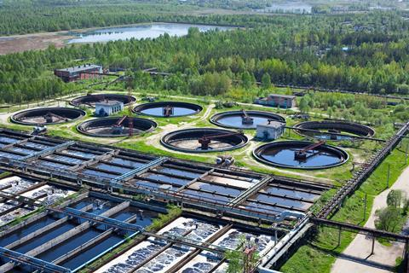
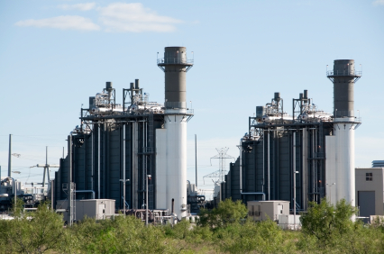
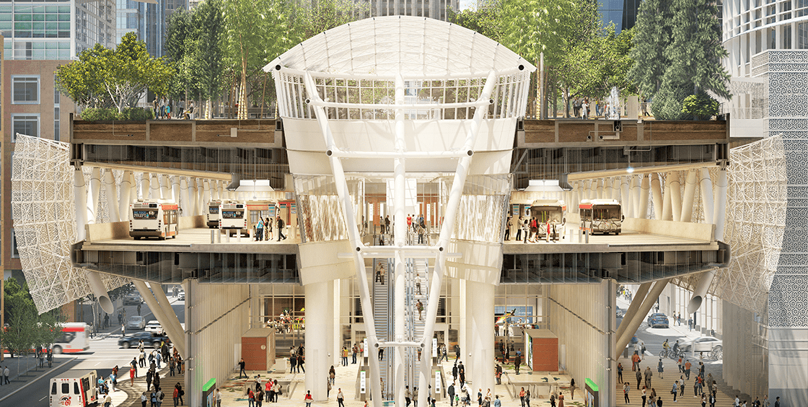
Flexible infrastructure assets are grouped by purpose
Water
Energy
Transportation
Obj. 2
Notes:
https://www.google.com/search?q=water+treatment+plant&source=lnms&tbm=isch&sa=X&ved=0ahUKEwjL8aOqlMjeAhXPxFkKHfJOBPsQ_AUIFCgC&biw=1536&bih=754#imgrc=4VngpJoXreI3CM:
Chris

Slide 15
Flexible infrastructure assets are grouped by purpose
Transportation
Energy
Water
Hydroelectric Dam
Flexible Water Treatment Plant (Verdygo)
Permeable Surfaces
Green Roofing
Permanent Microgrid
Transportable Microgrid
Flex Transformer
CHP with District Heating
Smart Pavement (Integrated Highways)
Self-Adaptive Traffic Light
Transit Green Building
Obj. 2
Notes:
https://www.google.com/search?q=water+treatment+plant&source=lnms&tbm=isch&sa=X&ved=0ahUKEwjL8aOqlMjeAhXPxFkKHfJOBPsQ_AUIFCgC&biw=1536&bih=754#imgrc=4VngpJoXreI3CM:
Chris

Slide 16
Criteria are universal characteristics of infrastructure
Flexibility
Multi-Purpose
Transportable
Responsive to Changing Demands Over Time
Infrastructure Assets
Obj. 2
Notes:
Eric change to chart? Or like dots on 18?

Slide 17
Criteria are universal characteristics of infrastructure
Stakeholders
Benefits
Infrastructure Assets
Property Owners
Public Community
Environment
Social
Environmental
Economic
Obj. 2
Notes:
Eric

Slide 18
Criteria are universal characteristics of infrastructure
Market
Market Size
Type of Market
Initial Cost
Payback Period
Ownership
Infrastructure Assets
X amount installed
Market valued at $
Existing
X-Y Years
Direct
No current market
Emerging
$XXX
Indirect
Obj. 2
Notes:
Eric dots Like this???

Slide 19
Sources to fill out matrix
Market
Benefits
Risks
Obj. 2
Notes:
Robert

Slide 20
Important criteria in choosing profiles
Size of Market
Ownership
Degree of Flexibility
Incentives
Benefits
Stakeholders
Obj. 3
Notes:
Eric

Slide 21
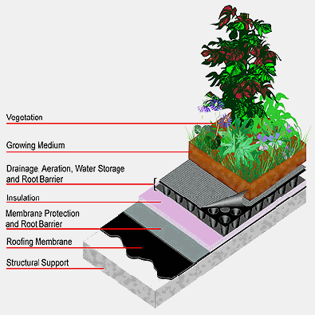
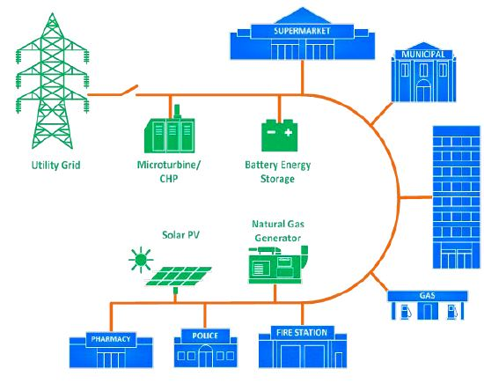
Profiles reveal importance of criteria
Green Roofs
Microgrids
Smart Traffic Systems
Obj. 3
Notes:
http://www.greasecontrol.com/img31.gif

Slide 22
1
Problems and Objectives
2
Approach to Data Collection
and Analysis
3
Findings and Conclusions
Notes:
Chris

Slide 23
Matrix allows for comparative analysis
Notes:
Edit text down

Slide 24
Patterns from the matrix
Direct ownership has a higher rate of installation compared to indirect ownership
Multi-purpose flexibility valued more than adaptability over time
Incentivised infrastructures see more development
Notes:
Roger slides 7-11, 26-28
Chris is 1-6, 22-25
Robert 12-19,
Eric 19-21,29-31

Slide 25
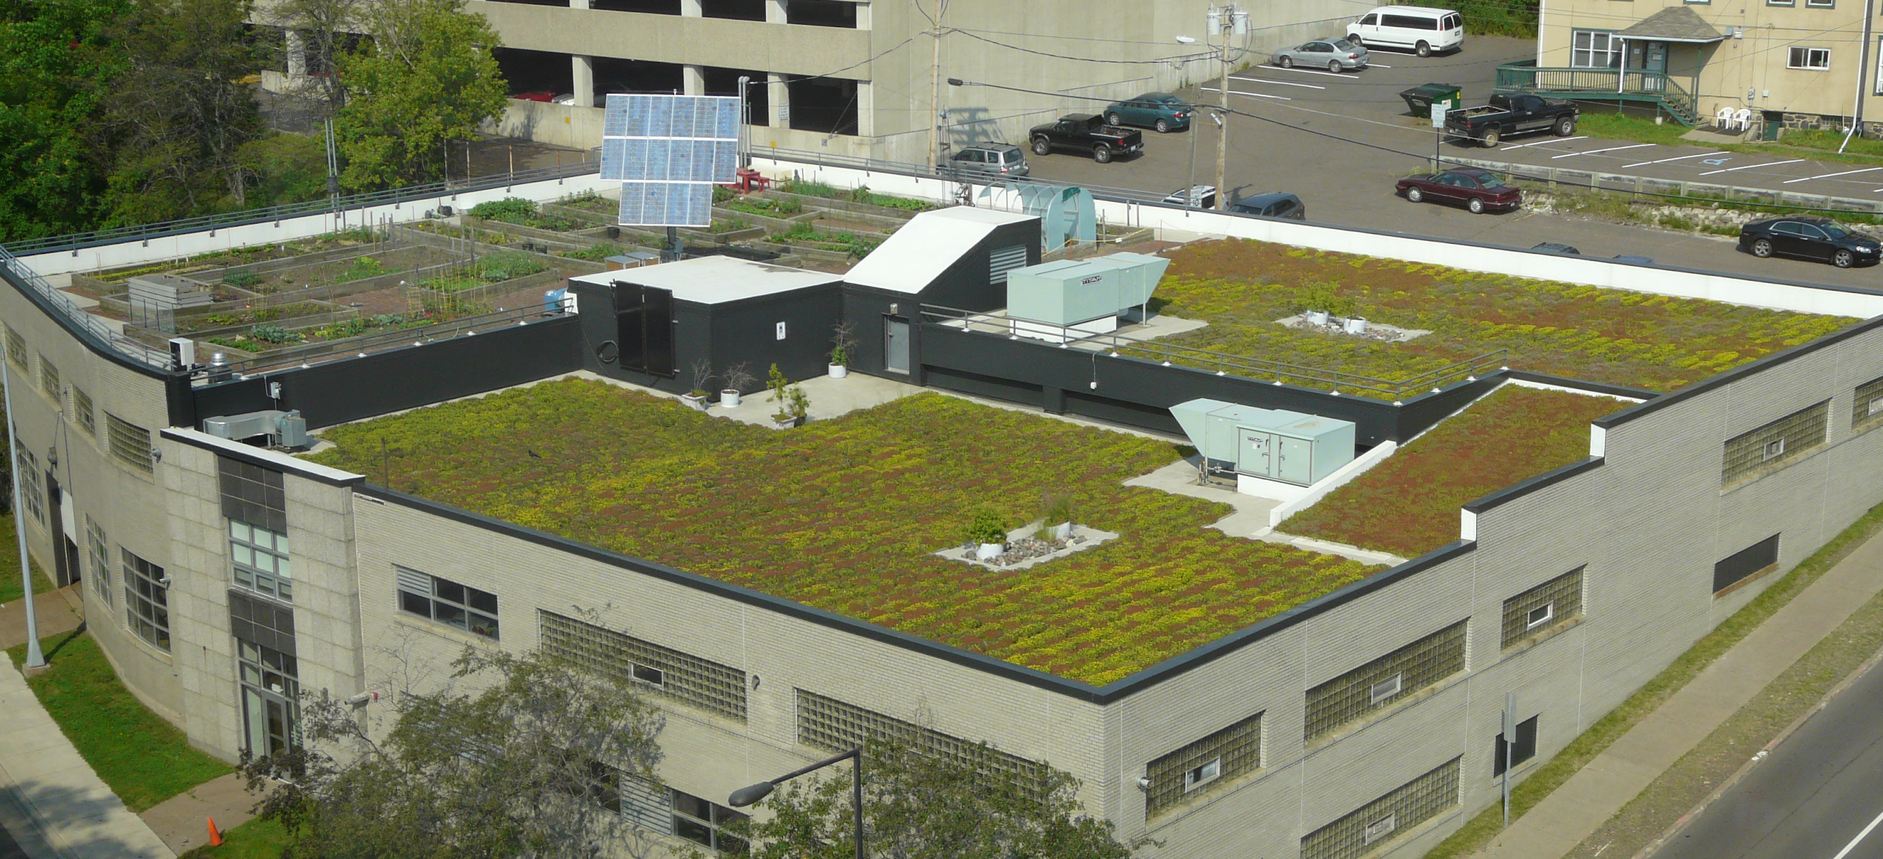
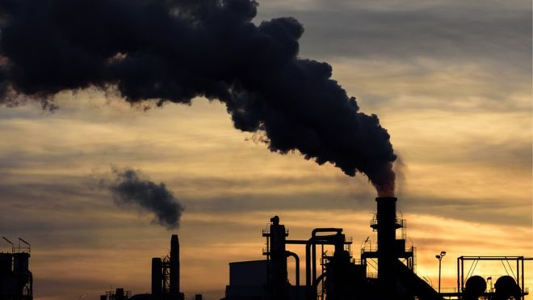
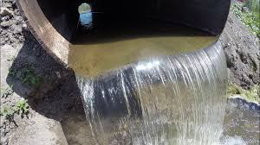
Incentives spark widespread implementation of green roofs

Slide 26
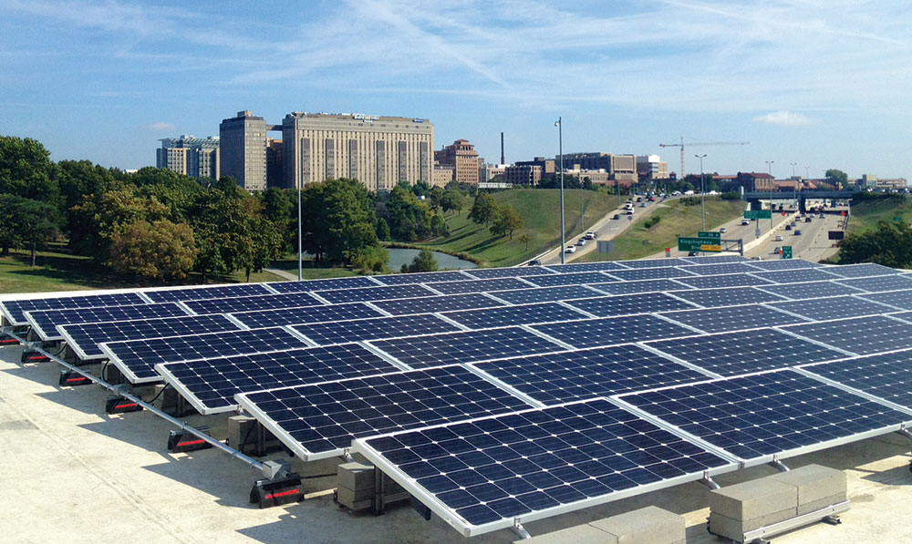
The value of microgrids varies based on location
Notes:
Mention electricity storage
Mention the complicated nature of implementing microgids

Slide 27
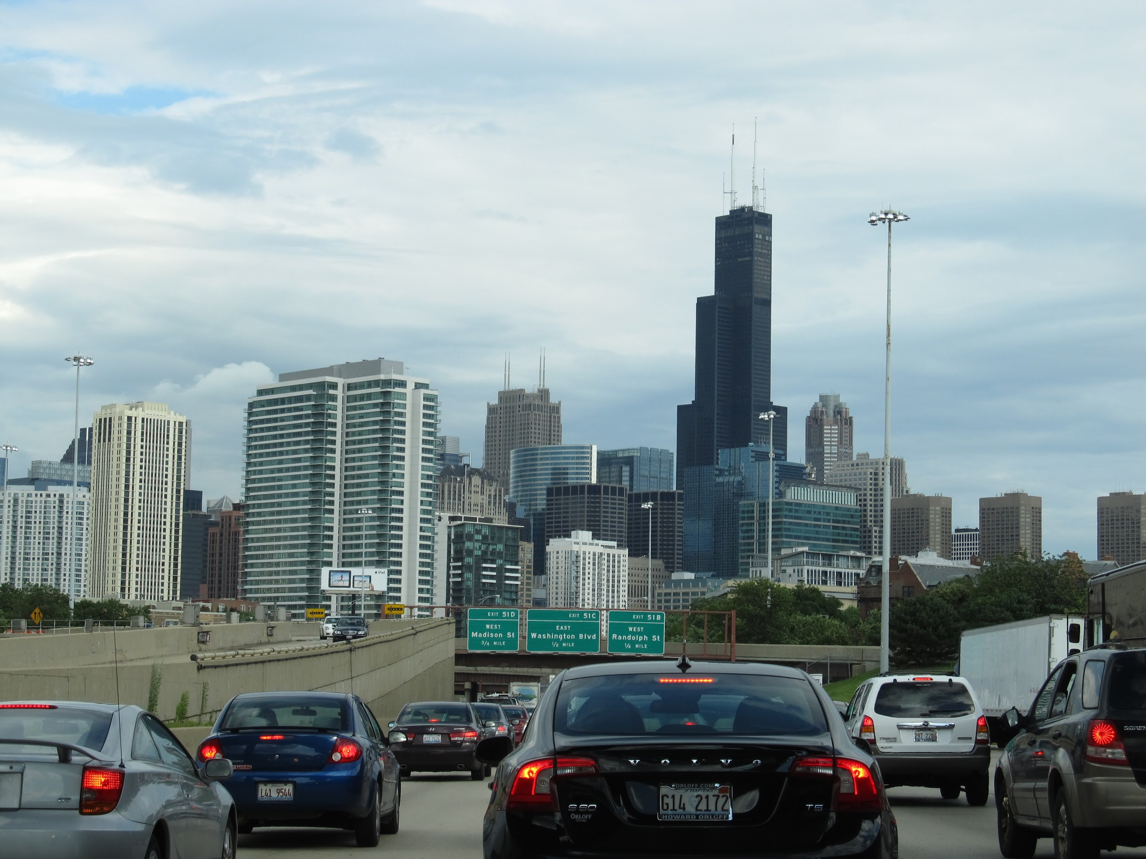
Smart traffic systems are adaptive
to public needs

Slide 28
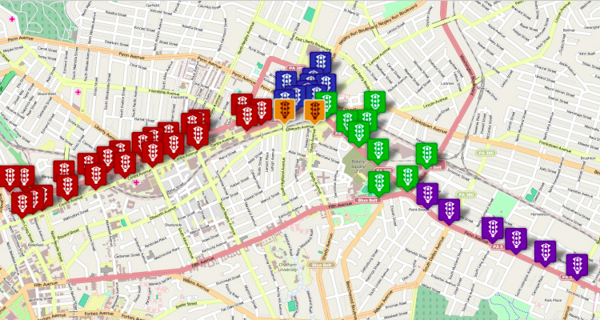
ICT is connecting infrastructures into a networked system

Slide 29
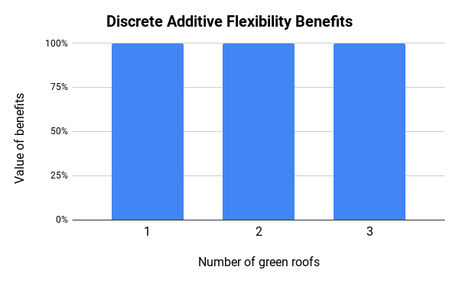
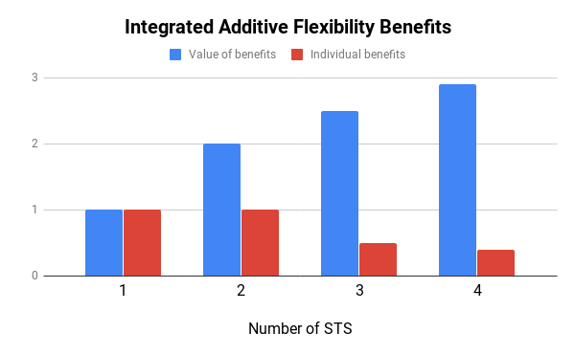
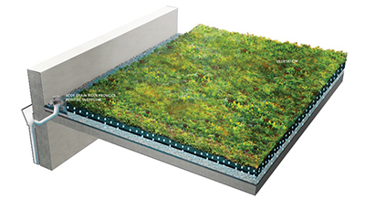
Integrated flexible infrastructures require more complex cost analysis

Slide 30
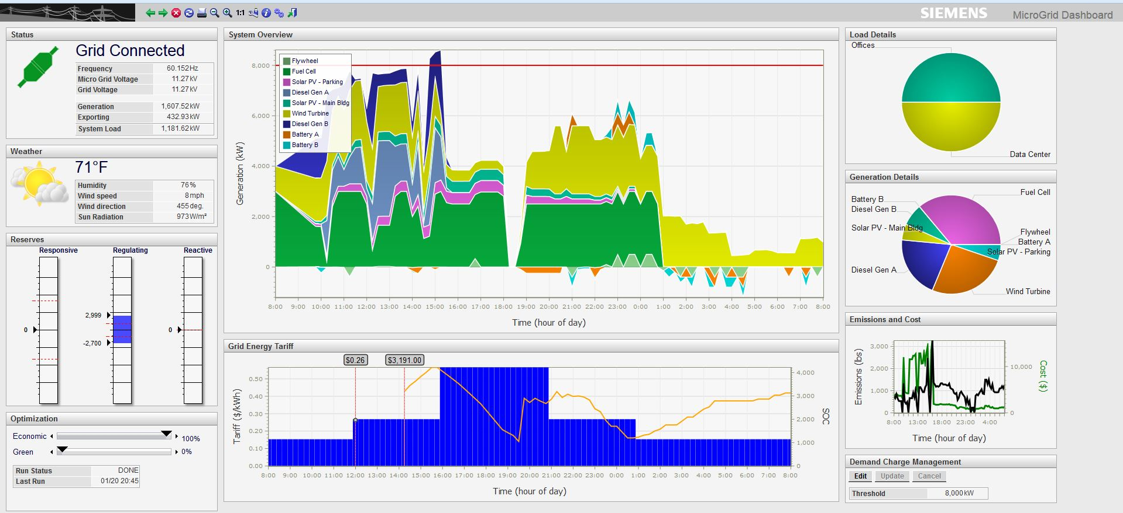
Specialized workforce required to maintain and operate integrated flexible infrastructures

Slide 31
Lack of information of assets inhibits development and analysis

Slide 32
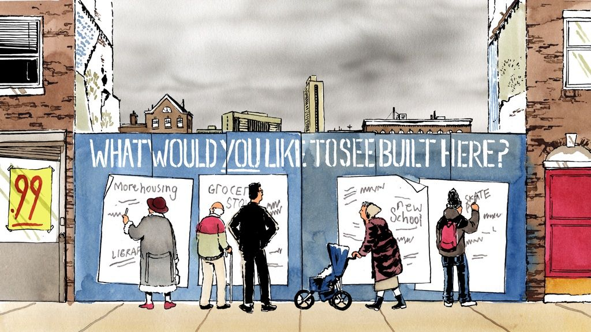
Recommendations to the DOE
Microgrid
CHP

Slide 33
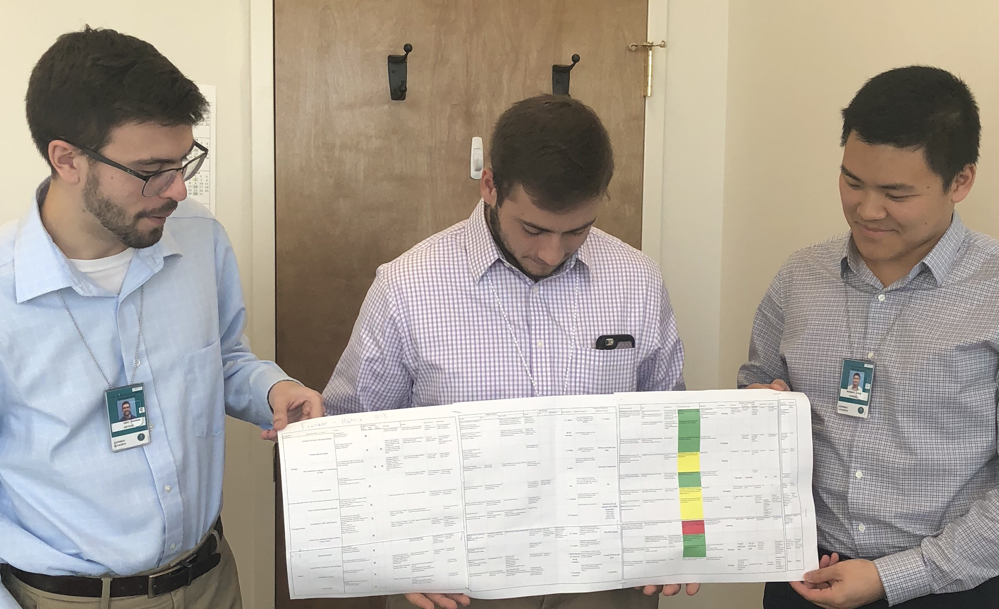
Thanks!
Notes:
No information
Evolving technology → hard to pinpoint research
Brainstorm → research → pattern → brainstorm
Not much on transportable infra.
Multipurpose vs. adaptable over time (not real time benefits)
Explore ways that transportability can provide
Relationship between GR and Solar

Slide 34
Photo References
Slide 3:
http://blog.mytmc.com/wp-content/uploads/2018/03/infrastructure-blog.png
Slide 4:
https://www.infrastructurereportcard.org/wp-content/uploads/2016/10/Grades-Chart.png
Slide 5:
https://external-preview.redd.it/gOIgwO404lvOtgD5m80XB5FgbVKwK_AUC0ZVPLfqQWY.jpg?auto=webp&s=b58226533b50c07f4fdcdf4fa22bb5d2765ffd08
http://s15858.pcdn.co/wp-content/uploads/sites/default/files/images/Main.png
Slide 6: webster.house.gov/_cache/files/1/8/18a7050a-67ac-488a-afec-f71b4ddd7536/54A1B9B49344DCF1FA3300CBAA50AF1A.americas-water-infrastructure-act-2-photogallery.png
bloximages.chicago2.vip.townnews.com/dcmilitary.com/content/tncms/assets/v3/editorial/0/b8/0b8feae5-e83c-55bd-8f41-0b9f711ee61b/57c979783b334.image.jpg
wikimedia.org/wikipedia/commons/thumb/e/e2/Seal_of_the_United_States_Department_of_Energy.svg/600px-Seal_of_the_United_States_Department_of_Energy.svg.png
Slide 8:
s3-us-west-1.amazonaws.com/assets.sanatcruzwaves.com/wp-content/uploads/2017/10/LowerRes_Couple-more-photos-by-producer-of-the-film-DamNation-Matt-Stoecker.-The-dam-is-the-San-Celemente-_unnamed-3-800x531.jpg
Slide 9:
www.verdygo.com/wp-content/uploads/2016/11/Schema_02.png
Slide 10:
http://faculty.engineering.asu.edu/nathanjohnson/wp-content/uploads/2014/11/container-picked-up-300x169.jpg
https://fullcircle.asu.edu/wp-content/uploads/2017/02/Micro-grid-test-bed1400x700-1280x640.jpg
Slide 13: d3qdvvkm3r2z1i.cloudfront.net/media/catalog/product/cache/1/image/1800x/6b9ffbf72458f4fd2d3cb995d92e8889/b/r/brainstorm_fullpic_artwork.jpg
Slide 14: s.yimg.com/ny/api/res/1.2/0_6rHkbV.TiwPJNg0pw0EA--~A/YXBwaWQ9aGlnaGxhbmRlcjtzbT0xO3c9ODAw/http://media.zenfs.com/en-US/homerun/motleyfool.com/df547eeb2bb253913949a411cf77470b
https://aceee.org/files/image/topics/chp2.jpg
https://lh3.googleusercontent.com/ZMGnUqvuHu5UgTAAVD67RPh3EhNBqTsK4JkIB7ZItT9XE1RaSAKHWrKhLAA1P6J13X2zVg=s170
Slide 21:
http://www.hohbach-lewin.com/sustainability/green-roofs/
https://www.montgomerycountymd.gov/DGS-OES/Resources/Images/Microgrids/MicrogridRockvilleCommunity.jpg
https://i0.wp.com/www.gtt.com/wp-content/uploads/howItWorks_trafficsensing_stopbar1.png
Slide 25:
https://www.denvergreenroof.org/wp-content/uploads/2016/12/GreenRoof-500x375.jpg
https://d2v9y0dukr6mq2.cloudfront.net/video/preview/sSSEAGK/storm-sewers-sewage-inside-the-pipe_hedbydf9g__SB_PM.mp4
Slide 26:
https://solarprofessional.com/sites/default/files/styles/article_gallery_active/public/articles/images/1_Microgrid_lead.jpg?itok=8LGLObNB
http://thermosystems.com/wp-content/uploads/2017/06/RAOTM-Meadowlands-HY-Microgrid_FINAL_5.19.17.pdf
Slide 27:
https://wtop.com/council-of-governments-rideshare/2018/11/visualizing-commute-times-in-the-u-s/slide/8/
Slide 28:
https://www.nextpittsburgh.com/wp-content/uploads/2014/12/Surtrac-750x400.jpg
Slide 29:
https://extremehowto.com/wp-content/uploads/2018/01/GreenRoof-WRT_PDA.jpg
https://cdn0.iconfinder.com/data/icons/essentials-volume-6/128/traffic-light-3-512.png
Slide 30:
https://jess814.files.wordpress.com/2010/11/cocoes.jpg?w=300&h=300
Slide 31:
https://news.usa.siemens.biz/press-release/siemens-introduces-companys-first-advanced-microgrid-management-software-control-distr
Slide 32:
https://nextcity.org/images/made/build_site_FINAL2_1024_577_80.jpg

Slide 35
Slide 19 Logo Urls
https://upload.wikimedia.org/wikipedia/commons/thumb/1/14/Environmental_Protection_Agency_logo.svg/606px-Environmental_Protection_Agency_logo.svg.png
https://static-content.springer.com/cover/journal/13753/9/3.jpg
upload.wikimedia.org/wikipedia/commons/thumb/8/8e/IHS_Markit_logo.svg/512px-IHS_Markit_logo.svg.png
https://upload.wikimedia.org/wikipedia/commons/thumb/2/2b/ASCE_logo.svg/250px-ASCE_logo.svg.png
https://upload.wikimedia.org/wikipedia/commons/thumb/a/af/Seal_of_the_United_States_Department_of_Transportation.svg/175px-Seal_of_the_United_States_Department_of_Transportation.svg.png
s3-us-west-2.amazonaws.com/lndr-landorcom-assets-prd/app/uploads/2016/05/03201013/SP-masterbrand.png
https://s3.amazonaws.com/awsemailuploads/uploads/nrel.gif

