Slide 1
Brought to you by:
Batteries and Capacitors
And How They Work!

Slide 2
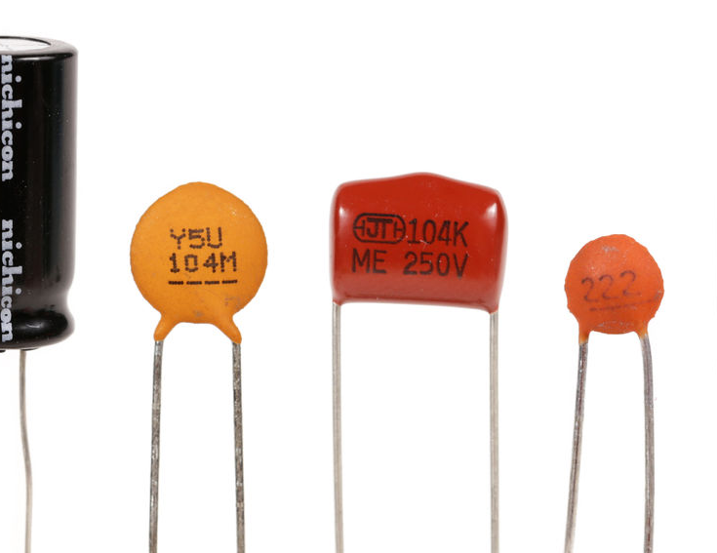
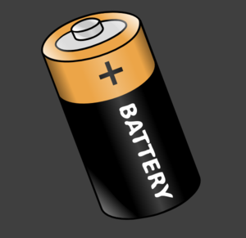
Overview
In this lesson, students begin to develop an understanding of how batteries and capacitors work by acting out the components of electrical circuits with a disposable battery. The concept is difficult to grasp by simply looking at diagrams, and the kinesthetic process of acting out the parts of the circuit will strengthen students’ understanding.
Capacitors
Battery

Slide 3
Students should be able to:
Understand the main components of batteries
Explain the difference between a battery and a capacitor
Objectives

Slide 4
Batteries

Slide 5
Warm-up Question:
What are some objects that require batteries that you use?

Slide 6
Battery Basics
A battery uses chemistry, not mechanical movement, to create a continuous flow of electricity.

Slide 7
3 Key Components
Positive electrode/terminal
- accepts electrons from circuit
Negative electrode/terminal
- releases electrons into circuit
Electrolyte
- separates positive and negative
electrodes
Electrolyte
+
Positive Electrode
-
Negative Electrode

Slide 8
The Electric Circuit
-
+
When the circuit is closed, chemical reactions begin within the battery to produce ions and electrons.
Electrons travel around the outer circuit from positive to negative
Ions travel within the battery towards the positive electrode
Electrons
-
+
+
-
+
Positive Electrode
-
Ions
-
Negative Electrode

Slide 9
Capacitors

Slide 10
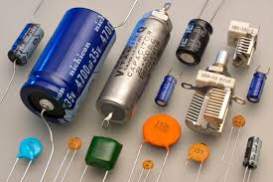
Capacitor Basics
Capacitors are another way we store energy.
Capacitors store energy electrically instead of chemically.

Slide 11
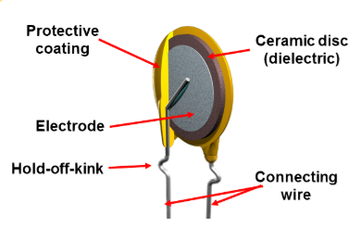
Capacitor Basics
They are created by 2 metal plates separated by an insulation called a dielectric.

Slide 12
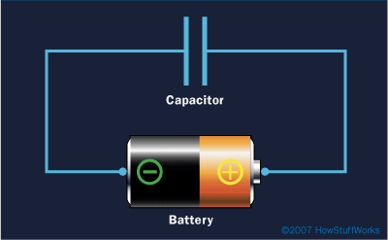
How Capacitors Work
The plate on the capacitor that attaches to the negative terminal of the battery accepts electrons the battery produces.
The charges get “stuck” on the plate because they can’t travel through the dielectric, giving that plate a strong negative charge.
The plate on the capacitor attached to the positive terminal loses electrons to the battery, causing a strong positive charge.
When it’s charged, the capacitor has the same voltage as the battery.

Slide 13
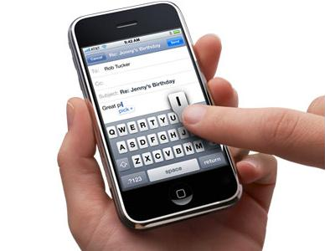
Capacitor Uses
To store charge for high-speed use, like the flash in a camera
Touch Screens – a built-in electrode pattern charges the screen so when touched, a current is drawn to the finger and creates a voltage drop

Slide 14
Resources

Slide 15
Lab Procedure

Slide 16
There are 2 parts to this lab:
Simple Electric Circuit
Electric Circuit with Battery Components and Light Bulb
The lab will get more advanced with the introduction of each new topic

Slide 17
Materials
Each group needs:
1 object (such as a pencil, eraser, or ball) for each participant (preferably the same) with 6 extras
Space to form a group circle
2 baskets or containers to hold the extra objects
Optional Materials:
Labeled signs worn by participants: “Battery,” “Negative Electrode,” “Positive Electrode,” “Electrolyte,” “Light Bulb,” and “Capacitor”

Slide 18
Simple Electric Circuit
Act out a simple series primary cell electric circuit, as described in the next steps
Make sure to have all materials prepared and to read the steps carefully!
Part 1
Guiding Questions
Why do electrons repel each other? Objects of the same charge always repel each other
What components are we missing in our circuit? An object to receive the power (ex. A light bulb) and potentially a switch
What do the hands of the “battery” represent? The left hand is the positive electrode and the right hand is the negative electrode

Slide 19
Ask participants to form a circle. One person will represent a battery (the teacher is recommended)
The rest of the participants will represent a wire conductor
The circle represents a circuit
Distribute an object (ball, pencil, eraser) to each person in the circle.
Ideally, everyone has the same object.
Step 1

Slide 20
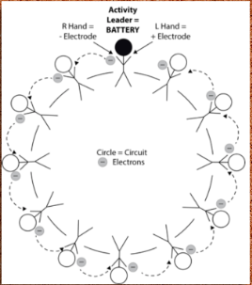
Explain that the objects represent electrons inside a wire conductor. Explain that wire conductors are full of electrons, although they are too small to see even under a microscope!
Remind participants of who is playing the part of the battery, which has a positive end or electrode (represented by the “battery’s” left hand) and a negative end or electrode (represented by the “battery’s” right hand)

Slide 21
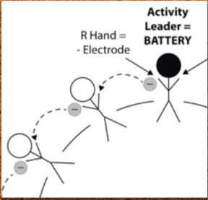
Step 2
The “battery” passes their “electron” to the participant on their right.
Explain that because electrons share the same negative charge, they repel one another, which keeps them moving along in the same direction.

Slide 22
The participant receiving the “electron” should in turn pass the one he or she is holding to the right. Have participants continue passing on electrons to the person on their right.
State that the flow of electrons through a conductor is called an electrical current
Step 3

Slide 23
To illustrate what happens when a circuit breaks, or opens: create a gap in the circle of participants that is too wide across to pass “electrons” – the current will stop as a result
As long as the circle remains intact and the electrons continue to flow, their circuit is closed
Step 4

Slide 24
Electric Circuit with Battery Components and Light Bulb
Act out an electric circuit with parts of a battery as described in the next steps
Make sure to have all materials prepared and to read the steps carefully!
Part 2
Guiding Questions
What causes the battery to release electrons? Chemical reactions that begin once the circuit is closed
What does it mean that the battery is exhausted? The battery has exhausted the chemicals necessary to produce electricity

Slide 25
Let one participant represent a light bulb or a different object that requires electricity (anywhere in the circle.
Additionally, three people will represent the battery.
Step 1

Slide 26
A battery has three main parts:
The negative electrode,
The positive electrode,
And a liquid or solid separating them called the electrolyte
Step 2.1

Slide 27
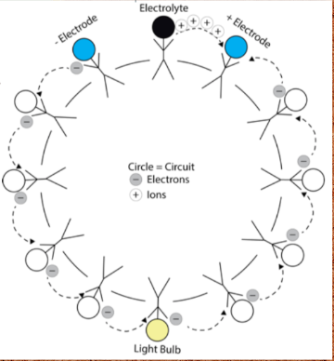
Step 2.2
The “battery” from Part 1 will now represent the electrolyte.
The participant to the right of the “battery” will represent the negative electrode.
The participant to the left of the “battery” will represent the positive electrode.

Slide 28
Explain that when a circuit is closed, chemical reactions start happening within the battery, which generate positive ions and negative electrons.
The positive ions flow through the electrolyte to the positive electrode while the electrons flow around the outside circuit to the positive electrode, releasing energy.
Step 2.3

Slide 29
Step 3
This time, the “negative electrode” to the right of the “electrolyte” will release an electron to the student to their right.
In the meantime, the “electrolyte” will pass a different object (representing ions) towards the “positive electrode” on their left.
Ask the “light bulb” to make a beeping noise every time they receive an electron to signify they are receiving electricity.
When all of the “electrons” are passed around to the “positive electrode,” the battery has exhausted the chemicals necessary to produce electricity and it is exhausted.

Slide 30
Activity Wrap Up
Afterwards, use the following discussion questions to debrief the activity.

Slide 31
Guiding Questions
Where was the electrical current in the activity?
What makes a battery go “bad”?
Why do devices require different amounts/different sizes of batteries?
What happens inside the batteries to produce electrons and ions?
What does it mean to have a closed circuit vs. an open circuit?
How does a capacitor differ from a battery? What are some applications of a capacitor?
What do you think will be next in terms of energy storage technology?

Slide 32
Credits
Lab
Photo Credits
Shapes & Icons
Lab Procedure File and powerpoint: https://smile.oregonstate.edu/lesson/understanding-batteries-and-capacitors
Vectorial Shapes in this Template were created by SlidesPPT
Icons on this template have been downloaded from Flaticon

