Slide 1
Universal Life Insurance
Andrea Avendano, Natalie Green, and Christine Hovermale

Slide 2
Background

Slide 3
Introduction to Life Insurance
Main goal: protect financial security of the policyholder’s family
Where:
Policyholder pays premiums into a life insurance policy
Death benefit collected at time of policyholder’s death
Can have other purposes, such as:
A source of income in retirement
A source of funding for large purchases
Paying off debts
Paying estate taxes

Slide 4
Term Life
Type of life insurance that is not permanent, typically offered for 10 to 30 yrs.
If policyholder dies, then beneficiaries receive a DB
Policy lapses at the end of term if policyholder has not died
Premiums are determined and fixed
Usually less expensive than permanent insurance
DB is only paid if policyholder dies within term of the policy

Slide 5
Whole Life
Is a type of permanent insurance, where:
The beneficiaries receive death benefit whenever policyholder dies
The death benefit, premium and payment schedule are fixed
Premiums are typically paid monthly or annually.
Whole life policies build cash value
Policy can be surrendered
Policyholder receives policy’s cash value minus surrender charges.

Slide 6
Types of Life Insurance Summary
 | Term Life | Whole Life | Universal Life
Premiums | Fixed | Fixed | Flexible
Death Benefit | Fixed | Fixed | Flexible
Surrender Option? | No | Yes | Yes

Slide 7
Universal Life
Type of permanent life insurance that has savings component
Allows for flexible premiums and death benefit
Build cash value that policyholder can take out a loan against
Option to fully or partially withdraw some of policy’s cash value
Also have a surrender option
If the cash value is below a certain amount, the policy will lapse

Slide 8
Components of UL

Slide 9
Loans Withdrawals
Amount Available to Borrow
Cash Surrender Value
Amount Available to Withdraw
Sum of all premiums paid
Interest
Interest on the outstanding loan balance is deducted from the account value every period
Income Taxes
Policyholder can withdraw as much as the face value of premiums paid into the policy
Impact on Death Benefit
If policyholder dies before paying back the loan, then DB is reduced by the amount of loan
Impact on Death Benefit
Death benefit is immediately decreased by the amount of withdrawal

Slide 10
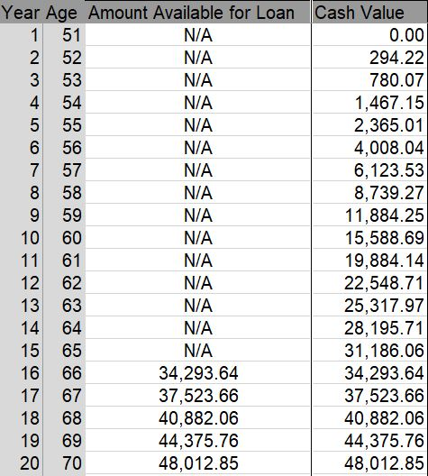
Loan Example
16 year period before you can take out loan
Amount available for loan at year t is equal to cash value at year t

Slide 11
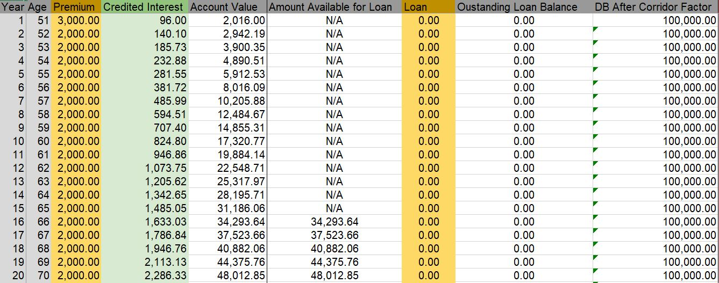
Loan Example
Before taking out a loan

Slide 12
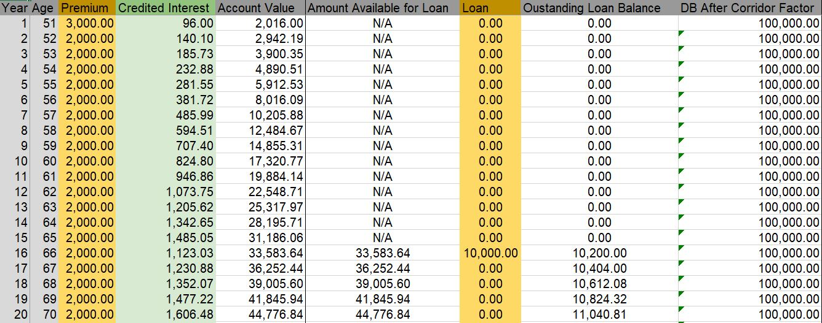
Loan Example Cont.
After taking out a loan

Slide 13
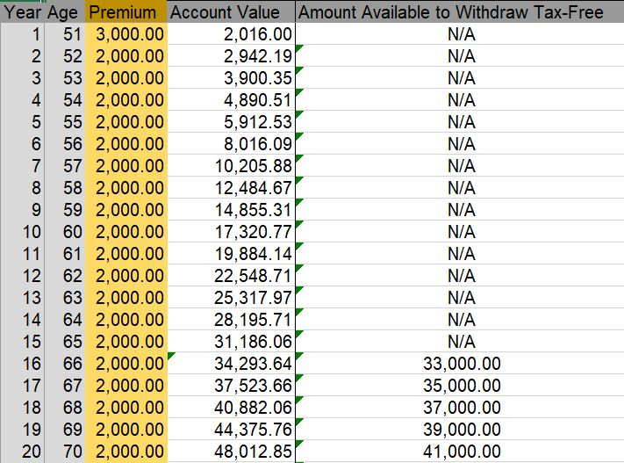
Withdrawal Example
10 year period before you can withdraw
Sum of all premiums at time t is equal to amount available to withdraw at time t

Slide 14
Withdrawal Example cont.
Before a withdrawal
After a withdrawal

Slide 15
Secondary Guarantee
What is it?
A secondary guarantee allows policy to stay in effect, even if account value below zero
Traditional UL policy
Account Value ≤ 0 Policy lapses
Secondary guarantee Policy
Account Value < 0 Policy still in effect
Must meet certain requirements in order to have this policy

Slide 16
Requirements of Secondary Guarantee
Must have a shadow account in order to have an SGUL
What is a shadow account?
Another account calculated the same was as as account value, but interest rates and mortality rates are different
Lower interest rates
Higher mortality rates
Example | Traditional | Secondary Guarantee
Interest Rate | 5% | 2%
Mortality Rates | CSO Rates | 2*CSO Rates
Shadow account value > 0 policy still in effect
Shadow account value < 0 policy lapses

Slide 17
Building Account Value

Slide 18
How Universal Life Works
Account Value
Commission Expense
Premiums
Policy Expenses
Interest
Cost of Insurance
Account Value = Premiums + Interest - Expenses

Slide 19
Example Policyholder Profile
50 year old non-smoking male
$100,000 death benefit
Interest credited at 5%
Premiums paid annually

Slide 20
Premium
Chosen by policy holder

Slide 21
Commission Charges
Def: a charge that allows the insurance company to regain the commission paid to the agent who sold the policy
Deducted at beginning of year
Example: 5% of the Death Benefit spread over 5 years

Slide 22
Policy Charges (EC)
Def: to pay expenses at the insurance company
Often a flat fee plus a percentage of the premium
Deducted beginning of policy year
Example: $50 + (1% of the Premium)

Slide 23
Cost of Insurance (CoI)
Def: charge to cover the cost of the death benefit
Deducted beginning of the year
Example:
Net Amount at Risk * Mortality Rate
Recall: Net Amount of Risk = Total Death Benefit - Account Value

Slide 24
Credited Interest
Def: amount of interest credited to the account
Can change period to period at the discretion of the insurer
Determined at end of the period
0.05*(Past Account Value + Premium - Expenses)

Slide 25
Account Value (AV)
Past Account Value + Premium - Expenses + Credited Interest

Slide 26
Account Value Overview
Determined by policy holder
5% of the Death Benefit spread over 5 years
$50 +
(1% of the Premium)
Net Amount at Risk * Mortality Rate
0.05*(Past Account Value + Premium - Expenses)

Slide 27
Rules Account Value has to follow
Death Benefit ≥ Corridor Factor
Account Value
If the ratio is smaller than the corridor factor then the DB has to be modified

Slide 28
Formula Summary
Recursive Formula for Account Value
AV_{t-1}
P_{t}
EC_{t}
C_{t}
CoI_{t}
i_{c}
= Account Value at the end of year t-1
= Premium paid at the beginning of year t
= Policy charges at the beginning of year t
= Commision charges at the beginning of year t
= Cost of insurance charge at the beginning of year t
= Credited interest rate

Slide 29
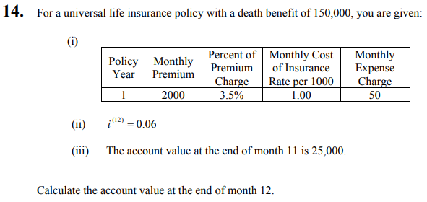
Example (MLC May 2013 #14)

Slide 30
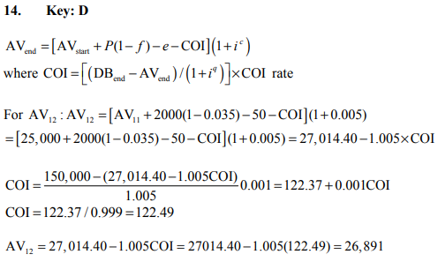
Solution

Slide 31
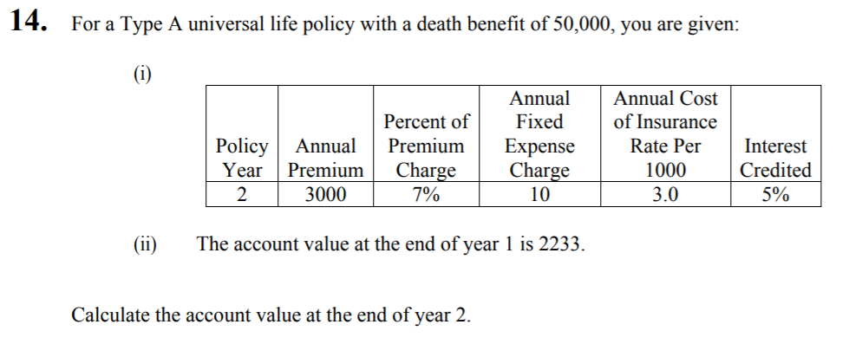
MLC 2016 Exam Question #14

Slide 32
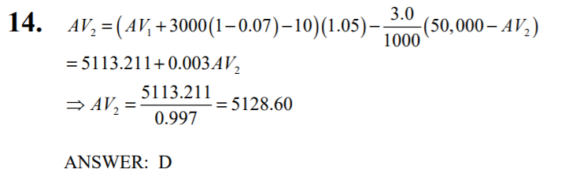
MLC 2016 Exam Solution #14

Slide 33
Example 3 - MLC Spring 2018 #13
For a Type A UL policy on (55), with a death benefit of 500,000, you are given
(i) The account value at time 10 is AV₁₀ = 66,600
(ii) Annual premiums of 10,000 are paid at the beginning of each policy year
(iii) Expense charges, payable at the beginning of each year, are 120 plus 5% of premium.
(iv) The cost of insurance rate in year 11 is 15 per 1000
(v) i^{c} = i^{q} = 0.04
Calculate the Additional Death Benefit for this policy at the end of policy year 11.

Slide 34
Solution
Option A => Level Death Benefit and variable Additional Death Benefit (ADB)
Need to find ADB = 500,000 - AV₁₁
First need to calculate AV₁₁
AV₁₁ = [66,600 + 10,000 - (120 + 0.05*10,000)]*1.04 + 15 * [500,000 - AV₁₁]
1,000
Evaluated at beginning of year 11, so accumulate to end of year 11
CoI evaluated at the end of year 11, so do not accumulate
0.985*AV₁₁ = 71,519.20
AV₁₁ = 72,608.32
ADB = 500,000 - 72,608.32 = 427,391

Slide 35
Reserving

Slide 36
PBR Overview
Reserving is the process of calculating the money that is set aside to pay policyholders at the time of their death
Regulated by several entities such as the National Association of Insurance Commissioners (NAIC) and IRS.
Due to the flexibility/versatility of UL, there is not a straightforward method of reserving
Notes:
It’s regulated by several entities such as the NAIC and IRS.
Reserving its done to ensure that the premiums collected don't exceed cost of benefits and services.

Slide 37
Why can’t traditional reserving be used for UL?
Typical Reserving Equation:
PV(future benefits) - PV(future premiums)
Unknown since the death benefit can change due to
Corridor Factor requirements
Policyholder wanting to change death benefit amount
Future premiums are unknown since how much and how often premiums are paid are determined by the policyholder
Therefore traditional reserving methods can’t be used for UL

Slide 38
Reserving Part I
Principle-Based Reserving

Slide 39
Principle Based Reserving
Net Premium Reserves

Slide 40
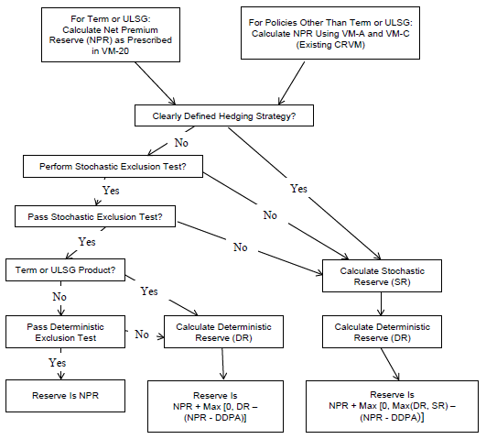
PBR Flow Chart from VM-20 Practice Note (2019)
40

Slide 41
Method 1 - When should it be used?
Policy Issued
End of Secondary Guarantee Period
Last Possible Premium Payment
Policy Year
0
m
s
If valuation date is here, use Method 1
Notes:
Method 1 = Section 3.B.5
Method 2 = Section 3.B.6

Slide 42
Method 1 - Calculate Level Gross Premium
Step 1: Calculate level gross premium at issue
Policy Year | Level Gross Premium | Account Value
1 | $2,893 | $1,770
2 | 2,893 | 3,440
: | : | :
70 | 0 | 50,035
71 | 0 | 0
Premium s.t. the policy will not lapse assuming the premium is paid every year

Slide 43
Method 1 - Calculate Expense Allowance
Step 2: Calculate expense allowance assuming expenses are front loaded into the first 5 years
x = issue age
s = # of premium payments allowed
t = policy year
E_{x+t} =
VNPR
* a_{x+t:s-t}
(x₁ + z₁)/a_{x:s} + y₂₋₅* C_{x+t}
Ratio of PV(benefits) to PV(premiums)
Amortize over remaining premiums
Amortize 1st Year Expenses over ALL premiums
Amortize 2nd - 5th Year Expenses

Slide 44
Method 1 - Expense Allowance Example
50 year old, $100,000 DB
Can pay premiums until age 100 (51 premiums)
Valuation date is policy year 3
Level Gross Premium = $2,893
E₅₃ =
0.34
* a_{53:48}
(2,893+250) + 289.3 1 + 1
a_{50:51}
a_{51:50}
a_{52:49}

Slide 45
Method 1 - Calculate NPR
Step 3: Calculate NPR
Actual Account Value
NPR = PV(benefits) - PV(valuation net premiums) - E_{x+t}
Account Value needed to prevent policy from lapsing
Capped at 1

Slide 46
Method 2 - When should it be used?
Policy Issued
End of Secondary Guarantee Period
Last Possible Premium Payment
Policy Year
0
m
s
If valuation date is here, calculate using both methods.
Choose the larger one as the NPR.
Notes:
Method 1 = Section 3.B.5
Method 2 = Section 3.B.6

Slide 47
Method 2 - Level Gross Premium
Step 1: Calculate level gross premium at issue
This is the same level gross premium as the one in Method 1

Slide 48
Method 2 - Calculate Expense Allowance
Step 2: Determine the value of the expense allowance components for the policy at issue
Amortize 2nd - 5th Year Expenses
Ratio of PV(benefits) to PV(premiums)
Find the PV of the expenses, spread over the secondary guarantee period
Amortize 1st Year
Expenses over ALL premiums

Slide 49
Method 2 - Calculate NPR
Step 3: Determine NPR
Actual Secondary Guarantee
Expense Allowance
ASG_{x+t}
,
1
* NSP_{x+t}
- E_{x+t}
NPR =
max
FFSG_{x+t}
Net Single Premium
Fully Funded
Secondary Guarantee

Slide 50
Method 2 - Terms
Actual Secondary Guarantee
The value of the Shadow Account based on the amount of premium the policyholder has actually paid
Fully Funded Secondary Guarantee
The value of the Shadow Account that in theory would ensure the policy won’t lapse under the secondary guarantee
Net Single Premium
Present value of the Death Benefit

Slide 51
Method 2 - NPR Calculation Interpretation
ASG_{x+t}
,
1
* NSP_{x+t}
- E_{x+t}
NPR =
max
FFSG_{x+t}
Expense allowance
A ratio applied to the present value of the Death Benefit
If the amount actually in the Shadow Account is more than needed, then the insurance company needs to put more aside in reserves since the DB will end up being higher, since the PH paid more into the policy than they needed to

Slide 52
Principle Based Reserving
Deterministic Reserves

Slide 53
Deterministic Reserve
Deterministic exclusion test ---> Failed. Then,
Measured according to:
Projections of the insurance company obligations for a policy
Gross Premium Valuation Method or Direct Iterative Method
Select after depending the conditions
Steps outlined in VM-20
Both methods give the same DR reserve
Value of the assets placed to satisfy them based on a single scenario
Notes:
using moderately adverse economic conditions.(NAIC)

Slide 54
Deterministic Reserve
Formula for calculating the DR:
The amount calculated under will equal the actuarial present value of benefits, expenses and related amounts, less the actuarial present value of premiums and related amounts.
DR = Actuarial PV (benefits,expenses, etc) - Actuarial PV (premiums, etc) + Balance (separate account) + Policy loan balance

Slide 55
Principle-Based Reserving
Stochastic Reserving

Slide 56
Stochastic Reserve
Reserving for a company that has thousands of UL policies
General outline of how to reserve:
Determine the number of product groups that will be calculated using this method
Determine margins and Prudent Estimation Assumptions for all Risk Factors
Have to be the same as assumptions for deterministic
Only exception is for assumptions dependent on economic scenarios
Generate stochastic economic scenarios
Determine number of stochastic economic scenarios used in calculation

Slide 57
Stochastic Reserve cont.
Then calculate stochastic reserve as followed
a. Project CFs for each model segment under each generated scenario
b. Calculate Scenario Reserve for each generated scenario
* * * What is a Scenario Reserve? * * *
Scenario Reserve: the negative PV of the accumulated net cash flows at either the beginning or end of the year when the PV of the accumulated deficiencies is the most negative during the projection period

Slide 58
Calculating the Scenario Reserve
At the valuation date and end of each projection year, calculate the discount value of the negative of the projected statement value of assets*
*The negative of the projected statement values is called the Negative Accumulated Deficiency
Discount the negative accumulated deficiencies at the end of each projection year to valuation date
Discount rate = 105% of US treasury rate
Add all the model segments of discounted negative accumulates deficiencies
Scenario reserve = largest of discounted values + starting asset amount

Slide 59
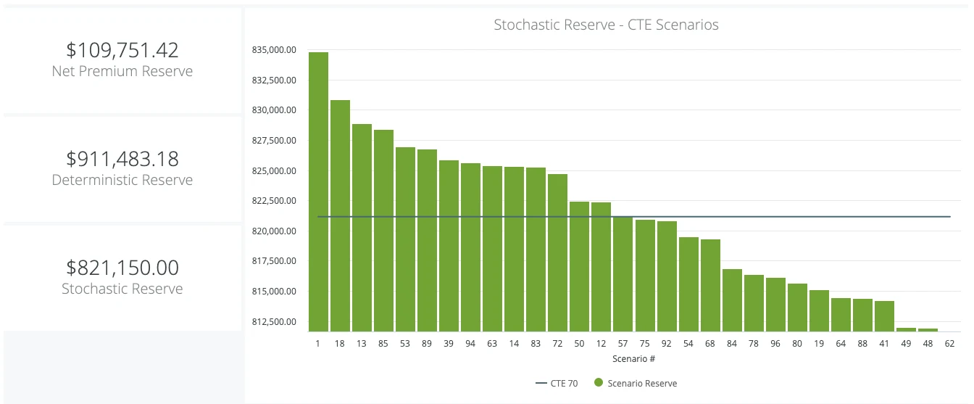
Stochastic Reserve Cont.
Rank the scenario reserves from lowest to highest
Average the highests 30% of the scenario reserves
100 scenario reserves
Highest 30%
Avg. of highest 30% = reserve
Scenario reserves

Slide 60
