Slide 1
Test Rig for Grease-Bearing Combination in Electrical Machinery
17 May 2018 - Final Presentation
Gabriel Calderón, Nikhil Maharshi, Vignesh Nagarajan, Rubén Noya, Siddharth Ramakrishnan, Samantha Robinson

Slide 2
Agenda
Introduction
Design Process
Final Design
Project Goals
5 Key Designs
Future Schedule

Slide 3
Project Goals
Introduction
Requirements
Design Parameters

Slide 4
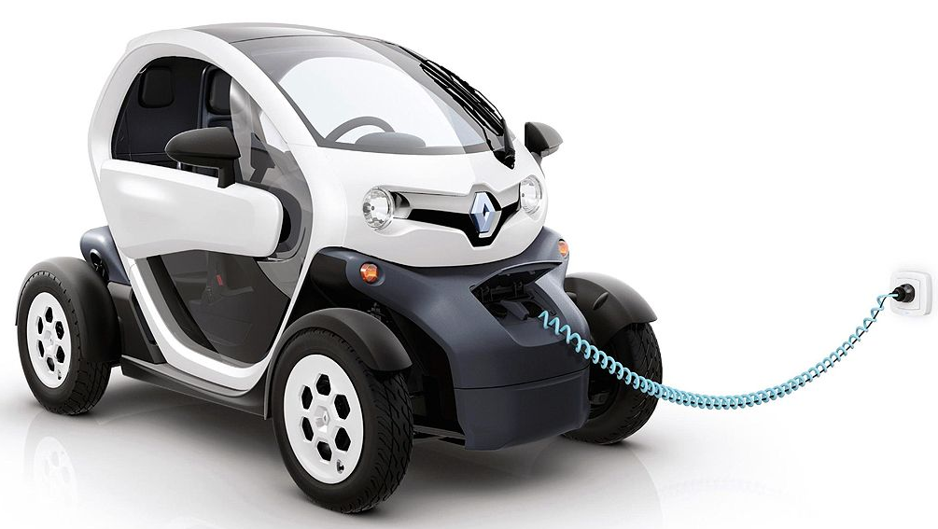
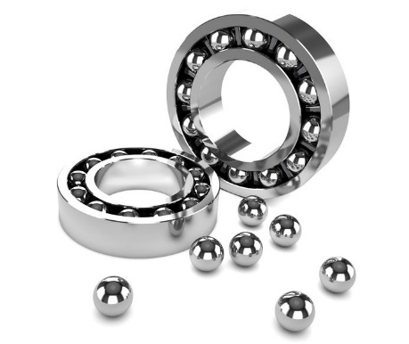
Introduction
New technology
New systems and components
New operating conditions
Bearings
Notes:
In the last decades, the demand for sustainable systems has led to the increase in use of
electric machinery instead of machines driven by combustion of fossil fuels. Nowadays, the
developments in the technology of electrical applications represents a growing business, and
also presents challenges for making the new designs appear more efficient. As in
conventional machinery, the electrical applications also have rotating components that need
bearings for allowing the rotation with minimal friction.
The conditions of the bearings in electrical applications such as hybrid or electric cars
are different than those of regular cars. The main difference among them is the electrical
potential generated by electric components or by the motion of the elements. The generated
potential has negative influence on bearing performance. This project covers the design and
construction of an equipment that can simulate these conditions and is able to test and provide
useful information for the analysis of different grease-bearing combinations.
The following document explains the requirement specification and planning for
executing the project and is based on the “Practical Guide of Project Management” by
Christine Petersen and the “PM-BOK Guide” by the PMI Project Management Institute.
Additionally, the book “The Mechanical Design Process” is used as reference for some parts
of the user requirements specification.

Slide 5
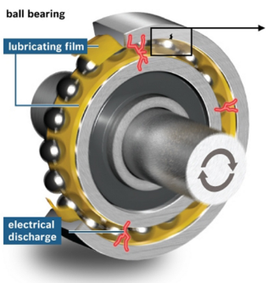
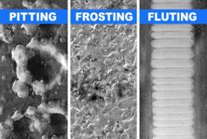
Bearings in Electrical Applications
24-48 Volts
Up to 400 Volts
FAILURE!!!

Slide 6
Project Goal
To evaluate conductive grease in deep groove ball bearings under conditions that simulate those in an electric motor
Requirements
Test deep groove ball bearing (620X) with various greases
Apply an electric potential across the bearing from 1 to 2 volts
Achieve speed factors from 600,000 to 800,000 NDm
Measure torque caused by the friction of the test bearing
Change the loads on the bearing in the range of 50 to 1000 N
Log the self-induced temperature during the test

Slide 7
Design Challenges
Isolation of Electric Current
Low Friction Torque
High Rotational Speeds
Misalignment & Vibrations

Slide 8
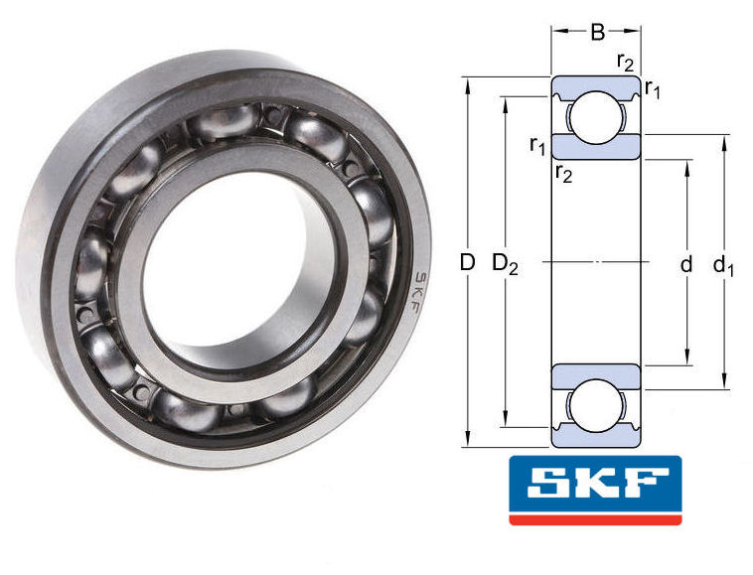
Required Speeds
Based on speed factor NDm
NDm = rpm *
ID
OD
(ID + OD)
2
Bearing Number | Inner Diameter [mm] | Outer Diameter [mm] | Speed at 600,000NDm [rpm] | Speed at 800,000NDm [rpm] | SKF Limiting Speed [rpm]
6204 | 20 | 47 | 17,910 | 23,880 | 20,000
6205 | 25 | 52 | 15,584 | 20,779 | 18,000
6206 | 30 | 62 | 13,043 | 17,391 | 15,000
6207 | 35 | 66 | 11,214 | 14,953 | 13,000
6208 | 40 | 80 | 10,000 | 13,333 | 11,000

Slide 9
Frictional Torque Estimation
Matlab calculation based on Schaeffler's Guide
Bearing Number | Lowest Force [N] | Lowest Speed [rpm] | Lowest Torque [mNm] | Highest Force [N] | Highest Speed [rpm] | Highest Torque [mNm]
6204 | 50 | 17,910 | 76.8 | 200 | 23,880 | 93.1
6205 | 100 | 15,584 | 106.3 | 400 | 20,779 | 129
6206 | 150 | 13,043 | 161 | 600 | 17,391 | 195.6
6207 | 200 | 11,214 | 229 | 800 | 14,953 | 278.3
6208 | 250 | 10,000 | 299.4 | 1000 | 13,333 | 363.7

Slide 10
Design Process
Initial Concepts
Key Designs
A
B
C
D
E

Slide 11
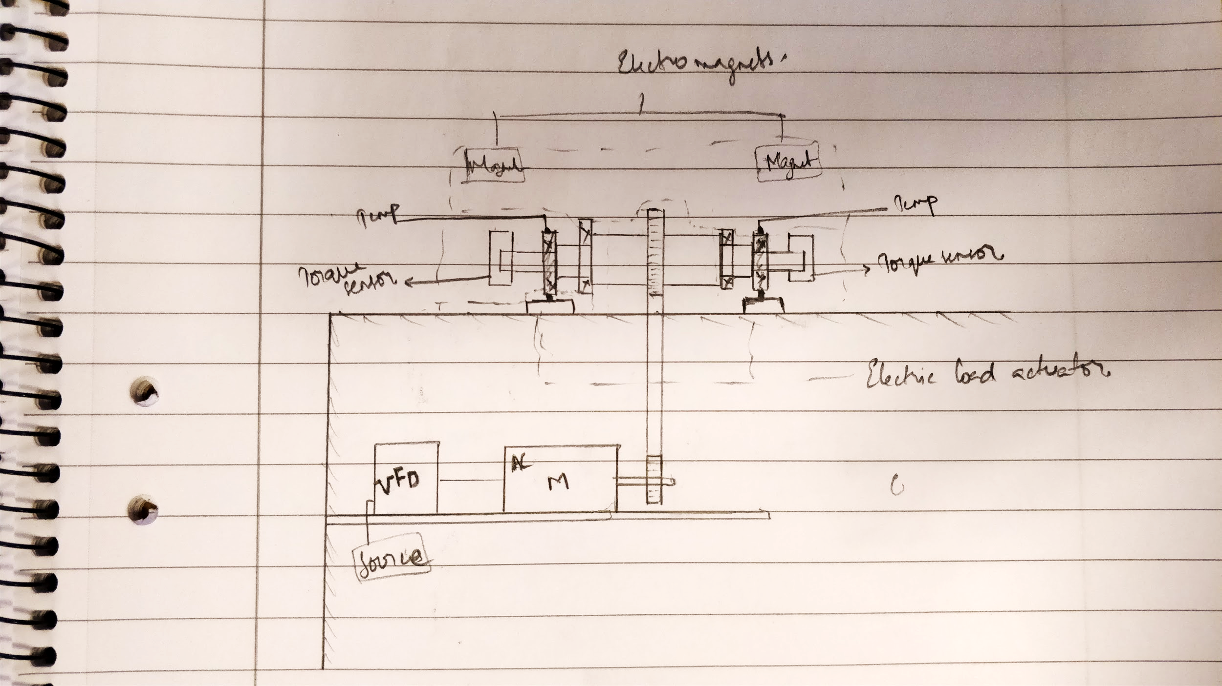
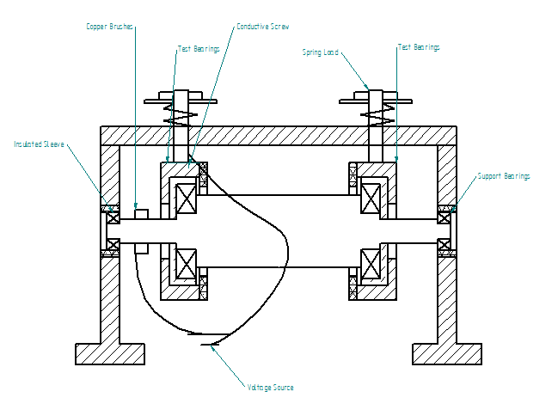
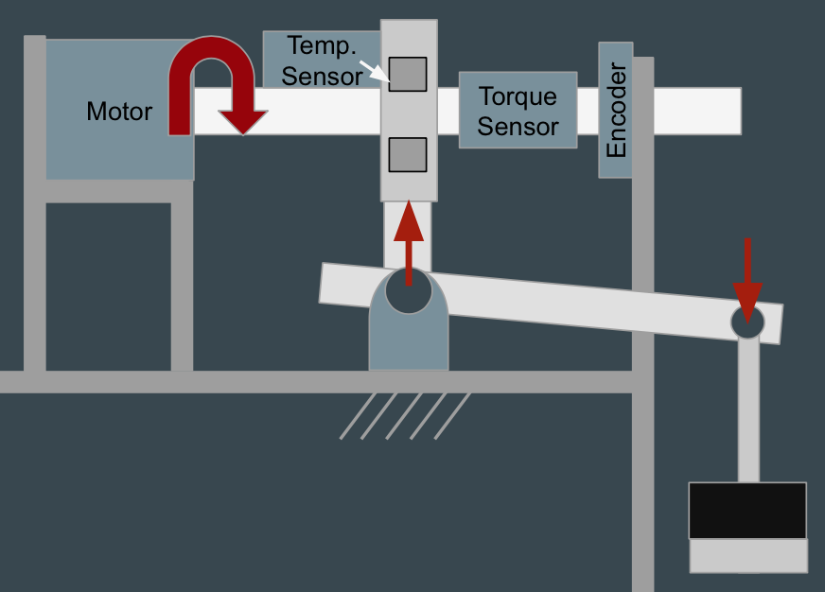
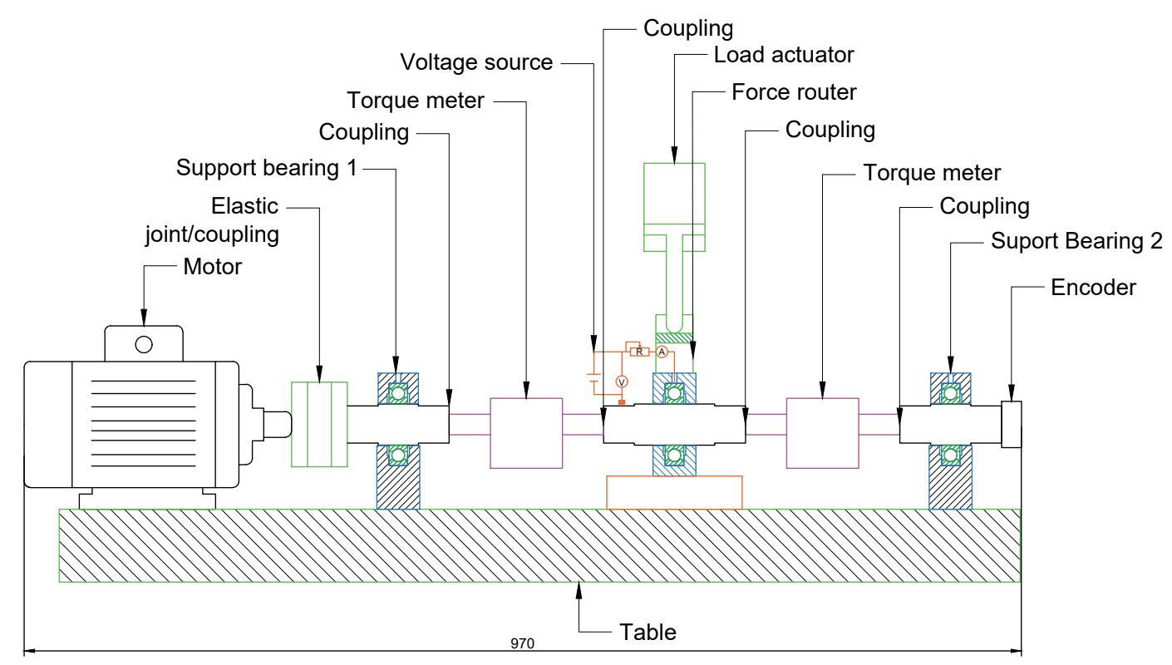
Initial Concepts
Notes:
Gabriel

Slide 12
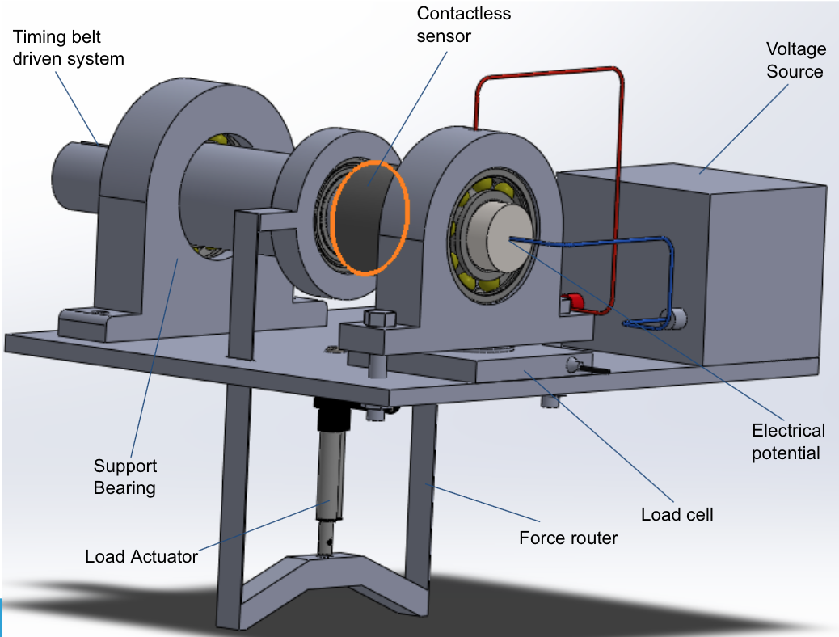
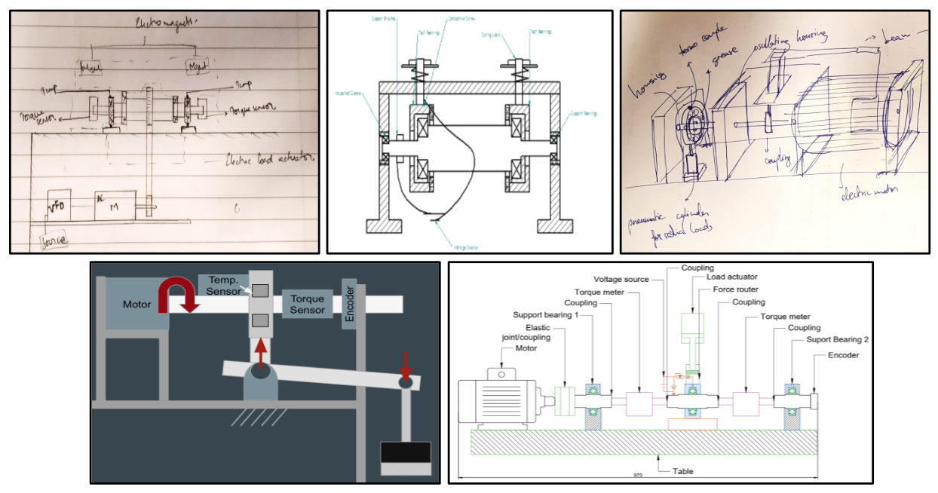
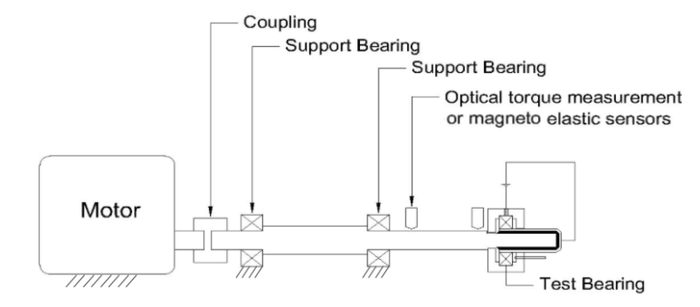
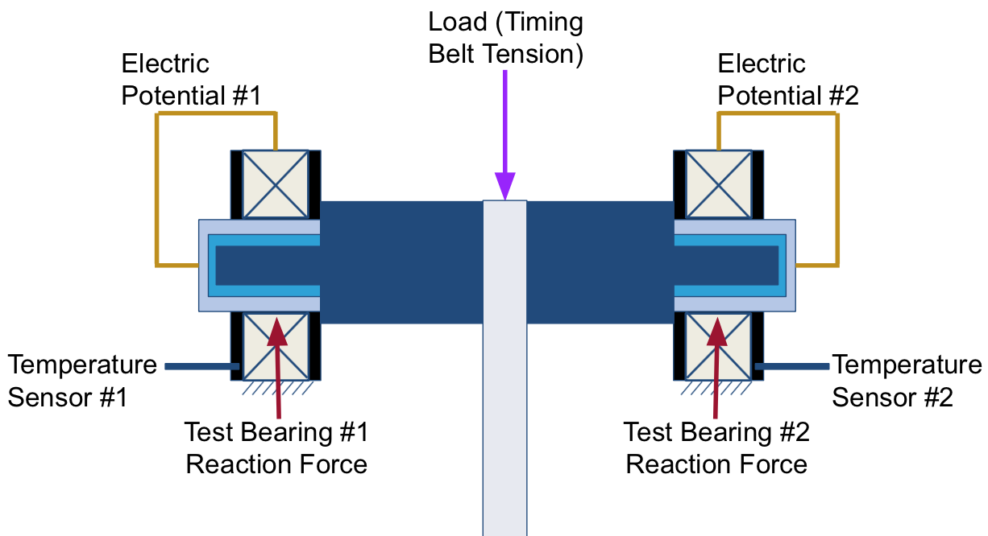
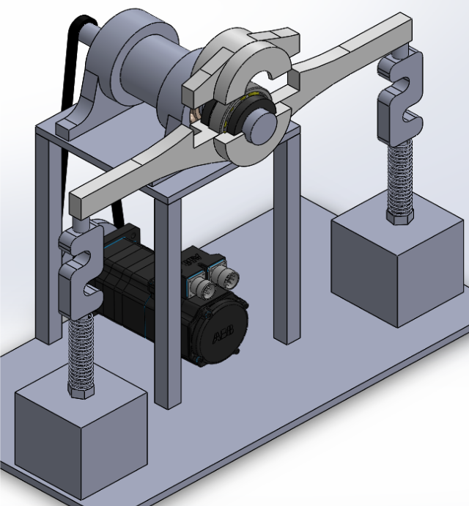
Design Process
Design B
Initial Concepts (1-5)
Design D
Design A
Design C
Design E
Notes:
Timing belt driven system → Input power from a motor (not selected yet, probably we will have to include a gearbox in order to get the desired speeds)
Shaft will be 3 times stepped (3 different diameters)
· 1 Support bearing on left side
· Loading system performed by floating bearing in the middle
· Non-contact friction torque sensor
· Test bearing with a load cell beneath, this will measure the reaction force due to loading system
· Two cap-screws to fix the test bearing housing to the ground
· Voltage source in a closed circuit bt end of the shaft and upper part of the bearing

Slide 13
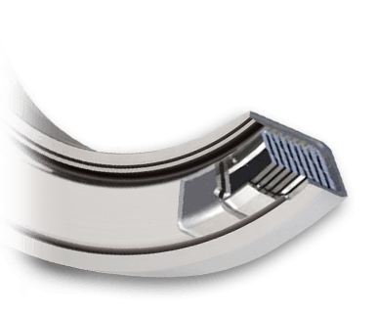
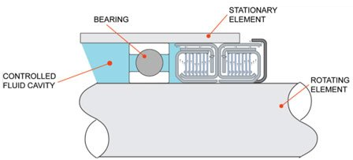
Centritec Non-Contact Seals
Utilizes centrifugal method: bearing rotation causes pressure to pump the lubricant into the bearing and back into the fluid reservoir
Tolerant of vibrations/shaft movement
No additional friction into the system
Customized product to given specifications

Slide 14
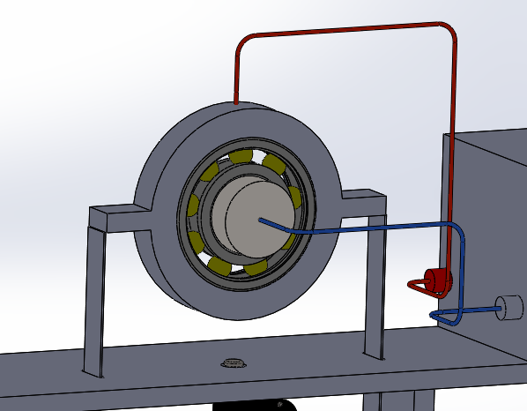
Temperature Sensor
Requirements regarding temperature:
Normal motor bearing operating temperatures goes from 40-71ºC
Grease provided in bearing remains effective to approx. 93-100ºC
Product: PT-100
3 wire configuration
IEC 60751 Class B : 2008
Sheath: 3mm or 6mm OD
Variety of lengths
Operating range: -75ºC to +250ºC
Terminated in a pot seal 12.7mm OD x 29mm long rated to 135ºC

Slide 15
Design A: Cantilever Concept

Slide 16
Electric Current
Voltage Application
1-2 Volts in AC and DC
Power source & signal generator
Closing the Circuit
Starts with contact at outer ring
Closed by point contact with brush
Isolation of Current
Isolative and conductive sleeves
Attached through keyways

Slide 17
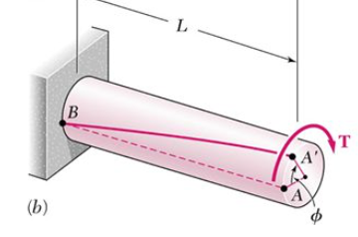
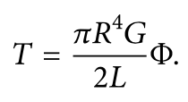
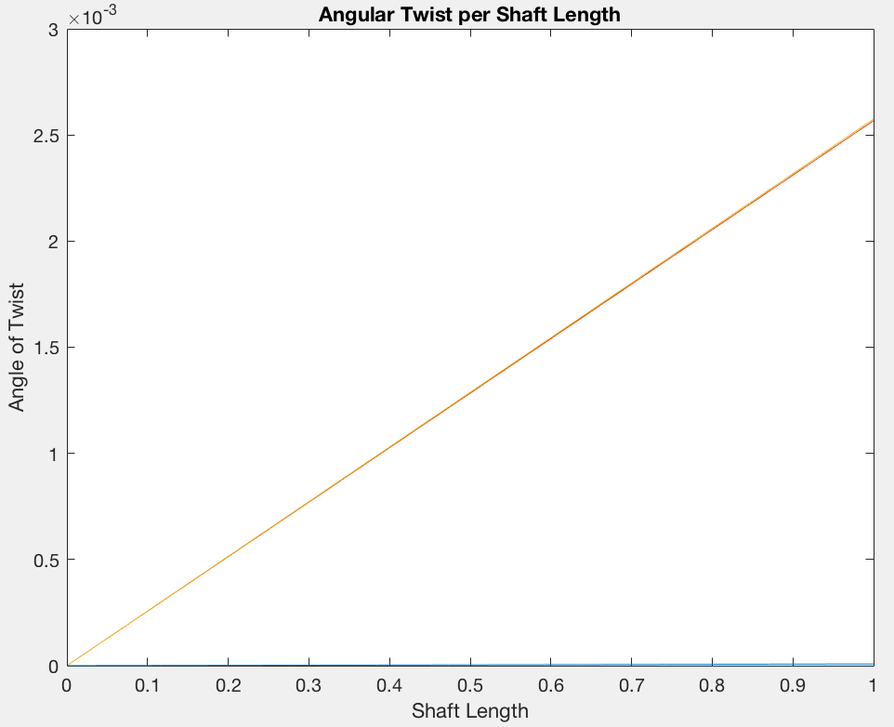
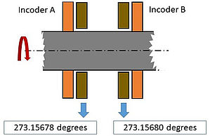
Torque through Angle of Twist
(degrees)
(m)

Slide 18
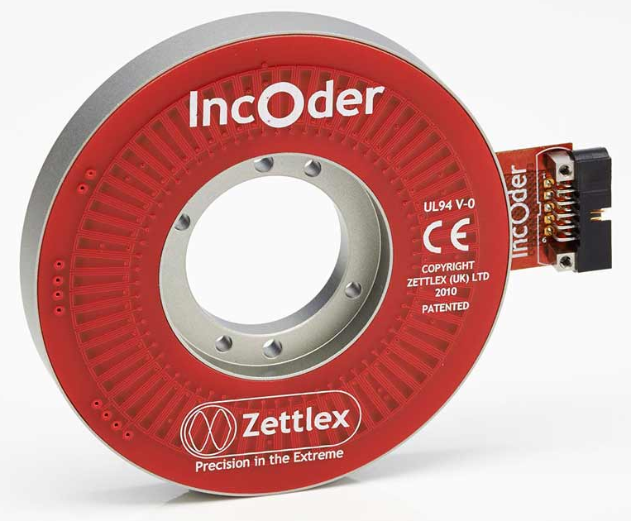
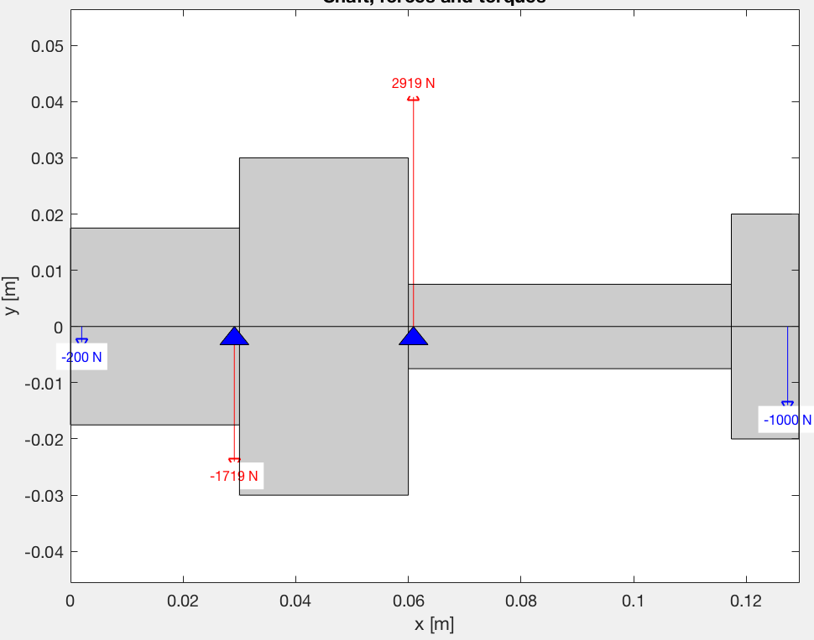
Optical Sensor
Zettlex “IncOder” (INC-3-100-211001-SSI1-AC1-12-AN)
Repeatability: 1%
Accuracy: 0.27%
Inner Diameter: 50 mm
Resolution: 0.00017 deg.
Max Misalignment: 0.25 mm
Limiting Speed: 10,000 rpm
Optimal Shaft Dimensions
Steel diameter: 15 mm
Rubber thickness: 35 mm
Segment length: 47.3 mm
Misalignment: 0.083 mm
Shaft Dimensions and Forces

Slide 19
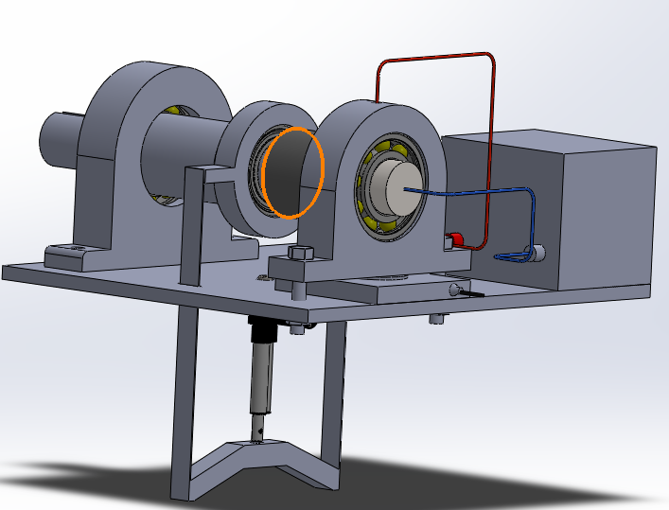
Design B: Central Loading
Contactless sensor
Timing belt driven system
Voltage Source
Electrical potential
Support Bearing
Load cell
Force router
Load Actuator
Notes:
Timing belt driven system → Input power from a motor (not selected yet, probably we will have to include a gearbox in order to get the desired speeds)
Shaft will be 3 times stepped (3 different diameters)
· 1 Support bearing on left side
· Loading system performed by floating bearing in the middle
· Non-contact friction torque sensor
· Test bearing with a load cell beneath, this will measure the reaction force due to loading system
· Two cap-screws to fix the test bearing housing to the ground
· Voltage source in a closed circuit bt end of the shaft and upper part of the bearing

Slide 20
Design C: Two Test Bearings
Load (Timing Belt Tension)
Electric Potential #1
Electric Potential #2
Temperature Sensor #1
Temperature Sensor #2
Test Bearing #1 Reaction Force
Test Bearing #2 Reaction Force
Torque Measurement: Motor Current
Motor
Notes:
Timing belt driven system → Input power from a motor (not selected yet, probably we will have to include a gearbox in order to get the desired speeds)
Shaft will be 3 times stepped (3 different diameters)
· 1 Support bearing on left side
· Loading system performed by floating bearing in the middle
· Non-contact friction torque sensor
· Test bearing with a load cell beneath, this will measure the reaction force due to loading system
· Two cap-screws to fix the test bearing housing to the ground
· Voltage source in a closed circuit bt end of the shaft and upper part of the bearing

Slide 21
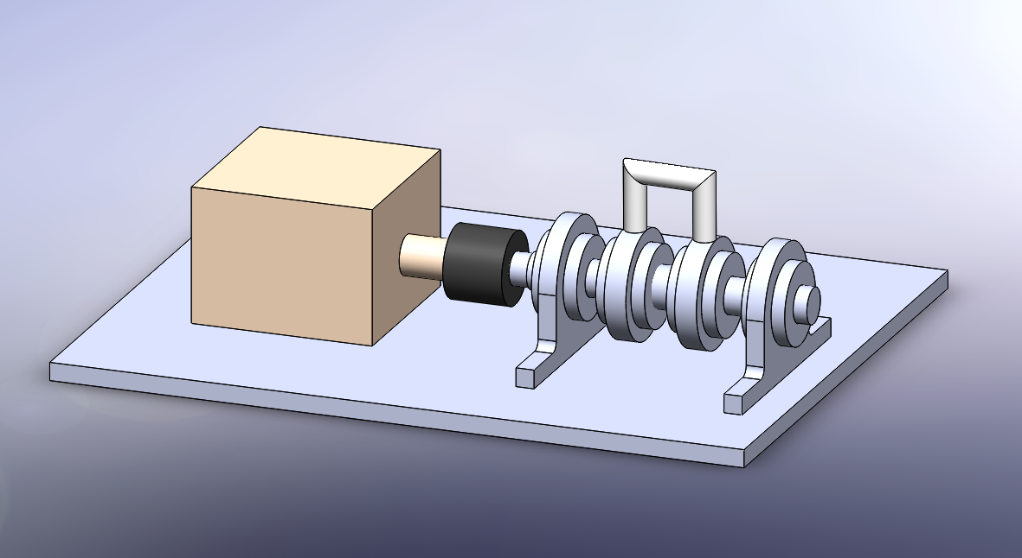
Design D: Four Test Bearings
Loading Mechanism
High-Speed
Motor
Test Bearings with seals
Torque Measurement: Motor Current
Notes:
Timing belt driven system → Input power from a motor (not selected yet, probably we will have to include a gearbox in order to get the desired speeds)
Shaft will be 3 times stepped (3 different diameters)
· 1 Support bearing on left side
· Loading system performed by floating bearing in the middle
· Non-contact friction torque sensor
· Test bearing with a load cell beneath, this will measure the reaction force due to loading system
· Two cap-screws to fix the test bearing housing to the ground
· Voltage source in a closed circuit bt end of the shaft and upper part of the bearing

Slide 22
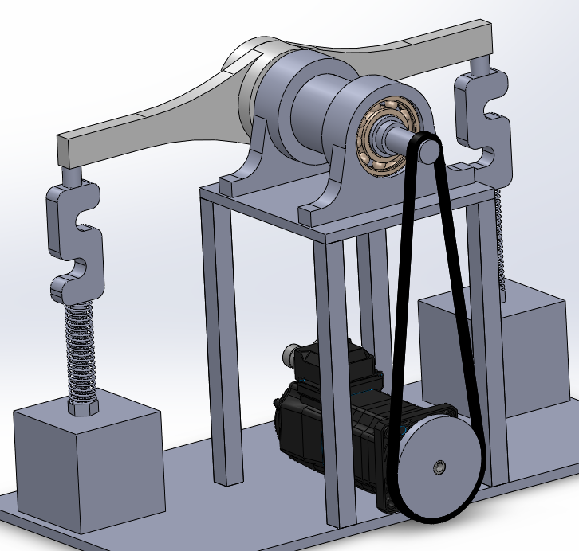
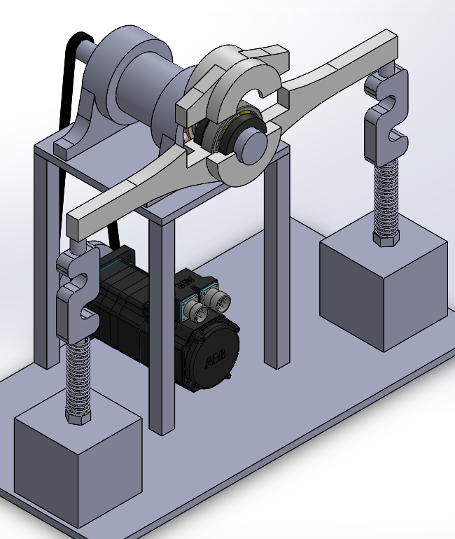
Design E: Advanced Cantilever
Support Bearings
Floating Housing
Motor
Pulley
Test Bearing
Sleeve
System
High Speed Motor
S-Type Load Cell
Torque Measurement: Loading Cells
Spring
Loading
Loading Nut
Notes:
Timing belt driven system → Input power from a motor (not selected yet, probably we will have to include a gearbox in order to get the desired speeds)
Shaft will be 3 times stepped (3 different diameters)
· 1 Support bearing on left side
· Loading system performed by floating bearing in the middle
· Non-contact friction torque sensor
· Test bearing with a load cell beneath, this will measure the reaction force due to loading system
· Two cap-screws to fix the test bearing housing to the ground
· Voltage source in a closed circuit bt end of the shaft and upper part of the bearing

Slide 23
Final Design
Design Evaluation
Matlab Calculations
System Details

Slide 24
Pugh’s Matrix

Slide 25
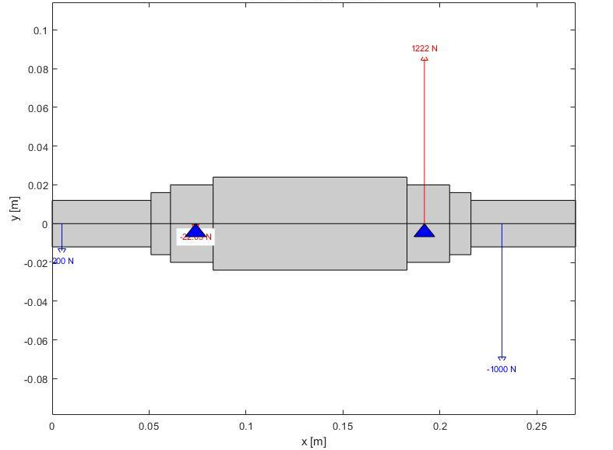
Final Design Static Analysis
Shaft Dimensions and Forces

Slide 26
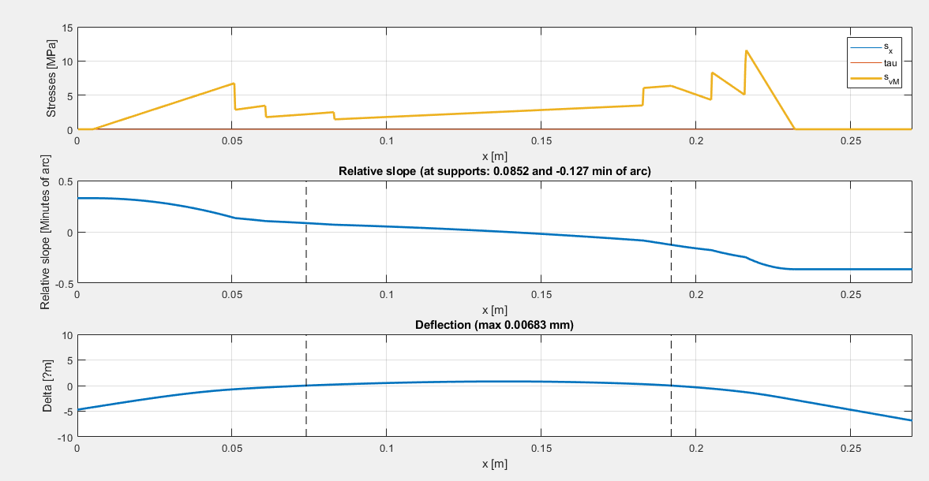
Deflection & Static Stresses

Slide 27
Critical Frequency Approximation
Nc: Critical speed [rpm]
g: Acceleration due to gravity[m/s^2]
∂st: Maximum static deflection [m]
Bearing Number | Speed at 600,000 NDm [rpm] | SKF Limiting Speed [rpm] | Critical Speed [rpm] | Speed at 800,000 NDm [rpm]
6208 | 10,000 | 11,000 | 11,444 | 13,333

Slide 28
Conclusion
Tests ball bearing 6208
Applies electric potential
Achieves required speeds
Measures friction torque
Applies various loads
Logs bearing temperature
Notes:
Timing belt driven system → Input power from a motor (not selected yet, probably we will have to include a gearbox in order to get the desired speeds)
Shaft will be 3 times stepped (3 different diameters)
· 1 Support bearing on left side
· Loading system performed by floating bearing in the middle
· Non-contact friction torque sensor
· Test bearing with a load cell beneath, this will measure the reaction force due to loading system
· Two cap-screws to fix the test bearing housing to the ground
· Voltage source in a closed circuit bt end of the shaft and upper part of the bearing

Slide 29
Next Semester Schedule
Dynamic analysis
A.
September
October
November
December
35
36
37
38
39
40
41
42
43
44
45
46
47
48
49
50
Optimize dimensions
Material selection
Freeze design
Cost estimation
Purchasing
Manufacturing
Assembly
Testing
Documentation

Slide 30
Thank You ☺

