Slide 1
Developing Marketing Materials for Legends Sports Leagues
An Interactive Qualifying Project By: Zhidong Ju, Evangelos Spanos, Trevor Weiler, and Nick Wright

Slide 2
Recreational sports leagues are growing throughout the United States
= 20 million physically active Americans
Sports participants
(216 million)
Team sports participants
(50 million)
Physical Activity Council, 2017
Notes:
Through our background research we found that… In 2017, the Physical Activity Council found that 216 million americans participated in sports.. 50 million of those american participated in team sports like baseball and basketball.

Slide 3
Recreational sports leagues provide benefits for participants
Physical
Mental Health
Social
Notes:
Physical: Helps with disease, Mental Health: Cope with depression; Social: Sense of community

Slide 4
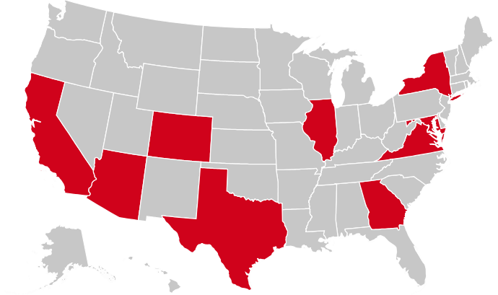
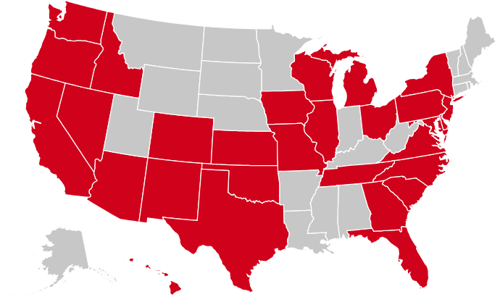
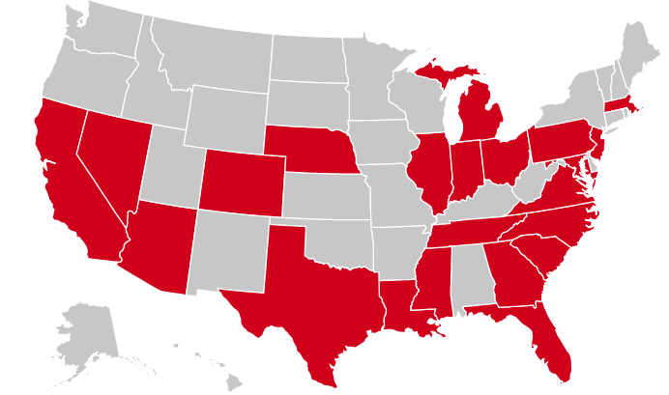
Legends has the opportunity to expand because recreational sports leagues are growing across the United States
States with Franchises
Notes:
Because of the growth of rec sports leagues…. Here are examples of rec sports franchises who have already had success expanding

Slide 5
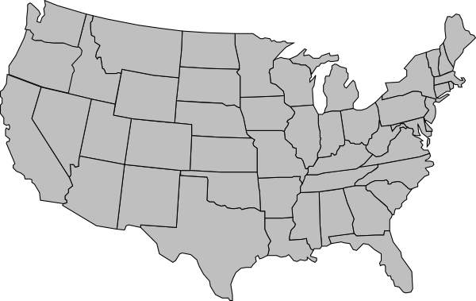
Visualization of Legends national expansion
Notes:
If Legends capitalizes on this growth, here’s what they could look like in a few years

Slide 6
Legends needs to develop training materials for potential franchisees
Notes:
Zhidong - in order for Legends franchise to be successful
Franchise manual, a guide for franchisees to run the business.

Slide 7
Legends’ golf league faces challenges
First Season: 24 Members
Third Season: 24 Members
Fifth Season: Cancelled
Fall 2016
Fall 2017
Spring 2017
Fall 2018
Second Season: 24 Members
Spring 2018
Fourth Season: 16 Members
Notes:
Zhidong - In addition to franchising, we were also asked to look into the Legends Golf and Pickleball leagues
Started 2016

Slide 8
Legends’ new pickleball league needs marketing materials
~72
~58
Members
First Season:
Spring 2018
Members
Second Season:
Fall 2018
Dedicated Pickleball Commissioner
Outside Recruitment
No Designated Pickleball Commissioner
Mainly recruited through Legends mailing list
Notes:
Zhidong - Legends had a great start because they recruited members from outside the league
In the second season, Legends didnt have the opportunity and time

Slide 9
Project Goal
To help Legends Sports Leagues through the development of marketing materials and recommendations for expansion

Slide 10
Objectives
01
Examine How Legends Currently Operates
02
Identify Best Practices in Rec Sports Leagues’ Marketing
03
Evaluate Legends’ Growth, Marketing, and Operation
04
Develop Marketing and Franchising Materials for Legends Sports Leagues
Notes:
To achieve our project goal, we came up with 4 objectives:

Slide 11
Deliverables
1.
Pickleball Logo
2.
Marketing Materials (McGrow)
Pickleball Promotional Video
3.
Legends Flyer and Hashtag
4.
Franchisee Training Manual
5.
Marketing Brochure
Notes:
For our 4th objective, we had to submit 5 deliverables

Slide 12
Background

Slide 13
Organizations should adopt the four C’s in their marketing strategy
01
Consumer Wants and Needs
02
Cost for the Consumer
03
Convenience of Buying
04
Communication

Slide 14
Word of mouth has become an important marketing tool
Functional Motivation
Social Motivation
Emotional Motivation
Notes:
\

Slide 15
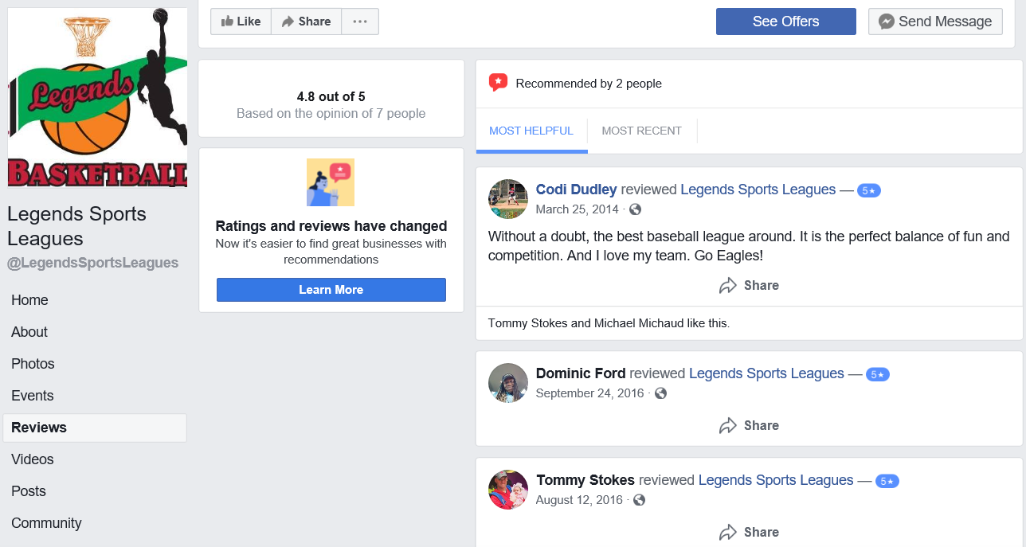
Customer reviews increase exposure and purchases
Source: Legends Sports League Facebook Page

Slide 16
Promotional videos are gaining popularity and effectiveness

Slide 17
The franchising business model
a distribution model
a licence
A Franchise is:
a path
a regulated business
Notes:
By reviewing the franchising business model, we came to the conclusion that a franchise is:
A distribution model to reach more people in more locations
A path to business expansion
A licence for use of a name and business concept
Regulated by federal and state laws

Slide 18
How do franchises work
Franchisee
- Operations Manual
- Legal Agreements
- FDD
- Franchise Prospectus
- Training Program
Franchisee
Franchisor
Franchisee
Franchisee
Notes:
Zhidong - Franchisor side provide these documents ……...

Slide 19
A franchisee is obligated to perform tasks
Franchisees Obligations and Responsibilities
Pay Royalties and Fees
Use Branding and Logo
Follow Business Model
Notes:
Zhidong - A franchisee should …..

Slide 20
Writers can prepare to write a training manual in three steps
1.
Complete a Front-end Analysis
2.
Divide the Contents into Modules
3.
Select a Style Sheet

Slide 21
Training materials should implement writing tips
Writing Tips
Use transitional devices
Use practices and feedback
Use active voice
Use images and bullets
Use white spaces
Use chunks

Slide 22
Methodology
Lit Review
Interviews
Surveys
User Tests
Notes:
Moving on to our methodology, we conducted background research. 5 exec interviews and 3 player interviews and a survey of the mailing list, which yielded 235 respondents. Users Tests on our deliverables.

Slide 23
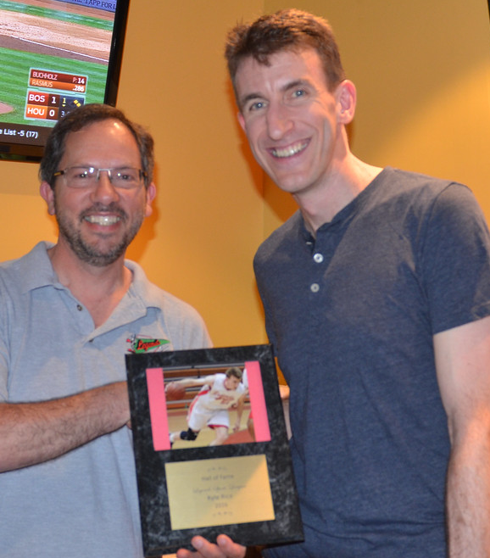
Research
Interviews
01
Examine How Legends Sports Leagues Currently Operates
Methodology
Start-up
Season Kickoff
Regular Season
Post-Season
Events

Slide 24
01
Examine How Legends Sports Leagues Currently Operates
Results
Start-up
Pre-Season Kickoff
Regular Season
Post-Season
Events
Set up website
Obtain permits through the County
Market leagues
Recruit officials
Announce registration
Close registration and create teams
Order and distribute uniforms
Create and post beginning of schedule
Attend opening night
Adjust teams
Enter game results and statistics
Post remaining schedule
Order prizes
Create brackets and schedule
Take pictures at finals
Post winners on blog
Pay officials and update league counts
Set up events:
3v3 Basketball tournaments
Annual Party
Hall of Fame
Charity Events

Slide 25
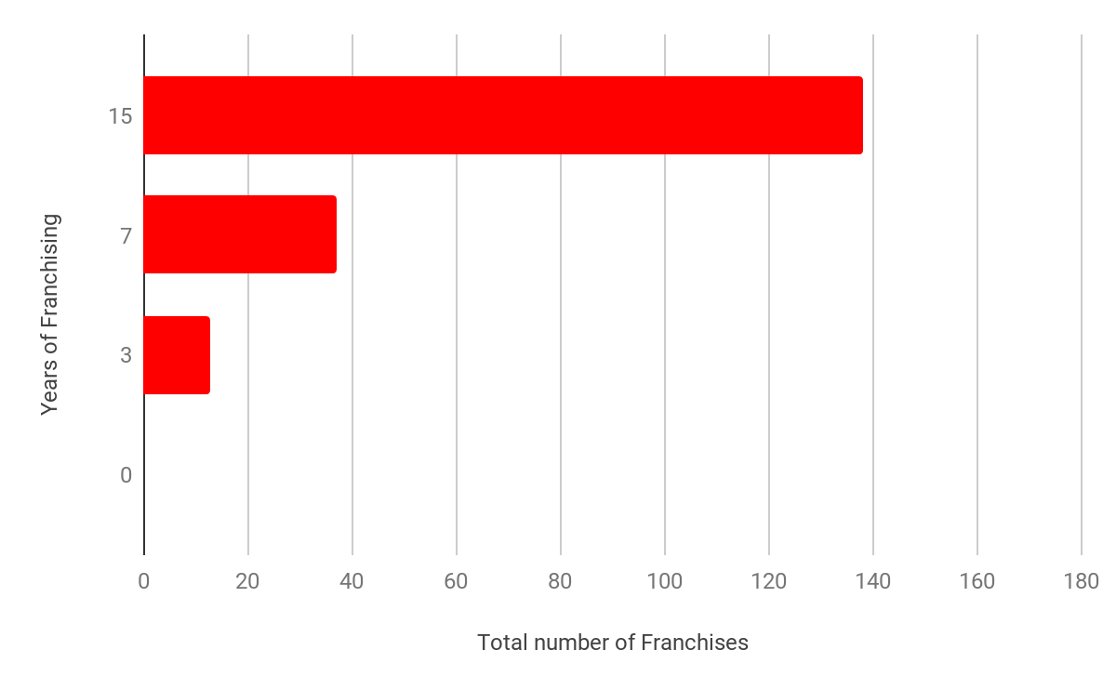
Lit Review
02
Identify Best Practices in Rec Sports Leagues’ Marketing
Methodology
Notes:
In addition to the background research on the best marketing practices, we learned about 3 other rec sports leagues that have successfully franchised - the longer they have been franchising - the more franchises they have

Slide 26
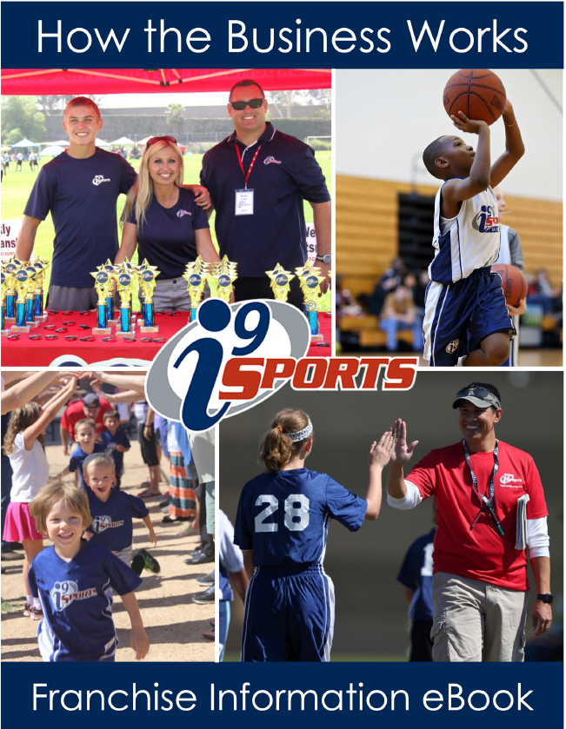
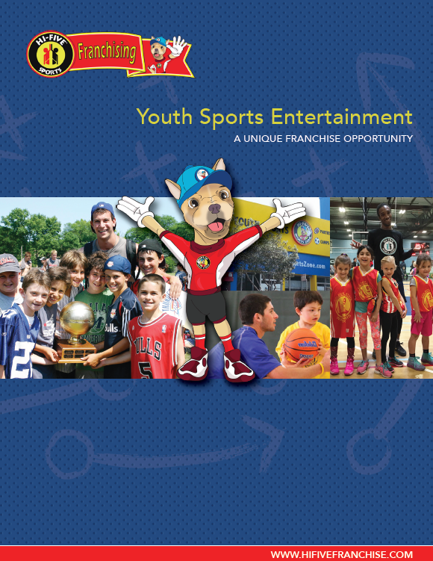
02
Identify Best Practices in Rec Sports Leagues’ Marketing
Results
Year-long Training Program:
Operate your franchise
Secure Venues
Use the proprietary software
Maintain the website
Build your own 12-month strategic business plan
Analyze Territory segmentation
Notes:
To help you where to concentrate your marketing

Slide 27
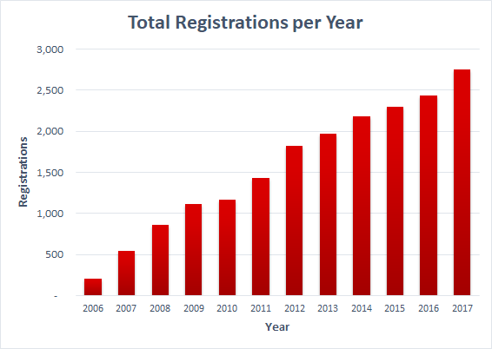
Research
Interviews
Surveys
03
Evaluate Legends Growth, Marketing, and Operation
Methodology

Slide 28
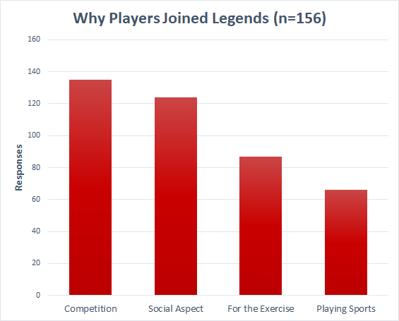
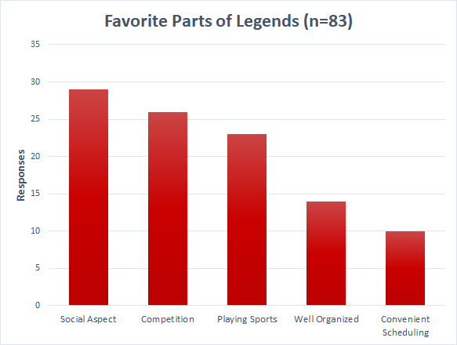
03
Players favorite parts of Legends are the same reasons they joined

Slide 29
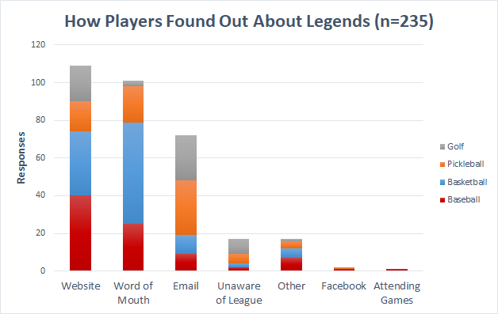
03
Players use website, word of mouth, and email to find out about Legends
Notes:
Angelos
What was noteworthy from our findings is that people who play golf & pickleball found out mainly through email which suggests that this is the main method of recruitment for these sports who were introduced later (compared to the other 2 sports)

Slide 30
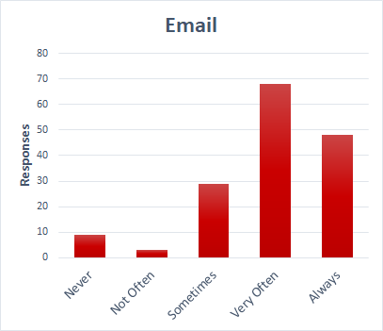
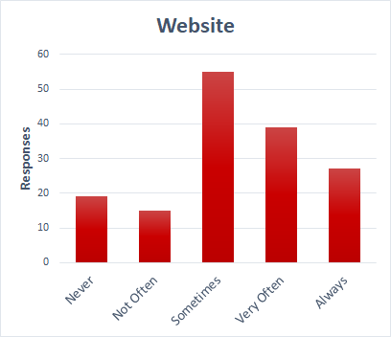
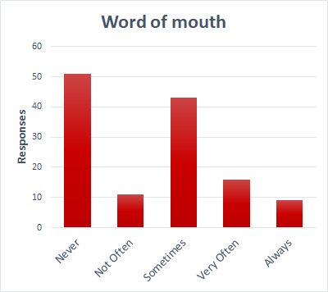
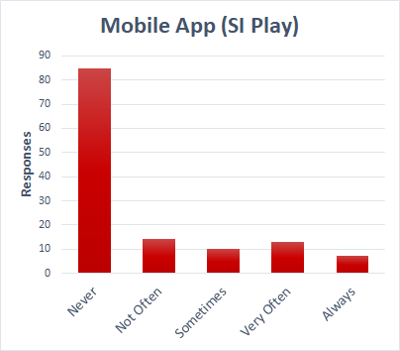
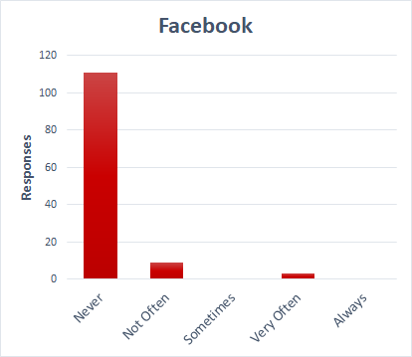
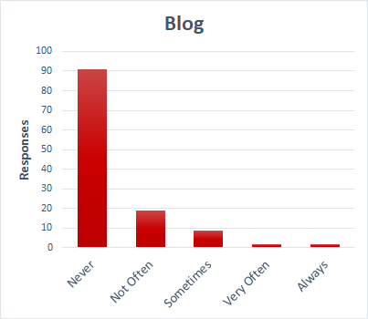
03
Players stay informed through Email, Website, and Word of Mouth
Notes:
Angelos
The most information is available through email, website and word of mouth, that comes to agreement with how players first found out about Legends
They are not used because

Slide 31
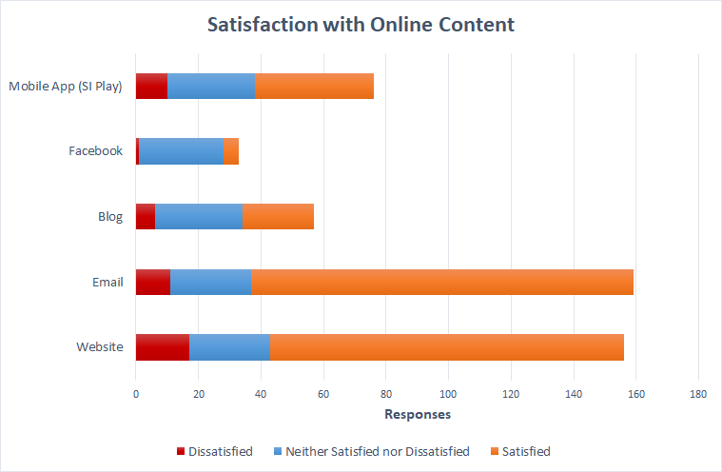
03
Players are satisfied with Legends’ online content
Notes:
Angelos
In addition, we found out that most players are really satisfied with the email and website in contrast to the other online content that is not extensively used for informational purposes

Slide 32
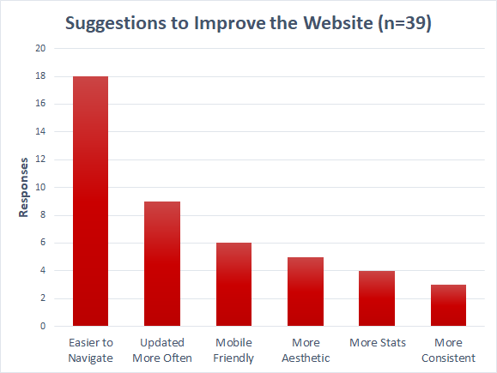
03
Players want the website to be easier to navigate

Slide 33
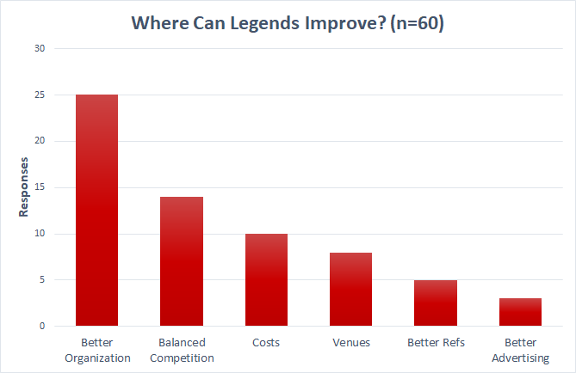
03
Legends can improve with better organization

Slide 34
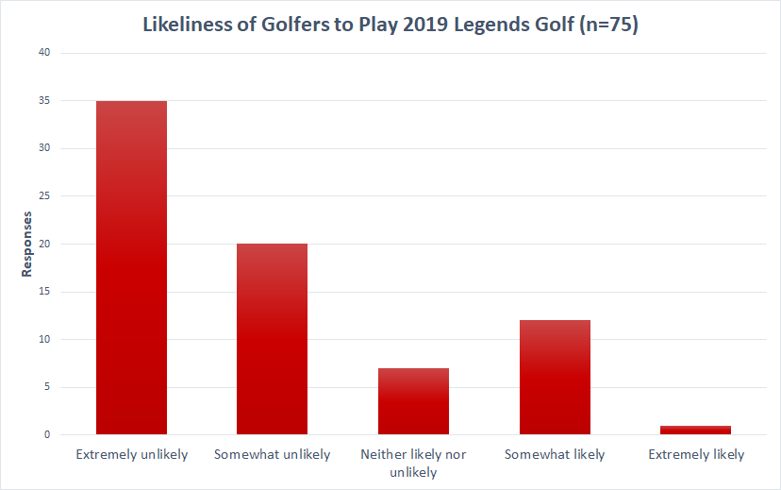
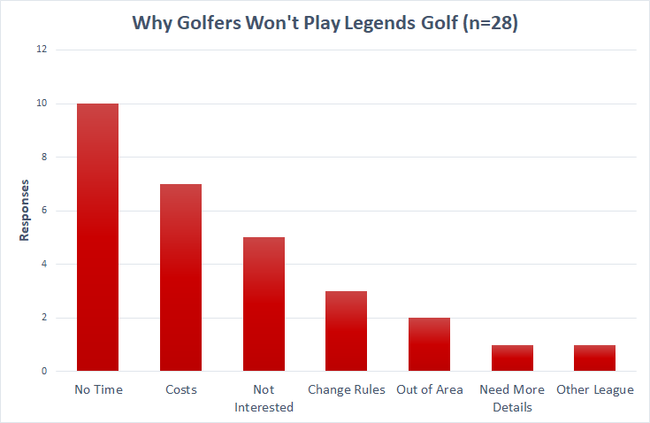
03
Golfers are not likely to play Legends golf in 2019 because they have no time

Slide 35
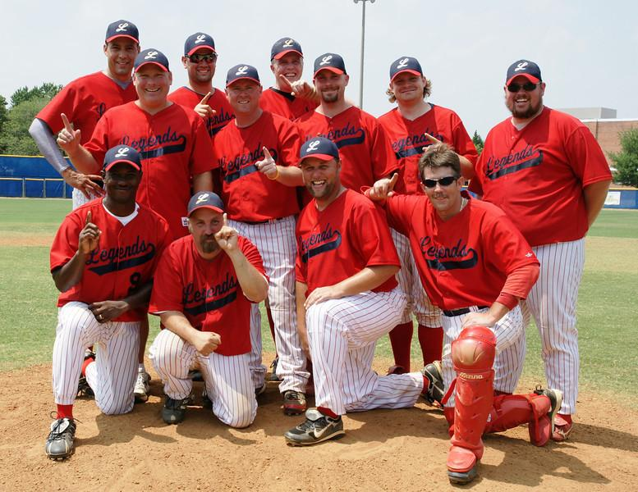
Lit Review
Interviews
Surveys
User Tests
04
Develop Marketing Strategies and Materials for Legends
Methodology
Franchising
Marketing

Slide 36
04
Marketing Deliverable
Pickleball Logo
Notes:
Zhidong - The other new legends logos are recognizable by people
Based on that, we developed a new set of logos for the pickleball league

Slide 37
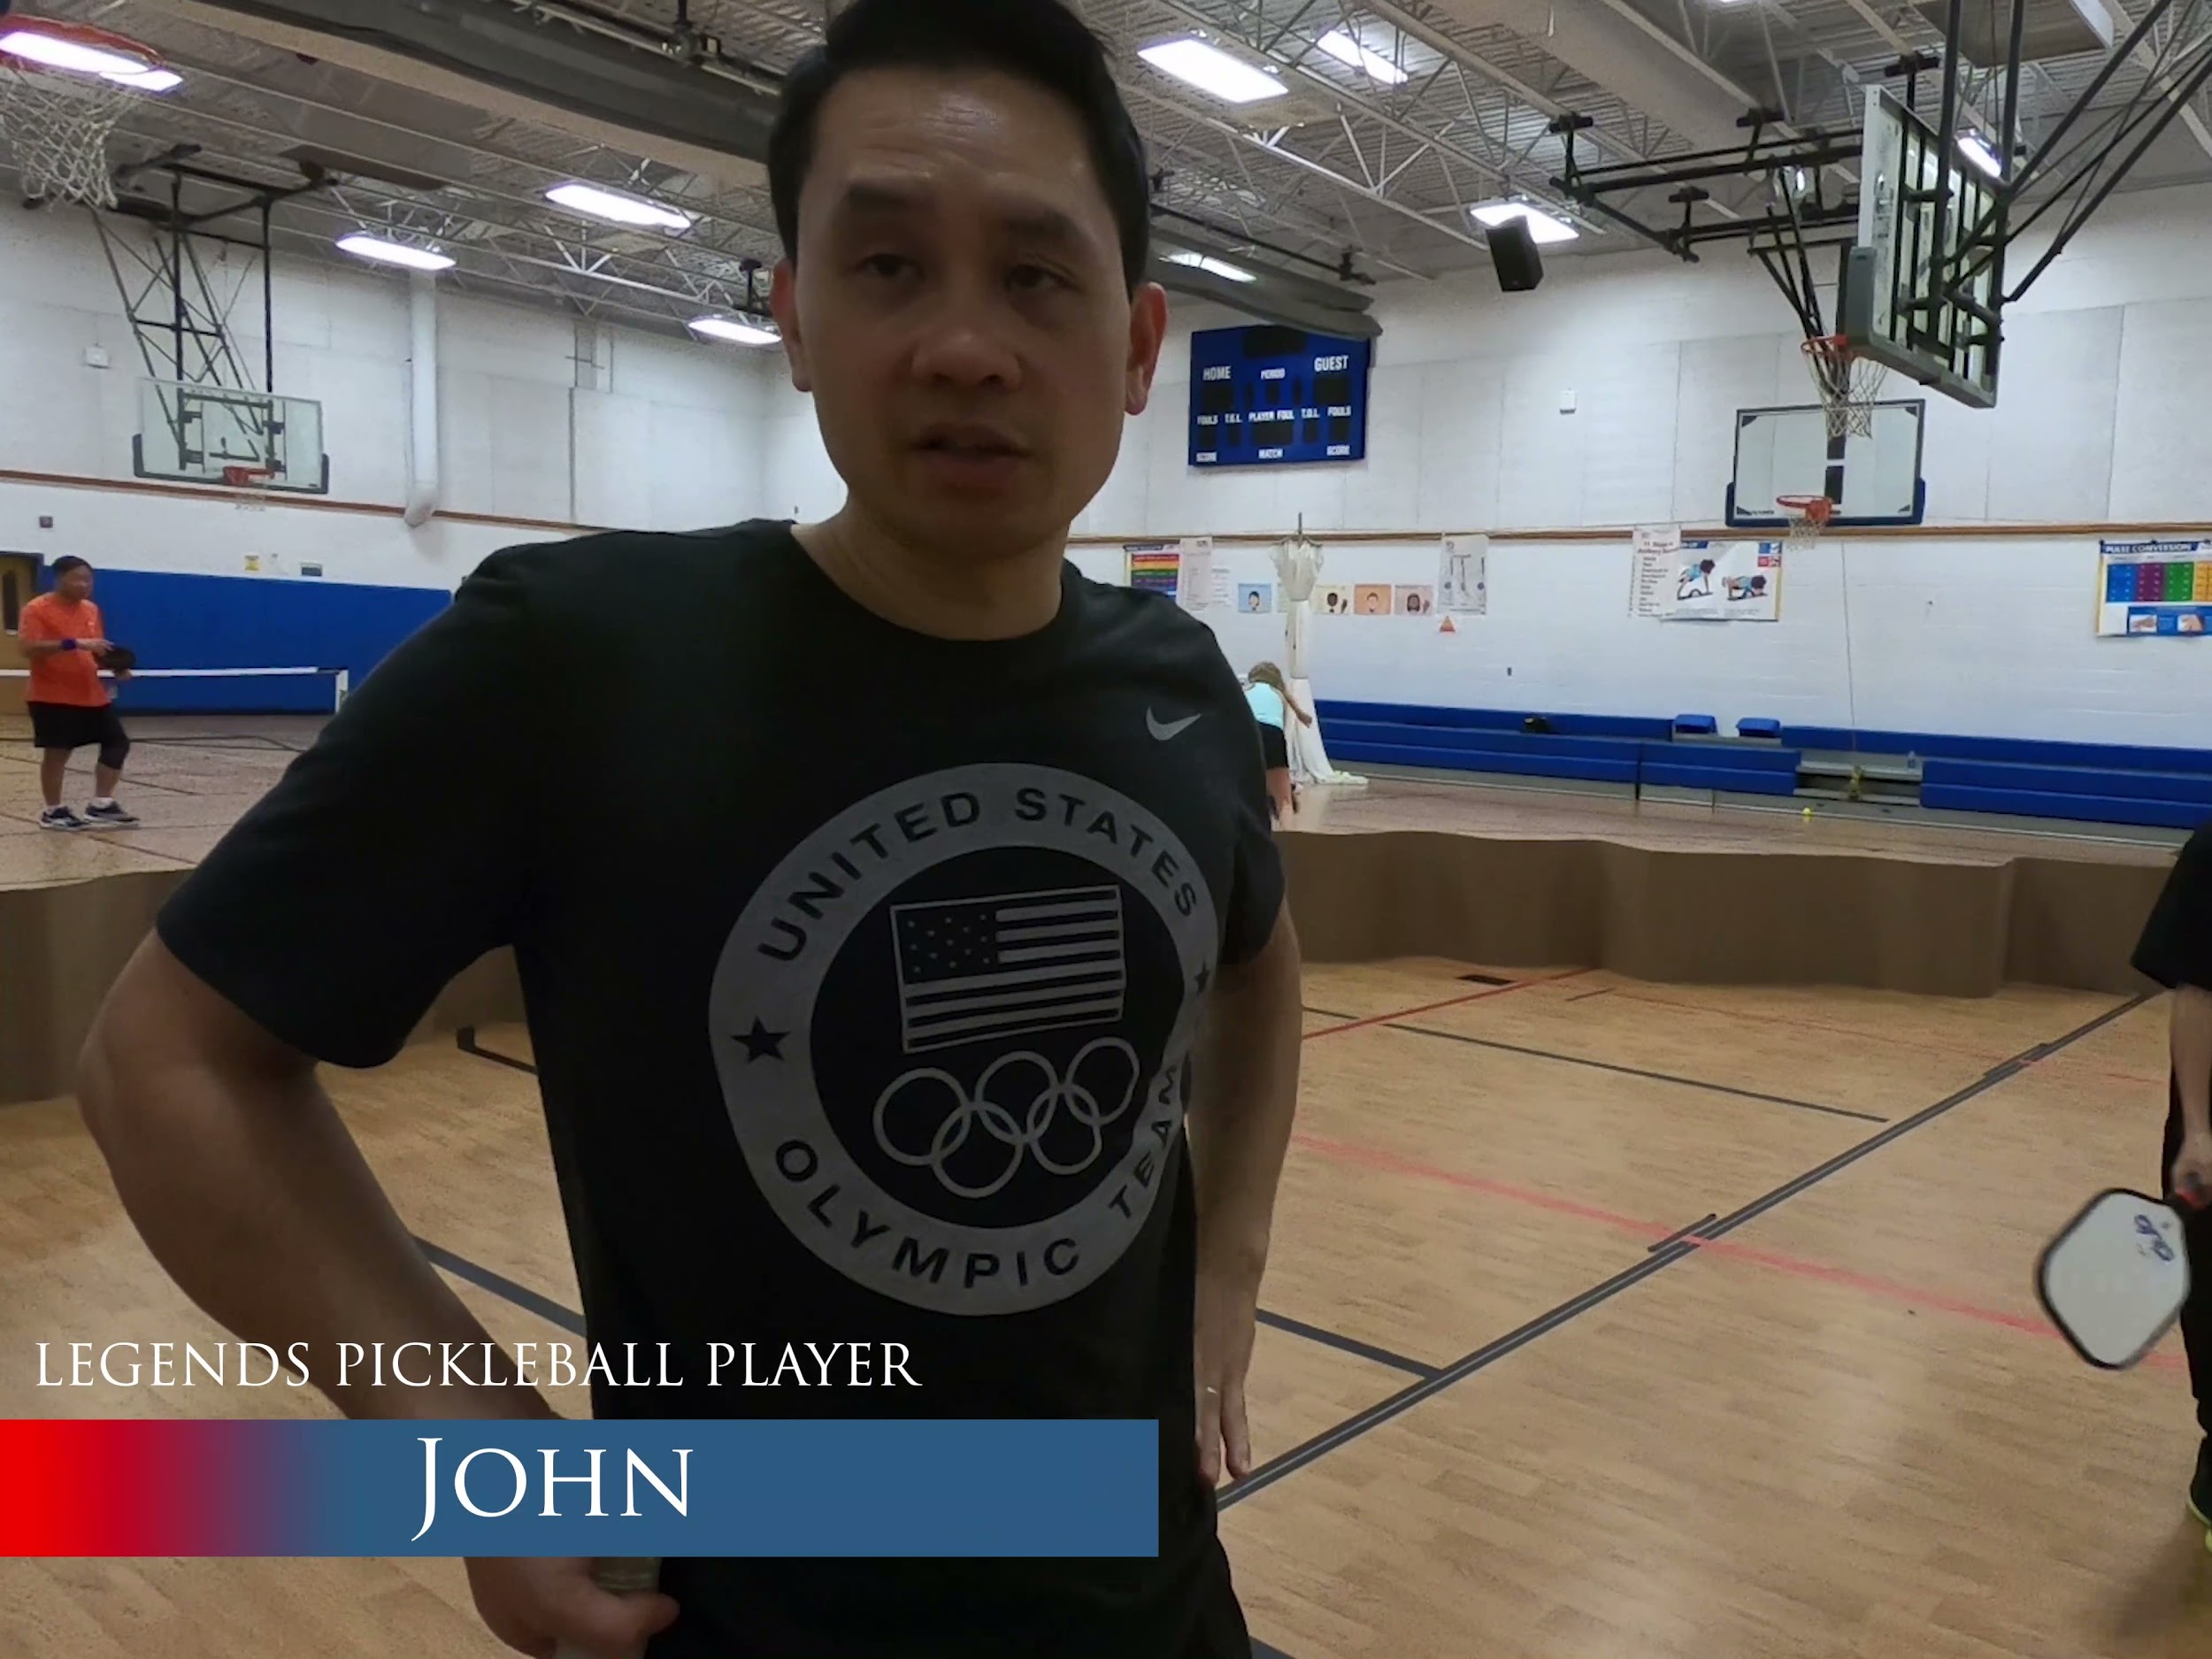
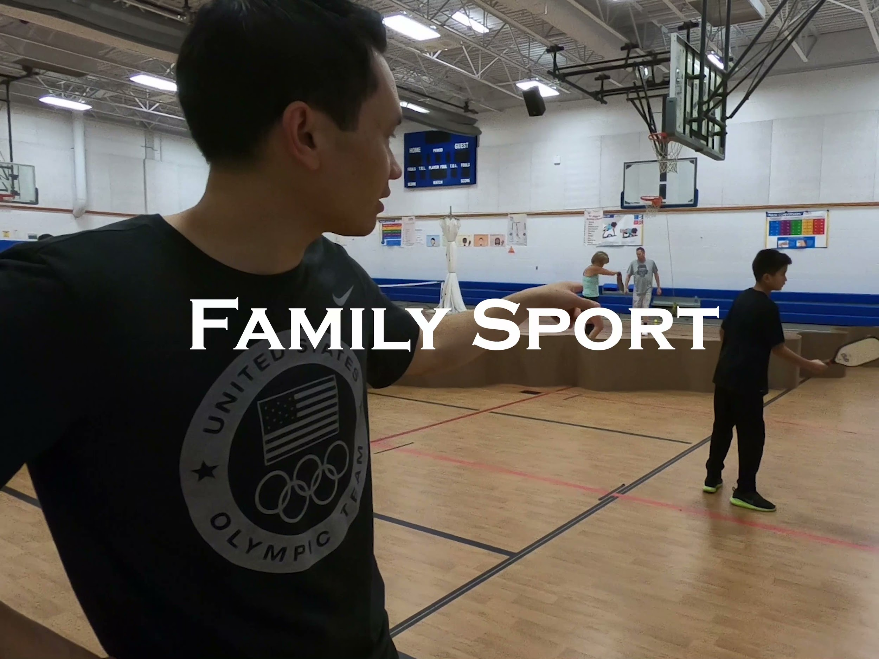
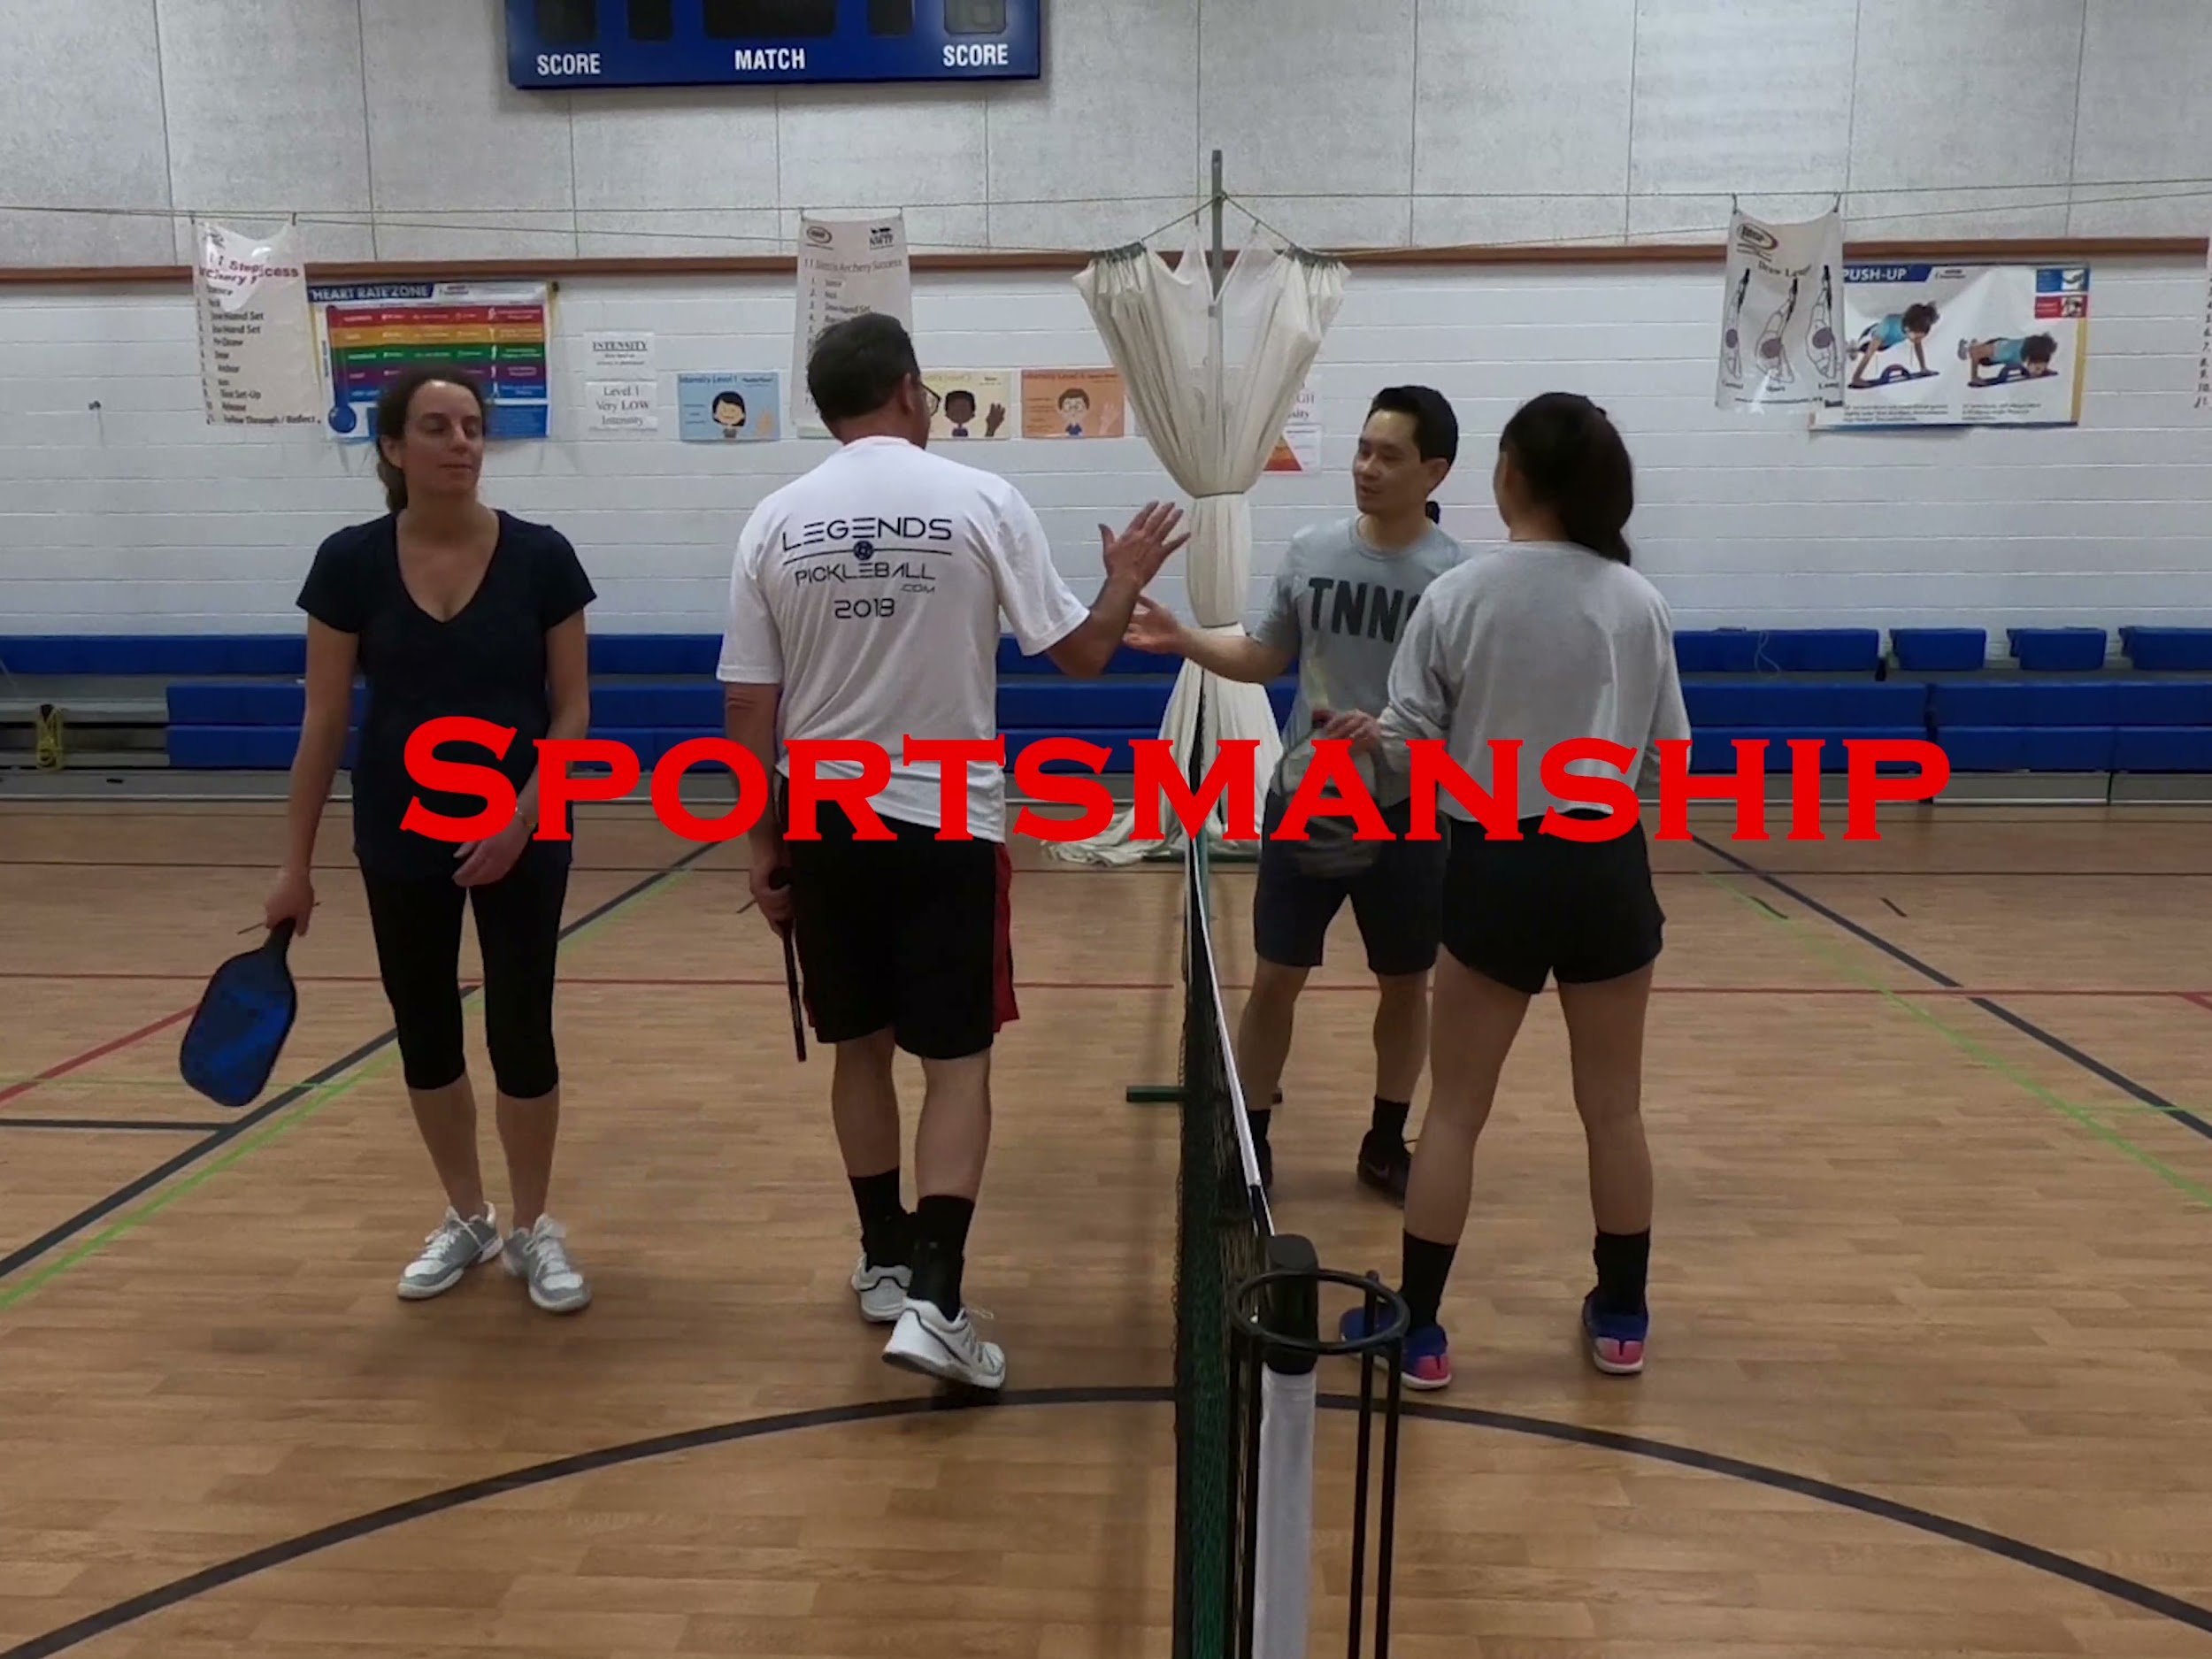
04
Marketing Deliverable
Pickleball Promotional Video
Notes:
Zhidong - Created a opening, took footages from Legends pickleball games,
Testimonials, additional feature compared to other promotional videos

Slide 38
04
Marketing Deliverable
Legends Flyer and Hashtag
Notes:
Zhidong - Annual party
Hashtag for all social media platform, both Legends and Legends players can upload photos on there with the hashtag

Slide 39
04
Franchising Deliverable
Franchisee Training Manual
Table of Contents
1. Introduction
2. Homework/Planning
3. Start-up
4. Pre-Season Kickoff
5. During the Regular Season
6. Post-Season
7. Tournaments and Events
8. Other
Notes:
Using the information we found from objective 1, we developed a franchisee training manual

Slide 40
04
Franchising Deliverable
Marketing Brochure
Content of Brochure
1. Why Legends?
2. Legends Franchise
3. Our Ideal Franchisee
4. Financial Investments
5. Legends Opportunities
6. Legends Franchise Start-up Timetable
7. Cost to Start a Legends Franchise
8. Frequently Asked Questions

Slide 41
Conclusions and Recommendations

Slide 42
Conclusion:
Legends Sports Leagues has limited staff, which may make expansion efforts challenging.
Recommendation:
Appoint commissioners for each sport
League Commissioner
Basketball Commissioner
Baseball
Commissioner
Pickleball
Commissioner
Golf Commissioner
Notes:
Marketing Assistant & Hashtag for what?

Slide 43
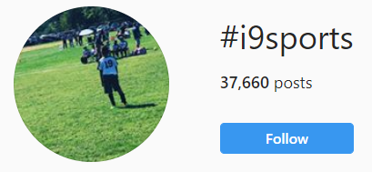
Conclusion:
Legends Sports Leagues has not fully exploited social media for marketing.
Recommendations:
Introduce the hashtag #LegendsNVA
Recruit a volunteer to manage social media accounts
Notes:
Marketing Assistant & Hashtag - Requires minimum effort to be implemented by legends as they will only have to inform the players/participants about it in order for them to use it in their social media posts and start creating an online legends’ community

Slide 44
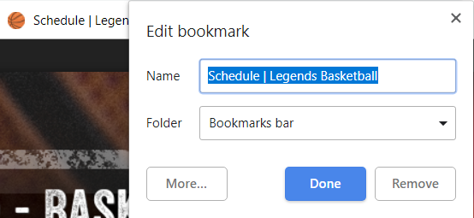
Conclusion:
Although the website contributes to league communications, some members would like to see improvements.
Recommendations:
Inform users about bookmarking frequently visited web pages
Delegate tasks, such as updating the content of the website

Slide 45
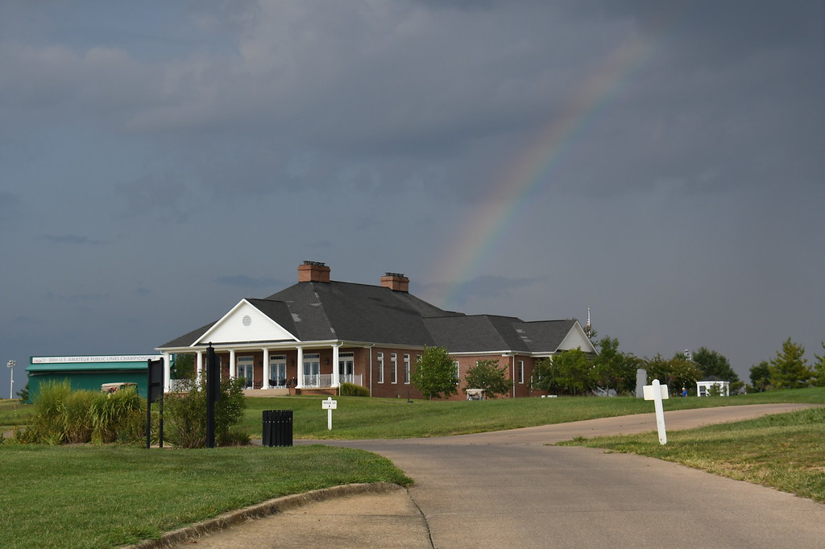
Conclusion:
To expand the golf league, Legends Sports Leagues may need to market beyond its current members.
Recommendations:
Market to people outside of the mailing list to obtain members
Organize an All Legends Golf Classic event

Slide 46
Conclusion:
To reach a larger audience, Legends should share the pickleball video beyond YouTube and the website.
Recommendation:
Share the pickleball video to local pickleball pages, such as “DMV Pickleball” on Facebook
Notes:
Zhidong - Which we heard from our interview

Slide 47
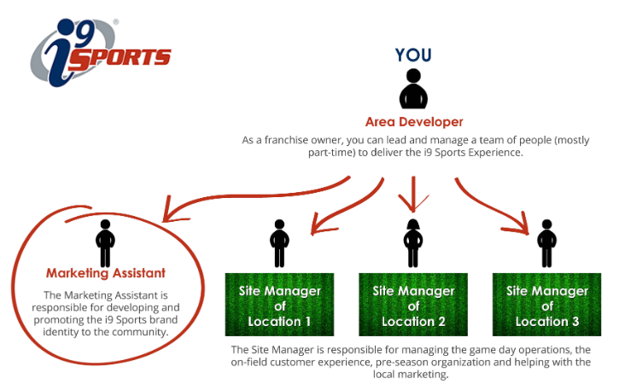
Conclusion:
Legends is in the early stages of franchising and could further review best practices from other rec sports franchises.
Recommendations:
Review what organizations provide for their franchisees
In the future, develop the services competitive organizations offer
Notes:
And implement anything that they can right now
Once they

Slide 48
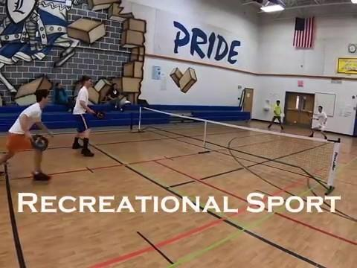
Pickleball Promotional Video
Notes:
To conclude our presentation, this is the pickleball promotional video that we developed

Slide 49
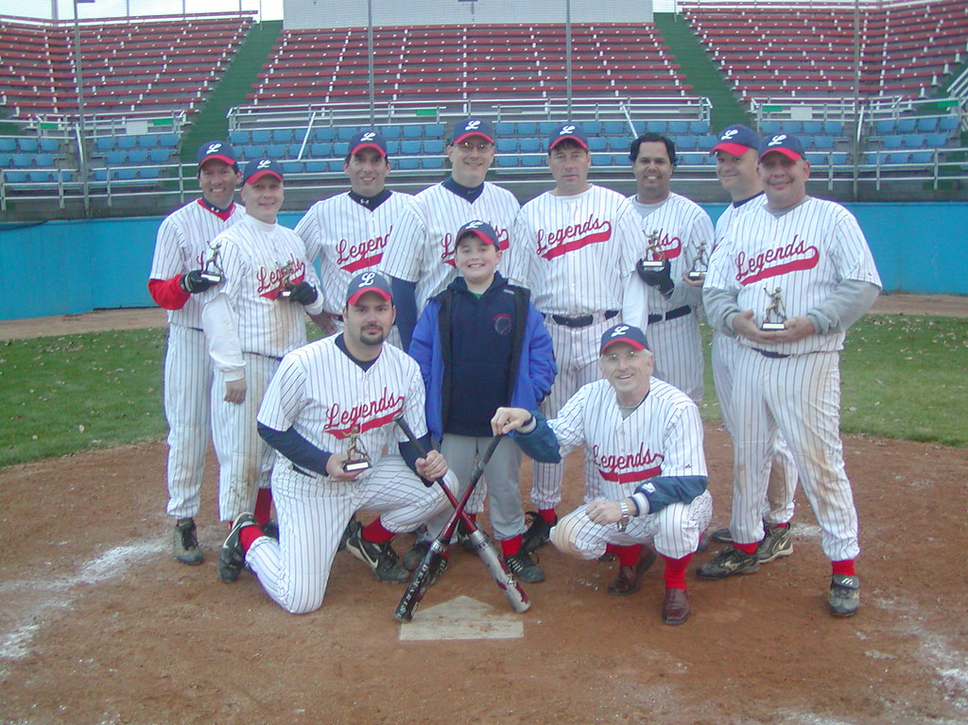
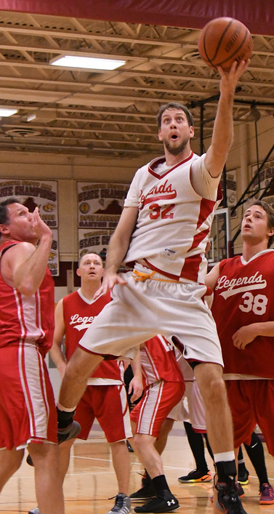
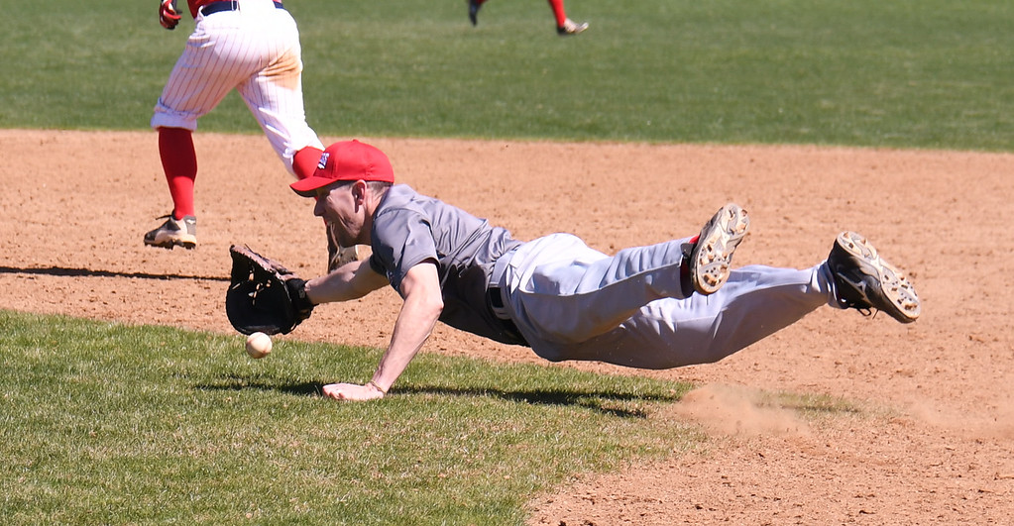
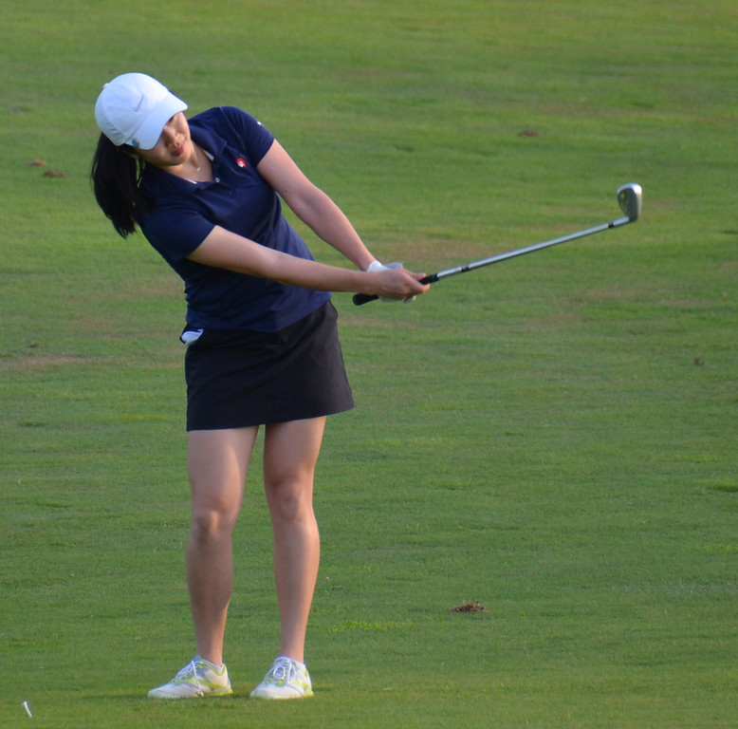
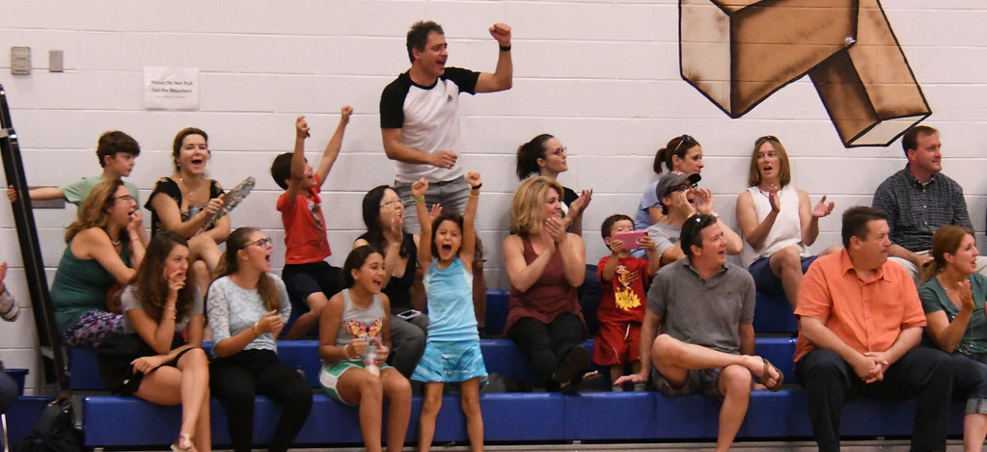
Thank you!
Questions?
Photos from: https://legends.smugmug.com/

