Slide 1
PATREON MANUAL
PREPARED FOR :
Armine Hovannisian
ORRAN

Slide 2
TABLE OF CONTENTS
VIEW SAMPLE PATREON FOR ORRAN AT: https://www.patreon.com/Orrantest
Creating an account. 2
Creating your page
BasicS
Tiers
Merch (optional)
Getting Paid
Page settings
Preview
Advanced
Posting on and Using Patreon
Other Points
Joining as a sponsor/patron

Slide 3
CREATE AN ACCOUNT
GO TO WEBSITE
CLICK ON “CREATE ON PATREON” ON THE TOP RIGHT OF THE PAGE
CREATE A NEW ACCOUNT UNDER “SIGN UP”.
You also have the options to sign in with Google accounts, sign in with Facebook, or log in to a previously existing account.

Slide 4
CREATING YOUR PAGE
BASICS
Tiers
Merch (optional)
Getting Paid
Page settings
Preview
Advanced

Slide 5
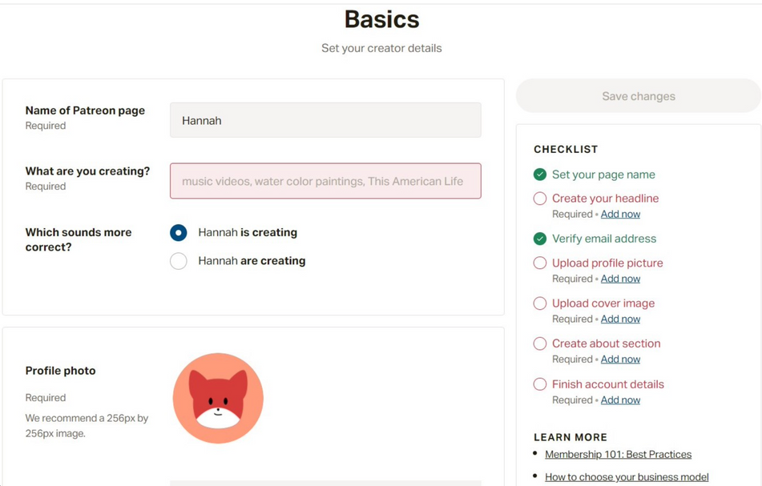
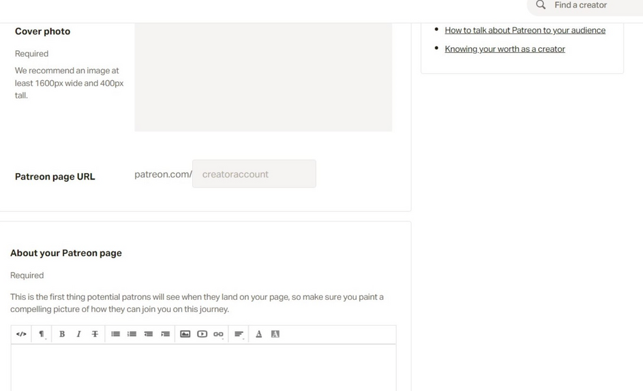
BASICS
SET CREATOR DETAILS SUCH AS NAME, CONTENT TYPE, PROFILE PHOTO, COVER PHOTO, AND PATREON DESCRIPTION. THE CHECKLIST TO THE RIGHT SHOWS THE AREAS THAT ARE REQUIRED TO BE FINISHED BEFORE THE PAGE IS ACTIVATED.

Slide 6
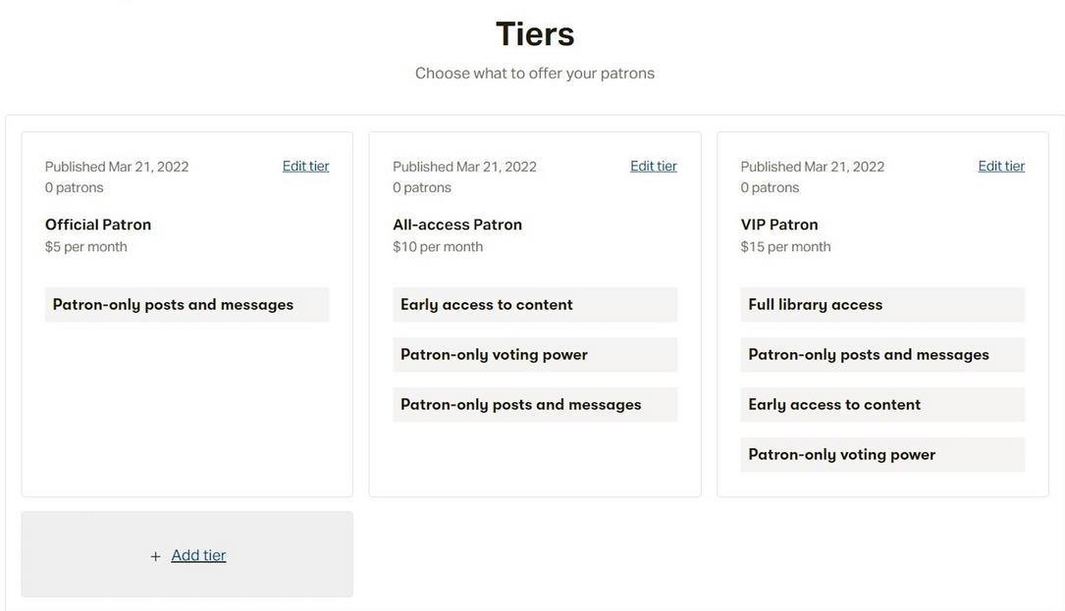
TIERS
PATREON OFFERS POTENTIAL TIERS FOR DONATION AMOUNTS, BUT YOU CAN ALSO CUSTOMIZE TIERS TO MAKE THEM MORE SPECIFIC TO YOUR NEEDS.
COULD MAKE DIFFERENT TIERS FOR DIFFERENT BENEFITS FOR THE CHILD AND THE SPONSOR:
THEY PAY X AMOUNT, THE CHILD GETS X PAID FOR, THE SPONSOR GETS X AMOUNT OF UPDATES FROM THE CHILD A WEEK
MAY WANT COSTS TO BE A BIT LOWER TO ATTRACT SPONSORS MORE, BUT THIS IS OPTIONAL
CAN CUSTOMIZE HOW MANY SPONSORS PER PATREON ACCOUNT, SO MAYBE ONE/TWO SPONSORS PER KID
SALES TAX INFORMATION IS AVAILABLE HERE: ABOUT ADVANCED SALES TAX SETTINGS – PATREON HELP CENTER

Slide 7
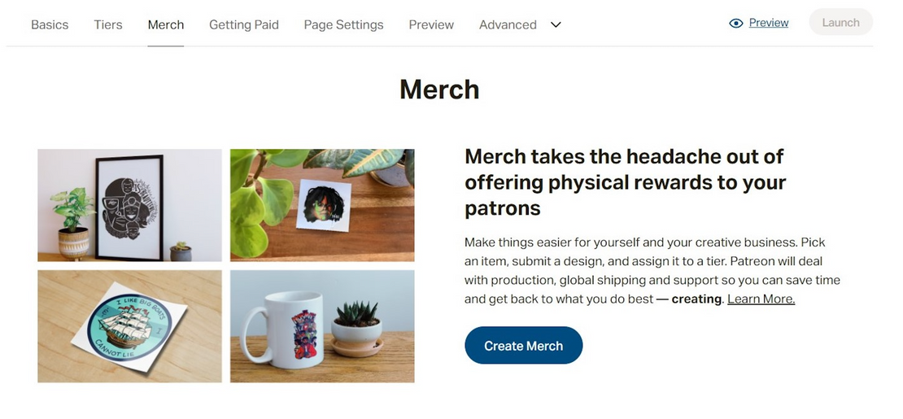
MERCHANDISE
IF YOU EVER WANT TO PROVIDE MERCHANDISE TO YOUR PATRONS OR SPONSORS, THIS SECTION OF THE PATREON CAN HELP CREATE SOME.

Slide 8
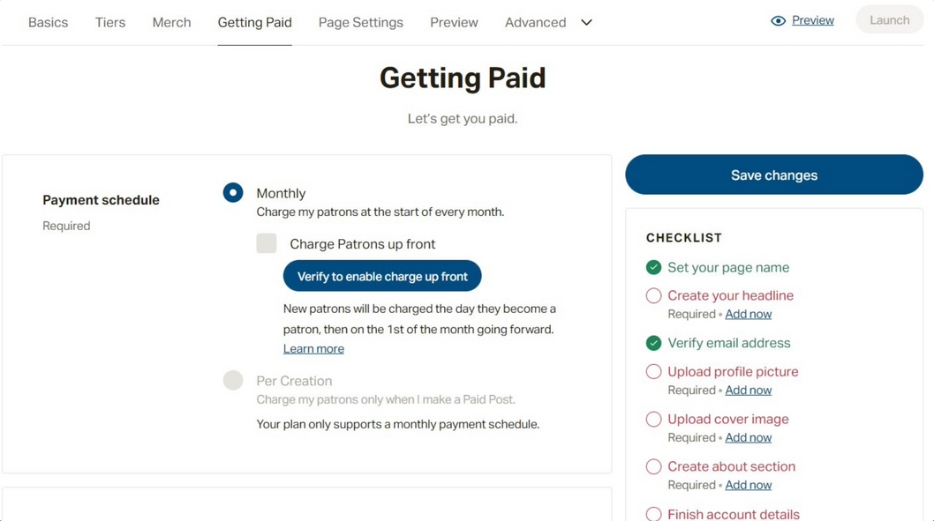
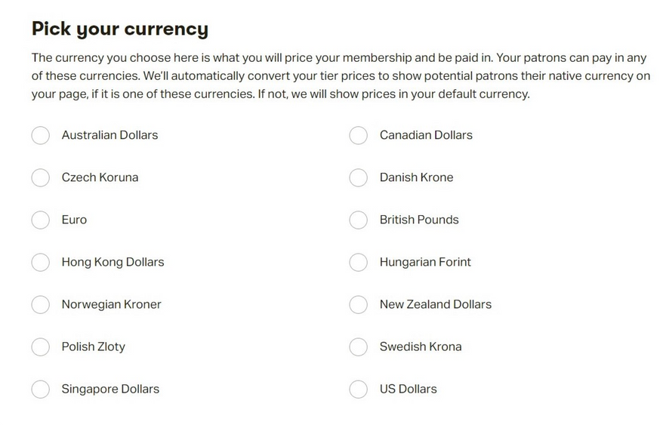
GETTING PAID
MUCH OF THE DONATION INFORMATION IS FOUND IN THIS SECTION.
PAYMENT SCHEDULES ARE USUALLY EITHER MONTHLY OR BY CREATION (BY POST)
IF A SPONSOR PAYS SAY $1 PER DAY FOR A CHILD, THE COST WOULD BE APPROXIMATELY $30-31 PER MONTH.
CAN ADJUST CURRENCIES FOR DONATIONS
ONCE YOUR CREATOR PAGE IS LAUNCHED, YOU CAN EDIT YOUR PAYOUT SETTINGS, INCLUDING HOW YOU'D LIKE TO GET PAID AND YOUR TAX INFORMATION.

Slide 9
GETTING PAID
CAN ADJUST CURRENCIES FOR DONATIONS
ONCE YOUR CREATOR PAGE IS LAUNCHED, YOU CAN EDIT YOUR PAYOUT SETTINGS, INCLUDING HOW YOU'D LIKE TO GET PAID AND YOUR TAX INFORMATION.

Slide 10
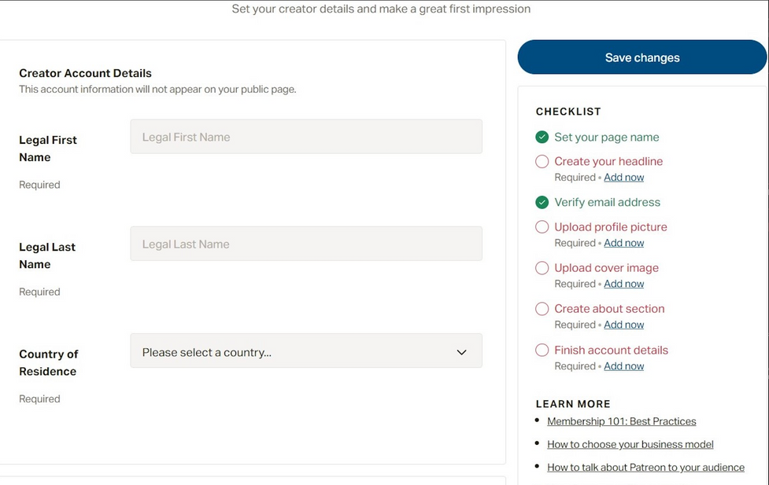
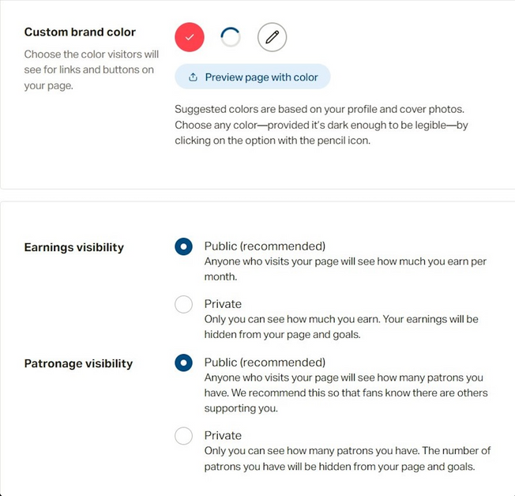
PAGE SET UP
SET CREATOR DETAILS SUCH AS NAME, CONTENT TYPE, PROFILE PHOTO, COVER PHOTO, AND PATREON DESCRIPTION. THE CHECKLIST TO THE RIGHT SHOWS THE AREAS THAT ARE REQUIRED TO BE FINISHED BEFORE THE PAGE IS ACTIVATED.
CHOOSE THE COLOR BRAND AND EARNINGS VISIBILITY (LIKELY KEPT PRIVATE)
SOCIAL LINKS CAN BE ADDED. MAYBE LINK TO ORRAN’S SOCIAL MEDIA AND ORRAN.ORG

Slide 11
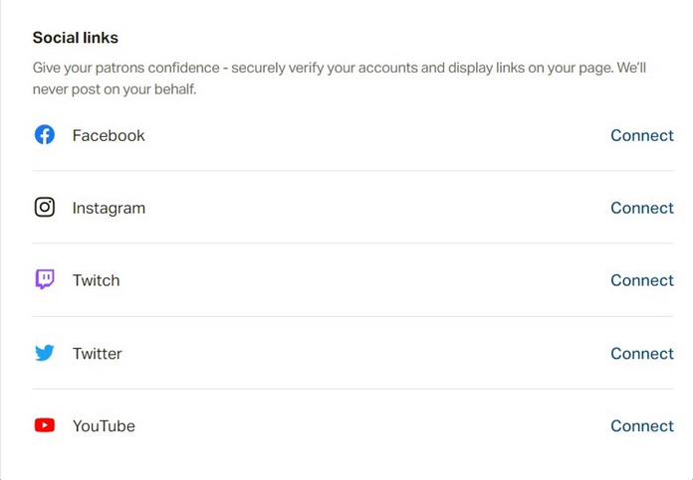
PAGE SET UP
CHOOSE THE COLOR BRAND AND EARNINGS VISIBILITY (LIKELY KEPT PRIVATE)
SOCIAL LINKS CAN BE ADDED. MAYBE LINK TO ORRAN’S SOCIAL MEDIA AND ORRAN.ORG

Slide 12
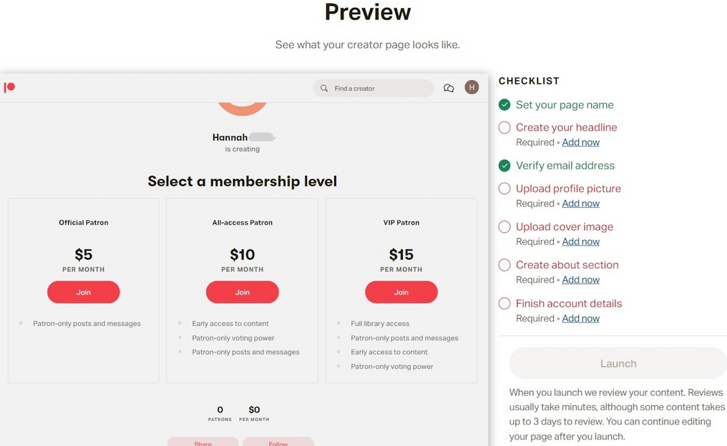
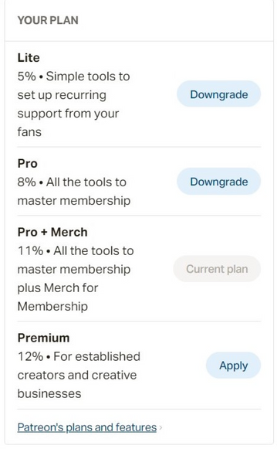
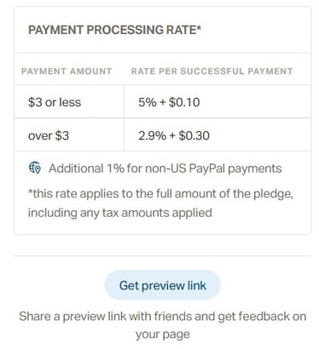
PREVIEW
YOU CAN PREVIEW THE PAGE BEFORE LAUNCHING, POSTING, AND MAKING UPDATES.
CAN CHOOSE A MEMBERSHIP PLAN FOR YOUR SPONSORS

Slide 13
ADVANCED
WELCOME NOTES
GOALS
SPECIAL OFFERS

Slide 14
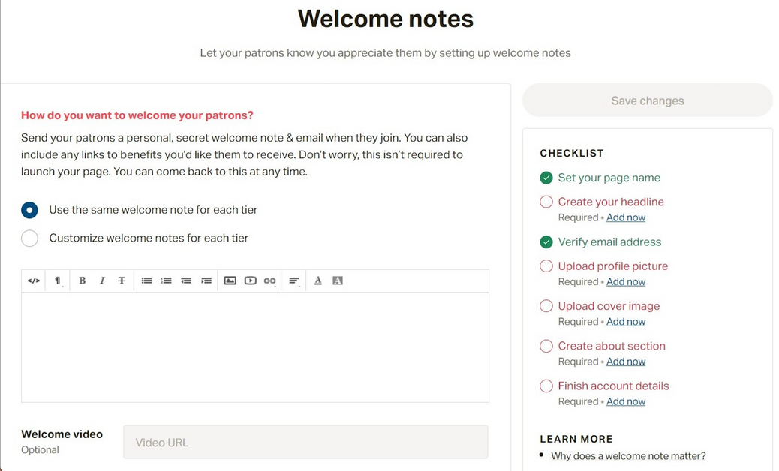
WELCOME NOTES
WELCOME NOTES:
CAN CUSTOMIZE HOW TO WELCOME SPONSORS POTENTIALLY
EVEN MAKE A WELCOME VIDEO IF WANTED

Slide 15
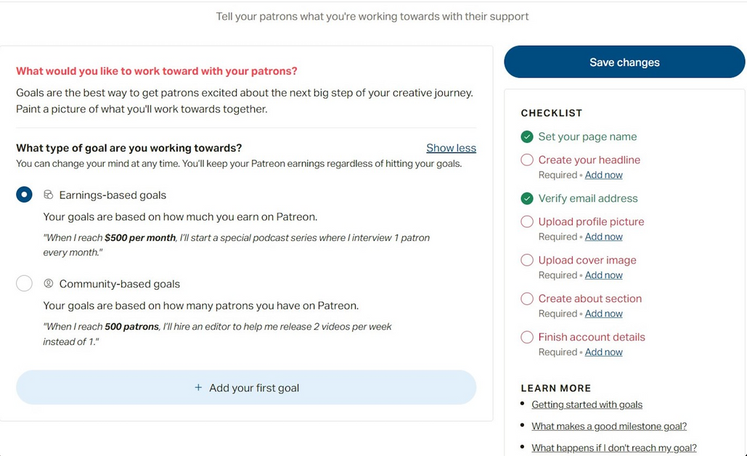
GOALS
GOALS:
CAN SET GOALS WITH THE PATREON ACCOUNT, POSSIBLE WAY TO ENCOURAGE SPONSORS TO STAY ENGAGED

Slide 16
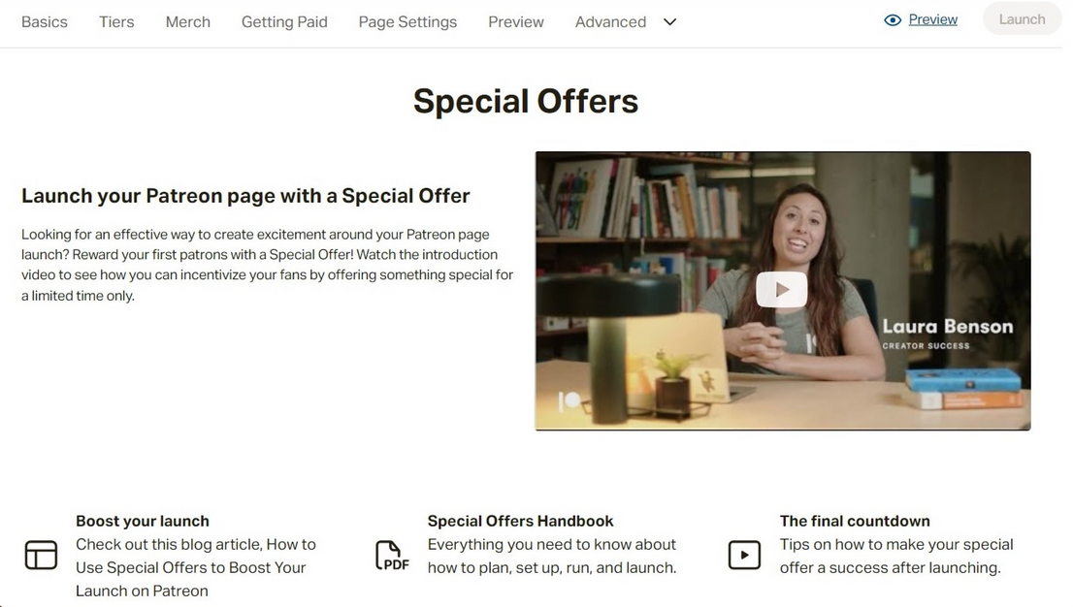
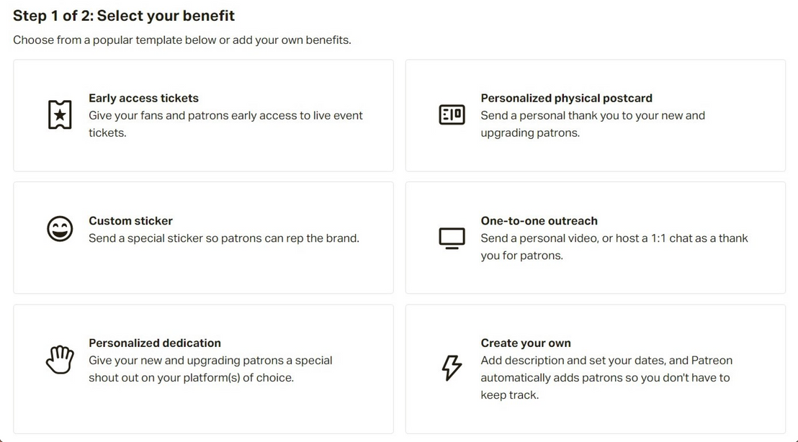
SPECIAL OFFERS
SPECIAL OFFERS:
ABILITY TO CREATE SPECIAL OFFERS IF DESIRED

Slide 17
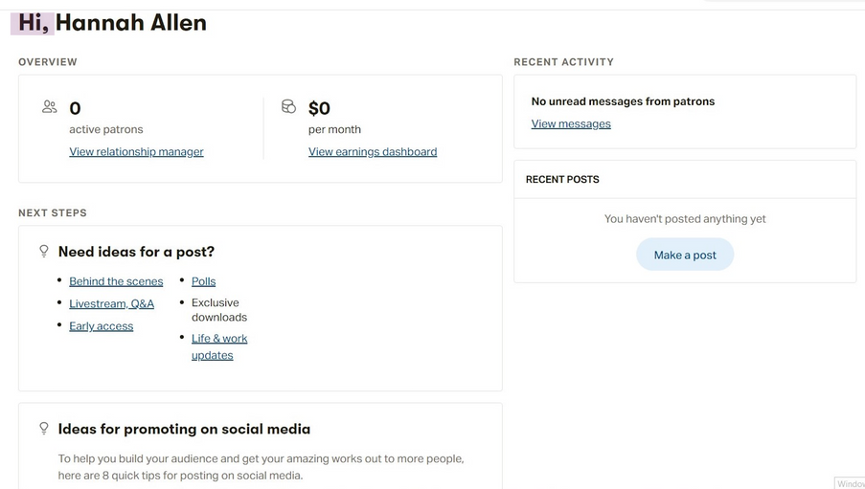
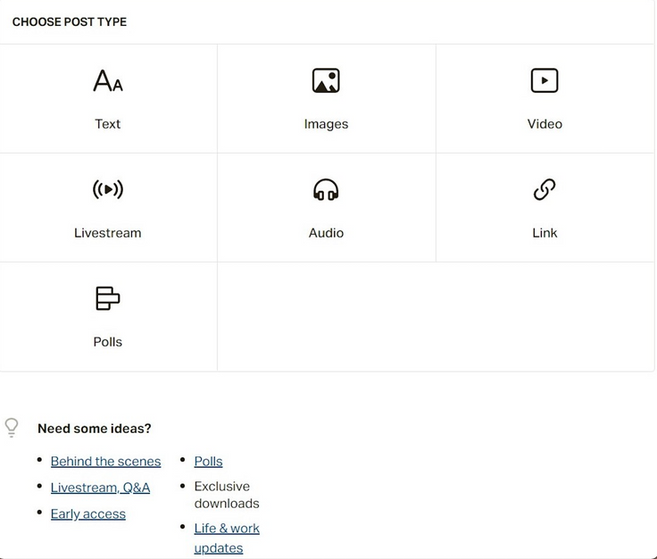
POSTING ON & USING PATREON
ON ACCOUNT DASHBOARD YOU CAN SEE
CLICKING “MAKE A POST” WILL LEAD YOU TO THIS
YOU CAN POST TEXT POSTS, IMAGES, VIDEOS, LIVESTREAM, AUDIO, LINKS, OR POLLS.

Slide 18
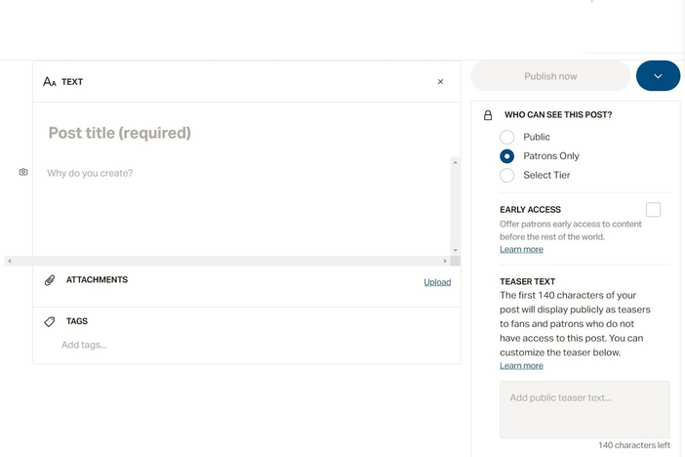
TYPES OF POSTS
TEXT POST
You can post a written message, choose who can see the post (sponsors on a pre-created tier most likely), add attachments and tags, and generate teaser text. You can also delete this post if you decide you don’t want it.
IMAGE POST
You can post images (Any JPG, JPEG, PNG, or GIF up to 512MB, and add an embedded URL), choose who can see the post (sponsors on a pre-created tier most likely), add attachments and tags, and generate teaser text. You can also delete this post if you decide you don’t want it.
VIDEO POST
You can post videos (from Vimeo or by adding a video URL) choose who can see the post (sponsors on a pre-created tier most likely), add attachments and tags, and generate teaser text. You can also delete this post if you decide you don’t want it.
AUDIO POST
You can post an audio message (select an audio file, add audio from a URL, and add an optional image), choose who can see the post (sponsors on a pre-created tier most likely), add attachments and tags, and generate teaser text. You can also delete this post if you decide you don’t want it.

Slide 19
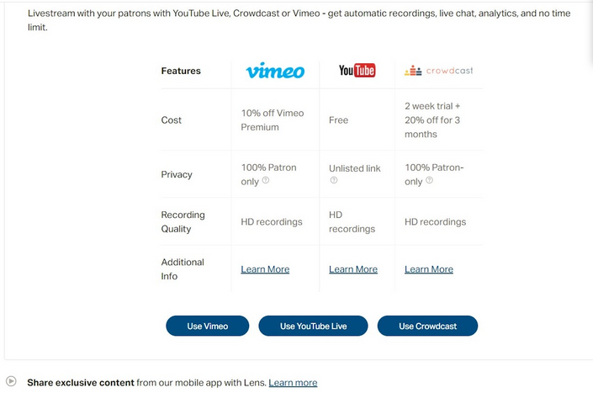
TYPES OF POSTS
LIVESTREAM
If you want to exit this draft post you can hit the X at the top right.
There are 3 ways to livestream:
POST A LINK
Type or paste a link for a post, choose who can see the post (sponsors on a pre-created tier most likely), add attachments and tags, and generate teaser text. You can also delete this post if you decide you don’t want it.
CREATE A POLL
Name the poll, and add the options for people to choose from, set an end date, edit the number of responses per patron. Choose who can see the post (sponsors on a pre-created tier most likely), add attachments and tags, and generate teaser text. You can also delete this post if you decide you don’t want it.

Slide 20
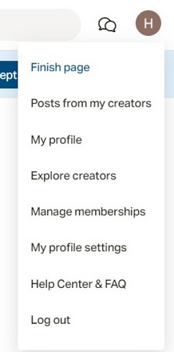
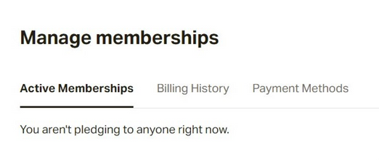
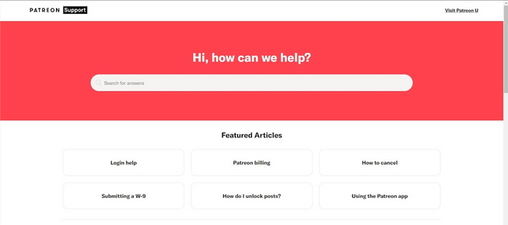
OTHER POINTS
Don’t have to launch until the patreon page is complete, can likely remove page if necessary
Clicking on your profile allows you to:
If there are other creators on Patreon you want to follow you can follow them and then go to “Post from my Creators”
If you’re struggling, you can always visit the Help Center and FAQ
Can try to promote Patreon on other platforms (ex. Social media) as many people gain traction on Patreon via social media. Could be a way to encourage more people to sponsor kids.

Slide 21
JOINING AS A SPONSOR/PATRON
Sponsor can choose how they want to support child (how much they want to donate per month)
Sign up for the patreon
Add their payment method
Then start seeing the child’s updates
ORRAN COULD ADD TO THEIR SITE WHERE THEY HAVE INFO ABOUT SPONSORING A CHILD, HOW TO USE THE PATREON FOR A CHILD.
For each patreon page, people have the ability to share or follow the page. If we enable only 1-2 patrons per page, we should be able to prevent random people from signing up for the page if that's a safety concern. We may just in case want to talk to a cs/IMGD person that specifically knows a decent amount about patreon to see if there are any safety features.
Maybe only the volunteers have access to the patreon and the kids just write/create posts in a separate platform such as microsoft word/google docs and the volunteers update the page?

