Slide 1
Distributed Virtual Environment for the Real-time Test and Evaluation of Radar Systems
Matthew Lyon James Montgomery Lucas Scotta
13 October 2010
Advisors: George T. Heineman Hugh Lauer Edward A. Clancy
MIT Lincoln Laboratory Supervisor: D. Seth Hunter
This work was sponsored by the Department of the Air Force under Contract No. FA8721-05-C-0002. Opinions, interpretations, recommendations and conclusions are those of the authors and are not necessarily endorsed by the United States Government.
Notes:
1
1

Slide 2
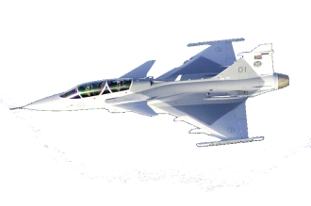
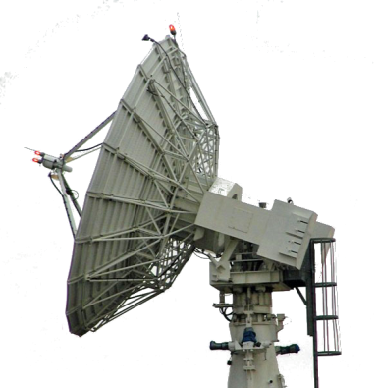
High-level Radar Overview
How does radar work?
Transmitter emits a short electromagnetic pulse
Pulse hits target, reflects back
Receiver listens for return energy
Radar processing software
Control radar hardware
Convert return energy to useful information
Radar Uses
Weather sensing
Remote Imaging
Track moving objects (our focus)
Pulse
Return
Radar
Sub systems
Radar Control Msg.
Radar
Processing
Software
Pulse Aux Data

Slide 3
Radar Simulation
Use software to simulate the radar hardware, targets, and environment
Need for testing before deployment
Saves time & money, don’t need physical hardware and real-life targets to test software
KMAR Simulator Developed at MIT LL, currently used for radar simulation
Simulated targets and environment
Simulated
Hardware
Simulator
Radar Control Msg.
Radar
Processing
Software
Pulse Aux Data

Slide 4
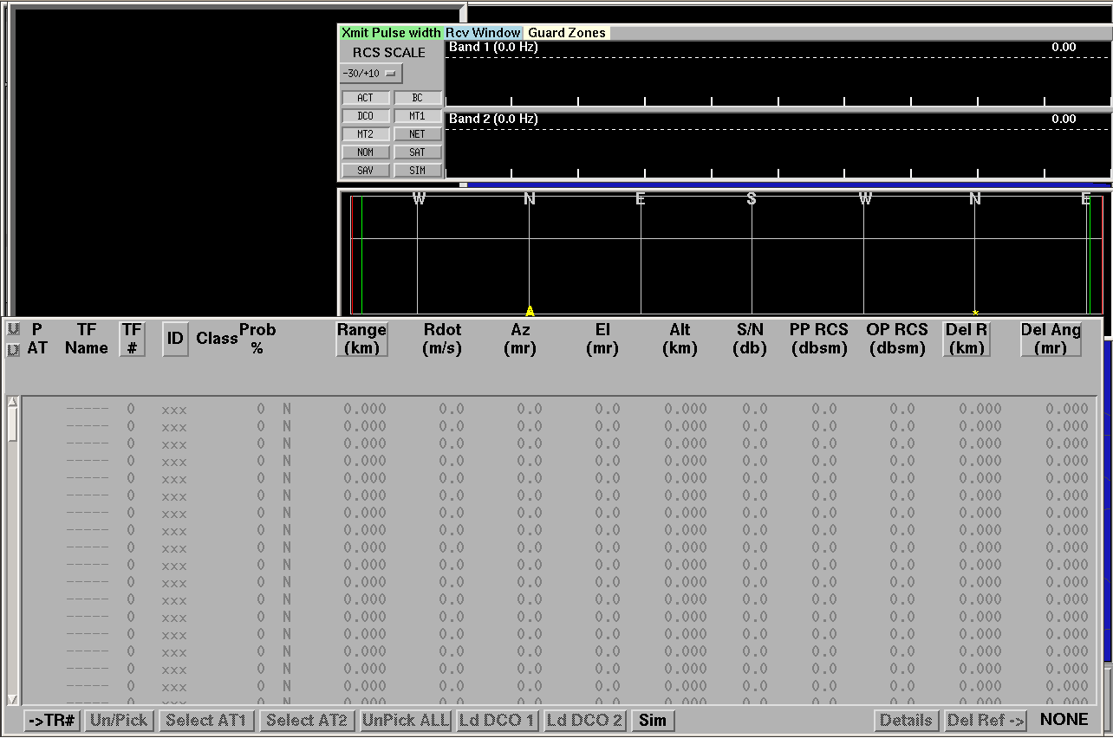
Current + Desired Simulator Features
KMAR Simulator
Features
Real-time, closed-loop
Complex environmental effects
High-fidelity waveforms
Trajectory models
Radar cross section models
Limitations
Single-machine
Typically supports only up to 64 targets
Difficult to extend

Slide 5
Current + Desired Simulator Features
KMAR Simulator
New Simulator
Features
Real-time, closed-loop
Complex environmental effects
High-fidelity waveforms
Trajectory models
Radar cross section models
Limitations
Single-machine
Typically supports only up to 64 targets
Difficult to extend
Requirements
Scalable to thousands of targets
Extensible to different types of targets and radar hardware
Design must support major features of KMAR simulator
Goals
Design an extensible simulator architecture
Implement a working prototype to demonstrate scalability
Use modern software techniques / tools

Slide 6
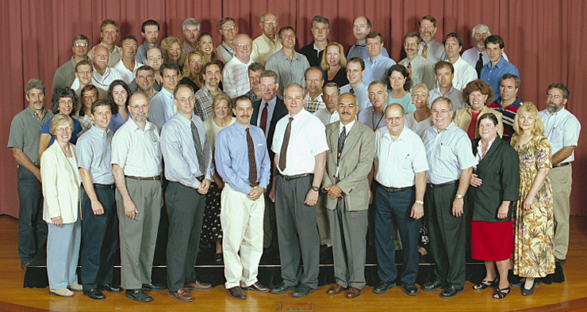
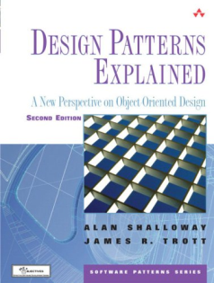
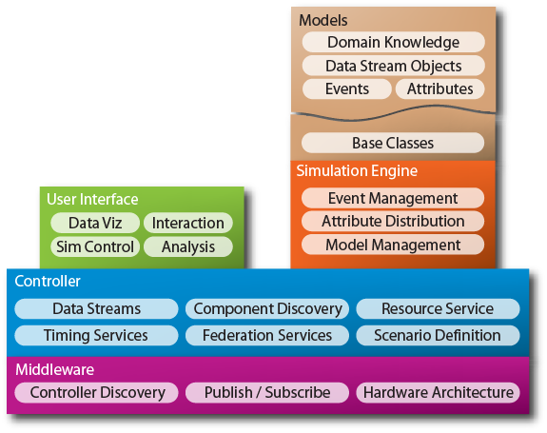
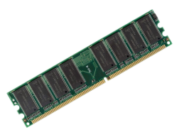
Methodology and Resources
ROSA II
LL Staff
Domain Literature
RTCL
OASIS Simulator Framework

Slide 7
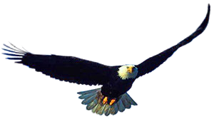
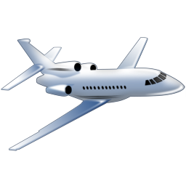
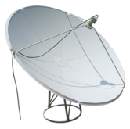
Design Overview
Pulse
Hardware Simulator
Environment Simulator
Return
Control message
Processed
Return
Radar Control Program

Slide 8
Event-based simulation
Process Event
Simulation engine
Models
Event Queue
Model State
Simulation Time
Schedule Event
Simulation Engine
Maintains simulation time
Contains event queue
Events
Associate an action with a time
Models
Maintain state
Process events to update state
Schedule events on other models

Slide 9
Radar in Detail

Slide 10
Models and Events
Pulse Event
Return Event
Transmitter Model
Target Model
Receiver Model

Slide 11
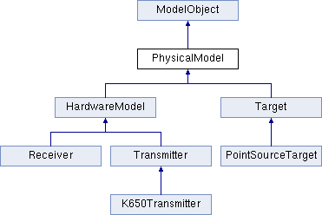
Extensibility
Target Class
Radar Cross Section
Trajectory

Slide 12
Layered Architecture
Based on OASIS simulation architecture
Adjacent layers interact during a simulation
Domain-specific models and events
Simulation control, logging
User interface, External software
Models
External components
Controller
Simulation Engine
Maintains event queue, time
Component
Middleware abstraction layer
Process base class
RTCL
Communications middleware
Inter-process communication

Slide 13
Distributed Event-based simulation
Hardware Simulator
Target Simulator
Models
Models
Engine
Engine
Events
Multiple simulation engines work together
Run independently
Separate event queues and models
Exchange relevant events
Synchronize simulation time

Slide 14
Scalability & Distributed Architecture
Target Simulator A
Simulate targets 1-100
Target Simulator B
Simulate targets 101-200
Radar Control Program
Hardware Simulator
Target 1 thread
Pulse Event
Target 2 thread
…
Target N thread
Target Simulator C
Simulate targets 201-300

Slide 15
Simulator Implementation
Working prototype
Multi-process, distributed
Complete test scenario
Basic transmitter, receiver models
Point source target model
Generic simulation engine
1
2
1 + 2
150 km

Slide 16
Project Deliverables
Design
Passed Lincoln Laboratory Design Review
Implementation
Functional basic implementation code
Documentation
User and Developer Guide
Doxygen source code comments
MQP Report
Testing
Complete testing suite, with 80% code coverage
Design Review
Attendees
Marcia Powell
Jeffrey McHarg
Andrew Clough
Matt Leahy
Seth Hunter
Rich Taylor
Sam Reynolds
Greg Gimler

Slide 17
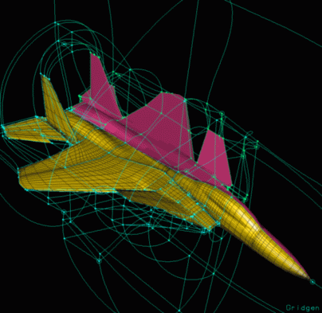
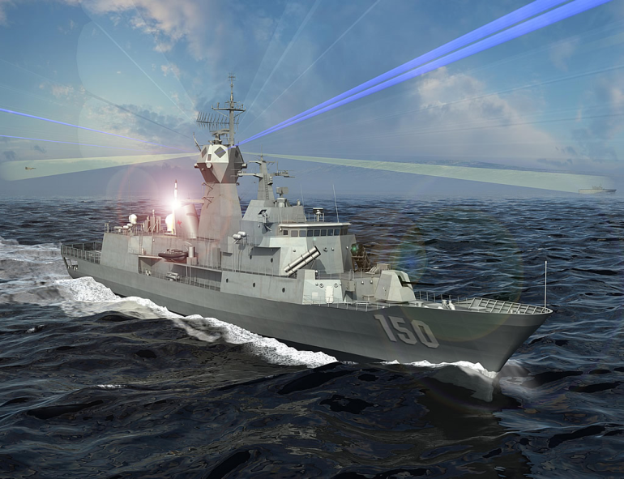
Future Work
More realistic transmitter and receiver models
Implement advanced target radar cross sections
Load balancing
Realistic environment models
Direct Integration with ROSA

Slide 18
Acknowledgements
Thanks to
MIT Lincoln Laboratory
Gary Ahlgren, John Nelson, Frank Robey
Seth Hunter
Marcia Powell, Andrew Clough, Greg Gimler, David Carpman, Matt Leahy
George Heineman, Hugh Lauer, Ted Clancy
Emily Anesta, Scot DeDeo, Adam Lewis
Questions?
Transmitter Model
Target Model
Receiver Model

